Slide 1
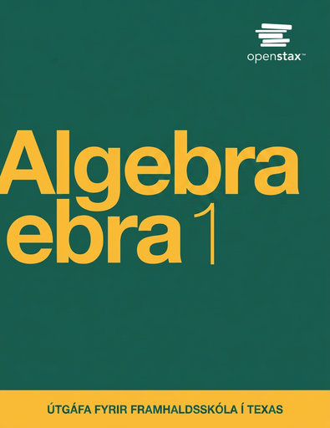

Algebra 1
Unit 1 Linear Equations
Lesson 1.10 Connecting Equations to Graphs, Part 1
Notes:
Teacher Slides assignments

Slide 2
How to use these slides
On the activity slides check the speaker notes for teacher support and instructional information.
Each lesson includes 1 warm up, 2-3 learning activities, a cool down, practice and a lesson synthesis.
  Learning activities are followed by a self check question, and review section.
Some slides have been hidden from student view, more information can be found on the next slide (Reference Key).
You can edit and use these slides for personal and classroom use, but cannot sell them and must keep the attribution logos.
For more information, Check out the digital quick start guide!

Slide 3






Reference Key
Check the top right corner for an icon referencing these unique sections.
 | Support for Students with Disability | Hidden | Learning Strategies slide, provides additional support to students for understanding the activity. Learning Strategies slide, provides additional support to students for understanding the activity.
 | Support for English Language Learners | Hidden
 | Extending Your Thinking | Hidden | Extending Your Thinking slide, provides an extra challenge for students.
 | Self Check | Not Hidden | Self Check slide, checkpoint to assess student understanding after the learning activity.
 | Review | Hidden | Self Check- Review slide, designed to help review topics from the self check question.
On the next slides, check the speaker notes for teacher instructions and support.

Slide 4

Learning Goals
By the end of this lesson you will be able to -
Describe how the equation ax + by = c connects to its graph and the rate of change.
Graph a linear equation written as ax + by = c.
Show how rewriting a linear equation helps reveal different information about the relationship and the graph.
Notes:
Lesson Narrative
Previously, students have written and interpreted equations that model quantitative relationships and constraints. They have also rearranged and solved equations, isolated one of the variables, and explained why the steps taken to rewrite equations are legitimate.
In this lesson, students consider how parts of two-variable linear equations—the parameters and variables—relate to features of the graphs of those equations. They also think about how different forms of two-variable equations affect the information we could gain about the relationships between the quantities and about the graphs.
Required Preparation
None
Required Materials
None
Texas Essential Knowledge and Skills
A1(A) apply mathematics to problems arising in everyday life, society, and the workplace
A1(D) communicate mathematical ideas, reasoning, and their implications using multiple representations, including symbols, diagrams, graphs, and language as appropriate
A1(G) display, explain, and justify mathematical ideas and arguments using precise mathematical language in written or oral communication
A2(C) write linear equations in two variables given a table of values, a graph, and a verbal description
A3(A) determine the slope of a line given a table of values, a graph, two points on the line, and an equation written in various forms, including y = mx + b, Ax + By = C, and y − y1 = m(x − x1)
A3(C) graph linear functions on the coordinate plane and identify key features, including x-intercept, y-intercept, zeros, and slope, in mathematical and real-world problems

Slide 5
Vocabulary
Previous
Equation
  A mathematical statement showing that two numbers, expressions, or objects are equal.
Expression
  The sum of products of numbers and variables.
Variable
  A quantity that can take on different values. Often represented by a letter such as 𝑥, 𝑦, 𝑎, 𝑏, 𝑚, etc.
New
None
Notes:
Lesson Vocabulary
To support student understanding of key vocabulary:
Introduce and review the vocabulary words students will see in this lesson.
Encourage students to notice how these words are used and to include them in their math discussions and explanations—both written and oral.
Use a word wall to reinforce vocabulary. Sample word wall cards are available here.
For newcomers or students with beginning English proficiency, use these Quizlet sets to support vocabulary learning:
Unit 1 Spanish Vocabulary – use first to build understanding
Unit 1 Vocabulary (English) – use after anchoring in Spanish
Support for English Language Learners
ELPS 2(F) listen to and derive meaning from a variety of media such as audio tape, video, DVD, and CD ROM to build and reinforce concept and language attainment
ELPS 3(I) adapt spoken language appropriately for formal and informal purposes
ELPS 4(D) use prereading supports such as graphic organizers, illustrations, and pretaught topic- related vocabulary and other prereading activities to enhance comprehension of written text
ELPS 4(F) use visual and contextual support and support from peers and teachers to read grade- appropriate content area text, enhance and confirm understanding, and develop vocabulary, grasp of language structures, and background knowledge needed to comprehend increasingly challenging language

Slide 6






Lesson Journey
Warm Up
Learning Activity
Practice
Warm Up
Learning Activity
Practice
Learning Activity
Cool Down
Lesson Synthesis
Learning Activity
Cool Down
Lesson Synthesis

Slide 7


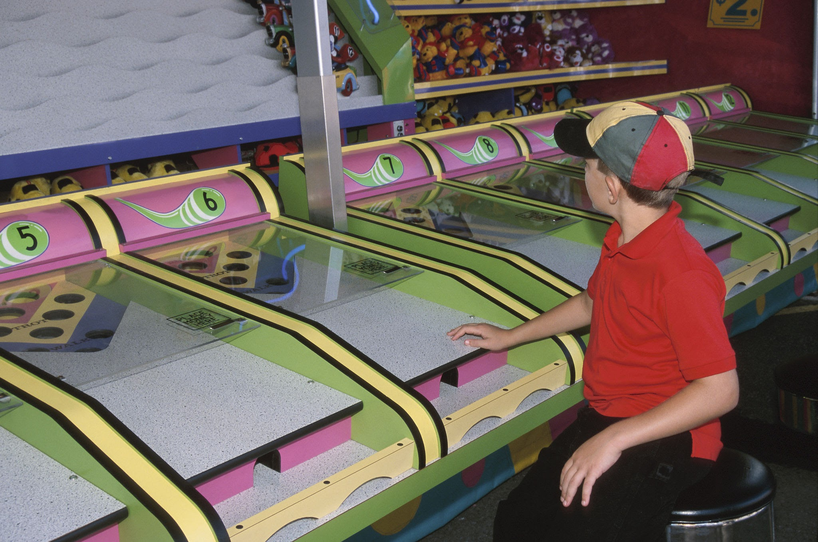
Warm Up - A Day at the Carnival
Jada has $20 to spend on games and rides at a carnival.
Games cost $1 each.
Rides are $2 each.
Which equation represents the relationship between the number of games, x, and the number of rides, y, Jada could do if she spends all $20?
Explain what each of the other two equations could mean in this situation.
x + y = 20 | 2x + y = 20 | x + 2y = 20
Notes:
Warm Up (5 minutes)
Throughout this lesson, students will use a context that involves two variables—the number of games and the number of rides at an amusement park—and a budgetary constraint. This warm up prompts students to interpret and make sense of some equations in context, familiarizing them with the quantities and relationships. Later in the lesson, students will dig deeper into what the parameters and graphs of the equations reveal.
Launch
Arrange students in pairs. If internet access is limited, students will complete their work on notebook paper. Otherwise, students can complete the Desmos activity. The Desmos version includes extra questions that guide students to create tables and write verbal descriptions. These help students build toward writing and interpreting equations for the scenario.
Desmos Activity: OpenStax Alg1 – 1.10.1 Interpreting Equations in Context; Log into student.desmos.com using the information provided by your teacher to complete the activity.
Unlike a standard graphing calculator, Desmos activities walk students through interactive tasks. Teachers can use the Teacher Dashboard to monitor progress, spot correct or incorrect answers, and select responses to share in discussion. Give students a few minutes to work quietly, then a minute to discuss with their partner. Finish with a whole-class discussion.
Activity Answers
x + 2y = 20 (C.)
Your answer may vary, but here are some samples: In this situation, the equation x + y = 20 could mean: Jada spends $20 on games and rides that cost $1 each. The combined number of games and rides that Jada enjoys is 20. OR In this situation, the equation 2x + y = 20 could mean: Jada spends $20 on games and rides, where games cost $2 each and rides are $1 each.

Slide 8

Lesson Journey
Warm Up
Learning Activity
Practice
Warm Up
Learning Activity
Practice
Learning Activity
Cool Down
Lesson Synthesis
Learning Activity
Cool Down
Lesson Synthesis

Slide 9

Learning Activity - Carnival Rides and Games
For numbers 1 – 5, use the equation x + y = 20 which represents the relationship between the number of games, x, the number of rides, y, and the dollar amount a student is spending on games and rides at an amusement park.
What’s the number of rides the student could get on if they don’t play any games? What would the coordinate be on the graph to represent the answer to question 1?
What’s the number of games the student could play if they don’t get on any rides? What would the coordinate be on the graph to represent the answer to question 3?
On the coordinate plane, mark the points found in numbers 1 and 2. Draw a line to connect the two points you’ve drawn. Use the graphing tool or technology outside the course. Students were given access to Desmos.
Notes:
Support for All Learners -
This activity offers additional support and an extension for students:
For English language learners and students with disabilities, be sure to review the Learning Strategies slide!
For students looking for an extra challenge, be sure to review the Extending Your Thinking slide!
Activity (20 minutes)
This activity introduces students to the structure of linear equations in two variables and how they connect to graphs and real-world situations.
Students begin by working with equations in standard form (Ax + By = C). They use these equations to answer questions and create graphs. Standard form helps highlight key quantities and constraints, and makes it easy to find intercepts—points where one variable is zero.
After graphing, students analyze the graphs to find the rate of change, slope, and vertical intercept. Then, they rearrange the equations to isolate y. This puts the equation in slope-intercept form, which clearly shows the slope and the y-intercept. These values give more insight into the relationship between the two quantities.
Launch
Tell students they’ll be working with an equation about games and rides. They’ll use it—and a graph—to figure out what combinations are possible based on prices and a budget. Read the opening paragraph of the task aloud and display the equation. Give students a minute of quiet think time to interpret what it means. Make sure they understand:
Each game and ride costs $1
The total budget is $20.
Have students work in groups of 3–4 to answer the questions. Allow time for quiet work first, then small group discussion to compare and refine responses.
Wrap up with a whole-class discussion to share ideas and clarify understanding.
Activity answers and synthesis on the next slide.

Slide 10
Learning Activity - Carnival Rides and Games
Complete the sentence: “If the student played no games, they can get on _____ rides.”
Complete the sentence: “For every additional game that the student plays, x, the possible number of y __________ (increases or decreases) by _____________.”
What is the slope of your graph?
At what point does the graph intersect the vertical axis?
Rearrange the equation to solve for y.
What connections, if any, do you notice between your new equation and the graph?
Are you ready for more?
Notes:
Answers
20; (0, 20)
20; (20, 0)
The coordinate plane should have the following equation graphed: y = x – 20 and go through the points (0, 20) and (20, 0)
20
Decreases by 1
–1
(0, 20)
Rearrange the equation to solve for y.
The new equation shows where the graph intersects the y-axis at 20, so if the student plays 0 games, they have the money to go on 20 rides. Since the slope of the graph is −1, for every 1 fewer ride they go on, they can play 1 game.
Activity Synthesis
If students continue to have trouble with the activity and need more practice, have students repeat the questions from activity 1.10.2 with one or both of the following equations:
Equation 2: Games cost $2.50 each, and rides cost $1 each. The student is spending $15 on them. 2.50x + y = 15
Equation 3: Games cost $1 each, and rides cost $4 each. The student is spending $28 on them. x + 4y = 28
Then repeat the questioning from the activity for each equation.

Slide 11

Learning Strategies - Carnival Rides & Games
What does this equation mean in your own words?
How can you tell what’s happening in the equation?
Can you describe what the equation shows using a real-life example or situation?
Maximize Meta-Awareness, Support Sense-Making
Teacher Instruction: Use these strategies to adjust the activity to support english language learners and students with disabilities.
You can copy and paste the callouts directly on top of the activity or give the instructions aloud.
Use three different colors to identify A, B, and C.
Use one color to illustrate where the slope appears in each equation and on the corresponding graph.
Internalize Comprehension
Notes:
Support for English Language Learners: MLR 2 Collect and Display: Maximize Meta-Awareness, Support Sense-Making
During the launch, listen for and collect language students use to describe the meaning of the three equations. Record a written interpretation next to each of the three equations on a visual display. Use arrows or annotations to highlight connections between specific language of the interpretations and the parts of the equations. This will provide students with a resource from which to draw language during small-group and whole-group discussions.
Design Principle(s): Maximize meta-awareness; Support sense-making
Provide support for students
Distribute graphic organizers to the students to assist them with participating in this routine.
Support for Students with Disabilities: Representation: Internalize Comprehension
Demonstrate, and encourage students to use color coding and annotations to highlight connections between representations in a problem. For example, use the same color to illustrate where the slope appears in each equation and corresponding graph. Continue to use colors consistently as students discuss “What do the A, B, and C represent in each equation?”
Supports accessibility for: Visual-spatial processing

Slide 12
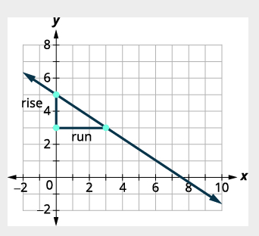
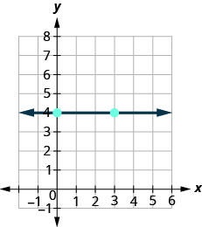
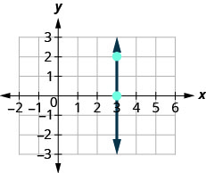
Extending Your Thinking - Slopes of ↔ and ↕
How do we find the slope of horizontal and vertical lines? To find the slope, choose two points on the line. Draw a right triangle between them. The rise is how far up or down, and the run is how far across. Slope = rise ÷ run.
m = rise/run
m = down 2/right 3
m = –⅔
m = rise/run
m = down 0/right 3
m = 0/3 or 0
m = rise/run
m = up 2/right 0
m = undefined
Notes:
Prompt
Sometimes we need to find the slope between two points without using a graph. While we could plot the points and count the rise and run, there’s a quicker way using a formula. Before we get there, we need to introduce some algebra notation.
An ordered pair like (𝑥, 𝑦) gives the location of a point. When we work with slope, we use two points, so we label them using subscripts to tell them apart:
First point: (𝑥₁, 𝑦₁)
Second point: (𝑥₂, 𝑦₂)
Let’s look at an example using the points (2, 3) and (7, 6).
Step 1: Use subscript notation.
(𝑥₁, 𝑦₁) = (2, 3)
(𝑥₂,𝑦₂) = (7, 6)
Step 2: Find the rise and run.
Rise = 6 − 3 = 3
Run = 7 − 2 = 5
Step 3: Use the slope formula.
𝑚 = rise/run
𝑚 = 3/5
We can generalize this process with any two points by using the formula:
𝑚 = (𝑦₂ − 𝑦₁)/(𝑥₂ − 𝑥₁)​
​
This is just another way of expressing slope as rise over run. You can now use this formula to find the slope between any two points, no graph needed!

Slide 13
Self Check
Which of the following equations correctly solved 2x + 4y = 8 for y?
y = −2x + 4 | y = −½x + 2
y = ½x + 2 | y = −½x + 8
Let’s review!
Notes:
Answers and Feedback
Incorrect. Make sure you solve for y, not x. The answer is y = −1/2x + 2.
Incorrect. Make sure to subtract 2x from both sides of the equation when solving for y. The answer is y = −1/2x + 2.
That’s correct! To solve for y, first subtract 2x from both sides then divide both sides by 4. Finally, simplify any fractions.
Incorrect. Make sure to divide all of the terms by 4. The answer is y = −1/2x + 2.

Slide 14
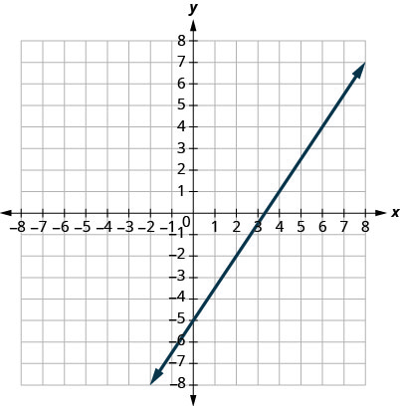
Self Check - Review
Find the slope of the line graph.
Step 1 - Locate two points (integers) on the graph.
Step 2 - Sketch a right triangle using the two coordinate points and the line.
Step 3 - Count the rise (how many spaces up or down). The rise is ___.
Step 4 - Count the run (how many spaces to the right or left). The run is ___.
Step 5 - Use the slope formula. 𝑚 = (𝑦₂ − 𝑦₁)/(𝑥₂ − 𝑥₁)​
Step 6 - Simplify.
Notes:
Answers
*Step 5 is used to verify/confirm the slope found in Step 4.
Your answer may vary, but here is a sample.
Step 1 - (0, −5); (4, 1)
Step 2 - Starting at (0, –5), sketch a right triangle to (4, 1).
Step 3 - Count the rise (how many spaces up or down). The rise is 6.
Step 4 - Count the run (how many spaces to the right or left). The run is 4.
Step 5 - Use the slope formula. 𝑚 = (1 − (−5))/(4 − 0); ​𝑚 = 6/4
Step 6 - Simplify. 𝑚 = 3/2

Slide 15
Lesson Journey
Warm Up
Learning Activity
Practice
Warm Up
Learning Activity
Practice
Learning Activity
Cool Down
Lesson Synthesis
Learning Activity
Cool Down
Lesson Synthesis

Slide 16
Learning Activity - Coin Jar 🫙
Andre’s coin jar contains 85 cents. There are no quarters or pennies in the jar, so the jar has all nickels, all dimes, or some of each.
Write an equation that relates the number of nickels, n, the number of dimes, d, and the amount of money, in cents, in the coin jar.
Graph your equation on the coordinate plane. Be sure to label the axes. Use the graphing tool or technology outside the course, if possible.
How many nickels are in the jar if there are no dimes?
How many dimes are in the jar if there are no nickels?
Notes:
Support for All Learners -
This activity offers additional support and an extension for students:
For English language learners and students with disabilities, be sure to review the Learning Strategies slide!
Activity (10 minutes)
This activity gives students practice with two main skills: writing and graphing linear equations in the form Ax + By = C to represent a constraint, and interpreting points on the graph based on the context. In this situation, only whole-number values make sense since we’re dealing with nickels and dimes (students should consider whether decimal answers are reasonable).
The coordinate grid is blank, so students must decide which variable goes on which axis. That choice affects what each point on the graph means. They’ll also decide whether to draw a continuous line or a graph with only points that show whole-number solutions. As students work, watch for how they make these choices. Look especially for those who use a discrete graph and ask them to explain why during the class discussion.
This task supports reasoning and modeling. Students think carefully about what solutions mean, write an equation for the situation, choose how to represent their model, and check whether their answers make sense in context.
Launch
Teachers may want to bring in coins (or ask students to) and ask students to create different combinations that will lead to 85 cents. This will lead into writing these combinations as equations. Consider keeping students in groups of 3 – 4.
Activity answers and synthesis on the next slide.

Slide 17
Learning Activity - Coin Jar 🫙
A linear equation is in standard form when it is written Ax + By = C.
Most people prefer to have A, B, and C be integers and A ≥ 0 when writing a linear equation in standard form, although it is not strictly necessary.
Linear equations have infinitely many solutions. For every number that is substituted for x there is a corresponding y value. This pair of values is a solution to the linear equation and is represented by the ordered pair (x, y).
When we substitute these values of x and y into the equation, the result is a true statement, because the value on the left side is equal to the value on the right side.
Are you ready for more?
Notes:
Answers
5n + 10d = 85, where n is the number of nickels and d is the number of dimes.
The graph of the line is y = -½x + 8.5 and goes through point (0, 8.5) and (17, 0).
17 nickels
It's not possible for the coin jar to have no nickels if the amount of money in it is 85 cents.
Anticipated Misconceptions
Some students who wish to change their equation from standard form to slope-intercept form may get stuck because they are not sure whether to solve for n or d. Either choice is acceptable, but this is a good opportunity for students to think through the implications of their choice. Ask students: “In y=mx+b, which variable goes on the horizontal axis? Which goes on the vertical?”
Other students might wish to graph using the equation in standard form without first rewriting it into another form. Ask if they could identify two points on the graph. Alternatively, ask them to think about how many nickels there would be if there were 0 dimes, 1 dime, 2 dimes, and so on, and plot some points accordingly.
Activity Synthesis
Ask a few selected students to share their graphs. For each, check if others drew something similar. If no one shows a discrete graph or mentions that fractional values of nickels or dimes don't make sense in this situation, bring it up for discussion. Display the following graphs (pdf link to graphs):
Linear graph: Number of dimes vs. number of nickels
Discrete graph: Number of dimes vs. number of nickels
Linear graph: Number of nickels vs. number of dimes
Discrete graph: Number of nickels vs. number of dimes
Explain that all are valid ways to show the relationship between nickels and dimes. A discrete graph (with only whole-number points) shows the true solution set, but a line graph can help us quickly visualize the relationship—as long as we remember only whole-number solutions make sense. For example, if a continuous graph shows 8.5 dimes and 0 nickels, students should recognize that this isn't possible in the context. The same reasoning applies when solving the equation algebraically and getting a non-whole number answer.
If Time Allows, Pose These Reflection Questions:
“What if we expressed the equation using dollars instead of cents? What would the equation be?” → 0.05𝑛 + 0.10𝑑 = 0.85
“What would its graph look like?” → The same line as 5𝑛 + 10𝑑 = 85
“Why are they the same?” → Because the equations are equivalent. Dividing the cents equation by 100 gives the dollars equation. Both represent the same combinations of coins.

Slide 18
Learning Strategies - Coin Jar 🫙
Teacher Instruction: Use these strategies to adjust the activity to support english language learners and students with disabilities.
You can copy and paste the callouts directly on top of the activity or give the instructions aloud.
Write down possible math questions that could be asked about this situation.
Compare your questions with a partner or the whole class.
Speaking, Reading
How many nickels would Andre have if there were 0, 1, 5, or 10 dimes in the jar. Then switch it, how many dimes would there be if there were 1, 5, or 10 nickels?
What do you notice about the steps you took? Can you use that to write an equation?
Internalize Comprehension
Notes:
Support for English Language Learners: MLR 5 Co-Craft Questions: Speaking, Reading
Use this routine to provide opportunities for students to analyze how different mathematical forms and symbols can represent different situations. Display only the problem statement without revealing the questions that follow. Invite students to write down possible mathematical questions that could be asked about the situation. Invite students to compare their questions before revealing the remainder of the question. Listen for and amplify any questions that address quantities of each type of coin.
Design Principle(s): Maximize meta-awareness; Support sense-making
Learn more about this routine
View the instructional video and follow along with the materials to assist you with learning this routine.
Provide support for students
Distribute graphic organizers to the students to assist them with participating in this routine.
Support for Students with Disabilities: Representation: Internalize Comprehension
Activate or supply background knowledge about generalizing a process to create an equation for a given situation. Some students may benefit by first calculating how many nickels Andre would have if there were 0, 1, 5, or 10 dimes in the jar, and then how many dimes if there were 1, 5, or 10 nickels in the jar. Invite students to use what they notice about the processes they used to create an equation.
Supports accessibility for: Visual-spatial processing; Conceptual processing

Slide 19
Self Check
A coin jar contains 75 cents and only contains quarters and nickels. Write an equation that relates the number of quarters, q, the number of nickels, n, and the amount of money, in cents, in the coin jar.
25q + 5n = 75 | 25q − 5n = 75
25q + 5n = 0.75 | 0.05n − 0.25q = 0.75
Let’s review!
Notes:
Answers and Feedback
25q + 5n = 75
That’s correct! Each quarter is worth 25 cents or 0.25 of a dollar, and each nickel is worth 5 cents or 0.05 of a dollar. The total is 75 cents or 0.75. Then multiply each decimal on both sides by 100.
25q + 5n = 0.75
Incorrect. Write the value of the quarters and nickels as cents. The correct answer is 25q + 5n = 75.
25q − 5n = 75
Incorrect. The sum, not the difference, of the amount of nickels and quarters will equal 75 cents. The correct answer is 25q + 5n = 75.
0.05n − 0.25q = 0.75
Incorrect. The sum, not the difference, of the amount of nickels and quarters will equal 75 cents. The correct answer is 25q + 5n = 75.

Slide 20
Self Check - Review
An ordered pair (x, y) is a solution to a linear equation like Ax + By = C if it makes the equation true when you plug in the values. Linear equations have many solutions. We can graph them on a coordinate grid. The points form a straight line, so we connect them with a line and add arrows to show it goes on forever.
The graph shows all the solutions to the equation.
Every point on the line is a solution.
Any point not on the line is not a solution.
If we solve the equation for y, we can quickly see the slope and the y-intercept (where the line crosses the y-axis).
Solve 9x − 3y = 15 for y.
Notes:
Answer
Step 1 - Move the x term to isolate the y term. Subtract 9x from both sides.
(9x − 9x) − 3y = 15 − 9x
Step 2 - Simplify.
−3y = 15 − 9x
Step 3 - Divide by the coefficient of y. Divide both sides by −3
(−3y)/−3 = (15−9x)/−3
Step 4 - Simplify.
y = 3x + 5
In the new equation, y = 3x + 5, the slope is 3 and the graph of the line would cross the y–axis at –5.

Slide 21

Lesson Journey
Warm Up
Learning Activity
Practice
Warm Up
Learning Activity
Practice
Learning Activity
Cool Down
Lesson Synthesis
Learning Activity
Cool Down
Lesson Synthesis

Slide 22
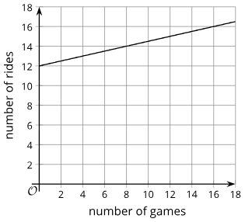
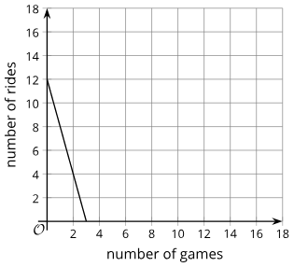
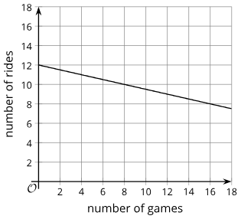
Cool Down
Kiran is spending $12 on games and rides at another carnival, where a game costs $0.25 and a ride costs $1.
Write an equation to represent the relationship between the dollar amount Kiran is spending and the number of games, x, and the number of rides, y, he could do.
Which graph represents the relationship between the quantities in this situation? Explain how you know.
 | B. | C.
Notes:
Cool Down (5 minutes)
Answers
0.25x + y = 12
Graph C (for y = 12 − 1/4x,); Compare your answer: Your answer may vary, but here are some samples:
If Kiran plays 0 games, he could get on 12 rides. If he gets on 0 rides, he could play 48 games. Both the points (0, 12) and (48, 0) are on the line in Graph C.
Rearranging the equation into slope-intercept form gives y = 12 − 1/4x, so the graph has a slope of −1/4 and intersects the y-axis at 12, which matches Graph C.
Response to Student Thinking - More Chances
Students will have more opportunities to understand the mathematical ideas in this cool down, so there is no need to slow down or add additional work to the next lessons. Instead, use the results of this cool down to provide guidance for what to look for and emphasize over the next several lessons to support students in advancing their current understanding.

Slide 23

Lesson Journey
Warm Up
Learning Activity
Practice
Warm Up
Learning Activity
Practice
Learning Activity
Cool Down
Lesson Synthesis
Learning Activity
Cool Down
Lesson Synthesis

Slide 24

Practice
Put your hard work to action, practice what you’ve learned!
Notes:
Access the practice pages at https://openstax.org/details/books/algebra-1

Slide 25

Lesson Journey
Warm Up
Learning Activity
Practice
Warm Up
Learning Activity
Practice
Learning Activity
Cool Down
Lesson Synthesis
Learning Activity
Cool Down
Lesson Synthesis

Slide 26
Lesson Synthesis
We saw equations in different forms representing the same constraint. For example, x + 4y = 28 and y = −14x + 7 both represent the games and rides that a student could do with a fixed budget. What information about the situation and about the graph can we gain from the standard form, Ax + By = C?
What information does the slope-intercept form give us?
What might be an efficient way to graph an equation of the form Ax + By = C?
Notes:
Prompt: After completing the Lesson Synthesis, wrap up the class by directing students to the Lesson Summary in their student textbook. In this section, students review the day’s learning targets, read summaries about the key takeaways from each activity, and then respond to a reflection question regarding their confidence with the material.
For more on the benefits of using this type of metacognitive reflection, see the Research in Practice section of the course.
Answers
In this example, the standard form allows us to see the cost per ride, the cost per game, and the budget.
It gives us the slope and y-intercept of the graph. The slope tells us what is given up in terms of rides for each additional game played. The y-intercept tells us how many rides are possible when no games are played.
Substituting 0 for x or for y in the equation. Doing so gives us (x, 0) and (0, y), which are the horizontal and vertical intercepts of the graph. We could choose two other points, but using 0 eliminates one of the variables, simplifying the calculation. Alternatively, we could isolate y and rearrange the equation into slope-intercept form, which shows us the y-intercept and the slope.

Slide 27
Self Assessment
How much do you agree with the following statements?
I can… | I can | Almost | Not yet
Describe the connections between an equation of the form ax + by = c, the features of its graph, and the rate of change in the situation.
Graph linear equations of the form ax + by = c.
Demonstrate that rewriting the equation for a line in different forms can make it easier to find certain kinds of information about the relationship and about the graph.

