Slide 1


Algebra 1
Unit 4 Functions
Lesson 4.15: Introducing Geometric Sequences

Slide 2
How to use these slides
On the activity slides check the speaker notes for teacher support and instructional information.
Each lesson includes 1 warm up, 2-3 learning activities, a cool down, practice and a lesson synthesis.
  Learning activities are followed by a self check question, and review section.
Some slides have been hidden from student view, more information can be found on the next slide (Reference Key).
You can edit and use these slides for personal and classroom use, but cannot sell them and must keep the attribution logos.
For more information, Check out the digital quick start guide!

Slide 3






Reference Key
Check the top right corner for an icon referencing these unique sections.
 | Support for Students with Disability | Hidden | Learning Strategies slide, provides additional support to students for understanding the activity. Learning Strategies slide, provides additional support to students for understanding the activity.
 | Support for English Language Learners | Hidden
 | Extending Your Thinking | Hidden | Extending Your Thinking slide, provides an extra challenge for students.
 | Self Check | Not Hidden | Self Check slide, checkpoint to assess student understanding after the learning activity.
 | Review | Hidden | Self Check- Review slide, designed to help review topics from the self check question.
On the next slides, check the speaker notes for teacher instructions and support.
Notes:
Check the Speaker Notes: On the next slides you can find discussion questions, lesson information, answers to the activities, and ways to adjust the activity for your students!

Slide 4

Learning Goals
By the end of this lesson you will be able to -
Find missing terms in a geometric sequence.
Notes:
Lesson Narrative
This lesson helps students understand what makes a sequence geometric and connect it to their prior learning on exponential functions. They use precise language to describe how each term in a geometric sequence is multiplied by the same factor (common ratio), such as in the sequence 0.5, 2, 8, 32, 128. Students explore this idea by analyzing examples and creating sequences through a paper-cutting context, using tables and graphs to find and apply the common ratio.
Students revisit the concept of functions, recognizing that geometric sequences are exponential functions with term positions as inputs. The lesson briefly refers to these earlier ideas, like describing piece size as a function of cuts, and comparing graphs of the related quantities. The final activity makes the connection to exponential functions clear.
A note on language and notation: In earlier courses, students may have learned that a ratio is an association between two or more quantities. In more advanced work, such as this course, “ratio” is typically used as a synonym for “quotient.” This expanded use of the word “ratio” comes into play in this lesson with the introduction of the term “common ratio.”
Required Preparation
Scissors and pieces of paper will be needed if students will physically carry out the paper cutting instead of observing how the paper-cutting would look. If using, prepare one pair of scissors and one 8 inch by 10 inch piece of blank paper for every two students.
Required Materials
Sheets of 8-inch by 10-inch paper
Scissors
Texas Essential Knowledge and Skills
A1(D) communicate mathematical ideas, reasoning, and their implications using multiple representations, including symbols, diagrams, graphs, and language as appropriate
A1(F) analyze mathematical relationships to connect and communicate mathematical ideas
A12(C) identify terms of arithmetic and geometric sequences when the sequences are given in function form using recursive processes

Slide 5
Vocabulary
Previous
Constant
  In an expression like (5𝑥 + 2), it is the number 2 because it doesn't change when the 𝑥-value changes.
Term
  Part of an expression that can be a single number, a variable, or a number and a variable that are multiplied together.
New
Geometric Sequence
  A sequence in which each term after the first nonzero term is found by multiplying the preceding term by a constant called the "common ratio 𝑟," where 𝑟 ≠ 0 or 1. A sequence where the ratio between consecutive terms is always the same.
Common Ratio
  𝑟, the ratio between consecutive terms in a geometric sequence.
Notes:
Lesson Vocabulary
To support student understanding of key vocabulary:
Introduce and review the vocabulary words students will see in this lesson.
Encourage students to notice how these words are used and to include them in their math discussions and explanations—both written and oral.
Use a word wall to reinforce vocabulary. Sample word wall cards are available here.
For newcomers or students with beginning English proficiency, use these Quizlet sets to support vocabulary learning:
Unit 4 Spanish Vocabulary, part 1 – use first to build understanding
Unit 4 Vocabulary (English), part 1 – use after anchoring in Spanish
Unit 4 Spanish Vocabulary, part 2 – use first to build understanding
Unit 4 Vocabulary (English), part 2 – use after anchoring in Spanish
Support for English Language Learners
ELPS 1(F) use accessible language and learn new and essential language in the process
ELPS 2(F) listen to and derive meaning from a variety of media such as audiotape, video, DVD, and CD-ROM to build and reinforce concept and language attainment
ELPS 3(E) share information in cooperative learning interactions
ELPS 3(G) express opinions, ideas, and feelings ranging from communicating single words and short phrases to participating in extended discussions on a variety of social and grade-appropriate academic topics
ELPS 3(H) narrate, describe, and explain with increasing specificity and detail as more English is acquired

Slide 6





Lesson Journey
Warm Up
Learning Activity
Practice
Learning Activity
Cool Down
Lesson Synthesis

Slide 7
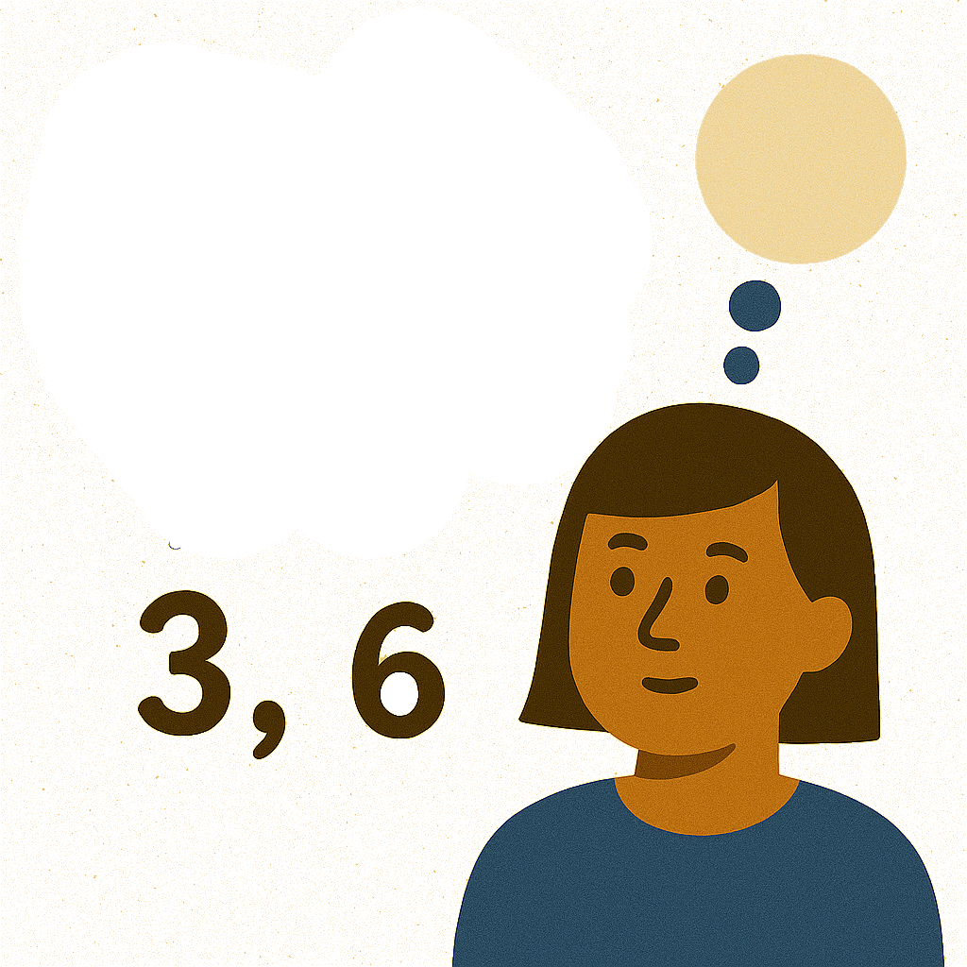
Warm Up - What Do You Notice and Wonder? 🤔
What do you notice?
What do you wonder?
40, 120, 360, 1,080, 3,240
2, 8, 32, 128, 512
1,000, 500, 250, 125, 62.5
256, 192, 144, 108, 81
Notes:
Warm Up (5 minutes)
In this activity, Students respond to “What do you notice? What do you wonder?” to make the math task accessible. Sharing responses helps engage all students and guides curiosity toward the lesson's focus.
The goal is to reintroduce the idea of a common ratio, helping students recognize consistent relationships between terms in geometric sequences.
As students share observations, they refine their language—starting informally and improving clarity and precision in how they describe patterns.
Sequences with common ratios less than 1 help students notice structure and understand that the term “common ratio” applies even when sequences are decreasing.
Launch
Display the four sequences for all to see. Ask students to think of at least one thing they notice and at least one thing they wonder. Give students 1 minute of quiet time to think individually, and then 1 minute to discuss the things they notice and wonder with their partner, followed by a whole-class discussion.
Activity Answers
Things students may notice:
The first two sequences are increasing, and the second two are decreasing.
The next number in the list comes from always multiplying the previous number by the same value.
If we choose a number in the list and divide it by the previous number, we always get the same value.
They are equal.
Things students may wonder:
Why do all the sequences start with even numbers?
Will the last sequence eventually have decimal numbers like the one before it since it is also decreasing?
Are these sequences related in some way?
Is the next term of the second sequence 1,024?
Activity Synthesis
Have students share what they noticed and wondered, and record their responses for all to see. Afterward, ask if anything on the list now raises new questions. Encourage respectful discussion and clarification.
If no one mentions a common ratio, prompt students to discuss the consistent change between terms. Guide them to use precise language like “term” and describe the multiplicative relationship clearly.
Explain that this repeated multiplication is called the common ratio or growth factor. For example, in a sequence where each term is multiplied by 4, the common ratio is 4.
For example:
“In the first sequence, you always multiply a term by 3 to get the next term.”
“In the last sequence, if you divide any term by the previous term, you always get 34.”
Tell students that this “same thing” is called the common ratio or growth factor, and that we will use the first of these. For example, in the second list, the common ratio is 4 because 8 = 4 ⋅ 2, 32 = 4 ⋅ 8, 128 = 4 ⋅ 32, and 512 = 4 ⋅ 128
Clarify that the common ratio is the multiplier between terms, or the quotient of a term and the previous one. While students might describe a sequence as “divide by 2,” the common ratio is still ½ because it’s the multiplying factor.
Students may know “ratio” as a comparison of parts, but here it’s used to mean “quotient” between terms.
.

Slide 8

Lesson Journey
Warm Up
Learning Activity
Practice
Learning Activity
Cool Down
Lesson Synthesis

Slide 9
Learning Strategies - Cut the Paper✂️
Write down possible mathematical questions that you could ask about Clare and how she is cutting paper.
Co-Craft Questions
Teacher Instruction: Use these strategies to adjust the activity to support English language learners and students with disabilities.
You can copy and paste the callouts directly on top of the activity or give the instructions aloud.
We are going to cut the paper like Clare did. What questions do you have?
Engagement
Notes:
Support for English Language Learners: MLR 5 Co-Craft Questions: Speaking, Reading
Use this routine to help students consider the context of this problem. Without revealing the questions that follow, display and read aloud only the task statement that describes Clare's actions. Ask students to write down possible mathematical questions that could be asked about the situation. Invite 3-4 students to share their questions with the class. Listen for and amplify any questions that include language related to looking for patterns.
Design Principle(s): Maximize meta-awareness; Support sense-making
Learn more about this routine
View the instructional video and follow along with the materials to assist you with learning this routine.
Provide support for students
Distribute graphic organizers to the students to assist them with participating in this routine.
Support for Students with Disabilities: Engagement: Provide Access by Recruiting Interest
Use this routine to help students consider the Engagement: Provide Access by Recruiting Interest. Begin with a whole-class demonstration. If time does not allow for students to carry out paper cutting themselves, demonstrate the initial cuts so that students can complete the first few rows of the table.
Supports accessibility for: Memory; Conceptual processing

Slide 10
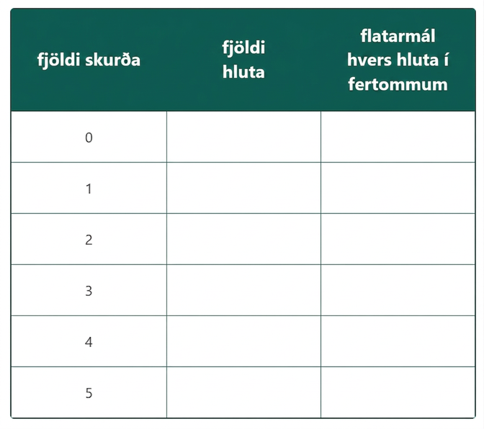
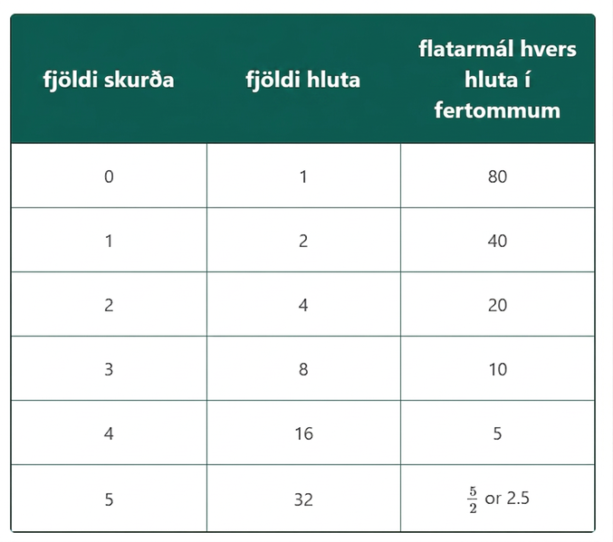
Learning Activity - Cut the Paper✂️
Clare takes a piece of paper, cuts it in half, then stacks the pieces. She takes the stack of two pieces, then cuts in half again to form four pieces, stacking them. She keeps repeating the process.
The original piece of paper has length 8 inches and width 10 inches. Complete the table.
Describe in words how you can use the results after 5 cuts to find the results after 6 cuts.
Notes:
Support for All Learners
This activity offers additional support and an extension for students:
For English language learners and students with disabilities, be sure to review the Learning Strategies slide!
For students looking for an extra challenge, be sure to review the Extending Your Thinking slide!
Activity (20 minutes)
In this activity, students generate two geometric sequences from a given situation, using tables and graphs to represent them. Writing equations is not required yet and will be addressed in a future lesson.
Observe and highlight students who create clear, accurate graphs. Although students might connect points with lines, it's not necessary to address the appropriateness of this now, as domain considerations will come in later lessons.
Launch
Pair students and have them read the task introduction. If time allows, let them cut paper and complete the first rows of the table; otherwise, demonstrate the cutting.
After the first few rows, pause and ask,
“What happens to the number of pieces?
What happens to the area of each piece?”
Have students discuss with a partner, then share out. Ensure they recognize that each cut doubles the number of pieces and halves the area. Then continue the activity.
Activity Answers
(Answer is also revealed on slide click)
Number of Cuts | Number of Pieces | Area (sq in) of Each Piece
---------------------- |------------------------ |----------------------------
0 | 1 | 80
1 | 2 | 40
2 | 4 | 20
3 | 8 | 10
4 | 16 | 5
5 | 32 | ⁵⁄₂ or 2.5
For example: Double the number of pieces, from 32 to 64. Halve the area of each piece, from ⁵⁄₂ to ⁵⁄₄.
More activity questions answer, and synthesis on the next slide.

Slide 11
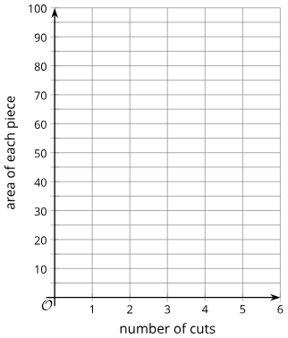
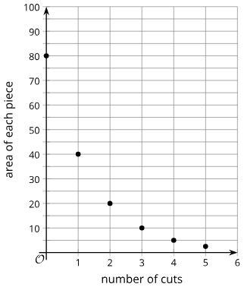
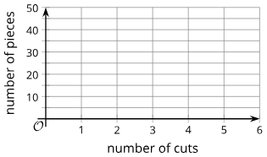
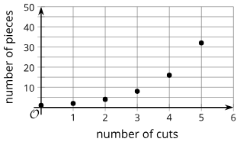
Learning Activity - Cut the Paper✂️
For questions 3 - 4 sketch a graph of the number of pieces as a function of the number of cuts. Then explain how can you see on the graph how the number of pieces is changing with each cut.
4.
Are you ready for more?
Notes:
Activity Answer
Completed Graph is revealed on slide click. For example: You see on the graph how the number of pieces is changing with each cut because the height of each plotted point is twice the height of the previous plotted point.
Completed Graph is revealed on slide click. For example: You see on the graph how the number of pieces is changing with each cut because the height of each plotted point is half the height of the previous plotted point.
Anticipated Misconceptions
If students struggle to remember the meaning of area, ask them what they remember about the idea from their previous courses. A workable definition is "the number of one-inch squares covered by the piece of paper." (Length times width is how one computes the area of the region bounded by a rectangle, but it doesn't explain what area means.)
Activity Synthesis
Students will identify the common ratio in sequences and learn that such sequences are called geometric sequences.
Have selected students share their graphs, and display the two sequences: (1, 2, 4, 8, 16, 32) and (80, 40, 20, 10, 5, 2.5).
Here are some possible questions for discussion:
"When did you stop cutting the paper and complete the table using a pattern?"
"What was the pattern you noticed?" (To find the number of pieces, multiply the previous number by 2. To find the area, multiply the previous number by ½.)
"How did you find the results after six cuts?" (Multiply 32 by 2 to get 64, and divide 2.5 by 2 to get 1.25.)
"What is the common ratio for each sequence?" (It's 2 for the number of pieces and ½.)
"How can you see the common ratio in each graph?" (For the number of pieces, the height of each plotted point is twice the height of the previous plotted point. For the area, the height of each plotted point is half the height of the previous plotted point.)
Explain that these are geometric sequences, defined by a common ratio—any term divided by the previous gives the same result.
Some students may notice similarities to exponential functions. Encourage these connections and explain that geometric sequences are a form of exponential function. If not brought up, prompt students to recall and compare exponential functions to geometric sequences.

Slide 12
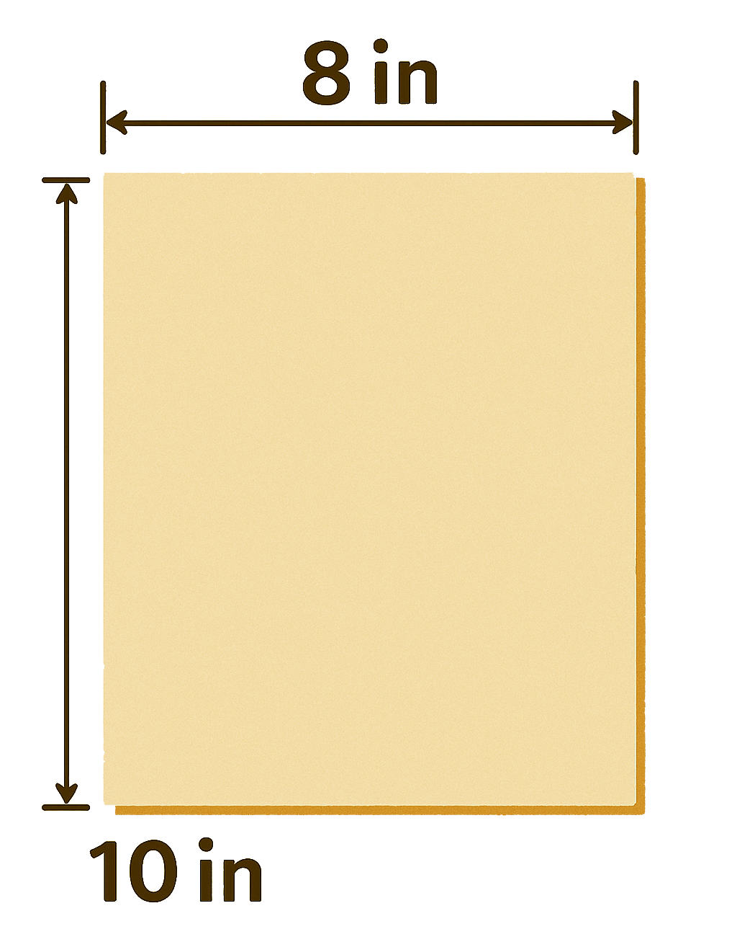
Extending Your Thinking
Clare has a piece of paper that is 8 inches by 10 inches.
  How many pieces of paper will Clare have if she cuts the paper in half n times?
  What will the area of each piece be?
Notes:
Answer
Clare has a piece of paper that is 8 inches by 10 inches.
2n pieces.
Each piece has area 80 ÷ 2⁹ square inches.

Slide 13
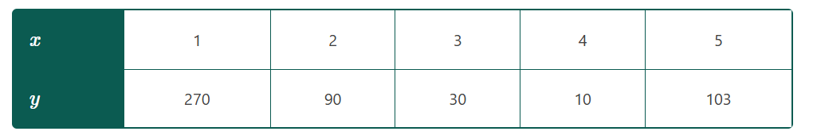
Self Check
Given the table, what would be the next term in the sequence?
¹⁰⁄₆
¹¹⁄₃
¹⁰⁄₉
¹⁰⁄₂₇
Let’s review!
Notes:
Answer Feedback - Individualized by Response
Incorrect. Each term is multiplied by ⅓ not ½. The answer is ¹⁰⁄₉.
Incorrect. To find the 6th term, the 5th term is multiplied by ⅓ , not added. The answer is ¹⁰⁄₉.
That’s correct! The 5th term was 103. Each term before was multiplied by ¹⁰⁄₃. So, ¹⁰⁄₃ ⋅ ⅓ = ¹⁰⁄₉..
Incorrect. This would be term 7. The answer is ¹⁰⁄₉.

Slide 14
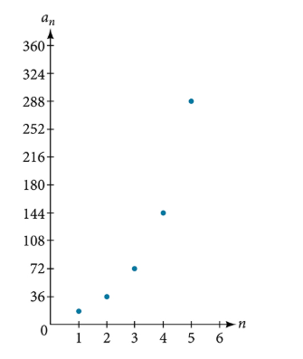
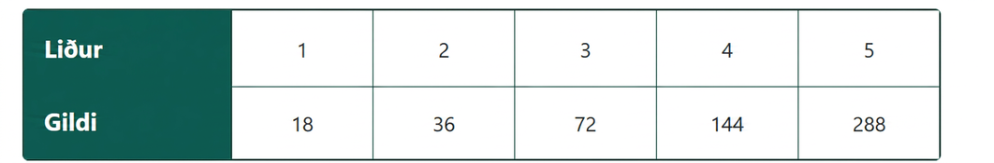
Self Check - Review
Graph the sequence {18, 36, 72, 144, 288, ..}
First make a table.
Then graph the points.
Notice that each height is double the previous height.
Each term is also double the previous term.

Slide 15
Lesson Journey
Warm Up
Learning Activity
Practice
Learning Activity
Cool Down
Lesson Synthesis

Slide 16
Learning Strategies - Geometric Sequence and Common Ratio 🪜
Do you think a calculator or graphing software would help us work through this activity?
Discussion Supports
Teacher Instruction: Use these strategies to adjust the activity to support English language learners and students with disabilities.
You can copy and paste the callouts directly on top of the activity or give the instructions aloud.
Notes:
Support for Students with Disabilities: Action and Expression: Provide Access for Physical Action
Provide access to tools and assistive technologies, such as a calculator or graphing software. Some students may benefit from a checklist or list of steps to use the calculator or software.
Supports accessibility for: Organization; Conceptual processing; Attention

Slide 17
Learning Activity - Geometric Sequence and Common Ratio 🪜
If you have not already done so, write the following terms and definitions in your math notebook:
A geometric sequence is a sequence in which each term is found by multiplying the previous term by the same constant.
The number that is multiplied by each term is called the common ratio.
Notes:
Support for All Learners
This activity offers additional support and an extension for students:
For English language learners and students with disabilities, be sure to review the Learning Strategies slide!
Activity (10 minutes)
The purpose of this task is to give students practice identifying the common ratio in geometric sequences. For each sequence, have a student explain how they extended the sequence and found the common ratio by dividing a term by the previous term. Emphasize that a constant ratio defines a geometric sequence.
Activity questions, answers, and synthesis on the next slide.

Slide 18
Learning Activity - Geometric Sequence and Common Ratio 🪜
Answer questions 1 and 2 for each of the following sequences:
  1.5, 3, 6, ___, 24, ___
  40, 120, 360, ____, ____
  200, 20, 2, ____, 0.02, ____
  ⅐, ____, ⁹⁄₇,²⁷⁄₇, ____
  24, 12, 6, ____, ____
Complete each geometric sequence.
For each sequence, find its common ratio.
Notes:
Answers
Complete each geometric sequence.
12 , 48
1,080, 3,240
0.2, 0.002
³⁄₇, ⁸¹⁄₇
3, 1.5
For each sequence, find its common ratio
2
3
⅒
3
12
Activity Synthesis
Before writing recursive definitions, students need to understand that in geometric sequences, the common ratio is the multiplier between terms, found by dividing a term by the previous term. For example, if a sequence follows “divide by 10 each time,” the common ratio is ⅒.

Slide 19
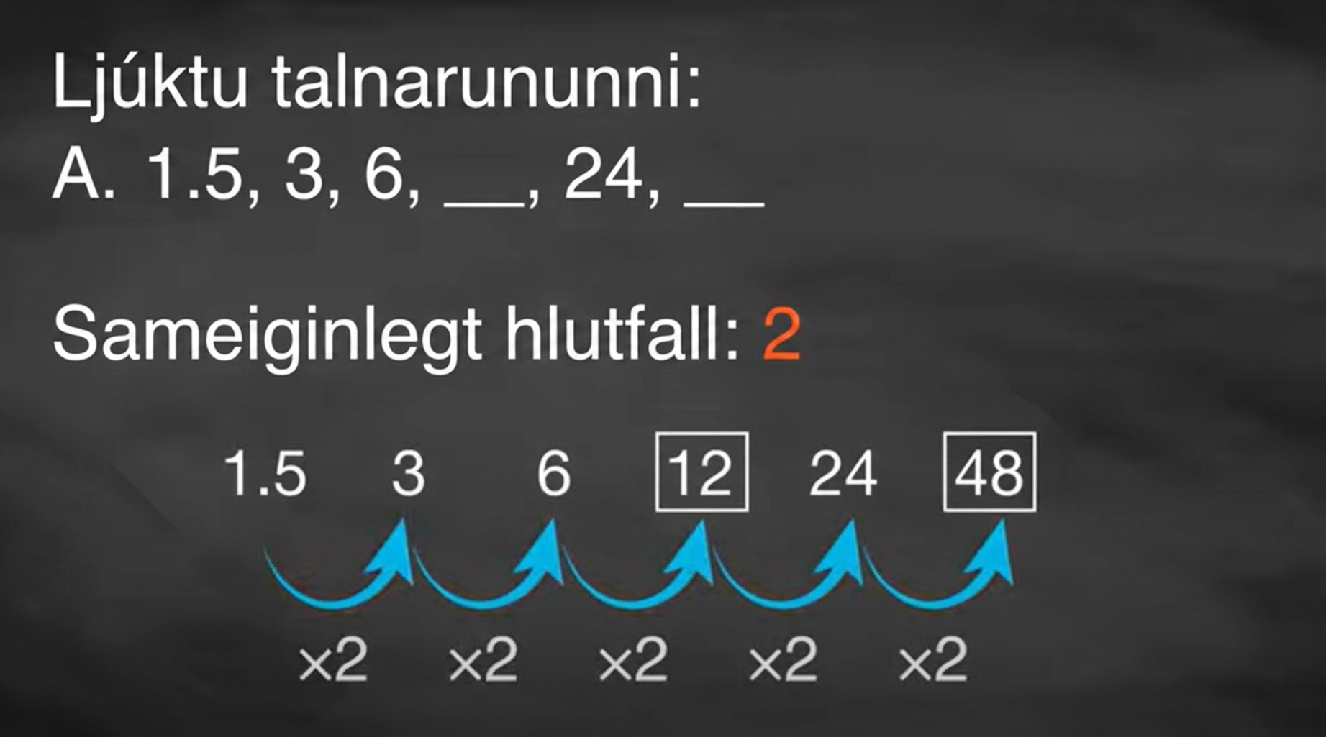
Video: Completing Geometric Sequences

Slide 20

Self Check
Which of the following sequences is geometric?
5, 10, 15, 20 . . .
48, 24, 12, 6, . . .
3, 5, 8, 10, 13, . . .
10, 7, 4, 1, . . .
Let’s review!
Notes:
Answer Feedback - Individualized by Response
Incorrect. The sequence creates terms by adding 5 to the previous term, so there is not a common ratio. The answer is 48, 24, 12, 6, . . .
That’s correct! The common ratio is ½, so this is a geometric sequence.
Incorrect. The sequence is formed by adding 2, then adding 3, and repeating that pattern. There is not a common ratio. The answer is 48, 24, 12, 6, . . .
Incorrect. The sequence is formed by subtracting 3 from the previous term. There is not a common ratio. The answer is 48, 24, 12, 6, . . .

Slide 21
Self Check - Review
Definition of a Geometric Sequence
A geometric sequence is a sequence where each term is found by multiplying the previous term by a constant called the common ratio (r).
General form: {a₁, a₁ · r, a₁ · r², a₁ · r³, ...}
Is the sequence geometric?
If so, find the common ratio.
a. 1, 2, 4, 8, 16, . . .
b. 48, 12, 4, 2, . . .
How to determine if a given a set of numbers represents a geometric sequence.
Divide each term by the previous term.
Compare the quotients. If they are the same, a common ratio exists and the sequence is geometric.
Notes:
Discuss the Answers with the Students:
Is a geometric sequence. Each term is multiplied by 2, so 2 is the common ratio.
This is not geometric because each term is not multiplied by the same constant. There is not a common ratio.

Slide 22

Lesson Journey
Warm Up
Learning Activity
Practice
Learning Activity
Cool Down
Lesson Synthesis

Slide 23

Cool Down
Here is a sequence: 500, 100, 20, . . .
Explain why this sequence could be a geometric sequence.
What is the next term?
Explain how you know the next term.
Notes:
Cool Down (5 minutes)
Answers
The given terms have a common ratio. 100 = ⅕ ⋅ 500, and 20 = ⅕ ⋅ 100.
20 ⋅ ⅕ = 4
Multiplying a term by the common ratio gives the next term.
Response to Student Thinking - More Chances
Students will have more opportunities to understand the mathematical ideas in this cool-down, so there is no need to slow down or add additional work to the next lessons. Instead, use the results of this cool-down to provide guidance for what to look for and emphasize over the next several lessons to support students in advancing their current understanding.

Slide 24

Lesson Journey
Warm Up
Learning Activity
Practice
Learning Activity
Cool Down
Lesson Synthesis

Slide 25

Practice
Put your hard work to action, practice what you’ve learned!
Notes:
Digital Practice: Access the practice pages at https://openstax.org/k12/algebra

Slide 26

Lesson Journey
Warm Up
Learning Activity
Practice
Learning Activity
Cool Down
Lesson Synthesis

Slide 27

Lesson Synthesis
Come up with a new geometric sequence and be prepared to explain why it is a geometric sequence.
Notes:
Prompt:
Arrange students in groups of 2. Ask each group to come up with a new geometric sequence and be prepared to explain why it is a geometric sequence. After a brief work time, select 3 – 4 groups to share their sequence and why it is a geometric sequence. Encourage students to use precise language as they share with the class, such as “term,” “multiplier,” and “common ratio.”
If time allows, ask students if they think the sequence 2, 2, 2, 2, 2 is a geometric sequence. (Yes, it has a common ratio of 1.)
Closing the Lesson
After completing the Lesson Synthesis, wrap up the class by directing students to the Lesson Summary in their student textbook. In this section, students review the day’s learning targets, read summaries about the key takeaways from each activity, and then respond to a reflection question regarding their confidence with the material.
For more on the benefits of using this type of metacognitive reflection, see the Research in Practice section of the course.

Slide 28
Self Assessment
How much do you agree with the following statements?
I can… | I can | Almost | Not yet
Explain when a relationship between two quantities Find missing terms in a geometric sequence.

