Slide 1
Algebra 1
Unit 8 Quadratic Equations
Lesson 8.7 Rewriting Quadratic Equations in Factored Form, Part 2

Slide 2

How to use these slides
On the activity slides check the speaker notes for teacher support and instructional information.
Each lesson includes 1 warm up, 2-3 learning activities, a cool down, practice and a lesson synthesis.
  Learning activities are followed by a self check question, and review section.
Some slides have been hidden from student view, more information can be found on the next slide (Reference Key).
You can edit and use these slides for personal and classroom use, but cannot sell them and must keep the attribution logos.
For more information, Check out the digital quick start guide!
OpenStax CC BY NC SA

Slide 3





Reference Key
Check the top right corner for an icon referencing these unique sections.
Icon | Title | View | Location and Description
n/a | Support for Students with Disability | Hidden | Learning Strategies slide, provides additional support to students for understanding the activity.
n/a | Support for English Language Learners | Hidden | Learning Strategies slide, provides additional support to students for understanding the activity.
n/a | Extending Your Thinking | Hidden | Extending Your Thinking slide, provides an extra challenge for students.
n/a | Self Check | Not Hidden | Self Check slide, checkpoint to assess student understanding after the learning activity.
n/a | Review | Hidden | Self Check - Review slide, designed to help review topics from the self check question.
On the next slides, check the speaker notes for teacher instructions and support.
Notes:
Check the Speaker Notes: On the next slides you can find discussion questions, lesson information, answers to the activities, and ways to adjust the activity for your students!

Slide 4

Learning Goals
By the end of this lesson you will be able to -
Explain how the numbers and signs in a quadratic expression in factored form relate to the numbers and signs in an equivalent expression in standard form.
Write an equivalent expression in factored form, given a quadratic expression in standard form with a negative constant term.
Notes:
Lesson Narrative
In an earlier lesson, students transformed quadratic expressions from standard form into factored form. There, the factored expressions are products of two sums, (𝑥 + 𝑚)(𝑥 + 𝑛), or two differences, (𝑥 − 𝑚)(𝑥 − 𝑛). Students continue that work in this lesson, extending it to include expressions that can be rewritten as products of a sum and a difference, (𝑥 + 𝑚)(𝑥 − 𝑛).
Students will notice that when we apply the distributive property to multiply out a sum and a difference, the product has a negative constant term, but the linear term can be negative or positive. Students will use this insight to transform quadratic expressions into factored form. They see that if a quadratic expression in standard form (with coefficient 1 for 𝑥²) has a negative constant term, one of its factors must have a negative constant term and the other must have a positive constant term. Emphasize that all of these quadratic expressions have a leading coefficient of 1 on the 𝑥² term.
Required Preparation
None
Required Materials
Paper and pencil
Texas Essential Knowledge and Skills
A1(F) analyze mathematical relationships to connect and communicate mathematical ideas.
A8(A) solve quadratic equations having real solutions by factoring, taking square roots, completing the square, and applying the quadratic formula.

Slide 5
Vocabulary
Previous
Quadratic expression
  A polynomial expression of degree two.
Factored form (of a quadratic expression)
  A quadratic expression in the form a(x – r₁)(x – r₂), where a, r₁, and r₂ are constants and a ≠ 0.
Standard form (of a quadratic expression)
  A quadratic expression in the form ax² + bx + c, where a, b, and c are constants and a ≠ 0.
Notes:
Lesson Vocabulary
To support student understanding of key vocabulary:
Introduce and review the vocabulary words students will see in this lesson.
Encourage students to notice how these words are used and to include them in their math discussions and explanations—both written and oral.
Use a word wall to reinforce vocabulary. Sample word wall cards are available here.
For newcomers or students with beginning English proficiency, use these Quizlet sets to support vocabulary learning:
Unit 8 Spanish Vocabulary – use first to build understanding
Unit 8 Vocabulary (English) – use after anchoring in Spanish
Support for English Language Learners
ELPS 2(F) listen to and derive meaning from a variety of media such as audiotape, video, DVD, and CD-ROM to build and reinforce concept and language attainment
ELPS 3(E) share information in cooperative learning interactions
ELPS 3(I) adapt spoken language appropriately for formal and informal purposes
ELPS 4(F) use visual and contextual support and support from peers and teachers to read grade-appropriate content area text, enhance and confirm understanding, and develop vocabulary, grasp of language structures, and background knowledge needed to comprehend increasingly challenging language

Slide 6
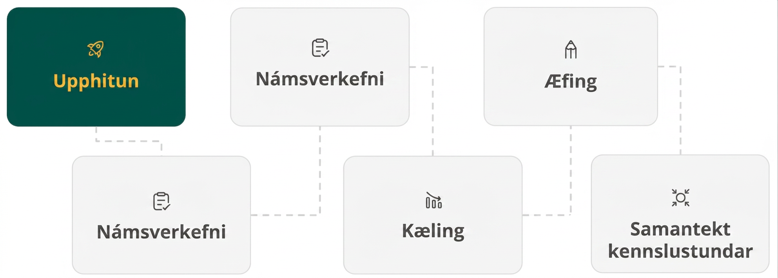
Lesson Journey
First Stop: Warm Up

Slide 7

Warm Up | Part 1
That’s a negative!
In the previous lesson, you experienced the role products and sums play in the way that quadratic expressions are converted between standard and factored forms. Now, you will expand your understanding of the concept.
Notes:
Warm Up (5 minutes)
This warm up serves two purposes. The first is to recall that if the product of two numbers is negative, then the two numbers must have opposite signs. The second is to review how to add two numbers with opposite signs.
Launch
Read the initial paragraph together as a class. Allow students quiet time to think individually to answer the questions.
Activity questions, answers, and synthesis on the next slide.

Slide 8
Warm Up | Part 2
That’s a negative!
List all pairs of integers whose product is –12. For example, 2 and –6.
Of the pairs of factors you found, list all pairs that have a positive sum. Explain why they have a positive sum.
Of the pairs of factors you found, list all pairs that have a negative sum. Explain why they have a negative sum.
Notes:
Answers
1 and –12, –1 and 12, 2 and –6, –2 and 6, 3 and –4, –3 and 4
–1 and 12, –2 and 6, –3 and 4. The positive number has a larger absolute value than the negative number (or equivalent).
1 and –12, 2 and –6, 3 and –4. The negative number has a larger absolute value than the positive number (or equivalent).
Anticipated Misconceptions
None
Activity Synthesis
Ask students to share their list of factors. Once all the pairs are listed, highlight that each pair has a positive number and a negative number because the product we are after is a negative number, and the product of a positive and a negative number is always negative.
Then, invite students to share their responses for the next two questions. Consider displaying a number line for all to see and using arrows to visualize the additions of factors. Make sure students understand that when adding a positive number and a negative number, the result is the difference of the absolute values of the numbers, and that sum takes the sign of the number that is farther from zero.Blah

Slide 9
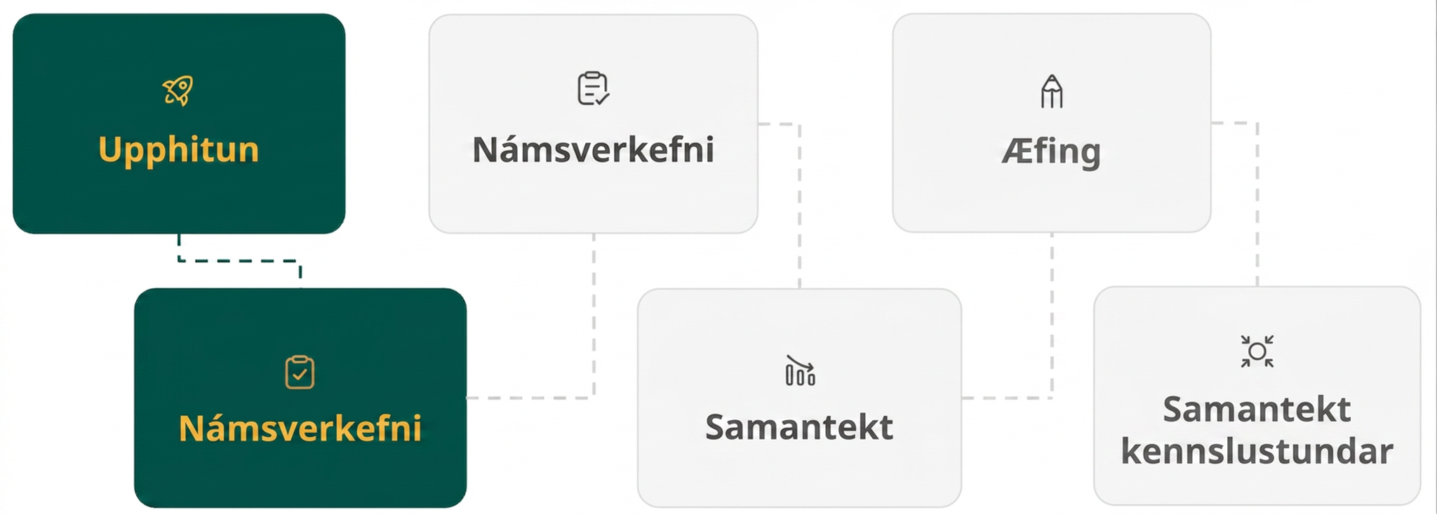
Lesson Journey
Second Stop: Learning Activity A

Slide 10

Learning Activity A | Learning Strategies
Make Them Equivalent 🔄 - Next Level
Teacher Instruction: Use these strategies to adjust the activity to support English language learners and students with disabilities.
You can copy and paste the callouts directly on top of the activity or give the instructions aloud.
Use these sentences to get started with your partner:
“_____ and _____ are different because . . .”
“One thing that is different is . . .”
“I noticed _____, so . . . .”
Conversing
Locate tools with important terms and vocabulary to help you!
Vocabulary Guide
Classroom Display
Representation
Notes:
Support for English Language Learners: MLR 8 Discussion Supports: Conversing
In groups of two, ask students to take turns describing the differences they notice between the expressions in each table. Display the following sentence frames for all to see: “_____ and _____ are different because . . .”, “One thing that is different is . . .” and “I noticed _____, so . . . .” Encourage students to challenge each other when they disagree. This will help students clarify their reasoning about the relationship between quadratic expressions with a negative constant term written in factored and standard form.
Design Principle(s): Support sense-making; Maximize meta-awareness
Support for Students with Disabilities: Representation: Develop Language and Symbols
Create a display of important terms and vocabulary. During the launch, take time to review terms students will need to access for this activity. Invite students to suggest language or diagrams to include that will support their understanding of factored form, standard form, linear term, constant term, coefficient, squared term, expression, and factors.
Supports accessibility for: Conceptual processing; Language

Slide 11
Learning Activity A | Part 1
Make Them Equivalent 🔄 - Next Level
Each row of the table below has a pair of equivalent expressions. Complete the table. If you get stuck, consider drawing a diagram.
Factored Form | Standard Form
(𝑥 + 5)(𝑥 + 6)
 | 𝑥² + 13𝑥 + 30
(𝑥 – 3)(𝑥 – 6)
 | 𝑥² – 11𝑥 + 18
Notes:
Support for All Learners
This activity offers additional support for students:
For English language learners and students with disabilities, be sure to review the Learning Strategies slide!
Activity (15 minutes)
In this activity, students encounter quadratic expressions that are in standard form and that have a negative constant term. They notice that, when such expressions are rewritten in factored form, one of the factors is a sum and the other is a difference. They connect this observation to the fact that the product of a positive number and a negative number is a negative number.
Students also recognize that the sum of the two factors of the constant term may be positive or negative, depending on which factor has a greater absolute value. This means that the sign of the coefficient of the linear term (which is the sum of the two factors) can reveal the signs of the factors.
Students will use their observations of these expressions and of operations to help transform expressions in standard form into factored form.
Launch
Arrange students in groups of two. Give students a few minutes of quiet time to attempt the first two rows of question 1.
Pause for a class discussion before students complete the rest of the table. Make sure students recall that when transforming an expression in standard form into factored form, they are looking for two numbers whose sum is the coefficient of the linear term and whose product is the constant term.
Next, display a completed table for the first question and the incomplete table for the second question for all to see.
Ask students to talk to their partner about at least one thing they notice and one thing they wonder about the expressions in the table. The online Teacher’s Guide offers additional examples of what students may notice and wonder.
Next, ask students to work quietly on the second question before conferring with their partner.
Activity questions, answers, anticipated misconceptions, and synthesis on this slide.

Slide 12
Learning Activity A | Part 1 Answers
Make Them Equivalent 🔄 - Next Level
Each row of the table below has a pair of equivalent expressions. Complete the table. If you get stuck, consider drawing a diagram.
Factored Form | Standard Form
(𝑥 + 5)(𝑥 + 6) | 𝑥² + 11𝑥 + 30
(𝑥 + 10)(𝑥 + 3) | 𝑥² + 13𝑥 + 30
(𝑥 – 3)(𝑥 – 6) | 𝑥² – 9𝑥 + 18
(𝑥 – 9)(𝑥 – 2) | 𝑥² – 11𝑥 + 18
ANSWERS
Notes:
Support for All Learners
This activity offers additional support for students:
For English language learners and students with disabilities, be sure to review the Learning Strategies slide!
Activity (15 minutes)
In this activity, students encounter quadratic expressions that are in standard form and that have a negative constant term. They notice that, when such expressions are rewritten in factored form, one of the factors is a sum and the other is a difference. They connect this observation to the fact that the product of a positive number and a negative number is a negative number.
Students also recognize that the sum of the two factors of the constant term may be positive or negative, depending on which factor has a greater absolute value. This means that the sign of the coefficient of the linear term (which is the sum of the two factors) can reveal the signs of the factors.
Students will use their observations of these expressions and of operations to help transform expressions in standard form into factored form.
Launch
Arrange students in groups of two. Give students a few minutes of quiet time to attempt the first two rows of question 1.
Pause for a class discussion before students complete the rest of the table. Make sure students recall that when transforming an expression in standard form into factored form, they are looking for two numbers whose sum is the coefficient of the linear term and whose product is the constant term.
Next, display a completed table for the first question and the incomplete table for the second question for all to see.
Ask students to talk to their partner about at least one thing they notice and one thing they wonder about the expressions in the table. The online Teacher’s Guide offers additional examples of what students may notice and wonder.
Next, ask students to work quietly on the second question before conferring with their partner.
Activity questions, answers, anticipated misconceptions, and synthesis on this slide.

Slide 13
Learning Activity A | Part 2
Make Them Equivalent 🔄 - Next Level
Each row of the table below has a pair of equivalent expressions. Complete the table. If you get stuck, consider drawing a diagram.
Factored Form | Standard Form
(𝑥 + 12)(𝑥 – 3)
 | 𝑥² – 9𝑥 – 36
 | 𝑥² – 35𝑥 – 36
 | 𝑥² + 35𝑥 – 36
Notes:
Support for All Learners
This activity offers additional support for students:
For English language learners and students with disabilities, be sure to review the Learning Strategies slide!
Activity (15 minutes)
In this activity, students encounter quadratic expressions that are in standard form and that have a negative constant term. They notice that, when such expressions are rewritten in factored form, one of the factors is a sum and the other is a difference. They connect this observation to the fact that the product of a positive number and a negative number is a negative number.
Students also recognize that the sum of the two factors of the constant term may be positive or negative, depending on which factor has a greater absolute value. This means that the sign of the coefficient of the linear term (which is the sum of the two factors) can reveal the signs of the factors.
Students will use their observations of these expressions and of operations to help transform expressions in standard form into factored form.
Launch
Arrange students in groups of two. Give students a few minutes of quiet time to attempt the first two rows of question 1.
Pause for a class discussion before students complete the rest of the table. Make sure students recall that when transforming an expression in standard form into factored form, they are looking for two numbers whose sum is the coefficient of the linear term and whose product is the constant term.
Next, display a completed table for the first question and the incomplete table for the second question for all to see.
Ask students to talk to their partner about at least one thing they notice and one thing they wonder about the expressions in the table. The online Teacher’s Guide offers additional examples of what students may notice and wonder.
Next, ask students to work quietly on the second question before conferring with their partner.
Activity questions, answers, anticipated misconceptions, and synthesis on this slide.

Slide 14
Learning Activity A | Part 2 Answers
Make Them Equivalent 🔄 - Next Level
Each row of the table below has a pair of equivalent expressions. Complete the table. If you get stuck, consider drawing a diagram.
Factored Form | Standard Form
(𝑥 + 12)(𝑥 – 3) | 𝑥² + 9𝑥 – 36
(𝑥 – 12)(𝑥 + 3) | 𝑥² – 9𝑥 – 36
(𝑥 – 36)(𝑥 + 1) | 𝑥² – 35𝑥 – 36
(𝑥 + 36)(𝑥 – 1) | 𝑥² + 35𝑥 – 36
ANSWERS
Notes:
Support for All Learners
This activity offers additional support for students:
For English language learners and students with disabilities, be sure to review the Learning Strategies slide!
Activity (15 minutes)
In this activity, students encounter quadratic expressions that are in standard form and that have a negative constant term. They notice that, when such expressions are rewritten in factored form, one of the factors is a sum and the other is a difference. They connect this observation to the fact that the product of a positive number and a negative number is a negative number.
Students also recognize that the sum of the two factors of the constant term may be positive or negative, depending on which factor has a greater absolute value. This means that the sign of the coefficient of the linear term (which is the sum of the two factors) can reveal the signs of the factors.
Students will use their observations of these expressions and of operations to help transform expressions in standard form into factored form.
Launch
Arrange students in groups of two. Give students a few minutes of quiet time to attempt the first two rows of question 1.
Pause for a class discussion before students complete the rest of the table. Make sure students recall that when transforming an expression in standard form into factored form, they are looking for two numbers whose sum is the coefficient of the linear term and whose product is the constant term.
Next, display a completed table for the first question and the incomplete table for the second question for all to see.
Ask students to talk to their partner about at least one thing they notice and one thing they wonder about the expressions in the table. The online Teacher’s Guide offers additional examples of what students may notice and wonder.
Next, ask students to work quietly on the second question before conferring with their partner.
Activity questions, answers, anticipated misconceptions, and synthesis on this slide.

Slide 15
Learning Activity A | Part 3
Make Them Equivalent 🔄 - Next Level
Name some ways that the expressions in the second table are different from those in the first table (aside from the fact that the expressions use different numbers).
Notes:
Activity Answer
A table including answers is on this slide.
A table including answers is on this slide.
In the second table, the expressions in standard form all have a negative constant term. In the first table, they are all positive and the numbers are smaller.
The factored expressions in the first table are either both sums or both differences (same operation in both binomials). In the second table, they all consist of a sum and a difference (different operations in the binomials).
Anticipated Misconceptions
None
Activity Synthesis
Display the incomplete second table for all to see. Invite some students to complete the missing expressions and explain their reasoning. Discuss questions such as:
"How did you know what signs the numbers in the factored expressions would take?" (Answer: The two numbers must multiply to -36, which is a negative number, so one of the factors must be positive and the other must be negative.)
"How do you know which factor should be positive and which should be negative?" (Answer: If the coefficient of the linear term in standard form is positive, the factor of -36 with the greater absolute value is positive. If the coefficient of the linear term is negative, the factor of -36 with the greater absolute value is negative. This is because the sum of a positive and a negative number takes the sign of the number with the greater absolute value.)
If not mentioned in students’ explanations, point out that all the factored expressions in the second table contain a sum and a difference. This can be attributed to the negative constant term in the equivalent standard form expression.

Slide 16
Learning Activity A
Self Check
Find the factored form of the expression, 𝑥² − 22𝑥 − 48.
(𝑥 + 12)(𝑥 − 4)
(𝑥 − 2)(𝑥 + 24)
(𝑥 + 2)(𝑥 − 24)
(𝑥 − 8)(𝑥 − 16)
Let’s review!
Notes:
Answer Feedback - Individualized by Response
Incorrect. The constants in these factors have the correct product, but they do not have a sum of -22.
Incorrect. The constants in these factors have the correct product, but they do not have a sum of -22.
That’s correct! Check yourself: Multiply the factors to check if they are equivalent to 𝑥2−22𝑥−48. Since they are equal, the answer is correct.
Incorrect. The constants in these factors have the correct sum, but they do not have a product of -48.

Slide 17

Learning Activity A
Self Check - Review
Find the factored form of each expression.
𝑥² − 2𝑥 − 24
𝑥² + 7𝑥 − 18
Notes:
Remind Students
For these examples, the coefficient of the x² term is 1 and the constant term is subtracted.
To find the factored form of each expression, we have to find factors of the constant term whose sum is the coefficient of the middle term.
What’s the same for these examples?
In both examples, the product of the factors is negative because the constant term is subtracted.
What’s different for these examples?
In example 1, the sum of the factors is negative (-2), so the negative factor has the larger absolute value.
In example 2, the sum of the factors is positive (+7), so the positive factor has the larger absolute value.
Access the online textbook for the work that explains how to solve these examples.

Slide 18

Lesson Journey
Third Stop: Learning Activity B

Slide 19
Learning Activity B | Learning Strategies
Race to 100👟👟
Teacher Instruction: Use these strategies to adjust the activity to support English language learners and students with disabilities.
  You can copy and paste the callouts directly on top of the activity or give the instructions aloud.
Access the Desmos guide PDF for tips on solving problems with the Desmos graphing calculator.
Action and Expression
Notes:
Support for Students with Disabilities: Action and Expression: Provide Access for Physical Action
Support effective and efficient use of tools and assistive technologies. To use graphing technology, some students may benefit from a demonstration or access to step-by-step instructions for a method to find pairs of factors for a given number.
Supports accessibility for: Organization; Memory; Attention

Slide 20
Learning Activity B | Part 1
Race to 100👟👟
Consider the expression 𝑥² + 𝑏𝑥 + 100. (Note the leading coefficient is 1.) Create a table with all pairs of factors of +100 that would give…
…positive values of 𝑏.
…negative values of 𝑏.
Factor 1 | Factor 2 | b (positive)
Factor 1 | Factor 2 | b (negative)
Notes:
Support for All Learners
This activity offers additional support and an extension for students:
For students with disabilities, be sure to review the Learning Strategies slide!
For students looking for an extra challenge, be sure to review the Extending Your Thinking slide!
Activity (15 minutes)
This activity aims to solidify students' observations connecting the standard form and factored form. Students find all pairs of factors of a number that would lead to a positive sum, a negative sum, and a zero sum. They then look for patterns in the numbers and draw some general conclusions about what must be true about the numbers to produce a certain kind of sum.
Launch
Give students time to complete the first table and then pause for a class discussion. If time is limited, consider arranging students in groups of two and asking one partner to answer the first question and the other to answer the second question. Alternatively, consider offering one pair of factors as an example in each table.
Before students answer the last question, consider displaying the completed tables for all to see and inviting students to observe any patterns or structure in them. Discuss questions such as:
"How are the pairs of factors of 100 like or unlike those of -100?" (The numbers are the same, but the signs are different.)
"In the first two tables, what do you notice about factor pairs that give positive 𝑏 values?" (They are both positive.) "What about factor pairs that give negative 𝑏 values?" (They are negative.)
"In the next two tables, what do you notice about factor pairs that give positive 𝑏 values?" (One factor is positive, and the other is negative. The positive number has a greater absolute value.)
"What about factor pairs that give negative 𝑏 values?" (One factor is positive, and the other is negative. The positive number has a greater absolute value.)
"What do you notice about the pair of factors that give a 𝑏 value of 0?" (They are opposites.)
Encourage students to use these insights to answer the last question.
Activity questions, answers, anticipated misconceptions, and synthesis on this slide.

Slide 21
Learning Activity B | Part 1 Answers
Race to 100👟👟
ANSWERS
Consider the expression 𝑥² + 𝑏𝑥 + 100. (Note the leading coefficient is 1.) Create a table with all pairs of factors of +100 that would give…
…positive values of 𝑏.
…negative values of 𝑏.
Factor 1 | Factor 2 | b (positive)
10 | 10 | 20
20 | 5 | 25
25 | 4 | 29
50 | 2 | 52
100 | 1 | 101
Factor 1 | Factor 2 | b (negative)
–10 | –10 | –20
–20 | –5 | –25
–25 | –4 | –29
–50 | –2 | –52
–100 | –1 | –101
Notes:
Support for All Learners
This activity offers additional support and an extension for students:
For students with disabilities, be sure to review the Learning Strategies slide!
For students looking for an extra challenge, be sure to review the Extending Your Thinking slide!
Activity (15 minutes)
This activity aims to solidify students' observations connecting the standard form and factored form. Students find all pairs of factors of a number that would lead to a positive sum, a negative sum, and a zero sum. They then look for patterns in the numbers and draw some general conclusions about what must be true about the numbers to produce a certain kind of sum.
Launch
Give students time to complete the first table and then pause for a class discussion. If time is limited, consider arranging students in groups of two and asking one partner to answer the first question and the other to answer the second question. Alternatively, consider offering one pair of factors as an example in each table.
Before students answer the last question, consider displaying the completed tables for all to see and inviting students to observe any patterns or structure in them. Discuss questions such as:
"How are the pairs of factors of 100 like or unlike those of -100?" (The numbers are the same, but the signs are different.)
"In the first two tables, what do you notice about factor pairs that give positive 𝑏 values?" (They are both positive.) "What about factor pairs that give negative 𝑏 values?" (They are negative.)
"In the next two tables, what do you notice about factor pairs that give positive 𝑏 values?" (One factor is positive, and the other is negative. The positive number has a greater absolute value.)
"What about factor pairs that give negative 𝑏 values?" (One factor is positive, and the other is negative. The positive number has a greater absolute value.)
"What do you notice about the pair of factors that give a 𝑏 value of 0?" (They are opposites.)
Encourage students to use these insights to answer the last question.
Activity questions, answers, anticipated misconceptions, and synthesis on this slide.

Slide 22
Learning Activity B | Part 2
Race to 100👟👟
Consider the expression 𝑥² + 𝑏𝑥 – 100. (Note the leading coefficient is 1.) Create a table with all pairs of factors of –100 that would give…
…positive values of 𝑏.
…negative values of 𝑏.
Factor 1 | Factor 2 | b (positive)
Factor 1 | Factor 2 | b (negative)
Notes:
Support for All Learners
This activity offers additional support and an extension for students:
For English language learners and students with disabilities, be sure to review the Learning Strategies slide!
For students looking for an extra challenge, be sure to review the Extending Your Thinking slide!
Activity (15 minutes)
This activity aims to solidify students' observations connecting the standard form and factored form. Students find all pairs of factors of a number that would lead to a positive sum, a negative sum, and a zero sum. They then look for patterns in the numbers and draw some general conclusions about what must be true about the numbers to produce a certain kind of sum.
Launch
Give students time to complete the first table and then pause for a class discussion. If time is limited, consider arranging students in groups of two and asking one partner to answer the first question and the other to answer the second question. Alternatively, consider offering one pair of factors as an example in each table.
Before students answer the last question, consider displaying the completed tables for all to see and inviting students to observe any patterns or structure in them. Discuss questions such as:
"How are the pairs of factors of 100 like or unlike those of -100?" (The numbers are the same, but the signs are different.)
"In the first two tables, what do you notice about factor pairs that give positive 𝑏 values?" (They are both positive.) "What about factor pairs that give negative 𝑏 values?" (They are negative.)
"In the next two tables, what do you notice about factor pairs that give positive 𝑏 values?" (One factor is positive, and the other is negative. The positive number has a greater absolute value.)
"What about factor pairs that give negative 𝑏 values?" (One factor is positive, and the other is negative. The positive number has a greater absolute value.)
"What do you notice about the pair of factors that give a 𝑏 value of 0?" (They are opposites.)
Encourage students to use these insights to answer the last question.
Activity questions, answers, anticipated misconceptions, and synthesis on this slide.

Slide 23
Learning Activity B | Part 2 Answers
Race to 100👟👟
ANSWERS
Consider the expression 𝑥² + 𝑏𝑥 – 100. (Note the leading coefficient is 1.) Create a table with all pairs of factors of –100 that would give…
…positive values of 𝑏.
…negative values of 𝑏.
Factor 1 | Factor 2 | b (positive)
20 | –5 | 15
25 | –4 | 21
50 | –2 | 48
100 | –1 | 99
Factor 1 | Factor 2 | b (negative)
–20 | 5 | –15
–25 | 4 | –21
–50 | 2 | –48
–100 | 1 | –99
Notes:
Support for All Learners
This activity offers additional support and an extension for students:
For English language learners and students with disabilities, be sure to review the Learning Strategies slide!
For students looking for an extra challenge, be sure to review the Extending Your Thinking slide!
Activity (15 minutes)
This activity aims to solidify students' observations connecting the standard form and factored form. Students find all pairs of factors of a number that would lead to a positive sum, a negative sum, and a zero sum. They then look for patterns in the numbers and draw some general conclusions about what must be true about the numbers to produce a certain kind of sum.
Launch
Give students time to complete the first table and then pause for a class discussion. If time is limited, consider arranging students in groups of two and asking one partner to answer the first question and the other to answer the second question. Alternatively, consider offering one pair of factors as an example in each table.
Before students answer the last question, consider displaying the completed tables for all to see and inviting students to observe any patterns or structure in them. Discuss questions such as:
"How are the pairs of factors of 100 like or unlike those of -100?" (The numbers are the same, but the signs are different.)
"In the first two tables, what do you notice about factor pairs that give positive 𝑏 values?" (They are both positive.) "What about factor pairs that give negative 𝑏 values?" (They are negative.)
"In the next two tables, what do you notice about factor pairs that give positive 𝑏 values?" (One factor is positive, and the other is negative. The positive number has a greater absolute value.)
"What about factor pairs that give negative 𝑏 values?" (One factor is positive, and the other is negative. The positive number has a greater absolute value.)
"What do you notice about the pair of factors that give a 𝑏 value of 0?" (They are opposites.)
Encourage students to use these insights to answer the last question.
Activity questions, answers, anticipated misconceptions, and synthesis on this slide.

Slide 24
Learning Activity B | Part 3
Race to 100👟👟
Create a table with all pairs of factors of –100 that would result in a zero value of 𝑏.
Write each expression in factored form.
𝑥² − 25𝑥 + 100
𝑥² + 15𝑥 − 100
𝑥² − 15𝑥 − 100
𝑥² + 99𝑥 − 100
Factor 1 | Factor 2 | b (zero)
Are you ready for more?
Notes:
Answers
A completely filled in table is on this slide.
A completely filled in table is on this slide.
A completely filled in table is on this slide.
A completely filled in table is on this slide.
Factor 1 is –10, and Factor 2 is 10.
(𝑥 − 20)(𝑥 − 5)
(𝑥 + 20)(𝑥 − 5)
(𝑥 − 20)(𝑥 + 5)
(𝑥 + 100)(𝑥 − 1)
Anticipated Misconceptions
When completing the tables to find 𝑏, some students may multiply the factors rather than add them. Remind them that what we are looking for is the coefficient of the linear term.
Consider completing one row of the table and displaying a rectangle diagram to remind students how the value of 𝑏 is obtained when we rewrite an expression such as (𝑥 + 20)(𝑥 + 5) in standard form. Applying the distributive property gives 𝑥² + 20𝑥 + 5𝑥 + 100 or 𝑥² + 25𝑥 + 100. Point out that in standard form, the product of the factors, 100, is the constant term. If the coefficient of the linear term is what we are after, we need to find the sum of the factors.
Activity Synthesis
Ask students to share their responses to 6 - 9. Discuss how the work in the tables helped them rewrite the quadratic expressions in factored form.
Highlight that the sign of the constant term can help us anticipate the signs of the numbers in the factors, making it a helpful first step in rewriting quadratic expressions in factored form. If the constant term is positive, the factors will have two negative numbers or two positive numbers. If the constant term is negative, the factors will have one positive number and one negative number. From there, we can determine which two factors give the specified value of 𝑏 in 𝑥² + 𝑏𝑥 + 𝑐.

Slide 25

Learning Activity B
Extending Your Thinking
How many different integers 𝑏 can you find so that the expression 𝑥² + 10𝑥 + 𝑏 can be written in factored form?
Notes:
Go back to Lesson Activity
Answer
Infinitely many. The number 𝑏 needs to have two factors that add up to 10. Here are some examples:
(𝑥 + 4)(𝑥 + 6) = 𝑥² + 10𝑥 + 24
(𝑥 + 2)(𝑥 + 8) = 𝑥² + 10𝑥 + 16
(𝑥 + 11)(𝑥 − 1) = 𝑥² + 10𝑥 − 11

Slide 26
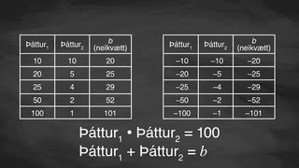
Learning Activity B | Video
Analyzing factors of 100 and -100
Notes:
This video discusses questions 1 & 2 of activity 8.7.3

Slide 27

Learning Activity B
Self Check
Consider the expression 𝑥² + 𝑏𝑥 − 48.
Identify all the pairs of factors of –48 that would result in positive values of 𝑏.
1 and –48, 2 and –24, 3 and –16, 4 and –12, 6 and –8 | 1 and 48, 2 and 24, 3 and 16, 4 and 12, 6 and 8 | –1 and –48, –2 and –24, –3 and –16, –4 and –12, –6 and –8 | –1 and 48, –2 and 24, –3 and 16, –4 and 12, –6 and 8
Let’s review!
Notes:
Answer Feedback - Individualized by Response
Incorrect. These factors result in a negative value of 𝑏 since their sum is negative. To get a positive value for 𝑏, you will want the larger number to be positive.
Incorrect. These factors each have a positive product, not -48. To get a negative product, the factors would need to be different signs.
Incorrect. These factors each have a positive product and a negative sum. To get a negative product, the factors would need to be different signs.
That's correct! Check yourself: Each pair of factors has a product of -48 and a positive sum since the factor with the larger absolute value is positive.

Slide 28
Learning Activity B
Self Check - Review
Let's consider the expression 𝑥² + 𝑏𝑥 – 40, where the leading coefficient equals 1.
Identify all the factors of –40 that would result in a positive value of 𝑏.
Identify all the factors of –40 that would result in a negative value of 𝑏.
Notes:
Remind Students
Consider having students complete these statements:
For positive values of 𝑏, the factor with the larger absolute value is ___. The other factor is ___.
For positive values of 𝑏, the factor with the larger absolute value is ___. The other factor is ___.
Access the online textbook and to see an explanation of this example and for additional examples .

Slide 29
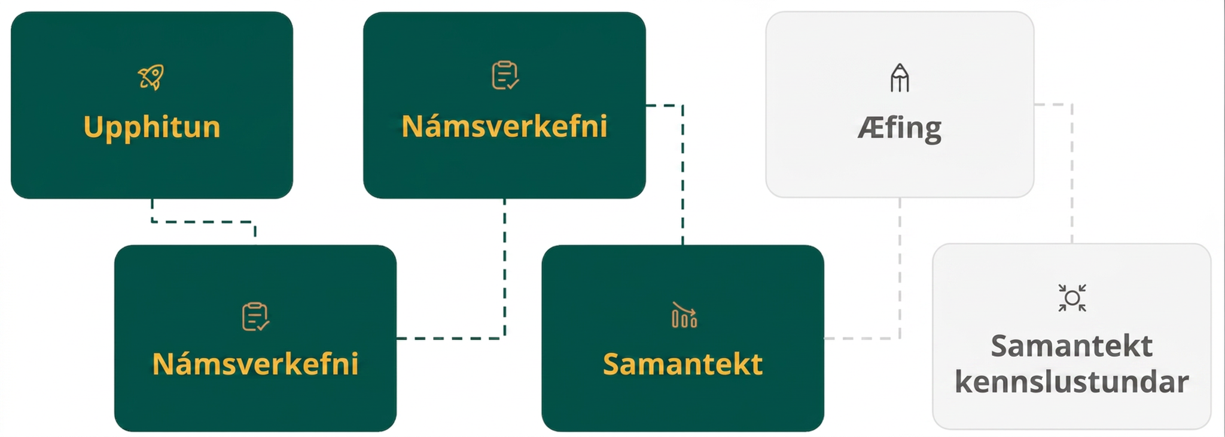
Lesson Journey
Fourth Step: Cool Down

Slide 30
Cool Down
Here are pairs of equivalent expressions in standard form and factored form. Find the missing symbols and numbers.
𝑥² ◻ 16𝑥 ◻ 17 and (𝑥 + 1)(𝑥 −17)
𝑥² ◻ 16𝑥 ◻ 17 and (𝑥 − 1)(𝑥 + 17)
𝑥² + 3𝑥 − 28 and (𝑥 + ◻)(𝑥 − ◻)
𝑥² − 12𝑥 − 28 and (𝑥 ◻ ◻)(𝑥 ◻ ◻)
Notes:
Cool Down (5 minutes)
Answers
− and –. The completed expression is 𝑥² − 16𝑥 − 17.
+ and −, respectively. The completed expression is 𝑥² + 16𝑥 − 17.
7 and 4, respectively. The completed expression is (𝑥 + 7)(𝑥 − 4).
−14 and +2. The completed expression is (𝑥 − 14)(𝑥 + 2).

Slide 31
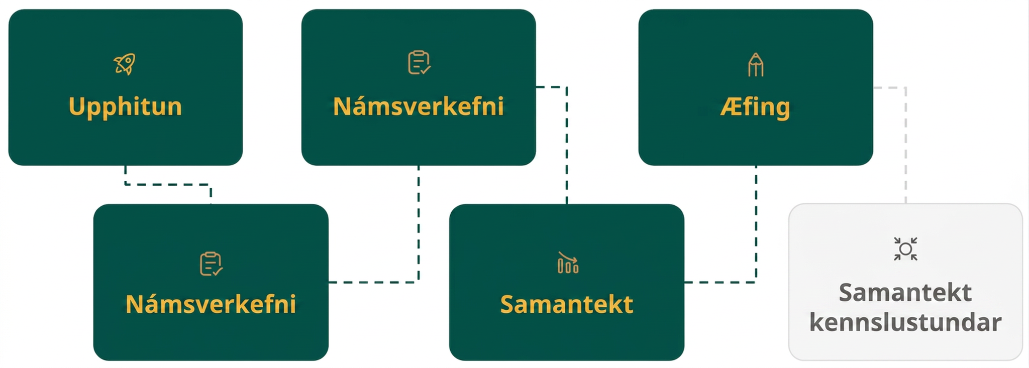
Lesson Journey
Fifth Stop: Practice

Slide 32

Practice
Put your hard work to action, practice what you’ve learned!
Notes:
Digital Practice: Access the practice pages at https://openstax.org/details/books/algebra-1

Slide 33
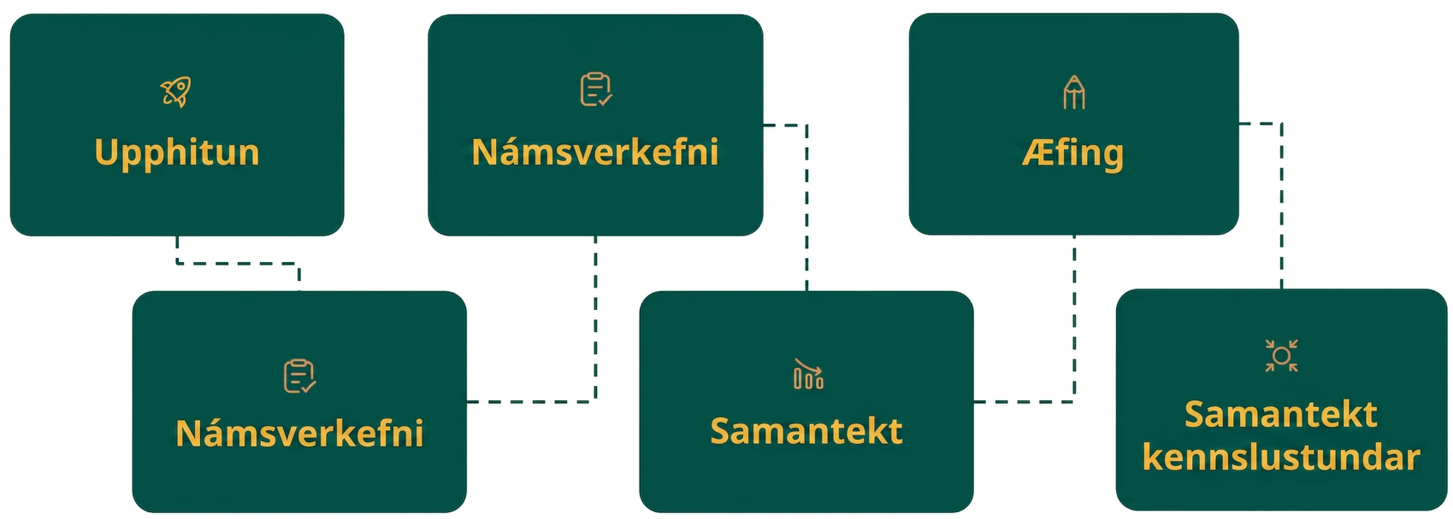
Lesson Journey
Sixth Stop: Lesson Synthesis

Slide 34
Lesson Synthesis
How would you explain to a classmate who is absent today how to rewrite 𝑥² + 16𝑥 − 36 in factored form?
How would you explain how to rewrite 𝑥² − 5𝑥 − 24 in factored form?
You are rewriting the quadratic expression 𝑥² + 𝑏𝑥 + 𝑐 in factored form (𝑥 + 𝑚)(𝑥 + 𝑛). How will the factors be different when the 𝑐 is positive versus when 𝑐 is negative?
Notes:
Suggested Launch
Help students consolidate the observations and insights from this lesson, by asking them to describe to a partner or write down their responses to each question.
Student responses might include -
Check to make sure the leading coefficient on the 𝑥² term is 1. Then look for factors of the constant term, –36, that result in a sum of the linear term, +16. We know that one factor must be positive and one factor must be negative. Use these factors to convert the expression into the factored form, (𝑥 + 𝑚)(𝑥 + 𝑛). Since the factors we are looking for are 18 and –2, the factored form is (𝑥 + 18)(𝑥 − 2).
Check to make sure the leading coefficient on the 𝑥² term is 1. Then look for factors of the constant term, –24, that result in a sum of the linear term, –5. We know that one factor must be positive and one factor must be negative. Use these factors to convert the expression into the factored form, (𝑥 + 𝑚)(𝑥 + 𝑛). Since the factors we are looking for are –8 and 3, the factored form is (𝑥 − 8)(𝑥 + 3).
When 𝑐 is positive, we know that the factors of 𝑐 we are looking for have the same sign. When 𝑐 is negative, we know that the factors of 𝑐 we are looking for have opposite signs.

Slide 35
Self Assessment
How much do you agree with the following statements?
Learning Goals | I can | Almost | Not yet
Explain how the numbers and signs in a quadratic expression in factored form relate to the numbers and signs in an equivalent expression in standard form. | ⃞ | ⃞ | ⃞
Write an equivalent expression in factored form, given a quadratic expression in standard form with a negative constant term. | ⃞ | ⃞ | ⃞

