Slide 1
Algebra 1
Unit 5 Introduction to Exponential Functions
Lesson 5.1 Properties of Exponents

Slide 2

How to use these slides
On the activity slides check the speaker notes for teacher support and instructional information.
Each lesson includes 1 warm up, 2-3 learning activities, a cool down, practice and a lesson synthesis.
  Learning activities are followed by a self check question, and review section.
Some slides have been hidden from student view, more information can be found on the next slide (Reference Key).
You can edit and use these slides for personal and classroom use, but cannot sell them and must keep the attribution logos.
For more information, Check out the digital quick start guide!
OpenStax CC BY NC SA

Slide 3





Reference Key
Check the top right corner for an icon referencing these unique sections.
Icon | Title | View | Location and Description
n/a | Support for Students with Disability | Hidden | Learning Strategies slide, provides additional support to students for understanding the activity.
n/a | Support for English Language Learners | Hidden | Learning Strategies slide, provides additional support to students for understanding the activity.
n/a | Extending Your Thinking | Hidden | Extending Your Thinking slide, provides an extra challenge for students.
n/a | Self Check | Not Hidden | Self Check slide, checkpoint to assess student understanding after the learning activity.
n/a | Review | Hidden | Self Check - Review slide, designed to help review topics from the self check question.
On the next slides, check the speaker notes for teacher instructions and support.
Notes:
Check the Speaker Notes: On the next slides you can find discussion questions, lesson information, answers to the activities, and ways to adjust the activity for your students!

Slide 4

Learning Goals
By the end of this lesson you will be able to -
Simplify expressions using different properties for exponents.
Simplify expressions containing exponents of zero.
Use the definition of a negative exponent to simplify expressions.
Notes:
Lesson Narrative
Students review the Product, Quotient, and Power Properties of Exponents and then learn to simplify expressions with zero and negative exponents. Additionally, they review how to apply the Product-to-a-Power and Quotient-to-a-Power Properties to simplify expressions where entire products or quotients are raised to a power.
Required Preparation
None
Required Materials
Paper and pencil
Texas Essential Knowledge and Skills
A1(G) display, explain, and justify mathematical ideas and arguments using precise mathematical language in written or oral communication.
A11(B) simplify numeric and algebraic expressions using the laws of exponents, including integral and rational exponents.

Slide 5
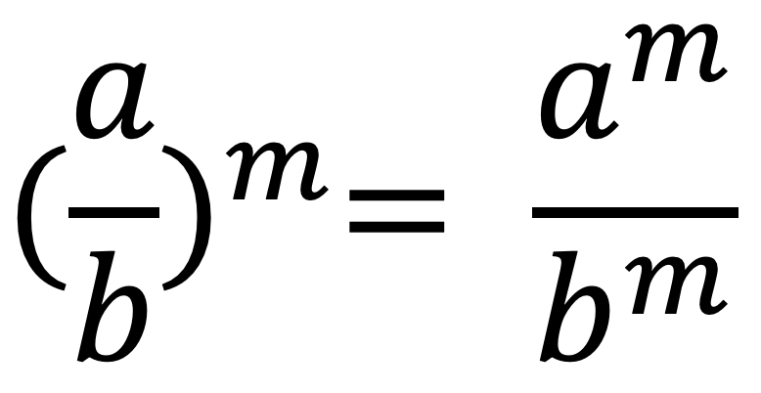
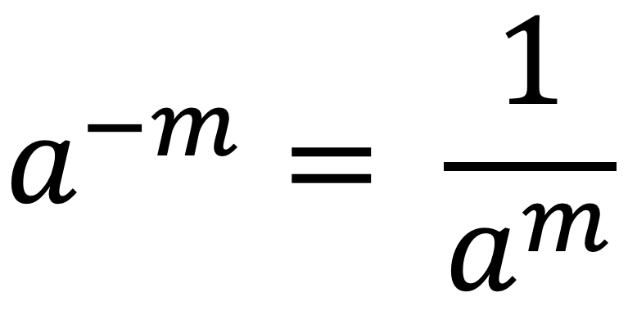
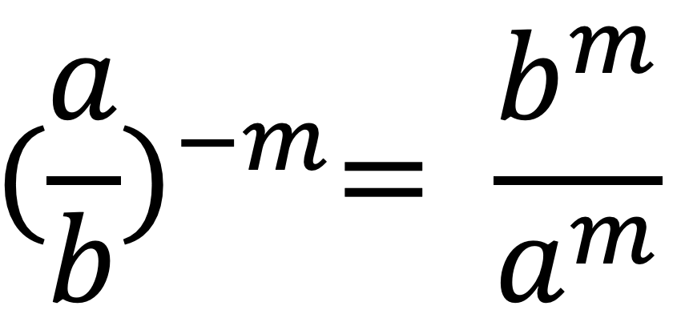
Vocabulary
New
Power property (𝑎^{𝑚})^{𝑛} = 𝑎^{mn}
Product to a power property 𝑎𝑏^{𝑚} = (𝑎^{𝑚})(𝑏^{𝑚})
Product property (𝑎^{𝑚})(𝑎^{𝑛}) = 𝑎^{𝑚+𝑛}
Zero exponent property 𝑎⁰ = 1
Quotient property
Property of negative exponents
Quotient to a negative power property
Notes:
Lesson Vocabulary
To support student understanding of key vocabulary:
Familiarize students with the vocabulary words they will see throughout the lesson. Encourage students to look for these words and notice their use and meanings.
Encourage students to use key vocabulary words in “math talk” and their written and oral explanations.
Utilize a word wall. Sample cards are located here: Mathematics Vocabulary Word Wall Cards
To support newcomers or students identified at the beginning level of language proficiency, share the following Quizlet links to help students gain an understanding of the academic vocabulary. Use the Spanish versions to anchor student understanding before bridging to the English versions.
Unit 5 Spanish Vocabulary
Unit 5 Vocabulary
Support for English Language Learners
ELPS 1(F) use accessible language and learn new and essential language in the process.
ELPS 2(F) listen to and derive meaning from a variety of media such as audiotape, video, DVD, and CD-ROM to build and reinforce concept and language attainment.
ELPS 3(E) share information in cooperative learning interactions.

Slide 6
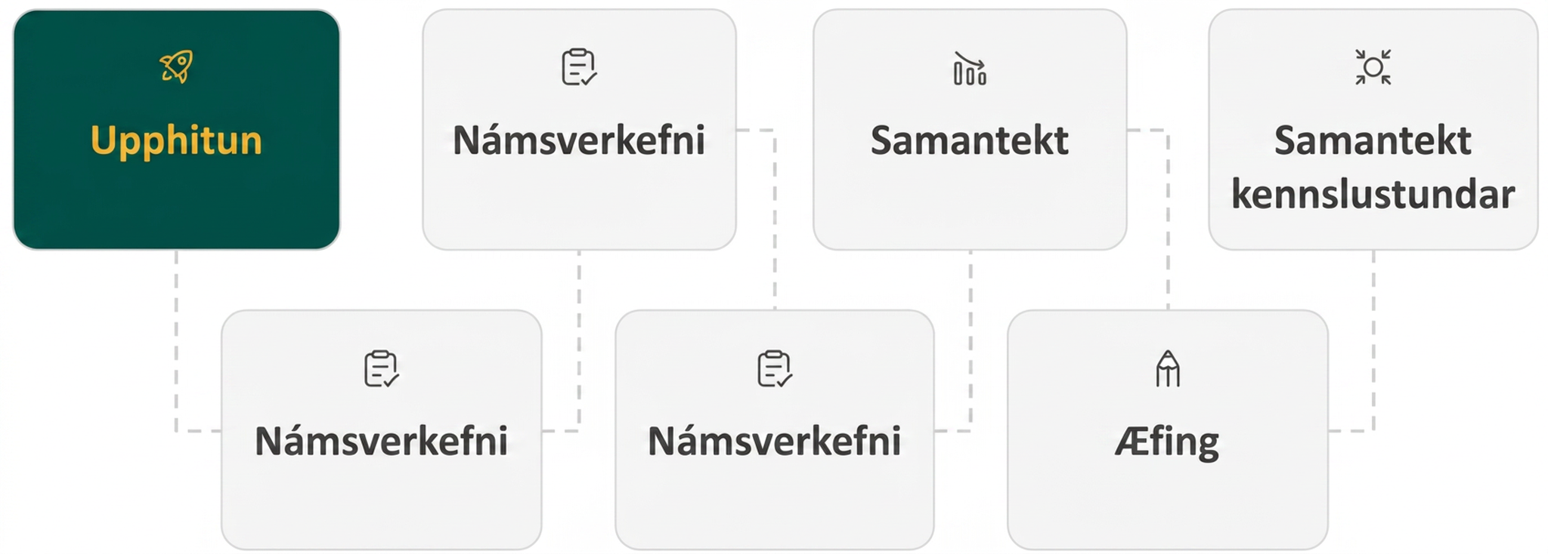
Lesson Journey
First Stop: Warm Up

Slide 7

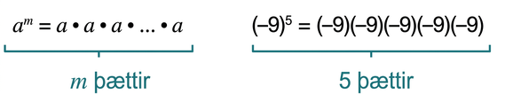
Warm Up
REPEAT … REPEAT … 👍
An exponent indicates repeated multiplication of the same quantity.
Expand each exponential expression to show repeated multiplication. Be prepared to signal when you have an answer.
4³
x⁵
(–8)⁶
(–z)³
Notes:
Warm Up (5 minutes)
This warm up reviews and reinforces the idea that exponents can be represented equivalently as repeated multiplication. Students will translate constant and variable bases with exponents to multiplication expressions.
Launch
Display the introduction and the example expressions.
Ask the class to explain the relationship between exponents and repeated multiplication.
Use the Math Talk protocol to display the exponential expressions one at a time until all problems are displayed (as described in steps 4 - 5). ANIMATION has been added to the slide to facilitate this instructional strategy. Click to display each new expression.
Give students quiet think-time for each problem and ask them to give a signal when they have an answer (for example, give a thumbs up).
Keep all problems displayed throughout the talk.
Follow with a whole-class discussion as needed to review the answers.
Activity Answers
4 . 4 . 4
x . x . x . x . x
(–8) . (–8) . (–8) . (–8) . (–8) . (–8)
(–z) . (–z) . (–z)
Activity Synthesis
Invite students to share their answers as each expression is simplified into repeated multiplication. Then, discuss with students:
What is the relationship between the base of the exponent and the factor used in the repeated multiplication expression? (The base of the exponent is the same value or variable that is used in the repeated multiplication expression.)
What is the relationship between the exponent value and the number of factors in the repeated multiplication expression? (The exponent value will be equal to the number of factors in the repeated multiplication expression.)

Slide 8
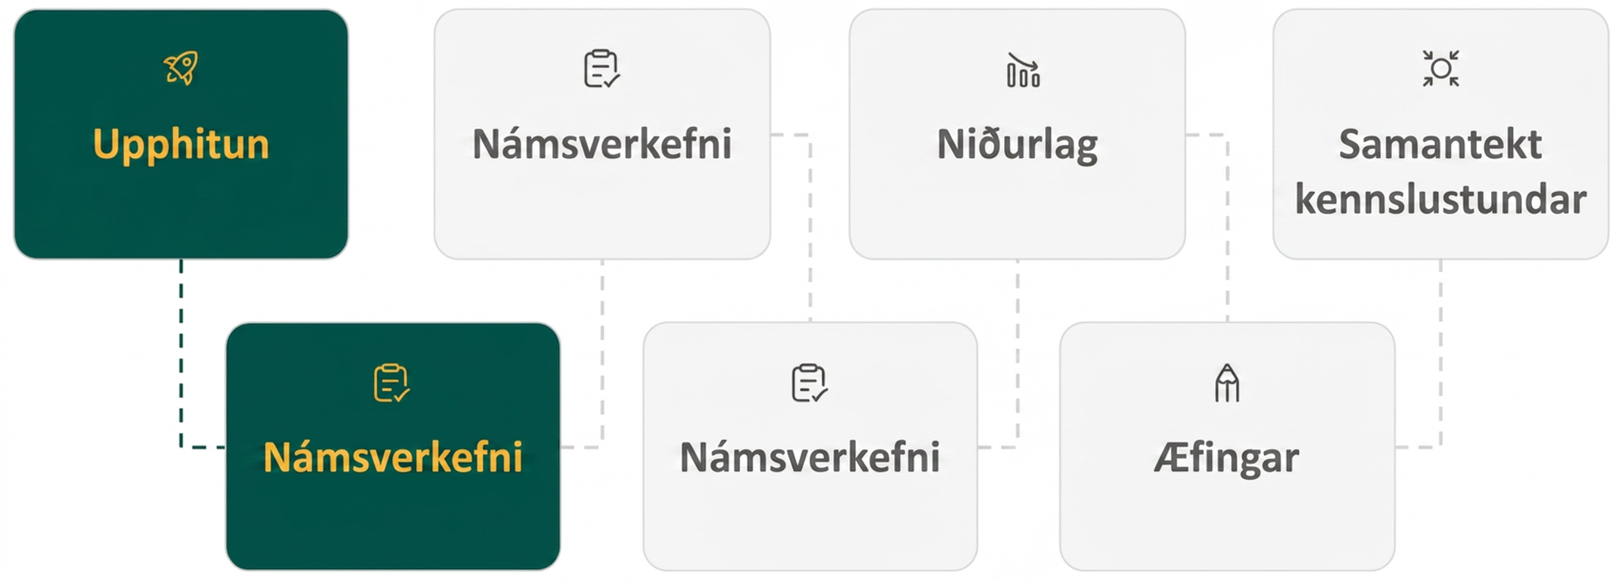
Lesson Journey
Second Stop: Learning Activity A

Slide 9
Learning Activity A | Part 1
Make It Simple! 🅰🅱🅲
Simplify the expressions.
d² 𑇐 d³
c⁴ 𑇐 c⁶
k³ 𑇐 k⁵
(–v)² 𑇐 (–v)¹
(𝑚)⁴ 𑇐 (𝑚)⁴
(−𝑝)⁶ 𑇐 (−𝑝)⁸
PRODUCT PROPERTY
FOR EXPONENTS
If a is a real number and m and n are integers, then
a^{m} 𑇐 a^{n} = a^{m+n}
To multiply with like bases, add the exponents.
Notes:
Activity (20 minutes)
This activity prompts students to simplify expressions using the Product and Quotient Properties for Exponents. Students must understand that –
To multiply like bases, the exponents are added
To divide like bases, the exponents are subtracted
The base in these situations always remains the same
Launch
Read the Product Property.
Review the example provided as a class. If needed, complete one additional example as a class.
Limit the time spent on the Product Property to 10 minutes and pause the class for questions before students move on to the Quotient Property.
Then, read the Quotient Property.
Review the example provided as a class. If needed, complete one additional example as a class.
Answers
d² . d³ = d²⁺³ = d⁵
c⁴ . c⁶ = c⁴⁺⁶ = c¹⁰
k³ . k⁵ = k³⁺⁵ = k⁸
(–v)² . (–v)¹ = (–v)³
(𝑚)⁴⋅(𝑚)⁴ = 𝑚⁴⁺⁴ = 𝑚⁸
(−𝑝)⁶⋅(−𝑝)⁸ = (−𝑝)⁶⁺⁸ = (−𝑝)¹⁴
Activity questions and synthesis continue on the next slide.

Slide 10
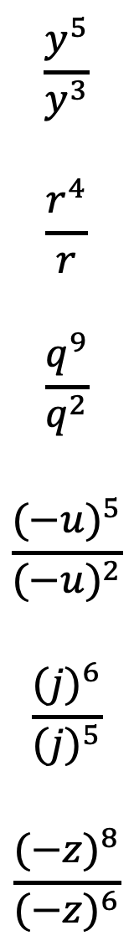
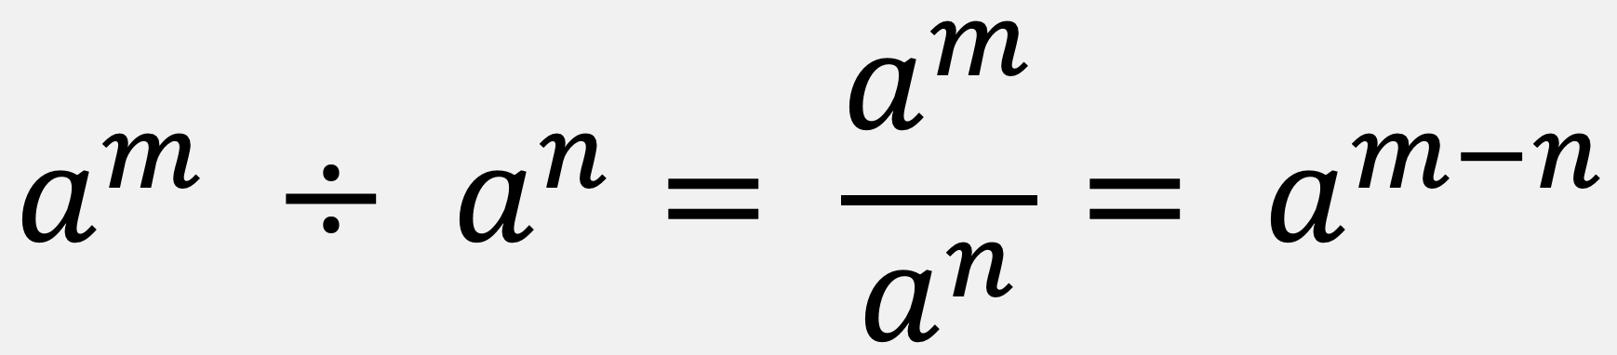
Learning Activity A | Part 2
Keep It Simple! ➊➋➌
Simplify the expressions.
QUOTIENT PROPERTY
FOR EXPONENTS
If a is a real number, a ≠ 0, and m and n are integers, then
To divide with like bases, subtract the exponents.
Notes:
Activity Answer
7. 𝑦⁵/𝑦³ = (𝑦)⁵⁻³ = (7)²
8. 𝑟⁴/𝑟 = (𝑟)⁴⁻¹ = (𝑟)³
9. 𝑞⁹/𝑞² = (𝑞)⁹⁻² = (𝑞)⁷
10. (−𝑢)⁵/(−𝑢)² = (−𝑢)⁵⁻² = (−𝑢)³
11. (𝑗)⁶/(𝑗)⁵ = (𝑗)⁶⁻⁵ = (𝑗)
12. (−𝑧)⁸/(−𝑧)⁶=(−𝑧)⁸⁻⁶ = (−𝑧)²
Activity Synthesis
Ask students to summarize the Product Property and Quotient Property for Exponents in their own words. Add any missing details as needed.
Emphasize that when multiplying like bases, the exponents are added, when dividing like bases, the exponents are subtracted. Stress that the base in these situations always remains the same.

Slide 11

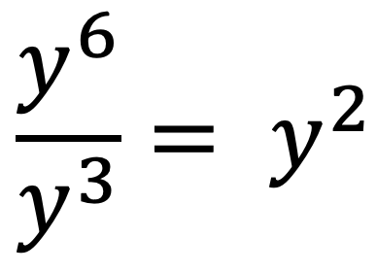
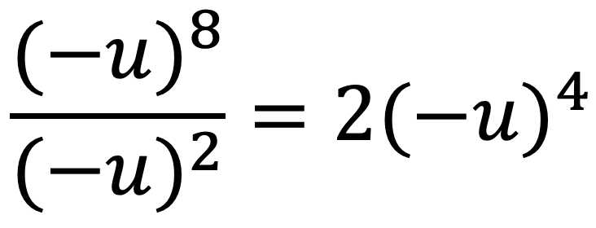
Learning Activity A
Self Check
Which of the following equations is correct?
y⁵ 𑇐 y³ = y⁸
x² 𑇐 x⁴ = x⁸
Let’s review!
Notes:
Answer Feedback - Individualized by Response
That’s correct! The expression uses the Product Property for Exponents. To multiply with like bases, add the exponents.
Incorrect. The expression uses the Product Property for Exponents. To multiply with like bases, you should add the exponents, not multiply them.
Incorrect. The expression uses the Quotient Property for Exponents. To divide with like bases, you should subtract the exponents, not divide them.
Incorrect. This expression uses the Quotient Property for Exponents. To divide with like bases, you should subtract the exponents, not divide them.

Slide 12

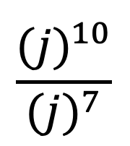
Learning Activity A
Self Check - Review
PRODUCT PROPERTY
FOR EXPONENTS
a^{m} 𑇐 a^{n} = a^{m+n}
To multiply with like bases, add the exponents.
Example 1 - Simplify
(2b)¹⁰ 𑇐 (2b)³
Example 2 - Simplify
j¹⁰ ÷ j⁷ or (j¹⁰ / j⁷) or
QUOTIENT PROPERTY
FOR EXPONENTS
To divide with like bases, subtract the exponents.
Notes:
Remind Students
When we combine like terms by adding and subtracting, we need to have the same base with the same exponent. But when you multiply and divide, the exponents may be different, and sometimes the bases may be different, too. However, when the bases are the SAME - then we can simplify the exponents.
Also, for the Quotient Property of Exponents:
If m > n, then (a^{m}/a^{n}) = a^{m–n}
If m < n, then (a^{m}/a^{n}) = 1/(a^{n–m}) since m – n will be a negative value.
Answers
Example 1 = (2b)¹³
Example 2 = j³

Slide 13
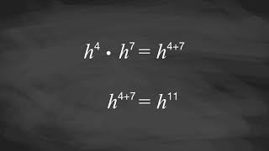
Learning Activity A | Video
Understanding Product and Quotient Properties for Exponents
Notes:
This video discusses question 3 of the Try It activity of the Additional Resources for 5.1.2.

Slide 14
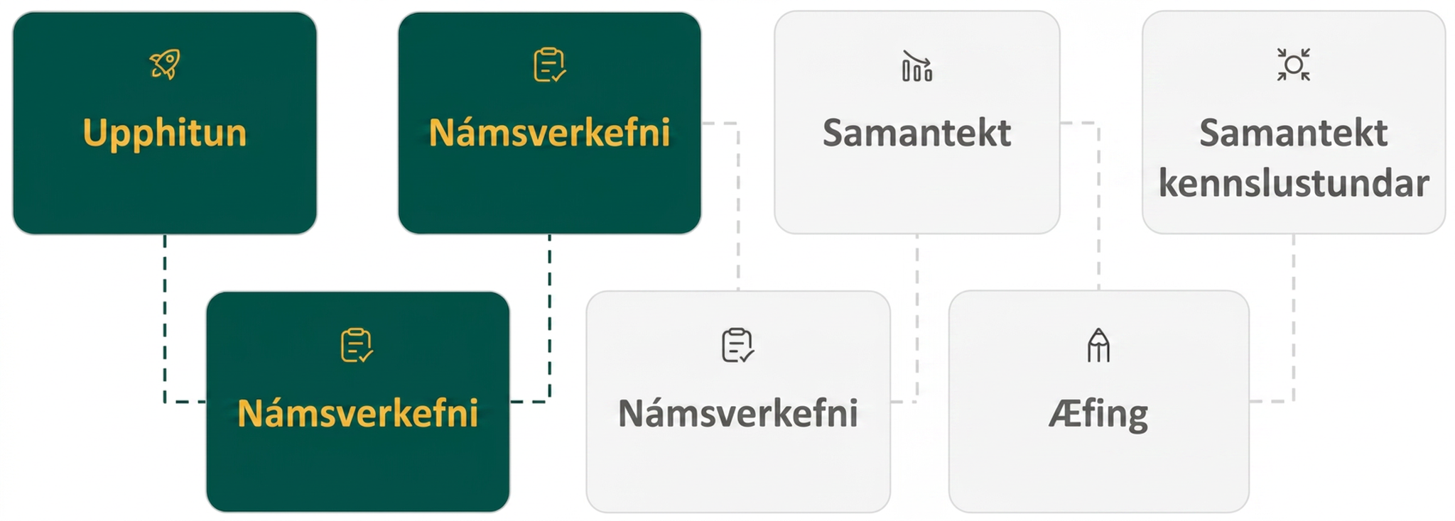
Lesson Journey
Third Stop: Learning Activity B

Slide 15
Learning Activity B | Part 1
Be Positive! ➕
Simplify the expressions.
d⁰
7⁰
(–8)⁰
(–v)⁰
r⁰ 𑇐 r⁰
ZERO EXPONENT PROPERTY
If a is a non-zero number, then
a⁰ = 1
Any non-zero
number raised to the zero power is 1.
Notes:
Activity (15 minutes)
This activity introduces how to simplify any expression with an exponent of 0. It also introduces the concept that a negative exponent is equivalent to the reciprocal of the expression while flipping the sign of the exponent.
As students complete the activity, monitor for those who:
try to reduce any value with an exponent of 0 to 0.
transfer a negative exponent to a negative sign in the base of the exponential expression.
Launch
Review the Zero Exponent Property. Stress that this is true for any value. If needed to reinforce this concept, complete the first problem as an example with the class.
Limit the time spent on the Zero Exponent Property to 5 minutes and pause the class for questions before students move on to the Negative Exponents Property.
Read the definition of a negative exponent written in the middle column. Complete one problem as a class to reinforce comprehension.
Then have students complete the second set of problems.
Answers
1
1
1
1
1
Activity questions, answers, anticipated misconceptions, and synthesis on the next slide.

Slide 16
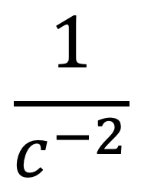
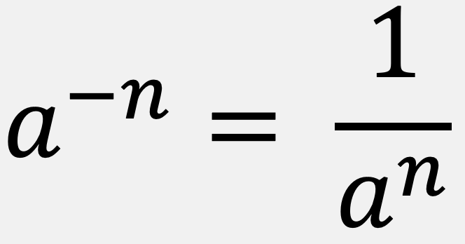
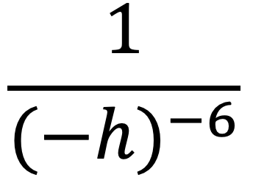
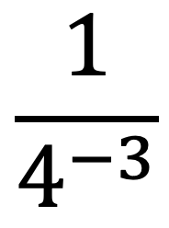
Learning Activity B | Part 2
Be Positive! ➕
Rewrite the expressions using only positive exponents.
g^{–4}
2^{–3}
DEFINITION OF A NEGATIVE EXPONENT
If n is an integer and
a ≠ 0, then
Notes:
Answers
1/g⁴
1/2³ or ⅛
c²
(–h)⁶ or h⁶
4³ or 64
Activity Synthesis
Ask students to summarize the Zero Exponent Property in their own words. Add any missing details as needed. Emphasize that any base raised to a power of 0 is always equal to 1.
Ask students to summarize the definition of a negative exponent in their own words. Ask students how they would find an equivalent expression using non-negative exponents. If needed, revisit the rule written in the table.

Slide 17
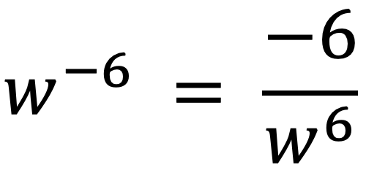
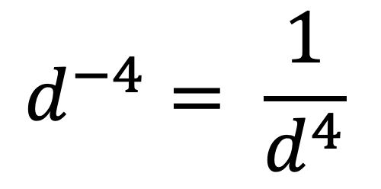
Learning Activity B
Self Check
Which of the following equations is true?
8⁰ = 0
7^{–3} = – 343
Let’s review!
Notes:
Answer Feedback - Individualized by Response
Incorrect. Any non-zero base raised to the power of zero equals 1.
Incorrect. The – 6 is an exponent, not a factor. Remember that a^{–n} = 1/a^{n}, so w^{–6}= 1/w⁶.
Incorrect. – 343 is the result of finding the opposite of 7³. Remember that a^{–n} = 1/a^{n}, so 7^{–3} = ¹/₃₄₃.
That’s correct! You remembered correctly that a^{–n} = 1/a^{n}.

Slide 18
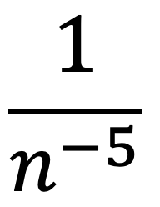
Learning Activity B
Self Check - Review
ZERO EXPONENT PROPERTY
a⁰ = 1
Any non-zero number raised to the zero power is 1.
Example 1 - Simplify
(–g)⁰
Example 2 - Simplify
1/n^{–5} or
DEFINITION OF A NEGATIVE EXPONENT
Notes:
Remind Students:
The Zero Exponent Property can be derived from the Quotient Property (if we are simplifying a^{m}/a^{m})
When the denominator was larger than the numerator, it led to the definition of negative exponents
The negative exponent tells us we can rewrite the expression by taking the reciprocal of the base and then changing the sign of the exponent
Stress that any expression that has negative exponents is NOT considered to be in simplest form.
Answers
Example 1 = 1
Example 2 = n⁵

Slide 19
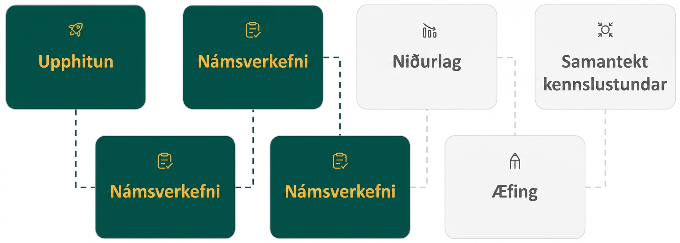
Lesson Journey
Fourth Stop: Learning Activity C

Slide 20
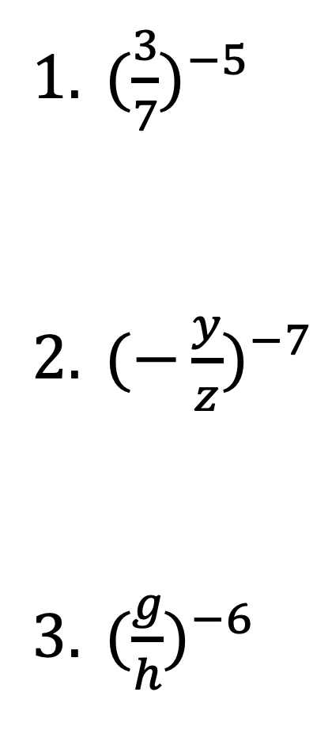
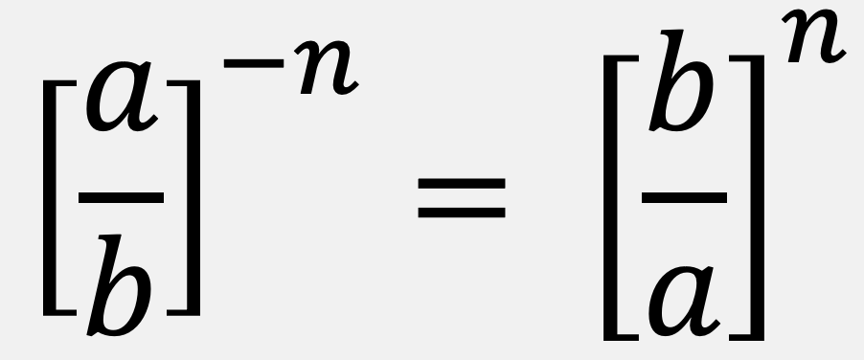
Learning Activity C | Part 1
SUPER Powers 💫
Simplify the expressions.
QUOTIENT TO A NEGATIVE POWER PROPERTY
If a and b are real numbers, a ≠ 0, b ≠ 0, and n is an integer, then
Notes:
Activity (20 minutes)
This activity builds on strategies we used to simplify more complicated expressions involving exponents. Review the definition of a negative exponent before beginning the activity. If students seem stuck on any property, complete the first problem as a class.
Launch
Arrange students in groups of 2.
Give students 3 – 5 minutes of quiet time section to simplify as many expressions as they can.
Then allow a minute to share their responses and strategies with their partner.
Answers
(7/3)⁵ = (7⁵/3⁵) = 16,807/243
(−𝑧/𝑦)⁷ = −𝑧⁷/𝑦⁷
(ℎ/𝑔)⁶ = ℎ⁶/𝑔⁶
Additional activity questions, answers, and synthesis on the next slide.

Slide 21
Learning Activity C | Part 2
SUPER Powers 💫
POWER PROPERTY FOR EXPONENTS
If a is a real number, m and n are integers, then
(a^{m})^{n} = a^{m𑇐n}
PRODUCT TO A POWER PROPERTY FOR EXPONENTS
If a and b are real numbers and m is a whole number, then
(ab)^{m} = a^{m}𑇐b^{m}
Simplify the expressions.
(4²)⁵
(𝑛³)⁷
(2³)²(𝑑⁴)³
(−2𝑡𝑣)⁷
(4𝑝𝑟²)⁵
(3ℎ³)⁻²
‹#›
Notes:
Answers
4¹⁰ = 1,048,576
𝑛²¹
(2⁶)(𝑑¹²) = 64𝑑¹²
(−2)⁷𝑡⁷𝑣⁷ = −128𝑡⁷𝑣⁷
4⁵𝑝⁵𝑟¹⁰ = 1,024𝑝⁵𝑟¹⁰
(⅓ ℎ³)² = (⅓) ²ℎ⁶ = ¹/₉ℎ⁶
Activity Synthesis
Invite partners to share any example that gave them trouble. Solve the example as a class, discussing any tricky moments.
Discuss how the Quotient to a Negative Power Property is only one additional step before using the Quotient to a Power Property when simplifying. (That step is finding the reciprocal of the value and flipping the sign.)

Slide 22
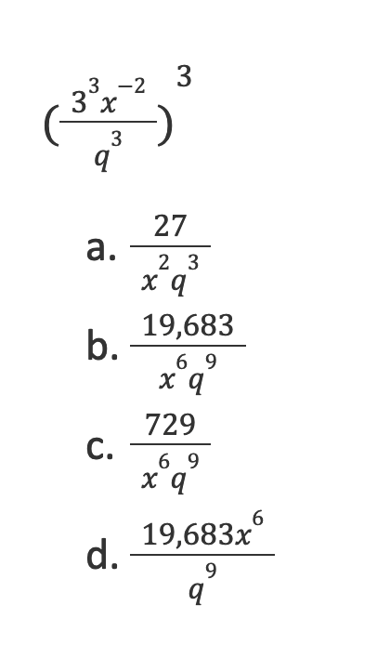
Learning Activity C
Self Check
Simplify the following expression.
Let’s review!
Notes:
Answer Feedback - Individualized by Response
Incorrect. This is the simplified form of the expression without raising it to the power of 3. Remember to raise each factor in parentheses to the power of 3. Did you find 3⁹? Did you use the Power Property on 𝑥 and 𝑞?
That’s correct! We use the Power Property on each part. 3⁹=19,683. The negative exponent on 𝑥 moves it to the denominator where it becomes positive.
Incorrect. This is the value if you add the exponents when you raise 3³ to the power of 3. Did you find 3⁹?
Incorrect. Did you address the negative exponent on 𝑥?

Slide 23
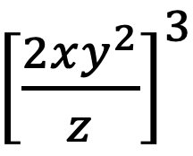
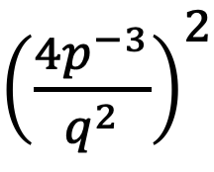
Learning Activity C
Self Check - Review
QUOTIENT TO A NEGATIVE POWER PROPERTY
POWER PROPERTY FOR EXPONENTS
(a^{m})^{n} = a^{m𑇐n}
PRODUCT TO A POWER PROPERTY FOR EXPONENTS
(ab)^{m} = a^{m}𑇐b^{m}
Identify which property could be used to simplify the following problems.
(4z)⁻³
(h⁴)⁵(h²)²
(− ^{r}/_{s})⁻²
(x³)⁵
(³/₇)⁻⁵
(−2cd)⁶
(2²)³
Notes:
Remind Students:
Of the stipulations for each property (a and b must be real numbers, m and n are integral values, etc.
If needed, before starting the review activity, use the online textbook to simplify an example for each of the properties.
All problems in this question are taken from the Try It of the Additional Resources. You may ask students to simplify each expression after they have identified the needed property.
Note that the last two expressions of the second column is an application of multiple properties - including the quotient property of exponents (from an earlier activity) and the product of a power property as well as the definition of a negative exponent.

Slide 24
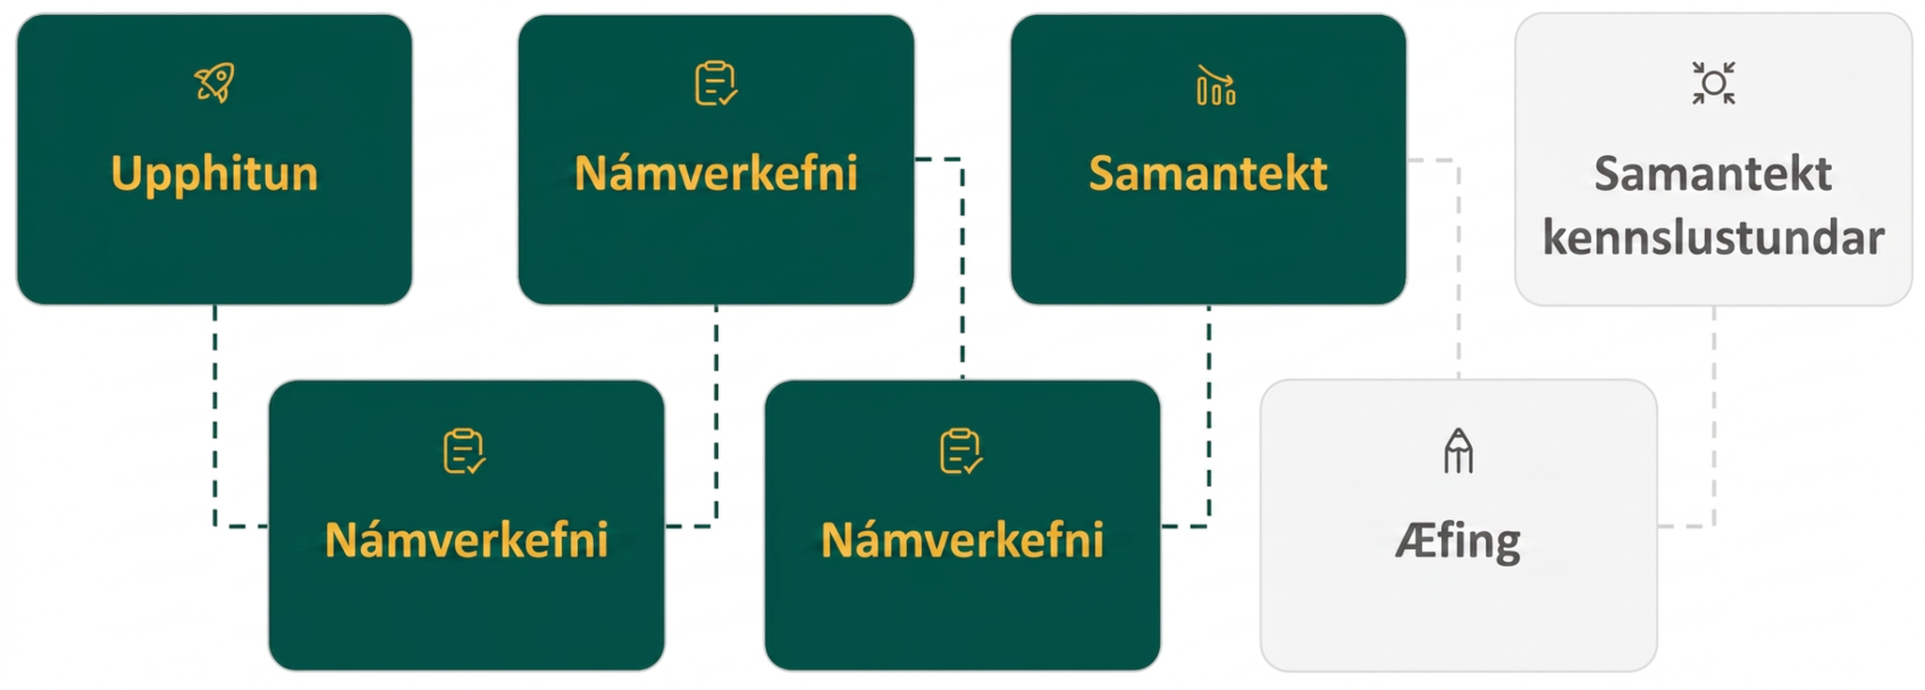
Lesson Journey
Fifth Step: Cool Down

Slide 25
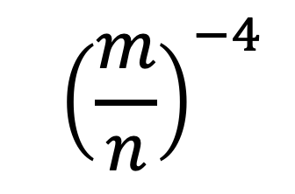
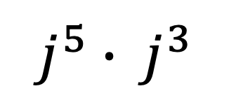
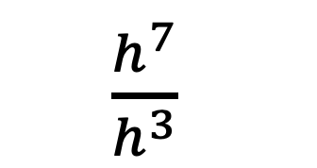
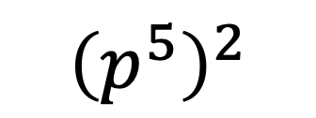
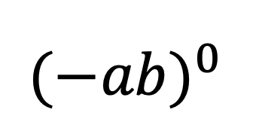
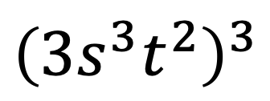
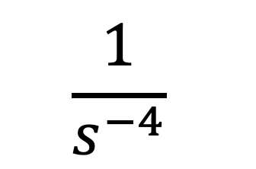
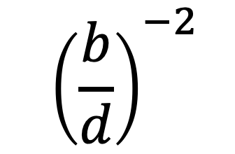
Cool Down
Simplify the expressions using all of the exponent properties you learned in the lesson.
1.
5.
2.
6.
3.
7.
4.
8.
Notes:
Cool Down (5 minutes)
Answers
𝑗⁸
ℎ⁴
1
𝑠⁴
𝑛⁴/𝑚⁴
𝑝¹⁰
3³𝑠⁹𝑡⁶ = 27𝑠⁹𝑡⁶
𝑑²𝑏²
Response to Student Thinking - More Chances
Students will revisit these concepts in upcoming lessons, so there's no need to slow down or add extra work now. Instead, use the results of this cool down to guide your focus in future lessons—pay attention to common gaps and emphasize those areas to help students deepen their understanding over time.

Slide 26
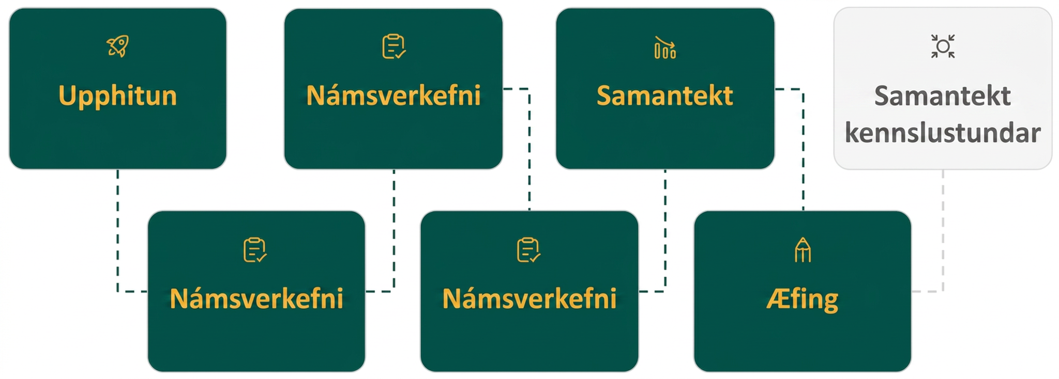
Lesson Journey
Sixth Stop: Practice

Slide 27

Practice
Put your hard work to action, practice what you’ve learned!
Notes:
Digital Practice: Access the practice pages at https://openstax.org/details/books/algebra-1

Slide 28
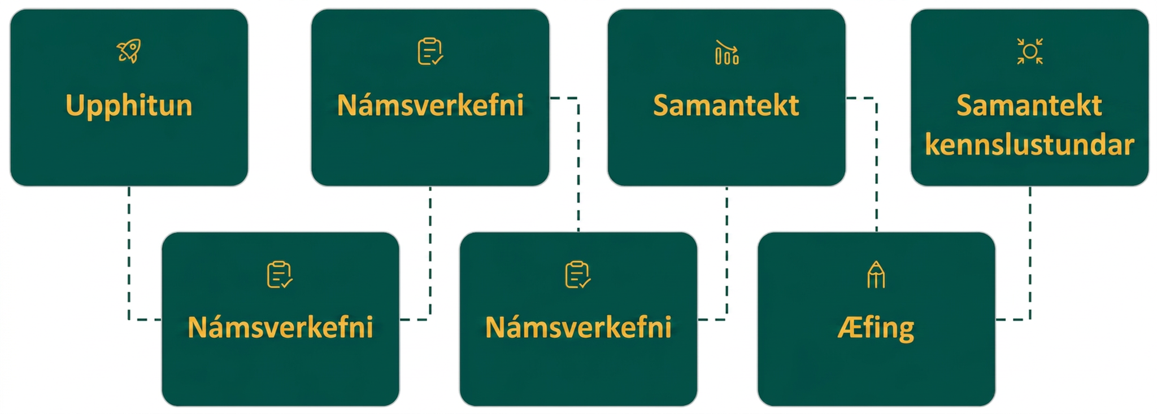
Lesson Journey
Seventh Stop: Lesson Synthesis

Slide 29
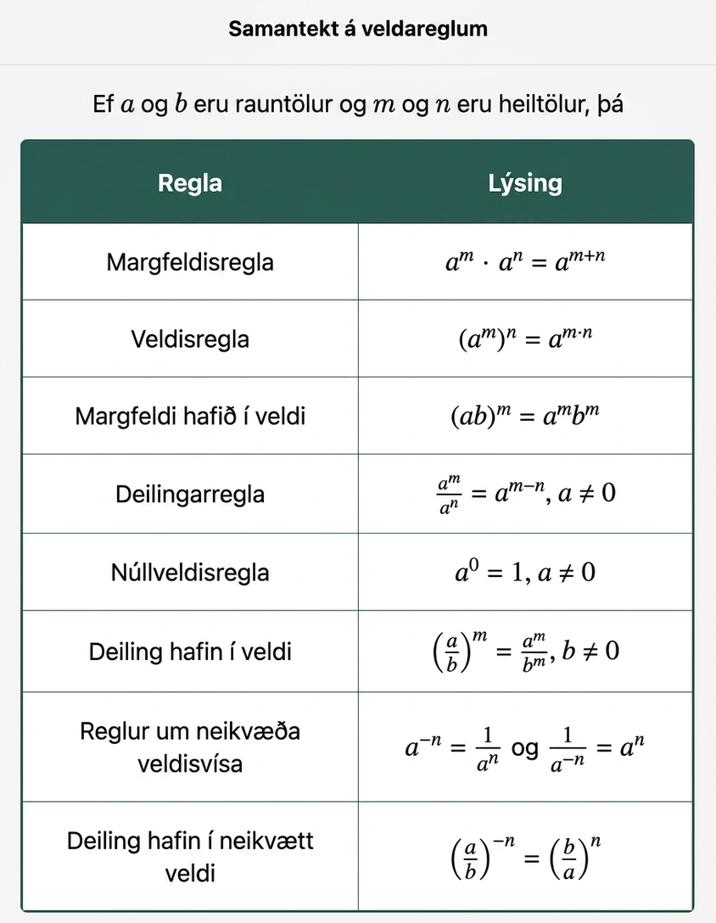
Lesson Synthesis
Which property is the easiest for you to remember or use?
Which property is the hardest for you to remember or use?
With a partner, create 2 problems that each require you to use at least 3 properties to simplify the expressions.
Be prepared to trade your problems with another set of partners to practice simplifying exponential expressions.
Notes:
Some key takeaways from this lesson are the properties used to simplify the different exponential expressions.
To help students see remember these properties, review the following points:
Exponential expressions can be represented using repeated multiplication.
The Product Property for Exponents is used when you are multiplying exponential terms with the same base. To simplify, the exponential terms are added and the same base is kept.
The Quotient Property for Exponents is used when you are dividing exponential terms with the same base. To simplify, the exponential terms are subtracted and the same base is kept.
The Zero Exponent Property states that any non-zero number raised to the zero power is 1.
The Properties of Negative Exponents state that when simplifying a term with a negative exponent, the reciprocal of the base is used and the sign of the exponent is flipped.
The Quotient to a Negative Power Property is used to simplify values being divided while all raised to a negative exponent. First, the expression is rewritten using the Properties of Negative Exponents to find its equivalent using non-negative exponents. Then the exponent is distributed to the dividend and the divisor so that each is raised to the same power.
The Power Property for Exponents states that to simplify an expression with equivalent bases in which a power is raised to a power, the exponents are multiplied.
The Product to a Power Property for Exponents states that when you raise products to a power, all factors being multiplied are raised to that power.
The Quotient to a Power Property for Exponents states that when you raise a divisor and dividend to a power, both are raised to that power.
If needed, review the chart in the last activity as a class to review the rules.
You may want to ask students which properties are easiest or hardest for them to remember or use when simplifying expressions. And, time permitting, have students create their own expressions with a partner. Then, use an interactive protocol such as Quiz-Quiz-Trade where students will meet another pair and exchange problems. Be sure you have checked each set of questions before beginning such an activity.
Quiz-Quiz-Trade protocol
Student pairs take their problems and find another set of partners.
They give each other their problems and “Quiz” them … each partner group works out the questions questions given to them and checks their answers. They “Quiz” each other (Hence, Quiz-Quiz.)
If someone doesn’t understand how to work a problem, the partners must explain how to get the correct answer.
The partners then “Trade” questions. That means they should not have the original questions they started with - they should have another set of questions!
Repeat the process - have students find a new set of partners, etc.
Complete as many rounds as time permits.

Slide 30
Self Assessment
How much do you agree with the following statements?
Learning Goals | I can | Almost | Not yet
Simplify expressions using different properties for exponents. | ⃞ | ⃞ | ⃞
Simplify expressions containing exponents of zero. | ⃞ | ⃞ | ⃞
Use the definition of a negative exponent to simplify expressions. | ⃞ | ⃞ | ⃞

