Slide 1
Algebra 1
Unit 7 Introduction to Quadratic Functions
Lesson 7.14 Graphs the Represent Situations
Notes:
How to Get Started
Review Slide 2: How to use these slides
Check out the Check out the digital quick start guide!
Review Slide 3: Reference Key of Icons

Slide 2

How to use these slides
On the activity slides check the speaker notes for teacher support and instructional information.
Each lesson includes 1 warm up, 2-3 learning activities, a cool down, practice and a lesson synthesis.
  Learning activities are followed by a self check question, and review section.
Some slides have been hidden from student view, more information can be found on the next slide (Reference Key).
You can edit and use these slides for personal and classroom use, but cannot sell them and must keep the attribution logos.
For more information, Check out the digital quick start guide!
OpenStax CC BY NC SA

Slide 3





Reference Key
Check the top right corner for an icon referencing these unique sections.
Icon | Title | View | Location and Description
n/a | Support for Students with Disability | Hidden | Learning Strategies slide, provides additional support to students for understanding the activity.
n/a | Support for English Language Learners | Hidden | Learning Strategies slide, provides additional support to students for understanding the activity.
n/a | Extending Your Thinking | Hidden | Extending Your Thinking slide, provides an extra challenge for students.
n/a | Self Check | Not Hidden | Self Check slide, checkpoint to assess student understanding after the learning activity.
n/a | Review | Hidden | Self Check - Review slide, designed to help review topics from the self check question.
On the next slides, check the speaker notes for teacher instructions and support.
Notes:
Check the Speaker Notes: On the next slides you can find discussion questions, lesson information, answers to the activities, and ways to adjust the activity for your students!

Slide 4

Learning Goals
By the end of this lesson you will be able to -
Explain how a quadratic equation and its graph relate to a situation.
Notes:
Lesson Narrative
Students will apply their knowledge of quadratic functions (in standard and factored forms) to real-world scenarios. The lesson focuses on interpreting quadratic equations and their corresponding graphs within specific contexts, enabling students to solve problems and compare functions presented in various representations. This process reinforces quantitative and abstract reasoning skills.
Required Preparation
Acquire devices that can run Desmos (recommended) or other graphing technology. It is ideal if each student has their own device.
Required Materials
Graphing technology
Pre-printed cards, cut from copies of the blackline master
Scientific calculators
Texas Essential Knowledge and Skills
A1(F) analyze mathematical relationships to connect and communicate mathematical ideas
A7(A) graph quadratic functions on the coordinate plane and use the graph to identify key attributes, if possible, including x-intercept, y-intercept, zeros, maximum value, minimum values, vertex, and the equation of the axis of symmetry

Slide 5
Vocabulary
Quadratic function
  A function where the output is given by a quadratic expression in the input.
𝑓(x) = ax² + bx + c.
Maximum
  The value of the function that is greater than or equal to all the other values. It corresponds to the highest point on the graph.
New
None
Previous
y-intercept
  The point of the graph of a function where the 𝑥-value is 0. This is where the graph of the function crosses the y axis. (0, y)
Vertex
  On a parabola, it is the point where the graph changes from increasing to decreasing or vice versa. It is the highest or lowest point on the graph.
Notes:
Lesson Vocabulary
To support student understanding of key vocabulary:
Introduce and review the vocabulary words students will see in this lesson.
Encourage students to notice how these words are used and to include them in their math discussions and explanations—both written and oral.
Use a word wall to reinforce vocabulary. Sample word wall cards are available here.
For newcomers or students with beginning English proficiency, use these Quizlet sets to support vocabulary learning:
Unit 7 Spanish Vocabulary – use first to build understanding
Unit 7 Vocabulary (English) – use after anchoring in Spanish
Support for English Language Learners
ELPS 1(F) use accessible language and learn new and essential language in the process
ELPS 2(F) listen to and derive meaning from a variety of media such as audiotape, video, DVD, and CD-ROM to build and reinforce concept and language attainment
ELPS 3(B) expand and internalize initial English vocabulary by learning and using high-frequency English words necessary for identifying and describing people, places, and objects, by retelling simple stories and basic information represented or supported by pictures, and by learning and using routine language needed for classroom communication
ELPS 3(D) speak using grade-level content area vocabulary in context to internalize new English words and build academic language proficiency
ELPS 3(E) share information in cooperative learning interactions
ELPS 3(F) ask and give information ranging from using a very limited bank of high-frequency, high-need, concrete vocabulary, including key words and expressions needed for basic communication in academic and social contexts, to using abstract and content-based vocabulary during extended speaking assignments
ELPS 4(D) use prereading supports such as graphic organizers, illustrations, and pretaught topic-related vocabulary and other prereading activities to enhance comprehension of written text
ELPS 5(B) write using newly acquired basic vocabulary and content-based grade-level vocabulary

Slide 6

Lesson Journey
First Stop: Warm Up

Slide 7


Warm Up
Frog Jumps 🐸
A frog’s jump height (in inches) is modeled by h(t) = 60t − 75t², where t is the time in seconds after it jumps. Using this equation:
Find h(0).
Find h(0.8).
What do these values of h(0) and h(0.8) mean in terms of the frog's jump?
After it jumped, how much time passed, in seconds, before the frog reached its maximum height?
Explain how you know this is the time the frog reached the maximum height.
Notes:
Warm Up (5 minutes)
In this warm-up, students use their new understanding of graphs to reason about a quadratic function. They evaluate the function, find its maximum, and interpret these values in context. The inputs that give an output of 0 remind them of zeros and x-intercepts. Instead of graphing, students can efficiently find the maximum by using the relationship between the x-intercepts and the vertex. Highlight students who make this connection and have them share their thinking.
Launch
Give students access to a calculator.
Activity Answers
0
0
They mean that the frog is on the ground when t = 0 (before jumping) and when t = 0.8 (when the frog lands on the ground).
0.4 seconds
The frog reached its maximum height at t = 0.4, as that is the halfway point of the jump. If we graph the function, the vertex of the graph will have a horizontal coordinate (t-coordinate) of 0.4.
Activity Synthesis
Select students to share their responses and explanations. Even though students are not asked to graph the function, make sure that they begin to connect the quadratic expression that defines the function to the features of the graph representing that function.
Ask students: "If we graph the equation, what would the graph look like? Where would the intercepts be? Would the graph open up or down? Where would the vertex be?"
Highlight the following points:
The graph intersects the horizontal axis at t = 0 and t = 0.8, because h(0) and h(0.8) both have a value of 0.
h(0.4) is the maximum height of the frog since t = 0.4 is halfway between the horizontal intercepts. If we were to graph it, (0.4, h(0.4)) would be the vertex.
The graph opens downward because the coefficient of the squared term is a negative number (-75).
Link to Desmos graph: https://www.desmos.com/calculator/nn9zwtfkkd

Slide 8
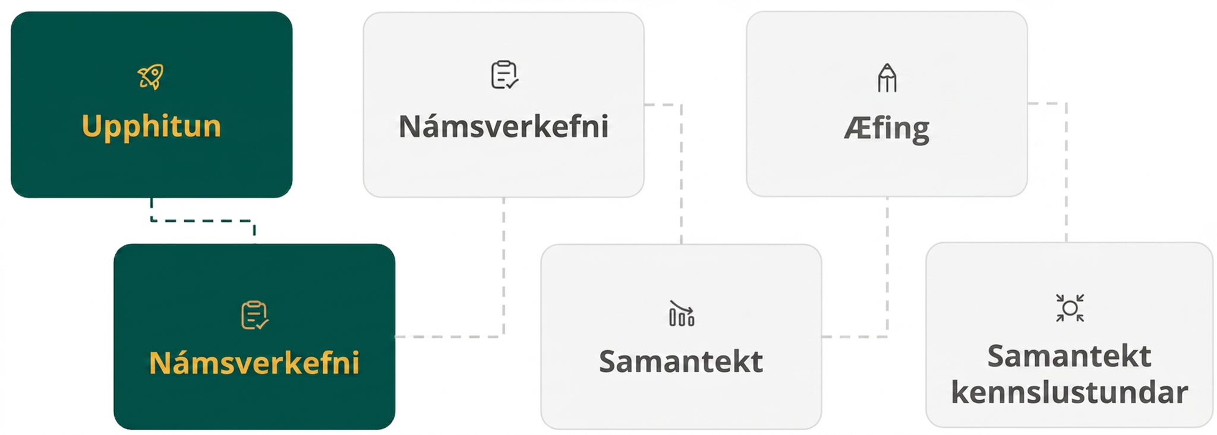
Lesson Journey
Second Stop: Learning Activity A

Slide 9

Learning Activity A | Learning Strategies
Punkin Chunkin🎃
Watch the video of a pumpkin being launched into the air.
Record math questions you could ask about what you see.
Share and compare your questions—look for ones about the graph’s shape or features.
Co-Craft Questions
Teacher Instruction: Use these strategies to adjust the activity to support English language learners and students with disabilities.
You can copy and paste the callouts directly on top of the activity or give the instructions aloud.
Follow along as the task is read aloud.
Think about what it’s asking.
Share your ideas with a partner.
Representation
Notes:
Support for English Language Learners: MLR 5 Co-Craft Questions: Speaking, Reading
Locate and display a video or image of a pumpkin that is catapulted up in the air. If unable to find an image or video, display only the task statement without the questions that follow. Before the activity, have students record possible mathematical questions that could be asked about the situation and invite them to share any questions they may have about the context. Invite students to compare the mathematical questions they have before revealing the remainder of the task. Listen for and amplify any questions involving interpretations of features of the quadratic graph.
Design Principle(s): Maximize meta-awareness; Support sense-making
Learn more about this routine
View the instructional video and follow along with the materials to assist you with learning this routine.
Provide support for students
Distribute graphic organizers to the students to assist them with participating in this routine.
Support for Students with Disabilities: Representation: Access for Perception
Invite students to follow along as you read the task statement and the questions from the first problem aloud. Students who both listen to and read the information will benefit from extra processing time. Pause for think time and then give students two to three minutes to discuss their initial thoughts with a partner before moving on.
Supports accessibility for: Language; Conceptual processing

Slide 10

Learning Activity A | Part 1
Punkin Chunkin🎃
The equation h(t) = 2 + 23.7t − 4.9t² represents the height of a pumpkin that is catapulted up in the air as a function of time, t, in seconds.
Use this information to answer the questions on the next slide.
The height is measured in meters above ground.
The pumpkin is shot up at a vertical velocity of 23.7 meters per second.
Notes:
Support for All Learners
This activity offers additional support and an extension for students:
For English language learners and students with disabilities, be sure to review the Learning Strategies slide!
For students looking for an extra challenge, be sure to review the Extending Your Thinking slide!
Activity (15 minutes)
Earlier in this unit, students read off of a diagram the position of an object dropped from the top of a building and then observed that the data is modeled by a quadratic function. This lesson continues to develop this idea with an additional layer of complexity, appropriate for this stage in the unit.
Launch
Arrange students in groups of two. Display the equation d = 10 + 406t − 16t² for all to see. Remind students that earlier in the unit, we saw this equation used to model the height of a cannonball that is shot up in the air as a function of time in seconds. The height was measured in feet. Ask students to recall what each term in the equation represents and briefly discuss their thinking.
Next, give students a few minutes of quiet time to think individually to read the first question (all four parts) to themselves and think about their responses.
Ask them to share their thoughts with a partner before proceeding to the graphing questions. Clarify, if needed, that "horizontal intercept" and "vertical intercept" are a more general way to refer to x- and y-intercepts when the equation that defines a function uses variables other than x and y.
Provide access to devices that can run Desmos or other graphing technology. If needed, remind students how to use the available graphing technology to identify the coordinates of points on a graph.
Activity questions and answers on the next slide.

Slide 11
Learning Activity A | Part 2
Punkin Chunkin🎃
What do you think the 2 in the equation
h(t) = 2 + 23.7t − 4.9t² tells us in this situation?
What do you think the − 4.9t² in the equation
h(t) = 2 + 23.7t − 4.9t² tells us in this situation?
If we graph the equation, will the graph open upward or downward? Why?
Notes:
Activity Answers
The 2 tells us the pumpkin is 2 meters above ground before it is launched.
The −4.9t² shows the height lost due to gravity (like the −16t² in the cannonball problem).
The graph would open downward. The height starts at 2 meters and then increases as the pumpkin is shot up, and eventually, it decreases as the pumpkin falls back to the ground.
More activity questions, answers, and synthesis on the next slide.

Slide 12
Learning Activity A | Part 3
Punkin Chunkin🎃
Are you ready for more?
Think about where the vertical intercept would be. What is the y-value of that vertical intercept?
What about the horizontal intercepts?
Graph h(t) = 2 + 23.7t − 4.9t² and answer the following:
  What is the vertical intercept and what does this point mean?
  What are the horizontal intercepts and what do these points mean?
  What is the vertex of the parabola and what does this point mean?
Notes:
Activity Answers
2. The vertical intercept would be at (0, 2), because when t is 0, the height is 2 meters.
The horizontal intercepts are hard to tell without graphing or having the equation in factored form. One of them will be located around (5, 0) because substituting 5 for t gives a height of -2 meters, which is pretty close to 0.
Link to Desmos graph: https://www.desmos.com/calculator/fakaknnviw
The vertical intercept is (0, 2). It tells us that the pumpkin's initial position is 2 meters above ground.
The graph intersects the horizontal axis around -0.08 and 4.9. The positive horizontal intercept tells us that the pumpkin hits the ground after about 4.9 seconds. The negative intercept doesn't have any meaning here since the time cannot be negative in this case.
The vertex is at approximately (2.4, 30.7). It tells us that the pumpkin reaches its maximum height of about 30.7 meters around 2.4 seconds after being fired.
Activity Synthesis
Invite students to share their graph and interpretations of the features of the graph. Discuss with students:
The graph shows two horizontal intercepts, one with a positive t-coordinate and the other with a negative t-coordinate. How do we make sense of the negative t-coordinate in this situation?" (Only the positive one has any meaning in this situation, since the negative value of time—the time before the pumpkin was shot into the air—is not relevant in this model.)
How would you estimate the coordinates of the vertex without using a graph? Suppose you know both of the horizontal intercepts." (We can find the halfway point of the two horizontal intercepts and evaluate the function at that value of t.)

Slide 13


Learning Activity A
Extending Your Thinking
Using the information from the activity. What approximate vertical velocity would this pumpkin need for it to stay in the air for about 10 seconds? (Assume that it is still shot from 2 meters above the ground and that the effect of gravity pulling it down is the same.)
Notes:
Go back to Lesson Activity
Answer
If h(t) = 2 + bt − 4.9t² takes the value 0 when t is close to 10, this means that 2+10b − 490 is close to zero. That means we want b to be 48.8. The pumpkin needs to be shot in the air at 48.8 meters per second.

Slide 14
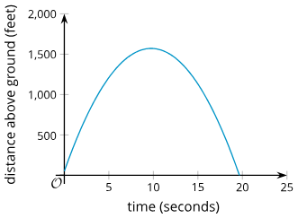
Learning Activity A
Self Check
What is the point (10,1600) and what does it mean in this situation?
y-intercept, the highest height the cannonball reaches.
Maximum height, the height the cannonball was launched.
Maximum height, the highest height the cannonball reaches.
y-intercept, the height the cannonball was launched.
The height, h, in feet of a cannonball t seconds after the ball leaves the cannon.
Let’s review!
Notes:
Answer Feedback - Individualized by Response
Incorrect. The y-intercept occurs when x = 0 and represents the height the cannonball is launched from.
Incorrect. The cannonball travels higher than where it is launched.
That’s correct! The point is at the peak of the graph, or the maximum height. It tells how high the cannonball goes before coming back down.
Incorrect. The y-intercept occurs when x = 0. You are describing the point where x = 10 and y is at the peak of the graph.

Slide 15

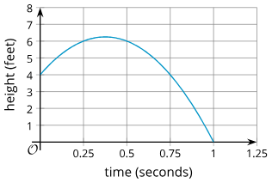
Learning Activity A
Self Check - Review
Suppose a tennis ball is hit straight up, and its height (in feet) is modeled by f(t) = 4 + 12t − 16t² where t is the time in seconds after the hit.
The vertical intercept is 4, meaning the ball was 4 ft high at t = 0 when it was hit.
The horizontal intercept (1, 0) shows the ball hit the ground 1 second after being hit.
The vertex at about (0.4, 6.3) means the ball reached its maximum height of 6.3 ft at 0.4 s.
The ball’s height over time, from the hit until it reaches the ground.
In factored form,
f(t) = (−16t − 4)(t − 1), the zeros are 1 and –¼. The negative zero is not meaningful because time before the hit doesn’t apply.
Notes:
Remind Students
Review the slide with students.

Slide 16
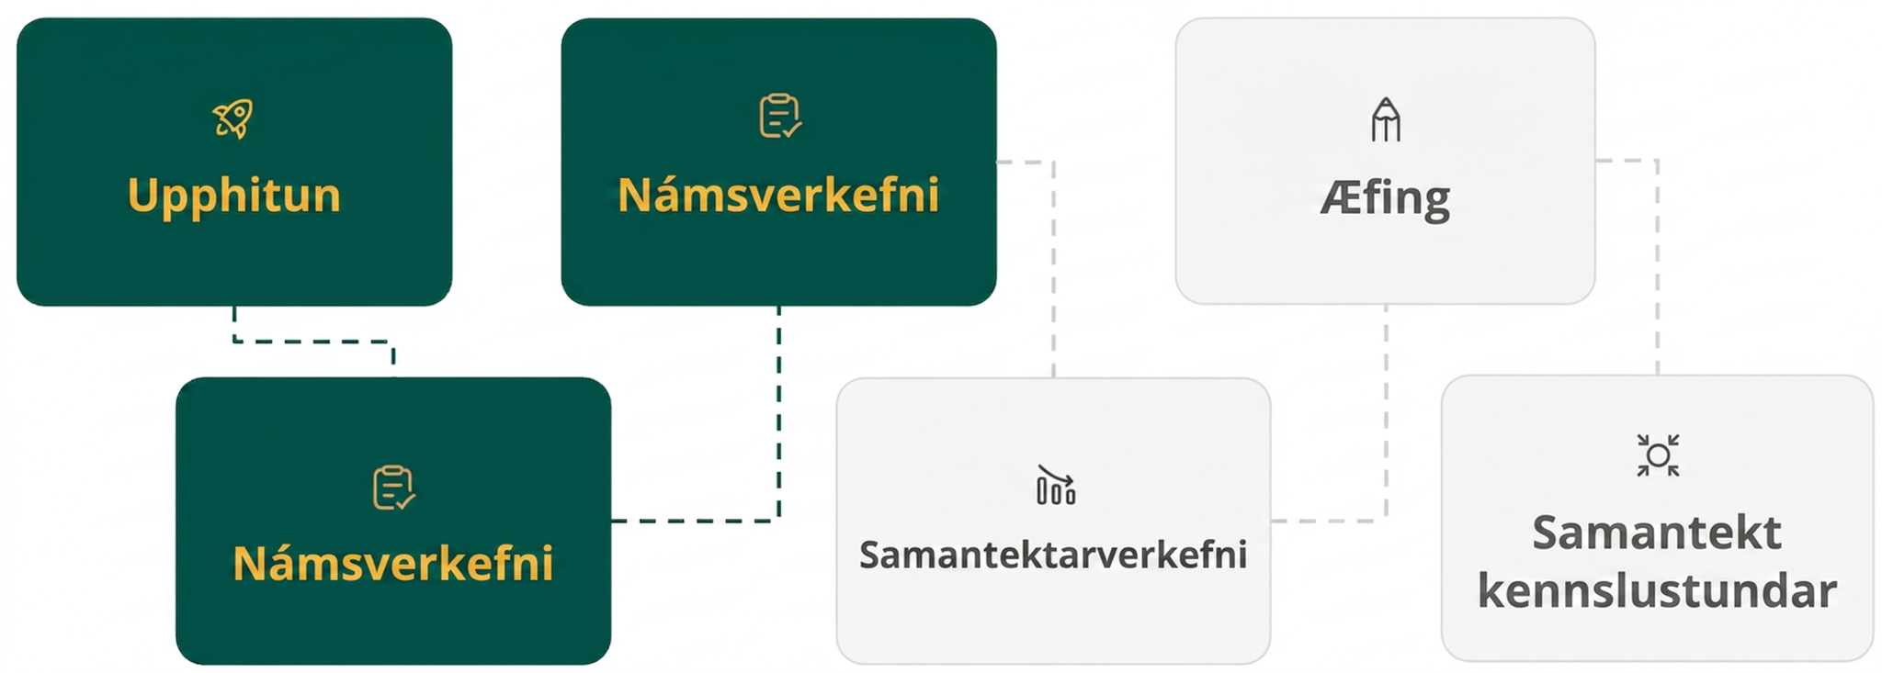
Lesson Journey
Third Stop: Learning Activity B

Slide 17
Learning Activity B | Learning Strategies
Baseball in Flight ⚾
Teacher Instruction: Use these strategies to adjust the activity to support English language learners.
  You can copy and paste the callouts directly on top of the activity or give the instructions aloud.
Discuss with your partner how to describe the graph and equation.
Use and add terms from the display (like constant term, y-intercept, starting height) to explain their connections.
Collect and Display
Notes:
Support for English Language Learners: MLR 2 Collect and Display: Conversing
As students discuss their explanations with a partner, capture student language that reflects a variety of ways to describe the different representations of quadratic functions. Write the students' words on a visual display of the graph. Emphasize connections between terms such as “constant term” and “y-intercept”, between “starting height” and “t = 0”, and between “x-intercepts” and “when the ball hits the ground”. Remind students to borrow language from the display as needed.
Principle(s): Optimize output (for explanation); Maximize meta-awareness
Provide support for students
Distribute graphic organizers to the students to assist them with participating in this routine.

Slide 18
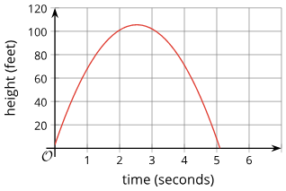
Learning Activity B | Part 1
Baseball in Flight ⚾
The graph shows the baseball’s height (h) in feet over time (t) in seconds after Player A hit it.
The function
g(t) = (−16t − 1)(t − 4) shows the baseball’s height (in feet) t seconds after Player B hit it.
Answer the questions on the next slide without graphing function g.
Notes:
Support for All Learners
This activity offers additional support for students:
For English language learners, be sure to review the Learning Strategies slide!
Activity (15 minutes)
In this activity, students analyze two quadratic functions—one given by a graph and one by an equation. Since they may not graph the second function, they must use their understanding of how equations relate to graphs to compare them. Students interpret information from the graph, the equation, and the problem context to reason quantitatively and abstractly. As they work, identify students whose reasoning aligns with the Activity Synthesis so they can share their thinking.
Launch
Give students a moment to read the task statement. Make sure students understand what it means for a baseball to "stay in flight."
Consider keeping students in groups of two and asking them to think quietly before discussing their thinking with a partner.
Answers
Player A's baseball stayed in flight longer. The zeros of function g are 4 and −1/16. The negative zero doesn't have any meaning in this situation. A zero in this situation means the time when the baseball has a height of 0 (or when it hits the ground). For Player B, this happened when t = 4 or 4 seconds after it was hit. Player A's baseball hit the ground a little over 5 seconds after it was hit.
Player A's baseball reached a greater maximum height. From the graph for Player A, it looks like the y-coordinate of the vertex is around 105 feet. For Player B, the vertex of the graph has a t-coordinate of about 2 (halfway between −1/16 and 4). We can find g(2) to estimate the height at that point. g(2) = (−16(2) − 1)(2 − 4) = (−33)(−2) = 66, so the highest point of Player B's baseball was around 66 feet.
We can look at the y-intercept of the graph, and it looks like the y-coordinate is about 5.
4 feet. Find the height when t = 0. g(0) = (−16(0) − 1)(0 − 4) = (−1)(−4) = 4, so it was hit at 4 feet.
Activity questions, answers, anticipated misconceptions, and synthesis on the next slide.

Slide 19

Learning Activity B | Part 2
Baseball in Flight ⚾
Which player's baseball stayed in flight longer?
Which player's baseball reached a greater maximum height?
Based on the graph, what is the approximate height, in feet, of Player A’s baseball when hit? How do you know?
What is the height, in feet, of Player B’s baseball when hit?
Notes:
Answers
Player A's baseball stayed in flight longer. The zeros of function g are 4 and −1/16. The negative zero doesn't have any meaning in this situation. A zero in this situation means the time when the baseball has a height of 0 (or when it hits the ground). For Player B, this happened when t = 4 or 4 seconds after it was hit. Player A's baseball hit the ground a little over 5 seconds after it was hit.
Player A's baseball reached a greater maximum height. From the graph for Player A, it looks like the y-coordinate of the vertex is around 105 feet. For Player B, the vertex of the graph has a t-coordinate of about 2 (halfway between −1/16 and 4). We can find g(2) to estimate the height at that point. g(2) = (−16(2) − 1)(2 − 4) = (−33)(−2) = 66, so the highest point of Player B's baseball was around 66 feet.
We can look at the y-intercept of the graph, and it looks like the y-coordinate is about 5.
4 feet. Find the height when t = 0. g(0) = (−16(0) − 1)(0 − 4) = (−1)(−4) = 4, so it was hit at 4 feet.
Anticipated Misconceptions
Some students may find it challenging to find the zeros of function g because of the -16 in −16t − 1. Support these students' reasoning about the equation −16t − 1 = 0 by asking whether this equation will have a positive or negative solution and whether it will have a solution close to 0 or not. Another challenge students may face is estimating the location of the vertex. Point out the graph of h and ask them how the vertex relates to the horizontal intercepts. It is not expected that students will compute the precise location by averaging −1/16 and 4. Encourage them to use the number between 0 and 4 as a good estimate of the t-coordinate of the vertex. Encourage struggling students to use technology to graph g to check their thinking.
Activity Synthesis
Invite students to share their responses and reasoning. If not mentioned in students' explanations, highlight the following points:
To determine which baseball stayed in flight longer, we can compare where the graphs intersect the horizontal axis or the zeros of the functions, which tell us when the baseball hits the ground.
The graph of function h intersects the horizontal axis around 5.
Function g is given in factored form, so one zero will be a very small negative number (about −1/16), and the other zero will be 4.
The maximum height of Player A's baseball (function h) is shown in the graph. For Player B (function g), we can approximate the halfway point between the horizontal intercepts, which is around t = 2, and then find g(2).
The baseball was hit at t=0, so to find the height we would look at the vertical intercept (y-intercept).
For function h, this point is shown on the graph.
For function g, it is not immediately apparent because the equation is in factored form. If it was in standard form, the constant term is the vertical intercept. We can either expand the (−16t − 1)(t − 4) and write an equivalent expression in standard form, or find g(0).

Slide 20
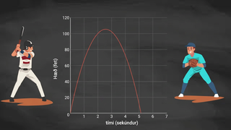
Learning Activity B | Video
Comparing Quadratic Functions
Notes:
This video discusses question 1 of activity 7.14.3

Slide 21

Learning Activity B
Self Check
Here are the functions that show how long (in seconds) four baseballs stayed in the air after being hit.
f(t) = (−16t − 1)(t − 5)
g(t) = (−16t − 1)(t − 10)
h(t) = (t − 7)(-16t − 1)
p(t) = (-8t − 1)(2t − 5)
Which function represents the ball that stayed in the air the longest?
Let’s review!
Notes:
Answer Feedback - Individualized by Response
Incorrect. This ball traveled 5 seconds. There are other choices that stayed in the air longer.
That's correct! Since t − 10 = 0 at t = 10, the ball travels 10 seconds. This is the farthest ball.
Incorrect. This ball traveled 7 seconds. There is another choice that stayed in the air longer.
Incorrect. This ball stays in the air 2.5 seconds. There are other choices that stayed in the air longer.

Slide 22
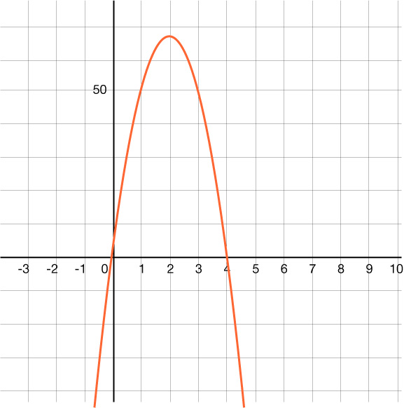
Learning Activity B
Self Check - Review
Jai kicks a football. The graph represents height (h) as a function of time, in seconds.
Kellan kicks a football and the height in feet, h, is represented by the function h(t) = (−16t − 1)(t − 6).
Which player’s football stayed in the air longer?
Notes:
Review with Students
Jai’s football landed after 4 seconds since the zero is at x = 4. The other zero, where x is negative, does not make sense in this problem.
Looking at the function of Kellan’s ball, find the zeros by setting each factor equal to zero.
−16t − 1 = 0 becomes t = −1/16. A negative time does not make sense in this problem.
t − 6 = 0 becomes t = 6.
Answer
Kellan’s ball was in the air for 6 seconds, so his ball stayed in the air 2 seconds longer than Jai’s.

Slide 23
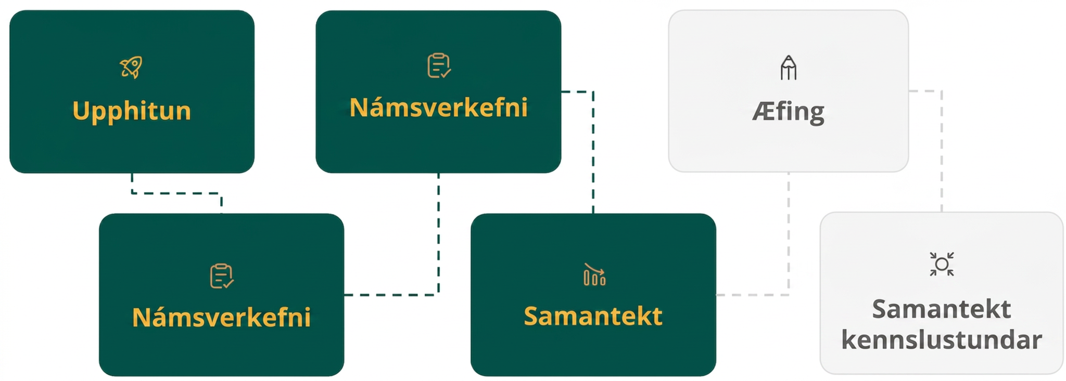
Lesson Journey
Fourth Step: Cool Down

Slide 24

Cool Down
The factored form of equation y = (−16t −2)(t − 1), shows that the graph crosses the horizontal axis at two points and represents the beach ball’s height (in feet) as a function of time t in seconds.
Use this information to find the zeros of the function
  Find one of the zeros of the functions using (−16t − 2).
  Find one of the zeros of the functions using (t − 1).
What do the zeros tell us in this situation?
Are both zeros meaningful?
From what height, in feet, is the beach ball thrown? Explain.
Notes:
Cool Down (5 minutes)
Launch
Provide continued access to graphing technology, in case students choose to use it.
Answers
-0.125 or − ⅛ . From the factored form, we can tell that the graph intersects the horizontal axis at t = −0.125 or − ⅛. The zero of the function is the same value.
1. From the factored form, we can tell that the graph intersects the horizontal axis at t = 1. The zero of the function is the same value.
The zeros mean the time in seconds when the ball is on the ground.
No. Only one of them is meaningful. The negative zero doesn't mean anything here.
2. The height when t = 0 is (−16(0) − 2)(0 −1) = (−2)(−1) = 2. If you graph the function, the graph shows a y-intercepts of (0, 2).
Response to Student Thinking - Press Pause
If students struggle to interpret functions in context, plan to spend extra time on this topic before the assessment by reviewing activities and practice problems.

Slide 25
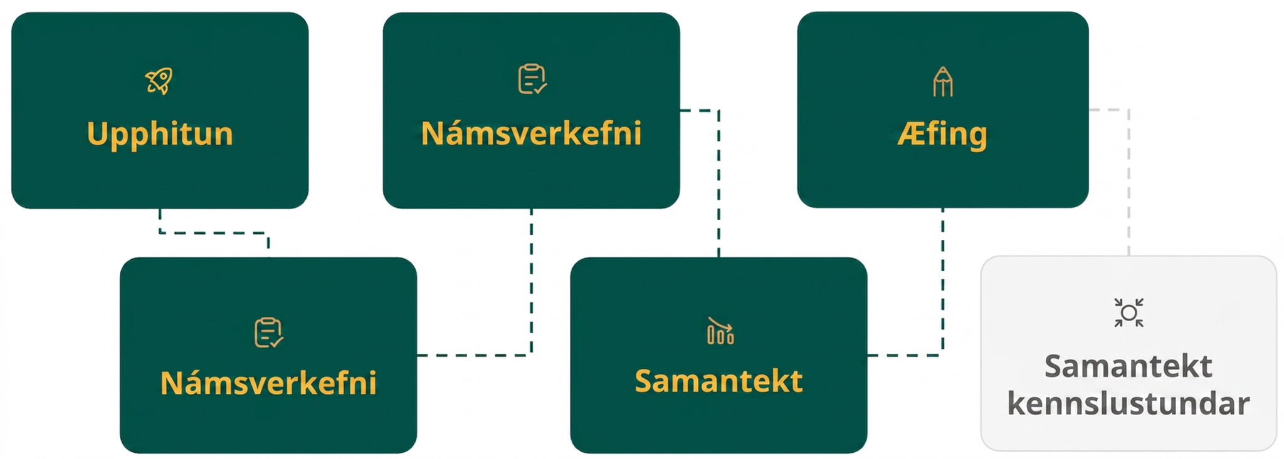
Lesson Journey
Fifth Stop: Practice

Slide 26

Practice
Put your hard work to action, practice what you’ve learned!
Notes:
Digital Practice: Access the practice pages at https://openstax.org/details/books/algebra-1

Slide 27
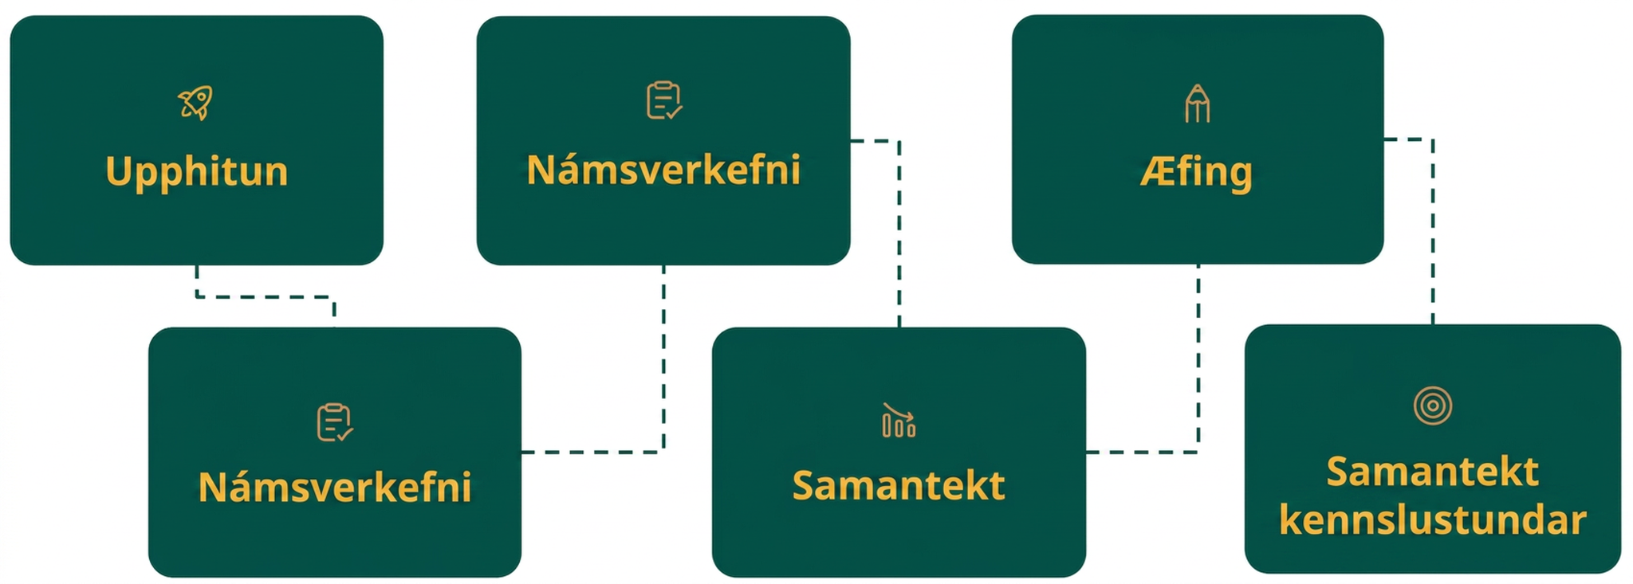
Lesson Journey
Sixth Stop: Lesson Synthesis

Slide 28
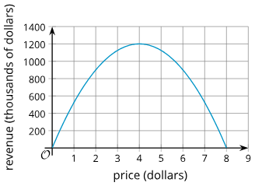
Lesson Synthesis
Earlier, we studied the quadratic function r(d) = d(600 − 75d), which represented ticket-sale revenue (in thousands of dollars). Use what you learned in this lesson about projectile motion to answer the questions.
What can you tell about the ticket sales and revenue from the equation?
In what form is the quadratic expression defining r written?
If we rewrite it in standard form, what new information would we gain?
Using the graph of the function. What do the horizontal intercepts, the vertical intercept, and the vertex tell us?
Notes:
Remind students
The examples students saw in this lesson were related to the motion of projectiles. Emphasize that the graphs that represent quadratic functions that model other kinds of situations can also be interpreted in context. For example, in an earlier lesson we saw a quadratic function defined by r(d) = d(600 − 75d). It described the revenue in thousands of dollars collected from ticket sales as a function of the price of one ticket.
Answers
If the ticket is sold for 0 dollars, or if d = 0, the revenue will be 0.
Factored form
In standard form, the equation is r(d) = 60d − 75d². It gives us the vertical intercept, but that is not new information. We saw that one of the horizontal intercepts is at (0, 0), so the vertical intercept is known.
The horizontal intercepts tell us that no revenue will be collected if the tickets are sold at $0 and $8. The vertical intercept gives the same information: that if the ticket is free, there will be no revenue. The vertex tells us that the greatest revenue will be collected when the ticket is sold at $4 each, and that amount is $1,200.

Slide 29
Self Assessment
How much do you agree with the following statements?
Learning Goals | I can | Almost | Not yet
Explain how a quadratic equation and its graph relate to a situation. | ⃞ | ⃞ | ⃞

