Slide 1
Algebra 1
Unit 9 More Quadratic Equations
Lesson 9.6 The Quadratic Formula
Notes:
How to Get Started
Review Slide 2: How to use these slides
Check out the Check out the digital quick start guide!
Review Slide 3: Reference Key of Icons

Slide 2

How to use these slides
On the activity slides check the speaker notes for teacher support and instructional information.
Each lesson includes 1 warm up, 2-3 learning activities, a cool down, practice and a lesson synthesis.
  Learning activities are followed by a self check question, and review section.
Some slides have been hidden from student view, more information can be found on the next slide (Reference Key).
You can edit and use these slides for personal and classroom use, but cannot sell them and must keep the attribution logos.
For more information, Check out the digital quick start guide!
OpenStax CC BY NC SA

Slide 3





Reference Key
Check the top right corner for an icon referencing these unique sections.
Icon | Title | View | Location and Description
n/a | Support for Students with Disability | Hidden | Learning Strategies slide, provides additional support to students for understanding the activity.
n/a | Support for English Language Learners | Hidden | Learning Strategies slide, provides additional support to students for understanding the activity.
n/a | Extending Your Thinking | Hidden | Extending Your Thinking slide, provides an extra challenge for students.
n/a | Self Check | Not Hidden | Self Check slide, checkpoint to assess student understanding after the learning activity.
n/a | Review | Hidden | Self Check - Review slide, designed to help review topics from the self check question.
On the next slides, check the speaker notes for teacher instructions and support.
Notes:
Check the Speaker Notes: On the next slides you can find discussion questions, lesson information, answers to the activities, and ways to adjust the activity for your students!

Slide 4

Learning Goals
By the end of this lesson you will be able to -
Use the quadratic formula to solve quadratic equations.
Explain when some methods for solving quadratic equations can be more convenient than others.
Notes:
Lesson Narrative
Students learn that the quadratic formula can solve any quadratic equation and verify that it gives the same solutions as other methods, while often being more practical. In future lessons, students apply the formula to real-world problems, analyze its structure, and later explore how it is derived. Solving with the formula requires careful attention to coefficients and flexible use of operations.
Required Preparation
None
Required Materials
Scientific calculators
Texas Essential Knowledge and Skills
A1(G) display, explain, and justify mathematical ideas and arguments using precise mathematical language in written or oral communication
A8(A) solve quadratic equations having real solutions by factoring, taking square roots, completing the square, and applying the quadratic formula.
A11(A) simplify numerical radical expressions involving square roots.

Slide 5

Vocabulary
Previous
Radical Expression
  An expression containing a root such as a square root, cube root, etc.
Completing the Square
  A method used with quadratic expressions to transform it into a perfect square trinomial.
Perfect Square
  The product of a whole number or expression that has been multiplied by itself.
New
Quadratic Formula
Notes:
Lesson Vocabulary
To support student understanding of key vocabulary:
Introduce and review the vocabulary words students will see in this lesson.
Encourage students to notice how these words are used and to include them in their math discussions and explanations—both written and oral.
Use a word wall to reinforce vocabulary. Sample word wall cards are available here.
For newcomers or students with beginning English proficiency, use these Quizlet sets to support vocabulary learning:
Unit 9 Spanish Vocabulary – use first to build understanding
Unit 9 Vocabulary (English) – use after anchoring in Spanish
Support for English Language Learners
ELPS 2(F) listen to and derive meaning from a variety of media such as audiotape, video, DVD, and CD-ROM to build and reinforce concept and language attainment
ELPS 3(E) share information in cooperative learning interactions
ELPS 3(I) adapt spoken language appropriately for formal and informal purposes

Slide 6

Lesson Journey
First Stop: Warm Up

Slide 7

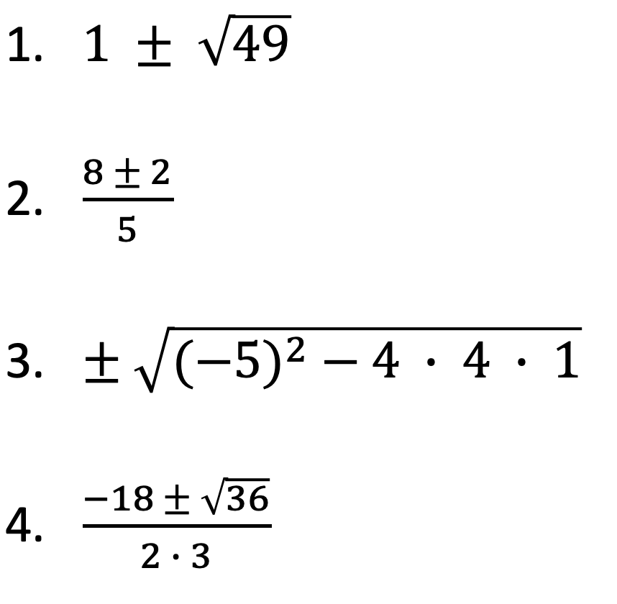
Warm Up
Find the Two Numbers🔎
Each expression represents two numbers. Evaluate the expressions and find the two numbers.
Notes:
Warm Up (5 minutes)
This warm up prompts students to evaluate the kinds of numerical expressions they will see in the lesson. The expressions involve rational square roots, fractions, and the ± notation.
As students work, notice any common errors or challenges so they can be addressed during the class discussion.
Launch
Tell students to evaluate the expressions without using a calculator.
Activity Answers
8, -6
2, 6/5
3, -3
-2, -4
Anticipated Misconceptions
Students may be unfamiliar with evaluating rational expressions in which the numerator contains more than one term. To help students see the structure of the expressions, consider decomposing them into a sum of two fractions. For example, show that (8 ± 2)/5 can be written as 8/5 ± 2/5. This approach can also help to avoid a common error of dividing only the first term by the denominator (4+7)/2 ≠ 2+7. Some students may incorrectly write √36/2 as √18. Point out that the first expression is equal to 3 while the other has to be greater than 3 since √18 ≈ 4.243.
Activity Synthesis
Select students to share their responses and reasoning. Address any common errors. As needed, remind students of the properties and order of operations and the meaning and use of the ± symbol.

Slide 8
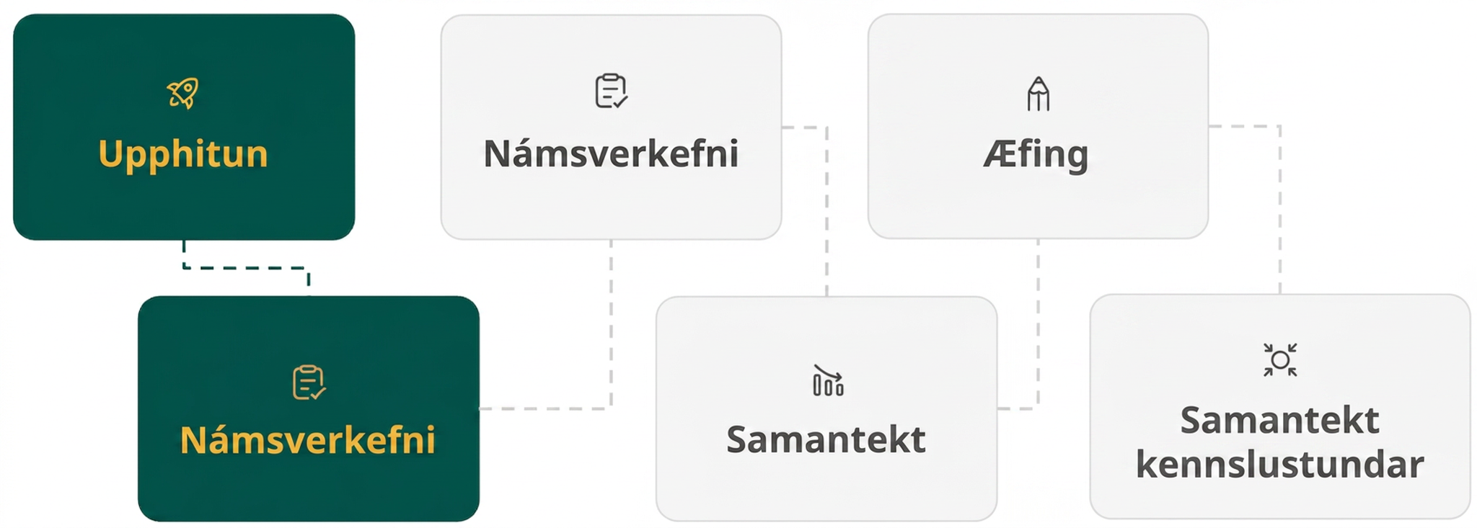
Lesson Journey
Second Stop: Learning Activity A

Slide 9

Learning Activity A | Learning Strategies
What is the Best Method? 🧠
Teacher Instruction: Use these strategies to adjust the activity to support English language learners and students with disabilities.
You can copy and paste the callouts directly on top of the activity or give the instructions aloud.
First I _____ because …
I tried _____ and what happened was …
How did you get … ?
Why did you …?
Discussion Supports
You already know factoring and completing the square.
Choose the method that feels easiest.
Be ready to say why you chose it.
Engagement
Notes:
Support for English Language Learners: MLR 8 Discussion Supports: Speaking, Representing
Use this routine to support small-group discussion. Provide the class with the following sentence frames to help them discuss their solution strategies with their partner: “First I _____ because. . .”, “I tried _____ and what happened was . . .”, “How did you get . . . ?”, and “Why did you . . . ?” Encourage students to challenge each other when they disagree. This will help students clarify their reasoning when solving quadratic equations.
Design Principle(s): Support sense-making
Support for Students with Disabilities: Engagement: Develop Effort and Persistence
Connect a new concept to one with which students have experienced success. Activate prior knowledge by reminding students that they have already successfully completed tasks by both factoring and completing the square. Invite them to brainstorm what might be important to consider when selecting a method to use.
Supports accessibility for: Social-emotional skills; Conceptual processing

Slide 10
Learning Activity A | Part 1
What is the Best Method? 🧠
Find the two solutions by rewriting it in factored form or by completing the square. Be prepared to explain your choice of method.
x² − 2x − 1.25 = 0
  2.5
  3
  – 1
  – 0.5
5x² − 9x − 44 = 0
  2.2
  – 20
  – 4
  11
Notes:
Support for All Learners
This activity offers additional support for students:
For English language learners and students with disabilities, be sure to review the Learning Strategies slide!
Activity (10 minutes)
In this activity, students encounter equations that are challenging to solve using the methods they have learned, motivating students to seek a more efficient method.
Launch
Arrange students in groups of two.
Ask partners to choose the same equation.
Give students quiet time to solve the equation and then time to discuss their solutions and strategy. If they finish solving their chosen equation, ask them to choose another one to solve.
Leave a few minutes for a whole-class discussion.
Provide access to calculators for numerical computations.
Answers
2.5, -0.5
2.2, -4
Click here to access the slide with the worked solutions for questions 1 and 2.
Activity questions, answers on the next slide.

Slide 11
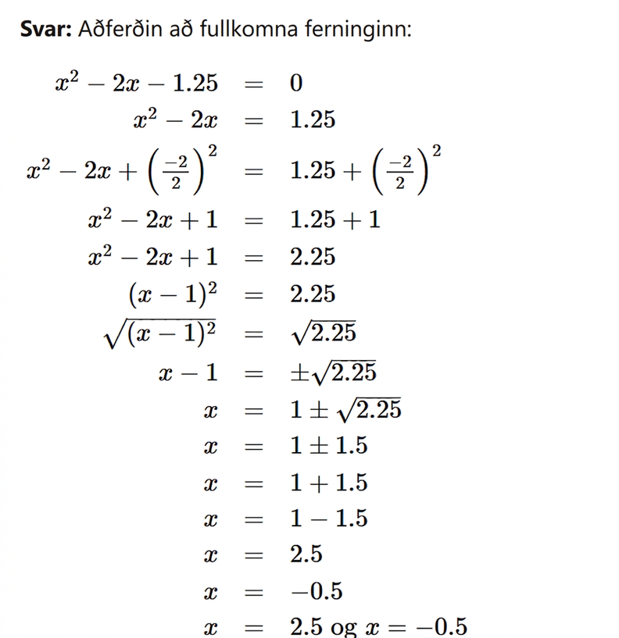
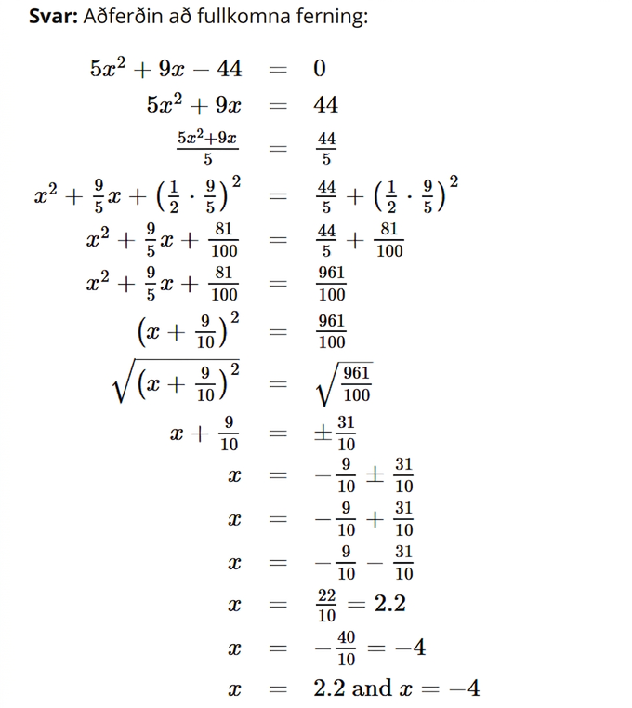
Learning Activity A | Part 1
What is the Best Method? 🧠 Worked Solutions
Notes:
Worked Solutions for questions 1 and 2

Slide 12
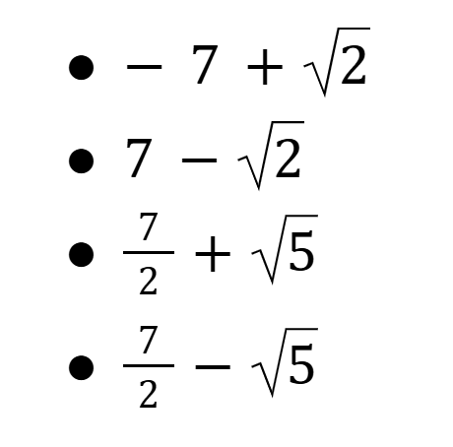
Learning Activity A | Part 2
What is the Best Method? 🧠
Find the two solutions by rewriting it in factored form or by completing the square. Be prepared to explain your choice of method.
x² − 1.25x = 0.375
  0.75
  0.25
  – 1.5
  2.5
4x² − 28x + 29 = 0
Notes:
Activity Answers
0.25, -1.5
√7/2 + 5, √7/2 − 5
Click here to access the slide with the worked solutions for questions 3 and 4.
Activity Synthesis
Consider arranging students who solved the same equation in groups of two to three to discuss their strategies and then displaying the correct solutions for all to see.
Invite students to share their reflections on the solving process. Discuss questions such as:
"What method did you choose and why?"
"Did you find yourself choosing one method and then switching to another? If so, what prompted you to do that?"
"Did you run into any challenges when rewriting the equation (or completing the square)? What were some of the challenges?"
Acknowledge that all of these equations are cumbersome to solve by either rewriting in factored form or completing the square. The last equation cannot be written in factored form (with rational coefficients), so completing the square is the only way to go. Tell students they are about to learn a formula that gives the solutions to any quadratic equation.

Slide 13
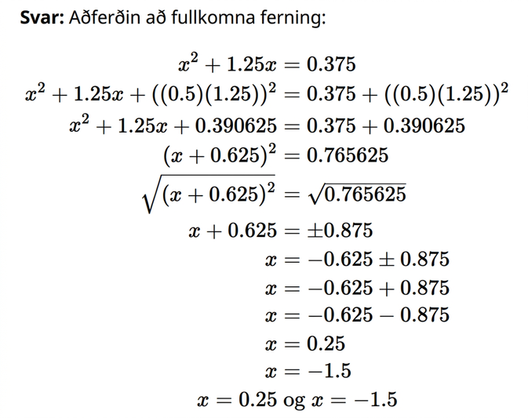
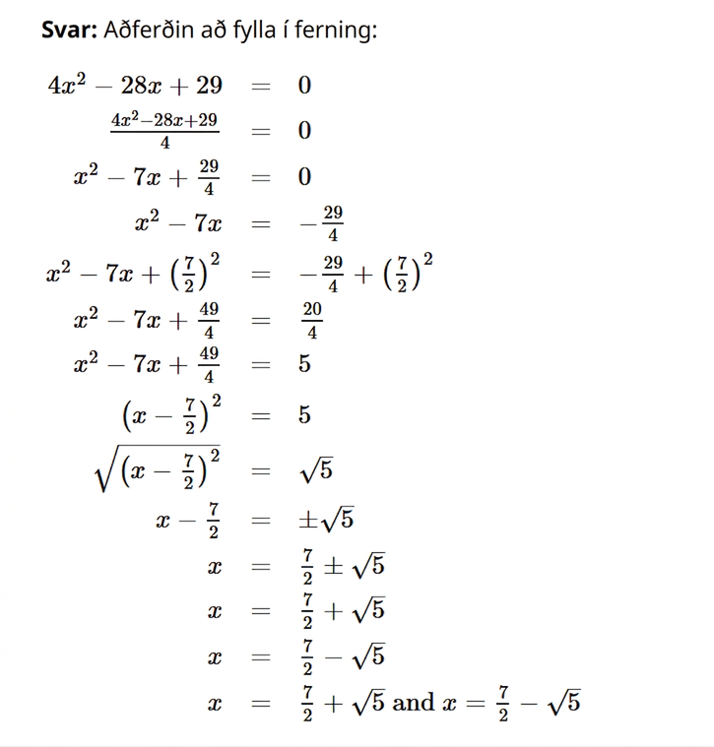
Learning Activity A | Part 2
What is the Best Method? 🧠 Worked Solutions
Notes:
Worked Solutions for questions 3 and 4

Slide 14
Learning Activity A
Self Check
Use completing the square to solve 2x² + 10x + 8 = 0.
x = ²⁵/₄
x = 1, x = 4
x = −4, x = −1
x = −5 ± √17
Let’s review!
Notes:
Answer Feedback - Individualized by Response
Incorrect. This is the value that completed the square. The equation then needs to be solved.
Incorrect. Make sure to subtract the c from both sides before completing the square, not add the positive value.
That’s correct! After taking the square root of both sides, the equation becomes x =−5/2 ± 3/2.
Incorrect. Divide all terms by the coefficient, 2, before completing the square, not just the first term.

Slide 15

Learning Activity A
Self Check - Review
SOLVING BY COMPLETING THE SQUARE
Step 1: Divide all terms by the leading coefficient.
Step 2: Move the constant to the right side of the equation.
Step 3: Complete the square and add to each side.
Step 4: Simplify. (Hint: create a common denominator before adding.)
Step 5: Take the square root of each side.
Step 6: Write two equations and solve.
Solve 2x² + 5x + 2 = 0
by completing the square.
Notes:
Answers
Step 1: (2x² + 5x + 2 = 0)/2
x² + 5/2x + 1 = 0
Step 2: x² + 5/2x = -1
Step 3: (5/2 × ½)² = 25/16 .
x² + 5/2x + 25/16 = −1 + 25/16
Step 4: x²+ 5/2x + 25/16 = −16/16 + 25/16
(x + 5/4)² = 9/16
Step 5: √(x + 5/4)² = √9/16
x + 5/4 = ± 3/4
Step 6: x + 5/4 = 3/4
x + 5/4 =−3/4
x = −2/4 = −½
x = −8/4 = −2
x = -½ and x = -2

Slide 16
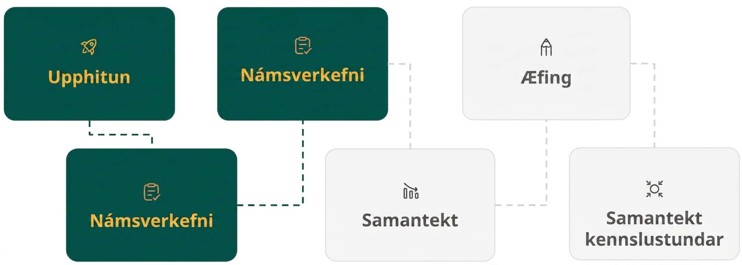
Lesson Journey
Third Stop: Learning Activity B

Slide 17
Learning Activity B | Learning Strategies
Unlocking Quadratic Equations🔑
Teacher Instruction: Use these strategies to adjust the activity to support English language learners and students with disabilities.
You can copy and paste the callouts directly on top of the activity or give the instructions aloud.
Make sure everyone can explain the steps.
Practice what to say.
Anyone may be asked to share.
Discussion Supports
Use a diagram to rewrite the expression.
List and test factors—it’s okay to try more than one.
You may use a calculator.
Representation
Notes:
Support for English Language Learners: MLR 8 Discussion Supports: Speaking, Representing
Give students time to make sure that everyone in the group can explain or justify each step or part of the problem. Invite groups to rehearse what they will say when they share with the whole class. Rehearsing provides students with additional opportunities to speak and clarify their thinking, and will improve the quality of explanations shared during the whole-class discussion. Then make sure to vary who is selected to represent the work of the group so that students get accustomed to preparing each other to fill that role.
Design Principle(s): Support sense-making; Cultivate conversation
Support for Students with Disabilities: Representation: Internalize Comprehension
Activate or supply background knowledge. Demonstrate how students can continue to use diagrams to rewrite expressions in which the coefficient of the squared term is not 1. Invite students to begin by generating a list of factors and to test them using the diagram. Encourage students to persist with this method, reiterating the fact that they are not necessarily expected to immediately recognize which factors will work without testing them. Allow students to use calculators to ensure inclusive participation.
Supports accessibility for: Visual-spatial processing; Organization

Slide 18
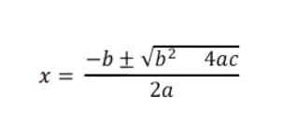
Learning Activity B | Part 1
Unlocking Quadratic Equations🔑
Here is a formula called the quadratic formula.
The formula can be used to find the solutions to any quadratic equation in the form of ax² + bx + c, where a, b, and c are numbers and a is not 0.
Notes:
Support for All Learners
This activity offers additional support and an extension for students:
For English language learners and students with disabilities be sure to review the Learning Strategies slide!
Activity (20 minutes)
This activity introduces the quadratic formula. Students begin by applying the formula and using it to solve various equations, ranging from those that can be easily solved using other methods to the kinds that would be quite tedious to solve without the formula. They then verify that the formula gives the same solutions as those calculated by another method. Students notice that, for equations that cannot be easily rewritten using factored form or solved by completing the square, the formula offers quite an efficient way to find the solutions.
Launch
Display ax² + bx + c = 0. Remind students that a, b, and c are numbers and a ≠ 0. Ask whether completing the square is possible without using specific numbers.
Explain that completing the square symbolically leads to a general solution, not numerical answers, called the quadratic formula.
Display the quadratic formula: x = (−b ± √(b² − 4ac))/2​a and state that it solves any equation in the form
ax² + bx + c = 0.
Model using the formula with x² − 8x + 15 = 0. First, ask students to predict the solutions by factoring: x = 3 and x = 5.
Identify coefficients: a = 1, b = −8, c = 15. Substitute into the formula and evaluate step by step to confirm x=3x=3x=3 and x=5x=5x=5.
Provide calculators for computation. If time allows, have students solve at least two equations, including one where a ≠ 1.
For students who struggle with substitution, use color-coding to match aaa, bbb, and ccc in the formula to the values from the equation.
Example on the next slide.

Slide 19
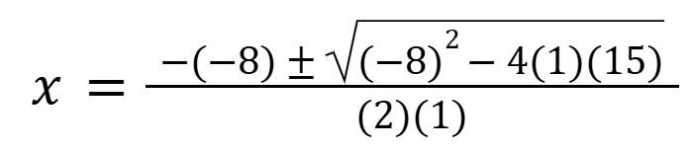
Learning Activity B | Part 2
Unlocking Quadratic Equations🔑
This example shows how it is used to solve x² − 8x + 15 = 0, in which a = 1, b = −8, and c = 15.
Step 1: State the original equation.
x² – 8x + 15 = 0
Step 2: Identify values of a, b, and c.
a = 1, b = – 8, c = 15
Step 3: Then substitute in the values of a, b, and c into the formula.
Notes:
Example Steps 1-3
More steps, activity questions, answers, and activity synthesis on the next slide.

Slide 20
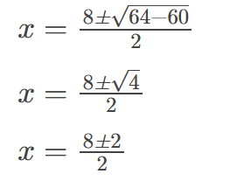
Learning Activity B | Part 3
Unlocking Quadratic Equations🔑
Step 4: Evaluate each part of the expression.
Step 5: Write each equation separately and solve.
x = ⁽⁸⁺²⁾⁄₂ and x = ⁽⁸ ⁻ ²⁾⁄₂
Step 6: Simplify.
x = ¹⁰⁄₂ and x = ⁶⁄₂
Step 7: Find the solutions.
x = 5 and x = 3
Notes:
Example Steps 4-7
Activity questions, answers, and activity synthesis on the next slide.

Slide 21
Learning Activity B | Part 4
Unlocking Quadratic Equations🔑
Here are some quadratic equations and their solutions. Use the quadratic formula to show that the solutions are correct.
x² + 4x − 5 = 0. The solutions are x = −5 and x = 1.
x² + 7x + 12 = 0. The solutions are x = −3 and x = −4.
x² + 10x + 18 = 0. The solution is x = −5 ± √7.
x² − 8x + 11 = 0. The solution is x = 4 ± √5.
9x² − 6x + 1 = 0. The solution is x = ⅓.
6x² + 9x − 15 = 0. The solutions are x = −⁵⁄₂ and x = 1.
Notes:
Answers
Link to question 1 worked solution
Link to question 2 worked solution
Link to question 3 worked solution
Link to question 4 worked solution
Link to question 5 worked solution
Link to question 6 worked solution
Activity Synthesis
Much of the student discussion will have happened in small groups. Focus the whole-class conversation on whether the quadratic formula works for solving all equations and when it might be a preferred method. Ask students:
"Look at the list of equations and the work you did to solve them. Do certain equations lend themselves to certain methods of solving? Why?" (We can see the factors of some expressions right away, so rewriting it in factored form would be the quickest method to solve the equations. Other expressions cannot be easily rewritten in factored form but can be easily transformed into perfect squares. For example, when the coefficient of x² is 1, the coefficient of the linear term is an even number, and the constant term is also a whole number, completing the square is straightforward. When the squared term has a coefficient other than 1, the other two methods are less practical, so the quadratic formula may be the quickest approach.)
"Why do you think the quadratic formula is useful only when the a in ax² + bx + c = 0 is not 0?" (If a is 0, the expression is no longer quadratic because the squared term disappears, leaving only bx + c, which is linear.)
Select students who used the quadratic formula to solve the last few equations to explain their solutions and display their work for all to see. Discuss any challenges or disagreements in using the formula.
Tell students that they will use the formula to solve other equations and find out more about its merits and how it compares to other methods of solving.
Watch for algebraic errors with negatives when a value is substituted in for b when it is made negative and also squared in the formula.

Slide 22
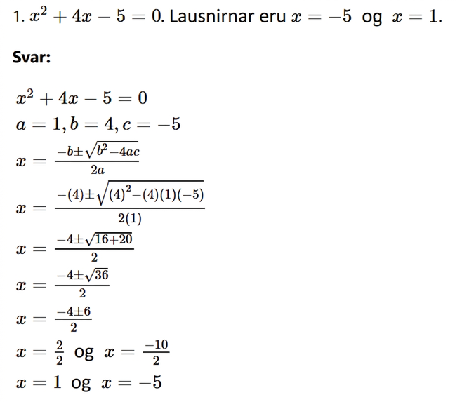
Learning Activity B | Part 5
Unlocking Quadratic Equations🔑Worked Solutions
Notes:
Worked Solution Question 1

Slide 23
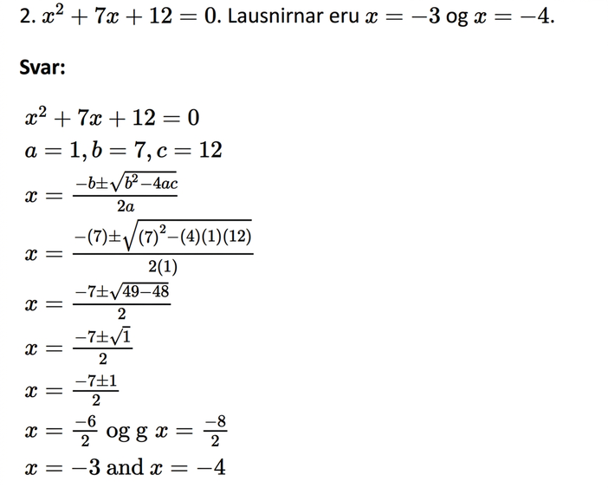
Learning Activity B | Part 6
Unlocking Quadratic Equations🔑Worked Solutions
Notes:
Worked Solution Question 2

Slide 24
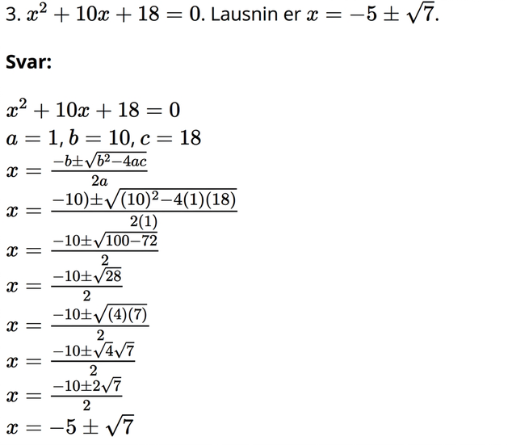
Learning Activity B | Part 7
Unlocking Quadratic Equations🔑Worked Solutions
Notes:
Worked Solution Question 3

Slide 25
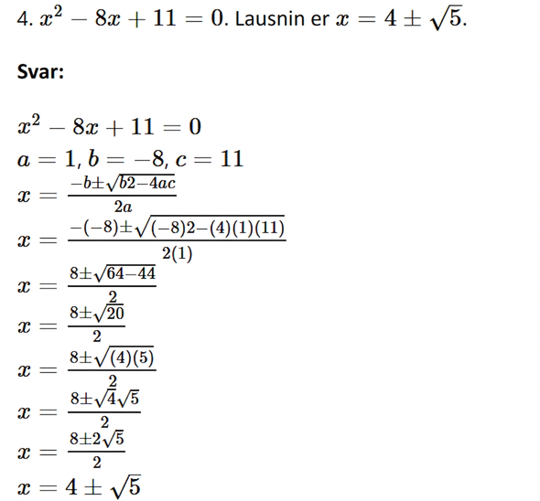
Learning Activity B | Part 8
Unlocking Quadratic Equations🔑Worked Solutions
Notes:
Worked Solution Question 4

Slide 26
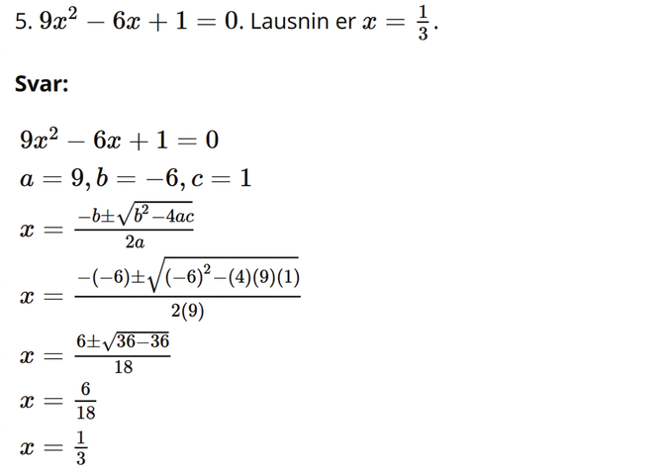
Learning Activity B | Part 9
Unlocking Quadratic Equations🔑Worked Solutions
Notes:
Worked Solution Question 5

Slide 27
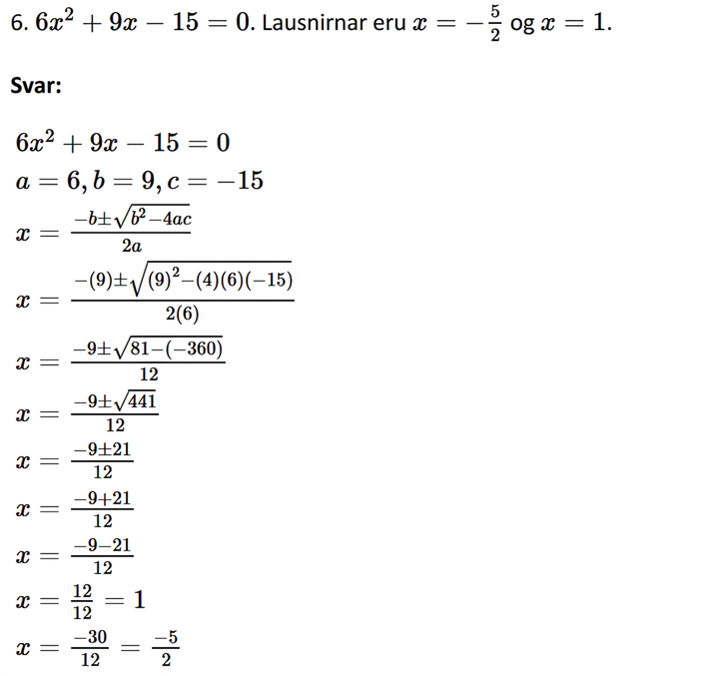
Learning Activity B | Part 10
Unlocking Quadratic Equations🔑Worked Solutions
Notes:
Worked Solution Question 6

Slide 28
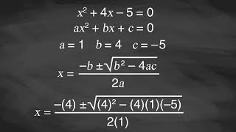
Learning Activity B | Video
Solving Quadratics With the Quadratic Formula
Notes:
This video discusses question 1 of activity 9.6.3

Slide 29

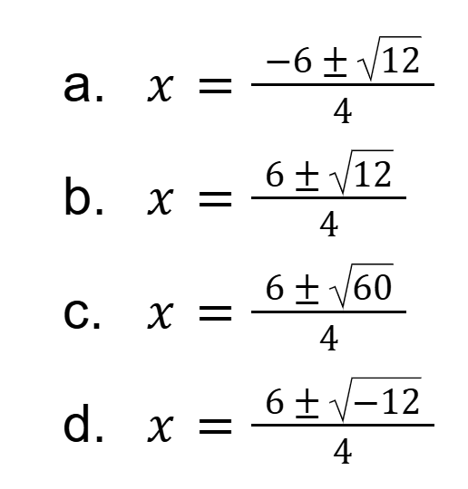
Learning Activity B
Self Check
Solve 2x² −6x + 3 = 0 using the quadratic formula.
Let’s review!
Notes:
Answer Feedback - Individualized by Response
Incorrect. Remember the formula begins with −b.
That's correct! Substitute a = 2, b = −6, and c = 3 into the quadratic formula then simplify.
Incorrect. Be sure to subtract 4ac from b², not add.
Incorrect. Remember, when you square a negative number, like in (−6)², it equals a positive.

Slide 30
Learning Activity B | Part 1
Self Check - Review
Quadratic Formula
The solutions to a quadratic equation
of the form ax² + bx + c, where a ≠ 0,
are given by the formula:
To use the quadratic formula:
Step 1 - Write the quadratic equation in standard form. ax² + bx + c = 0.
Step 2 - Substitute the values of a, b, and c from the standard form into the expression on the right side of the formula.
Step 3 - Simplify the expression (on the right).
Step 4 - The result is the pair of solutions to the quadratic equation. Solve each.
Step 5 - Make sure you use both sides of the equation, if needed.
Notes:
Review the quadratic formula with students before starting the review activity.

Slide 31
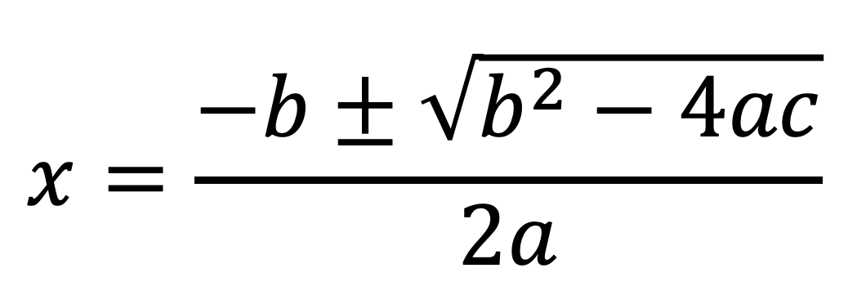
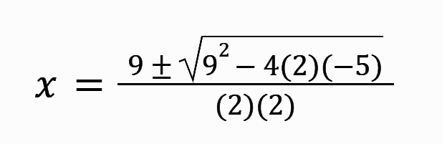
Learning Activity B | Part 2
Self Check - Review
Step 1 - Write the quadratic equation in standard form. ax² + bx + c = 0.
2x² + 9x − 5 = 0
Step 2 - Substitute the a, b, and c values into the formula.
a = 2, b = 9, c = −5
Notes:
Note for instruction:
ANIMATION HAS BEEN ADDED - Click to reveal each step.
Have students write down their answers before the correct answer to each step is revealed.
Step 5 is on the next slide.

Slide 32
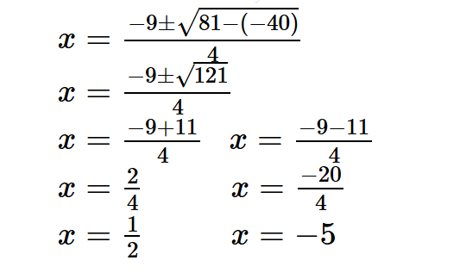
Learning Activity B | Part 3
Self Check - Review
Step 3 - Simplify the expression.
Step 4 - The result is the pair of solutions to the quadratic equation. Solve each.
Notes:
Note for instruction:
ANIMATION HAS BEEN ADDED
Have students write down their answers to steps 3 and 4 before clicking to reveal the correct answers.
How to check the answers is on the next slide.

Slide 33
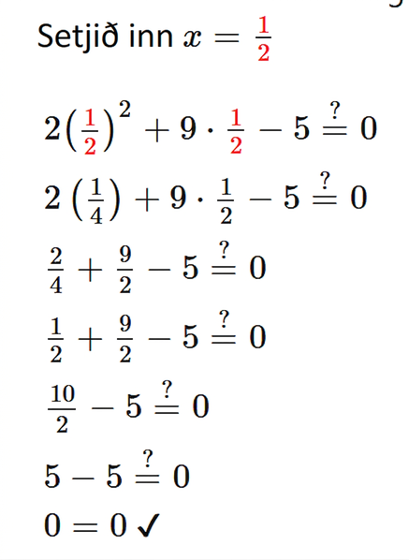
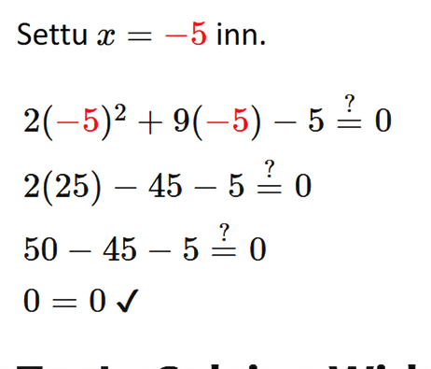
Learning Activity B | Part 4
Self Check - Review
Check the two solutions.
Substitute each answer in the original equation to check.
Notes:
Note for instruction:
Have students write down their answer to step 6 before clicking to reveal the correct answer.
There are 2 solutions, this slide will require you to click once for the first solution, then again for the second one.

Slide 34
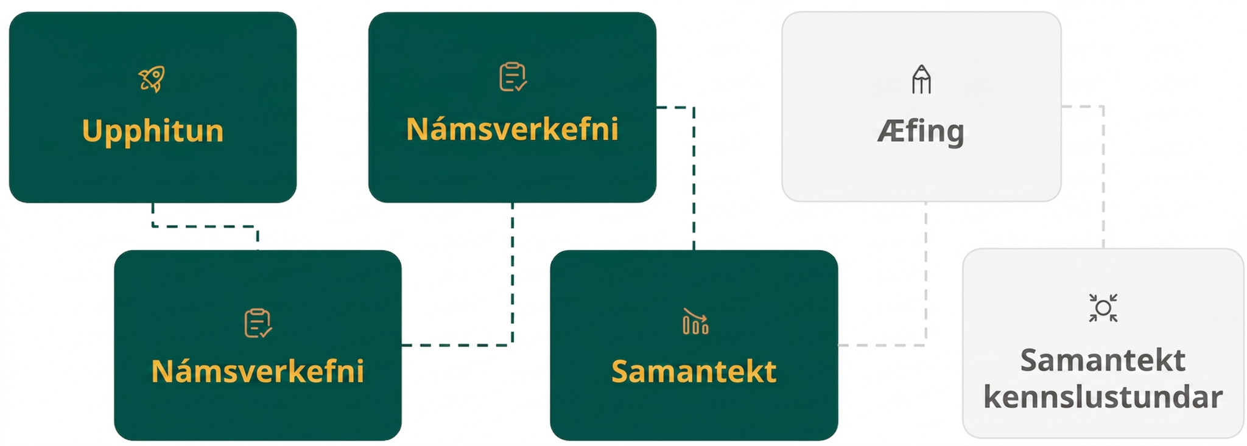
Lesson Journey
Fourth Step: Cool Down

Slide 35
Cool Down
Use the quadratic formula to solve the equation
x² + 9x + 8 = 0.
Notes:
Cool Down (5 minutes)
Launch
Ask students to put away their devices for the cool down. You may want to have students access their STAAR End of Course Formula Chart that lists the quadratic formula or, have students reference an anchor chart or word wall in the classroom.
Answer
The solutions are – 8 and – 1.
Apply the quadratic formula for a = 1, b = 9, c = 8:
x = (−9 ± √((9)² − 4(1)(8))/2(1) = (−9 ± √(49))/2, which means x = (−9 −7)/2 = −8 and x =( −9 + 7)/2 = −1.
Response to Student Thinking - More Chances
Students will have more opportunities to understand the mathematical ideas in this cool down, so there is no need to slow down or add additional work to the next lessons. Instead, use the results of this cool down to provide guidance for what to look for and emphasize over the next several lessons to support students in advancing their current understanding.

Slide 36
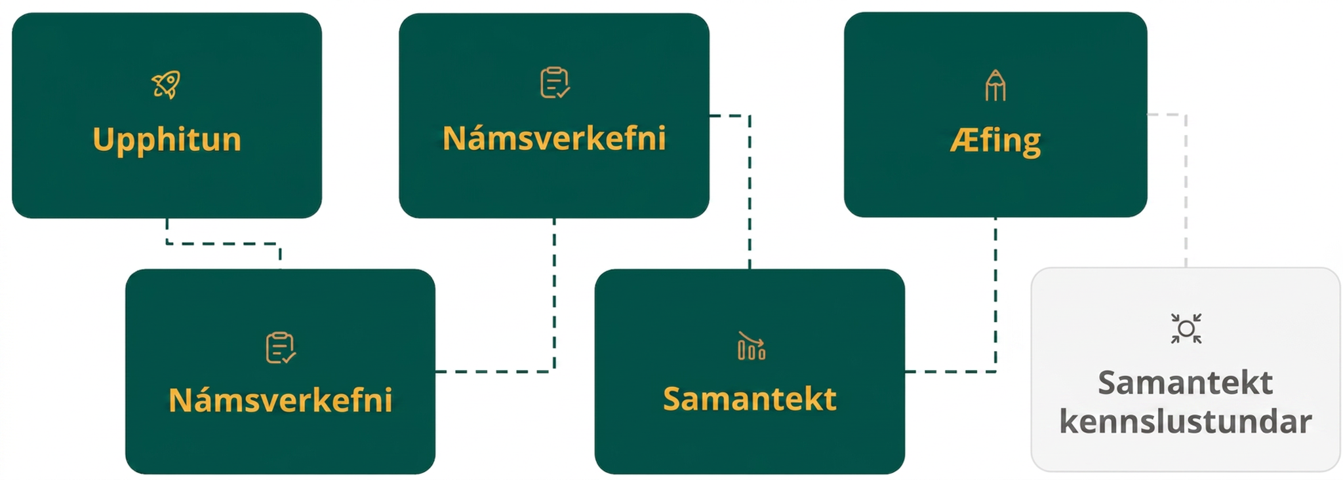
Lesson Journey
Fifth Stop: Practice

Slide 37

Practice
Put your hard work to action, practice what you’ve learned!
Notes:
Digital Practice: Access the practice pages at https://openstax.org/details/books/algebra-1

Slide 38
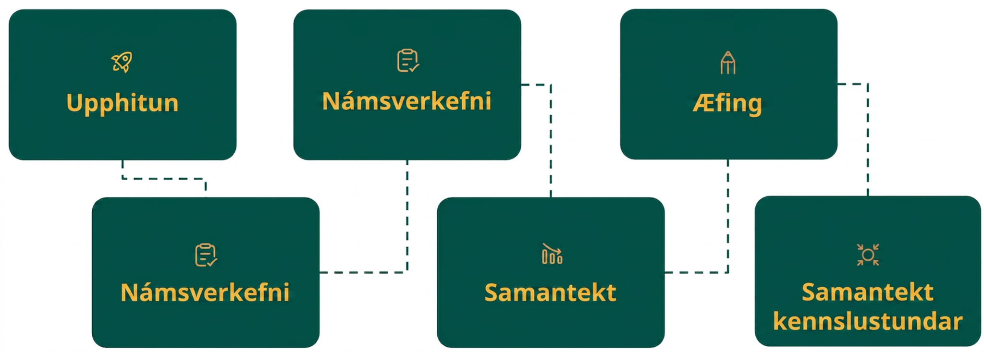
Lesson Journey
Sixth Stop: Lesson Synthesis

Slide 39

Lesson Synthesis
Consider this equation: 25x² − 50x + 16 = 0
How would you prefer to solve this equation?
Explain why you you choose that method.
Solve the equation using their preferred method.
Notes:
Answers
Answers may vary: rewriting the expression in factored form, completing the square, or using the quadratic formula
Possible explanations for the different methods:
Rewriting in factored form: The equation can be rewritten as (5x − 8)(5x − 2) = 0 and solved using the zero product property.
Completing the square: 25x² − 50x + 25 is a perfect square, so we can just add 9 to either side of the original equation and find the square root of 9.
The quadratic formula, because it always works.
⅖ and 8/5

Slide 40
Self Assessment
How much do you agree with the following statements?
Learning Goals | I can | Almost | Not yet
Use the quadratic formula to solve quadratic equations. | ⃞ | ⃞ | ⃞
Explain when some methods for solving quadratic equations can be more convenient than others. | ⃞ | ⃞ | ⃞

