Slide 1
Algebra 1
Unit 5 Introduction to Exponential Functions
Lesson 5.6 Negative Exponents and Scientific Notation

Slide 2

How to use these slides
On the activity slides check the speaker notes for teacher support and instructional information.
Each lesson includes 1 warm up, 2-3 learning activities, a cool down, practice and a lesson synthesis.
  Learning activities are followed by a self check question, and review section.
Some slides have been hidden from student view, more information can be found on the next slide (Reference Key).
You can edit and use these slides for personal and classroom use, but cannot sell them and must keep the attribution logos.
For more information, Check out the digital quick start guide!
OpenStax CC BY NC SA

Slide 3





Reference Key
Check the top right corner for an icon referencing these unique sections.
Icon | Title | View | Location and Description
n/a | Support for Students with Disability | Hidden | Learning Strategies slide, provides additional support to students for understanding the activity.
n/a | Support for English Language Learners | Hidden | Learning Strategies slide, provides additional support to students for understanding the activity.
n/a | Extending Your Thinking | Hidden | Extending Your Thinking slide, provides an extra challenge for students.
n/a | Self Check | Not Hidden | Self Check slide, checkpoint to assess student understanding after the learning activity.
n/a | Review | Hidden | Self Check - Review slide, designed to help review topics from the self check question.
On the next slides, check the speaker notes for teacher instructions and support.
Notes:
Check the Speaker Notes: On the next slides you can find discussion questions, lesson information, answers to the activities, and ways to adjust the activity for your students!

Slide 4

Learning Goals
By the end of this lesson you will be able to -
Describe the meaning of a negative exponent
in equations that represent exponential growth and decay.
Write equations that represent exponential growth and decay to solve problems.
Graph an equation that represents exponential decay to solve a problem.
Convert numbers between decimal form and scientific notation.
Use scientific notation to solve problems arising from real-world situations.
Notes:
Lesson Narrative
In this lesson, students examine the meaning of negative exponents in context. In these cases, time 𝑡 is the independent variable, and 𝑡 = 0 corresponds to a particular moment when a quantity is first measured. In these situations, a value of 𝑡 that is less than 0 corresponds to a time before the initial measurement, while a value of 𝑡 that is greater than 0 refers to a time after the measurement.
Then, students learn to convert fluently between decimal form and scientific notation. They will combine what they have learned using negative exponents to find the solution to a real-world problem in scientific notation.
Required Preparation
None
Required Materials
Graphing technology
Texas Essential Knowledge and Skills
A1(A) apply mathematics to problems arising in everyday life, society, and the workplace.
A1(E) create and use representations to organize, record, and communicate mathematical ideas.
A1(F) analyze mathematical relationships to connect and communicate mathematical ideas.
A9(C) write exponential functions in the form 𝑓(𝑥) = 𝑎 ● 𝑏^{𝑥} (where 𝑏 is a rational number) to describe problems arising from mathematical and real-world situations, including growth and decay.

Slide 5
Vocabulary
Previous
Equation
  A mathematical statement demonstrating two numbers, expressions, or other objects are equal.
New
Scientific notation
  A number that is expressed in the form:
  𝑎 × 10^{𝑛} where 1 ≤ |𝑎| < 10 and 𝑛 is an integer.
Notes:
Lesson Vocabulary
To support student understanding of key vocabulary:
Introduce and review the vocabulary words students will see in this lesson.
Encourage students to notice how these words are used and to include them in their math discussions and explanations—both written and oral.
Use a word wall to reinforce vocabulary. Sample word wall cards are available here.
For newcomers or students with beginning English proficiency, use these Quizlet sets to support vocabulary learning:
Unit 5 Spanish Vocabulary – use first to build understanding
Unit 5 Vocabulary (English) – use after anchoring in Spanish
Support for English Language Learners
ELPS 2(F) listen to and derive meaning from a variety of media such as audiotape, video, DVD, and CD-ROM to build and reinforce concept and language attainment.
ELPS 2(G) understand the general meaning, main points, and important details of spoken language ranging from situations in which topics, language, and contexts are familiar to unfamiliar.
ELPS 2(H) understand implicit ideas and information in increasingly complex spoken language commensurate with grade-level learning expectations.

Slide 6
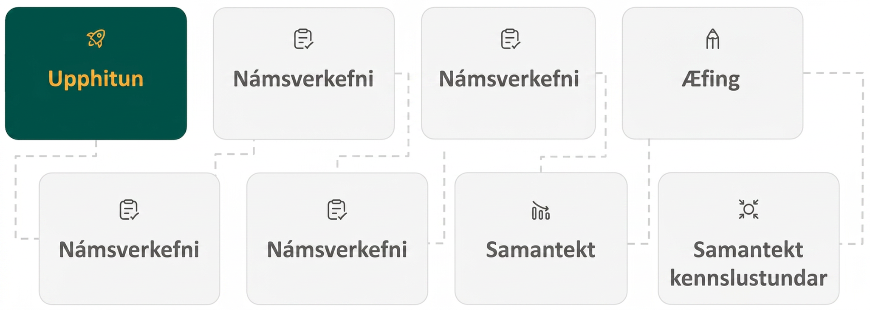
Lesson Journey
First Stop: Warm Up

Slide 7

Warm Up
Get It Together! 🙏
Rewrite each of the following using a single exponent.
2⁴ • 2⁰
2⁴ • 2^{–1}
2⁴ • 2^{–3}
2⁴ • 2^{–4}
Notes:
Warm Up (5 minutes)
This warm up prepares students to work with expressions involving negative exponents. Students have studied exponents and their properties in grade 8 and encountered negative exponents at that time. The goal here is to review the fact that for integer exponents 𝑚 and 𝑛 and a non-zero base 𝑏, this property holds: 𝑏^{𝑚} 𑇐 𝑏^{𝑛} = 𝑏^{𝑚+𝑛}.
Answers
2⁴
2³
2¹ or 2
2⁰
Activity Synthesis
Review, if needed, the conventions that 2⁰ = 1 and 2⁻¹ = ½, emphasizing that these conventions guarantee that 2^{𝑎} 𑇐 2^{𝑏} = 2^{𝑎+𝑏} for any two integers 𝑎 and 𝑏.

Slide 8
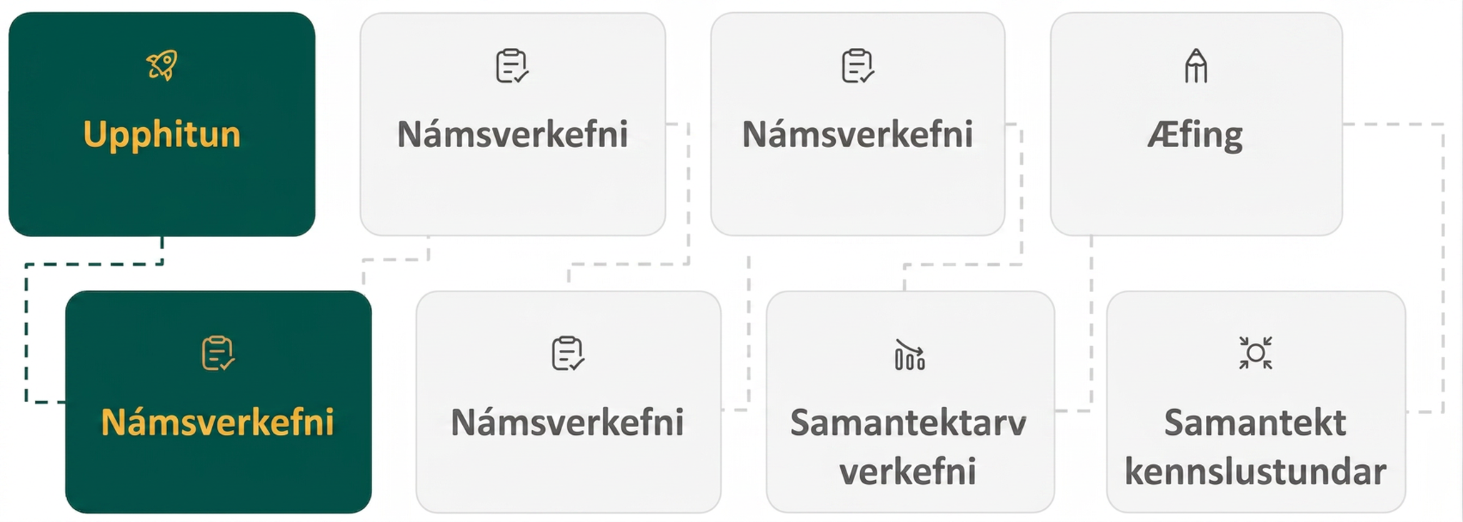
Lesson Journey
Second Stop: Learning Activity A

Slide 9

Learning Activity A | Learning Strategies
1 Fish, 2 Fish, Red Fish …
A marine biologist estimates that a structure of coral has a volume of 1,200 cubic centimeters and its volume doubles each year.”
Write your own math questions (1–2 min).
Share and notice questions about the situation.
Co-Craft Questions
Teacher Instruction: Use these strategies to adjust the activity to support English language learners and students with disabilities.
You can copy and paste the callouts directly on top of the activity or give the instructions aloud.
On a sticky note or next to the table, create a timeline.
Draw a starting point in the middle. Label that point “ZERO.”
  Label the years that come after (positive side of the line).
  Label the years that came before (negative side of the line).
Representation
Notes:
Support for English Language Learners: MLR 5 Co-Craft Questions: Reading, Conversing, Writing
To help students make sense of the language of exponential situations, start by displaying the task statement: “A marine biologist estimates that a structure of coral has a volume of 1,200 cubic centimeters and that its volume doubles each year.” Give students 1 – 2 minutes to write their own mathematical questions about the situation. Invite students to share their questions with the class, and then reveal the activity’s questions. Listen for and amplify any questions referring to the value of 𝑡, especially those wondering about time in the past. This will build student understanding and interpretation of the language used to represent negative exponents.
Design Principle(s): Maximize meta-awareness; Cultivate conversation
Learn more about this routine
View the instructional video and follow along with the materials to assist you with learning this routine.
Provide support for students
Distribute graphic organizers to the students to assist them with participating in this routine.
Support for Students with Disabilities: Representation: Internalize Comprehension
Begin the activity with concrete or familiar contexts. Encourage students to create a timeline next to their tables, selecting a starting point year for zero and then labeling the years correlated with the positive exponents prior to labeling years associated with negative exponents.
Supports accessibility for: Conceptual processing; Memory

Slide 10

Learning Activity A | Part 1
1 Fish, 2 Fish, Red Fish …
A marine biologist estimates that a
structure of coral has a volume of 1,200
cubic centimeters and that its volume
doubles each year.
Write an equation of the form y = a • b^{t} representing the relationship, where t is time in years since the coral was measured and y is volume of coral in cubic centimeters.
HINT: You need to figure out what numbers a and b are in this situation.
Notes:
Support for All Learners
This activity offers additional support for students:
For English language learners and students with disabilities, be sure to review the Learning Strategies slide!
Activity (15 minutes)
Up to this point in the unit, students have written and interpreted equations representing exponential change that were meaningful for non-negative input values. In this lesson, they interpret the meaning of a negative value in a context. The independent variable is time, 𝑡, so negative values of 𝑡 refer to times before 𝑡 is 0.
Activity narrative will continue on the next slide. Continue scrolling down for directions on how to launch this activity and the answer to the question.
Launch
Arrange students in groups of 2.
Encourage them to think quietly about the questions before discussing with their partner.
Creating a table or spreadsheet may help students organize the work in the second question. If needed, encourage students to do so.
Answer
y = 1200 𑇐 2^{t}
Additional activity questions, answers, and synthesis on the next slide.

Slide 11
Learning Activity A | Part 2
1 Fish, 2 Fish, Red Fish …
Use the equation you just found
[y = 1200 𑇐 2^{t}] to create a table to find the
volume of coral when t is 5, 1, 0, – 1, – 2.
Note that when t = –1, this represents one year before the marine biologist made the original estimate.
What does it mean, in this situation, when t is – 2?
In a certain year, the volume of the coral is 37.5 cubic centimeters. Which year is this? Be prepared to share your reasoning.
Notes:
Activity (continued)
For the last question, to find the time when the coral had the given volume, students may:
Calculate the values of 𝑦 when 𝑡 is –3, –4, –5, etc. (i.e., extend the table of values, if they previously created one) until they reach 37.5 or a value close to it.
Repeatedly divide by 2 (or multiply by ½) the value of 𝑦 when 𝑡 is –2 until it approaches or hits 37.5.
Use the equation 1,200 𑇐 2^{𝑡} = 37.5 to find the value of 2^{𝑡} and then reason about 𝑡 from there.
Look for students using these or other strategies so they can share later.
Answers
At t = 5, y = 38,400
At t = 1, y = 2,400
At t = 0, y = 1,200
At t = – 1, y = 600
At t = – 2, y = 300
This represents the time 2 years before the scientist made the estimate of 1,200 cubic centimeters.
t is –5, or 5 years before the scientist made the estimate of 1,200 cubic centimeters.
Anticipated Misconceptions
Students may struggle to think of how to start finding the values for 𝑎 and 𝑏. Suggest that they make a table of corresponding values of 𝑡 and 𝑦, and think about starting with 𝑡 and calculating 𝑦.
They may also struggle with understanding a negative value for 𝑡 referring to years. Emphasize that a value of 𝑡 = − 1 represents the time 1 year before the estimate was made. Ask what a value of 𝑡 = − 4 represents.
Activity Synthesis
Review how students found an equation, 𝑦 = 1,200 𑇐 2^{𝑡}, to represent the volume of coral. Make sure that they recall that the 1,200 represents the 1,200 cubic centimeters of coral when it was first measured, and the 2 indicates the doubling of its volume each year.
Select students to share their interpretations of negative values of 𝑡 and how they found the value of 𝑡 when given a volume. Ask questions such as:
In this situation, what does it mean to say that when 𝑡 is – 3, 𝑦 is 1,200 𑇐 2⁻³ or 150? (3 years before the coral was measured to be 1,200 cubic centimeters, its volume was 150 cubic centimeters.)
How did you estimate or find 𝑡 when the volume of the coral was 37.5 cubic centimeters?
It may be helpful to display a graph of 𝑦 = 1,200 𑇐 2^{𝑡}, such as this one in Desmos. Display the graph (either with or without the points from the table plotted) and ask students to identify the volume of coral when 𝑡 is – 3 and the time when the volume of coral is 37.5 cubic centimeters. [The graph can be accessed on the slide by clicking on the link to the word “reasoning.”]
If using the Desmos graph, consider asking students to gesture at points on the graph corresponding to questions in the activity. Then, use the cursor to trace a point on the function and observe the values of the point for demonstration.

Slide 12
Learning Activity A
Self Check
Using the equation p = 10,000 ⦁ 2^{d}, find the value of p when d = – 2.
2,500
20,000
5,000
40,000
Let’s review!
Notes:
Answer Feedback - Individualized by Response
That’s correct! The expression p = 10,000 ⦁ 2^{–2} = 2,500.
Incorrect. This is the value when d = 1. Evaluate the expression when d = – 2.
Incorrect. This is the value when d = – 1. Evaluate the expression when d = – 2.
Incorrect. This is the value when d = 2. Evaluate the expression when d = – 2.

Slide 13

Learning Activity A
Self Check - Review
A forest fire has been burning for several days. The burned area, in acres, is given by the equation y = 4,800 ⦁ 2^{d}, where d is the number of days since the area of the fire was first measured.
Complete the table.
Look at the value of y = 4,800 ⦁ 2^{d} when
d = – 1. What does it tell you about the area burned in the fire?
How much area had the fire burned a week before it measured 4,800 acres?
d, days since first measure-ment | y, acres burned since fire started
0 | 4800
–1 | 2400
–2 | ?
–3 | ?
–5 | ?
Notes:
Remind Students
Negative exponents can tell us what happened in a context BEFORE measurements began
If students struggle to understand, relate it to a rocket launch scenario when the countdown is announced, “T minus 10 seconds and counting …” implying that time (T) is at – 10 and then goes to –9, –8, etc.
Answers
At d = – 2, y = 1,200;
At d = – 3, y = 600;
At d = – 5, y = 150
The y value at d = – 1 represents the fact that 2,400 acres had burned 1 day before the first measurement was taken.
A week before the burn area measured 4,800 acres, the fire had only burned 37.5 acres.

Slide 14
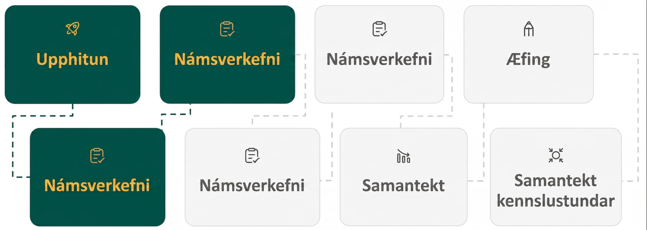
Lesson Journey
Third Stop: Learning Activity B

Slide 15
Learning Activity B | Learning Strategies
Be Safe! 🏥
Teacher Instruction: Use this strategy to adjust the activity to support students with disabilities.
  You can copy and paste the callout directly on top of the activity or give the instructions aloud.
Which tools might help you with this activity? What do you prefer using?
Graph paper, ruler?
Graphing calculator?
Desmos?
GeoGebra?
Action and Expression
Notes:
Support for Students with Disabilities: Action and Expression: Provide Access for Physical Action
Provide access to graph paper or to tools and assistive technologies, such as graphing calculators or graphing software.
Supports accessibility for: Visual-spatial processing; Conceptual processing; Organization

Slide 16
Learning Activity B | Part 1
Be Safe! 🏥
t, time (hours) | m, medicine (mg)
–3 | ?
–1 | ?
0 | 100
1 | 50
2 | 25
A person took some medicine but does not
remember how much. Concerned that she
took too much, she has a blood test every
hour for several hours.
What is the decay factor?
What is the amount of medicine in her
body when the first blood test was taken?
Find the amount of medicine in the patient’s body when t is – 1.
Find the amount of medicine in the patient’s body when t is – 3.
What does t = 0 mean in this context?
What does t = – 3 mean in this context?
Notes:
Support for All Learners
This activity offers additional support and an extension for students:
For students with disabilities, be sure to review the Learning Strategies slide!
For students looking for an extra challenge, be sure to review the Extending Your Thinking slide!
Activity (15 minutes)
In this activity, students use a description and table of values to write an equation that represents them. Then, they interpret the equation for negative values of the exponent and produce a graph. They also interpret the numbers in the equation in terms of the context.
Launch
Arrange students in groups of 2.
Encourage them to think quietly about the questions before discussing with their partner.
Provide access to graph paper or graphing technology.
Answers
The decay factor, b = ½
The value of a, when the first blood test was taken = 100.
m = 200
m = 800
t = 0 means the time when the doctor did the first blood test.
t = – 3 means three hours before the time when the doctor did the first blood test.
Additional activity questions, answers, anticipated misconceptions, and synthesis on the next slide.

Slide 17
Learning Activity B | Part 2
Be Safe! 🏥
t, time (hours) | m, medicine (mg)
–3 | ?
–1 | ?
0 | 100
1 | 50
2 | 25
The medicine was taken when t is – 5.
Assuming the person did not have
any of the medication in her body
beforehand, how much medicine did
the patient take?
Plot the points given in the table on
a coordinate plane.
Based on your graph, when do you think the patient will have –
  500 mg of medicine remaining in her body?
  1,000 mg of medicine remaining in her body?
Are you ready for more?
Notes:
Activity (continued)
For the final question, only an estimate is possible. Expect different answers that range between 2 and 3 hours before the medicine was measured because a more precise answer cannot be given right now. Look for students who use the graph and try to extend it to values between integer hours.
If students continue to use graphing technology while working on this task, they are likely to enter their equation and see a smooth curve. It is not the intention that they try to sketch a curve at this time. Draw their attention to the instructions that say to plot the points (create a scatter plot).
Answers
3,200 mg. Each hour, this is cut in half. After being halved 5 times, it leaves 100 mg, the amount of medicine in the person’s body when 𝑡 = 0.
Desmos Graph
(a) Between 2 and 3 hours before the patient first had her blood tested.
(b) Your answer may vary, but here are some samples:
Sometime after 10 hours. The amount of medicine falls below 0.1 mg after about 10 hours and might be too small to be detectable after that point.
Eventually, all of the medicine will be out of the patient’s body (but the mathematical model for the amount of medicine does not reach 0).
Anticipated Misconceptions
Students may struggle with understanding the negative time values. It may help to give clock values to the numbers. For example, the first blood test was done at 5:00 p.m. (𝑡 = 0). Ask students what 𝑡 would be when it is 6:00 p.m. and 4:00 p.m. It is important throughout this entire lesson to emphasize that time is not typically negative, but in this case is emphasizing events that happened prior to initial measurement.
Activity Synthesis
Ask students how they labeled the axes on the graph.
For the domain, it needs to include times from 3 hours before the medicine was measured to 2 hours after. (Students may also choose to include 5 hours before the first measurement.)
The vertical axis should include 0 up to at least 800 (higher if students include the value for 𝑡 = −5 in the table).
Use the last question about when there was 500 mg of medicine to begin a discussion about values between integer hours.
Elicit from students how the graph might look if we consider non-integer time values.
If students still have access to graphing technology for this activity, they can enter their equation and see the curve for themselves.
To follow up on the last question, consider discussing: How long could the decrease by half go on? Is there a point at which it is no longer practical or reasonable to use the mathematical model?

Slide 18
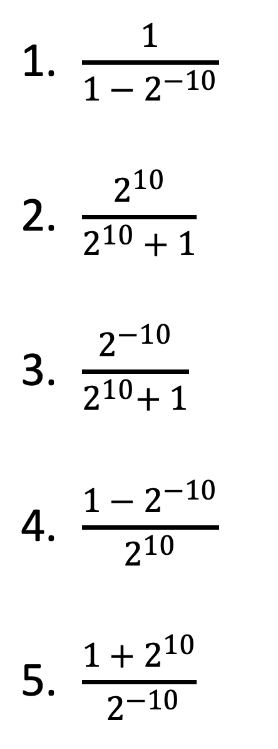

Extending Your Thinking
Without evaluating them, describe each of the given quantities as close to 0, close to 1, or much larger than 1.
Notes:
Go back to activity information.
Answers
Close to 1
Close to 1
Close to 0
Close to 0
Much larger than 1

Slide 19

Learning Activity B
Self Check
A census of hemlock trees is taken in a national park. The rangers have found that only ⅘ of the population has survived each year. The data are shown in the table. Find the number of hemlocks that were in the park 2 years before the census was taken.
156,250
125,000
80,000
100,000
y, years since census | h, no. of hemlocks
–2 | ?
0 | 64,000
1 | 51,200
3 | 32,768
Let’s review!
Notes:
Answer Feedback - Individualized by Response
Incorrect. This is the solution for 4 years before the census was taken. Find the solution 2 years before the census was taken. The equation to represent this situation is h = 64,000 (⅘ )^{y}. The solution is found by substituting –2 for 𝑦.
Incorrect. This is the solution for 3 years before the census was taken. Find the solution 2 years before the census was taken. The equation to represent this situation is h = 64,000 (⅘ )^{y}. The solution is found by substituting –2 for 𝑦.
Incorrect. This is the solution for 1 year before the census was taken. Find the solution 2 years before the census was taken. The equation to represent this situation is h = 64,000 (⅘ )^{y}. The solution is found by substituting –2 for 𝑦.
That's correct! The equation to represent this situation is h = 64,000 (⅘ )^{y}.

Slide 20
Learning Activity B
Self Check - Review
b = n ⦁ f ^{d}
A scientist records the population of a bacterial population in a petri dish.
What is the decay factor, f? And, what
is the starting population, n, on the
first day of testing?
What do d = – 1 and d = –3 mean in
this context?
How many bacteria were present
1 day before the first test?
Assume the peak of the population
was 3 days before the first test. How many bacteria were present at the
peak of the population?
d, days since first test | b, number of bacteria
–3 | ?
–1 | ?
0 | 40,000
1 | 20,000
3 | 5,000
Notes:
Remind Students
A scientist records the population of a bacterial population in a petri dish.
The number of days 𝑑 since the first test corresponds with the number of bacteria, 𝑏, estimated to be alive in the petri dish.
Answers
Since the number of bacteria found on day 0 is 40,000, then 𝑛 = 40,000. Since after each day, the number of bacteria is cut in half, then the decay factor, 𝑓, is 12. The equation to represent this situation is 𝑏 = 40,000 ⋅ (12)^{𝑑}.
Since the day the first test is taken is defined as 𝑑 = 0, then days with a negative value occurred before the first test. 𝑑 = −1 means 1 day before the scientist did the first test. 𝑑 = −3 means 3 days before the scientist did the first test.
Substitute –1 for d in the equation b = 40,000 (½ )^{d}. After simplifying, the equation, b = 80,000 (all work can be accessed in the online textbook). There were 80,000 bacteria in the petri dish 1 day before the test.
Substitute –3 for d in the equation b = 40,000 (½ )^{d}. After simplifying, the equation, b = 320,000 (all work can be accessed in the online textbook). There were 320,000 bacteria in the petri dish 3 days before the test.

Slide 21
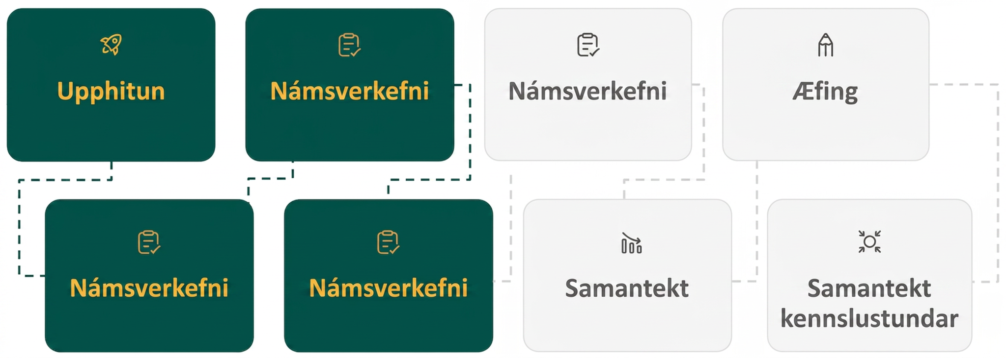
Lesson Journey
Fourth Stop: Learning Activity C

Slide 22
Learning Activity C | Part 1
Going Back and Forth 👈 👉 👈 👉 👈 👉
How would you write each of the following numbers in scientific notation?
Decimal form | Scientific notation
0.00000654 | ?
0.0000947 | ?
683,000 | ?
0.022 | ?
5,200 | ?
0.000352 | ?
Notes:
Activity (optional activity)
Launch
Allow students to work in partners.
Watch for students who struggle with identifying the correct location in which to place the decimal.
Listen for students who simply count the number of zeros instead of counting the place values that have “changed.”
Also, students may struggle to determine if the exponent on the power of 10 should be positive or negative. Encourage student groups to use peer teaching to help each other understand this key concept associated with scientific notation.
Answers
6.54 × 10^{–6}
9.47 × 10^{–5}
6.83 × 10⁵
2.2 × 10^{–2}
5.2 × 10³
3.52 × 10^{–4}
Additional activity questions, answers, anticipated misconceptions, and synthesis on the next slide.

Slide 23
Learning Activity C | Part 2
Going Back and Forth 👈 👉 👈 👉 👈 👉
How would you write each of the following scientific notation values in decimal form?
Scientific notation | Decimal form
7.26 × 10^{–4} | ?
3.32 × 10^{–2} | ?
9.4 × 10⁶ | ?
8.87 × 10^{–1} | ?
6.395 × 10⁴ | ?
4.0 × 10^{–3} | ?
Notes:
Answers
0.000726
0.0332
9,400,000
0.887
63,950
0.004
Anticipated Misconceptions
As mentioned, students may struggle to determine if the exponent on the power of 10 should be positive or negative when converting from decimal form to scientific notation. Have students place the decimal in the coefficient (first part of the number) and then determine the numeric value of the exponent. Then, have them consider what must happen to the number when it is changed back FROM scientific notation into decimal form.
If the number must return to a very small decimal, then the value is being divided or multiplied by values of 10 that make the number smaller. The exponent will need to be negative to create small factors of 10 to achieve that result.
If the number must return to a very large decimal, then the value is being multiplied by values of 10 that make the number larger. The exponent will need to be positive to create big factors of 10 to achieve that result.
Activity Synthesis
Ask students to work in pairs to develop a flowchart or list of steps that summarize the steps they take to convert between different forms.

Slide 24
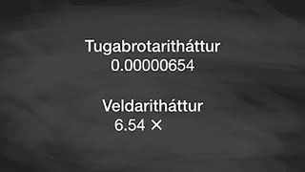
Learning Activity C | Video
Converting between Scientific Notation and Decimal Form
Notes:
This video discusses question 1 of activity 5.6.4.

Slide 25
Learning Activity C
Self Check
Which of the following equations is true?
7.64 × 10³ = 76,400
9.11 × 10⁵ = 91,100
8.5 × 10^{–4} = 0.00085
2.36 × 10^{–5} = 0.00000236
Let’s review!
Notes:
Answer Feedback - Individualized by Response
Incorrect. Multiplying by 10³ means multiplying by 1,000. 7.64 × 1,000 = 7,640.
Incorrect. Multiplying by 10⁵ means multiplying by 100,000. 9.11 × 100,000 = 911,000.
That's correct! Multiplying by 10^{–4} means dividing by 10,000. The values are equivalent.
Incorrect. Multiplying by 10^{–5} means dividing by 100,000. 2.36 × 10^{–5} = 0.0000236.

Slide 26
Learning Activity C
Self Check - Review
CONVERTING TO SCIENTIFIC NOTATION
Step 1 - Move the decimal point so the first factor is greater than or equal to 1 but less than 10.
Step 2 - Count the number of decimal places, n, that the decimal point was moved.
Step 3 - Write the number as a product with a power of 10. If the original number is –
Greater than 1, the power of 10 will be 10^{n}
Between 0 and 1, the power of 10 will be 10^{–n}
CONVERTING FROM SCIENTIFIC NOTATION
Step 1 - Determine the exponent, n, on the factor of 10.
Step 2 - Move the decimal n places, adding zeros if needed.
If the exponent is positive, move the decimal point n places to the right
If the exponent is negative, move the decimal point n places to the left.
Example: Write 37,000 in scientific notation.
Example: Write 6.2 × 10³ in decimal form.
Notes:
Remind Students
A number in scientific notation has two parts:
The first factor is a number greater than or equal to 1 but less than 10
The second factor is a power of 10 written in exponential form
a × 10^{n} where 1 < |a| < 10 and n is an integer
It is customary to use as the × multiplication sign even though we avoid its use elsewhere in algebra.
Answers
3.7 × 10⁴ (the decimal was moved 4 places and since the original number was greater than 1, n will be positive)
6,200 (n = 3, and since the n is positive we move the decimal point 3 places to the right)

Slide 27
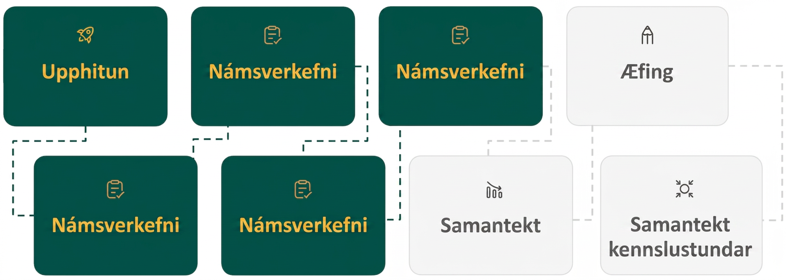
Lesson Journey
Fifth Stop: Learning Activity D

Slide 28
Learning Activity D | Part 1
Putting Things In Order
Park | Bird population
Shady Elm | 7.0 × 10³
Westcott Park | 105,000
Brighton Park | 4.5 × 10²
Red Elk | 22,300
Bear Park | 1.1 × 10⁵
Daniels Park | 3,300
Blue Spruce | 1.25 × 10⁴
Yellow Jay Park | 2.25 × 10⁴
A biologist receives bird population estimates for different parks. The estimates are shown in the table. Work with your partner to arrange these estimates in order from least to greatest.
Notes:
Activity (optional activity)
Launch
Allow students to work in partners.
Use the learning strategy of productive failure by allowing partners to organize the lists on their own first. Do not provide hints or suggestions. You may want to ask clarifying questions such as:
Why did you think this part had more birds than this park?
What about this number makes you think it is larger/smaller than this number?
Do you have a process for how you are working through this task?
Select three groups to share their thinking and sequence the order in which they will share - making sure the order allows the content to build upon the information provided from each group. For instance,
Group one might say, I know Daniels Park is smaller than Westcott Park because I know that the number 3,300 is less than 105,000.
Group two might say, I compared all the scientific notation numbers and compared the exponents - so Brighton Park only has an exponent of 2 and Bear Park has an exponent of 5, so Bear Park has a bigger population of birds.
Group three might share their process. (Converting all of the numbers into decimal format; Using an understanding of place values to semi-change the numbers to scientific notation - Daniels Park would be 10³, Westcott is 10⁵, Red Elk is 10⁴ - then just comparing the first values, etc.)
Answer
Brighton Park, 4.5 × 10²
Daniels Park, 3,300
Shady Elm, 7.5 × 10³
Blue Spruce, 1.25 × 10⁴
Red Elk, 22,300
Yellow Jay Park, 2.25 × 10⁴
Westcott Park, 105,000
Bear Park, 1.1 × 10⁵
Additional activity questions and answers on the next slide.

Slide 29
Learning Activity D | Part 2
Putting Things In Order
Enrico weighs the small objects shown for a science project. Work with your partner to arrange these weights in order from
heaviest to lightest.
What do you notice when comparing numbers in scientific notation with different negative exponents?
Object | Weight (lb)
Grain of sand | 1.4 × 10^{–4}
Grain of pollen | 0.00001014
1 drop of water | 0.00011
A feather | 1.8 × 10^{–5}
1 kernel of corn | 1.1 × 10^{–3}
House fly | 3.08 × 10^{–5}
Notes:
Answers
one kernel of corn, 1.1 × 10⁻³
grain of sand, 1.4 × 10⁻⁴
one drop of water, 0.00011
house fly, 3.08 × 10⁻⁵
a feather, 1.8 × 10⁻⁵
grain of pollen, 0.00001014
If both exponents are negative, then the number with the smaller absolute value exponent is the larger number. For example, the number with the exponent – 3 is larger than the number with the exponent – 4.

Slide 30
Learning Activity D
Self Check
Which of the numbers shown is the greatest?
0.0065
7.2 × 10^{–3}
0.00084
9.6 × 10^{–5}
Let’s review!
Notes:
Answer Feedback - Individualized by Response
Incorrect. Compare the numbers in the same form. 0.0065 is equivalent to 6.5 × 10^{–3}. This is not the greatest number.
That’s correct! The number 7.2 × 10^{–3} is the largest value. It is equivalent to 0.0072.
Incorrect. Compare the numbers in the same form. 0.00084 is equivalent to 8.4 × 10^{–4}. 10^{–4} is less than 10^{–3}.
Incorrect. 10^{–5} is less than 10^{–4}. 9.6 × 10^{–5} is equivalent to 0.000096.

Slide 31
Learning Activity D
Self Check - Review
Specimen | Length (m)
A | 7.0 × 10^{–3}
B | 0.0000847
C | 0.00022
D | 1.8 × 10^{–4}
E | 8.92 × 10^{–3}
F | 6.03 × 10^{–2}
The specimens in the table are measured lengths of different tiny animals.
Arrange them in order from shortest to longest.
Notes:
Remind students -
Some real-world problems involving scientific notation require measurements to be compared.
If needed, provide the hint: Try converting all of the measurements to decimal form and then comparing them.
Answers
Specimen A = 0.007
Specimen B = 0.0000847
Specimen C = 0.00022
Specimen D = 0.00018
Specimen E = 0.00892
Specimen F = 0.0603
That means from shortest to longest are: B, D, C, A, E, F
Have students convert each length into scientific notation to check their answer and look for patterns.
Specimen A = 7.0 × 10^{–3}
Specimen B = 8.47 × 10^{–5}
Specimen C = 2.2 × 10^{–4}
Specimen D = 1.8 × 10^{–4}
Specimen E = 8.92 × 10^{–3}
Specimen F = 6.03 × 10^{–2}
The negative exponent with the largest absolute value represents the smallest number, so B is the shortest length.
The negative exponent with the smallest absolute value represents the largest number, so F is the longest length.
When the exponents are equal, compare the decimal part of the number.
The order B, D, C, A, E, F is correct from shortest to longest length.

Slide 32
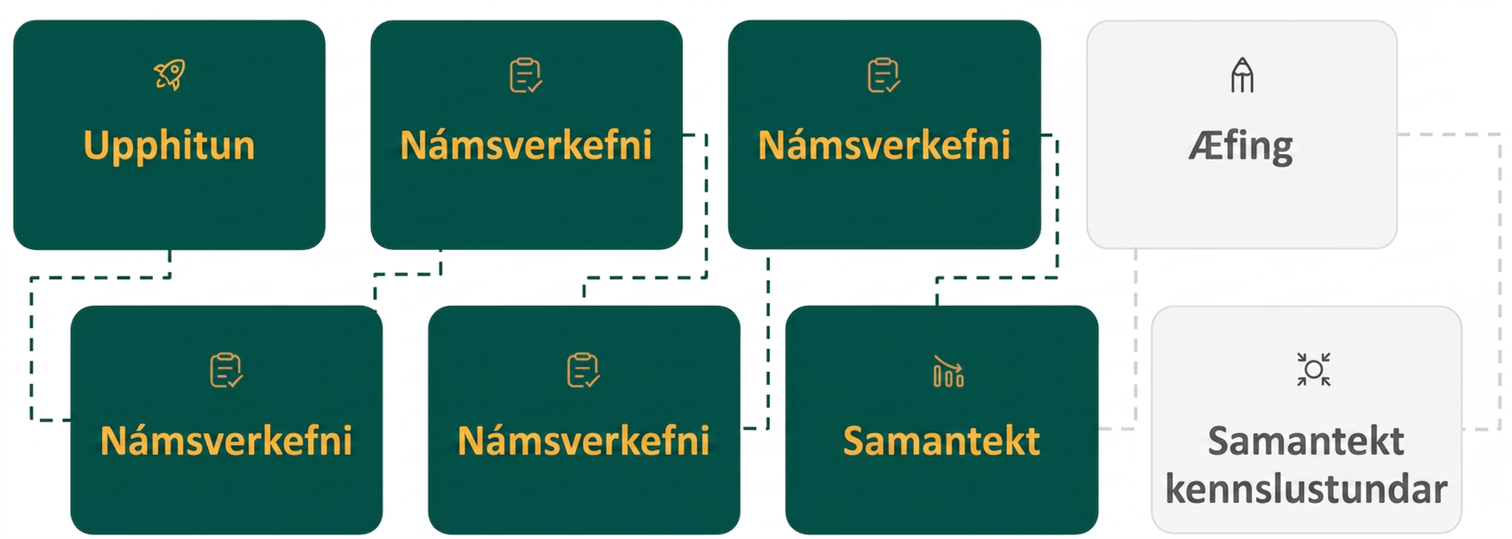
Lesson Journey
Sixth Step: Cool Down

Slide 33
Cool Down
The equation p = 5,000 • 2^{t} represents the population of an invasive fish species in a large lake, t years since 2005, when the fish population in the lake was first surveyed.
What was the population in 2005?
What is this value of the population in 2005 in scientific notation?
For this model, what does it mean when t is – 2?
For t = –2, is the fish population more or less than 1,000? How do you know?
Write the value of the fish population when t = – 2 in scientific notation.
Notes:
Cool Down (5 minutes)
Answers
5,000, because 5,000 • 2⁰ = 5,000.
5.0 × 10³
It means 2 years before 2005, which is 2003.
More than 1,000. For t = –2 yields 5,000 • 2^{–2} = 1,250.
1.25 × 10³
Response to Student Thinking - Points to Emphasize
If students struggle to interpret negative exponents, use student work from this cool down to guide a brief discussion on the topic in a subsequent lesson.

Slide 34
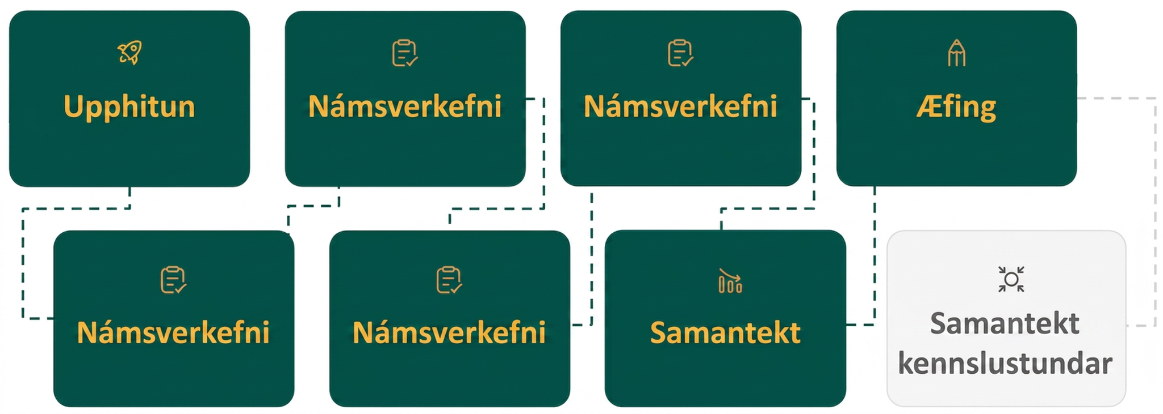
Lesson Journey
Seventh Stop: Practice

Slide 35

Practice
Put your hard work to action, practice what you’ve learned!
Notes:
Digital Practice: Access the practice pages at https://openstax.org/details/books/algebra-1

Slide 36
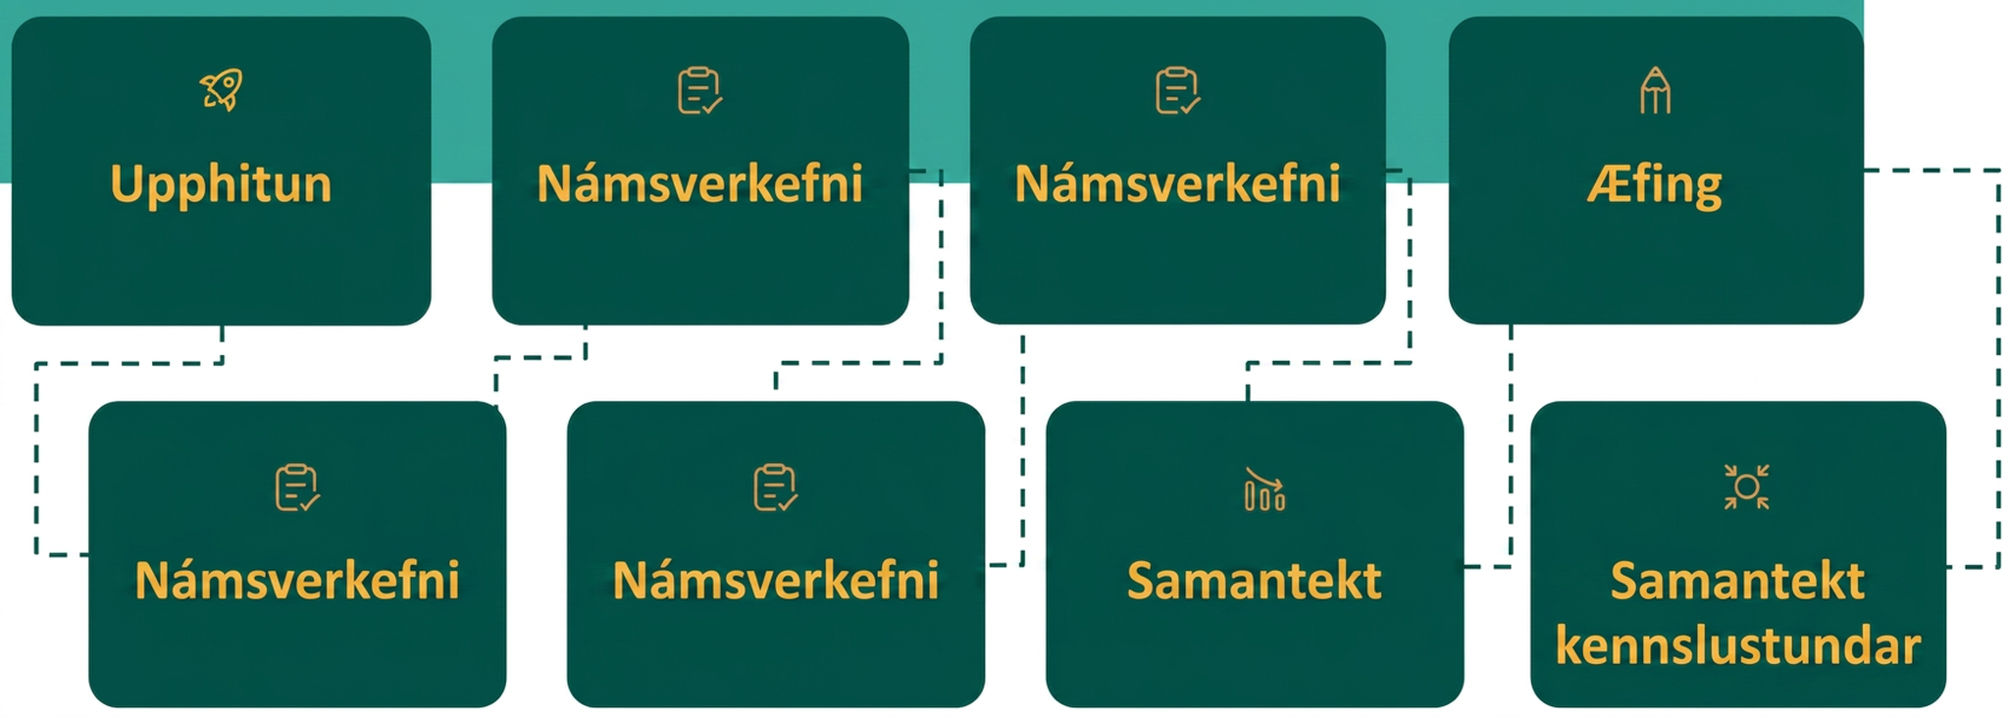
Lesson Journey
Eighth Stop: Lesson Synthesis

Slide 37
Lesson Synthesis
Describe some situations where negative exponent values are meaningful.
Provide an example for why it is important to choose appropriate/accurate labels, intervals, and scale values for the axes when graphing data.
Explain how to compare values written in scientific notation.
Notes:
In this lesson, students used data from a table to construct equations representing exponential growth and decay. They used these equations to answer questions given the context of the situation.
To help students, review the following points:
We looked at some situations where negative values (exponents) representing units of times are meaningful. In those cases, a value of –1 might represent 1 year before a particular time when an estimate or census occurred.
Choosing the appropriate labels and tick marks on the axes is important for correctly displaying a graph. Make sure you select intervals that can help differentiate among points but still allow for the display of every point in the data.
When trying to compare values that are in decimal form and scientific notation, first convert all the values into one form or the other.
Values written in scientific notation can be used to solve problems in context just like values in decimal form.

Slide 38
Self Assessment
How much do you agree with the following statements?
Learning Goals | I can | Almost | Not yet
Describe the meaning of a negative exponent in equations that represent exponential growth and decay. | ⃞ | ⃞ | ⃞
Write equations that represent exponential growth and decay to solve problems. | ⃞ | ⃞ | ⃞
Graph an equation that represents exponential decay to solve a problem. | ⃞ | ⃞ | ⃞
Convert numbers between decimal form and scientific notation. | ⃞ | ⃞ | ⃞
Use scientific notation to solve problems arising from real-world situations. | ⃞ | ⃞ | ⃞

