Slide 1
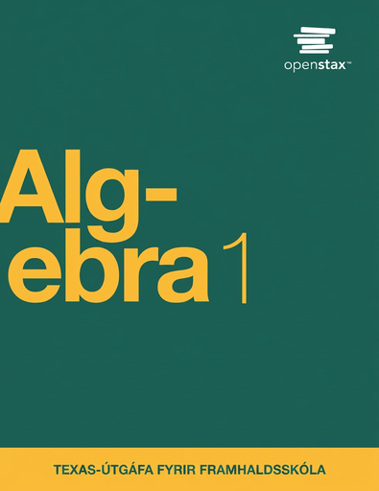

Algebra 1
Unit 7 Introduction to Quadratic Functions
Lesson 7.8 Equivalent Quadratic Expressions
Notes:
How to Get Started
Review Slide 2: How to use these slides
Check out the digital quick start guide!
Review Slide 3: Reference Key of Icons

Slide 2
How to use these slides
On the activity slides check the speaker notes for teacher support and instructional information.
Each lesson includes 1 warm up, 2-3 learning activities, a cool down, practice and a lesson synthesis.
  Learning activities are followed by a self check question, and review section.
Some slides have been hidden from student view, more information can be found on the next slide (Reference Key).
You can edit and use these slides for personal and classroom use, but cannot sell them and must keep the attribution logos.
For more information, Check out the digital quick start guide!

Slide 3






Reference Key
Check the top right corner for an icon referencing these unique sections.
 | Support for Students with Disability | Hidden | Learning Strategies slide, provides additional support to students for understanding the activity. Learning Strategies slide, provides additional support to students for understanding the activity.
 | Support for English Language Learners | Hidden
 | Extending Your Thinking | Hidden | Extending Your Thinking slide, provides an extra challenge for students.
 | Self Check | Not Hidden | Self Check slide, checkpoint to assess student understanding after the learning activity.
 | Review | Hidden | Self Check- Review slide, designed to help review topics from the self check question.
On the next slides, check the speaker notes for teacher instructions and support.
Notes:
Check the Speaker Notes: On the next slides you can find discussion questions, lesson information, answers to the activities, and ways to adjust the activity for your students!

Slide 4

Learning Goals
By the end of this lesson you will be able to -
Rewrite quadratic expressions in different forms by using an area diagram or the distributive property.
Notes:
Lesson Narrative
Students have explored many situations modeled by quadratic functions and are now moving from concrete contexts to more abstract reasoning.
In this lesson, they use area diagrams—viewing expressions like (x + 4)(x + 7) as rectangles with side lengths split into x and constants, to expand expressions such as x² + 11x+ 28. They see that adding the partial areas is the same as applying the distributive property.
This prepares students to later use diagrams more abstractly and to learn the formal terms standard form and factored form in upcoming lessons.
Required Preparation
None
Required Materials
None
Texas Essential Knowledge and Skills
A1(C) select tools, including real objects, manipulatives, paper and pencil, and technology as appropriate, and techniques, including mental math, estimation, and number sense as appropriate, to solve problems
A10(B) multiply polynomials of degree one and degree two

Slide 5
Vocabulary
Previous
Expression
  The sum of products of numbers and variables. The variables can be raised to different powers.
Factor
  If 𝑎 · b = m then 𝑎 and b. These are the values or expressions that multiply to be a specific product.
Distributive Property
  A property indicating a special way in which multiplication is applied to addition of two or more numbers in which each term inside a set of parentheses can be multiplied by a factor outside the parentheses, such as 𝑎(𝑏 + 𝑐) = 𝑎𝑏 + 𝑎𝑐.
New
None
Notes:
Lesson Vocabulary
To support student understanding of key vocabulary:
Introduce and review the vocabulary words students will see in this lesson.
Encourage students to notice how these words are used and to include them in their math discussions and explanations—both written and oral.
Use a word wall to reinforce vocabulary. Sample word wall cards are available here.
For newcomers or students with beginning English proficiency, use these Quizlet sets to support vocabulary learning:
Unit 7 Spanish Vocabulary – use first to build understanding
Unit 7 Vocabulary (English) – use after anchoring in Spanish
Support for English Language Learners
ELPS 2(F) listen to and derive meaning from a variety of media such as audiotape, video, DVD, and CD-ROM to build and reinforce concept and language attainment
ELPS 3(E) share information in cooperative learning interactions
ELPS 5(B) write using newly acquired basic vocabulary and content-based grade-level vocabulary

Slide 6





Lesson Journey
Warm Up
Learning Activity
Practice
Learning Activity
Cool Down
Lesson Synthesis

Slide 7
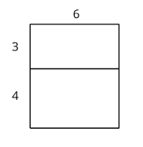
Warm Up - Area Diagrams ⏹️
Explain why the diagram shows that 6(3 + 4) = 6 ⋅ 3 + 6 ⋅ 4.
Draw a diagram to show that 5(x + 2) = 5x + 10.
Notes:
Warm Up (5 minutes)
In this activity, students recall that an area diagram can be used to illustrate multiplication of a number and a sum. This work prepares them to use diagrams to reason about the product of two sums that are variable expressions.s.
Launch
Arrange students in groups of two.
Give students quiet work time and then time to share their work with a partner.
Activity Answers
The entire diagram represents the product 6(3 + 4). The upper half represents 6 ⋅ 3 while the lower half represents 6 ⋅ 4.
Diagrams will vary, but should show a large rectangle with two sub-rectangles, with one sub-rectangle representing 5 ⋅ x, and the other representing 5 ⋅ 2. For example:
5
+-------+
| |
x | |
+-------+
2 | |
+-------+
Activity Synthesis
Make sure students understand that the expressions 6 ⋅ 3 + 6 ⋅ 4 and 6(3 + 4) are two ways of representing the area of the same rectangle.
One expression treats the area of the largest rectangle as a sum of the areas of the two smaller rectangles that are 6 by 3 and 6 by 4.
The other expression describes the area of the largest rectangle as a product of its two side lengths, which are 6 and the sum of 3 and 4.
We can reason about 5(x + 2) and 5x + 10 the same way. 5(x + 2) can represent the area of a large rectangle that is 5 by x + 2, and 5x + 10 can represent the area of a large rectangle composed of two smaller ones whose areas are 5x and 5 ⋅ 2 or 10. When we express 5(x + 2) as 5x + 10, we are applying the distributive property.

Slide 8

Lesson Journey
Warm Up
Learning Activity
Practice
Learning Activity
Cool Down
Lesson Synthesis

Slide 9
Learning Strategies - Using Diagrams with Algebraic Expressions 🔢
What is incorrect about this reasoning in the statement your teacher showed you?
What should happen when 3a is multiplied by (a + 2) explain why the product should include a square term?
Show the correct steps and the correct product.
Share your explanation with a partner or small group.
Clarify, Critique, Correct
Teacher Instruction: Use these strategies to adjust the activity to support English language learners and students with disabilities.
  You can copy and paste the callouts directly on top of the activity or give the instructions aloud.
How diagrams can show math ideas?
Choose a diagram to represent your thinking.
Label and complete your diagram as you work.
Representation
Notes:
Support for English Language Learners: MLR3 Clarify, Critique, Correct: Reading, Writing, Speaking
Before students share their responses, display the following incorrect statement: “I know that 3a(a + 2) equals 3a² + 6a because I have to distribute to multiply the 3a.” Invite students to identify the error, critique the reasoning, and write a correct explanation. Invite one to two students to share their critiques and corrected explanations with the class. Listen for and amplify the language students use to describe what should happen when (a + 2) is multiplied by 3a and explain why the product should include a square term. This will help students understand how to write equivalent quadratic expressions using the distributive property.
Design Principle(s): Optimize output (for explanation); Maximize meta-awareness
Learn more about this routine
View the instructional video and follow along with the materials to assist you with learning this routine.
Provide support for students
Distribute graphic organizers to the students to assist them with participating in this routine.
Support for Students with Disabilities: Representation: Internalize Comprehension
Activate or supply background knowledge. Some students may benefit from additional support to learn how to draw appropriate diagrams. Consider providing access to some blank, or partially completed diagrams to start with.
Supports accessibility for: Visual-spatial processing; Organization

Slide 10
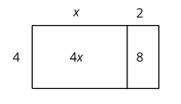
Learning Activity - Using Diagrams with Algebraic Expressions 🔢
Applying the distributive property to multiply out the factors of, or expand, 4(x + 2) gives us 4x + 8, so we know the two expressions are equivalent. We can use a rectangle with side lengths (x + 2) and 4 to illustrate the multiplication.
Draw a diagram to show that n(2n + 5) and 2n² + 5n are equivalent expressions.
For each expression, use the distributive property to write an equivalent expression. If you get stuck, consider drawing a diagram.
  6(⅓ n + 2)
  p(4p + 9)
  5r(r + ⅗)
  (0.5w +7)w
Notes:
Support for All Learners
This activity offers additional support for students:
For English language learners and students with disabilities, be sure to review the Learning Strategies slide!
Activity (10 minutes)
This activity builds on students' prior knowledge of writing equivalent expressions. They expand the product of a number (or a variable) and a sum by drawing diagrams and applying the distributive property. Unlike the work in earlier grades, however, some of the resulting expressions are quadratic expressions. The visual and algebraic reasoning here builds toward the next activity, where they will expand expressions containing two sums.
Launch
Remind students that multiplying out the factors in an expression like 5(x+2) and writing it as 5x+10 is often called expanding an expression.
Answers
2n 5
+--------+------+
n | 2n² | 5n |
+--------+------+
2n + 12
4p² + 9p
5r² + 3r
0.5w² + 7w
Activity Synthesis
Share your diagrams and explanations.
Notice how each part of the diagram matches parts of the expression.
The distributive property lets us write equivalent expressions without drawing diagrams.
It also works when a factor has more than two terms (e.g., 3𝑥(2 + 𝑥 + 4y) ).
Use algebra tiles if you need help visualizing the model.

Slide 11
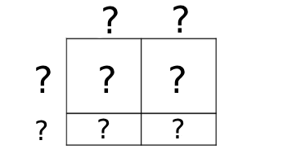
Self Check
Which expression is equivalent to 4t(t − ¾)?
4t² - 3
4t² - ¾t
4t² - 3t
4t² - ¾
Let’s review!
Notes:
Answer Feedback - Individualized by Response
Incorrect. Be sure to multiply both terms by 4t, not just 4.
Incorrect. When 4t is multiplied by ¾ , the result is 3t.
That’s correct! Multiply 4t by t, then multiply 4t by -3.
Incorrect. Multiply each term by 4t.

Slide 12
Self Check - Review
Distributive Property
If a, b, c are real numbers, then: a(b + c) = ab + ac
Other forms:
a(b − c) = ab − ac
(b + c)a = ba + ca
Simplify the expressions.
3(x + 4)
m(7 - 2m)
5x(x - ⅖)
Notes:
Distributive Property
Remind students:
Step 1: Distribute
Step 2: Multiply the terms
Step 3: Simplify
Answers
3x + 12
7m − 2m²
5x² − 2x

Slide 13
Lesson Journey
Warm Up
Learning Activity
Practice
Learning Activity
Cool Down
Lesson Synthesis

Slide 14
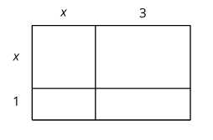
Learning Activity - Use Diagrams to Transform Expressions🐦‍🔥
Here is a diagram of a rectangle with side lengths x + 1 and x + 3. Use this diagram to show that (x + 1)(x + 3) and x² + 4x + 3 are equivalent expressions.
Draw diagrams to help you write an equivalent expression for each of the following:
  (x + 5)²
  2x(x + 4)
  (2x + 1)(x + 3)
  (x + m)(x + n)
Write an equivalent expression for each expression without drawing a diagram. Use the distributive property to help. Remember FOIL for multiplying binomials: Multiply the First terms, the Outer terms, the Inner terms, and the Last terms.
  (x + 2)(x + 6)
  (x + 5)(2x + 10)
Are you ready for more?
Notes:
Support for All Learners
This activity offers an extension for students:
For students looking for an extra challenge, be sure to review the Extending Your Thinking slide!
Activity (20 minutes)
Students connect quadratic expressions written as products and as sums. Using rectangular area diagrams, they see how a product can be rewritten as a sum. This helps them notice structure and recognize equivalent quadratic expressions.
Launch
Give students quiet think time to find an equivalent expression for (10 + 2)(10 + a).
Invite a few to share strategies, such as:
Drawing a rectangle, partitioning, and adding partial areas.
Rewriting 10 + 2 as 12, then using 12(10 + a) → 120 + 12a.
Distributing each term: 100 + 10a + 20 + 2a = 120 + 12a.
Explain that these strategies also work for multiplying two sums with variables, like (x + 1)(x + 3).
Have students discuss reasoning with a partner.
Pause after the second question to connect diagram areas to expressions.
Highlight how recognizing this structure helps them expand expressions without diagrams.
Answers
x 3
+-------+-------+
x | x² | 3x |
+-------+-------+
1 | x | 3 |
+-------+-------+
x ⋅ x = x²
1 ⋅ x = x
x ⋅ 3 = 3x
1 ⋅ 3 = 3
Adding these together gives x² + 4x + 3.
The diagram should show partial products that add up to x² + 10x + 25.
The diagram should show partial products that add up to 2x² + 8x.
The diagram should show partial products that add up to 2x² + 7x + 3.
The diagram should show partial products that add up to x² + xn + mx + xn or x² + (m + n) x + mn.
x² + 8x + 12
2x² + 20x + 50
Anticipated Misconceptions
Some students may be unfamiliar with decomposing a rectangular diagram into sub-rectangles, especially when the side lengths represent variable expressions like 2x + 1 and x + 3. They may benefit from seeing an example involving only numbers. Show that to reason about 21 ⋅ 13, we can draw a rectangular diagram with side lengths 20 + 1 and 10 + 3, decompose the rectangle to separate the tens and ones on each side, compute the four partial areas separately, and then find the sum of those partial areas.
Some students may write (x + 5)² as (x² + 5²). Remind them that (x + 5)² = (x + 5)(x + 5).
Activity Synthesis
Select students to share diagrams and explain how they used them to write equivalent expressions without diagrams.
Ask guiding questions:
For (x + 2)(x + 6): Which terms do we multiply first? Does order matter? (No—each term in one factor multiplies each term in the other.)
Remind students that drawing arrows can help keep track of the distributions (see example on the slide).
Is x² + 6x + 2x +12 equivalent to (x + 2)(x + 6)? (Yes; simplify to x² + 8x + 12.)
How are all expanded expressions alike? (Each has x², x-term(s), and a constant.)
How are they different? (Coefficients and constants vary.)
For (x + 88)(x + 22): How do we find the middle term? ((88 + 22)x.)
Does it matter which side shows (x + 2)? (No, both diagrams represent the same area and expression.)

Slide 15
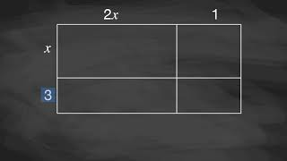
Video: Using Diagrams to Find Equivalent Quadratic Expressions

Slide 16

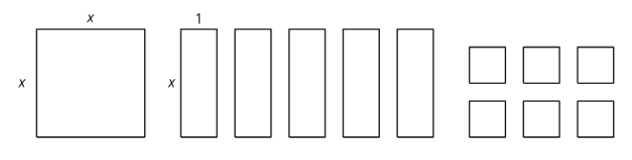
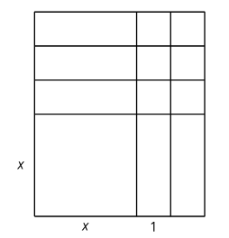
Extending Your Thinking
Image 1
Image 2
Are the images equivalent? Explain or show your reasoning.
What does this tell you about an equivalent expression for x² + 5x + 6?
Is there a different non-zero number of 1-by-1 squares that we could use instead that would allow us to arrange the combined figures into a single large rectangle?
Notes:
Answer
Yes, because x ⋅ x + 5(1x) + 6(1) = (x + 2)(x + 3).
This shows that an equivalent expression is (x + 2)(x + 3).
We could use four 1-by-1 squares. This would give the expression x² + 5x + 4. The rectangle would be (x + 4)(x + 1).
The image would be the same as Image 2 with one more row added on top. (4 rows above the x by x and 1 squares.)
Go back to activity information.

Slide 17
Self Check
Which expression is equivalent to (x + 2) (x + 4)?
x² + 4x
x² + 6x + 8
7x² + 8
x² + 2x + 8
Let’s review!
Notes:
Answer Feedback - Individualized by Response
Incorrect. Be sure to distribute the 2 in (x + 2) to the (x + 4).
That’s correct! Multiply the x times the (x + 4), then multiply the 2 by (x + 4).
Incorrect. Like terms are combined with addition, not multiplication.
Incorrect. The x in (x + 2) must also be multiplied by the 4 in (x + 4).

Slide 18
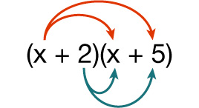
Self Check - Review
Answer the questions to help write an expression equivalent to (x + 2)(x + 5).
The first step is to distribute using the FOIL method. What do each of the letters of F O I L mean?
Write out the four terms.
Combine like terms and write the expression.
Notes:
Multiplying Binomials
Answers
First terms, Outer terms, Inner terms, and Last terms.
x² + 5x + 2x + 10
x² + 7x + 10

Slide 19

Lesson Journey
Warm Up
Learning Activity
Practice
Learning Activity
Cool Down
Lesson Synthesis

Slide 20
Cool Down
Draw a diagram to show that (3x + 1)(x + 2) is equivalent to 3x² + 7x +2.
Is (x + 4)² equivalent to 2x² + 8x + 8? Explain or show your reasoning.
Notes:
Cool Down (5 minutes)
Answers
Diagram should show partial products of 3x(x), 6x, x, and 2, which add up to 3x² + 7x + 2.
No. (x + 4)(x + 4) = x² + 4x + 4x +16 = x² + 8x + 16.

Slide 21

Lesson Journey
Warm Up
Learning Activity
Practice
Learning Activity
Cool Down
Lesson Synthesis

Slide 22

Practice
Put your hard work to action, practice what you’ve learned!
Notes:
Digital Practice: Access the practice pages at https://openstax.org/k12/algebra

Slide 23

Lesson Journey
Warm Up
Learning Activity
Practice
Learning Activity
Cool Down
Lesson Synthesis

Slide 24
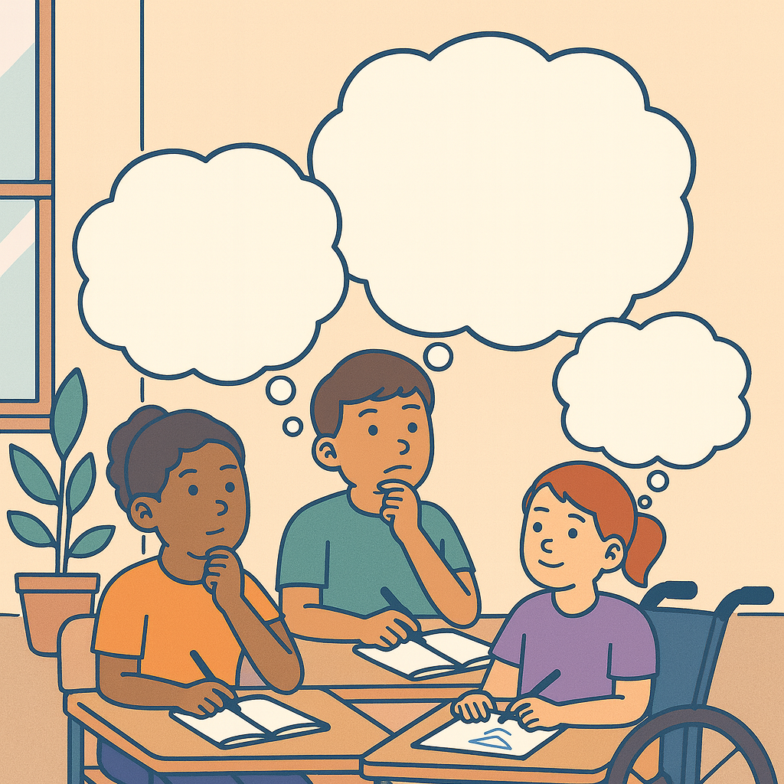
Lesson Synthesis
Answer the questions to reflect on the strategies for writing equivalent quadratic expressions
In what ways are area diagrams:
  Useful for expanding expressions like (x + 4)(x + 9)?
  Are there any drawbacks to drawing diagrams?
In what ways is using the distributive property:
  Helpful?
  Are there any drawbacks?
Which strategy would you choose to expand
(x + 11)(2x + 3) and write an equivalent expression? Why?
Notes:
Possible Answers
a. The diagrams can help us see and keep track of the different parts of the factors that need to be multiplied and make sure
they are all accounted for.
b. Drawing a diagram every time we want to expand an expression would be time consuming.
a. Expanding expressions with the distributive property is probably quicker than drawing diagrams.
b. If we don't keep track of the terms closely, we may miss some terms that need to be multiplied.
Answers may vary.

Slide 25
Self Assessment
How much do you agree with the following statements?
I can… | I can | Almost | Not yet
Rewrite quadratic expressions in different forms using an area diagram or the distributive property.

