Slide 1


Algebra 1
Unit 4 Functions
Lesson 4.14: Sequences

Slide 2
How to use these slides
On the activity slides check the speaker notes for teacher support and instructional information.
Each lesson includes 1 warm up, 2-3 learning activities, a cool down, practice and a lesson synthesis.
  Learning activities are followed by a self check question, and review section.
Some slides have been hidden from student view, more information can be found on the next slide (Reference Key).
You can edit and use these slides for personal and classroom use, but cannot sell them and must keep the attribution logos.
For more information, Check out the digital quick start guide!

Slide 3






Reference Key
Check the top right corner for an icon referencing these unique sections.
 | Support for Students with Disability | Hidden | Learning Strategies slide, provides additional support to students for understanding the activity. Learning Strategies slide, provides additional support to students for understanding the activity.
 | Support for English Language Learners | Hidden
 | Extending Your Thinking | Hidden | Extending Your Thinking slide, provides an extra challenge for students.
 | Self Check | Not Hidden | Self Check slide, checkpoint to assess student understanding after the learning activity.
 | Review | Hidden | Self Check- Review slide, designed to help review topics from the self check question.
On the next slides, check the speaker notes for teacher instructions and support.
Notes:
Check the Speaker Notes: On the next slides you can find discussion questions, lesson information, answers to the activities, and ways to adjust the activity for your students!

Slide 4

Learning Goals
By the end of this lesson you will be able to -
Give examples of a sequence
Explain the meaning of the term “sequence.”
Explain the meaning of the term “term,” as it is used in a mathematical sequence.
Notes:
Lesson Narrative
The purpose of this lesson is for students to work with sequences and describe them recursively in an informal way. A sequence is defined here as a list of numbers, while a term (of a sequence) is one of the numbers in the list.
Using the Tower of Hanoi puzzle, students explore the rules and try different numbers of discs to find the minimum moves needed. This leads to recognizing a recursive pattern and encourages them to explain their reasoning and critique others'. Though the unit focuses on arithmetic and geometric sequences, this puzzle’s sequence is neither—chosen to spark deeper discussion and reasoning.
Required Preparation
Students should manipulate either physical or digital objects to experiment with the Tower of Hanoi puzzle. For physical, each group could use a quarter, nickel, penny, and dime, and a piece of paper with 3 circles drawn on it. For students using the digital version of the materials, acquire devices that can run the digital applet. It is ideal if each student has their own device.
If you are doing the checker jumping puzzle, each group needs at least 3 tokens each of 2 different colors. These could be actual checkers, counting chips, pennies and nickels, or any other appropriate tokens.
Required Materials
Internet-enabled device for applet activity
If not using the digital applet, each student could use a quarter, nickel, penny, and dime, and a piece of paper with 3 circles drawn on it.
Texas Essential Knowledge and Skills
A1(A) apply mathematics to problems arising in everyday life, society, and the workplace
A1(B) use a problem-solving model that incorporates analyzing given information, formulating a plan or strategy, determining a solution, justifying the solution, and evaluating the problem-solving process and the reasonableness of the solution
A1(D) communicate mathematical ideas, reasoning, and their implications using multiple representations, including symbols, diagrams, graphs, and language as appropriate
A12(C) identify terms of arithmetic and geometric sequences when the sequences are given in function form using recursive processes

Slide 5
Vocabulary
Previous
None
New
Sequence
  A list of numbers in which the order matters.
Term (of a sequence)
  Each number in a sequence.
Notes:
Lesson Vocabulary
To support student understanding of key vocabulary:
Introduce and review the vocabulary words students will see in this lesson.
Encourage students to notice how these words are used and to include them in their math discussions and explanations—both written and oral.
Use a word wall to reinforce vocabulary. Sample word wall cards are available here.
For newcomers or students with beginning English proficiency, use these Quizlet sets to support vocabulary learning:
Unit 4 Spanish Vocabulary, part 1 – use first to build understanding
Unit 4 Vocabulary (English), part 1 – use after anchoring in Spanish
Unit 4 Spanish Vocabulary, part 2 – use first to build understanding
Unit 4 Vocabulary (English), part 2 – use after anchoring in Spanish
Support for English Language Learners
ELPS 2(F) listen to and derive meaning from a variety of media such as audiotape, video, DVD, and CD-ROM to build and reinforce concept and language attainment
ELPS 3(D) speak using grade-level content area vocabulary in context to internalize new English words and build academic language proficiency
ELPS 3(E) share information in cooperative learning interactions
ELPS 3(F) ask and give information ranging from using a very limited bank of high-frequency, high-need, concrete vocabulary, including key words and expressions needed for basic communication in academic and social contexts, to using abstract and content-based vocabulary during extended speaking assignments
ELPS 5(B) write using newly acquired basic vocabulary and content-based grade-level vocabulary

Slide 6





Lesson Journey
Warm Up
Learning Activity
Practice
Learning Activity
Cool Down
Lesson Synthesis

Slide 7
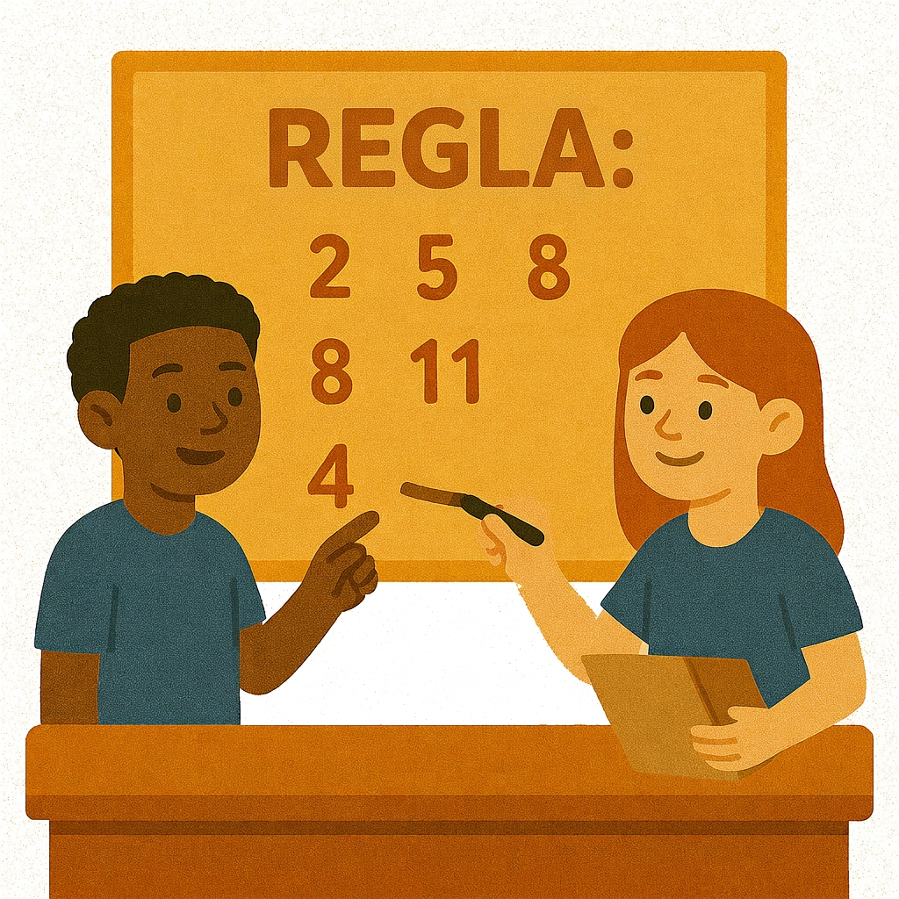
Warm Up - Build the Rule 🧱
Here is a rule for making a list of numbers:
Each number is 1 less than twice the previous number.
Pick a number to start with. Then follow the rule to build a list of 5 numbers.
Notes:
Warm Up (5 minutes)
The goal of this task is for students to create a list of numbers based on a rule, building the habit of generating and making sense of mathematical objects without needing formal vocabulary yet. In the next activity, they'll identify patterns in a list created from a puzzle.
While students work, look for successful examples to highlight during the discussion.
Launch
Arrange students in groups of 2. Tell students there are many possible answers. After brief quiet work time, ask students to compare their responses to their partner’s and decide whether they are both correct, even if they are different. Follow with a whole-class discussion.
Avoid demonstrating a possible sequence of 5 numbers for the whole class first to set up the expectation that students are responsible for making sense of the activities.
Activity Answers
2, 3, 5, 9, 17
5, 9, 17, 33, 65
1, 1, 1, 1, 1
Anticipated Misconceptions
If a student has trouble getting started, ask them to first pick a number. Once they’ve picked a number, ask what the next number would be, according to the rule. Then invite them to continue.
Some students may interpret “1 less than twice a number” as 1 − 2x (where x is the number). Ask these students questions like:
“What’s 1 less than 5?” (4)
“What’s 1 less than 5 times 2?” (9)
“What’s 1 less than 100?” (99)
“What’s 1 less than 100 times 2?” (199)
Write some of these statements on the board along with their translation into mathematical expressions. For example, write “1 less than 5 times 2” next to 5 ⋅ 2 − 1.
Activity Synthesis
Invite previously identified students to present their lists. Ask the other students to verify their calculations.

Slide 8

Lesson Journey
Warm Up
Learning Activity
Practice
Learning Activity
Cool Down
Lesson Synthesis

Slide 9
Learning Strategies - Tower of Hanoi🗼
“What pattern did Jada notice?”
“How do you know your answer is the smallest number of moves?”
Stronger and Clearer Each Time
Teacher Instruction: Use these strategies to adjust the activity to support English language learners and students with disabilities.
You can copy and paste the callouts directly on top of the activity or give the instructions aloud.
We are going to use _____ and _____ to represent the discs and each tower
Representation
Notes:
Support for English Language Learners: MLR 1 Stronger and Clearer Each Time: Writing, Speaking
Use this routine to give students a structured opportunity to revise and refine their explanations for how Jada used the solution for 3 discs to help her solve the puzzle for 4 discs. As students share their responses with their partner, listeners should press for details and clarity as appropriate based on what each speaker produces. Provide students with prompts for feedback that will help individuals strengthen their ideas and clarify their language. For example, “What pattern did Jada notice?” or “How do you know your answer is the smallest number of moves?” Students can borrow ideas and language from each partner to strengthen their final product.
Design Principle(s): Optimize output (for explanation)
Provide support for students
Distribute graphic organizers to the students to assist them with participating in this routine.
Support for Students with Disabilities: Representation: Develop Language and Symbols
If the applet is not available, provide physical manipulatives to represent the discs and each tower.
Supports accessibility for: Conceptual processing

Slide 10
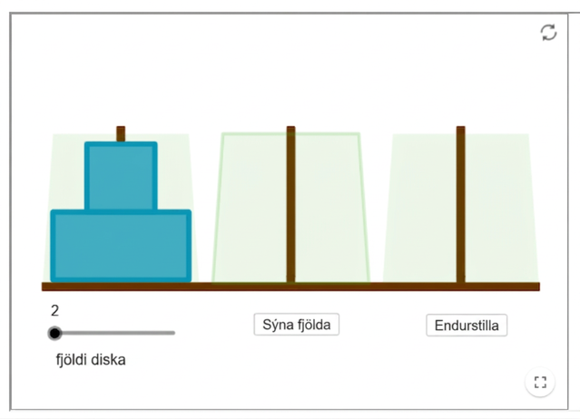
Learning Activity - Tower of Hanoi🗼
In the Tower of Hanoi puzzle, a set of discs sits on a peg, while there are 2 other empty pegs.
Rules: A move in the Tower of Hanoi puzzle involves taking a disc and moving it to another peg. There are two rules:
Only move 1 disc at a time.
Never put a larger disc on top of a smaller one.
You complete the puzzle by building the complete tower on a different peg from the starting peg.
Notes:
Support for All Learners
This activity offers additional support and an extension for students:
For English language learners and students with disabilities, be sure to review the Learning Strategies slide!
Activity (30 minutes)
This activity introduces the term “sequence” as students solve the Tower of Hanoi puzzle with different numbers of discs. They identify a pattern in the number of moves and describe it informally. It also encourages experimentation, pattern recognition, explanation, justification, and respectful listening.
The activity is most effective when students use manipulatives or the GeoGebra applet to explore the puzzle dynamically. If devices aren’t available for everyone, project the applet during the launch.
Watch for students who write clear explanations of Jada’s reasoning and the moves needed for solving with 5 discs to share during the discussion.
Students should use physical or digital tools to explore the puzzle. Physical tools can include coins and a paper with three circles; for digital, provide devices that support the applet, ideally one per student.
Launch
If possible, allow students to use the GeoGebra Applet : https://www.geogebra.org/m/gv3hdvgf or project the applet for the class. If that is not possible, distribute the physical tools to each group.
Arrange students in groups of 2. Set up either a physical puzzle with 2 discs or the digital version with 2 discs and display a table for all to see that looks like this throughout the discussion:
| Number of discs | 1 | 2 | 3 | 4 | 5 | 6 | 7 |
|--------------------------|----|----|----|---|----|----|----|
| Number of moves | | | | | | | |
Have students read the two rules, then discuss allowed moves (e.g., moving the top disc) and forbidden ones (e.g., moving both discs together). Work as a class to solve the puzzle with 2 discs in the fewest moves (3), and record the result. Then, have students explore solutions for more discs using physical or digital tools.
Give students time to solve the puzzle with 2 discs after reviewing the rules. Remind them to track their moves and aim for the minimum. Encourage peer collaboration to compare solutions. If needed, have a student demonstrate the 3-move solution before moving on.
Activity image answer, and synthesis on the next slide.

Slide 11
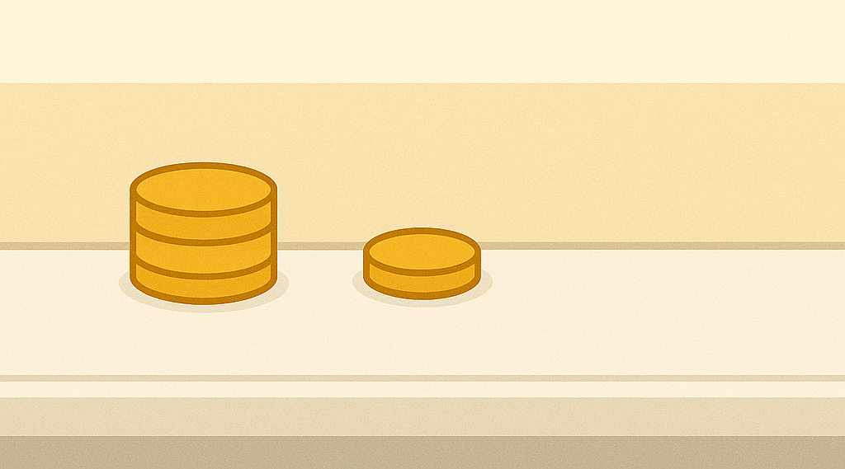
Learning Activity - Tower of Hanoi🗼
In this activity, you have started to find a sequence of terms.
Write these definitions.
A sequence is a list of numbers, possibly going on forever, such as all the odd positive integers arranged in order: 1, 3, 5, 7, . . . .
The term (of a sequence) is one of the numbers in a sequence.
For questions 1-2, complete the puzzle. Then, record
the smallest number of moves needed to solve it.
Moving 3 discs.
Moving 4 discs.
Jada says she used the solution for 3 discs to help her solve the puzzle for 4 discs. Describe how this might happen.
For questions 4-5, estimate how many moves you think it will take to complete a puzzle. Explain your answer.
Moving 5 discs.
Moving 7 discs.
Notes:
Activity Answer
7 moves
15 moves
For example: Jada moved the tower of discs 1 – 3, then moved disc 4, and then moved the remaining discs 1 – 3 onto it.
31 moves. For example: Double the previous answer, and then add 1. The number of moves is 31 because
2⋅15 + 1 = 31.
127 moves
Anticipated Misconceptions
Students may incorrectly interpret the rules or presume there is no better solution once they find one solution that works. Encourage groups to regularly switch who is in charge of moving the discs and to check with other groups around them once they think they have found a solution with the smallest number of moves.
Activity Synthesis
Use this discussion to define “sequence” and “term,” while reinforcing norms like transitioning from work time to whole-class synthesis and naming key math ideas after exploration.
Ask how many moves it takes for 1 disc (answer: 1). Have students share their minimum moves for 3 and 4 discs, and check if anyone found a more efficient solution. Share or demonstrate the minimum if needed.
Have selected students explain Jada’s method and how many moves are needed for 5 discs, completing the table with 1, 3, 7, 15, and 31.
Urge groups to compare strategies. If needed, have a student show why 2 discs require 3 moves to ensure everyone understands the rules.

Slide 12
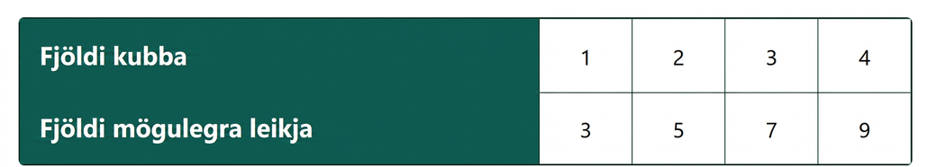
Self Check
The table shows the number of chips in a game and the number of moves that can be made.
How many moves would be possible with 7 chips?
11
14
15
13
Let’s review!
Notes:
Answer Feedback - Individualized by Response
Incorrect. This is the number of possible moves for 5 chips. The answer is 15.
Incorrect. This is twice the number of chips. The rule is twice the number of chips plus 1. The answer is 15.
That’s correct! As the number of chips increases by 1, the number of moves increases by 2. When the table reaches 5 chips, there will be 15 possible moves.
Incorrect. This is the number of possible moves for 6 chips. The answer is 15.

Slide 13
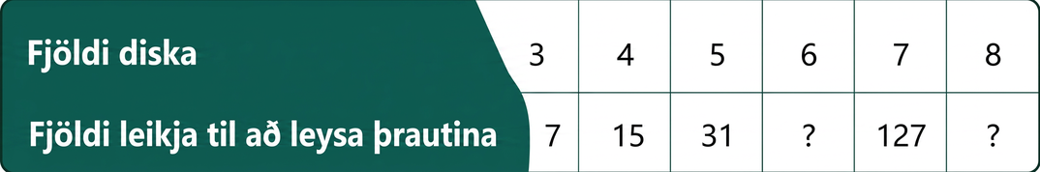
Self Check - Review
A table can help identify patterns to solve problems. For the Tower of Hanoi, record the number of discs and the fewest moves needed, using data from the activity.
The pattern was to double the previous answer and then add 1.
Using this pattern, complete the table for 6 discs. 2(31) + 1= 63
Then use this rule to find how many moves are needed to complete the puzzle with 8 discs.
There were 127 moves for 7 discs.
So, double 127 and add 1: 2(127) + 1 = 255.

Slide 14
Lesson Journey
Warm Up
Learning Activity
Practice
Learning Activity
Cool Down
Lesson Synthesis

Slide 15
Learning Strategies - Checker Game🏁
Teacher Instruction: Use these strategies to adjust the activity to support English language learners and students with disabilities.
  You can copy and paste the callouts directly on top of the activity or give the instructions aloud.
We are going to use black and red checkers for this activity.
Representation
Notes:
Support for Students with Disabilities: Representation: Develop Language and Symbols
Use virtual or concrete manipulatives to connect symbols to concrete objects. Provide black and red checkers if the applet is not available.
Supports accessibility for: Conceptual processing

Slide 16
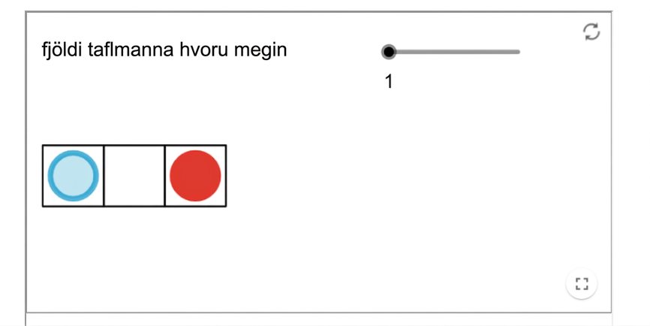
Learning Activity - Checker Game🏁
You complete the puzzle by switching the colors completely: ending up with blue (or black) on the right, red on the left, and 1 empty space between them.
Checkers are lined up with blue (or black) on one side, red on the other, and one empty space in between.
Rules:
A move is either sliding forward one space or jumping over one opposing checker.
Jumping same-color checkers, moving backward, or sharing spaces is not allowed.
Notes:
Support for All Learners
This activity offers additional support and an extension for students:
For English language learners and students with disabilities, be sure to review the Learning Strategies slide!
Activity (30 minutes)
Use this activity to reinforce the lesson or as an alternative if students are familiar with Tower of Hanoi, following a similar launch and discussion structure.
The activity is most effective with individual access to 4 red and 4 black checkers or the GeoGebra applet; if not, project the applet during the launch.
During the activity, look for students who clearly explain Noah’s reasoning and determine the number of moves for 7 checkers per side to share in the discussion.
Launch
If possible, allow students to use the GeoGebra Applet : https://www.geogebra.org/m/rzbzad2q or project the applet for the class. If that is not possible, distribute 4 red and 4 black checkers to each group.
Have students read the puzzle rules and solve it with 3 spaces and 1 checker per side (one red, one black), tracking their moves to find the minimum. Encourage them to compare solutions with peers. Before continuing, select a student to demonstrate on the applet or with manipulatives why 3 moves are needed to ensure everyone understands the rules.
Activity image answer, and synthesis on the next slide.

Slide 17
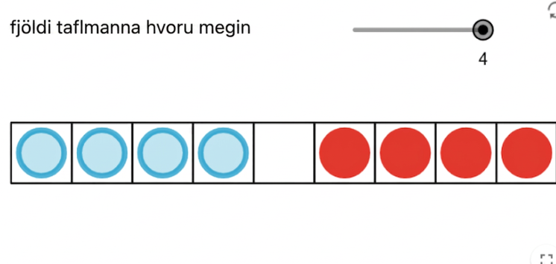
Learning Activity - Checker Game🏁
For questions 1-2, complete the puzzle. Then,
record the smallest number of moves needed
to solve it.
Using 1 checker on each side.
Using 3 checkers on each side.
Estimate the number of moves needed if there are 2 or 4 checkers on each side. Then test your guesses.
Noah says he used the solution for 3 checkers on each side to help him solve the puzzle for 4 checkers. Describe how this might happen.
How many moves do you think it will take to complete a puzzle with 7 checkers on each side?
Notes:
Activity Answer
3 moves
15 moves
8 moves and 24 moves
For example: The moves that don’t involve the fourth checker on each side are the same as before, so it is possible to decide the number of moves by running the first half of the three-checker game, then moving the fourth checkers, and then running the second half.
63 moves
Anticipated Misconceptions
Students may incorrectly interpret the rules or presume that there is no better solution once they find one solution that works. Encourage groups to regularly switch who is in charge of moving the checkers and to check with other groups around them once they think they have found a solution with the smallest number of moves.
Activity Synthesis
Have students share the smallest number of moves they found for 2, 3, and 4 checkers. Ask if anyone found a more efficient solution. If not, give more time, share the minimum, or demonstrate it.
Ask selected students to explain Noah’s strategy and the number of moves for 3 checkers. By now, the table should include 3, 8, 15, and 24.
If this replaced the Tower of Hanoi, define “sequence” and “term,” then have students describe a rule for the next term after quiet thinking. Select a few to share informal recursive rules like “add the next odd number.” Formal notation isn’t required but can be explored if suggested.

Slide 18
Self Check
The table shows the number of checkers and the number of moves needed to win a skipping game.
How many skips are needed with 6 checkers on each side?
Number of Checkers | Number of Skips Needed
1 | 2
2 | 8
3 | 18
4 | 32
50
72
128
48
Let’s review!
Notes:
Answer Feedback - Individualized by Response
Incorrect. his is the number of skips needed with 5 checkers. The answer is 72.
That’s correct! In every column, the number of checkers is multiplied by 2 more than the number in the previous column. 6 will be multiplied by 12, which results in 72 moves.
Incorrect. This assumes the number of skips needed started to double, which is not the case. The answer is 72.
Incorrect. This did not change the number being multiplied by each time and kept multiplying the number of checkers by 8. The answer is 72.

Slide 19
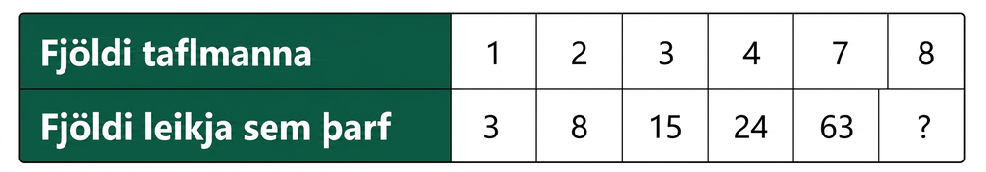
Self Check - Review
What is the pattern that you used in the previous activity to find the number of moves depending on the number of checkers?
Each row is multiplied by 1 more, so:
1 ⋅ 3 = 3
2 ⋅ 4 = 8
3 ⋅ 5 = 15
4 ⋅ 6 = 24
How many moves are needed with 5 checkers?
How many moves are needed with 6 checkers?
Notes:
Discuss the answers with the students
5 ⋅ 7 = 35 moves
6 ⋅ 8 = 48 moves

Slide 20

Lesson Journey
Warm Up
Learning Activity
Practice
Learning Activity
Cool Down
Lesson Synthesis

Slide 21
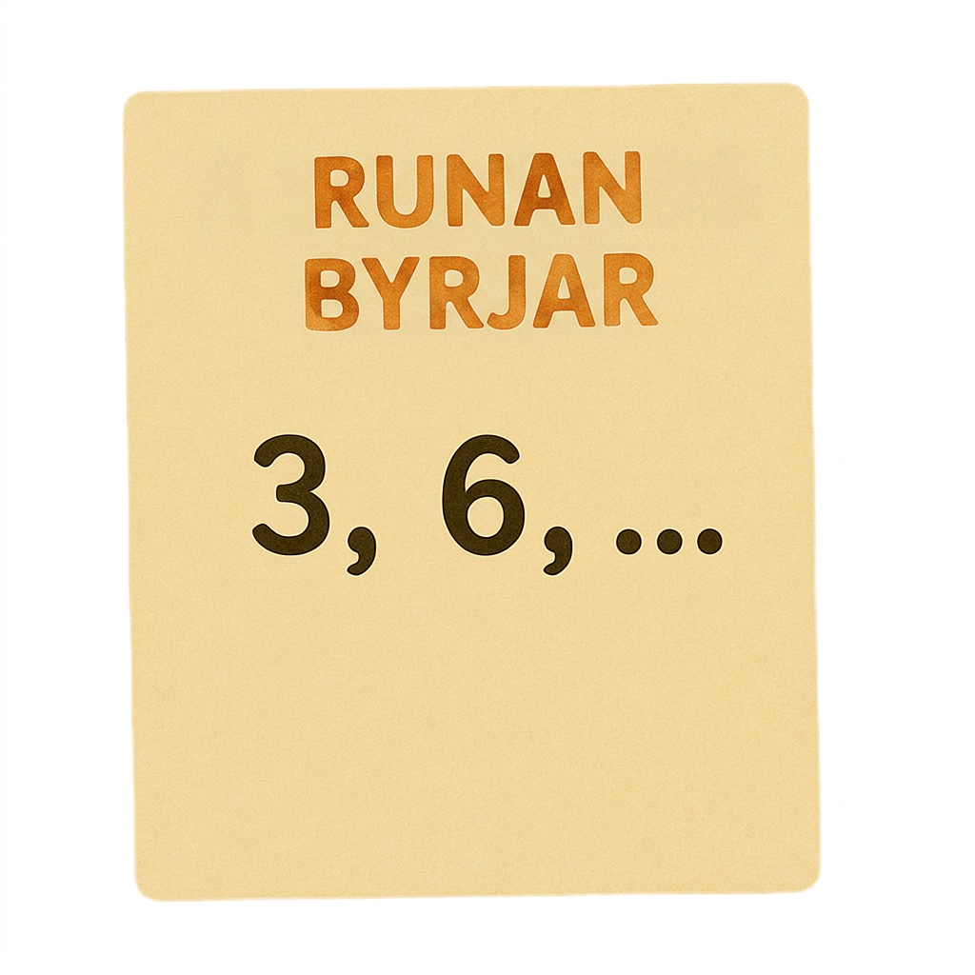
Cool Down
A sequence starts 3, 6, . . .
Give a rule the sequence could follow, and list the next 3 terms.
Give a different rule the sequence could follow, and list the next 3 terms.
Notes:
Cool Down (5 minutes)
Answers
Sample Responses: Each term adds 3 from the previous term. The next three terms are 9, 12, 15.
Sample Responses: Each term doubles the previous term. The next three terms are 12, 24, 48.

Slide 22
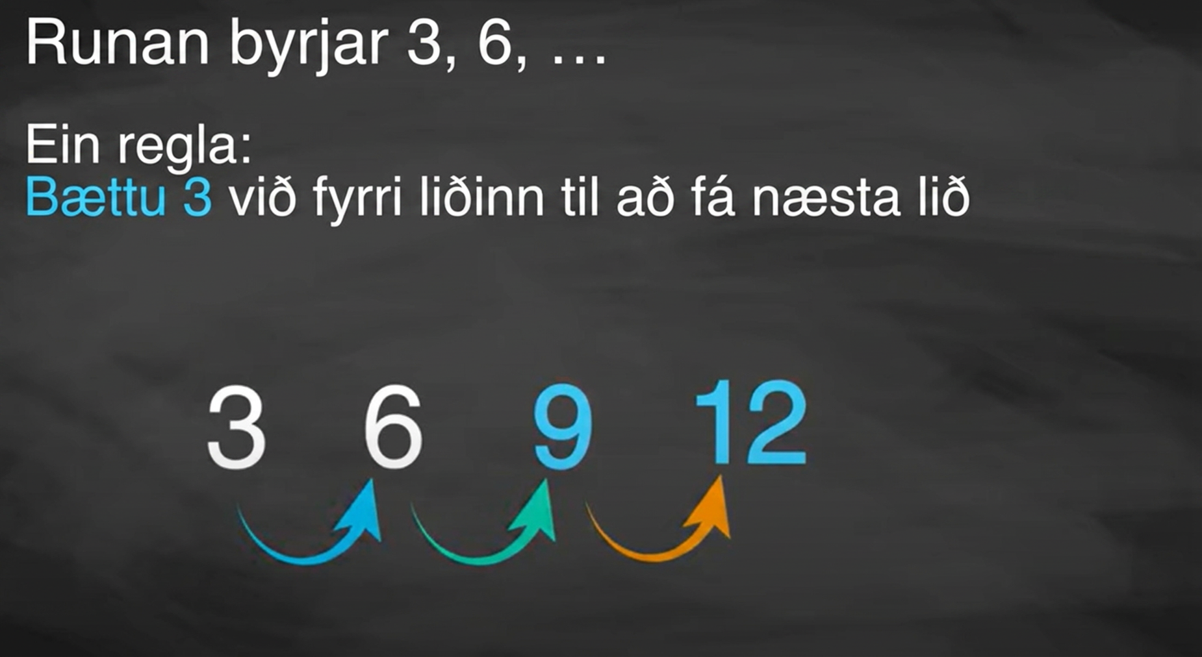
Video: Finding Rules of Sequences

Slide 23

Lesson Journey
Warm Up
Learning Activity
Practice
Learning Activity
Cool Down
Lesson Synthesis

Slide 24

Practice
Put your hard work to action, practice what you’ve learned!
Notes:
Digital Practice: Access the practice pages at https://openstax.org/details/books/algebra-1

Slide 25

Lesson Journey
Warm Up
Learning Activity
Practice
Learning Activity
Cool Down
Lesson Synthesis

Slide 26

Lesson Synthesis
Come up with a sequence of 5 numbers that follows some rule and write it down on a piece of paper.
Notes:
Prompt: Arrange students in groups of 2. Ask students to come up with a sequence of 5 numbers that follows some rule and write it down on a piece of paper. After a brief quiet time to think individually, tell students to exchange papers with their partners and then try to find the next term in their partner’s sequence along with the rule they used.
Conclude the lesson by inviting students to share a sequence and rule their partner wrote that they found interesting. Display these for all to see while students share.
Closing the Lesson
After completing the Lesson Synthesis, wrap up the class by directing students to the Lesson Summary in their student textbook. In this section, students review the day’s learning targets, read summaries about the key takeaways from each activity, and then respond to a reflection question regarding their confidence with the material.
For more on the benefits of using this type of metacognitive reflection, see the Research in Practice section of the course.

Slide 27
Self Assessment
How much do you agree with the following statements?
I can… | I can | Almost | Not yet
Give examples of a sequence.
Explain the meaning of the term “sequence.”
Explain the meaning of the term “term,” as it is used in a mathematical sequence.

