Slide 1
Algebra 1
Unit 9 More Quadratic Equations
Lesson 9.9 Writing Quadratics in Different Forms
Notes:
How to Get Started
Review Slide 2: How to use these slides
Check out the Check out the digital quick start guide!
Review Slide 3: Reference Key of Icons

Slide 2

How to use these slides
On the activity slides check the speaker notes for teacher support and instructional information.
Each lesson includes 1 warm up, 2-3 learning activities, a cool down, practice and a lesson synthesis.
  Learning activities are followed by a self check question, and review section.
Some slides have been hidden from student view, more information can be found on the next slide (Reference Key).
You can edit and use these slides for personal and classroom use, but cannot sell them and must keep the attribution logos.
For more information, Check out the digital quick start guide!
OpenStax CC BY NC SA

Slide 3





Reference Key
Check the top right corner for an icon referencing these unique sections.
Icon | Title | View | Location and Description
n/a | Support for Students with Disability | Hidden | Learning Strategies slide, provides additional support to students for understanding the activity.
n/a | Support for English Language Learners | Hidden | Learning Strategies slide, provides additional support to students for understanding the activity.
n/a | Extending Your Thinking | Hidden | Extending Your Thinking slide, provides an extra challenge for students.
n/a | Self Check | Not Hidden | Self Check slide, checkpoint to assess student understanding after the learning activity.
n/a | Review | Hidden | Self Check - Review slide, designed to help review topics from the self check question.
On the next slides, check the speaker notes for teacher instructions and support.
Notes:
Check the Speaker Notes: On the next slides you can find discussion questions, lesson information, answers to the activities, and ways to adjust the activity for your students!

Slide 4

Learning Goals
By the end of this lesson you will be able to -
Identify the vertex of a quadratic function from an equation.
Write quadratics in vertex, factored, and standard forms.
Write quadratic functions in vertex form given a vertex and another point.
Notes:
Lesson Narrative
This lesson begins with reviewing how to identify the vertex of a quadratic from the vertex form. The lesson also provides students with the opportunity to practice writing quadratic functions in vertex form, standard form, and factored form. When working to rewrite the equations through the different forms, students will strengthen their skills in the distributive property, completing the square, and using inverse operations.
In the cool down of the lesson, students will connect transformations of the quadratic parent function with the vertex and standard forms.
Students use this reasoning to justify why the vertex gives the maximum or minimum value and to communicate their thinking precisely.
Required Preparation
None
Required Materials
None
Texas Essential Knowledge and Skills
A1(A) apply mathematics to problems arising in everyday life, society, and the workplace
A1(D) communicate mathematical ideas, reasoning, and their implications using multiple representations, including symbols, diagrams, graphs, and language as appropriate
A1(F) analyze mathematical relationships to connect and communicate mathematical ideas
A1(G) display, explain, and justify mathematical ideas and arguments using precise mathematical language in written or oral communication
A7(A) graph quadratic functions on the coordinate plane and use the graph to identify key attributes, if possible, including x-intercept, y-intercept, zeros, maximum value, minimum values, vertex, and the equation of the axis of symmetry
A8(A) solve quadratic equations having real solutions by factoring, taking square roots, completing the square, and applying the quadratic formula.

Slide 5
Vocabulary
Previous
Axis of Symmetry
  A line that divides a figure into equivalent halves. In a quadratic function of the form 𝑦 = a(x − h)² + k, where (h, k) is the vertex of the parabola, it is x = h.
Vertex (of a graph)
  On a parabola, it is the point where the graph changes from increasing to decreasing or vice versa. It is the highest or lowest point on the graph.
Completing the Square
  A method used with quadratic expressions to transform them into perfect square trinomials.
Forms (of a quadratic)
  Vertex: a(x − h)² + k where a, h, and k are constants, and a ≠ 0.
  Standard: f(x) = a𝑥² + b𝑥 + c.
  Factored: 𝑓(𝑥) = 𝑎(𝑥 − 𝑟₁)(𝑥 − 𝑟₂).
Maximum
  The function value greater than or equal to all the other values. The highest point on the graph.
Minimum
  The function value less than or equal to all the other values. The lowest point on the graph.
Notes:
Lesson Vocabulary
To support student understanding of key vocabulary:
Introduce and review the vocabulary words students will see in this lesson.
Encourage students to notice how these words are used and to include them in their math discussions and explanations—both written and oral.
Use a word wall to reinforce vocabulary. Sample word wall cards are available here.
For newcomers or students with beginning English proficiency, use these Quizlet sets to support vocabulary learning:
Unit 9 Spanish Vocabulary – use first to build understanding
Unit 9 Vocabulary (English) – use after anchoring in Spanish
Support for English Language Learners
ELPS 1(B) monitor oral and written language production and employ self-corrective techniques or other resources
ELPS 2(A) distinguish sounds and intonation patterns of English with increasing ease
ELPS 2(B) recognize elements of the English sound system in newly acquired vocabulary such as long and short vowels, silent letters, and consonant clusters
ELPS 3(A) practice producing sounds of newly acquired vocabulary such as long and short vowels, silent letters, and consonant clusters to pronounce English words in a manner that is increasingly comprehensible
ELPS 4(A) learn relationships between sounds and letters of the English language and decode (sound out) words using a combination of skills such as recognizing sound-letter relationships and identifying cognates, affixes, roots, and base words
ELPS 5(A) learn relationships between sounds and letters of the English language to represent sounds when writing in English

Slide 6

Lesson Journey
First Stop: Warm Up

Slide 7

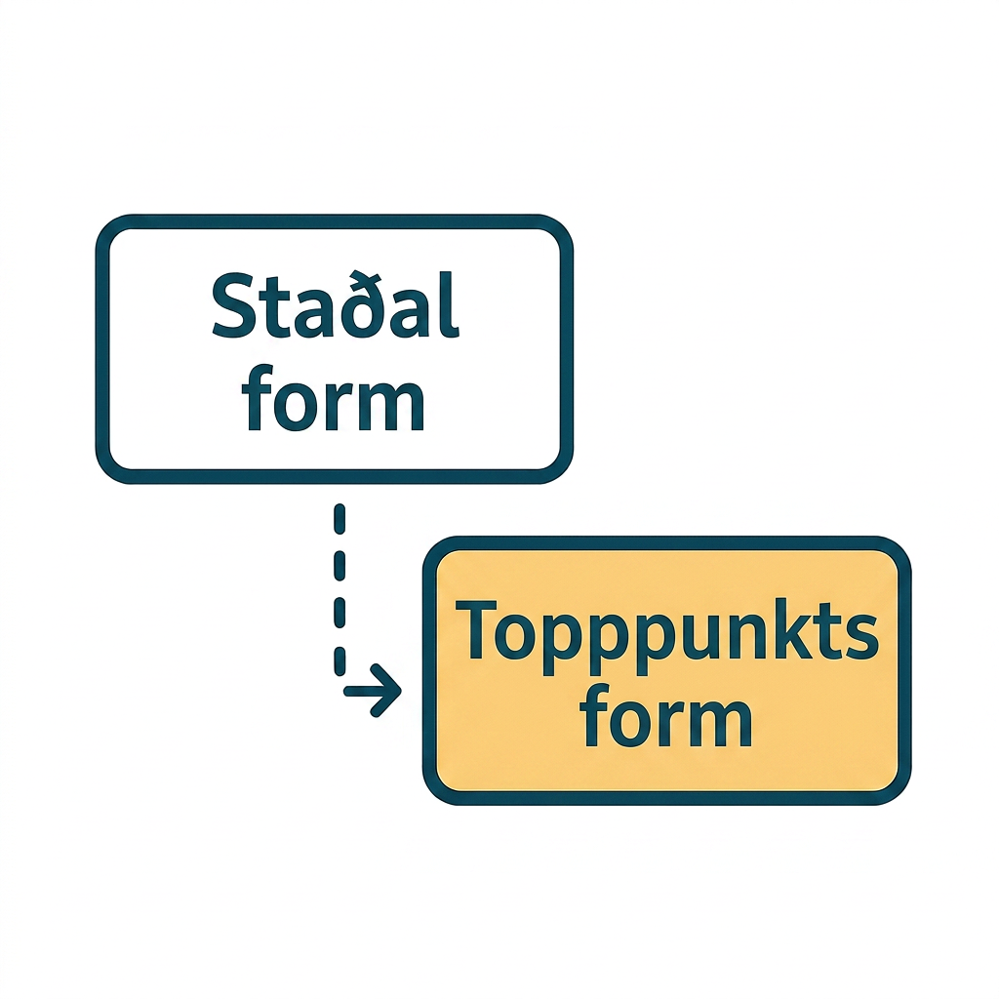
Warm Up | Part 1
Finding the Vertex 🔎
Write the quadratic function
f(x) = x² + 6x + 13 in vertex form.
Using the vertex form of the quadratic found in question 1, what is the vertex?
Graph both equations from question 1 (in standard form and vertex form).
Determine if the vertex for the quadratic function is a maximum or minimum.
What is the axis of symmetry?
Notes:
Warm Up (5 minutes)
This warm up revisits the idea that the vertex of a quadratic can be found from vertex form. Students begin by changing a quadratic function from standard to vertex form using completing the square. They will then identify the vertex. To confirm their work, they will then graph the function in both standard and vertex form using graphing technology to identify the vertex as a maximum or minimum value. This helps connect skills from unit 7 to unit 9.
Launch
Arrange students in groups of two.
Allow students to answer question 1 on their own, then check their steps for completing the square with their partner before moving on to question 2.
Activity Answers
f(x) = (x + 3)² + 4
(b/2)² = (6/2)² = 36/4 = 9
f(x) = x² + 6x+ 9 + 13 − 9
f(x) = x² + 6x+ 9 + 4
f(x) = (x + 3)² + 4
(−3, 4)
Link to Desmos graph: https://www.desmos.com/calculator/7l0wpbgffx
minimum
x = −3
Activity Synthesis
Ask students to describe what completing the square does in their own words. For example, it creates a perfect square.
Some students may think the vertex is (3, 4). Remind them that that formula is f(x) = (x −h)² + k where (h, k) is the vertex.
This is also a great place to revisit parent functions.
Ask students to determine what the parent function is, f(x) = x², and the transformations needed to get to the function for questions 1–5. Facilitate the connection to the vertex and the transformation.
Finally, ask students to define the axis of symmetry in their own words.
Ask: What are some ways knowing the axis of symmetry can help you? One possible answer—if they know the axis of symmetry and a point on the quadratic, they know there will be another point equidistant from the axis of symmetry on the other side of the quadratic.

Slide 8
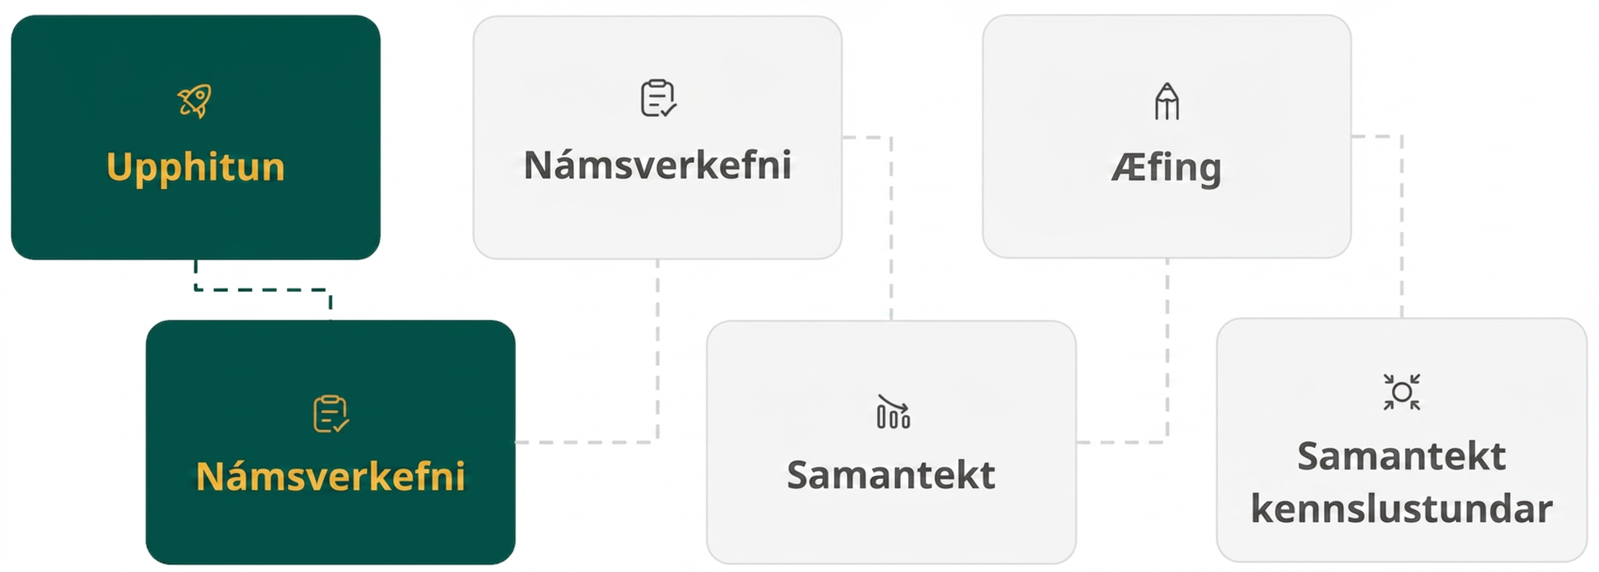
Lesson Journey
Second Stop: Learning Activity A

Slide 9

Learning Activity A | Learning Strategies
Form Switch ⬆️⬇️
Teacher Instruction: Use these strategies to adjust the activity to support English language learners.
You can copy and paste the callouts directly on top of the activity or give the instructions aloud.
If you are the Sage (speaking):
Practice saying new words
Work on English sounds (vowels, blends, silent letters)
Use clues like roots or prefixes to sound out words
If you are the Scribe (writing):
Write steps using sound–letter patterns
Practice spelling new vocabulary
Use what you know about English sounds
Everyone:
Listen, speak, and write to build English skills
Discussion Supports
Notes:
Support for English Language Learners: MLR 8 Discussion Supports: Speaking, Writing
For the Sage or Scribe activity, allow the ELL student to choose the role where they are most comfortable, first.
When speaking as the sage, students should focus on practicing to
distinguish sounds and intonation patterns of English with increasing ease
practice producing sounds of newly acquired vocabulary such as long and short vowels, silent letters, and consonant clusters to pronounce English words in a manner that is increasingly comprehensible
learn relationships between sounds and letters of the English language and decode (sound out) words using a combination of skills such as recognizing sound-letter relationships and identifying cognates, affixes, roots, and base words
When writing the steps as the scribe and describing the steps on paper during their feedback reflection students will work to:
learn relationships between sounds and letters of the English language to represent sounds when writing in English
recognize elements of the English sound system in newly acquired vocabulary such as long and short vowels, silent letters, and consonant clusters
Monitor English language learners for progress on the above as they listen, write, and speak.
Design Principle(s): Optimize output

Slide 10
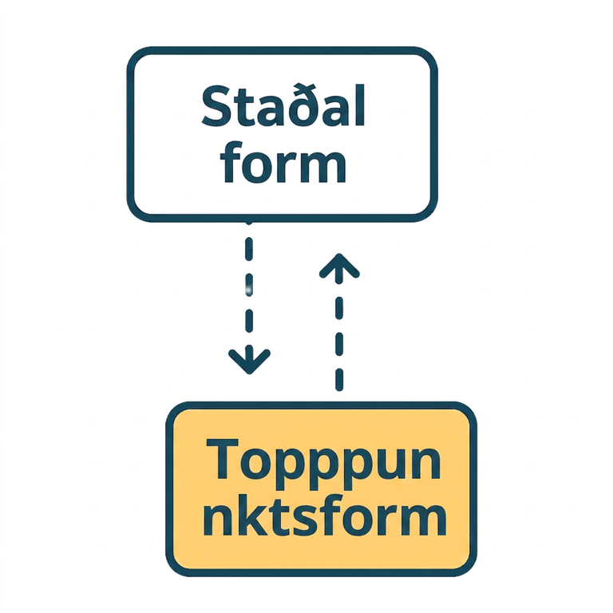
Learning Activity A
Form Switch ⬆️⬇️
Write each function in vertex form.
y = x² − 4x + 7
y = (x − 1)(x + 3)
y = (x − 2)(x + 2)
y = −x² − 2x − 6
y = 2x² − 12x + 22
Write each function in standard form.
y = (x − 2)² + 7
y = x² + 6x + 7
Are you ready for more?
Notes:
Support for All Learners
This activity offers additional support and an extension for students:
For English language learners, be sure to review the Learning Strategies slide!
For students looking for an extra challenge, be sure to review the Extending Your Thinking slide!
Activity (20 minutes)
In this activity, students convert functions in factored or standard form to vertex form then convert vertex form to standard form. Previously, in the warm up, students used the vertex form to find the maximum or minimum of the quadratic function. This activity supports students by focusing on the mechanics of changing forms and finding the coordinates of the vertex.
Launch
Begin with a class discussion asking students to name the different forms of quadratic functions (vertex, standard, and factored forms) and their formulas.
The vertex and standard forms are given on the STAAR Algebra I Reference Materials.
Ask students what useful information they can get easily from each form. (For example: Standard form helps to find intercepts, factored form helps to find roots, vertex form is helpful for the vertex and axis of symmetry).
Divide the class into pairs.
Practice the sage and scribe technique.
For question 1, one person is the sage and describes how to do the problem, and the other partner is the scribe and writes the mathematical work.
They then enter their answer and reflect on the feedback.
They then describe the steps in words on their paper for each step. For example, complete the square by dividing b by 2 and squaring the result. For question 2,
they switch roles and continue to switch roles throughout the activity.
Activity Answers
Anticipated Misconceptions
When writing from standard or factored form to vertex form, students may not remember to subtract the new constant they add in when they complete the square to balance the equation. Encourage students who struggle with this concept to use a different color to write the number that completes the square and then the same number when it is subtracted from the original constant.
When writing from factored to vertex form, students may forget to distribute the two factors first and distribute the factors thoroughly. Reminding them of the acronym, FOIL, can be helpful.
Activity Synthesis
Have students reflect on the Sage or Scribe activity.
Ask them if they changed how they explained their work to the Scribe.
Did they need to be more specific?
Use more mathematical terms?
Which role was easier?
Did they learn anything from their partner when they were a Scribe and listening to the steps?

Slide 11
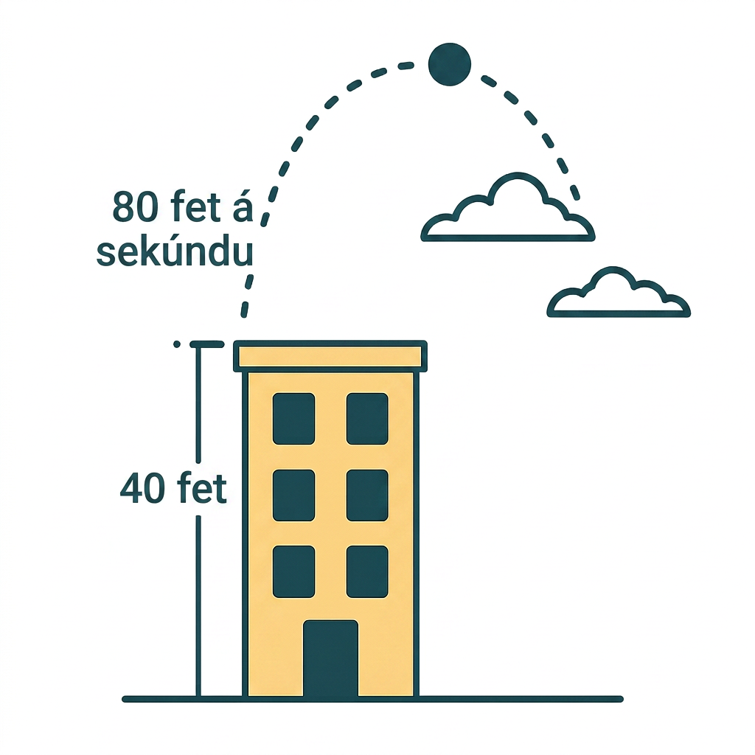

Learning Activity A
Extending Your Thinking
A ball is thrown upward from the top of a 40 foot high building at a speed of 80 feet per second. The ball’s height above ground can be modeled by the equation
H(t) = −16t² + 80t + 40.
What is the maximum height?
HINT: Rewrite the function in vertex form.
Step 1 - Factor the (– 16).
Step 2 - Complete the square.
Step 3 - Add the constant to complete the square and subtract to balance the equation.
Step 4 - Factor and simplify.
Step 5 - Find the vertex.
Notes:
Go back to Lesson Activity
If needed, a hint has been provided to help students to rewrite the function in vertex form. In order for students to complete the square, they will need to factor the coefficient from the squared term - hence, step 1. THE HINT HAS BEEN ANIMATED TO ONLY DISPLAY WITH A CLICK so that it will not be seen by students unless you determine it is needed.
Answer
To find the maximum height, find the vertex. Write the function in vertex form.
H(t) = −16t² + 80t + 40
Step 1 - Factor -16 out of the first two terms.
H(t) = −16(t² − 5t) + 40
Step 2 - Complete the square.
(−5/2)² = 25/4
Step 3 - Add the constant to complete the square and subtract from the 40 to balance the equation. Note that because there is a (−16) outside of the parentheses. This makes the constant equation to be (−16 × (25/4) = −100. Because a (−100) was really added in, then a positive 100 will balance the equation.
H(t) = −16(t² − 5t + (25/4)) + 40 −(−100)
H(t) = −16(t² − 5t + (25/4)) + 40 + 100
Step 4 - Factor and simplify.
H(t) = −16(t +(5/2))² + 140
Step 5 - Find the vertex.
((5/2), 140)
Therefore, the maximum height is 140 feet. (It reaches this high point after 2.5 seconds.)le is 10 − 4 or 6 units.

Slide 12
Learning Activity A
Self Check
Which of the following is f(x) = (x − 2)² + 15 written in standard form?
f(x) = x² + 19
f(x) = x² - 4x +11
f(x) = x² - 4x +19
f(x) = x² + 4x +19
Let’s review!
Notes:
Answer Feedback - Individualized by Response
Incorrect. Recall that (x − 2)² = (x − 2)(x − 2) which then needs to be distributed.
Incorrect. When distributing, −2x −2 = +4 which is added to the constant, 15.
That’s correct! (x − 2)² = (x − 2)(x − 2). After distributing with FOIL, the function becomes f(x) = x² − 4x + 19.
Incorrect. When distributing, the terms become x² − 2x − 2x + 4 + 15.

Slide 13

Learning Activity A | Part 1
Self Check - Review
Three Common Quadratic Forms:
The STANDARD FORM of a quadratic function is f(x) = ax² + bx + c where a, b, c, are real numbers and a ≠ 0.
The VERTEX FORM of a quadratic function is f(x) = a(x − h)² + k
where (h, k) is the vertex.
The FACTORED FORM of the quadratic function is f(x) = (x − a)(x − b) where a and b are roots of f(x).
Notes:
Review
The three common quadratic forms.
More review on the next slide.

Slide 14
Learning Activity A | Part 2
Self Check - Review
Example 1 -
Write the function f(x) = (x − 2)(x + 8) in standard form.
CHANGING
FACTORED FORM
TO STANDARD FORM
Step 1 - Multiply the binomials using distribution (FOIL).
Step 2 - Simplify.
Notes:
Answers
Step 1 f(x) = (x − 2)(x + 8)
f(x) = x² − 2x + 8x − 16
Step 2 - Simplify.
f(x) = x² + 6x − 16
More review on the next slide.

Slide 15
Learning Activity A | Part 3
Self Check - Review
CHANGING
FACTORED FORM
TO VERTEX FORM
Step 1 - Multiply the binomials using distribution (FOIL).
Step 2 - Simplify.
Step 3 - Complete the square.
Step 4 - Balance the equation by adding the constant to the quadratic to complete the square and subtract it from the original constant.
Step 5 - Factor the trinomial and simplify.
Example 2 -
Write the function f(x) = (x − 2)(x + 8) in vertex form.
Notes:
Remind students -
Steps 1 and 2 were the steps from the previous example (for how to change the factored form to standard form).
Answers
Steps 1 & 2 are from Example 1.
Step 3: (^{b}/₂)² = (⁶/₂)² = 9
Step 4: f(x) = x² + 6x + 9 − 16 − 9
Step 5: f(x) = (x + 3)² − 25
More review on the next slide.

Slide 16
Learning Activity A | Part 4
Self Check - Review
CHANGING
VERTEX FORM
TO STANDARD FORM
Step 1 - Multiply to expand the squared binomial.
Step 2 - Distribute the coefficient.
Step 3 - Simplify like terms.
Example 3 -
Write the function in standard form f(x) = 6(x − 2)² + 4.
Notes:
Answers
Step 1: 6(x − 2)² + 4
6(x² − 4x + 4) + 4
Step 2: 6x²− 24x + 24 + 4
Step 3: f(x) = 6x²− 24x + 28
If an additional example is needed, consider using Example 4: Rewrite the function in standard form: f(x) = 5(x − 3)² + 2.
Answer for question
Step 1: 5(x − 3)² + 2
5(x² − 6x + 9) + 2
Step 2: 5x²− 30x + 45 + 2
Step 3: f(x) = 5x²− 30x + 47

Slide 17
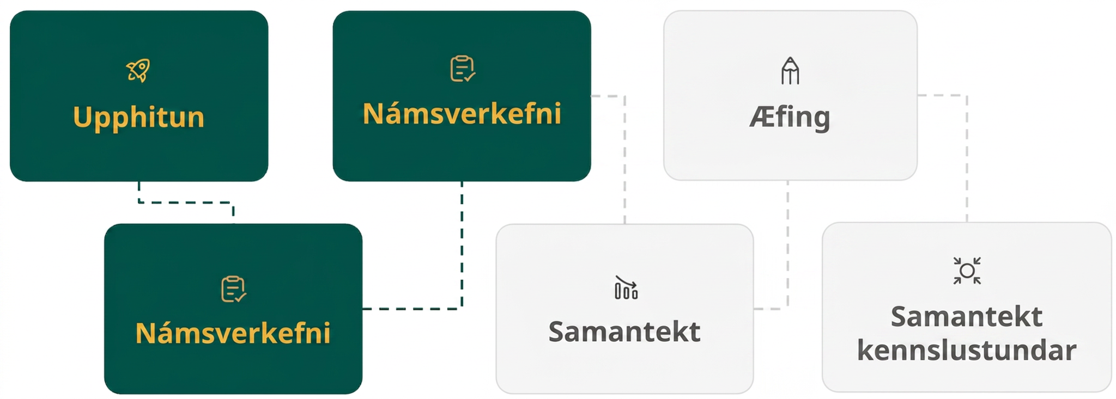
Lesson Journey
Third Stop: Learning Activity B

Slide 18
Learning Activity A | Learning Strategies
What Can I do with a Point and a Vertex? 🤔
Teacher Instruction: Use these strategies to adjust the activity to support English language learners.
You can copy and paste the callouts directly on top of the activity or give the instructions aloud.
If you are the Sage (speaking):
Practice saying new words
Work on English sounds (vowels, blends, silent letters)
Use clues like roots or prefixes to sound out words
If you are the Scribe (writing):
Write steps using sound–letter patterns
Practice spelling new vocabulary
Use what you know about English sounds
Everyone:
Listen, speak, and write to build English skills
Discussion Supports
Notes:
Support for English Language Learners: MLR 8 Discussion Supports: Speaking, Writing
For the Sage or Scribe activity, allow the ELL student to choose the role where they are most comfortable, first.
When speaking as the sage, students should focus on practicing to
distinguish sounds and intonation patterns of English with increasing ease
practice producing sounds of newly acquired vocabulary such as long and short vowels, silent letters, and consonant clusters to pronounce English words in a manner that is increasingly comprehensible
learn relationships between sounds and letters of the English language and decode (sound out) words using a combination of skills such as recognizing sound-letter relationships and identifying cognates, affixes, roots, and base words
When writing the steps as the scribe and describing the steps on paper during their feedback reflection students will work to:
learn relationships between sounds and letters of the English language to represent sounds when writing in English
recognize elements of the English sound system in newly acquired vocabulary such as long and short vowels, silent letters, and consonant clusters
Monitor English language learners for progress on the above as they listen, write, and speak.
Design Principle(s): Optimize output

Slide 19
Learning Activity B
What Can I do with a Point and a Vertex? 🤔
You are given the vertex and and point for each quadratic function:
Find the value of a.
Write the equation in vertex form.
A vertex at (5, 8) and also goes through point (−3, 6).
A vertex at (−4, 3) and also goes through the point (2, 5).
A vertex at (6, 2) and also goes through the point (3, 1).
Notes:
Support for All Learners
This activity offers additional support for students:
For English language learners be sure to review the Learning Strategies slide!
Activity (20 minutes)
In previous activities and lessons, students have worked on manipulating the different quadratic forms to find equivalent equations. In this activity, students will write the equation of a quadratic function in vertex form given a point and a vertex. Ask the class for the vertex form of a quadratic and display it on the board for reference throughout the activity.
Launch
Switch pairs from activity 9.9.2 and repeat the sage and scribe strategy.
Answer
y = a(x − h)² + k
6 = a(−3 − 5)² + 8
6 = a(−8)² + 8
−2 = 64a
a = (−2/64) = (−1/32)
y = (-1/32)(x - 5)² + 8
y = a(x − h)² + k
5 = a(2 − (− 4))² + 3
5 = a(6)² + 3
2 = 36a
a = (2/36) = (1/18)
y = (1/18)(x + 4)² + 3
y = a(x − h)² + k
1 = a(3 − 6)² + (-2)
1 = a(-3)² - 2
3 = 9a
a = (3/9) = (⅓)
y = (1/3)(x - 6)² - 2
Anticipated Misconceptions
Students may not substitute the points in the correct places in the formula. It can be helpful for students to write the vertex in one color and point in another and also color code the vertex formula to match so h and k are the color of the vertex point and x and y are the color of the additional point.
Activity Synthesis
If time allows, have students create their own problems where they choose a vertex and a point and have their partners write the equation in vertex form. Partners can also try to “stump” other partners. As an extension, have students use graphing technology to graph the point and vertex of each quadratic and graph the quadratic to see how the graph connects to the equation and the points also lie on the parabola. This can also provide time to quickly discuss any key characteristics in the graphs that were discussed in unit 7 and earlier in unit 9.

Slide 20
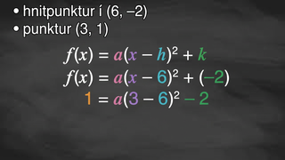
Learning Activity B | Video
Writing an Quadratic Equation from a Vertex and a Point
Notes:
This video discusses questions 5 and 6 of activity 9.9.3

Slide 21

Learning Activity B
Self Check
Which of the following is the quadratic equation of the quadratic with a vertex of (4, −2) that also goes through the point (6, 5)?
y = ⁴/₇(x − 4)² − 2
y = ⁷/₄(x − 4)² − 2
y = ⁷/₄(x − 6)² − 5
y = ⁴/₇(x − 6)² − 5
Let’s review!
Notes:
Answer Feedback - Individualized by Response
Incorrect. When solving for a, be sure to divide correctly.
That's correct! Substitute the vertex and point into the vertex form to solve for a, 5 = a(6 − 4)² − 2 so a = 7/4. Then write the equation, y = 7/4(x − 4)² − 2.
Incorrect. Substitute the vertex (4, −2) in for (h, k), not the point.
Incorrect. Substitute the vertex (4, −2) in for (h, k), not the point and be sure to divide correctly when finding the slope.

Slide 22
Learning Activity B
Self Check - Review
WRITING A QUADRATIC FUNCTION GIVEN THE VERTEX AND ANOTHER POINT ON THE PARABOLA
y = a(x − h)² + k
Step 1 - Substitute the vertex into (h, k).
Step 2 - Substitute the other point into (x, y).
Step 3 - Solve for a.
Step 4 - Substitute the value of a value and the vertex (h, k) into the vertex form.
Write the quadratic function in vertex form that has a vertex at (3, 4) and goes through the point (1, 2).
Notes:
Answer
Step 1: y = a(x − 3)² + 4
Step 2: 2 = a(1 − 3)² + 4
Step 3: 2 = a(1 − 3)² + 4
2 = a(−2)² + 4
2 = a(4) + 4
2 − 4 = a(4) + 4 − 4
−2 = a(4)
−(2/4) = (a(4)/4)
a = −½
Step 4: y = −½ (x − 3)² + 4

Slide 23
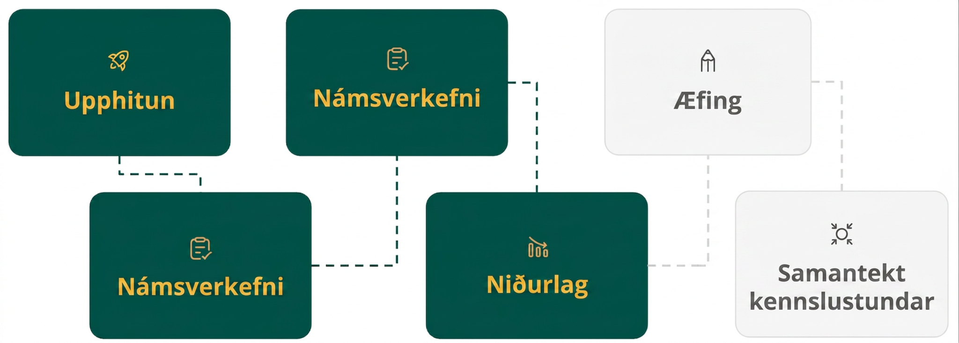
Lesson Journey
Fourth Step: Cool Down

Slide 24
Cool Down
For questions 1 – 2, use the function f(x) = x² that is shifted to create the function g(x) that has a vertex at (3, −2).
Write g(x) in vertex form.
Write g(x) in standard form.
Notes:
Cool Down (5 minutes)
Answers
g(x) = (x − 3)² − 2
The vertex form of a quadratic is f(x) = a(x − h)² + k.
Since there is not a vertical stretch or compression or reflection mentioned, the vertex values are substituted for (h, k).
g(x) = (x − 3)² + -2 becomes g(x) = (x − 3)² − 2.
Compare your answer: g(x) = x² − 6x +7
g(x) = (x − 3)² − 2
g(x) = (x − 3)(x − 3) − 2
g(x) = x² − 3x − 3x + 9 − 2
g(x) = x² − 6x + 7
Response to Student Thinking - More Chances
Students will have more opportunities to understand the mathematical ideas in this cool down in 9.10, so there is no need to slow down or add additional work to the next lessons. Instead, use the results of this cool down to provide guidance for what to look for and emphasize over the next lesson to support students in advancing their current understanding.

Slide 25
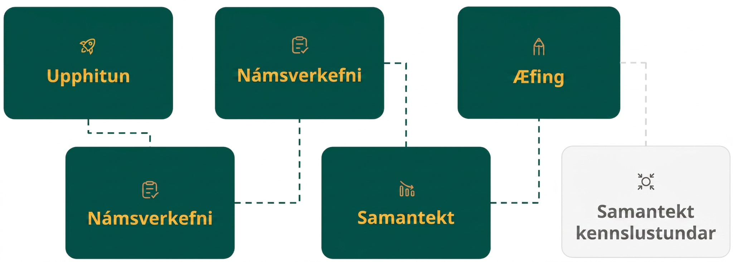
Lesson Journey
Fifth Stop: Practice

Slide 26

Practice
Put your hard work to action, practice what you’ve learned!
Notes:
Digital Practice: Access the practice pages at https://openstax.org/details/books/algebra-1

Slide 27
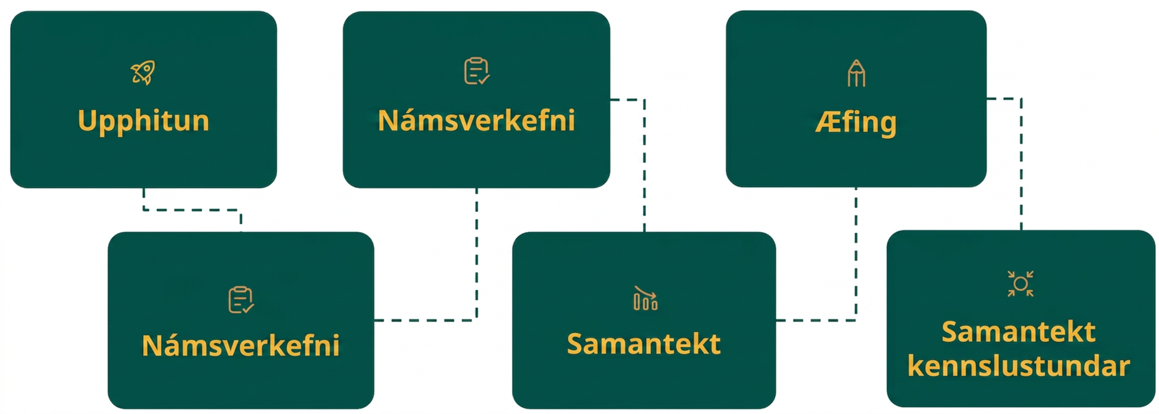
Lesson Journey
Sixth Stop: Lesson Synthesis

Slide 28

Lesson Synthesis
Our key takeaway from this lesson is the idea that quadratic functions can be written in a variety of equivalent forms.
Summarize how you would go from:
Vertex to standard form.
Factored to standard form.
Standard to vertex form.
Notes:
Discussion
Discuss as a class what information each form can easily provide.
Review
How to write a quadratic equation in vertex form from a vertex and a point.
Ask students to reflect on steps that could cause mistakes, such as:
Substituting a point in for the wrong values
Not balancing the equation when completing the square.
Remind Students
That expressions, equations, and inequalities are mathematical models.
A model is a mathematical representation of a real-life situation.
When people create models, they rely on the information they have, but they also make assumptions and decisions that affect the models. If the information or assumptions change, the model would also change

Slide 29
Self Assessment
How much do you agree with the following statements?
Learning Goals | I can | Almost | Not yet
Identify the vertex of a quadratic function from an equation. | ⃞ | ⃞ | ⃞
Write quadratics in vertex, factored, and standard forms. | ⃞ | ⃞ | ⃞
Write quadratic functions in vertex form given a vertex and another point. | ⃞ | ⃞ | ⃞

