Slide 1


Algebra 1
Unit 4 Functions
Lesson 4.7 Finding Slope

Slide 2
How to use these slides
On the activity slides check the speaker notes for teacher support and instructional information.
Each lesson includes 1 warm up, 2-3 learning activities, a cool down, practice and a lesson synthesis.
  Learning activities are followed by a self check question, and review section.
Some slides have been hidden from student view, more information can be found on the next slide (Reference Key).
You can edit and use these slides for personal and classroom use, but cannot sell them and must keep the attribution logos.
For more information, Check out the digital quick start guide!

Slide 3






Reference Key
Check the top right corner for an icon referencing these unique sections.
 | Support for Students with Disability | Hidden | Learning Strategies slide, provides additional support to students for understanding the activity. Learning Strategies slide, provides additional support to students for understanding the activity.
 | Support for English Language Learners | Hidden
 | Extending Your Thinking | Hidden | Extending Your Thinking slide, provides an extra challenge for students.
 | Self Check | Not Hidden | Self Check slide, checkpoint to assess student understanding after the learning activity.
 | Review | Hidden | Self Check- Review slide, designed to help review topics from the self check question.
On the next slides, check the speaker notes for teacher instructions and support.
Notes:
Check the Speaker Notes: On the next slides you can find discussion questions, lesson information, answers to the activities, and ways to adjust the activity for your students!

Slide 4

Learning Goals
By the end of this lesson you will be able to -
Write the slope of a line.
Write the equation of a line in different forms.
Notes:
Lesson Narrative
In this lesson, students learn to calculate slope from two points using the slope formula, from a table, or from a graph using rise over run. They apply this knowledge to write linear equations in slope-intercept, point-slope, and standard form—given two points or one point and a slope. While students practiced finding slope from graphs in Lesson 1.10 and converting from standard to slope-intercept form in 1.11.3, they have not yet formally calculated slope from coordinates or tables. Continued practice is needed in converting between the three equivalent forms.
Required Preparation
None
Required Materials
None
Texas Essential Knowledge and Skills
A1(E) create and use representations to organize, record, and communicate mathematical ideas
A3(B) calculate the rate of change of a linear function represented tabularly, graphically, or algebraically in context of mathematical and real-world problems;
A2(B) write linear equations in two variables in various forms, including y = mx + b, Ax + By = C, and y−y¹ = m(x−x¹), given one point and the slope and given two points.

Slide 5
Vocabulary
Previous
Slope
  The change in two dependent values of a linear function divided by the change in the corresponding two independent values. This can be thought of rise over run, the rate of change in 𝑦 over the change in 𝑥, or steepness of a line.
y-intercept
  The point of the graph of a function where the 𝑥-value is 0. This is where the graph of the function crosses the 𝑦 axis. (0, 𝑦)
New
slope-intercept form
  𝑦 = 𝑚𝑥 + 𝑏 where 𝑚 is the slope of the line and 𝑏 is the 𝑦-intercept.
point-slope form
  The equation of a line with slope 𝑚 and containing the point(𝑥¹, 𝑦¹) when in the form: (𝑦 − 𝑦¹) = 𝑚(𝑥 − 𝑥¹).*Need equation*
standard form of a linear equation
  𝐴𝑥 + 𝐵𝑦 = 𝐶, where 𝐴, 𝐵, and 𝐶 are real numbers, and 𝐴 and𝐵 are not both zero.
Notes:
Lesson Vocabulary
To support student understanding of key vocabulary:
Introduce and review the vocabulary words students will see in this lesson.
Encourage students to notice how these words are used and to include them in their math discussions and explanations—both written and oral.
Use a word wall to reinforce vocabulary. Sample word wall cards are available here.
For newcomers or students with beginning English proficiency, use these Quizlet sets to support vocabulary learning:
Unit 4 Spanish Vocabulary, part 1 – use first to build understanding
Unit 4 Vocabulary (English), part 1 – use after anchoring in Spanish
Unit 4 Spanish Vocabulary, part 2 – use first to build understanding
Unit 4 Vocabulary (English), part 2 – use after anchoring in Spanish
Support for English Language Learners
ELPS 1(G) demonstrate an increasing ability to distinguish between formal and informal English and an increasing knowledge of when to use each one commensurate with grade-level learning expectations
ELPS 4(C) develop basic sight vocabulary, derive meaning of environmental print, and comprehend English vocabulary and language structures used routinely in written classroom materials

Slide 6





Lesson Journey
Warm Up
Learning Activity
Practice
Learning Activity
Cool Down
Lesson Synthesis

Slide 7

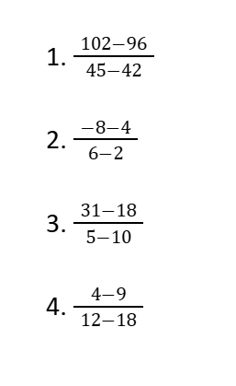
Warm Up - Comparing Function Values ➗➖
Evaluate mentally:
Notes:
Warm Up (5 minutes)
The purpose of this Math Talk is to elicit strategies and understandings students have for subtracting and dividing. These understandings help students develop fluency and will be helpful later in this lesson when students will need to be able to find the slope of the line through two given points.
Launch
Display one problem at a time. Give students quiet think time for each problem, and ask them to give a signal when they have an answer and a strategy. Keep all problems displayed throughout the talk. Follow with a whole-class discussion.
Activity Answers
2
-3
⁻¹³⁄₅
⅚
Activity Synthesis
Ask students to share their strategies for each problem. Record and display their responses for all to see. To involve more students in the conversation, consider asking:
“Who can restate _____’s reasoning in a different way?”
“Did anyone have the same strategy but would explain it differently?”
“Did anyone solve the problem in a different way?”
“Does anyone want to add on to _____’s strategy?”
“Do you agree or disagree? Why?”

Slide 8

Lesson Journey
Warm Up
Learning Activity
Practice
Learning Activity
Cool Down
Lesson Synthesis

Slide 9
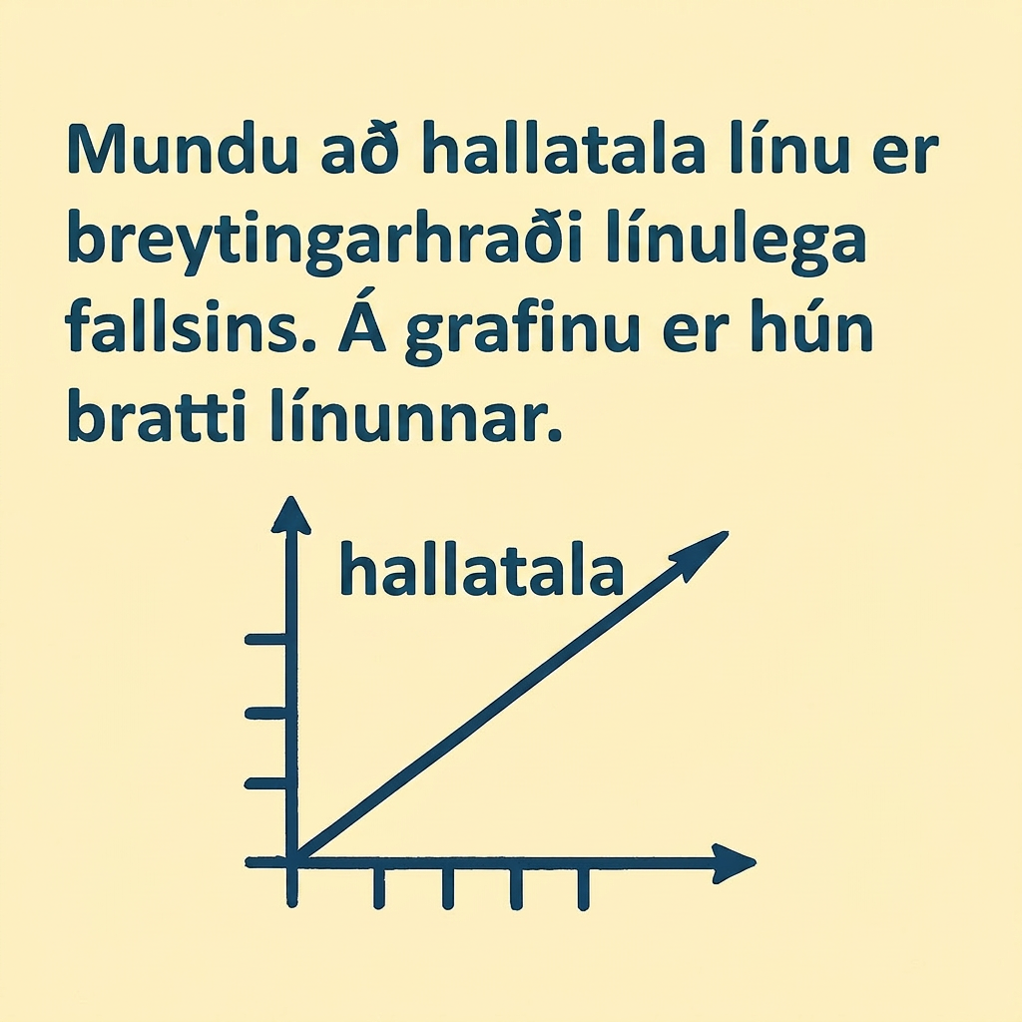
Learning Activity - Slope of the Line📉
Use this information to answer the questions on the next slide.
Notes:
Support for All Learners
This activity offers additional support and an extension for students:
For English language learners and students with disabilities, be sure to review the Learning Strategies slide!
Activity (20 minutes)
In this activity, students practice finding the slope from two points given as coordinates, on a graph, or in a table. This builds their skill with the slope formula, allowing them to focus more on context and meaning when finding average rate of change in Lesson 4.8.
Launch
Ask students to share what the slope of a line means. Facilitate the discussion to the types of slope, positive, negative, zero, or no slope and what those lines look like on a graph. Recall that, to find slope, students must find the change in y values over the change in x values; this is also represented in the slope formula
y₂ − y₁
m = ——
x₂ − x₁
Activity image answer, and synthesis on the next slide.

Slide 10
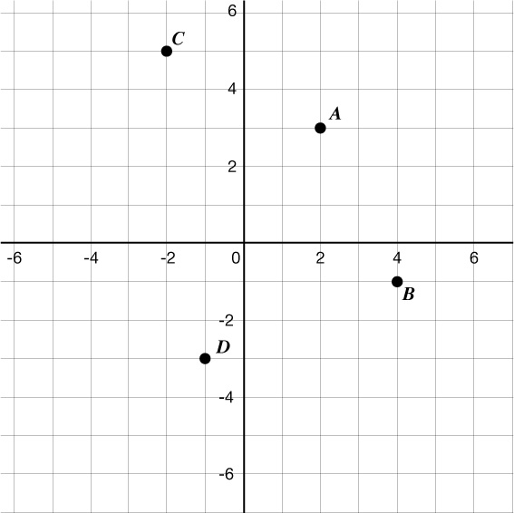
Learning Activity - Slope of the Line📉
Find the slope of the line that connects the given points.
(0,0) and (3,2)
(1,−2) and (2,5)
(−3,4) and (−5,−2)
Use the graph to find the slope of the line that goes through the two points.
A and B
A and D
C and D
Determine the slope of the equation whose values are in the given table. Simplify your answer.
x | 2 | 5 | 8 | 11
y | 4 | 1 | -3 | -6
Notes:
Activity Answer
Compare your work: Your answer may vary, but here is a sample for each day.
⅔
7
3
-2
2
⁻³⁄₃ = -1
Anticipated Misconceptions
When finding slope, students often write the change in x over the change in y. Continue to reinforce the correct order and relate it back to the graph problems with rise over run.
Activity Synthesis
The purpose of the discussion is to clarify the meaning of slopes. Select students to share their solutions, including how they arrived at the value. Ask students:
“If line A has a slope of 2 and line B has a slope of 5, describe how the graphs of these two lines would look different.” (Line B would be more steep. That is, for every increase of 1 in the horizontal direction, the line rises 5 units in the vertical direction for line B, while line A only rises 2 units.
Utilizing the TPR used in the “Support for English Language Learners,” students could be asked to use their arms to compare a slope of 2 versus the slope of 5.
“What does it mean for the graph of a line when it has a negative slope?” (It means the graph is decreasing. In other words, for every increase of 1 in the horizontal direction, the line falls some amount in the vertical direction.)
Again, using TPR, ask students how they would change their arms to represent a negative slope to help make the connection.
“Can you think of a situation that connects two variables with a negative slope?” (The distance to home as a function of time when someone is walking home.)

Slide 11
Learning Strategies - Slope of the Line📉
Create an icon or environmental print to remember that the difference in y is in the numerator and difference in x is in the denominator.
Use your arms to show a positive slope, negative slope, no slope and zero slope.
Create a story about a “ski hill” or “sled hill” .
Discussion Supports
Teacher Instruction: Use these strategies to adjust the activity to support English language learners and students with disabilities.
  You can copy and paste the callouts directly on top of the activity or give the instructions aloud.
Notes:
Support for English Language Learners: MLR 8 Discussion Supports: Speaking, Representing
As students discuss finding slope, encourage students to use the words slope and change in y over change in x; also numerator and denominator, as more formal mathematical language. Students may be more comfortable with informal language such as up and down, top and bottom, and rise over run. Students can create an icon or environmental print to remember that the difference in y is in the numerator and difference in x is in the denominator.
When discussing slope, have students use Total Physical Response (TPR) to associated the directions of lines with the types of slope. Have students all face the same direction and make their arms create a positive slope, negative slope, no slope and zero slope.
Next, have students create a “ski hill” or “sled hill” with a story. This could be with an illustration and verbal story or an illustration with a written story to practice goals appropriate to the student. This could also be done as a whole class or small group.Example story: As student ride up the ski lift (positive slope), then cross country to the start of the slope (zero slope), then go down the hill (negative slope). Then as they gain confidence, they will try harder mountains. They go to a double black diamond that looks like it is straight up and down. They say “oh NO,” I’m not going down that mountain. It has NO slope.
Using TPR and creating stories like this will help students reinforce what slope is when they see the word “slope” and different types of slope in print that are regularly used in this lesson and the lessons that follow. This will help them as they explain their graphs and later their equations of lines.
Design Principle(s): Support sense-making

Slide 12
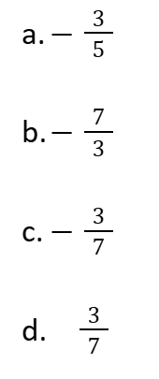
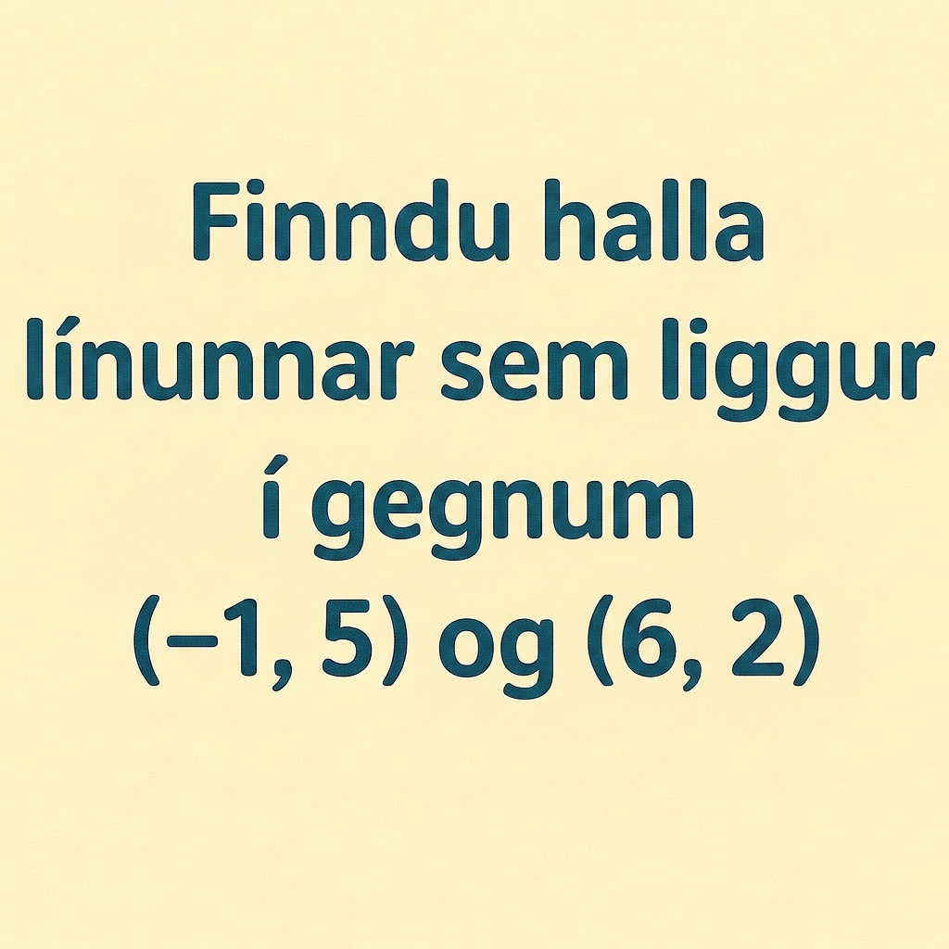
Self Check
Find the slope of the line that goes through (−1,5) and (6,2).
Let’s review!
Notes:
Answer Feedback - Individualized by Response
Incorrect. When finding the denominator, 6−(−1) becomes 6 + 1, or 7. The answer is -³⁄₇.
Incorrect. To find slope, the change in y is in the numerator and the change in x is in the denominator. The answer is -³⁄₇.
That’s correct!: Use the slope formula, m = ²⁻⁵⁄₆₋₍₋₁₎ = -³⁄₇.
Incorrect. Be careful with the positive and negative signs when subtracting. The answer is -³⁄₇.

Slide 13
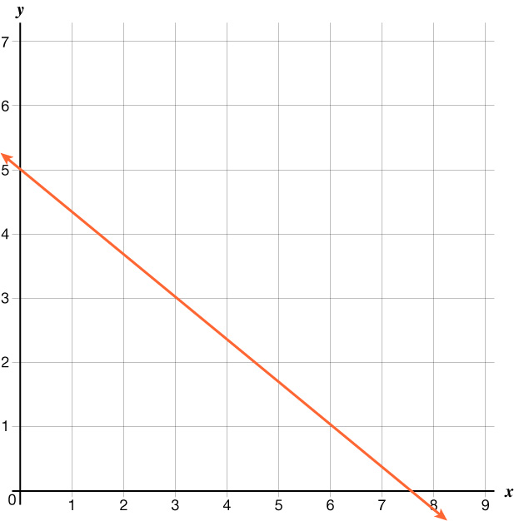
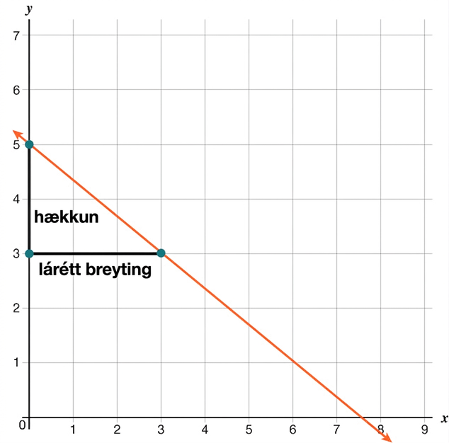
Self Check - Review - Slope of a Line
Slope of a Line - Here’s how to find the slope of a line from its graph using m = ʳⁱˢᵉ⁄ᵣᵤₙ.
Step 1 - Locate two points on the line whose coordinates are integers. (0,5) and (3,3)
Step 2 - Starting with one point, sketch a right triangle, going from the first point to the second point.
Step 3 - Count the rise and the run on the legs of the triangle. The rise is -2. The run is 3.
Step 4 - Take the ratio of rise to run to find the
slope: m = ʳⁱˢᵉ⁄ᵣᵤₙ. m = −⅔
Step 2
Step 3
Notes:
Click here to review Finding Slope from Two Points

Slide 14



Self Check - Review - Finding Slope from Two Points
Finding Slope from Two Points - Here’s how to find the slope of a line when given two points on the line.
Use the slope formula to find the slope of the line through the points (−2,−3) and (−7,4).
(x₁ | y₁ ) | (x₂ | y₂ )
(-2 | -3) | (-7 | 4)
Step 1 - Label the points (x₁, y₁) and (x₂, y₂).
Step 2 - Substitute into the slope formula.
Step 3 - Simplify.

Slide 15
Lesson Journey
Warm Up
Learning Activity
Practice
Learning Activity
Cool Down
Lesson Synthesis

Slide 16
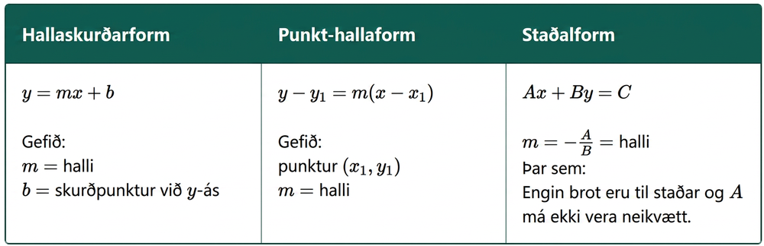
Learning Activity - Forms of Linear Equations📏
In Algebra, equations are commonly written in three different ways: slope-intercept form, point-slope form, and standard form. They are equivalent ways to write the same equation, but each one is useful for different reasons.
Notes:
Support for All Learners
This activity offers additional support and an extension for students:
For English language learners and students with disabilities, be sure to review the Learning Strategies slide!
Activity (20 minutes)
This activity has students write linear equations in slope-intercept, standard, and point-slope form, and convert between them. Facilitate discussion on when each form is useful and ensure students place values correctly. Remind them to use inverse operations when changing forms.
Launch
Ask students if they’ve seen these forms before and what they remember, especially what m stands for from activity 4.7.2. Have students work in pairs; independent students may work alone, but some may need support with substitution.
Answers
The temperature when the stove was turned on was 72 degrees Fahrenheit.
The temperature after 5 minutes was warmer than the temperature after 2 minutes.
The temperature of the water after 10 minutes was 212 degrees Fahrenheit.
The temperature of the water was the same after 10 minutes and after 12 minutes.
The temperature after 15 minutes was higher than the temperature after 30 minutes.
The temperature when the stove was turned on was lower than the temperature 30 minutes lat
More activity questions, answers, anticipated misconceptions, and synthesis on the next slide.

Slide 17
Learning Activity - Forms of Linear Equations📏
For slope-intercept form, the slope and y-intercept are needed:
Write an equation in slope-intercept form for a line whose slope is -2 and y-intercept is (0,4).
For point-slope form, the slope and one point are needed:
Write an equation in point-slope form for a line whose slope is ½ and goes through the point (3,−5).
Standard form of a linear equation is often used to find x- and y-intercepts of graphs. Often, equations start in another form and gets put into standard form. Standard form does not have fractions or decimals and cannot lead with a negative number.
Use the equation y = 2x + 3 for questions 3 and 4.
What is the slope of the equation?
Write the equation in standard form.
Notes:
Answers
y =−2x + 4
y + 5 = ½ (x − 3)
Substitute in the formula for (x₁,y₁) and slope.
y − y₁ = m(x − x₁)
y − (-5) = ½ (x − 3)
y + 5 = ½ (x − 3)
The slope (m) is 2.
2x − y = −3
Write the equation in the form Ax + By = C
Step 1 - Rearrange terms so the x term and the y term are both on the left side of the equation.
Subtract 2x from both sides:
y − 2x = 2x − 2x + 3
Step 2 - Write the x term first and simplify.
−2x + y = 3
Step 3 - Multiply both sides by -1, so as not to lead with a negative.
−1(−2x + y = 3)
2x − y = −3
Anticipated Misconceptions
If students have trouble with where to substitute values into the formulas, it can be helpful to have them highlight variables and the matching value, or use colored pencils to color code the value that will substitute into the formula. For example, in y = mx + b, if m = 3 and the y-intercept is -2, highlight the m and the 3 in pink in the formula and the given value, then highlight the b and the y-intercept value in yellow.
Activity Synthesis
Invite pairs to explain their steps and compare them to the feedback—did they use the same order?
Ask:
Which form is easiest? Hardest?
What should you watch out for in each?
Sample tips:
Slope-intercept: substitute slope and y-intercept correctly
Point-slope: plug into (x₁, y₁), not (x, y)
Standard: eliminate decimals/fractions, start with the x-term, avoid leading negatives
If time allows, have students write equations in one form and challenge a partner to rewrite it in another.

Slide 18
Learning Strategies - Forms of Linear Equations📏
Meet with other groups and share steps for rewriting equations.
Move away from saying plus, minus, take away, times, etc.
Use formal math language like: add, subtract, multiply, etc.
Stronger and Clearer Each Time
Teacher Instruction: Use these strategies to adjust the activity to support English language learners and students with disabilities.
You can copy and paste the callouts directly on top of the activity or give the instructions aloud.
Notes:
Support for English Language Learners: MLR 1 Stronger and Clearer Each Time: Writing, Listening, Conversing
Use this routine to prepare students for the whole-class discussion by providing them with multiple opportunities to clarify their explanations through conversation. Before the whole-class discussion begins, give students time to meet with 1-2 other groups to share their steps for rewriting equations from one form to the other. Invite listeners to press for accurate mathematical language to help speakers move away from informal language such as plus, minus, take away, times, etc. Encourage the use of more formal language such as add, subtract, multiply, etc.
Design Principle(s): Optimize output (for explanation); Maximize meta-awareness
Provide support for students
Distribute graphic organizers to the students to assist them with participating in this routine.

Slide 19
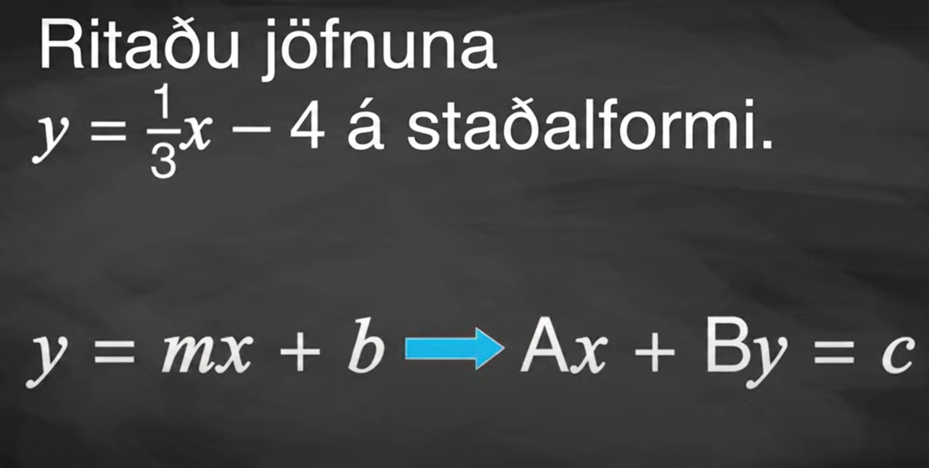
Writing Equations in Different Forms

Slide 20
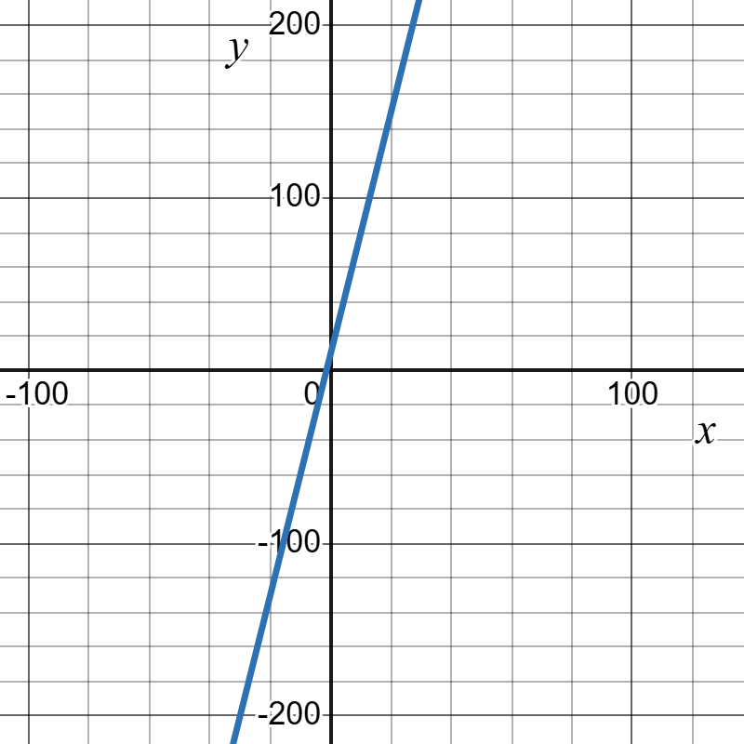
Self Check
Write the equation of the line in point-slope form that has a slope of 7 and goes through (−1,2).
y = 7x + 9
y − 2 = 7(x + 1)
y − 2 = 7(x − 1)
2 − y = 7(−1 − x)
Let’s review!
Notes:
Answer Feedback - Individualized by Response
y = 7x + 9
Incorrect. This is slope-intercept form. The correct answer is y − 2 = 7(x + 1).
y − 2 = 7(x + 1)
That’s correct! Substitute into point-slope form y − y₁ = m(x − x₁), where m is 7 and x₁ = 1 and y₁ = 2.
y − 2 = 7(x − 1)
Incorrect. Recall that x −(−1) becomes x + 1. The correct answer is y − 2 = 7(x + 1).
2 − y = 7(−1 − x)
Incorrect. Be sure to substitute the point into x₁ and y₁.

Slide 21
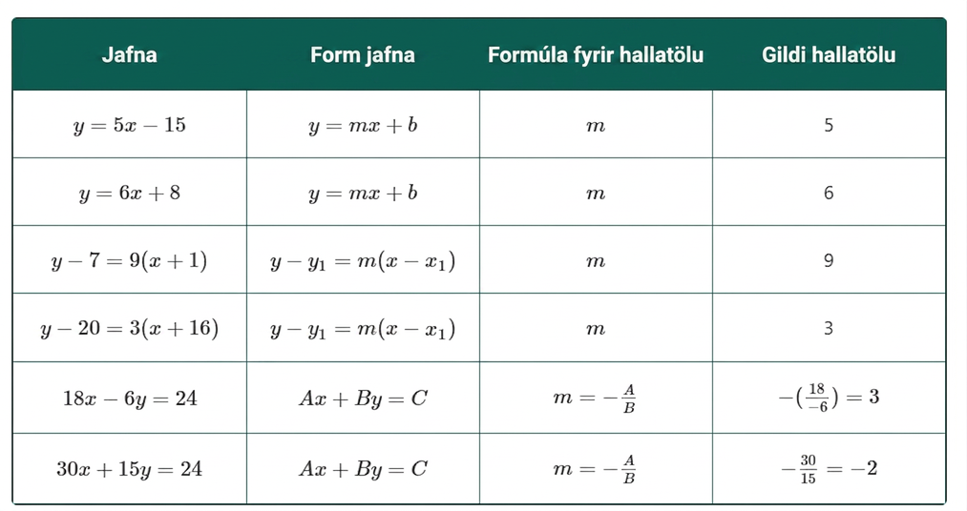
Self Check - Review
Example 1: When you look at equations in these forms, it's easy to identify the slope of m.
Notes:
Click here for additional review on the next slide.

Slide 22
Self Check - Review - Examples 2 and 3
Example 2: Find the equation of a line with slope −9 and y-intercept (0,−4) in slope-intercept form.
Step 1 - Identify the m and b.
Step 2 - Substitute into the formula.
Example 3: Find the equation of a line in point-slope form given a slope of −⅓ and the point (6,−4)
Step 1 - Identify the m and (x₁ , y₁).
Step 2 - Substitute into the formula.
Step 3 - Simplify.
Notes:
Click here for additional review on the next slide.
Example 2: Find the equation of a line with slope −9 and y-intercept (0,−4) in slope-intercept form.
Step 1 - Identify the m and b.
m = −9, b = −4
Step 2 - Substitute into the formula.
y = −9x − 4
Example 3: Find the equation of a line in point-slope form given a slope of −⅓ and the point (6,−4)
Step 1 - Identify the m and (x₁ , y₁).
m = −⅓, x₁ = 6, y₁ = −4
Step 2 - Substitute into the formula.
y − (−4) = −⅓(x − 6)
Step 3 - Simplify.
y + 4 = −⅓(x − 6)

Slide 23
Self Check - Review - Example 4
Example 4: Write the equation y + 4 = −⅓(x − 6) in standard form.
Step 1 - Multiply to get rid of the fraction. Remember, standard form cannot have decimals or fractions.
Step 2 - Distribute.
Step 3 - Rearrange terms so the x term and the y term are both on the left side of the equation.
Step 4 - Simplify.
Step 5 - Bring the constants to the right side.
Step 6 - Simplify.
Step 7 - Write the x term before the y term.
Notes:
Click here for additional review on the next slide.
Step 1 - Multiply to get rid of the fraction.
Remember, standard form cannot have decimals or fractions.
Multiply every term by 3.
3(y + 4) = 3(−⅓(x − 6))
3y + 12 = −(x − 6)
Step 2 - Distribute.
3y + 12 = −x + 6
Step 3 - Rearrange terms so the x term and the y term are both
on the left side of the equation.
Add x to both sides.
3y + 12 + x = −x + x + 6
Step 4 - Simplify.
3y + 12 + x = 6
Step 5 - Bring the constants to the right
side. Subtract 12 from both sides.
3y + 12 + x − 12 = 6 −12
Step 6 - Simplify.
3y + x = -6
Step 7 - Write the x term before the y term.
x + 3y = -6

Slide 24

Lesson Journey
Warm Up
Learning Activity
Practice
Learning Activity
Cool Down
Lesson Synthesis

Slide 25

Cool Down
With a partner, use what you have learned to write an equation in each form from two points.
Find the slope of the line that goes through (2,3) and (6, −4).
Write the equation of the line in point-slope form that goes through (2, 3)and (6, −4).
Write the equation of the line in slope-intercept form that goes through (2, 3) and (6, −4). (Hint: use the equation from number 2).
Write the equation of the line in standard form that goes through (2, 3) and (6, −4). (Hint: use the equation from number 3.)
Notes:
Cool Down (10 minutes)
Answers
Click HERE(Next Slide) for answers to questions 1 and 2
Response to Student Thinking - More Chances
If students are struggling with the concepts, pay close attention during the cool down and provide assistance where needed. Students will have more time in 4.8 to explore finding slope using the slope formula as a way to find the rate of change.

Slide 26
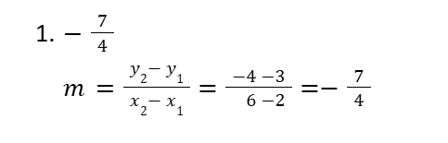
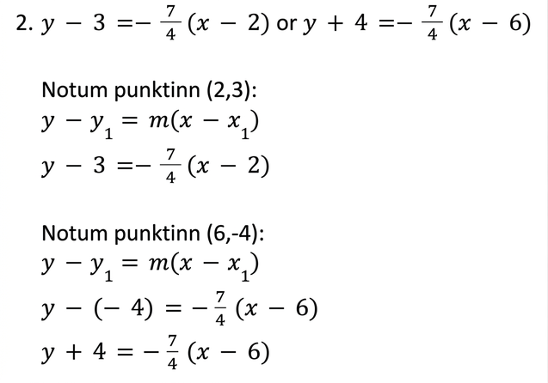
Cool Down - Answers Questions 1 and 2
Notes:
Answer Slide Questions 1 and 2
Click HERE(Next Slide) for answers to questions 3 and 4
Response to Student Thinking - More Chances
If students are struggling with the concepts, pay close attention during the cool down and provide assistance where needed. Students will have more time in 4.8 to explore finding slope using the slope formula as a way to find the rate of change.

Slide 27
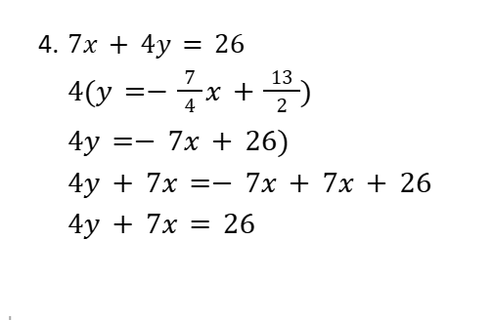
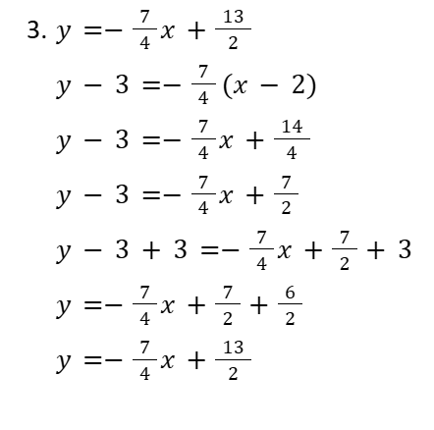
Cool Down - Answers Questions 3 and 4
Notes:
Answer Slide Questions 3 and 4
Response to Student Thinking - More Chances
If students are struggling with the concepts, pay close attention during the cool down and provide assistance where needed. Students will have more time in 4.8 to explore finding slope using the slope formula as a way to find the rate of change.

Slide 28

Lesson Journey
Warm Up
Learning Activity
Practice
Learning Activity
Cool Down
Lesson Synthesis

Slide 29

Practice
Put your hard work to action, practice what you’ve learned!
Notes:
Digital Practice: Access the practice pages at https://openstax.org/details/books/algebra-1

Slide 30

Lesson Journey
Warm Up
Learning Activity
Practice
Learning Activity
Cool Down
Lesson Synthesis

Slide 31
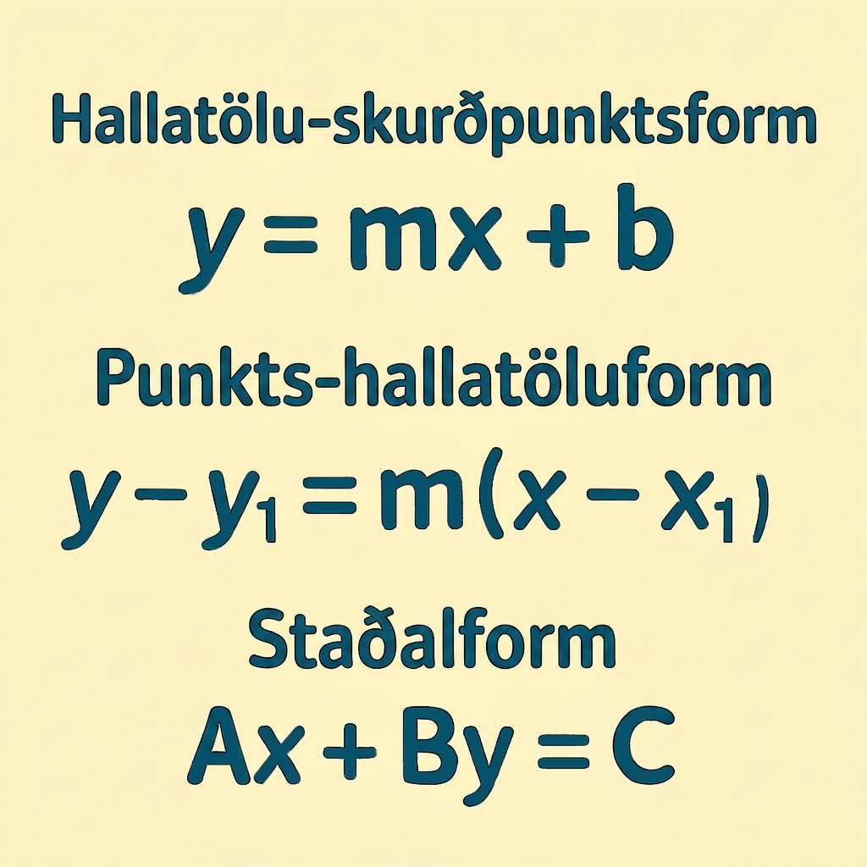
Lesson Synthesis
Some key takeaways from this lesson are that equations can be written in different forms. Often, one form is better than another based on the information given.
Ask students to create their own problems and write the equation three different ways.
Show that an equation in all three forms is equivalent by substituting a point into all three equations.
Continue to have students use formal mathematical vocabulary around slope and the different forms.
Notes:
In the next lesson, students will see how slope as rate of change occurs in real-world situations.
Closing the Lesson
After completing the Lesson Synthesis, wrap up the class by directing students to the Lesson Summary in their student textbook. In this section, students review the day’s learning targets, read summaries about the key takeaways from each activity, and then respond to a reflection question regarding their confidence with the material.
For more on the benefits of using this type of metacognitive reflection, see the Research in Practice section of the course.

Slide 32
Self Assessment
How much do you agree with the following statements?
I can… | I can | Almost | Not yet
Write the slope of a line.
Write the equation of a line in different forms.

