Slide 1


Algebra 1
Unit 2 Linear Inequalities and Systems
Lesson 2.8 Representing Situations with Inequalities

Slide 2
How to use these slides
On the activity slides check the speaker notes for teacher support and instructional information.
Each lesson includes 1 warm up, 2-3 learning activities, a cool down, practice and a lesson synthesis.
  Learning activities are followed by a self check question, and review section.
Some slides have been hidden from student view, more information can be found on the next slide (Reference Key).
You can edit and use these slides for personal and classroom use, but cannot sell them and must keep the attribution logos.
For more information, Check out the digital quick start guide!

Slide 3






Reference Key
Check the top right corner for an icon referencing these unique sections.
 | Support for Students with Disability | Hidden | Learning Strategies slide, provides additional support to students for understanding the activity. Learning Strategies slide, provides additional support to students for understanding the activity.
 | Support for English Language Learners | Hidden
 | Extending Your Thinking | Hidden | Extending Your Thinking slide, provides an extra challenge for students.
 | Self Check | Not Hidden | Self Check slide, checkpoint to assess student understanding after the learning activity.
 | Review | Hidden | Self Check- Review slide, designed to help review topics from the self check question.
On the next slides, check the speaker notes for teacher instructions and support.
Notes:
Check the Speaker Notes: On the next slides you can find discussion questions, lesson information, answers to the activities, and ways to adjust the activity for your students!

Slide 4

Learning Goals
By the end of this lesson you will be able to -
Write inequalities that represent the constraints in a situation.
Notes:
Lesson Narrative
Until now, students have worked with equations. In this lesson and the next two, they focus on interpreting, writing, and solving inequalities in one variable, building on grade 7 work (TEKS 7.10).
The lesson emphasizes writing inequalities to represent real-world constraints. Students identify key quantities, choose variables, and decide if multiple inequalities are needed, engaging in mathematical modeling.
Future lessons will build on this by finding and interpreting solutions to inequalities that model situations.
Required Preparation
None
Required Materials
None
Texas Essential Knowledge and Skills
A1(G) display, explain, and justify mathematical ideas and arguments using precise mathematical language in written or oral communication
A5(B) solve linear inequalities in one variable, including those for which the application of the distributive property is necessary and for which variables are included on both sides

Slide 5
Vocabulary
Previous
Constraint
  A limitation on the possible values of variables in a model, often expressed by an equation or inequality.
New
Inequality
  A mathematical sentence that contains <, >, ≥, ≤, or ≠ in order to compare two quantities.
Notes:
Lesson Vocabulary
To support student understanding of key vocabulary:
Familiarize students with the vocabulary words they will see throughout the lesson. Encourage students to look for these words and notice their use and meanings.
Encourage students to use key vocabulary words in “math talk” and their written and oral explanations.
Utilize a word wall. Sample cards are located here: Sample word wall cards are available here.
For newcomers or students with beginning English proficiency, use these Quizlet sets to support vocabulary learning:
Unit 2 Spanish Vocabulary – use first to build understanding
Unit 2 Vocabulary (English) – use after anchoring in Spanish
Support for English Language Learners
ELPS 1(A) use prior knowledge and experiences to understand meanings in English
ELPS 2(F) listen to and derive meaning from a variety of media such as audio tape, video, DVD, and CD ROM to build and reinforce concept and language attainment
ELPS 3(B) expand and internalize initial English vocabulary by learning and using high-frequency English words necessary for identifying and describing people, places, and objects, by retelling simple stories and basic information represented or supported by pictures, and by learning and using routine language needed for classroom communication
ELPS 3(E) share information in cooperative learning interactions
ELPS 3(F) ask and give information ranging from using a very limited bank of high-frequency, high- need, concrete vocabulary, including key words and expressions needed for basic communication in academic and social contexts, to using abstract and content-based vocabulary during extended speaking assignments
ELPS 3(H) narrate, describe, and explain with increasing specificity and detail as more English is acquired
ELPS 4(G) demonstrate comprehension of increasingly complex Eng by participating in shared reading, retelling or summarizing material, responding to questions, and taking notes commensurate with content area and grade level needs
ELPS 5(B) write using newly acquired basic vocabulary and content-based grade-level vocabulary

Slide 6





Lesson Journey
Warm Up
Learning Activity
Practice
Learning Activity
Cool Down
Lesson Synthesis

Slide 7


Warm Up - Inequalities 🚫
For questions 1–3, translate the inequality symbols into words.
h > 50
h ≤ 20
30 ≥ h
Is 25 a solution to any of the inequalities? Which one(s)?
Is 40 a solution to any of the inequalities? Which one(s)?
Is 30 a solution to any of the inequalities? Which one(s)?
Notes:
Warm Up (5 minutes)
In this activity, students recall the meaning of inequality symbols (<, >, ≤, and ≥) and the meaning of “solutions to an inequality.” They are reminded that an inequality in one variable can have a range of values that make the statement true. Students also pay attention to the value that is at the boundary of an inequality and consider whether it is or isn’t a solution to an inequality.
Launch
Give students 1 – 2 minutes of quiet work time. Follow with a whole-class discussion.
Activity Answers
greater than
less than or equal to
greater than or equal to
Yes; 25 is a solution to 30 ≥ h because 30 is greater than or equal to 25.
No; 40 is not a solution to any of the inequalities because 40 does not make any of the inequalities true when substituted in for h.
Yes; 30 is a solution to 30 ≥ h.
Activity Synthesis
Draw students’ attention to the last inequality (30≥h). Make sure students see that, even though the symbol is read “greater than or equal to,” it doesn’t mean that we’re looking for values that are greater than or equal to 30. The statement reads “30 is greater than or equal to h,” which means h must be less than or equal to 30.
Ask how students know if 50, 20, or 30 are solutions. Emphasize testing boundary values by checking if they make the statement true.
Show equations h=50h=50h=50, h=20h=20h=20, and 30=h30=h30=h. Discuss how equations have one solution, while inequalities have a range of solutions.

Slide 8

Lesson Journey
Warm Up
Learning Activity
Practice
Learning Activity
Cool Down
Lesson Synthesis

Slide 9

Learning Strategies - Senior Dance 💃
Teacher Instruction: Use these strategies to adjust the activity to support english language learners and students with disabilities.
You can copy and paste the callouts directly on top of the activity or give the instructions aloud.
First read: listen and describe the situation without numbers.
Second read: list what can be counted or measured.
Third read: listen for the question and brainstorm ways to solve.
Three Reads
Ask for help if any directions are unclear.
Representation
Notes:
Support for English Language Learners: MLR 6 Three Reads: Reading, Listening, Conversing
Use this routine to support reading comprehension of this problem. Use the first read to orient students to the situation. Ask students to describe what the situation is about without using numbers (students planning a budget for an upcoming special event). Take time to discuss the meaning of unfamiliar terms at this time (Senior Dance, budget, chaperone, profit, etc.). Use the second read to identify quantities and relationships. Ask students what can be counted or measured without focusing on the values (number of people who attended in the past, maximum number of people expected this year, ratio of chaperones to students, maximum ticket price, minimum amount of profit needed, etc.). After the third read, ask students to brainstorm possible strategies to answer the questions. This will help students make sense of language used to describe situations involving inequalities.
Design Principle(s): Support sense-making
Learn more about this routine
View the instructional video and follow along with the materials to assist you with learning this routine.
Provide support for students
Distribute graphic organizers to the students to assist them with participating in this routine.
Support for Students with Disabilities: Representation: Internalize Comprehension
Provide appropriate reading accommodations and supports to ensure student access to written directions, word problems, and other text-based content.
Supports accessibility for: Language; Conceptual Processing

Slide 10

Learning Activity - Senior Dance 💃
Seniors in a high school student council are trying to develop a budget for the Senior Dance. The revenue from ticket sales needs to cover the cost of the meals and entertainment and also make a profit of at least $200 to be contributed to the school.
Here is some information they have gathered:
Last year, 120 people attended. It was a success and is expected to be even bigger this year. Up to 200 people will attend.
There needs to be at least 1 chaperone for every 20 students.
The ticket price cannot exceed $20 per person.
Notes:
Support for All Learners
This activity offers additional support and an extension for students:
For english language learners and students with disabilities, be sure to review the Learning Strategies slide!
For students looking for an extra challenge, be sure to review the Extending Your Thinking slide!
Activity (15 minutes)
This activity prompts students to interpret several inequalities that represent the constraints in a situation. To explain what the letters in the inequalities mean in the given context, students cannot simply match the numbers in the verbal descriptions and those in the inequalities. They must attend carefully to the symbols and any operations and reason both quantitatively and abstractly. The work here also engages students in an aspect of mathematical modeling. As students discuss with their partners, listen for those who could interpret the inequalities clearly and accurately. Ask them to share their interpretations later.
Launch
Arrange students in groups of 2. Give them a few minutes of quiet time to think individually, followed by some time to share their thinking with their partner.
Activity image answer, and synthesis on the next slide.

Slide 11

Learning Activity - Senior Dance 💃
Here are some inequalities the seniors wrote about the situation. Each letter stands for one quantity in the situation. Determine the meaning of each letter(variable) .
t ≤ 20
120 ≤ p ≤ 200
pt − m ≥ 200
c ≥ p/20
Are you ready for more?
Notes:
Activity Answer
t ≤ 20 means that the ticket price, t, must be less than or equal to $20.
120 ≤ p ≤ 200 means that between 120 and 200 people are expected to attend (120 is less than or equal to the number of people; the number of people is less than or equal to 200). p represents the number of people attending the dance.
pt − m ≥ 200 means that the total amount collected from ticket sales in dollars, pt, minus the cost of meals and entertainment in dollars, m, must be greater than or equal to $200.
c ≥ p/20 means that the number of chaperones, c, must be at least 120 of the number of students attending.
Activity Synthesis
Invite previously identified students to share their responses. Make sure students understand why the symbols accurately represent the constraints in the situation.
For the last two inequalities, make sure students see how the operations represent the constraints on profit and on the number of chaperones.
If needed, use numbers to illustrate the relationship between variables. For example, to help students make sense of c ≥ p/20, ask: “How many chaperones are needed if there are 120 students?” (at least 120/20 or 6 chaperones, or c ≥ 120/20) “180 students?” (at least 180/20 or 9 chaperones, or c ≥ 180/20)

Slide 12

Extending Your Thinking
Kiran says we should add the constraint t ≥ 0 to the list made by the seniors.
What is the reasoning behind this constraint?
What other “natural constraint” like this should be added?
Notes:
Answer
We can't have a negative ticket price.
By the same reasoning, we might want to include m ≥ 0. Note that the other variables should also be greater than or equal to 0, but those conditions are already implied by the existing constraints.

Slide 13

Self Check
A zookeeper feeds the tigers a meal of rabbits and chickens. The average rabbit weighs 4 pounds, and the average chicken weighs 5 pounds. Each tiger must eat at least 15 pounds of meat per day. The zookeeper writes the inequality 4x + 5y ≥ 15 to represent a tiger’s daily diet.
What is meant by the letter y in the inequality above?
the number of rabbits a tiger eats daily
the average weight of a rabbit
the number of chickens a tiger eats daily
the average weight of a chicken
Let’s review!
Notes:
Answer Feedback - Individualized by Response
the number of rabbits a tiger eats daily
Incorrect. Let’s try again a different way: The number of rabbits a tiger eats daily is represented by x. The answer is the number of chickens a tiger eats daily.
the average weight of a rabbit
Incorrect. Let’s try again a different way: The average weight of a rabbit is 4 pounds. The answer is the number of chickens a tiger eats daily.
the number of chickens a tiger eats daily
That’s correct! Check yourself: The letter y represents the number of chickens a tiger eats daily.
the average weight of a chicken
Incorrect. Let’s try again a different way: The average weight of a chicken is 5 pounds. The answer is the number of chickens a tiger eats daily.

Slide 14
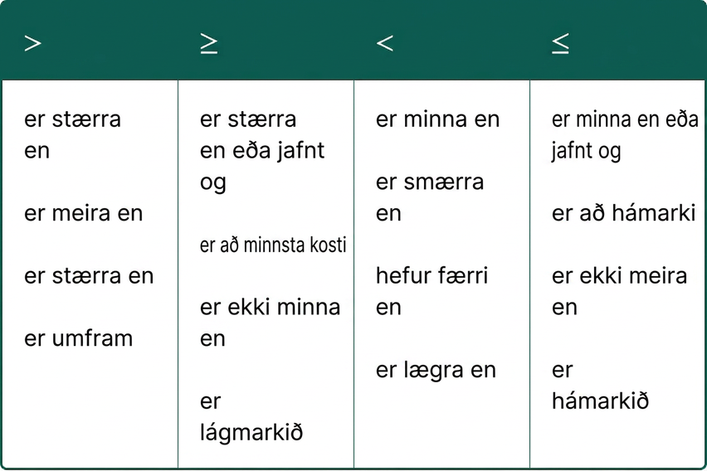


Self Check - Review
Translate the following sentences into inequalities using the symbols.
1.
2.
Notes:
To translate English sentences into inequalities, we need to recognize the phrases that indicate the inequality. Some words are easy, like “more than” and “less than.” But others are not as obvious. The table shows some common phrases that indicate inequalities.
Answer
X - 27 ≥ 48
Z + 5 < 52

Slide 15
Lesson Journey
Warm Up
Learning Activity
Practice
Learning Activity
Cool Down
Lesson Synthesis

Slide 16
Learning Strategies - Elevator Car 🛗
Teacher Instruction: Use these strategies to adjust the activity to support english language learners and students with disabilities.
  You can copy and paste the callouts directly on top of the activity or give the instructions aloud.
Share your responses with the class.
We’ll record and highlight words or phrases that explain what each equation or inequality means.
Notice how the same idea can be shown in different ways—through words in the problem or with equations and inequalities.
Collect and Display
Notes:
Support for English Language Learners: MLR 2 Collect and Display: Speaking, Representing
Use this routine to support whole-class discussion. As students share their responses, amplify and record any words and phrases that describe the meaning of each equation or inequality on a display. Call students’ attention to the different ways the constraints are represented by language in context and equations or inequalities of different forms.
Design Principle(s): Maximize meta-awareness; Cultivate conversation
Provide support for students
Distribute graphic organizers to the students to assist them with participating in this routine.
Support for Students with Disabilities: N/A

Slide 17

Learning Activity - Elevator Car 🛗
An elevator holds at most 15 people. Each car can carry a maximum of 1,500 kg. Adults weigh 70 kg, children 35 kg, and each person carries 4 kg of gear.
Write as many equations/inequalities as you can to model the constraints. Define your variables (don’t use z, m, or g).
After finishing, explain how you adjusted the equations and inequalities for clarity. Then trade with a partner and read each other’s work.
Notes:
Support for All Learners
This activity offers additional support and an extension for students:
For english language learners and students with disabilities, be sure to review the Learning Strategies slide!
Activity (15 minutes)
Previously, students interpreted inequalities. Now they write inequalities to model constraints, identifying key quantities and relationships. Look for students who represent the same constraint in different ways (e.g., w ≤ 1500, 1500 ≥ w,
w < 1500, or w = 1500) and have them share.
Launch
Keep students in groups of 2.
Answers:
Your answer may vary, but here are some samples:
p≤15 , where p represents the number of people in an elevator car
w=70a+35c+4a+4c
74a+39c≤1,500
Your answers will vary.
More activity questions, answers, anticipated misconceptions, and synthesis on the next slide.

Slide 18

Learning Activity - Elevator Car 🛗
Rewrite your equations and inequalities so that they would work for a different building where:
  an elevator car can hold at most z people
  each car can carry a maximum of m kilograms
  each person carries d kg of gear
Notes:
Answers
Your answer may vary, but here are some samples:
n elevator car can hold at most z people
each car can carry a maximum of m kilograms
each person carries d kg of gear
Anticipated Misconceptions
Students who use a variable for the number of adults and another for the number of children may have trouble accounting for the weight of the gear because it applies to both groups. Calculating the weight of a specific combination of adults and children (with their gear) may help.
Activity Synthesis
Invite students to share their equations and inequalities, starting with those that are more concrete (from the first question) and ending with the ones that are more abstract (from the last question).
Emphasize that the same constraints may be accurately represented by statements of different forms. Consider reading aloud the different inequalities that represent the same constraint. For example, if w represents the total weight:
w≤1,500 can be read: “The total weight is less than or equal to 1,500 kilograms” or “The total weight is at most 1,500 kilograms.”
1,500≥w can be read: “Fifteen hundred kilograms is greater than or equal to the total weight.”
w<1,500 or w=1,500 can be read: “The total weight is less than 1,500 kilograms, or it is equal to 1,500 kilograms.”
For constraints that involve multiple quantities, some students may write, for instance, 74a+39c≤1,500, while others may write 70a+4a+35c+4c≤1,500. Ask students why these expressions are equivalent, encouraging them to use the context in their explanation. Point out that although a constraint can be written in different ways, writing it using fewer terms may be more convenient and may allow us to gain certain insights about the situation.

Slide 19
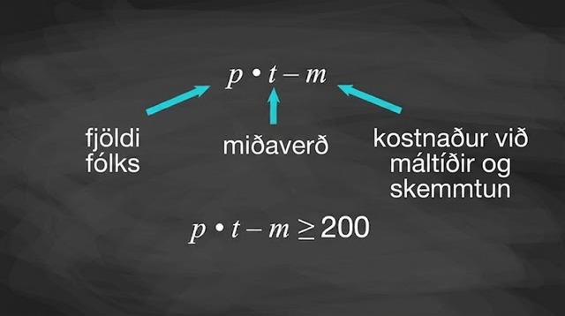
Video: Writing Inequalities to Represent Constraints Solution

Slide 20

Self Check
Serena is running a juice shop. Oranges cost $2 per pound. She can spend at most $64 per day on oranges. If p represents the number of pounds of oranges Serena can buy per day, which of the following inequalities is true?
2p ≤ 64
2p < 64
2p ≥ 64
2p > 64
Let’s review!
Notes:
Answer Feedback - Individualized by Response
2p ≤ 64
That's correct! Check yourself: The statement 2p≤64 means she can spend at most $64 at $2 per pound.
2p<64
Incorrect. Let’s try again a different way: This statement needs to include spending exactly $64. The answer is 2p≤64.
2p ≥ 64
Incorrect. Let’s try again a different way: The cost cannot be greater than $64. The answer is 2p≤64.
2p > 64
Incorrect. Let’s try again a different way: The cost cannot exceed $64. The answer is 2p≤64.

Slide 21

Self Check - Review
Dawn won a mini-grant of $4,000 to buy tablet computers for her classroom. The tablets she would like to buy cost $254.12 each, including tax and delivery. Write an inequality to represent the maximum number of tablets Dawn can buy.
Step 1 - Read the problem.
Step 2 - Identify what you are looking for.
Step 3 - Name what you are looking for.
Step 4 - Translate. Write a sentence that gives the information to find it.
Notes:
Many real-life situations require us to solve inequalities. The method we will use to solve applications with linear inequalities is very much like the one we used when we solved applications with equations.
We will read the problem and make sure all the words are understood. Next, we will identify what we are looking for and assign a variable to represent it. We will restate the problem in one sentence to make it easy to translate into an inequality.
Solution
Step 1 - Read the problem.
Step 2 - Identify what you are looking for.
the maximum number of tablets Dawn can buy
Step 3 - Name what you are looking for. Choose a variable to represent that quantity.
Let 𝑛=the number of tablets.
Step 4 - Translate. Write a sentence that gives the information to find it.
$254.12 times the number of tablets is no more than $4,000.
Translate into an inequality.
254.12𝑛≤4000

Slide 22

Lesson Journey
Warm Up
Learning Activity
Practice
Learning Activity
Cool Down
Lesson Synthesis

Slide 23

Cool Down
Han has a budget of $25 to buy grapes. Write inequalities to represent the number of pounds of grapes that Han could buy in each situation:
Grapes cost $1.99 per pound.
Grapes cost $2.49 per pound.
Grapes cost $c per pound.
Notes:
Cool Down (5 minutes)
Answers
1.99g≤25
2.49g≤25
cg≤25
Response to Student Thinking - More Chances
Students will have more opportunities to understand the mathematical ideas in this cool-down, so there is no need to slow down or add additional work to the next lessons. Instead, use the results of this cool-down to provide guidance for what to look for and emphasize over the next several lessons to support students in advancing their current understanding.

Slide 24

Lesson Journey
Warm Up
Learning Activity
Practice
Learning Activity
Cool Down
Lesson Synthesis

Slide 25
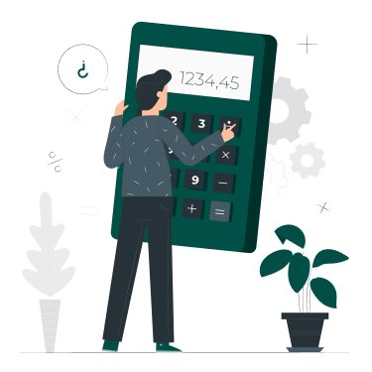
Practice
Put your hard work to action, practice what you’ve learned!
Notes:
Digital Practice: Access the practice pages at https://openstax.org/details/books/algebra-1

Slide 26

Lesson Journey
Warm Up
Learning Activity
Practice
Learning Activity
Cool Down
Lesson Synthesis

Slide 27
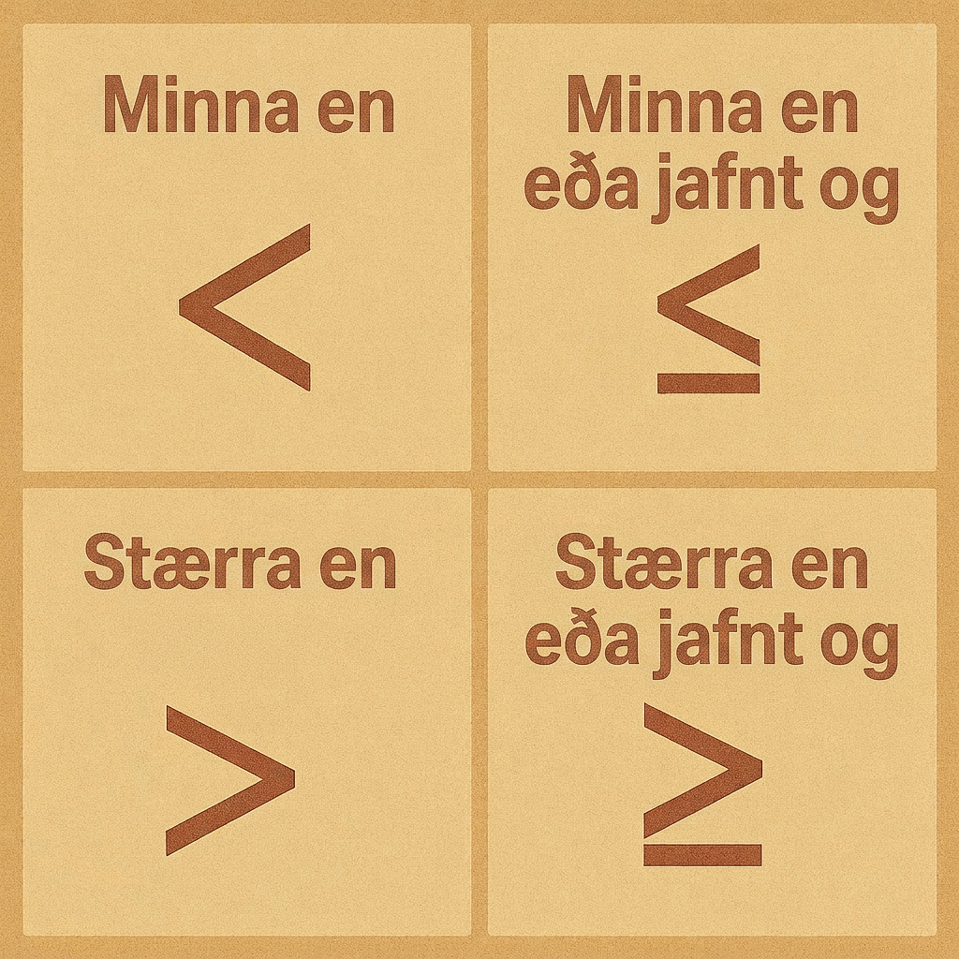
Lesson Synthesis
What are some of the advantages and disadvantages for representing constraints as inequalities?
Share some advice for students who might just be learning to write inequalities to represent constraints. What should they pay attention to? What are some potential sources of confusion or error they should look out for?
Notes:
Prompt and Answers: Solicit from students any advantages and disadvantages for representing constraints as inequalities.
Some advantages students might bring up:
Compared to written words, inequalities are a simpler and quicker way to describe what is happening in a situation.
It is easier to see what values a certain quantity could or could not take when the constraint is written with symbols and numbers.
Possible disadvantages:
Unless we know what the variables stand for, we can’t be sure about the meaning of an inequality.
If we don’t recall what the symbols mean or how to read them, we can’t access the information.
Next, invite students to share some advice for students who might just be learning to write inequalities to represent constraints. What should they pay attention to? What are some potential sources of confusion or error they should look out for? Students might mention that the following are important things to attend to:
Specifying the meaning of each variable
Not using the same variable to represent different quantities
Making sure that the correct symbols are used to represent relationships
Using words to read each inequality to make sure that it fully represents a constraint

Slide 28
Self Assessment
How much do you agree with the following statements?
I can… | I can | Almost | Not yet
Write inequalities that represent the constraints in a situation.

