Slide 1
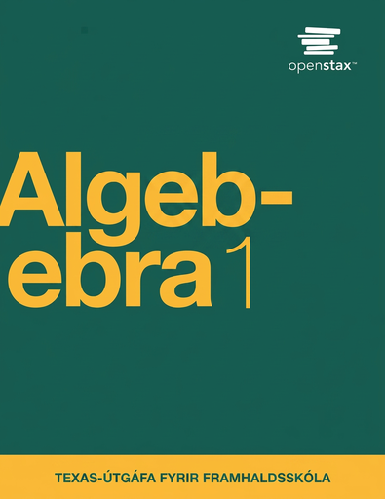

Algebra 1
Unit 4 Functions
Lesson 4.4 Using Function Notation to Describe Rules, Part 1

Slide 2
How to use these slides
On the activity slides check the speaker notes for teacher support and instructional information.
Each lesson includes 1 warm up, 2-3 learning activities, a cool down, practice and a lesson synthesis.
  Learning activities are followed by a self check question, and review section.
Some slides have been hidden from student view, more information can be found on the next slide (Reference Key).
You can edit and use these slides for personal and classroom use, but cannot sell them and must keep the attribution logos.
For more information, Check out the digital quick start guide!

Slide 3






Reference Key
Check the top right corner for an icon referencing these unique sections.
 | Support for Students with Disability | Hidden | Learning Strategies slide, provides additional support to students for understanding the activity. Learning Strategies slide, provides additional support to students for understanding the activity.
 | Support for English Language Learners | Hidden
 | Extending Your Thinking | Hidden | Extending Your Thinking slide, provides an extra challenge for students.
 | Self Check | Not Hidden | Self Check slide, checkpoint to assess student understanding after the learning activity.
 | Review | Hidden | Self Check- Review slide, designed to help review topics from the self check question.
On the next slides, check the speaker notes for teacher instructions and support.
Notes:
Check the Speaker Notes: On the next slides you can find discussion questions, lesson information, answers to the activities, and ways to adjust the activity for your students!

Slide 4

Learning Goals
By the end of this lesson you will be able to -
Explain rules of functions when they are written in function notation and create tables and graphs to represent the functions.
Write equations that represent the rules of functions.
Notes:
Lesson Narrative
In earlier lessons, students used function notation to represent specific input-output pairs or relationships between them, like p(2.5) = 18 or W(10) = W(12).
In this lesson, students learn that function notation can express a general rule. For instance, they see that if the output of a function f can be found by multiplying the input by 3 and then subtracting 10 from the result, we can write
f(x) = 3x − 10 to represent this rule. We can also use this rule (either the verbal description or the equation) to find the output for any input. In some cases, the rule can also be used to find the input when we know the output.
Students continue translating between situations and symbolic representations and connect different forms of functions by identifying structure.
Required Preparation
None
Required Materials
None
Texas Essential Knowledge and Skills
A1(F) analyze mathematical relationships to connect and communicate mathematical ideas
A12(B) evaluate functions, expressed in function notation, given one or more elements in their domains

Slide 5
Vocabulary
Previous
Function
  A relation that takes inputs from one set and assigns them to outputs from another set, assigning exactly one output to each input.
Input
  The value that is substituted into a function.
Output
  The value that results from substituting the input values into a
  function.
New
None
Notes:
Lesson Vocabulary
To support student understanding of key vocabulary:
Introduce and review the vocabulary words students will see in this lesson.
Encourage students to notice how these words are used and to include them in their math discussions and explanations—both written and oral.
Use a word wall to reinforce vocabulary. Sample word wall cards are available here.
For newcomers or students with beginning English proficiency, use these Quizlet sets to support vocabulary learning:
Unit 4 Spanish Vocabulary, part 1 – use first to build understanding
Unit 4 Vocabulary (English), part 1 – use after anchoring in Spanish
Unit 4 Spanish Vocabulary, part 2 – use first to build understanding
Unit 4 Vocabulary (English), part 2 – use after anchoring in Spanish
Support for English Language Learners
ELPS 1(F) use accessible language and learn new and essential language in the process
ELPS 2(F) listen to and derive meaning from a variety of media such as audiotape, video, DVD, and CD-ROM to build and reinforce concept and language attainment
ELPS 3(F) ask and give information ranging from using a very limited bank of high-frequency, high-need, concrete vocabulary, including key words and expressions needed for basic communication in academic and social contexts, to using abstract and content-based vocabulary during extended speaking assignments

Slide 6





Lesson Journey
Warm Up
Learning Activity
Practice
Learning Activity
Cool Down
Lesson Synthesis

Slide 7
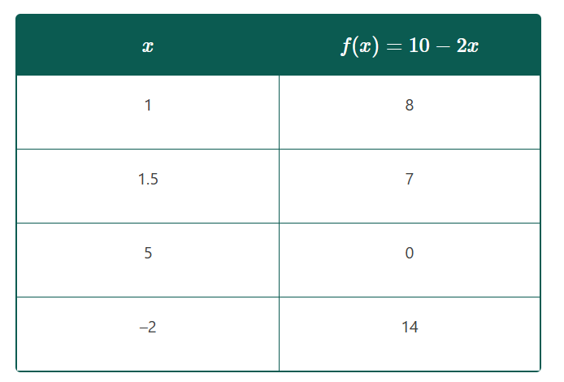
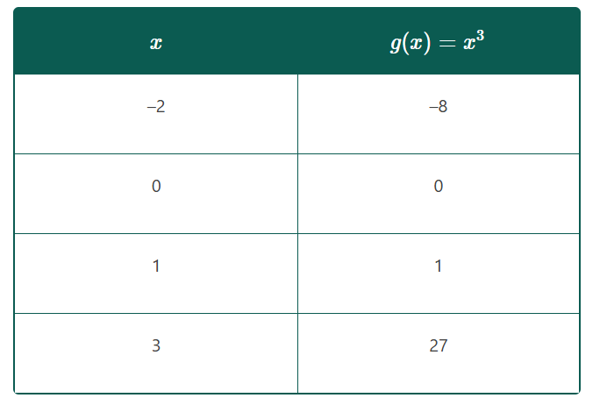
Warm Up - Functions In Tables 🔢
Think of at least one thing you notice and at least one thing you wonder about the tables,.
Now discuss the things you noticed with your partner,
Notes:
Warm Up (5 minutes)
This warm-up introduces a new use of function notation and previews the lesson.
It helps students notice structure, such as how values in the tables match each function’s expression. The specific structure they might notice is how the values in the f(x) and the g(x) columns in each table correspond to the expression describing each function.
By sharing what they notice and wonder, students practice using precise language to describe their observations.
Launch
Display the tables for all to see. Tell students that their job is to think of at least one thing they notice and at least one thing they wonder. Give students 1 minute of quiet time to think individually, and then 1 minute to discuss the things they notice with their partner, followed by a whole-class discussion.
Activity Answers
What do you notice?
The tables don't say “input” and “output.”
While there is a column labeled x , there is not a column labeled y.
One function is called f. The other is called g.
There’s an expression (rather than a number) on the right side of the equation f(x) = 10 − 2x and g(x) = x³.
If we substitute the values in the left column for the x in the expression, we get the values in the right column.
What do you wonder?
Why is there an x on the right side of the equal sign?
Are there rules about how to name functions?
What does each equation, f(x) = 10 − 2x and g(x) = x³, mean?
Activity Synthesis
Ask students to share the things they noticed and wondered. Record and display their responses for all to see. If possible, record the relevant reasoning on or near the tables. After all responses have been recorded without commentary or editing, ask students, “Is there anything on this list that you are wondering about?” Encourage students to respectfully disagree, ask for clarification, or point out contradicting information.

Slide 8

Lesson Journey
Warm Up
Learning Activity
Practice
Learning Activity
Cool Down
Lesson Synthesis

Slide 9

Learning Activity - Functions Have Rules📄
This function takes any input and cubes it to generate the output.
Find the output when the inputs are 0, 1, 3, and x.
Write the input-output relationship using function notation and name the function g.
Notes:
Support for All Learners
This activity offers additional support and an extension for students:
For English language learners and students with disabilities, be sure to review the Learning Strategies slide!
For students looking for an extra challenge, be sure to review the Extending Your Thinking slide!
Activity (10 minutes)
In this activity, students learn that functions can be defined by rules described in words or equations. They explore simple rules and connect verbal and algebraic representations, encouraging them to notice structure.
The use of function notation reinforces their understanding and builds their ability to describe functions symbolically.
Launch
Display an image of a “function machine” with “cube the input” as the rule.
Tell students that a function takes any input and cubes it to generate the output. Ask students to:
Find the output when the inputs are 0, 1, 3, and x.
Write the input-output relationship using function notation and name the function g.
Answers:
g(0) = 0
g(1) = 1
g(3) = 27
g(x) = x³
If not mentioned by students, point out that these equations describe the same function as that shown by the second table in the warm up.
Explain to students that some functions have a specific rule for getting the output. The rule can be described in words (like “cube the input”) or with expressions (such as x³). Tell students that they’ll now look at some rules expressed in both ways.
More activities, answers, and synthesis on the next slide.

Slide 10
Learning Strategies - Functions Have Rules📄
Teacher Instruction: Use these strategies to adjust the activity to support English language learners and students with disabilities.
You can copy and paste the callouts directly on top of the activity or give the instructions aloud.
“The equation _____ matches _____ because . . .”
“I noticed _____, so . . .”
Use mathematical language such as “input” and “output.
Discussion Supports
Once you have completed a match, wait for the rest of the class to finish so we can discuss our choices before we move on.
Would anyone like to share their strategies?
Representation
Notes:
Support for English Language Learners: MLR 8 Discussion Supports: Speaking, Representing
Use this routine to support whole-class discussion as students explain how they matched the descriptions to the equations. Display the following sentence frames for all to see: “The equation _____ matches _____ because . . .” and “I noticed _____, so . . . .” Encourage students to challenge each other when they disagree. If necessary, re-voice student ideas to demonstrate using mathematical language such as “input” and “output.” This will help students use the structure of equations to make connections between equations and descriptions of functions.
Design Principle(s): Support sense-making
Support for Students with Disabilities: Representation: Internalize Comprehension
Chunk this task into more manageable parts to differentiate the degree of difficulty or complexity. Give students a subset of the expressions and descriptions to start with and hold a brief small-group or whole-class discussion once students have completed the first match. Invite 1 – 2 students to share their strategies for finding a match before introducing the remaining expressions and descriptions.
Supports accessibility for: Conceptual processing; Organization

Slide 11
Learning Activity - Functions Have Rules📄
Match each equation with a verbal description that represents the same function.
f(x) = 3x − 7
g(x) = 3(x − 7)
h(x) = ˣ⁄₃ − 7
k(x) = ⁽ ˣ⁻⁷⁾⁄₃
Subtract 7 from the input, then divide the result by 3.
Divide the input by 3, and then subtract 7 from the result.
Subtract 7 from the input, then multiply the result by 3.
Multiply the input by 3, then subtract 7 from the result.
Which function has an output of –3 when the input is 6? Explain how you know.
Which function value is the greatest when the input is 0?
Which function value is the greatest when the input is 10?
Are you ready for more?
Notes:
Activity Answer
Compare your work: Your answer may vary, but here is a sample for each day.
d
c
b
a
The correct answer is function g, because when x is 6, the expression 3(x − 7) has a value of –3.
When x is 0, k(x) has the greatest value.
When x is 10, f(x) has the greatest value.
Activity Synthesis
Invite students to briefly share how they matched the equations and verbal descriptions in the first question. Discuss questions such as:
“The expressions for functions f and g both involve multiplying by 3 and subtracting 7. How are they different?”
The order of operations is different. Function f multiplies by 3, then subtracts 7. Function g subtracts 7 first, then multiplies by 3.
“The expressions for h and k both involve subtracting 7 and dividing by 3. How did you decide which one corresponds to description A and which one corresponds to D?”
By identifying what happens to x first. In h, x is divided by 3 before subtracting 7, so it matches description D.
Next, ask:
Which function has (6, –3) as an input-output pair?
g(x) = 3(x − 7)
Which function has the greatest output when x is 0?
Which function has the greatest output when x is 10?
f(x) = 3x − 7
Highlight explanations involving evaluating the functions at those input values.each function at those input values and seeing which one generates –3 for the output or gives the greatest output.
The functions in this activity are given without a context. Tell students that they will now look at rules that describe relationships between quantities in situations.

Slide 12
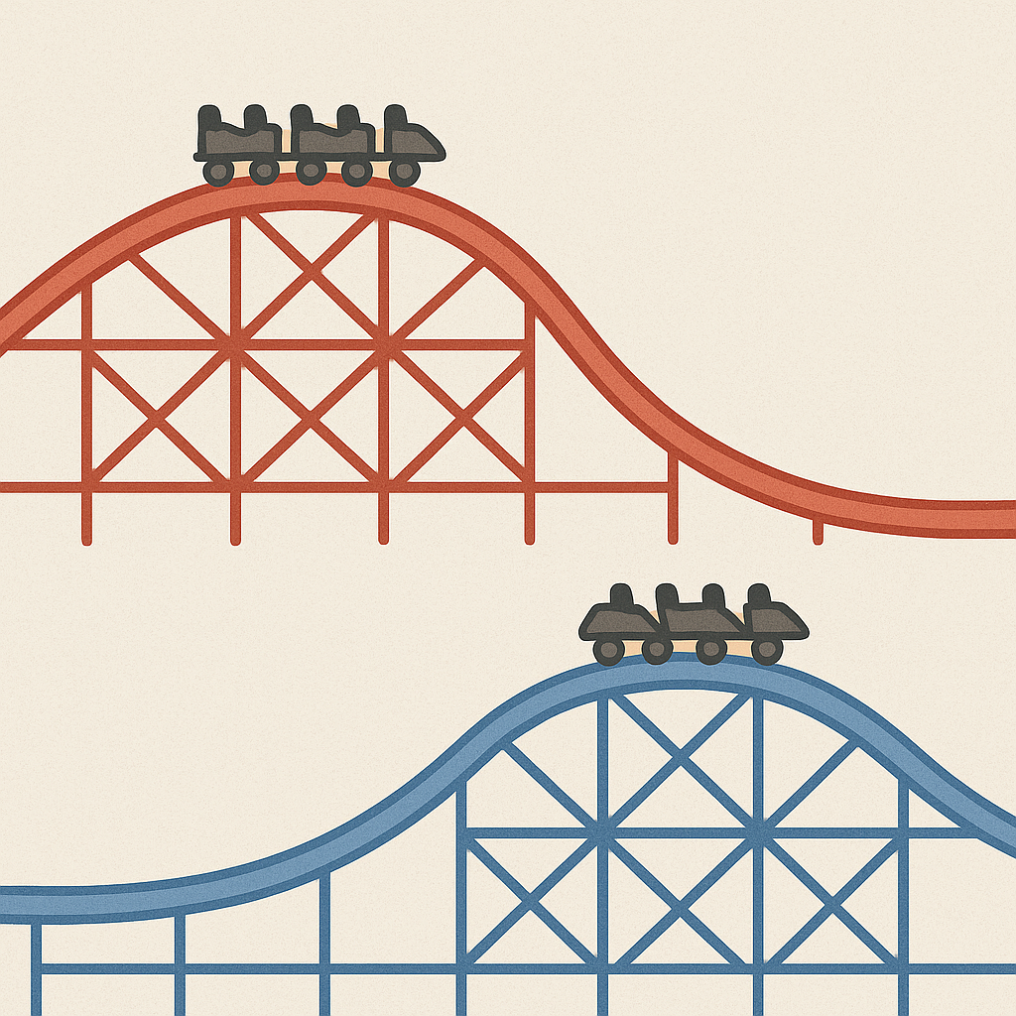
Extending Your Thinking
f(x) = 3x − 7
g(x) = 3(x − 7)
Mai says f(x) is always greater than g(x) for the same value of x. Is this true? Explain how you know.
Notes:
Answer
Your answer may vary, but here is a sample.
Mai's statement is true.
We can start by rewriting g(x) as g(x) = 3x − 21.
Then, to get the output of both functions, we first multiply the input, x, by 3 to get 3x, and then we subtract a value from it.
For function f, we subtract 7.
For function g, we subtract 21.
The output of g will always be 14 less than that of f.

Slide 13
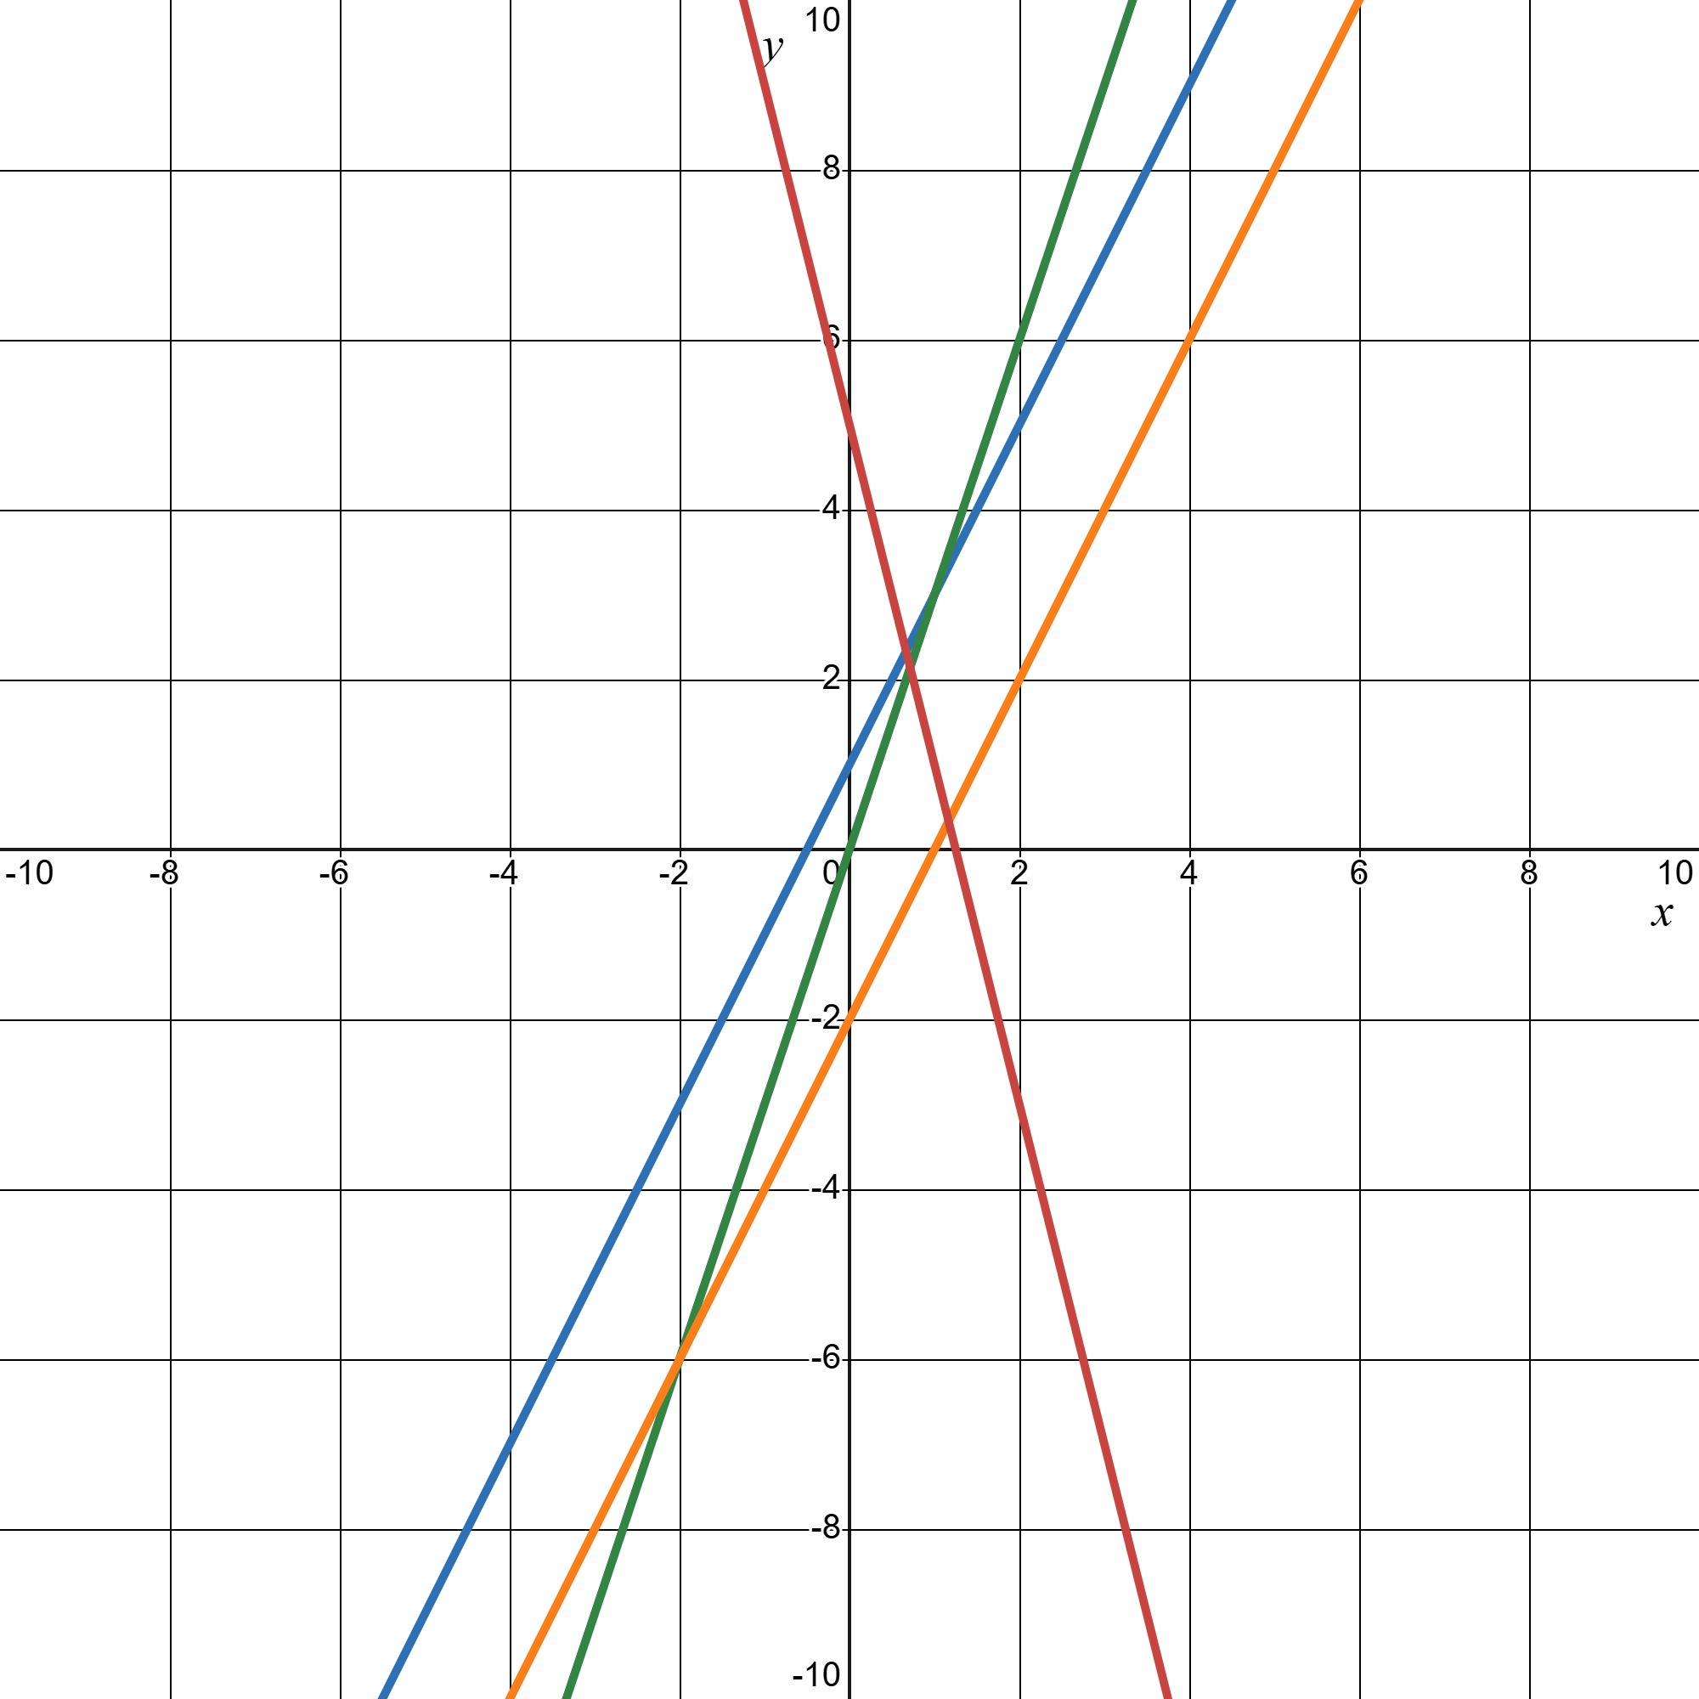
Self Check
Which function has the least value when x = 0?
f(x) = 2x + 1
f(x) = 3x
f(x) = 2(x − 1)
f(x) = −4x + 5
Let’s review!
Notes:
Answer Feedback - Individualized by Response
Incorrect. Substitute x = 0: 2(0) + 1 = 1. Check all of the functions. One is not the least value. The answer is f(x)=2(x − 1).
Incorrect. Substitute x = 0: 3(0) = 0. Check all of the functions. Zero is not the least value. The answer is f(x)=2(x − 1).
That’s correct! Substitute x = 0 and 2(0 − 1) = 2(−1) = −2.
Incorrect. Substitute x = 0: −4(0) + 5 = 5. This is the greatest value, not the least value. The answer is f(x)=2(x − 1).

Slide 14
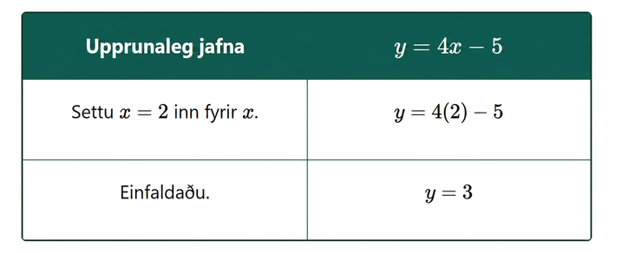
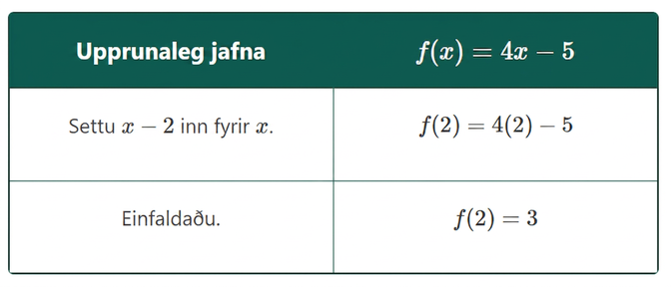
Self Check - Review
This process of finding the value of f(x) for a given value of x is called evaluating the function.
Given x = 2, compare the steps to solve an equation as shown in the left table, versus the steps to evaluate a function as shown in the right.
Let’s look at the equation y = 4x − 5.
The same equation in function notation is f(x) = 4x - 5
Table 1
Table 2
Notes:
Evaluating Functions with Function Notation
Answer:
Using Table 1: To find the value of y when x = 2, substitute x = 2 into the equation and then simplify. The value of the y at x = 2 is 3.
Using Table 2: To find the value of the function when x = 2, substitute x = 2 into the equation and then simplify. The value of function at x = 2 is 3.
Find the Value of a Function
It is very convenient to name a function, and most often we name it f, g, or h.
In any function, for each x-value from the domain we get a corresponding y-value in the range.
For the function f, we write this range value y as f(x). This is called function notation.
Function Notation
For the function y=f(x):
f is the name of the function.
x is the input value.
f(x) is the output value, y, corresponding to the value of x.
We read f(x) as f of x or the value of f at x.
Independent and Dependent Variables
For the function y=f(x),
We call x the independent variable as it can be any value in the domain.
We call y the dependent variable as its value depends on x.
Much as when you first encountered the variable x, function notation may be rather unsettling. It seems strange because it is new. You will feel more comfortable with the notation as you use it.

Slide 15
Lesson Journey
Warm Up
Learning Activity
Practice
Learning Activity
Cool Down
Lesson Synthesis

Slide 16
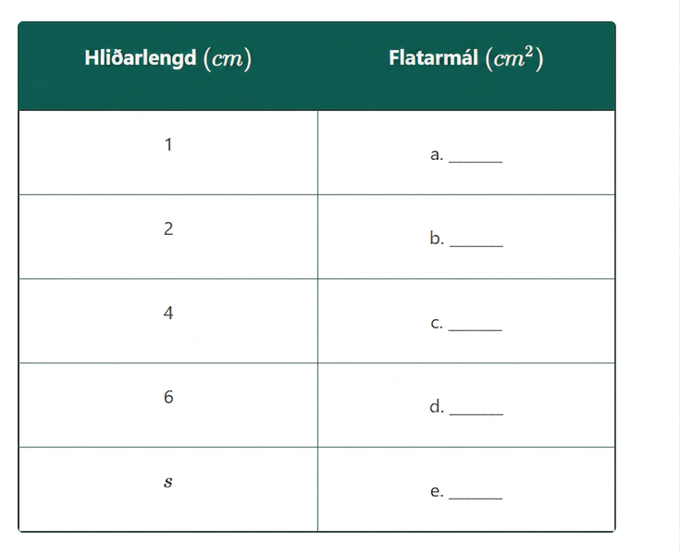
Learning Activity - Analyze Real-World Relationships 🌍
A square that has a side length of 9cm, an area of 81cm². The relationship between the side length and the area of the square is a function.
Answer questions a - e using the table.
What does A(2) represent in this situation? What is its value?
Sketch a graph of this function.
Notes:
Activity (20 minutes)
Previously, students focused on how input values are transformed to produce outputs. In this activity, they analyze real-world relationships, create tables, generalize rules, and graph values to define functions. The reasoning is familiar from earlier work with expressions and equations, but now students frame relationships as functions and use function notation.
Students often graph by plotting table values and connecting the points. When working with the linear perimeter function 𝑃(𝑙) = 2𝑙 + 6, look for those who connect it to y = 2x + 6 and graph it with a y-intercept of (0, 6) and slope of 2. Invite them to share during the discussion.
Launch
Have students work in pairs. Allow a few minutes of quiet work on the first set of questions, followed by partner discussion. Then, pause for a brief class discussion before moving to the second set.
Ask students to share their area rules—some may write
A = s²
A(s) = s²
Have them explain their reasoning. Highlight that A names the function and function notation requires an input, s.
Clarify that while A often represents area, here it names the function. If using a variable for the output instead of function notation, choose a different letter to avoid confusion.
Answers
1
4
16
36
A(s)=s²
A(2) is the area of the square in cm² when the side length is 2 cm. Its value is 4.
Click here for the slide with image g.
More activity questions, answers, anticipated misconceptions, and synthesis on the next slide.

Slide 17
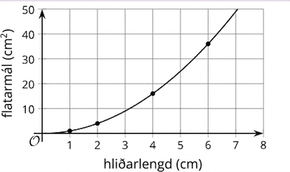
Learning Activity - Analyze Real-World Relationships 🌍
Image g
Notes:
Activity Images

Slide 18
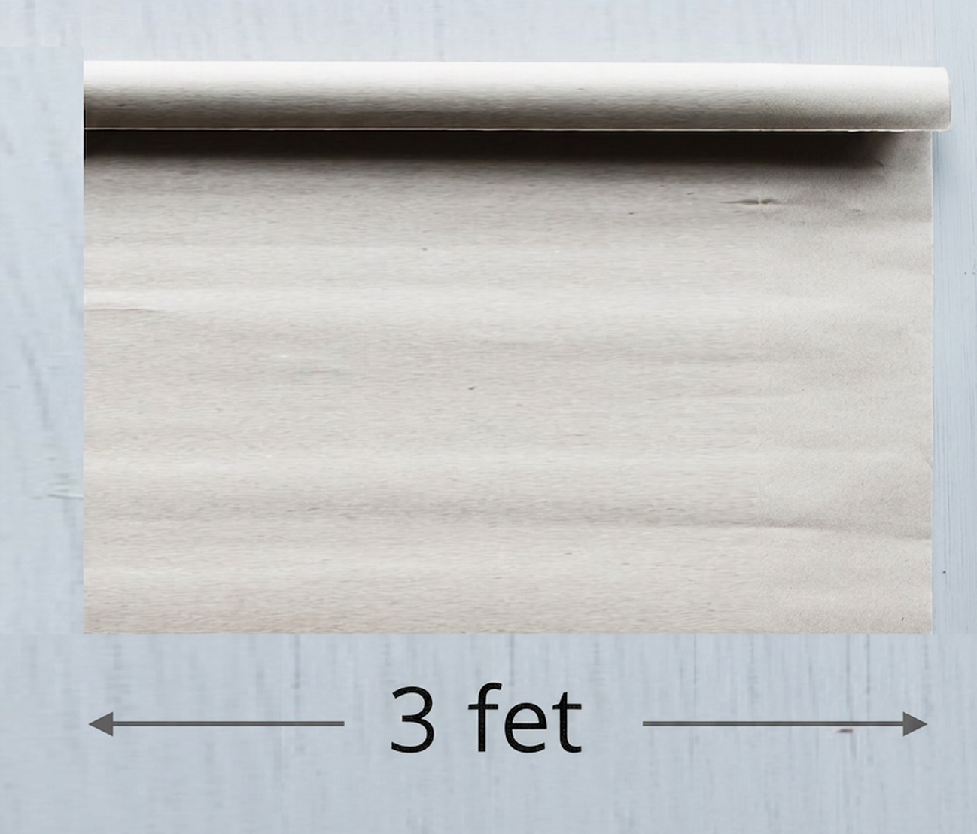
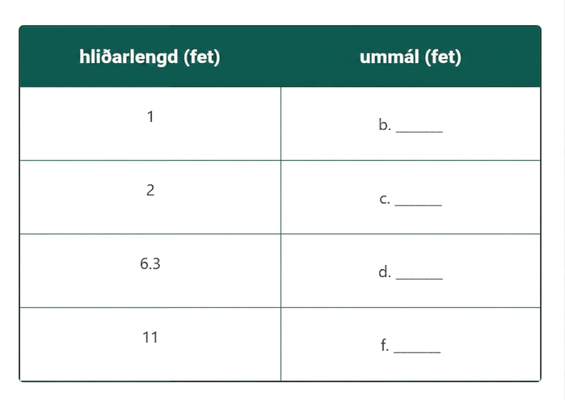
Learning Activity - Analyze Real-World Relationships 🌍
A roll of paper that is 3 feet wide can be cut to any length.
If we cut a length of 2.5 feet, what is the perimeter of the paper?
Use the table to answer questions b - e.
Write a rule for a function, P, that gives the perimeter of the paper in feet when the side length in feet is l.
What does P(11) represent in this situation? What is its value?
Notes:
Answers
Your answers may vary, but here are some samples.
11 feet
8
10
18.6
28
P(l) = 6 + 2l
P(11) is the perimeter of the paper in feet when the paper is cut at a length of 11 feet. Its value is 28.
Anticipated Misconceptions
If students struggle to graph the functions, suggest that they use the coordinate pairs in the tables to help them.
Activity Synthesis
Select students to share the rule they wrote for the perimeter function (from the second set of questions) and how they determined the rule. Students may have written expressions of different forms for P(l):
l + l + 3 + 3
2l + 2(3)
2(l + 3)
6 + 2l
Record and display all variations and discuss whether they all represent P(l). Ask students to explain how they know the expressions are equivalent.
Then, discuss how they graphed the function. If no one mentions the slope and intercept, prompt them by showing the graph and asking how to write its equation.

Slide 19

Video: Writing Function Rules

Slide 20
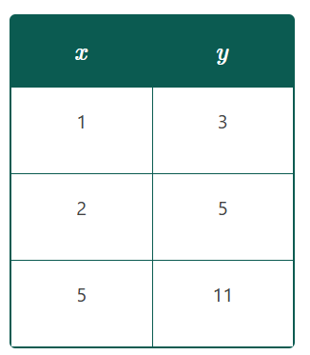
Self Check
Which function rule can describe the table?
f(x) = x + 3
f(x) = 2x + 1
f(x) = 2x + 2
f(x) = x + 2
Let’s review!
Notes:
Answer Feedback - Individualized by Response
Incorrect. When 1 is substituted for x, (1) + 3 = 4, not 3. This function does not work for the values. The answer is f(x) = 2x + 1.
That’s correct! When x = 1, 2(1) + 1 = 3, when x = 2, 2(2) + 1 = 5, and when x = 5, 2(5) + 1 = 11.
Incorrect. When 1 is substituted for x, 2(1) +2 = 4, not 3. This function does not work for the values. The answer is f(x) = 2x + 1.
Incorrect. While this rule works for the first row of the table, when x = 2, (2) + 2 = 4, not 5, so the rule does not work for all values in the table. The answer is f(x) = 2x + 1.

Slide 21
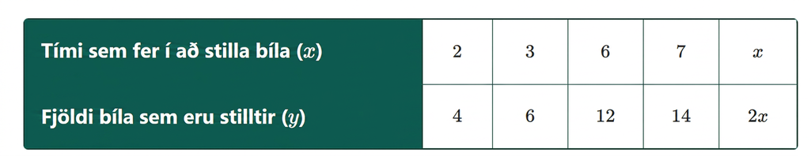
Self Check - Review
Kelly can tune 6 cars in 3 hours. The table is completed to show this relationship. The last column has the output for any x. This is the rule of the function.
Kelly can tune 6 cars in 3 hours or 2 cars in 1 hour, so the function rule is f(x) = 2x.
Notes:
Remind Students
The last column has the output for any x. This is the rule of the function.

Slide 22

Lesson Journey
Warm Up
Learning Activity
Practice
Learning Activity
Cool Down
Lesson Synthesis

Slide 23
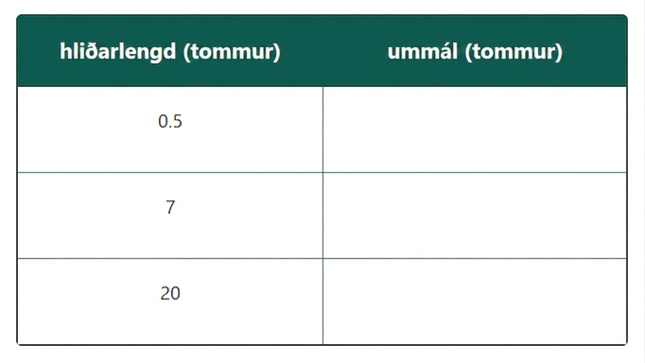
Cool Down
Complete the table with the perimeter of a square for each given side length.
Write a rule for a function, P, that gives the perimeter of a square in inches when the side length is x inches.
What is the value of P(9.1)? What does it tell us about the side length and perimeter of the square?
Notes:
Cool Down (5 minutes)
Answers
side length (inches) perimeter (inches)
0.5 2
7 28
20 80
P(x) = 4x
P(9.1) = 36.4. It tells us that when the side length of the square is 9.1 inches, the perimeter of the square is 36.4 inches.

Slide 24

Lesson Journey
Warm Up
Learning Activity
Practice
Learning Activity
Cool Down
Lesson Synthesis

Slide 25

Practice
Put your hard work to action, practice what you’ve learned!
Notes:
Digital Practice: Access the practice pages at https://openstax.org/details/books/algebra-1

Slide 26

Lesson Journey
Warm Up
Learning Activity
Practice
Learning Activity
Cool Down
Lesson Synthesis

Slide 27
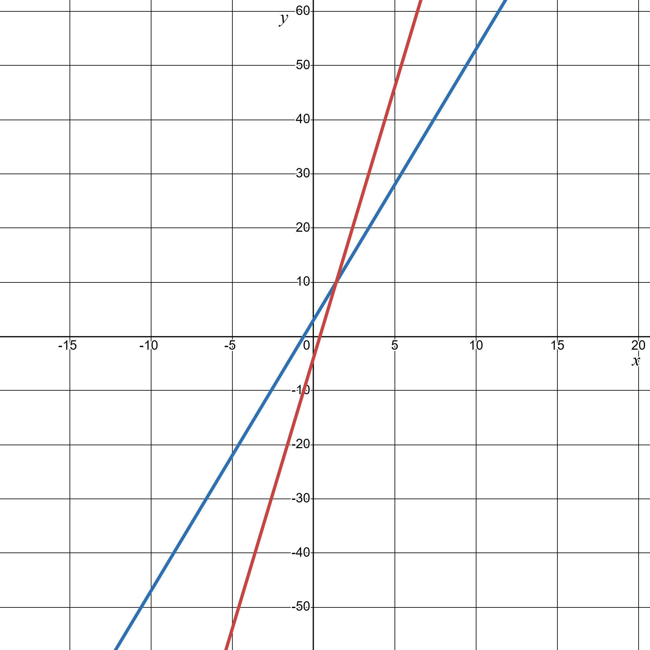
Lesson Synthesis
Discuss these two functions.
f(x) = 5x + 3
g(x) = 10x − 4
Notes:
Prompt: Ask Students:
“How would you describe to a classmate who is absent today what each equation means? What would you say to help them make sense of these?”
(Each equation gives the rule of a function. The rule for f says that, to get the output, we multiply the input by 5 and add 3. The rule for g says that the output is 10 times the input, minus 4.)
“How do the rules help us find the value of f(10) or g(10)?”
(If we substitute 10 for x in each equation and evaluate the expression, we would have the values of f or g
at x = 10, which are 53 and 96, respectively.)
“Is it possible to graph a function described this way? How?”
(We could create a table of values and find the coordinate pairs at different x-values. Or, if a rule is expressed as a linear equation, we could use it to identify the slope and vertical intercept of the graph.)

Slide 28
Self Assessment
How much do you agree with the following statements?
I can… | I can | Almost | Not yet
Explain rules of functions when they are written in function notation and create tables and graphs to represent the functions.
Write equations that represent the rules of functions.

