Slide 1


Algebra 1
Unit 2 Linear Inequalities and Systems
Lesson 2.6 Solving Systems by Elimination, Part 3

Slide 2
How to use these slides
On the activity slides check the speaker notes for teacher support and instructional information.
Each lesson includes 1 warm up, 2-3 learning activities, a cool down, practice and a lesson synthesis.
  Learning activities are followed by a self check question, and review section.
Some slides have been hidden from student view, more information can be found on the next slide (Reference Key).
You can edit and use these slides for personal and classroom use, but cannot sell them and must keep the attribution logos.
For more information, Check out the digital quick start guide!

Slide 3






Reference Key
Check the top right corner for an icon referencing these unique sections.
 | Support for Students with Disability | Hidden | Learning Strategies slide, provides additional support to students for understanding the activity. Learning Strategies slide, provides additional support to students for understanding the activity.
 | Support for English Language Learners | Hidden
 | Extending Your Thinking | Hidden | Extending Your Thinking slide, provides an extra challenge for students.
 | Self Check | Not Hidden | Self Check slide, checkpoint to assess student understanding after the learning activity.
 | Review | Hidden | Self Check- Review slide, designed to help review topics from the self check question.
On the next slides, check the speaker notes for teacher instructions and support.
Notes:
Check the Speaker Notes: On the next slides you can find discussion questions, lesson information, answers to the activities, and ways to adjust the activity for your students!

Slide 4

Learning Goals
By the end of this lesson you will be able to -
Explain how multiplying equations by a factor can help us solve systems of linear equations.
Notes:
Lesson Narrative
This is the last lesson in a series of three lessons on solving systems of equations by elimination. Two new ideas are introduced here.
The first idea is that we can multiply one or both equations in the system by a factor to make it possible to eliminate a variable.
The second new idea is that, whenever we multiply equations in a system by a factor, add or subtract the equations, or otherwise manipulate the equations, we are essentially creating an equivalent system that would help us get closer to finding the solution of the original system.
The work here builds on earlier work on acceptable moves and equivalent equations.
Required Preparation
Acquire devices that can run Desmos (recommended) or other graphing technology. It is ideal if each student has their own device.
Be prepared to display a graph using technology for all to see.
Required Materials
Graphing technology
Pre-printed slips, cut from copies of the blackline master
Texas Essential Knowledge and Skills
A1(B) use a problem-solving model that incorporates analyzing given information, formulating a plan or strategy, determining a solution, justifying the solution, and evaluating the problem-solving process and the reasonableness of the solution.
A1(C) select tools, including real objects, manipulatives, paper and pencil, and technology as appropriate, and techniques, including mental math, estimation, and number sense as appropriate, to solve problems.
A5(C) solve systems of two linear equations with two variables for mathematical and real-world problems.

Slide 5
Vocabulary
Previous
Elimination
  A method of solving a system of equations where you add or subtract a multiple of one equation to another to get an equation with one variable.
Substitution
  A method replacing a variable with an expression it is equal to.
New
Equivalent Systems
  Two systems that share the exact same solution set.
Notes:
Lesson Vocabulary
To support student understanding of key vocabulary:
Familiarize students with the vocabulary words they will see throughout the lesson. Encourage students to look for these words and notice their use and meanings.
Encourage students to use key vocabulary words in “math talk” and their written and oral explanations.
Utilize a word wall. Sample cards are located here: Sample word wall cards are available here.
For newcomers or students with beginning English proficiency, use these Quizlet sets to support vocabulary learning:
Unit 2 Spanish Vocabulary – use first to build understanding
Unit 2 Vocabulary (English) – use after anchoring in Spanish
Support for English Language Learners
ELPS 1(D) speak using learning strategies such as requesting assistance, employing non-verbal cues, and using synonyms and circumlocution (conveying ideas by defining or describing when exact English words are not known)
ELPS 1(E) internalize new basic and academic language by using and reusing it in meaningful ways in speaking and writing activities that build concept and language attainment
ELPS 2(F) listen to and derive meaning from a variety of media such as audio tape, video, DVD, and CD ROM to build and reinforce concept and language attainment
ELPS 3(E) share information in cooperative learning interactions A3(I) adapt spoken language appropriately for formal and informal purposes

Slide 6





Lesson Journey
Warm Up
Learning Activity
Practice
Learning Activity
Cool Down
Lesson Synthesis

Slide 7

Warm Up - Comparing Equations
Consider two equations in a system:
Equation A: 4x + y = 1
Equation B: x + 2y = 9
Use the graphing tool or technology outside the course. Solve the system of equations.
What is the x value?
What is the y value?
Notes:
Warm Up (5 minutes)
In this warm up, experiment with the graphical effects of multiplying both sides of an equation in two variables by a factor. Students are prompted to multiply one equation in a system by several factors to generate several equivalent equations. They then graph these equations on the same coordinate plane that shows the graphs of the original system. Students notice that no new graphs appear on the coordinate plane and reason about why this might be the case.
NOTE: Students are using the instructional version of Desmos and asked to graph equations that are given in standard form (not in slope intercept form).
Continue scrolling down for directions on how to launch the activity and answer for these questions.
Launch
Display the equation x + 5 = 11 for all to see. Ask students:
What is the solution to this equation?
x = 6
If we multiply both sides of the equation by a factor, say, 4, what equation would we have?
4x + 20 = 44
What is the solution to this new equation?
x = 6
What if we multiply both sides by 100?
100x + 500 = 1,100
By 0.5?
0.5x + 2.5 = 5.5
Is the solution to each of these equations still x=6
Yes
Remind students that these equations are one-variable equations, and that multiplying both sides of a one-variable equation by the same factor produces an equivalent equation with the same solution.
Ask students: "What if we multiply both sides of a two-variable equation by the same factor? Would the resulting equation have the same solutions as the original equation?" Tell students that they will now investigate this question by graphing.
Arrange students in groups of 2 - 4 and provide access to graphing technology to each group. To save time, consider asking group members to divide up the tasks. (For example, one person could be in charge of graphing while the others write equivalent equations, and everyone analyze the graphs together.)
Answers
Use this Desmos graph.
x = – 1
y = 5
Additional activity questions, answers, and synthesis on the next slide.

Slide 8
Warm Up - Comparing Equations
Use Equation A: 4x + y = 1:
Multiply the equation by 2, show the resulting equivalent equation, and label it A1.
Multiply the equation by – 5, show the resulting equivalent equation, and label it A2.
Multiply the equation by ½, show the resulting equivalent equation, and label it A3.
The new equations A1, A2, and A3 and Equation B: x + 2y = 9
Graph the system of equations A1 and B. [Desmos graph]
Graph the system of equations A2 and B. [Desmos graph]
Graph the system of equations A3 and B. [Desmos graph]
Make a couple of observations about the graphs of Equations A1, A2, and A3.
Notes:
Activity Answers
2(4x + y = 1) = 8x + 2y = 2
−5(4x + y = 1) = −20x − 5y = −5
½ (4x + y = 1) = 2x + ½ y = ½
Access the online Teacher Guide to see the graph for this question or this Desmos graph. Remember to toggle a graph “on” click the open circle next to the equation.
Access the online Teacher Guide to see the graph for this question or this Desmos graph. Remember to toggle a graph “on” click the open circle next to the equation.
Access the online Teacher Guide to see the graph for this question or this Desmos graph. Remember to toggle a graph “on” click the open circle next to the equation.
Your answer may vary, but here is a sample. No new graphs appeared. The graphs of the equivalent equations are identical to that of Equation A. The graphs all intersect the graph of Equation B at (−1, 5).
Activity Synthesis
Invite students to share their observations about the graphs they created. Ask students why the graphs of equations A1, A2, and A3 all coincide with the graphs of the original equation A. Discuss with students:
How can we explain the identical graphs?
Equations A1, A2, and A3 are equivalent to equation A, so they all have the same solutions as equation A, and their graphs are the same lines as the graphs of A.
What move was made to generate A1, A2, and A3? Why did it create equations that are equivalent to A?
The two sides of equation A was multiplied by the same factor, which keeps the two sides equal.
To further illustrate that equations A1, A2, and A3 are equivalent to equation A, and if time permits, consider: Using tables to visualize the identical (x, y) pairs. Access the online Teacher Guide to see the tables for this question.

Slide 9

Lesson Journey
Warm Up
Learning Activity
Practice
Learning Activity
Cool Down
Lesson Synthesis

Slide 10
Learning Activity - Elena’s Moves 🧮
Here is a system you solved by graphing earlier. To start solving the system, Elena wrote step 1 and then step 2.
Original System
Equation A: 4x + y = 1 Equation B: x + 2y = 9
Step 1
4x + y = 1 4x + 8y = 36
Step 2
4x + y = 1 – 4x + – 8y = – 36
– 7y = – 35
What was Elena’s first move?
What was Elena’s second move?
What might be possible reasons for those moves?
Complete the solving process algebraically. Show that the solution is indeed x = −1, y = 5.
Notes:
Activity (15 minutes)
In an earlier lesson, students learned that adding the two equations in a system creates a new equation that shares a solution with the system. In the warm up, they saw that multiplying an equation by a factor creates an equivalent equation that shares all the same solutions as the original equation.
Here students learn that each time we perform a move that creates one or more new equations, we are in fact creating a new system that is equivalent to the original system.
Equivalent systems are systems with the same solution set, and we can write a series of them to help us get closer to finding the solution of an original system.
Continue scrolling down for directions on how to launch the activity, answers, and synthesis questions.
Launch
Arrange students in groups of 2.
Give students 2-3 minutes of quiet work time, and then 1-2 minutes to discuss their thinking with their partner.
Follow with a whole-class discussion.
Answers
First, she multiplied each side of the second equation by 4, which produces an equivalent equation with 4x in it.
Next, she subtracted the new equation from the first equation. Doing that creates another equation where the variable x is eliminated, leaving only one variable and making it possible to solve for y.
Doing these steps creates another equation where the x variable is eliminated, leaving only one variable making it possible to solve for y.
−7y = −35 can be rewritten as y = 5. Substituting 5 for y in the first equation, we have 4x + 5 = 1 or 4x = −4, which means x = −1.
Activity Synthesis
Invite students to share their analyses of Elena's moves. Highlight responses that point out that Elena's moves enabled her to eliminate the x-variable. (In other words, multiplying equation B by 4 gives 4x + 8y = 36 and subtracting this equation from equation A removes the x-variable.)
Display the two original equations in the system alongside the new equations Elena wrote (4x + 8y = 36 and –7y = – 35). Then, ask students to predict what the graphs of all four equations might look like.
Next, use graphing technology to display all four graphs. Access the online Teacher Guide to see the graphs for this question or use this Desmos graph.

Slide 11

Self Check
Solve the system of equations using elimination.
(5, – 1)
(– 10, 4)
(– 4, 2)
(2, 0)
6x – 5y = – 34 2x + 6y = 4
Let’s review!
Notes:
Answer Feedback -
Incorrect. Did you multiply the second equation by – 3?
Incorrect. Did you multiply the second equation by – 3?
That’s correct! The ordered pair makes both equations true. When you multiply the second equation by – 3, the result is – 6x + (– 18y) = – 12. Then, when the equations are added together, the sum is – 23y = – 46. This yields y = 2 and can be used to find the value of x.
Incorrect. Did you multiply the second equation by – 3?

Slide 12
Self Check - Review
SOLVING SYSTEMS BY ELIMINATION
Step 1 – Write both equations in standard form.
Step 2 – Check to see if the coefficients of one variable are opposites or equivalent.
Step 3 – Simplify.
Step 4 – Add the equations to eliminate one variable.
Step 5 – Solve for the remaining variable.
Step 6 – Substitute the solution into one of the original equations. Then solve for the other variable.
Step 7 – Check that the ordered pair is a solution to both original equations.
Solve the following system of equations using elimination.
4x – 3y = 9 7x + 2y = – 6
Notes:
Answers
Step 1 – Write both equations in standard form. If any coefficients are fractions, clear them.
Equations are already in standard form.
Step 2 – Check to see if the coefficients of one variable are opposites or equivalent. To get opposite coefficients of y, we will need to multiply the first equation by 2 and the second equation by 3.
2(4x – 3y) = 2(9)
3(7x + 2y) = 3( – 6)
Step 3 – Simplify
8x – 6y = 18
21x + 6y = – 18
Step 4 – Add the equations to eliminate one variable.
29x = 0
Step 5 – Solve for the remaining variable.
x = 0
Step 6 – Substitute the solution into one of the original equations. Then solve for the other variable.
7x + 2y = – 6
7(0) + 2y = – 6
0 + 2y = – 6
2y = – 6
y = – 3
Step 7 – Check that the ordered pair is a solution to both original equations.
7x + 2y = – 6
7(0) + 2(– 3) = – 6?
0 – 6 = – 6?
– 6 = – 6 ✓
4x – 3y = 9
4(0) – 3(– 3) = 9?
0 + 9 = 9?
9 = 9 ✓

Slide 13
Lesson Journey
Warm Up
Learning Activity
Practice
Learning Activity
Cool Down
Lesson Synthesis

Slide 14
Learning Strategies - Right Step, Right Time
Take turns picking and explaining each card.
Use prompts like:
“I agree because…”
“I disagree because …”
Encourage each other to use mathematical terms.
Discussion Supports
Teacher Instruction: Use these strategies to adjust the activity to support English language learners and students with disabilities.
  You can copy and paste the callouts directly on top of the activity or give the instructions aloud.
Start by finding first and last cards.
Find where the solution for y appears. How do you know?
Use those cards to organize the rest.
Action and Expression
Notes:
Support for English Language Learners: MLR 8 Discussion Supports: Speaking, Representing
Use this routine to support student conversation as they take turns selecting cards and explaining how each system came from the previous one. Display the following prompts for students to use as they respond to reasoning shared by the partner who selected the card: “I agree because…” or “I disagree because…” Encourage students not only to challenge each other if they disagree with the card selected, but also to press for clear explanations that use mathematical language.
Design Principle(s): Support sense-making
Support for Students with Disabilities: Action and Expression: Internalize Executive Functions
Chunk this task into more manageable parts to support students who benefit from support with organization and problem solving. For example, guide students in a strategy by prompting them to begin by identifying the first and last cards. Next, ask students to identify the card where the solution for y first appears, and to explain how they know. Encourage students to use these three cards as benchmarks for sorting the remaining cards.
Supports accessibility for: Organization; Attention

Slide 15
Learning Activity - Right Step, Right Time
Arrange the cards on your table so you and your partner can both see them.
Find the card that is labeled, “Start here.”
You and your partner will take turns arranging the slips in the order that would lead to a solution.
Be prepared to:
  Describe what move takes one system to the next system.
  Explain why the systems are equivalent between this step and the previous step.
Make sure you listen to your partner’s reasoning and agree with their thinking. If you disagree, discuss the changes in the equations until you reach an agreement.
You have 5 minutes.
Are you ready for more?
Notes:
Support for All Learners
This activity offers additional support and an extension for students:
For English language learners and students with disabilities, be sure to review the Learning Strategies slide!
For students looking for an extra challenge, be sure to review the Extending Your Thinking slide!
Activity (20 minutes)
Earlier, students encountered the idea of equivalent systems. They described the moves that lead to equivalent equations and explained why the solution to those equations was the same as the solution to the original system. This activity reinforces that work.
Given an unordered set of equivalent systems, students work with a partner to arrange the systems such that the order constitutes logical steps toward solving an original system. Along the way, they take turns describing how each system came from the previous one and explaining how they know it has the same solution as its predecessor. The work allows students to practice constructing logical arguments and critiquing those of others.
Continue scrolling down for directions on how to launch the activity, answers, anticipated misconceptions, and synthesis questions.
Launch
Arrange students in groups of 2.
Give one set of pre-cut slips or cards from the blackline master to each group.
Ask students to find the slip or card that shows a system of equations and is labeled "Start here."
Explain that all the other slips contain equivalent systems that represent steps in solving the starting system. Ask students to arrange the slips in the order that would lead to its solution, and to make sure they can explain what moves take each system to the next system and why each system is equivalent to the one before it.
Partners should take turns finding the next step in the solving process and explaining their reasoning.
As one student explains, the partner's job is to listen and make sure they agree and the explanation makes sense.
If they disagree, the partners should discuss until they reach an agreement.
Give students 5 minutes to arrange the systems. Follow with a whole-class discussion.
Answers
Original System
45𝑥 + 6𝑦 = 15
– 𝑥 + 18𝑦 = 11
Multiply the first equation by 5.
Step 1 System
4𝑥 + 30𝑦 = 75
– 𝑥 + 18𝑦 = 11
Multiply the second equation by 4.
Step 2 System
4𝑥 + 30𝑦 = 75
– 4𝑥 + 72𝑦 = 44
Add the two equations in Step 2.
Step 3 System
4𝑥 + 30𝑦 = 75
102𝑦 = 119
Divide each side of 102𝑦 = 119 by 102 to solve for 𝑦.
Step 4 System
4𝑥 + 30𝑦 = 75
𝑦 = ⁷/₆
Substitute ⁷/₆ for 𝑦 in the first equation and evaluating the expression.
Step 5 System
4𝑥 + 35 = 75
𝑦 = ⁷/₆
Subtract 35 from each side of the first equation.
Step 6 System
4x = 40
𝑦 = ⁷/₆
Divide each side of 4x = 40 by 4 to solve for x.
Step 7 System:
x = 10
𝑦 = ⁷/₆
Anticipated Misconceptions
Students who are thinking algorithmically about solving systems of equations may think that the first step should involve multiplying each side of the second equation by ⁴/₅, becoming frustrated when no cards show that step. Encourage them to compare both the first and the second equations in the starting card to the first and second equations on other cards to gain some ideas about what steps might have been taken.
Activity Synthesis
Ask students to share the order in which the systems should be arranged to lead to the solution. Display the ordered systems for all to see.
Point out to students that this particular solution path involves multiplying each of the two equations by a factor in order to eliminate the x-variable. Ask students if it's possible to eliminate a variable by multiplying only one equation by a factor. (Yes, we could multiply the first equation by 54 to eliminate x, or by 3 to eliminate y. Or we could multiply the second equation by 45 to eliminate x, or by 13 to eliminate y.)

Slide 16
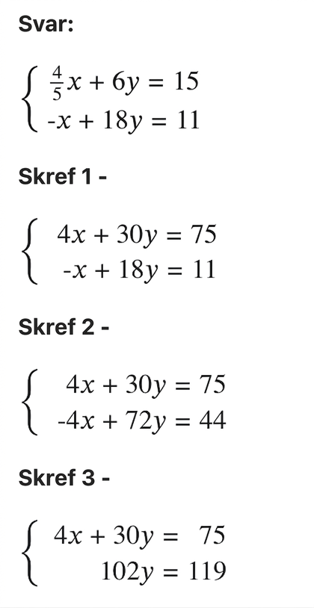
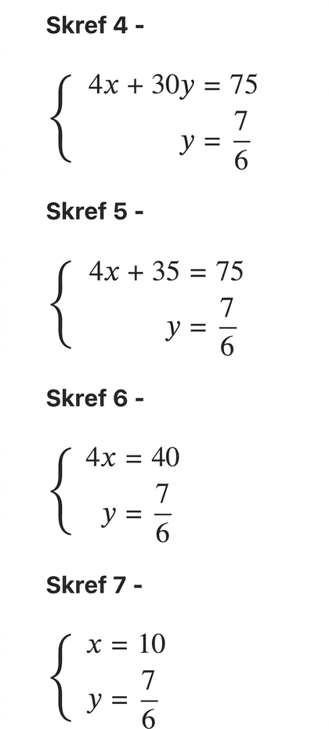
Learning Activity - Right Step, Right Time
Answers to card sort:
Notes:
This slide has been hidden. If you wish students to see the answers as indicated in the Activity Synthesis, unhide this slide.
Anticipated Misconceptions
Students who are thinking algorithmically about solving systems of equations may think that the first step should involve multiplying each side of the second equation by 4/5, becoming frustrated when no cards show that step. Encourage them to compare both the first and the second equations in the starting card to the first and second equations on other cards to gain some ideas about what steps might have been taken.
Activity Synthesis
Ask students to share the order in which the systems should be arranged to lead to the solution. Display the ordered systems for all to see (unhide this slide).
Point out to students that this particular solution path involves multiplying each of the two equations by a factor in order to eliminate the x-variable. Ask students if it's possible to eliminate a variable by multiplying only one equation by a factor. (Yes, we could multiply the first equation by 54 to eliminate x, or by 3 to eliminate y. Or we could multiply the second equation by 45 to eliminate x, or by 13 to eliminate y.)

Slide 17
Extending Your Thinking
This system of equations has the solution (5, – 2):
Find the missing value of A.
Find the missing value of B.
Ax – By = 24 Bx + Ay = 31
Notes:
Answer
A = 2
B = 7

Slide 18
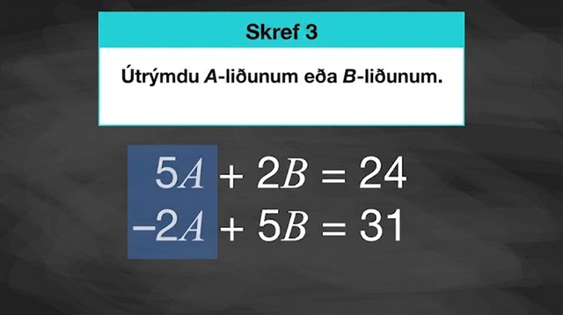
Video: Writing a New System to Solve a Given System
Notes:
This video supports the Extending Your Thinking question.

Slide 19
Self Check
Solve the system of equations using elimination.
(7, – 5)
(1, 2)
(0, – 1.5)
(½ , ¼)
7x – 2y = 3 4x + 5y = 3.25
Let’s review!
Notes:
Answer Feedback
Incorrect. You can multiply the first equation by 5 and the second equation by 2. The resulting equations are 35x – 10y = 15 and 8x + 10y = 6.5 and will allow the y-terms to be eliminated.
Incorrect. You can multiply the first equation by 5 and the second equation by 2. The resulting equations are 35x – 10y = 15 and 8x + 10y = 6.5 and will allow the y-terms to be eliminated.
Incorrect. You can multiply the first equation by 5 and the second equation by 2. The resulting equations are 35x – 10y = 15 and 8x + 10y = 6.5 and will allow the y-terms to be eliminated.
That's correct! You can multiply the first equation by 5 and the second equation by 2. The resulting equations are 35x – 10y = 15 and 8x + 10y = 6.5 and will allow the y-terms to be eliminated. 43x = 21.5 yields an x-value of ½ that can be used to find the y-value. The ordered pair (½, ¼) makes both equations true.

Slide 20
Self Check - Review
SOLVING SYSTEMS BY ELIMINATION
Step 1 – Write both equations in standard form.
Step 2 – Check to see if the coefficients of one variable are opposites or equivalent.
Step 3 – Simplify.
Step 4 – Add the equations to eliminate one variable.
Step 5 – Solve for the remaining variable.
Step 6 – Substitute the solution into one of the original equations. Then solve for the other variable.
Step 7 – Check that the ordered pair is a solution to both original equations.
Solve the following system of equations using elimination.
x + ½y = 6 ³⁄₂x + ⅔y = ¹⁷⁄₂
Notes:
Answers
Step 1 – Write both equations in standard form. To clear the fractions, multiply each equation by its LCD (Least Common Denominator).
2(x + ½y = 6) → 2x + y = 12
6(³⁄₂x + ⅔y = ¹⁷⁄₂) → 9x + 4y = 51
Step 2 – Check to see if the coefficients of one variable are opposites or the equivalent. Multiply the first equation by – 4.
– 4( 2x + y = 12)
9x + 4y = 51
Step 3 – Simplify the equations.
– 8x – 4y = – 48
9x + 4y = 51
Step 4 – Eliminate one of the variables and simplify the equation.
x = 3
Step 5 – Solve for the remaining variable.
x = 3
Step 6 – Substitute the solution into one of the original equations and solve for the other variable.
x + ½ y = 6
(3) + ½ y = 6
½ y = 3
y = 6
Step 7 – Write the solution as an ordered pair.
(3, 6)
Step 8 – Check that the ordered pair is a solution to both original equations.
x + ½ y = 6
(3) + ½(6) = 6?
3 + 3 = 6?
6 = 6 ✓
³/₂ x + ⅔ y = ¹⁷/₂
³/₂ (3) + ⅔(6) = ¹⁷/₂ ?
⁹/₂ + 4 = ¹⁷/₂ ?
⁹/₂ + ⁸/₂ = ¹⁷/₂ ?
¹⁷/₂ = ¹⁷/₂ ✓

Slide 21

Lesson Journey
Warm Up
Learning Activity
Practice
Learning Activity
Cool Down
Lesson Synthesis

Slide 22
Cool Down
Here is a system of equations. To solve this system, Diego wrote these equivalent systems for his first two steps.
Original System
12a + 5b = – 15 8a + b = 11
Step 1
12a + 5b = – 15 8a + b = 11
Step 2
12a + 5b = – 15 – 28a = – 70
Describe the move that Diego made between the original system and step 1.
How do you know the system of equations in step 1 is equivalent to the original system?
Describe the move that Diego made between step 1 and step 2.
How do you know the system of equations in step 2 is equivalent to the ones in step 1 (and to the original system)?
Notes:
Cool Down (5 minutes)
Answers
Multiply the second equation by – 5. −5(8a + b = 11) = −40a − 5b = −55
Multiplying each side of an equation by the same number gives an equivalent equation with the same solution.
Add the resulting equation to the first equation to eliminate the variable b
Adding an equal amount to each side of an equation keeps the two sides equal, so the solution for the first equation is also a solution for the sum.

Slide 23
Cool Down
Here is a system of equations. To solve this system, Diego wrote these equivalent systems for his first two steps.
Original System
12a + 5b = – 15 8a + b = 11
Step 1
12a + 5b = – 15 8a + b = 11
Step 2
12a + 5b = – 15 – 28a = – 70
Write another set of equivalent systems (different from Diego's first two steps) that will allow one variable to be eliminated and enable you to solve the original system. Be prepared to describe the moves you make to create each new system and to explain why each one has the same solution as the original system.
Use your equivalent systems to solve the original system. Then, check your solution by substituting the pair of values into the original system.
Notes:
Cool Down (5 minutes)
Answers
Answers may vary, but here is a sample: Multiply the second equation in the original system by ³/₂.
This gives us
12a + 5b = – 15
³/₂(8a + b = 11) → 12a + ³/₂b = ³³/₂
Solving equations created in question 5:
Subtract the resulting equations (or multiply the second equation by – 1 and add):
⁷/₂ b = – ⁶³/₂
Solve:
b = – 9
12a + 5b = – 15
12a + 5(– 9) = – 15
12a – 45 = – 15
12a = 30
a = ³⁰/₁₂ = ⁵/₂ = 2.5
Substituting these values into the original equations:
12a + 5b = – 15
12(2.5) + 5(– 9) = – 15?
30 – 45 = – 15?
– 15 = – 15 ✓
8a + b = 11
8(2.5) + (– 9) = 11?
20 – 9 = 11?
11 = 11 ✓

Slide 24

Lesson Journey
Warm Up
Learning Activity
Practice
Learning Activity
Cool Down
Lesson Synthesis

Slide 25

Practice
Put your hard work to action, practice what you’ve learned!
Notes:
Digital Practice: Access the practice pages at https://openstax.org/details/books/algebra-1

Slide 26

Lesson Journey
Warm Up
Learning Activity
Practice
Learning Activity
Cool Down
Lesson Synthesis

Slide 27
Lesson Synthesis
Explain what move takes one system to the next and how you know the new system is equivalent to the one before it.
Step | System | What move was made? | Why is the new system equivalent to the previous one?
0 | ⅘ x + 6y = 15 – x +18y =11
1 | 4x + 30y = 75 – x + 18y = 11
2
….
Notes:
Refer to the systems that students have ordered in the "Finding Solutions to Unordered Sets of Equivalent Systems" activity (blackline masters). Invite students to explain what move takes one system to the next and how they know the new system is equivalent to the one before it (even though one equation has been transformed).
Answers
Answers will vary depending on the description of moves and justifications. Consider using a graphic organizer, as shown here. (A completed organizer could be preserved and used as a reference by students later.)
If time is limited, focus on discussing the justifications on why one system in the sequence is equivalent to the before it (the last column in the graphic organizer).
Highlight statements such as:
Adding equal amounts to the two sides of an equation keeps the two sides equal, so the same x- and 𝑦-values that make the first equation true also makes this new equation true. This means that the same pair of values is also a solution to the new system.
If no students explained in this way, demonstrate it.

Slide 28
Self Assessment
How much do you agree with the following statements?
I can… | I can | Almost | Not yet
Explain how multiplying equations by a factor can help solve systems of linear equations.

