Slide 1
Algebra 1
Unit 9 More Quadratic Equations
Lesson 9.2 Completing the Square, Part I

Slide 2

How to use these slides
On the activity slides check the speaker notes for teacher support and instructional information.
Each lesson includes 1 warm up, 2-3 learning activities, a cool down, practice and a lesson synthesis.
  Learning activities are followed by a self check question, and review section.
Some slides have been hidden from student view, more information can be found on the next slide (Reference Key).
You can edit and use these slides for personal and classroom use, but cannot sell them and must keep the attribution logos.
For more information, Check out the digital quick start guide!
OpenStax CC BY NC SA

Slide 3





Reference Key
Check the top right corner for an icon referencing these unique sections.
Icon | Title | View | Location and Description
n/a | Support for Students with Disability | Hidden | Learning Strategies slide, provides additional support to students for understanding the activity.
n/a | Support for English Language Learners | Hidden | Learning Strategies slide, provides additional support to students for understanding the activity.
n/a | Extending Your Thinking | Hidden | Extending Your Thinking slide, provides an extra challenge for students.
n/a | Self Check | Not Hidden | Self Check slide, checkpoint to assess student understanding after the learning activity.
n/a | Review | Hidden | Self Check - Review slide, designed to help review topics from the self check question.
On the next slides, check the speaker notes for teacher instructions and support.
Notes:
Check the Speaker Notes: On the next slides you can find discussion questions, lesson information, answers to the activities, and ways to adjust the activity for your students!

Slide 4

Learning Goals
By the end of this lesson you will be able to -
Explain what it means to "complete the square" and describe how to do it
Solve quadratic equations by completing the square and finding square roots
Notes:
Lesson Narrative
Previously, students saw that a squared expression of the form (x + n)² is equivalent to x² + 2nx + n². This means that, when written in standard form ax² + bx + c (where a is 1), b is equal to 2n and c is equal to n².
Here, students begin to reason the other way around. They recognize that if ax² + bx + c is a perfect square, then the value being squared to get c is half of b, or ^{b}/₂)². Students use this insight to build perfect squares, which they then use to solve quadratic equations by completing the square.
Required Preparation
None
Required Materials
None
Texas Essential Knowledge and Skills
A1(C) select tools, including real objects, manipulatives, paper and pencil, and technology as appropriate, and techniques, including mental math, estimation, and number sense as appropriate, to solve problems.
A1(F) analyze mathematical relationships to connect and communicate mathematical ideas.
A8(A) solve quadratic equations having real solutions by factoring, taking square roots, completing the square, and applying the quadratic formula.

Slide 5
Vocabulary
Previous
Factoring
  Determining the numbers or expressions that multiply to a specific product.
Quadratic equation
  Polynomial equations of degree two.
Perfect Square Trinomial
  A perfect square trinomial fits the pattern 𝑎² + 2𝑎𝑏 + 𝑏² = (𝑎 + 𝑏)² or
  𝑎² − 2𝑎𝑏 + 𝑏² = (𝑎 − 𝑏)².
New
Completing the square
  A method used with a quadratic expression to transform it into a perfect square trinomial.
Notes:
Lesson Vocabulary
To support student understanding of key vocabulary:
Introduce and review the vocabulary words students will see in this lesson.
Encourage students to notice how these words are used and to include them in their math discussions and explanations—both written and oral.
Use a word wall to reinforce vocabulary. Sample word wall cards are available here.
For newcomers or students with beginning English proficiency, use these Quizlet sets to support vocabulary learning:
Unit 9 Spanish Vocabulary – use first to build understanding
Unit 9 Vocabulary (English) – use after anchoring in Spanish
Support for English Language Learner
ELPS 2(F) listen to and derive meaning from a variety of media such as audiotape, video, DVD, and CD-ROM to build and reinforce concept and language attainment
ELPS 3(E) share information in cooperative learning interactions
ELPS 3(F) ask and give information ranging from using a very limited bank of high-frequency, high-need, concrete vocabulary, including key words and expressions needed for basic communication in academic and social contexts, to using abstract and content-based vocabulary during extended speaking assignments
ELPS 3(G) express opinions, ideas, and feelings ranging from communicating single words and short phrases to participating in extended discussions on a variety of social and grade-appropriate academic topics

Slide 6

Lesson Journey
First Stop: Warm Up

Slide 7

Warm Up
Is it Perfect? 🫢
Select three expressions that are perfect squares.
(x + 5)(5 + x)
(x + 5)(x – 5)
(x – 3)²
x² + 8x + 16
x² + 10x +20
Explain how you know the expressions you selected are perfect squares.
Notes:
Warm Up (5 minutes)
This activity reinforces the meaning of perfect squares and the fact that a perfect square can appear in different forms.
Launch
Encourage and support opportunities for peer interactions by inviting students to talk about their ideas with a partner before writing them down.
Answers
(x + 5)(5 + x), (x – 3)², x² + 8x + 16
Because each of them is the product of an expression and itself. x² + 8x + 16 is equivalent to (x + 4)(x + 4)
Anticipated Misconceptions
Students may need to be reminded –
that when adding terms, addition is commutative.
what “squared” means.
Activity Synthesis
Display the expressions for all to see. Invite students to share their responses and record them for all to see. For each expression that they consider a perfect square, ask them to explain how they know. For expressions that students believe aren't perfect squares, ask them to explain why not.
For the last expression, x² + 10x + 20 , students may reason that it is not a perfect square because:
The constant term 20 is not a perfect square. (Most students are likely to reason this way.)
If 20 is seen as (⎷(20))², then the coefficient of the linear term would have to be 2(⎷(20))², not 10.
Though students have been dealing mostly with rational numbers, the second line of reasoning is also valid and acceptable.
Invite students to offer other expressions that are perfect squares.

Slide 8
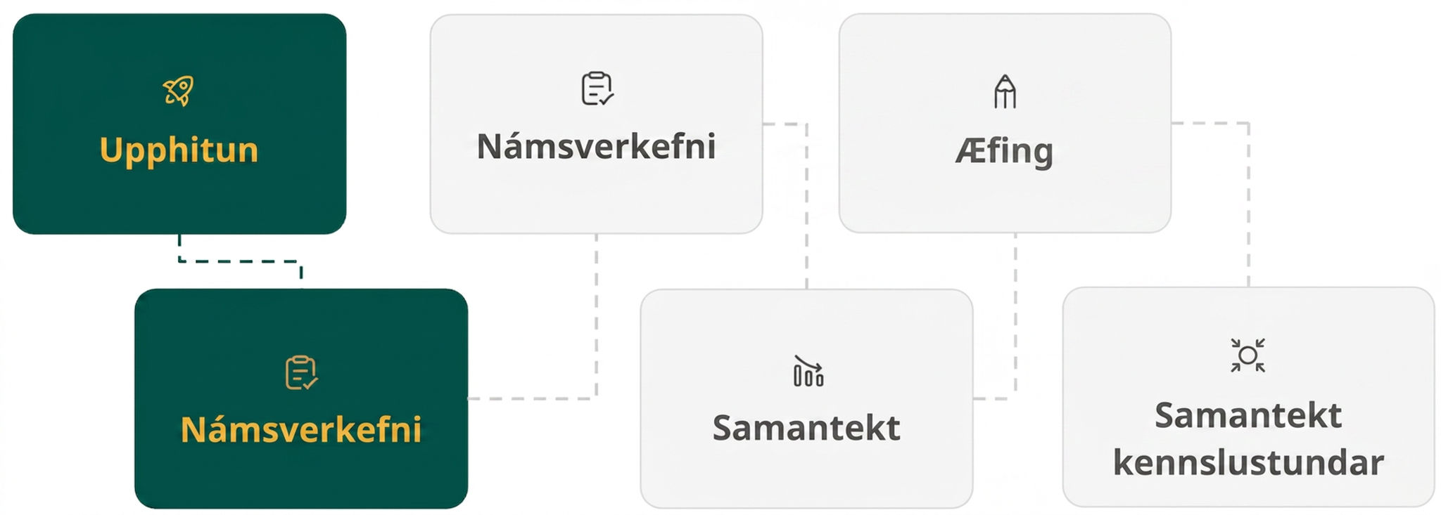
Lesson Journey
Second Stop: Learning Activity A

Slide 9

Learning Activity A | Learning Strategies
Factor Frenzy 🤪
Share your thinking about how to rewrite perfect squares from standard to factored form.
Listen and watch for words and phrases that connect ideas for you.
Refer back to the words and phrases of the process as you discuss different problems with your partner or the class.
Collect and Display
Teacher Instruction: Use these strategies to adjust the activity to support English language learners and students with disabilities.
You can copy and paste the callouts directly on top of the activity or give the instructions aloud.
Examine the selected equation.
Highlight the coefficient of the linear term of the standard form equation, label it n.
Highlight the constant term in the standard form equation in a different color and label it n².
Write n² next to the constant term in the factored form expression and highlight it the same color.
Representation
Notes:
Support for English Language Learners: MLR 2 Collect and Display
Listen for and collect vocabulary, gestures, and diagrams students use to explain how to rewrite perfect squares from standard form to factored form, and vice versa. Write the students’ words on a visual display and update it throughout the remainder of the lesson. Refer back to the visual display during the activity synthesis to reiterate key ideas. Remind students to borrow language from the display as needed. This will help students read and use mathematical language during their partner and whole-class discussions.
Design Principle(s): Maximize meta-awareness; Support sense-making
Provide support for students
Distribute graphic organizers to the students to assist them with participating in this routine.
Support for Students with Disabilities: Representation: Internalize Comprehension
Use color and annotations to illustrate student thinking. As students share their conclusions about the relationship between the terms in different forms of perfect squares, scribe their thinking on a visible display. Choose one example from the given problems. Highlight the coefficient of the linear term in the standard form expression, labeling it n, then highlight the constant term in the standard form expression and write (n²). Finally, write n² next to the constant term in the factored form expression and highlight it in the same color. Encourage students to select and annotate another example from the activity on their own to check for understanding.
Supports accessibility for: Visual-spatial processing; Conceptual processing

Slide 10
Learning Activity A | Part 1
Factor Frenzy 🤪
What is the factored form of x² + 6x + 9?
What is the factored form of x² – 10x + 25?
What is the standard form (x – 7)²?
What is the value of c in the expression x² – 20x + c?
If x² – 20x + c is factored to be (x – )², what is the missing value of the factored form of this expression?
Notes:
Support for All Learners
This activity offers additional support for students:
For English language learners and students with disabilities, be sure to review the Learning Strategies slide!
Activity (10 minutes)
In this activity, students begin to complete the square. They start by transforming given perfect squares from standard form to factored form, and vice versa. Then, they are given an incomplete expression in standard form that contains only the squared term and linear term. Students need to decide what constant term makes the expression a perfect square, and then write the equivalent expression in factored form. To accomplish these tasks, students must rely on the structure they noticed in an earlier lesson about the relationship between the standard and factored forms of perfect squares.
Launch
Arrange students in groups of two.
Give students a few minutes of quiet time to think individually and then ask them to discuss their responses with their partner.
Follow with a whole-class discussion.
Answers
(x + 3)²
(x – 5)²
x² –14x + 49
100
10
Additional activity questions, answers, and synthesis on the next slide.

Slide 11
Learning Activity A | Part 2
Factor Frenzy 🤪
What is the value of c in the expression x² + 16x + c?
If x² + 16x + c is factored to be (x – )², what is the missing value of the factored form of this expression?
What is the value of c in the expression x² + 7x + c?
If x² + 7x + c is factored to be (x – )², what is the missing value of the factored form of this expression?
What is the value of c in the expression x² + bx + c?
If x² + bx + c is factored to be (x – )², what is the missing value of the factored form of this expression?
Notes:
Activity Answers
6. 64
7. 8
8. ⁴⁹/₄
9. ⁷/₂
10. (^{b}/₂)²
11. ^{b}/₂
Anticipated Misconceptions
If students have trouble determining the constant term in standard form, suggest that they draw a rectangular diagram and work backward to determine the factors along the two sides of the rectangle. Afterward, they can find the corresponding value of the constant term.
See online teacher’s guide for examples or access this document (answer is on the second page).
Activity Synthesis
Display the incomplete table for all to see. Ask students to complete the missing values or expressions.
Discuss how students knew what numbers or expressions to write in the last four pairs of expressions. Make sure students understand that:
If the constant term in the factored form is n, the constant term in standard form is n², a squared number.The coefficient of the linear term in standard form is twice n, or 2n.
This means that n is half of the coefficient of the linear term. If the linear term is 20x, the n is 10, and the constant term in standard form is 10² or 100.
If the linear term in standard form is bx (as in the last row of the table), then the constant term in standard form is (^{b}/₂)², and the constant term in factored form is b².
Explain to students that finding the constant term to add in order to create a perfect square is called "completing the square." In the next activity, we will look at completing the square as a strategy to solve quadratic equations.

Slide 12
Learning Activity A
Self Check
Which value will create a perfect square trinomial when added to x² − 14x + ______?
– 7
– 49
49
196
Let’s review!
Notes:
Answer Feedback - Individualized by Response
Incorrect. After dividing the –14 by 2, square the –7.
Incorrect. When a negative is squared, it becomes positive.
That’s correct! Check yourself: Divide the –14 by 2 to get –7. When –7 is squared, it becomes 49.
d. Incorrect. Divide the -14 by 2 before squaring it.

Slide 13

Learning Activity A
Self Check - Review
Complete the square to make a perfect square trinomial. Then, write the result as a binomial squared.
x² – 26x
COMPLETING THE SQUARE
OF x² + bx
Step 1 - Identify 𝑏⁢, the coefficient of 𝑥.
Step 2 - Find half of 𝑏 and then square it. In other words, (^{b}/₂)².
Step 3 - Add the (^{b}/₂)² value to x² + bx.
Step 4 - Factor the perfect square trinomial, writing it as a binomial squared.
Notes:
Answer
x² – 26x + 169 = (x – 13)2
NOTE: The wording in the steps prepares students for the steps in subsequent lessons. This intial wording will be refined later in this lesson to facilitate consistency across lessons.

Slide 14

Lesson Journey
Third Stop: Learning Activity B

Slide 15
Learning Activity B | Learning Strategies
Same or Different? ☯️
“_____ and _____ are alike because . . .”
“One thing that is the same is …”
“_____ and _____ different because . . .”
“One thing that is different is …”
Discussion Supports
Teacher Instruction: Use these strategies to adjust the activity to support English language learners and students with disabilities.
  You can copy and paste the callouts directly on top of the activity or give the instructions aloud.
Make a T-chart on a sheet of paper. Label the columns “similar” and “different.”
Number the steps in the examples from Diego and Mia.
Compare each step in the students’ processes: What is the same? What is different?
List the step and its number in the two column note under the correct label.
Action and Expression
Notes:
Support for English Language Learners: MLR 8: Discussion Supports: Speaking
To support students in producing statements about how features of the strategies are alike and how they are different, provide sentence frames for students to use when they are comparing and contrasting. For example, “_____ and _____ are alike because . . .”, “_____ and _____ are different because . . .”, “One thing that is the same is . . .”, “One thing that is different is . . . .”
Design Principle(s): Support sense-making
Support for Students with Disabilities: Action and Expression: Internalize Executive Functions
Provide students with a two-column graphic organizer to record their ideas as they compare and contrast the two solution methods. Label the left column “alike” and the right column “different.” Encourage students to use the organizer to take notes and then prepare their ideas to share with the whole class. If students are unsure how to start, tell them to number the steps in the examples and compare each step individually, placing it in the correct spot on the diagram.
Supports accessibility for: Language; Organization

Slide 16
Learning Activity B | Part 1
Same or Different? ☯️
Here are two examples of how Diego and Mai completed the square to solve the same equation.
What is the same?
What is different?
Diego
x² + 10x + 9 = 0
x² + 10x = -9
x² + 10x + 25 = -9 + 25
x² + 10x + 25 = 16
(x + 5)² =16
⎷(x +5)² = ⎷(16)
x + 5 = ± 4
x + 5 = 4 or x + 5 = – 4
x = – 1 and x = – 9
Mai
x² + 10x + 9 = 0
x² + 10x + 9 +16 =16
x² + 10x + 25 = 16
(x + 5)² =16
⎷(x +5)² = ⎷(16)
x + 5 = ± 4
x + 5 = 4 or x + 5 = – 4
x = – 1 and x = – 9
Notes:
Support for All Learners
This activity offers additional support and an extension for students:
For English language learners and students with disabilities, be sure to review the Learning Strategies slide!
For students looking for an extra challenge, be sure to review the Extending Your Thinking slide!
Activity (20 minutes)
Earlier, students recognized that an expression in standard form can be written as a perfect square and learned to write it that way. Here, they learn to use that skill to solve quadratic equations.
Launch
Consider keeping students in groups of two.
Display for all to see the two solution methods in the activity statement (Diego’s and Mai’s).
Ask students if the quadratic expression in the original equation is a perfect square.
Then, ask them to study the methods and make sense of the steps.
Afterward, discuss with students:
How are the two solution methods alike? (They both involve making the expression on the left a perfect square. They are the steps for solving the same equation, so the solutions are the same.)
How are they different? (In the first solution, Diego first subtracted 9 from each side, and then added 25 to complete the square. In the second, Mai added 16 to 9 because that is what is needed to make 25.)
Tell students that either method works, but some people prefer the first approach because moving the original constant term to the other side of the equal sign (the right side, in this case) allows them to see what constant term is needed to make a perfect square on the left side. They also find it to be less prone to errors.
Activity questions, answers, anticipated misconceptions, and synthesis on the next slide.

Slide 17
Learning Activity B | Part 2
Same or Different? ☯️
Using the process modeled in the worked examples, try to solve these equations by completing the square.
x² + 6x + 8 = 0
x² + 12x = 13
0 = x² – 10x + 21
x² – 2x + 3 = 83
x² + 40 = 14x
Are you ready for more?
Notes:
Answers
x = – 4 and x = – 2
x = – 13 and x = 1
x = 3 and x = 7
x = – 8 and x = 10
x = 4 and x = 10
Activity Synthesis
Select students to share their solutions to questions 1 – 5 and to display their reasoning for all to see. Encourage students to explain how they used the worked solutions to help solve the equations on their own. After each student presents, ask if others found the same solution but completed the square in a different way. Make sure students see that the steps could vary, but the solutions should be the same if equality between the two sides of the equal sign is maintained throughout the solving process.
Ask students how they could check their solutions. One way is by substituting the solutions back into the equation and seeing if the equation is true at those values of the variable. For example, to see if – 4 and – 2 are the right solutions to the equation x² + 6x + 8 = 0, we can evaluate (−4)² + 6(−4) + 8 and (−2)²+6(−2)+8 and see if each has a value of 0. Both 16 − 24 + 8 and 4 − 12 + 8 give 0, so the solutions are correct.
For students who need more scaffolding, print out the worked solutions and have students label the steps. They can then use these steps to help them solve questions 1 – 5. Students may also benefit from working so that each partner takes a turn doing one step in the process.

Slide 18

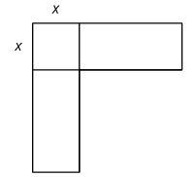
Learning Activity B | Part 1
Extending Your Thinking
Here is a diagram made of a square and two congruent rectangles. Its total area is
x² + 35x square units.
What is the length of the unlabeled side of each of the two rectangles in
Diagram A?
Diagram A
Notes:
Go back to Lesson Activity
Answer
17.5

Slide 19
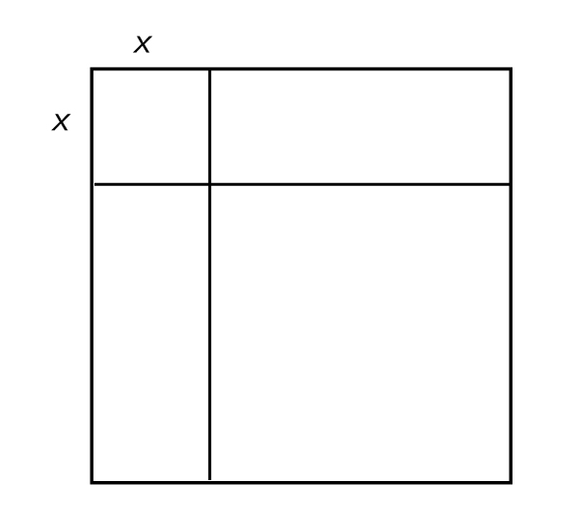
Learning Activity B | Part 2
Extending Your Thinking
In Diagram B, we add lines to make the figure a square. The area of the square becomes a quadratic equation.
Calculate the equation, then put that equation in the standard form ax² + bx + c.
  What is the value of the coefficient b?
  What is the value of the coefficient c?
How is the process of finding the area of the entire figure like the process of building perfect squares for expressions like 𝑥² + 𝑏𝑥?
Diagram B
Notes:
Go back to Lesson Activity
Answers
b = 35; c = 306.25
First, we had to figure out what number was half of 35 (which is 17.5) to find the side length of the rectangles. Then, we had to square the number 17.5 to find the area of the missing piece.

Slide 20

Learning Activity B
Self Check
Find the solutions to 𝑥² − 10𝑥 = −9 by completing the square.
𝑥 = 25
𝑥 = 1, 𝑥 = 9
𝑥 = 21
𝑥 = 9
Let’s review!
Notes:
Answer Feedback - Individualized by Response
Incorrect. This is the value of (^{b}/₂)².
That's correct! Add 25 to each side to create a perfect square trinomial. The equation becomes (𝑥 − 5)² = 16. Taking the square root of each side, the equation becomes 𝑥 − 5 = ±4. This results in two solutions.
Incorrect. After adding – 9 and 25, remember to take the square root of both sides.
Incorrect. There are two solutions. Remember to use the plus/minus sign when using the square root property.

Slide 21
Learning Activity B
Self Check - Review
SOLVING QUADRATICS BY COMPLETING THE SQUARE
Step 1 - Write the equation in the form 𝑎⁢𝑥² + 𝑏⁢𝑥 = 𝑐.
Step 2 - Complete the square by finding (^{b}/₂)².
Step 3 - Add the value to both sides of the equation.
Step 4 - Factor the perfect square trinomial and simplify the constants.
Step 5 - Take the square root of each side (don’t forget ±).
Step 6 - Write two separate equations and solve each.
Solve x² + 8x = 48 by completing the square.
Notes:
NOTE: The wording in the steps have been minorly altered to match the steps in subsequent lessons to facilitate consistency across lessons.
FYI - Original wording given in this lesson:
Step 1 - Isolate the variable terms on one side and place the constant term on the other. This equation has all the variables on the left.
Step 2 - Find (^{𝑏}/₂)², the number to complete the square. Add to both sides of the equation.
Step 3 - Factor the perfect square trinomial as a binomial square.
Step 4 - Use the square root property.
Step 5 - Simplify the radical and then solve the two resulting equations.
Step 6 - Check the solutions. Put each answer in the original equation to check.

Slide 22
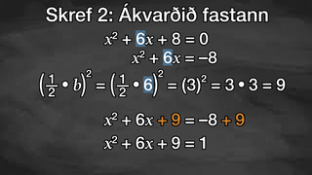
Learning Activity B | Video
Solve Equations by Completing the Square
Notes:
This video discusses question 1 of activity 9.2.3.

Slide 23
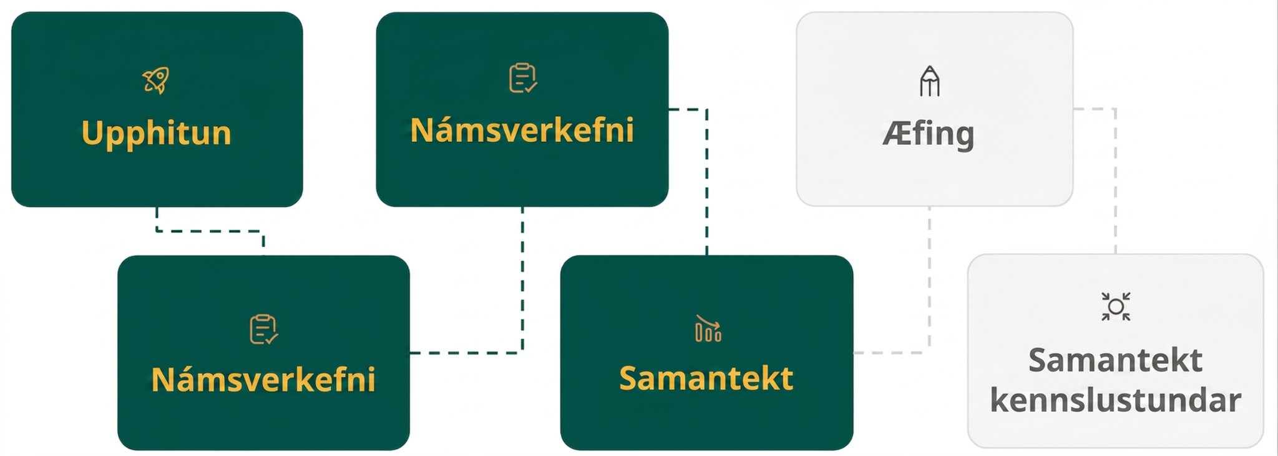
Lesson Journey
Fourth Step: Cool Down

Slide 24
Cool Down
For questions 1 – 3, what could be added to each expression to make it a perfect square?
x² + 12x
x² – 6x + 1
x² + 14x – 10
Solve the equation x² – 16x = – 60 by completing the square. Show your reasoning.
Notes:
Cool Down (5 minutes)
Answers
36; The constant term 𝑐 = 36 can be added to make the perfect square 𝑥² + 12𝑥 + 36.
8; 8 can be added to the constant term 𝑐 = 1 to make the perfect square 𝑥² − 6𝑥 + 9.
59; 59 can be added to the constant term 𝑐 = −10 to make the perfect square 𝑥² + 14𝑥 + 49.
𝑥 = 6 or 𝑥 = 10; See the online textbook for all of the steps.
Response to Student Thinking - More Chances
Students will have more opportunities to understand the mathematical ideas in this cool down, so there is no need to slow down or add additional work to the next lessons. Instead, use the results of this cool down to provide guidance for what to look for and emphasize over the next several lessons to support students in advancing their current understanding.

Slide 25
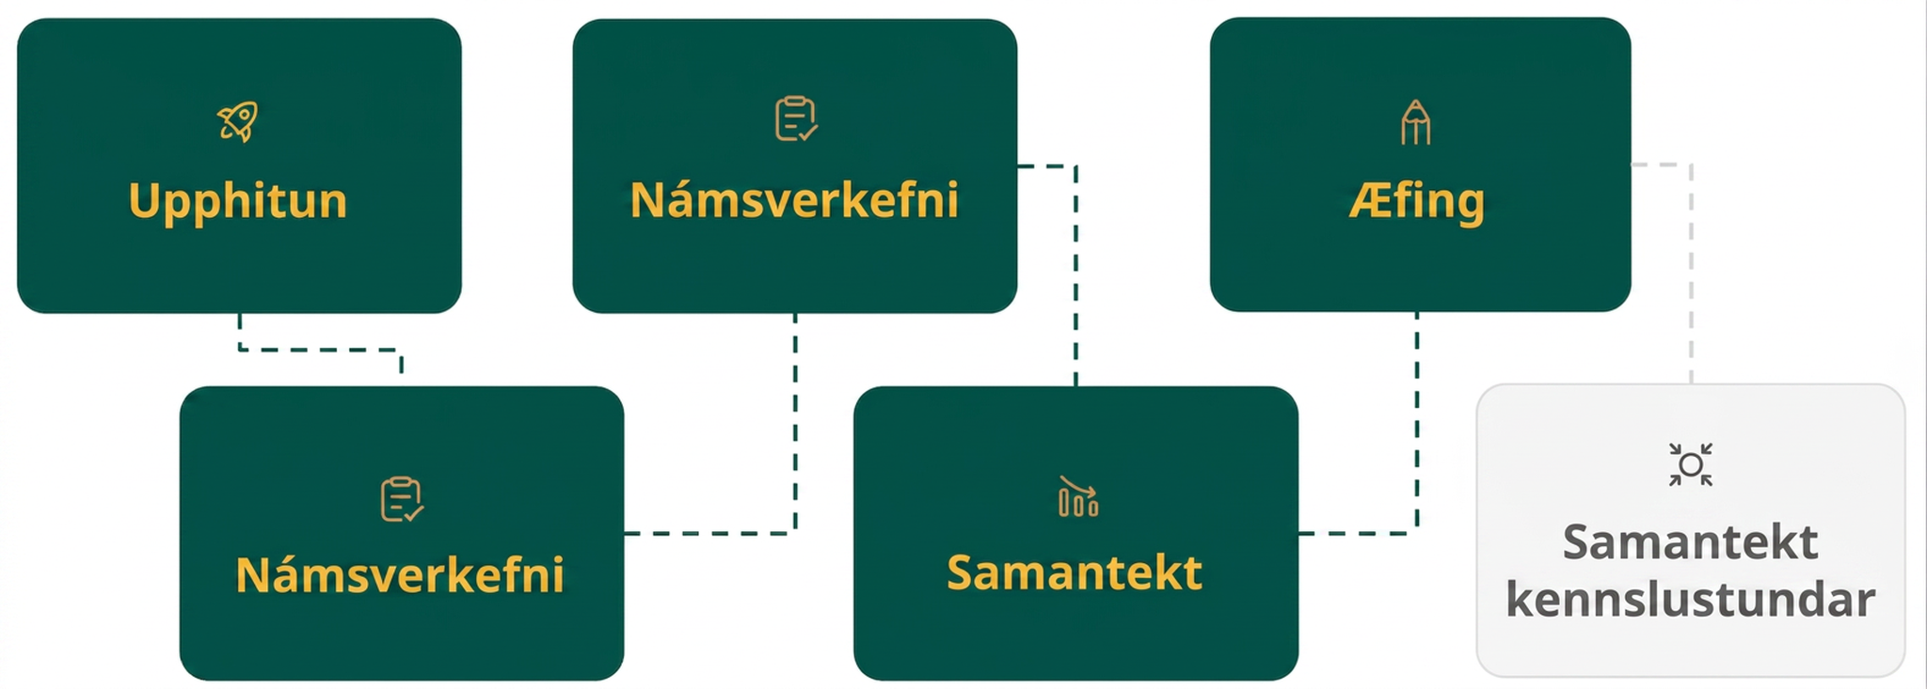
Lesson Journey
Fifth Stop: Practice

Slide 26

Practice
Put your hard work to action, practice what you’ve learned!
Notes:
Digital Practice: Access the practice pages at https://openstax.org/details/books/algebra-1

Slide 27
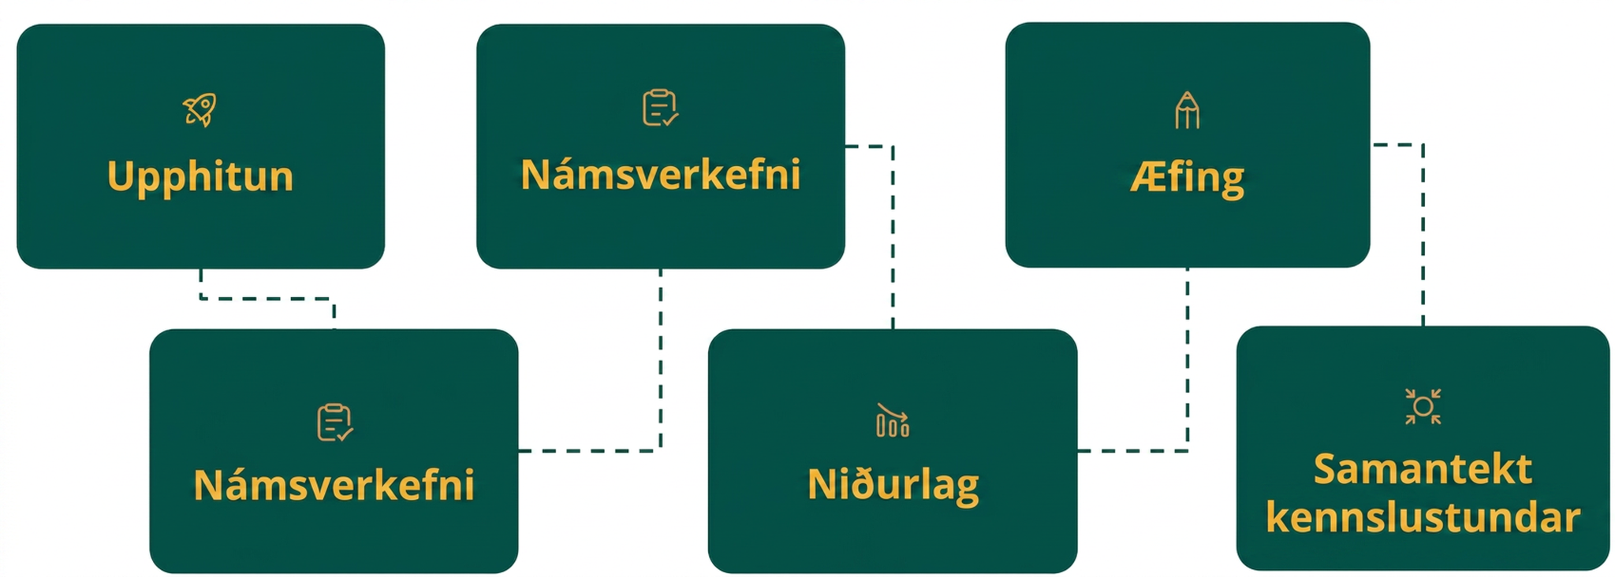
Lesson Journey
Sixth Stop: Lesson Synthesis

Slide 28
Lesson Synthesis
Which of these quadratic expressions are perfect squares? Which are not?
How can you tell?
𝑥² + 4𝑥 + 8
𝑥² + 24𝑥 + 144
𝑥² + 6𝑥 + 16
𝑥² – 40𝑥 + 400
Why isn't the third expression a perfect square? Isn't 16 a perfect square?
Suppose we have two equations:
𝑥² − 10𝑥 + 16 = 9 and 𝑥² − 40𝑥 + 400 = 9.
Which is easier to solve? Why?
Can't we simply rewrite the left side of
𝑥² − 10𝑥 + 16 = 9 in factored form and solve?
Notes:
Discuss - Note: The questions have been animated to reveal questions 3, 4, and then 5 on a click so that the subsequent questions do not give away answers to the earlier questions.
The second and fourth expressions are perfect squares. The other two are not.
When in standard form, an expression with perfect squares has a constant term that is a number squared and a linear term that is twice that number. In 𝑥² + 24𝑥 + 144, we can see 144 is 12 squared, and 24 is twice 12. In 𝑥² − 40𝑥 + 400, the term 400 is – 20 squared and – 40 is twice – 20.
16 is 4 squared or – 4 squared, but for the expression to be a perfect square, the coefficient of the linear term should be 8 (twice 4) or – 8 (twice – 4).
The second one, because the equation has a perfect square on each side. It can be rewritten as (𝑥 − 20)² = 9. There are two numbers that can be squared to make 9, which are 3 and – 3, so 𝑥 − 20 = 3 or 𝑥 − 20 = − 3.
Rewriting the left side gives (𝑥 − 8)(𝑥 − 2) = 9, but now we are stuck. We can't use the zero product property because the expression does not equal 0.
Notice that questions 1 – 2 have been asked in a previous lesson, but questions 3, 4, and 5 are slightly altered from previous questions to reflect this lesson’s learning targets.

Slide 29
Self Assessment
How much do you agree with the following statements?
Learning Goals | I can | Almost | Not yet
Explain what it means to "complete the square" and describe how to do it. | ⃞ | ⃞ | ⃞
Solve quadratic equations by completing the square and finding square roots. | ⃞ | ⃞ | ⃞

