Slide 1


Algebra 1
Unit 5 Introduction to Exponential Functions
Lesson 5.11 Modeling Exponential Behavior

Slide 2
How to use these slides
On the activity slides check the speaker notes for teacher support and instructional information.
Each lesson includes 1 warm up, 2-3 learning activities, a cool down, practice and a lesson synthesis.
  Learning activities are followed by a self check question, and review section.
Some slides have been hidden from student view, more information can be found on the next slide (Reference Key).
You can edit and use these slides for personal and classroom use, but cannot sell them and must keep the attribution logos.
For more information, Check out the digital quick start guide!

Slide 3






Reference Key
Check the top right corner for an icon referencing these unique sections.
 | Support for Students with Disability | Hidden | Learning Strategies slide, provides additional support to students for understanding the activity. Learning Strategies slide, provides additional support to students for understanding the activity.
 | Support for English Language Learners | Hidden
 | Extending Your Thinking | Hidden | Extending Your Thinking slide, provides an extra challenge for students.
 | Self Check | Not Hidden | Self Check slide, checkpoint to assess student understanding after the learning activity.
 | Review | Hidden | Self Check- Review slide, designed to help review topics from the self check question.
On the next slides, check the speaker notes for teacher instructions and support.
Notes:
Check the Speaker Notes: On the next slides you can find discussion questions, lesson information, answers to the activities, and ways to adjust the activity for your students!

Slide 4

Learning Goals
By the end of this lesson you will be able to -
Use exponential functions to model situations that involve exponential growth or decay.
Determine an appropriate model for a situation described by data.
Notes:
Lesson Narrative
In this lesson, students explore bounce heights to model and compare the bounciness of different balls. They may collect their own data or work with provided “messy” data that mimics real experimentation. Students decide what kind of model fits best and, though the data are not perfectly exponential or linear, an exponential model is usually more accurate. They must then find reasonable parameters, using different strategies such as ratios of bounce heights or examining the full dataset. By comparing and critiquing models, students build arguments and refine reasoning. Technology is optional but encouraged for analysis.
Required Preparation
Graphing technology should be available if students request it. Measuring tapes and balls that bounce are only needed if doing the extension activity.
Required Materials
A collection of balls that bounce (extension activity)
Measuring tapes (extension activity)
Graphing technology
Texas Essential Knowledge and Skills
A1(B) use a problem-solving model that incorporates analyzing given information, formulating a plan or strategy, determining a solution, justifying the solution, and evaluating the problem-solving process and the reasonableness of the solution.
A1(D) communicate mathematical ideas, reasoning, and their implications using multiple representations, including symbols, diagrams, graphs, and language as appropriate
A1(E) create and use representations to organize, record, and communicate mathematical ideas.
A1(F) analyze mathematical relationships to connect and communicate mathematical ideas.
A9(C) write exponential functions in the form f(x)=ab^{x} (where b is a rational number) to describe problems arising from mathematical and real-world situations, including growth and decay
A9(E) write, using technology, exponential functions that provide a reasonable fit to data and make predictions for real-world problems

Slide 5
Vocabulary
Previous
Exponential function
  A function that has a constant growth factor. Another way to say this is that it grows by equal factors over equal intervals.
New
None
Notes:
Lesson Vocabulary
To support student understanding of key vocabulary:
Introduce and review the vocabulary words students will see in this lesson.
Encourage students to notice how these words are used and to include them in their math discussions and explanations—both written and oral.
Use a word wall to reinforce vocabulary. Sample word wall cards are available here.
For newcomers or students with beginning English proficiency, use these Quizlet sets to support vocabulary learning:
Unit 5 Spanish Vocabulary – use first to build understanding
Unit 5 Vocabulary (English) – use after anchoring in Spanish
Support for English Language Learners
ELPS 2(F) listen to and derive meaning from a variety of media such as audio tape, video, DVD, and CD ROM to build and reinforce concept and language attainment
ELPS 3(C) speak using a variety of grammatical structures, sentence lengths, sentence types, and connecting words with increasing accuracy and ease as more English is acquired
ELPS 3(D) speak using grade-level content area vocabulary in context to internalize new English words and build academic language proficiency
ELPS 3(E) share information in cooperative learning interactions
ELPS 3(H) narrate, describe, and explain with increasing specificity and detail as more English is acquired
ELPS 5(B) write using newly acquired basic vocabulary and content-based grade-level vocabulary

Slide 6





Lesson Journey
Warm Up
Learning Activity
Practice
Learning Activity
Cool Down
Lesson Synthesis

Slide 7
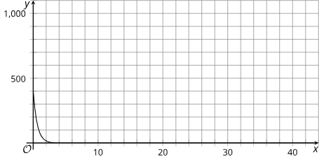
Warm Up - Graphing Window 🪟
Here is a graph of a function f(x) = 400 ⋅ (0.2)^{x}.
Identify the approximate graphing window shown.
Be prepared to explain your reasoning when suggesting a new graphing window that would:
  make the graph more informative or meaningful.
  make the graph less informative or meaningful.
Notes:
Warm Up (5 minutes)
This warm up prompts students to think about how changing the graphing window influences what you can see and understand about an exponential function.
Launch
Ask students to close books/devices and think of at least one notice and one wonder.
Display the table, give 1 minute quiet think time, then select 3–5 students to share.
Record and display responses; if not pointed out, ask: “Describe how the data are changing as t increases.” (p decreases at a slower rate.)
Ask students to reopen books/devices, complete the activity, and follow with whole-class discussion.
Activity Answers
0 < x < 44 and 0 < y < 1,100 or equivalent
a. 0 < x < 10 and 0 < y < 450. This window would include x-values where meaningful changes happen and exclude the parts where the changes are very small. The y-values are limited to values that matter, between 0 and 400, allowing us to see more clearly the changes in that range.
b. -10 < x < 80 and 0 < y < 100. This window would show a lot of useless x-values and cut off the y-values at 100, which would make the behavior of the function when 𝑥 is between 0 and 1 very difficult to observe.
Activity Synthesis
Ask students to suggest graphing windows that are more or less helpful and explain why. Emphasize that the x-values should match the quantity being studied, while y-values should be chosen so data appear clearly and trends are visible.
If time allows, discuss why the graph drops steeply between x = 0 and x = 2 but flattens later. With a decay factor of 0.2, each step keeps only 20% of the value. Early decreases are large—for example, f(0) = 400 to f(1) = 80, a drop of 320—but later decreases are much smaller, like about 11 from x=2 to x=3.

Slide 8

Lesson Journey
Warm Up
Learning Activity
Practice
Learning Activity
Cool Down
Lesson Synthesis

Slide 9
Learning Strategies - Bouncing Balls⚽
Create a visual display of your reasoning.
Quietly read at least 2 other displays.
Think about similarities and differences.
Discuss with your group which model fits best.
Compare and Connect
Teacher Instruction: Use these strategies to adjust the activity to support English language learners and students with disabilities.
  You can copy and paste the callouts directly on top of the activity or give the instructions aloud.
Watch a demo or video of a ball bouncing to see what bounce height means.
Use color or notes to match numbers in the table with parts of the equation y = 1000 ⋅ (½)^{x}.
Representation
Notes:
Support for English Language Learners: MLR 7 Compare and Connect: Representing, Conversing
Use this routine to prepare students for the whole-class discussion. At the appropriate time, ask students to prepare a visual display that shows their mathematical thinking and reasoning for the first question. Invite students to quietly circulate and read at least 2 other posters or visual displays in the room. Give students quiet time to think individually to consider what is the same and what is different about the displays. Next, ask students to return to their group to discuss what they noticed. Listen for and amplify observations for choosing an exponential or linear model. This will help students interpret real-world data and provide justification for choosing an exponential model.
Design Principle(s): Cultivate conversation
Learn more about this routine
View the instructional video and follow along with the materials to assist you with learning this routine.
Provide support for students
Distribute graphic organizers to the students to assist them with participating in this routine.
Support for Students with Disabilities: Representation: Internalize Comprehension
Begin with a demonstration or video of bouncing a ball to clarify what bounce height means. Highlight connections between representations by using color coding or annotations to connect the numbers in the table to the symbols in the equation y = 1000 ⋅ (½)^{x}.
Supports accessibility for: Conceptual processing; Visual-spatial processing

Slide 10
Learning Activity - Bouncing Balls⚽
The table shows measurements for the maximum height of a tennis ball after bouncing several times on a concrete surface.
Which function is a better model of the maximum height ℎ(cm) after 𝑛 bounces: linear or exponential? Use the table to explain.
A tennis ball should rebound to 53–58% of its drop height. Does this ball meet the rule? Show your reasoning.
Write an equation that models the bounce height h after n bounces.
n Bounce Number | h Height (Centimeters)
0 | 150
1 | 80
2 | 43
3 | 20
4 | 11
Notes:
Support for All Learners
This activity offers additional support for students:
For English language learners and students with disabilities, be sure to review the Learning Strategies slide!
Activity (15 minutes)
In this activity, students examine the successive heights that a tennis ball reaches after several bounces on a hard surface and consider how to model the relationship between the number of bounces and the height of the rebound. To do so, they need to determine the growth factor of successive bounce heights. Because some data are provided here, students engage in only some aspects of mathematical modeling. To engage students in the full modeling cycle that includes data gathering, consider asking students to measure the bounce heights of a ball, as suggested in the next activity.
Real-world data are often messy, and that is the case for the data provided here. Monitor for students who try the following approaches in deciding whether a linear or exponential model is more appropriate for modeling the data:
Use the table of values and look at successive differences.
Use the table of values and look at successive quotients.
Plot the points and observe the general trend in bounce height.
Plot the points using graphing technology and use the technology to generate a line or curve of best fit.
While each successive bounce height is about half of the preceding height, there is variation in the data, with the largest factor being a little more than 0.55 and the smallest a little less than 0.47. Monitor the way students choose to deal with this variation, which affects the model they consider appropriate. They may:
Decide that an exponential model is not appropriate because the growth factor is different from bounce to bounce.
Make a rough approximation for the growth factor, for example, by observing that each bounce height h is about half the preceding bounce height: h = 150⋅(½)^{n}.
Find and use the growth factor from the first two points: h = 150 ⋅ (8/15)^{n}.
Take an average of the successive quotients: h = 150 ⋅ (0.53)^{n}.
Use graphing technology to generate a regression equation: h = 150.389 ⋅ (0.527)^{n}.
Select students who use these strategies to share during the discussion. Encourage those who do not think an exponential model is appropriate to look for an exponential model that best fits the given data.
Making graphing technology available gives students an opportunity to choose appropriate tools strategically.
Launch
Arrange students in groups of 2 – 4.
Answers
Exponential. Your answer may vary, but here is a sample.
Plotting the points in the plane, they are not close to being on a line.
Link to Demos Graph https://www.desmos.com/calculator/q4t7xlulpt
A linear function of the bounce height would decrease by the same amount for each successive bounce. The differences in heights between successive bounces are not close to being the same, as shown in the table. They are decreasing with each bounce, so the function is not linear.
Bounce Number | Difference from Height of Previous Bounce
0 | –
1 | 70
2 | 37
3 | 23
4 | 9
An exponential function of the bounce height would decrease by the same factor for each successive bounce. It looks like each successive bounce is about half as high as the previous bounce, making an exponential model appropriate.
Your answer may vary, but here is a sample.
Yes. The first rebound is a little over 53%, the second is almost 54%, and the fourth is 55%. The third rebound is only about 47%, but there could be some measurement error.
No, the third rebound is less than 50% of the height from which the tennis ball fell, falling out of the allowable range.
It is not possible to tell. One of the values is too low, and the others are close enough to 53% that it is impossible to be sure whether the bounces of this ball fall within the regulations.
Your answer may vary, but here is a sample.
h = 150 ⋅ (0.53)^{n} (A factor of exactly 0.5 is also acceptable, or any value between 0.53 and 0.58.)
More activity questions, answers, misconceptions, and synthesis on the next slide.

Slide 11

Learning Activity - Bouncing Balls⚽
About how many bounces will it take before the rebound height of the tennis ball is less than 1 centimeter? Be prepared to show your reasoning.
Use the graphing tool or technology outside the course. Graph the equation that models the bounce height h after n bounces for this tennis ball.
Use the graph of the equation that models the bounce height h after n bounces for this tennis ball.to predict the difference in height after 6 bounces.
Notes:
Activity Answer
Your answer may vary, but here is a sample. 8 bounces. For example:
The height of the ball is decreasing by a factor of about ½ after each bounce. So after 3 more bounces, it will decrease by a factor of about ⅛ (giving a little more than 1 cm), but after 4 more bounces, it will decrease by a factor of about 1/16.
Graphing h = 150 ⋅ (0.53)^{n} and h=1 simultaneously using graphing technology shows the bounce height first goes below h=1 on the 8th bounce.
Link to Demos Graph https://www.desmos.com/calculator/lzbwbqhyfm
The difference in height after 6 bounces is 2.
Using the equation: h = 150 ⋅ (0.50)^{n} and graphing h = 150 ⋅ (0.50)⁶. The graph shows the height to be 2.344 after 6 bounces (n = 6).
This is consistent with the reasoning :
The height of the ball is decreasing by a factor of about ½ after each bounce.
After the 4th bounce, the height difference is 9. It should decrease by ½ for each bounce after that. So, after 2 more bounces (the 6th bounce), it will decrease by a factor of about ¼. The 6th bounce would be 9⋅14 ≈ 2.25.
Rounding either 2.344 or 2.25 results in the answer 2.
Anticipated Misconceptions
Students may not be comfortable with the data not fitting an exponential function exactly. Remind them that real-world data is messy, so, when modeling, we must do our best to approximate the data. If an exponential model does a good job at approximating the data and showing its general trend, then this is a reasonable model to use even though it does not accurately predict or match all of the data.
Activity Synthesis
Ask students to share how they decided whether a linear or exponential function is more appropriate for modeling the data. Once the class concludes that a linear model is less suitable, select previously identified students to share how they determined a growth factor to use for their models and the resulting equations. Sequence the strategies being presented as shown in the Activity Narrative.
Connect the discussion about growth factors to the data and what the factors tell us about whether the tennis ball satisfies the bounce regulations. Ask questions such as:
“Do most of the data support the conclusion?”
“How can we explain the third bounce?” (E.g., it is too low, but there could have been a mis-measurement, or the tennis ball could have hit something on the floor.)
To follow up on the last question, consider discussing the practical domain in this context. Ask, for instance: “How long could we expect this behavior to continue? Can it go on indefinitely? What is a reasonable domain for our model?”

Slide 12
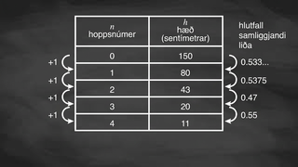
Video: Determining a Model and an Equation from a Real-World Scenario

Slide 13
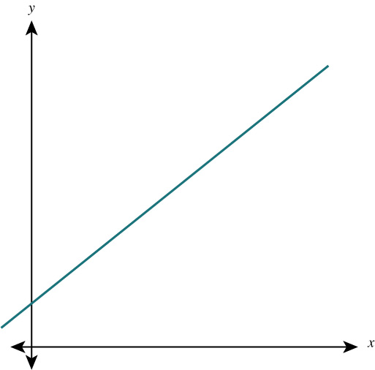
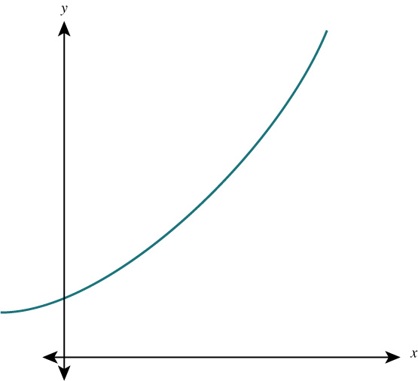
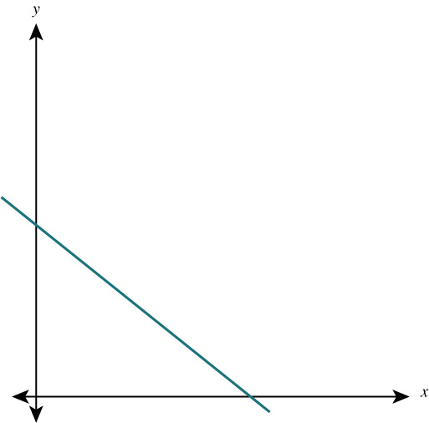
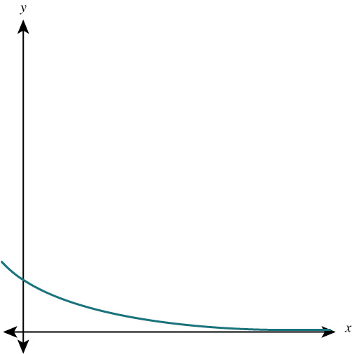
Self Check
The table gives predictions of the average costs of a gasoline car after the year 2030.
Which graph best represents the relationship between time and the predicted cost?
Time (Years) | Cost (Thousand of Dollars)
0 | 35
5 | 40.2
10 | 46.3
15 | 53.2
20 | 61.2
a.
c.
b.
d.
Let’s review!
Notes:
Answer Feedback - Individualized by Response
Incorrect. This graph shows a linear model. The table represents an exponential relationship. The answer is graph c.
Incorrect. This graph shows a decreasing linear relationship. The numbers in the table are growing in a nonlinear and increasing way. The answer is graph c.
That’s correct! The cost of the car increases at an increasing rate over time.
Incorrect. This graph shows a decreasing relationship. The cost of the car increases over time. The answer is graph c.

Slide 14
Self Check - Review
The table is a lab researchers record of the first four hours of growth of the population of a yeast colony.
Did you notice that the population doubles every hour?
Hours into Study | 0 | 1 | 2 | 3 | 4
Yeast Colony Population (Thousands) | 5 | 10 | 20 | 40 | 80
The starting value is 5 (thousand) and the population doubles, so the growth factor is 2. If you use this table to make predictions what will the yeast colony’s future population size be in:
5 hours?
6 hours?
10 hours?
Notes:
Using an Exponential Model
Answers
The population will be 160,000. You will double the 80 which represents 80,000.
The population will be 320,000. You will double the 160 which represents 160,000.
You may have to use a calculator to figure this one out. You will double it four more times. The population will be 5,120,000.
The equation to model this growth is P(t) = 5 ⋅ 2^{t} .
Link to the Desmos graph: https://www.desmos.com/calculator/6jj8avz6og

Slide 15
Lesson Journey
Warm Up
Learning Activity
Practice
Learning Activity
Cool Down
Lesson Synthesis

Slide 16
Learning Strategies - The Rebound Factor⚽
“In the table, I noticed that . . .”
“I interpreted the successive quotients to mean . . .”
“The equation helped determine the bounciness by . . .”
Conversing
Teacher Instruction: Use these strategies to adjust the activity to support English language learners and students with disabilities.
You can copy and paste the callouts directly on top of the activity or give the instructions aloud.
Remember: the number of bounces is counted each time the ball hits the floor.
A “bounce” means the ball hits the floor and changes direction.
If you see something like 1½ bounces, that’s really talking about time, not the number of bounces.
Representation
Notes:
Support for English Language Learners: MLR 8 Discussion Supports: Conversing
Use this routine to help students reflect on their reasoning process in deciding on the bounciness of the balls. Before the whole-class discussion, arrange students in groups of 2. Provide the following sentence frames as partners share their ideas: “In the table, I noticed that . . .”; “I interpreted the successive quotients to mean . . .”; or “The equation helped determine the bounciness by . . . .” This will help students make sense of exponential decay through discussing the ball-bouncing situation with a partner.
Design Principle(s): Support sense-making; Cultivate conversation
Support for Students with Disabilities: Representation: Internalize Comprehension
Activate or supply background knowledge about discrete and continuous contexts. The number of bounces is counted every time the ball hits the floor. If a student asks about 1½ bounces, clarify that would be measuring the time since the ball had been released, not the number of bounces; a “bounce” is the event of hitting the floor and changing direction.
Supports accessibility for: Memory; Conceptual processing

Slide 17
Learning Activity - The Rebound Factor⚽
The table shows some heights of a ball after a certain number of bounces
Bounce Number | Height (Centimeters)
0
1
2 | 73.5
3 | 51.5
4 | 36
Be prepared to show your reasoning for each question.
Is this ball more or less bouncy than the tennis ball in activity 5.11.2, which has the equation h=150⋅(0.53)^{n}?
From what height was the ball dropped? Remember your units!
Write an equation that represents the bounce height of the ball, h, in centimeters after n bounces.
Notes:
Support for All Learners
This activity offers additional support for students:
For English language learners and students with disabilities, be sure to review the Learning Strategies slide!
Activity (15 minutes)
This activity explores exponential decay through ball bounces. Students calculate a rebound factor, write a function to model bounce heights, and use it to answer questions. They also consider the domain, noting that bounces are discrete(t does not make sense to examine ⅔ of a bounce), so the graph should not be continuous.
Launch
Remind students that earlier they explored exponential growth; now they will look at exponential decay with ball bounces.
Show the bounce height data and ask: “What do you notice about how the heights change after each bounce?”
Tell students they will calculate a rebound factor and use it to write a function for the bounce heights.
Highlight that only whole numbers of bounces make sense, so the graph will be discrete, not continuous.
Answers
This ball is more bouncy. Each bounce of this ball reaches a height that is about 0.7 times that of the previous bounce (51.5 ÷ 73.5 ≈ 0.7). The tennis ball in the earlier task loses about half of its height with each bounce.
150 centimeters; 73.5 ÷ 0.7 = 105 and 105 ÷ 0.7 = 150.
h = 150 ⋅ (0.7)^{n}
More activity questions, answers, and synthesis on the next slide.

Slide 18
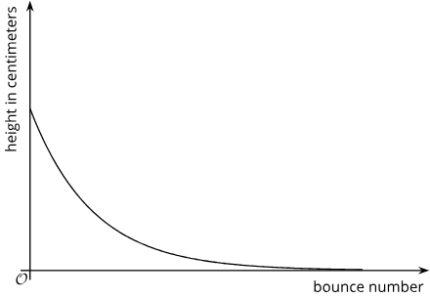
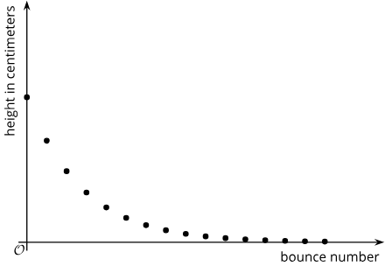
Learning Activity - The Rebound Factor⚽
Which graph would more appropriately represent the equation for h: Graph A or Graph B?
A.
B.
Will the nth bounce of this ball be lower than the nth bounce of the tennis ball?
The table shows an exponential decay that starts at 640. What exponential decay problem is it modeling?
x | 0 | 1 | 2 | 3
y | 640 | 160 | 40 | 10
Notes:
Answers
Graph B is more appropriate. Only whole-number n values make sense in this context. We cannot have bounce number 3.4, for example.
No, the height of this ball after any given bounce will not be lower than that of the tennis ball because they were dropped from the same height and this ball has a greater rebound factor, so it will always bounce up to a higher point than the tennis ball.
Compare your answer.
The pattern for the decay is starting at 640 and then decreasing by ¾ with only ¼ remaining. The equation is y = 640 ⋅ (1 − ¾)^{x}
or y = 640 ⋅ (¼)^{x}.
Anticipated Misconceptions
If students struggle to make sense of the graph, remind them that the horizontal axis depicts the number of bounces, not the height of the ball or time. Although height and time are continuous, the number of bounces is discrete.
Activity Synthesis
Invite students to share how they decided on the bounciness of the balls and to reflect on their reasoning process:
“How are the data here different from the data in the first activity?” (In this case, the successive quotients are very close to the same value, making the choice of rebound factor more straightforward.)
“When working with the table, how is calculating the missing value in the row above a given value different from calculating a missing value in the row below?” (To find the missing value in the row above, we need to divide by the rebound factor rather than multiply.)
“In the final question, why are both the initial height and the bounciness important?” (The value of h is found by multiplying the initial height by the rebound factor n times, so both values matter.)

Slide 19
Self Check
The population of deer in a forest is divided in half every decade. Which of the following graphs could represent this situation?
a.
c.
b.
d.
Let’s review!
Notes:
Answer Feedback - Individualized by Response
Incorrect. This graph shows an increasing linear model. The population is decreasing in a nonlinear way. The answer is graph d.
Incorrect. This graph shows a decreasing linear relationship. The population is decreasing in a nonlinear way. The answer is graph d.
Incorrect. This shows an increasing relationship. The population is decreasing by a factor of ½. The answer is graph d.
That’s correct! The population of deer will decrease over time, but the rate at which it decreases will slow down.

Slide 20
Self Check - Review
Data has been entered into a table that shows exponential decay. How would you write the equation that represents this model?
x | 0 | 1 | 2 | 3
y | 200 | 100 | 50 | 25
A car sells for $4,000 and loses ⅛ of its value each year. Write a function that gives the car’s value, V(t), t years after it is sold.
Notes:
Writing Exponential Decay Functions
Answers
The formula for exponential decay is y = a ⋅ (1 − b)^{x} where a is the starting value and b is the amount that value decreases each unit of time x.
The pattern for the decay is starting at 200 and then decreasing by ½ with only ½ remaining. The equation is y = 200 ⋅ (1− ½)^{x} or y = 200⋅(½)^{x}.
Since the car loses ⅛ of its value each year, it keeps 7/8 of its value from year to year, so the growth factor is 7/8.
V(t) = 4000 ⋅ (7/8)^{t}

Slide 21

Lesson Journey
Warm Up
Learning Activity
Practice
Learning Activity
Cool Down
Lesson Synthesis

Slide 22
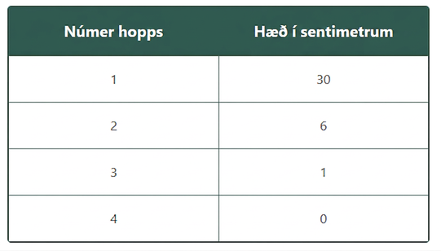
Cool Down
A ball is dropped from a certain height. The table shows the rebound heights of the ball after a series of bounces.
From what height, approximately, do you think the ball was dropped? Be prepared to show your reasoning.
Notes:
Cool Down (5 minutes)
Answers
For example: Between 150 cm and 180 cm. The rebound factors are ⅕ , ⅙, and 0 (this last measurement is probably not reliable because it could have been a very small bounce height, which would be difficult to measure). Because ⅕ of 150 is 30 and ⅙ of 180 is 30, the ball was probably dropped from between 150 cm and 180 cm.
Response to Student Thinking - More Chances
Students will have more opportunities to understand the mathematical ideas in this cool-down, so there is no need to slow down or add additional work to the next lessons. Instead, use the results of this cool-down to provide guidance for what to look for and emphasize over the next several lessons to support students in advancing their current understanding.

Slide 23

Lesson Journey
Warm Up
Learning Activity
Practice
Learning Activity
Cool Down
Lesson Synthesis

Slide 24

Practice
Put your hard work to action, practice what you’ve learned!
Notes:
Digital Practice: Access the practice pages at https://openstax.org/k12/algebra

Slide 25

Lesson Journey
Warm Up
Learning Activity
Practice
Learning Activity
Cool Down
Lesson Synthesis

Slide 26
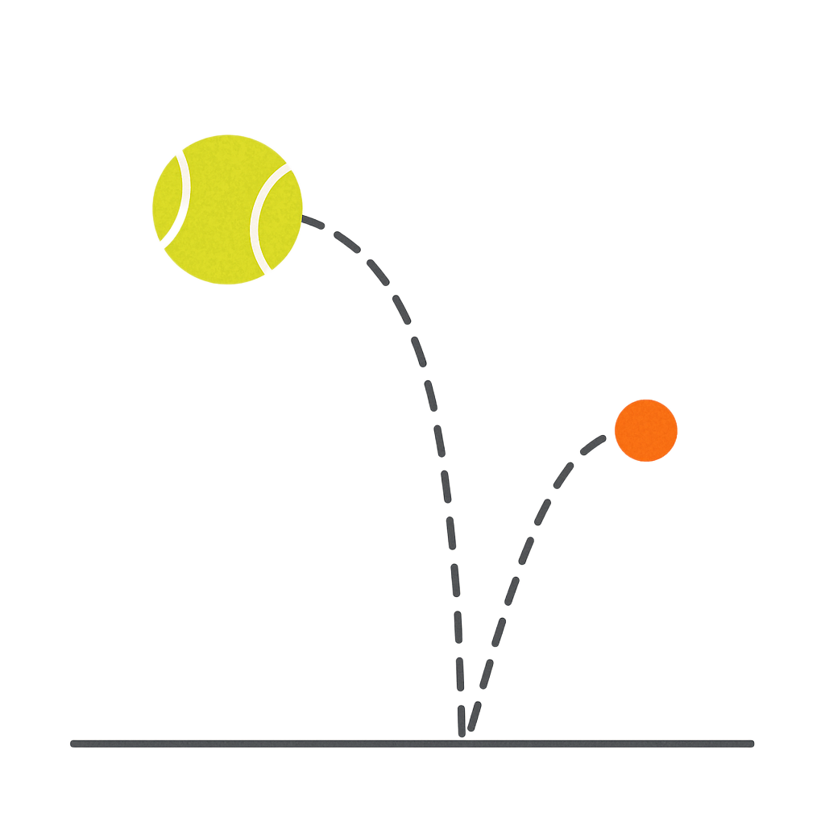
Lesson Synthesis
Answer the following:
Were the data completely accurate? Why or why not?
We saw different rebound factors for different pairs of successive data points. How do we decide if an exponential model is still appropriate?
Given the inconsistency, how do we find an appropriate factor to use for our model?
Notes:
In this lesson, students explored models to represent successive bounce heights of different kinds of balls. The data they used were rather messy. Invite students to reflect on the process of modeling with such data by discussing the questions.
Answers
Depending on the tools used, it can be very hard to get exact measurements of rebound heights, and it gets harder the lower the bounces are. Measurement errors are likely.
We might want to see if the differences are small enough to treat them as measurement error. In the lesson, they are all within about 0.05 of 0.5, and most of them are close to about 0.54.
We might disregard the factor(s) that are very different from the rest, or we might consider finding an average of the factors
In this lesson, students explored models to represent successive bounce heights of different kinds of balls. The data they used were rather messy. Invite students to reflect on the process of modeling with such data by discussing the questions.
If time permits, discuss possible limitations of the models. Ask questions such as:
“Do the models we produce work well after 45 bounces? After 78 bounces? What about when the rebound height is less than 1 cm?”
“Can we rely on the models to be appropriate if we bounce the ball on a different hard surface?”
“What level of accuracy should we consider? For example, is 0.5 or 0.54 more appropriate for the rebound factor?”

Slide 27
Self Assessment
How much do you agree with the following statements?
I can… | I can | Almost | Not yet
Use exponential functions to model situations that involve exponential growth or decay.
Determine an appropriate model for a situation described by data.

