Slide 1


Algebra 1
Unit 4 Functions
Lesson 4.5 Using Function Notation to Describe Rules, Part 2

Slide 2
How to use these slides
On the activity slides check the speaker notes for teacher support and instructional information.
Each lesson includes 1 warm up, 2-3 learning activities, a cool down, practice and a lesson synthesis.
  Learning activities are followed by a self check question, and review section.
Some slides have been hidden from student view, more information can be found on the next slide (Reference Key).
You can edit and use these slides for personal and classroom use, but cannot sell them and must keep the attribution logos.
For more information, Check out the digital quick start guide!

Slide 3






Reference Key
Check the top right corner for an icon referencing these unique sections.
 | Support for Students with Disability | Hidden | Learning Strategies slide, provides additional support to students for understanding the activity. Learning Strategies slide, provides additional support to students for understanding the activity.
 | Support for English Language Learners | Hidden
 | Extending Your Thinking | Hidden | Extending Your Thinking slide, provides an extra challenge for students.
 | Self Check | Not Hidden | Self Check slide, checkpoint to assess student understanding after the learning activity.
 | Review | Hidden | Self Check- Review slide, designed to help review topics from the self check question.
On the next slides, check the speaker notes for teacher instructions and support.
Notes:
Check the Speaker Notes: On the next slides you can find discussion questions, lesson information, answers to the activities, and ways to adjust the activity for your students!

Slide 4

Learning Goals
By the end of this lesson you will be able to -
Use technology to graph a function given in function notation, and use the graph to find the values of the function.
Use the vertical line test to determine whether or not a graph represents a function.
Explain different ways to find the value of a function and to solve equations written in function notation.
Explain what makes a function a linear function.
Notes:
Lesson Narrative
Previously, students saw that functions can be defined by rules and written in function notation. Now, they use these rules to evaluate functions and solve for inputs when outputs are known. They also interpret function rules in context, building quantitative and abstract reasoning.
Students are introduced to the term linear function, connecting it to their middle school understanding: a function is linear when the output changes at a constant rate with respect to the input.
An optional extension (not included in this slide deck) uses technology to graph and evaluate functions, supporting deeper understanding and problem-solving in this and future units. It can be found online at https://raiselearning.org/mod/lesson/view.php?id=115726&pageid=768925
Required Preparation
For the extension activity Function Notation and Graphing Technology, acquire devices that can run Desmos (recommended) or other graphing technology. It is ideal if each student has their own device.
Required Materials
Graphing technology
Texas Essential Knowledge and Skills
A1(F) analyze mathematical relationships to connect and communicate mathematical ideas
A12(A) decide whether relations represented verbally, tabularly,graphically , and symbolically define a function
A12(B) evaluate functions, expressed in function notation, given one or more elements in their domains

Slide 5
Vocabulary
Previous
Dependent variable
  This value represents the output of a function.
Function notation
  A way of writing the outputs of a function that you have given a name to. If the function is named 𝑓 and 𝑥 is an input, then 𝑓(𝑥) denotes the corresponding output.
Independent variable
  This value represents the input of a function.
New
Linear function
  A function that has a constant rate of change.
Vertical line test
  A visual way to determine if a graph is a function
Notes:
Lesson Vocabulary
To support student understanding of key vocabulary:
Introduce and review the vocabulary words students will see in this lesson.
Encourage students to notice how these words are used and to include them in their math discussions and explanations—both written and oral.
Use a word wall to reinforce vocabulary. Sample word wall cards are available here.
For newcomers or students with beginning English proficiency, use these Quizlet sets to support vocabulary learning:
Unit 4 Spanish Vocabulary, part 1 – use first to build understanding
Unit 4 Vocabulary (English), part 1 – use after anchoring in Spanish
Unit 4 Spanish Vocabulary, part 2 – use first to build understanding
Unit 4 Vocabulary (English), part 2 – use after anchoring in Spanish
Support for English Language Learners
ELPS 2(E) use visual, contextual, and linguistic support to enhance and confirm understanding of increasingly complex and elaborate spoken language
ELPS 2(F) listen to and derive meaning from a variety of media such as audiotape, video, DVD, and CD-ROM to build and reinforce concept and language attainment
ELPS 3(D) speak using grade-level content area vocabulary in context to internalize new English words and build academic language proficiency
ELPS 4(F) use visual and contextual support and support from peers and teachers to read grade-appropriate content area text, enhance and confirm understanding, and develop vocabulary, grasp of language structures, and background knowledge needed to comprehend increasingly challenging language

Slide 6





Lesson Journey
Warm Up
Learning Activity
Practice
Learning Activity
Cool Down
Lesson Synthesis

Slide 7
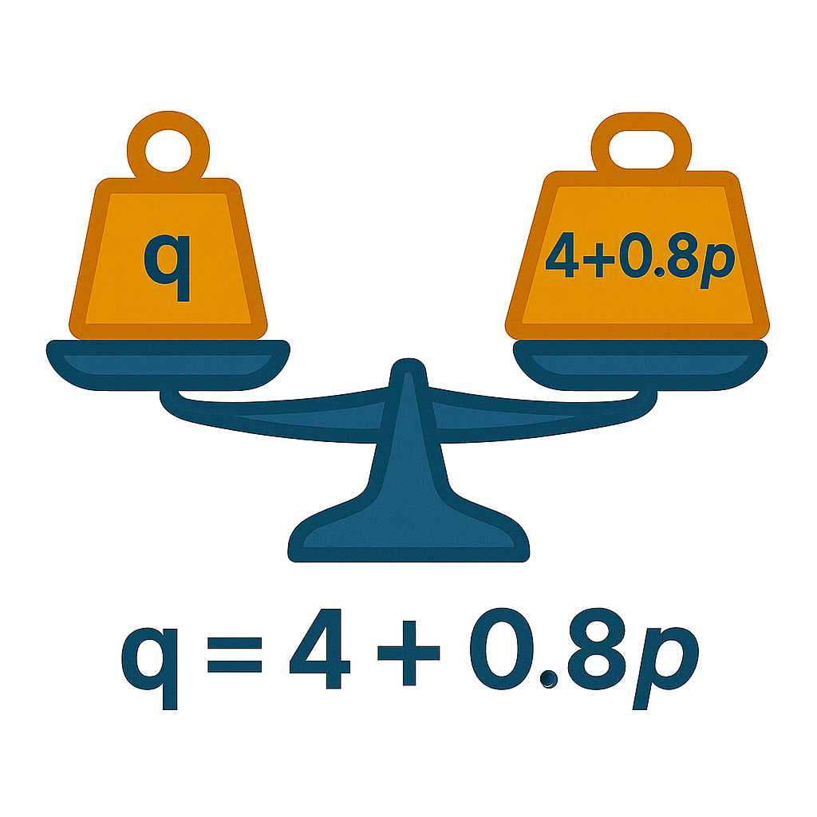
Warm Up - Evaluating & Solving Equations 🟰
Consider the equation q = 4 + 0.8p.
What value of q would make the equation true when p is 7?
What value of q would make the equation true when p is 100?
What value of p would make the equation true when q is 12?
What value of p would make the equation true when q is 60?
Notes:
Warm Up (5 minutes)
This warm-up reviews evaluating and solving equations, reinforcing that solving means finding values that make the equation true. It prepares students to use function notation to find unknown inputs or outputs in upcoming tasks.
Answers:
q = 4 + 0.8(7)
q = 4 + 5.6
q = 9.6
q = 4 + 0.8(100)
q = 4 + 80
q = 84
12 = 4 + 0.8p
12 − 4 = 4 + 0.8p − 4
8 = 0.8 p
8/0.8=0.8p/0.8
p=10
60 = 4 + 0.8p
60 − 4 = 4 + 0.8p − 4
56 = 0.8p
56/0.8 = 0.8p/0.8
p = 70
Activity Synthesis
Invite students to share their response and strategy for answering the questions.
To find the values of p in the second set of questions, some students may have guessed and checked, but many students should have recognized that they could solve the equations for p (either before or after substituting the value of q). If no students mentioned solving the equations, bring it to their attention.
Remind students that to solve 12 = 4 + 0.8p is to find the value of p that makes the equation true.

Slide 8

Lesson Journey
Warm Up
Learning Activity
Practice
Learning Activity
Cool Down
Lesson Synthesis

Slide 9
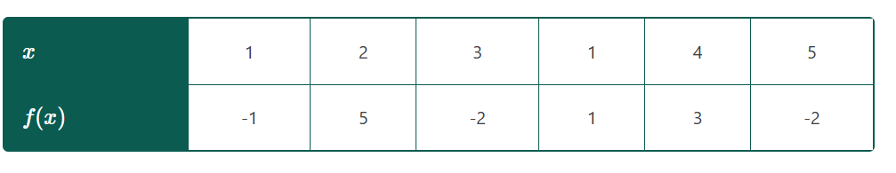
Learning Activity - Vertical Line Test ⬆️
A table for the function f.
Is this relation a function? Explain your answer.
Graph the points in the relation.
What do you notice about the points (1,−1) and (1,1)?
Notes:
Activity (25 minutes)
Answers:
f is not a function because f(1) = −1 and f(1) = 1.
Click here for the slide with image 2.
g(3) = 27
More activities, answers on the next slide.

Slide 10
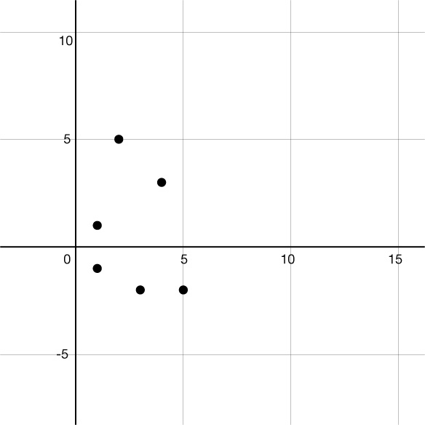
Learning Activity - Vertical Line Test ⬆️
Image 2
Notes:
Activity Images

Slide 11
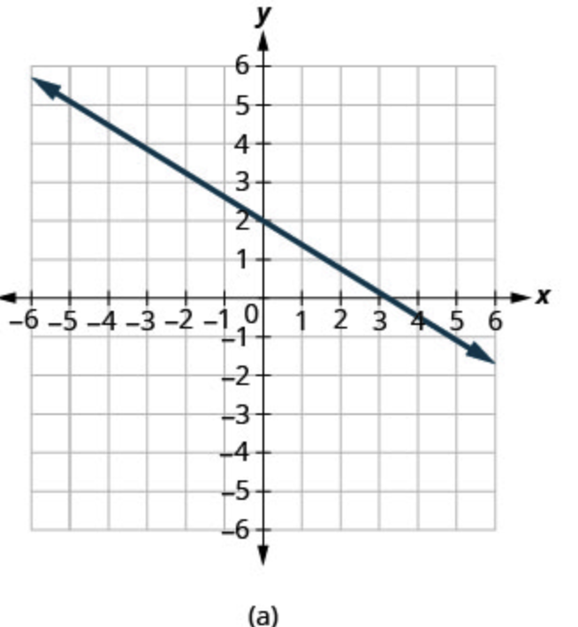
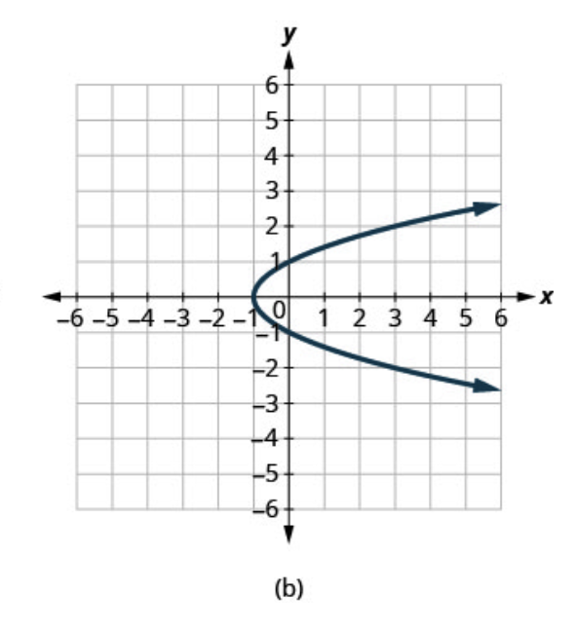
Learning Activity - Vertical Line Test ⬆️
4.
Vertical Line Test
Draw a vertical line anywhere on a graph. You can determine if the graph is a function by counting how many times it and the vertical line intersect.
Intersections > 1: not a function
Intersections = 1: a function
If the graph does represent a function, we say it “passes the vertical line test.”
For questions 4 and 5, determine if the graph passes the vertical line test and then explain how this identifies the graph as a function or not.
5.
Notes:
Activity Answer
Compare your work: Your answer may vary, but here is a sample for each day.
Yes, this passes the vertical line test (see the sample blue lines below) for all points on the line so the graph is a function.
No, this graph does not pass the vertical line test, so it is not a function. For example, the vertical line x = 1 crosses the graph more than once.

Slide 12
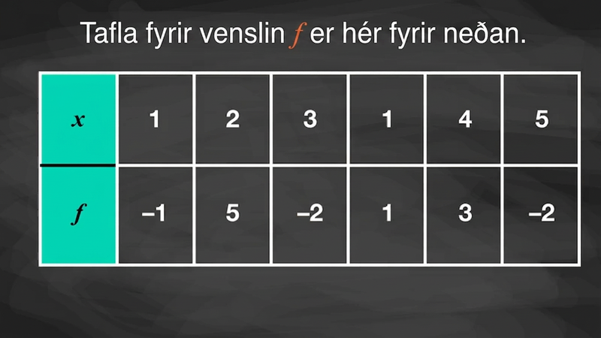
Video: Using the Vertical Line Test

Slide 13
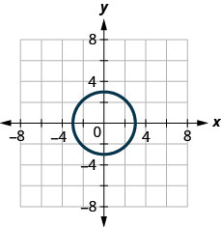
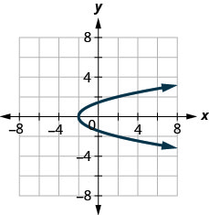
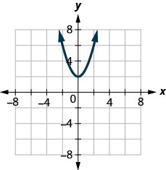
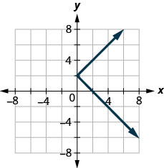
Self Check
Which of the following graphs is the graph of a function?
a.
b.
c.
d.
Let’s review!
Notes:
Answer Feedback - Individualized by Response
Incorrect. For a graph to be that of a function, it must pass the vertical line test. For this graph, there are multiple places where an imaginary vertical line would touch more than once. For example, the vertical line x = 2 crosses the graph more than once. The answer is: graph c.
Incorrect. For a graph to be that of a function, it must pass the vertical line test. For this graph, there are multiple places where an imaginary vertical line would touch more than once. For example, the vertical line x = 2 crosses the graph more than once. The answer is: graph c.
That’s correct! If an imaginary vertical line were drawn anywhere on the graph, it would only touch once. This graph passes the vertical line test and is the graph of a function.
Incorrect. For a graph to be that of a function, it must pass the vertical line test. For this graph, there are multiple places where an imaginary vertical line would touch more than once. For example, the vertical line x = 2 crosses the graph more than once. The answer is: graph c.

Slide 14
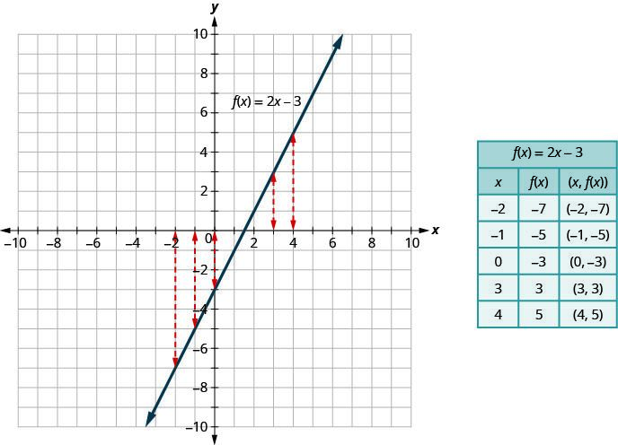
Self Check - Review
Another
Example
Determine if a Graph Is a Function
A relation is a function if each input has exactly one output. Since lines such as f(x) = 2x - 3 always meet this condition, they are called linear functions.
On the graph, each vertical dashed line intersects a function at most once, because each x-value must have only one y-value.
If a vertical line crosses the graph more than once, it means an input has multiple outputs, so it's not a function.
This idea is known as the vertical line test: a graph represents a function if no vertical line intersects it more than once.
Notes:
Click the Another Example button for another review example

Slide 15
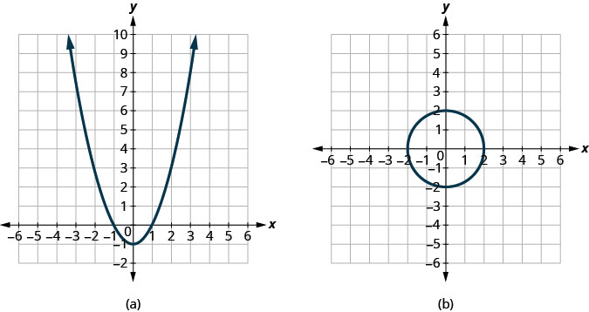
Self Check - Review Additional Example
Graph (a) passes the vertical line test because if an imaginary vertical line were drawn anywhere on the graph, it would only touch one time.
Graph (a) is a function.
Graph (b) does not pass the vertical line test because when a vertical line is drawn down the graph, there is at least one place where the vertical line touches twice.
Graph (b) is not a function.
Notes:
This is an additional review example.

Slide 16
Lesson Journey
Warm Up
Learning Activity
Practice
Learning Activity
Cool Down
Lesson Synthesis

Slide 17
Learning Strategies - Compare Data Plans 📱
Walk around and analyze strategies in w other displays.
Think about what’s the same and different about the strategies.
Talk with your partner about what you noticed
Compare and Connect
Teacher Instruction: Use these strategies to adjust the activity to support English language learners and students with disabilities.
You can copy and paste the callouts directly on top of the activity or give the instructions aloud.
Share your ideas about the data plans and graphs.
Representation
Notes:
Support for English Language Learners: MLR 7 Compare and Connect: Representing, Conversing
Use this routine to prepare students for the whole-class discussion. At the appropriate time, invite students to create a visual display that shows their strategy for the last question. Allow students time to quietly circulate and analyze the strategies in at least 2 other displays in the room. Give students quiet time to think individually to consider how the strategies are alike and how they are different. Next, ask students to find a partner to discuss what they noticed. This will help students make connections between the strategies used to solve for an unknown input value.
Design Principle(s): Optimize output; Cultivate conversation
Learn more about this routine
View the instructional video and follow along with the materials to assist you with learning this routine.
Provide support for students
Distribute graphic organizers to the students to assist them with participating in this routine.
Support for Students with Disabilities: Representation: Internalize Comprehension
Use color and annotations to illustrate student thinking. As students share their reasoning about the two data plans and the graphs that represent the linear functions of each, scribe their thinking on a visible display.
Supports accessibility for: Visual-spatial processing; Conceptual processing

Slide 18

Learning Activity - Compare Data Plans 📱
A college student is choosing between two data plans for her new cell phone. Both plans include an allowance of 2 gigabytes of data per month. The monthly cost of each option can be seen as a function and represented with an equation:
Option A: A(x)=60
Option B: B(x)=10x+25
In each function, the input, x, represents the gigabytes of data used over the monthly allowance.
The student decides to find the cost of each option when she exceeds the 2 gigabytes of data allowed each month. Use the function rules to help her compare the data plans.
Notes:
Support for All Learners
This activity offers additional support and an extension for students:
For English language learners and students with disabilities, be sure to review the Learning Strategies slide!
For students looking for an extra challenge, be sure to review the Extending Your Thinking slide!
Activity (25 minutes)
In this activity, students use function rules from real situations to connect different representations. They evaluate functions and interpret input and output in context -for example, recognizing that B(1) gives the cost for 1 extra gigabyte on Data Plan B, found by calculating 10(1) + 25.
Students also use rules of functions to solve for an unknown input value. For example, given the rule B(x) = 10x + 25 and the statement B(x) = 50, they work to find a value of x that makes B(x) = 50 true. They do so by:
guessing and checking
analyzing the graph of y = 10x + 25 and identifying the x-value when y is 50
reasoning that a budget of $50 means that only $25 is available for extra data, and at $10 per gigabyte, it means 2.5 gigabytes of data
solving 10x + 25 = 50 algebraically
Identify students who use different strategies and ask them to share their thinking later.
Launch
Arrange students in groups of 2.
As a class, read the opening and first question together. Ask, “What do A(1) and B(1) represent? What does the 1 in each expression mean?” Give students quiet think time, then partner discussion.
Invite students to share their interpretations, in particular the meaning of "allowance." Most data plans include a basic amount of data at a fixed cost but start charging an additional fee if usage goes beyond this allowance. Before students begin the activity, make sure they see that an input value of 1 represents usage of 1 gigabyte of data beyond the monthly allowance.
Answers
1
4
16
36
A(s)=s²
A(2) is the area of the square in cm² when the side length is 2 cm. Its value is 4.
Link to graph: https://k12.openstax.org/contents/raise/resources/09ea7f96b3cf45cb99f26dcf599536e434d70294
ALT TEXT: A graph showing area (cm²) versus side length (cm) from 0 to 8. The curve rises steeply, indicating area increases with side length. Four data points are marked along the curve.
More activity questions, answers, anticipated misconceptions, and synthesis on the next slide.

Slide 19

Learning Activity - Compare Data Plans 📱
What is the value of A(1)?
What is the value of B(1)?
Which plan is better if 1 extra gigabyte is used?
What is the value of A(7.5)?
What is the value of B(7.5)?
Which plan is better if 7.5 extra gigabytes are used?
Explain which plan you think she should choose.
She only budgeted $50 and wondered, “How much data can I get for $50 with Option B?” She wrote B(x) = 50. How many extra gigabytes beyond the included 2 can she use?
Explain how you knew how many gigabytes of data she would have for $50.
Are you ready for more?
Notes:
Answers
Your answers may vary, but here are some samples.
60
35
If only 1 extra gigabyte is used, then Option B is the best option because it would be cheaper.
60
100
If 7.5 extra gigabytes are used, then Option A is the best option because it would be cheaper.
Your answer may vary, but here are some samples: She should choose Option A if she plans on using around 7.5 gigabytes a month. She should choose Option A if she uses more than 5.5 gigabytes a month (or more than 3.5 gigabytes over the allowance). She should choose Option B if she uses only about 2 gigabytes a month.
She can use 2.5 gigabytes beyond the initial 2 provided by the plan (for a total of 4.5 gigabytes each month).
Your answer may vary, but here are some samples: I used the graph to estimate the gigabytes of data when the cost is $50, and it is about 2.5. I knew that B(x) is equal to 10x + 25, so I wrote 10x + 25 = 50 and solved for x, which gave x = 2.5.
Anticipated Misconceptions
Students may question if A is a function at all, because unlike B or other function rules they have seen so far, A(x) is defined with a constant instead of an expression containing the dependent variable. Or they may wonder why A(x) has the same value no matter what the input value is. Ask students to recall the definition of function and to consider whether each input value gives only one output value. Because it does, even though it is always the same output value, A is still a function.
Activity Synthesis
Select students to share their interpretations of the two data plans. Make sure students see that:
The equation A(x) = 60 tells us that, regardless of the extra gigabytes of data used, x, the cost, A(x) is always 60.
The 10x in the rule of B(x) tells us that each extra gigabyte of data used costs $10, and that there is a $25 fixed fee.
Explain that both functions are linear because their outputs change at a constant rate. Option B increases by $10 per extra gigabyte, while Option A has no increase.
Ask how students graphed the functions. They likely plotted points, but if no one mentions slope and intercept, prompt them to do so.
Then discuss the final question about how many gigabytes $50 buys under Option B. Have selected students share their strategies. If needed, introduce solving with a graph or the equation 10x + 25 = 50.
Explain the following points to help students connect some key ideas:
We can graph functions like A(x) = 60 and B(x) = 10x + 25 without plotting individual coordinate pairs.
A(x) is the output of function A and is represented by vertical values on a coordinate plane. The vertical values are typically labeled with the variable y, so we can write y = A(x) and graph y = 60 to represent function A.
Likewise, B(x) is the output of function B and is represented by vertical values on a plane. We can write y = B(x) and graph y = 10x + 25 to represent function B.
To solve equations like B(x) = 50 means to find one or more values of x that make the equation true. We can do this, among other ways, by using the graph of B and by solving an equation algebraically.
On the graph of B, we can look for one or more values of x that correspond to the vertical value of 50. This might involve some estimating.
Because B(x) is equal to 10x + 25 and B(x) is also equal to 50, we can write 10x + 25 = 50 and solve the equation.
If time permits, invite students to share which option they believe the college student should choose and why.

Slide 20
Extending Your Thinking
Describe a different data plan that, for any amount of data used, would cost no more than one of the given plans and no less than the other given plan. Explain or show how you know this data plan would meet these requirements.
Notes:
Answer
Here is a possible answer:
The graph of this data plan would be a line whose slope is between the slope of the other two graphs (greater than 0 but less than 10) and goes through the intersection of the other two graphs.
The plan charges $4 for each gigabyte of data over the 2 gigabyte allowance, plus a $6 fee. With this plan:
If we use exactly 13.5 additional gigabytes above the allowance (that is, 5.5 gigabytes in total), all three plans would cost $60.
If we use less than that, our plan would cost less than Option A but more than Option B.
If we use more than that, our plan would cost more than Option A but less than Option B.

Slide 21

Self Check
Rental car company A charges $50 a day plus $0.50 a mile, m, and is modeled by function A.
Rental car company B charges $20 a day plus $1.00 a mile, m, and is modeled by function B.
Which statement is true for the cost of one day after m miles?
Company A is always more than Company B.
A(100) < B(100)
A(100) = B(100)
A(100) > B(100)
Let’s review!
Notes:
Answer Feedback - Individualized by Response
Company A is always more than Company B.
Incorrect. A(m) = 50 + 0.50m , B(m) = 20 + 1m are the two equations so A(100) = 100 and B(100) = 120. The answer is A(100) < B(100).
A(100) < B(100)
That’s correct! A(m) = 50 + 0.50m, B(m) = 20 + 1m are the two equations so A(100) = 100 and B(100) = 120..
A(100) = B(100)
Incorrect. A(m) = 50 + 0.50m , B(m) = 20 + 1m are the two equations so A(100) = 100 and B(100) = 120. The answer is A(100) < B(100).
A(100) > B(100)
Incorrect. A(m) = 50 + 0.50m , B(m) = 20 + 1m are the two equations so A(100) = 100 and B(100) = 120. The answer is A(100) < B(100).

Slide 22

Self Check - Review
Functions are used in a variety of real life situations. They are useful in making comparisons, especially when comparing the cost.
The daily cost to printing company A to print a book is modeled by a function C(x) = 3.25x + 1500 where C is the total daily cost, in dollars, and x is the number of books printed.
Their competitor, company B can print a book at a cost modeled by C(x) = 2.75x + 2500
Find C(1000) for each company and make a statement
about the result.
Company A: C(1000) = 3.25(1000) + 1500, C = 4750
Company B: C(1000) = 2.75(1000) + 2500, C = 5250
When 1000 books are printed, Company A has the best price.
Notes:
Remind Students
The last column has the output for any x. This is the rule of the function.

Slide 23

Lesson Journey
Warm Up
Learning Activity
Practice
Learning Activity
Cool Down
Lesson Synthesis

Slide 24
Cool Down
The college student who is looking for a data plan for her cell phone found a third option, which also offers a 2-gigabyte monthly allowance for data.
The monthly cost of this option can be represented by function C, defined by C(x) = 30x + 5, where x is the gigabytes of data used over the monthly allowance.
Find C(0.7) and explain what it means in this situation.
Her budget is still $50 a month. To find out how many gigabytes of data she could use if she chose this plan, she writes C(x) = 50 and solves for x. What value of x makes this equation true? Be prepared to show your reasoning.
Notes:
Cool Down (5 minutes)
Answers
C(0.7) = 26 because 30(0.7) + 5 = 26. Here is a possible explanation: It means that the cost would be $26 if she used 0.7 gigabyte over the 2-gigabytes allowance in a month.
x = 1.5. Here is a possible explanation: Because C(x) = 30x + 5, we can write C(x) = 50 as 30x + 5 = 50 and solve for x, which gives 1.5.
Response to Student Thinking - Press Pause
At this point, students need to be able to evaluate and interpret equations given in function notation. If students continue to struggle, select examples of cool-downs from this unit to highlight and clarify misconceptions, and then have students work to revise cool-downs and reflect on their misconceptions. Practice problems 1, 3, 4, and 5 from this lesson all provide opportunities for practice and additional formative assessment.

Slide 25

Lesson Journey
Warm Up
Learning Activity
Practice
Learning Activity
Cool Down
Lesson Synthesis

Slide 26

Practice
Put your hard work to action, practice what you’ve learned!
Notes:
Digital Practice: Access the practice pages at https://openstax.org/details/books/algebra-1

Slide 27

Lesson Journey
Warm Up
Learning Activity
Practice
Learning Activity
Cool Down
Lesson Synthesis

Slide 28
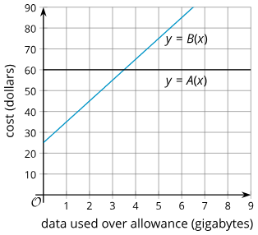
Lesson Synthesis
Use the graphs to find:
the values of A(0.8) and B(0.8).
the solutions to A(x) = 72 and B(x) = 72
Use the equations:
A(x) = 60
B(x) = 10x + 25
To find:
the values of A(0.8) and B(0.8).
the solutions to A(x) = 72 and B(x) = 72
Notes:
Refer back to the Function Rules activity. Display the two graphs for all to see.
Ask students to use the graphs to find:
the values of A(0.8) and B(0.8).
the solutions to A(x) = 72 and B(x) = 72
Next, display the two equations for all to see. (Hold off on discussing students’ responses.)
Ask students to use the equations to find the same four values they have just found using the graphs.
A(x) = 60
B(x) = 10x + 25
Invite students to compare and contrast the graphical and algebraic approaches for finding unknown inputs and outputs of linear functions. Discuss questions such as:
“How easy was it to use the graph of B to find an output value, such as B(0.8)?
What about using the graph to find an input value, such as the x in B(x) = 72?”
(Both were fairly straightforward, but they may not have been very precise. Some estimation was necessary. It was very easy to see that there was no solution to A(x) = 72.)
“How easy was it to use the rule B(x) = 10x + 25 to find an output value, such as B(0.8)?
What about finding an input value, such as the x in B(x) = 72?”
(Both were fairly simple, but if the rule or the given input or output involves numbers that are harder to compute
by hand, it might be more complicated.)
If students did the extension activity on using graphing technology, ask students to identify some ways that technology could help them find unknown input and output values of a function.

Slide 29
Self Assessment
How much do you agree with the following statements?
I can… | I can | Almost | Not yet
Use technology to graph a function given in function notation, and use the graph to find the values of the function.
Identify if a graph represents a function through the vertical line test.
Explain different ways to find the value of a function and to solve equations written in function notation.
Explain what makes a function a linear function.

