Slide 1
Algebra 1
Unit 5 Introduction to Exponential Functions
Lesson 5.3 Patterns of Growth

Slide 2

How to use these slides
On the activity slides check the speaker notes for teacher support and instructional information.
Each lesson includes 1 warm up, 2-3 learning activities, a cool down, practice and a lesson synthesis.
  Learning activities are followed by a self check question, and review section.
Some slides have been hidden from student view, more information can be found on the next slide (Reference Key).
You can edit and use these slides for personal and classroom use, but cannot sell them and must keep the attribution logos.
For more information, Check out the digital quick start guide!
OpenStax CC BY NC SA

Slide 3





Reference Key
Check the top right corner for an icon referencing these unique sections.
Icon | Title | View | Location and Description
n/a | Support for Students with Disability | Hidden | Learning Strategies slide, provides additional support to students for understanding the activity.
n/a | Support for English Language Learners | Hidden | Learning Strategies slide, provides additional support to students for understanding the activity.
n/a | Extending Your Thinking | Hidden | Extending Your Thinking slide, provides an extra challenge for students.
n/a | Self Check | Not Hidden | Self Check slide, checkpoint to assess student understanding after the learning activity.
n/a | Review | Hidden | Self Check - Review slide, designed to help review topics from the self check question.
On the next slides, check the speaker notes for teacher instructions and support.
Notes:
Check the Speaker Notes: On the next slides you can find discussion questions, lesson information, answers to the activities, and ways to adjust the activity for your students!

Slide 4

Learning Goals
By the end of this lesson you will be able to -
Compare growth patterns using calculations and graphs.
Use words and expressions to describe patterns in tables of values.
Write expressions and create tables of values to represent them using descriptions of linear and exponential relationships.
Begin making connections between linear and exponential growth and the real world (especially financially).
Notes:
Lesson Narrative
The goal of this lesson is to encounter two different growth patterns—one pattern is linear, and the other is exponential. Students think about and compare the patterns by performing calculations and using graphs. This lesson contains many opportunities for students to notice and make use of structure. There is also an opportunity to use appropriate tools strategically.
They see that the pattern that grows by repeatedly doubling starts off slowly but eventually overtakes the other pattern, which increases by repeatedly adding the same amount. In fact, the first pattern eventually leaves the second pattern far behind. It is important that the teacher makes the connections between linear and exponential growth and the real world. Students need to understand how exponential growth can affect them financially through debts and investments, and how it’s always important to compare different offers given.
Students continue to examine two types of patterns by looking at tables, noting that one type is characterized by common differences and the other by common factors. They then match different representations with two contexts. This is an opportunity for students to notice structure in expressions. Note we are still not expecting students to use the words linear or exponential to describe these patterns, though they may naturally use the word linear to describe linear growth since they have encountered these types of functions before.
Throughout the unit, students will study exponential patterns systematically (eventually viewing them as functions) before returning to this comparison with linear functions toward the end of the unit.
Some technology is required for this lesson, but there are opportunities for students to select appropriate technology in the lesson. We recommend making scientific calculators and spreadsheet technology available.
Required Preparation
Acquire scientific calculators or devices that can run GeoGebra (recommended) or other spreadsheet technology. It is ideal if each student has their own device. (GeoGebra Spreadsheet is available here)
Required Materials
Scientific calculators
Spreadsheet technology
Texas Essential Knowledge and Skills
A1(D) communicate mathematical ideas, reasoning, and their implications using multiple representations, including symbols, diagrams, graphs, and language as appropriate
A1(F) analyze mathematical relationships to connect and communicate mathematical ideas
A9(C) write exponential functions in the form f(x) = ab^{x} (where b is a rational number) to describe problems arising from mathematical and real-world situations, including growth and decay

Slide 5
Vocabulary
Previous
None
New
Common difference
  The difference between consecutive terms in an arithmetic sequence, d.
Common ratio
  The ratio between consecutive terms in a geometric sequence, r.
Notes:
Lesson Vocabulary
To support student understanding of key vocabulary:
Introduce and review the vocabulary words students will see in this lesson.
Encourage students to notice how these words are used and to include them in their math discussions and explanations—both written and oral.
Use a word wall to reinforce vocabulary. Sample word wall cards are available here.
For newcomers or students with beginning English proficiency, use these Quizlet sets to support vocabulary learning:
Unit 5 Spanish Vocabulary – use first to build understanding
Unit 5 Vocabulary (English) – use after anchoring in Spanish
Support for English Language Learners
ELPS 2(F) listen to and derive meaning from a variety of media such as audiotape, video, DVD, and CD-ROM to build and reinforce concept and language attainment
ELPS 2(I) demonstrate listening comprehension of increasingly complex spoken English by following directions, retelling or summarizing spoken messages, responding to questions and requests, collaborating with peers, and taking notes commensurate with content and grade-level needs
ELPS 4(F) use visual and contextual support and support from peers and teachers to read grade-appropriate content area text, enhance and confirm understanding, and develop vocabulary, grasp of language structures, and background knowledge needed to comprehend increasingly challenging language
ELPS 4(G) demonstrate comprehension of increasingly complex English by participating in shared reading, retelling or summarizing material, responding to questions, and taking notes commensurate with content area and grade level needs

Slide 6
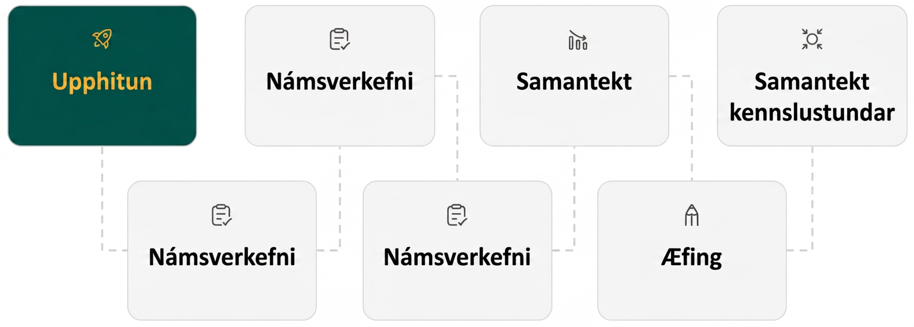
Lesson Journey
First Stop: Warm Up

Slide 7

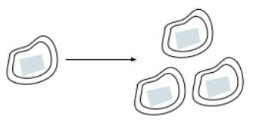
Warm Up | Part 1
Bacteria Explosion!
There are some bacteria in a dish. Every hour, each bacterium splits into 3 bacteria.
This diagram shows a bacterium in hour 0 and then hour 1. Draw what happens in hours 2 and 3.
How many bacteria are there in hour 2?
How many bacteria are there in hour 3?
Notes:
Warm Up (5 minutes)
This opening warm up gives students an opportunity to create a pictorial representation of exponential growth. The purpose of this warm up is to help students make sense of the situation coming up in the next activity, where they are not explicitly asked to make a pictorial representation.
Answers
A drawing is shown on the next slide (currently hidden).
9 bacteria in hour 2
27 bacteria in hour 3
Anticipated Misconceptions
None
Activity Synthesis
Invite a few students to share their drawings and their observations about how the number of bacteria is growing.

Slide 8
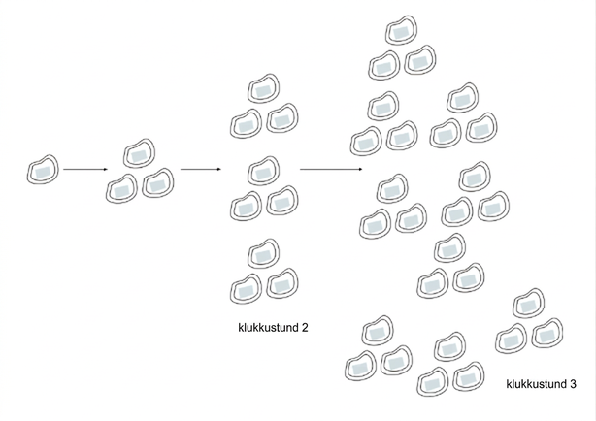
Warm Up | Part 2
Bacteria Explosion!
There are some bacteria in a dish. Every hour, each bacterium splits into 3 bacteria.
This diagram shows a bacterium in hour 0 and then hour 1. Draw what happens in hours 2 and 3.

Slide 9
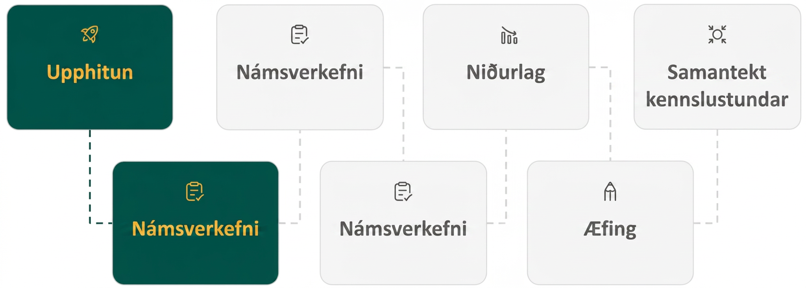
Lesson Journey
Second Stop: Learning Activity A

Slide 10

Learning Activity A | Learning Strategies
Choose Wisely!🤔
Teacher Instruction: Use these strategies to adjust the activity to support English language learners and students with disabilities.
You can copy and paste the callouts directly on top of the activity or give the instructions aloud.
First read: listen and describe the situation without numbers.
Second read: list what can be counted or measured.
Third read: listen for the question and brainstorm ways to solve.
Three Reads
Sketch a diagram to show how the amount of money grows over the first few days.
Representation
Notes:
Support for English Language Learners: MLR 6 Three Reads: Reading, Listening, Conversing
Use this routine to support reading comprehension of this word problem. Use the first read to orient students to the situation. Ask students to describe what the situation is about without using numbers (as a reward, students make a choice between Purse A and Purse B). Use the second read to identify quantities and relationships. Ask students what can be counted or measured without focusing on the values. Listen for, and amplify, the important quantities that vary in relation to each other in this situation: the amount of money, in dollars, and the amount of time, in days. After the third read, invite students to brainstorm possible strategies to answer the questions. This helps students connect the language in the word problem and the reasoning needed to solve the problem.
Design Principle(s): Support sense-making
Learn more about this routine
View the instructional video and follow along with the materials to assist you with learning this routine.
Provide support for students
Distribute graphic organizers to the students to assist them with participating in this routine.
Support for Students with Disabilities: Representation: Internalize Comprehension
Represent the same information through different modalities by using diagrams. Encourage students to sketch diagrams that show how the amount of money grows over the first few days. Students may benefit from this visual as they transition to the use of a table or other representation to track growth.
Supports accessibility for: Conceptual processing; Visual-spatial processing

Slide 11
Learning Activity A | Part 1
Choose Wisely!🤔
You are walking along a beach, and your toe hits something hard. You reach down, grab onto a handle, and pull out a lamp! It is sandy. You start to brush it off with your towel. Poof! A genie appears.
He tells you, “Thank you for freeing me from that bottle! I was getting claustrophobic. You can choose one of these purses as a reward.”
Purse A, which contains $1,000 today. If you leave it alone, it will contain $1,200 tomorrow (by magic). The next day, it will be $1,400. This pattern of an additional $200 per day will continue.
Purse B, which contains 1 penny today. Leave that penny in there because tomorrow it will (magically) turn into 2 pennies. The next day, there will be 4 pennies. The amount in the purse will continue to double each day.
Notes:
Support for All Learners
This activity offers additional support and an extension for students:
For English language learners and students with disabilities, be sure to review the Learning Strategies slide!
Activity (15 minutes)
The goal of this activity is to allow students to explore two growth patterns and to notice that a doubling pattern eventually grows very, very large, even with a small starting value. Students may perform a repeated calculation, or they may generalize the process by writing expressions or equations.
Making spreadsheet technology available gives students an opportunity to choose appropriate tools strategically.
Launch
Provide access to calculators or spreadsheets.
Present the situation (either by asking students to read it quietly or by performing a dramatic reading).
Before students do any calculating or any other work, poll the class about which option they think is better.
Display the results of the poll (the number of students who think Purse A is better and the number who think Purse B is better) for all to see.
Activity questions, answers, anticipated misconceptions, and synthesis on the next slide.

Slide 12
Learning Activity A | Part 2
Choose Wisely!🤔
How much money will be in Purse A after a 7-day week?
How much money will be in Purse B after a 7-day week?
How much money will be in Purse A after two weeks?
How much money will be in Purse B after two weeks?
The genie later adds that he will let the money in each purse grow for three weeks.
  How much money will be in Purse A in three weeks?
  How much money will be in Purse B in three weeks?
Which purse contains more money after 30 days?
Notes:
Activity Answer
After 7 days, Purse A will contain $2,400 because it grows by $200 each day for 7 days.
Purse B will contain $1.28. It doubles each day for 7 days, so it will have 1⋅2⁷ or 128 cents (the 1 here represents the 1 cent for when the genie appeared).
After 2 weeks, Purse A will contain an additional $1,400 for a total of $3,800.
After 2 weeks, Purse B will contain 1⋅2¹⁴ cents. This is 16,384 cents or $163.84.
a. Purse A will have an additional $1,400 during the third week for a total of $5,200.
b. Purse B will have 128 times as much money (compared to the end of two weeks) for a total of $20,971.52.
Purse B will have a lot more money. Purse A will have 1,000 + 30⋅200 or $7,000, which is much less than the doubling purse on day 21.
Anticipated Misconceptions
Some students may confuse the units for the two purses. Remind them that Purse B contains pennies (and thus cents rather than dollars).
Vocabulary such as claustrophobic and double may need to be clarified so students are clear on what the question is asking.
Due to prior experience with genie stories, students may be suspicious of the offers. Ask them to show their mathematical reasoning, rather than basing their choice of purses on their suspicions or other considerations such as how to carry a purse containing over 2 million pennies.
Activity Synthesis
Focus the discussion on how students found the amounts of money in the two purses after many days. Invite students who performed recursive calculations and those who wrote expressions or equations to share. Record and display students’ reasoning for all to see. Seeing the repeated reasoning will support students’ generalization work later. For example, the amount in Purse A will be 1,000 + 200 for day 1, then 1,000 + 200 + 200 for day 2, 1,000 + 200 + 200 + 200 for day 3, and so on. Connect this to writing expressions like 1,000 + 200⋅3
and 1,000 + 200𝑥 where 𝑥 represents the number of days since the genie appeared.
For Purse B, highlight the fact that after two days it contains (1⋅2)⋅2 cents, which is 2² cents. After three days, it contains (1⋅2)⋅2⋅2 cents, which is 2³ cents. (Here the day the genie appears is treated as day 0.) This is a good opportunity to emphasize the meaning of exponential notation. Exponential notation is particularly useful for expressing the amount in Purse B on day 30, which is 230 cents.
If no students use a spreadsheet, consider demonstrating how it might be helpful in performing calculations like these.

Slide 13
Learning Activity A
Self Check
Olivia has two different job offers for babysitting next Saturday.
Job 1: She will receive $5 for accepting the job, then $10 for every hour she works.
Job 2: She will receive $1.50 for accepting the job, $3 after the first hour, $6 after the second hour, and for each additional hour her pay per hour will double.
Olivia can only work 3 hours. How much would she make at each job?
Olivia would make $35 at Job 1 and $12 at Job 2.
Olivia would make $35 at Job 1 and $22.50 at Job 2.
Olivia would make $25 at Job 1 and $10.50 at Job 2.
Olivia would make $30 at Job 1 and $21 at Job 2.
Let’s review!
Notes:
Answer Feedback - Individualized by Response
Incorrect. $12 is the amount she would make after the third hour. To find the total, add: $1.50 + $3 + $6 + $12 or $22.50. The answer is Olivia would make $35 at Job 1 and $22.50 at Job 2.
That’s correct! Check yourself: Job 1 would be $5 + $10 + $10 + $10 or $35. Job 2 would be $1.50 + $3 + $6 + $12 or $22.50.
Incorrect. This would be the amount for 2 hours, not 3. For Job 1, add another $10. For Job 2, add $12. The answer is Olivia would make $35 at Job 1 and $22.50 at Job 2.
Incorrect. Be sure to add the amount she makes for accepting the job, $5 for Job 1 and $1.50 for Job 2. The answer is Olivia would make $35 at Job 1 and $22.50 at Job 2.

Slide 14

Learning Activity A
Self Check - Review
The tables listed below are modeling four different functions, all showing growth. Which one does not have the same growth pattern as the others?
Table A
Table B
Table C
Table D
x | y
1 | 8
2 | 16
3 | 24
4 | 32
8 | 64
x | y
0 | 0
2 | 16
4 | 32
6 | 48
8 | 64
x | y
0 | 1
1 | 4
2 | 16
3 | 64
4 | 256
x | y
0 | 4
1 | 8
2 | 12
3 | 16
4 | 20
Notes:
Remind Students
When determining growth, there are a few ways to check.
When given a table, you could graph each, or you could check the rate of change.
Linear functions have a constant rate of change, where consecutive terms have a common difference.
Exponential functions have a constant ratio or common multiplier.
The common difference is a value that is added to or subtracted from consecutive terms to find the next term.
The constant ratio is a value that is multiplied or divided from consecutive terms to find the next term.
Access the online textbook for an answer with explanation to this question.

Slide 15
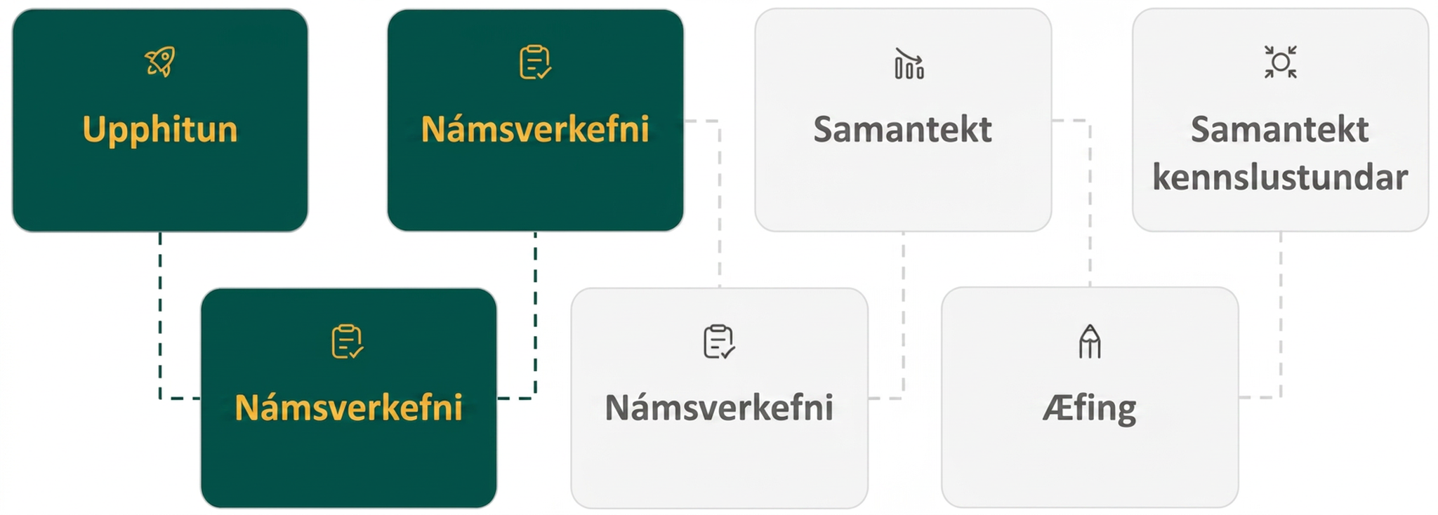
Lesson Journey
Third Stop: Learning Activity B

Slide 16
Learning Activity B | Learning Strategies
Graph the Offers📈
Teacher Instruction: Use these strategies to adjust the activity to support English language learners and students with disabilities.
  You can copy and paste the callouts directly on top of the activity or give the instructions aloud.
Write down possible math questions that could be asked about this situation.
Compare your questions with a partner or the whole class.
Co-Craft Questions
Notes:
Support for English Language Learners: MLR 5 Co-Craft Questions: Reading, Conversing, Writing
Before revealing the task, begin by displaying only the graphs that show how the amount of money in the purses changes. Give students 1 – 2 minutes to write their own mathematical questions about the situation. Invite students to share their questions with the class. Listen for and amplify any questions seeking to determine which purse is the better choice or those that reference specific critical points on the graphs. This will build student understanding of the language of mathematical comparisons and help ensure students interpret the task correctly.
Design Principle(s): Maximize meta-awareness; Cultivate conversation
Learn more about this routine
View the instructional video and follow along with the materials to assist you with learning this routine.
Provide support for students
Distribute graphic organizers to the students to assist them with participating in this routine.

Slide 17
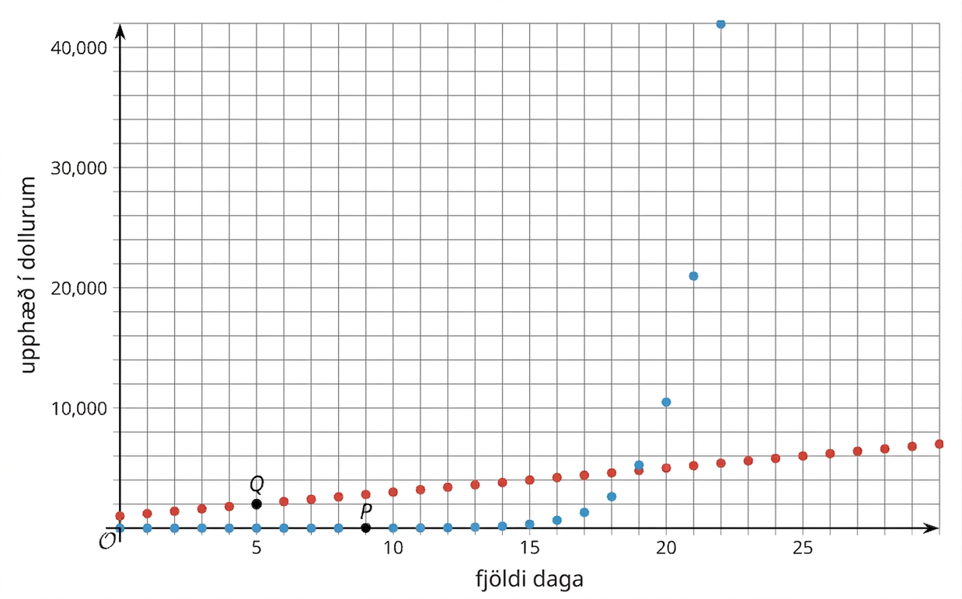
Learning Activity B | Part 1
Graph the Offers📈
Here are graphs showing how the amount of money in each of the purses change.
Remember, Purse A starts with $1,000 and grows by $200 each day. Purse B starts with $0.01 and doubles each day.
Notes:
Support for All Learners
This activity offers additional support and an extension for students:
For English language learners, be sure to review the Learning Strategies slide!
For students looking for an extra challenge, be sure to review the Extending Your Thinking slide!
Activity (15 minutes)
This activity allows students to compare and contrast the two patterns visually and to make sense of the graphs and use them to answer questions in the context of the genie’s offer. They recall that a quantity that grows by adding the same amount at each step forms a line when plotted, and they see an example where a quantity that grows by the same factor at each step forms a curve when plotted.
Launch
Tell students they will now consider what the two offers look like graphically.
One of the questions asks students about the vertical intercept. If needed, review the meaning of the term.
Activity questions and answers on the next slide.

Slide 18
Learning Activity B | Part 2
Graph the Offers📈
Which data on the graph shows the amount of money in Purse 𝐴? Which data on the graph shows the amount of money in Purse 𝐵? Explain how you know.
Points 𝑃 and 𝑄 are labeled on the graph. Explain what they mean in terms of the genie’s offer.
What are the coordinates of the vertical intercept for each graph? Explain how you know.
When does Purse B become a better choice than Purse A? Be prepared to show your reasoning.
Knowing what you know now, which purse would you choose? Be prepared to show your reasoning.
Notes:
Answers
The blue data on the graph containing 𝑃 is Purse 𝐵, and the red data on the graph containing 𝑄 is Purse 𝐴. Purse 𝐵 starts with less money than Purse 𝐴, so its graph will be lower at the beginning. The blue data on the graph containing 𝑃 is Purse 𝐵, and the red data on the graph containing 𝑄 is Purse 𝐴. Purse 𝐵 starts with less money than Purse 𝐴, so its graph will be lower at the beginning.
Point 𝑃 says that 9 days after the genie has appeared, Purse B contains $5.12. Point 𝑄 says that 5 days after the genie has appeared, Purse A contains $2,000.
For Purse A, the vertical intercept is (0,1,000) because when the genie appears (day 0), the purse has $1,000. For Purse B, the vertical intercept is (0,0.01) because it only contains $0.01 when the genie appears.
According to the graphs, on day 19 and afterward, Purse B is worth more than Purse A. This can be seen on the graph since Purse B has a greater 𝑦-coordinate for the first time when 𝑥 is 19.
Your answer may vary, but here is a sample: Purse B is worth more after 19 days, but there may be other considerations to take into account.
Additional activity questions, answers, anticipated misconceptions, and synthesis on the next slide.

Slide 19
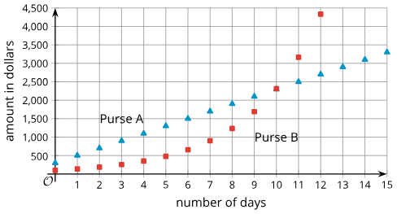
Learning Activity B | Part 3
Graph the Offers📈
Your friend discovers a different genie. This genie also offers two purses to choose from, and he gives you a graph to show how the money in each purse will grow.
The genie is still deciding how many days he will let the money in the purses grow. Help your friend plan a strategy for picking the purse with more money while the genie thinks.
Triangular marks = Purse A
Square marks = Purse B.
Are you ready for more?
Notes:
Answers
The vertical intercept for Purse B is lower, so Purse B starts off with less money than Purse A. The values in Purse B stay lower than the values in Purse A until day 10, when they appear to be the same. So Purse A is better up to day 10, and after that point Purse B becomes a better choice.
Anticipated Misconceptions
Due to the exponential nature of the problem, the scale for the vertical axis makes it difficult to accurately estimate vertical coordinates of points from the graph. Remind students that they know how the value of each purse is calculated, so they may use calculations similar to those in the previous activity to compute actual dollar values.
If color versions of the materials are not available, it may be difficult to determine which points correspond with which purse. Encourage students to imagine connecting the dots (perhaps using a ruler for Purse A) to distinguish the two sets of points.
Activity Synthesis
Invite students to share their responses with the class. Discuss how they interpreted the points on the graphs and the intersection of the two graphs.
To highlight the power of using graphs to illustrate what is happening in a situation, ask, “You have used calculations and graphs to compare the genie’s offers. Did using graphs help? Did they add new insights to the offers?” (The graphs give a clear visual representation of how the amount of money in each purse grows. It is easier to tell when Purse B becomes a better option than Purse A and how different the two values are at different points in time. They de-emphasize the actual numbers, so they give a very clean comparison of the two situations.)
Consider asking students to explain to a partner their response and reasoning to the last question: “Knowing what you know now, which purse would you choose? Why?”

Slide 20

Learning Activity B
Extending Your Thinking
“Okay, okay,” the genie smiles, disappointed. “I will give you an even more enticing deal.” He explains that Purse B stays the same, but Purse A now increases by $250,000 every day. Which purse should you choose?
Notes:
Go back to Lesson Activity
Answer
Purse B surpasses Purse A on day 30, with about $10.7 million in Purse B and only about $7.5 million in Purse A. So it’s better to choose Purse A if the amounts grow for less than 30 days, and it’s better to choose Purse B if they grow for 30 days or more.

Slide 21

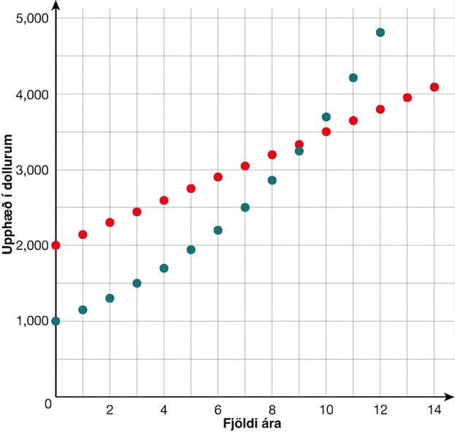
Learning Activity B
Self Check
The graph shows the yearly balance, in dollars, in two
investment accounts. Account A starts with $2,000.
Account B starts with $1,000. Which statement is true?
Account A grows more quickly as time goes on.
Account B grows by the same amount each year.
Account A grows by the same amount each year.
Account B grows more quickly as time goes on.
Both accounts grow more quickly as time goes on.
Both accounts grow by the same amount
each year.
Let’s review!
Notes:
Answer Feedback - Individualized by Response
Incorrect. You may have confused the graphs of the two accounts. The graph of Account A forms a line and has a constant rate of change. The graph of Account B increases more quickly as the 𝑥-values increase.
That's correct! Check yourself: The graph of Account A forms a line and has a constant rate of change. The graph of Account B increases more quickly as time goes on.
Incorrect. The graph of Account A forms a line and has a constant rate of change.
Incorrect. The graph of Account B increases more quickly as the 𝑥-values increase.

Slide 22
Learning Activity B
Self Check - Review
Compare and contrast the graphs of 𝑦 = 2𝑥 and 𝑦 = 2^{𝑥}.
To compare and contrast graphs:
Graph both equations on the same plane.
Compare key features of the graphs, including:
Points of intersection
Intercepts
Shape (linear or exponential)
Any intervals on which one graph is greater than the other.
Notes:
Remind Students
Consider providing students with a more structured approach to answering questions like this using the steps listed on the right side of the slide.
Access the online textbook for an answer to this question.

Slide 23
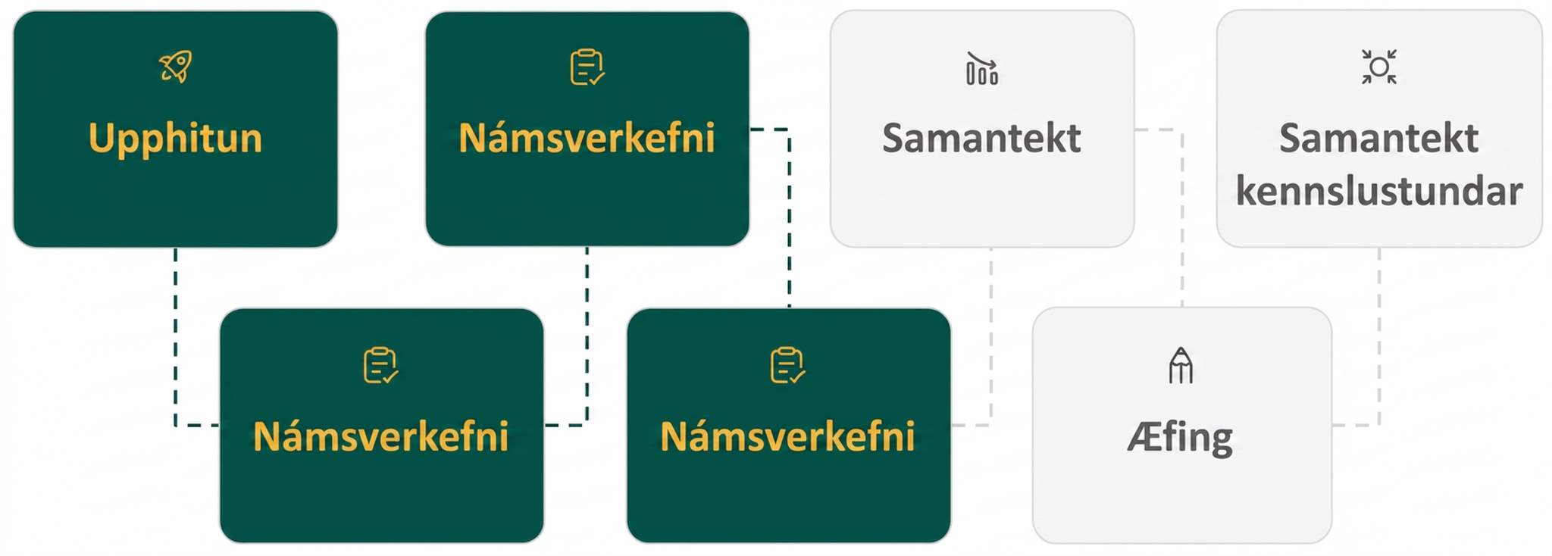
Lesson Journey
Fourth Stop: Learning Activity C

Slide 24
Learning Activity C | Learning Strategies
Find the Match🧩🧩
Teacher Instruction: Use these strategies to adjust the activity to support English language learners and students with disabilities.
You can copy and paste the callouts directly on top of the activity or give the instructions aloud.
Listen carefully to each statement shared by other students with the whole class.
Restate what you heard using math language to your partner.
Discussion Supports
Use different colors to show connections between the text, tables and expressions for each situation.
Representation
Notes:
Support for English Language Learners: MLR 8 Discussion Supports: Speaking
Use this routine to support whole-class discussion. For each observation that is shared, ask students to restate what they heard using precise mathematical language. Consider providing students time to restate what they hear to a partner before selecting one or two students to share with the class. Ask the original speaker if their peer was accurately able to restate their thinking. Call students’ attention to any words or phrases that helped clarify the original statement. This provides more students with an opportunity to produce language as they interpret the reasoning of others.
Design Principle(s): Support sense-making
Support for Students with Disabilities: Representation: Internalize Comprehension
Use color coding and annotations to highlight important connections between the text of each situation and the corresponding tables and expressions. Begin by asking students what they noticed to help identify how common differences and common factors appear in each representation.
Supports accessibility for: Visual-Spatial Processing; Conceptual processing

Slide 25
Learning Activity C | Part 1
Find the Match🧩🧩
Here are verbal descriptions of two situations, followed by tables and expressions that could help answer one of the questions in the situations.
Situation 1: A person has 80 followers on social media. The number of followers triples each year. How many followers will she have after 4 years?
Situation 2: A tank contains 80 gallons of water and is getting filled at a rate of 3 gallons per minute. How many gallons of water will be in the tank after 4 minutes?
Notes:
Support for All Learners
This activity offers additional support for students:
For English language learners and students with disabilities, be sure to review the Learning Strategies slide!
Activity (10 minutes)
Students study two stories characterized by different growth patterns and match expressions and tables with the two situations.
Launch
The numbers in the two scenarios are identical, so students need to focus on the mathematical relationships and the operations in the expressions to successfully complete the activity.
If students are evaluating the expressions, encourage them to reason about the operations without calculating anything.
Activity questions, answers, anticipated misconceptions, and synthesis on the next slide.

Slide 26
Learning Activity C | Part 2
Find the Match🧩🧩
Use the descriptions of Situation 1 and Situation 2 to help you answer these questions. Be prepared to explain how the table or expression answers the question.
Which situation best describes 80⋅3⋅3⋅3⋅3?
Which situation best describes the following table?
Which situation best describes 80+3+3+3+3?
Which situation best describes 80+4⋅3?
Which situation best describes the following table?
Which situation best describes 80⋅81?
x | 0 | 1 | 2 | 3 | 4
y | 80 | 240 | 720 | 2,160 | 6,480
x | 0 | 1 | 2 | 3 | 4
y | 80 | 83 | 86 | 89 | 92
Notes:
Activity Answer
Situation 1
Situation 1. The table shows the growth of the followers multiplied by 3 each year.
Situation 2
Situation 2. 4⋅3 is another way of expressing 3+3+3+3.
Situation 2. The table shows the gallons of water in the tank increasing by 3 gallons each minute.
Situation 1. The 81 comes from 3⋅3⋅3⋅3.
Anticipated Misconceptions
None
Activity Synthesis
Focus the discussion on how students went about matching the cards and the situations. Record students’ reasoning for all to see. In particular, highlight observations about common differences and common ratios. Ask questions such as:
“Besides evaluating the expression, how could you tell (a certain expression) matched one of the situations?”
“How could you tell (a certain table) matched one of the situations?”
“How is the number of followers growing every 2 years?”
“How is the amount of water in the tank increasing every 2 minutes?”

Slide 27
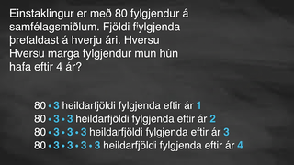
Learning Activity C | Video
Matching Verbal Situations to Expressions and Tables
Notes:
This video discusses the situation in activity 5.3.4

Slide 28
Learning Activity C
Self Check
Which of the following is NOT an example of a way to represent a chain of stores that currently has 4 stores but plans to double the number of stores they have each year for the next 5 years?
4⋅2⋅2⋅2⋅2⋅2
4 + 5⋅2
4⋅32
x | 0 | 1 | 2 | 3 | 4 | 5
y | 4 | 8 | 16 | 32 | 64 | 128
Let’s review!
Notes:
Answer Feedback - Individualized by Response
Incorrect. You are looking for an expression that does NOT represent the situation. This is an expression that represents having 4 stores and then multiplying by 2, or doubling the amount, 5 times to show 5 years.
That’s correct! Check yourself: They started with 4 stores, and doubling means multiplying by 2 for each additional year. You would need to multiply by 2 five times, NOT 5⋅2.
Incorrect. You are looking for an expression that does NOT represent the situation. This is an expression that represents having 4 stores and doubling the amount each year for 5 years, or multiplying by 2 five times, or 2⋅2⋅2⋅2⋅2, which is 32.
Incorrect. You are looking for an expression that does NOT represent the situation. This is the table that represents starting with 4 stores and multiplying by 2, or doubling, for 5 years.

Slide 29
Learning Activity C
Self Check - Review
A food company currently has 5 convenience stores. It is considering two plans for expanding its chain of stores. How many stores will there be after 5 years under each plan?
Plan A | Plan B
Open 20 new stores each year. | Double the number of stores each year.
Match each representation with one situation. Be prepared to explain how the table or expression answers the question.
5 + 20 + 20 + 20 + 20 + 20
5⋅32
5⋅2⋅2⋅2⋅2⋅2
5 + 100
years | 0 | 1 | 2 | 3 | 4 | 5
number of stores | 5 | 10 | 20 | 40 | 80 | 160
years | 0 | 1 | 2 | 3 | 4 | 5
number of stores | 5 | 25 | 40 | 65 | 85 | 105
Notes:
NOTE: The order of representations 4 and 5 has been switched from the ordering in online text for ease of formatting.
Remind Students
To determine which options go with which scenario, you first need to analyze each scenario.
Since Plan A is to open 20 new stores each year for a food company that currently has 5 convenience stores, they are ADDING 20 stores to the total from the previous year.
Plan B also starts at 5 stores, but it doubles the number of stores each year. Double means to MULTIPLY by 2.
Access the online textbook for an answer with explanation to this question and additional examples.

Slide 30
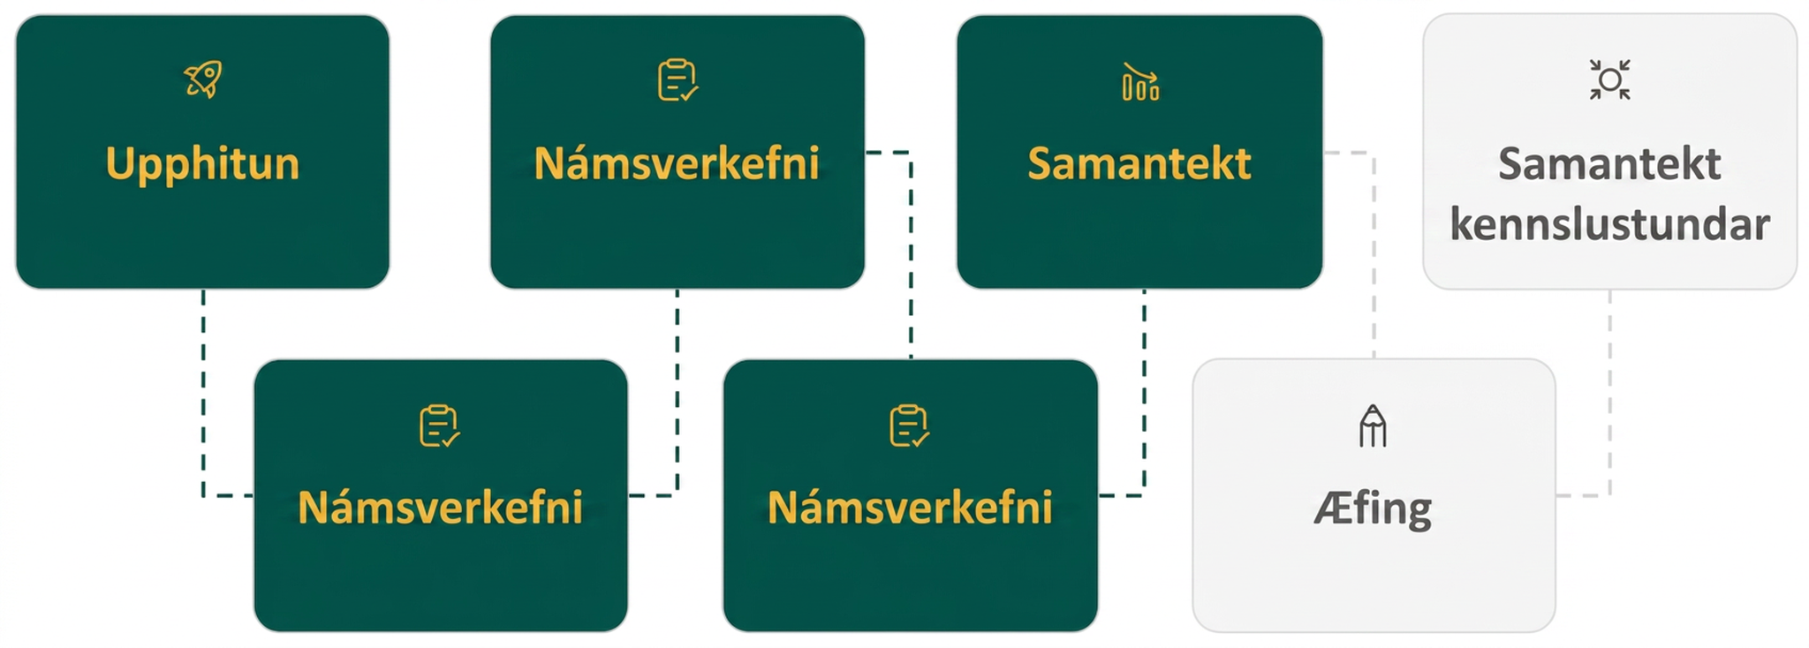
Lesson Journey
Fifth Step: Cool Down

Slide 31
Cool Down
The tables show the cat population on two islands over several years. Describe mathematically, as precisely as you can, how the cat population on each island is changing.
Year | 0 | 1 | 2 | 3 | 4
Number of Cats on Meow Island | 2 | 6 | 18 | 54 | 162
Year | 0 | 1 | 2 | 3 | 4
Number of Cats on Purr Island | 2 | 6 | 10 | 14 | 18
Notes:
Cool Down (5 minutes)
Answers
The cat population on Meow Island is:
tripling each year
growing by a common ratio each year
The cat population on Purr Island is:
adding 4 cats each year
characterized by a common difference each year
Response to Student Thinking - More Chances
Students will have more opportunities to understand the mathematical ideas in this cool-down, so there is no need to slow down or add additional work to the next lessons. Instead, use the results of this cool-down to provide guidance for what to look for and emphasize over the next several lessons to support students in advancing their current understanding.

Slide 32
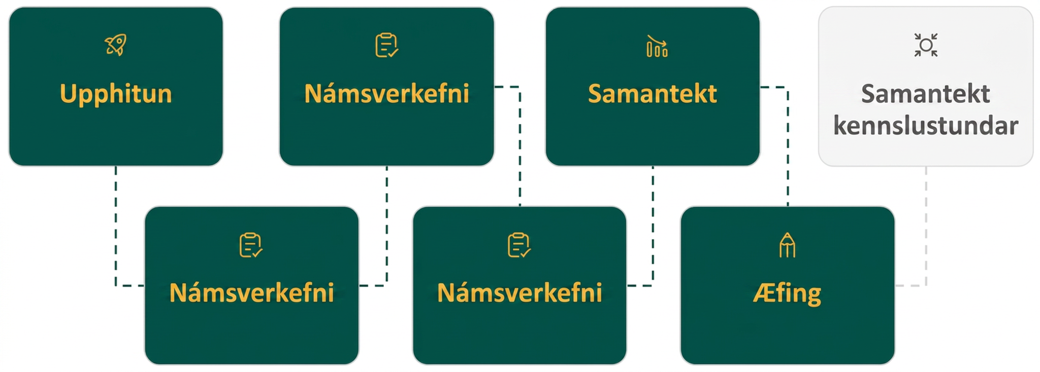
Lesson Journey
Sixth Stop: Practice

Slide 33

Practice
Put your hard work to action, practice what you’ve learned!
Notes:
Digital Practice: Access the practice pages at https://openstax.org/details/books/algebra-1

Slide 34
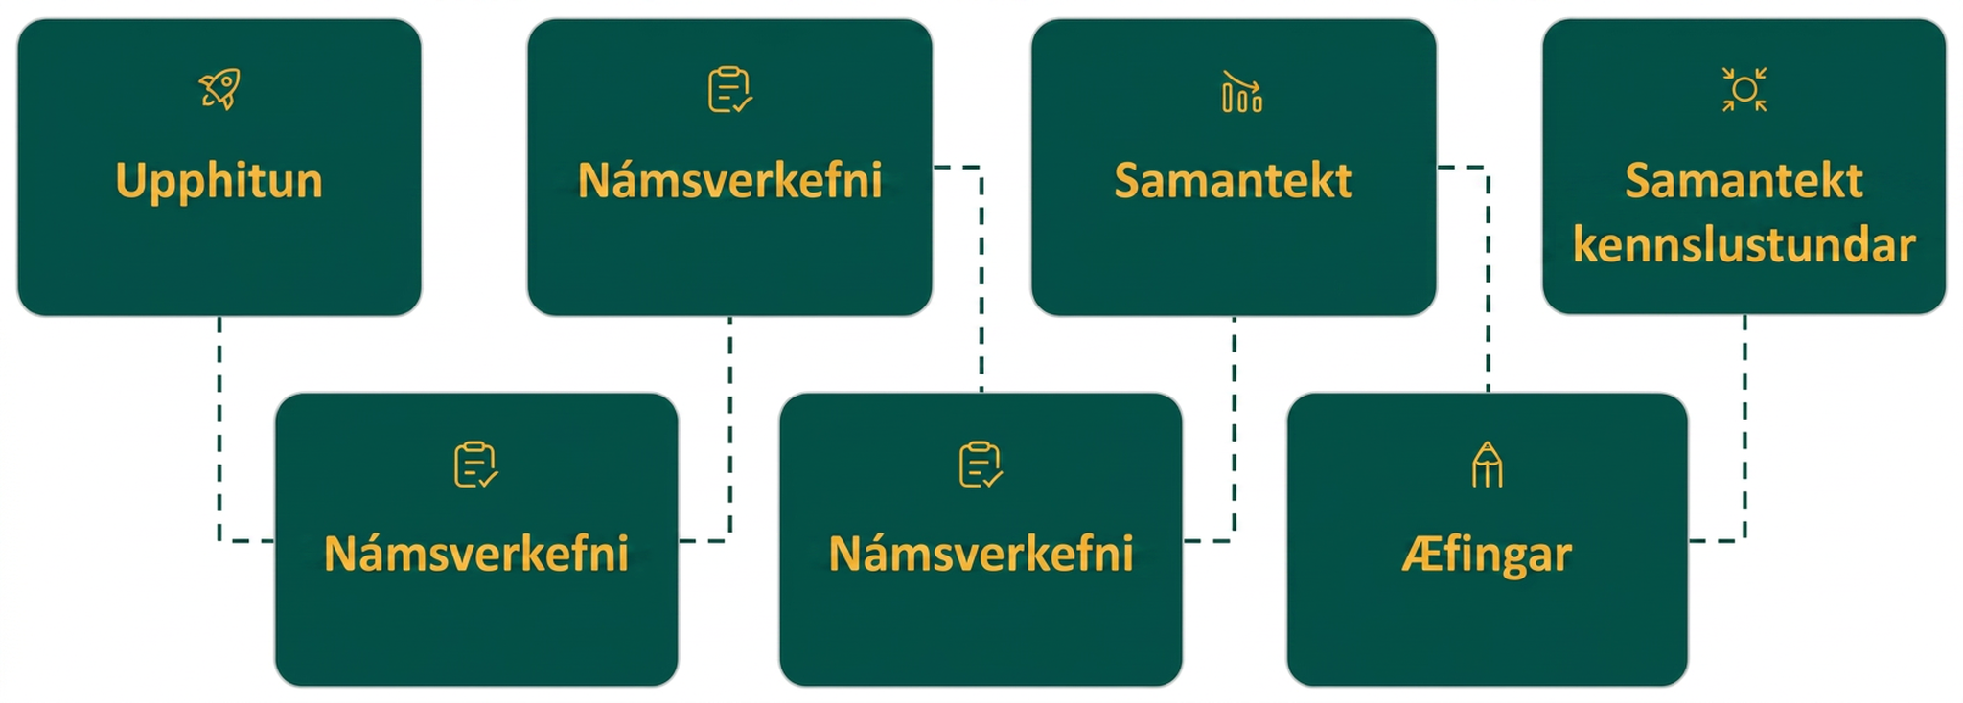
Lesson Journey
Seventh Stop: Lesson Synthesis

Slide 35
Part 1
Lesson Synthesis
We looked at two different situations: one where the same amount was added each day, and one where the amount doubled each day.
What happened in this lesson that surprised you?
What happened in this lesson that confused you?
What questions do you have about what you learned today?
Notes:
Launch
Using the prompts on this slide, ask students to reflect on the work done today, either verbally or in writing.
Consider saying, “We looked at tables of values and expressions that represent two different patterns of growth.”
Ask students to summarize the key features of the two patterns of growth explored in this lesson using tables and situations from a classroom activity, or new tables and situations such as those on the next slide (currently hidden).
To facilitate the discussion, consider asking questions such as:
How are the values in each table growing?
Which table shows common differences? Which one shows common factors?
What expression can we write to find the height of the water after 10 minutes?
What expression can we write to find the number of possible outcomes for 7 coins?
Tell students that throughout this unit, that will look at many situations where quantities grow or decrease by applying the same factor repeatedly.

Slide 36
Part 2
Lesson Synthesis
For each situation, summarize the key features of the pattern of growth.
Situation A. The height, in centimeters, of water in a swimming pool as it is being filled.
Situation B. The total number of possible outcomes (heads or tails) when flipping a certain number of coins.
Time in Minutes | Height (cm)
0 | 50
1 | 53
2 | 56
3 | 59
4 | 62
Number of Coins | Number of Outcomes
1 | 2
2 | 4
3 | 8
4 | 16
5 | 32
Notes:
Launch
Consider saying, “We looked at tables of values and expressions that represent two different patterns of growth.”
Ask students to summarize the key features of the two patterns of growth explored in this lesson using the tables and situations on this slide (currently hidden).
To facilitate the discussion, consider asking questions such as:
How are the values in each table growing?
Which table shows common differences? Which one shows common factors?
What expression can we write to find the height of the water after 10 minutes?
What expression can we write to find the number of possible outcomes for 7 coins?
Tell students that throughout this unit, that will look at many situations where quantities grow or decrease by applying the same factor repeatedly.
The content on this slide can be accessed directly from the Teacher’s Guide.

Slide 37
Self Assessment
How much do you agree with the following statements?
Learning Goals | I can | Almost | Not yet
Compare growth patterns using calculations and graphs. | ⃞ | ⃞ | ⃞
Use words and expressions to describe patterns in tables of values. | ⃞ | ⃞ | ⃞
Write expressions and create tables of values to represent them using descriptions of linear and exponential relationships. | ⃞ | ⃞ | ⃞
Begin making connections between linear and exponential growth and the real world (especially financially). | ⃞ | ⃞ | ⃞

