Slide 1


Algebra 1
Unit 1 Linear Equations
Lesson 1.4 Equations and Their Solutions

Slide 2
How to use these slides
On the activity slides check the speaker notes for teacher support and instructional information.
Each lesson includes 1 warm up, 2-3 learning activities, a cool down, practice and a lesson synthesis.
  Learning activities are followed by a self check question, and review section.
Some slides have been hidden from student view, more information can be found on the next slide (Reference Key).
You can edit and use these slides for personal and classroom use, but cannot sell them and must keep the attribution logos.
For more information, Check out the digital quick start guide!

Slide 3






Reference Key
Check the top right corner for an icon referencing these unique sections.
 | Support for Students with Disability | Hidden | Learning Strategies slide, provides additional support to students for understanding the activity. Learning Strategies slide, provides additional support to students for understanding the activity.
 | Support for English Language Learners | Hidden
 | Extending Your Thinking | Hidden | Extending Your Thinking slide, provides an extra challenge for students.
 | Self Check | Not Hidden | Self Check slide, checkpoint to assess student understanding after the learning activity.
 | Review | Hidden | Self Check- Review slide, designed to help review topics from the self check question.
On the next slides, check the speaker notes for teacher instructions and support.
Notes:
Check the Speaker Notes: On the next slides you can find discussion questions, lesson information, answers to the activities, and ways to adjust the activity for your students!

Slide 4

Learning Goals
By the end of this lesson you will be able to -
Explain what it means for a value or pair of values to be a solution to an equation.
Find solutions to equations by reasoning about a situation or by using algebra.
Notes:
Lesson Narrative
In middle school, students learned that a solution to an equation makes the equation true. In this lesson, they revisit that idea for both one-variable and two-variable equations. They continue practicing how to model relationships with equations and understand solutions in context.
Students check if values are solutions by reasoning or testing them in the equation. Some may solve equations using familiar steps from middle school, but formal algebraic methods are not expected yet. That will come later in the unit.
The next lesson will focus on how coordinate pairs on a graph represent solutions to equations in two variables.
Required Preparation
None
Required Materials
None
Texas Essential Knowledge and Skills
A1(A) apply mathematics to problems arising in everyday life, society, and the workplace
A1(C) select tools, including real objects, manipulatives, paper and pencil, and technology as appropriate, and techniques, including mental math, estimation, and number sense as appropriate, to solve problems
A2(C) write linear equations in two variables given a table of values, a graph, and a verbal description

Slide 5
Vocabulary
Previous
Constraint
  A limitation on the possible values of variables in a model, often expressed by an equation or inequality.
Model
  A mathematical representation of a problem from STEM or everyday life, used to solve problems and make decisions.
New
None
Notes:
Lesson Vocabulary
To support student understanding of key vocabulary:
Introduce and review the vocabulary words students will see in this lesson.
Encourage students to notice how these words are used and to include them in their math discussions and explanations—both written and oral.
Use a word wall to reinforce vocabulary. Sample word wall cards are available here.
For newcomers or students with beginning English proficiency, use these Quizlet sets to support vocabulary learning:
Unit 1 Spanish Vocabulary – use first to build understanding
Unit 1 Vocabulary (English) – use after anchoring in Spanish
Support for English Language Learners
ELPS 1(C) use strategic learning techniques such as concept mapping, drawing, memorizing, comparing, contrasting, and reviewing to acquire basic and grade-level vocabulary
ELPS 2(F) listen to and derive meaning from a variety of media such as audiotape, video, DVD, and CD-ROM to build and reinforce concept and language attainment
ELPS 3(G) express opinions, ideas, and feelings ranging from communicating single words and short phrases to participating in extended discussions on a variety of social and grade-appropriate academic topics

Slide 6






Lesson Journey
Warm Up
Learning Activity
Practice
Warm Up
Learning Activity
Practice
Learning Activity
Cool Down
Lesson Synthesis
Learning Activity
Cool Down
Lesson Synthesis

Slide 7

Warm Up - Math Talk 🗣️
A granola bite contains 27 calories. Most of the calories come from c grams of carbohydrates. The rest come from other ingredients. One gram of carbohydrate contains 4 calories.
The equation 4c + 5 = 27 represents the relationship between these quantities.
What could the 5 represent in this situation?
Priya said that neither 8 nor 3 could be the solution to the equation. Is she correct?
Notes:
Warm-Up (5 minutes):
This warm-up helps students recall how to solve equations in one variable. They interpret an equation in context, explain why some values don’t work, and identify the correct solution.
Launch:
Assign students a partner and allow them to “turn and talk” to their partner about their answers.
Activity questions, answers, and synthesis on the next slide.

Slide 8
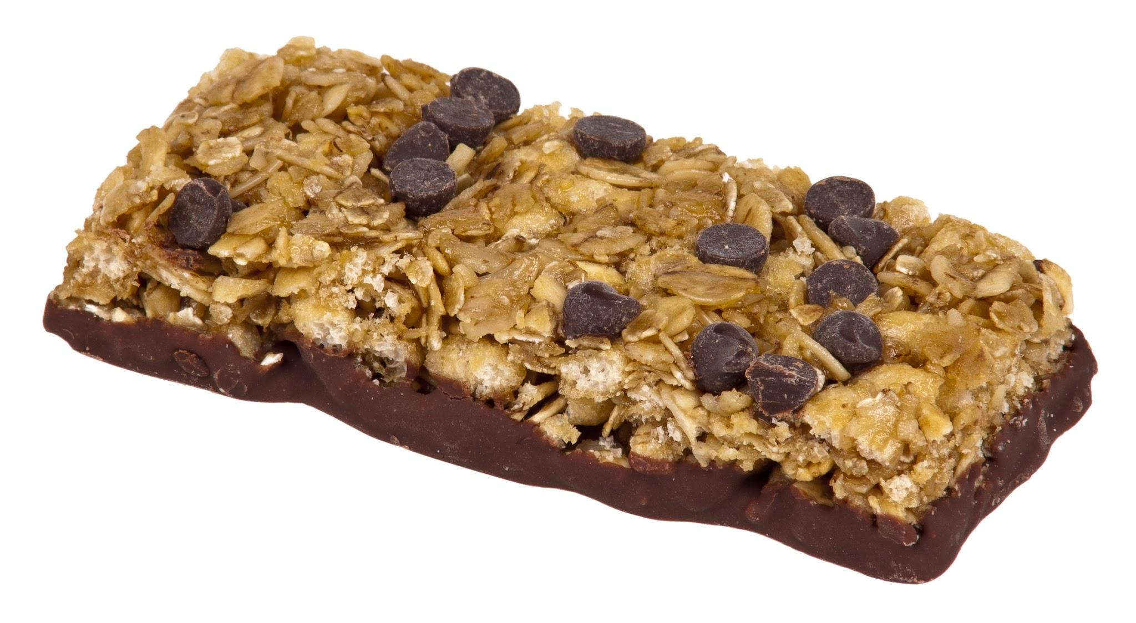
Warm Up - Math Talk 🗣️
Marcus said the solution is 5.5. Is he correct? Explain.
Notes:
Activity Answers
For example: It could represent the calories from other ingredients (such as oil or sugar) in the granola bite.
Yes, she is correct that 8 and 3 could not be solutions. Sample explanation: 4(8) + 5 = 37, not 27, and 4(3) + 5 = 17, not 27.
Yes, he is correct that 5.5 is a solution. 4(5.5) + 5 = 27.
Activity Synthesis
Focus the discussion on how students knew that 8 and 3 are not solutions to the equation and how they found the solution. Highlight strategies that are based on reasoning about what values make the equation true.
Ask students: “In general, what does a solution to an equation mean?” Make sure students recall that the solution to an equation in one variable is a value for the variable that makes the equation a true statement.

Slide 9

Lesson Journey
Warm Up
Learning Activity
Practice
Learning Activity
Cool Down
Lesson Synthesis

Slide 10
Learning Activity - Take-Home Pay
Jada can earn money on weekends by working at a local bookstore for $12.20 an hour. Each workday, she spends $7.15 on bus fare to get there and back.
Write an equation that represents Jada’s take-home earnings in dollars, E, if she works at the bookstore for h hours in one day.
One day, Jada takes home $90.45 after working h hours and after paying the bus fare. Write an equation to represent this situation.
Is 4 a solution to the last equation you wrote? Is 7 a solution to the last equation you wrote?
Notes:
Support for All Learners
This activity offers additional support and an extension for students:
For english language learners and students with disabilities, be sure to review the Learning Strategies slide!
For students looking for an extra challenge, be sure to review the Extending Your Thinking slide!
Activity (15 minutes)
In this activity, students write one-variable equations to represent the constraints in a situation, then solve and interpret the solutions in context. Some students may use trial and error, while others solve algebraically by isolating the variable. Note different strategies and invite students to share.
Launch:
Have students work in pairs and (if possible) use Desmos to model the equation in Question 1. Let groups compare equations or briefly discuss as a class before moving on.
For Questions 2–4, give a few minutes for quiet work, then partner discussion. Ask students to explain why 4 and 7 are or are not solutions. *If needed, clarify that “take-home earnings” means the amount Jada keeps after paying expenses (like bus fare).
Continued activity and synthesis on the next slide.

Slide 11

Learning Activity - Take-Home Pay
Look back at the equation you wrote in question 2 that shows Jada’s take-home pay is $90.45. What does the solution to that equation tell you in this situation?
Need a hint? Solve the equation. What does the answer represent?
Are you ready for more?
Notes:
Anticipated Misconceptions
If students struggle to write equations in the first question, ask them how they might find out Jada’s earnings if she works 1 hour, 2 hours, 5 hours, and so on. Then, ask them to generalize the computation process for h hours.
Activity Synthesis
Ask a student to share the equation that represents Jada earning $90.45. Make sure students understand why 90.45 = 12.20h – 7.15 fits the situation. Next, have students explain how they knew whether 4 or 7 are or are not solutions. Highlight that substituting those values into the equation and evaluating them gives false equations.
Invite students who used different strategies to share how they found the correct solution. Some may reason that since 7 hours gives too little, they tried 8. If no one mentions this, ask the class about it. Finally, be sure students understand what the solution means: Jada worked 8 hours to earn $90.45 after paying $7.15 in bus fare.
Activity Answer
E = 12.20h − 7.15
90.45 = 12.20h − 7.15 (or equivalent)
Your answer may vary, but here is a sample: Substituting 4 into the equation gives 90.45 = 12.20(4) − 7.15 or 90.45 = 41.65, which is not a true statement. Substituting 7 into the equation gives 90.45 = 78.25, which is also false. The solution is 8. Substituting 8 into the equation gives 90.45 = 90.45, which is true.
It tells us the number of hours that Jada worked that allowed her to take home $90.45 after paying for her bus fare.

Slide 12

Learning Strategies - Describing Relationships
Teacher Instruction: Use these strategies to adjust the activity to support english language learners and students with disabilities.
You can copy and paste the callouts directly on top of the activity or give the instructions aloud.
Write down possible math questions that could be asked about this situation.
Compare your questions with a partner or the whole class.
Co-Craft Questions
After you’ve worked for a few minutes, be ready to share how you started your equation. What numbers did you use, and where did they come from?
Action and Expression
Notes:
Support for English Language Learners: MLR 5 Co-Craft Questions: Speaking, Reading
Use this routine to help students interpret the language of writing equations and to increase awareness of language used to talk about representing situations with equations. Display only the task statement that describes the context, without revealing the questions that follow. Invite students to discuss possible mathematical questions that could be asked about the situation. Listen for and amplify any questions involving equations that connect the quantities in this situation.
Design Principle(s): Maximize meta-awareness; Support sense-making
Learn more about this routine
View the instructional video and follow along with the materials to assist you with learning this routine.
Provide support for students
Distribute graphic organizers to the students to assist them with participating in this routine.
Support for Students with Disabilities: Action and Expression: Internalize Executive Functions
Chunk this task into more manageable parts for students who benefit from support with organizational skills in problem solving. Check in with students after the first 2 – 3 minutes of work time. Invite 1 – 2 students to share how they determined an equation that represents Jada’s take-home earnings. Record their thinking on a display and keep the work visible as students continue to work.
Supports accessibility for: Organization; Attention

Slide 13
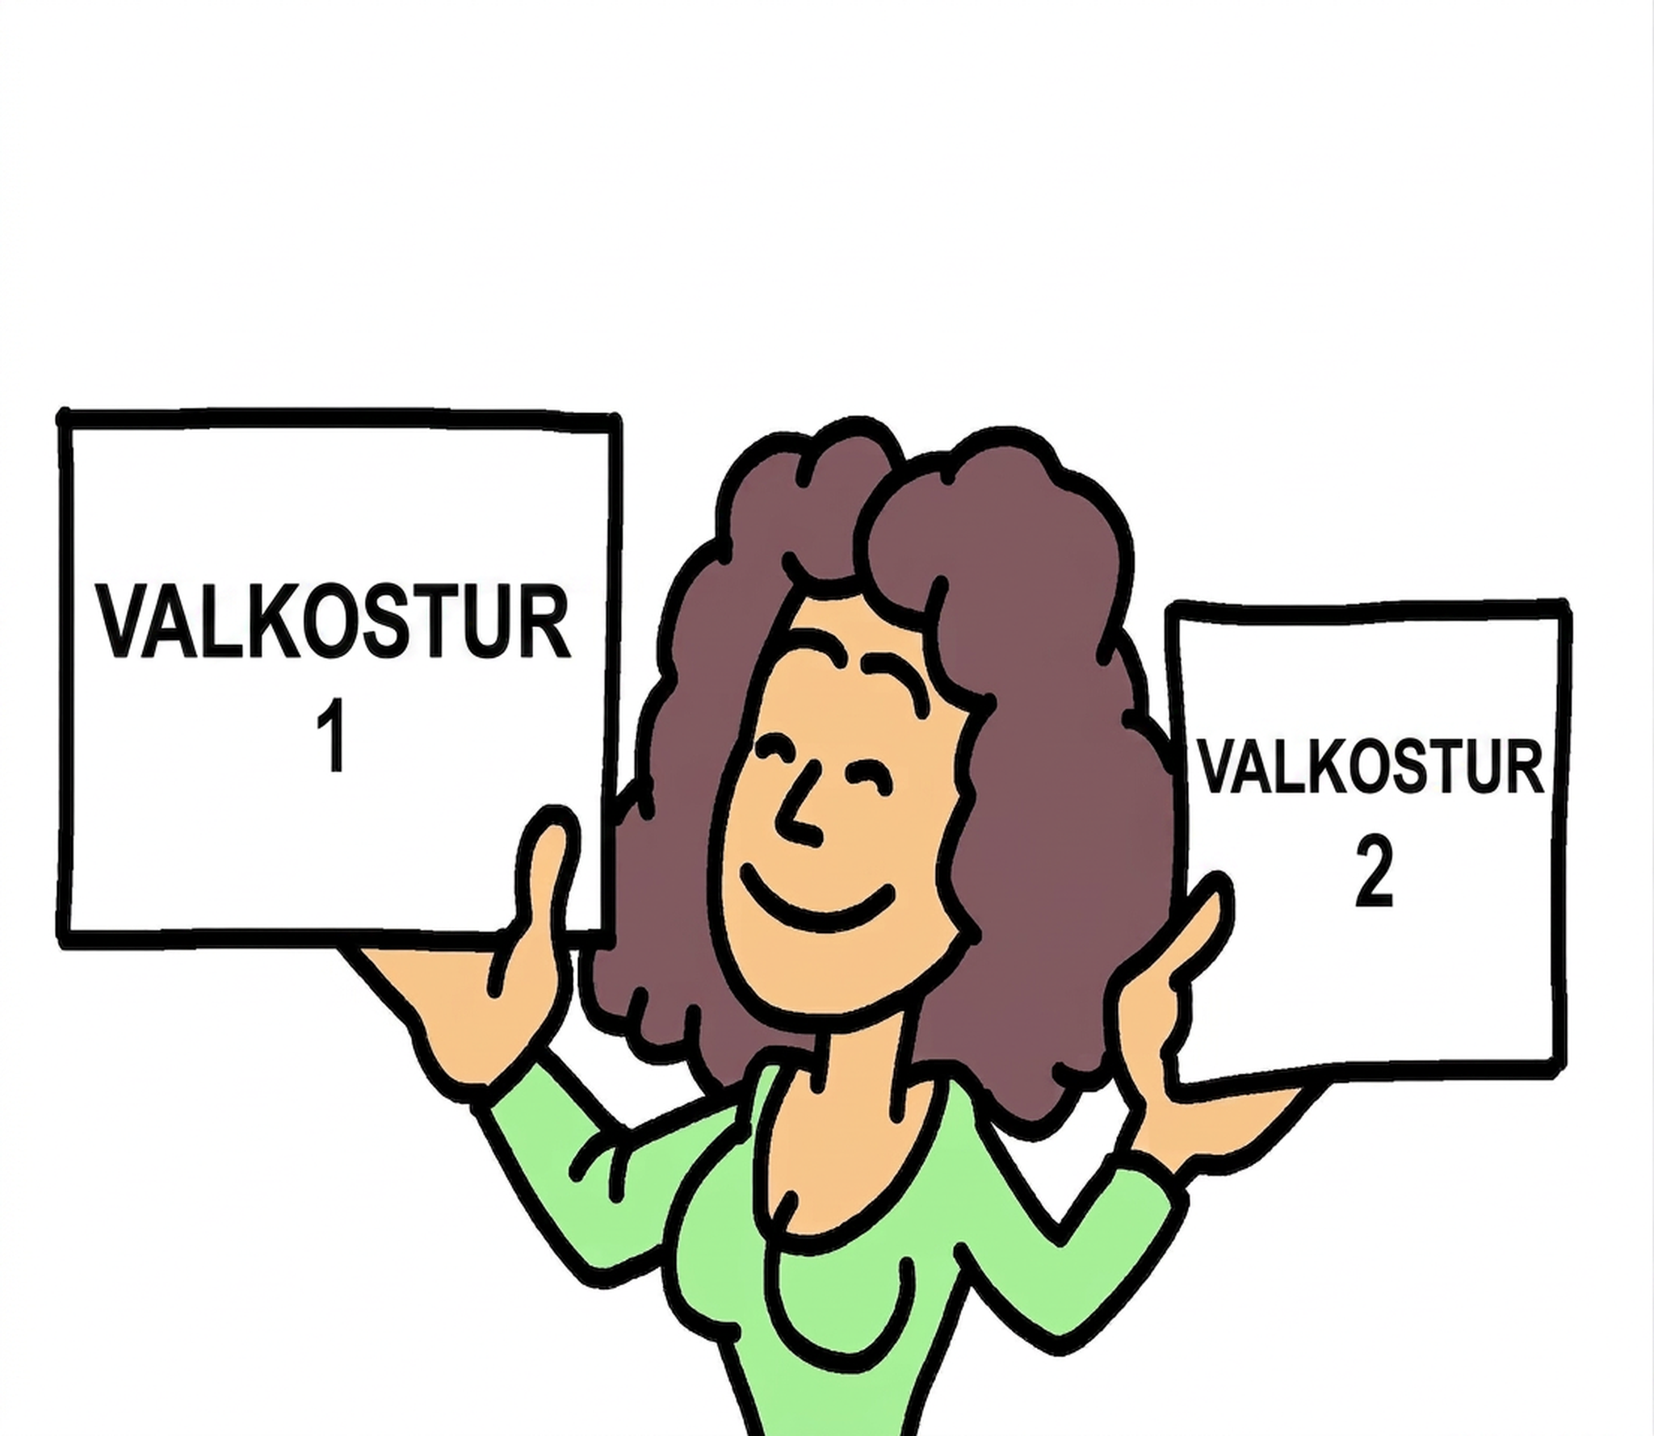
Extending Your Thinking - Decisions 🤔
Jada has a second option to earn money: she could help some neighbors with errands and computer work for $11 an hour. After considering her schedule, Jada realizes that she has about only 9 hours available to work one day of the weekend.
Which option should she choose—sorting books at the bookstore for 9 hours or helping her neighbors for 9 hours? Be prepared to show your reasoning.
Notes:
Answer
Students could argue either way, depending on their assumptions.
Jada should work at the bookstore because she would earn more there. Her pay would be $109.80, and after subtracting $7.15 for the bus fare, she would still earn $102.65. She would earn $99 from the other option.
Jada should help her neighbors. Working 9 hours at the bookstore would mean a few more dollars than working 9 hours helping her neighbors, but it would also mean losing some personal time because of the travel involved.

Slide 14

Self Check
Jada found a third job option and was offered a position working at a camp for $10.50 per hour. The total bus fare to and from the camp is $8.40. Write an equation that represents how much she will make in a day, d, after working h hours.
d = 10.50h − 8.40 c. d = 10.50h ÷ 8.40
d = 10.50h + 8.40 d. d = 8.40h + 10.50
Let’s review!
Notes:
Answer Feedback - Individualized by Response
d = 10.50h − 8.40
That’s correct! Jada will make $10.50 per hour (10.50h) but must subtract the bus fare for the day of 8.40.
d = 10.50h + 8.40
Incorrect. The bus fare should be subtracted from what Jada is making per hour. The answer is d = 10.50h − 8.40.
d = 10.50h ÷ 8.40
Incorrect. The bus fare should be subtracted from what Jada is making per hour. The answer is d = 10.50h − 8.40.
d = 8.40h + 10.50
Incorrect. The amount Jada makes per hour is 10.50, so that should be multiplied by the number of hours, h. The answer is d = 10.50h − 8.40.

Slide 15
Self Check - Review 🖉
Solving an equation is like solving a puzzle. You're trying to find the value that makes both sides of the equation equal. Any value of the variable that makes the equation true is called a solution of an equation. It is the answer to the puzzle!
Example: The equation 2l + 2w = 72 shows the perimeter of a rectangle. If l = 15, what value of w makes the equation true?
Step 1 - Substitute the number in for the variable in the equation.
Step 2 - Simplify the expressions on both sides of the equation.
Step 3 - Check if both sides of the equation are equal. If they are, the number is a solution. If they are not, it’s not a solution.
Notes:
Answer
Step 1 - 2(15) + 2w = 72 (This is an equation in one variable because w is the only quantity that we don't know. To solve this equation means to find a value of w
that makes the equation true.)
Step 2 - 2(15) + 2w = 72; 2(15) + 2(21) = 72; 30 + 42 = 72 (In this case, 21 is the solution because substituting 21 for w in the equation results in a true statement.)
Step 3 - 72 = 72
Additional Example:
The equation 2l + 2w = 48 represents the perimeter of a rectangle.
If the width of the rectangle is 10, what is the new equation? (Answer: 2l + 2(10) = 48 or 2l + 20 = 48)
What is the length of the rectangle that has a width of 10? (Answer: 14 is the length of the rectangle that makes the statement 2l + 20 = 48 true)
Verify the solution. (Answer: To verify the solution, substitute w = 10 and l = 14 into 2l + 2w = 48: 2(14) + 2(10) = 48 → 28 + 20 = 48 → 48 = 48 is a true statement, so the solution works!)

Slide 16
Lesson Journey
Warm Up
Learning Activity
Practice
Learning Activity
Cool Down
Lesson Synthesis

Slide 17
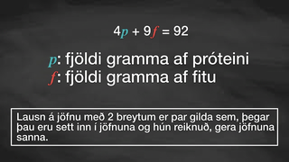
Video: Working Through the Equation

Slide 18
Learning Activity - Macronutrients 🥗
One gram of protein contains 4 calories. One gram of fat contains 9 calories. A snack has 60 calories from p grams of protein and f grams of fat.
Determine if 5 grams of protein and 2 grams of fat could be the number of grams of protein and fat in the snack. Explain your reasoning.
Determine if 10.5 grams of protein and 2 grams of fat could be the number of grams of protein and fat in the snack. Explain your reasoning.
Notes:
Support for All Learners
This activity offers additional support and an extension for students:
For english language learners and students with disabilities, be sure to review the Learning Strategies slide!
Activity (15 minutes)
In the previous activity, students recalled what it means for a number to be a solution to an equation in one variable. In this activity, they review the meaning of a solution to an equation in two variables.
Launch
Arrange students in groups of two to three. Without giving away the equation, present the scenario and ask students whether they are familiar with this kind of situation. Then encourage students to use Desmos to model the scenario with an equation.
As students work, quietly ask one or two students if they would be willing to share their reasoning with the class. After they share out, discuss why the values in problems 1 and 3 do not satisfy the equation (or appear on the graph).
Activity questions, answers, anticipated misconceptions, and synthesis on the next slide.

Slide 19
Learning Activity - Macronutrients 🥗
Determine if 8 grams of protein and 4 grams of fat could be the number of grams of protein and fat in the snack. Explain your reasoning.
If there are 6 grams of fat in the snack, how many grams of protein are there? Be prepared to show your reasoning.
In this situation, what does a solution to the equation 4p + 9f = 60 tell us? Give an example of a solution.
Notes:
Answers
No, because 4(5) + 9(2) = 20 + 18 = 38, not 60.
Yes, because 4(10.5) + 9(2) = 42 + 18 = 60.
No, because 4(8) + 9(4) = 32 + 36 = 68, not 60.
1.5 grams. For example: 4p +9(6) = 60, so r must be 1.5 for the equation to be true.
It means a pair of grams of protein and fat in the snack that add up to 60 calories. One example would be 6 grams of protein and 4 grams of fat.
Activity Synthesis
The goal of the discussion is to make sure students understand that a solution to an equation in two variables is any pair of values that, when substituted into the equation and evaluated, make the equation true. Discuss questions such as:
“In this situation, what does it mean when we say that p = 12 and f = 1.5 are not solutions to the equation?” (They are not a combination of protein and fat that would produce 60 calories. Substituting them for the variables in the equation leads to a false equation of 61.5=60.)
“How did you find out the grams of protein in the snack given that there are 6 grams of fat?” (Substitute 6 for f and solve the equation.)
“Can you find another combination that is a solution?”
“How many possible combinations of grams of protein and fat (or p and f) would add up to 60 calories?” (many solutions)
As a segue to the next lesson, solicit some ideas on how we know that there are many solutions to the equation. If no one mentions using a graph, bring it up and tell students that they will explore the graphs of two-variable equations next.

Slide 20
Learning Strategies - Macronutrients 🥗
Teacher Instruction: Use these strategies to adjust the activity to support english language learners and students with disabilities.
  You can copy and paste the callouts directly on top of the activity or give the instructions aloud.
How can you show the relationship between the two quantities? Can you explain it with words, a table, or a diagram?
Choose a way to represent the relationship—write about it, make a table, or draw a picture. What does your representation show?
Action and Expression
Notes:
Support for Students with Disabilities: Action and Expression: Develop Expression and Communication
Provide options for communicating understanding. Invite students to describe the relationships between quantities in different ways, for example, using verbal (written or oral) descriptions, tables, diagrams, or other representations.
Supports accessibility for: Language; Organization

Slide 21
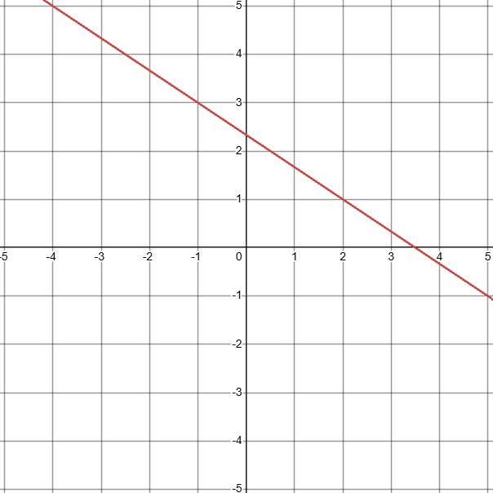
Self Check
Which of the following is a solution (x, y) to 2x + 3y = 7?
(2, 1) | (4, –1)
(1, 2) | (–2, 4)
Let’s review!
Notes:
Answer Feedback - Individualized by Response
(2, 1)
That’s Correct! When x = 2 and y = 1, 2(2) + 3(1) = 7 is a true statement.
(1, 2)
Incorrect. Let x = 2 and y = 1. The correct answer is (2, 1).
(4, –1)
Incorrect. When x = 4 and y = −1, the equation becomes 2(4)+3(−1)=7 or 5=7, which is not a true statement. The correct answer is (2, 1).
(–2, 4)
Incorrect. When x = −2 and y = 4, the equation becomes 2(−2) + 3(4) = 7 or 8 = 7, which is not a true statement. The correct answer is (2, 1).

Slide 22
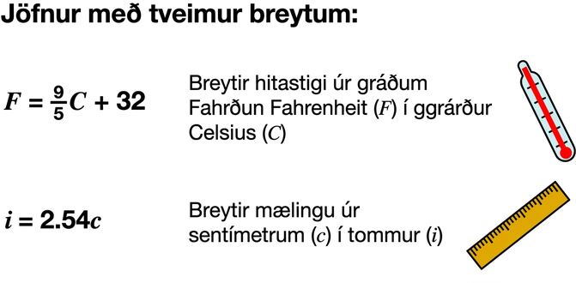
Self Check - Review 🌡
An equation that contains two unknown quantities or two quantities that vary is called an equation in two variables.
Try it: Is a = 3 and b = 5 a solution to 6a − 3b = 3?
Notes:
Answer
These values make the equation true. They are a solution to the equation, because:
6(3) − 3(5) = 3
18 − 15 = 3
3 = 3
Additional Instruction
SAY: Suppose Tyler spends $45 on T-shirts and socks. A T-shirt costs $10, and a pair of socks costs $2.50. If t represents the number of T-shirts and p represents the number of pairs of socks that Tyler buys, we can represent this situation with the equation: 10t + 2.50p = 45.
SAY: This is an equation in two variables. More than one pair of values for t and p make the equation true. Which pair of values makes the equation 10t + 2.50p = 45 true?
t = 3 and p = 6
Answer: These values make the equation true, because: 10(3) + 2.50(6) = 45; 30 + 15 = 45; 45 = 45
t = 4 and p = 2
Answer: These values make the equation true, because: 10(4) + 2.50(2) = 45; 40 + 5 = 45; 45 = 45
t = 1 and p = 10
Answer: These values make the equation false, because: 10(1) + 2.50(10) = 45; 10 + 25 = 45; 35 ≠ 45
In this situation, one constraint is that the combined cost of shirts and socks must equal $45. Solutions to the equations are pairs of t and p values that satisfy this constraint, such as in questions 1 - 2. Combinations such as t = 1 and p = 10, as in question 3, are not solutions because they don't meet the constraint. When these pairs of values are substituted into the equation, they result in statements that are false.

Slide 23

Lesson Journey
Warm Up
Learning Activity
Practice
Learning Activity
Cool Down
Lesson Synthesis

Slide 24
Cool Down 👕
An empty shipping box weighs 250 grams. The box is then filled with T-shirts. Each T-shirt weighs 132.5 grams. The equation W = 250 + 132.5T represents the relationship between the quantities in this situation, where W is the weight, in grams, of the filled box and T the number of shirts in the box.
Name two possible solutions to the equation W = 250 + 132.5T.
What do the solutions mean in this situation?
Consider the equation 2,900 = 250 + 132.50T . In this situation, what does the solution to this equation tell us?
Notes:
Cool Down (5 minutes)
Answers
Your answer may vary, but here are some examples: T = 2 and W = 515 or T = 10 and W = 1575
Each solution tells us the number of T-shirts in the box and the corresponding total weight in grams.
It tells us the number of T-shirts in the box that results in a total weight of 2,900 grams.
Response to Student Thinking - More Chances
Students will keep building on these ideas in upcoming lessons, so no need to slow down or add extra work. Use this cool-down to help plan what to focus on and support students as they grow their understanding.

Slide 25

Lesson Journey
Warm Up
Learning Activity
Practice
Learning Activity
Cool Down
Lesson Synthesis

Slide 26

Practice
Put your hard work to action, practice what you’ve learned!
Notes:
Digital Practice: Access the practice pages at https://openstax.org/details/books/algebra-1

Slide 27

Lesson Journey
Warm Up
Learning Activity
Practice
Learning Activity
Cool Down
Lesson Synthesis

Slide 28
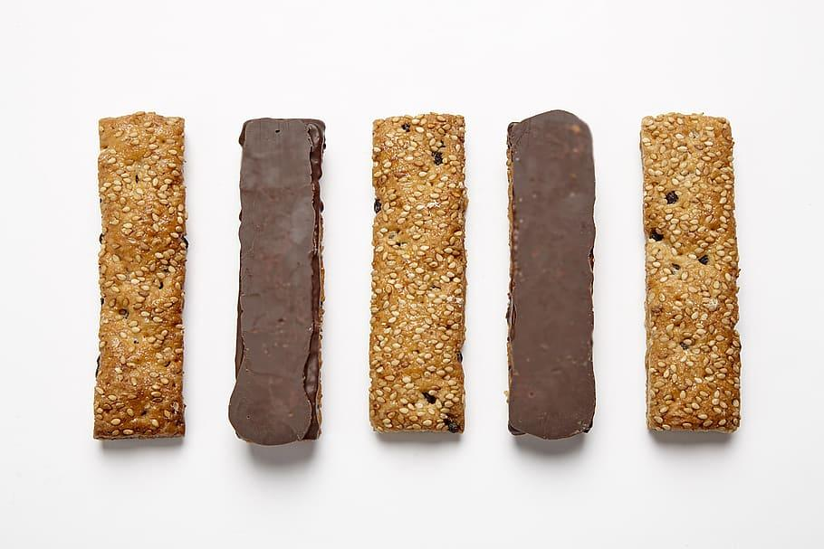
Lesson Synthesis
Remember: 1 gram of protein = 4 calories and 1 gram of fat = 9 calories
What does the equation 4x + 9y = 110 represent?
What does it mean to solve the equation?
Is 11g protein and 5g fat a solution? Why or why not?
What does 4(5) + 9y = 110 mean?
Notes:
Prompt: Real-life situations can often be modeled with equations involving two variables. To help students make this connection, revisit the protein and fat activity. You might bring in—or let students bring in—different snack or protein bars. Have groups identify the total calorie constant for their bar, for instance 110 calories. Remind students that:
A gram of protein = 4 calories
A gram of fat = 9 calories
Use questions the following questions to guide discussion:
What does the equation 4x + 9y = 110 represent? (A total of 110 calories made up of protein and fat.)
What does it mean to solve the equation? (Find combinations of protein and fat grams that total 110 calories.)
Is 11g protein and 5g fat a solution? Why or why not? (No—those values don’t satisfy the equation.)
What does 4(5) + 9y = 110 mean? (The snack has 5g of protein; solve for fat grams that total 110 calories.)
Remind students that expressions, equations, and inequalities are models—mathematical tools to represent real-world situations. Models are based on available info and assumptions, so if either changes, the model does too.

Slide 29
Self Assessment
How much do you agree with the following statements?
I can… | I can | Almost | Not yet
Explain what it means for a value or pair of values to be a solution to an equation.
Find solutions to equations by reasoning about a situation or by using algebra.

