Slide 1


Algebra 1
Unit 1 Linear Equations
Lesson 1.3 Writing Equations to Model Relationships, Part 2

Slide 2
How to use these slides
On the activity slides check the speaker notes for teacher support and instructional information.
Each lesson includes 1 warm up, 2-3 learning activities, a cool down, practice and a lesson synthesis.
  Learning activities are followed by a self check question, and review section.
Some slides have been hidden from student view, more information can be found on the next slide (Reference Key).
You can edit and use these slides for personal and classroom use, but cannot sell them and must keep the attribution logos.
For more information, Check out the digital quick start guide!

Slide 3






Reference Key
Check the top right corner for an icon referencing these unique sections.
 | Support for Students with Disability | Hidden | Learning Strategies slide, provides additional support to students for understanding the activity. Learning Strategies slide, provides additional support to students for understanding the activity.
 | Support for English Language Learners | Hidden
 | Extending Your Thinking | Hidden | Extending Your Thinking slide, provides an extra challenge for students.
 | Self Check | Not Hidden | Self Check slide, checkpoint to assess student understanding after the learning activity.
 | Review | Hidden | Self Check- Review slide, designed to help review topics from the self check question.
On the next slides, check the speaker notes for teacher instructions and support.
Notes:
Check the Speaker Notes: On the next slides you can find discussion questions, lesson information, answers to the activities, and ways to adjust the activity for your students!

Slide 4

Learning Goals
By the end of this lesson you will be able to -
Identify and describe (orally and in writing) patterns in tables of values and in calculations.
Use representations, like diagrams and tables, to help make sense of a described situation and write equations for it.
Notes:
Lesson Narrative
In this lesson, students build on their skills to identify, describe, and model relationships using mathematics. Instead of working from familiar descriptions, they now use tables to find and explain patterns between quantities. Some relationships are new or tricky, so students will need to think carefully and stick with the problem to figure them out.
Required Preparation
Prepare 1 copy of the blackline master for every 2 students.
Required Materials
Blackline Master: “Whose Data Is This?”
Texas Essential Knowledge and Skills
A1(A) apply mathematics to problems arising in everyday life, society, and the workplace
A1(C) select tools, including real objects, manipulatives, paper and pencil, and technology as appropriate, and techniques, including mental math, estimation, and number sense as appropriate, to solve problems
A2(C) write linear equations in two variables given a table of values, a graph, and a verbal description

Slide 5
Vocabulary
Previous
Constraint
  A limitation on the possible values of variables in a model, often expressed by an equation or inequality.
Model
  A mathematical representation of a problem from STEM or everyday life, used to solve problems and make decisions.
New
None
Notes:
Lesson Vocabulary
To support student understanding of key vocabulary:
Introduce and review the vocabulary words students will see in this lesson.
Encourage students to notice how these words are used and to include them in their math discussions and explanations—both written and oral.
Use a word wall to reinforce vocabulary. Sample word wall cards are available here.
For newcomers or students with beginning English proficiency, use these Quizlet sets to support vocabulary learning:
Unit 1 Spanish Vocabulary – use first to build understanding
Unit 1 Vocabulary (English) – use after anchoring in Spanish
Support for English Language Learners
ELPS 1(E) internalize new basic and academic language by using and reusing it in meaningful ways in speaking and writing activities that build concept and language attainment
ELPS 2(F) listen to and derive meaning from a variety of media such as audiotape, video, DVD, and CD-ROM to build and reinforce concept and language attainment
ELPS 3(B) expand and internalize initial English vocabulary by learning and using high-frequency English words necessary for identifying and describing people, places, and objects, by retelling simple stories and basic information represented or supported by pictures, and by learning and using routine language needed for classroom communication
ELPS 3(E) share information in cooperative learning interactions

Slide 6






Lesson Journey
Warm Up
Learning Activity
Practice
Warm Up
Learning Activity
Practice
Learning Activity
Cool Down
Lesson Synthesis
Learning Activity
Cool Down
Lesson Synthesis

Slide 7

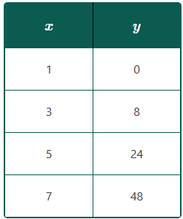
Warm Up - Math Talk 🗣️
Here is a table of values. The two quantities, x and y, are related. What are some strategies you could use to find a relationship between x and y? Brainstorm as many ways as possible.
Notes:
Warm-Up (5 minutes):
Students will look at a table of values, search for patterns, and think about how to turn those patterns into equations. The focus is on how they approach the problem—not just finding the answer.
Launch:
Have students work in pairs. Show the table and explain that the two columns are related. Ask them to find a possible relationship and pay close attention to the strategies they use. Emphasize that the goal is to explore different ways of thinking, not just getting the “right” equation.
Activity questions, answers, and synthesis on the next slide.

Slide 8
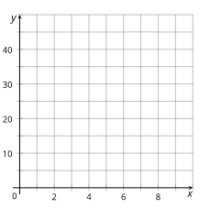
Warm Up - Math Talk 🗣️
What do you notice about how the values of y change as x increases?
Is there an operation you can do to x that gets you close to y? Can you explain your thinking?
What would the coordinate points look like on a graph?
Notes:
Activity Answers
Possible observations from page 1: See if there is an operation that could be done to x that would produce y; Compare how the x-values change and the y-values change, and see if there is a pattern; See if the numbers in one column follow a special pattern and if that pattern could be connected to the numbers in the other column; Plot the x- and y-values on a coordinate plane and see if the graph looks like a familiar relationship.
Some students might notice that when x increases by 2, y increases by more each time.
y is always 1 less than x squared.
Activity Synthesis
Invite groups to share their strategies and record them for everyone to see. If students haven’t already shared specific approaches, walk through each one using the table, or ask students to explain how a strategy works. Some students might notice that when x increases by 2, y increases by more each time. Others may see that y is always 1 less than x squared. These insights aren’t required, but ask students if they notice any helpful patterns in the table.
If no one suggests graphing the values, and time allows, use the graph to plot the points as a class to explore the relationship visually.
Remind students: the goal isn’t just to find the correct equation, but to think carefully about the strategies they use to uncover relationships. Ask students to keep in mind the different strategies as they work on the activities in the lesson.

Slide 9

Lesson Journey
Warm Up
Learning Activity
Practice
Warm Up
Learning Activity
Practice
Learning Activity
Cool Down
Lesson Synthesis
Learning Activity
Cool Down
Lesson Synthesis

Slide 10
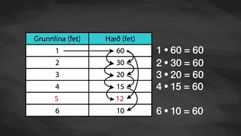
Video: Describing Relationships

Slide 11
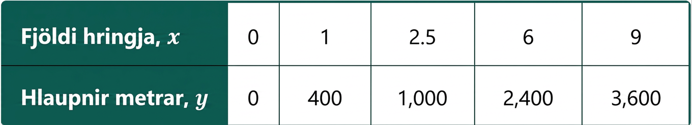
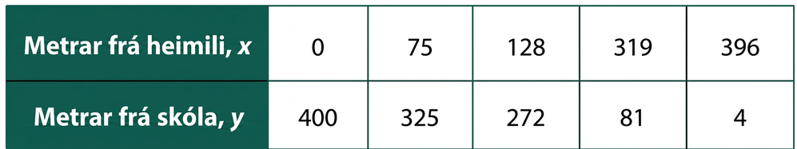
Learning Activity - Describing Relationships
Create a math story that describes how the two quantities in each table are related. Then, write an equation to represent each situation.
Notes:
Support for All Learners
This activity offers additional support and an extension for students:
For english language learners and students with disabilities, be sure to review the Learning Strategies slide!
For students looking for an extra challenge, be sure to review the Extending Your Thinking slide!
Activity (15 minutes)
In a previous lesson, students wrote equations based on verbal descriptions. In this partner activity, they’ll now work with pairs of values and describe the relationship—first in words, then as equations.
Students will look for patterns, interpret the context, and generalize relationships. As they take turns explaining and listening, they’ll practice reasoning and critiquing each other’s thinking. Listen for the different ways students describe the same relationship. For example, for a table showing “meters from home” and “meters from school,” students might say:
The two distances always add up to 400.
The distance from school is 400 minus the distance from home.
As one distance increases, the other decreases.
It shows someone moving from home to school.
Select students with a variety of interpretations to share with the class.
Launch:
Print the “Whose Data Is This?” handout. Have students cut out the variable cards and data boxes. In pairs, they should match the variables to the data and explain their reasoning. This helps spark discussion about how the quantities are related.
Clarify terms as needed—some students may not understand “amount deposited” in Table D. If time is short, have each group work with just two tables. You can also have students match the tables to equations from questions 5–8.
Continued activity and synthesis on the next slide.

Slide 12
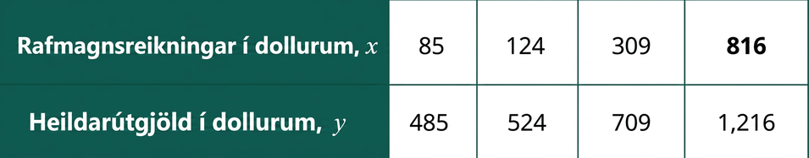
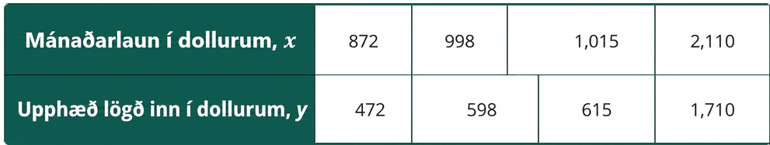
Learning Activity - Describing Relationships
Create a math story that describes how the two quantities in each table are related. Then, write an equation to represent each situation.
Are you ready for more?
Notes:
Anticipated Misconceptions
The relationship in the last table (monthly salary/amount deposited) may not be obvious to students. Encourage students who get stuck to look at the equations in the third table, using that as a springboard to describe the relationship between the numbers in the last table.
Activity Synthesis
Invite a few selected students to share how they made sense of one of the relationships. Try to include students that started with the equation and then described the relationship as well as students that started with the description and then wrote the equation to highlight different ways of thinking.
Discuss how each approach helped—or made it harder—to determine the relationship shown in each table. Emphasize that understanding what’s happening in the situation helps make sense of the math. *Clarify any unfamiliar terms, like "amount deposited" in last table (monthly salary/amount deposited).
If short on time, have students work on two tables instead of all four. Encourage partners to take turns explaining their thinking.
Activity Answer
Your answer may vary, but here is a sample: Every lap is 400 meters, so the distance run is 400 times the number of laps. 400 ⋅ x = y
Your answer may vary, but here is a sample: The distance between home and school is 400 meters. Every meter traveled away from home is a meter closer to school. x + y = 400
Your answer may vary, but here is a sample: Total expenses can be found by adding $400 to electricity bills (i.e.: the $400 could represent rent payment). 400 + x = y
Your answer may vary, but here is a sample: The amount deposited is $400 less than the monthly salary. This could be due to deductions like taxes or expenses paid before making the deposit. x − 400 = y

Slide 13

Learning Strategies - Describing Relationships
Teacher Instruction: Use these strategies to adjust the activity to support english language learners and students with disabilities.
You can copy and paste the callouts directly on top of the activity or give the instructions aloud.
_____ and _____ are equivalent because . . .
I noticed _____ , so I matched . . .
Conversing
Describe a real-world scenario represented by each table before writing an equation.
Engagement
Notes:
Support for English Language Learners: MLR 8 Discussion Supports: Conversing
Arrange students in groups of 2. Students should take turns finding a match and explaining their reasoning to their partner. Display the following sentence frames for all to see: “_____ and _____ are equivalent because . . .” and “I noticed _____ , so I matched . . .” Encourage students to challenge each other when they disagree. This will help students clarify their reasoning about equations that represent the relationship.
Design Principle(s): Support sense-making; Maximize meta-awareness
Support for Students with Disabilities: Engagement: Provide Access by Recruiting Interest
Leverage choice around perceived challenge. Invite students to select 1 – 2 tables to describe in words and to use the tables they described as a starting point to write equations. Chunking this task into more manageable parts may also benefit students who benefit from additional processing time.
Supports accessibility for: Organization; Attention; Social-emotional skills

Slide 14
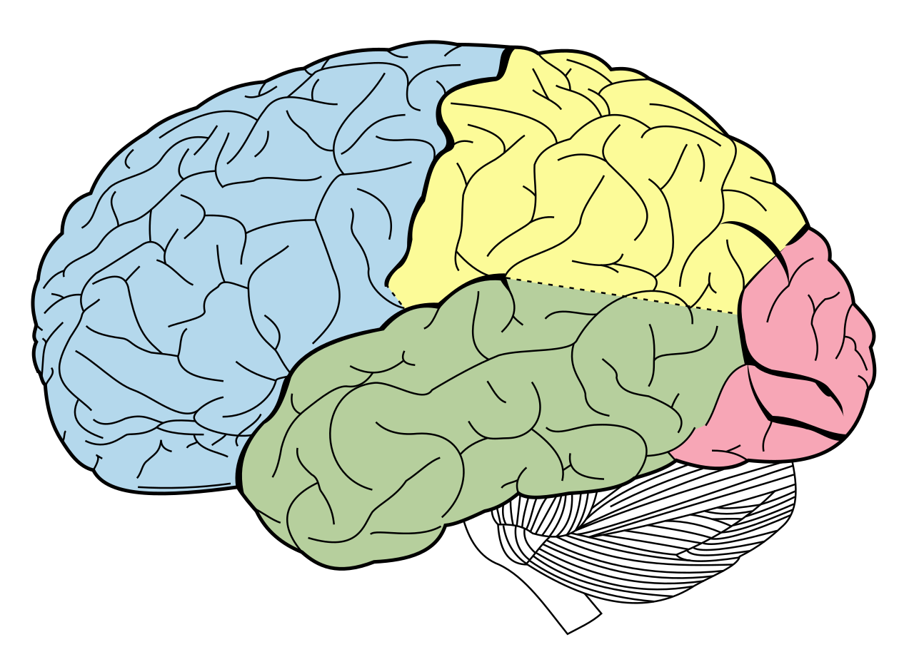
Extending Your Thinking
4
Express every number between 1 and 20 at least one way using exactly four 4s and any operations. For example, 1 could be written as 4 ÷ 4 + 4 − 4.
4 ÷ 4 + 4 − 4 9. __________ 17. __________
__________ 10. __________ 18. __________
__________ 11. __________ 19. __________
__________ 12. __________ 20. __________
__________ 13. __________
__________ 14. __________
__________ 15. __________
__________ 16. __________
Notes:
Answer
The octahedron has 12 edges; the icosahedron has 30 edges.
The octahedron has 6 vertices; the icosahedron has 30 vertices.
The tetrahedron, cube, and dodecahedron have 3 faces meeting at each vertex. The octahedron has 4 faces meeting at each vertex. The icosahedron has 5 faces meeting at each vertex.

Slide 15
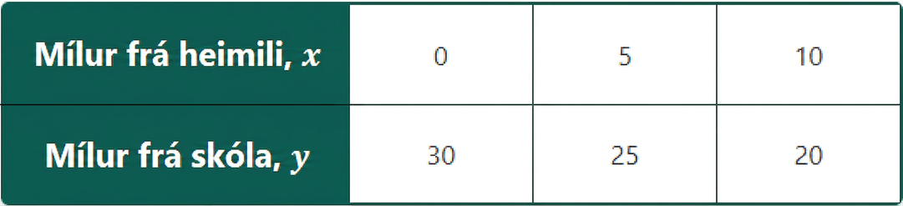
Self Check
Look at the table. Which equation shows the relationship between miles from home and miles from school?
y = 30 + x c. y = 30 – x
y = 20 + x d. y = 30x
Let’s review!
Notes:
Answer Feedback - Individualized by Response
y = 30 + x
Incorrect. This equation works for the first column, but not the others. Look for a pattern that works for every column. How do the y-values change as the x-values change? The answer is y = 30 − x.
y = 20 + x
Incorrect. This equation works for the third column, but not the others. Look for a pattern that works for every column. How do the y-values change as the x-values change? The answer is y = 30 − x.
y = 30 – x
That’s correct! The student lives 30 miles from school, so subtract how far they are from home to see how far they are from school at any given time.
y = 30x
Incorrect. This equation does not work for any value of x. Look for a pattern that works for every column. How do the y-values change as the x-values change? The answer is y = 30 − x.

Slide 16
Self Check - Review
A cell phone company charges a monthly service fee of $40 plus $0.04/min talk-time. Write an equation to describe the relationship between the number of minutes and the total cost.
Step 1 - Read the problem.
Step 2 - Identify the variables and known values.
Step 3 - Write a sentence or create a table using the relationship among the values.
Step 4 - Translate the sentence into an equation.
Notes:
Answers:
Step 2: Monthly Fee: $40, Cost per Minute: $0.04
Step 3: The total cost, t, equals the fee, 40, plus 0.04 per minute.
If drawing a table the x-values (minutes talked in 1 month) are: 0, 1, 2, 3, 100 and the y-values (total $ for 1 month) are 40, 40.04, 40.08, 40.12, 44
Step 4: t = 40 + 0.04m

Slide 17
Lesson Journey
Warm Up
Warm Up
Learning Activity
Learning Activity
Practice
Practice
Learning Activity
Learning Activity
Cool Down
Cool Down
Lesson Synthesis
Lesson Synthesis

Slide 18
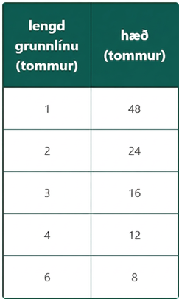
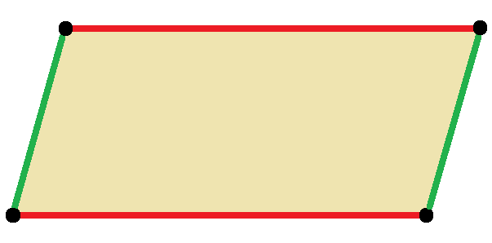
Learning Activity - Writing Equations ✍️
The table represents the relationship between the base length and the height of some parallelograms. Both measurements are in inches.
What is the relationship between the base length and the height of these parallelograms?
Notes:
Support for All Learners
This activity offers additional support and an extension for students:
For english language learners and students with disabilities, be sure to review the Learning Strategies slide!
Activity (15 minutes)
In a previous activity, students explored linear relationships using tables, verbal descriptions, and equations.
In this activity, students analyze new situations to describe and represent relationships between quantities. The first two involve inverse variation (students do not need to know the term or the concept to be able to reason about the relationships), and the last involves a proportional relationship. The final problem requires careful reasoning about how gallons and ounces relate, using cups as a bridge.
Watch for different strategies students use to describe relationships—whether broadly (“As base increases, height decreases”), precisely (“base × height = 48”), or through diagrams, tables, graphs, or equations. Select students with a range of approaches to share during the discussion.
Launch
Let students know they’ll now explore relationships between two quantities in new situations. If time is short, have them focus on the first two questions.
If you have more time, try these ways to boost engagement: (a) Give early finishers graph paper to draw the parallelograms from the table. (b) Let students guess how many beans are in a jar while one student counts. (c) If available, bring measuring containers and liquid for the jug activity—just don’t forget paper towels!
Activity questions, answers, anticipated misconceptions, and synthesis on the next slide.

Slide 19

Learning Activity - Writing Equations ✍️
At a carnival, you can guess how many beans are in a jar. If you guess the exact number, you win $300. If more than one person guesses correctly, they share the $300 equally.
How does the number of winners affect how much money each person gets?
A ½-gallon jug of milk fills 8 cups, while 32 fluid ounces of milk fills 4 cups.
What is the relationship between gallons and ounces?
*Tip: Try making a tables to help you determine the relationship.
Notes:
Answers
Possible answers:
As the base length increases by 1, the height decreases, but not by a steady amount.
Multiplying the base length and the height gives 48. The area of each parallelogram is 48 square inches.
b ⋅ h = 48 or 48b = h (or equivalent).
The height varies inversely as b.
Possible answers:
The amount in dollars received by each winner is 300 divided by the number of winners.
a = 300n or a ⋅ n = 300 (or equivalent), where a is the dollar amount a winner receives and n is the number of winners.
The amount in dollars, a, varies inversely as n.
Possible answers:
If 4 cups contain 32 fluid ounces, then 8 cups must contain 64 fluid ounces. Because there are 16 cups in 1 gallon and 16 is twice as much as 8, there must be 128 fluid ounces in a gallon.
Multiplying the number of gallons by 128 gives the number of fluid ounces.
f = 8 ⋅ 8 ⋅ 2 ⋅ g or f = 128g (or equivalent), where f is the number of fluid ounces and g is the number of gallons.
The number of fluid ounces, f, varies directly as the number of gallons, g.
Anticipated Misconceptions
If students think they must use equations and get stuck, remind them that explanations, tables, or other formats are also valid. When answering the first question, some students may focus only on the bottom rows of the table and think the y-values always decrease by 4. Encourage them to look at the whole table and compare values across columns.
Students may struggle to start the milk volume problem or set up a table. Ask which units are given and suggest using headings like “gallons,” “cups,” and “fluid ounces.” Encourage them to fill in one row using the given info. If they’re stuck, try starting with a different unit (e.g., 4 or 8 cups). You can also suggest finding how many ounces are in 8 cups.
Activity Synthesis
Invite selected students to share their thinking, starting with broad explanations and moving to precise equations (remind students using equations to define their variables). If different equation forms are shared, display them all to show they are equivalent. If no one used a table, ask how it might help and show an example—especially for the last two problems, where tables can clarify relationships.
Show these equations for the three situations: 𝑏 ⋅ ℎ = 48 or ℎ = 48/𝑏; 𝑎 ⋅ 𝑛 = 300 or 𝑎 = 300/𝑛; 𝑓 = 128𝑔
Highlight how equations capture relationships efficiently. Ask students which quantities are changing and which stay the same. Note that while all are equations with two variables, not all show linear relationships.

Slide 20
Learning Strategies - Writing Equations ✍️
Teacher Instruction: Use these strategies to adjust the activity to support english language learners and students with disabilities.
  You can copy and paste the callouts directly on top of the activity or give the instructions aloud.
How can you show the relationship between the two quantities? Can you explain it with words, a table, or a diagram?
Choose a way to represent the relationship—write about it, make a table, or draw a picture. What does your representation show?
Action and Expression
Notes:
Support for Students with Disabilities: Action and Expression: Develop Expression and Communication
Provide options for communicating understanding. Invite students to describe the relationships between quantities in different ways, for example, using verbal (written or oral) descriptions, tables, diagrams, or other representations.
Supports accessibility for: Language; Organization

Slide 21
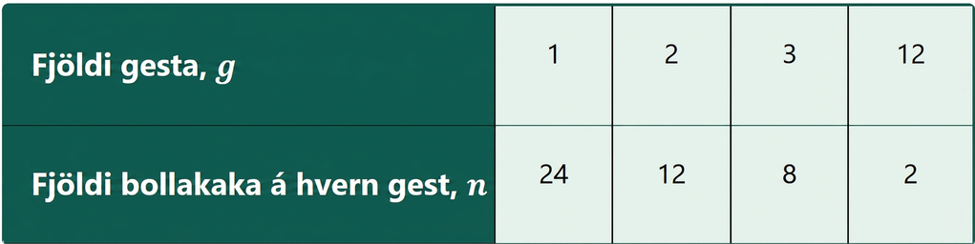
Self Check
What is one way to write the relationship between the number of guests and the number of cupcakes per guest from the table?
n = 24g | n = g/24
n = 24/g | n = 24 – g
Let’s review!
Notes:
Answer Feedback - Individualized by Response
n = 24g
Incorrect. Each guest does not get 24 cupcakes. The total number will always be 24 cupcakes. The correct answer is n = 24/g.
n = 24/g
That’s Correct! The 24 cupcakes will be divided by the number of guests, so this is the correct answer.
n = g/24
Incorrect. The number of cupcakes for each guest is found by dividing the total cupcakes by the number of guests. The correct answer is n = 24/g.
n = 24 – g
Incorrect. This does not work for the values in the table. The number of cupcakes for each guest is found by dividing the total cupcakes by the number of guests. The correct answer is n = 24/g.

Slide 22
Self Check - Review
Sometimes, it’s not easy to see how two things are related. You may need to do some math or look for a pattern to figure it out.
A local business is giving away $20,000 in scholarships to students at local high schools. What’s the relationship between the number of students, s, and the amount each student gets, d?
If 2 students are picked, how much does each get? What if 5 students are picked? What if 20 students are picked?
What equation shows the relationship between the number of students, s, receiving scholarships and the dollar amount, d, they receive?
Notes:
Answers
$10,000; $4,000; $1,000
Your answer may vary, but here is a sample: The amount each student receives is $20,000 divided by the number of students or, d = 20,000/s. The dollar amount each student receives, d, varies inversely as the number of students, s.
Additional Instruction
A plane departed from New Orleans and is heading to San Diego. The coordinates show its distance from New Orleans, x, and its distance from San Diego, y, at some points along the way: (100, 1,500) (300, 1,300) (500, 1,100) (__, 1,200) (900, 700) (1,450, __) (x, y)
What is the relationship between the two distances? (Your answer may vary, but here are some samples. The distances represent one path—the distance from New Orleans to San Diego. The two distances sum to 1600 miles. x + y = 160)
Do you see any patterns in how each quantity is changing? (Your answer may vary, but here are some samples. As the x-values increase, the y-values decrease. As the x-values increase by 200 miles, the y-values decrease by 200 miles. The quantities, x and y, sum to 1600 even after changing.)
What is the value of x when y = 1020? (580 miles)
What is the value of y when x = 1450? (150 miles)
A company is donating $50,000 to charity. It will give the money equally to up to 20 organizations chosen by employees. What is the relationship between the number of organizations, s, and the amount each one gets, d? To begin, let's examine some specific values to help uncover the pattern.
If 5 organizations are selected, how much will each charity receive? ($10,000)
If 10 organizations are selected, how much will each charity receive? ($5,000)
If 20 organizations are selected, how much will each charity receive? ($2,500)

Slide 23

Lesson Journey
Warm Up
Learning Activity
Practice
Warm Up
Learning Activity
Practice
Learning Activity
Cool Down
Lesson Synthesis
Learning Activity
Cool Down
Lesson Synthesis

Slide 24
Cool Down 📚
Clare volunteers at a local library during the summer. Her work includes putting labels on 750 books.
How many minutes will she need to finish labeling all books if she takes no breaks and labels 10 books a minute?
How many minutes will she need to finish labeling all books if she takes no breaks and labels 15 books a minute?
Suppose Clare labels the books at a constant speed of s books per minute. Write an equation that represents the relationship between her labeling speed and the number of minutes it would take her to finish labeling.
Notes:
Cool Down (5 minutes)
Answers
75 minutes
50 minutes
s · m = 750 or m = 750s, where m is the number of minutes and s is the speed in books per minute.
Response to Student Thinking - More Chances
Students will have more opportunities to understand the mathematical ideas in this cool-down, so there is no need to slow down or add additional work to the next lessons. Instead, use the results of this cool-down to provide guidance for what to look for and emphasize over the next several lessons to support students in advancing their current understanding.

Slide 25

Lesson Journey
Warm Up
Learning Activity
Practice
Learning Activity
Cool Down
Lesson Synthesis

Slide 26

Practice
Put your hard work to action, practice what you’ve learned!
Notes:
Digital Practice: Access the practice pages at https://openstax.org/details/books/algebra-1

Slide 27

Lesson Journey
Warm Up
Learning Activity
Practice
Learning Activity
Cool Down
Lesson Synthesis

Slide 28
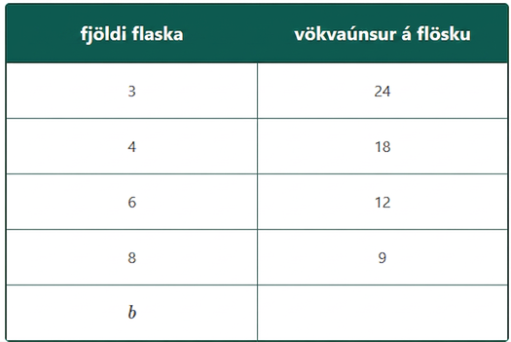


Lesson Synthesis
A student has $30 in a lunch account. Each lunch costs $1.75. How are the number of lunches and the money left related?
A chef pours oil into equal-size bottles. The table shows how many bottles are used and how much oil goes in each.
Notes:
Prompt: In today’s lesson, you used different strategies to figure out how two quantities are related and to write equations to show those relationships. Let’s review some of the ways you did this: (a) Making a table to see how the numbers change and how they relate, (b) Looking for patterns in the table (like how the values increase or decrease), (c) Testing different values to see how changing one number affects the other. Choose one or two examples from the lesson to talk about. If there’s time, try questions 1 and 2.
Answers:
Answers will vary, but here is an example: A = 30 - 1.75n, where A = total $ in account and n = number of lunches purchased.
Answers will vary, but here is an example: f = ⁷²/_{b}, where f = fluid ounces per bottle and b = number of bottles.

Slide 29
Self Assessment
How much do you agree with the following statements?
I can… | I can | Almost | Not yet
Use words and equations to describe the patterns in a table of values or in a set of calculations.
Use representations, like diagrams and tables, to help make sense of a described situation and write equations for it.

