Slide 1


Algebra 1
Unit 2 Linear Inequalities and Systems
Lesson 2.10 Writing and Solving Inequalities in One Variable

Slide 2
How to use these slides
On the activity slides check the speaker notes for teacher support and instructional information.
Each lesson includes 1 warm up, 2-3 learning activities, a cool down, practice and a lesson synthesis.
  Learning activities are followed by a self check question, and review section.
Some slides have been hidden from student view, more information can be found on the next slide (Reference Key).
You can edit and use these slides for personal and classroom use, but cannot sell them and must keep the attribution logos.
For more information, Check out the digital quick start guide!

Slide 3






Reference Key
Check the top right corner for an icon referencing these unique sections.
 | Support for Students with Disability | Hidden | Learning Strategies slide, provides additional support to students for understanding the activity. Learning Strategies slide, provides additional support to students for understanding the activity.
 | Support for English Language Learners | Hidden
 | Extending Your Thinking | Hidden | Extending Your Thinking slide, provides an extra challenge for students.
 | Self Check | Not Hidden | Self Check slide, checkpoint to assess student understanding after the learning activity.
 | Review | Hidden | Self Check- Review slide, designed to help review topics from the self check question.
On the next slides, check the speaker notes for teacher instructions and support.
Notes:
Check the Speaker Notes: On the next slides you can find discussion questions, lesson information, answers to the activities, and ways to adjust the activity for your students!

Slide 4

Learning Goals
By the end of this lesson you will be able to -
Analyze the structure of an inequality in one variable to help determine if the solution is greater or less than the solution to the related equation.
Write and solve inequalities to answer questions about a situation.
Notes:
Lesson Narrative
This lesson serves two main goals. The first is to prompt students to write and solve inequalities to answer questions about a situation. The second goal is to practice finding the solution set to an inequality by reasoning about its composition and parts. The lesson includes an extension activity for practice solving inequalities without any context.
Required Preparation
None
Required Materials
None
Texas Essential Knowledge and Skills
A1(B) use a problem-solving model that incorporates analyzing given information, formulating a plan or strategy, determining a solution, justifying the solution, and evaluating the problem-solving process and the reasonableness of the solution
A1(C) select tools, including real objects, manipulatives, paper and pencil, and technology as appropriate, and techniques, including mental math, estimation, and number sense as appropriate, to solve problems
A5(B) solve linear inequalities in one variable, including those for which the application of the distributive property is necessary and for which variables are included on both sides

Slide 5
Vocabulary
Previous
Inequality
  A mathematical sentence that contains <, >, ≥, ≤, or ≠ in order to compare two quantities.
Solution Set
  The set of all solutions to an equation or inequality.
Substitution
  A method replacing a variable with an expression it is equal to.
New
None
Notes:
Lesson Vocabulary
To support student understanding of key vocabulary:
Familiarize students with the vocabulary words they will see throughout the lesson. Encourage students to look for these words and notice their use and meanings.
Encourage students to use key vocabulary words in “math talk” and their written and oral explanations.
Utilize a word wall. Sample cards are located here: Sample word wall cards are available here.
For newcomers or students with beginning English proficiency, use these Quizlet sets to support vocabulary learning:
Unit 2 Spanish Vocabulary – use first to build understanding
Unit 2 Vocabulary (English) – use after anchoring in Spanish
Support for English Language Learners
ELPS 1(E) internalize new basic and academic language by using and reusing it in meaningful ways in speaking and writing activities that build concept and language attainment
ELPS 2(F) listen to and derive meaning from a variety of media such as audio tape, video, DVD, and CD ROM to build and reinforce concept and language attainment
ELPS 3(E) share information in cooperative learning interactions
ELPS 3(G) express opinions, ideas, and feelings ranging from communicating single words and short phrases to participating in extended discussions on a variety of social and grade- appropriate academic topics
ELPS 3(I) adapt spoken language appropriately for formal and informal purposes

Slide 6





Lesson Journey
Warm Up
Learning Activity
Cool Down
Lesson Synthesis
Learning Activity
Learning Activity
Practice

Slide 7


Warm Up - Drama Club 🎭
Kiran is getting dinner for his drama club on the evening of their final rehearsal. He plans to buy some prepared dishes from a supermarket.
For each question, explain your reasoning.
Represent the constraints in the situation mathematically. If you use variables, specify what each one means.
How many pounds of prepared dishes can Kiran buy? Be prepared to show your reasoning.
The budget for the dinner is $60.
The prepared dishes are sold by the pound, at $5.29 per pound.
He also plans to buy two large bottles of sparkling water at $2.49 each.
Notes:
Warm Up (5 minutes)
In this warm up, students practice writing an inequality to represent a constraint, reasoning about its solutions, and interpreting the solutions. To write an inequality, students need to attend carefully to verbal clues so they can appropriately model the situation. The word “budget,” for instance, implies that the exact amount given or any amount less than it meets a certain constraint, without explicitly stating this. Discuss how budgets can be useful as a way to measure spending in a household, at a company, or even as a government. Using budgets to measure the amount that can be spent is a useful tool for financial responsibility.
Activity Answers
5.29p+2(2.49)≤60 or 5.29p+4.98≤60. p is the pounds of prepared foods Kiran could buy without going over budget.
Up to 10.4 pounds, or p≤10.4. For example: After removing the cost of sparkling water, Kiran still has $55.02. Dividing that amount by 5.29 gives 10.4.
Activity Synthesis
Make sure students see one or more inequalities that appropriately model the situation. Then, focus the discussion on the solution set. Discuss questions such as:
“What strategy did you use to find the number of pounds of dishes Kiran could buy?”
“Does Kiran have to buy exactly 10.4 pounds of dishes?” (No.) “Can he buy less? Why or why not?” (Yes. He can buy any amount as long as the cost of the food doesn’t exceed $55.02. This means he can buy up to 10.4 pounds.)
“What is the minimum amount he could buy?” (He could buy 0 pounds of food, but it wouldn’t make sense if his goal is to feed the club members.)

Slide 8

Lesson Journey
Warm Up
Learning Activity
Cool Down
Lesson Synthesis
Learning Activity
Learning Activity
Practice

Slide 9

Learning Strategies - Mowing Lawns 🦗
Read just the story part (no questions yet).
Take 1–2 minutes to write your own math questions.
Share your questions with a partner.
Look for questions that include limits or restrictions.
After sharing, you’ll see the full task.
Co-Craft Questions
Teacher Instruction: Use these strategies to adjust the activity to support english language learners and students with disabilities.
You can copy and paste the callouts directly on top of the activity or give the instructions aloud.
Draw a 5-gallon tank with an unknown amount of gas.
Label the diagram in your own words.
Show how it connects to math (example: “at most 5 gallons”).
Representation
Notes:
Support for English Language Learners: MLR 5 Co-Craft Questions: Speaking, Reading
Use this routine to increase awareness of language used to talk about solutions of inequalities. Display only the context of this problem without revealing the questions that follow. Give students 1 – 2 minutes to write their own mathematical questions about the situation, and then invite them to share their questions with a partner. Listen for and amplify any questions that involve possible constraints. Once students compare their questions, reveal the remainder of the task.
Design Principle(s): Maximize meta-awareness; Support sense-making
Learn more about this routine
View the instructional video and follow along with the materials to assist you with learning this routine.
Provide support for students
Distribute graphic organizers to the students to assist them with participating in this routine.
Support for Students with Disabilities: Representation: Internalize Comprehension
Represent the same information through different modalities by using a diagram. If students are unsure where to begin, suggest that they draw a diagram of a 5-gallon tank and an unknown quantity of gas. Encourage students to label the diagram with their own interpretations of the significant elements. Look for phrases that indicate students are fully internalizing comprehension of the diagram and exploring how to apply the information mathematically. For example, look for phrases that lend themselves to translation into mathematical symbols, such as “there is at most 5 gallons.”
Supports accessibility for: Conceptual processing; Visual-spatial processing

Slide 10
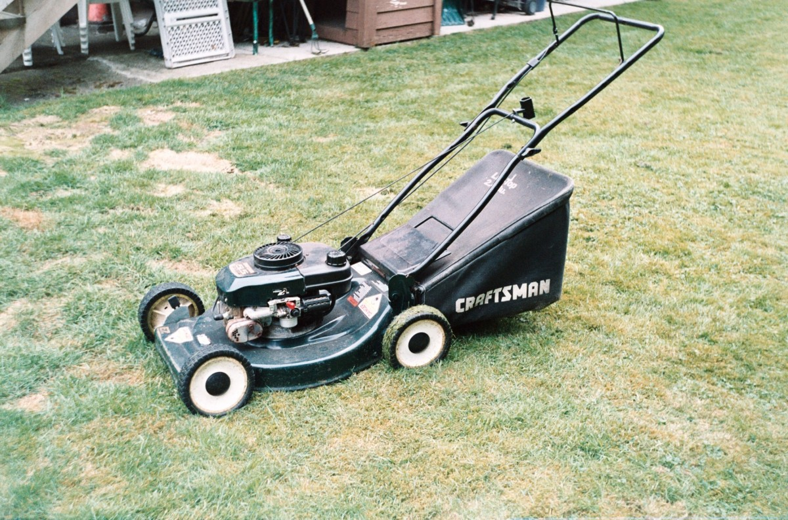
Learning Activity - Mowing Lawns 🦗
Han is about to mow some lawns in his neighborhood. His lawn mower has a 5-gallon fuel tank, but Han is not sure how much gasoline is in the tank.
He knows, however, that the lawn mower uses 0.4 gallon of gasoline per hour of mowing.
What are all the possible values for x, the number of hours Han can mow without refilling the lawn mower?
Write one or more inequalities to represent your response. Be prepared to show your reasoning.
Notes:
Support for All Learners
This activity offers additional support and an extension for students:
For english language learners and students with disabilities, be sure to review the Learning Strategies slide!
Activity (10 minutes)
This activity enables students to use inequalities to solve a problem about a situation whose constraints might be unfamiliar and in which multiple quantities are unknown. To reason about the problem, students need to interpret the descriptions carefully and consider their assumptions about the situation. To make sense of the situation, some students may define additional variables or use diagrams, tables, or other representations.
Activity Answer
x≤12.5 and x≥0.
x≤50.4 or x≤12.5 and x≥0. If the tank is completely full, Han can mow for at most 12.5 hours without refilling. If it is all the way empty, he can mow for 0 hours. It is not possible for Han to mow for a negative number of hours.
Activity Synthesis
Select previously identified students to share their responses, in the order as listed in the Activity Narrative. Also invite students who explicitly stated that x must be positive to explain why they included that lower boundary in their response. Emphasize that although it is probably understood from the context that the amount of gasoline in the tank cannot be negative and that the lowest possible number of hours of mowing is 0, it is not apparent from a mathematical statement like x≤12.5. Writing 0≤x≤12.5 or x≥0 and x≤12.5 makes this assumption explicit and leaves less room for misinterpretation.

Slide 11
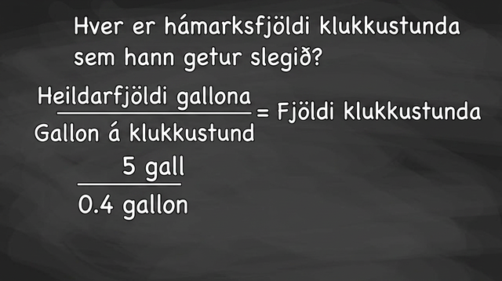
Video: Using Inequalities to Solve a Problem

Slide 12

Self Check
Samantha is feeding the horses at her barn. She has 6 buckets of oats. If each horse eats 3/4 bucket of oats, how many horses can she feed at most?
x ≤ 6, Samantha can feed a maximum of 6 horses.
x ≤ 4, Samantha can feed a maximum of 4 horses.
x ≤ 8, Samantha can feed a maximum of 8 horses.
x ≤ 10, Samantha can feed a maximum of 10 horses.
Let’s review!
Notes:
Answer Feedback - Individualized by Response
x ≤ 6, Samantha can feed a maximum of 6 horses.
Incorrect. Let’s try again a different way: Each horse does not eat 1 bucket of oats. Did you start with the inequality 34x≤6? The answer is Samantha can feed up to 8 horses.
x ≤ 4, Samantha can feed a maximum of 4 horses.
Incorrect. Let’s try again a different way: Is 5 a solution? Did you start with the inequality 34x≤6? The answer is Samantha can feed up to 8 horses.
x ≤ 8, Samantha can feed a maximum of 8 horses.
That’s correct! Check yourself: x≤8 means Samantha can feed up to 8 horses.
x ≤ 10, Samantha can feed a maximum of 10 horses.
Incorrect. Let’s try again a different way: Is 9 a solution? Did you start with the inequality 34x≤6? The answer is Samantha can feed up to 8 horses.

Slide 13

Self Check - Review
A school is repainting its classroom walls. The school has at most 30 gallons of paint. The painter needs 52 gallons of paint for each classroom. How many classrooms can the school paint at most?
We know that the answer is greater than or equal to 0 classrooms, so x ≥ 0.
We also know that each classroom requires 52 or 2.5 gallons of paint.
Notes:
Answers
Let’s take a guess at how many classrooms and check if we are close to the solution. How many gallons of paint would we need to paint 10 classrooms?
10 × 2.5 = 25, and since 25<30, it could be possible for the school to paint 10 classrooms.
We can try 11 classrooms.
11 × 2.5 = 27.5, and since 27.5<30, it could be possible for the school to paint 11 classrooms.
We can try 12 classrooms.
12 × 2.5 = 30, and since 30=30, the most classrooms the school could paint is 12 classrooms.

Slide 14
Lesson Journey
Warm Up
Learning Activity
Cool Down
Lesson Synthesis
Learning Activity
Learning Activity
Practice

Slide 15
Learning Strategies - Solving Strategy ✅
Teacher Instruction: Use these strategies to adjust the activity to support english language learners and students with disabilities.
  You can copy and paste the callouts directly on top of the activity or give the instructions aloud.
Make a visual display of the two inequalities you solved.
Add notes so others can understand your thinking.
We’ll study 2–4 displays quietly for a few minutes, then hear from the authors.
Compare and Connect
Show Priya’s and Andre’s work separately.
Use different colors for their strategies.
Read and discuss one strategy at a time.
Representation
Notes:
Support for English Language Learners: MLR 7 Compare and Connect: Representing, Conversing
Use this routine to prepare students for the whole-class discussion. At the appropriate time, invite students to create a visual display showing the two inequalities they selected to solve. Students should consider how to display their work so that another student can interpret what they see. Encourage students to add notes or details to their displays to help communicate their thinking. Begin the whole-class discussion by selecting and arranging 2 – 4 displays for all to see. Give students 2 – 3 minutes of quiet time to think individually to interpret the displays before inviting the authors to present their work.
Design Principle(s): Optimize output; Cultivate conversation
Learn more about this routine
View the instructional video and follow along with the materials to assist you with learning this routine.
Provide support for students
Distribute graphic organizers to the students to assist them with participating in this routine.
Support for Students with Disabilities: Representation: Develop Language and Symbols
Display or provide copies of Priya’s work and Andre’s work on separate displays. Write Priya’s and Andre’s descriptive phrases (as given on the Student Facing materials) in contrasting colors/texts so students can more easily sort and process information. Some students may benefit from time to read and interpret each strategy one at a time.
Supports accessibility for: Conceptual processing; Memory

Slide 16
Learning Activity - Solving Strategy ✅
Andre | Priya
2(2x+1.5) = 18 - x 4x+3 = 18 - x 4x−15 = -x −15 = -5x 3 = x Testing to see if x = 4 is a solution: 2(2⋅4+1.5) < 18 - 4 2(9.5) < 14 19 < 14 The inequality is false, so 4 is not a solution. If a number greater than 3 is not a solution, the solution must be less than 3, or x<3. | 2(2x+1.5) = 18 - x 4x+3 = 18 - x 5x + 3 = 18 5x = 15 x =3 In 4x+3=18−x, there is 4x on the left and −x on the right. If x is a negative number, 4x+3 could be positive or negative, but 18−x will always be positive. For x+3<18−x to be true, x must include negative numbers or x must be less than 3.
Review the different strategies Andre and Priya used to solve
2(2x + 1.5) ≤ 18 − x
Notes:
Support for All Learners
This activity offers additional support and an extension for students:
For english language learners and students with disabilities, be sure to review the Learning Strategies slide!
For students looking for an extra challenge, be sure to review the Extending Your Thinking slide!
Activity (10 minutes)
In this activity, you’ll see two ways to decide if an inequality’s solution set is greater than or less than a boundary value (found by solving a related equation). Priya and Andre get the same boundary but use different methods: one tests values on each side, the other analyzes the structure of the inequality.
Launch
Revisit the inequality −½x + 6 < 4x − 3. Remind students there are many valid first steps (like adding ½x to both sides or multiplying by 2). Emphasize that treating both sides equally means any correct method will lead to the same solution.
Arrange students in groups of 2. Give students a few minutes of quiet time to make sense of what Andre and Priya have done, and then time to discuss their thinking with their partner. Pause for a class discussion before students move to the second set of questions and try to solve inequalities using Andre’s and Priya’s methods.
Select students to share their analyses of Andre’s and Priya’s work. Make sure students can follow Priya’s reasoning and understand how Priya decided on x<3 by focusing her comparison on 4x+3 and 18−x.
Activity questions, answers, anticipated misconceptions, and synthesis on the next slide.

Slide 17
Learning Activity - Solving Strategy ✅
Summarize the strategy Andre used to solve the inequality.
Summarize the strategy Priya used to solve the inequality.
Examine four inequalities:
  ⅕p > -10
  4(x + 7) ≤ 4(2x + 8)
  -9n < 36
  c/3 < -2(c - 7)
Work with a partner to decide on at least two inequalities to solve. Solve one inequality using Andre's strategy (by testing values on either side of the given solution), while your partner uses Priya's strategy (by reasoning about the parts of the inequality). Switch strategies for the other inequality.
Are you ready for more?
Notes:
Answers
Your answer may vary, but here is a sample. Andre solved the companion equation and found 3=x. Then, he tested a number greater than 3. That created a false mathematical statement so he concluded that any number greater than 3 would not be a solution.
Your answer may vary, but here is a sample. Priya solved the companion equation and found x=3. Then, she reasoned that the left side of the equation, 4x+3, could be either negative or positive while the right side of the equation, 18−x, would always be positive - if negative x values for are substituted into the expressions. So, the possible values for x need to include both positive and negative numbers. That happens when the x values are less than 3.
Your answer may vary. Access the online Teacher Guide to see some samples for this question.
Anticipated Misconceptions
Students who perform procedural steps on the inequality may find incorrect answers. For instance, in the third inequality, they may divide each side by −9 and arrive at the incorrect solution n<−4. Encourage these students to check their work by substituting numbers into the original inequality.
Activity Synthesis
Students should recognize that the solution set for each inequality should be the same regardless of the reasoning method used.
Select as many students as time permits to share how they used a strategy similar to Priya’s to determine the solution set of each inequality. There may be more than one way to reason structurally about a solution set. Invite students who reason in different ways to share their thinking. Record and display their thinking for all to see.

Slide 18
Extending Your Thinking
Using positive integers between 1 and 9 and each positive integer at most once, fill in values to get two constraints so that x = 7 is the only integer that will satisfy both constraints at the same time.
❒x + ❑ < ❑x + ❑
❒x + ❒ < ❒x + ❒
Notes:
Answer
4x+1<3x+9
6x+2>5x+8

Slide 19
Self Check
Solve the following inequality by solving the related equation and reasoning what the answer may be given the situation. ⅓p < 4
p > 12; The solution to the related equation is p = 12. For ⅓ p to be less than 4, the solution must contain large positive numbers.
p < 12; The solution to the related equation is p = 12. Since ⅓ p must be less than 4, the solution cannot include large positive numbers, so numbers larger than 12 cannot be included in the solution.
p < ¾; The related equation is p = ¾. Since the solution set must contain negative numbers, p must be less than ¾.
p < 4⁄3; The related equation is p = 4⁄3. Since the solution set must contain negative numbers, p must be less than 4⁄3.
Let’s review!
Notes:
Answer Feedback - Individualized by Response
Incorrect. Let’s try again a different way: In the inequality, one-third of p is less than, not greater than, 12. The answer is p < 12.
That's correct! Check yourself: Any negative number substituted into ⅓ p will be less than 4, so the solution must include negative numbers.
Incorrect. Let’s try again a different way: Multiplying both sides of the related equation by 3 results in p=12. The answer is p<12.
Incorrect. Let’s try again a different way: For the related equation, instead of multiplying one-third by 4, multiply both sides of the equation by 3. The answer is p<12.

Slide 20
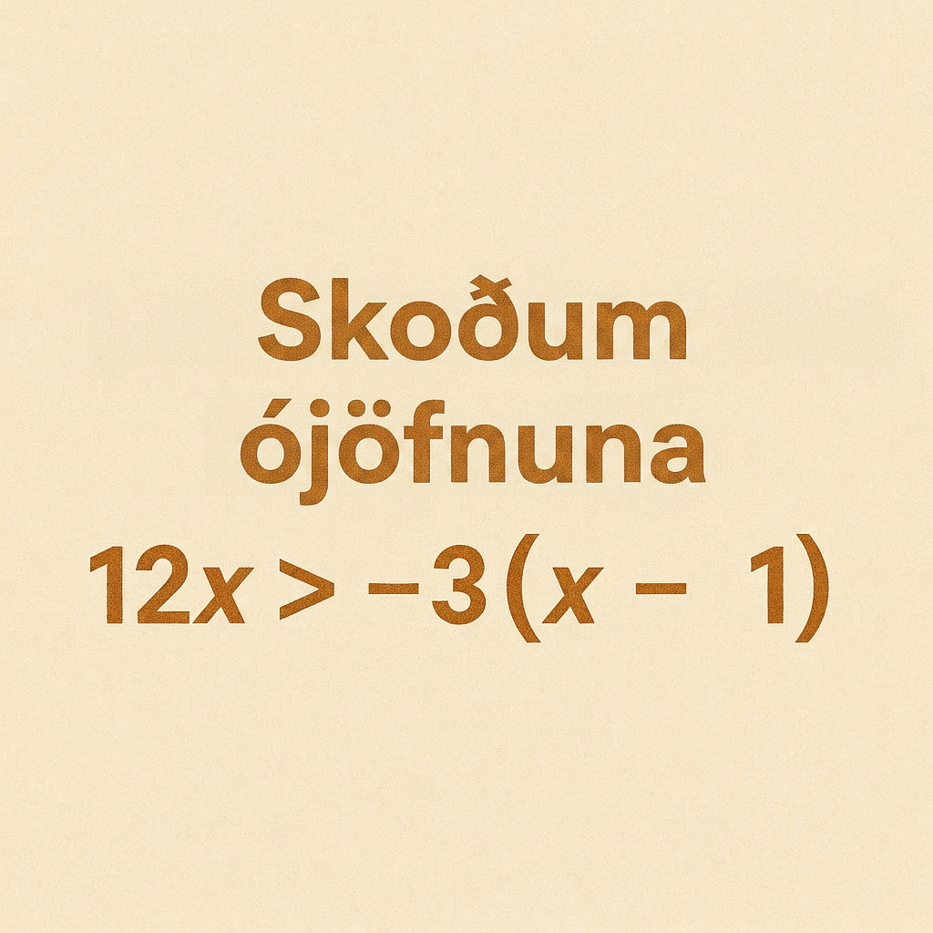
Self Check - Review
You can derive a lot of information about the solution set to an inequality by studying the inequality itself.
The left side of the inequality contains 12𝑥. The right side of the inequality contains −3𝑥.
We can think to ourselves: “What values of 𝑥 would make 12𝑥 greater than −3𝑥?”
Notes:
Answer
If 𝑥 is a large positive number, then 12𝑥 will still be positive. If 𝑥 is a large positive number, then −3𝑥 will be a negative number. This makes the inequality true, so the solution set must include large positive numbers.
Let’s solve the related equation.
x = 3/15
Since we know that the solution set must include large positive numbers, then 𝑥>3/15 must be the solution to the inequality.

Slide 21
Lesson Journey
Warm Up
Learning Activity
Cool Down
Lesson Synthesis
Learning Activity
Learning Activity
Practice

Slide 22
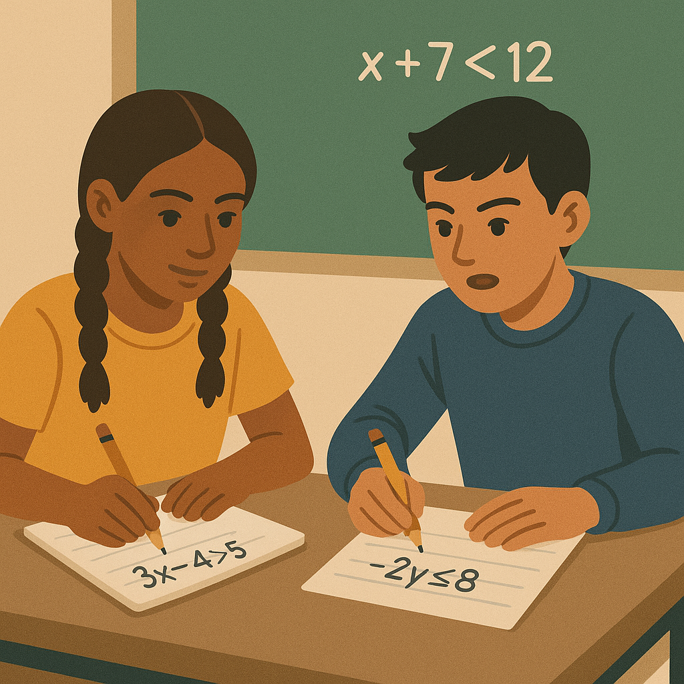
Learning Activity - Inequality 🚫
In this activity, we’re going to solve inequalities. Work with a partner to solve each inequality given. Then match it with the number line representing its solution.
As you complete the activity, discuss with your partner how you know each number line is the solution to its inequality.
When you think you’ve found the correct number line for an inequality, substitute a test point that is on the highlighted part of the number line into the inequality. Is it true?
Try a test point that is not highlighted. Is the inequality false?
Notes:
Activity (15 minutes)
Launch
In preparation for the activity, review the properties of equality. When the same operation is performed with the same number to both sides of an equation, the equation remains true. This will be used as a base to build upon for operations performed on an inequality.
Activity questions, answers, anticipated misconceptions, and synthesis on the next slide.

Slide 23




Learning Activity - Inequality 🚫
Solve each inequality and match it to its graph and the method(s) used to solve it.
x - 4 ≤ -6 | Graph A | Multiplication Property of Inequality
x + 6 ≥ 8 | Graph B | Addition Property of Inequality
4x ≤ 8 | Graph C | Division Property of Inequality
–½x ≤ 1 | Graph D | Subtraction Property of Inequality
Notes:
Answers
Equation 1 - Graph C - Addition Property of Inequality.
Equation 2 - Graph A - Subtraction Property of Inequality.
Equation 3 - Graph D - Multiplication Property of Inequality or Division Property of Inequality.
Equation 4 - Graph B - Multiplication Property of Inequality or Division Property of Inequality.
Ask students: Is there anything unique about the method used to solve –1/2𝑥≤1? Explain.
Yes. The inequality contains a less than or equal to symbol (≤). However, in the solution there is a greater than or equal to symbol (≥). When using the Multiplication and Division Properties of Inequality, you must reverse the symbol when you multiply or divide by a negative number.

Slide 24




Self Check
Solve the inequality. Which number line represents the solution?
–13m ≤ 5
Let’s review!
Notes:
Answer Feedback - Individualized by Response
Incorrect. Let’s try again a different way: This number line represents m ≤ 15. However, substituting −16 makes the inequality false. The answer is D, or m ≥ −15.
Incorrect. Let’s try again a different way: This number line represents m≥15. However, substituting 14 makes the inequality true. The answer is D, or m≥−15.
Incorrect. Let’s try again a different way: This number line represents m≤−15. However, substituting −16 makes the inequality false. The answer is D, or m≥−15.
That's correct! Check yourself: The correct answer is m≥−15. Substituting −14 makes the inequality true. Substituting −16 makes the inequality false.

Slide 25


Self Check - Review
Solve the following linear inequalities:
9y < 54
  Step 1: Divide both sides of the inequality by 9; since 9 is positive, the inequality stays the same.
  Step 2: Simplify.
    y < 6
  Step 3: Graph the solution on the number line.
  Step 4: Write the solution in interval notation.
    (−∞,6)
-13m ≥ 65
  Step 1: Divide both sides of the inequality by −13. Since −13 is negative, the inequality reverses.
  Step 2: Simplify.
    m ≤ −5
  Step 3: Graph the solution on the number line.
  Step 4: Write the solution in interval notation.
    (−∞,−5)
Notes:
A linear inequality is much like a linear equation—but the equal sign is replaced with an inequality sign. So, when we solve linear equations, we are able to use the properties of equality to add, subtract, multiply, or divide both sides and still keep the equality. Similar properties hold true for inequalities.
Addition and Subtraction Properties of Inequality: We can add or subtract the same quantity from both sides of an inequality and still keep the inequality.
Multiplication and Division Properties of Inequality: When we divide or multiply an inequality by a:
positive number, the inequality stays the same.
negative number, the inequality reverses.
Sometimes when solving an inequality, the variable ends up on the right. We can rewrite the inequality in reverse to get the variable to the left.

Slide 26

Lesson Journey
Warm Up
Learning Activity
Cool Down
Lesson Synthesis
Learning Activity
Learning Activity
Practice

Slide 27

Cool Down
Lin’s job pays $8.25 an hour plus $10 of transportation allowance each week. She has to work at least 5 hours a week to keep the job, and she can earn up to $175 per week, including $10 to cover transportation per week.
Represent this situation mathematically. If you use variables, specify what each one means.
How many hours per week can Lin work? Be prepared to show your reasoning.
Notes:
Cool Down (5 minutes)
Answers
Your answer may vary, but here is an example. 8.25h+10≤175 and h≥5, where h represents the number of hours Lin works in a week.
Your answer may vary, but here is an example. At least 5 hours and at most 20 hours (or 5≤h≤20). For example: The maximum amount she could earn, not including the transportation allowance, is $165. That amount is equal to 20 hours of work, 165/8.25=20."
Response to Student Thinking - More Chances
Students will have more opportunities to understand the mathematical ideas in this cool-down, so there is no need to slow down or add additional work to the next lessons. Instead, use the results of this cool-down to provide guidance for what to look for and emphasize over the next several lessons to support students in advancing their current understanding. Students will have more opportunities in Lesson 2.13 (Solving Problems with Inequalities in Two Variables) to write inequalities to represent a situation.

Slide 28

Lesson Journey
Warm Up
Learning Activity
Cool Down
Lesson Synthesis
Learning Activity
Learning Activity
Practice

Slide 29

Practice
Put your hard work to action, practice what you’ve learned!
Notes:
Digital Practice: Access the practice pages at https://openstax.org/details/books/algebra-1

Slide 30

Lesson Journey
Warm Up
Learning Activity
Cool Down
Lesson Synthesis
Learning Activity
Learning Activity
Practice

Slide 31
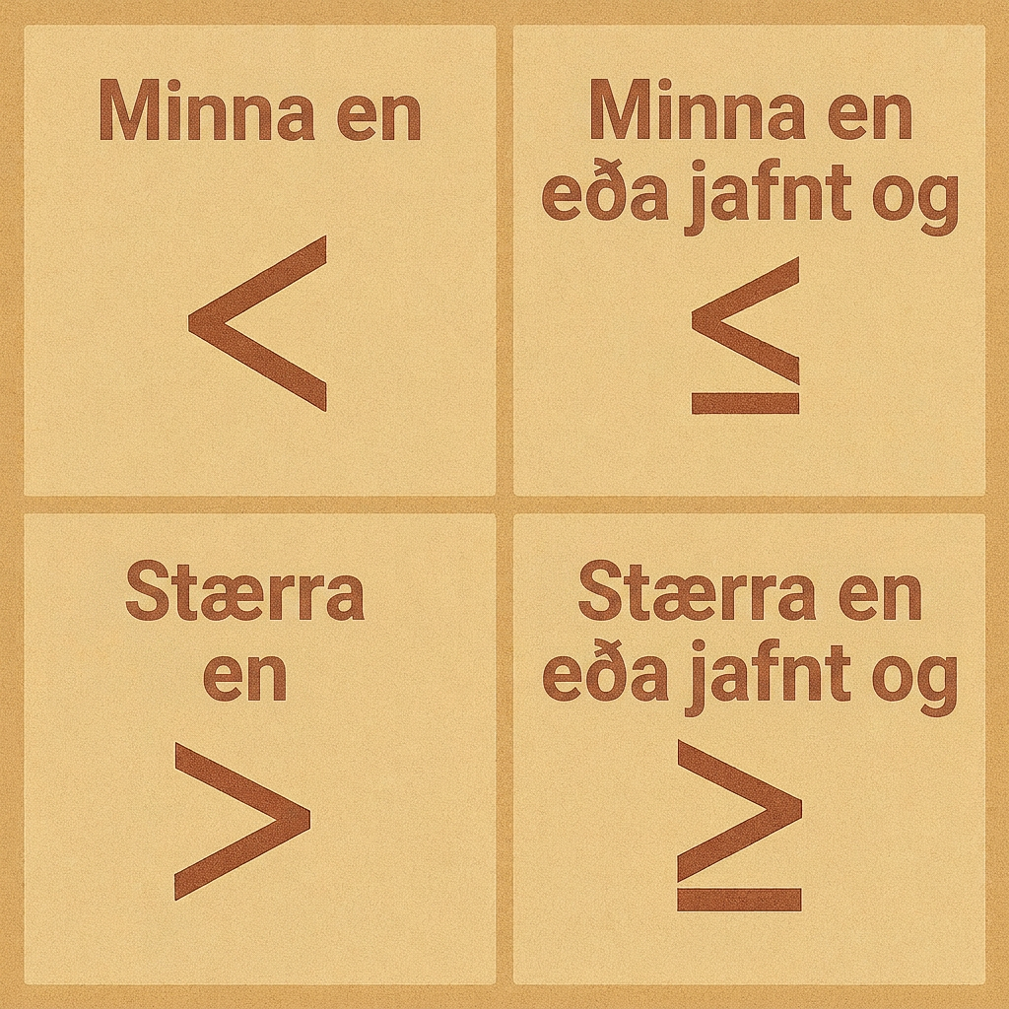
Lesson Synthesis
You saw these inequalities throughout the lesson.
5.29p + 4.98 ≤ 60
0.4x ≤ 5 and x ≥ 0
2(2x + 1.5) < 18 − x
15x > −10
Based on your experience solving them, do you agree or disagree with the following statements about inequalities?
We can usually represent the constraints in a situation with a single inequality.
The only way to check the solutions to an inequality is to see if they make sense in a situation.
The only way to find the solutions to an inequality in one variable is by testing different values for the variable and seeing which ones work.
To express the solutions to an inequality in one variable, we always use the same inequality symbol as in the original inequality.
Notes:
Prompt: Display the following inequalities. Remind students that they are examples of inequalities written and solved in the lesson.
Answers:
Disagree. Sometimes multiple inequalities are needed, depending on what’s happening in the situation.
Disagree. We can also check by substituting some values in the solution set back into the inequality to see if they make the inequality a true statement.
Disagree. We can also reason about the solutions in context, solve a related equation and test a higher and lower value, or use the structure of the inequality.
Disagree. There are different ways to express a solution set. The symbol we use would depend on how we reason about the solutions. For example, x<3 and 3>x both represent the solution set to 2(2x+1.5)<18−x.
Remind students: Make sure students see that there are reasons for disagreeing with each of these statements and can articulate some of the reasons.

Slide 32
Self Assessment
How much do you agree with the following statements?
I can… | I can | Almost | Not yet
Analyze the structure of an inequality in one variable to help determine if the solution is greater or less than the solution to the related equation.
Write and solve inequalities to answer questions about a situation.

