Slide 1
Algebra 1
Unit 7 Introduction to Quadratic Functions
Lesson 7.17 Changing the Vertex
Notes:
How to Get Started
Review Slide 2: How to use these slides
Check out the Check out the digital quick start guide!
Review Slide 3: Reference Key of Icons

Slide 2

How to use these slides
On the activity slides check the speaker notes for teacher support and instructional information.
Each lesson includes 1 warm up, 2-3 learning activities, a cool down, practice and a lesson synthesis.
  Learning activities are followed by a self check question, and review section.
Some slides have been hidden from student view, more information can be found on the next slide (Reference Key).
You can edit and use these slides for personal and classroom use, but cannot sell them and must keep the attribution logos.
For more information, Check out the digital quick start guide!
OpenStax CC BY NC SA

Slide 3





Reference Key
Check the top right corner for an icon referencing these unique sections.
Icon | Title | View | Location and Description
n/a | Support for Students with Disability | Hidden | Learning Strategies slide, provides additional support to students for understanding the activity.
n/a | Support for English Language Learners | Hidden | Learning Strategies slide, provides additional support to students for understanding the activity.
n/a | Extending Your Thinking | Hidden | Extending Your Thinking slide, provides an extra challenge for students.
n/a | Self Check | Not Hidden | Self Check slide, checkpoint to assess student understanding after the learning activity.
n/a | Review | Hidden | Self Check - Review slide, designed to help review topics from the self check question.
On the next slides, check the speaker notes for teacher instructions and support.
Notes:
Check the Speaker Notes: On the next slides you can find discussion questions, lesson information, answers to the activities, and ways to adjust the activity for your students!

Slide 4

Learning Goals
By the end of this lesson you will be able to -
Describe how changing a number in the vertex form of a quadratic function affects its graph.
Notes:
Lesson Narrative
Students previously used vertex form to visualize a parabola’s vertex and direction. In this lesson, they reverse the process by identifying expressions that produce graphs with given vertices. They focus on how changing h and k in a(x − h)² + k shifts the graph, and how a determines the direction the parabola opens.
Students continue reasoning about graphs and expressions, reconnecting these ideas to context in one activity. They build on and apply the structures and patterns developed in earlier lessons.
Required Preparation
Acquire devices that can run Desmos (recommended) or other graphing technology. It is ideal if each student has their own device.
Required Materials
Graphing technology
Texas Essential Knowledge and Skills
A1(F) analyze mathematical relationships to connect and communicate mathematical ideas
A1(G) display, explain, and justify mathematical ideas and arguments using precise mathematical language in written or oral communication
A6(A) determine the domain and range of quadratic functions and represent the domain and range using inequalities
A7(A) graph quadratic functions on the coordinate plane and use the graph to identify key attributes, if possible, including x-intercept, y-intercept, zeros, maximum value, minimum values, vertex, and the equation of the axis of symmetry
A7(C) determine the effects on the graph of the parent function f(x) = x² when f(x) is replaced by af(x), f(x) + d, f(x − c), f(bx) for specific values of a, b, c, and d

Slide 5
Vocabulary
Previous
Quadratic Function
  A function where the output is given by a quadratic expression in the input f(x) = ax² + bx +c.
Vertex
  On a parabola, it is the point where the graph changes from increasing to decreasing or vice versa. It is the highest or lowest point on the graph.
Parabola
  All points in a plane that are the same distance from a fixed point and a fixed line. The curved shape of the graph of a quadratic function.
New
None
Notes:
Lesson Vocabulary
To support student understanding of key vocabulary:
Introduce and review the vocabulary words students will see in this lesson.
Encourage students to notice how these words are used and to include them in their math discussions and explanations—both written and oral.
Use a word wall to reinforce vocabulary. Sample word wall cards are available here.
For newcomers or students with beginning English proficiency, use these Quizlet sets to support vocabulary learning:
Unit 7 Spanish Vocabulary – use first to build understanding
Unit 7 Vocabulary (English) – use after anchoring in Spanish
Support for English Language Learners
ELPS 1(E) internalize new basic and academic language by using and reusing it in meaningful ways in speaking and writing activities that build concept and language attainment
ELPS 2(F) listen to and derive meaning from a variety of media such as audiotape, video, DVD, and CD-ROM to build and reinforce concept and language attainment
ELPS 3(B) expand and internalize initial English vocabulary by learning and using high-frequency English words necessary for identifying and describing people, places, and objects, by retelling simple stories and basic information represented or supported by pictures, and by learning and using routine language needed for classroom communication
ELPS 3(D) speak using grade-level content area vocabulary in context to internalize new English words and build academic language proficiency
ELPS 3(E) share information in cooperative learning interactions

Slide 6

Lesson Journey
First Stop: Warm Up

Slide 7

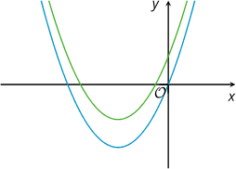
Warm Up | Part 1
Which One Matches? 📉
The graphs represent:
f(x) = x(x + 6)
g(x) = x(x + 6) + 4
Answer the following questions and explain your reasoning.
Which graph represents f(x) = x(x + 6)?
Which graph represents g(x) = x(x + 6) + 4?
Where does the graph of f meet the x-axis?
Notes:
Warm Up (5 minutes)
In this warm up, students revisit quadratic expressions in different forms and what the expressions reveal about the graphs that represent them. They match equations and graphs representing two quadratic functions. The axes of the graphs are unlabeled, so students need to reason abstractly about the parameters in the expressions and the features of the graphs.
Launch
Encourage and support opportunities for peer interactions.
Invite students to talk about their ideas with a partner before writing them down.
Activity Answers
The lower graph (which goes through the origin) is the graph of f.
The value of g is always 4 greater than the value of f, no matter which value of x we choose.
Rewriting the equation in standard form gives f(x) = x² + 6x. This form shows that the y-intercept of the graph representing f is (0, 0).
The expression that defines function f is in factored form. It shows that the two x-intercepts are (0, 0) and (−6, 0).
The lower graph (which goes through the origin) is the graph of f, and the upper one is the graph of g.
The value of g is always 4 greater than the value of f, no matter which value of x we choose.
Rewriting the equation in standard form gives g(x) = x² + 6x + 4.This form shows that the y-intercept of the graph representing g is (0, 4).
x = −6 and x = 0, because these are the two values of x that make x(x + 6) equal to 0.
Activity Synthesis
Invite students to share their matches and explanations. If one or more explanations in the student response are not mentioned, bring them up so that students can see multiple ways of reasoning about the equations and graphs.

Slide 8
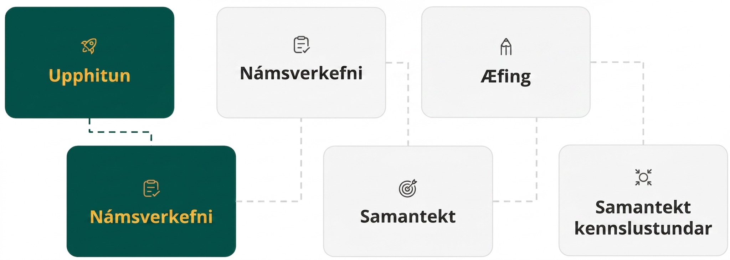
Lesson Journey
Second Stop: Learning Activity A

Slide 9

Learning Activity A | Part 1
Change the Graph, the Vertex Moves🚛
How would you change the equation f(x) = x² so that the vertex of the graph of the new equation is located at the following coordinates and the graph opens as described?
  (0, 11), opens up
  (7, 11), opens up
  (7, −3), opens down
Graph your equations to verify your
predictions.
Notes:
Activity (15 minutes)
In this activity, students apply what they know about the vertex form to modify a given quadratic expression such that its graph is translated in particular ways to produce a different vertex. Students also consider (by analyzing an argument) whether modifying the squared term of a quadratic expression in standard form produces the same translation on the graph as modifying the squared term of an expression in vertex form.
As they modify expressions to translate graphs, students make use of structure. As they analyze an argument about how changing a quadratic expression in standard form affects the graph, they practice explaining their thinking and critiquing the reasoning of others.
Launch
Remind students that they have studied the connections between quadratic expressions and their graphs over several lessons. They have matched expressions and graphs and sketched graphs of given expressions. Now they will think about how to change one or more parts of a quadratic expression so that its graph has certain features.
Before beginning the activity, ask students to describe the graph representing f(x) = x². Make sure students recall that the graph has a vertex at the origin and opens up. If needed, ask them to name some points that are on the graph, for example, (−3, 9), (−2, 4), (−1, 1), (0, 0), (1, 1), (2, 4), (3, 9).
Give students access to graphing technology, but tell students to answer the first question without using technology.
Consider arranging them in groups of two and encouraging them to discuss the last question with a partner after some quiet time to think individually. If students use a graph to illustrate that Kiran's statement is incorrect, encourage them to also use the expression in their justification.
Activity Answers
f(x) = x² + 11
f(x) = (x − 7)² + 11
f(x) = -1(x − 7)²− 3
Link to Desmos graph: https://www.desmos.com/calculator/xptp0intpi
More activity questions, answers on the next slide.

Slide 10
Learning Activity A | Part 1
Change the Graph, the Vertex Moves🚛
Kiran graphed the equation f(x) = x² + 1 and noticed that the vertex is at (0, 1). He changed the equation to f(x) = (x − 3)² + 1 and saw that the graph shifted 3 units to the right and the vertex is now at (3, 1).
Next, he graphed the equation f(x) = x² + 2x + 1 and observed that the vertex is at (−1, 0). Kiran thought, "If I change the squared term x² to (x − 5)², the graph will move 5 units to the right and the vertex will be at (4, 0)."
Do you agree with Kiran?
Explain or show your reasoning why you agree or disagree.
Notes:
Activity Answers
Disagree
Link to Desmos graph: https://www.desmos.com/calculator/gnsr3oqdlj
The vertex of the graph of the original equation f(x) = x² + 2x + 1 is at (−1, 0). The vertex of f(x) = (x − 5)² + 2x + 1 is at (4, 10).
f(x) = (x − 5)² + 2x + 1 at x = 4 gives f(4) = 10, not f(4)=0.
The original equation is not in vertex form, so changing x2 into (x − 5)² does not change the location of the vertex 5 units to the right.
More activity questions, answers on the next slide.

Slide 11
Learning Activity A | Part 1
Change the Graph, the Vertex Moves🚛
f(x) = (x + 4)² − 1 is a parabola with a vertex at (−4, 1) that opens upward.
If we multiply y by 2, we get 2f(x) =2[(x + 4)²−1] = 2(x + 4)² − 2. How does this change the graph?
If we multiply f(x) by ½, we get
½f(x) = ½[(x + 4)² − 1] = ½(x + 4 )² − ½ .
How does this change the graph?
Verify your prediction by graphing.
Notes:
Activity Answers
The parabola is narrower and the vertex is lower. The x-intercepts stay the same.
The parabola is wider and the vertex is higher. The x-intercepts stay the same.
Link to Desmos graph: https://www.desmos.com/calculator/3qbdpjwglh
More activity questions, answers, and synthesis on the next slide.

Slide 12
Learning Activity A | Part 1
Change the Graph, the Vertex Moves🚛
Sophia graphed the equation f(x) = x² − 6x + 9. Read each statement and decide if you agree or disagree with Sophia’s predictions.
Sophia predicted that if she replaced each x with 3x the parabola would be narrower, and the x-intercepts and y-intercepts would change.
Sophia also predicted that if she replaced every x with ⅓x, that the parabola would be wider, and the x-intercepts and y-intercepts would change.
Verify your prediction by graphing.
Notes:
Activity Answers
The parabola will be narrower and the x-intercepts will change, but the y-intercept will stay the same.
The parabola will be wider and the x-intercepts will change, but the y-intercept will stay the same.
Link to Desmos graph: https://www.desmos.com/calculator/w3wcrkrxdf
Activity Synthesis
Have students share their equations for the first question and explain how they decided which modifications to make.
Then shift the discussion to the third question, how they knew that adding a constant inside the squared term in standard form does not create the same translation as in vertex form. Students are not expected to give a full justification yet, only to notice and explain the difference.
Gather several explanations. If needed, point out that x²+2x + 1 is not in vertex form, so its parameters don’t correspond to the graph the same way.
If time allows, note that in x²+ 2x + 1, xx appears in both the squared and linear terms. Changing the input in only the squared term does not shift the graph; both terms would need the same input change for a true horizontal translation.

Slide 13

Learning Activity A
Self Check
What transformations and shifts need to be made to change y = x² to y = −(x + 5)² − 10?
Right 5 and down 10
Left 5 and down 10
Reflect over the x-axis, left 5, and down 10
Reflect over the x-axis, left 5, and up 10
Let’s review!
Notes:
Answer Feedback - Individualized by Response
Incorrect. To move the graph to the right, 5 would have to be added to x. Also, notice the coefficient of the squared term is negative.
Incorrect. The equation leads with a negative.
That’s correct! he negative in the front causes the parabola to reflect over the x-axis. The vertex will be at (−5, −10) so the graph of f(x) = x² shifts left 5 and down 10.
Incorrect. The constant term is negative, so the graph shifts down.

Slide 14

Learning Activity A
Self Check - Review
Let’s review translating and dilating functions.
Translating Functions
f(x + c) + d
A vertical shift moves the graph up or down by d units.
A horizontal shift moves it left or right by c units.
Dilating Functions
a f (bx)
A vertical dilation stretches or compresses the output values by a scale factor of “a”.
A horizontal dilation stretches or compresses the input values by a scale factor of “b”.
Notes:
Review with Students
Review the key points about translating and dilating functions.
More review on the next slide.

Slide 15
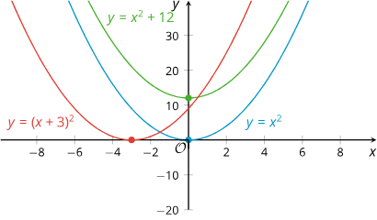
Learning Activity A
Self Check - Review
TRANSLATION
Translating the parent function y = x².
The graphs all have the same shape but their locations are different.
The parent function, f(x) = x², the blue graph, has its vertex at (0, 0).
The green graph shows that adding 12 to f(x) = x² raises the graph by 12 units, now the vertex is at (0, 12).
Replacing x² in f(x) = x² with (x + 3)² shifts the graph 3 units to the left, so the vertex is now at (−3, 0) on the red graph.
Notes:
Remind Students
Review with students, the key points about translating graphs of quadratics.
More review on the next slide.

Slide 16
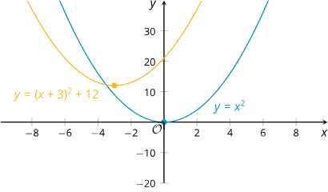
Learning Activity A
Self Check - Review
TRANSLATION
Graphs can shift both horizontally and vertically at the same time.
The yellow graph,
f(x) = (x + 3)² + 12 shifts horizontally and vertically when transformed from the blue graph, f(x) = x².
It shifts 12 units up and 3 units to the left.
Its vertex is at (−3, 12).
Notes:
Review with Students
Review with students the key points about translating graphs of quadratics horizontally and vertically at the same time.
More review on the next slide.

Slide 17
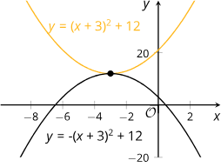
Learning Activity A
Self Check - Review
TRANSLATION
What caused this graph to flip?
Notice that both graphs have the same vertex at (−3, 12).
What if the squared term (x + 3)² on the yellow graph,
f(x) = (x + 3)² + 12, is multiplied by a negative number?
The result is represented in the black graph, f(x) = -(x + 3)² + 12.
The negative number causes the graph to flip over horizontally, so that it opens downward.
Notes:
Review with Students
Review the key points about what happens to the graph when multiplying by a negative number.
More review on the next slide.

Slide 18
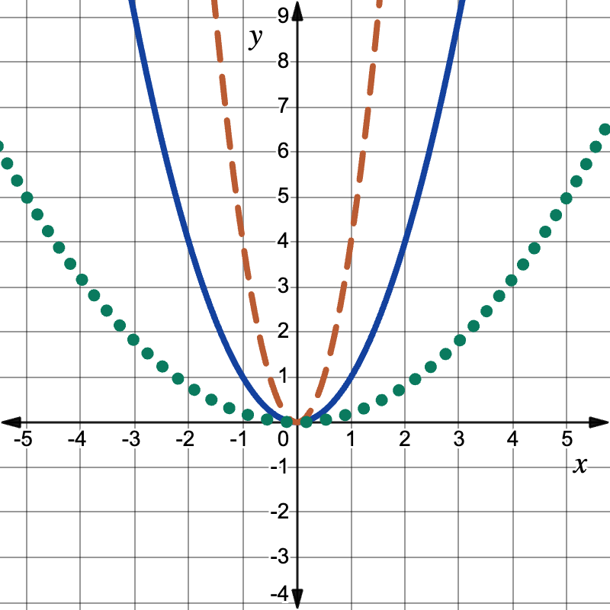
Learning Activity A
Self Check - Review
DILATION
Vertical dilation of the parent function y = x².
The graphs are all parabolas.
The solid blue graph is the parent function, f(x) = x².
Multiplying f(x) = x² by 4 causes the orange dashed graph, f(x) = 4x² to shrink. This dilation is an example of a vertical stretch.
Multiplying f(x) = x² by ⅕ causes the green dotted graph, f(x) = ⅕x² to expand. This dilation is an example of a vertical compression.
Notes:
Remind Students
Review with students, the key points about vertical dilation of graphs of quadratics.
More review on the next slide.

Slide 19
Learning Activity A
Self Check - Review
DILATION
Important Note About Scale Factor in Vertical Dilations.
The scale factor of the coefficient we multiply by determines the impact on the graph.
If the scale factor is greater than 1, then the dilation is a vertical stretch.
If the scale factor is between 0 and 1, then the dilation is a vertical compression.
Notes:
Remind Students
Review with students, the impact the scale factor has on the vertical dilation of the graph..
More review on the next slide.

Slide 20
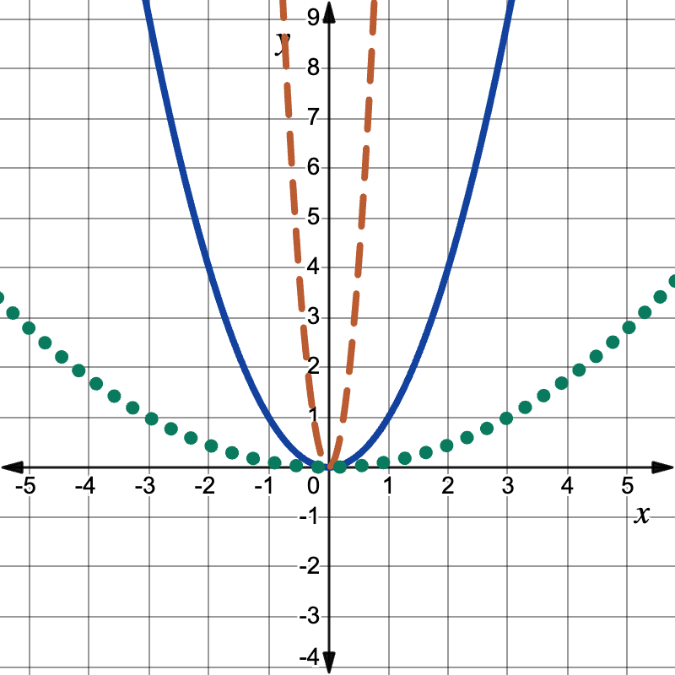
Learning Activity A
Self Check - Review
DILATION
Horizontal dilation of the parent function y = x².
Horizontal dilations affect the input values before the function is applied.
The solid blue graph is the parent function, f(x) = x².
Multiplying x by 4 then squaring causes the orange dashed graph, f(x) = (4x)² to shrink. This dilation is an example of a horizontal compression.
Multiplying x by ⅓ then squaring causes the green dotted graph, f(x) = (⅓x)² to expand. This dilation is an example of a horizontal stretch.
Notes:
Remind Students
Review with students, the key points about horizontal dilation of graphs of quadratics.
More review on the next slide.

Slide 21
Learning Activity A
Self Check - Review
DILATION
Important Note About Scale Factor in Horizontal Dilations.
The scale factor of the coefficient we multiply by determines the impact on the graph.
If the scale factor is greater than 1, then the dilation is a horizontal compression.
If the scale factor is between 0 and 1, then the dilation is a horizontal stretch.
Notes:
Remind Students
Review with students, the impact the scale factor has on the horizontal dilation of the graph.

Slide 22

Lesson Journey
Third Stop: Learning Activity B

Slide 23
Learning Activity A | Learning Strategies
Jumping Peanut 🥜
Teacher Instruction: Use these strategies to adjust the activity to support English language learners and students with disabilities.
You can copy and paste the callouts directly on top of the activity or give the instructions aloud.
Share your values for h and k.
Look at how the graph shows those values.
Check the equation to see what h and k mean.
Notice how the equation and graph connect.
Compare and Connec
You may use reading tools or supports to help you understand directions, word problems, and other written text.
Representation
Notes:
Support for English Language Learners: MLR 7 Compare and Connect: Representing, Conversing
As students share their values of h and k with the class, call students' attention to the different ways the output is represented graphically within the context of the situation. Take a close look at the equation to distinguish what the h and k represent in each situation. Wherever possible, amplify student words and actions that describe the connections between a specific feature of one mathematical representation and a specific feature of another representation.
Design Principle(s): Maximize meta-awareness
Learn more about this routine
View the instructional video and follow along with the materials to assist you with learning this routine.
Provide support for students
Distribute graphic organizers to the students to assist them with participating in this routine.
Support for Students with Disabilities:Representation: Internalize Comprehension
Provide appropriate reading accommodations and supports to ensure student access to written directions, word problems, and other text-based content.
Supports accessibility for: Language; Conceptual processing

Slide 24
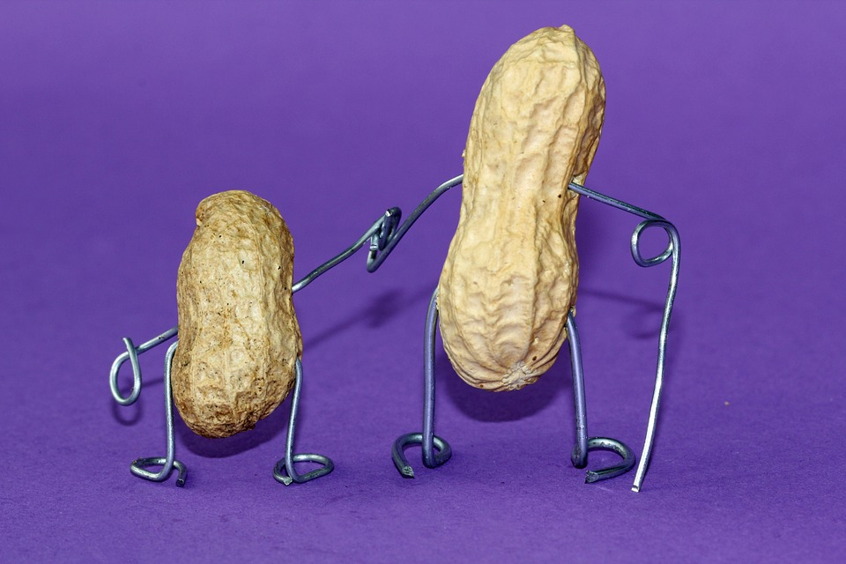
Learning Activity B | Part 1
Jumping Peanut 🥜
Mai is learning to create computer
animation by programming. In one
part of her animation, she uses a
quadratic function to model the path of the main character, an animated peanut, jumping over a wall.
Mai uses the equation f(x) = −0.1(x −h)² + k to represent the path of the jump. f represents the height of the peanut as a function of the horizontal distance it travels, x.
Notes:
Support for All Learners
This activity offers additional support for students:
For English language learners and students with disabilities, be sure to review the Learning Strategies slide!
Activity (15 minutes)
In this activity, students apply what they know about quadratic expressions and graphs to solve a contextual problem involving the path of an animated peanut. They adjust the parameters of a quadratic function so the peanut follows a parabolic path that meets given constraints.
A brief notice-and-wonder helps students see that the equation represents both horizontal and vertical motion, setting them up to adjust the expression later. The key idea to surface is how the vertex relates to the parameters in the equation.
For the second question, many values of h and k are possible. Notice strategies such as:
Shifting the peanut’s starting position horizontally toward the wall
Keeping the start the same but moving the vertex closer to the wall
Shifting both the start and the vertex
If students use graphing technology to experiment or check their results, they are selecting tools strategically.
Launch
Ask students to read the first couple of paragraphs in the statement. (slide 1) Then, display this graph for all to see. (slide2) Tell students that when Mai used the equation f(x) = −0.1(x − 16)² + 7, this is the path of the peanut's jump.
Ask students what they notice and wonder about the equation and the graph. Make sure students see the connection between the parameters in the equation and the vertex of the graph before they proceed with the activity.
Provide continued access to graphing technology, in case students choose to use it..
Activity questions and answers on the next slide.

Slide 25
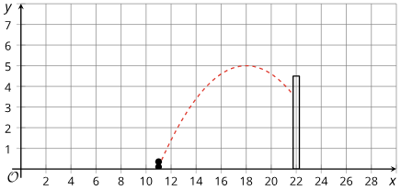
Learning Activity B | Part 2
Jumping Peanut 🥜
On Mai’s computer screen, the base of the wall is located at (22, 0), with the top of the wall at (22, 4.5). The dashed curve in the picture shows the graph of one equation Mai tried, where the peanut fails to make it over the wall.
What is the value of h?
What is the value of k?
Starting with Mai's equation, choose values for h and k that will guarantee the peanut stays on the screen but also makes it over the wall. Explain your reasoning.
Notes:
Answers
18
5
Explanation:
Use 22 for h. Because h is the x-coordinate of the highest point of the jump, if that point is directly over the wall and the k-value remains at 5, then the peanut would clear the wall. So the new equation would be
f(x) = −0.1(x − 22)² + 5.
Change the value of k, which is the vertical coordinate of the vertex, to 7 so that the vertex is at (18, 7) and there is still enough vertical distance to clear the 4.5-unit-tall wall when x is 22. The new equation would be f(x) = −0.1(x − 18)² + 7.
Anticipated Misconceptions
Some students may randomly choose values for h and k until they find a combination whose graph meets the requirements. Encourage them to reason about the problem more systematically, by considering what they learned about the vertex form.
Activity Synthesis
Select a few students with different strategies to share their equations and explanations. To check whether their equations match the animation, consider graphing their equations for the class. Highlight the three strategies from the Activity Narrative.
Explain one key difference from earlier projectile-motion graphs: previously, height was a function of time, so the physical path didn’t look like the graph. In this activity, height is a function of horizontal distance, so the object’s path actually matches the shape of the parabola.

Slide 26
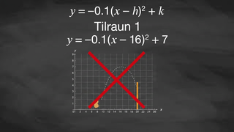
Learning Activity B | Video
Changing the Parameters of a Quadratic Expression
Notes:
This video discusses question 3 of activity 7.17.3

Slide 27

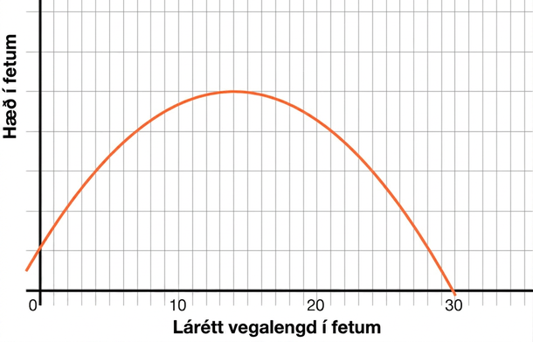
Learning Activity B
Self Check
Cash kicked a football. Its path is modeled by y = −0.02(x − h)² + k, Find the vertex and explain what it means.
(0, 1), the ball was kicked from a height of 1 foot.
(14, 5), the football hit its highest height of 5 feet after traveling 14 feet.
(14, 5) the football hit its highest height of 14 feet after traveling 5 feet.
(30, 0), the football travels 30 feet before hitting the ground.
Let’s review!
Notes:
Answer Feedback - Individualized by Response
Incorrect. his is the starting height. You want the vertex, which represents the maximum height.
That's correct! The x-coordinate is the horizontal distance and the x-coordinate is the height.
Incorrect. The y-value is the height. The answer is (14,5), the football hit its highest height of 5 feet after traveling 14 feet.
Incorrect. This is how far it traveled before landing. You are looking for the vertex to find the maximum height.

Slide 28
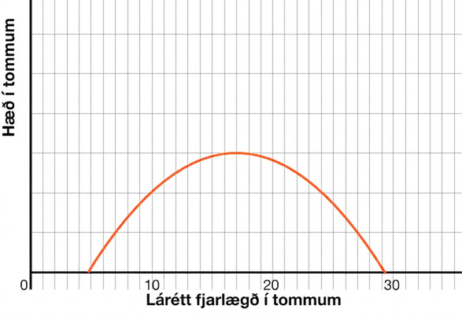
Learning Activity B
Self Check - Review
Zaren made a paper football for a game at indoor recess and flicked it in the air from a table. The path of the paper football is shown below and represented by the function
f(x) = −0.02(x − h)² + k.
Find the value of the vertex and its meaning.
Notes:
Answer
The peak of the graph is at (17, 3). This means the maximum horizontal distance traveled was 17 inches when the height of the object was 3 inches.

Slide 29
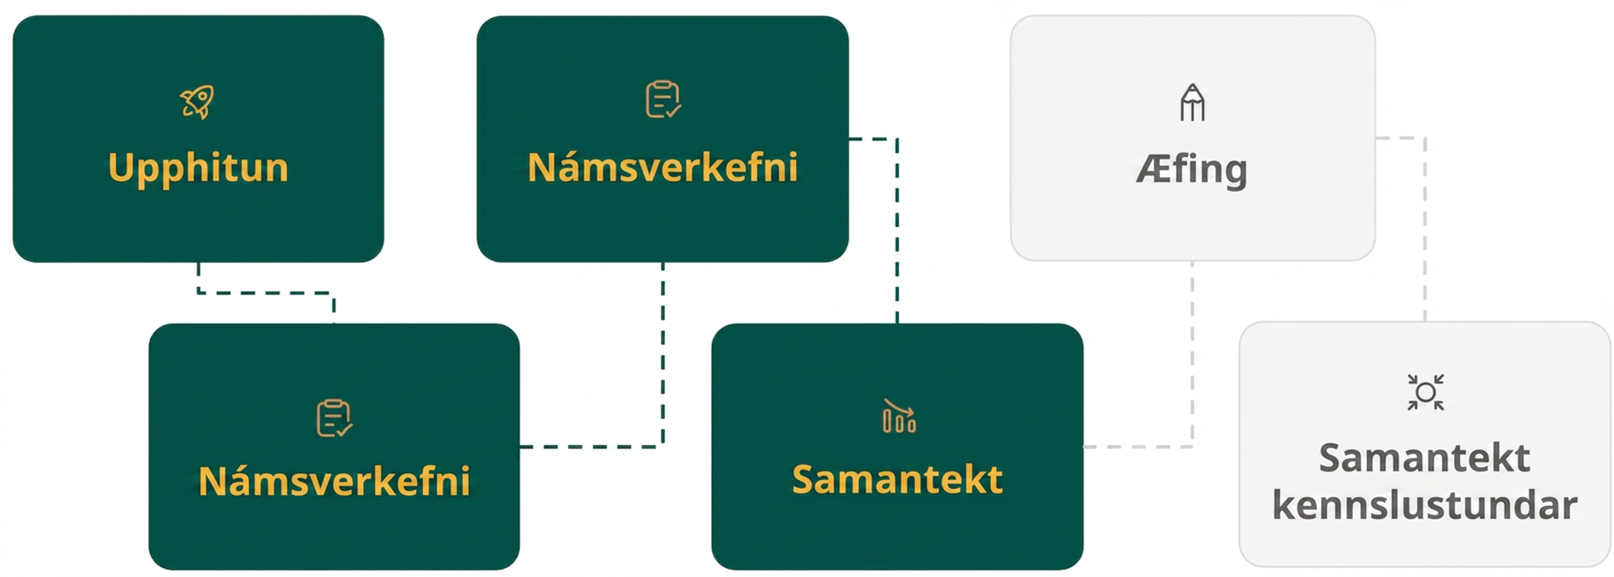
Lesson Journey
Fourth Step: Cool Down

Slide 30
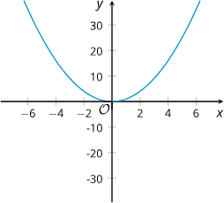
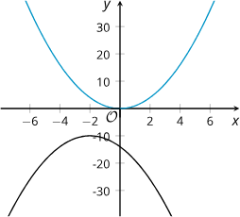
Cool Down
Graph A
Graph A represents f(x) = x². On the same coordinate plane, sketch a graph that represents f(x) = (x − 6)² + 10.
Graph B represents f(x) = x², shifted 2 units to the left, 10 units down, and flipped so that it opens downward, Which equation defines this curve?
f(x) = −(x + 2)² − 10
f(x) = (x + 2)² − 10
f(x) = −(x + 2)² + 10
f(x) = (x + 2)² + 10
Graph B
Notes:
Cool Down (5 minutes)
Answers
Link to Desmos graph: https://www.desmos.com/calculator/lbrvor23wj
a, f(x) = −(x + 2)² − 10
Response to Student Thinking - More Chances
Students will revisit vertex form at the end of Unit 9. This cool down goes beyond the understanding of vertex form students need to demonstrate on the Unit 7 Quiz.

Slide 31
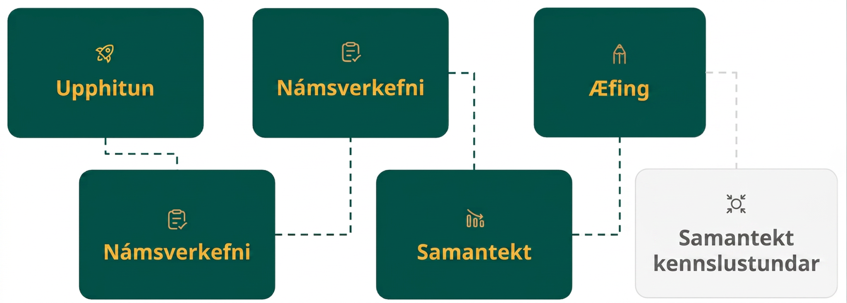
Lesson Journey
Fifth Stop: Practice

Slide 32

Practice
Put your hard work to action, practice what you’ve learned!
Notes:
Digital Practice: Access the practice pages at https://openstax.org/details/books/algebra-1

Slide 33
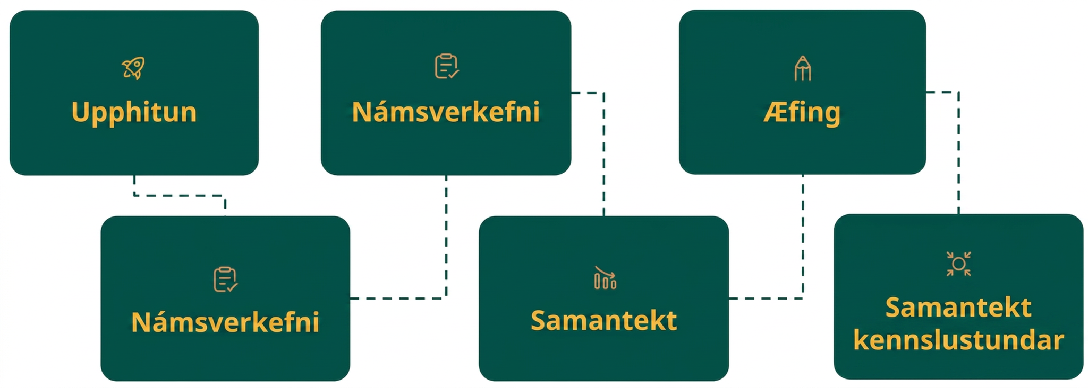
Lesson Journey
Sixth Stop: Lesson Synthesis

Slide 34

Lesson Synthesis
Answer these questions to enhance your understanding of what expressions would produce graphs with particular vertices.
We are given y = 2x² + p. How does adding this positive number,
p, to y = 2x² affect the vertex of the graph?
We are given: y = (x + q)². How does replacing x² with (x + q)² where q is a positive number affect the vertex of the graph?
If we replace x² with (x + q)², where q is a negative number, and then add p, also a negative number. How is the vertex of the graph representing
y = (x + q)² + p different than that of y = x²?
What is the vertex of the graph representing y = −x² − 9 ? Does the graph open up or down?
What equation will translate the graph so that its vertex is at (−5, 2) but it still opens down?
Notes:
Answers
It moves the graph p units up. The x-coordinate of the vertex is the same but the y-coordinate increases by p.
It shifts the graph q units to the left. The vertex is now (−q, 0).
(Its vertex is shifted q units to the right and p units down.
(0,−9) . It opens down, due to the negative coefficient of x².
y = −(x + 5)² + 2

Slide 35
Self Assessment
How much do you agree with the following statements?
Learning Goals | I can | Almost | Not yet
Describe how changing a number in the vertex form of a quadratic function affects its graph. | ⃞ | ⃞ | ⃞

