Slide 1


Algebra 1
Unit 4 Functions
Lesson 4.12: Domain and Range, Part 1

Slide 2
How to use these slides
On the activity slides check the speaker notes for teacher support and instructional information.
Each lesson includes 1 warm up, 2-3 learning activities, a cool down, practice and a lesson synthesis.
  Learning activities are followed by a self check question, and review section.
Some slides have been hidden from student view, more information can be found on the next slide (Reference Key).
You can edit and use these slides for personal and classroom use, but cannot sell them and must keep the attribution logos.
For more information, Check out the digital quick start guide!

Slide 3






Reference Key
Check the top right corner for an icon referencing these unique sections.
 | Support for Students with Disability | Hidden | Learning Strategies slide, provides additional support to students for understanding the activity. Learning Strategies slide, provides additional support to students for understanding the activity.
 | Support for English Language Learners | Hidden
 | Extending Your Thinking | Hidden | Extending Your Thinking slide, provides an extra challenge for students.
 | Self Check | Not Hidden | Self Check slide, checkpoint to assess student understanding after the learning activity.
 | Review | Hidden | Self Check- Review slide, designed to help review topics from the self check question.
On the next slides, check the speaker notes for teacher instructions and support.
Notes:
Check the Speaker Notes: On the next slides you can find discussion questions, lesson information, answers to the activities, and ways to adjust the activity for your students!

Slide 4

Learning Goals
By the end of this lesson you will be able to -
Describe the “domain” and “range” of a function.
When given a description of a function in a situation, determine a reasonable domain and range for the function.
Notes:
Lesson Narrative
Before this lesson, students informally considered meaningful inputs and outputs based on context—for example, using whole numbers for bagels bought or barks counted, and restricting time for a projectile’s flight.
This lesson formalizes that thinking by introducing domain and range. Students identify and describe them using words, number lists, or inequalities, all grounded in context.
An optional extension lets students explore domain without context, helping build abstract reasoning.
These insights support future work with piecewise, exponential, and quadratic functions and strengthen students' mathematical modeling skills.
Required Preparation
Graphing technology is required for the extension activity 4.12.4 "Using Graphs to Determine the Domain of a Function." Acquire devices that can run Desmos (recommended) or other graphing technology. It is ideal if each student has their own device.
Required Materials
Graphing technology
Pre-printed cards, cut from copies of the blackline master
Texas Essential Knowledge and Skills
A1(C) select tools, including real objects, manipulatives, paper and pencil, and technology as appropriate, and techniques, including mental math, estimation, and number sense as appropriate, to solve problems
A1(D) communicate mathematical ideas, reasoning, and their implications using multiple representations, including symbols, diagrams, graphs, and language as appropriate
A1(F) analyze mathematical relationships to connect and communicate mathematical ideas
A1(G) display, explain, and justify mathematical ideas and arguments using precise mathematical language in written or oral communication
A2(A) determine the domain and range of a linear function in mathematical problems; determine reasonable domain and range values for real-world situations, both continuous and discrete; and represent domain and range using inequalities

Slide 5
Vocabulary
Previous
Function
  A relation that takes inputs from one set and assigns them to outputs from another set, assigning exactly one output to each input.
Input
  The value that is substituted into a function.
Output
  The value that results from substituting the input values into a function.
New
Domain
  The set of all possible input values for a function. Set of the first numbers or abscissa of the ordered pairs in a relationship.
Range
  The set of all possible output values for a function. Set of the
  second numbers in the ordered pairs of a relationship.
Notes:
Lesson Vocabulary
To support student understanding of key vocabulary:
Introduce and review the vocabulary words students will see in this lesson.
Encourage students to notice how these words are used and to include them in their math discussions and explanations—both written and oral.
Use a word wall to reinforce vocabulary. Sample word wall cards are available here.
For newcomers or students with beginning English proficiency, use these Quizlet sets to support vocabulary learning:
Unit 4 Spanish Vocabulary, part 1 – use first to build understanding
Unit 4 Vocabulary (English), part 1 – use after anchoring in Spanish
Unit 4 Spanish Vocabulary, part 2 – use first to build understanding
Unit 4 Vocabulary (English), part 2 – use after anchoring in Spanish
Support for English Language Learners
ELPS 1(F) use accessible language and learn new and essential language in the process
ELPS 2(F) listen to and derive meaning from a variety of media such as audiotape, video, DVD, and CD-ROM to build and reinforce concept and language attainment
ELPS 3(E) share information in cooperative learning interactions
ELPS 3(G) express opinions, ideas, and feelings ranging from communicating single words and short phrases to participating in extended discussions on a variety of social and grade-appropriate academic topics

Slide 6





Lesson Journey
Warm Up
Learning Activity
Practice
Learning Activity
Cool Down
Lesson Synthesis

Slide 7

Warm Up - Barking as an Input/Output 🐶
Earlier, you saw a situation where the total number of times a dog has barked was a function of the time, in seconds, after its owner tied its leash to a post and left. Less than 3 minutes after he left, the owner returned, untied the leash, and walked away with the dog.
Could each value be an input of the function? Be prepared to explain your reasoning.
  15
  84 ½
  300
Could each value be an output of the function? Be prepared to explain your reasoning.
  15
  84 ½
  300
Notes:
Warm Up (5 minutes)
This warm up prompts students to consider possible input and output values for a familiar function in a familiar context. The work here prepares students to do the same in other mathematical contexts and to think about domain and range in the rest of the lesson.
Activity Answers
Could each value be an input of the function? Be prepared to explain your reasoning.
Yes
Yes
No. The owner returned in under 180 seconds and then walked away with the dog, so 300 is not a possible input (assuming that the function is limited to the time the dog was tied to the leash and when the owner was away).
More activity questions, answers, and activity synthesis on the next slide.

Slide 8

Lesson Journey
Warm Up
Learning Activity
Practice
Learning Activity
Cool Down
Lesson Synthesis

Slide 9
Learning Strategies - Possible or Impossible Input❓
“_____ is a possible/impossible input because . . .”
“I agree because . . .” or “I disagree because . . . .”
Discussion Supports
Teacher Instruction: Use these strategies to adjust the activity to support English language learners and students with disabilities.
You can copy and paste the callouts directly on top of the activity or give the instructions aloud.
Notes:
Support for English Language Learners: MLR 8 Discussion Supports: Speaking, Representing
After sorting possible inputs for the first function, provide the class with the following sentence frames to help groups respond to each other: “_____ is a possible/impossible input because . . .” and “I agree/disagree because . . . .” When monitoring discussions, re-voice student ideas to demonstrate mathematical language. This will help students listen and respond to each other as they explain how they sorted the cards.
Design Principle(s): Support sense-making

Slide 10
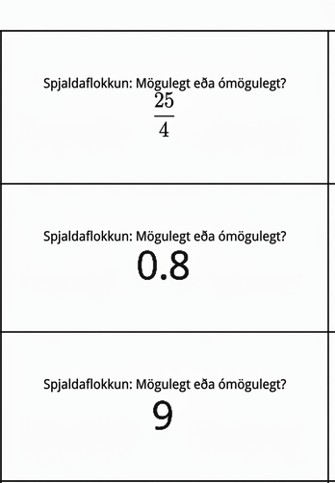
Learning Activity - Possible or Impossible Input❓
Your teacher will give you a set of cards that each contain a number. Decide whether each number is a possible input for the functions described on the next slide. Sort the cards into two groups: possible inputs and impossible inputs. Record your sorting decisions.
Notes:
Support for All Learners
This activity offers additional support and an extension for students:
For English language learners and students with disabilities, be sure to review the Learning Strategies slide!
Activity (20 minutes)
Students continue to think about reasonable input values for functions based on the situation that they represent. They are given three functions and a set of cards containing rational values. For each function, they determine which values make sense as inputs and why. The idea of the domain of a function is then introduced.
Each blackline master contains two sets of cards. Here are the numbers on the cards for your reference and planning:
–3
9
35
15
0.8
4
0
254
0.001
–18
6.8
72
As students sort the cards and discuss their thinking in groups, listen for their reasons for classifying a number one way or another. Identify students who can correctly and clearly articulate why certain numbers are or are not possible inputs.
Launch
Arrange students in groups of 2 – 4. Give each group a set of cards from the blackline master.
Have students sort cards into “possible” and “impossible” inputs for each function, recording results before moving on. Repeat the sort for all three functions.
After sorting the first function, have groups compare results and discuss any disagreements before continuing.
Some students may be unfamiliar with camps, and they may not know that other units besides Fahrenheit and Celsius are used to measure temperature. Provide a brief orientation, if needed.
Activity image answer, and synthesis on the next slide.

Slide 11
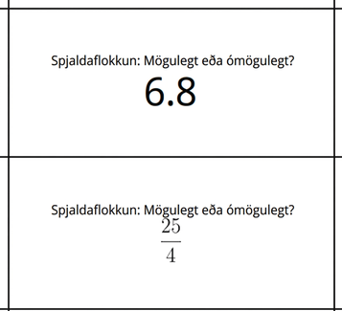
Learning Activity - Possible or Impossible Input❓
List possible inputs and outputs for each question.
The area of a square, in square centimeters, is a function of its side length, s, in centimeters. The equation A(s) = s² defines this function.
A tennis camp charges $40 per student for a full-day camp. The camp only runs if at least 5 students sign up, and it limits the enrollment to 16 campers a day. The amount of revenue, in dollars, that the tennis camp collects is a function of the number of students who enroll. The equation R(n) = 40n defines this function.
The relationship between temperature in Celsius and the temperature in Kelvin can be represented by a function k. The equation k(c) = c + 273.15 defines this function, where c is the temperature in Celsius and k(c) is the temperature in Kelvin.
The domain of a function is the set of all of its possible input values.
Notes:
Activity Answer
Possible inputs: 9, 35, 15, 0, 0.8, 4, ²⁵⁄₄ , 0.001, 6.8, 72
Impossible inputs: –3, –18
Possible inputs: 9, 15
Impossible inputs: −3, −18, 35, 0.8, 0, ²⁵⁄₄, 0.001, 4, 6.8, 72
Possible inputs: All values
Impossible inputs: No Values
Activity Synthesis
Students may not know that 0°K or –273.15°C is absolute zero temperature, or a temperature that is agreed upon as the lowest possible temperature. Consider sharing this information with them as they describe the domain of function k.
Area: s, the input of function A, can be any value equal to or greater than 0: s ≥ 0. The side length can be 0 or any positive number, including irrational numbers. There may be a debate over whether 0 is a possible length of the side of a square. Either side of the debate should be accepted as long as the connection between the input and the side length of a square is made correctly.
Tennis camp: n, the input of function R, can be any whole-number value that is at least 5 and at most 16: 5≤ n ≤16. The number of campers cannot be fractional.
Temperature: c, the input of function k, can be any value that is greater than –273.15.

Slide 12
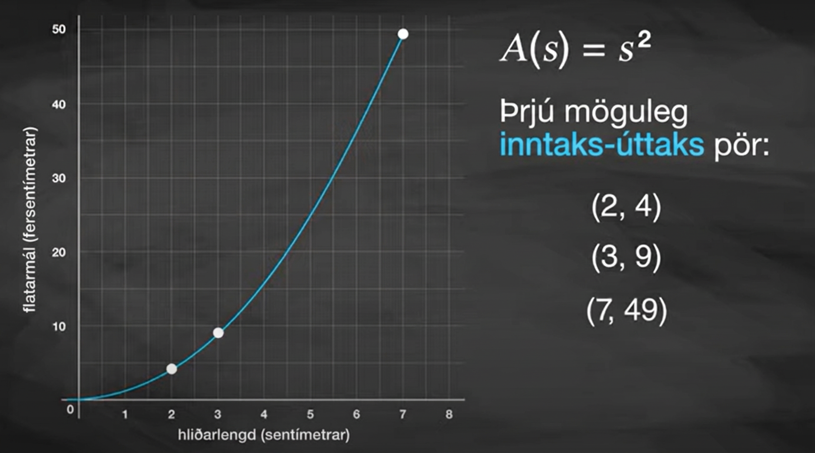
Video: Identifying Outputs of a Function

Slide 13
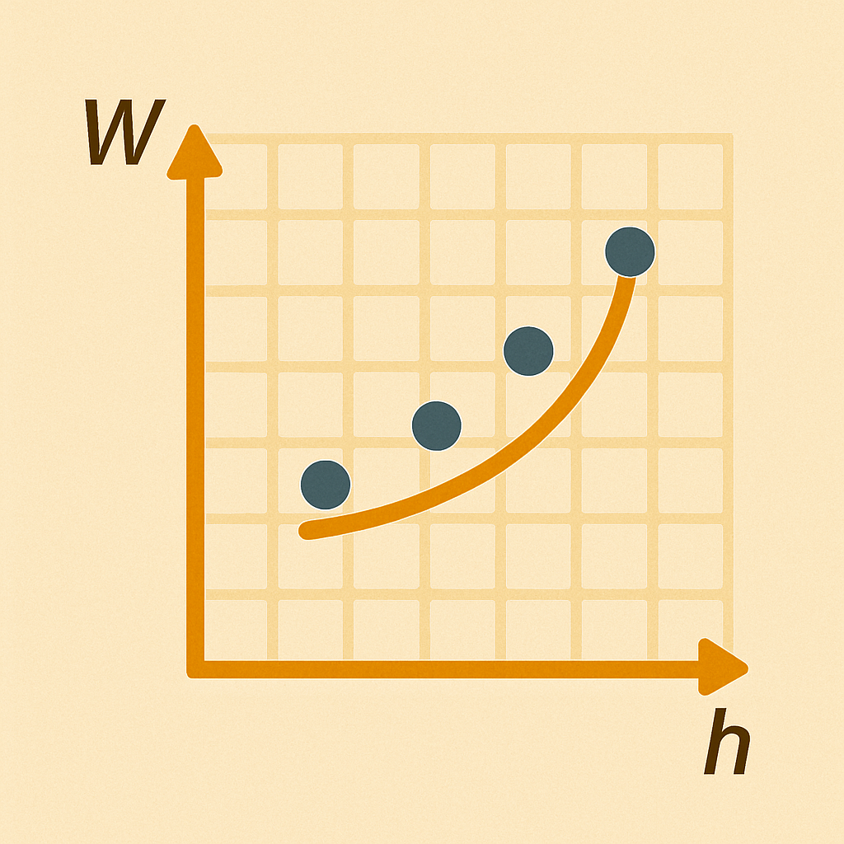
Self Check
Jose created a function W(h) for the weight, W, of his family members given their height, h, in inches.
Which of the following provides a group of possible inputs for the function?
36, 52, −70
5, 40, 62
47, 50.2, 60½
62, −68, 70¾
Let’s review!
Notes:
Answer Feedback - Individualized by Response
Incorrect. Height cannot be negative. The answer is 47, 50.2, 60½.
Incorrect. A height of 5 inches is not realistic. The answer is 47, 50.2, 60½.
That’s correct! Height can be expressed in fractions and decimals, and these are reasonable values for the input in inches.
Incorrect. Height cannot be negative. The answer is 47, 50.2, 60½.

Slide 14

Self Check - Review
Finding Possible Input Values
Micah mows lawns every week where the function M represents the number of lawns mowed as a function of d, days, modeled by the equation M(d) = 4d. Select three from the list on the right that are inputs for this function.
−2
0
2.5
4
Elena runs at a constant speed. Her distance, D, in miles is a function of the time, t, in minutes. Her running distance is represented by the function D(t) = 9t. Select three from the list on the right that are inputs for this function.
−7
40
⅔
60.5
Notes:
Answers
0, 2.5, and 4. −2 is incorrect because it is not possible for him to work a negative number of days.
40, 60.5, and ⅔ .
−7 is not possible because she cannot run for a negative amount of time.
⅔ is possible. However, it is not always reasonable because it stands for ⅔ of one minute. It is important to always look at the entire problem to see if there are any other restrictions, like a minimum amount of time running.
45 - 60.5 are both possible input values because she could run for 45 minutes or 60.5 minutes.

Slide 15
Lesson Journey
Warm Up
Learning Activity
Practice
Learning Activity
Cool Down
Lesson Synthesis

Slide 16
Learning Strategies - Range of a Function 📤
Where is the error in this statement?
“The outputs of A are numbers from 0 to 50 because I looked on the vertical axis and saw that the graph reaches up to 50.”
Clarify, Critique, Correct:
Teacher Instruction: Use these strategies to adjust the activity to support English language learners and students with disabilities.
You can copy and paste the callouts directly on top of the activity or give the instructions aloud.
Analyze either the area function or the revenue function
Engagement
Notes:
Support for English Language Learners: MLR 3 Clarify, Critique, Correct: Reading, Writing, Speaking
Before students share their descriptions of the possible output values of A, present an incorrect response and explanation. For example, “The outputs of A are numbers from 0 to 50 because I looked on the vertical axis and saw that the graph reaches up to 50.” Ask students to identify the error, critique the reasoning, and write a correct explanation. As students discuss with a partner, monitor for students who clarify that the output values are not restricted by the graphing boundaries shown. This helps students evaluate, and improve upon, the written mathematical arguments of others as they discuss the range of a function.
Design Principle(s): Optimize output (for explanation); Maximize meta-awareness
Learn more about this routine
View the instructional video and follow along with the materials to assist you with learning this routine.
Provide support for students
Distribute graphic organizers to the students to assist them with participating in this routine.
Support for Students with Disabilities: Engagement: Provide Access by Recruiting Interest
Leverage choice around perceived challenge. Invite students to analyze either the area function or the revenue function
Supports accessibility for: Organization; Attention; Social-emotional skills

Slide 17
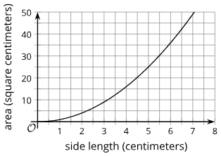
Learning Activity - Range of a Function 📤
In an earlier activity, you saw a function representing the area of a square (function A) and another representing the revenue of a tennis camp (function R). Refer to the descriptions of those functions to answer these questions.
Here is a graph that represents function A,
defined by A(s) = s², where s is the side
length of the square in centimeters.
Name three possible input-output
ordered pairs of this function.
Earlier, we said the input values of A
are “any number ≥ 0.” How would you
describe the possible outputs of A?
Notes:
Support for All Learners
This activity offers additional support and an extension for students:
For English language learners and students with disabilities, be sure to review the Learning Strategies slide!
For students looking for an extra challenge, be sure to review the Extending Your Thinking slide!
Activity (10 minutes)
Earlier, students learned that the domain of a function refers to the set of all possible inputs. In this activity, students are introduced to the range of a function and examine it in terms of a situation. They begin to consider how the domain and range of a function are related to the features of its graph.
Launch
Keep students in groups of 2 – 4. Give students a few minutes of quiet work time, and then a moment to share their responses with their group. Leave a few minutes for whole-class discussion.
Answers
Here is a graph that represents function A, defined by A(s) = s², where s is the side length of the square in centimeters.
A(2) = 4, A(3) = 9, and A(7) = 49
or (2,4), (3,9), (7,49)
The outputs of A are also all numbers greater than or equal to 0.
More activity questions, answers, anticipated misconceptions, and synthesis on the next slide.

Slide 18
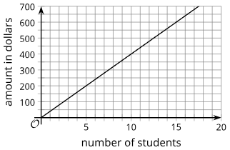
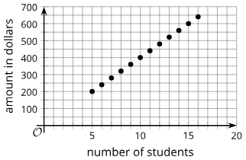
Learning Activity - Range of a Function 📤
Function R is defined by R(n) = 40n, where n is the number of campers.
Is 20 a possible output value in this situation? What about 100? Show your reasoning.
Here are two graphs of student numbers vs. camp revenue. Which could represent function R, and why couldn’t the other?
Describe the set of all possible
output values of R.
Are you ready for more?
Notes:
Answers
Your answers may vary, but here are some samples.
Function R is defined by R(n) = 40n, where n is the number of campers.
No, both 20 and 100 cannot be outputs because the input (the number of campers) cannot be fractions.
The second graph could represent function R. The first graph could not represent the function R because it includes all points for n-values between 0 and 5, n-values greater than 16, and fractional n-values. All of these n-values don’t apply in this situation.
The outputs of R are all multiples of 40 between 200 and 640 (200, 240, 280, and so on).
Anticipated Misconceptions
Some students may confuse domain and range with the visible graphing window or axis scales. For example, they might think the range only goes to 50 because the y-axis stops there. Ask if changing the scale or graphing window is possible, and clarify that domain and range depend on the situation, not the graph’s display.
Activity Synthesis
Have students share the possible outputs for each function and explain that this set is called the range, which depends on the domain.
For the square’s area, the range includes all values ≥ 0.
For the tennis camp revenue, the range includes multiples of 40 from 200 to 640.
Focus on function R. Ask which values can or cannot be outputs and which graph represents the function. Explain that while a graph of discrete points is more accurate, a line graph can be used if we clarify the domain (whole numbers) and range (multiples of 20).
If time allows, revisit the temperature function k(c) = c + 273.15:
Domain: values ≥ –273.15 (Celsius)
Range: values ≥ 0 (Kelvin)

Slide 19

Extending Your Thinking
If the camp wishes to collect at least $500 from the participants, how many students can they have? Explain how this information is shown on the graph.
Notes:
Answer
They will need at least 13 students to collect $500 or more, so the possibilities are 13, 14, 15, and 16. On the graph, there are only 4 dots that lie on or above the horizontal line representing $500.

Slide 20
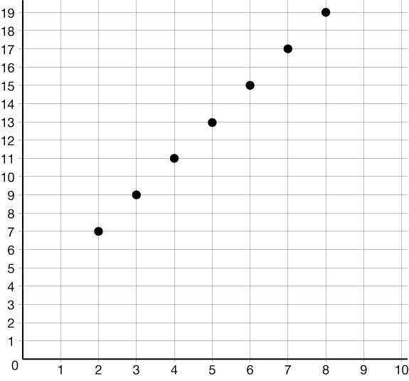
Self Check
Looking at the graph, which statement about the values graphed is true?
The largest output value is 8.
The largest output value is 19.
The largest input value is 19.
All odd numbers are outputs..
Let’s review!
Notes:
Answer Feedback - Individualized by Response
The largest output value is 8.
Incorrect. When graphed, the largest input value is 8 since it is an x-value in the point (8,19). The answer is the largest output value is 19.
The largest output value is 19.
That’s correct! he largest y-value graphed is 19, so that is the largest output.
The largest input value is 19.
Incorrect. Since 19 in the point (8,19) is a y-coordinate, it is an output value. The answer is the largest output value is 19.
All odd numbers are outputs.
Incorrect. While the output values are odd numbers, the numbers in the outputs do not begin until 7. The answer is the largest output value is 19.

Slide 21
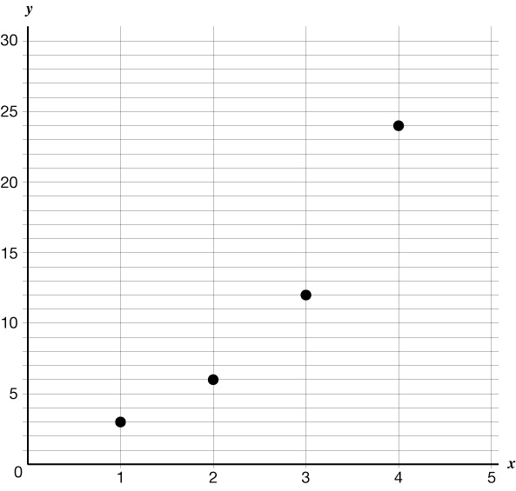
Self Check - Review
Naming Input-Output Pairs
A graph is yet another way that a relation can be represented.
The set of ordered pairs of all the points plotted is the relation.
The set of all x-coordinates, or the input values, is the domain of the relation.
The set of all y-coordinates, or outputs, is the range.
Recall a coordinate is written (x , y).
Name the input-output pairs for the graph.
Notes:
Answer
The input values are the x-values, and the output values are y-values.
(1,3) (2,6) (3,12) (4,24)
This means the domain for the graphed relation is { 1, 2, 3, 4 } and the range is {3, 6, 12, 24}.

Slide 22

Lesson Journey
Warm Up
Learning Activity
Practice
Learning Activity
Cool Down
Lesson Synthesis

Slide 23

Cool Down
Diego’s club earns money for charity when members of the club perform community service after school. For each student who does community service, the club earns $5. There are 12 students in the club.
The total dollar amount earned, E, is a function of the number of members who perform community service, n.
Is 5 a possible input value? Why or why not?
Is 24 a possible output value? Why or why not?
Describe the domain of this function.
Describe the range of this function.
Notes:
Cool Down (5 minutes)
Answers
Is 5 a possible input value? Why or why not?
n = 5 is possible. It means that 5 students perform community service.
Is 24 a possible output value? Why or why not?
No, 24 is not possible as an output value. An output value has to be a multiple of 5.
Describe the domain of this function.
All integers from 0 to 12
Describe the range of this function.
Multiples of 5 from 0 to 60
Response to Student Thinking - More Chances
Students will have more opportunities to understand the mathematical ideas in this cool-down, so there is no need to slow down or add additional work to the next lessons. Instead, use the results of this cool-down to provide guidance for what to look for and emphasize over the next several lessons to support students in advancing their current understanding.

Slide 24

Lesson Journey
Warm Up
Learning Activity
Practice
Learning Activity
Cool Down
Lesson Synthesis

Slide 25

Practice
Put your hard work to action, practice what you’ve learned!
Notes:
Digital Practice: Access the practice pages at https://openstax.org/details/books/algebra-1

Slide 26

Lesson Journey
Warm Up
Learning Activity
Practice
Learning Activity
Cool Down
Lesson Synthesis

Slide 27
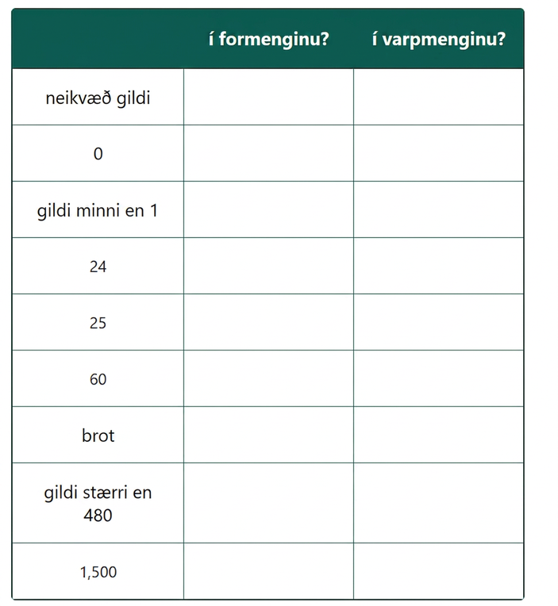
Lesson Synthesis
Function q gives the number of minutes a person sleeps as a function of the number of hours they sleep in a 24-hour period.
Decide whether each value or set of values described in the first column could be in the domain and in the range of the function.
Notes:
Prompt:
Tell students that function q gives the number of minutes a person sleeps as a function of the number of hours they sleep in a 24-hour period. Display a graphic organizer such as shown.
Ask students to decide whether each value or set of values described in the first column could be in the domain and in the range of the function. They should be prepared to explain their decisions (some of which may depend on the assumptions they made about the situation).
Once the class completes the organizer (an example is shown here), give students a moment to come up with a holistic description of the domain and range of this function.
Answer
| In the Domain? | In the Range?
------------------------------------ |------------------------- |-------------------
Negative values | No | No
0 | Yes | Yes
Values less than 1 | Yes | Yes
24 | Yes | Yes
25 | No | Yes
60 | No | Yes
Fractions | Yes | Yes
Values greater than 480 | No | Yes
1,500 | No | No
Closing the Lesson
After completing the Lesson Synthesis, wrap up the class by directing students to the Lesson Summary in their student textbook. In this section, students review the day’s learning targets, read summaries about the key takeaways from each activity, and then respond to a reflection question regarding their confidence with the material.
For more on the benefits of using this type of metacognitive reflection, see the Research in Practice section of the course.

Slide 28
Self Assessment
How much do you agree with the following statements?
I can… | I can | Almost | Not yet
Describe the “domain” and “range” of a function.

