Slide 1
Algebra 1
Unit 9 More Quadratic Equations
Lesson 9.5 Quadratic Equations with Irrational Solutions

Slide 2

How to use these slides
On the activity slides check the speaker notes for teacher support and instructional information.
Each lesson includes 1 warm up, 2-3 learning activities, a cool down, practice and a lesson synthesis.
  Learning activities are followed by a self check question, and review section.
Some slides have been hidden from student view, more information can be found on the next slide (Reference Key).
You can edit and use these slides for personal and classroom use, but cannot sell them and must keep the attribution logos.
For more information, Check out the digital quick start guide!
OpenStax CC BY NC SA

Slide 3





Reference Key
Check the top right corner for an icon referencing these unique sections.
Icon | Title | View | Location and Description
n/a | Support for Students with Disability | Hidden | Learning Strategies slide, provides additional support to students for understanding the activity.
n/a | Support for English Language Learners | Hidden | Learning Strategies slide, provides additional support to students for understanding the activity.
n/a | Extending Your Thinking | Hidden | Extending Your Thinking slide, provides an extra challenge for students.
n/a | Self Check | Not Hidden | Self Check slide, checkpoint to assess student understanding after the learning activity.
n/a | Review | Hidden | Self Check - Review slide, designed to help review topics from the self check question.
On the next slides, check the speaker notes for teacher instructions and support.
Notes:
Check the Speaker Notes: On the next slides you can find discussion questions, lesson information, answers to the activities, and ways to adjust the activity for your students!

Slide 4

Learning Goals
By the end of this lesson you will be able to -
Use the radical and "plus-minus" symbols to represent solutions to quadratic equations.
Explain why the plus-minus symbol is used when solving quadratic equations by finding square roots.
Notes:
Lesson Narrative
This lesson serves two main purposes: to reiterate that some solutions to quadratic equations are irrational, and to give students the tools to express those solutions exactly and succinctly.
Up until this point, students have been writing the solutions to quadratic equations that have positive and negative solutions separately. For example, the solutions of 𝑥² = 49 are 𝑥 = 7 and 𝑥 = –7. Here, students are introduced to the plus-minus symbol (±) as a way to express both solutions (for example, 𝑥 = ±7).
Students also briefly recall the meanings of rational and irrational numbers. They see that sometimes the solutions are expressions that involve a rational number and an irrational number—for example, 𝑥 = ±√8 + 3. While this is compact, exact, and efficient, it is not always easy to intuit the size of the solutions just by looking at the expressions. Students make sense of these solutions by finding their decimal approximations and by solving the equations by graphing.
Required Preparation
Acquire devices that can run Desmos (recommended) or other graphing technology. It is ideal if each student has their own device.
Required Materials
Graphing technology
Texas Essential Knowledge and Skills
A1(D) communicate mathematical ideas, reasoning, and their implications using multiple representations, including symbols, diagrams, graphs, and language as appropriate.
A1(F) analyze mathematical relationships to connect and communicate mathematical ideas.
A8(A) solve quadratic equations having real solutions by factoring, taking square roots, completing the square, and applying the quadratic formula.
A11(A) simplify numerical radical expressions involving square roots.

Slide 5
Vocabulary
Previous
Completing the Square
  A method used with quadratic expressions to transform it into a perfect square trinomial.
Rational Number
  A fraction or the opposite of a fraction.
New
Irrational Number
  A number that cannot be expressed as a fraction or zero.
Notes:
Lesson Vocabulary
To support student understanding of key vocabulary:
Introduce and review the vocabulary words students will see in this lesson.
Encourage students to notice how these words are used and to include them in their math discussions and explanations—both written and oral.
Use a word wall to reinforce vocabulary. Sample word wall cards are available here.
For newcomers or students with beginning English proficiency, use these Quizlet sets to support vocabulary learning:
Unit 9 Spanish Vocabulary – use first to build understanding
Unit 9 Vocabulary (English) – use after anchoring in Spanish
Support for English Language Learners
ELPS 2(F) listen to and derive meaning from a variety of media such as audiotape, video, DVD, and CD-ROM to build and reinforce concept and language attainment.
ELPS 3(E) share information in cooperative learning interactions.
ELPS 3(G) express opinions, ideas, and feelings ranging from communicating single words and short phrases to participating in extended discussions on a variety of social and grade-appropriate academic topics.
ELPS 3(H) narrate, describe, and explain with increasing specificity and detail as more English is acquired.
ELPS 4(F) use visual and contextual support and support from peers and teachers to read grade-appropriate content area text, enhance and confirm understanding, and develop vocabulary, grasp of language structures, and background knowledge needed to comprehend increasingly challenging language.
ELPS 5(B) write using newly acquired basic vocabulary and content-based grade-level vocabulary.

Slide 6
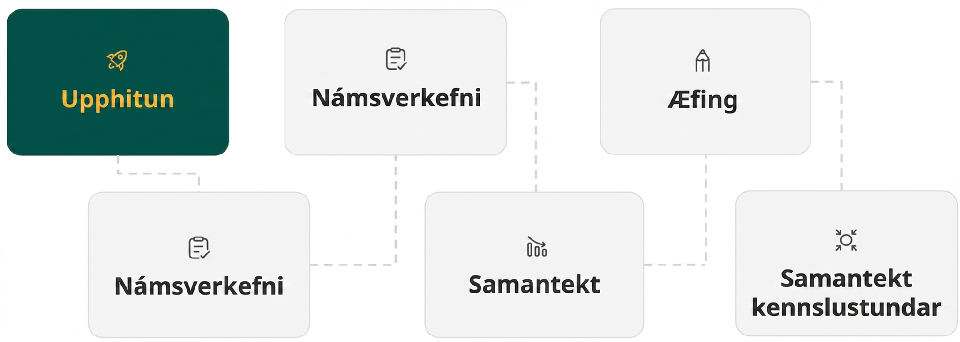
Lesson Journey
First Stop: Warm Up

Slide 7

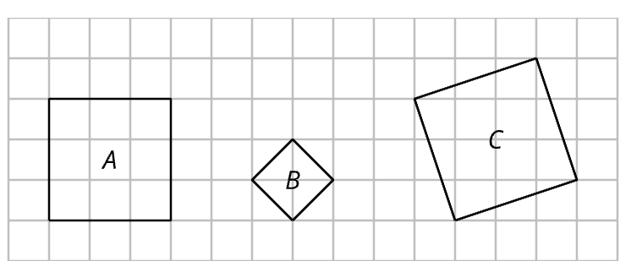
Warm Up
Tilted Squares 🔷
Here are some squares whose vertices are on a grid.
What is the area of Graph A?
What is the side length of Graph A?
What is the area of Graph B?
What is the side length of Graph B?
What is the area of Graph C?
What is the side length of Graph C?
Notes:
Warm Up (5 minutes)
This warm up reminds students that we can use the notation √𝐴 to express the side length of a square with area 𝐴 and that the value of √𝐴 may not be a whole number or a fraction.
To find the area of a tilted square, students might choose different strategies:
Decompose the square and rearrange the parts into rectangles.
Enclose the tilted square with another square that is on the grid and subtract the areas of the extra triangles.
Use the Pythagorean Theorem to calculate the squared value of the side length.
Launch
Display the entire task for all to see.
Give students quiet time to think individually.
Select students to share their responses and how they reasoned about the side length and area of each square.
Answers
9 square units
3 units
2 square units
√2 units
10 square units
√10 units
Anticipated Misconceptions
Watch out for students who conclude that the length of the sides of the tilted squares, B and C, is found by counting the number of grid boxes crossed from one corner to a consecutive corner. If needed, prompt students to use alternate strategies (e.g., Pythagorean Theorem) to find the side lengths for squares B & C.
Activity Synthesis
Invite students to share their solutions. It is not essential to discuss how students found the area. What is important is that students recall that we can use the square root notation √9 to refer to the side length of a square with area 9 square units and that √9 = 3. When the area is 2 or 10 square units, the square root of each number is not a whole number or a fraction, but we can write √2 and √10 rather than writing their decimal approximations.
Remind students that any positive number has two square roots because there are two numbers (one positive and one negative) that, when squared, give that number. Also remind students that the √ symbol refers only to the positive square root of a number. In this context, if 𝑠 is the side length of a square and 𝐴 its area, we can describe the relationship between the two quantities as 𝑠 = √𝐴 because only positive side lengths make sense.

Slide 8
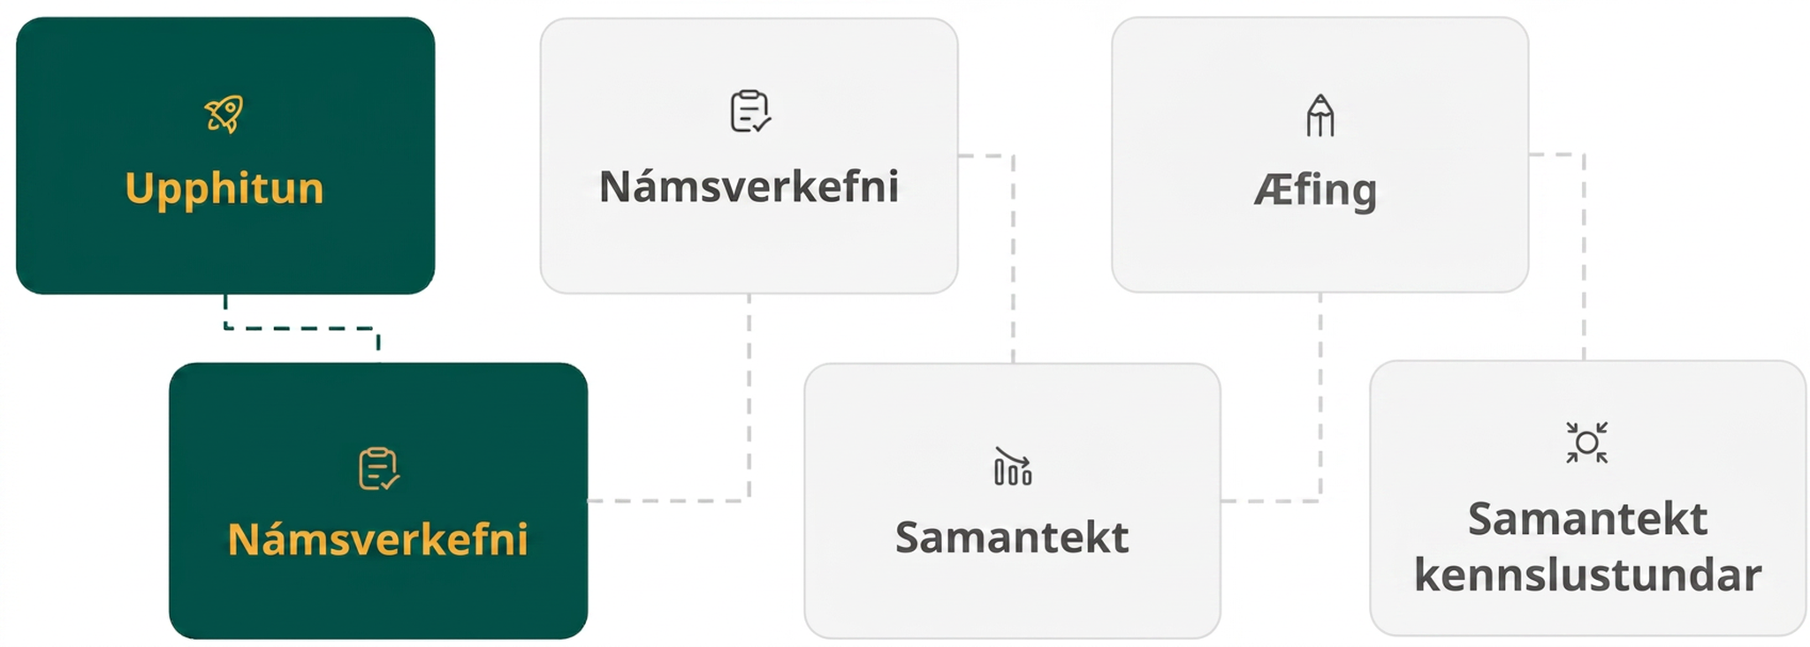
Lesson Journey
Second Stop: Learning Activity A

Slide 9

Learning Activity A | Learning Strategies
Introducing ±
Critique the reasoning in the following to identify the error:
“The solutions to x² = 18 are 9 and –9. I took the square root of each side and divided by 2. Since we are doing square roots, I made sure to put a positive and negative solution.”
Correct the error and write it down.
Clarify your explanation with a partner.
Critique, Correct, Clarify
Teacher Instruction: Use these strategies to adjust the activity to support English language learners.
You can copy and paste the callout directly on top of the activity or give the instructions aloud.
Notes:
Support for English Language Learners: MLR 3 Clarify, Critique, Correct: Reading, Writing, Speaking
Before students share their solutions, present an incorrect solution and explanation for the equation x² = 18 . For example, “The solutions are 9 and – 9. I took the square root of each side and divided by 2. Since we are doing square roots, I made sure to put a positive and negative solution.” Ask students to identify the error, critique the reasoning, and write a correct explanation. As students discuss with a partner, monitor for students who clarify the meaning of square root by using a simpler example. Highlight explanations that verify the solution by multiplying the same number by itself. This helps students evaluate, and improve upon, the written mathematical arguments of others, as they solidify their understanding of square root.
Design Principle(s): Optimize output (for explanation); Maximize meta-awareness
Learn more about this routine
View the instructional video and follow along with the materials to assist you with learning this routine.
Provide support for students
Distribute graphic organizers to the students to assist them with participating in this routine.

Slide 10
Learning Activity A | Part 1
Introducing ±
Solve each equation. Use the ± notation when appropriate and express radicals in simplest form.
x² − 13 = −12
(x − 6)² = 0
x² + 9 = 0
SIMPLIFYING RADICALS
Step 1 - Look at the ways to factor the number under the radical (√).
Step 2 - Choose a factorization of the number that includes a perfect square. Rewrite the number under the radical using that factorization.
Step 3 - Recall that √(𝑎 𑇐 𝑏) = (√𝑎) 𑇐 (√𝑏)
Step 4 - Simplify the perfect squares.
Notes:
Support for All Learners
This activity offers additional support for students:
For English language learners, be sure to review the Learning Strategies slide!
Activity (15 minutes)
This activity introduces the use of the ± notation as a simple way to express the two square roots of a number. Students solve several simple equations by finding square roots and express their solutions using the notation.
Students also see that sometimes the solutions are not rational numbers and can be expressed exactly using the radical notation rather than using their decimal approximations. For example, the solutions to 𝑥² = 24 can be written as 𝑥=±√24 rather than 𝑥 ≈ ±4.9 and the solutions to (𝑥 − 3)² = 24 can be written as 𝑥=±√24 + 3 instead of 𝑥 ≈ ±4.9+3.
Launch
Remind students that we have seen that some quadratic equations have two solutions. Take the equation 𝑥² = 25, for example. For the equation to be true, 𝑥 can be 5 and –5 because 5² = 25 and (−5)² = 25. We have been writing the solutions as: 𝑥 = 5 and 𝑥 = −5. Explain that a shorter way to convey the same information is by writing 𝑥 = ±5.
Before answering questions 4-6, students may need to review simplifying radicals. Highlight that simplifying a radical does not mean that it is rational. Consider using the steps on the next slide to demonstrate how to simplify √12 (details for simplifying √12 are available in the online text.)
Activity image answer, and synthesis on the next slide.

Slide 11
Learning Activity A | Part 2
Introducing ±
Solve each equation. Use the ± notation when appropriate and express radicals in simplest form.
x² = 18
x² + 1= 18
(x + 1)² = 18
SIMPLIFYING RADICALS
Step 1 - Look at the ways to factor the number under the radical (√).
Step 2 - Choose a factorization of the number that includes a perfect square. Rewrite the number under the radical using that factorization.
Step 3 - Recall that √(𝑎 𑇐 𝑏) = (√𝑎) 𑇐 (√𝑏)
Step 4 - Simplify the perfect squares.
Notes:
Activity Answer
𝑥 = ±1
𝑥 = 6
No real solution
𝑥 = ±3√2 (Note: The gray box on this slide provides a review of simplifying radicals. Refer to the online text for a specific example.)
𝑥 = ±√17
𝑥 = −1±3√2 (or equivalent)
Anticipated Misconceptions
When using ± the notation for the first time, some students may struggle to remember that it shows a number and its opposite. Encourage those students to continue writing their answers both ways in this lesson to reinforce the meaning of the new notation. Show students how both solutions work in the original equation by checking the answers.
Some students may still struggle to understand the meaning of the square root. Watch for students who evaluate a square root by dividing by 2. Ask these students what the square root of 9 is. If this does not convince students that dividing by two is the incorrect operation, demonstrate that we call 3 a square root of 9 because 3⋅3 = 9.
Activity Synthesis
Invite students to share their solutions. Record and display the solutions for all to see. Discuss any disagreements, if there are any.
Draw students' attention to the last three sets of solutions, which are irrational. Ask students to recall the meaning of rational numbers and irrational numbers. Remind students that a rational number is a fraction or its opposite, for example: 12, -7, 1/8, −1/8, 90.38, or 0.005. Irrational numbers are numbers that are not rational, for example: √2, 𝜋, and √10.
Highlight that when the solution is irrational, the most concise way to write an exact solution is, for example, 𝑥=±√18 − 1. Writing this in decimal form only allows us to write an approximate solution. For example, in this case, 3.24 and -5.24 are approximate solutions.
Then, display the variations in writing the solutions to (𝑥 + 1)² = 18 for all to see. Discuss how they are all different ways of writing the same two solutions.
𝑥 = ±√18 − 1
𝑥 = √18 − 1 and 𝑥=−√18 − 1
𝑥 = −1 ± √18
𝑥 = −1 + √18 and 𝑥=−1 − √18

Slide 12
Learning Activity A
Self Check
Solve x² − 3 = 19.
x = − 4, x = 4
x = ± √(19) + 3
x = ± √(22)
x = ± 22
Let’s review!
Notes:
Answer Feedback
Incorrect. Be sure to add 3 to each side before taking the square root.
Incorrect. Be sure to add 3 to each side before taking the square root.
That's correct! First add 3 to both sides, then take the square root, remembering the positive and negative solutions.
Incorrect. Be sure to take the square root after adding 3 to each side.

Slide 13

Learning Activity A
Self Check - Review
Solve the equation and, if needed, write the solution as a square root using the ± symbol.
(x + 4)² = 11
When solving quadratics with radical solutions, remember —
Any positive number has two square roots, one positive and one negative, because there are two numbers that can be squared to make that number.
Express the positive square root of a number using the square root symbol (√).
Express the negative square root of a number by placing a negative sign in front of the square root symbol (–√).
Express the square roots of any number using ± in front of the square root symbol (±√).
Notes:
Remind Students
Emphasize key ideas listed in the gray box on the right side of this slide.
For additional practice problems, access the online text.

Slide 14
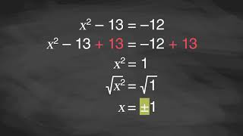
Learning Activity A | Video
Solving Quadratic Equations with Square Roots
Notes:
This video discusses question 1 of activity 9.5.2

Slide 15
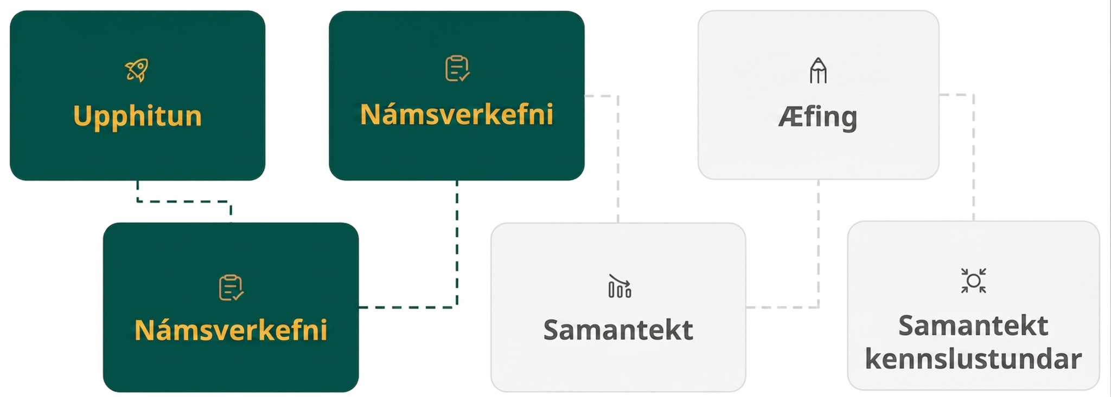
Lesson Journey
Third Stop: Learning Activity B

Slide 16
Learning Activity B | Learning Strategies
Multiple Points of Entry🚪
Teacher Instruction: Use these strategies to adjust the activity to support English language learners and students with disabilities.
  You can copy and paste the callouts directly on top of the activity or give the instructions aloud.
“That could/couldn’t be true because …”
“How do you know …?”
“How did you get … ?”
Discussion Supports
Use the Activity 9.5.3 Checklist as you work with a partner:
Check the box in the cell for each method to show you have completed a verification.
Then, add your initials to prove you are switching roles accordingly.
Engagement
Notes:
Support for English Language Learners: MLR 8 Discussion Supports: Conversing
Use this routine to support small-group discussion as students take turns solving the quadratic equations using different methods and explaining their reasoning. Display the following sentence frames for all to see: “That could (or couldn’t) be true because . . .”, “How do you know . . .?”, and “How did you get . . . ?” Encourage students to challenge each other when they disagree. This will help students clarify their reasoning about solving quadratic expressions by completing the square and by graphing.
Design Principle(s): Support sense-making; Maximize meta-awareness
Support for Students with Disabilities: Engagement: Develop Effort and Persistence
Provide a checklist for completing the activity that supports increasing the length of on-task orientation in the face of distractions. For example, provide students with a two-column checklist with the headers of “graphing” and “completing the square” for students to record their verification. Number the list 1–4 for each problem. As students work through each list item, have them initial by each method to show they have completed a verification, and that they are switching roles accordingly. To support student focus, consider displaying a classroom timer of three minutes for each of the four verifications. [Access the Activity 9.5.3 Checklist, if needed]
Supports accessibility for: Attention; Social-emotional skills

Slide 17
Learning Activity B | Part 1
Multiple Points of Entry 🚪
For each equation, find the exact solutions by completing the square and the approximate solutions by graphing. Then, verify that the solutions found using the two methods are close.
x² + 4x + 1 = 0
  Find the exact solutions by completing the square.
  Graph the equation to find approximate solutions.
  Are the solutions you found using the two methods close?
x² − 10x + 18 = 0
  Find the exact solutions by completing the square.
  Graph the equation to find approximate solutions.
  Are the solutions you found using the two methods close?
Notes:
Support for All Learners
This activity offers additional support and an extension for students:
For English language learners and students with disabilities, be sure to review the Learning Strategies slide!
For students looking for an extra challenge, be sure to review the Extending Your Thinking slide!
Activity (15 minutes)
This activity allows students to integrate several skills and ideas they have learned so far: solving quadratic equations by graphing and by completing the square, using the ± notation, and expressing solutions both approximately and exactly (using the square root symbol). In solving the equations algebraically and using the notations to express and verify solutions, students practice attending to precision.
The last equation may be challenging for some students as it involves fractions and messier-looking solutions. It is not essential that all students get to this equation. They will have a chance to encounter more complicated equations and solutions in upcoming lessons.
Launch
Display the equation 𝑥² + 6𝑥 + 7 = 0 for all to see.
Ask students if they could solve it by rewriting it in factored form. (The expression cannot be rewritten in factored form.)
Remind students that they know how to solve any equation by completing the square, which would give exact solutions. They also know how to solve by graphing, which would give approximate solutions.
Arrange students in groups of two and provide access to graphing technology.
One partner should find exact solutions by completing the square and the other should find approximate solutions by graphing.
Partners should confirm that the 𝑥-intercepts of the graph (or the zeros of the function represented by the graph) approximate the exact solutions obtained algebraically.
Ask partners to switch roles for each equation.
Activity questions, answers, anticipated misconceptions, and synthesis on the next slide.

Slide 18
Learning Activity B | Part 2
Multiple Points of Entry🚪
Are you ready for more?
For each equation, find the exact solutions by completing the square and the approximate solutions by graphing. Then, verify that the solutions found using the two methods are close.
x² + 5x+ ¼ = 0
  Find the exact solutions by completing the square.
  Graph the equation to find approximate solutions.
  Are the solutions you found using the two methods close?
x² + ⁸/₃ x + ¹⁴/₉ = 0
  Find the exact solutions by completing the square.
  Graph the equation to find approximate solutions.
  Are the solutions you found using the two methods close?
Notes:
Answers
a. x = –2 ± √3
b. Desmos graph
c. Yes. Solutions were the same: 𝑥 ≈ −0.268 and 𝑥 ≈ −3.732.
a. x = 5 ± √7
b. Desmos graph
c. Yes. Solutions were the same: 𝑥 ≈ 7.646 and 𝑥 ≈ 2.354.
a. x = –5/2 ± √6
b. Desmos graph
c. Yes. Solutions were the same: 𝑥 ≈ −4.949 and 𝑥 ≈ −0.051.
a. x = –4/3 ± √2/3
b. Desmos graph
c. Yes. Solutions were the same: 𝑥 ≈ −0.862 and 𝑥 ≈ −1.805.
Anticipated Misconceptions
None
Activity Synthesis
Discuss any common struggles or common mistakes made when solving the equations. Then, invite students to reflect on the merits and challenges of solving by each method. Ask questions such as:
"What are some benefits of solving by graphing? What are some drawbacks?" (Benefits: It is quick and straightforward. It shows the solutions, or that there are no solutions, even when the equations involve fractions or very large numbers. Drawbacks: It does not give exact solutions. Some tools may require adjusting the graphing window quite a bit to see the solutions.)
"What are some benefits and drawbacks of solving by completing the square?" (Benefit: It can be used to find exact solutions to any equation. Drawbacks: It can be pretty time consuming. When the equations have fractions or very large or very small numbers, the calculations get complicated and may be prone to error.)

Slide 19

Learning Activity B
Extending Your Thinking
What quadratic equation of the form ax² + bx + c = 0 would have the solutions x = 5 − √2 and x = 5 + √2?
Notes:
Go back to Lesson Activity
Answer
𝑥² − 10𝑥 + 23 = 0

Slide 20

Learning Activity B
Self Check
Which of the following are the solutions to (x − 2)² = 12, rounded to the nearest thousandth?
x ≈ − 3.162, x ≈ 3.162
x ≈ − 1.464, x ≈ 5.464
x = 14
x ≈ 3.162
Let’s review!
Notes:
Answer Feedback - Individualized by Response
Incorrect. This is the rounded decimal for ±√10. Be sure to take the square root then add the 2 to both sides.
That's correct! First take the square root of 12, then add 2 to both sides. There are two solutions because of the plus-minus sign.
Incorrect. You must take the square root before adding 2.
Incorrect. There are two solutions because the plus-minus sign is needed after taking the square root.

Slide 21
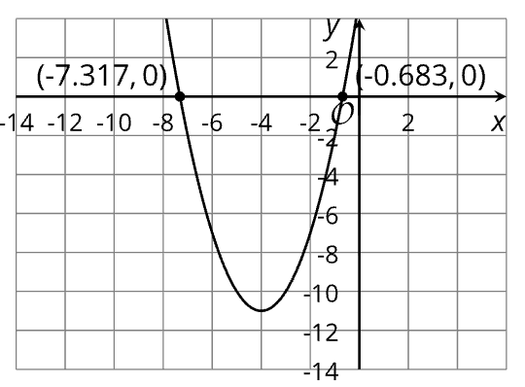
Learning Activity B
Self Check - Review
The exact solutions to the equation (x + 4)² = 11 are: x = −4 ± √11.
How large or small are these numbers? Are they positive or negative?
Use a calculator to approximate the values.
Alternate strategy: Use a graph to solve (x + 4)² = 11
Graph the equivalent equation, (x + 4)² — 11 = 0.
Find its zeros by locating the x-intercepts of the graph.
Notes:
Answers
Calculator approximations: −4 + √11 ≈ − 0.683 and −4 – √11 ≈ − 7.317
Graph question is animated to display on click after the calculations. Also, the answer graph is animated so that you may have students graph the equation and identify the x-intercepts before showing them the answers.
Discuss
Ask students to compare the approximate answers they determined using the quadratic formula vs. the ones they obtained from the graph.

Slide 22
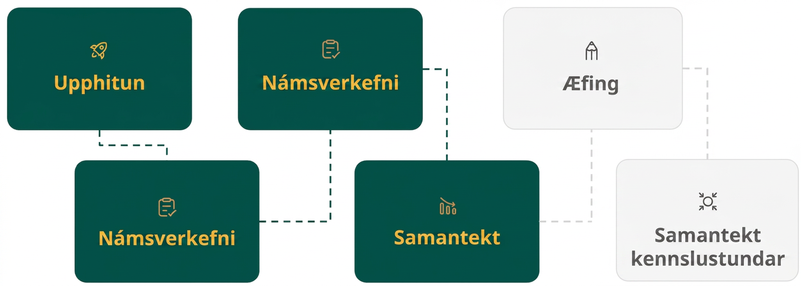
Lesson Journey
Fourth Step: Cool Down

Slide 23
Cool Down
For the equation 𝑥² + 14𝑥 = − 46, the approximate solutions are 𝑥 ≈ − 8.732 and 𝑥 ≈ − 5.268.
Find the exact solutions by completing the square. Show your reasoning.
Notes:
Cool Down (5 minutes)
Answers
x = –7 ± √3 (A complete solution is provided in the online text.)
Response to Student Thinking - More Chances
Students will have more opportunities to understand the mathematical ideas in this cool down, so there is no need to slow down or add additional work to the next lessons. Instead, use the results of this cool down to provide guidance for what to look for and emphasize over the next several lessons to support students in advancing their current understanding.

Slide 24
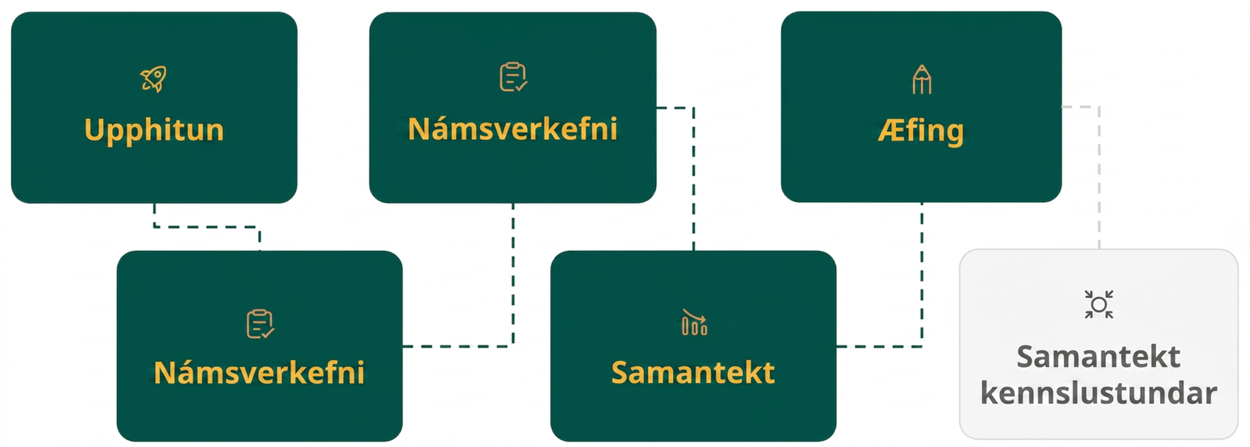
Lesson Journey
Fifth Stop: Practice

Slide 25

Practice
Put your hard work to action, practice what you’ve learned!
Notes:
Digital Practice: Access the practice pages at https://openstax.org/details/books/algebra-1

Slide 26
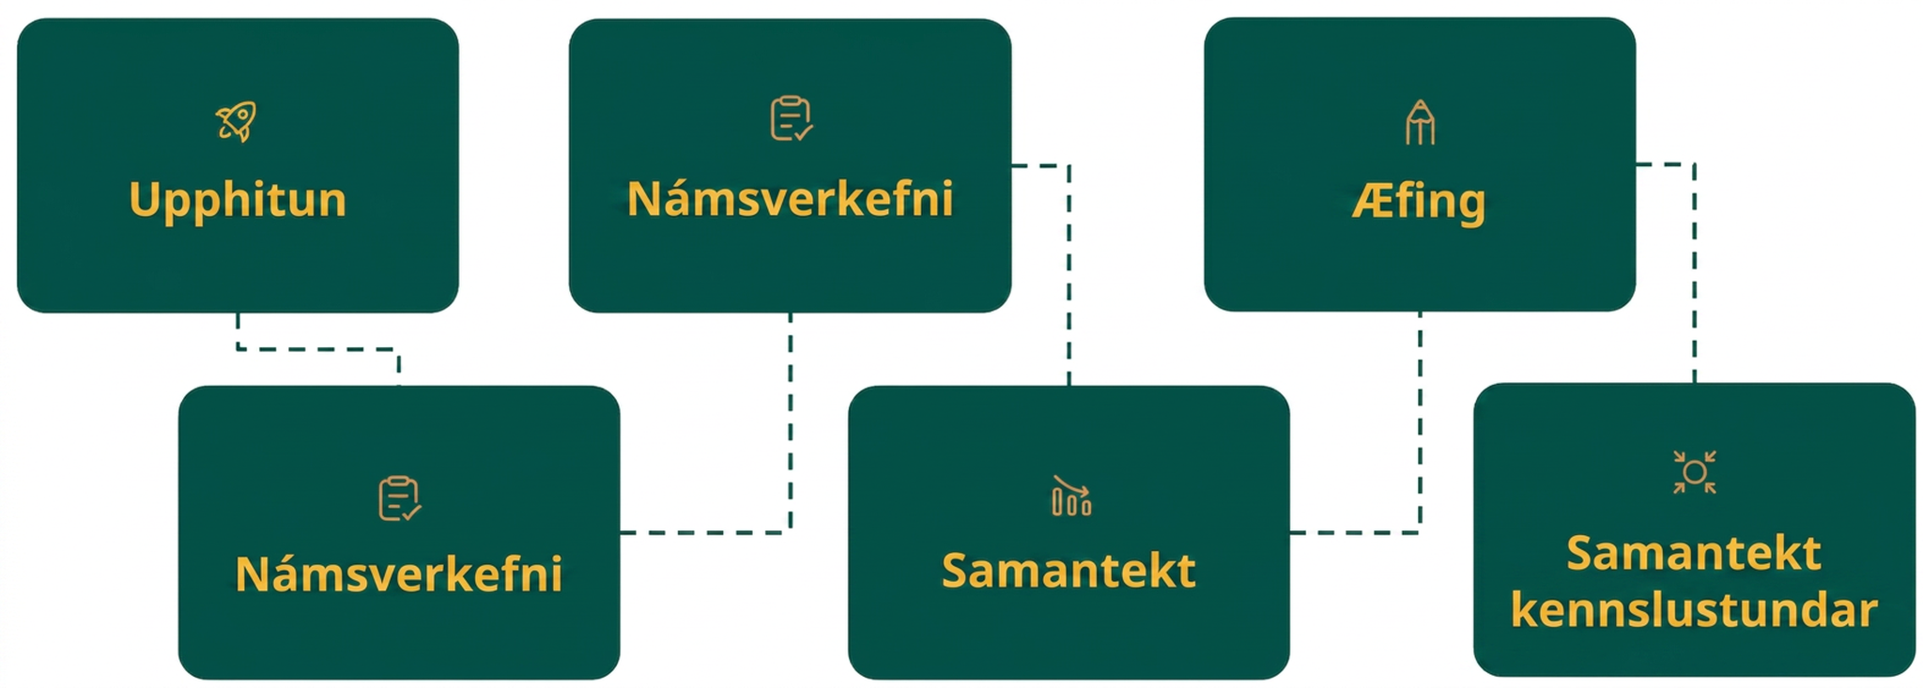
Lesson Journey
Sixth Stop: Lesson Synthesis

Slide 27
Lesson Synthesis
Key Ideas
Explain why any positive number has two square roots and provide an example.
Explain the different ways that the square roots are written or represented. Provide an example for each. [HINT: There are three different expressions to consider.]
Notes:
Emphasize
Any positive number has two square roots, one positive and one negative, because there are two numbers that can be squared to make that number. For example, 6² and (−6)² both equal 36, so 6 and −6 are both square roots of 36.
Express the positive square root of a number using the square root symbol (√). The square root of 36 is 6, but it can also be written as √36 because √36 𑇐 √36 = 36.
Express the negative square root of a number by placing a negative sign in front of the square root symbol (–√). The negative square root of 36 is −6 or −√36.
Express the square roots of any number using ± in front of the square root symbol (±√). The square roots of 40 are √40 and −√40, which can be written as ±√40.

Slide 28
Self Assessment
How much do you agree with the following statements?
Learning Goals | I can | Almost | Not yet
Use the radical and "plus-minus" symbols to represent solutions to quadratic equations. | ⃞ | ⃞ | ⃞
Explain why the plus-minus symbol is used when solving quadratic equations by finding square roots. | ⃞ | ⃞ | ⃞

