Slide 1
Algebra 1
Unit 7 Introduction to Quadratic Functions
Lesson 7.12 Graphing the Standard Form, Part 1
Notes:
How to Get Started
Review Slide 2: How to use these slides
Check out the Check out the digital quick start guide!
Review Slide 3: Reference Key of Icons

Slide 2

How to use these slides
On the activity slides check the speaker notes for teacher support and instructional information.
Each lesson includes 1 warm up, 2-3 learning activities, a cool down, practice and a lesson synthesis.
  Learning activities are followed by a self check question, and review section.
Some slides have been hidden from student view, more information can be found on the next slide (Reference Key).
You can edit and use these slides for personal and classroom use, but cannot sell them and must keep the attribution logos.
For more information, Check out the digital quick start guide!

Slide 3





Reference Key
Check the top right corner for an icon referencing these unique sections.
Icon | Title | View | Location and Description
n/a | Support for Students with Disability | Hidden | Learning Strategies slide, provides additional support to students for understanding the activity.
n/a | Support for English Language Learners | Hidden | Learning Strategies slide, provides additional support to students for understanding the activity.
n/a | Extending Your Thinking | Hidden | Extending Your Thinking slide, provides an extra challenge for students.
n/a | Self Check | Not Hidden | Self Check slide, checkpoint to assess student understanding after the learning activity.
n/a | Review | Hidden | Self Check - Review slide, designed to help review topics from the self check question.
On the next slides, check the speaker notes for teacher instructions and support.
Notes:
Check the Speaker Notes: On the next slides you can find discussion questions, lesson information, answers to the activities, and ways to adjust the activity for your students!

Slide 4

Learning Goals
By the end of this lesson you will be able to -
Explain how the a and c in
ax² + bx + c affect the graph of the equation.
Find the vertex and y-intercept of the graph of a quadratic function in factored form without graphing it first.
Notes:
Lesson Narrative
Students deepen their understanding of the connection between quadratic functions and their graphs. After exploring factored form, they now experiment with standard form quadratics, focusing on how the coefficient of x² and the constant term affect the graph’s shape, direction, and vertical position. Using technology, they adjust parameters, observe the effects, and describe patterns.
Students then practice identifying equivalent quadratic expressions in both standard and factored form and matching them to their corresponding graphs. In doing so, they look for and make use of structure, strengthening their understanding of how equations, tables, and graphs are related.
Previously, students worked mostly with monic quadratics (a = 1) in the form (x + m)(x + n), which made it easier to see the link between the numbers in the factors and the x-intercepts. When working in standard form, that restriction isn’t needed, since the role of the coefficient aaa in controlling the graph’s steepness and direction becomes clearer.
In a later unit, students will use the zero product property to solve quadratic equations and revisit how factored form reveals the x-intercepts, including for non-monic expressions like (px + m)(qx + n).
Required Preparation
Print and cut up cards from the blackline master. Prepare one copy for every two students.
Acquire devices that can run Desmos (recommended) or other graphing technology. It is ideal if each student has their own device.
Required Materials
Graphing technology
Pre-printed cards, cut from copies of the blackline master
Texas Essential Knowledge and Skills
A1(E) create and use representations to organize, record, and communicate mathematical ideas
A1(F) analyze mathematical relationships to connect and communicate mathematical ideas
A7(A) graph quadratic functions on the coordinate plane and use the graph to identify key attributes, if possible, including x-intercept, y-intercept, zeros, maximum value, minimum values, vertex, and the equation of the axis of symmetry;
A7(B) describe the relationship between the linear factors of quadratic expressions and the zeros of their associated quadratic functions;
A7(C) determine the effects on the graph of the parent function f(x) = x² when f(x) is replaced by af(x), f(x) + d, f(x − c), f(bx) for specific values of a, b, c, and d

Slide 5
Vocabulary
Factored Form
  An expression written as a product of its factors.
Parent Function
  In quadratic functions, 𝑓(x) = x².
Standard Form
  A quadratic expression written as f(x) = ax²+ bx + c.
Transformation
  The movement of a parent function vertically, horizontally, through shifts, reflections, stretches, and compressions.
New
None
Previous
Slope
  The rate of change or steepness of a line, found by rise ÷ run (change in y ÷ change in x).
y-intercept
  The point where the graph crosses the y-axis; the x-value is 0. (0, y).
Quadratic functions
  A function where the output is given by a quadratic expression in the input. f(x) = ax²+ bx + c.
Notes:
Lesson Vocabulary
To support student understanding of key vocabulary:
Introduce and review the vocabulary words students will see in this lesson.
Encourage students to notice how these words are used and to include them in their math discussions and explanations—both written and oral.
Use a word wall to reinforce vocabulary. Sample word wall cards are available here.
For newcomers or students with beginning English proficiency, use these Quizlet sets to support vocabulary learning:
Unit 7 Spanish Vocabulary – use first to build understanding
Unit 7 Vocabulary (English) – use after anchoring in Spanish
Support for English Language Learners
ELPS 1(E) internalize new basic and academic language by using and reusing it in meaningful ways in speaking and writing activities that build concept and language attainment
ELPS 2(F) listen to and derive meaning from a variety of media such as audiotape, video, DVD, and CD-ROM to build and reinforce concept and language attainment
ELPS 3(E) share information in cooperative learning interactions
ELPS 3(G) express opinions, ideas, and feelings ranging from communicating single words and short phrases to participating in extended discussions on a variety of social and grade-appropriate academic topics

Slide 6
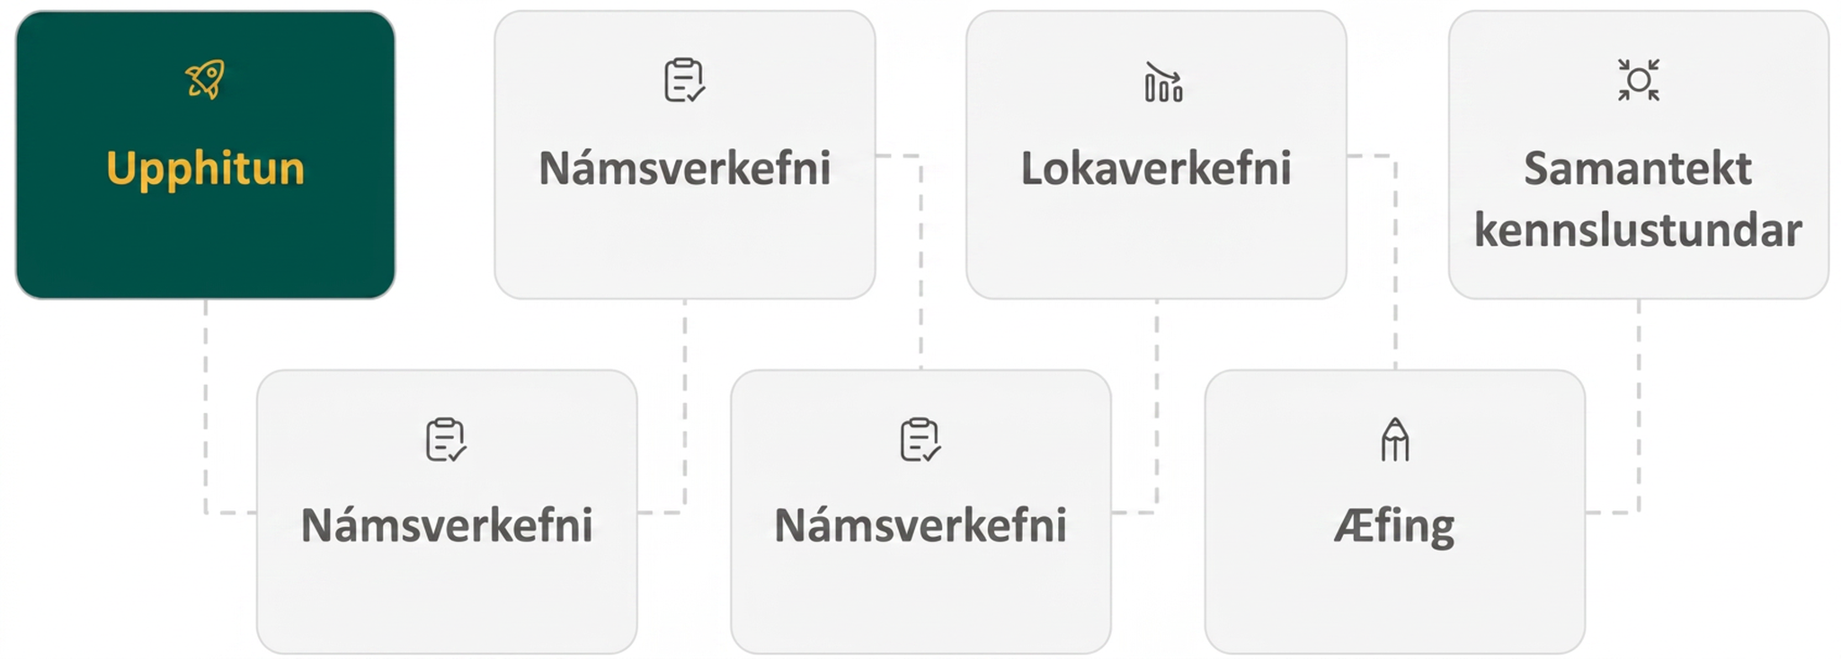
Lesson Journey
First Stop: Warm Up

Slide 7

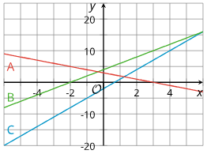
Warm Up
Use the Graph to Find the Equation! 🔎
The graphs A (red), B (green), and C (blue) represent three linear equations. Determine which graph represents the listed equation?
y = 2x + 4
y = 3 - x
y = 3x - 2
Notes:
Warm Up (5 minutes)
This warm up activates students' prior knowledge about how the parameters of a linear expression are visible on its graph, preparing students to make similar observations about quadratic expressions and their graphs.
Students may approach the matching task in different ways:
By starting with the graphs and thinking about corresponding equations. For example, they may notice that Graph A has a negative slope and must therefore correspond to y = 3 − x, the only equation whose linear term has a negative coefficient. They may notice that the slope of C is greater than that of B, so C must correspond to y = 3x − 2.
By starting with the equations and then visualizing the graphs. For example, they may see that y = 3x − 2 has a constant term of -2, so it must correspond to C, and that Graph B intercepts the y-axis at a higher point than Graph A, so B must correspond to y = 2x + 4.
Invite students with contrasting approaches to share during discussion.
Launch
Review what the coefficient and constant term tell us about a line’s slope and y-intercept.
Match each equation to its graph using reasoning about slope and intercept.
Share strategies and highlight how the coefficient and constant term connect equations and graphs.
Answers
Graph B (green). The graph representing y = 2x + 4 has a slope of 2 and intersects the y-axis at 4, so it is Graph B.
Graph A (red). The graph representing y = 3 − x has a slope of -1 and intersects the y-axis at 3, so it is Graph A.
Graph C (blue). The graph representing y = 3x − 2 has a slope of 3 and intersects the y-axis at -2, so it is Graph C.
has a slope of 2 and intersects the y-axis at 4, so it is Graph B.
Activity Synthesis
Select students to share how they matched the equations and the graphs. As students refer to the numbers that represent the slope and y-intercept in the equations, encourage students to use the words "coefficient" and "constant term" in their explanations.
To support students' vocabulary development and to prepare them for the lesson, consider writing the equations from the warm up for all to see and identify the coefficient and constant terms in each equation.
Highlight that the equations and the graphs are connected in more than one way, so there are different ways to know what a graph would look like given its equation or what an equation would entail given its graph.
Tell students that we will look at such connections between the expressions and graphs that represent quadratic functions.

Slide 8
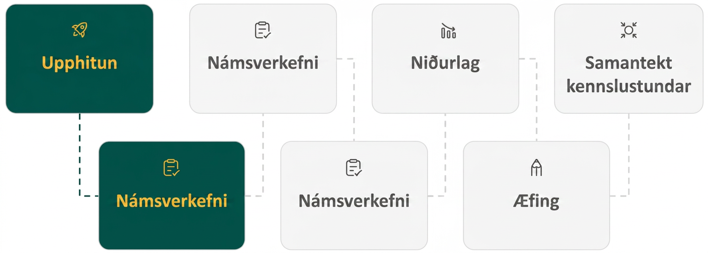
Lesson Journey
Second Stop: Learning Activity A

Slide 9

Learning Activity A | Learning Strategies
Graph f(x) = x² then Watch it Transform👀
Teacher Instruction: Use these strategies to adjust the activity to support English language learners and students with disabilities.
You can copy and paste the callouts directly on top of the activity or give the instructions aloud.
Discuss with your group how the graphs change or stay the same when the function changes.
Use words like: opens upward, opens downward, steeper, wider.
We’ll add your ideas to a class list of graph descriptions.
Discussion Supports
Sketch each function to show the same information in a new way.
Use the graphic organizer to record your sketches and observations for each equation.
Include helpful details in your sketches, like shape, direction, and key points.
Representation
Notes:
Support for English Language Learners: MLR 2 Discussion Supports: Representing, Conversing
To support small-group discussion, invite students to share what they notice about how the graphs change or stay the same depending on how they change the function. Listen for and amplify language students use to describe the features of the graph such as “opens upward”, “opens downward”, “steeper”, “wider”, etc. Post the collected language in the front of the room so that students can refer to it throughout the rest of the activity and lesson.
Design Principle(s): Maximize meta-awareness; Support sense-making
Provide support for students
Distribute graphic organizers to the students to assist them with participating in this routine.
Support for Students with Disabilities: Representation: Internalize Comprehension
Represent the same information through different modalities by using individual sketches of each function. Provide students with a graphic organizer that provides space to include sketches and observations for each equation. Some students may benefit from additional support to learn what types of details are helpful in a sketch of a graph.
Supports accessibility for: Conceptual processing; Visual-spatial processing

Slide 10
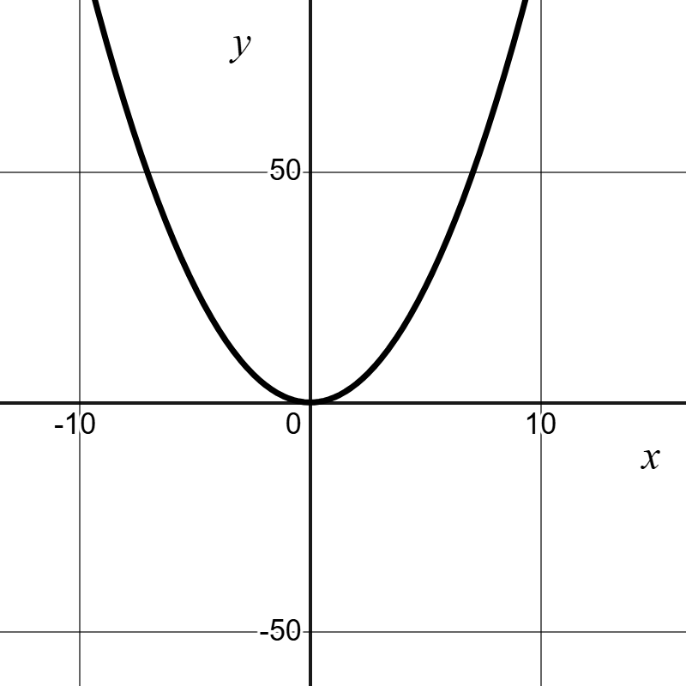
Learning Activity A | Part 1
Graph f(x) = x² then Watch it Transform👀
Graph f(x) = x², and then experiment with each of the changes to the function in questions 1 – 7. Record your observations of what you noticed or wondered about each set of changes to the function (include sketches, if helpful).
Add different constant terms to x² (for example: x²+5, x² + 10, x² − 3).
Multiply x² by different positive coefficients greater than 1 (for example: 3x², 7.5x²).
Multiply x² by different negative coefficients less than or equal to -1 (for example: −x², −4x²).
Notes:
Support for All Learners
This activity offers additional support and an extension for students:
For English language learners and students with disabilities, be sure to review the Learning Strategies slide!
For students looking for an extra challenge, be sure to review the Extending Your Thinking slide!
Activity (15 minutes)
This activity helps students see how the coefficients in a quadratic expression affect its graph. Using technology, they graph f(x) = x², then explore how adding constants and changing coefficients alters the graph. Students record and discuss patterns they notice. Working with partners, they take turns graphing and explaining their reasoning, giving and receiving feedback as they compare observations.
Launch
Provide access to devices that can run Desmos or other graphing technology. Consider arranging students in groups of two. Ask one partner to operate the graphing technology and the other to record the group's observations, and then to switch roles halfway.
If time is limited, consider arranging students in groups of four and asking each group member to experiment with one of the four changes listed in the activity and then reporting the results to their group.
Remind students to adjust their graphing window as needed. If using Desmos, instruct students that creating a slider might be a helpful tool for this activity. For students who need reminding, they can create sliders by
More activity questions, answers and synthesis on the next slide.

Slide 11
Learning Activity A | Part 2
Graph f(x) = x² then Watch it Transform 👀
Multiply x² by different coefficients between -1 and 1 (for example: 12x² , −0.25x² ).
Add different constants to x before squaring the term (for example (x − 1)², (x + 2)², (x − 3)²).
Multiply x by different positive coefficients greater than 1 (for example: (3x)², (7.5x)²).
Multiply x by different positive coefficients between 0 and 1 (for example: (0.5x)², (0.1x)²).
Are you ready for more?
Notes:
Activity Answer
Multiplying x² by numbers between -1 and 1 changed the opening of the graph as well as the direction of the graph. Shrinking the coefficient from 1 toward 0 made the graph "shallower" and wider. This change vertically compressed the graph. When the coefficient is 0, the graph becomes a horizontal line. Raising the coefficient from -1 to 0 had the same effect of vertically compressing the graph, except that the graph started out opening downward.
When a constant is added to the x in x², the graph moves horizontally to the left. When a constant is subtracted from the x in x², the graph moves horizontally to the right.
Multiplying x by different positive numbers changed the shape of the graph, making it more narrow when the constant is larger and less narrow when the constant is smaller.
Multiplying x by different positive numbers between 0 and 1 changed the shape of the graph, making it wider as the decimal gets closer to zero.
For quadratics, the parent function is f(x) = x² . From there, any moves created by making changes to the function like in questions 1 – 7 above are called transformations.
Activity Synthesis
Invite students to share their observations, and if possible, demonstrate their experiments for all to see. Tell students that people often describe the shape when a is positive as a parabola that "opens upward" and the shape when a is negative as a parabola that "opens downward."
For each change to the expression (for example, adding a constant, or multiplying x² by a positive number) and the observed change on the graph, solicit students' ideas about why the graph transformed that way. For example, ask: "Why do you think subtracting a number from x² moves the graph down?"
Discuss questions such as:
"The points (1, 1),(2, 4), and (3, 9) are three points on the graph representing x². When we add 3 to x², how do the y-values for x = 1, x = 2, and x = 3 change?" (Their y-values increase by 3: (1, 4), (2, 7), (3, 12).)
"What about when we subtract 3 from x²?" (They decrease by 3: (1, −2), (2, 1), (3, 6).)
"How do the y-values change when you multiply x² by a positive number, say, 3?" (The y -values for 3x² triple those of x². For x = 1, x = 2, and x = 3, the points will be (1, 3), (2, 12) and (3, 27).)
"How do the tripled y-values affect the graph? (They stretch the graph up vertically, making the graph appear narrower.)
To help students make stronger connections between the parameters of a quadratic expression and the features of its graph, consider the activity “Understanding the Behaviors of a Graph in Relation to Its Quadratic Expression” in this lesson.

Slide 12

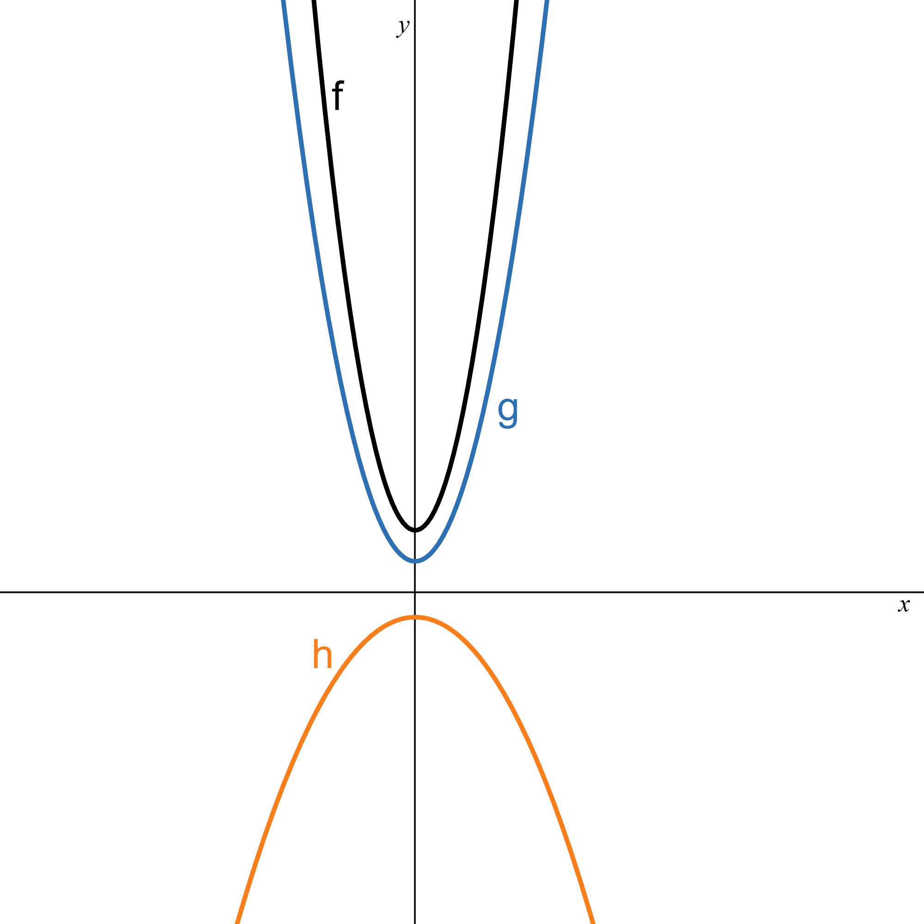
Learning Activity A
Extending Your Thinking
Examine the graphs of three quadratic functions. What can you say about the coefficient of x² in the expression that defines:
f (black)
g (blue)
h (orange)
How do each of the functions compare to each other?
Notes:
Go back to Lesson Activity
Answer
It is positive because the graph of f opens upward.
It is positive because the graph of g opens upward.
Or
The coefficient is less than the coefficient for the graph of f (but still greater than 0) because g is wider.
It is negative because the graph of h opens downward.
Or
The absolute value of the coefficient of h is less than the absolute value of the coefficients for both f and g because h is wider.
The coefficients cannot be identified exactly without knowing the coordinates of some points on the graph. The coefficient of the squared term of f is greater than that of g because the graph of f is narrower, indicating that it is growing faster than the graph of g. The absolute value of the coefficient of h is less than that of g because the graph of h is wider, indicating that it is not growing as quickly.

Slide 13

Learning Activity A
Self Check
How is the graph of f(x) = (x−4)² transformed from the graph of f(x) = x²?
Up 4
Down 4
Right 4
Left 4
Let’s review!
Notes:
Answer Feedback - Individualized by Response
Incorrect. This would be x² + 4. Subtracting a constant from x moves the graph of y = x² that many places right.
Incorrect. This would be x² - 4. Subtracting a constant from x moves the graph of y = x² that many places right.
That’s correct! When a constant is being subtracted from the x in the parent function, f(x) = x², the graph moves horizontally to the right.
Incorrect. This would be (x + 4)² . Subtracting a constant from x moves the graph of y = x² that many places right.

Slide 14

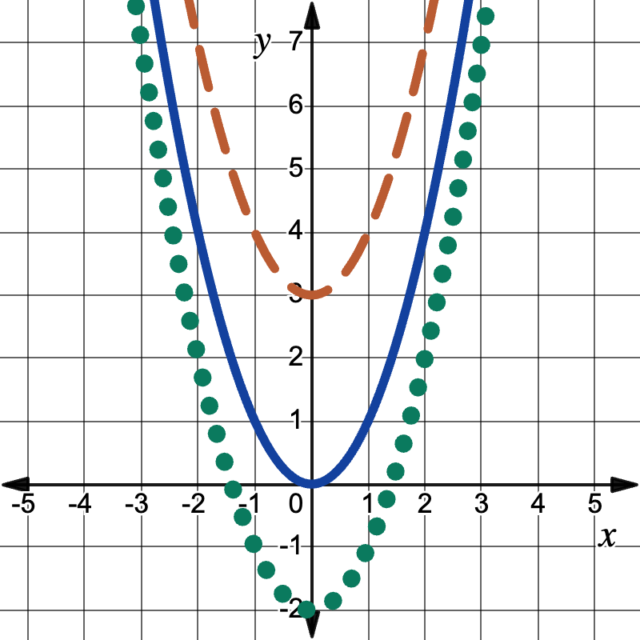
Learning Activity A | Part 1
Self Check - Review
Decide if the Orange, dashed or the green dotted graph represents the listed function:
f(x) = x² + 3
f(x) = x² - 2
The parent function f(x) = x² is the blue solid line.
Graph a Quadratic Function of the form f(x) = x² + k Using a Vertical Shift
The graph of f(x) = x² + k shifts the graph of f(x) = x² vertically k units.
If k > 0, shift the parabola vertically up k units.
If k < 0, shift the parabola vertically down |k|units.
Notes:
Answers
Orange, dashed graph. The parabola has been shifted vertically up 3 units. Since k = 3 and 3 > 0.
Green, dotted graph. The parabola has been shifted vertically down 2 units. Since k = -2 and -2 < 0.
More questions and answers on the next slide.

Slide 15
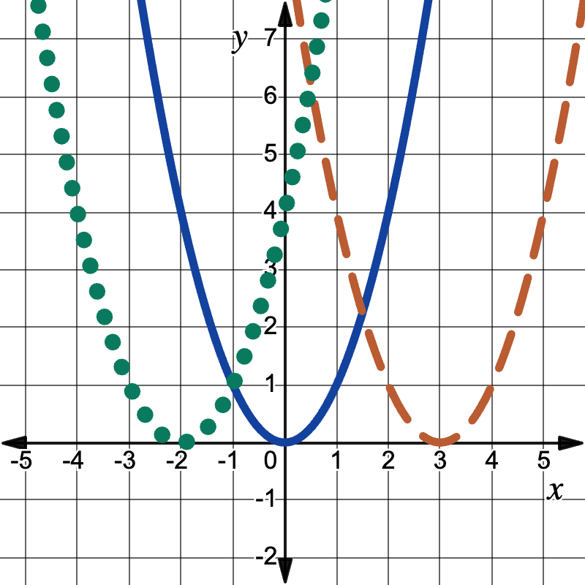
Learning Activity A | Part 2
Self Check - Review
The parent function f(x) = x² is the blue solid line.
Decide if the orange, dashed or the green dotted graph represents the listed function
f(x) = (x - 3)²
f(x) = (x + 2)²
Graph a Quadratic Function of the form f(x) = (x - h)² Using a Horizontal Shift
The graph of f(x) = (x - h)² shifts the graph of f(x) = x² horizontally h units.
If h > 0, shift the parabola horizontally right h units.
If h < 0, shift the parabola horizontally left |h|units.
Notes:
Answers
Orange, dashed graph. The parabola has been shifted horizontally right 3 units. Since h = 3 and 3 > 0.
Green, dotted graph. The parabola has been shifted horizontally left 2 units. Since h = -2 and -2 < 0.
More questions and answers on the next slide.

Slide 16
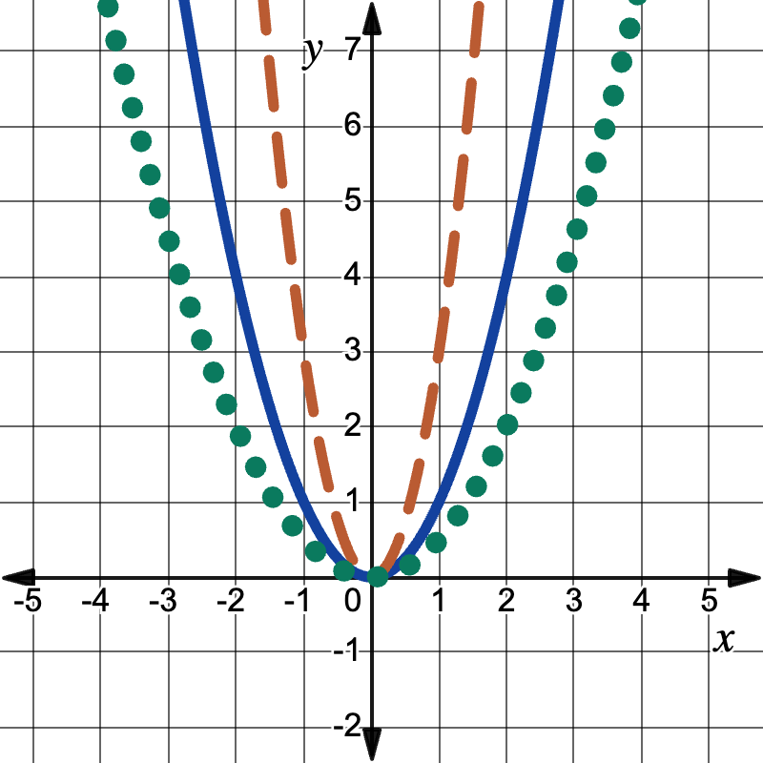
Learning Activity A | Part 3
Self Check - Review
Decide if the orange, dashed or the green dotted graph represents the listed function
f(x) = ½x²
f(x) = 3x²
The parent function f(x) = x² is the blue solid line.
Graph a Quadratic Function of the form f(x) = ax ²
The coefficient a in the function f(x) = ax² affects the graph of f(x) = x² by stretching or compressing it.
If 0 < |a|, the graph of f(x) = ax² will be “wider” than the graph of f(x) = x².
If |a| > 1, the graph of f(x) = ax² will be “skinnier” than the graph of f(x) = x².
Notes:
Answers
Green, dotted graph. The parabola has been vertically compressed by a scale factor of 2. Since a = ½ and 0 < ½ < 1.
Orange, dashed graph. The parabola has been vertically stretched by a scale factor of 3. Since a = 3 and 3 > 1.
More questions and answers on the next slide.

Slide 17
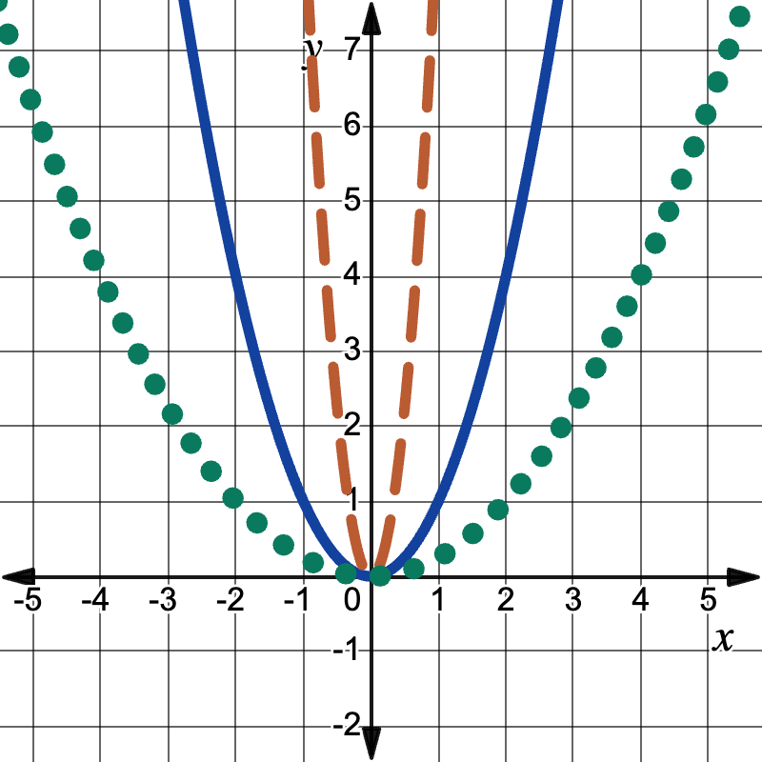
Learning Activity A | Part 4
Self Check - Review
Decide if the orange, dashed or the green dotted graph represents the listed function
f(x) = (3x)²
f(x) = (½x)²
The parent function f(x) = x² is the blue solid line.
Graph a Quadratic Function of the form f(x) = (bx)²
The coefficient b in the function f(x) = (bx)² affects the graph of f(x) = x² by stretching or compressing it.
If 0 < |b|, the graph of f(x) = (bx)² will appear “wider” than the graph of f(x) = x².
If |b| > 1, the graph of f(x) = (bx)² will appear “skinnier” than the graph of f(x) = x².
Notes:
Answers
Orange, dashed graph. The parabola has been horizontally compressed by a scale factor of 3. Since b = 3 and 3 > 1.
Green, dotted graph. The parabola has been horizontally stretched by a scale factor of 2. Since b = ½ and 0 < ½ < 1.

Slide 18
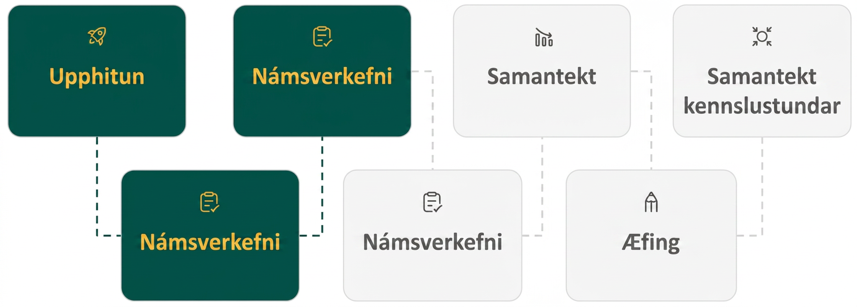
Lesson Journey
Third Stop: Learning Activity B

Slide 19
Learning Activity B | Part 1
Evaluate Quadratic Expressions 🤨
Answer questions a–g for the values of x² + 10.
Answer questions h–n for the values of x² - 3.
In lesson 7.12.2 you saw how adding or subtracting a constant affected the graph of 𝑥². Use this table to explain why the graph shifts when a constant term is added or subtracted.
x | -3 | -2 | -1 | 0 | 1 | 2 | 3
x² | 9 | 4 | 1 | 0 | 1 | 4 | 9
x² + 10 | a. | b. | c. | d. | e. | f. | g.
x² - 3 | h. | i. | j. | k. | l. | m. | n.
Notes:
Activity (10 minutes)
Earlier, students observed how changing parameters in quadratic expressions affected their graphs. This activity deepens that understanding by having them explain those changes. Students evaluate quadratic expressions with different coefficients and constants, compare them to 𝑥², and notice how adding or multiplying terms shifts or stretches the graph. Using a spreadsheet helps them analyze patterns and choose tools strategically.
Launch
If students have access to a spreadsheet, suggest that it might be a helpful tool in this activity to speed up the calculation process.
Activity Answers
a. 19
b. 14
c. 11
d. 10
e. 11
f. 14
g. 19
h. 6
i. 1
j. -2
k. -3
l. -2
m. 1
n. 6
All values in the third row are 10 more than those in the second row, and all values in the last row are 3 less than those in the second row. This suggests that all the points that represent x² + 10 are 10 units higher on the graph than those for x², and all the points that represent x² − 3 are 3 units lower than those for x², which explains why the graphs move up or down when a constant term is added or subtracted.

Slide 20
Learning Activity B | Part 2
Evaluate Quadratic Expressions 🤨
Answer questions a–g for the values of 2x².
Answer questions h–n for the values of ½x².
Answer questions o–n for the values of ½x².
In lesson 7.12.2 you explored how multiplying x² by different numbers affects its graph. Use this table to explain why the graph changes when x² is multiplied by a number greater than 1, a negative number, or a number between –1 and 1.
x | -3 | -2 | -1 | 0 | 1 | 2 | 3
x² | 9 | 4 | 1 | 0 | 1 | 4 | 9
2x² | a. | b. | c. | d. | e. | f. | g.
½x² | h. | i. | j. | k. | l. | m. | n.
-2x² | o. | p. | q. | r. | s. | t. | u.
Notes:
Activity Answers
a. 18
b. 8
c. 2
d. 0
e. 2
f. 8
g. 18
h. 4½
i. 2
j. ½
k. 0
l. ½
m. 2
n. 4½
a. -18
b. -8
c. -2
d. 0
e. -2
f. -8
g. -18
When we multiply x² by the positive coefficient 2, all the output values double. For any input value x , the output value of 2x² is twice as large as that of x². So, the width of the graph becomes narrower because it grows faster. When we multiply x² by a number between 0 and 1, the output values become smaller, so the graph becomes wider or vertically compressed. When we multiply by a negative number, all the positive values become negative, which reflects the direction of the opening of the graph from opening up to opening down.
Activity Synthesis
Invite students to share their analyses on how the values in the tables relate the behaviors of the graphs they saw earlier. Consider plotting the points on a dynamic graphing tool to make explicit the connections between the values in the tables and the graphs.
Link to Desmos Graph: https://www.desmos.com/calculator/b7wbguartm

Slide 21
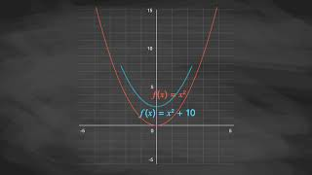
Learning Activity B | Video
Understanding the Behaviors of a Graph in Relation to Its Quadratic Expression
Notes:
This video discusses question 1 of activity 7.12.3

Slide 22

Learning Activity B
Self Check
Which curve is narrower than f(x) = x²?
f(x) = x² + 3
f(x) = 3x²
f(x) = ⅓x²
f(x) = (x +3)²
Let’s review!
Notes:
Answer Feedback - Individualized by Response
Incorrect. This will move the graph of f(x) = x² up 3 (a vertical shift).
That's correct! Since the coefficient of f(x) = x² is 3 and 3 > 1, this will make the graph narrower or skinnier than the parent graph f(x) = x² (a vertical stretch).
Incorrect. This will make the graph of f(x) = x² wider (a vertical compression).
Incorrect. This will move the graph of f(x) = x² to the left 3 (a horizontal shift).

Slide 23
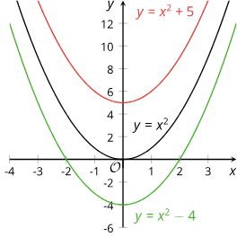
Learning Activity B | Part 1
Self Check - Review
The Constant Term c in the Quadratic Expression ax² + bx + c
x | –3 | –2 | –1 | 0 | 1 | 2 | 3
x² | 9 | 4 | 1 | 0 | 1 | 4 | 9
x² + 5 | 14 | 9 | 6 | 5 | 6 | 9 | 14
x² - 4 | 5 | 0 | –3 | –4 | –3 | 0 | 5
The graph of f(x) = x² (black) is a parabola opening upward with vertex at (0, 0).
Adding a constant term 5 gives f(x) = x² + 5 (red) and raises the graph up by 5 units.
Subtracting 4 from x² gives f(x) = x² − 4 (blue) and moves the graph down by 4 units.
Notes:
Tables for this lesson can be found here.
Questions on the next slide.
Remind Students
The coefficients in the quadratic expression ax² + bx + c describe its graph’s shape and position.
The graph representing any quadratic function is a shape called a parabola.
The vertex is where the graph changes direction.
The opening:
Upward when the vertex is the lowest point
Downward when the vertex is the highest point.
In general, the constant term of a quadratic expression in standard form influences the vertical position of the graph. An expression with no constant term (such as x² or x² + 9x) means that the constant term is 0, so the y-intercept of the graph is on the x-axis. It's not shifted up or down relative to the x-axis.
Explain to the Students
A table of values can help us see that:
Adding 5 to x² increases all the output values of f(x) = x² by 5, which explains why the graph moves up 5 units.
Subtracting 4 from x² decreases all the output values of f(x) = x² by 4, which explains why the graph shifts down by 4 units.
More topic review, questions, and answers are on the next slide.

Slide 24
Learning Activity B | Part 2
Self Check - Review
Using the numbers in the table what is the missing equation?
How many units will the graph shift?
Will the graph move up or down?
x | –3 | –2 | –1 | 0 | 1 | 2 | 3
x² | 9 | 4 | 1 | 0 | 1 | 4 | 9
x² + 5 | 14 | 9 | 6 | 5 | 6 | 9 | 14
x² - 4 | 5 | 0 | –3 | –4 | –3 | 0 | 5
…..?..... | 1 | –4 | –7 | –8 | –7 | –4 | 1
Notes:
Additional review on the next slide.
Answers
x² - 8
8
Down, because you are subtracting 8 from x².
More topic review, questions, and answers are on the next slide.

Slide 25
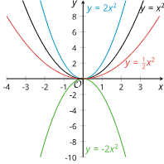
Learning Activity B | Part 3
Self Check - Review
Coefficient of the Squared Term a in the Quadratic Expression ax² + bx + c
x | –3 | –2 | –1 | 0 | 1 | 2 | 3
x² | 9 | 4 | 1 | 0 | 1 | 4 | 9
2x² | 18 | 8 | 2 | 0 | 2 | 8 | 18
½x² | 4 ½ | 2 | ½ | 0 | ½ | 2 | 4 ½
-2x² | –18 | –8 | –2 | 0 | –2 | –8 | –18
The graph of f(x) = x² (black) is a parabola opening upward with vertex at (0, 0).
Multiplying x² by 2 gives f(x) = 2x² (blue) makes the graph steeper and the parabola narrower.
Multiplying x² by ½ gives f(x) = ½x² (red) makes the graph less steep and the parabola wider.
Multiplying x² by -2 gives f(x) = -2x² (green) makes the graph open downward.
Notes:
Questions on the next slide.
Remind Students
The coefficient of the squared term in a quadratic function also tells us something about its graph. The coefficient of the squared term in f(x) = x² is 1. Its graph is a parabola that opens upward.
Multiplying x² by a number greater than 1 makes the graph steeper, so the parabola is narrower than that representing x².
Multiplying x² by a number less than 1 but greater than 0 makes the graph less steep, so the parabola is wider than that representing x².
Multiplying x² by a number less than 0 makes the parabola open downward.
Explain to the Students
If we compare the output values of 2x² and −2x², we see that they are opposites, which suggests that one graph would be a reflection of the other across the x-axis.
More topic review, questions, and answers are on the next slide.

Slide 26
Learning Activity B | Part 4
Self Check - Review
Using the numbers in the table, what is the missing equation?
Will the graph be less or more steep?
Will the parabola be narrower, wider, or the same?
Will the parabola open upward or downward?
x | –3 | –2 | –1 | 0 | 1 | 2 | 3
x² | 9 | 4 | 1 | 0 | 1 | 4 | 9
2x² | 18 | 8 | 2 | 0 | 2 | 8 | 18
-2x² | –18 | –8 | –2 | 0 | –2 | –8 | –18
…..?..... | 45 | 20 | 5 | 0 | 5 | 20 | 45
Notes:
Additional review on the next slide.
Answers
5x²
Steeper
Narrower
Upward
More topic review, questions, and answers are on the next slide.

Slide 27
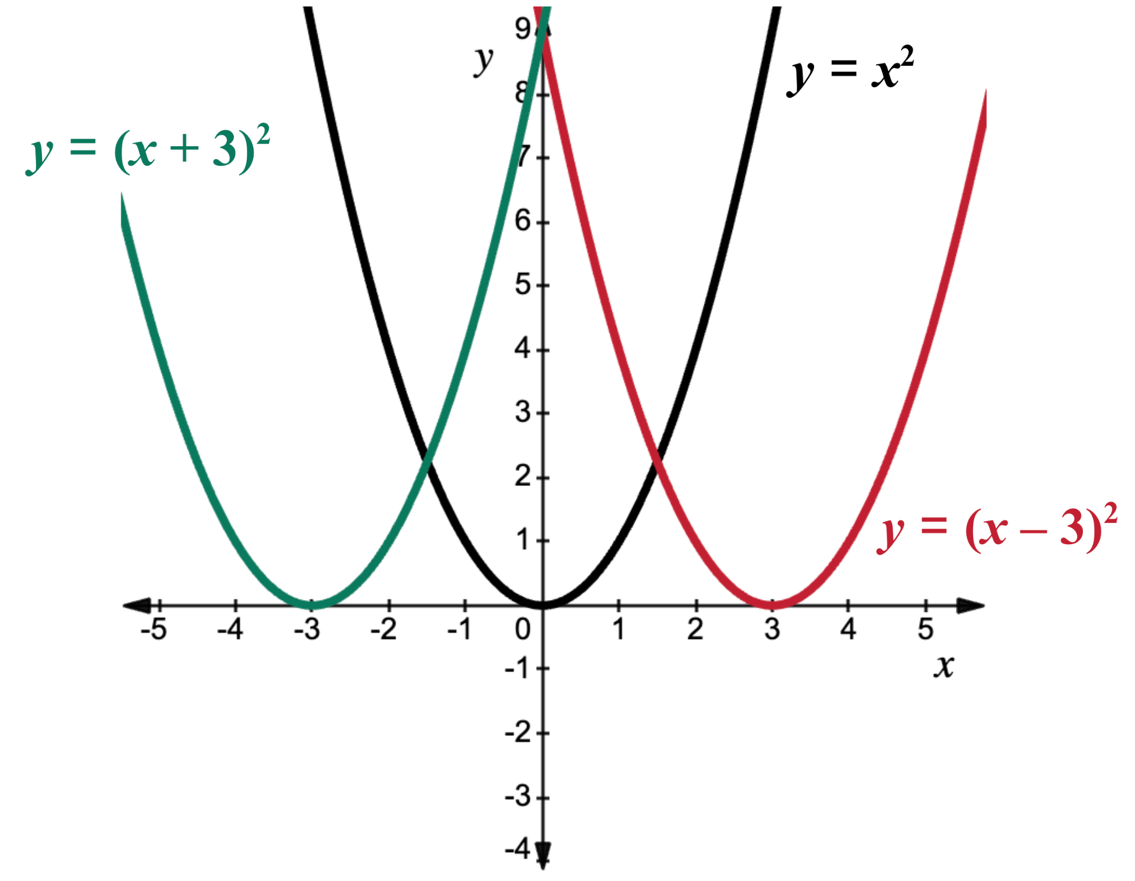
Learning Activity B | Part 5
Self Check - Review
Horizontal Shifts
x | –3 | –2 | –1 | 0 | 1 | 2 | 3
x² | 9 | 4 | 1 | 0 | 1 | 4 | 9
(x - 3)² | 36 | 25 | 16 | 9 | 4 | 1 | 0
(x - -3)² or (x + 3)² | 0 | 1 | 4 | 9 | 16 | 25 | 36
The graph of f(x) = x² (black) is a parabola opening upward with vertex at (0, 0).
When the constant 3 is subtracted from x² before squaring it gives f(x) = (x – 3)² (red). This shifts the graph horizontally 3 units to the right.
When the constant –3 is subtracted from x² before squaring it gives f(x) = (x – –3)² = (x + 3)² (green). This shifts the graph horizontally 3 units to the left.
Notes:
Questions on the next slide.
Explain to the Students
In the previous examples, parameters were being applied to the output values of the function. In other words, after an input value was squared, something was then added, subtracted, or multiplied with the squared value. The resulting impact on the graph was to vertically alter it. However, what happens when the input value is altered before applying the exponent? In these situations, the impact on the graph is to produce a horizontal transformation.
Return to the quadratic parent function, f(x) = x². The function is equivalent to f(x) = (x − 0)². While a bit obvious, this implies there is no change to the input value before being squared.
If the number used to change the input is greater than 0, then the graph of the function is shifted to the right.
Conversely, if the number used to change the input is less than 0, the graph of the function is shifted to the left. Note the impact to the subtraction operation when negative values are subtracted from the input.
Notice in this table of values that the change to the input values takes place before squaring the term. The constant is directly affecting the x-value before applying the function rule.
Examine the vertex of each graph. When we compare the graphs of (x − 3)² and (x + 3)² to the graph of the parent function, we see the parabola has been shifted to the right 3 units and left 3 units, respectively. Thus, a horizontal shift in the graph results when a constant has been subtracted from the input value.
More topic review, questions, and answers are on the next slide.

Slide 28
Learning Activity B | Part 6
Self Check - Review
Using the numbers in the table, what is the missing equation?
What number was subtracted from x before squaring?
Will the graph shift left or right?
x | –3 | –2 | –1 | 0 | 1 | 2 | 3
x² | 9 | 4 | 1 | 0 | 1 | 4 | 9
(x – 3)² | 36 | 25 | 16 | 9 | 4 | 1 | 0
(x – –3)² or (x + 3)² | 0 | 1 | 4 | 9 | 16 | 25 | 36
…..?..... | 1 | 4 | 9 | 16 | 25 | 36 | 49
Notes:
Additional Review on the next slide.
Answers
(x - -4)² or (x + 4)²
-4
Left
More topic review, questions, and answers are on the next slide.

Slide 29
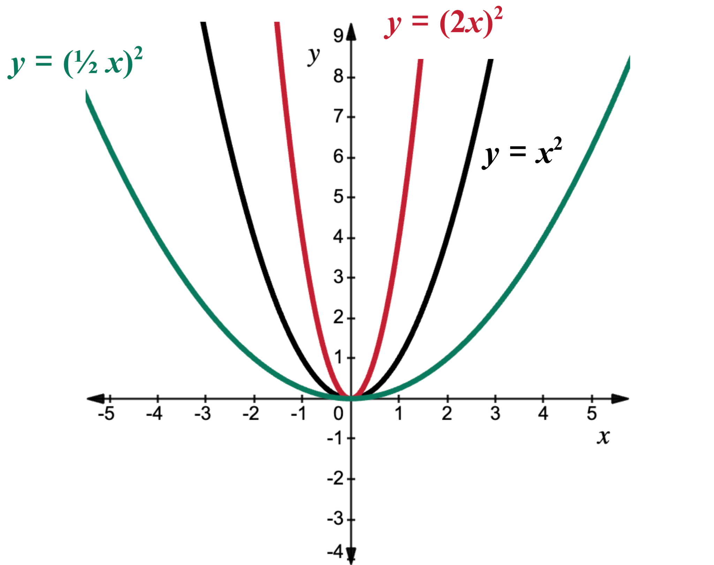
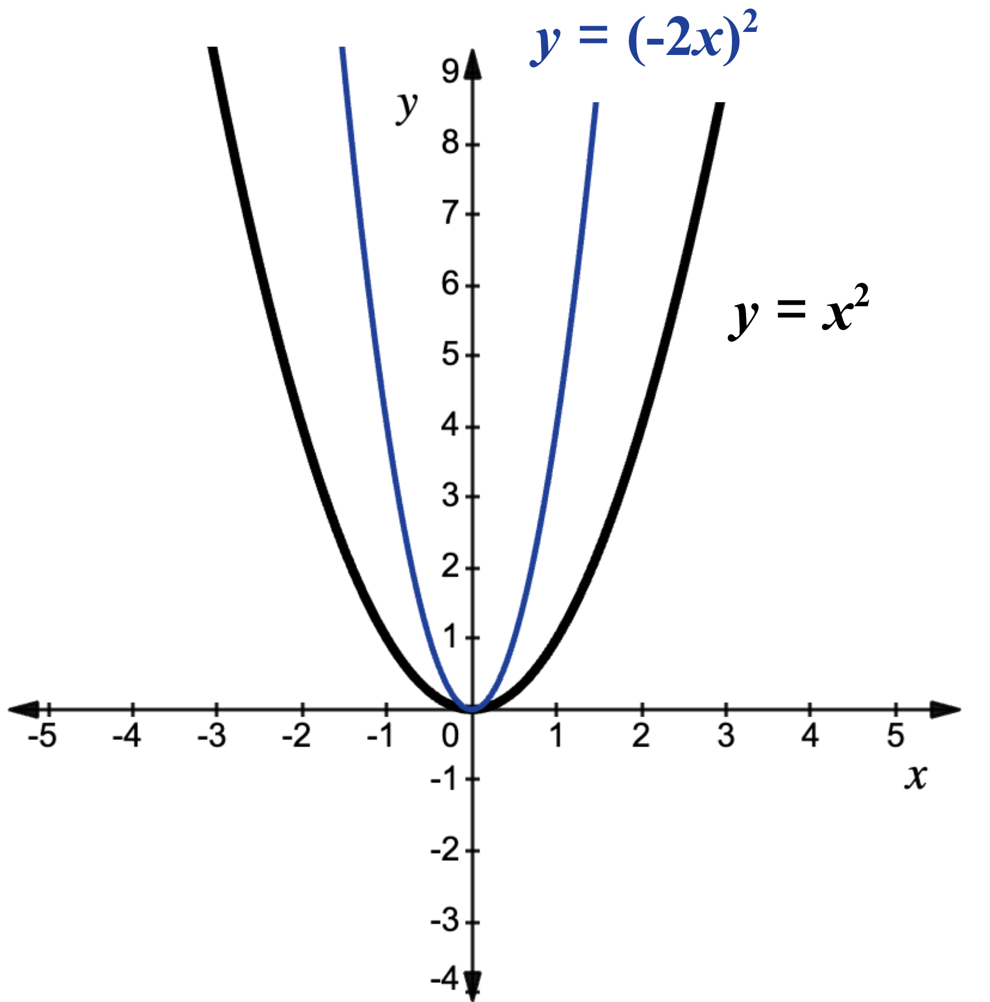
Learning Activity B | Part 7
Self Check - Review
Horizontal Dilations and Reflections
x | –3 | –2 | –1 | 0 | 1 | 2 | 3
x² | 9 | 4 | 1 | 0 | 1 | 4 | 9
(2x)² | 36 | 16 | 4 | 0 | 4 | 16 | 36
(½x)² | 2 ¼ | 1 | ¼ | 0 | 1 | ¼ | 2 ¼
(-2x)² | 36 | 16 | 4 | 0 | 4 | 16 | 36
The graph of f(x) = x² (black) is a parabola opening upward with vertex at (0, 0).
Multiplying x by 2 before squaring gives f(x) = (2x)² (red) and makes a horizontal compression.
Multiplying x by ½ before squaring gives f(x) = (½x)² (green) and makes a horizontal stretch.
Multiplying x² by –2 before squaring gives f(x) = (–2x)² (blue) and makes a horizontal compression. Why do think its graph is symmetric to f(x) = (2x)² despite the negative sign?
Notes:
Questions on the next slide.
Explain to the Students
Now we will investigate the impact of a coefficient on the input value.
Multiplying the input value by a value greater than 1 and then applying the exponent, results in a parabola that has been horizontally compressed.
Multiplying the input value by a value that is between 0 and 1, yields a parabola that has been horizontally stretched.
If the input value is multiplied by a negative number, then the parabola is reflected over the y-axis. However, due to the symmetric nature of parabolas, this is difficult to discern visually.
Multiplying the input value by a number changes the quantity that is squared. As a result, the graph of the equation is horizontally stretched or compressed.
More questions and answers are on the next slide.

Slide 30
Learning Activity B | Part 8
Self Check - Review
Using the numbers in the table, what is the missing equation?
Is the number that is multiplied by the input value positive or negative?
Will the parabola be horizontally stretched or compressed?
x | –3 | –2 | –1 | 0 | 1 | 2 | 3
x² | 9 | 4 | 1 | 0 | 1 | 4 | 9
(2x)² | 36 | 16 | 4 | 0 | 4 | 16 | 36
(½x)² | 2 ¼ | 1 | ¼ | 0 | 1 | ¼ | 2 ¼
(–2x)² | 36 | 16 | 4 | 0 | 4 | 16 | 36
…..?..... | 225 | 100 | 25 | 0 | 25 | 100 | 225
Notes:
Answers
(5x)² or (-5x)² you can not tell from just the table.
You can not tell from just the table because a positive and a negative number when multiplied and squared will yield the same answer.
Since the number is not between 1 and 0 it will be horizontally compressed.

Slide 31
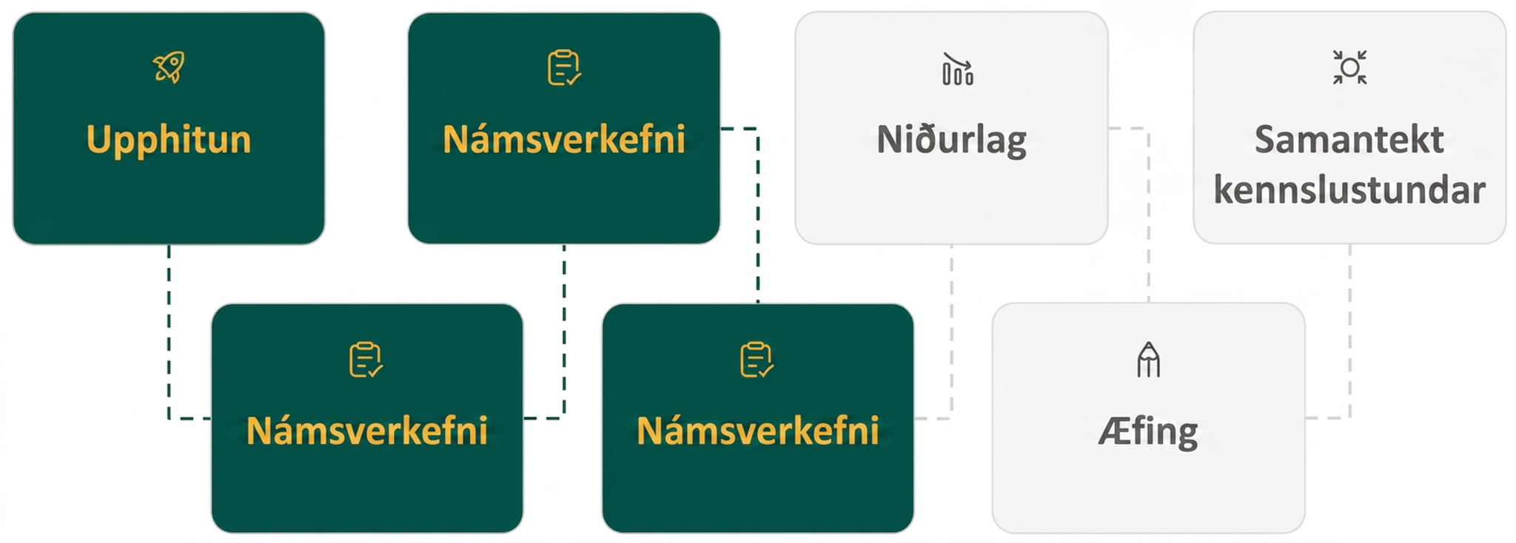
Lesson Journey
Fourth Stop: Learning Activity C

Slide 32
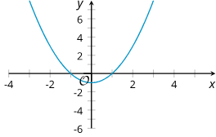
Learning Activity C | Part 1
Quadratic Functions Card Sort 🃏
Your group will receive a set of cards. Each card shows a graph or an equation.
Take turns with your partner to sort the cards into sets so that each set contains two equations and a graph that all represent the same quadratic function.
For each set of cards that you put together, explain to your partner how you know they belong together.
For each set that your partner puts together, listen carefully to their explanation. If you disagree, discuss your thinking and work to reach an agreement.
Once all the cards are sorted and discussed, record the equivalent equations, sketch the corresponding graph, and write a brief note or explanation about why the representations were grouped together.
Notes:
Activity (15 minutes)
In this activity, students connect quadratic expressions with their graphs and identify equivalent equations in standard and factored forms. They sort cards into sets of three, two equivalent equations and a matching graph, and explain their reasoning to a partner. This sorting task helps them analyze structure, make connections, and justify their choices. Monitor how students match cards, some may start with the graphs, others with the equations, and plan for contrasting strategies to share in discussion.
Here are the equations and graphs for reference and planning:
y = x² −1
Link to Desmos Graph: https://www.desmos.com/calculator/m0bttcetey
y = x² −4x
Link to Desmos Graph: https://www.desmos.com/calculator/umlfomglnd
y = x² −4x + 4
Link to Desmos Graph https://www.desmos.com/calculator/mk3a37zbsv
y = x² −5x + 4
Link to Desmos Graph https://www.desmos.com/calculator/cpifprhyh1
y = x(x − 4)
Link to Desmos Graph: https://www.desmos.com/calculator/umlfomglnd
y = (x + 1)(x − 1)
Link to Desmos Graph: https://www.desmos.com/calculator/m0bttcetey
y = (x − 1)(x − 4)
Link to Desmos Graph https://www.desmos.com/calculator/cpifprhyh1
y = (x − 2)²
Link to Desmos Graph https://www.desmos.com/calculator/mk3a37zbsv
Launch
Arrange students in pairs and provide each pair with a set of pre-printed cards.
Tell students to take turns sorting the cards into sets that represent the same quadratic function.
The student sorting a set explains how they know the cards belong together, while the partner listens, asks clarifying questions, and discusses any disagreements.
The last student to sort a set should still explain their reasoning.
After sorting, students record their matched sets and reasoning in the provided graphic organizer.
If time allows, have pairs compare their sorted sets with another group and discuss any differences.
Activity Answers
Set 1:
Standard Form: y = x² −1
Factored Form: y = (x + 1)(x − 1)
Link to Desmos Graph: https://www.desmos.com/calculator/m0bttcetey
Set 2:
Standard Form: y = x² −4x
Factored Form: y = x(x − 4)
Link to Desmos Graph: https://www.desmos.com/calculator/umlfomglnd
Set 3:
Standard Form: y = x² −5x + 4
Factored Form: y = (x − 1)(x − 4)
Link to Desmos Graph https://www.desmos.com/calculator/cpifprhyh1
Set 4:
Standard Form: y = x² −4x + 4
Factored Form: y = (x − 2)²
Link to Desmos Graph https://www.desmos.com/calculator/mk3a37zbsv
Anticipated Misconceptions
Some students may think a factor such as (x − 1) relates to an x-intercept of (−1, 0). In earlier lessons, students learned that the zeros of the function give the x-coordinates of the x-intercepts. Show students the equations x − 1 = 0 and x + 1 = 0 and ask them to solve each equation and relate the solutions back to making the expression (x + 1)(x − 1) equal 0. Some students may benefit from seeing the expression x − 1 written as x + −1 to further emphasize that the expression takes the value 0 when x is the opposite. Students will continue this work when solving quadratic equations in the next unit.
Activity Synthesis
Invite students to share how they found pairs of equivalent equations and how they matched the equations to the graphs.
Highlight these explanations:
The y-intercept of the graph helps to find the equation in standard form (or vice versa).
The x-intercepts of the graph help find the equation in factored form (or vice versa).
The quadratic expression in factored form can be expanded to find the equivalent expression in standard form.

Slide 33
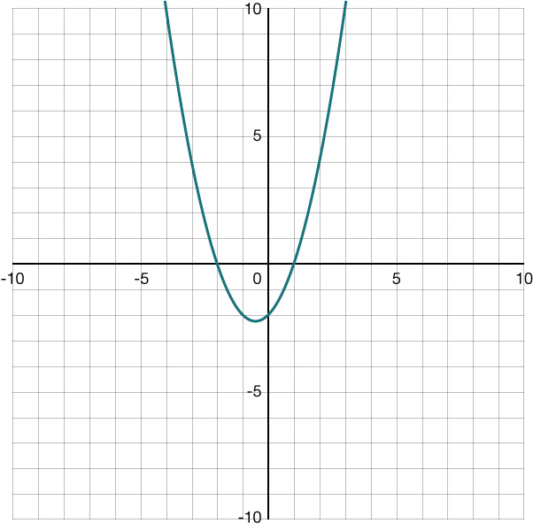
Learning Activity C
Self Check
Which function matches the graph?
f(x) = (x − 2)(x + 1)
f(x) = (x + 2)(x - 1)
f(x) = (x + 2)(x + 1)
f(x) = (x - 2)(x - 1)
Let’s review!
Notes:
Answer Feedback - Individualized by Response
Incorrect. The zeros for this function are -2 and 1. The x-values that make the factors 0 are the zeros on the graph.
That’s correct! The values x = −2 and x = 1 will make each function equal 0. They are also zeros on the graph.
Incorrect. The zeros for this function are -2 and 1. The x-values that make the factors 0 are the zeros on the graph.
Incorrect. The zeros for this function are -2 and 1. The x-values that make the factors 0 are the zeros on the graph.

Slide 34
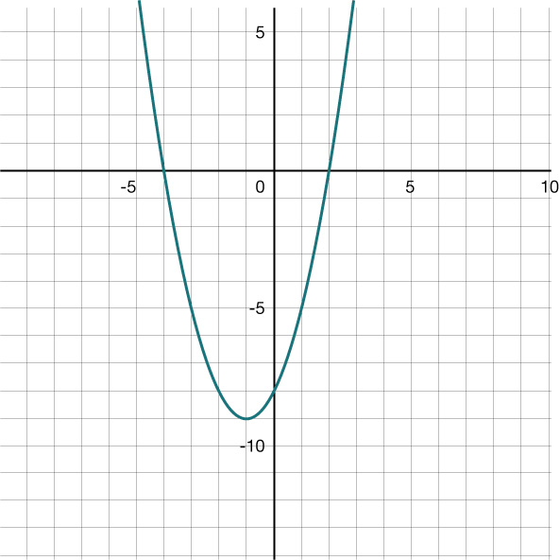
Learning Activity C
Self Check - Review
Standard Form: f(x) = x² + 2x − 8
Factored Form: f(x) = (x + 4)(x − 2)
Use both forms and the graph of the quadratic function to answer the following:
Which form is faster to find the zeros?
What are the zeros?
Which form is faster to find the y-intercept?
What is the y-intercept?
How can you use the graph to verify the y-intercept?
Notes:
Remind Students
The factored form gives the zeros since the zeros (x-intercepts) are located where each factor equals 0.
The y-intercept occurs when x = 0.
Answers:
The factored form.
x = −4 and x = 2
The standard form.
f(0) = −8
On the graph, the y-intercept is (0, −8).

Slide 35
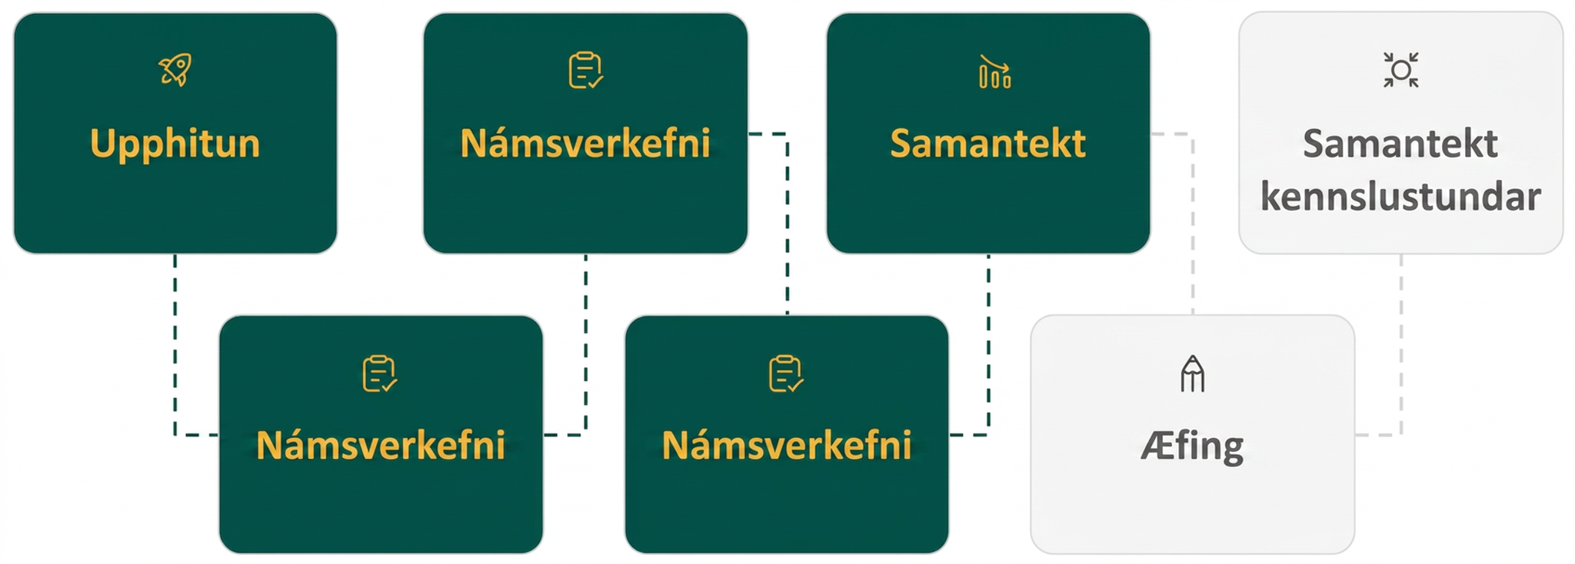
Lesson Journey
Fifth Step: Cool Down

Slide 36
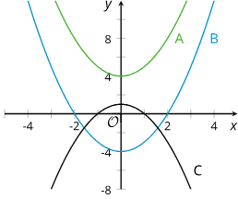
Cool Down
Here are graphs that represent three quadratic functions. Graph A is green, Graph B is Blue, and Graph C is black. Choose which one represents the function.
f(x) = x² − 4
g(x) = 1 − x²
h(x) = x² + 4
Which part of the
equation tells us
that Graph C opens downward?
Notes:
Cool Down (5 minutes)
Launch
Since this activity was designed to be completed without technology, ask students to put away any devices.
Answers
Blue Graph B
Black Graph C
Green Graph A
y = 1 − x² is the equation. The negative coefficient of x² makes the graph open downward.
Response to Student Thinking - Press Pause
If students are still struggling with finding x- and y-intercepts of the graph, consider skipping lesson 7.13 and, instead, addressing misconceptions in the cool downs and working on practice problems.

Slide 37
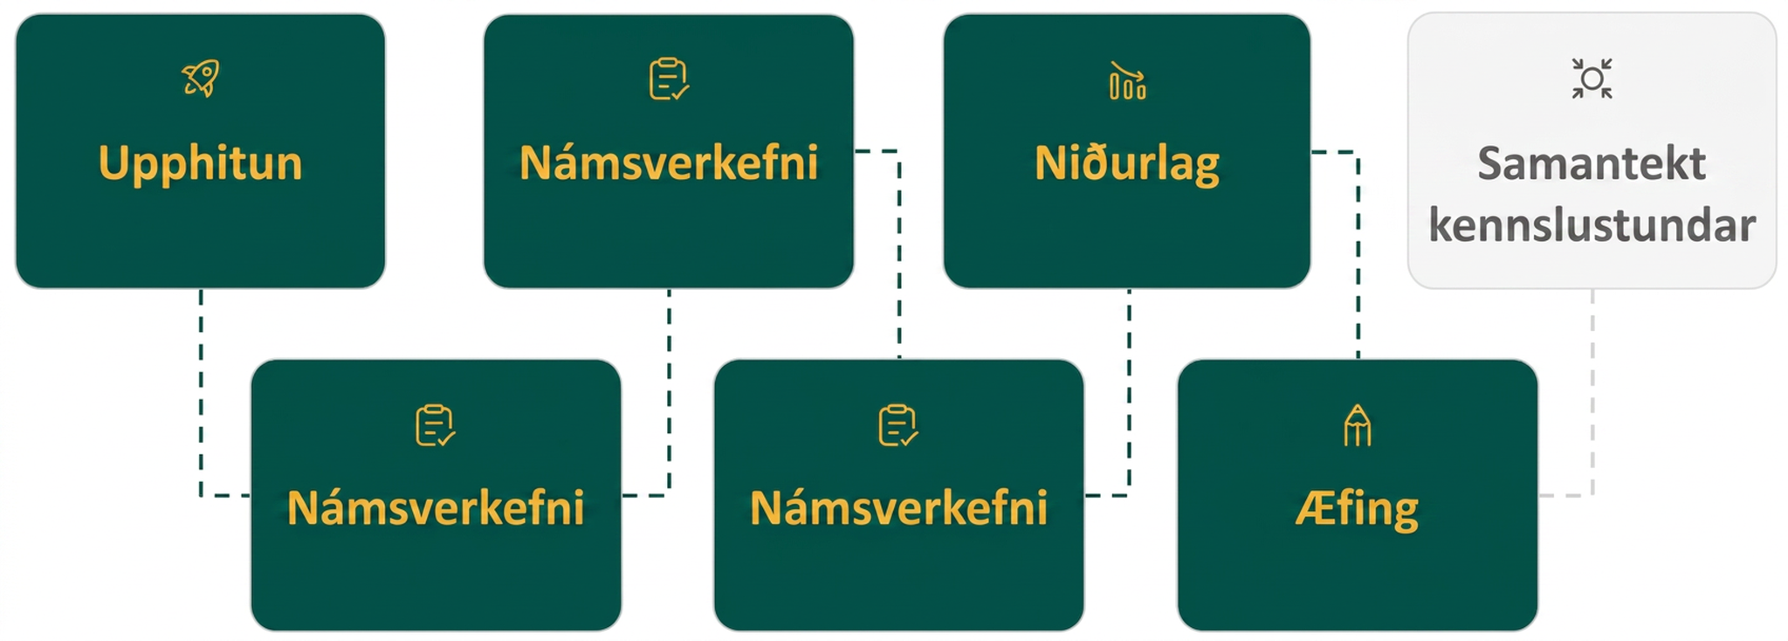
Lesson Journey
Sixth Stop: Practice

Slide 38

Practice
Put your hard work to action, practice what you’ve learned!
Notes:
Digital Practice: Access the practice pages at https://openstax.org/details/books/algebra-1

Slide 39
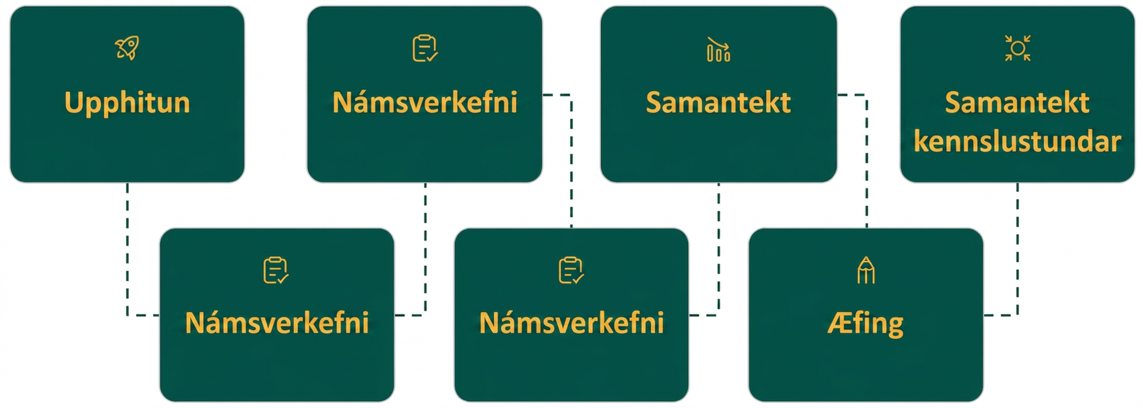
Lesson Journey
Seventh Stop: Lesson Synthesis

Slide 40
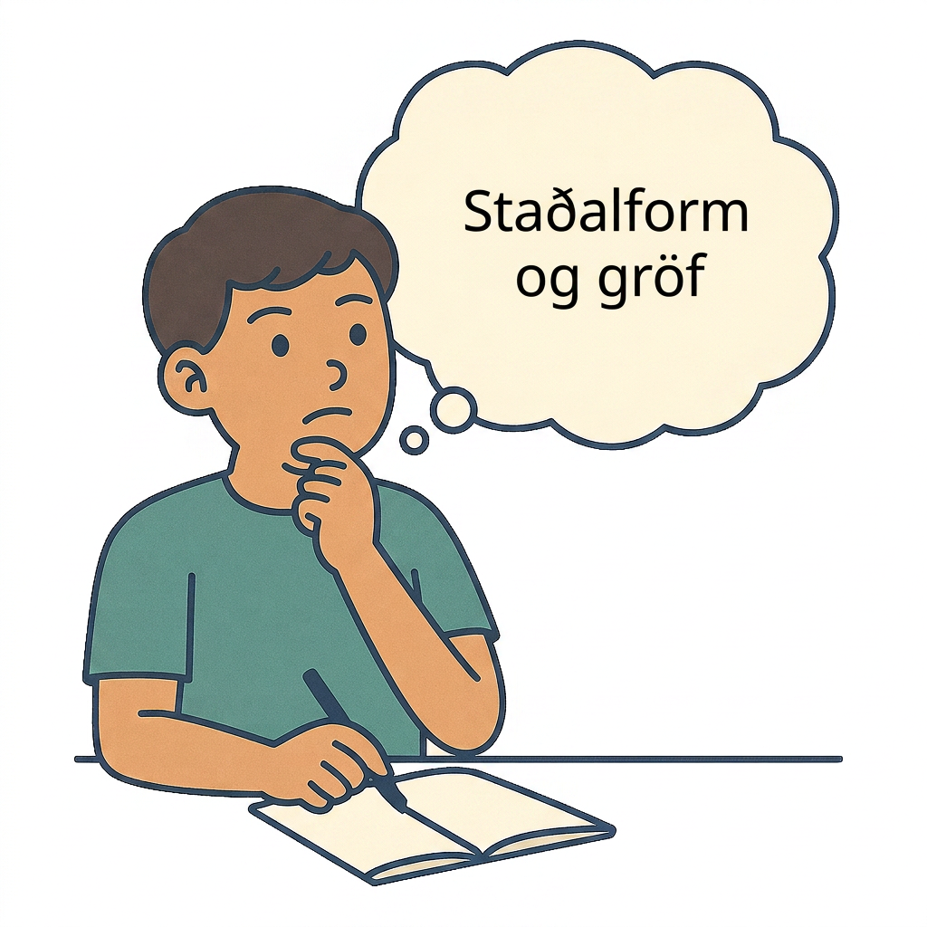
Lesson Synthesis
How is the constant term in a quadratic equation in standard form, the c in y = ax² + bx + c, like or unlike the constant term in a linear equation in slope-intercept form, the b in y = mx + b?
Is the coefficient of the squared term in a quadratic equation in standard form (the a in y = ax² + bx + c) like the coefficient of the linear term in slope-intercept form (the m in y = mx + b)? Why or why not?
What information about the graph can you easily obtain from an expression in standard form?
What information can we easily obtain from the factored form?
Notes:
To help students consolidate their new insights, have them answer the questions 1 and 2 to connect them to what they already know about the graphs representing linear functions.
Answers
They both tell us about the y-intercept. Increasing the value of each constant term moves the graph up, and decreasing it moves the graph down.
They both affect the behavior of the graph in similar ways:
In linear equations of the form y = mx + b, the greater m is, the steeper the line gets. In quadratic equations in standard form, the greater a is, the steeper or narrower the U-shaped graph gets.
A negative m results in a graph that is a downward-sloping line. A negative a gives a graph that opens downward.
Encourage students to reflect on the advantages of using expressions in different forms to anticipate the graphs representing quadratic functions by answering questions 3 and 4.
Whether the graph opens up or down, the y-intercept.
The x-intercepts, the x-coordinate of the vertex.
An upcoming extension lesson looks at the impact of the coefficient of the linear term. If you are planning on using that lesson, you might tell students that we will look at the linear term, b in y = ax² + bx + c, in an upcoming lesson.

Slide 41
Self Assessment
How much do you agree with the following statements?
Learning Goals | I can | Almost | Not yet
Explain how the a and c in ax² + bx + c affect the graph of the equation. | ⃞ | ⃞ | ⃞
Find the vertex and y-intercept of the graph of a quadratic function in factored form without graphing it first. | ⃞ | ⃞ | ⃞

