Slide 1
Algebra 1
Unit 6 Working with Polynomials
Lesson 6.4 Greatest Common Factor and Factor by Grouping

Slide 2

How to use these slides
On the activity slides check the speaker notes for teacher support and instructional information.
Each lesson includes 1 warm up, 2-3 learning activities, a cool down, practice and a lesson synthesis.
  Learning activities are followed by a self check question, and review section.
Some slides have been hidden from student view, more information can be found on the next slide (Reference Key).
You can edit and use these slides for personal and classroom use, but cannot sell them and must keep the attribution logos.
For more information, Check out the digital quick start guide!
OpenStax CC BY NC SA

Slide 3





Reference Key
Check the top right corner for an icon referencing these unique sections.
Icon | Title | View | Location and Description
n/a | Support for Students with Disability | Hidden | Learning Strategies slide, provides additional support to students for understanding the activity.
n/a | Support for English Language Learners | Hidden | Learning Strategies slide, provides additional support to students for understanding the activity.
n/a | Extending Your Thinking | Hidden | Extending Your Thinking slide, provides an extra challenge for students.
n/a | Self Check | Not Hidden | Self Check slide, checkpoint to assess student understanding after the learning activity.
n/a | Review | Hidden | Self Check - Review slide, designed to help review topics from the self check question.
On the next slides, check the speaker notes for teacher instructions and support.
Notes:
Check the Speaker Notes: On the next slides you can find discussion questions, lesson information, answers to the activities, and ways to adjust the activity for your students!

Slide 4

Learning Goals
By the end of this lesson you will be able to -
Find the greatest common factor of two or more expressions.
Factor the greatest common factor from a polynomial.
Factor by grouping.
Notes:
Lesson Narrative
This lesson provides students an introduction to factoring expressions and polynomials. Students will master finding the greatest common factor (GCF) of two or more expressions by factoring the expressions into their prime factors and finding all their common factors.
Students will learn to factor a polynomial by grouping in this lesson. They will use the “reverse” of the Distributive Property, and more complicated ways of factoring by grouping will be taught in later lessons. Finally, students will start to recognize when a polynomial is prime and cannot be factored any further.
Required Preparation
For Activity 6.4.2, prepare sheets of paper with the expressions 120𝑚³𝑛²𝑝⁴ and 80𝑚²𝑛𝑠⁴ written separately on individual pieces. Prepare a set of these expressions for every pair of students in your class.
Required Materials
None
Texas Essential Knowledge and Skills
A1(A) apply mathematics to problems arising in everyday life, society, and the workplace.
A1(F) analyze mathematical relationships to connect and communicate mathematical ideas.
A10(D) rewrite polynomial expressions of degree one and degree two in equivalent forms using the distributive property.
A10(E) factor, if possible, trinomials with real factors in the form 𝑎𝑥² + 𝑏𝑥 + 𝑐, including perfect square trinomials of degree two.
A10(F) decide if a binomial can be written as the difference of two squares and, if possible, use the structure of a difference of two squares to rewrite the binomial.

Slide 5
Vocabulary
Previous
Factoring
  Determining the numbers or expressions that multiply to a specific product.
New
Greatest common factor [GCF]
  The largest expression that is a factor of all given expressions.
Notes:
Lesson Vocabulary
To support student understanding of key vocabulary:
Introduce and review the vocabulary words students will see in this lesson.
Encourage students to notice how these words are used and to include them in their math discussions and explanations—both written and oral.
Use a word wall to reinforce vocabulary. Sample word wall cards are available here.
For newcomers or students with beginning English proficiency, use these Quizlet sets to support vocabulary learning:
Unit 6 Spanish Vocabulary – use first to build understanding
Unit 6 Vocabulary (English) – use after anchoring in Spanish
Support for English Language Learners
ELPS 1(E) internalize new basic and academic language by using and reusing it in meaningful ways in speaking and writing activities that build concept and language attainment.
ELPS 2(F) listen to and derive meaning from a variety of media such as audiotape, video, DVD, and CD-ROM to build and reinforce concept and language attainment.
ELPS 3(D) speak using grade-level content area vocabulary in context to internalize new English words and build academic language proficiency.
ELPS 3(E) share information in cooperative learning interactions.
ELPS 3(F) ask and give information ranging from using a very limited bank of high-frequency, high-need, concrete vocabulary, including key words and expressions needed for basic communication in academic and social contexts, to using abstract and content-based vocabulary during extended speaking assignments.
ELPS 3(I) adapt spoken language appropriately for formal and informal purposes.

Slide 6
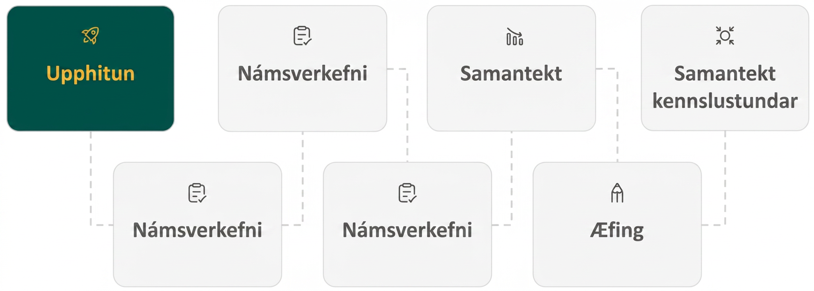
Lesson Journey
First Stop: Warm Up
Notes:
Alt text draft 1:
Image of six rectangles connected by dotted lines conveying the progression of the Lesson. Each rectangle has an icon with text.
The first rectangle is green with a yellow icon and text. The icon is a rocket and text reads Warm Up.
It is connected to the second rectangle, which is light gray with a dark gray icon and text. The icon is a clipboard with a checkmark and the text reads Learning Activity.
It is connected to the third rectangle, which is light gray with a dark gray icon and text. The icon is a clipboard with a checkmark and the text reads Learning Activity.
It is connected to the fourth rectangle, which is light gray with a dark gray icon and text. The icon is a three progressively smaller bar graph rectangles with an arrow on top, following the slope. The text reads Cool Down.
It is connected to the fifth rectangle, which is light gray with a dark gray icon and text. The icon is a pencil tip and the text reads Practice.
It is connected to the sixth rectangle, which is light gray with a dark gray icon and text. The icon is a four arrows pointing at a circle. The text reads Lesson Synthesis.

Slide 7


Warm Up
Finding Factors
A prime number
is a number greater
than 1 whose
only factors are 1 and the number itself. Examples of prime numbers are: 2, 3, 5, 7, 11, 13 . . .
The least common multiple (LCM) of two numbers is the smallest number that is a multiple of both numbers.
Factor 56 into its prime numbers.
Find all of the factors of 42𝑚³𝑦².
Find all of the common factors between 6𝑛²𝑝² and 9𝑛𝑠².
Find the least common multiple (LCM) of 3𝑥² and 8𝑥⁴.
Notes:
Warm Up (5 minutes)
This warm up activity builds and refreshes skills that are needed to factor polynomials later in the lesson. Students will split a number until all of its factors are prime numbers. They will write exponents in expanded form as repeated multiplication expressions, such as writing 𝑥³ as 𝑥⋅𝑥⋅𝑥.
Launch
To help with key concepts in the activity, ask students to define a prime number. If there is any confusion, introduce the definition here:
A prime number is a number greater than 1 whose only factors are 1 and the number itself. Examples of prime numbers are: 2, 3, 5, 7, 11, 13 . . .
Remind students that the least common multiple (LCM) of two numbers is the smallest number that is a multiple of both numbers.
Allow students to work on the questions independently.
Answers
7⋅2⋅2⋅2
7⋅2⋅3⋅𝑚⋅𝑚⋅𝑚⋅𝑦⋅𝑦
3 and 𝑛
24𝑥⁴
Activity Synthesis
Emphasize the following key points from the lesson:
A prime number is a number greater than 1 whose only factors are 1 and the number itself.
Any expression can be factored until it is prime or each of its factors is prime.
The factors of an expression can be written out in expanded form as repeated multiplication. This format is useful for finding common factors between two different expressions.

Slide 8
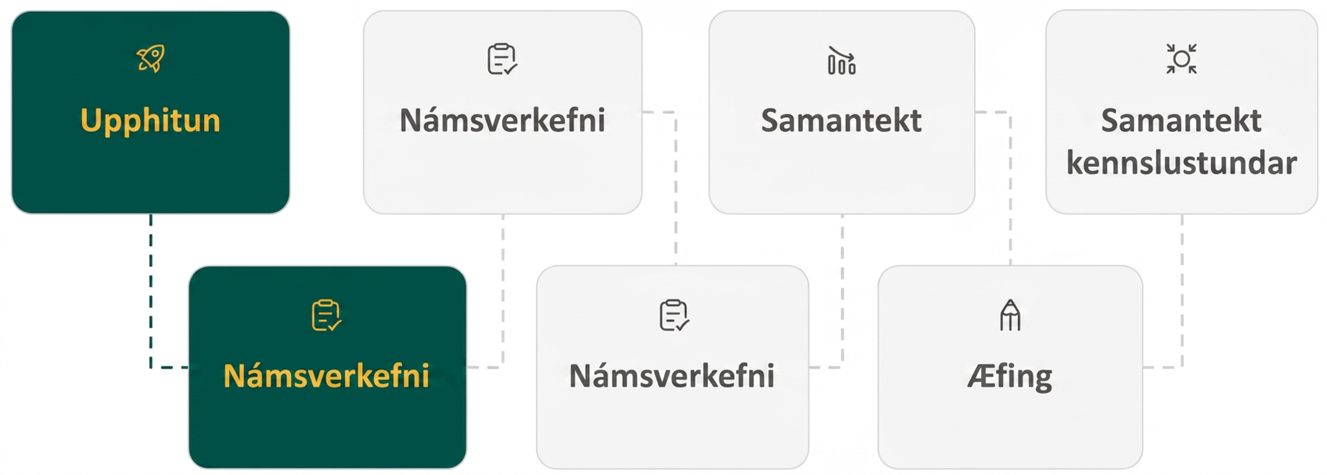
Lesson Journey
Second Stop: Learning Activity A

Slide 9

Learning Activity A | Learning Strategies
Guessing Game 🤔
Teacher Instruction: Use these strategies to adjust the activity to support students with disabilities.
You can copy and paste the callout directly on top of the activity or give the instructions aloud.
List the factors for each term in the expression.
Stack the terms vertically so the common factors line up (use graph paper if it is helpful).
Highlight or use color coding to identify the common factors.
Representation
Notes:
Support for Students with Disabilities: Representation: Illustrate Connections
Use different colors to help show the common factors across two or more expressions. Students can find and highlight the factors of each expression only when they occur in all of the expressions.
Supports accessibility for: Organizing; Visual-spatial processing

Slide 10
Learning Activity A | Part 1
Guessing Game 🤔
When you receive your paper, look at your expression. Do not show it to your partner.
Write down all of the factors in your expression.
  If your expression was 100𝑥³𝑦², you would write down 2⋅2⋅5⋅5⋅𝑥⋅𝑥⋅𝑥⋅𝑦⋅𝑦.
  Do not share these factors with your partner yet.
When you both have finished finding the factors of your expressions, try to determine the GCF of these two terms without actually knowing the other’s expression:
  Take turns with your partner sharing one factor and the quantity of that factor.
  For example, say, “My expression has two factors that are 5” or “My expression has three factors that are 𝑥.”
  Write down the factors your partner has shared with you.
Once you and your partner have finished taking turns sharing factors, you should know all of the factors in your partner’s expression. Determine your partner’s expression.
Compare the factors for your expression and your partner’s expression. Find the GCF of these two expressions.
Compare your answer with your partner’s. Did you have the same answer?
Notes:
Support for All Learners
This activity offers additional support for students:
For students with disabilities, be sure to review the Learning Strategies slide!
Activity (25 minutes)
This activity uses several different methods to introduce students to finding the greatest common factor (GCF) of two or more expressions. Students will factor each expression into all of its prime factors. They will compare these lists of factors to determine which ones they all have in common. By multiplying these common factors together, students will find their GCF.
Continue scrolling down for complete directions for how to launch the activity, answers, and anticipated misconceptions.
Launch
Start the lesson by introducing vocabulary that will be helpful:
Factoring an expression: Factoring is splitting a product into its prime factors. If these factors are multiplied together, the result will be the original product.
Greatest common factor: The greatest common factor (GCF) of two or more expressions is the largest expression that is a factor of all the expressions.
Students will become more familiar with these terms as the lesson progresses.
Prepare sheets of paper with the expressions 120𝑚³𝑛²𝑝⁴ and 80𝑚²𝑛𝑠⁴ written separately on individual pieces. Prepare a set of these expressions for every pair of students in your class.
Arrange the students into pairs for the activity.
Hand out one expression, 120𝑚³𝑛²𝑝⁴, to one student of the pair and the other expression, 80𝑚²𝑛𝑠⁴, to the other student. Instruct the students not to share their expression with anyone.
Read the instructions for the activity as a class and address any confusion around the rules.
Allow 5 minutes for the pairs to complete the activity.
After the activity is complete, share the expressions that were used and their GCF, 40𝑚²𝑛.
Spend 5 minutes reviewing the next example as a class. Walk the students through each step, stopping to address any concerns. [(Question 4) Find the GCF of 18𝑔⁴ℎ² and 63𝑔³ℎ³ ]
Then allow the remainder of the time for students to complete the exercises individually (questions 5 – 8). With any additional time, answer any questions students may have about finding the GCF of these expressions.
Answers
(Question 1)
Expression A: 120𝑚³𝑛²𝑝⁴
Factors of Expression A: 2⋅2⋅2⋅3⋅5⋅𝑚⋅𝑚⋅𝑚⋅𝑛⋅𝑛⋅𝑝⋅𝑝⋅𝑝⋅𝑝
(Question 2)
Expression B: 80𝑚²𝑛𝑠⁴
Factors of Expression B: 2⋅2⋅2⋅2⋅5⋅𝑚⋅𝑚⋅𝑛⋅𝑠⋅𝑠⋅𝑠⋅𝑠
(Question 3)
GCF: 2⋅2⋅2⋅5⋅𝑚⋅𝑚⋅𝑛 = 40𝑚²𝑛
(Question 4) Find the GCF of 18𝑔⁴ℎ² and 63𝑔³ℎ³
Step 1 - Factor each coefficient into primes. Write all variables with exponents in expanded form.
18𝑔⁴ℎ² = 3⋅3⋅2⋅𝑔⋅𝑔⋅𝑔⋅𝑔⋅ℎ⋅ℎ
63𝑔³ℎ³ = 3⋅3⋅7⋅𝑔⋅𝑔⋅𝑔⋅ℎ⋅ℎ⋅ℎ
Step 2 - List all factors, matching common factors in a column. In each column, circle the common factors.
In the online textbook, there is an image of mathematical equations showing the prime factorization of 18𝑔⁴ℎ² and 63𝑔³ℎ³ with like factors grouped by red ovals for clarity. The factors that are circled include 3, 3, g, g, g, h, and h.
Step 3 - Bring down the common factors that all expressions share.
GCF = 3⋅3⋅𝑔⋅𝑔⋅𝑔⋅ℎ⋅ℎ
Step 4 - Multiply the factors.
GCF = 9𝑔³ℎ²
Anticipated Misconceptions
As students play the game with their partner, it is important that, in the first step, they correctly factor their original expression into its prime factors. Monitor for those who do not completely factor each expression into all of its prime factors. Challenge students to analyze each factor they have found and be sure that each factor cannot be factored any further.
Additional activity questions, answers, and synthesis continue on the next slide.

Slide 11
Learning Activity A | Part 2
Guessing Game 🤔
Find the greatest common factor of each of the following sets of expressions.
10p³q, 12pq²
8a²b³, 10ab²
10a³, 12a², 14a
35x³y², 10x⁴y, 5x⁵y³
Notes:
Answers
2𝑝𝑞
2𝑎𝑏²
2𝑎
5𝑥³𝑦
Activity Synthesis
Ask students how they were able to determine their partner’s expression in the game without actually knowing what it was. (By multiplying all of the factors their partner provided, they could find their partner’s expression.)
Ask a student to explain in their own words how to find the GCF of two different expressions. Use the list below to help the student as needed:
Step 1 - Factor each coefficient into primes. Write all variables with exponents in expanded form.
Step 2 - List all factors, matching common factors in a column. In each column, circle the common factors.
Step 3 - Bring down the common factors that all expressions share.
Step 4 - Multiply the factors.

Slide 12
Learning Activity A
Self Check
Find the greatest common factor of 25m⁴, 35m³, 20m².
10m²
5m
5m²
10m
Let’s review!
Notes:
Answer Feedback - Individualized by Response
Incorrect. Each expression does not share the factor 2, so the GCF cannot include 10.
Incorrect. Each expression has at least two factors of m, so the GCF will have m².
That’s correct! All of these expressions share the factors 5 ⏺ m ⏺ m.
Incorrect. Each expression does not share the factor 2, so the GCF cannot include 10. Each expression has at least two factors of m, so the GCF will have m².

Slide 13

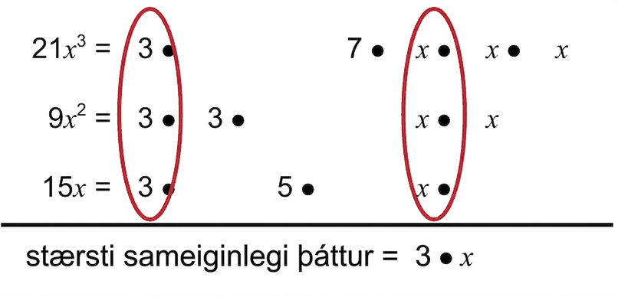
Learning Activity A
Self Check - Review
FINDING THE GCF
OF TWO EXPRESSIONS
Step 1 - Factor each coefficient into primes. Write all variables with exponents in expanded form.
Step 2 - List all factors, matching common factors in each column. Circle the common factors in each column.
Step 3 - Bring down the common factors.
Step 4 - Multiply the factors.
Find the greatest common factor of 21x³, 9x², and 15x.
The GCF of 21x³, 9x², and 15x = 3x.
Notes:
Remind students –
Multiplying factors together yields a product. When the process is reversed, we start with a product and then break it down into its factors. Splitting a product into factors is called factoring.
The greatest common factor (GCF) of two or more expressions is the largest expression that is a factor of all the expressions.
Answer will appear on click.

Slide 14
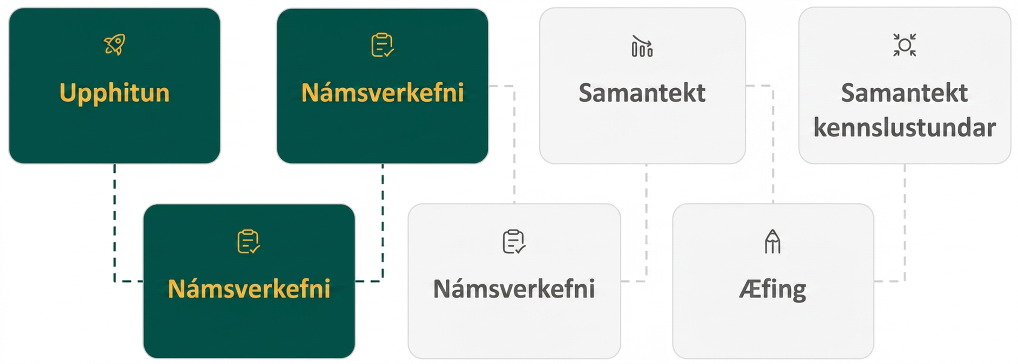
Lesson Journey
Third Stop: Learning Activity B

Slide 15
Learning Activity B | Learning Strategies
Going In Reverse 🚗⇉
Teacher Instruction: Use these strategies to adjust the activity to support English language learners.
  You can copy and paste the callout directly on top of the activity or give the instructions aloud.
Prepare to share your thinking with the class.
Listen and watch for words and phrases that connect ideas for you.
Identify how the same methods for factoring can be expressed differently.
Collect and Display
Notes:
Support for English Language Learners: MLR 2 Collect and Display: Conversing
As students describe how to factor and find the GCF with the class, listen for and collect the language students use to identify and describe the factoring process. Write the students' words and phrases on a visual display and update it throughout the remainder of the lesson. Remind students to borrow language from the display as needed. This will help students read and use mathematical language during their partner and whole-group discussions.
Design Principle(s): Maximize meta-awareness
Provide support for students
Distribute graphic organizers to the students to assist them with participating in this routine.

Slide 16
Learning Activity B | Part 1
Going In Reverse 🚗⇉
Factor: 7z⁵ − 21sz³
Step 1 - Find the GCF of the terms in the polynomial.
7z⁵ = 7 ⦁ z ⦁ z ⦁ z ⦁ z ⦁ z
21sz³ = 7 ⦁ 3 ⦁ s ⦁ z ⦁ z ⦁ z
The GCF of the terms is _____
Step 2 - Apply the Distributive Property “in reverse” to factor out the GCF from each term.
7z⁵ − 21sz³ =
___⦁ z² − ___⦁ 3s = ___ (z² − 3s)
The factored form is ___ (z² – 3s)
DISTRIBUTIVE PROPERTY OF MULTIPLICATION OVER ADDITION
If a, b, and c are real numbers, then
a(b + c) = ab + ac and ab + ac = a(b + c)
The form on the left
is used to multiply.
The form on the right
is used to factor.
Notes:
Support for All Learners
This activity offers additional support for students:
For English Language Learners, be sure to review the Learning Strategies slide!
Activity (20 minutes)
This activity takes the steps students have learned so far, factoring expressions and finding their GCF, and adds the step of factoring the GCF from the polynomial. Having a mastery of the Distributive Property is crucial for understanding how it can be “reversed” to factor the GCF out of each expression in a polynomial.
Continue scrolling down for directions on how to launch the activity and answers to the table of values.
Launch
Start the lesson by reviewing the Distributive Property with students.
Emphasize that the equation on the left is often used to distribute a value into a group of expressions.
The equation on the right can be thought of as the Distributive Property “in reverse” and will be very useful in factoring expressions.
Use 7 – 8 minutes to review the example at the start of the activity. As students have already performed many of the steps for factoring the values and finding the GCF, ask them to explain the first steps as far as they can. Guide them through any missing steps.
Finally, ask students to complete questions 1 – 8 individually. If needed, solve the first one together as a class.
Answers
Step 1 - Circle the 7 and 3 z’s
The GCF is 7z³
Step 2 - 7z³ should be factored from each term and is what goes in each blank space.
Additional activity questions, answers, and synthesis questions continue on the next slide.

Slide 17
Learning Activity B | Part 2
Going In Reverse 🚗⇉
Factor the GCF from each polynomial.
5x³ − 25x²
8x³y − 10x²y² + 12xy³
− 5y³ + 35y² − 15y
15x³y − 3x²y² + 6xy³
− 4p³q − 12p²q² + 16pq²
5x(x + 1) + 3(x + 1)
3b(b − 2) − 13(b − 2)
6m(m − 5) − 7(m − 5)
Notes:
Remind students -
If the leading coefficient is negative, then the GCF will be negative.
Answers
5𝑥²(𝑥 − 5)
2𝑥𝑦(4𝑥² − 5𝑥𝑦 + 6𝑦²)
−5𝑦(𝑦² − 7𝑦 + 3)
3𝑥𝑦(5𝑥² − 𝑥𝑦 + 2𝑦²)
−4𝑝𝑞(𝑝² + 3𝑝𝑞 − 4𝑞)
(𝑥 + 1)(5𝑥 + 3)
(𝑏 − 2)(3𝑏 − 13)
(𝑚 − 5)(6𝑚 − 7)
Anticipated Misconceptions
Students may run into trouble in the activity if they are unable to find the correct GCF of the expressions in the polynomial. Students who do not list each prime factor for each expression may not completely factor those expressions. This will lead to finding a common factor that is not the greatest common factor. After factoring out their common factor, the polynomial will not be completely factored. Emphasize that listing the prime factors for each expression is a very important step in the process.
Activity Synthesis
Ask a student to describe each step in factoring a GCF from a polynomial. Use the list below to help the student as needed:
STEP 1 - Find the GCF of all the terms in the polynomial.
STEP 2 - Rewrite each term as a product using the GCF.
STEP 3 - Use the “reverse” of the Distributive Property to factor the expression.
STEP 4 - Check your answer by multiplying the factors together.

Slide 18

Learning Activity B
Self Check
Factor 8a³b + 2a²b² − 6ab³.
– 2ab(4a² + ab − 3b²)
ab(8a² + 2ab − 6b²)
2b(4a³ + a²b − 3ab²)
2ab(4a² + ab − 3b²)
Let’s review!
Notes:
Answer Feedback - Individualized by Response
Incorrect. You should not have factored out a negative sign in the GCF.
Incorrect. The GCF you found is missing the factor 2.
Incorrect. The GCF you found is missing the factor a.
That’s correct! Multiply 2ab(4a² + ab – 3b²) to see if it equals 8a³b + 2a²b² – 6ab³. Since it does, the answer is correct.

Slide 19
Learning Activity B
Self Check - Review
Factor: 8m³ – 12m²n + 20mn²
FACTORING THE GCF
OF TWO POLYNOMIALS
Step 1 - Find the GCF of all the terms in the polynomial.
Step 2 - Rewrite each term using the GCF.
Step 3 - Factor the GCF (“reverse distribute”).
Step 4 - Check by multiplying the factors.
Notes:
Discuss
If needed, review how to find the GCF of a polynomial expression.
Also, review the Distributive Property of multiplication over addition:
If 𝑎, 𝑏, and 𝑐 are real numbers, then
𝑎(𝑏 + 𝑐) = 𝑎𝑏 + 𝑎𝑐 and 𝑎𝑏 + 𝑎𝑐 = 𝑎(𝑏 + 𝑐)
The form on the left is used to multiply. The form on the right is used to factor.

Slide 20
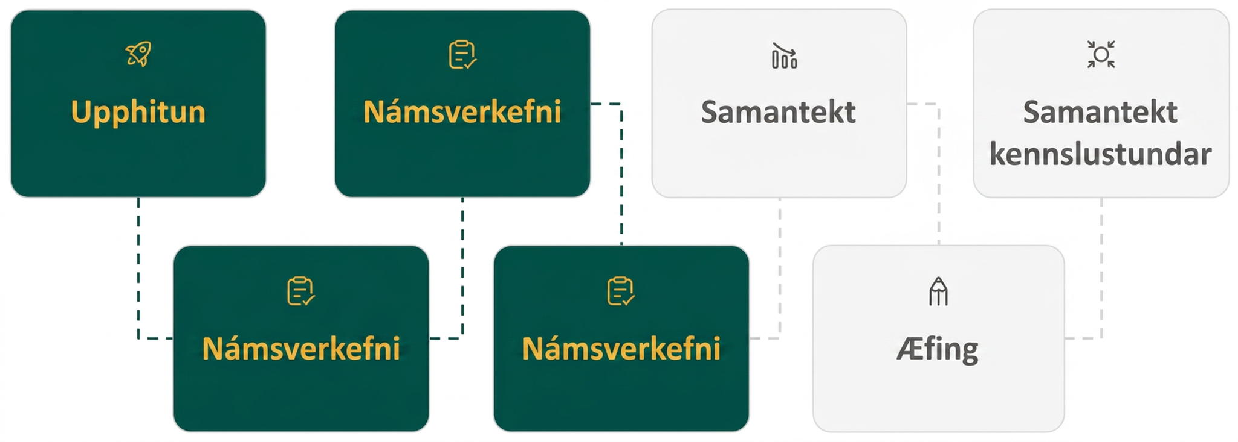
Lesson Journey
Fourth Stop: Learning Activity C

Slide 21
Learning Activity C | Part 1
Group Hug 🤗 Time
What GCF could we use to factor the following polynomial?
ms – 4m + 7s – 28
Notes:
Activity (20 minutes)
This activity prompts students to find a way to factor a polynomial in which there is not a common factor in all of the terms of the polynomial. By grouping different parts of the polynomial together, they can find a GCF for each individual part. If the polynomial can be factored, a common factor will emerge from both parts.
Launch
Start the lesson by explaining that some polynomials will not have a common factor in all of their terms. Use the polynomial in the first example to illustrate this point, 𝑚𝑠 − 4𝑚 + 7𝑠 − 28. Challenge students to find any common factor in all the terms of the polynomial.
Explain that polynomials can be split into smaller parts, and we can start factoring there. Review the example step by step (see answer below). Check for understanding after each step.
Finally, ask students to complete questions 1 – 8 individually. If needed, solve the first one together as a class.
Answer
If there is no common term in all of the terms of a polynomial, it may be possible to factor by grouping. To do this, separate the polynomial into two parts with two terms in each part. Then look for the GCF in each part. If the polynomial can be factored, you will find that a common factor emerges from both parts.
Step 1 - Group terms with common factors.
Is there a GCF of all four terms? No, so let’s separate the first two terms from the second two.
𝑚𝑠 − 4𝑚 + 7𝑠 − 28
Step 2 - Factor out the common factor in each group.
Factor the GCF from the first two terms. Factor the GCF from the second two terms.
𝑚(𝑠 − 4) + 7𝑠 − 28
𝑚(𝑠 − 4) + 7(𝑠 − 4)
Step 3 - Factor out the common factor from the expression.
Notice that each term has a common factor of (𝑠 − 4). Factor out the common factor.
𝑚(𝑠 − 4) + 7(𝑠 − 4)
(𝑠 − 4) (𝑚 + 7)
Step 4 - Check.
Multiply (𝑠 − 4) (𝑚 + 7). Is the product the original expression?
(𝑠 − 4) (𝑚 + 7)
𝑠𝑚 + 7𝑠 − 4𝑚 − 28
𝑚𝑠 − 4𝑚 + 7𝑠 − 28 ✓
Additional activity questions, answers, anticipated misconceptions and synthesis continue on the next slide.

Slide 22
Learning Activity C | Part 2
Group Hug 🤗 Time
Factor by grouping.
xy + 7y + 8x + 56
x² + 2x − 5x − 10 video
20x² − 16x − 15x + 12
x² + 4x − 7x − 28
2x² − 14x − 5x + 35
xy − 6x − 4y + 24
9x² + 12x − 15x − 20
xy − 9x + 2y − 18
Notes:
Answers
(𝑥 + 7)(𝑦 + 8)
(𝑥 − 5)(𝑥 + 2) A video explaining how to do this problem is available.
(5𝑥 − 4)(4𝑥 − 3)
(𝑥 + 4)(𝑥 − 7)
(𝑥 − 7)(2𝑥 − 5)
(𝑦 − 6)(𝑥 − 4)
(3𝑥 − 5)(3𝑥 + 4)
(𝑥 + 2)(𝑦 − 9)
Anticipated Misconceptions
Emphasize to students that if the first two terms do not have a common factor, that does not guarantee that the polynomial cannot be factored by grouping. They should still look for a GCF in the last two terms. It might also be possible to rearrange the terms so that the polynomial can be factored by grouping. Students should check all possibilities before determining that a polynomial is prime.
Also, watch for students who struggle with factoring negative values like in questions 2, 3, 4, or 5 among others. It may be helpful for students to redefine subtraction as “adding the opposite” before factoring to help keep track of what happens to operations when a negative value is factored.
Activity Synthesis
Ask students to write down the steps used when factoring by grouping. Use the list below to guide students as needed:
Step 1 - Group terms with common factors.
Step 2 - Factor out the common factor in each group.
Step 3 - Factor out the common factor from the expression.
Step 4 - Check your answer by multiplying the factors together.
Ask students how many unique ways there are to group a polynomial with four terms into two pairs of terms.
There are 3 ways:
Grouping the first two terms together
Grouping the first and third terms together
Grouping the first and last terms together

Slide 23
Learning Activity C
Self Check
Factor by grouping 42m² − 18m − 35m + 15.
(14m − 3)(3m − 5)
(7m − 3)(6m − 5)
(7m + 3)(6m + 5)
(7m − 5)(6m − 3)
Let’s review!
Notes:
Answer Feedback - Individualized by Response
Incorrect. Factor out 6m from the first two terms and – 5 from the second two terms.
That’s correct! Multiply (7𝑚 – 3)(6𝑚 – 5) to see if it is equal to 42𝑚² − 18𝑚 − 35𝑚 + 15.
Incorrect. Check the signs of each factor. Factor out 6m from the first two terms and – 5 from the second two terms.
Incorrect. Factor out 6m from the first two terms and – 5 from the second two terms. Be careful to match the second term of each binomial with the correct first term.

Slide 24
Learning Activity C
Self Check - Review
Factor: x² + 3x – 2x – 6
FACTORING BY GROUPING
Step 1 - Group the terms with common factors.
Step 2 - Factor out the common factor in each group.
Step 3 - Factor the common factor from the expression.
Step 4 - Check by multiplying the factors.
Notes:
Emphasize with students the difference between steps 2 and 3 is that the common factor is being pulled from within each group of terms and then from across the expression, respectively.

Slide 25
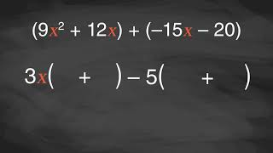
Learning Activity B | Video
Factoring by Grouping
Notes:
This video discusses question 7 of activity 6.4.4.

Slide 26
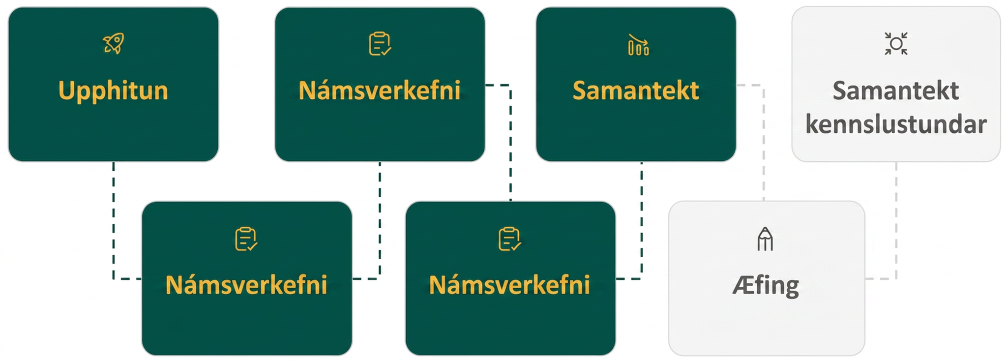
Lesson Journey
Fifth Step: Cool Down

Slide 27
Cool Down
Which of these polynomials has a greatest common factor of 1?
  10q² + 14q + 20
  12x³ – 2x
  12x³y – 7g⁸h³ + 11s²
  – 2x – 4
Determine if the expression can be factored by grouping.
If it can, factor the expression.
If not, answer “prime.”
cd + 6c + 4d + 24
x² – y + 4w – 3
Notes:
Cool Down (5 minutes)
Answers
12x³y – 7g⁸h³ + 11s²
(d + 6)(c + 4)
prime
Response to Student Thinking - Points to Emphasize
If students are still struggling to identify GCFs, encourage them to write out the factors of each term in the polynomial and use a highlighter or other type of annotation to identify anything that is common amongst the terms. It may also be helpful to return to the steps provided in activity 6.4.2.
Students will have opportunities to review and practice how to factor polynomial expressions again in Unit 8 when they use factoring to solve quadratic equations.

Slide 28
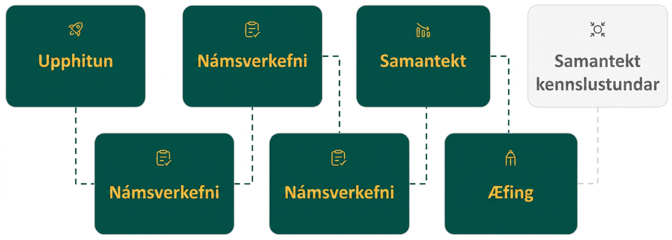
Lesson Journey
Sixth Stop: Practice

Slide 29

Practice
Put your hard work to action, practice what you’ve learned!
Notes:
Digital Practice: Access the practice pages at https://openstax.org/details/books/algebra-1

Slide 30
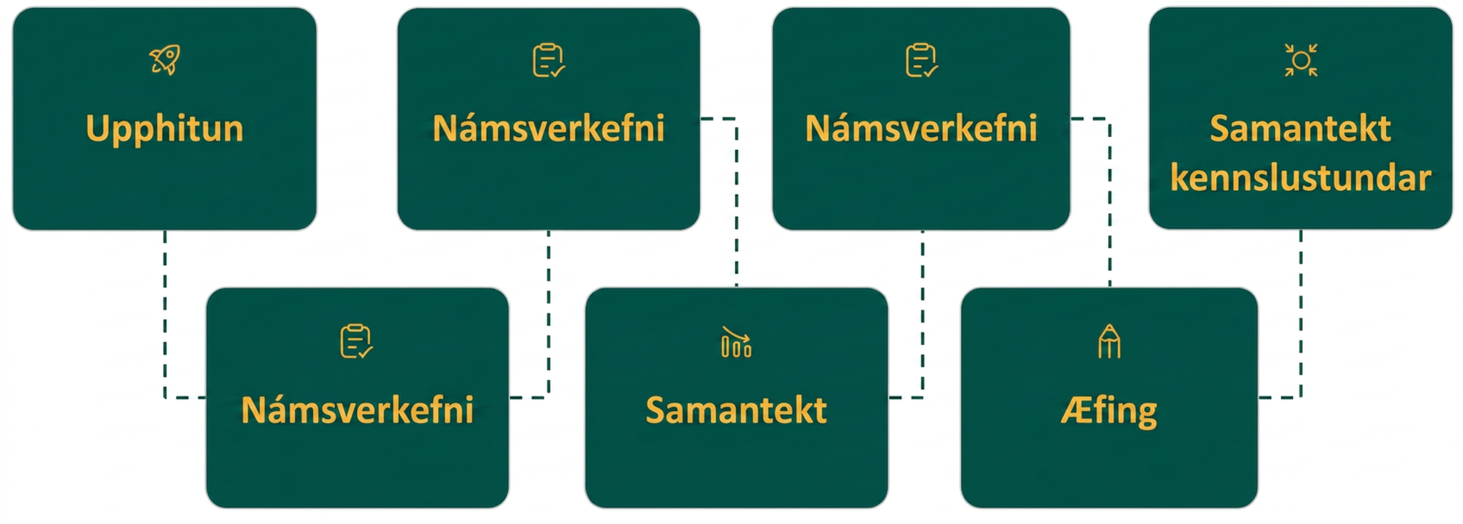
Lesson Journey
Seventh Stop: Lesson Synthesis

Slide 31
Lesson Synthesis
Create a foldable note set by folding your paper into quarter sections.
Write the questions in each row of the first column and answer them.
Use the second column to provide examples to illustrate your answers to the questions.
How do you determine or find a GCF from a polynomial? | Explain with an example.
What does a GCF have to do with factoring by grouping? | Explain with an example.
Notes:
Here are some key takeaways from this lesson to share with students:
An essential step in finding the GCF of two or more expressions is writing each of the expressions in expanded form as the multiplication of all of its prime factors.
To find the GCF of two or more expressions, list all the factors of each expression. Then find the common factors that are in every expression. Multiply these factors together.
To factor the GCF from a polynomial, first find the GCF of all of the terms in the polynomial. Then use the “reverse” of the Distributive Property to factor the GCF out of each expression in the polynomial.
Sometimes there is not a common factor in every term of a polynomial. However, it can still be factored using a method called grouping. The terms of the polynomial are grouped together so that a GCF can be factored from the first part and another GCF can be factored from the second part. If the polynomial can be factored further, a common factor will emerge from both parts.

Slide 32
Self Assessment
How much do you agree with the following statements?
Learning Goals | I can | Almost | Not yet
Find the greatest common factor of two or more expressions. | ⃞ | ⃞ | ⃞
Factor the greatest common factor from a polynomial. | ⃞ | ⃞ | ⃞
Factor by grouping. | ⃞ | ⃞ | ⃞

