Slide 1


Algebra 1
Unit 2 Linear Inequalities and Systems
Lesson 2.13 Solving Problems with Inequalities in Two Variables

Slide 2
How to use these slides
On the activity slides check the speaker notes for teacher support and instructional information.
Each lesson includes 1 warm up, 2-3 learning activities, a cool down, practice and a lesson synthesis.
  Learning activities are followed by a self check question, and review section.
Some slides have been hidden from student view, more information can be found on the next slide (Reference Key).
You can edit and use these slides for personal and classroom use, but cannot sell them and must keep the attribution logos.
For more information, Check out the digital quick start guide!

Slide 3






Reference Key
Check the top right corner for an icon referencing these unique sections.
 | Support for Students with Disability | Hidden | Learning Strategies slide, provides additional support to students for understanding the activity. Learning Strategies slide, provides additional support to students for understanding the activity.
 | Support for English Language Learners | Hidden
 | Extending Your Thinking | Hidden | Extending Your Thinking slide, provides an extra challenge for students.
 | Self Check | Not Hidden | Self Check slide, checkpoint to assess student understanding after the learning activity.
 | Review | Hidden | Self Check- Review slide, designed to help review topics from the self check question.
On the next slides, check the speaker notes for teacher instructions and support.
Notes:
Check the Speaker Notes: On the next slides you can find discussion questions, lesson information, answers to the activities, and ways to adjust the activity for your students!

Slide 4

Learning Goals
By the end of this lesson you will be able to -
Use graphing technology to find the solution to a two-variable inequality.
Connect the different representations and interpret them in terms of the situation, when given inequalities, graphs, and descriptions that represent the constraints in a situation.
Notes:
Lesson Narrative
In this lesson, they learn to use graphing technology to find the solution set of a linear inequality in two variables. Students then use this skill to solve problems that involve inequalities. They write linear inequalities to represent the constraints in situations and then use the representations (including the graphs of the solutions) to answer questions about the situations. As they write inequalities from descriptions, decide on the solution sets, and interpret points in a solution region, students engage in quantitative and abstract reasoning.
Required Preparation
Pre-printed slips, cut from copies of the blackline master for 2.13.3 card sort
Acquire devices that can run Desmos (recommended) or other graphing technology. It is ideal if each student has their own device.
Required Materials
Graphing technology
Pre-printed slips, cut from copies of the blackline master
Texas Essential Knowledge and Skills
A1(C) select tools, including real objects, manipulatives, paper and pencil, and technology as appropriate, and techniques, including mental math, estimation, and number sense as appropriate, to solve problems
A1(E) create and use representations to organize, record, and communicate mathematical ideas
A1(F) analyze mathematical relationships to connect and communicate mathematical ideas
A2(H) write linear inequalities in two variables given a table of values, a graph, and a verbal description
A3(D) graph the solution set of linear inequalities in two variables on the coordinate plane

Slide 5
Vocabulary
Previous
Boundary Line
  A line that separates the coordinate plane into regions.
Linear Inequality
  A mathematical statement formed by placing two or more numbers or expressions with one variable on either side of the following signs: <, >, ≠, <, >.
Solution to a Linear Equation
  The value(s) that makes an inequality true when they are substituted for the variable.
New
None
Notes:
Lesson Vocabulary
To support student understanding of key vocabulary:
Familiarize students with the vocabulary words they will see throughout the lesson. Encourage students to look for these words and notice their use and meanings.
Encourage students to use key vocabulary words in “math talk” and their written and oral explanations.
Utilize a word wall. Sample cards are located here: Sample word wall cards are available here.
For newcomers or students with beginning English proficiency, use these Quizlet sets to support vocabulary learning:
Unit 2 Spanish Vocabulary – use first to build understanding
Unit 2 Vocabulary (English) – use after anchoring in Spanish
Support for English Language Learners
ELPS 1(F) use accessible language and learn new and essential language in the process
ELPS 2(F) listen to and derive meaning from a variety of media such as audiotape, video, DVD, and CD-ROM to build and reinforce concept and language attainment
ELPS 3(E) share information in cooperative learning interactions

Slide 6





Lesson Journey
Warm Up
Learning Activity
Cool Down
Lesson Synthesis
Learning Activity
Learning Activity
Practice

Slide 7

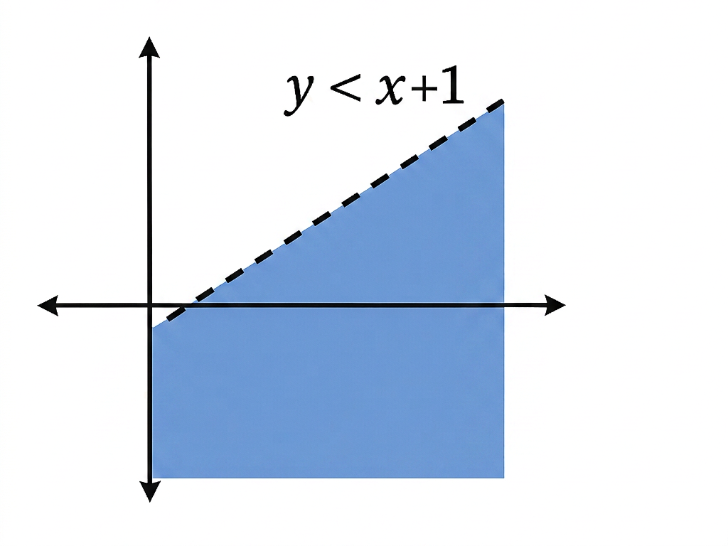
Warm Up - Graph the Inequality ⚖️
Graph each inequality. Adjust the graphing window as needed to show meaningful information.
y > x
y ≥ x
y < -8
-x + 8 ≤ y
y < 10x − 200
2x + 3y > 60
Notes:
Warm Up (5 minutes)
In this warm up, students use graphing technology to graph simple linear inequalities in two variables. They practice adjusting the graphing window until the solution regions become visible and give useful information. Later in the lesson, students will write inequalities that represent constraints in different situations and find the solution sets. The exercises here prepare students to do the latter using graphing technology.
Launch
Give students access to graphing technology. If using Desmos:
Explain to students that typing "<= " gives the ≤ symbol and typing ">=" gives the ≥ symbol.
Remind students that the + and − buttons can be used to zoom in and out of the graphing window, and that the wrench button in the upper right corner can be used to set the graphing window precisely.
If using other graphing technology available in your classroom:
Demonstrate how to enter the ≤ and ≥ symbols.
Remind students how to set a useful graphing window by zooming in or out, and how to set a precise graphing window by specifying the horizontal and vertical boundaries.
(For technology that takes only equations or inequalities in slope-intercept form:) Remind students that some inequalities might need to be rewritten such that y is isolated before the inequality can be entered into the graphing tool.
Activity Answers
Link to Graph
Link to Graph
Link to Graph
Link to Graph
Link to Graph
Link to Graph
Activity Synthesis
Display the correct solution regions for all to see and ask students to check their graphs. Discuss any challenges students may have come across when trying to graph using technology. Explain to students that they will now use graphing technology to find solutions to some inequalities that represent constraints in situations

Slide 8

Lesson Journey
Warm Up
Learning Activity
Cool Down
Lesson Synthesis
Learning Activity
Learning Activity
Practice

Slide 9

Learning Strategies - Bank Accounts 💵
Teacher Instruction: Use these strategies to adjust the activity to support english language learners and students with disabilities.
You can copy and paste the callout directly on top of the activity or give the instructions aloud.
Choose one situation to work on.
Break it into smaller parts if it feels challenging.
Take your time to think it through.
Be ready to share your part with the class.
Engagement
Notes:
Support for Students with Disabilities: Engagement: Provide Access by Recruiting Interest
Leverage choice around perceived challenge. Chunking this task into more manageable parts may also support students who benefit from additional processing time. Invite students to select one of the situations to work on. If students are arranged in groups, each member should be prepared to share during the whole-class discussion.
Supports accessibility for: Language; Memory

Slide 10



Learning Activity - Inequalities in Real Life 💵🎟️📦
We’ll practice writing inequalities by using real-world situations, graphing their solutions, and explaining what the solution regions mean.
A customer deposits up to $600 into their checking and savings accounts, possibly keeping some cash instead of depositing it..
Two kinds of tickets to an outdoor concert were sold: lawn tickets and seat tickets. Fewer than 400 tickets in total were sold.
An advertising agency wants to sell over $60,000 in advertising through their $1000 basic and $2500 premium ad packages.
Notes:
Support for All Learners
This activity offers additional support and an extension for students:
For english language learners and students with disabilities, be sure to review the Learning Strategies slide!
For students looking for an extra challenge, be sure to review the Extending Your Thinking slide!
Activity (25 minutes)
In this activity, students practice writing inequalities in two variables, graphing solutions with technology, interpreting solution regions, and applying them to real-world contexts. Questions come with shared contexts, preparing students for upcoming work on systems of inequalities.
Decide on the structure for the activity depending on the time available and the amount of practice each student needs. Here are some possibilities:
Assigning all three pairs of questions to all students.
Assigning each student a pair of questions, arranging students who work on different pairs in groups of 3, and asking them to explain their solutions to one another.
Arranging students in groups of 3, assigning the same pair of questions to each group, and-for each pair of questions-asking one group to present the solutions to the class.
Launch
Continue to provide access to graphing technology. Explain that students will now write and graph inequalities to solve problems about some situations.
Assign at least one pair of questions about the same context to each student. See Activity Narrative for some possible ways to structure the activity.
Some students might not be familiar with terms such as "savings," "checking," or "premium." Explain any unfamiliar terms as needed.
Activity questions and answers on the next slide.

Slide 11
Learning Activity - Inequalities in Real Life 💵🎟️📦
For each situation on the previous slide, answer the following questions:
Write an inequality to describe the constraints. Specify what each variable represents.
Rewrite your inequality using slope-intercept form. Then, use the graphing tool or technology outside the course. Graph the inequality that represents this scenario.
Name one solution to the inequality and explain what it represents in that situation.
Notes:
Activity Answer
Bank Account
x + y ≤ 600, where x represents the amount deposited in the checking account and y the amount deposited in the savings account.
Rewrite your inequality using slope-intercept form. Then, use the graphing tool, technology outside the course, or graph paper. Graph the inequality that represents this scenario.
Hint for Desmos: To restrict the x and y values to the constraints of the problem, enter {0 ≤ x ≤ 600} {0 ≤ y ≤ 600} after your inequality.
Link to Graph
Your answer may vary, but here is a sample. (500,100). $500 is deposited in checking and $100 in savings. The total is $600, which is the maximum amount the customer plans to deposit.
Concert Tickets
x + y < 400, where x represents the number of lawn tickets and y represents the number of seat tickets.
Rewrite your inequality using slope-intercept form. Then, use the graphing tool, technology outside the course, or graph paper. Graph the inequality that represents this scenario.
Hint for Desmos: To restrict the x and y values to the constraints of the problem, ente {0 ≤ x } { 0 ≤ y} after your inequality (because you cannot have a negative number of tickets).
Link to Graph
Your answer may vary, but here is a sample. (100,200). 100 lawn tickets and 200 seat tickets were sold. The total is 300 tickets, which is fewer than 400.
Advertising Packages
1,000x + 2,500y > 60,000, where x represents the number of basic packages and y represents the number of premium packages.
Rewrite your inequality using slope-intercept form. Then, use the graphing tool, technology outside the course, or graph paper. Graph the inequality that represents this scenario.
Hint for Desmos: To restrict the x and y values to the constraints of the problem, ente {0 ≤ x } { 0 ≤ y} after your inequality.
Link to Graph
Your answer may vary, but here is a sample. (10,30). 10 basic packages and 30 premium packages are sold. The total value is $85,000, which is more than $60,000.

Slide 12
Learning Activity - Inequalities in Real Life 💵🎟️📦
Answer the specific questions for each scenario.
Bank Account
If the customer deposits $200 in their checking account, what can you say about the amount they deposit in their savings account?
Concert Tickets
If you know that exactly 100 lawn tickets were sold, what can you say about the number of seat tickets?
Advertising Packages
If you know that exactly 10 premium packages were sold, what can you
say about the number of basic packages the agency needs to sell to
Are you ready for more?
Notes:
Answers:
The customer deposits $400 or less in savings.
Fewer than 300 seat tickets were sold.
The agency needs to sell more than 35 basic packages.
Anticipated Misconceptions
One inequality in the bank account context involves only one variable. Some students might think that all inequalities they write must include two variables. Reassure them that this might not always be the case. Consider pointing to examples from earlier activities in which they wrote or graphed inequalities such as y > 2 or b < 10.
Activity Synthesis
Select one student or one group to present their solutions for each pair of questions. Focus the discussion on how students used the inequalities and graphs to help answer the question about each situation.
Students who worked on the same questions might end up with different graphs and answers because they wrote different inequalities (which might not correctly represent the constraints in the situation). If this happens, analyze the different inequalities and look for the potential causes for the discrepancy. One possibility is that the wrong symbols or the wrong numbers were entered into the graphing tool.
Another possibility might be that students made different decisions about the quantities being assigned to the vertical and horizontal axes. In that case, both versions of the graphs might be correct, but the answers to questions might be different if one of the graphs is not interpreted correctly.

Slide 13
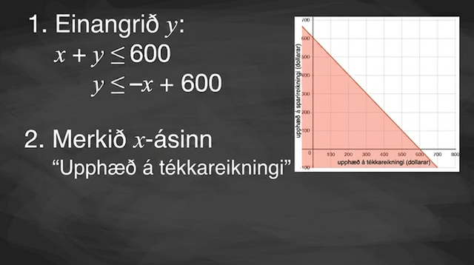
Video: Solving Problems with Inequalities in Two Variables

Slide 14

Extending Your Thinking
This activity will require a partner and either graph paper or Desmos.
Notes:
Answer
Your answer may vary, but here are some sample guesses.
y = (⅔)x + 1
y ≥ (⅔)x + 1
I know the y-intercept is between -3 and 3, so I can guess a coordinate value of y between -3 and 3 and x = 0.

Slide 15
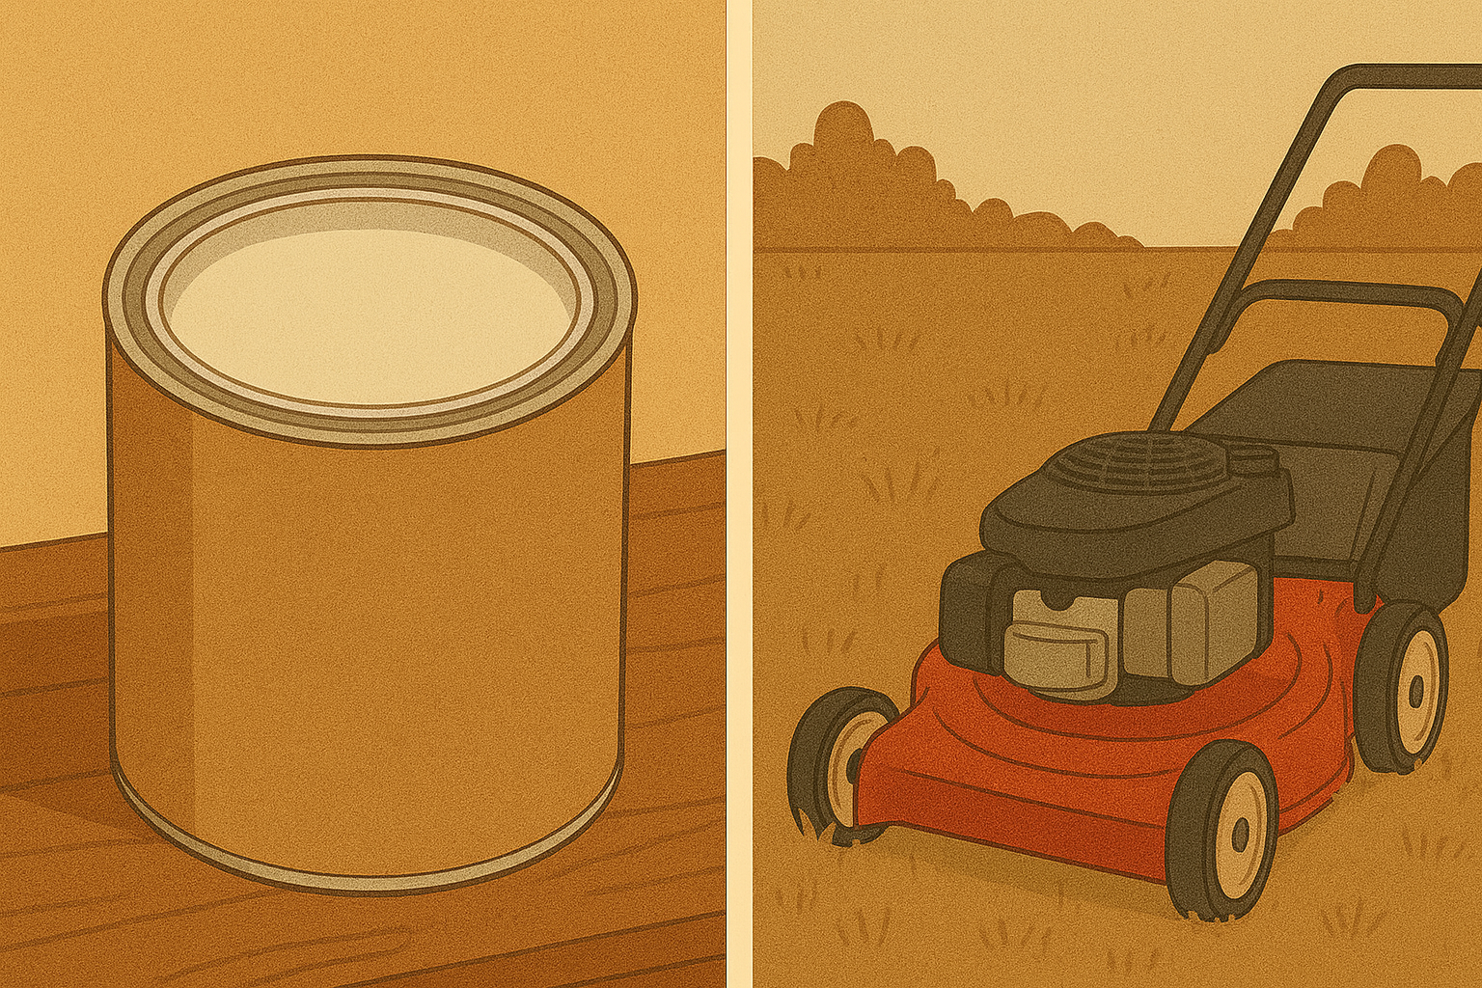
Self Check
Use graphing technology or graph paper to solve the following problem.
Jacob charges $20 to mow a lawn in his neighborhood and $100 to paint a room. Which combination of jobs earns Jacob more than $1,000?
Jacob mows 10 lawns and paints 8 rooms.
Jacob mows 8 lawns and paints 10 rooms.
Jacob mows 35 lawns and paints 1 room.
The total area of the framed picture will be 36 square inches.
Let’s review!
Notes:
Answer Feedback - Individualized by Response
Jacob mows 10 lawns and paints 8 rooms.
Incorrect. Let’s try again a different way:
Jacob wants to earn more than $1,000. The correct answer is Jacob mows 8 lawns and paints 10 rooms.
Jacob mows 8 lawns and paints 10 rooms.
That’s correct! Check yourself:
Jacob mows 8 lawns and paints 10 rooms and earns more than $1,000.
Jacob mows 35 lawns and paints 1 room.
Incorrect. Let’s try again a different way:
Jacob earns $20 to mow a lawn and $100 to paint a room. Does this earn Jacob more than $1,000? The correct answer is Jacob mows 8 lawns and paints 10 rooms.
Jacob mows 5 lawns and paints 9 rooms.
Incorrect. Let’s try again a different way:
Does this represent earning more than $1,000? The correct answer is Jacob mows 8 lawns and paints 10 rooms.

Slide 16


Self Check - Review
Hilaria works two part-time jobs in order to earn enough money to meet her obligations of at least $240 a week. Her job in food service pays $10 an hour and her tutoring job on campus pays $15 an hour. How many hours does Hilaria need to work at each job to earn at least $240?
Let x = hours in food service and y = hours tutoring. Write an inequality to model this situation.
Graph the inequality.
Find three solution pairs (x,y) to the inequality and explain what they mean for Hilaria.
Notes:
Answers:
We let x be the number of hours she works at the job in food service and let y be the number of hours she works tutoring. She earns $10 per hour at the job in food service and $15 an hour tutoring. At each job, the number of hours multiplied by the hourly wage will gives the amount earned at that job.
The amount earned at the food service job: 10x
The amount earned tutoring: 15y
Total amount earned is at least $240: ≧ 240
10x + 15y ≧ 240
Graph the inequality.
To graph the inequality, we put it in slope-intercept form.
10x + 15y ≧ 240
15y ≧ -10x + 240
y ≧ ⁻¹⁰ˣ⁄₁₅ + ²⁴⁰⁄₁₅
y ≧ -⅔x + 16
Link to Graph
Find three ordered pairs (x,y) that would be solutions to the inequality. Then, explain what that means for Hilaria.
From the graph, we see that the ordered pairs (15,10), (0,16), (24,0) represent three of infinitely many solutions.
Check the values in the inequality.
(15,10)
10x + 15y ≧ 240
10(15) + 15(10) ≧ 240
150 + 150 ≧ 240
300 ≧ 240 ✅ TRUE
(0,16)
10x + 15y ≧ 240
10(0) + 15(16) ≧ 240
0 + 240 ≧ 240
240 ≧ 240 ✅ TRUE
(24,0)
10x + 15y ≧ 240
10(24) + 15(0) ≧ 240
240 + 0 ≧ 240
240 ≧ 240 ✅ TRUE
For Hilaria, it means that to earn at least $240, she can work 15 hours tutoring and 10 hours at her fast-food job, earn all her money tutoring for 16 hours, or earn all her money while working 24 hours at the job in food service.

Slide 17
Lesson Journey
Warm Up
Learning Activity
Cool Down
Lesson Synthesis
Learning Activity
Learning Activity
Practice

Slide 18
Learning Strategies - Matching Cards 🃏
Teacher Instruction: Use these strategies to adjust the activity to support english language learners and students with disabilities.
  You can copy and paste the callouts directly on top of the activity or give the instructions aloud.
Create a group display for one situation.
Add details like notes, arrows, or annotations.
Walk around to study other groups’ displays before presenting.
Compare and Connect
Check off steps as you go.
Take turns explaining matches.
Share 2 explanations & 2 challenges each, then agree on 4.
Engagement
Notes:
Support for English Language Learners: MLR 7 Compare and Connect: Representing, Conversing
Use this routine to prepare students for the whole-class discussion. At the appropriate time, invite groups to create a visual display for one of the situations. In addition to the 4 cards, students should consider what types of details (annotations, notes, arrows, etc.) to include on their displays that will help communicate the reasoning behind their choices. Begin the whole-class discussion by selecting and arranging 2-4 displays for all to see. Give students 2-3 minutes of quiet time to think individually to interpret the displays before inviting the authors to present their work.
Design Principle(s): Optimize output; Cultivate conversation
Learn more about this routine
View the instructional video and follow along with the materials to assist you with learning this routine.
Provide support for students
Distribute graphic organizers to the students to assist them with participating in this routine.
Support for Students with Disabilities: Engagement: Develop Effort and Persistence
Provide a checklist that focuses on increasing the length of on-task orientation in the face of distractions. For example, use the directions to create a bulleted checklist of the steps. Invite students to check off the steps at the completion of each phase of the activity. An example list may include items such as: taking turns with matching, 2 explanations for each partner, 2 responses/rebuttals for each partner, and 4 agreed upon final responses as a team.
Supports accessibility for: Attention; Social-emotional skills

Slide 19
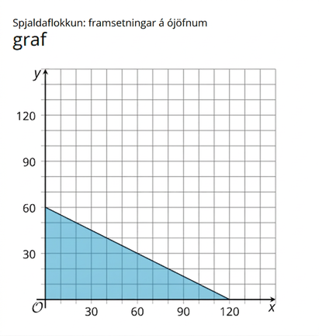
Learning Activity - Matching Cards 🃏
Your teacher will give you a set of cards. Take turns with
your partner to match a group of 4 cards that contain:
A situation.
An inequality that represents it.
A graph that represents the solution region.
A solution written as a coordinate pair.
For each match that you find, explain to your partner how
you know it's a match.
For each match that your partner finds, listen carefully to
their explanation. If you disagree, discuss your thinking and
work to reach an agreement.
Record your matches.
Notes:
Support for All Learners
This activity offers additional support and an extension for students:
For english language learners and students with disabilities, be sure to review the Learning Strategies slide!
Activity (15 minutes)
This activity allows students to practice interpreting inequalities in context and reasoning about their solutions graphically and numerically. A sorting and matching task gives students opportunities to analyze representations, statements, and structures closely and to make connections.
As students explain their thinking to a partner, encourage them to use precise language and mathematical terms to refine their explanations.
Card Sort: Representations of Inequalities blackline masters
Launch
Arrange students in groups of 2. Distribute one set of pre-cut slips or cards to each group.
Ask students to take turns matching a group of 4 cards with representations of the same situation and explaining how they know the representations belong together. Emphasize that while one partner explains, the other should listen carefully, and the group should discuss any disagreements.
Answers
Group 1: Situation - Perimeter of a Rectangle
Group 2: Situation - Jar of Coins
Group 3: Situation - Honey and Jam
Group 4: Situation - A School Trip
Each group answer is shown as an image on this slide.
Activity Synthesis
Select groups of students to share their results and explain their rationales. After a group explains why they believe a set of cards belong together, ask if other groups reasoned about the matches the same way or if they approached the matching differently.
Attend to the language that students use in their explanations by giving them opportunities to describe the inequalities, graphs, or solutions more precisely.

Slide 20
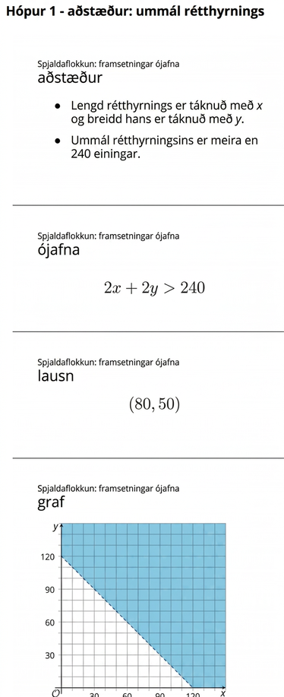
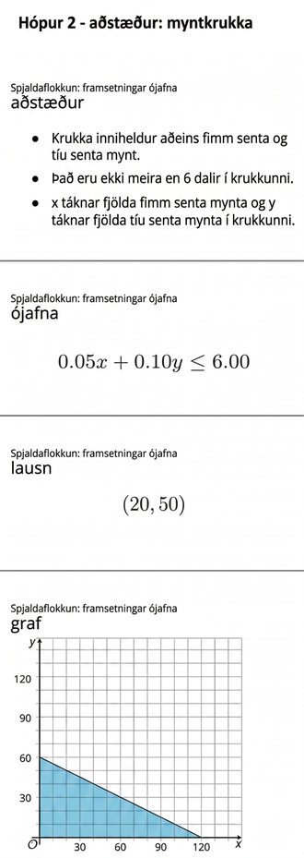
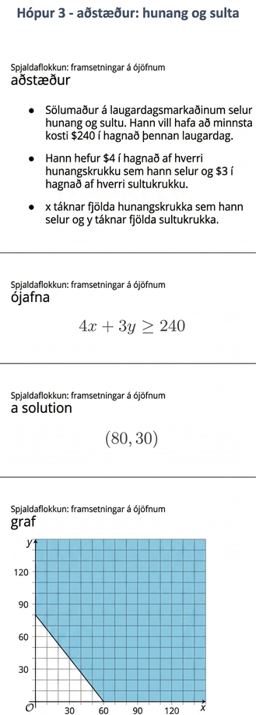
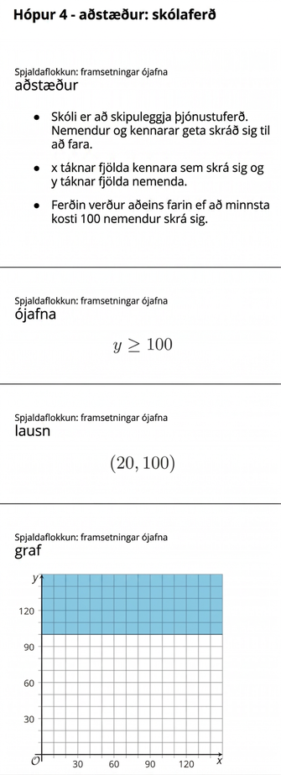
Learning Activity - Matching Cards 🃏
Notes:
Solutions
Group 1: Situation - Perimeter of a Rectangle
Group 2: Situation - Jar of Coins
Group 3: Situation - Honey and Jam
Group 4: Situation - A School Trip

Slide 21
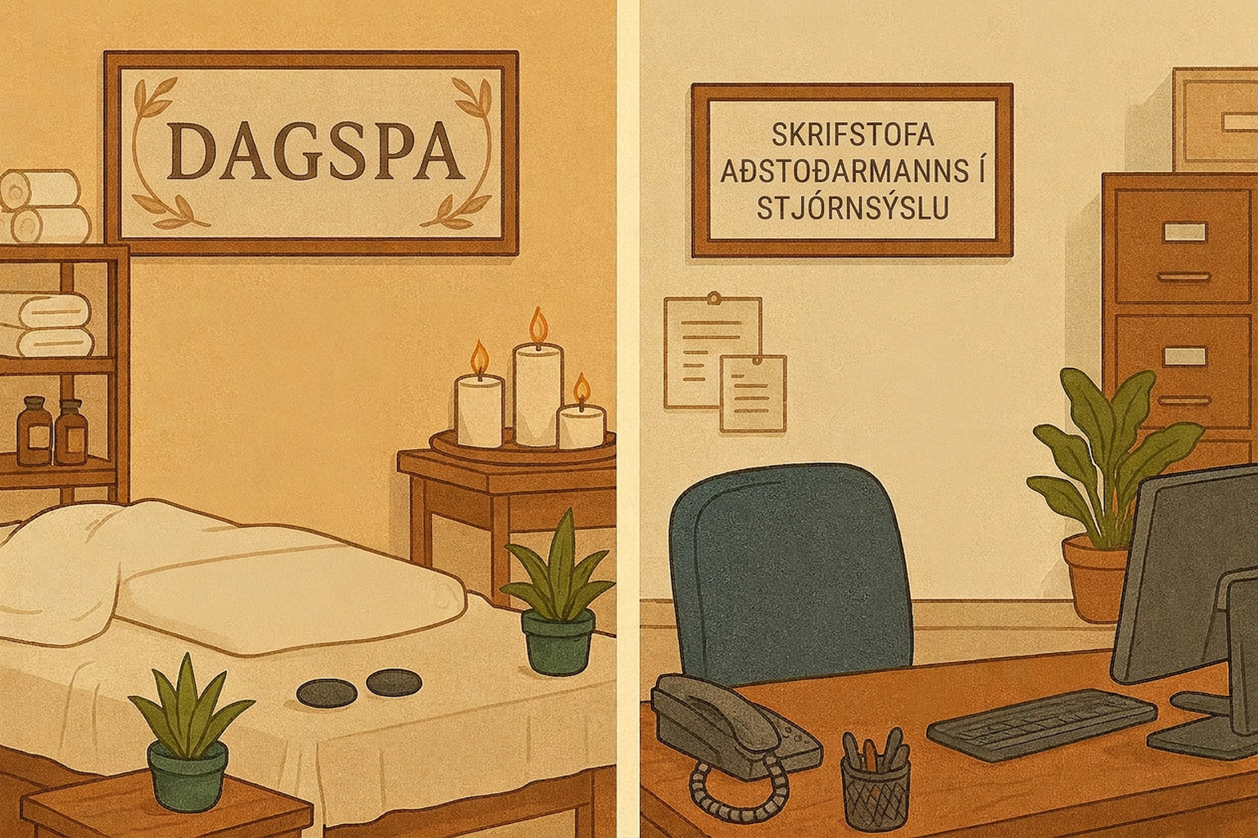
Self Check
Veronica works two part time jobs in order to earn enough money to meet her obligations of at least $280 a week. Her job at the day spa pays $10 an hour and her administrative assistant job on campus pays $17.50 an hour. Which of the following is a solution that allows Veronica to earn enough money?
5 hours at the day spa and 10 hours as an administrative assistant
10 hours at the day spa and 10 hours as an administrative assistant
15 hours at the day spa and 5 hours as an administrative assistant
5 hours at the day spa and 15 hours as an administrative assistant
Let’s review!
Notes:
Answer Feedback - Individualized by Response
5 hours at the day spa and 10 hours as an administrative assistant
Incorrect. Let’s try again a different way: This does not allow Veronica to earn enough money. The correct answer is 5 hours at the day spa and 15 hours as an administrative assistant
10 hours at the day spa and 10 hours as an administrative assistant
Incorrect. Let’s try again a different way: This does not allow Veronica to earn enough money. The correct answer is 5 hours at the day spa and 15 hours as an administrative assistant.
15 hours at the day spa and 5 hours as an administrative assistant
Incorrect. Let’s try again a different way: You may have mixed up the pay rates. Veronica earns $10 at the spa and $17.50 as an administrative assistant. She would not earn more than $280 with this choice. The correct answer is 5 hours at the day spa and 15 hours as an administrative assistant.
5 hours at the day spa and 15 hours as an administrative assistant
That's correct! Check yourself: 5(10)+15(17.50)=312.50, which is greater than 280.

Slide 22

Self Check - Review
Connecting Representations of Inequalities
In order to connect the constraints of a situation with an inequality, its graph, and possible solutions, we need a mastery of each representation.
Let x be the number of small photos and y be the number of large photos that Christy displays.
We know that each small photo costs $4 to display and each large photo costs $10. We also know that she doesn’t want to spend more than $200.
Write the inequality that represents this situation.
Notes:
Answer
4x + 10y ≤ 200

Slide 23
Lesson Journey
Warm Up
Learning Activity
Cool Down
Lesson Synthesis
Learning Activity
Learning Activity
Practice

Slide 24

Learning Activity - Trail Mix 🥜
Andre is making trail mix with dried fruit and mixed nuts. Dried fruit costs $3 per pound and mixed nuts cost $6 per pound. He wants to spend no more than $54 on the trail mix. The inequality y ≤ − 2x + 18 represents the number of pounds of dried fruit, y, he can buy for x pounds of nuts.
The related equation y = −2x + 18 represents the boundary line of the inequality. Complete the table of values to find points on the boundary line of the inequality.
x | y
0
2
4
5
Notes:
Activity (20 minutes)
This activity enables students to continue to use the skills from previous lessons involving inequalities and graphing lines. Students have used a table of values previously to graph linear equations. In this lesson, students will use a table of values to graph the boundary line of an inequality by using the related equation. Students will solve inequalities in two variables using tables to graph the solutions.
The questions in this activity are written as a step-by-step guide to help students identify the key points to help them graph the inequality.
Launch
Students will not use technology to solve the problems in this activity. However, you may want to allow them access to check their graphs. Explain that they will now be solving linear inequalities using tables.
Answers
| x | y |
|---|----|
| 0 | 18 |
| 2 | 14 |
| 4 | 10 |
| 6 | 6 |
More activity questions and answers on the next slide.

Slide 25

Learning Activity - Trail Mix 🥜
Graph the data from your table of values that represents this scenario.
Is the boundary line for the inequality y ≤ −2x + 18 a solid line or a dashed line? Explain how you know.
Is the point (0,0) a solution to the inequality?
Use the graph from question 2. Enter the inequality
y ≤ −2x + 18 to represent the data. Notice the shading for the solution region of this inequality.
Notes:
Answers
Link to Graph
The line is solid because the inequality ≤ means the points on the line are included as solutions.
Yes, 0 ≤ −2(0) + 18, 0 ≤ 18.
Link to Graph
More activity questions, answers, anticipated misconceptions, and synthesis on the next slide.

Slide 26
Learning Activity - Trail Mix 🥜
Graph the data from this table of values and label the points.
Using the graph from question 6, add the graph y = x.
How does the line need to move to capture all of the points?
Using desmos, adjust the slope and/or the y-intercept to find an inequality that could be a possibility.
x | y
-2 | -5
0 | -6
2 | 1
3 | 5
Notes:
Answers
Link to Graph
Link to Graph
Answers may vary. Increase the y-intercept or the slope to capture the point (3,5).
Answers may vary. These are possible representation of where the line could on the graph.
Solutions
Less Than: y < 2x. Link to Graph
Less Than or Equal to: y ≤ 2x - 1. Link to Graph
Greater Than: y < x - 7. Link to Graph
Greater Than or Equal to: y ≥ x - 6. Link to Graph
Not a Solution
y ≤ x - 1 Link to Graph
Anticipated Misconceptions
Students can use a table of values to find the boundary line by identifying the related equation. Any point not on the line can serve as a test point—(0,0) is often easiest. If substituting the test point makes the inequality true, shade that side of the line; if false, shade the opposite side.
Activity Synthesis
Select student pairs to share their solutions. Have them show the work as they substitute the x-values into the related equation, plot the points, draw the line, and shade. At each step, have students explain how they decided whether the line should be dashed or solid. Ask how they chose the test point and ask if anyone else chose a different test point. Ask how they knew which side of the line to shade. Repeat this for the second scenario. Focus discussions on the process for graphing the solutions of the inequality.

Slide 27
Self Check
Which table of values can be used to graph the boundary line of the inequality y > −3x + 1?
x
y
x | -2 | 0 | 1 | 3
y | 7 | 1 | -5 | -11
x | -2 | 0 | 1 | 3
y | 7 | 1 | -2 | -8
x | -2 | 0 | 1 | 3
y | 8 | 2 | -1 | -8
x | -2 | 0 | 1 | 3
y | -5 | 1 | 4 | 10
Let’s review!
Notes:
Answer Feedback - Individualized by Response
Incorrect. Let’s try again a different way: Substitute each x-value into the related equation, y=−3x+1. Notice that the x-values in the table do not increase by the same amount.
That's correct! Check yourself: Substitute each x-value into the related equation, y=−3x+1.
Incorrect. Let’s try again a different way: The y-values in this table are solutions to the inequality. You want to find the solutions to the related equation, y=−3x+1, to find the boundary line.
Incorrect. Let’s try again a different way: Substitute the x-values into the related equation, y=−3x+1, to find the boundary line. Notice the 3 is negative.

Slide 28
Self Check - Review
Connecting Representations of Inequalities
Tables can be used to help you to write and solve inequalities in two variables. Let’s examine this in two parts.
Reminder: The type of inequality depends on the position of the solutions relative to the boundary line.
Part 1: Write a linear inequality in two variables based on the given data:
x | y
-4 | -6
1 | 1
3 | -5
3 | 5
5 | 8
Position of the Solutions
On the line | ≤ or ≥
Above the line | >
Below the line | <
Notes:
Answers:
Part 1
If you are given a set of possible points like the table shown, there could be multiple lines that the data points could represent. Let’s figure out a few possibilities for this given set.
Step 1 - Graph the points on a coordinate plane. Link to Graph
Step 2 - Determine possible lines.
Remember that the dots can be on the line, but they all have to be either above or below to create an inequality. If the line has points on both sides, then the line isn’t a possibility.
Let’s try a few possibilities. We can start with the equation y = x to see if the points are above the line or below the line.
Link to Graph
The equation y = x cannot be a possibility because there are points above and below the line.
Step 3 - Adjust the slope or y-intercept
We can change the slope and the y -intercept to see how we can shift the line to be able to capture all the points. Let’s move the line to below the (3,−5) and (−4,−6). We can leave the slope as 1 and change the y-intercept to -7.
Link to Graph
There is still one point below the line. We could decrease the slope of the line to m = ⅓.
Link to Graph
Now all of the points are above the line. This means that the value of y is always greater than the x value.
So, one of the possible solutions could be y > ⅓ x − 7.
Part 2 questions and answers on the next slide.

Slide 29
Self Check - Review
Connecting Representations of Inequalities
Tables can be used to help you to write and solve inequalities in two variables. Let’s examine this in two parts.
Part 2: Using Tables to Solve Inequalities in Two Variables
Graph the linear inequality y < ½ x − 1 using a table.
x | y
HINT: To begin, create a table of values using the related equation y = ½ x − 1
Notes:
Answers:
Part 2
Step 1 - Create a table of values using the related equation y = ½ x − 1 to identify points on the boundary line of the inequality.
| x | y |
|-----|-----|
| -4 | -3 |
| -2 | -2 |
| 0 | -1 |
| 2 | 0 |
Link to Graph
Step 2 - Plot the points and sketch the boundary line.
If the inequality is ≤ or ≥, the boundary line is solid.
If the inequality is < or >, the boundary line is dashed.
The inequality sign is <, so we draw a dashed line.
Link to Graph
Step 3 - Test a point that is not on the boundary line. Is it a solution of the inequality?
Test (0,0) as it is not on the boundary line of the inequality.
Link to Graph
y < ½x−1
(0) < ½ (0) − 1
0 < −1 is False.
So, (0,0) is not a solution.
Step 4 - Shade in one side of the boundary line.
If the test point is a solution, shade in the side that includes the point.
If the test point is not a solution, shade in the opposite side.
The test point (0,0) is not a solution, so shade in the side of the boundary line that does not include (0,0)
Link to Graph
All points in the shaded region and not on the boundary line represent the solutions to y < ½ x −1
.

Slide 30

Lesson Journey
Warm Up
Learning Activity
Cool Down
Lesson Synthesis
Learning Activity
Learning Activity
Practice

Slide 31
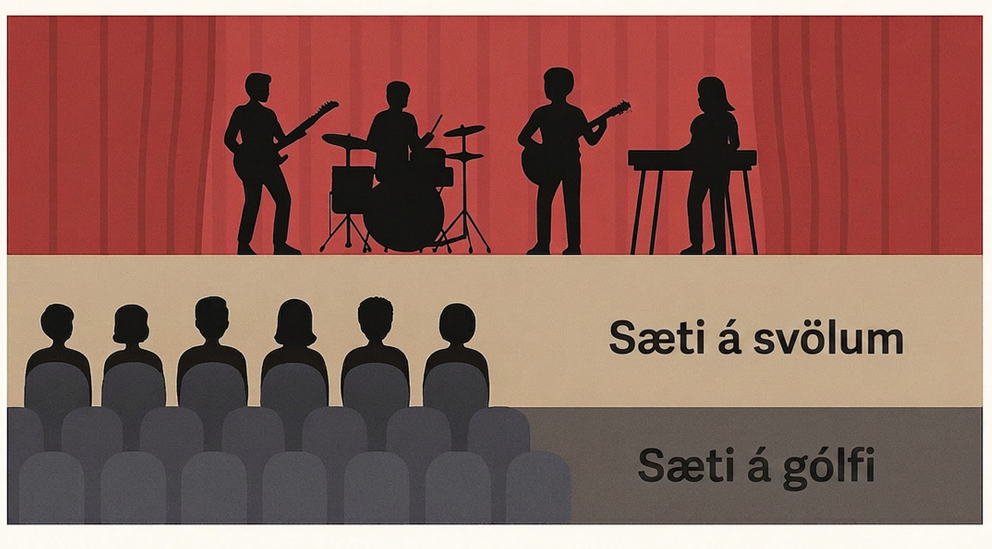
Cool Down
A band is playing at an auditorium with floor seats and balcony seats. The band wants to sell the floor tickets for $15
each and balcony tickets for $12 each. They want to make at least $3,000 in ticket sales.
Write 3 linear inequalities in two variables given this table of values:
x | y
4 | 4
1 | 5
-2 | 3
0 | 0
How much money will they collect for selling x floor tickets?
How much money will they collect for selling y balcony tickets?
Write an inequality whose solutions are the number of floor and
balcony tickets sold if they make at least $3,000 in ticket sales.
Graph the inequality that represents this scenario.
Notes:
Cool Down (5 minutes)
Provide access to graphing technology.
Answers
15x
12y
15x + 12y ≥ 3,000
Link to Graph
Answers will vary.
Response to Student Thinking - Points to Emphasize
Select student work from the cool-down to highlight in the next lesson, with attention to ways to determine which side of the boundary line to shade.

Slide 32

Lesson Journey
Warm Up
Learning Activity
Cool Down
Lesson Synthesis
Learning Activity
Learning Activity
Practice

Slide 33

Practice
Put your hard work to action, practice what you’ve learned!
Notes:
Digital Practice: Access the practice pages at https://openstax.org/details/books/algebra-1

Slide 34

Lesson Journey
Warm Up
Learning Activity
Cool Down
Lesson Synthesis
Learning Activity
Learning Activity
Practice

Slide 35
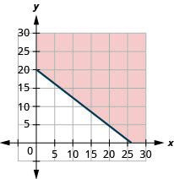
Lesson Synthesis
Of the four things you were asked to do in the first activity which one did you find most challenging or prone to error?
    writing an inequality
    graphing the solutions
    identifying and interpreting a particular solution
    answering the question about the situation
How is graphing linear inequalities using technology similar to graphing them by hand? How is it different?
You have previously used technology to graph linear equations in two variables. How is graphing linear inequalities in two variables different than graphing equations?
Notes:
Prompt: Summarize the lesson by discussing students' work for the first activity (about bank accounts, concert tickets, and advertising packages) and inviting them to reflect on their reasoning process.
Answers:
Answers may vary.
Closing the Lesson
After completing the Lesson Synthesis, wrap up the class by directing students to the Lesson Summary in their student textbook. In this section, students review the day’s learning targets, read summaries about the key takeaways from each activity, and then respond to a reflection question regarding their confidence with the material.
For more on the benefits of using this type of metacognitive reflection, see the Research in Practice section of the course.

Slide 36
Self Assessment
How much do you agree with the following statements?
I can… | I can | Almost | Not yet
Use graphing technology to find the solution to a two-variable inequality.
Connect the different representations and interpret them in terms of the situation, when given inequalities, graphs, and descriptions that represent the constraints in a situation.

