Slide 1


Algebra 1
Unit 1 Linear Equations
Lesson 1.9 Choosing the Correct Variable to Solve For, Part 2
Notes:
Teacher Slides assignments

Slide 2
How to use these slides
On the activity slides check the speaker notes for teacher support and instructional information.
Each lesson includes 1 warm up, 2-3 learning activities, a cool down, practice and a lesson synthesis.
  Learning activities are followed by a self check question, and review section.
Some slides have been hidden from student view, more information can be found on the next slide (Reference Key).
You can edit and use these slides for personal and classroom use, but cannot sell them and must keep the attribution logos.
For more information, Check out the digital quick start guide!

Slide 3






Reference Key
Check the top right corner for an icon referencing these unique sections.
 | Support for Students with Disability | Hidden | Learning Strategies slide, provides additional support to students for understanding the activity. Learning Strategies slide, provides additional support to students for understanding the activity.
 | Support for English Language Learners | Hidden
 | Extending Your Thinking | Hidden | Extending Your Thinking slide, provides an extra challenge for students.
 | Self Check | Not Hidden | Self Check slide, checkpoint to assess student understanding after the learning activity.
 | Review | Hidden | Self Check- Review slide, designed to help review topics from the self check question.
On the next slides, check the speaker notes for teacher instructions and support.

Slide 4

Learning Goals
By the end of this lesson you will be able to -
Solve an equation for one of the variables.
Notes:
Lesson Narrative
In earlier lessons, students practiced solving for one variable after plugging in values for the others. Now, they focus on solving for the variable before substituting values. This method often makes problem-solving quicker and more flexible.
In this lesson, students rearrange equations to isolate a variable and express it in terms of the others. They learn that once a variable is isolated, tools like spreadsheets or calculators can quickly compute its value for different inputs. This shows how isolating a variable can help test different scenarios more efficiently.
Required Preparation
Graphing calculators, Desmos access, or other devices are required for the digital version of the activity “Writing an Equation to Represent a Constraint.”
Required Materials
Four-function calculators
Spreadsheet technology
Texas Essential Knowledge and Skills
A1(A) apply mathematics to problems arising in everyday life, society, and the workplace
A1(G) display, explain, and justify mathematical ideas and arguments using precise mathematical language in written or oral communication
A2(C) write linear equations in two variables given a table of values, a graph, and a verbal description
A12(E) solve mathematic and scientific formulas, and other literal equations, for a specified variable

Slide 5
Vocabulary
Previous
Equation
  A mathematical statement showing that two numbers, expressions, or objects are equal.
Expression
  The sum of products of numbers and variables.
Variable
  A quantity that can take on different values. Often represented by a letter such as 𝑥, 𝑦, 𝑎, 𝑏, 𝑚, etc.
New
None
Notes:
Lesson Vocabulary
To support student understanding of key vocabulary:
Introduce and review the vocabulary words students will see in this lesson.
Encourage students to notice how these words are used and to include them in their math discussions and explanations—both written and oral.
Use a word wall to reinforce vocabulary. Sample word wall cards are available here.
For newcomers or students with beginning English proficiency, use these Quizlet sets to support vocabulary learning:
Unit 1 Spanish Vocabulary – use first to build understanding
Unit 1 Vocabulary (English) – use after anchoring in Spanish
Support for English Language Learners
ELPS 2(F) listen to and derive meaning from a variety of media such as audiotape, video, DVD, and CD-ROM to build and reinforce concept and language attainment
ELPS 3(I) adapt spoken language appropriately for formal and informal purposes
ELPS 3(J) respond orally to information presented in a wide variety of print, electronic, audio, and visual media to build and reinforce concept and language attainment
ELPS 4(G) demonstrate comprehension of increasingly complex English by participating in shared reading, retelling or summarizing material, responding to questions, and taking notes commensurate with content area and grade level needs

Slide 6






Lesson Journey
Lesson Journey
Warm Up
Learning Activity
Practice
Warm Up
Learning Activity
Practice
Learning Activity
Cool Down
Lesson Synthesis
Learning Activity
Cool Down
Lesson Synthesis
‹#›

Slide 7


Warm Up - Platonic Solids 🧊
In an earlier lesson, you saw the equation V + F − 2 = E, which relates the number of vertices, faces, and edges in a Platonic solid.
In questions 1 - 2, write an equation that makes it easier to find the number of vertices in each of the Platonic solids described:
An octahedron (shown here), which has 8 faces.
An icosahedron, which has 30 edges
A Buckminsterfullerene (also known as a Buckyball) is a shape with 60 vertices. It isn’t a Platonic solid, but the number of faces, edges, and vertices follow the same rule. Write an equation to help find the number of faces if you know how many edges there are.
Notes:
Warm Up (5 minutes)
In this warm up, students are given a simple equation in three variables and are prompted to rearrange it to pin down a particular variable. In each question, only the value of one variable is given, so students need to manipulate the equation even when some quantities are unknown. The work here prepares students to rearrange other variable equations later in the lesson.
As students work, look for those who substitute the given value before rearranging and those who first isolate the variable of interest before substituting. Invite them to share their approaches during class discussion.
Launch
Arrange students in groups of 2. For the last question, ask each partner to come up with a new equation.
Activity Answers
V + F − 2 = E; V + 8 − 2 = E; V + 6 = E; V = E − 6
V + F − 2 = E; V + F − 2 = 30; V + F − 2 + 2 = 3 0 + 2; V + F = 32; F = 32 − F
V + F − 2 = E; 60 + F − 2 = E; 58 + F = E; 58 − 58 + F = E − 58; F = E − 58
Anticipated Misconceptions
Some students may be unclear about what it means to write an equation that “makes it easier to find the number of vertices (or faces).” Remind them of the work in an earlier activity. In the post-parade clean-up activity, for instance, they wrote the equation ℓ = 2/n to quickly find the length of the road section each volunteer would clean up, ℓ, if there were n volunteers. They wrote n = 2/ℓ to quickly find the number of volunteers, n, if each volunteer were to clean up ℓ miles.
Activity Synthesis
Select previously identified students to share their responses and strategies. Record and display for all to see the steps they take to rearrange the equations. Emphasize how each step constitutes an acceptable move and how it keeps the equation true.
Make sure students see that we can substitute known values into the given equation before rearranging it, or we can rearrange the equation first before substituting known values. In the examples here, it doesn’t matter which way it is done. Ultimately, we were solving for V in the first question and for F in the second question.
Explain that there will be times when one strategy might be more helpful than the other, as students will see in subsequent activities.

Slide 8

Lesson Journey
Lesson Journey
Warm Up
Learning Activity
Practice
Warm Up
Learning Activity
Practice
Learning Activity
Cool Down
Lesson Synthesis
Learning Activity
Cool Down
Lesson Synthesis
‹#›

Slide 9
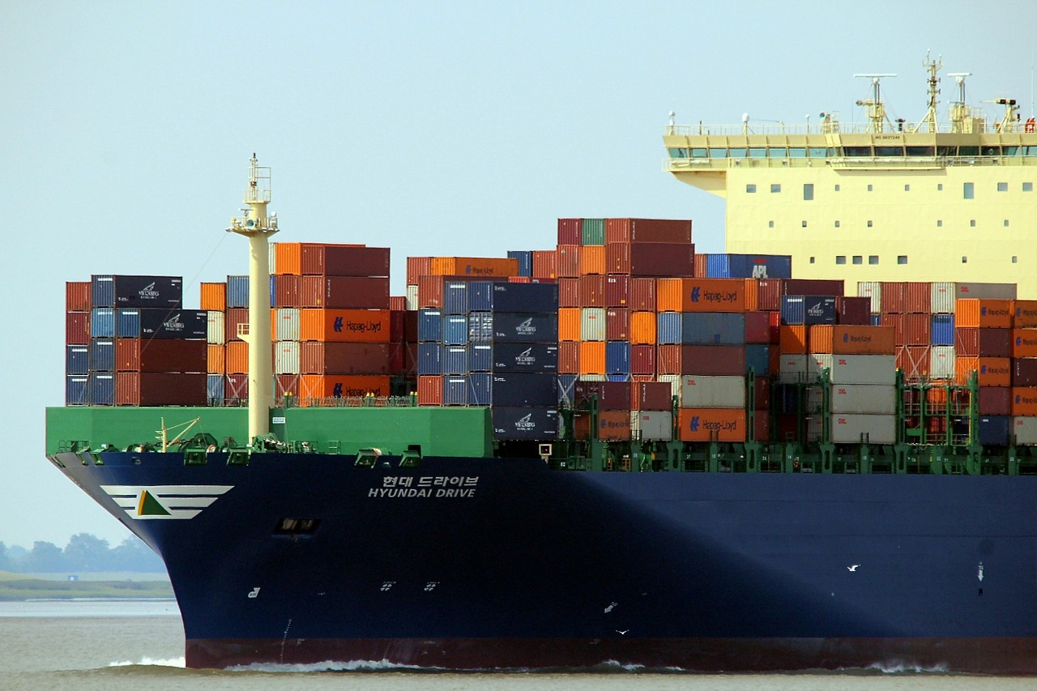
Learning Activity - Shipping Automobiles
An automobile manufacturer is preparing a shipment of cars and trucks on a cargo ship that can carry 21,600 tons.
The cars weigh 3.6 tons each, and the trucks weigh 7.5 tons each.
Write an equation that represents the weight constraint of a shipment. Let c be the number of cars and t be the number of trucks.
Find the number of cars that can be shipped if the cargo already has 480 trucks. Already has 1,500 trucks. Already has 2,736 trucks.
Find the number of cars that can be shipped if the cargo already has t trucks.
Notes:
Support for All Learners -
This activity offers additional support and an extension for students:
For English language learners and students with disabilities, be sure to review the Learning Strategies slide!
For students looking for an extra challenge, be sure to review the Extending Your Thinking slide!
Activity (20 minutes)
This activity encourages students to write an equation in two variables to represent a constraint and then solve for each of the variables. One motivation for rearranging the equation is to find an expression that, when entered into a calculator or computer, can be used to quickly find the value of one quantity given the value of the other.
As they use spreadsheet technology to create mathematical models, test them, and solve problems, students engage in aspects of mathematical modeling.
Launch
Arrange students in groups of 3–4 and make sure each group has access to a calculator, spreadsheet, or graphing tool.
Start by giving students a few quiet minutes to think through the first question on their own. Then, have them discuss their ideas with their group. Pause the activity for a quick class check-in. Make sure everyone is using a correct equation before they move on.
Once groups finish the second question, ask them to share how they figured out the number of cars that could be shipped with a given number of trucks. Then, have them share the equations they wrote to find the number of cars based on the number of trucks. Write these equations where everyone can see. Let students know they can test these equations using a calculator or computer. Show an example if needed, and be ready with backup directions if your classroom uses different tools.
Finally, explain that their next job is to reverse the process: use the number of cars to figure out how many trucks can be shipped. Encourage them to test their equations with the available technology.
Activity image answer, and synthesis on the next slide.

Slide 10
Learning Activity - Shipping Automobiles
Use the following information for questions 4 - 6. For a different shipment, cars are loaded first, and then trucks are loaded afterward.
Write an equation you could enter into a calculator or a spreadsheet tool to find the number of trucks that can be shipped if the number of cars is known.
Use your equation and a calculator or a computer to find the number of trucks that can be shipped if the cargo already has 1,000 cars.
Use your equation and a calculator or a computer to find the number of trucks that can be shipped if the cargo already has 4,250 cars.
Are you ready for more?
Notes:
Answers
3.6c + 7.5t = 21,600
5,000; 2,875; 300
(21,600 – 7.5t)/3.6
(21,600 – 3.6c)/7.5, where c is the number of cars.
2,400
840
Activity Synthesis
When students are given the number of trucks (t), they may figure out the number of cars (c) by calculating and then generalizing the pattern, arriving at the expression: 𝑐 = (21,600 − 7.5𝑡)/3.6. Similarly, when given the number of cars, they might arrive at: 𝑡 = (21,600 − 3.6𝑐)/7.5. Both strategies are reasonable and expected. Just be sure students also understand that these expressions can be found by rearranging the original equation: 3.6𝑐 + 7.5𝑡 = 21,600.
Point out that we can solve for c when we know the number of trucks, or solve for t when we know the number of cars. This flexibility is an important part of working with equations in two variables.

Slide 11

Learning Strategies - Shipping Automobiles
Teacher Instruction: Use these strategies to adjust the activity to support english language learners and students with disabilities.
You can copy and paste the callouts directly on top of the activity or give the instructions aloud.
I will out step-by-step directions for using your graphing tool. Follow along as I read them out loud so everyone knows how to enter equations and test them.
Use the directions to enter your equation. Then, try typing in a value for one variable to see what the other one would be. Let’s test a few together first!"
Access for Perception
Notes:
Support for Students with Disabilities: Representation: Access for Perception
Provide students with a physical copy of written directions for using the spreadsheet or graphing technology available and read them aloud. Include step-by-step directions for how to enter equations, find the value of one variable by entering the value of another, and test equations.
Supports accessibility for: Language; Memory

Slide 12
Extending Your Thinking
For numbers 1 and 2, use the following situation:
For yet another shipment, the manufacturer is also shipping motorcycles, which weigh 0.3 ton each.
Write an equation that you could enter into a calculator or a spreadsheet tool to find the number of motorcycles that can be shipped, m, if the number of cars and trucks are known.
Use your equation to find the number of motorcycles that can be shipped if the cargo already contains 1,200 trucks and 3,000 cars.
Notes:
Answers
(m = 21,600 − 7.5t − 3.6c)/0.3
6,000

Slide 13
Self Check
The total revenue a high school makes from a play is T dollars. The revenue is made from selling tickets at $3.25 per child ticket, c, and $7.50 per adult ticket, a. Which equation is best to find the number of child tickets sold?
T = 3.25c + 7.50a | a = (T – 3.25c)/7.50
c = (T – 7.50a)/3.25 | C = (T)/3.25
Let’s review!
Notes:
Answers and Feedback
T = 3.25c + 7.50a
Incorrect. This equation would be best for finding the total ticket revenue. Try solving for c. The answer is c = (T – 7.50a)/3.25.
c = (T – 7.50a)/3.25
That’s correct! The number of child tickets sold is found by subtracting the cost of an adult ticket times the number of adults from the ticket revenue and then dividing by the cost of a child ticket.
a = (T – 3.25c)/7.50
Incorrect. This equation would be best for finding the number of adult tickets sold. Try solving for c. The answer is c = (T – 7.50a)/3.25.
C = (T)/3.25
Incorrect. The amount made from adult tickets must be subtracted from the total. The answer is c = (T – 7.50a)/3.25.

Slide 14
Self Check - Review
You are buying chicken and steak for a barbeque. Chicken costs $1.29/lb and steak costs $3.49/lb.
STEP 1: Identify known variables.
STEP 2: What sentence might you use to describe the total cost of the barbeque?
STEP 3: Write an equation to show the total cost, T, of the meat.
You have $100 to spend on the barbeque. Use this information and rewrite the equation from STEP 3 to find the number of pounds of chicken, c, that you can buy.
You have $100 to spend on the barbeque. Use this information and rewrite the equation from STEP 3 to find the number of pounds of steak, s, that you can buy.
Notes:
Answers
STEP 1:
Let c represent the number of pounds of chicken that you can buy.
Let s represent the number of pounds of steak that you can buy.
Let T represent the total cost of the barbeque.
STEP 2: Your answer may vary, but here are some examples.
The total cost of the barbeque is the sum of the total cost of all the chicken purchased and the total cost of all the steak purchased.
The cost per pound of the chicken multiplied by the number of pounds purchased plus the cost per pound of the steak multiplied by the number of pounds purchased equals the total cost of the barbeque.
STEP 3: T = 1.29c + 3.49s
c = (100 − 3.49s)/1.29
s = (100 − 1.29c)/3.49

Slide 15
Lesson Journey
Lesson Journey
Warm Up
Learning Activity
Practice
Warm Up
Learning Activity
Practice
Learning Activity
Cool Down
Lesson Synthesis
Learning Activity
Cool Down
Lesson Synthesis
‹#›

Slide 16

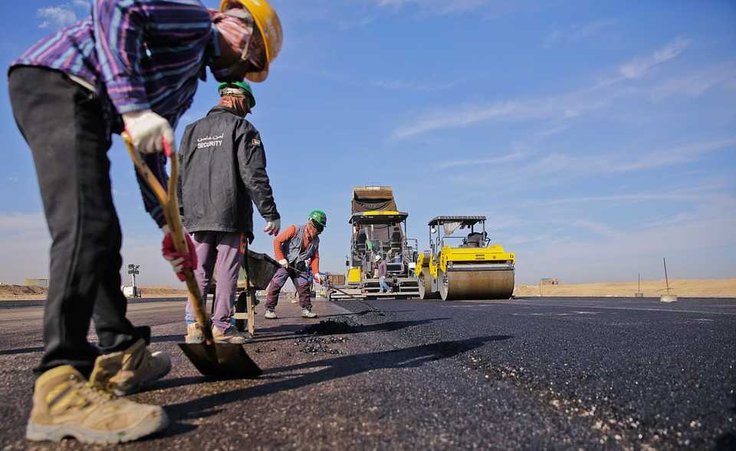
Learning Activity - Resurfacing Roads
A city’s Department of Streets has a budget of $1,962,800 for resurfacing roads and hiring additional workers this year.
The cost of resurfacing a mile of 2-lane road is estimated at $84,000. The average starting salary of a worker in the department is $36,000 a year.
Write an equation that represents the relationship between the miles of 2-lane roads the department could resurface, m, and the number of new workers it could hire, p, if it spends the entire budget.
Use the equation you wrote in the first question to solve for p.
Explain what the solution to the equation in question 2 represents in this situation.
Use the equation you wrote in the first question to solve for m.
Notes:
Support for All Learners -
This activity offers additional support and an extension for students:
For English language learners and students with disabilities, be sure to review the Learning Strategies slide!
Activity (10 minutes)
This activity gives students another opportunity to write and rearrange equations in two variables and to do so in context.
Unlike in previous activities, students no longer start by computing one quantity given numerical values of the other quantity and then generalizing the process. Instead, they are prompted to write one equation, solve for each variable, and interpret the solution. Students also articulate why one model might be more helpful than the other under a certain circumstance. Along the way, students reason quantitatively and abstractly and engage in aspects of modeling.
Making spreadsheet technology available gives students an opportunity to choose appropriate tools strategically.
Launch
Familiarize students with the idea of organizational budgets, if needed. Explain that every governmental agency has a budget (not unlike a budget for a pizza party) and needs to decide how to allocate a limited amount of funds. Ask students to think of examples of expenses that a city’s Department of Streets might have (road repairs, new street construction, additional workers, new equipment, and so on). Given a set budget, spending more on one thing means having less to spend on something else, so the agency would need to weigh its options and prioritize its needs.
Activity answers, and synthesis on the next slide.

Slide 17
Learning Activity - Resurfacing Roads
Explain what the solution to the equation in question 4 represents in this situation.
The city is planning to hire 6 new workers and use its entire budget. Which equation should be used to find how many miles of 2-lane roads it could resurface?
Explain your reasoning.
To the nearest hundredth, how many miles of 2-lane roads could the city resurface if it hires 6 new workers?
Are you ready for more?
Notes:
Answers
84,000m + 36,000p = 1,962,800
p = 1,962,800 − 84,000m)/36,000
It represents the number of new workers the department could hire if it resurfaces m miles of roads and spends its entire budget.
m = (1,962,800 − 36,000p)/84,000
It represents the miles of roads the department could resurface if it spends the entire budget and hires p new workers.
m = 1(,962,800 − 36,000p)/84,000
Substitute 6 for p in the expression that is equal to m to find the miles of roads that could be resurfaced.
20.8; m = (1,962,800 − 36,000(6))/84,000; m = (1,962,800−216,00084,000)/84,000; m = 20.8
Anticipated Misconceptions
Some students may have trouble sorting out the given information because of unfamiliarity with the context or with certain terms. Ask them to explain the setup of the problem as best they understand it, and then point out any information that might be missing.
Activity Synthesis
Verify that the equations students wrote correctly isolate each variable. If students wrote expressions in different forms for a variable (for instance, (4,907−201m)/91
and (1,962,800−84,000m)/36,400 for p), discuss how the expressions are equivalent.
If time permits, consider asking students to use their equations to answer these questions:
“How many people could be hired if the department is resurfacing 16 miles of roads?” (17 people) “3 miles?” (47 people)
“How many miles of roads could be resurfaced if the department is hiring 2 new workers?” (22.5 miles) “If no new workers are hired?” (About 23.37 miles)
Make sure students understand that solving for p makes it possible to quickly find the number of people that the department could hire given some miles of road to be resurfaced (and while sticking to the budget). Similarly, solving for m makes it possible to quickly find the miles that could be resurfaced given any number of new hires.

Slide 18
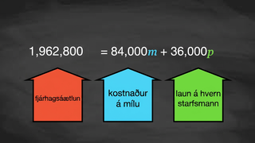
Video: Writing an Inequality for the Constraint

Slide 19
Learning Strategies - Resurfacing Roads
Teacher Instruction: Use these strategies to adjust the activity to support english language learners and students with disabilities.
You can copy and paste the callouts directly on top of the activity or give the instructions aloud.
First read: listen and describe the situation without numbers.
Second read: list what can be counted or measured.
Third read: listen for the question and brainstorm ways to solve.
Reading, Listening, Conversing
We will read the directions together out loud as a class. Then, turn and talk with a partner to make sure you both understand what to do.
Internalize Comprehension
Notes:
Support for English Language Learners: MLR 6 Three Reads: Reading, Listening, Conversing
Ask students to keep their books or devices closed and display only the image and the task statement without revealing the questions that follow. Use the first read to orient students to the situation. Ask students to describe what the situation is about without using numbers (a city department has money to resurface roads this year). Use the second read to identify quantities and relationships. Ask students, “What can be counted or measured?” Listen for, and amplify, the important quantities that vary in relation to each other in this situation: the total amount of money available, the cost to resurface 1 mile of a 2-lane road, the average worker’s salary, and the number of miles of road to resurface. After the third read, reveal the first question and ask students to brainstorm possible strategies to write an equation. This routine helps students interpret the language within a given situation needed to create an equation.
Design Principle(s): Support sense-making
Learn more about this routine
View the instructional video and follow along with the materials to assist you with learning this routine.
Provide support for students
Distribute graphic organizers to the students to assist them with participating in this routine.
Support for Students with Disabilities: Representation: Internalize Comprehension
Provide appropriate reading accommodations and supports to ensure student access to written directions, word problems, and other text-based content.
Supports accessibility for: Language; Conceptual processing

Slide 20
Self Check
A farmer makes money selling pumpkins and apples in the fall. His revenue, M, is made from selling pumpkins, p, for $4.00 and apples, a, for $0.75. Which equation is solved to help him find out how many pumpkins he sold?
M = 4.00p + 0.75a | p = M/4.00
a = (M − 4.00p)/1.75 | p = (M − 0.75a)/4.00
Let’s review!
Notes:
Answers and Feedback
M = 4.00p + 0.75a
Incorrect. This would help the farmer find out how much revenue he made. Solve for p. The answer is p = (M − 0.75a)/4.00.
a = (M − 4.00p)/1.75
Incorrect. This would help the farmer find out how many apples he sold. Try solving for p. The answer is p = (M − 0.75a)/4.00.
p = M/4.00
Incorrect. Make sure to consider the amount made from apples in the equation. The answer is p = (M − 0.75a)/4.00.
p = (M − 0.75a)/4.00
That’s correct! To find out how many pumpkins were sold, take the total revenue, M, subtract the amount made from apples, and then divide by $4.00.

Slide 21
Self Check - Review
Solve 2x − 4y = 20 for x.
Step 1: Use inverse operations to bring the y term to the right side of the equation by adding 4y.
Step 2: Simplify.
Step 3: Divide both sides by 2.
Step 4: Simplify.
Notes:
Answers
Step 1: 2x − 4y + 4y = 20 + 4y
Step 2: 2x = 20 + 4y
Step 3: (2x)/2 = (20+4y)/2
Step 4: x = 10 + 2y

Slide 22

Lesson Journey
Lesson Journey
Warm Up
Learning Activity
Practice
Warm Up
Learning Activity
Practice
Learning Activity
Cool Down
Lesson Synthesis
Learning Activity
Cool Down
Lesson Synthesis
‹#›

Slide 23
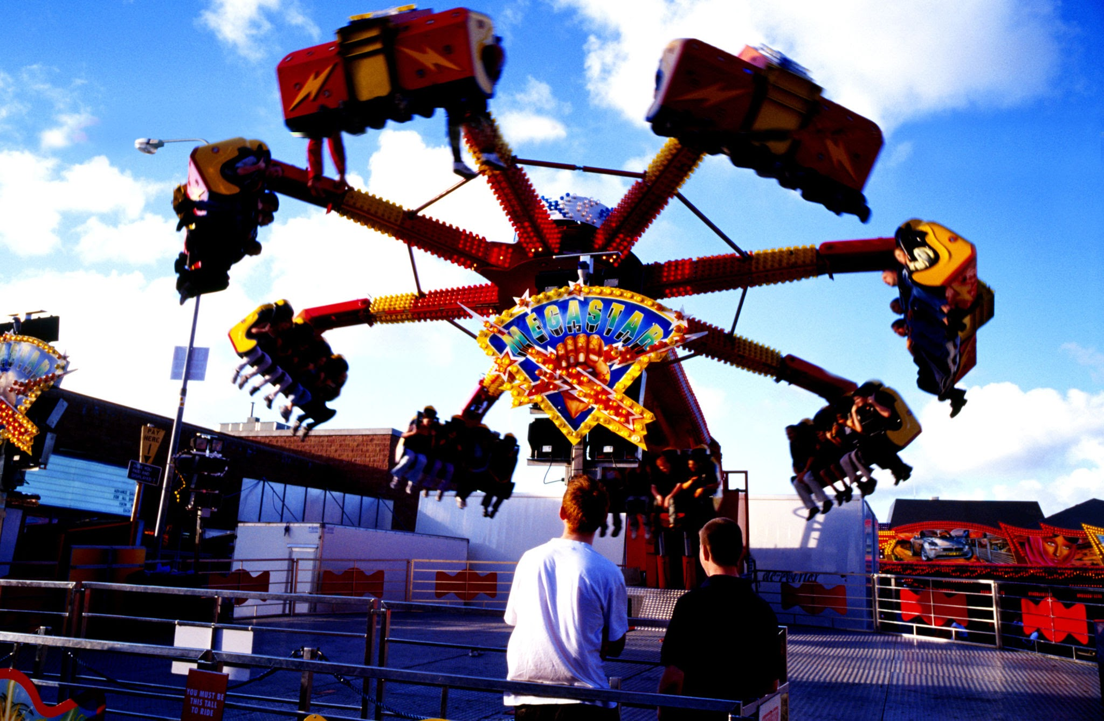
Cool Down
A school is holding a carnival and hopes to raise $500. Child tickets cost $3, and adult tickets cost $5. If the school sells x child tickets and y adult tickets, then the equation 3x+5y=500 expresses the fact that the school raised exactly $500 from ticket sales.
Solve the equation for x.
Explain when it might be helpful to rewrite the equation this way.
Notes:
Cool Down (5 minutes)
Give students 5 minutes to work though the problem before reviewing as a class.
Answers
x = (500 − 5y)/3
Your answer may vary, but here is a sample. Solving for x helps us find out the number of child tickets to sell if we know the number of adults attending the carnival and we want to make exactly $500 from ticket sales.
Response to Student Thinking - More Chances
Students will have more opportunities to understand the mathematical ideas in this cool down, so there is no need to slow down or add additional work to the next lessons. Instead, use the results of this cool down to provide guidance for what to look for and emphasize over the next several lessons to support students in advancing their current understanding.

Slide 24

Lesson Journey
Lesson Journey
Warm Up
Learning Activity
Practice
Warm Up
Learning Activity
Practice
Learning Activity
Cool Down
Lesson Synthesis
Learning Activity
Cool Down
Lesson Synthesis
‹#›

Slide 25

Practice
Put your hard work to action, practice what you’ve learned!
Notes:
Access the practice pages at https://openstax.org/details/books/algebra-1

Slide 26

Lesson Journey
Lesson Journey
Warm Up
Learning Activity
Practice
Warm Up
Learning Activity
Practice
Learning Activity
Cool Down
Lesson Synthesis
Learning Activity
Cool Down
Lesson Synthesis
‹#›

Slide 27
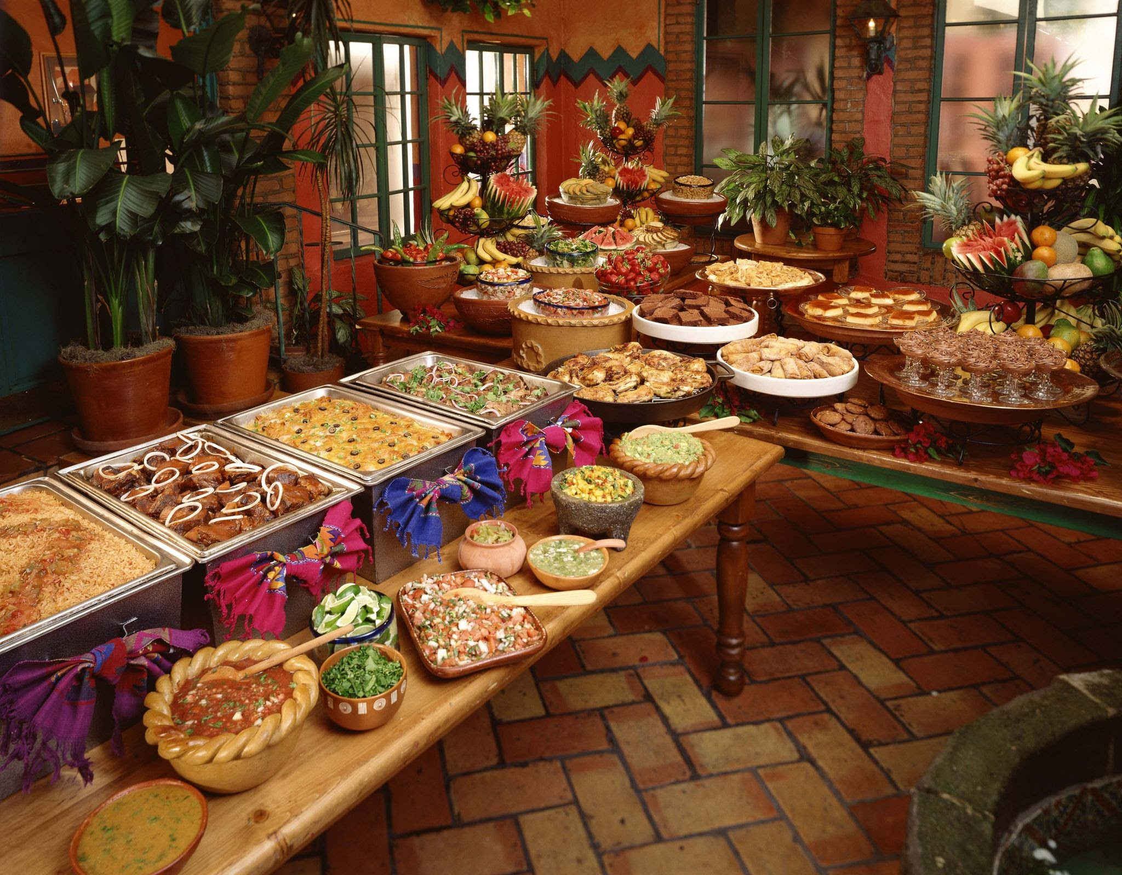
Lesson Synthesis
Suppose you are organizing a party and have a budget of b dollars for the appetizers. You plan to order v vegetarian spring rolls at $0.75 each and s shrimp rolls at $0.95 each. The equation 0.75v + 0.95s = b represents this constraint.
The right side of the class will solve for v, the left side of the class will solve for s.
Each side will share their equation with the class.
When might it be most handy to use each of these equations in your party planning?
Notes:
Prompt: I want you to turn to the Lesson Summary in your textbook. This section is a quick way to review what we learned today. You’ll see the learning targets, a summary of each activity, and a reflection question at the end.
Take a couple of minutes to read through it and think about how confident you feel with today’s material. This type of reflection helps your brain process and hold on to what you’ve learned.
Answers
0.75v + 0.95s = b (When we want to find out how much different combinations of rolls would cost)
v = (b − 0.95s)/0.75 (When we know the budget and want to find out how many vegetarian rolls we could get if we order different numbers of shrimp rolls)
s = (b − 0.75v)/0.95 (When we know the budget and want to find out how many shrimp rolls we could get if we order different numbers of vegetarian rolls)

Slide 28
Self Assessment
How much do you agree with the following statements?
I can… | I can | Almost | Not yet
Solve an equation for one of the variables.

