Slide 1
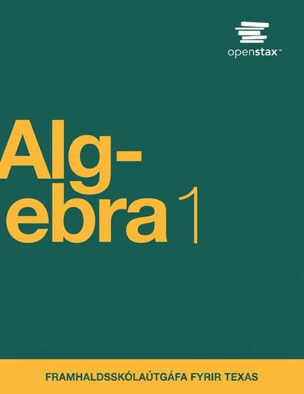

Algebra 1
Unit 7 Introduction to Quadratic Functions
Lesson 7.9 Standard Form and Factored Form
Notes:
How to Get Started
Review Slide 2: How to use these slides
Check out the digital quick start guide!
Review Slide 3: Reference Key of Icons

Slide 2
How to use these slides
On the activity slides check the speaker notes for teacher support and instructional information.
Each lesson includes 1 warm up, 2-3 learning activities, a cool down, practice and a lesson synthesis.
  Learning activities are followed by a self check question, and review section.
Some slides have been hidden from student view, more information can be found on the next slide (Reference Key).
You can edit and use these slides for personal and classroom use, but cannot sell them and must keep the attribution logos.
For more information, Check out the digital quick start guide!

Slide 3






Reference Key
Check the top right corner for an icon referencing these unique sections.
 | Support for Students with Disability | Hidden | Learning Strategies slide, provides additional support to students for understanding the activity. Learning Strategies slide, provides additional support to students for understanding the activity.
 | Support for English Language Learners | Hidden
 | Extending Your Thinking | Hidden | Extending Your Thinking slide, provides an extra challenge for students.
 | Self Check | Not Hidden | Self Check slide, checkpoint to assess student understanding after the learning activity.
 | Review | Hidden | Self Check- Review slide, designed to help review topics from the self check question.
On the next slides, check the speaker notes for teacher instructions and support.
Notes:
Check the Speaker Notes: On the next slides you can find discussion questions, lesson information, answers to the activities, and ways to adjust the activity for your students!

Slide 4

Learning Goals
By the end of this lesson you will be able to -
Rewrite quadratic expressions given in factored form in standard form using either the distributive property or a diagram.
Know the difference between “factored form” and “standard form.”
Notes:
Lesson Narrative
Students extend their understanding of expanding (x + p)(x + q)to cases with negative terms, such as (x + 3)(x − 4) or (x − 5)². They may still use area diagrams for support, though diagrams become less intuitive with differences. This lesson shifts students from viewing diagrams as concrete area models to using them as abstract organizers for multiplication. Students also learn to distinguish between factored form and standard form, refining their language about quadratic expressions in preparation for graphing them in later lessons.
Required Preparation
None
Required Materials
None
Texas Essential Knowledge and Skills
A1(D) communicate mathematical ideas, reasoning, and their implications using multiple representations, including symbols, diagrams, graphs, and language as appropriate
A6(B) write equations of quadratic functions given the vertex and another point on the graph, write the equation in vertex form
f(x) = a(x − h)² + k, and rewrite the equation from vertex form to standard form f(x) = ax² + bx + c
A10(B) multiply polynomials of degree one and degree two

Slide 5
Vocabulary
Expression
  The sum of products of numbers and variables. The variables can be raised to different powers.
Factor
  If 𝑎 · b = m then 𝑎 and b. These are the values or expressions that multiply to be a specific product.
New
Factored Form
  The form of a number or algebraic expression when it has been broken down into a product of its factors.
Standard Form (quadratic expression)
  ax² + bx + c
Previous
Coefficient
  In an algebraic expression, it is the constant the variable is multiplied by.
Constant Term
  In an expression like (5𝑥 + 2), it is the number 2 because it doesn't change when the 𝑥-value changes.
Distributive Property
  A property indicating a special way in which multiplication is applied to addition of two or more numbers in which each term inside a set of parentheses can be multiplied by a factor outside the parentheses, such as 𝑎(𝑏 + 𝑐) = 𝑎𝑏 + 𝑎𝑐.
Notes:
Lesson Vocabulary
To support student understanding of key vocabulary:
Introduce and review the vocabulary words students will see in this lesson.
Encourage students to notice how these words are used and to include them in their math discussions and explanations—both written and oral.
Use a word wall to reinforce vocabulary. Sample word wall cards are available here.
For newcomers or students with beginning English proficiency, use these Quizlet sets to support vocabulary learning:
Unit 7 Spanish Vocabulary – use first to build understanding
Unit 7 Vocabulary (English) – use after anchoring in Spanish
Support for English Language Learners
ELPS 1(C) use strategic learning techniques such as concept mapping, drawing, memorizing, comparing, contrasting, and reviewing to acquire basic and grade-level vocabulary
ELPS 2(F) listen to and derive meaning from a variety of media such as audiotape, video, DVD, and CD-ROM to build and reinforce concept and language attainment
ELPS 2(I) demonstrate listening comprehension of increasingly complex spoken English by following directions, retelling or summarizing spoken messages, responding to questions and requests, collaborating with peers, and taking notes commensurate with content and grade-level needs
ELPS 3(B) expand and internalize initial English vocabulary by learning and using high-frequency English words necessary for identifying and describing people, places, and objects, by retelling simple stories and basic information represented or supported by pictures, and by learning and using routine language needed for classroom communication
ELPS 3(D) speak using grade-level content area vocabulary in context to internalize new English words and build academic language proficiency
ELPS 3(E) share information in cooperative learning interactions
ELPS 4(D) use prereading supports such as graphic organizers, illustrations, and pretaught topic-related vocabulary and other prereading activities to enhance comprehension of written text
ELPS 5(B) write using newly acquired basic vocabulary and content-based grade-level vocabulary

Slide 6





Lesson Journey
Warm Up
Learning Activity
Practice
Learning Activity
Cool Down
Lesson Synthesis

Slide 7
Learning Strategies - Mental Math 🟰
Use phrased like these when explaining your strategy
  First, I _____ because . . . .
  I noticed _____ so I . . . .
If you think you need extra practice, share your explanation with a partner before you share with everyone.
Discussion Supports
Teacher Instruction: Use these strategies to adjust the activity to support English language learners.
  You can copy and paste the callouts directly on top of the activity or give the instructions aloud.
Notes:
Support for English Language Learners: MLR 8 Discussion Supports: Speaking
Display sentence frames to support students when they explain their strategy. For example, “First, I _____ because . . . .” or “I noticed _____ so I . . . .” Some students may benefit from the opportunity to rehearse what they will say with a partner before they share with the whole class.
Design Principle(s): Optimize output (for explanation)

Slide 8

Warm Up - Mental Math 🟰
Solve each equation mentally. Then, check your answer.
40 − 8 = 40 + n
25 + −100 = 25 − n
−3 − ½ = 3 + ½n
72 − n = 72 + 6
Notes:
This activity offers additional support for students:
For English language learners, be sure to review the Learning Strategies slide!
Warm Up (5 minutes)
This activity helps students recognize that subtracting a number is the same as adding its opposite (e.g., 100 − 5 = 100 + −5) and to use the structure of expressions to solve mentally.
For instance, when finding n in 40 − 8 = 40 + n, students might reason that since 40 − 8 = 32, n must be −8. Others may solve algebraically by subtracting 40 from both sides.
Any valid strategy is fine—the key idea is that the number added on one side is the opposite of the number subtracted on the other. Once students demonstrate this understanding, they can move on.
These insights prepare them to see (x − 1)(x − 4) as (x + −1)(x + −4), supporting expansion using diagrams and the distributive property.
Launch
Display one problem at a time.
Give students quiet time to think individually for each problem and ask them to give a signal when they have an answer and a strategy.
Keep all problems displayed throughout the talk.
Follow with a whole-class discussion.
Activity Answers
8
100
-13
-6
Activity Synthesis
Ask students to share their strategies for each problem. Record and display their responses for all to see. To involve more students in the conversation, consider asking:
“Who can restate ______’s reasoning in a different way?”
“Did anyone have the same strategy but would explain it differently?”
“Did anyone solve the problem in a different way?”
“Does anyone want to add on to ______’s strategy?”
“Do you agree or disagree? Why?”
If not already made clear in students’ explanations, highlight that subtracting a number gives the same outcome as adding the opposite of that number.
Tell students that remembering that subtraction can be thought of in terms of addition can help us rewrite quadratic expressions such as (x − 5)(x + 2) or
(x − 9)(x − 3), where one or both factors are differences.

Slide 9

Lesson Journey
Warm Up
Learning Activity
Practice
Learning Activity
Cool Down
Lesson Synthesis

Slide 10

Learning Activity - Squaring the Difference 🧮
Show that (x − 1)(x − 1) and x² − 2x + 1 are equivalent expressions by drawing a diagram or applying the distributive property. Show your reasoning.
For each expression, write an equivalent expression.
Show your reasoning.
  (x + 1)(x − 1)
  (x − 2)(x + 3)
  (x − 2)²
Example Diagram
Notes:
Activity (20 minutes)
In this activity, students work with quadratic expressions in factored form, including factors that involve subtraction. Some may reason with rectangular diagrams, while others apply what they learned about multiplying sums, knowing that (x + p)(x + q) expands to x² + (p + q)x + pq, even when p or q are negative.
Encourage either approach but guide students to move from using diagrams to directly applying the distributive property. Emphasize that negative factors can be written as sums (e.g., (x − 1)(x − 1) = (x + −1)(x + −1)) and that diagrams now serve as organizational tools, not area models.
Launch
Remind students that area diagrams help expand expressions like x(x + 5) to x² + 5x.
When negatives appear, areas no longer make sense, but diagrams can still organize terms when applying the distributive property.
For example:
x(x − 5) = x(x + −5) = x² − 5x
Students may also show equivalence algebraically (e.g., using FOIL).
Have students work in pairs, think individually first, then discuss their reasoning together.
Answers
The sum of the partial products are x² + (−x) + (−x) + 1 or x² − 2x +1.
x -1
+-------+------+
x | x² | -x |
+-------+------+
-1 | -x | 1 |
+-------+------+
Applying the Distributive Property:
Applying the distributive property to (x − 1)(x − 1) gives x² + x ⋅ (−1) + (−1) ⋅ x + (−1)² = x² − x −x + 1 = x² − 2x + 1.
x²−1. For example, applying the distributive property to (x + 1)(x − 1) gives x² +x −x −1, which equals x² − 1.
x² + x − 6, because (x + 3)(x − 2) = x² − 2x + 3x − 6 = x² + x −6.
Or using a diagram:
x 3
+-------+------+
x | x² | 3x |
+-------+------+
-2 | -2x | -6 |
+-------+------+
Adding the partial products in the four sub-rectangles gives x² + 3x + −2x + −6, which equals x² + x − 6.
x² − 4x + 4, because (x − 2)(x − 2) = x² − 2x − 2x + 4 = x² − 4x + 4.
Anticipated Misconceptions
Some students will write the expression in the last question as x² − 2². Remind them that just as x² means x ⋅ x, the expression (x − 2)² means (x − 2)(x − 2).
Activity Synthesis
Have students with different strategies share their work. Show examples that use diagrams and connect them to those that use the distributive property.
Explain that x − 1 can be seen as x + (−1), so (x − 1)(x − 1) is (x + −1)(x + −1). Similarly, (x + 3)(x − 2) becomes (x + 3)(x + −2). Diagrams help organize terms, while the distributive property shows how each term multiplies across factors.
If time allows, help students generalize:
(x + p)(x + q) = x² + (p + q)x + pq
Ask:
Is this still true when p or q is negative? (Yes—differences can be written as sums.)
What if both are negative? (Yes—same reasoning applies.)

Slide 11
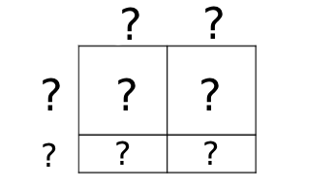
Self Check
Which of the following expressions is equivalent to (x − 2)²?
x² - 4
x² + 4
x² - 4x + 4
x² + 4x + 4
Let’s review!
Notes:
Answer Feedback - Individualized by Response
Incorrect. This is the square of the first and last term. Remember (x − 2)² = (x − 2)(x − 2). Distribute to multiply the binomials.
Incorrect. This is the square of the first and last term. Remember (x − 2)² = (x − 2)(x − 2). Distribute to multiply the binomials.
That’s correct! Multiply (x − 2)(x − 2) and distribute. The answer becomes x² - 2x - 2x + 4. Combining like terms gives x² - 4x + 4.
Incorrect. Watch the signs when multiplying. (x − 2)(x − 2) equals x² - 2x - 2x + 4.

Slide 12
Self Check - Review
In a previous lesson, you learned how to square a binomial.
(a + b)² = a² + 2ab + b² and (a − b)² = a² − 2ab + b²
Find the expression equivalent to:
(x - 3)²
(x - 4)(x + 2)
Notes:
Multiplying Binomials with Negative Numbers
Remind students:
Step 1: Distribute using FOIL
Step 2: Combine like terms
Step 3: Simplify
Answers
x² - 6x + 9
x² - 2x + 8

Slide 13
Lesson Journey
Warm Up
Learning Activity
Practice
Learning Activity
Cool Down
Lesson Synthesis

Slide 14

Learning Strategies - Learning Activity - Is it a Standard or Factored Form of a Quadratic?
Meet with your partnet to share your response to the question, “Why do you think that form is called factored form?”.
To help clarify your ideas, ask your partner:
  Can you say more about what each expression means?
  I understand _____, but can you clarify . . .
Revise your initial draft based on feedback from your partner.
Stronger and Clearer Each Time
Teacher Instruction: Use these strategies to adjust the activity to support English language learners and students with disabilities.
  You can copy and paste the callouts directly on top of the activity or give the instructions aloud.
Use the organizer to record examples.
Left column: Standard form (ax² + bx + c)
Right column: Factored form (a(x + m)(x + n))
Check that both forms match.
Bottom space: add your notes or reminders about each form.
Action and Expression
Notes:
Support for English Language Learners: MLR 1 Stronger and Clearer Each Time: Writing, Conversing
Use this routine to help students improve their writing by providing them with multiple opportunities to clarify their explanations through conversation. Give students time to meet with one to two partners to share their response to the final question, “Why do you think that form is called factored form?” Provide listeners with prompts for feedback that will help their partner add detail to strengthen and clarify their ideas. For example, students can ask their partner, “Can you say more about what each expression means?” or “I understand _____, but can you clarify . . .” Next, provide students with two to three minutes to revise their initial draft based on feedback from their peers.
Design Principle(s): Optimize output (for explanation)
Provide support for students
Distribute graphic organizers to the students to assist them with participating in this routine.
Support for Students with Disabilities: Action and Expression: Internalize Executive Functions
Provide students with a graphic organizer that can be used to brainstorm the activity. Include one column for standard form and one column for factored form. Include a space at the bottom of the organizer for student-generated notes or reminders about standard form and factored form.
Supports accessibility for: Language; Organization

Slide 15
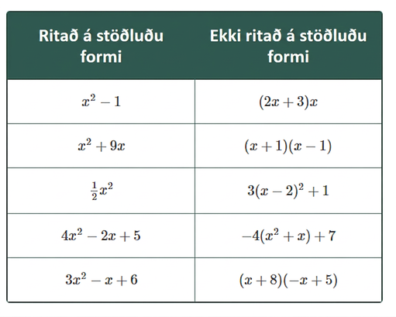
Learning Activity - Is it a Standard or Factored Form of a Quadratic?
The quadratic expression x² + 4x + 3 is written in standard form.
In the table the quadratic expressions on the left are written in standard form and the expressions on the right are not.
What are some characteristics of expressions in standard form?
(x + 1)(x − 1) and (2x + 3)x in the right column are quadratic expressions written in factored form. Why do you think that form is called factored form?
Are you ready for more?
Notes:
Support for All Learners
This activity offers additional support and an extension for students:
For English language learners and students with disabilities, be sure to review the Learning Strategies slide!
For students looking for an extra challenge, be sure to review the Extending Your Thinking slide!
Activity (10 minutes)
Students have seen quadratic expressions in both standard form and factored form since the beginning of the unit. In this activity, they learn to distinguish the expressions by their forms and to refer to each form by its formal name. Refining their language about the different forms prepares students to be more precise in their thinking about the graphs of quadratic functions in later lessons.
Launch
Arrange students in groups of two.
Give students quiet work time and then time to share their work with a partner.
Answers
1. The standard form always starts with an x² term and is in decreasing order of degree.
It does not need to have an x term or a numerical term.
Standard form is ax² + bx + c where a is not zero.
The standard form shows a sum or difference of terms.
2. It is a product of two factors. Each factor could be a variable, a number, or an expression with a variable (with no exponent) and a number.
Activity Synthesis
Display both columns of expressions and ask students what they notice about each form. Record their ideas and invite others to agree, disagree, or clarify.
A quadratic expression in standard form is ax² + bx + c, where a is the coefficient of x², b is the coefficient of x, and c is the constant.
Ask:
How would you write (2x + 3)x in standard form? (2x² + 3x)
Is 2x² + 3x still in standard form? (Yes, c = 0)
How would you write −4(x² + 14x) + 7 in standard form? (−4x² − 56x + 7)
What are a, b, and c in −4x² − x + 7? (a = −4, b = −1, c = 7)
Clarify that factored form shows the expression as a product of two linear factors, such as (x + 1)(x − 1), (2x + 3)x, or x(4x). Including a constant factor, like 2(x + 2)(x − 1), is also factored form.
Each form reveals different information about the same quadratic, which students will explore in future lessons.

Slide 16
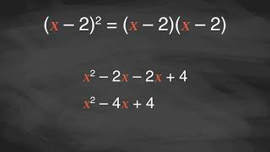
Video: Finding Products of Differences

Slide 17

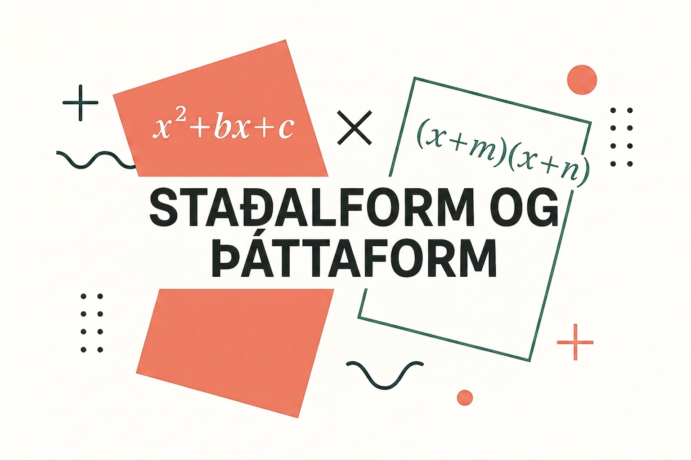
Extending Your Thinking
Which quadratic expression can be described as being both standard form and factored form? Explain how you know.
Notes:
Answer
x² could be viewed as both standard and factored. It has an x² term even though there is not a constant or linear term. It can also be written as the product of two linear expressions because x² is equal to x ⋅ x.
Go back to activity information.

Slide 18

Self Check
Which of the following expressions is a quadratic expression written in standard form?
x - 4
x² - 9x + 20
x(x - 5)
7(x − 6)² + 1
Let’s review!
Notes:
Answer Feedback - Individualized by Response
Incorrect. This expression does not have an x² term.
That’s correct! his expression leads with an x² term and is in standard form.
Incorrect. This is in factored form.
Incorrect. : This is not in the form ax² + bx + c.

Slide 19
Self Check - Review
What is the standard form of a quadratic expression?
Decide if each expression is in standard form.
  x² − 3x
  9(x − 2)
  x² + 4x − 45
  7 − x
  x(x + 10)
  x²
  x² − 9
What do all the expressions in standard form have in common?
Notes:
Standard Form of Quadratics
Answers
ax² + bx + c, where a ≠ 0.
a. Yes
b. No
c. Yes
d. No
e. No
f. Yes
g. Yes
These examples have an x² and lead with it.

Slide 20

Lesson Journey
Warm Up
Learning Activity
Practice
Learning Activity
Cool Down
Lesson Synthesis

Slide 21
Cool Down
For each expression, write an equivalent expression in standard form. Show your reasoning.
(2x + 5)(x + 1)
(x − 2)(x + 2)
Notes:
Cool Down (5 minutes)
Answers
2x² + 7x + 5. The diagram shows that(2x + 5)(x + 1) = 2x ⋅ x + 2x ⋅1 + 5 ⋅ x + 5 ⋅ 1. Adding this together gives 2x² + 7x + 5 in standard form.
2x 5
+-------+-------+
x | 2x² | 5x |
+-------+-------+
1 | 2x | 5 |
+-------+-------+
x² − 4. (x + 2)(x − 2) = x² + (−2x) + 2x + (−4) = x² − 4. The diagram also shows that (x + 2)(x − 2) = x² − 4.
x 2
+-------+-------+
x | x² | 2x |
+-------+-------+
-2 | -2x | -4 |
+-------+-------+

Slide 22

Lesson Journey
Warm Up
Learning Activity
Practice
Learning Activity
Cool Down
Lesson Synthesis

Slide 23

Practice
Put your hard work to action, practice what you’ve learned!
Notes:
Digital Practice: Access the practice pages at https://openstax.org/k12/algebra

Slide 24

Lesson Journey
Warm Up
Learning Activity
Practice
Learning Activity
Cool Down
Lesson Synthesis

Slide 25
Lesson Synthesis
Answer the questions to reinforce your understanding of standard and factored forms.
What does it mean to expand a factored expression?
How can a diagram can help expand (x + 4)(x − 10)?
How can we expand (x + 4)(x − 10) using the Distributive Property and without drawing a diagram?
How would you explain to a friend how to write an equivalent expression for (x − 10)(x − 15)?
Give different examples of quadratic expressions in standard and factored form.
Notes:
Possible Answers
To multiply out all the terms in each factor.
Each part of the rectangle shows a partial product: x² + 4x - 10x - 40 = x² - 6x - 40
x 4
+-------+-------+
x | x² | 4x |
+-------+-------+
-10 | -10x | -40 |
+-------+-------+
Multiply each term in the first factor by each in the second:
(x)(x − 10) + 4(x − 10) = x² − 10x + 4x −40 =x² − 6x− 40.
Use distribution or a diagram:
x² − 15x − 10x + 150 = x² − 25 x + 150.
x -10
+-------+-------+
x | x² | -10x |
+-------+-------+
-15 | -15x | 150 |
+-------+-------+
You answers many vary, but here are some samples.
Factored form: (x + 3)(x + 5), (x − 4)(x + 7)
Standard form: x² + 8x + 15, x² + 3x −28

Slide 26
Self Assessment
How much do you agree with the following statements?
I can… | I can | Almost | Not yet
Rewrite quadratic expressions given in factored form in standard form using either the distributive property or a diagram.
Explain the difference between “factored form” and “standard form.”

