Slide 1
Algebra 1
Unit 7 Introduction to Quadratic Functions
Lesson 7.13 Graphing the Standard Form, Part 2
Notes:
How to Get Started
Review Slide 2: How to use these slides
Check out the Check out the digital quick start guide!
Review Slide 3: Reference Key of Icons

Slide 2

How to use these slides
On the activity slides check the speaker notes for teacher support and instructional information.
Each lesson includes 1 warm up, 2-3 learning activities, a cool down, practice and a lesson synthesis.
  Learning activities are followed by a self check question, and review section.
Some slides have been hidden from student view, more information can be found on the next slide (Reference Key).
You can edit and use these slides for personal and classroom use, but cannot sell them and must keep the attribution logos.
For more information, Check out the digital quick start guide!
OpenStax CC BY NC SA

Slide 3





Reference Key
Check the top right corner for an icon referencing these unique sections.
Icon | Title | View | Location and Description
n/a | Support for Students with Disability | Hidden | Learning Strategies slide, provides additional support to students for understanding the activity.
n/a | Support for English Language Learners | Hidden | Learning Strategies slide, provides additional support to students for understanding the activity.
n/a | Extending Your Thinking | Hidden | Extending Your Thinking slide, provides an extra challenge for students.
n/a | Self Check | Not Hidden | Self Check slide, checkpoint to assess student understanding after the learning activity.
n/a | Review | Hidden | Self Check - Review slide, designed to help review topics from the self check question.
On the next slides, check the speaker notes for teacher instructions and support.
Notes:
Check the Speaker Notes: On the next slides you can find discussion questions, lesson information, answers to the activities, and ways to adjust the activity for your students!

Slide 4

Learning Goals
By the end of this lesson you will be able to -
Explain how the b in ax² + bx + c affects the graph of the equation.
Match equations given in standard and factored form with their graph.
Notes:
Lesson Narrative
In this lesson, students continue to examine the ties between quadratic expressions in standard form and the graphs that represent them. The focus this time is on the coefficient of the linear term, the b in ax² + bx + c, and how changes to it affect the graph. Students are not expected to know how to modify given expressions to transform the graphs in certain ways, but they will notice that adding a linear term to the squared term translates the graph in both horizontal and vertical directions. This understanding will help students to conclude that writing an expression such as x² + bx in factored form can help us reason about the graph.
Students also practice writing expressions that produce particular graphs. To do so, students make use of the structure in quadratic expressions and what they learned about the connections between expressions and graphs.
Required Preparation
Acquire devices that can run Desmos (recommended) or other graphing technology. It is ideal if each student has their own device.
Required Materials
Graphing technology
Texas Essential Knowledge and Skills
A1(F) analyze mathematical relationships to connect and communicate mathematical ideas
A6(C) write quadratic functions when given real solutions and graphs of their related equations
A7(A) graph quadratic functions on the coordinate plane and use the graph to identify key attributes, if possible, including x-intercept, y-intercept, zeros, maximum value, minimum values, vertex, and the equation of the axis of symmetry;

Slide 5
Vocabulary
Previous
None
New
None
Notes:
Lesson Vocabulary
To support student understanding of key vocabulary:
Introduce and review the vocabulary words students will see in this lesson.
Encourage students to notice how these words are used and to include them in their math discussions and explanations—both written and oral.
Use a word wall to reinforce vocabulary. Sample word wall cards are available here.
For newcomers or students with beginning English proficiency, use these Quizlet sets to support vocabulary learning:
Unit 7 Spanish Vocabulary – use first to build understanding
Unit 7 Vocabulary (English) – use after anchoring in Spanish
Support for English Language Learners
ELPS 1(E) internalize new basic and academic language by using and reusing it in meaningful ways in speaking and writing activities that build concept and language attainment
ELPS 2(F) listen to and derive meaning from a variety of media such as audiotape, video, DVD, and CD-ROM to build and reinforce concept and language attainment
ELPS 3(B) expand and internalize initial English vocabulary by learning and using high-frequency English words necessary for identifying and describing people, places, and objects, by retelling simple stories and basic information represented or supported by pictures, and by learning and using routine language needed for classroom communication
ELPS 3(D) speak using grade-level content area vocabulary in context to internalize new English words and build academic language proficiency
ELPS 3(E) share information in cooperative learning interactions

Slide 6
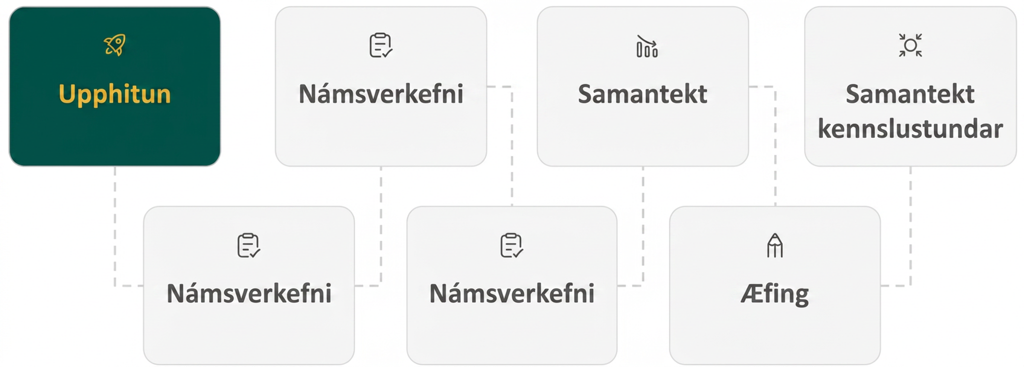
Lesson Journey
First Stop: Warm Up

Slide 7

Warm Up
What Do You Think They Have In Common? 💭
Complete each row with an equivalent expression in standard form or factored form.
What do the quadratic expressions in each column have in common (besides the fact that everything in the left column is in standard form and everything in the other column is in factored form)? Be prepared to share your observations.
Standard Form | Factored Form
x² | a. ___
d. ___ | x(x + 9)
x² - 18x | b. ___
e. ___ | x(x - 9)
-x² + 10x | c. ___
f. ___ | -x(x + 2.75)
Notes:
Warm Up (5 minutes)
In this warm up, students practice applying the distributive property to write equivalent quadratic expressions in standard and factored forms. They also notice that when a quadratic expression has no constant term (that is, is in the form of x² + bx), its factors are a variable and a sum (or a difference). Their awareness of this structure prepares them to think about how the linear term in a quadratic expression affects the behavior of the graph later in the lesson.
Launch
Arrange students in groups of two.
Give them a moment of quiet time to think individually, and then time to briefly share their responses with their partner.
Activity Answers
x ⋅ x
x(x - 18)
−x(x − 10) or x(−x + 10) or x(10 − x)
x² + 9x
-x² + 6x
-x² - 2.75x
In the left column, all the expressions in standard form have a squared term and a linear term but no constant term, and the squared term has a coefficient of either 1 or -1. In the right column, one of the factors is just a variable whose coefficient is 1 or -1, and the other factor is either a sum or a difference.
Activity Synthesis
Consider displaying the completed table for all to see. If needed, discuss only the last few expressions that can be written in a few different but equivalent ways.
Then, focus the discussion on the second question. Ask students:
"Look at all the quadratic expressions in standard form. What do they have in common?" (They have a squared term and a linear term. They do not have a constant term.)
"From these expressions, what can we predict, if anything, about the features of the graphs that represent them?" (Their y-intercept is (0, 0).) "Can you tell where the x-intercepts or the vertex will be?" (Not easily.)
"Look at all the expressions in factored form. What do they have in common?" (They are all in the form of x or -x times a sum or a difference.)
"From these expressions, what can we predict, if anything, about the features of the graphs?" (We can "see" their x-intercepts and the vertex.)
Remind students that they have looked at how the constant term and the coefficient of the squared term affect the features of a graph representing a quadratic function. Tell them that they will now explore how the linear term influences the graph, and that along the way, it can be helpful to think flexibly about the expressions that represent a function.

Slide 8
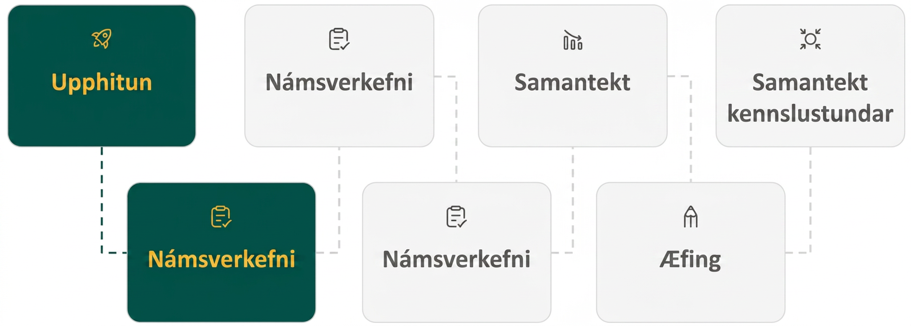
Lesson Journey
Second Stop: Learning Activity A

Slide 9

Learning Activity A | Learning Strategies
Experiment with the Linear Term 🧪
Teacher Instruction: Use these strategies to adjust the activity to support English language learners and students with disabilities.
You can copy and paste the callouts directly on top of the activity or give the instructions aloud.
Listen to a classmate’s explanation.
Restate their reasoning using math words from the lesson.
Try saying it again with phrases like “opens upward” or “coefficient of x².”
Repeat key phrases together to strengthen understanding.
Discussion Supports
Discuss the question in your small group.
Choose one person to share your group’s ideas with the class.
Be ready to speak for your group if called on.
Engagement
Notes:
Support for English Language Learners: MLR 8 Discussion Supports: Conversing, Representing
Use this routine to encourage students’ use of mathematical language to communicate understanding. After a student shares a response, invite them to repeat their reasoning using mathematical language relevant to the lesson. For example, say, “Can you say that again, using the phrase . . .?” Consider inviting remaining students to repeat completed phrases to provide additional opportunities for all students to produce language and solidify understanding.
Design Principle(s): Support sense-making
Support for Students with Disabilities: Engagement: Develop Effort and Persistence
Break the class into small discussion groups and then invite a representative from each group to report back to the whole class. Remind students that each member should be prepared to speak on behalf of the group if called on.
Supports accessibility for: Attention; Social-emotional skills

Slide 10
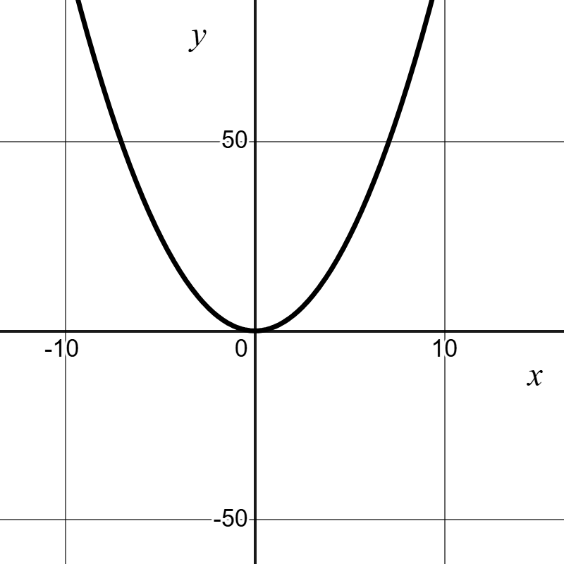
Learning Activity A | Part 1
Experiment with the Linear Term 🧪
Use a graphing tool.
Graph y = x², and then experiment with adding different linear terms (for example, x² + 4x, x² + 20x,
x² − 50x).
Record your observations.
Notes:
Support for All Learners
This activity offers additional support for students:
For English language learners and students with disabilities, be sure to review the Learning Strategies slide!
Activity (20 minutes)
In this activity, students use graphing technology to explore how adding a linear term (bx) to quadratic expressions of the form ax² + bx affects the graph’s position and shape. They observe that adding bx shifts the parabola both horizontally and vertically, changing the x-intercepts and vertex. For instance, y = x² has an x-intercept at (0, 0), while y = x² + 20x shifts left and down, with x-intercepts at (−20, 0) and (0, 0) and a vertex at (−10, −100). Students connect these patterns to factoring, noting that x² + 20x = x(x + 20) and that setting each factor to zero reveals the intercepts. They also observe that when the linear term is missing but a constant is added, factoring becomes more complex and x-intercepts may disappear, laying groundwork for later exploration of non-real roots.
Launch
Provide access to devices that can run Desmos or other graphing technology.
Consider arranging students in groups of two.
For the first question, ask one partner to operate the graphing technology and the other to record the group's observations, and then to switch roles halfway.
If using Desmos, instruct students that creating a slider to experiment with linear terms might be a useful tool in this activity.
Activity Answers
The graph still looks like a quadratic function when adding a linear term but it "shifts" both horizontally and vertically. Adding a positive multiple of x to x² shifts it down and to the left while adding a negative multiple of x shifts it down and to the right.
More activity questions, answers, and synthesis on the next slide.

Slide 11
Learning Activity A | Part 2
Experiment with the Linear Term 🧪
Use your observations from question 1 to answer questions 2 – 5.
Equation | x-intercept | x-coordinate of the vertex
y = x² + 6x | a. ___ | b. ___
y = x² - 10x | a. ___ | b. ___
y = -x² + 50x | a. ___ | b. ___
y = -x² + 36x | a. ___ | b. ___
y = x² - 25 | a. ___ | b. ___
y = x² + 16 | a. ___ | b. ___
Note:
Questions 6-7 have no linear terms. (It is possible for the graph not to intersect the x-axis.)
Notes:
Activity Answer
(0, 0), (−6, 0)
-3
(0, 0), (10, 0)
5
(0, 0), (50, 0)
25
(0, 0), (-36, 0)
-18
(5, 0), (-5, 0)
0
There are no x-intercepts.
0
Activity Synthesis
To help students make sense of shifts in x-intercepts, connect standard and factored forms of quadratic expressions. In factored form, the zeros (and therefore the x-intercepts) are visible.
For example:
x² − 20x = x(x − 20) → zeros at x = 0 and x = 20, giving x-intercepts (0, 0) and (20, 0).
x² + 50x = x(x + 50) → zeros at x = 0 and x = 50, x-intercepts (0,0) and (−50,0).
If the squared term has a negative coefficient, as in y = −x²−36x = −x(x + 36), the zeros are x = 0 and x = −36x. The vertex is still halfway between the two x-intercepts, even when the graph opens downward.
If there is no linear term but a constant term, such as y = x² + 16 or y = x² − 25, it is harder to find x-intercepts from the equation. y = x² + 16 has none, while y = x² − 25 = (x − 5)(x + 5) has two.
To extend thinking, have students predict how adding both a linear and constant term changes the graph, for example y = x² − 9x + 8. The graph now has a y-intercept at (0, 8), but finding x-intercepts requires new methods they will learn in upcoming lessons.

Slide 12
Learning Activity A
Self Check
Find the x-coordinates of all of the x-intercepts of the function f(x) = x² − 5x.
x = 5
x = 0, x = 5
x = 0
x = 0, x = -5
Let’s review!
Notes:
Answer Feedback - Individualized by Response
Incorrect. This is one of the x-intercepts, but there are two. Factor the expression, set each factor equal to zero, and solve.
That’s correct! In factored form, f(x) = x² − 5x = x(x − 5). The factors equal 0 at these values.
Incorrect. This is one of the x-intercepts, but there are two. Factor the expression, set each factor equal to zero, and solve
Incorrect. While x = 0 is an x-intercept, x = −5 is not. Factor f(x) = x² − 5x . Watch the signs when setting each factor equal to zero and solving

Slide 13

Learning Activity A
Self Check - Review
Find the x-intercepts and the vertex for
f(x) = x² − 4.
Step 1 - Write the function in factored form. Use difference of squares.
Step 2 - Set each factor equal to 0.
Step 3 - Find the x-value in the middle of the two x-intercepts. This occurs at x = 0. This is the x-coordinate of the vertex.
Notes:
Remind Students
The x-intercepts are (2, 0) and (−2, 0).
Vertex: (0, −4)

Slide 14
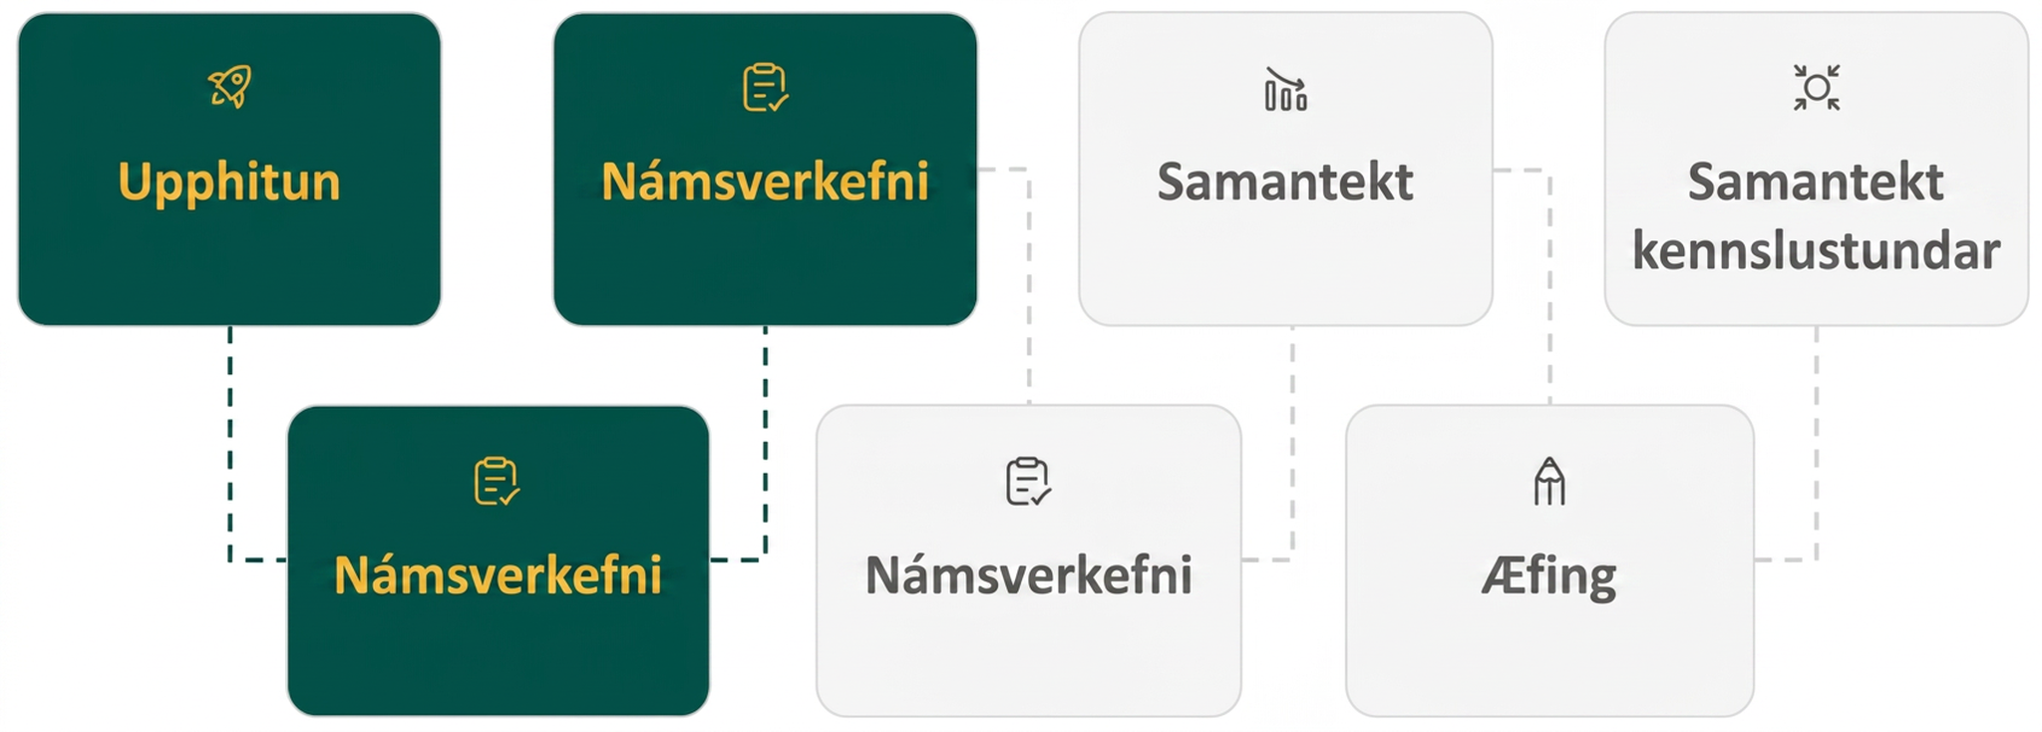
Lesson Journey
Third Stop: Learning Activity B

Slide 15
Learning Activity B | Learning Strategies
Identify the Function 🔎
Teacher Instruction: Use these strategies to adjust the activity to support English language learners and students with disabilities.
  You can copy and paste the callouts directly on top of the activity or give the instructions aloud.
Work with your partner to match each equation to its graph.
Partner A explains using: “Equation ___ matches graph ___ because….”
Partner B asks for details about intercepts, vertex, or direction of opening.
Switch roles for each new equation.
Discussion Supports
Choose at least 4 or 5 graphs to find their equations.
Start where you feel comfortable,
Each graph gets more challenging from A to J.
Engagement
Notes:
Support for English Language Learners: MLR 8 Discussion Supports: Conversing
Use this routine to help students describe their strategies for writing equations. Arrange students in groups of two. Invite Partner A to begin with this sentence frame: “Equation _____ matches with graph _____, because . . . .” Invite the listener, Partner B, to press for additional details referring to specific features of the graphs such as intercepts, vertex, and direction of opening. Students should switch roles for each equation. This will help students justify how features of quadratic graphs can be used to write equations.
Design Principle(s): Support sense-making; Cultivate conversation
Support for Students with Disabilities: Engagement: Provide Access by Recruiting Interest
Leverage choice around perceived challenge. Invite students to find functions for at least four or five of the graphs. Be sure to let students know that the equations increase in complexity as students move from Graph A to Graph J.
Supports accessibility for: Organization; Attention; Social-emotional skills

Slide 16
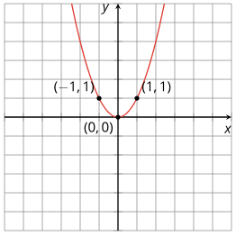
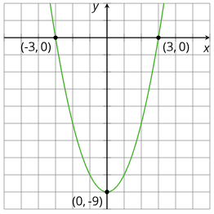
Learning Activity B | Part 1
Identify the Function 🔎
Use a graphing tool to identify the function that matches each graph. Make sure your graph goes through all three points shown!
2.
Notes:
Support for All Learners
This activity offers additional support for students:
For English language learners and students with disabilities, be sure to review the Learning Strategies slide!
Activity (10 minutes)
Students now work in reverse, writing equations to match given graphs using what they know about quadratic forms and their graph connections. Each graph shows at least three labeled points to support their reasoning. Some equations are easier to write in factored form, others in standard form. Highlight students who use the given information strategically and invite them to share their thinking.
Note: Questions 1, 2, 5, and 10 are shown in this slide version. All problems can be found in the online version.
Launch
Provide access to graphing technology.
The activity allows for instant feedback to students (if an equation is incorrect, the graph that results will not match the given graph).
Because the equations increase in complexity as students move from Graph A to Graph J, students may find that their equations are off but not know what the issue is or how to correct them.
Consider arranging students in groups of two so that they can discuss how to write the more-challenging equations.
Activity Answers
y = x²
y = x² - 9 or y = (x − 3)(x + 3)
More activity questions, answers, and synthesis on the next slide.

Slide 17
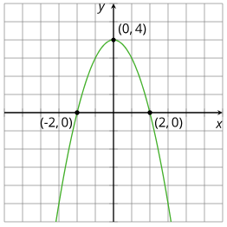
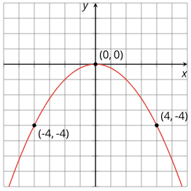
Learning Activity B | Part 2
Identify the Function 🔎
Questions 3,4,6-9 can be found in the online textbook.
5.
10.
Notes:
Answers
y = (x + 2)(x − 3)
y = x(x + 6)
Activity Synthesis
Select students to share strategies for writing equations. Emphasize these key ideas:
• If a graph opens up, the x² term’s coefficient is positive; if it opens down, it’s negative.
• With two x-intercepts, use factored form.
• When the graph is centered on the y-axis and the y-intercept is (0, c), the equation is y = ax² + c (no linear term).
• If (0, 0) is the only intercept and vertex, the equation is y = ax².
Discuss Graph F as an example with one x-intercept (2, 0) and a y-intercept not at the origin. Its equation can be found by squaring the repeated factor:
(x − 2)(x − 2) = x² − 4x + 4, showing the y-intercept (0, 4).
Connecting this to earlier work, shifting y = x(x − 4) up by 4 units also gives y = x² − 4x + 4.

Slide 18
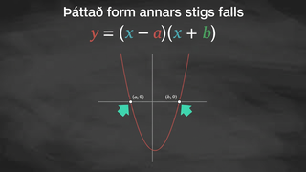
Learning Activity B | Video
Writing Equations that Represent a Quadratic Graph
Notes:
This video discusses question 2 of activity 7.13.3

Slide 19
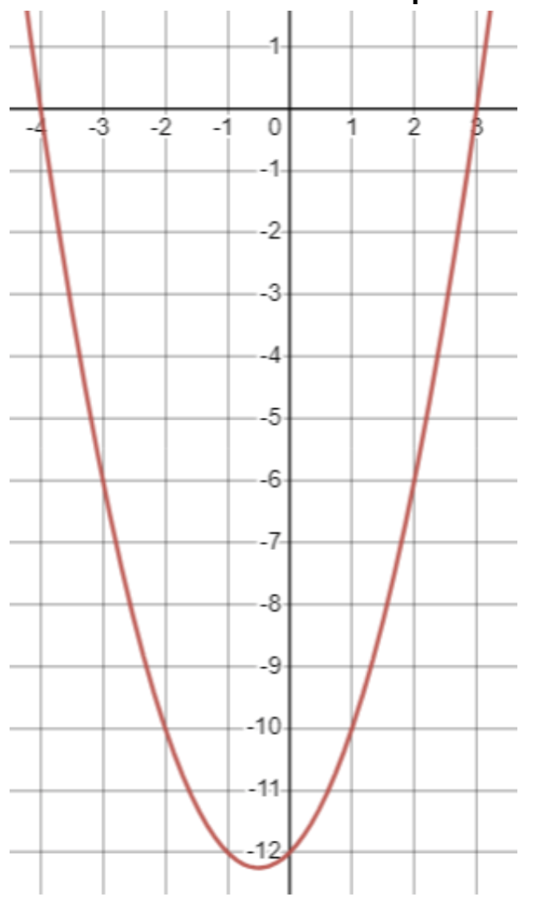
Learning Activity C
Self Check
Which equation describes the graph?
f(x) = (x + 3)(x − 4)
f(x) = x + 12
f(x) = x(x + 3)
f(x) = (x − 3)(x + 4)
Let’s review!
Notes:
Answer Feedback - Individualized by Response
Incorrect. The signs of the constants in the factors should be opposite signs as the x-intercepts.
Incorrect. Factored form is based on the x-intercepts, not the vertex.
Incorrect. The x-intercepts of this function are 0 and -3. x = 0 is not an x-intercept. Watch the signs when writing the factors from the intercepts.
That’s correct! The x-intercepts are at 3 and -4 so the factors are (x − 3) and (x + 4).

Slide 20
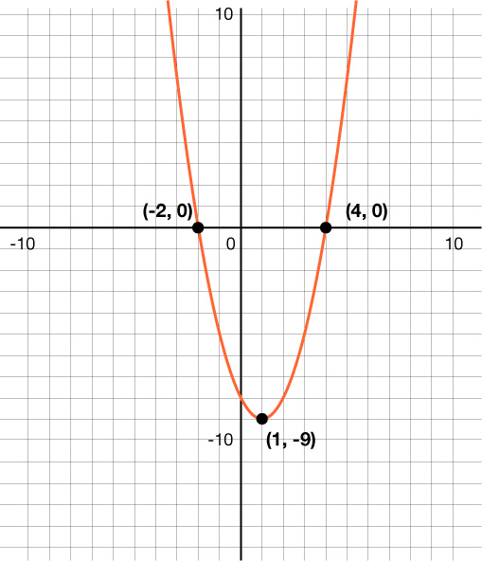
Learning Activity B
Self Check - Review
Write an equation for the graph.
Step 1 - Locate the x-intercepts
Step 2 - Write the factor for each x-intercept.
Step 3 - Use graphing technology to check your answer.
Notes:
Remind Students
f(x) = (x + 2)(x − 4).

Slide 21
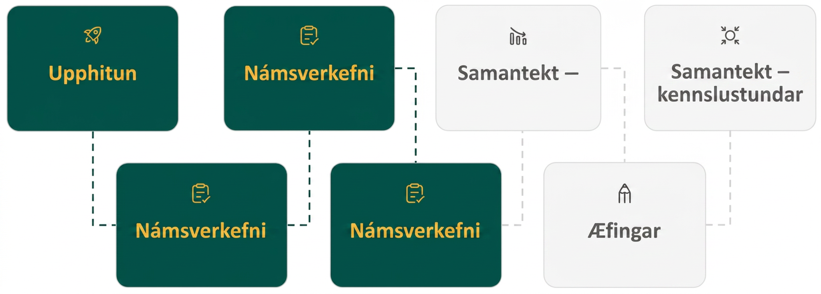
Lesson Journey
Fourth Stop: Learning Activity C

Slide 22

Learning Activity C
Quadratic Equations without Graphing🚫📈
A parabola crosses the x-axis at (-1, 0) and (2, 0). We want to write a quadratic equation with those x-intercepts without graphing.
When y = 0, what must x be?
Rewrite the equations from number 1 so they both equal zero.
What equation do you get when you multiply the previous equations together?
Multiply the binomials.
Notes:
Activity (15 minutes)
In this activity, students work backward from the x-intercepts of a parabola to build its quadratic equation, connecting what they know about factoring and real solutions. This helps them see how the structure of an equation reflects the graph’s key features.
Launch
Students may be tempted to solve these problems using Desmos or another technology as they did in the previous section.
Remind students the purpose of this unit is writing quadratic equations from real solutions without graphing.
Activity Answer
We know that (-1, 0) and (2, 0) are points on the graph when y = 0. So there are two possibilities for x: x = −1 and x = 2. x = −1 and x = 2 are called the real solutions of the quadratic because they are the solutions of the equation when we set y = 0.
x + 1 = 0 and x − 2 = 0. Because each of the equations equals zero, multiplying them together will also equal zero.
(x + 1)(x − 2) = 0
x² − x − 2 = 0
This answer can also give us the more general quadratic with those x-intercepts. We replace 0 with y to show that y varies and isn’t always 0. So, y = x² − x − 2 is a parabola that crosses the x-axis at -1 and 2.
Activity Synthesis
Students now reverse their earlier process, working from known x-intercepts to write a quadratic equation. Extensions could include determining whether the parabola opens up or down or using a known point, such as the y-intercept, to find the value of a.

Slide 23

Learning Activity B
Self Check
Write a quadratic from the real solutions x = −3 and x = 4 without graphing.
y = x² − x − 12
y = x² − x + 12
y = x² + x − 12
y = x² + x + 12
Let’s review!
Notes:
Answer Feedback - Individualized by Response
That's correct! x = −3 and x = 4 becomes x + 3 = 0 and x − 4 = 0. y = (x + 3)(x − 4) = x² − x − 12.
Incorrect. Check your signs when you use FOIL to multiply the binomials.
Incorrect. Remember that x = −3 and x = 4 becomes x + 3 = 0 and x − 4 = 0. y = (x + 3)(x − 4) = x² − x − 12.
Incorrect. Check your signs when you use FOIL to multiply the binomials.

Slide 24
Learning Activity C
Self Check - Review
Find the x-intercepts of:
y = x² + 2x − 3
Step 1 - Write the quadratic in factored form.
Step 2 - Set y = 0, to find the places where the parabola crosses the x-axis.
Step 3 - Find the x-intercepts
Step 3 - Use graphing technology to check your answer.
Notes:
Answers
−3 and 1

Slide 25
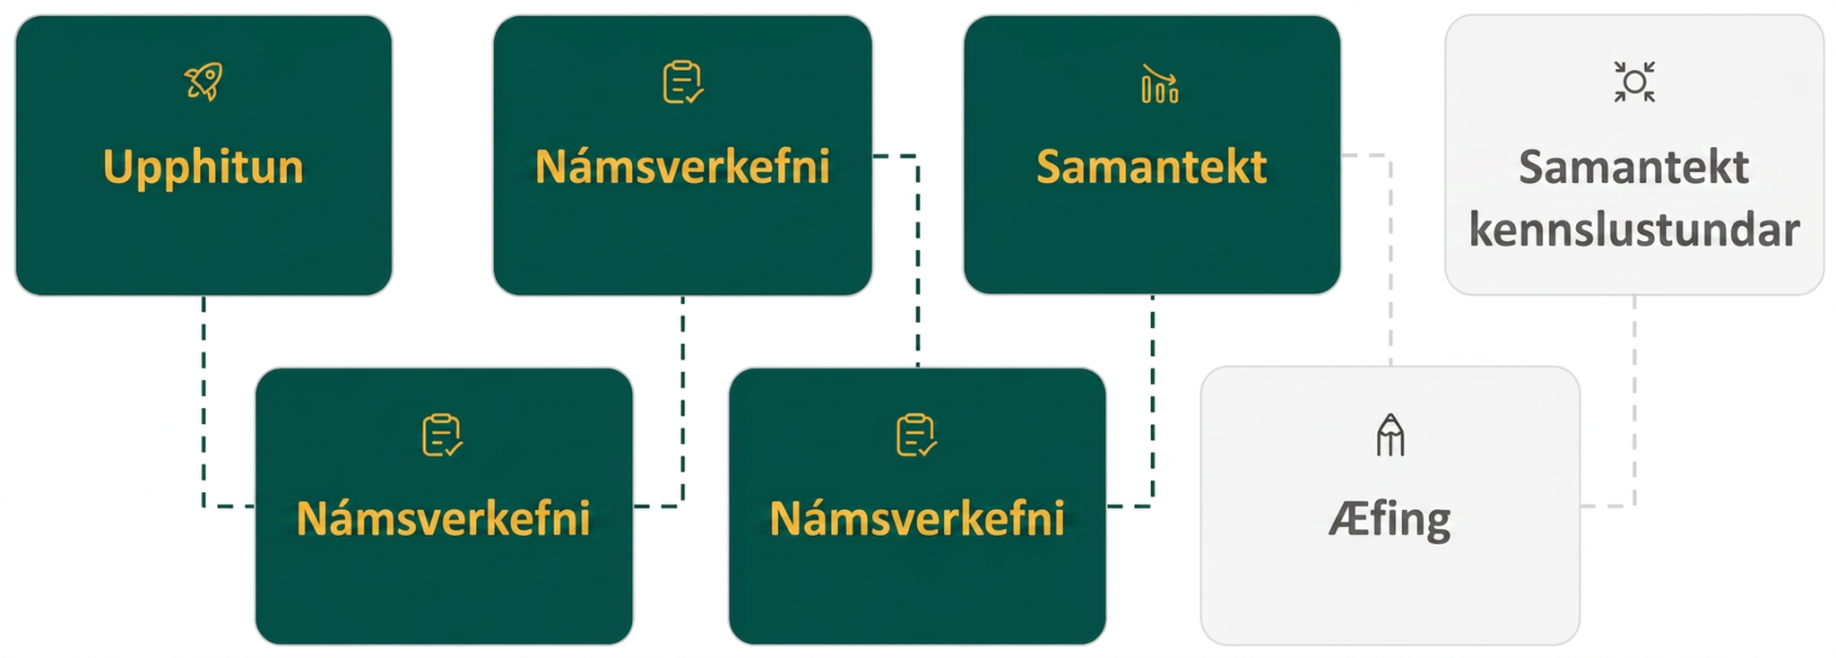
Lesson Journey
Fifth Step: Cool Down

Slide 26
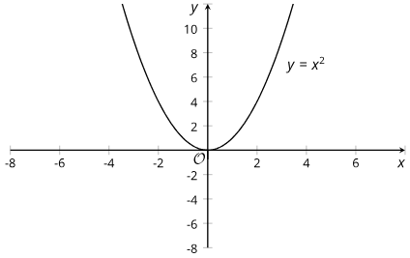
Cool Down
Consider the graph of quadratic equation y = x² − 4x.
  Where are the x-intercepts located?
  What is the x-coordinate of the vertex?
Here is a graph of y = x² . Copy it and graph
y = x + 5x on the same graph and explain how you knew where to sketch it.
Notes:
Cool Down (5 minutes)
Launch
Ask students to put away devices for this cool down.
Answers
x = 0 and x = 4.
2. The vertex is halfway between the intercepts at x = 2.
x² + 5x is equivalent to x(x + 5), so the x-intercepts are at x = 0 and x = −5. Calculate the vertex by finding the x-coordinate in between x = −5 and x = 0 which is x = −2.5. Substitute x = −2.5 into the equation to find the y-coordinate:
y = (−2.5)2 + 5(−2.5) = −6.188. The vertex is at (−2.5, −6.188). The squared term has a positive coefficient so the graph opens upward. Adding a positive linear term to x² shifts the graph down and to the left.
Link to Desmos graph: https://www.desmos.com/calculator/ntvpk3pd1h
Response to Student Thinking - More Chances
This lesson goes beyond the depth of understanding required to address the standards, so there is not a need to slow down if students struggle with these ideas.

Slide 27
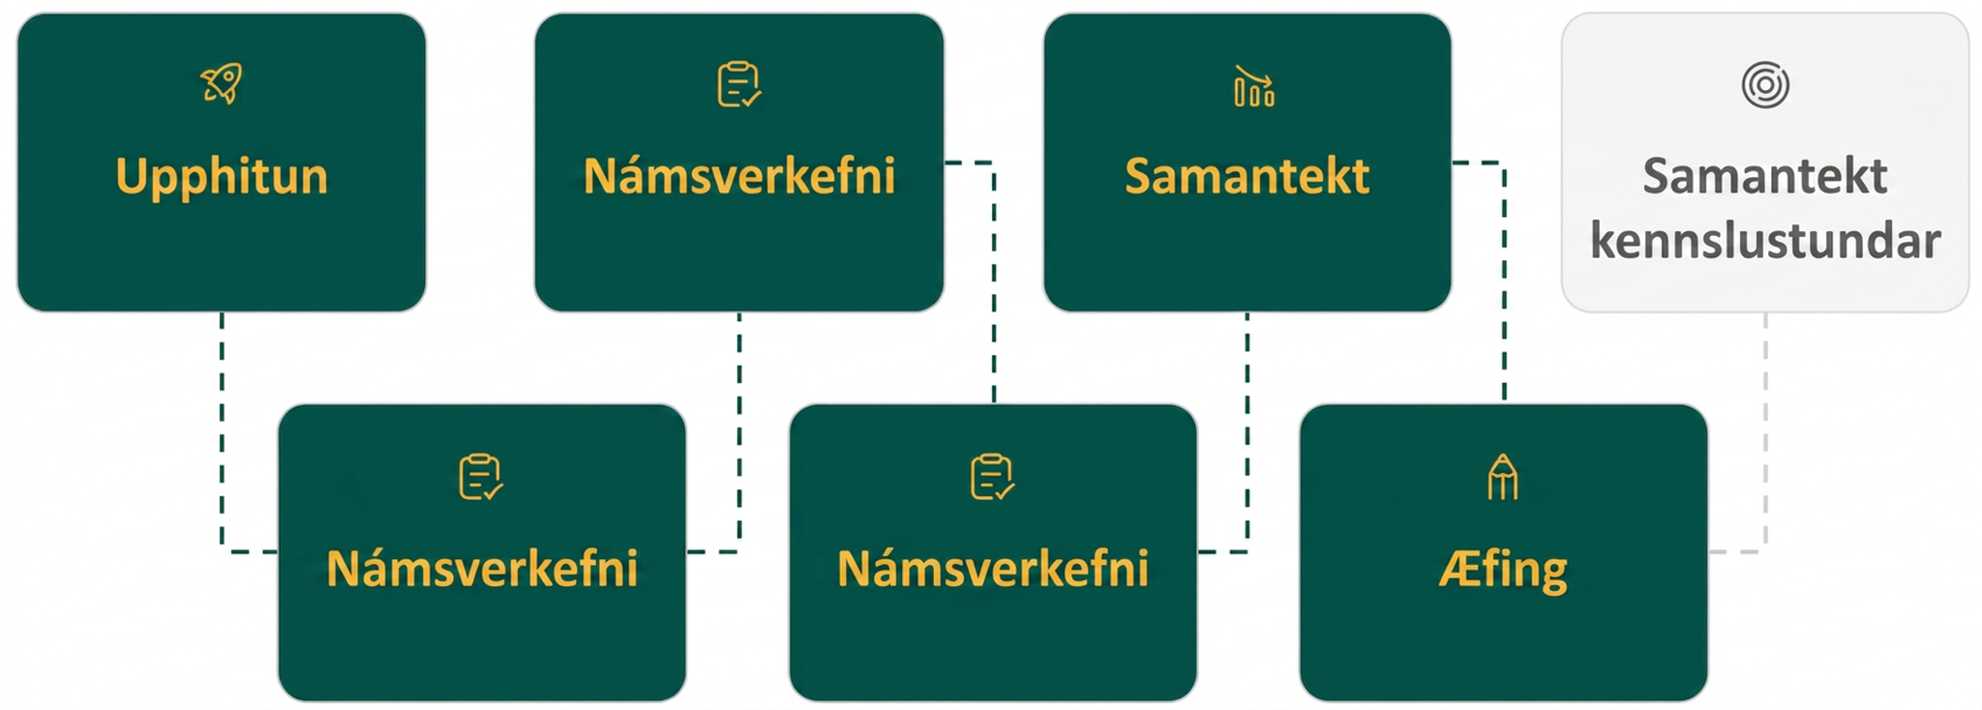
Lesson Journey
Sixth Stop: Practice

Slide 28

Practice
Put your hard work to action, practice what you’ve learned!
Notes:
Digital Practice: Access the practice pages at https://openstax.org/details/books/algebra-1

Slide 29
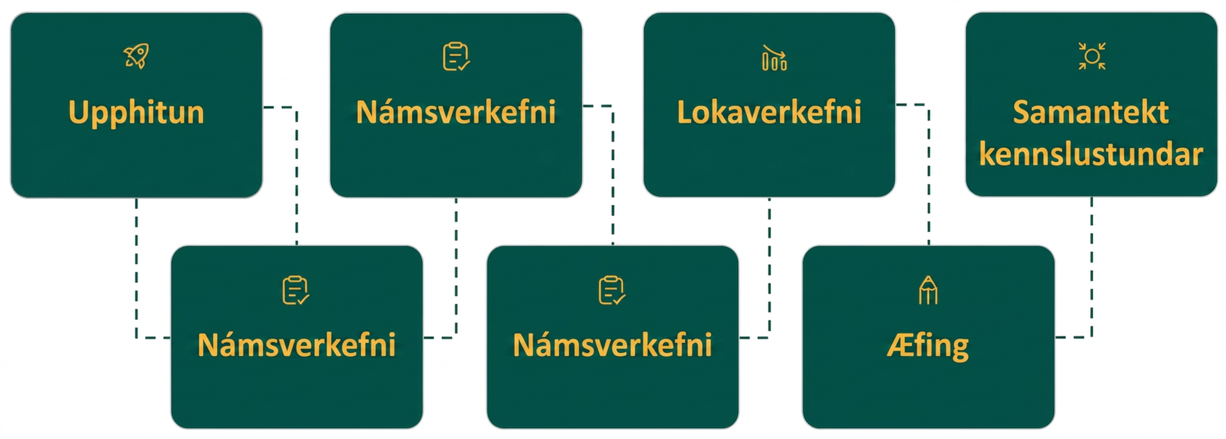
Lesson Journey
Seventh Stop: Lesson Synthesis

Slide 30
Lesson Synthesis
Answer each question to reflect on the lesson how each form of quadratic expression reveals the features of the graph.
Suppose two students are debating whether an expression in standard form or in factored form is more useful for sketching the graph representing y = (x + 1)(x − 6), which is equivalent to
y = x² − 5x − 6.
Tyler claims that the standard form is more useful. Clare thinks the factored form is the way to go.
If you were Tyler, how would you support your claim?
What if you were Clare?
Draw a Venn diagram to compare the features of a graph that can be identified from standard and factored forms.

Slide 31
Self Assessment
How much do you agree with the following statements?
Learning Goals | I can | Almost | Not yet
Explain how the b in ax² + bx + c affects the graph of the equation. | ⃞ | ⃞ | ⃞
Match equations given in standard and factored form with their graph. | ⃞ | ⃞ | ⃞

