Slide 1


Algebra 1
Unit 3 Two Variable Statistics
Lesson 3.6 Causal Relationships

Slide 2
How to use these slides
On the activity slides check the speaker notes for teacher support and instructional information.
Each lesson includes 1 warm up, 2-3 learning activities, a cool down, practice and a lesson synthesis.
  Learning activities are followed by a self check question, and review section.
Some slides have been hidden from student view, more information can be found on the next slide (Reference Key).
You can edit and use these slides for personal and classroom use, but cannot sell them and must keep the attribution logos.
For more information, Check out the digital quick start guide!

Slide 3






Reference Key
Check the top right corner for an icon referencing these unique sections.
 | Support for Students with Disability | Hidden | Learning Strategies slide, provides additional support to students for understanding the activity. Learning Strategies slide, provides additional support to students for understanding the activity.
 | Support for English Language Learners | Hidden
 | Extending Your Thinking | Hidden | Extending Your Thinking slide, provides an extra challenge for students.
 | Self Check | Not Hidden | Self Check slide, checkpoint to assess student understanding after the learning activity.
 | Review | Hidden | Self Check- Review slide, designed to help review topics from the self check question.
On the next slides, check the speaker notes for teacher instructions and support.
Notes:
Check the Speaker Notes: On the next slides you can find discussion questions, lesson information, answers to the activities, and ways to adjust the activity for your students!

Slide 4

Learning Goals
By the end of this lesson you will be able to -
Determine whether or not there is a causal relationship.
Notes:
Lesson Narrative
The mathematical purpose of this lesson is to understand that the relationship between variables can be, but is not always, a causal relationship. A causal relationship is one in which a change in one of the variables directly causes a change in the other variable.
When students determine that there is a causal relationship, they are attending to precision because they are refining their language to be more precise.
When students analyze the relationship between two variables to determine whether they have a causal relationship, they are modeling with mathematics.
The work of this lesson connects to previous work because students interpreted the relationship between two variables using the correlation coefficient.
Required Preparation
None
Required Materials
None
Texas Essential Knowledge and Skills
A1(A) apply mathematics to problems arising in everyday life, society, and the workplace.
A1(G) display, explain, and justify mathematical ideas and arguments using precise mathematical language in written or oral communication.
A4(B) compare and contrast association and causation in real-world problems.

Slide 5
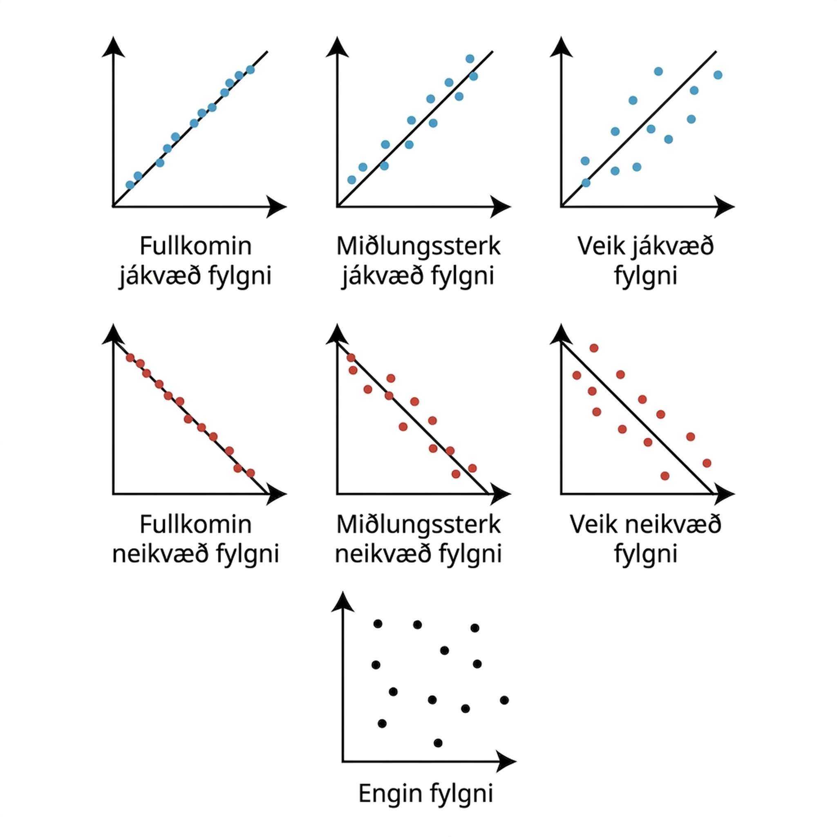
Vocabulary
Previous
Correlation coefficient
  Describes the strength and direction of a linear association between two numerical variables.
Negative relationship
  An increase in one variable tends to be paired with a decrease in the other variable.
Positive relationship
  An increase in one variable tends to be paired with a increase in the other variable.
Notes:
Lesson Vocabulary
To support student understanding of key vocabulary:
Introduce and review the vocabulary words students will see in this lesson.
Encourage students to notice how these words are used and to include them in their math discussions and explanations—both written and oral.
Use a word wall to reinforce vocabulary. Sample word wall cards are available here.
For newcomers or students with beginning English proficiency, use these Quizlet sets to support vocabulary learning:
Unit 3 Spanish Vocabulary – use first to build understanding
Unit 3 Vocabulary (English) – use after anchoring in Spanish
Support for English Language Learners
ELPS 1(E) internalize new basic and academic language by using and reusing it in meaningful ways in speaking and writing activities that build concept and language attainment
ELPS 2(F) listen to and derive meaning from a variety of media such as audiotape, video, DVD, and CD-ROM to build and reinforce concept and language attainment
ELPS 3(D) speak using grade-level content area vocabulary in context to internalize new English words and build academic language proficiency
ELPS 3(E) share information in cooperative learning interactions
ELPS 4(E) read linguistically accommodated content area material with a decreasing need for linguistic accommodations as more English is learned
ELPS 5(B) write using newly acquired basic vocabulary and content-based grade-level vocabulary

Slide 6
Vocabulary
Previous
Strong relationship
  A relationship between two numerical variables where data is tightly clustered around the best fit line.
Weak relationship
  A relationship between two numerical variables where data is loosely spread around the best fit line.
New
Causal relationship
  A relationship in which a change in one variables causes a change in the other variable.

Slide 7






Lesson Journey
Warm Up
Learning Activity
Practice
Learning Activity
Cool Down
Lesson Synthesis

Slide 8

Warm Up - Describe the Relationship 🚗
Describe the strength and sign of the relationship you expect for each pair of variables. Be prepared to show your reasoning.
Used car price and original sale price of the car
Used car price and number of cup holders in the car
Used car price and number of oil changes the car has had
Used car price and number of miles the car has been driven
Notes:
Warm Up (5 minutes)
The mathematical purpose of this activity is for students to describe the relationship between variables using mathematical terminology, such as strong or weak relationship and positive or negative relationship. These terms were defined in the previous lesson.
Launch
Arrange students in groups of 2. After quiet work time, ask students to compare their responses to their partner’s and decide if they are both correct, even if they are different. Follow with a whole-class discussion.
To help students understand some of the context, explain that for many modern cars, it is recommended that the oil be changed every 5,000 miles driven or every 5 months.
Continue to scroll down through the notes for activity answers and synthesis questions.
Answers: Tell students there are many possible answers for the questions (these are some samples).
Strong, positive linear relationship since a car that cost a lot at first is probably still worth more later than a car that was less expensive when it was first bought.
Weak to no relationship. Although it is useful to have some cup holders, very little of a car’s value is based on the number present in the car.
Strong, positive linear relationship since cars usually have their oil changed every few thousand miles or every few months, so a lot of oil changes indicates the car has either been driven very far or owned for a long time, so it is probably worth less than a car with fewer oil changes.
Strong, negative relationship since the number of miles a car has been driven usually indicates more wear on the engine and other car parts, so the car is not worth as much as a car that has been driven less.
Activity Synthesis
The purpose of this discussion is for students to discuss the strength of relationships in preparation for having students distinguish between causal relationships and statistical relationships. Encourage the use of the terms strong or weak relationship and positive or negative relationship in the discussion.
The discussion should focus on the reasoning for the last 2 problems and how they are similar and different. Here are some questions for discussion.

Slide 9

Lesson Journey
Warm Up
Learning Activity
Practice
Learning Activity
Cool Down
Lesson Synthesis

Slide 10

Learning Strategies - Describe Relationships
Teacher Instruction: Use these strategies to adjust the activity to support English language learners or students with disabilities.
  You can copy and paste the callouts directly on top of the activity or give the instructions aloud.
What other terms or diagrams should we add?
How can we color code the terms and graphs to highlight connections?
Representation
Notes:
Support for Students with Disabilities: Representation: Develop Language and Symbols
Create a display of important terms and vocabulary. After the first question, invite students to suggest language or diagrams to include that will support their understanding of causal relationships. Examples to include can be phrases such as, “increased rain causes people to wear jackets.” The two variables can be color-coded in two different colors to reveal the relationship. Both the axes and the labels can be highlighted with the color that connects it to the type of variable it addresses.
Supports accessibility for: Conceptual Processing; Language

Slide 11
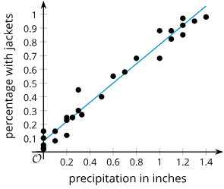
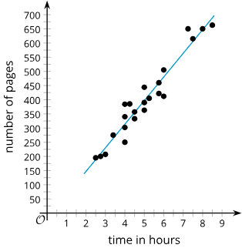
Learning Activity - Describe Relationships
How are the variables related?
Graph 1 - During the month of April, Elena keeps track of the number of inches of rain, or precipitation, recorded for the day and the percentage of people who come to school with rain jackets. |  | Graph 2 - A school book club has a list of 100 books for its members to read. They keep track of the number of pages in the books the members read from the list and the amount of time it took to read the book.
Notes:
Support for All Learners
This activity offers additional support for students:
For students with disabilities, be sure to review the Learning Strategies slide!
Activity (15 minutes)
The mathematical purpose of this activity is for students to describe how two variables are related and to determine whether there is a causal relationship or simply an association.
Students should begin to recognize that some variables may be related, but one does not cause the other to change. At this point, the mathematics of scatter plot analysis cannot determine whether there is a causal relationship. The relationship must be thought through carefully to decide, based on the situation, whether the related variables have a causal relationship.
Launch
Arrange students in groups of 2. Tell students there are many possible answers for the questions. After quiet work time, ask students to compare their responses to their partner’s and decide if they are both correct, even if they are different. Follow with a whole-class discussion.
Answers
When there is more rain, it is more likely people will wear jackets.
Longer books will take more time to read.
Additional activity questions, answers, and synthesis are on the next slide.

Slide 12
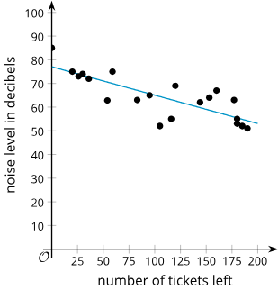
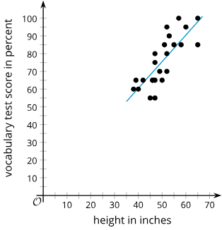
Learning Activity - Describe Relationships
How are the variables related?
Graph 3 - Number of tickets left for holiday parties at a venue and noise level at the party. |  | Graph 4 - The height and score on a test of vocabulary for several children ages 6 to 13.
Notes:
Answers
When more tickets are left, the party will have fewer people to have loud conversations, so it will be quieter.
Children who are taller are usually older, so they have had more time to be in school and learn more vocabulary.
Activity Synthesis
The goal is for students to develop an understanding of what it means for a relationship between two variables to be a causal relationship.
For each pair of variables, ask students what might have caused the variables to be linked.
In the first two graphs here, one of the variables causes a change in the other. - CAUSAL RELATIONSHIPS
In the last two graphs here, an additional variable or situation is the cause of the change. - ASSOCIATIONS
Ask students to compare and contrast the difference between situations that are causal and those that are merely associations. (Associations may indicate a relationship between data sets or variables, but causal relationships indicate one variable directly causes or impacts the other variable.)
Tell students that since most people are used to seeing independent variables on the 𝑥-axis and dependent variables on the 𝑦-axis, the convention is to put the causal variable on the 𝑥-axis and the other variable on the 𝑦-axis when one of the variables does cause the other to change. NOTE: The book club scatter plot should probably have the axes switched to meet the convention.
Here are some questions for discussion.
Why does an increase in precipitation cause an increase in the percentage of people wearing rain jackets?
When it rains, people usually wear coats to stay dry.
An increase in the time it takes to read a book does not cause the number of pages in the book to increase. Does an increase in the number of pages in a book cause the time it takes to read a book to increase? Be prepared to show your reasoning.
Yes, if you switch the axes on the graph, you can see that relationship. It is causal because it takes longer to read more pages.

Slide 13
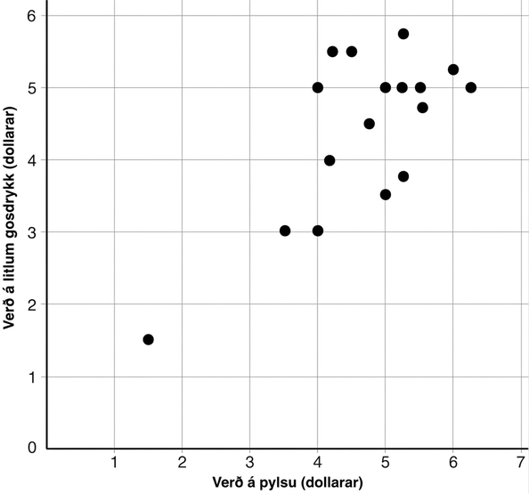
Self Check
In this scatter plot, which sentence best describes how the two variables are related?
The more hot dogs that are bought, the more sodas that are bought.
Hot dog prices and small soft drink prices are not related.
At different locations, as hot dog prices increase, small soda prices also increase.
As hot dog prices go up, soft drink prices go down.
3.6.2 Describing How Two Variables Are Related
Let’s review!
Notes:
Answer Feedback
Incorrect. The scatter plot shows the price of hot dogs and sodas and how they are related, not the quantity bought.
Incorrect. The scatter plot shows a relatively strong positive relationship.
That’s correct! As a general trend, as the hot dog prices go up, so do the soft drink costs.
Incorrect. This describes a negative relationship, but the scatter plot shows a positive relationship.

Slide 14
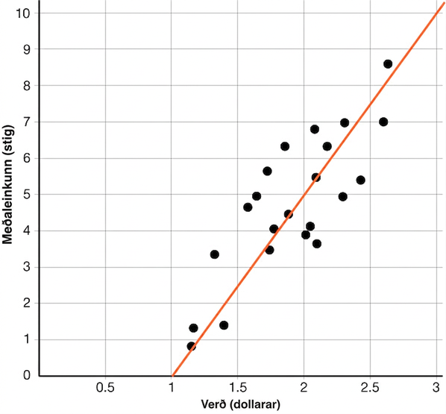
Self Check - Review
Causal Relationships
A panel is rating different kinds of potato chips. The scatter plot shows the relationship between their average rating and the price of the chips, along with the line of best fit.
How could the variables be related?
Does this represent a causal relationship or simply an association?
Notes:
Answers
As the price of a bag of chips in dollars increases, the average rating of the bag of chips in points increases.
In this situation, the independent variable, price, does not seem to cause the rating a person gives the chips. While there appears to be a positive association, there are other factors that may cause the ratings for a bag of chips to go up. For instance, advertising on tv or social media might cause a particular kind of chip to increase in ratings without a change in their price.

Slide 15
Lesson Journey
Warm Up
Learning Activity
Practice
Learning Activity
Cool Down
Lesson Synthesis

Slide 16
Learning Strategies - “Causal” Relationships
Teacher Instruction: Use these strategies to adjust the activity to support English language learners or students with disabilities.
  You can copy and paste the callouts directly on top of the activity or give the instructions aloud.
Write an initial draft explanation.
Share your response and get feedback.
Revise your draft based on the feedback received.
Stronger and Clearer Each Time
Brainstorm pairs of variables.
Use the sentence stems:
“ ___ reminds me of ___ because …”
“___’s idea reminds me of … “
Analyze which pairs of variables best fit each condition
Engagement
Notes:
Support for English Language Learners: MLR 1 Stronger and Clearer Each Time: Conversing
Use this routine to help students improve their writing by providing them with multiple opportunities to clarify their ideas through conversation. Give students time to meet with 2–3 partners to share their response to the last question. Students should first check to see if they agree with the experiment to show a correlation or causation. Provide listeners with prompts for feedback that will help their partner add detail to strengthen and clarify their ideas. For example, students can ask their partner: “Why do you think these are not causal?” or “How would the data show if the relationship was correlation or causal?” Next, provide students with 3–4 minutes to revise their initial draft based on feedback from their peers. This will help students understand relationships that may or may not be causal.
Design Principle(s): Support sense-making; Optimize output (for explanation)
Provide support for students
Distribute graphic organizers to the students to assist them with participating in this routine.
Support for Students with Disabilities: Engagement: Develop Effort and Persistence
Encourage and support opportunities for peer collaboration. Prior to directing students’ attention to the task, invite students to brainstorm various pairs of variables (both with and without correlation). Encourage students to free-associate and build on each other’s ideas. When students share their work with a partner, display sentence frames to support conversation, such as: “_____ reminds me of _____ because . . .” and “_____’s idea reminds me of . . .” After students have developed a list of several options, share the conditions list and then encourage them to analyze and select which one best fits each condition.
Supports accessibility for: Language; Social-emotional skills

Slide 17
Learning Activity - “Causal” Relationships
The phrases “correlation, not causation” or “association, not causation” are often used to refer to situations in which there is a relationship, but it is not a causal relationship.
While correlation is used to describe the strength of the relationship between variables, a causal relationship means a change in one of the variables actually causes a change in the other variable.
Notes:
Support for All Learners
This activity offers additional support and an extension for students:
For English language learners and students with disabilities, be sure to review the Learning Strategies slide!
For students looking for an extra challenge, be sure to review the Extending Your Thinking slide!
Activity (10 minutes)
The mathematical purpose of this activity is for students to practice using the term causal relationship and think of situations to which it might apply and where relationships are causal.
Launch
Tell students that people often use the phrase “correlation, not causation” or “association, not causation” to refer to situations in which there is a relationship, but it is not a causal relationship. A causal relationship means that a change in one of the variables actually causes a change in the other variable.
Arrange students in groups of 2 – 4. Give students several minutes to record answers to the questions individually and then ask students to share their answers with each other and determine if the answer is correct.
Activity questions, answers, anticipated misconceptions and synthesis on the next slide.

Slide 18
Learning Activity - “Causal” Relationships
Describe a pair of variables with each condition. Be prepared to show your reasoning.
Two variables have a causal relationship.
Two variables have an association in which the variables are strongly related, but a third factor might be the cause for the changes in the variables.
The variables are not related.
How are associations and causal relationships similar?
How are associations and causal relationships different?
How are associations and causal relationships different from data sets representing data that are not related?
Are you ready for more?
Notes:
Answers - Answers will vary, but here are some samples.
Length of a person’s foot in inches and their men’s shoe size. Increased foot size would cause someone to purchase larger shoe sizes.
Amount of power produced by solar panels and percentage of people wearing sunglasses while driving. These factors are probably strongly, positively related, but the cause is the amount of sunlight getting through to the ground for each variable rather than either one of the variables causing the other to increase directly.
The number of hits by a certain baseball player per game for a season and the price of a barrel of oil on the day of the games. There is no reasonable relationship between the variables, and they are very unlikely to be related even by external causes.
Associations and causal relationships indicate that two data sets or variables are related in some way.
Causal relationships involve variables that interact in a way that one causes the other. Associations may have other factors that impact the relationship or they simply have a correlation, but one does not cause the other.
Associations and causal relationships have some type of relationship or interaction between the variables. Unrelated data my just be random numbers or pairings of data sets.
Anticipated Misconceptions
Students may still wonder how two variables can be correlated without having a causal relationship. It may help to provide an example, such as sales of ice cream and sales of sunburn remedies.
Ask students why these variables might be related and whether increasing one would cause the other variable to increase.
Ask students to think of something that might cause two distinct outcomes to result.
Activity Synthesis
The goal of this discussion is for students to gain a deeper understanding of what it means for variables to have a causal relationship. Here are some questions for discussion.
Which pair of variables was the most difficult for you to describe? Explain your reasoning.
I had a hard time describing a pair of variables that were strongly related but where a third factor might be the cause. It was difficult because I kept coming up with causal relationships.
For question 1, how did you convince yourself or your group that one variable causes a change in the other?
To convince them, I gave an example of using the variables in context. My two variables were snail weight and shell volume. When a snail has more weight, then it increases in volume, which means it needs a bigger shell.

Slide 19

Extending Your Thinking
Look through news articles or advertisements for claims of causation or correlation. Find 2 or 3 claims and read or watch the articles or the advertisements. Answer these questions for each of the claims.
What is the claim?
What evidence is provided for the claim?
Does there appear to be evidence for
causation or correlation? Explain your thinking.
Choose the claim with the least or no evidence. Describe an experiment or other way that you could collect data to show correlation or causation.
Notes:
Answers - Answers may vary, but here are some samples.
Question 1
Claim 1: Green tea lowers blood pressure.
Claim 2: Chocolate improves health.
Claim 3: Soda helps with heartburn.
Question 2
Claim 1: Study groups were given either green tea or a drink that was colored like green tea for several weeks, and their blood pressure was taken before and after the study.
Claim 2: They analyzed the number of antioxidants in chocolate as compared to fruit.
Claim 3: No evidence was provided other than that it seemed to work for some people.
Question 3
Claim 1: There appears to be evidence for correlation because there was a control group, and the blood pressure was taken before and after drinking tea. However, there was no mention of how the groups were randomized or selected, so I am not sure if there is evidence for causation.
Claim 2: The only evidence provided is the quantity of antioxidants chocolate contains, so a study would need to be done on antioxidants and health to show correlation or causation.
Claim 3: There is no evidence for correlation or causation because only a testimonial is provided.
Question 4
To show that heartburn relief is correlated with or caused by drinking soda, I would have to randomly assign subjects to different treatment groups. One group would get soda, and the other would get a placebo. I would then need to collect and compare data about their heartburn symptoms to determine if there is correlation or causation.

Slide 20
Self Check
Which of the following is a causal relationship?
The number of kids in a family and the number of pets in a family.
The temperature and number of people buying hot chocolate.
The size of a deck and number of wood boards used.
The lower the temperature, the more people that go ice skating.
Let’s review!
Notes:
Answer Feedback
Incorrect. The number of kids in a family does not cause the number of pets in a family to change.
Incorrect. Depending on the weather, more people may buy hot chocolate, but it does not mean the weather will cause people to buy more hot chocolate.
Correct! A larger deck causes more boards to be used.
Incorrect. When the temperature decreases, it does not cause more people to ice skate. Other factors also contribute.

Slide 21

Self Check - Review
Is It Causation?
Correlation means there is a relationship or pattern between the values of two variables.
Causation means that one event causes another event to occur and can only be determined from an appropriately designed experiment.
Example
Liam collected data on the sales of ice cream cones and air conditioners in his hometown.
He found:
When ice cream sales were low, air conditioner sales tended to be low
When ice cream sales were high, air conditioner sales tended to be high
Can Liam conclude a correlation? Causation?
Notes:
Why doesn’t correlation mean causation?
Even if there is a correlation between two variables, we cannot conclude that one variable causes a change in the other. This relationship could be coincidental, or a third factor may be causing both variables to change.
Example
Liam collected data on the sales of ice cream cones and air conditioners in his hometown. He found that when ice cream sales were low, air conditioner sales tended to be low, and that when ice cream sales were high, air conditioner sales tended to be high.
Liam can conclude that sales of ice cream cones and air conditioners are positively correlated.
Liam can’t conclude that selling more ice cream cones causes more air conditioners to be sold. It is likely that the increases in the sales of both ice cream cones and air conditioners are caused by a third factor, an increase in temperature!

Slide 22

Lesson Journey
Warm Up
Learning Activity
Practice
Learning Activity
Cool Down
Lesson Synthesis

Slide 23




Cool Down
For each pair of variables, decide whether there is:
a very weak or no relationship
a strong relationship that is not a causal relationship
a causal relationship
Be prepared to show your reasoning.
Number of snow plows owned by a city and mitten sales in the city
Number of text messages sent per day by a person and number of shirts owned by the person
Price of a pizza and number of calories in the pizza
Amount of gas used on a trip and number of miles driven on the trip
Notes:
Cool Down (5 minutes)
Answers:
A strong relationship that is not a causal relationship.
The variables are related since cities with more snow plows will probably also have high sales of mittens compared to places with fewer snow plows. The climate, number of people living in the city, and amount of snow all affect both of these variables. A city having extra snow plows would not cause people to buy more mittens, nor would the reverse happen.
A very weak or no relationship.
These variables seem unrelated, and there is not another variable like age or wealth that would seem to be related to both of these variables consistently.
A strong relationship that is not a causal relationship.
The variables are related since a more expensive pizza will generally be larger or have more toppings, leading to more calories, but it is the size or number of toppings that is the cause for the increase in both variables.
Causal relationship.
Longer trips will cause greater gas consumption, and shorter trips will require less gas.
Response to Student Thinking - Points to Emphasize
If students struggle to describe relationships between variables, spend the first five minutes of Lesson 3.6.4 highlighting key ideas from cool downs in Lessons 3.6.1 through 3.6.3 for students to focus on during their work in Lesson 3.6.4.

Slide 24

Video: Determining the Type of Relationships

Slide 25

Lesson Journey
Warm Up
Learning Activity
Practice
Learning Activity
Cool Down
Lesson Synthesis

Slide 26

Practice
Put your hard work to action, practice what you’ve learned!
Notes:
Digital Practice: Access the practice pages at https://openstax.org/details/books/algebra-1

Slide 27

Lesson Journey
Warm Up
Learning Activity
Practice
Learning Activity
Cool Down
Lesson Synthesis

Slide 28


Lesson Synthesis
How can you determine if there is a causal relationship between two variables? Be prepared to show your reasoning.
Mai states that the relationship between the number of miles driven in a taxi and the price of the taxi ride is a causal relationship. Do you agree with Mai? What other information would help further convince you one way or the other?
Jada states that the relationship between the size of a pasture and the number of cows kept at various farms is a causal relationship. Do you agree with Jada? Be prepared to show your reasoning.
Notes:
Some key takeaways from this lesson are –
Finding relationships with the help of the correlation coefficient is a very good way to notice that there is a connection between variables.
To determine whether the relationship is causal, the next step is usually to carefully design an experiment that isolates and precisely controls only one of the variables to determine how it affects the other variable.
Pose the provided questions for discussion with students.
Answers:
To determine a causal relationship, you need to think about the context and determine if a change in one variable causes the other variable to change. One way to help determine whether there is a causal relationship is to design an experiment that controls one of the variables.
I agree with her. It makes sense that the farther you go in a taxi, the more you will be charged. It might help convince me to take several taxi rides of the same length, but with different starting points or destinations, and see if the cost is the same.
I do not agree. The increase in pasture size does not cause an increase in the number of cows [nor does an increase in number of cows make the pasture larger]. The increase in land might mean there is more food for the cows, but it is the farmer who decides how many cows there are on a farm.
Remind students:
One common mistake people tend to make using statistics is to think that all relationships between variables are causal. Scatter plots can only show a relationship between the two variables. To determine if change in one of the variables actually causes a change in the other variable, or has a causal relationship, the context must be better understood and other options ruled out.

Slide 29
Self Assessment
How much do you agree with the following statements?
I can… | I can | Almost | Not yet
Describe the strength of a relationship between two variables.
Analyze connections between two variables to determine whether or not there is a causal relationship.

