Slide 1


Algebra 1
Unit 5 Introduction to Exponential Functions
Lesson 5.5 Representing Exponential Decay

Slide 2
How to use these slides
On the activity slides check the speaker notes for teacher support and instructional information.
Each lesson includes 1 warm up, 2-3 learning activities, a cool down, practice and a lesson synthesis.
  Learning activities are followed by a self check question, and review section.
Some slides have been hidden from student view, more information can be found on the next slide (Reference Key).
You can edit and use these slides for personal and classroom use, but cannot sell them and must keep the attribution logos.
For more information, Check out the digital quick start guide!

Slide 3






Reference Key
Check the top right corner for an icon referencing these unique sections.
 | Support for Students with Disability | Hidden | Learning Strategies slide, provides additional support to students for understanding the activity. Learning Strategies slide, provides additional support to students for understanding the activity.
 | Support for English Language Learners | Hidden
 | Extending Your Thinking | Hidden | Extending Your Thinking slide, provides an extra challenge for students.
 | Self Check | Not Hidden | Self Check slide, checkpoint to assess student understanding after the learning activity.
 | Review | Hidden | Self Check- Review slide, designed to help review topics from the self check question.
On the next slides, check the speaker notes for teacher instructions and support.
Notes:
Check the Speaker Notes: On the next slides you can find discussion questions, lesson information, answers to the activities, and ways to adjust the activity for your students!

Slide 4

Learning Goals
By the end of this lesson you will be able to -
Use only multiplication to represent “decreasing
a quantity by a fraction of itself.”
Write an expression or equation to represent a
quantity that decays exponentially.
Know the meanings of “exponential growth” and “exponential decay.”
Explain the meanings of 𝑎 and 𝑏 in an equation that represents exponential decay and is written as 𝑦 = 𝑎 ⋅ 𝑏^{𝑥}.
Find a growth factor from a graph and write an equation to represent exponential decay.
Graph equations that represent quantities that change by a growth factor between 0 and 1.
Notes:
Lesson Narrative
This lesson continues to examine quantities that change exponentially, focusing on a quantity that decays or decreases. They work from an equation to a graph and from a graph to an equation. In both cases, they interpret the different parts of their equation in terms of the situation and use the graph to answer questions.
Technology isn’t required for this lesson, but we recommend making technology available.
Required Preparation
If possible, acquire devices that can run Desmos (recommended) or other graphing technology as an option for students to select during the lesson.
Required Materials
None
Texas Essential Knowledge and Skills
A1(A) apply mathematics to problems arising in everyday life, society, and the workplace.
A1(F) analyze mathematical relationships to connect and communicate mathematical ideas.
A1(G) display, explain, and justify mathematical ideas and arguments using precise mathematical language in written or oral communication.
A9(B) interpret the meaning of the values of 𝑎 and 𝑏 in exponential functions of the form 𝑓(𝑥) = 𝑎𝑏^{𝑥} in real-world problems.
A9(C) write exponential functions in the form 𝑓(𝑥) = 𝑎𝑏^{𝑥} (where 𝑏 is a rational number) to describe problems arising from mathematical and real-world situations, including growth and decay
A9(D) graph exponential functions that model growth and decay and identify key features, including 𝑦-intercept and asymptote, in mathematical and real-world problems.

Slide 5
Vocabulary
Previous
Growth factor
  In an exponential function, the output is multiplied by the same factor every time the input increases by one. This value is the multiplier.
Notes:
Lesson Vocabulary
To support student understanding of key vocabulary:
Introduce and review the vocabulary words students will see in this lesson.
Encourage students to notice how these words are used and to include them in their math discussions and explanations—both written and oral.
Use a word wall to reinforce vocabulary. Sample word wall cards are available here.
For newcomers or students with beginning English proficiency, use these Quizlet sets to support vocabulary learning:
Unit 5 Spanish Vocabulary – use first to build understanding
Unit 5 Vocabulary (English) – use after anchoring in Spanish
Support for English Language Learners
ELPS 2(F) listen to and derive meaning from a variety of media such as audio tape, video, DVD, and CD ROM to build and reinforce concept and language attainment.
ELPS 3(I) adapt spoken language appropriately for formal and informal purposes.
ELPS 4(D) use prereading supports such as graphic organizers, illustrations, and pretaught topic- related vocabulary and other prereading activities to enhance comprehension of written text.
ELPS 4(G) demonstrate comprehension of increasingly complex English by participating in shared reading, retelling or summarizing material, responding to questions, and taking notes commensurate with content area and grade level needs.

Slide 6





Lesson Journey
Warm Up
Learning Activity
Cool Down
Lesson Synthesis
Learning Activity
Learning Activity
Practice

Slide 7

Warm Up - What Change Do You See? 👀
Use the patterns you notice to complete the tables.
If possible, determine an equation or expression to explain how you determined the last value in the table.
x | 0 | 1 | 2 | 3 | 4 | 25
y | 2.5 | 10 | 17.5 | 25
Table A
32.5
190
x | 0 | 1 | 2 | 3 | 4 | 25
y | 2.5 | 10 | 40 | 160
Table B
640
2.5⋅4²⁵
Notes:
Warm Up (5 minutes)
This warm up asks students not only to identify that a quantity is changing linearly or exponentially, but also to identify a term when the preceding value is not given.
Launch
Arrange students in groups of 2.
For the last value in each table, ask each partner to come up with an equation or expression.
Answers (click slide to reveal)
Table A: 32.5 when 𝑥 is 4, and 190 (or 2.5+25⋅7.5) when 𝑥 is 25.
Table B: 640 when 𝑥 is 4, and 2.5⋅4²⁵ when 𝑥 is 25.
Anticipated Misconceptions
For the last entry in each table, students may struggle to find the actual value to write in the table. Explain that an expression representing the value is all that’s needed.
Activity Synthesis
Focus the discussion on how students used the patterns in the tables to generate a 𝑦-value for a non-consecutive value of 𝑥.
Make sure students are able to express the pattern of repeated addition in the first table, using an expression like 2.5 + 7.5^{𝑥}, and that they can express the pattern of repeated multiplication in the second table using an exponential expression like (2.5)⋅4^{𝑥}.
Highlight the words linear and exponential to describe how the quantities are changing suggested by the tables.

Slide 8

Lesson Journey
Warm Up
Learning Activity
Cool Down
Lesson Synthesis
Learning Activity
Learning Activity
Practice

Slide 9

Learning Strategies - Let’s Buy A Car! 🚗 🚙
A new car costs $18,000. Every year after purchase, it loses ⅓ of its value.
List questions that could be asked about this scenario.
Compare your questions with a partner and other classmates.
Co-Craft Questions
Teacher Instruction: Use these strategies to adjust the activity to support English language learners and students with disabilities.
You can copy and paste the callout directly on top of the activity or give the instructions aloud.
Car depreciation is how quickly a car loses value. Things that can impact it include:
How many miles are on the car (mileage)?
How old is the car (age)?
Is the car a newer model or older design?
What condition is the car in (wrecked, scratched, dented, clean, etc.)?
Representation
Notes:
Support for English Language Learners: MLR 5 Co-Craft Questions: Reading, Conversing, Writing
To help students make sense of the language of exponential decay, start by displaying only the context for the question: “Every year after a new car is purchased, it loses ⅓ of its value. Let’s say that a new car costs $18,000.” Give students 1 – 2 minutes to write their own mathematical questions about the situation. Then invite students to share their questions with the class. Listen for and amplify any questions about the future value of the car, especially those using language such as “losing value” and “decrease.” This will build student understanding of the language of exponential decay and help ensure students interpret the task correctly.
Design Principle(s): Maximize meta-awareness; Cultivate conversation
Learn more about this routine
View the instructional video and follow along with the materials to assist you with learning this routine.
Provide support for students
Distribute graphic organizers to the students to assist them with participating in this routine.
Support for Students with Disabilities: Representation: Internalize Comprehension
Activate or supply background knowledge. Allow students to use calculators to ensure inclusive participation in the activity.
Supports accessibility for: Memory; Conceptual processing

Slide 10
Learning Activity - Let’s Buy A Car! 🚗 🚙
Year | Value of Car ($)
0 | 18,000
1
2
3
6
t
Year | Value of Car ($)
0 | 18,000
1 | 18,000 ⋅ ⅔
2 | 18,000 ⋅ (⅔)²
3 | 18,000 ⋅ (⅔)³
6 | 18,000 ⋅ (⅔)⁶
t | 18,000 ⋅ (⅔)^{t}
Every year after a new car is purchased, it
loses ⅓ of its value. Another way to think
about this is that the car retains ⅔ of its
value each year. Let’s say that a new car
costs $18,000.
A buyer worries that the car will be worth
nothing in three years. Do you agree?
Write an expression to show how to find
the value of the car for each year listed in the table.
Write an equation relating the value of the car in dollars, 𝑣, to the number of years, 𝑡.
Notes:
Support for All Learners
This activity offers additional support and an extension for students:
For English language learners and students with disabilities, be sure to review the Learning Strategies slide!
For students looking for an extra challenge, be sure to review the Extending Your Thinking slide!
Activity (15 minutes)
In this activity, students examine a situation where a quantity decreases by repeated multiplication by the same factor. They represent the pattern of decrease with an equation and interpret the different parts of the equation in terms of the context (the depreciation of a car). The definition of growth factor is expanded to accommodate situations involving decrease.
Continue scrolling down for the directions on how to launch the activity and answers to the questions.
Launch
Explain the scenario to the class. Many students may need additional explanation about how a car depreciates.
When students understand the scenario, just display the first sentence of the task: Every year after a new car is purchased, it loses ⅓ of its value. Another way to think about this is that the car retains ⅔ of its value each year. Let’s say that a new car costs $18,000.
Ask the class to estimate: Without calculating, what do you think the value of the car will be 4 years after it was purchased as a new car?
Poll the class for their estimates.
Clarify to students that they may complete the table with numerical expressions that show how to find the values rather than with the results of evaluating the expressions.
Answers
Disagree. Sample explanation: If the car loses a third of its value each year, then after one year its value will be ⅔ of $18,000 or $12,000. After two years its value will be ⅔ of $12,000 or $8,000. And after three years its value will be ⅔ of $8,000 or about $5,333. The buyer might have thought that “losing a third of its value each year” meant losing $6,000 each year, so after 3 years the cars would be worthless (because 3 ⋅ 6,000 = 18,000). He may not realize that after one year, the value of the car is no longer $18,000.
(click slide to reveal)
After 1 year = 18,000 ⋅ ⅔
After 2 years = 18,000 ⋅ ⅔ ⋅ ⅔ or 18,000 ⋅ (⅔)²
After 3 years = 18,000 ⋅ ⅔ ⋅ ⅔ ⋅ ⅔ or 18,000 ⋅ (⅔)³
After 6 years = 18,000 ⋅ (⅔)⁶
After t years = 18,000 ⋅ (⅔)^{t}
v = 18,000 ⋅ (⅔)^{t}
Additional activity questions, answers, and the activity synthesis are included on the next slide.

Slide 11
Learning Activity - Let’s Buy A Car! 🚗 🚙
Use your equation [ v = 18,000 ⋅ (⅔)^{t} ] to find 𝑣 when 𝑡 is 0. What does this value of 𝑣 mean in this situation?
A different car loses value at a different rate. The value of this different car in dollars, 𝑑, after 𝑡 years can be represented by the equation 𝑑 = 10,000 ⋅ (⅘)^{𝑡}. Explain what the numbers 10,000 and ⅘ mean in this situation.
Are you ready for more?
Notes:
Answers
𝑣 = 18,000. This is the value of the car when 𝑡 = 0, which is when the car is purchased.
10,000 is the initial value of the car in dollars, and the car retains ⅘ of its value each year.
Activity Synthesis
Make sure that students understand the expression for the value of cars after 𝑡 years came from multiplying by ⅔ repeatedly (𝑡 times). Tell students that we still say this quantity changes exponentially, though sometimes people use the more specific terms “exponential growth” and “exponential decay” to indicate whether the amount is increasing or decreasing. The multiplier is still called the growth factor, but when it is a positive number less than 1, the result decreases with every iteration. Sometimes people use “decay factor” to indicate that a quantity that decreases exponentially involves a positive factor less than 1.
Questions for discussion:
Why does it make sense to multiply an entry in one row by ⅔ to get the entry for the next row? (Each year, only ⅔ of the car value remains.)
Why not write the expression for each year as subtraction, for instance, 18,000 − ⅓ ⋅ 18,000? (We could, but writing subtraction can get unwieldy quickly. For year 2, the expression would be (18,000 − ⅓ ⋅ 18,000) − ⅓(18,000 − ⅓ ⋅ 18,000). If we calculate the value of each term, it would be simpler (12,000 − ⅓ ⋅ 12,000), but it would still not allow us to see a pattern and write a general expression as easily.)
Does the ⅘ in the last equation mean losing ⅘ of the value each year? Why or why not? (No. Multiplying by ⅘ repeatedly means each time only ⅘ of the value remains, so the car is losing ⅕ of its value each year.)
Will the value of the second car (starting at $10,000 and losing ⅕ of it each year) ever be worth more than the first car (starting at $18,000 and losing ⅓ of it each year)? Explain. (Yes. After 4 years, the value of the second car will be $4,096, while the value of the first car will be $3,555.56.)
Make sure that students understand the exponential expression for the value of a car after 𝑡 years came from multiplying by ⅔ repeatedly (𝑡 times).

Slide 12
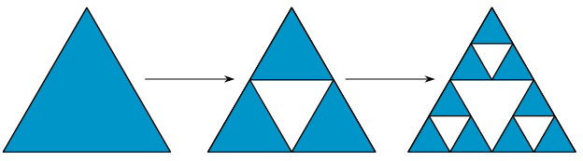

Extending Your Thinking
Start with an equilateral triangle with area 1 square unit, divide it into 4 congruent pieces as in the figure, and remove the middle one. Then, repeat this process with each of the remaining pieces. Repeat this process over and over for the remaining pieces. The figure shows the first two steps of this construction.
What fraction of the area is removed each time?
How much area is removed after the n^{th} step?
Use a calculator to find out how much area remains
in the triangle after 50 such steps have been taken.
Notes:
Answer
Each step, ¼ of the remaining area is removed since taking away ¼ from each smaller triangle results in taking ¼ of the total remaining area. That means that each step, the remaining area is multiplied by ¾ since 1 − ¼ = ¾. So after 𝑛 steps, the remaining area is simply (¾)^{𝑛}. After 50 steps, this leaves an area of only about 0.000000566321656 square units, so there’s almost nothing left!
If you can imagine doing this process forever, the resulting shape is called the Sierpinski triangle. To display a representational image of the Sierpinski triangle, click for the animation to display the lower image.

Slide 13
Self Check
Which of the following could represent a population of bacteria, 𝑏, that decreases at a rate of 18 every hour, ℎ? Consider an initial amount of 100 bacteria.
𝑏 = 100 ⋅ (⅞)^{ℎ}
𝑏 = 100 ⋅ (⅛)^{ℎ}
𝑏 = 100 ⋅ (⅞)ℎ
𝑏 = 100 ⋅ (⅛)ℎ
Let’s review!
Notes:
Answer Feedback -
That’s correct! Exponential functions have the form 𝑦 = 𝑎 ⋅ 𝑏^{𝑥}, with 𝑎 representing the initial value and 𝑏 representing the growth factor. There are initially 100, and it decreases by ⅛ each hour, so ⅞ is the growth factor.
Incorrect. Since it’s decreasing by a rate of ⅛, the growth factor is 1 − ⅛ = ⅞.
Incorrect. Since it’s decreasing by a rate of ⅛, that means it’s an exponential function, and the ℎ should be an exponent.
Incorrect. Since it’s decreasing by a rate of ⅛, that means it’s an exponential function and the ℎ should be an exponent. The growth factor is 1 − ⅛ = ⅞.

Slide 14

Self Check - Review
1 – % = GROWTH RATE
When analyzing exponential decay and given the fraction or percent by which it decreases, remember that one minus that fraction or percent is the growth rate.
At the beginning of April, a colony
of ants had a population of 5,000.
The colony decreases by ⅕ during April.
Write an expression that represents the
ant population at the end of April.
During May, the colony decreases again by ⅕ of its size. Write an expression that represents the ant population at the end of May.
The colony continues to decrease by ⅕ of its size each month. Write an expression that represents the ant population after 6 months.
Write an equation to represent the population of ants, 𝑝, after 𝑚 months.
Notes:
Remind students -
When you are analyzing exponential decay and are given the fraction or percent by which it decreases, you need to remember that one minus that fraction or percent is the growth rate. In the case of the ant colony, because it is decreasing by ⅕, that means that the growth factor is 1 − ⅕ or ⅘.
Answers
Answers vary, but here are some samples for an expression to represent the ant population at the end of April:
5,000 − (⅕ ⋅ 5000)
5,000 ⋅ ⅘
4,000
(Each line is the simplification of the line above it.)
Answers vary, but here are some samples:
5,000 ⋅ ⅘ ⋅ ⅘
4,000 ⋅ ⅘
4,000 − (⅕ ⋅ 4,000)
3,200
(Question 2 is asking you to find ⅘ of April’s total. Basically, you take the answer from April and multiply by ⅘ again since the growth factor is ⅘. You could also look at it as taking the initial value times ⅘ twice.)
Question 3 asks you to extend the pattern to 6 months after the initial population was measured. After the 2nd month, you multiplied the initial value by the growth factor twice, so for this situation you would need to multiply the initial value by the growth factor 6 times, or raise it to the sixth power. The possible answers would be 5,000 ⋅ ⅘ ⋅ ⅘ ⋅ ⅘ ⋅ ⅘ ⋅ ⅘ ⋅ ⅘, or 5000 ⋅ (⅘)⁶, which means that after 6 months the population would be about 1,311.
Question 4 wants the general equation to represent the situation. If you use the pattern from question 3, you can see that it can be written in the exponential form 𝑦 = 𝑎𝑏^{𝑥}, where 𝑎 is the initial value and 𝑏 is the growth factor. Using the variables suggested, the equation would be 𝑝 = 5,000(⅘)^{𝑚}.

Slide 15
Lesson Journey
Warm Up
Learning Activity
Cool Down
Lesson Synthesis
Learning Activity
Learning Activity
Practice

Slide 16
Learning Strategies - No Swimming 🚫
Not sure what an algal bloom is?
Algae occur naturally in all surface water in Texas.
But “blooms” grow out of control and can discolor the water and produce scum or foam.
Sometimes they produce harmful toxins that are dangerous.
Watch this or Read this for more information.
Representation
Teacher Instruction: Use these strategies to adjust the activity to support students with disabilities.
You can copy and paste the callout directly on top of the activity or give the instructions aloud.
Notes:
Support for Students with Disabilities: Representation: Internalize Comprehension
Activate or supply background knowledge. Provide students with access to a blank table of values (like this Google sheet). Invite students to complete the table for when 𝑡 is 0, 1, 2, 3, and 4, and then discuss how to use this information to choose an appropriate scale for the axes (scaffold questions provided in the Google sheet).
Supports accessibility for: Visual-spatial processing; Organization

Slide 17
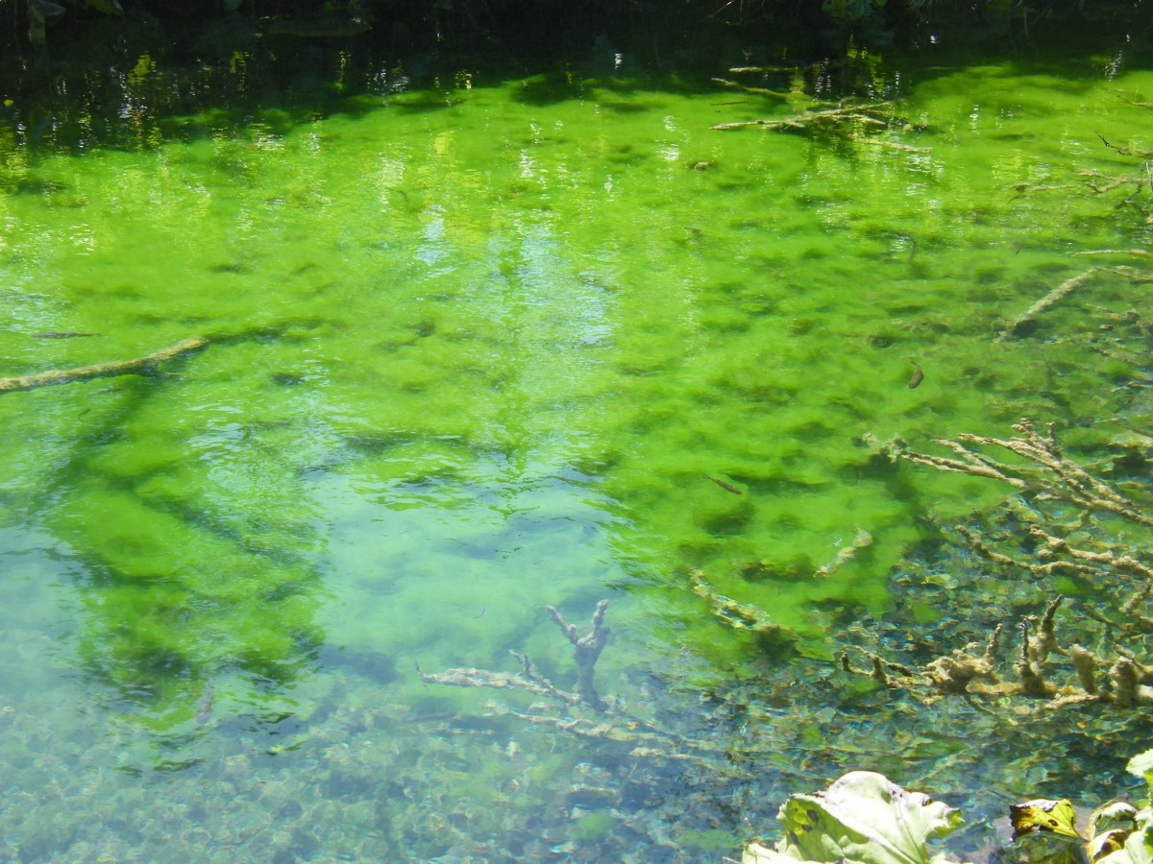
Learning Activity - No Swimming 🚫
To control an algae bloom in a lake, scientists introduce
some treatment products.
Once the treatment begins, the area covered by algae in
square yards, 𝐴, is given by the equation 𝐴 = 240 ⋅ (⅓)^{𝑡}.
Time, 𝑡, is measured in weeks.
In the equation, what does 240 tell us about the algae?
What does the ⅓ tell us?
Create a graph to represent 𝐴 = 240 ⋅ (⅓)^{𝑡} when 𝑡 is 0, 1, 2, 3, 4. Think carefully about how you choose the scale for the axes.
Approximately, how many square yards will the algae cover after 2.5 weeks?
Are you ready for more?
Notes:
Support for All Learners
This activity offers additional support and an extension for students:
For students with disabilities, be sure to review the Learning Strategies slide!
For students looking for an extra challenge, be sure to review the Extending Your Thinking slide!
Activity (15 minutes)
In this activity, students focus on producing and interpreting a graph representing a quantity that decays exponentially. They can then use the graph to make some estimates about the context, which is about algae control. After students create their graph, use the activity synthesis to encourage students to interpret the meaning of input values that are not whole numbers.
Note that the axes on the given graph aren’t scaled. Students will need to make sure that the vertical intercept can be plotted and that it is not too close to 0.
Continue scrolling down for directions on how to launch the activity, answers, anticipated misconceptions and the activity synthesis.
Launch
To introduce the context and keep students thinking about exponential growth and decay, consider presenting a riddle:
A certain area of the pond is covered in algae. Each day, the algae-covered area doubles. If it takes 24 days for the algae to completely cover the pond, how many days did it take to cover half of the pond?
Given the word “half,” students may be inclined to immediately say that it takes 12 days. But if they ponder the situation a bit, they should recognize that it takes 23 days to cover half the pond because it only takes one more day—or one more doubling—to cover the whole pond.
Answers
The algae initially covers 240 square yards.
Every week, the area covered is ⅓ of the area covered the previous week.
Access the graph and table in the online textbook or use this Desmos graph and Google sheet.
The algae will cover fewer than 27 square yards and more than 9 square yards because the area covered by the algae is decreasing. A number between 15 and 20 would be a good guess. (Click on the circle next to the point in the Desmos graph (entry 7) to display the guess value on the Desmos graph. You may also wish to change the point’s coordinates to other y-values as needed.)
Anticipated Misconceptions
Students may find it challenging to choose a scale for the axes in a way that helps them plot the points and see a pattern. If they are still struggling to choose a scale for the axes after a few minutes, ask students to think about the greatest and least vertical coordinates they need to show on the graph and what the height of each rectangle on the grid should be to show these values. In addition, if they get stuck plotting points, suggest that they first make a table of values.
Activity Synthesis
Once students have created reasonable graphs, focus the discussion on the non-integer values of 𝑡. Discuss questions such as:
What does a 𝑡 value of 2.5 mean? (A 𝑡 value of 2.5 means 2.5 weeks, or a little more than 17 days after treatment begins.)
How did you estimate the area covered by algae after a certain non-whole number of weeks? (We can use the graph to estimate the area of algae, which is between the area in week 2 and that in week 3, though not too much precision can be given. It is definitely less than 27 square yards and more than 9 square yards. Following the general trend of the points decreasing less and less rapidly as time goes on, an estimate of 15 is reasonable.)
Time permitting, consider discussing the following question:
Someone says that after seven weeks, the algae will disappear. Do you agree? (Answers may vary, but here are some samples: No, if we keep multiplying by ⅓, the area will keep getting smaller, but it will never reach 0. No, after seven weeks there would be about ⅑ of a square yard or 1 square foot covered by algae. Yes, rounded to the nearest square yard, there are 0 square yards covered by the algae after seven weeks.)

Slide 18
Extending Your Thinking
The scientists estimate that to keep the algae bloom from spreading after the treatment concludes, they will need to get the area covered under one square foot.
How many weeks should they run the treatment to achieve this?
Notes:
Answer
7 weeks. There are 9 square feet in every square yard, so 1 square foot is ⅑ square yard (or about 0.111 square yard). At 7 weeks is the first time the area covered by algae is less than ⅑ because 240 ⋅ (⅓)⁶ ≈ 0.329, and 240 ⋅ (⅓)⁷ ≈ 0.110.

Slide 19
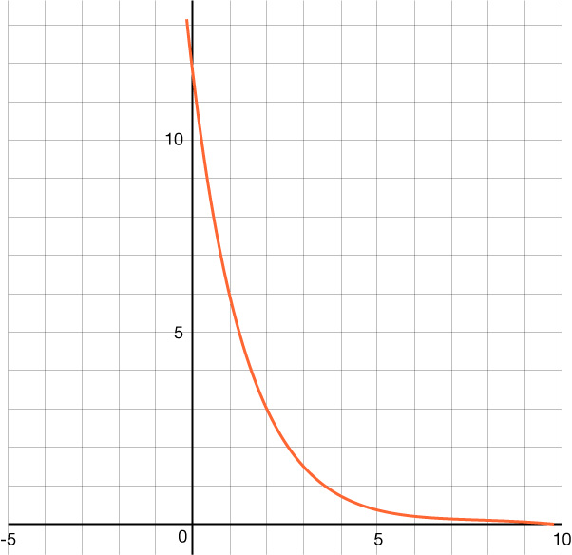
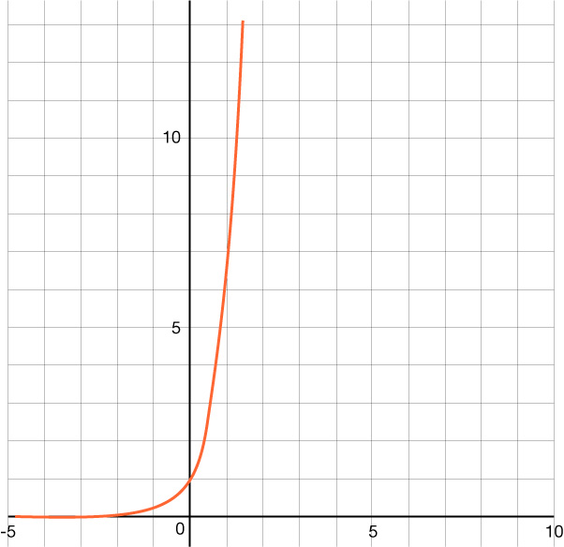
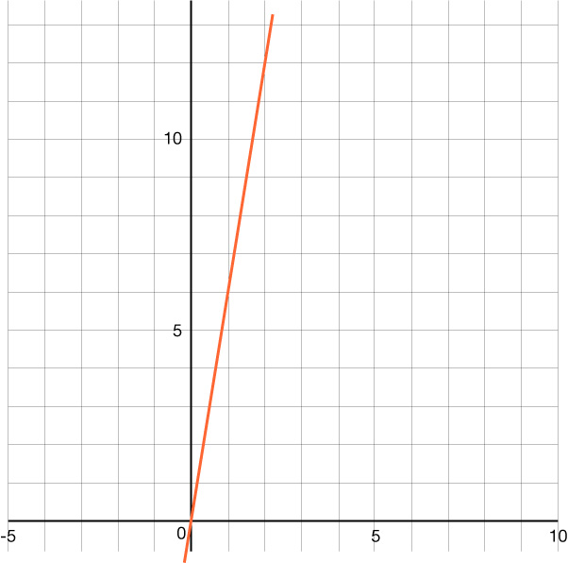
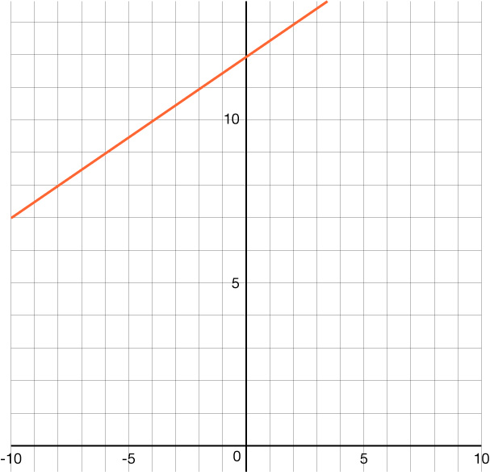
Self Check
Which of the following is the graph of y = 12(½)^{x}?
a. |  | c.
b. |  | d.
Let’s review!
Notes:
Answer Feedback - Individualized by Response
That’s correct! Exponential functions have the form y = ab^{x}, where a is the initial value or y-intercept. Since 12 is the a-value, the graph crosses the y-axis at (0, 12).
Incorrect. This is the graph of a linear function. Exponential functions are a smooth curve.
Incorrect. Remember you have to use the order of operations, so do not multiply 12 and ½ before using the exponent.
Incorrect. This graph is a linear function. Exponential functions are a smooth curve.

Slide 20

Self Check - Review
A population 𝑝 of migrating butterflies
satisfies the equation 𝑝 = 100,000 ⋅ (⅘)^{𝑤}
where 𝑤 is the number of weeks since they began their migration.
Use the questions to complete a table, then create a graph representing the scenario.
What is the number of butterflies when they began their migration?
What is the number of butterflies 1 week after they began their migration?
What is the number of butterflies 3 weeks after they began their migration?
Create a graph that best represents the butterfly population.
What is the vertical intercept, or “𝑦-intercept,” of the graph? What does it tell you about the butterfly population?
When does the butterfly population reach approximately 50,000?
What is the asymptote of the graph? What does it tell you about the butterfly population over time?
Notes:
Remind students –
When you have the equation that represents the situation, you can substitute values in and use the order of operations to find the values for the table.
Answers
Part 1 is asking for the initial value. Since the equation 𝑝 = 100,000(⅘)^{𝑤} is in the form 𝑦 = 𝑎𝑏^{𝑥}, you know the initial value is 𝑎 or 100,000.
Part 2 is 1 week after migration, so replace the 𝑤 in the equation with 1 to get 80,000.
In part 3, the 𝑤 can be replaced with 3 to get 51,200.
The rest of the values of the table can be found the same way, and once you have the completed table, you can plot the points. Once you have plotted the points, you can connect them with a smooth curve.
Table of values can be displayed in this Google sheet. {(0, 100,000), (1, 80,000), (2, 64,000), (3, 51,200), (4, 40,960)}
The graph can be viewed using the online textbook or this Desmos graph.
Part 5 asks about the vertical intercept and what it means. The vertical intercept is 100,000, which is the initial amount of the butterfly population. This means that when the butterflies start their migration (at 𝑤 = 0 weeks), the population is initially 100,000.
The “𝑦-intercept,” or more accurately, the “𝑝-intercept,” is the value of 𝑝 when 𝑤 = 0, which corresponds to the initial condition or starting point of the migration. Substituting 𝑤 = 0 into the equation, we have 𝑝 = 100,000 ⋅ (⅘)⁰ = 100,000 ⋅ 1 = 100,000.
For part 6, you could continue the table (see tab 2) or use the Desmos graph to see where it is 50,000, which is around 3 weeks.
For part 7, an asymptote is a line or curve that a function approaches but does not intersect or touch. In other words, as the input values of a function approach a certain value or tend towards infinity or negative infinity, the function values get arbitrarily close to the asymptote without actually crossing it. Asymptotes can provide valuable information about the behavior of a function and can help in understanding its limits and range.
To determine the asymptote, we examine the behavior of the function as 𝑤 approaches infinity. In this case, as 𝑤 becomes larger and larger, the term (⅘)^{𝑤} will grow exponentially smaller. Consequently, the population 𝑝 will also grow infinitely smaller as it gets closer and closer to zero. Thus, the horizontal asymptote in this equation is the 𝑥-axis. The graph of the function will continue to decrease towards the 𝑥-axis as 𝑤 increases, approaching 𝑦 = 0. The butterfly population will decrease over time due to the migration.

Slide 21
Lesson Journey
Warm Up
Learning Activity
Cool Down
Lesson Synthesis
Learning Activity
Learning Activity
Practice

Slide 22
Learning Strategies - Tracking Your Health 🏥
First read: listen and describe the situation without numbers.
Second read: list what can be counted or measured.
Third read: listen for the question and brainstorm ways to solve.
Three Reads
Teacher Instruction: Use these strategies to adjust the activity to support English language learners and students with disabilities.
You can copy and paste the callout directly on top of the activity or give the instructions aloud.
Do you know someone with diabetes? Insulin is a hormone that can help them.
Insulin helps process glucose (sugar) in the body.
Repeated injections are needed to control glucose levels because insulin breaks down fairly rapidly in the bloodstream.
Representation
Notes:
Support for English Language Learners: MLR 6 Three Reads: Reading
Use this routine to support reading comprehension without solving for students. Be sure to display the task statement along with the corresponding graph representing the situation. Use the first read to orient students to the situation. Ask students to describe what the situation is about without using numbers (a diabetic patient who receives insulin). Use the second read to identify quantities and relationships. Ask students what can be counted or measured without focusing on the values. Listen for, and amplify, the important quantities that vary in relation to each other in this situation: amount of insulin and time in minutes. After the third read, ask students to brainstorm possible strategies to answer the questions.
Design Principle(s): Support sense-making
Learn more about this routine
View the instructional video and follow along with the materials to assist you with learning this routine.
Provide support for students
Distribute graphic organizers to the students to assist them with participating in this routine.
Support for Students with Disabilities: Representation: Internalize Comprehension
Activate or supply background knowledge. Allow students to use calculators to ensure inclusive participation in the activity.
Supports accessibility for: Memory; Conceptual processing

Slide 23
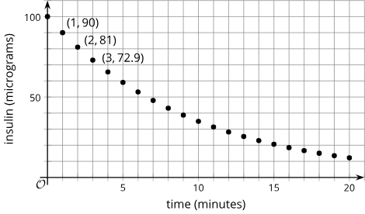
Learning Activity - Tracking Your Health 🏥
Scientists have found that the amount of
insulin in a patient’s body changes
exponentially. How can you check if
the graph supports the scientists’ claim?
(a) How much insulin broke down in
the first minute? (b) What fraction
of the original insulin is that?
(a) How much insulin broke down
in the second minute? (b) What fraction
is that of the amount one minute earlier?
What fraction of insulin remains in the
bloodstream for each minute that passes?
A patient who is diabetic receives 100 micrograms of insulin. The graph shows the amount of insulin, in micrograms, remaining in his bloodstream over time, in minutes.
Notes:
Support for All Learners
This activity offers additional support for students:
For English language learners and students with disabilities, be sure to review the Learning Strategies slide!
Activity (15 minutes)
Here, students make sense of a graph representing a situation characterized by exponential decay. They justify why the amount of insulin in a patient’s body could change exponentially and use the graph to answer questions about the situation. The numbers, chosen explicitly to provide a realistic model of the insulin context, are more complex than what students have seen so far. They will need to apply their understanding both to identify the growth factor and to write an expression showing how much insulin remains after 𝑚 minutes.
Continue scrolling down for how to launch the activity and answers to the questions.
Launch
Explain that insulin is a hormone that is needed to process glucose (sugar) in the body. For people with diabetes, a disorder in which the body cannot process glucose properly or does not produce enough insulin, injections of insulin are sometimes needed. Once in the bloodstream, insulin breaks down fairly rapidly, so additional injections are needed over the course of a day to control the person’s glucose.
Display the graph for all to see.
Ask students to observe the graph and be prepared to share one thing they notice and one thing they wonder.
Give students a moment to share their observations and questions with a partner.
Answers
If the insulin decays exponentially, that means that after each minute, the same fraction of insulin will decay and remain. So one way to check if this prediction matches the data is to see what fraction of insulin decays (or remains) after the first minute, then after the second minute, and so on. If these fractions are the same, then the graph supports the scientists’ claim.
a. 10 micrograms broke down. b. ⅒ of the initial injection
a. 9 micrograms broke down. b. ⅒ of the amount one minute earlier
⁹/₁₀. For example: In the next minute, another ⅒ of insulin broke down. Each time, ⁹/₁₀ of the amount remains.
Continuation of the activity questions, answers, anticipated misconceptions and the activity synthesis are included on the next slide.

Slide 24
Learning Activity - Tracking Your Health 🏥
Complete the table to show the predicted amount of insulin 4 and 5 minutes after injection.
(a) Describe how you would find how many micrograms of insulin remain in his bloodstream after 10 minutes.
(b) After 𝑚 minutes?
Time after injection (minutes) | 0 | 1 | 2 | 3 | 4 | 5
Insulin in bloodstream (micrograms) | 100 | 90 | 81 | 72.9
Notes:
Activity Answers
After 4 minutes, 65.62 micrograms. After 5 minutes, 59.05 micrograms.
a. Multiply 100 by ⁹/₁₀ ten times: 100 ⋅ ( ⁹/₁₀)¹⁰.
b. Multiply 100 by ⁹/₁₀ m times: 100 ⋅ ( ⁹/₁₀)^{m}.
Anticipated Misconceptions
Students may notice that the insulin values decrease by ⅒ each minute and say, in response to the first two questions, that ⅒ of the original insulin remains after each minute. Ask them what ⅒ of 10 micrograms (mcg) is. Then ask them if that is the amount of insulin that remains after 1 minute. If needed, ask them what fraction of 10 mcg is the amount of insulin that remains after 1 minute. Is that the same as the fraction of 9 mcg of insulin that remains after 2 minutes?
Activity Synthesis
Invite students to share their responses with the class. If not already mentioned in students’ explanations, highlight the connections between the equation, the graph, and the quantities in the situation. Ask students:
How can we use an equation to express the micrograms of insulin in the body (𝐼) after 𝑚 minutes using an equation? (𝐼 = 100 ⋅ (⁹/₁₀)^{𝑚})
Where can we see the 100 mcg in the graph? (the vertical intercept)
What about the ⁹/₁₀? (The coordinates tell us that ⅒ of insulin gets removed each minute, so ⁹/₁₀ of it, which is most of it, is left in the body every minute. The amount of insulin decays relatively slowly, which shows in the points dropping gradually.)
Also consider asking:
Will there be any insulin remaining in the bloodstream an hour after the injection?
If so, when will the body completely run out of insulin?
These are difficult questions to answer. The mathematical model will never reach 0 because a positive quantity multiplied by ⁹/₁₀ is always positive. Practically speaking, however, the insulin given to the patient will eventually disappear, unless a new dose is injected. The model also doesn’t account for any insulin that the body produces naturally. This is a good opportunity to remind students that mathematical models are simplified descriptions of reality.

Slide 25
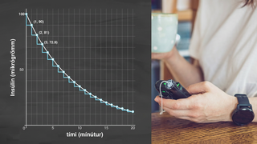
Video: Analyzing Exponential Graphs and Writing Equations
Notes:
This video discusses questions 4 and 6 of activity 5.5.4

Slide 26
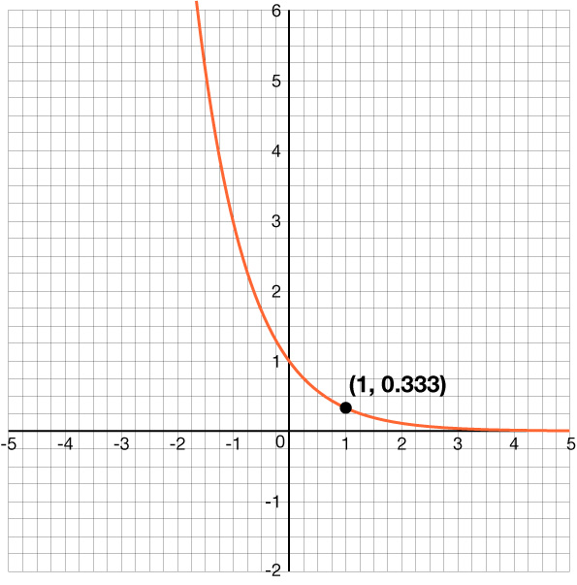
Self Check
Which of the following is the equation of the graph provided?
𝑦 = 3^{𝑥}
𝑦 = – 3𝑥 + 1
𝑦 = – ⅓ 𝑥
𝑦 = (⅓)^{𝑥}
Let’s review!
Notes:
Answer Feedback - Individualized by Response
Incorrect. The graph is an exponential decay, so it should have a growth factor less than 1.
Incorrect. This is a linear equation. The graph is exponential, so it should have a variable as an exponent.
Incorrect. This is a linear equation with slope − ⅓. The graph is a decreasing exponential function, so it should have a variable as an exponent and a base less than 1.
That’s correct! The shape of the graph is exponential, it has a 𝑦-intercept of 1, and since it passes through (1, ⅓), it has a growth factor of ⅓.

Slide 27
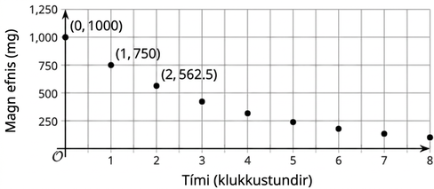
Self Check - Review
The graph shows the amount of a chemical in a patient’s body at different times, measured in hours since the levels were first checked.
Could the amount of this chemical in the patient be decaying exponentially? Explain how you know.
Notes:
The graph does seem to have the shape of exponential decay, but ask students how it can be confirmed.
Answers
To confirm if the chemical in the patient is decaying exponentially, you can find the growth factor. Since terms are usually multiplied by the growth factor, you can divide consecutive terms to see if there is the same growth factor each time.
Since ⁶⁰⁰/₁₀₀₀ = ³⁶⁰/₆₀₀ = ⁶/₁₀, the growth factor is ⁶/₁₀. Therefore, it is decaying exponentially, and the equation is
𝑦 = 1,000(⁶/₁₀)^{𝑥}, where 𝑦 is the amount of chemical in mg in the patient and 𝑥 is the time in hours.
As the time continues, the amount of chemical in the patient is approaching 0 mg. We can see this in the graph as the data points approach the 𝑥-axis where 𝑦 = 0. The equation of the line that the data points approach is called the asymptote. In this example it is 𝑦 = 0.

Slide 28

Lesson Journey
Warm Up
Learning Activity
Cool Down
Lesson Synthesis
Learning Activity
Learning Activity
Practice

Slide 29
Cool Down
Acetaminophen is a common
pain reliever and fever reducer.
The graph shows the amount
of acetaminophen, in milligrams,
in an adult’s body at different
times after they take a normal dose.
What is the vertical intercept? What does it mean in this situation?
What fraction of the medicine remained after one hour?
Write an equation representing the amount of medicine, a, after t hours.
Notes:
Cool Down (5 minutes)
Answers
1,000; It means there are 1,000 mg of acetaminophen in the person’s body after taking the medicine (this is the dose size).
¾ of the medicine remained after 1 hour since ⁷⁵⁰/₁₀₀₀ = ¾.
a = 1,000(¾)^{t}
Response to Student Thinking - Points to Emphasize
If students are still struggling with writing equations to represent exponential growth or decay, highlight a few examples from cool-downs and use practice problems from this lesson to provide further opportunities to examine the meaning of 𝑎 and 𝑏 terms and to practice writing equations to represent exponential decay.

Slide 30

Lesson Journey
Warm Up
Learning Activity
Cool Down
Lesson Synthesis
Learning Activity
Learning Activity
Practice

Slide 31

Practice
Put your hard work to action, practice what you’ve learned!
Notes:
Digital Practice: Access the practice pages at https://openstax.org/details/books/algebra-1

Slide 32

Lesson Journey
Warm Up
Learning Activity
Cool Down
Lesson Synthesis
Learning Activity
Learning Activity
Practice

Slide 33
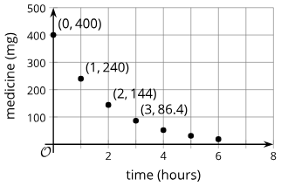
Lesson Synthesis
What is the vertical (m) intercept,
and what does it mean in this context?
How can you tell from the graph that
⅖ of the medicine is broken down after
one hour?
How can you tell from the graph that ⅗ remained after each hour?
What is an equation representing the amount of medicine in mg, 𝑚, 𝑡 hours after taking the medicine?
Why does it make sense to write (⅗)^{𝑡}?
What is the horizontal asymptote, and what does it mean in this context?
Notes:
In this lesson, students studied quantities that decrease or decay by the same factor repeatedly. Use examples from activities in the lesson, or use a new example like this one: Display the graph showing the amount, in mg, of a medicine in a person’s body at different times, measured in hours after taking the medicine. Every hour, ⅖ of the medicine is broken down by the body.
Discuss
What is the vertical intercept, and what does it mean in this context? (400. It is the milligrams of medicine in the person’s body right after taking the pill.)
How can you tell from the graph that ⅖ of the medicine is broken down after one hour? (The amount of medicine after 1 hour dropped by 160 mg, and 160 is ⅖ of 400.)
How can you tell from the graph that ⅗ remained after each hour? (240 is ⅗ of 400, 144 is ⅗ of 240, and so on.)
What is an equation representing the amount of medicine in mg, 𝑚, 𝑡 hours after taking the medicine? (𝑚 = 400(⅗)^{𝑡})
Why does it make sense to write (⅗)^{𝑡}? (⅗ of the medicine remained after every hour, so for 𝑡 hours, we multiply the 400 by ⅗, 𝑡 times.)
What is the horizontal asymptote, and what does it mean in this context? (𝑦 = 0. As time progresses, the amount of medicine in a person’s body approaches 0 mg.)

Slide 34
Self Assessment
How much do you agree with the following statements?
I can… | I can | Almost | Not yet
Use only multiplication to represent “decreasing a quantity by a fraction of itself.”
Write an expression or equation to represent a quantity that decays exponentially.
Define “exponential growth” and “exponential decay.”
Explain the meanings of 𝑎 and 𝑏 in an equation that represents exponential decay and is written as 𝑦 = 𝑎 ⋅ 𝑏^{𝑥}.
Find a growth factor from a graph and write an equation to represent exponential decay.
Graph equations that represent quantities that change by a growth factor between 0 and 1.

