Slide 1


Algebra 1
Unit 4 Functions
Lesson 4.6: Features of Graphs

Slide 2
How to use these slides
On the activity slides check the speaker notes for teacher support and instructional information.
Each lesson includes 1 warm up, 2-3 learning activities, a cool down, practice and a lesson synthesis.
  Learning activities are followed by a self check question, and review section.
Some slides have been hidden from student view, more information can be found on the next slide (Reference Key).
You can edit and use these slides for personal and classroom use, but cannot sell them and must keep the attribution logos.
For more information, Check out the digital quick start guide!

Slide 3






Reference Key
Check the top right corner for an icon referencing these unique sections.
 | Support for Students with Disability | Hidden | Learning Strategies slide, provides additional support to students for understanding the activity. Learning Strategies slide, provides additional support to students for understanding the activity.
 | Support for English Language Learners | Hidden
 | Extending Your Thinking | Hidden | Extending Your Thinking slide, provides an extra challenge for students.
 | Self Check | Not Hidden | Self Check slide, checkpoint to assess student understanding after the learning activity.
 | Review | Hidden | Self Check- Review slide, designed to help review topics from the self check question.
On the next slides, check the speaker notes for teacher instructions and support.
Notes:
Check the Speaker Notes: On the next slides you can find discussion questions, lesson information, answers to the activities, and ways to adjust the activity for your students!

Slide 4

Learning Goals
By the end of this lesson you will be able to -
Identify important features of graphs of functions and explain what they mean in the situations represented.
Explain and apply the terms “horizontal intercept,” “vertical intercept,” “maximum,” and “minimum” when talking about functions and their graphs.
Identify important features of linear functions.
Notes:
Lesson Narrative
Before this lesson, students described graphs and interpreted points in context. Now, they deepen that understanding using the concept of function as a key focus.
Students use terms like “intercept,” “maximum,” and “minimum” to analyze graphs and connect those features to the functions they represent. They interpret increasing intervals on a graph as where function values are rising and use notation like h(0) or h(t) = 0 to describe key points.
By now, students are familiar with the idea of intercepts. Note that in these materials, the terms “horizontal intercept” and “vertical intercept” are used to refer to intercepts more generally, especially when a function is defined using variables other than x and y. If needed, clarify these terms for students who may be accustomed to using only x-intercept and y-intercept.
As students connect function representations to real-world quantities, they practice problem-solving and reasoning. Using precise math language and notation helps develop their attention to detail.
Required Preparation
None
Required Materials
None
Texas Essential Knowledge and Skills
A1(A) apply mathematics to problems arising in everyday life, society, and the workplace
A1(D) communicate mathematical ideas, reasoning, and their implications using multiple representations, including symbols, diagrams, graphs, and language as appropriate
A1(F) analyze mathematical relationships to connect and communicate mathematical ideas
A1(G) display, explain, and justify mathematical ideas and arguments using precise mathematical language in written or oral communication
A3(A) determine the slope of a line given a table of values, a graph, two points on the line, and an equation written in various forms, including y = mx + b,
Ax + By = C, and y − y₁ = m(x − x₁)
A3(C) graph linear functions on the coordinate plane and identify key features, including x-intercept, y-intercept, zeros, and slope, in mathematical and real-world problem
A7(A) graph quadratic functions on the coordinate plane and use the graph to identify key attributes, if possible, including x-intercept, y-intercept, zeros, maximum value, minimum values, vertex, and the equation of the axis of symmetry
A12(B) evaluate functions, expressed in function notation, given one or more elements in their domains

Slide 5
Vocabulary
Previous
Relation
  any set of ordered pairs, (𝑥, 𝑦)
Constant
  Linear function of the form 𝑓(𝑥) = 𝑏.
Expression
  The sum of products of numbers and variables. The variables can be raised to different powers.
Slope
  The change in two dependent values of a linear function divided by the change in the corresponding two independent values. This can be thought of rise over run, the rate of change in 𝑦 over the change in 𝑥, or steepness of a line.
New
Maximum
  The function’s greatest value, shown as the highest point on the graph.
Minimum
  The function’s least value, shown as the lowest point on the graph.
x-intercept or horizontal intercept
  The point where the graph crosses the x-axis; the y-value is 0. (x, 0)
y-intercept or vertical intercept
  The point where the graph crosses the y-axis; the x-value is 0. (0, y)
Notes:
Lesson Vocabulary
To support student understanding of key vocabulary:
Introduce and review the vocabulary words students will see in this lesson.
Encourage students to notice how these words are used and to include them in their math discussions and explanations—both written and oral.
Use a word wall to reinforce vocabulary. Sample word wall cards are available here.
For newcomers or students with beginning English proficiency, use these Quizlet sets to support vocabulary learning:
Unit 4 Spanish Vocabulary, part 1 – use first to build understanding
Unit 4 Vocabulary (English), part 1 – use after anchoring in Spanish
Unit 4 Spanish Vocabulary, part 2 – use first to build understanding
Unit 4 Vocabulary (English), part 2 – use after anchoring in Spanish
Support for English Language Learners
ELPS 2(F) listen to and derive meaning from a variety of media such as audiotape, video, DVD, and CD-ROM to build and reinforce concept and language attainment
ELPS 3(F) ask and give information ranging from using a very limited bank of high-frequency, high-need, concrete vocabulary, including key words and expressions needed for basic communication in academic and social contexts, to using abstract and content-based vocabulary during extended speaking assignments
ELPS 4(D) use prereading supports such as graphic organizers, illustrations, and pretaught topic-related vocabulary and other prereading activities to enhance comprehension of written text
ELPS 5(B) write using newly acquired basic vocabulary and content-based grade-level vocabulary

Slide 6





Lesson Journey
Warm Up
Learning Activity
Cool Down
Lesson Synthesis
Learning Activity
Learning Activity
Practice

Slide 7
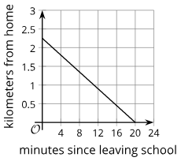
Warm Up - Walking Home 🏠
Diego is walking home from school at a constant rate. This graph represents function d, which gives his distance from home, in kilometers, m minutes since leaving the school.
Notes:
Warm Up (5 minutes)
This warm up is an opportunity to practice interpreting statements in function notation. It also draws attention to statements that correspond to the intercepts of a graph of a function (for instance, d(0) and d(m)=0), preparing students to reason about them in the lesson (particularly in the second activity).
Activity questions, answers, and synthesis on the next slide.

Slide 8

Warm Up - Walking Home 🏠
For each question, explain your reasoning.
What is d(0), and what does it represent in the situation?
What is d(12)?
What does d(m) = 1 mean in this context, and what is the value of m?
What does d(m) = 0 mean in this context, and what is the value of m?
Notes:
Activity Answers
d(0) = 2.25; The moment Diego is leaving school, he is 2.25 kilometers from home (or Diego’s school is a little more than 2 kilometers from his house).
d(12) = 0.9
m is approximately 10.5. At approximately 10.5 minutes, Diego is 1 kilometer from home.
m is 20. At 20 minutes, Diego is at home (or it takes Diego 20 minutes to walk the 2.25 kilometers home from school).
Activity Synthesis
Ask students to interpret each statement in function notation before soliciting their response to each question. Make sure students understand, for instance, that d(0) represents Diego’s distance from school at the time of leaving (or at 0 minutes), and d(m) = 0 represents his distance from school being 0 km, m minutes after leaving his house.
If time permits, discuss with students:
“Is the relationship between Diego’s distance from school and time a linear function? How can we tell?” (Yes. The graph is a line, which means the function’s value changes at a constant rate.)
“Can we tell from the graph how far away Diego’s house is from school? How?” (Yes. From the graph, we can see that at the time he leaves school, he 2.25 km from home.)
“Can we tell from the graph how long it took Diego to get home? How?” (Yes. From the graph, we can see the distance reaching 0 when the time is 20 minutes.)
“Why does the graph slant downward (or have a negative slope)?” (As the input, m, increases, the output, d(m),

Slide 9

Lesson Journey
Warm Up
Learning Activity
Cool Down
Lesson Synthesis
Learning Activity
Learning Activity
Practice

Slide 10
Learning Strategies - Rocket vs. Drone🚀
Teacher Instruction: Use these strategies to adjust the activity to support English language learners and students with disabilities.
  You can copy and paste the callouts directly on top of the activity or give the instructions aloud.
Write down possible mathematical questions about the situation.
What important information can we find about the objects movement?
Co-Craft Question
“It looks like . . .”
“I notice that . . .,”
“_____ represents _____,”
“What does this part of _____ mean?”
Action and Expression
Notes:
Support for English Language Learners: MLR 5 Co-Craft Questions: Speaking, Reading
Use this routine to help students interpret a situation to identify the key features of a graph. Display the student task statement and graphs, without the questions. Ask students to write down possible mathematical questions that could be asked about the situation. Invite students to compare their questions before revealing the activity’s questions. Listen for and amplify any questions involving the behavior of the toy rocket and drone, or questions about features or places on the graph that show important information about each object’s movement. This will help students produce the language of key features of graphs of functions, such as maximum, minimum, and intervals.
Design Principle(s): Maximize meta-awareness; Support sense-making
Learn more about this routine
View the instructional video and follow along with the materials to assist you with learning this routine.
Provide support for students
Distribute graphic organizers to the students to assist them with participating in this routine.
Support for Students with Disabilities: Action and Expression: Develop Expression and Communication
To help students get started, display sentence frames such as: “It looks like . . .,” “I notice that . . .,” “_____ represents _____,” “What does this part of _____ mean?”
Supports accessibility for: Language, Organization

Slide 11
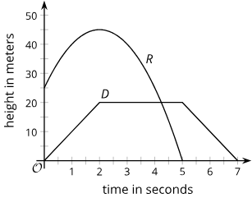
Learning Activity - Rocket vs. Drone🚀
A toy rocket and a drone were launched at the same time. The graphs that represent the heights of two objects as a function of time since they were launched.
Height is measured in meters above the ground, and time is measured in seconds since launch.
Analyze the toy rocket graph and describe its motion clearly enough for someone to visualize it without seeing the graph. Include when and where it starts and stops.
Analyze the drone’s graph and give a clear description of its motion, including where it starts and when it stops, so someone could picture it without seeing the graph.
At what point were the drone and the toy rocket at the same height?
Which graph features show key information about each object’s movement? List them.
Notes:
Support for All Learners
This activity offers additional support and an extension for students:
For English language learners and students with disabilities, be sure to review the Learning Strategies slide!
Activity (15 minutes)
In this activity, students analyze graphs of functions, identify key features such as intercepts, maximums, minimums, and intervals of increase or decrease and relate them to real-world situations.
These features and terms should be familiar from earlier grades; this lesson sharpens their definitions. Students will later learn to differentiate between a graph’s maximum and a function’s maximum.
Launch
Give students about 5 minutes of quiet work time. Follow with a whole-class discussion.
Answers
The toy rocket was launched from a height of 25 meters above ground. It went up quickly, but it slowed down and then stopped getting higher when it reached 45 meters, which was 2 seconds after launch. At that point, it started to come back down. It hit the ground 5 seconds after it was launched.
The drone took off from the ground. It went up at a constant speed for 2 seconds, up to a height of 20 meters. Then, it hovered at that height for 3 seconds. Afterward, it started descending at a constant speed for 2 seconds. It landed back on the ground 7 seconds after launch.
A little after 4 seconds, the drone and the toy rocket were at the same height (20 meters).
Sample Responses:
the points where the graphs begin (when t is 0)
the points where the graphs cross the horizontal axis
the point where the graphs change direction
the shape of each graph (curved or straight)
the intervals when the graphs behave certain ways
the parts highlighted in the graph
Click here for the slide with image 5.
Anticipated Misconceptions
When analyzing the graphs and describing what is happening with each object, some students may mistakenly think that the horizontal axis represents horizontal distance, neglecting to notice that it represents time. They may then describe how the objects were moving vertically as they traveled horizontally, rather than with respect to the number of seconds since they took off. Encourage these students to check the label of each axis and revisit their descriptions.
Activity Synthesis
Select a few students to share their description of the graphs, and have each student describe the motion of one flying object.
Display a blank coordinate plane for all to see. As each student shares their response, sketch a graph to match what is being described.
Click here for the slide with Image Blank Coordinate Plane.
Make reasonable assumptions to fill in any missing details in students' descriptions when sketching. For example, if the starting height isn't given, choose a plausible value. If asked, let students revise their descriptions and update the sketch.
Next, invite other students to share their response to the last question. On the graphs, highlight the features students noted. (See Student Response for an example.) Use the terms “vertical intercepts,” “horizontal intercepts,” “maximum,” and “minimum” to refer to those features and label them on the graphs.
Explain to students that:
A point on the graph that is as high as or higher than all other points is called a maximum of the graph (or a relative maximum because its height is viewed in relation to other points shown on the graph).
A point on the graph that is as low as or lower than all other points is called a minimum of the graph (or a relative minimum).
A graph could have more than one relative maximum or minimum. For instance, the points (2,(D(2)) and (5,D(5)) are both relative maximums, and (0,D(0)) and (7,D(7)) are both relative minimums.
If no students mentioned the intervals in which each function was increasing, staying constant, or decreasing, draw their attention to these features on the graphs and label them as such.

Slide 12
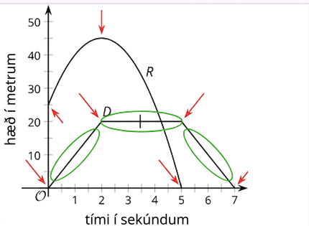
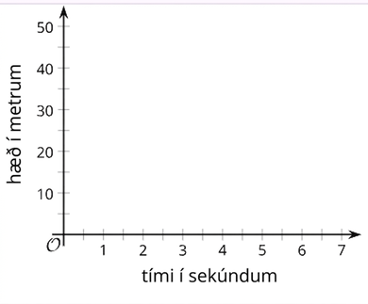
Learning Activity - Rocket vs. Drone🚀
Image 5
Image: Blank Coordinate Plane
Notes:
Activity Images

Slide 13
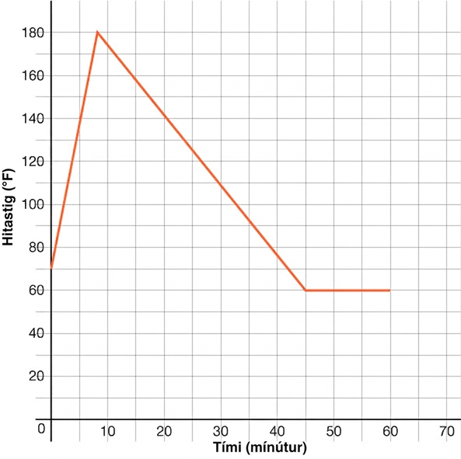
Self Check
The graph represents the temperature, t(m), in degrees Fahrenheit of water used for a cup of hot tea over time in minutes, m. What does t(0) represent?
t(0) = 70; After 70 minutes, the temperature is 0 degrees.
t(0) = 180; After 0 minutes, the temperature is 180 degrees.
t(0) = 70; After 0 minutes, the temperature is 70 degrees.
t(0) = 180; After 180 minutes, the temperature is 0 degrees.
Let’s review!
Notes:
Answer Feedback - Individualized by Response
t(0) = 70; After 70 minutes, the temperature is 0 degrees.
Incorrect. Remember the value inside the parentheses is the minutes passed, so t(0) means 0 minutes have passed. The answer is t(0) = 70; At 0 minutes, the temperature is 70 degrees.
t(0) = 180; After 0 minutes, the temperature is 180 degrees.
Incorrect. On the graph provided, the graph intersects the vertical axis at 70, not 180. The answer is t(0) = 70; at 0 minutes, the temperature is 70 degrees.
t(0) = 70; After 0 minutes, the temperature is 70 degrees.
That’s correct! t(0) = 70 means that the x value is 0, or it is the point on the vertical axis. The point where the graph intersects the vertical axis is 70 degrees.
t(0) = 180; After 180 minutes, the temperature is 0 degrees.
Incorrect. Remember the value inside the parentheses is the minutes passed, so t(0) means 0 minutes have passed. The answer is t(0) = 70; At 0 minutes, the temperature is 70 degrees.

Slide 14
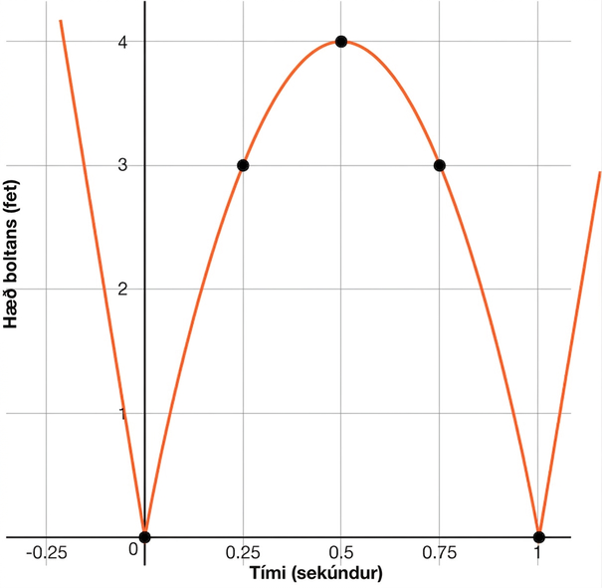
Self Check - Review
Real-Life Graphs of Functions
A ball is bouncing across the school yard. The vertical or y-axis represents the height of the ball in feet, h(t), while the horizontal or x-axis represents the time, t, that has passed in seconds
On the graph, t = 0 represents the first time the ball touches the ground.
What is h(1), and what does it represent in the context of the problem?
Notes:
Answer
h(1) = 0, and it represents the height of the ball after 1 second, or the ball has a height of zero after 1 second. The value inside of the parentheses is the value from the x-axis or horizontal axis. The solution is the value of the graph at that point.

Slide 15
Lesson Journey
Warm Up
Learning Activity
Cool Down
Lesson Synthesis
Learning Activity
Learning Activity
Practice

Slide 16
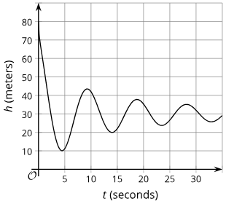

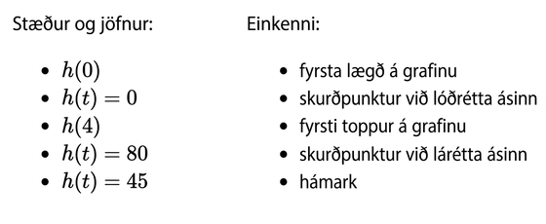
Learning Activity - Bungee Jumping 🦘
In a bungee jump, the height of the jumper is a function of time since the jump begins.
Function h defines the height, in meters, of a jumper above a river, t seconds since leaving the platform.
Graph of function h.
Notes:
Support for All Learners
This activity offers additional support and an extension for students:
For English language learners and students with disabilities, be sure to review the Learning Strategies slide!
For students looking for an extra challenge, be sure to review the Extending Your Thinking slide!
Activity (15 minutes)
Earlier, students identified key graph features and linked them to real-world situations. In this activity, they continue connecting graphs and verbal descriptions, using mathematical terms and linking features to expressions or equations in function notation.
In the synthesis, students learn to distinguish relative and absolute maximums and minimums. They see that a graph's maximum refers to a high point on the graph, while a function's maximum is the highest value the function reaches.
Launch
Arrange students in groups of 2. Give students a few minutes of quiet time to think individually, and then time to discuss their response with their partner.
As an alternative to completing this task digitally, you may wish to have students complete the task using a paper copy. For this option, it is suggested to print pages 1 and 2 of the Unit 4 Lesson 6 Student Activity 3 document on separate pages.
Activity questions, answers, and synthesis on the next slide.

Slide 17
Learning Activity - Bungee Jumping 🦘
Match each jump description to an equation and a graph feature.
Description of Jump
a. the greatest height that the jumper is from the river
b. the height from which the jumper was jumping
c. the time at which the jumper reached the highest point after the first bounce
d. the lowest point that the jumper reached in the entire jump
e. the time at which the jumper hits the surface of the river
Are you ready for more?
2. If t = 0, then h(0) equals what value?
4. If h(t) = 45, then t equals what value?
3. If t = 4, then h(4) equals what value?
5. If h(t) = 0, then t equals what value?
Notes:
Answers
Description of Jump
the greatest height that the jumper is from the river
Expression or Equation: h(t) = 80
Feature of Graph: maximum
the height from which the jumper was jumping
Expression or Equation: h(0)
Feature of Graph: vertical intercept
the time at which the jumper reached the highest point after the first bounce
Expression or Equation: h(t) = 45
Feature of Graph: first peak in the graph
the lowest point that the jumper reached in the entire jump
Expression or Equation: h(4)
Feature of Graph: first dip in the graph also the minimum of the graph shown
the time at which the jumper hits the surface of the river
Expression or Equation: h(t) = 0
Feature of Graph: horizontal intercept
h(0) = 80
h(4) ≈ 80
The approximate solutions to h(t) = 45 are t = 2 and t = 9.
There is no solution to h(t) = 0 when t is between 0 and 35, which is what is shown on the graph. We don't know if the function will have a solution when t is greater than 35.
Activity Synthesis
Have students pair up to discuss how they matched expressions to verbal descriptions and how they interpreted expressions without a match. The teacher should circulate to check for accuracy and listen for any unusual interpretations. If time allows, have students share their different responses, or just share outliers with the class.
Ensure students understand that h(t) = 0 means the jumper is on the surface of the water. Since the graph has no horizontal intercept and no matching verbal description, h(t) = 0 has no match.
Have students discuss why h(t) = 0 has no solutions in this context. While it's possible the jumper could reach the water if the graph extended further, based on the given graph, there's no solution.
Introduce the difference between the maximum/minimum of a graph and the maximum/minimum of a function:
What is the greatest value of h? 80
Why can’t h(t) be greater than 80? The jumper can’t go higher than the platform.
What is the least value of h? About 10, based on the graph
Could h(t) be less than 10? Yes, if the jumper continues downward, but that's not shown.
Explain:
The graph shows one maximum point, which also represents the maximum value of the function.
The graph shows a minimum point at (4, 10), but this is not necessarily the minimum of the function, since the jumper could go lower.
Emphasize that:
A maximum/minimum of a graph is a point relative to what's shown.
A maximum/minimum of a function is the greatest/least value the function can take for any input.

Slide 18
Learning Strategies - - Bungee Jumping 🦘
Teacher Instruction: Use these strategies to adjust the activity to support English language learners and students with disabilities.
  You can copy and paste the callouts directly on top of the activity or give the instructions aloud.
"_____ matches _____ because . . ."
"I noticed _____ , so I matched . . ."
"The strategy that I used was . . . ."
Conversing
Highlight matching descriptions, equations, and parts of the graph in the same color.
Internalize Comprehension
Notes:
Support for English Language Learners: MLR 8 Discussion Supports: Conversing
As students share their matches and explain their reasoning to their partner, display the following sentence frames for all to see: "_____ matches _____ because . . .", "I noticed _____ , so I matched . . .", and "The strategy that I used was . . . ." Encourage students to challenge each other when they disagree. While monitoring discussions, amplify student ideas to demonstrate use of mathematical language such as "first peak", "maximum", "minimum", or "vertical intercept." This routine will help students connect graphical and verbal representations of a function through partner discussions.
Design Principle(s): Support sense-making; Maximize meta-awareness
Support for Students with Disabilities: Internalize Comprehension
Provide students with a paper copy of the activity. Use color coding and annotations to highlight connections between representations in a problem. For example, invite students to highlight matching descriptions, equations, and parts of the graph in the same color.
Supports accessibility for: Visual-spatial processing

Slide 19

Video: The Meaning of Function Notation

Slide 20
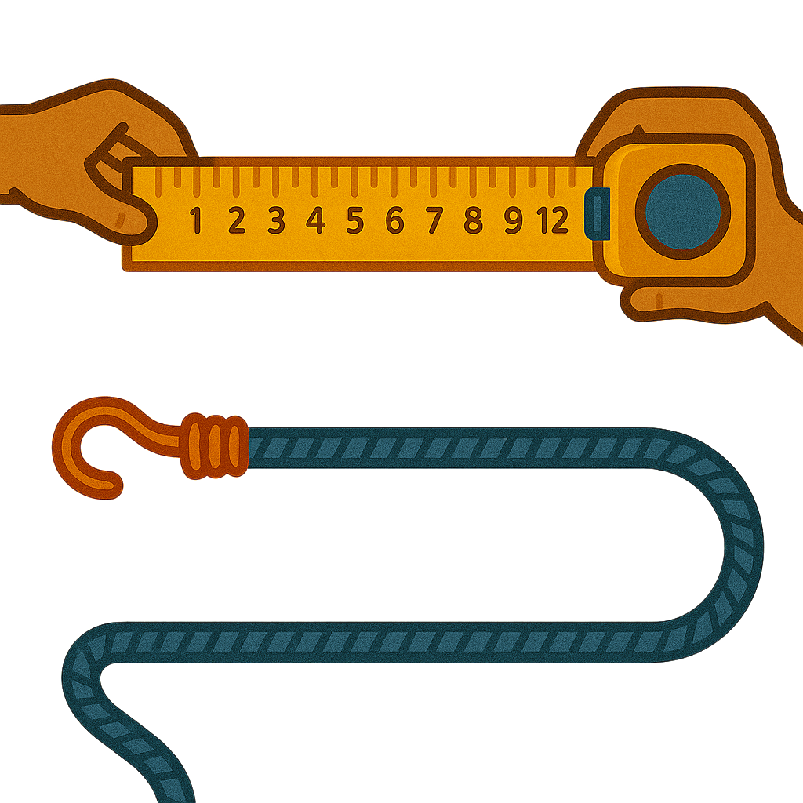
Extending Your Thinking
Based on the information available, how long do you think the bungee cord is?
Make an estimate and explain your reasoning.
Notes:
Answer
For example: About 50 meters. The low points on the graph increase with each bounce and the high points decrease. They look like they are approaching about 30 meters in height above the river. Since the jump started from 80 meters above the river, this means that the bungee cord is about 50 meters long.

Slide 21
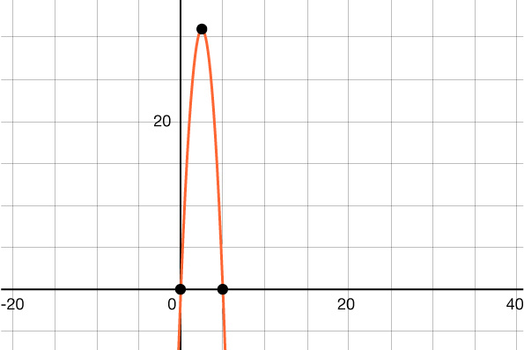
Self Check
The graph models the height, in feet, of a kickball over time. When is the ball at its maximum height?
h(2.5) = 31, The maximum height is about 31 feet. It occurred about 2.5 seconds after the ball was kicked.
h(5) = 0, The maximum height occurs about 6 seconds after the ball was kicked.
h(1) = 20, The maximum height occurred 1 second after the ball was kicked.
h(2.5) = 31, The maximum height is about 2.5 feet. It occurred about 31 seconds after the ball was kicked
Let’s review!
Notes:
Answer Feedback - Individualized by Response
That's Correct! Maximums are the highest points on the graph. The maximum of this graph h(2.5) = 31.
Incorrect. h(5) = 0 represents the point when the ball returns to the ground, or the horizontal axis intercept. The answer is The maximum of this graph h(2.5) = 31.
Incorrect. The maximum is the highest point on the graph. h(1) = 20 is not the highest point. The answer is h(2.5) = 31. The maximum of this graph is 31.
Incorrect. The maximum is the highest value on the vertical axis. h(2.5) = 31 is the correct answer, but the 2.5 represents the time and 31 represents the height. The answer is the maximum is about 31 feet and it occurred after 2.5 seconds.

Slide 22
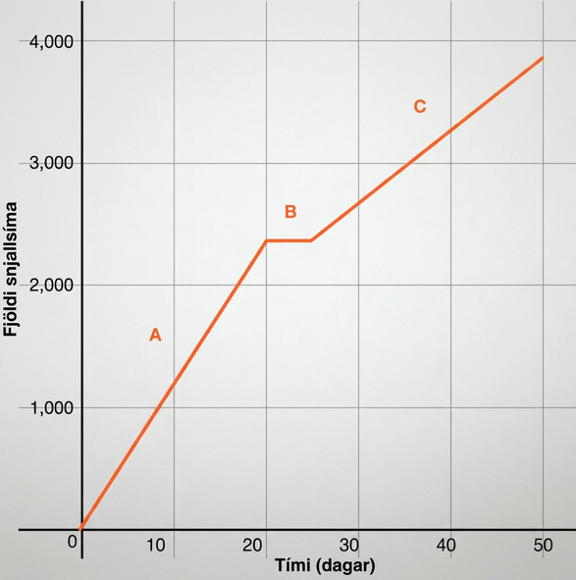
Self Check Review
The graph represents the total number of smartphones that are shipped to a retail store over the course of 50 days.
Why does f(20) = f(22)?
Notes:
Answer
Since section B is not changing it represents the period of time where the store did not receive new shipments, so f(20) = f(22).

Slide 23
Lesson Journey
Warm Up
Learning Activity
Cool Down
Lesson Synthesis
Learning Activity
Learning Activity
Practice

Slide 24
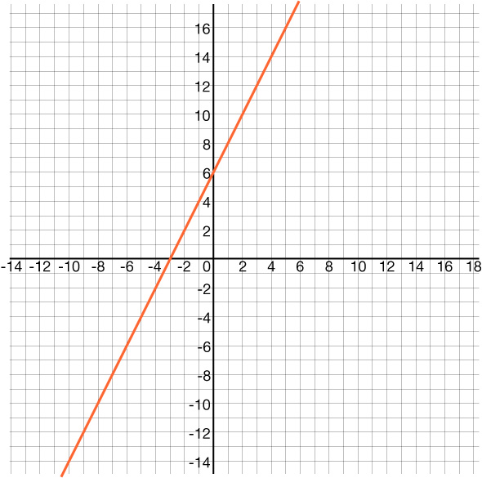
Learning Activity - What Defines a Linear Function? ✖️
Answer the questions about the linear function
f(x) = 2x + 6 and its key features.
What is the value of f (−3)?
What key feature of the linear function is the point (−3,0)?
What is the slope of the linear function?
What part of the linear function is the point (0,6)?
Graph representing the function:
f(x) = 2x + 6
Notes:
Activity (15 minutes)
Earlier in the lesson, students explored key features of the graphs of functions and what they mean in the context of a real life situation. Now, students will focus specifically on the graphs of linear functions. Students will identify x-intercepts as zeros, y-intercepts, and slopes.
Launch
Arrange students in groups of 2. Give students a few minutes of quiet time to think individually, and then time to discuss their response with their partner.
More activity questions on the next slide.

Slide 25
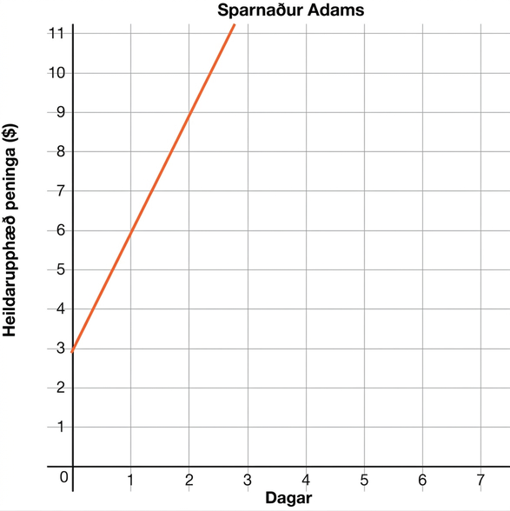
Learning Activity - What Defines a Linear Function? ✖️
Answer the questions about the graph of Adam’s Savings.
What is the y-intercept of the graph?
What does the y-intercept mean in the context of the problem?
What is the slope?
What does the slope mean in the context of the problem?
The graph shows the amount of money Adam saves in dollars.
Notes:
More activity questions, answers, anticipated misconceptions, and synthesis on the next slide.

Slide 26
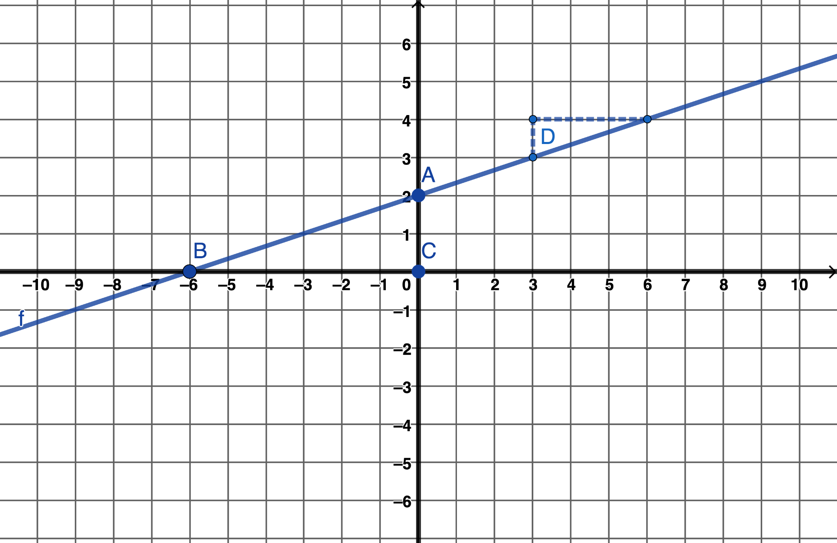
Learning Activity - What Defines a Linear Function? ✖️
What is the key feature on the graph…
…labeled A?
…labeled B?
…labeled C?
…labeled D?
Graph representing the function:
f(x) = ⅓ x + 2
Notes:
Answers
0
The x-intercept, or zero
2
The y-intercepts
The point is (0,3).
Your answer may vary. When Adam started saving, he already had 3 dollars on day 0.
The slope is 3.
Your answer may vary. Every 1 day, Adam saves 3 dollars.
A, (0, 2), is the y-intercept.
B, (-6, 0), is the x-intercept or zero.
C, (0, 0), is the origin.
D, ⅓, is the slope.
Activity Synthesis
Have student pairs share their answers.
The first question focuses on the intercepts. This is an opportunity to help students identify intercepts. Ask students:
How can you identify the x-intercept from the graph? (It is the point where the graph crosses the x-axis.)
Which coordinate of the x-intercept is zero? (The y-coordinate is zero.)
How can you identify the y-intercept from the graph? (It is the point where the graph crosses the y-axis.)
Which coordinate of the y-intercept is zero? (The x-coordinate is zero.)
The second question focuses on the meaning of the y-intercept in context and the slope. Ask students:
How do you interpret the meaning of the y-intercept in content? (The x-values represent days and the y-values represent the amount of money he saves. So the point (0,3) represents that he started on day zero with $3.)
How do you find the slope using the graph? (Use rise over run to count from one point on the graph to another point on the graph. From (0,3) count over 1 and up 3 to (1,6), so the slope is 3.)
How do you interpret the meaning of the slope in context? (The slope in the change in y, amount saved, over the change in x, the number of days. So for each day, the amount saved is $3.)
The third question focuses on labeling the graph. To help students identify the key features, ask:
What are the coordinates of the point labeled A? (0,2)
What key feature has zero and the x-coordinate? (The y-intercept has an x-coordinate of zero.)
What are the coordinates of the point labeled B? (−6,0)
What key feature has zero and the y-coordinate? (The x-intercept has a y-coordinate of zero.)
What are the coordinates of the point labeled C? (0,0)
What key feature of a graph has coordinates (0,0)? (The origin has coordinates (0,0).)
What does 31 represent in the graph? (31 is rise over run and represents the slope of the line.)

Slide 27
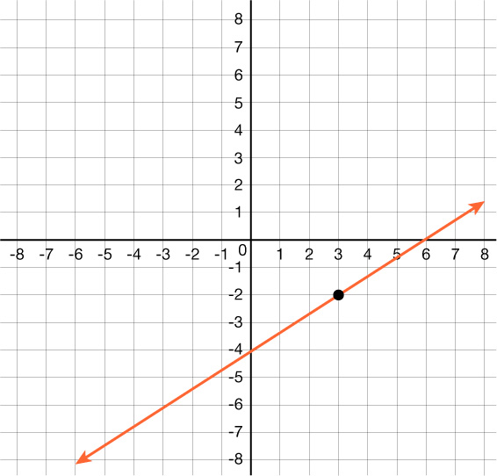
Self Check
What is the zero of the graphed linear function?
(6,0)
(0,-4)
(0,6)
(0,0)
Let’s review!
Notes:
Answer Feedback - Individualized by Response
(6,0)
That’s Correct! The zero is where the function crosses the x-axis.
(0,-4)
Incorrect. This is the y-intercept. The zero is located where the function value is zero, at the x-intercept. The answer is (6,0).
(0,6)
Incorrect. The x-coordinate is the first value in the ordered pair, and the y-coordinate is the second value. The answer is (6,0).
(0,0)
Incorrect. This is the origin, but it is not a point on the graph of this linear function. The answer is (6,0).

Slide 28
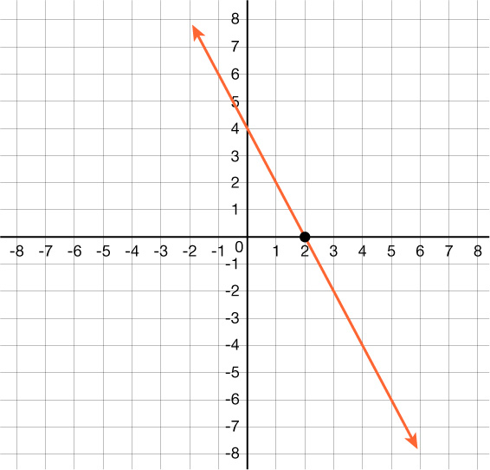


Self Check - Review
Features of Linear Functions
The graph of a linear function is a line that extends infinitely in both directions, so it has no maximum or minimum unless the domain restricted to a specific part of the graph.
You can still pick out key features of linear functions.
The x-intercept, or zero, is where the line crosses the x-axis. This is where the y-coordinate is 0.
  In this linear function, the x-intercept, or zero, is x=2 and written as the point (2,0).
The y-intercept is where the line crosses the y-axis and the x-coordinate is 0.
  In this linear function, the y-intercept is y=4 and written as the point (0,4).
The slope of the line can be found as in previous units as the change in y over the change in x.
The slope of this linear function is
Notes:
Remind Students: The slope of a line is m. M equals Rise over Run which is the same as the change in y over the change in x.
Identify the input values.
Identify the output values.
If each input value leads to only one output value, classify the relationship as a function. If any input value leads to two or more outputs, do not classify the relationship as a function.
Discuss the Answers with the Students:
Let’s begin by considering the input values as the items on the menu. The output values are then the prices. Each item on the menu has only one price, so the price is a function of the item.
Two items on the menu have the same price. If we consider the prices to be the input values and the items to be the output, then the same input value could have more than one output associated with it.
The mapping helps to show that two items on the menu have the same price, therefore, an item is a not a function of price.

Slide 29

Lesson Journey
Warm Up
Learning Activity
Cool Down
Lesson Synthesis
Learning Activity
Learning Activity
Practice

Slide 30
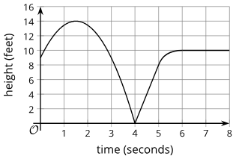
Cool Down
A squirrel runs up and down a tree.
The graph shows the height of the squirrel, h (feet), as a function of time, t (seconds).
What is the highest point the squirrel reaches?
Solve h(t)=0. What does this solution tell you about the squirrel?
Find the vertical intercept of the graph. What does it tell you about the squirrel?
Notes:
Cool Down (5 minutes)
Answers
14 feet
t = 4 means that after 4 seconds, the squirrel is at the bottom of the tree on the ground.
(0,9) means that at the beginning, the squirrel is 9 feet high in the tree.
Response to Student Thinking - More Chances
Students will have more opportunities to understand the mathematical ideas in this cool down, so there is no need to slow down or add additional work to the next lessons. Instead, use the results of this cool down to provide guidance for what to look for and emphasize over the next several lessons to support students in advancing their current understanding.

Slide 31

Lesson Journey
Warm Up
Learning Activity
Cool Down
Lesson Synthesis
Learning Activity
Learning Activity
Practice

Slide 32

Practice
Put your hard work to action, practice what you’ve learned!
Notes:
Digital Practice: Access the practice pages at https://openstax.org/details/books/algebra-1

Slide 33

Lesson Journey
Warm Up
Learning Activity
Cool Down
Lesson Synthesis
Learning Activity
Learning Activity
Practice

Slide 34
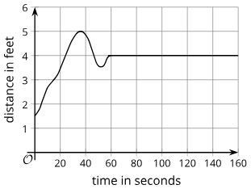
Lesson Synthesis
Discuss these two functions and the graph.
Function b gives the vertical distance (or the height) of a bee from the ground as a function of time, t.
Function d gives the distance of a child from where his mom is sitting as a function of time, t.
Notes:
Keep students in groups of 2. Display the graph and the descriptions of two functions for all students to see:
Prompt
Ask partners to choose a function. For that function, they should take turns identifying the following features on the graph and interpreting them in terms of the situation:
vertical intercept
horizontal intercept
maximum
minimum
intervals where the function is increasing
intervals where the function is decreasing
intervals where the function is staying constant
solution or solutions to b(t) = 3.5 or d(t) = 3.5
Then, discuss questions such as:
“How can you tell that a point on the graph is a maximum, a minimum, or neither?” (Look around it, left and right, to see whether the given point is higher than all the other points, lower than all the others, or neither.)
“How many intercepts can the graph of a function have?” (An unlimited number on the horizontal axis, but only one on the vertical axis.)

Slide 35
Self Assessment
How much do you agree with the following statements?
I can… | I can | Almost | Not yet
Identify important features of graphs of functions and explain what they mean in the situations represented.
Explain and apply the terms “horizontal intercept,” “vertical intercept,” “maximum,” and “minimum” when talking about functions and their graphs.
Identify important features of linear functions.

