Slide 1


Algebra 1
Unit 2 Linear Inequalities and Systems
Lesson 2.2 Writing Systems of Equations

Slide 2
How to use these slides
On the activity slides check the speaker notes for teacher support and instructional information.
Each lesson includes 1 warm up, 2-3 learning activities, a cool down, practice and a lesson synthesis.
  Learning activities are followed by a self check question, and review section.
Some slides have been hidden from student view, more information can be found on the next slide (Reference Key).
You can edit and use these slides for personal and classroom use, but cannot sell them and must keep the attribution logos.
For more information, Check out the digital quick start guide!

Slide 3






Reference Key
Check the top right corner for an icon referencing these unique sections.
 | Support for Students with Disability | Hidden | Learning Strategies slide, provides additional support to students for understanding the activity. Learning Strategies slide, provides additional support to students for understanding the activity.
 | Support for English Language Learners | Hidden
 | Extending Your Thinking | Hidden | Extending Your Thinking slide, provides an extra challenge for students.
 | Self Check | Not Hidden | Self Check slide, checkpoint to assess student understanding after the learning activity.
 | Review | Hidden | Self Check- Review slide, designed to help review topics from the self check question.
On the next slides, check the speaker notes for teacher instructions and support.
Notes:
Check the Speaker Notes: On the next slides you can find discussion questions, lesson information, answers to the activities, and ways to adjust the activity for your students!

Slide 4

Learning Goals
By the end of this lesson you will be able to -
Write a system of equations.
Graph systems of equations by hand.
Estimate real-world solutions by graphing systems of equations.
Notes:
Lesson Narrative
This lesson reinforces the concept of the solution of a system of two linear equations. Students are also asked to write systems of equations from a table of values and connect that to a graph of a system of equations using technology. Students then write the systems of equations from a graph and solve the system using the graph. In the cool down, students will explore how a system of equations represents a real world problem.
Required Preparation
None
Required Materials
Graph Paper
Texas Essential Knowledge and Skills
A1(A) apply mathematics to problems arising in everyday life, society, and the workplace.
A1(C) select tools, including real objects, manipulatives, paper and pencil, and technology as appropriate, and techniques including mental math, estimation, and number sense as appropriate, to solve problems.
A2(I) write systems of two linear equations given a table of values, a graph, and a verbal description.
A3(F) graph systems of two linear equations in two variables on the coordinate plane and determine the solutions if they exist
A3(G) estimate graphically the solutions to systems of two linear equations with two variables in real-world problems

Slide 5
Vocabulary
Previous
Slope-intercept form
  y = mx + b, where m is the slope, or the rate of change in y over the change in x, of the line and b is the y-intercept where the function crosses the y-axis.
New
Identities
  Equation that is true for variables equal to any value. (All real solutions)
Contradictions
  Equation that is never true for any value of the variable. (No real solutions)
Notes:
Lesson Vocabulary
To support student understanding of key vocabulary:
Familiarize students with the vocabulary words they will see throughout the lesson. Encourage students to look for these words and notice their use and meanings.
Encourage students to use key vocabulary words in “math talk” and their written and oral explanations.
Utilize a word wall. Sample cards are located here: Mathematics Vocabulary Word Wall Cards.
For newcomers or students with beginning English proficiency, use these Quizlet sets to support vocabulary learning:
Unit 2 Spanish Vocabulary – use first to build understanding
Unit 2 Vocabulary (English) – use after anchoring in Spanish
Support for English Language Learners
ELPS 2(A) distinguish sounds and intonation patterns of English with increasing ease
ELPS 2(B) recognize elements of the English sound system in newly acquired vocabulary such as long and short vowels, silent letters, and consonant clusters
ELPS 3(A) practice producing sounds of newly acquired vocabulary such as long and short vowels, silent letters, and consonant clusters to pronounce English words in a manner that is increasingly comprehensible
ELPS 4(A) learn relationships between sounds and letters of the English language and decode (sound out) words using a combination of skills such as recognizing sound-letter relationships and identifying cognates, affixes, roots, and base words
ELPS 4(B) recognize directionality of English reading such as left to right and top to bottom
ELPS 4(H) read silently with increasing ease and comprehension for longer periods
ELPS 4(J) demonstrate English comprehension and expand reading skills by employing inferential skills such as predicting, making connections between ideas, drawing inferences and conclusions from text and graphic sources, and finding evidence supporting text evidence commensurate with content area needs
ELPS 5(C) spell familiar English words with increasing accuracy, and employ English spelling patterns and rules with increasing accuracy as more English is acquired
ELPS 5(D) edit writing for standard grammar and usage, including subject-verb agreement, pronoun agreement, and appropriate verb tenses commensurate with grade-level expectations as more English is acquired
ELPS 5(E) employ increasingly complex grammatical structures in content area writing commensurate with grade-level expectations
ELPS 5(Ei) using correct verbs, tenses, and pronouns/antecedents

Slide 6





Lesson Journey
Warm Up
Learning Activity
Practice
Learning Activity
Cool Down
Lesson Synthesis

Slide 7

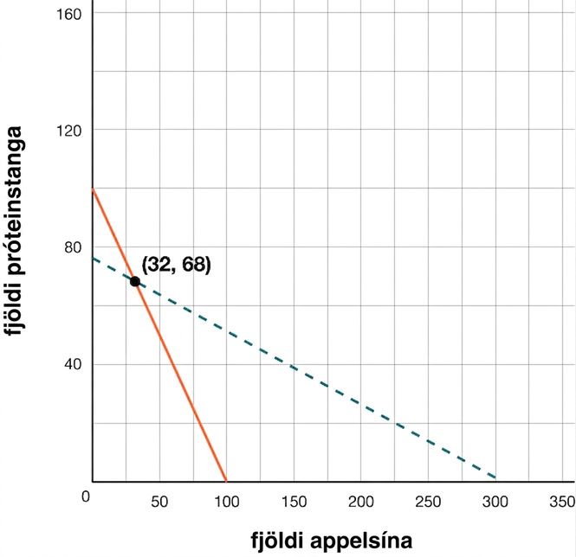
Warm Up - Concession Stand 🍊
A club is selling snacks at a track meet. Oranges cost $1 each and protein bars cost $4 each. They sell a total of 100 items, and collect $304.
What do you notice about the given graph and scenario?
What do you wonder about the given graph and scenario?
Notes:
Warm Up (5 minutes)
While students may notice and wonder many things about these images, intersection points and solutions are the important discussion points.
Through articulating things they notice and things they wonder about the point of intersection and what it means in the situation, students have an opportunity to attend to precision in the language they use to describe what they see. They might first propose less formal or imprecise language, and then restate their observation with more precise language in order to communicate more clearly.
Launch
Display the graph for all to see.
Ask students to think of at least one thing they notice and at least one thing they wonder.
Give students quiet thinking time, and then time to discuss the things they notice and wonder with their partner.
Students can then work together to answer questions 3–6.
Follow with a whole class discussion.
Answers
Things students may notice:
There are two lines.
It’s about snacks.
The lines intersect.
The point of intersection is labeled (32,68).
The sum of 32 and 68 is 100.
Things students may wonder:
What does each line mean?
What does the point of intersection mean?
Where can you see the information from the problem on the graph?
Additional activity questions, answers, and synthesis on the next slide.

Slide 8
Warm Up - Concession Stand 🍊
What is the approximate y-intercept of the green dashed line?
What is the approximate slope of the green dashed line?
What is the approximate y-intercept of the orange solid line?
What is the approximate slope of the orange solid line?
Notes:
Activity Answers
Answers may vary: 76
Answers may vary: – ¼
Answers may vary: 100
Answers may vary: – 1
Activity Synthesis
Ask students to share the things they noticed and wondered. Record and display their responses for all to see. If possible, record the relevant reasoning on or near the image. After all responses have been recorded without commentary or editing, ask students,
Is there anything on this list that you are wondering about?
Encourage students to respectfully disagree, ask for clarification, or point out contradicting information.
If the meaning of the point of intersection does not come up during the conversation, ask students to discuss this idea.
Solicit a discussion asking students what the point of intersection means in the context of the problem.
Consider the labels of the x- and y-axes. What do the lines mean in the context of the problem?
Connect the lines and intersection to the possible ways that oranges and protein bars can be sold to make $304.

Slide 9

Lesson Journey
Warm Up
Learning Activity
Practice
Learning Activity
Cool Down
Lesson Synthesis

Slide 10

Learning Strategies - Pool Plan 🏖️
Teacher Instruction: Use these strategies to adjust the activity to support english language learners and students with disabilities.
You can copy and paste the callout directly on top of the activity or give the instructions aloud.
First read: listen and describe the situation without numbers.
Second read: list what can be counted or measured.
Third read: listen for the questions and brainstorm ways to solve the system.
Three Reads
Notes:
Support for English Language Learners: MLR 6 Three Reads: Speaking
Ask students to keep their books or devices closed and display only the image with the opening task statement, without revealing the questions that follow. Use the first read to orient students to the situation by asking students to describe what the situation is about without using numbers (a family compares two options for using the community pool). Use the second read to identify quantities and relationships; ask students: “What can be counted or measured?” Listen for, and amplify, the important quantities that vary in relation to each other in this situation: number of visits to the pool, initial cost for the membership, and total cost of each option. After the third read, reveal the questions that follow and invite students to brainstorm possible strategies to find the solution to the system. This routine helps students interpret the language within a given situation needed to create a system of equations.
Design Principle(s): Support sense-making; Cultivate conversation
Learn more about this routine
View the instructional video and follow along with the materials to assist you with learning this routine.
Provide support for students
Distribute graphic organizers to the students to assist them with participating in this routine.
As students talk with partners, ensure they are recognizing elements of the English sound system in newly acquired vocabulary such as long and short vowels, silent letters, and consonant clusters in words such as slope and intercept.Monitor ELL students for the following:
When reading their partner's paragraph (to themselves and aloud):
recognize directionality of English reading such as left to right and top to bottom
practice producing sounds of newly acquired vocabulary such as long and short vowels, silent letters, and consonant clusters to pronounce English words in a manner that is increasingly comprehensible specifically for the words slope and 𝑦-intercept
distinguish sounds and intonation patterns of English with increasing ease
learn relationships between sounds and letters of the English language and decode (sound out) words using a combination of skills such as recognizing sound-letter relationships and identifying cognates, affixes, roots, and base words
When writing their own paragraph:
use correct verbs, tenses, and pronouns/antecedents
spell familiar English words with increasing accuracy, and employ English spelling patterns and rules with increasing accuracy as more English is acquired
edit writing for standard grammar and usage, including subject-verb agreement, pronoun agreement, and appropriate verb tenses commensurate with grade-level expectations as more English is acquired

Slide 11
Learning Activity - Pool Plan 🏖️
The Flores family wants to purchase a family membership to the community pool. Mrs. Flores called the community pool to find out different membership plans for a family of six. The receptionist at the community center told her that there are two options. Option A is to pay $100 for the summer and $20 per visit. The second option, Option B, is to pay $250 for the summer and $5 per visit.
At dinner, the Flores family talked about how many times a week they think they will visit the pool and how many times total in the summer they will visit.
How can the Flores family decide which option to choose? Which option do you think they will pick and why?
Notes:
Support for All Learners
This activity offers additional support for students:
For English language learners, be sure to review the Learning Strategies slide!
Activity (20 minutes)
In this activity, students will work to make a table of values from a given situation, then write an equation for each option. They then graph the equations on the same graph and discuss what the intersection means.
Launch
Ask students if they have ever belonged to a pool or if their parents belong to a gym. Maybe they have a streaming service at home. These types of memberships cost money and often people are given options with the plans that they choose. It is helpful to understand how to compare the plans and decide which one is the better deal.
Allow students time to read the passage to themselves, then ask them to brainstorm the questions with a partner to make predictions and support their choices. Do the partners agree or disagree?
Activity questions, answers, anticipated misconceptions and synthesis on the next slide.

Slide 12
Learning Activity - Pool Plan 🏖️
For both Option A and Option B:
  Make a table of values for 0–10 visits.
  Identify the y-intercept (where x = 0).
  Identify the slope between any two points.
  Write an equation of the line in slope-intercept form.
Write the system of equations.
Graph your system of equations that represents this scenario.
What is the point of intersection of the two lines?
Talk with your partner. What does this intersection mean in the context of the problem?
Write a paragraph to describe when Option A is better and when Option B is better. Share your paragraph with your partner and then discuss if you agree or disagree.
Option A: $100 for the summer and $20 per visit
Option B: $250 for the summer and $5 per visit
Notes:
Answers
(Answers are presented in the format Option A and Option B)
Access the online Teacher Guide to see the tables for this question or access these Google sheets.
Option A = {(0, 100), (1, 120), (2, 140), (3, 160), (4, 180), (5, 200), (6, 220), (7, 240), (8, 260), (9, 280), (10, 300)}
Option B = {(0, 250), (1, 255), (2, 260), (3, 265), (4, 270), (5, 275), (6, 280), (7, 285), (8, 290), (9, 295), (10, 300)}
y-intercepts are: 100 for Option A and 250 for Option B
Slopes are: 20 for Option A and 5 for Option B
Option A: y = 20x + 100 and Option B: y = 5x + 250
y = 20x + 100; y = 5x + 250
Access the online Teacher Guide to see the graph for this question or use this Desmos graph.
(10, 300) - (Desmos graph)
At 10 visits, the cost is the same at $300.
Answers may vary, but here is a sample. The two options cost the same at 10 visits. Since Option A is less money up front, Option A will be less expensive until the 10th visit. After 10 visits, however, Option B is less expensive.
Anticipated Misconceptions
Students may need to reactivate the meaning of slope and where to find the slope in the table. When writing the equations, students often switch the slope and 𝑦-intercept values in the slope-intercept formula.
Activity Synthesis
Invite partners to share their reasoning for questions 12 and 13. Ask volunteers to extend each table of values to show if their reasoning is true.
If time allows, consider having students write their own situations and trade with a partner. Students will then write their own table of values, graphs, and equations for the situations. This would also allow for an opportunity for partners to create presentations on their situations for their classmates.

Slide 13
Self Check
A streaming service offers two options for subscription plans. Option A charges $10.99 a month plus $2 per movie. Option B charges $5.99 a month plus $3 per movie. The table below describes this. Which of the following systems of equations represents the two options for one month? (x = number of movies)
y = 10.99x + 2;
y = 5.99x + 3
y = 2x – 10.99;
y = 3x – 5.99
y = 2x + 10.99;
y = 3x + 5.99
y = 3x + 10.99;
y = 2x + 5.99
 | 0 | 1 | 2 | 3
Option A | 10.99 | 12.99 | 14.99 | 16.99
Option B | 5.99 | 8.99 | 11.99 | 14.99
Let’s review!
Notes:
Answer Feedback - Individualized by Response
Incorrect. The slope and y-intercepts are switched.
Incorrect. The price per movie gets added to the monthly rate.
That’s correct! Option A has an upfront cost of $10.99, the starting point or y-intercept, then a slope of $2 per movie. Option B has an upfront cost of $5.99, the starting point or y-intercept, then a slope of $3 per movie.
Incorrect. Read the problem and table carefully. The slopes should be switched to match with the correct y-intercepts.

Slide 14
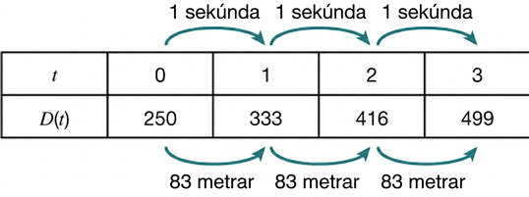
Self Check - Review
Suppose a maglev train travels a long distance and maintains a constant speed of 83 meters per second for a period of time once it is 250 meters from the station. Here is a table that shows this constant speed. Write the equation in slope intercept form.
Step 1 – Find the y-intercept, b.
Step 2 – Find the slope, m.
Step 3 – Write the equation in slope-intercept form,
y = mx + b.
Notes:
Remind Students
A system of equations is two or more equations.
Like other equations, the equations that make up the system can be represented by a table.
When writing any equation from a table into slope-intercept form, two things are needed: a slope and point, often the 𝑦-intercept.
Answers
Step 1 – Find the y-intercept. Notice that when t = 0, D(t) = 250. This is the y-intercept.
Step 2 – Find the slope. To find the slope, find the change of y over the change of x: m = ⁸³⁄₁ = 83.
Step 3 – Write the equation in slope-intercept form. y = mx + b, where m is the slope and b is the y-intercept: y = 83x + 250.

Slide 15
Lesson Journey
Warm Up
Learning Activity
Practice
Learning Activity
Cool Down
Lesson Synthesis

Slide 16
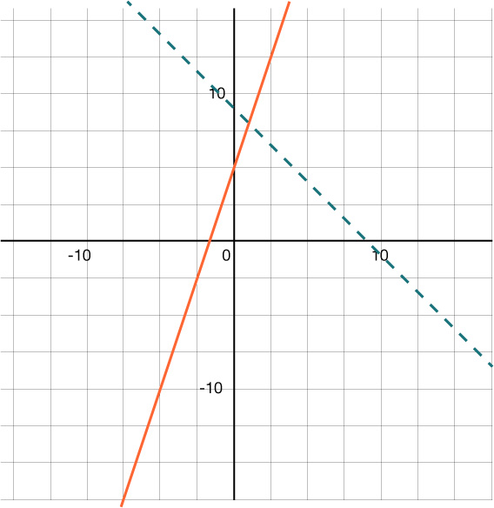
Learning Activity - Graphing Practice 📈
For the green dashed line:
What is the y-value of the y-intercept?
What is the slope?
What is the equation in slope-intercept form?
For the orange solid line:
What is the y-value of the y-intercept?
What is the slope?
What is the equation in slope-intercept form?
Write the two equations as a system of linear equations.
What is the solution of the system of equations?
Notes:
Support for All Learners
This activity offers additional support for students:
For students looking for an extra challenge, be sure to review the Extending Your Thinking slide!
Activity (20 minutes)
This activity prompts students to write a system of equations from a graph, then reverse their steps to graph a system of equations by hand. Students will need to –
Identify the slope and y-intercept from both the graph and an equation in y-intercept form
Recall that slope is the change in y over the change in x.
Recognize that a solution to a system of equations is where the equations intersect on the graph.
Launch Part 1
Students will begin with a graph of the systems of equations and write the system from the graph.
Facilitate a discussion about how to find slope and y-intercept from a graph.
Have students share and compare their answers.
NOTE: This is not a time to utilize technology as the goal is for students to graph by hand.
Answers
Part 1:
9
– 1
y = – x + 9
5
3
y = 3x +5
y = − x + 9
y = 3x + 5
(1, 8)
Additional activity questions, answers, anticipated misconceptions, and synthesis on the next slide.

Slide 17
Learning Activity - Graphing Practice 📈
Now that you wrote a system of equations from a given graph, how can you work backward and graph a given system of equations by hand? Discuss this with a partner.
For questions 1 – 2, use this system of equations: y = 4x – 4 y = – 2x + 8 Graph the equations on the same coordinate plane. What is the solution to the system of equations? | For questions 3 – 4, consider the system of equations: y = – ¾ x + 5 y = ½ x – 5 Graph the equations on the same coordinate plane. What is the solution to the system of equations?
Are you ready for more?
Notes:
Launch Part 2
Put students in pairs.
After students discuss with their partner, have a whole class discussion about working backward from a given system of equations to graph the system by hand.
As a class, write the steps on the board. When graphing the equations, students may want to graph each equation with a different color on their coordinate plane.
Answers Part 2
Access the online Teacher Guide to see the graph for this question or use this Desmos graph.
(2, 4)
Access the online Teacher Guide to see the graph for this question or use this Desmos graph.
(8, – 1)
Anticipated Misconceptions
Students may still have trouble mixing up the slope and y-intercept in slope-intercept form.
Additionally, when finding the slope, students may mix up the rise and run. Encourage students to draw on their graphs to emphasize the rise and run.
Activity Synthesis
Encourage students to check their solutions to each system of equations into both of the equations to show that the solution works in both equations.

Slide 18
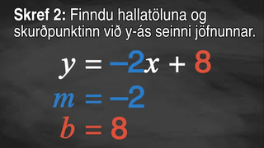
Video: Graphing a System of Equations

Slide 19
Extending Your Thinking
Graph the following system of equations on a coordinate plane:
Find the solution.
(Hint: For the second equation, solve for y first.)
y = 2x + 5 4x – 2y = 10
Notes:
Answer
Infinitely many solutions.
When the second equation is solved for y, it becomes −2y = −4x + 10 then y = 2x + 5.
Both equations are the same. So, on the graph, one line is on top of the other and all solutions are possible.
Anticipated Misconceptions
Students may need to visually see that the lines are the same (or sitting on top of each other) and that multiple points are solutions to both equations.

Slide 20
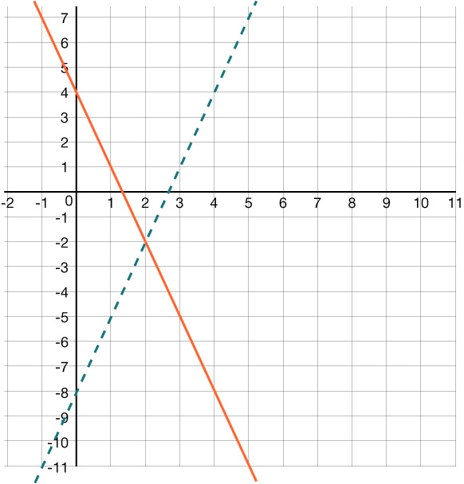
Self Check
Which of the following systems of equations is graphed:
y = 3x + 4 y = −3x – 8
y = 4x – 3 y = – 8x + 3
y = – 3x + 4 y = 3x – 8
y = 3x + 4 y = 3x – 8
Let’s review!
Notes:
Answer Feedback - Individualized by Response
Incorrect. The slopes are mixed up. The line with the y-intercept of 4 should have a negative slope and the dashed line that has the y-intercept of – 8 should have a positive slope.
That's correct! The solid line has a y-intercept at 4 and a slope of – 3. The dashed line has a y-intercept of – 8 and a slope of 3.
Incorrect. In each equation, the slope and y-intercept need to switch. For instance, the solid line has a y-intercept at 4 and a slope of – 3 while the dashed line has a y-intercept at – 8 and a slope of 3.
Incorrect. The solid line is decreasing from left to right and has a negative slope, not positive.

Slide 21
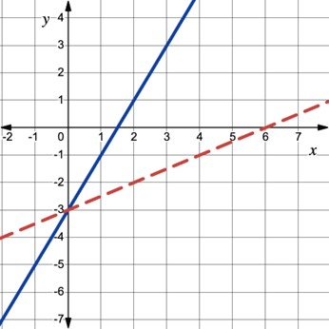
Self Check - Review
WRITE A SYSTEM OF EQUATIONS FROM A GRAPH
Step 1 – Find the slope and y-intercept of the first line.
Step 2 – Find the slope and y-intercept of the second line.
Step 3 – Write the two equations for a system of equations:
y = mx + b
Determine the system of equations graphed below.
Notes:
Remind students:
If the lines intersect, estimate the point of intersection. Check to make sure it is a solution to both equations. This is the solution to the system.
If the lines are parallel, the system has no solution.
If the lines are the same, the system has an infinite number of solutions.
Answers
Step 1 – Find the slope and y-intercept of the red dotted line.
Slope is ½. Access the online Teacher Guide to see the work for this question.
y-intercept is (0, –3)
Step 2 – Find the slope and y-intercept of the blue solid line.
Slope is 2. Access the online Teacher Guide to see the work for this question.
y-intercept is (0, –3)
Step 3 – Write the two equations for a system of equations
For the red dotted: y = ½x – 3
For the solid blue: y = 2x – 3
Additional examples are available in the Additional Resources section for this lesson of the online textbook.

Slide 22

Lesson Journey
Warm Up
Learning Activity
Practice
Learning Activity
Cool Down
Lesson Synthesis

Slide 23

Cool Down
When Jenna spent 10 minutes on the elliptical trainer and then lifted weights for 20 minutes, her fitness app said she burned 278 calories. When she spent 20 minutes on the elliptical trainer and 30 minutes lifting weights she burned 473 calories. How many calories does she burn for each minute on the elliptical trainer? How many calories does she burn for each minute of lifting weights?
Let x = calories burned per minute on the elliptical and y = calories burned per minute lifting weights.
Write a system of equations.
Using graphing technology, graph the system of equations.
Use the graph to estimate the solution.
Notes:
Cool Down (5 minutes)
Answers
10x + 20y = 278; 20x + 30y = 473
Access the online Teacher Guide to see the graph for this question or use this Desmos graph.
Answers may vary. Here is a sample response. (11, 8.5) The elliptical burns about 11 calories per minute. Lifting weights burns about 8.5 calories per minute. (Desmos graph)
Response to Student Thinking - More Chances
Students will have more opportunities to understand the mathematical ideas in this cool down, so there is no need to slow down or add additional work to the next lessons. Instead, use the results of this cool down to provide guidance for what to look for and emphasize over the next several lessons to support students in advancing their current understanding.

Slide 24

Lesson Journey
Warm Up
Learning Activity
Practice
Learning Activity
Cool Down
Lesson Synthesis

Slide 25

Practice
Put your hard work to action, practice what you’ve learned!
Notes:
Digital Practice: Access the practice pages at https://openstax.org/details/books/algebra-1

Slide 26

Lesson Journey
Warm Up
Learning Activity
Practice
Learning Activity
Cool Down
Lesson Synthesis

Slide 27
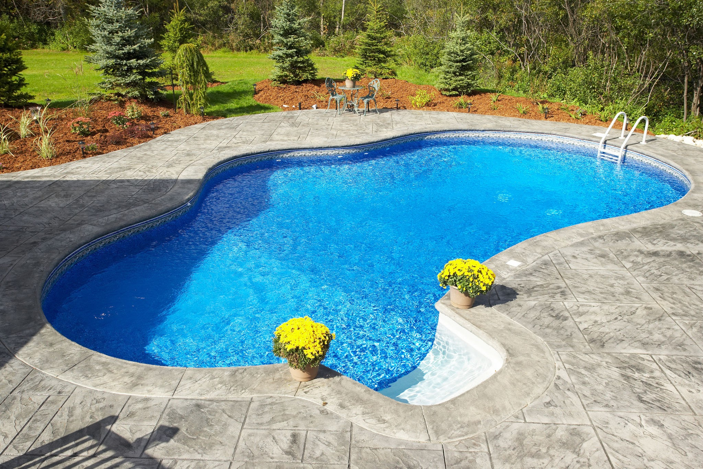
Lesson Synthesis
How are the solutions to systems of equations connected to the graph of the system?
How can you find the solution to a system of equations using tables?
Can you think of any other situations that can be modeled by systems of equations?
Notes:
Some key takeaways from this lesson are the ideas that real-life situations are often represented by systems of equations. Systems, like other equations, can be represented by tables, graphs, and verbal descriptions.
Tell students that expressions, equations, and inequalities are mathematical models. A model is a mathematical representation of a real-life situation. When people create models, they rely on the information they have, but they also make assumptions and decisions that affect the models. If the information or assumptions change, the model would also change.

Slide 28
Self Assessment
How much do you agree with the following statements?
I can… | I can | Almost | Not yet
Write a system of equations from tables of values and graphs.
Graph systems of equations by hand.

