Slide 1
Algebra 1
Unit 8 Quadratic Equations
Lesson 8.4 Solving Equations with the Zero Product Property

Slide 2

How to use these slides
On the activity slides check the speaker notes for teacher support and instructional information.
Each lesson includes 1 warm up, 2-3 learning activities, a cool down, practice and a lesson synthesis.
  Learning activities are followed by a self check question, and review section.
Some slides have been hidden from student view, more information can be found on the next slide (Reference Key).
You can edit and use these slides for personal and classroom use, but cannot sell them and must keep the attribution logos.
For more information, Check out the digital quick start guide!
OpenStax CC BY NC SA

Slide 3





Reference Key
Check the top right corner for an icon referencing these unique sections.
Icon | Title | View | Location and Description
n/a | Support for Students with Disability | Hidden | Learning Strategies slide, provides additional support to students for understanding the activity.
n/a | Support for English Language Learners | Hidden | Learning Strategies slide, provides additional support to students for understanding the activity.
n/a | Extending Your Thinking | Hidden | Extending Your Thinking slide, provides an extra challenge for students.
n/a | Self Check | Not Hidden | Self Check slide, checkpoint to assess student understanding after the learning activity.
n/a | Review | Hidden | Self Check - Review slide, designed to help review topics from the self check question.
On the next slides, check the speaker notes for teacher instructions and support.
Notes:
Check the Speaker Notes: On the next slides you can find discussion questions, lesson information, answers to the activities, and ways to adjust the activity for your students!

Slide 4

Learning Goals
By the end of this lesson you will be able to -
Explain the meaning of the "zero product property."
Find solutions to quadratic equations when one side is a product of factors and the other side is zero.
Notes:
Lesson Narrative
In this lesson, students learn about the zero product property. They use it to reason about the solutions to quadratic equations that each have a quadratic expression in factored form on one side and 0 on the other side. They see that when an expression is a product of two or more factors and that product is 0, one of the factors must be 0. This fact enables us to find unknown values in the factored expression.
Students also continue to make connections to their earlier work on quadratic functions. They have seen that sometimes we want to find the input values of a function when the output is zero. They also learned that the factored form can help us identify the zeros of a quadratic function and the 𝑥-intercepts of its graph. They have not investigated how or why this form enables us to do so, however. Here, students make use of the structure of a quadratic expression in factored form and the zero product property to understand the connections between the numbers in the form and the 𝑥-intercepts of its graph.
Required Preparation
None
Required Materials
Paper and pencil
Texas Essential Knowledge and Skills
A1(A) apply mathematics to problems arising in everyday life, society, and the workplace.
A8(A) solve quadratic equations having real solutions by factoring, taking square roots, completing the square, and applying the quadratic formula.

Slide 5
Vocabulary
Previous
Quadratic Equation
  Polynomial equation of degree two.
Factored form
  A quadratic equation in the form y = a(x-r₁)(x-r₂).
Zero (of a function)
  A value of x where the function is 0.
New
Zero Product Property
  If the product of factors is zero, then one or more of the factors equal zero.
Notes:
Lesson Vocabulary
To support student understanding of key vocabulary:
Introduce and review the vocabulary words students will see in this lesson.
Encourage students to notice how these words are used and to include them in their math discussions and explanations—both written and oral.
Use a word wall to reinforce vocabulary. Sample word wall cards are available here.
For newcomers or students with beginning English proficiency, use these Quizlet sets to support vocabulary learning:
Unit 8 Spanish Vocabulary – use first to build understanding
Unit 8 Vocabulary (English) – use after anchoring in Spanish
Support for English Language Learners
ELPS 2(F) listen to and derive meaning from a variety of media such as audiotape, video, DVD, and CD-ROM to build and reinforce concept and language attainment
ELPS 3(B) expand and internalize initial English vocabulary by learning and using high-frequency English words necessary for identifying and describing people, places, and objects, by retelling simple stories and basic information represented or supported by pictures, and by learning and using routine language needed for classroom communication
ELPS 3(F) ask and give information ranging from using a very limited bank of high-frequency, high-need, concrete vocabulary, including key words and expressions needed for basic communication in academic and social contexts, to using abstract and content-based vocabulary during extended speaking assignments
ELPS 4(G) demonstrate comprehension of increasingly complex English by participating in shared reading, retelling or summarizing material, responding to questions, and taking notes commensurate with content area and grade level needs

Slide 6
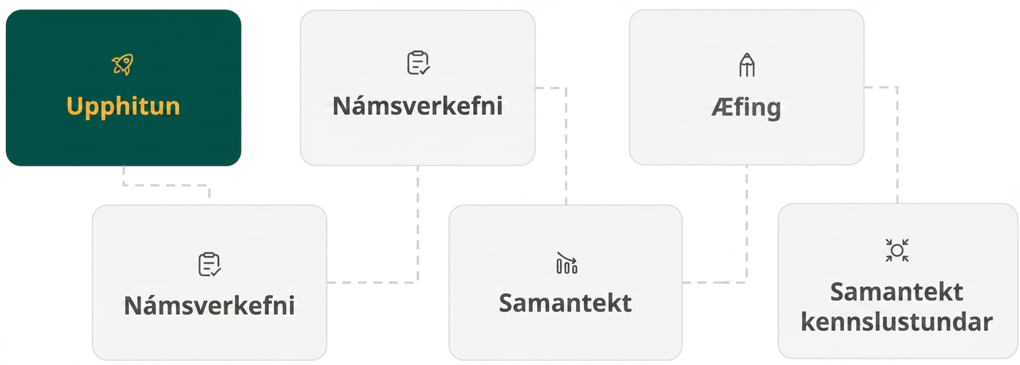
Lesson Journey
First Stop: Warm Up

Slide 7

Warm Up | Part 1
What makes 🪶𑛀 🪶 = 0?
What values of the variables make each equation true?
6 + 2a = 0
7b = 0
7(c – 5) = 0
Which statements are true if 𝑔𑛀ℎ=0?
𝑔 = 0
𝑔 = ℎ = 0
ℎ = 0
𝑔 ≠ 0 and ℎ ≠ 0
Notes:
Warm Up (10 minutes)
This warm up introduces students to the zero product property and prepares them to use it to solve quadratic equations. It reminds students that if two numbers are multiplied and the result is 0, then one of the numbers has to be 0.
Launch
Display one problem at a time and ask students to respond without writing anything down.
Give students quiet time to think individually for each problem and ask them to give a signal when they have an answer and a strategy.
Keep all problems displayed throughout the talk.
Follow with a whole-class discussion about the zero product property using the definition and the lesson synthesis.
As you discuss the solution to question 5 with students, take note that question 1 also adheres to this pattern. There is only one factor in question 1, (6+2𝑎).
Activity questions, answers, and synthesis on the next slide.

Slide 8
Warm Up | Part 2
What makes 🪶𑛀 🪶 = 0?
What did you notice about one of the factors in each of the previous problems?
ZERO PRODUCT PROPERTY
If the product of factors is 0, then one or more of the factors equal 0.
If 𝑎𝑏 = 0, then 𝑎 = 0
or 𝑏 = 0, or 𝑎 = 𝑏 = 0.
Notes:
Answers
𝑎 = −3
𝑏 = 0
𝑐 = 5
Either 𝑔 = 0 or ℎ = 0, or 𝑔 = ℎ = 0
At least one of the factors in each equation was 0 or equivalent to 0.
Consider saying to students: “We will use the zero product property to help solve quadratic equations throughout this lesson.”
Anticipated Misconceptions
You may want to provide additional explanation for the statements in question 4:
𝑔 = 0. In other words, 𝑔 equals zero and ℎ may be any real number.
𝑔 = ℎ = 0. In other words, both 𝑔 and ℎ are equal to zero.
ℎ = 0. In other words, ℎ equals zero and 𝑔 may be any real number.
𝑔 ≠ 0, ℎ ≠ 0. In other words, neither 𝑔 nor ℎ are equal to zero.
Activity Synthesis
Ask students to share their strategies for each problem. Record and display their responses for all to see. To involve more students in the conversation, consider asking:
"Who can restate _______'s reasoning in a different way?"
"Did anyone have the same strategy but would explain it differently?"
"Did anyone solve the problem in a different way?"
"Does anyone want to add on to _______'s strategy?"
"Do you agree or disagree? Why?"
Highlight explanations that state that any number multiplied by 0 is 0. Then, introduce the zero product property, which states that if the product of two numbers is 0, then at least one of the numbers is 0.

Slide 9
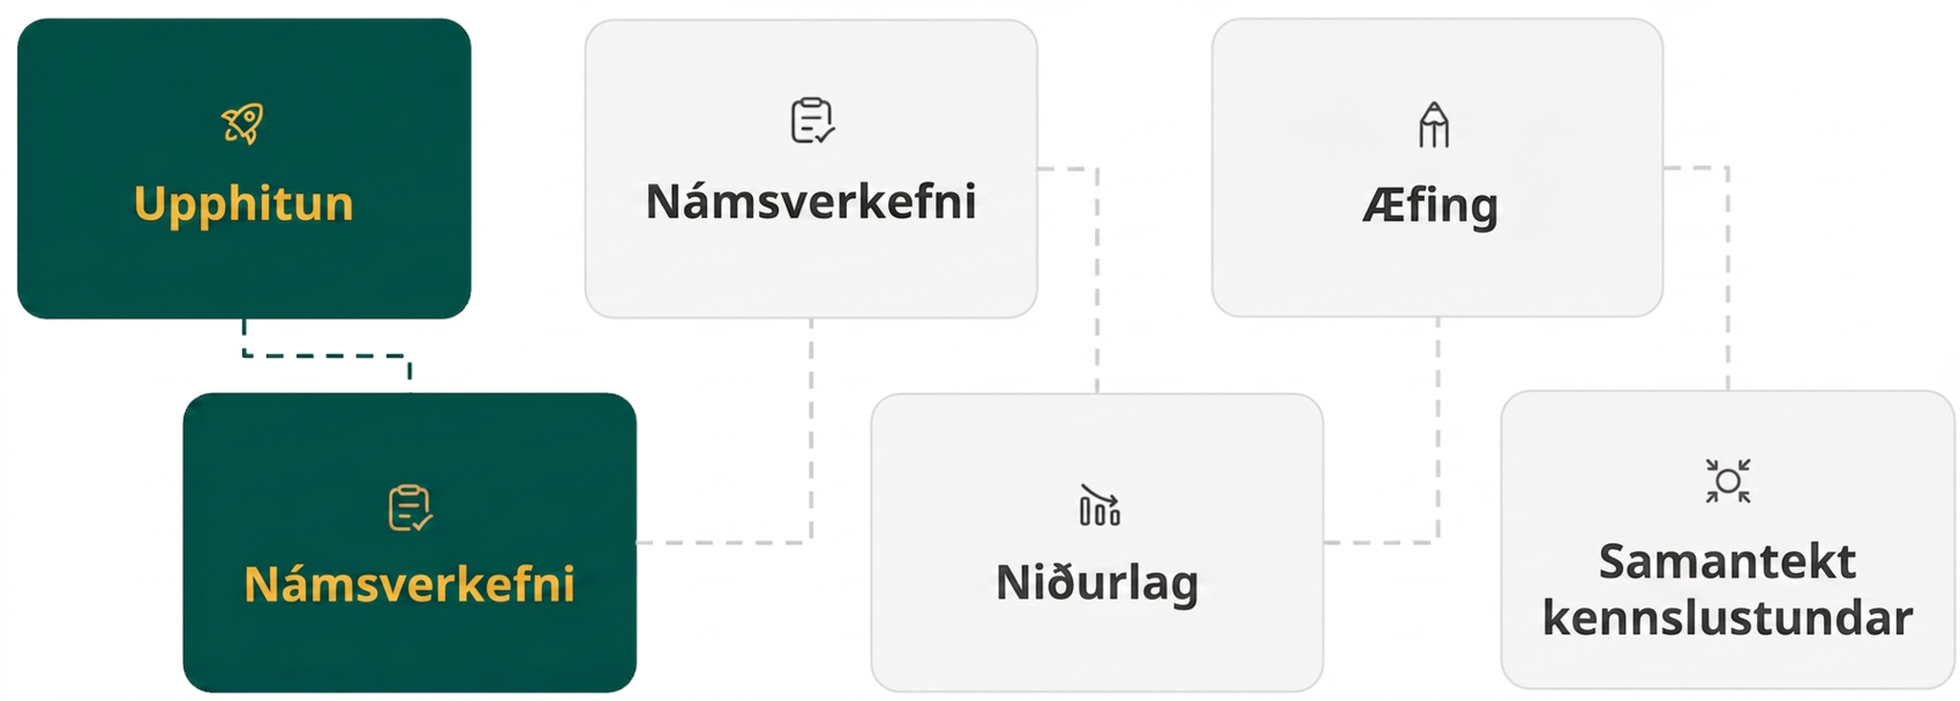
Lesson Journey
Second Stop: Learning Activity A

Slide 10

Learning Activity A | Learning Strategies
Industrial-Strength Solving👷
Teacher Instruction: Use these strategies to adjust the activity to support English language learners and students with disabilities.
You can copy and paste the callouts directly on top of the activity or give the instructions aloud.
For each problem:
Use the zero product property to write two separate equations.
Record how you recognized the number of solutions.
Memory & Organization
Notes:
Support for Students with Disabilities: Action and Expression: Internalize Executive Functions
To support development of organizational skills, check in with students within the first two to three minutes of work time, especially when students arrive at problems with two solutions. Look for students who quickly recognize that they will need to solve two equations and are organizing their work to account for the appropriate number of solutions for each problem. To support students in recognizing examples with two solutions, demonstrate annotating the problem by writing two equations separately, or drawing arrows from each factor to indicate two solutions. Encourage students to prepare their explanations by recording how they recognized the number of solutions as they work.
Supports accessibility for: Memory; Organization

Slide 11
Learning Activity A | Part 1
Industrial-Strength Solving👷
For each equation, find its solution or solutions. Be prepared to explain your reasoning.
For questions 1 – 3, review the process of solving equations.
x – 3 = 0
x + 11 = 0
2x + 11 = 0
Notes:
Support for All Learners
This activity offers additional support and an extension for students:
For English language learners and students with disabilities, be sure to review the Learning Strategies slide!
For students looking for an extra challenge, be sure to review the Extending Your Thinking slide!
Activity (15 minutes)
In this activity, students solve equations of increasing complexity and do so by reasoning. They begin with linear equations, move toward a series of quadratic expressions in factored form, and end with a cubic expression in factored form. The progression prompts students to reason about the parts and structure of the expressions, rather than to memorize steps for solving without understanding.
As students discuss their reasoning with their partner, listen for those who invoke the zero product property to explain how the last four equations could be solved, and those who notice a pattern in how the equations could be solved. (Though the last question involves a cubic equation, solving it involves the same reasoning as solving quadratic expressions.)
Launch
Arrange students in groups of two.
Tell students to work quietly and answer at least half of the questions before discussing their thinking with a partner.
If needed, remind students that some equations have more than one solution.
Because we want students to use reasoning and the structure of equations to develop their solutions, discourage use of graphing technology in this activity.
Activity image answer, and synthesis on the next slide.

Slide 12
Learning Activity A | Part 2
Industrial-Strength Solving👷
The zero product property means that each (or all) of the factors could be equal to zero when their product is zero. Solve each equation by setting each factor equal to zero and solving.
𝑥(2𝑥 + 11) = 0
(𝑥 − 3)(𝑥 + 11) = 0
(𝑥 − 3)(2𝑥 + 11) = 0
𝑥(𝑥 + 3)(3𝑥 − 4) = 0
Are you ready for more?
Notes:
Answers
x = 3
x = -11
x = -11୵2
x = 0 and x = -11୵2
x = 3 and x = -11
x = 3 and x = -11୵2
x = 0, x = -3, x =-4୵3
Anticipated Misconceptions
Students may incorrectly think that 𝑥 can represent a different value in each factor in an equation. For example, upon finding 𝑥=−11
and 𝑥=3 as solutions to (𝑥−3)(𝑥+11)=0, they think that one solution is for the 𝑥 in (𝑥−3) and the other for the 𝑥 in (𝑥−11).
Remind students that solving the equation (𝑥−3)(𝑥+11)=0 is like finding the zeros of the function defined by (𝑥−3)(𝑥−11). Although there may be two values of 𝑥 that lead to 0 for the value of (𝑥−3)(𝑥−11), only one input can be entered into the function at a time. Ask students to substitute the solutions into the equations and check if the expression is equal to 0 each time.
When 𝑥=−11, the value of the expression is (−11−3)(−11+11) or (−14)(0), which is 0.
When 𝑥=3, the value of the expression is (3−3)(3+11) or (0)(14), which is 0.
Activity Synthesis
Invite students to share their strategies for solving the nonlinear equations. As they explain, record and organize each step of their reasoning process and display for all to see.
A detailed explanation for how we can organize the solving process is provided here.
Emphasize that because at least one of the factors must be 0, for the product to be 0, we can write each expression that is a factor as equal to 0 and solve each of these equations separately.
Remind students that we can check our solutions by substituting each one back into the equation and seeing if the equation remains true. Although the two factors, (𝑥−3) and (2𝑥−11), won't be 0 simultaneously when 3 or -11୵2 is substituted for 𝑥, the expression on the left side of the equation will have a value of 0 because one of the factors is 0. Additional explanation is provided here.

Slide 13

Learning Activity A
Extending Your Thinking
Use factors of 48 to find as many solutions as you can to the equation (𝑥 – 3)(𝑥 + 5) = 48.
Once you think you have all the solutions, explain why these must be the only solutions.
Notes:
Go back to Lesson Activity
Answers
𝑥=7 and 𝑥=−9
The numbers expressed by 𝑥−3 and 𝑥+5 are 8 units apart. The only factor pairs of 48 that are 8 units apart are 4 and 12, as well as –4 and –12.

Slide 14
Learning Activity A
Self Check
Solve the equation. (𝑥 + 4)(8𝑥 − 16) = 0
𝑥 = 4 and 𝑥 = −4
𝑥 = 4 and 𝑥 = −2
𝑥 = 2 and 𝑥 = −2
𝑥 = 2 and 𝑥 = −4
Let’s review!
Notes:
Answer Feedback - Individualized by Response
Incorrect. Find the values that make each of the factors equal to 0. While 𝑥=−4 is correct, check your solution when solving the factor (8𝑥−16)=0.
Incorrect. The signs on these answers are opposite of the correct responses. Find the values that make each of the factors equal to 0.
Incorrect. Find the values that make each of the factors equal to 0. While 𝑥=2 is correct, the other value is not. Check your solution when solving the factor (𝑥+4)=0.
That’s correct! Check yourself: Substitute each value into the equation and check if they are true. (2+4)(8(2)−16)=0, and ((−4)+4)(8(−4)−16)=0. Since they are both true, your answer is correct.

Slide 15
Learning Activity A
Self Check - Review
Use the zero product property to solve these quadratic equations.
(𝑥 − 7)(2𝑥 + 12) = 0
𝑥(𝑥 − 9)(3𝑥 − 8) = 0
ZERO PRODUCT PROPERTY
If the product of factors is 0, then one or more of the factors equal 0.
If 𝑎𝑏 = 0, then 𝑎 = 0
or 𝑏 = 0, or 𝑎 = 𝑏 = 0.
Notes:
Remind Students
We can use the zero product property to help reason through finding the solutions to complex quadratic equations.
We know that if factors are multiplied together and the result is 0, then one of those factors must equal 0.
Access the online textbook for the work that explains how to solve this specific example and for additional examples.

Slide 16

Lesson Journey
Third Stop: Learning Activity B

Slide 17
Learning Activity B | Learning Strategies
Catchy Title + emoji
Teacher Instruction: Use these strategies to adjust the activity to support English language learners and students with disabilities.
  You can copy and paste the callouts directly on top of the activity or give the instructions aloud.
Share your response, starting with either:
“I agree because . . .”
“I disagree because . . . .”
Speaking & Representing
Use the graph to help you make sense of the correct solution in this situation.
Internalize Comprehension
Notes:
Support for English Language Learners: MLR 8 Discussion Supports: Speaking, Representing
Use this routine to support whole-class discussion. After each student shares, provide the class with the following sentence frames to help them respond: “I agree because . . .” or “I disagree because . . . .” If necessary, revoice student ideas to demonstrate mathematical language use by restating a statement as a question in order to clarify, apply appropriate language, and involve more students. For example, a statement such as, “The first one is more helpful” can be restated as a question such as, “Do you agree that the factored form is more helpful for finding when the object has a height of 0 meters?”
Design Principle(s): Support sense-making
Support for Students with Disabilities: Representation: Internalize Comprehension
Represent the same information through different modalities. Display a sketch of a graph of a projectile, and label the y-intercept, vertex, and the x-intercepts. Keep the display visible for the duration of the activity and refer to it when students discuss why the negative solution is not viable.
Supports accessibility for: Conceptual processing; Language

Slide 18
Learning Activity B | Part 1
Send It!🚀
We have seen quadratic functions modeling the height of a projectile as a function of time.
Here are two ways to define the same function that approximates the height of a projectile in meters, 𝑡 seconds after launch:
ℎ(𝑡) = –5𝑡² + 27𝑡 + 18 ℎ(𝑡)=(–5𝑡 − 3)(𝑡 − 6)
Notes:
Support for All Learners
This activity offers additional support for students:
For English language learners and students with disabilities, be sure to review the Learning Strategies slide!
Activity (10 minutes)
This activity enables students to apply the zero product property to solve a contextual problem and reinforces the idea of solving quadratic equations as a way to reason about quadratic functions.
Previously, students have encountered two equivalent quadratic expressions that define the same quadratic function. Here, they work to show that two quadratic expressions—one in standard form and the other in factored form—really do define the same function. There are several ways to do this, but an efficient and definitive way to show equivalence would be to use the distributive property to expand quadratic expressions in factored form.
Next, they consider which of the two forms helps them find the zeros of the function and then use it to find the zeros without graphing. The work here reiterates the connections between finding the zeros of a quadratic function and solving a quadratic equation where a quadratic expression that defines a function has a value of 0.
Launch
Keep students in groups of two.
Display the two equations that define ℎ for all to see. Tell students that the two equations define the same function. Ask students how they could show that the two equations indeed define the same function.
Give students a moment of quiet time to think of a strategy and test it, and then time to discuss with a partner, if possible.
Then, discuss their responses. Examples of some likely strategies are provided here.
Once students see some evidence, ask students to proceed to the activity.
Activity questions, answers, anticipated misconceptions, and synthesis on the next slide.

Slide 19
Learning Activity B | Part 2
Send It!🚀
Which way of defining the function allows us to use the zero product property to find out when the height of the object is 0 meters (when the object is on the ground)?
Without graphing, determine at what time(s) the height of the object is 0 meters (when the object is on the ground). Show your reasoning.
Using the function in standard form, determine the height of the object before it started its motion, at 𝑡=0 seconds. Be prepared to show your reasoning.
Notes:
Answers
The one with a quadratic expression in factored form.
The object has a height of 0 meters after 6 seconds. Applying the zero product property to solve (−5𝑡−3)(𝑡−6)=0 gives 𝑡=−35 and 𝑡=6. Because the object was launched at 𝑡=0, the negative solution doesn't make sense in this context.
The object has a height of 18 meters at 0 seconds. By substituting 0 for 𝑡 into the standard form, the starting height can be determined. ℎ(0)=−5(0)2+27(0)+18=18.
Anticipated Misconceptions
Consider using this as an opportunity to highlight the importance of thinking about context in real world scenarios. While one of the solutions is negative, 𝑡=−35, it does not make sense for this situation since the context is time.
Activity Synthesis
Ask students to share their responses and reasoning. Discuss questions such as:
"Why is the factored form more helpful for finding the time when the object has a height of 0 meters?" (To find the input values when the output has a value of 0 is to solve the equation quadratic expression =0. When the expression is in factored form, we can use the zero product property to find the unknown inputs.)
"What if we tried to solve the equation in standard form by performing the same operation to each side?" (We would get stuck. For instance, we could add or subtract terms from each side, but then there are no like terms to combine on either side, so we are no closer to isolating the variable.)
If no students related solving equations in factored form to using the factored form to find the horizontal intercepts of a graph of a quadratic function, discuss that connection.
"In an earlier unit, we saw that the factored form of a quadratic expression such as (𝑥−5)(𝑥+9) allows us to see the 𝑥-intercepts of its graph, but we didn't look into why the graph crosses the 𝑥-axis at those points. Can you explain why it does now?" (The 𝑥-intercepts have a 𝑦-value of 0, which means the quadratic function is 0 at those 𝑥-values: (𝑥−5)(𝑥+9)=0. If multiplying two numbers gives 0, one of them must be 0. So either 𝑥−5=0 or 𝑥+9=0. If 𝑥−5=0, then 𝑥 is 5. If 𝑥+9=0, then 𝑥 is –9.)

Slide 20
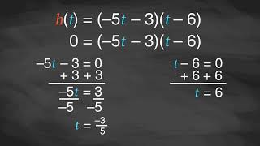
Learning Activity B | Video
Applying the Zero Product Property
Notes:
This video discusses questions 1-3 in activity 8.4.3.

Slide 21

Learning Activity B
Self Check
The equivalent functions below model the height of a projectile in meters, 𝑡 seconds after launch.
ℎ(𝑡) = –8𝑡² + 27𝑡 + 20 ℎ(𝑡) = (–8𝑡 − 5)(𝑡 − 4)
Without graphing, determine at what time the height of the object is 0 meters (when the object is on the ground).
0 seconds
⅝ seconds
4 seconds
8 seconds
Let’s review!
Notes:
Answer Feedback - Individualized by Response
Incorrect. The projectile does not start on the ground. Set the function in factored form equal to zero and solve. There are two solutions, 𝑡=-⅝ and 𝑡=4. In this context of time, the solution must be positive. You would not have a negative amount of time.
Incorrect. Set the function in factored form equal to zero and solve. There are two solutions, 𝑡=-⅝ and 𝑡=4. In this context of time, the solution must be positive. You would not have a negative amount of time.
That's correct! Check yourself: There are two solutions to the function when it is set equal to 0. Since 𝑡=-⅝ is negative, it does not make sense in this context of time. You would not have a negative amount of time. The answer is 4 seconds.
Incorrect. Set the function in factored form equal to zero and solve. There are two solutions, 𝑡=-⅝ and 𝑡=4. In this context of time, the solution must be positive. You would not have a negative amount of time.

Slide 22

Learning Activity B
Self Check - Review
The equivalent functions below model the height, in feet, of a baseball 𝑡 seconds after being hit.
ℎ(𝑡) = –15𝑡² + 44𝑡 + 3 ℎ(𝑡) = (–15𝑡 − 1)(𝑡 − 3)
Without graphing, determine when the baseball hits the ground.
Notes:
Remind Students
Using the zero product property, the quadratic expression in factored form allows you to more easily find out when the height of the baseball is 0 feet.
Access the online textbook for the work that explains how to solve this specific example and for additional examples.

Slide 23
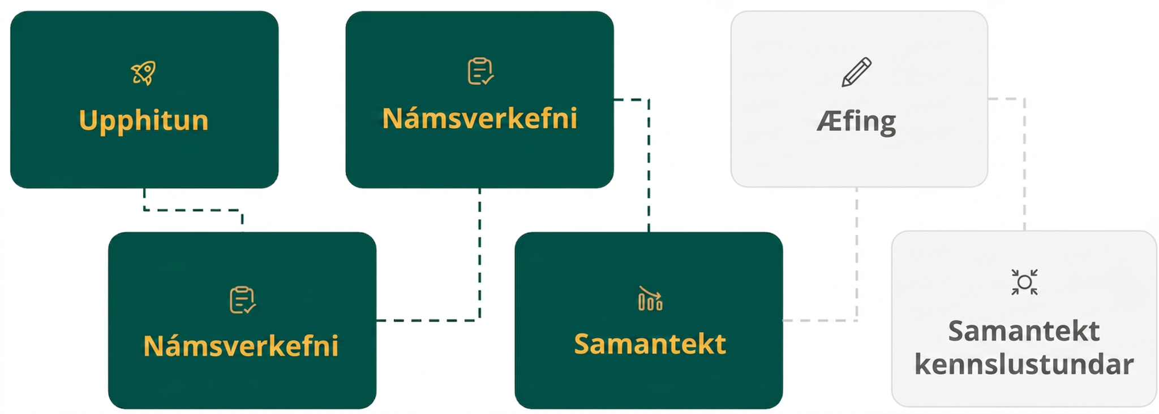
Lesson Journey
Fourth Step: Cool Down

Slide 24
Cool Down
Find all solutions to (𝑥 + 5)(2𝑥 − 3) = 0.
Explain or show your reasoning.
Notes:
Cool Down (5 minutes)
Launch
No technology should be used for this cool down.
Answers
x = -5 and x = 3/2
Response to Student Thinking - More Chances
Students will have more opportunities to understand the mathematical ideas in this cool down, so there is no need to slow down or add additional work to the next lessons. Instead, use the results of this cool down to provide guidance for what to look for and emphasize over the next several lessons to support students in advancing their current understanding.

Slide 25
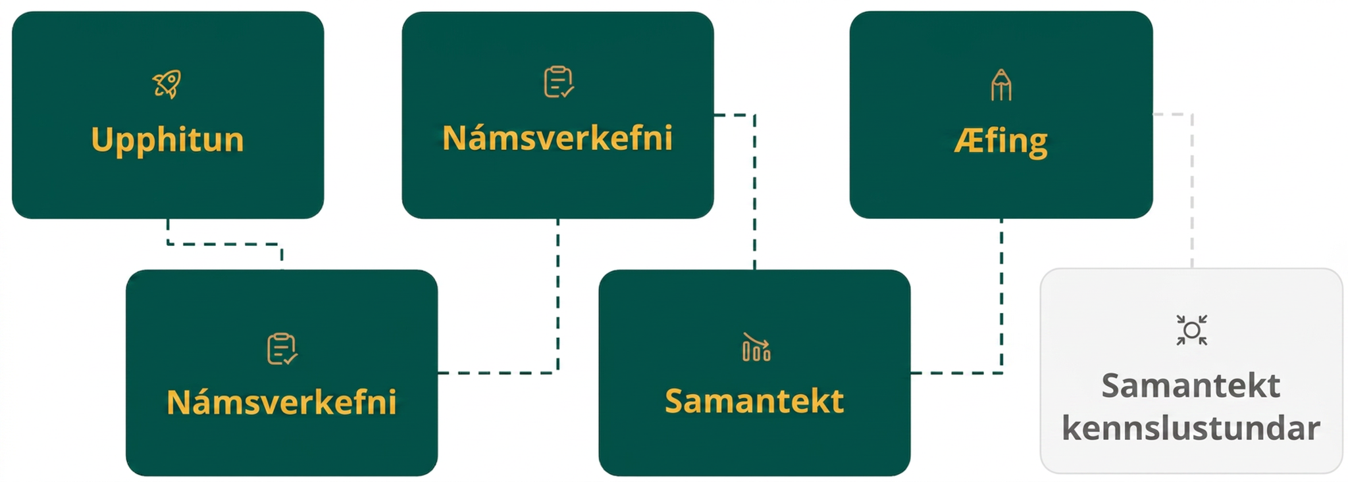
Lesson Journey
Fifth Stop: Practice

Slide 26

Practice
Put your hard work to action, practice what you’ve learned!
Notes:
Digital Practice: Access the practice pages at https://openstax.org/details/books/algebra-1

Slide 27
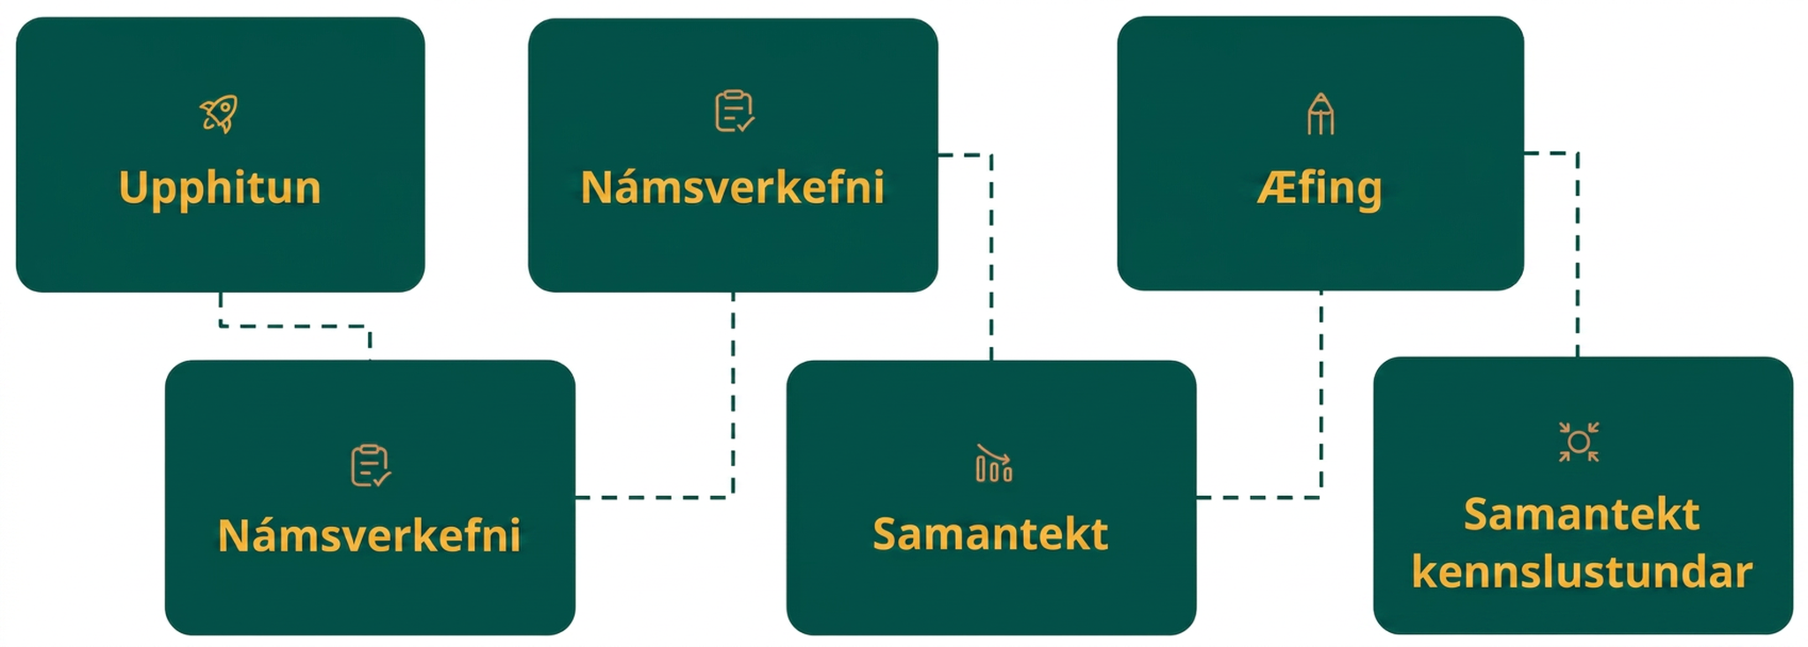
Lesson Journey
Sixth Stop: Lesson Synthesis

Slide 28
Lesson Synthesis
How does the zero product property help us find the solutions to (𝑥 − 3)(𝑥 + 4) = 0?
Why are the solutions to (𝑥 − 3)(𝑥 + 4) = 8 not x = 3 and x = –4?
The expression 𝑥² − 𝑥 − 12 is equivalent to (x + 3)(x − 4). Can we apply the zero product property to solve 𝑥² − 𝑥 − 12 = 0?
Can we solve 𝑥² − 𝑥 − 12 = 0 by performing the same operation to each side of the equation?
Notes:
Lesson Synthesis
To help students consolidate the ideas in the lesson, discuss the questions on this slide.
Answers to Discussion Questions
It tells us that either 𝑥−3=0 or 𝑥+4=0, and each of these equations can be solved easily.
The zero product property only works when the product of the factors is zero. When the product is any other number, we can’t conclude that each factor is that number.
Only if we rewrite the expression on the left in factored form first. We can’t use the zero product property when the expression is not a product of factors.
No, doing that doesn’t help us isolate the variable.

Slide 29
Self Assessment
How much do you agree with the following statements?
Learning Goals | I can | Almost | Not yet
Explain the meaning of the "zero product property." | ⃞ | ⃞ | ⃞
Find solutions to quadratic equations when one side is a product of factors and the other side is zero. | ⃞ | ⃞ | ⃞

