Slide 1
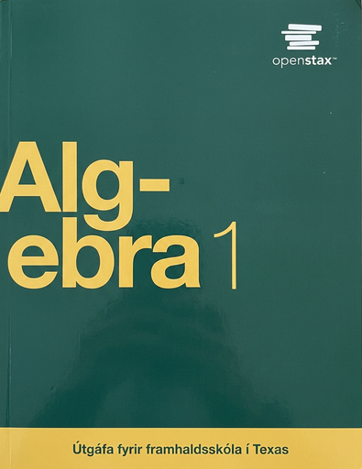

Algebra 1
Unit 4 Functions
Lesson 4.3 Interpreting & Using Function Notation

Slide 2
How to use these slides
On the activity slides check the speaker notes for teacher support and instructional information.
Each lesson includes 1 warm up, 2-3 learning activities, a cool down, practice and a lesson synthesis.
  Learning activities are followed by a self check question, and review section.
Some slides have been hidden from student view, more information can be found on the next slide (Reference Key).
You can edit and use these slides for personal and classroom use, but cannot sell them and must keep the attribution logos.
For more information, Check out the digital quick start guide!

Slide 3






Reference Key
Check the top right corner for an icon referencing these unique sections.
 | Support for Students with Disability | Hidden | Learning Strategies slide, provides additional support to students for understanding the activity. Learning Strategies slide, provides additional support to students for understanding the activity.
 | Support for English Language Learners | Hidden
 | Extending Your Thinking | Hidden | Extending Your Thinking slide, provides an extra challenge for students.
 | Self Check | Not Hidden | Self Check slide, checkpoint to assess student understanding after the learning activity.
 | Review | Hidden | Self Check- Review slide, designed to help review topics from the self check question.
On the next slides, check the speaker notes for teacher instructions and support.
Notes:
Check the Speaker Notes: On the next slides you can find discussion questions, lesson information, answers to the activities, and ways to adjust the activity for your students!

Slide 4

Learning Goals
By the end of this lesson you will be able to -
Describe the connections between a statement in function notation and the graph of the function.
Use function notation to efficiently represent a relationship between two quantities in a situation.
Use statements in function notation to sketch a graph of a function.
Notes:
Lesson Narrative
In this lesson, students continue learning to interpret function notation in context, including inequalities like f(a) > f(b), while focusing more on units and practicing precise, quantitative reasoning.
They also start linking function notation to graphs by seeing each input-output pair as a point (x, f(x)) and using this to sketch possible graphs.
At this stage, graphing is informal; more formal analysis of graph features will come in a later lesson.
Required Preparation
None
Required Materials
Coordinate grid paper
Texas Essential Knowledge and Skills
A1(D) communicate mathematical ideas, reasoning, and their implications using multiple representations, including symbols, diagrams, graphs, and language as appropriate
A12(B) evaluate functions, expressed in function notation, given one or more elements in their domains

Slide 5
Vocabulary
Previous
Function
  A relation that takes inputs from one set and assigns them to outputs from another set, assigning exactly one output to each input.
New
None
Notes:
Lesson Vocabulary
To support student understanding of key vocabulary:
Introduce and review the vocabulary words students will see in this lesson.
Encourage students to notice how these words are used and to include them in their math discussions and explanations—both written and oral.
Use a word wall to reinforce vocabulary. Sample word wall cards are available here.
For newcomers or students with beginning English proficiency, use these Quizlet sets to support vocabulary learning:
Unit 4 Spanish Vocabulary, part 1 – use first to build understanding
Unit 4 Vocabulary (English), part 1 – use after anchoring in Spanish
Unit 4 Spanish Vocabulary, part 2 – use first to build understanding
Unit 4 Vocabulary (English), part 2 – use after anchoring in Spanish
Support for English Language Learners
ELPS 1(E) internalize new basic and academic language by using and reusing it in meaningful ways in speaking and writing activities that build concept and language attainment
ELPS 2(F) listen to and derive meaning from a variety of media such as audiotape, video, DVD, and CD-ROM to build and reinforce concept and language attainment
ELPS 3(F) ask and give information ranging from using a very limited bank of high-frequency, high-need, concrete vocabulary, including key words and expressions needed for basic communication in academic and social contexts, to using abstract and content-based vocabulary during extended speaking assignments
ELPS 3(I) adapt spoken language appropriately for formal and informal purposes
ELPS 5(B) write using newly acquired basic vocabulary and content-based grade-level vocabulary

Slide 6





Lesson Journey
Warm Up
Learning Activity
Practice
Learning Activity
Cool Down
Lesson Synthesis

Slide 7
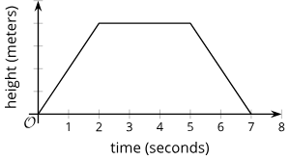
Warm Up - Comparing Function Values 🎮
Here is a graph that represents function f, which gives the height of a drone, in meters, t seconds after it leaves the ground.
Use the graph to determine whether the function values are equal or if one is greater. Explain your thinking.
f(0) or f(4)
f(2) or f(5)
f(3) or f(7)
f(t) or f(t+1)
Notes:
Warm Up (5 minutes)
In this warm up, students are prompted to compare function values. To do so, they need to interpret statements in function notation and connect their interpretations to the graph of the function.
Previously, students recognized that if a point with coordinates (2,20) is on the graph of a function, the 2 is an input and the 20 is a corresponding output. Here, they begin to see the second value in a coordinate pair more abstractly, as f(2) when the input is 2, or as f(4) when the input is 4.
Launch
Give students 1 – 2 minutes of quiet time to think individually. Follow with a whole-class discussion.
Some students might be unfamiliar with drones. If needed, give a brief explanation of what they are.
Activity questions, answers, and activity synthesis on the next slide.

Slide 8

Lesson Journey
Warm Up
Learning Activity
Practice
Learning Activity
Cool Down
Lesson Synthesis

Slide 9

Learning Activity - Writing Statements from Function Notation📱
The function P gives the number of people, in millions, who own a smartphone, t years after the year 2000. So, any value for which t is negative would represent the number of years before 2000.
Use this information to answer the questions on the following slide.
Notes:
Support for All Learners
This activity offers additional support and an extension for students:
For English language learners and students with disabilities, be sure to review the Learning Strategies slide!
For students looking for an extra challenge, be sure to review the Extending Your Thinking slide!
Activity (20 minutes)
In this activity, students deepen their interpretation of function notation in context, with new elements that promote precision and quantitative reasoning.
Outputs are in millions, so students must attend to units to avoid misinterpretation (e.g., 2 billion vs. 2 thousand).
Inputs represent years after 2000, so t = 10 means the year 2010.
A negative input requires students to reason about its meaning in context.
Students use descriptions and function notation to sketch a graph, with context suggesting the values increase roughly exponentially, (though students do not need to know that term at this point).
Launch
Read the activity's opening sentence together and have students identify the function’s input, output, and their units.
Arrange students in groups of 2. Give them 1–2 minutes to quietly read and think about the first two questions, focusing on identifying input and output values.
Allow time for partners to discuss and then, for statements such as P(17) = 2320, write complete sentence interpretations using quantity names and units. Pause for a class discussion before continuing.
Invite students to share their responses to the first two questions. Before students complete the remaining questions, make sure they see why:
The number of smartphone owners in the first question is not a couple of thousand people. The output is measured in millions, so a number such as 2,320 means 2,320 million or 2.32 billion people.
The input value for year 2010 is not 2010. The input is measured in “years after the year 2000,” so the input for year 2010 is 10. An input of 2010 would mean year 4010!
Activity image answer, and synthesis on the next slide.

Slide 10

Learning Activity - Writing Statements from Function Notation📱
What does each equation tell us about smartphone ownership?
P(17) = 2320
P(−10) = 0
Use function notation to represent each statement.
In 2010, the number of people who owned a smartphone was 296,600,000.
In 2015, about 1.86 billion people owned a smartphone.
Are you ready for more?
Notes:
Activity Answer
Compare your work: Your answer may vary, but here is a sample for each day.
In 2017, about 2,320 million or 2.32 billion people owned a smartphone.
No one owned a smartphone in 1990, 10 years before 2000.
P(10) = 296.6
P(15) = 1860

Slide 11
Learning Activity - Writing Statements from Function Notation📱
Mai is curious about the value of t in P(t) = 1000.
What would the value of t tell Mai about the situation?
Mai is curious about the value of t in P(t) = 1000. Is 4 a possible value of t here?
Use the information you have so far to sketch a graph of the function. Your graph should go through these four points: (−10,0), (10,296.6), (15,1860), and (17,2320).
Notes:
The year when 1 billion people owned a smartphone (adding the value of t to 2000 gives the year).
No. t = 4 corresponds to the year 2004. At that time, the number of smartphone owners should be below that of 2010, which was 296 million.
Sample graph:
https://k12.openstax.org/contents/raise/resources/4dac1bfb02e50aed4951b01ef5ff6311e029f0fa
ALT TEXT: A graph shows population growth in millions versus years since 2000. Key points are marked: (10, 296.6), (15, 1860), and (17, 2320). The curve starts low and sharply rises after year 10.
Anticipated Misconceptions
Some students may struggle to express a number like 296,600,000 in millions, or they may think that a quantity like “2,320 million” doesn’t quite make sense. Ask them to write these quantities as numerals: 1 million, 10 million, 100 million, and so on, and then use their list to help figure out how to say 296,600,000 in millions or to write 2,320 million as a numeral.
Students may think they do not have enough information to sketch a graph of P. Encourage them to read through the activity to identify points that must be part of the graph of P, but that are not written in (x,y) form.
Activity Synthesis
Make sure students can interpret a statement such as P(15) = 1860 and P(ti = 1000 in terms of the situation and articulate it completely. For instance, students might say, “The output is 1,860 when the input is 15,” or “When the input is t years, the output is 1,000 million,” or some other variation that doesn’t convey the quantities fully. Push them to refine their interpretation so that it is clear that P(15)=1860 means “1.86 billion people owned a smartphone in the year 2015” and P(t)=1000 means “A billion people owned a smartphone t years after 2000.”
Explain that while multiple graphs could fit the four data points for P, the context suggests little change before 2010 followed by rapid growth, even though exact behavior between points is unknown.
Output units in millions: Using “millions” instead of individual people avoids long, hard-to-read numbers and highlights important graph features more clearly.
Input in years after 2000: Yes, we could use calendar years like 2002, but using “years after 2000” simplifies the numbers.
Why use years after 2000: It allows for smaller numbers and emphasizes duration, which can be more meaningful—especially if 2000 marks a key moment in smartphone development.

Slide 12

Video: Understanding Equations in Function Notation

Slide 13

Learning Strategies - Writing Statements from Function Notation📱
Teacher Instruction: Use these strategies to adjust the activity to support English language learners and students with disabilities.
  You can copy and paste the callouts directly on top of the activity or give the instructions aloud.
Talk about your ideas with a partner before writing them down.
When you explain your strategy try to use sentences like
“_____ stands for _____”;
“What does this part of _____mean?”
“What other details are important?”
Engagement
Notes:
Support for Students with Disabilities: Engagement: Develop Effort and Persistence
Encourage and support opportunities for peer interactions. Invite students to talk about their ideas with a partner before writing them down. Display sentence frames to support students when they explain their strategy. For example, “_____ stands for _____”; “What does this part of _____ mean?”; “What other details are important?”
Supports accessibility for: Language; Social-emotional skills

Slide 14
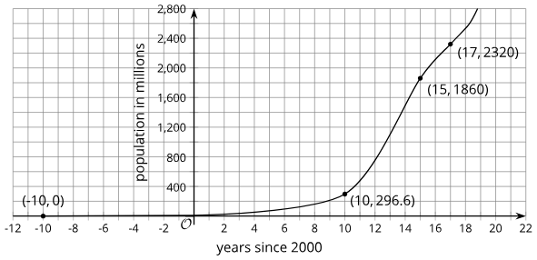
Extending Your Thinking
What can you say about the value or values of t when P(t)=1000?
Notes:
Answer
There is not enough information to know exactly when 1 billion (1,000 million) people owned a smartphone, but there is likely only one value of t when P(t)=1000, and that value is somewhere between 10 and 15. This is because the number of smartphone users was less than a billion in 2010 and more than a billion in 2015.

Slide 15

Self Check
The function Q gives the number of people, in millions, that own a smart watch n years after 2015. What does the equation Q(6)=7.25 mean?
In 2006, 7.25 million people owned smart watches.
In the beginning of 2023, 6 million people owned smart watches.
In 2021, 7.25 million people owned smart watches.
In the year 2005, there were 300 more police officers than in 2004.
Let’s review!
Notes:
Answer Feedback - Individualized by Response
In 2006, 7.25 million people owned smart watches.
Incorrect. The 6 represents the years after 2015, not 2000. The answer is in 2021, 7.25 million people owned smart watches.
In the beginning of 2023, 6 million people owned smart watches.
Incorrect. 6 is the number of years after 2015. The 7.25 is the millions of people, not the years. The answer is in 2021, 7.25 million people owned smart watches.
In 2021, 7.25 million people owned smart watches.
That’s correct!: 2021 is 6 years after 2015, and the function Q gives the number in millions, so 7.25 million people owned smart watches in 2021.
In 2021, 7.25 million more people owned smart watches than in 2015.
Incorrect. The function, Q, gives the number of people who own the smart watches in the year, not how many more people owned them than in 2015. The answer is in 2021, 7.25 million people owned smart watches.

Slide 16
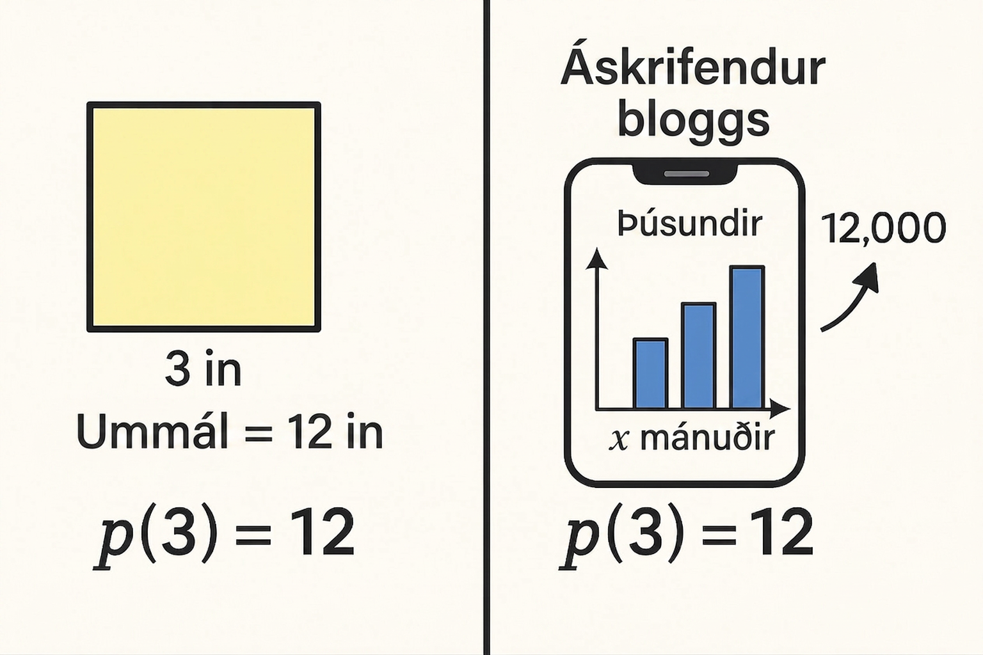
Self Check - Review
What does a statement like p(x) = 12 mean?
We can interpret statements like p(x) = 32 to mean "a square with side length x has a perimeter of 32 inches"
Knowing what the input and output represent helps us understand the function better.
What does p(3) = 12 mean?
The statement p(x) = 32 represents the perimeter of a square. Find x.
If p gives blog subscribers (in thousands) after x months, what does p(3) = 1200 mean?
Notes:
Interpreting Equations in Function Notation
Answers:
If function p gives a square’s perimeter in inches, then p(3) = 12 means a 3-inch side gives a 12-inch perimeter.
We can also interpret statements like p(x) = 32 means a square has a 32-inch perimeter, so x must be 8 and p(8) = 32.
If p gives blog subscribers (in thousands) after x months, then p(3) = 1200 means 12,000 subscribers after 3 months.
Analysis
It is important to pay attention to the units of measurement when analyzing a function. Otherwise, we might mistake what is happening in the situation. If we miss that p(x) is measured in thousands, we might misinterpret p(36) to mean “there are 36 blog subscribers after x months,” while it actually means “after 36 months, there are x thousands of blog subscribers.”

Slide 17
Lesson Journey
Warm Up
Learning Activity
Practice
Learning Activity
Cool Down
Lesson Synthesis

Slide 18
Learning Strategies - Function Notation and Temperature 🌡️
“I agree because . . .” or “I disagree because . . . .”
“At what time (or input value) was the temperature 72 degrees Fahrenheit?”
Listen and respond to each other as you explain the meaning of each statement.
Discussion Supports
Teacher Instruction: Use these strategies to adjust the activity to support English language learners and students with disabilities.
You can copy and paste the callouts directly on top of the activity or give the instructions aloud.
Highlight the W, 0, and 72 in W(0) = 72 in different colors, then highlight the same parts of the first sentence of the task statement with the same colors.
Representation
Notes:
Support for English Language Learners: MLR 8 Discussion Supports: Speaking, Representing
Use this routine to support whole-class discussion. After each student shares, provide the class with the following sentence frames to help them respond: “I agree because . . .” or “I disagree because . . . .” If necessary, re-voice students’ ideas by restating their statements as questions. For example, if a student says, “the temperature was 72 degrees Fahrenheit,” ask: “At what time (or input value) was the temperature 72 degrees Fahrenheit?” This will help students listen and respond to each other as they explain the meaning of each statement represented in function notation.
Design Principle(s): Support sense-making
Support for Students with Disabilities: Representation: Internalize Comprehension
Use color coding and annotations to highlight connections between representations in a problem. For example, invite students to highlight the W, 0, and 72 in W(0) = 72 in different colors and highlight the corresponding parts of the first sentence of the task statement in the same color to show what each part represents. Remind students to refer to their copy of the annotated function notation.
Supports accessibility for: Visual-spatial processing

Slide 19
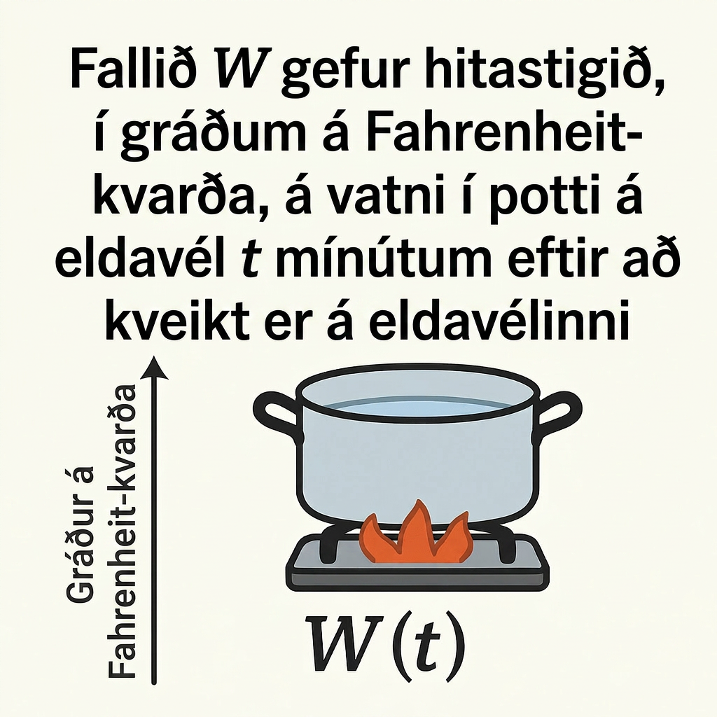
Learning Activity - Function Notation and Temperature 🌡️
The function W gives the temperature, in degrees Fahrenheit, of a pot of water on a stove, t minutes after the stove is turned on.
Take turns explaining each statement. Listen to your partner’s ideas, if you disagree, discuss your thinking and work to reach an agreement.
W(0) = 72
W(5) > W(2)
W(10) = 212
W(12) = W(10)
W(15) > W(30)
W(0) < W(30)
Notes:
Support for All Learners
This activity offers additional support and an extension for students:
For English language learners and students with disabilities, be sure to review the Learning Strategies slide!
Activity (10 minutes)
This activity reinforces students’ understanding about what makes a relationship between two variables a function, namely, that it gives a unique output for each input. It also prompts students to use function notation to express a functional relationship that does not involve numerical values for its input and output.
Launch
Keep students in pairs. Have them take turns explaining each statement in the first question. Partners should listen and discuss any disagreements until they agree. Then, each student sketches their own graph based on their shared interpretation.
Answers
The temperature when the stove was turned on was 72 degrees Fahrenheit.
The temperature after 5 minutes was warmer than the temperature after 2 minutes.
The temperature of the water after 10 minutes was 212 degrees Fahrenheit.
The temperature of the water was the same after 10 minutes and after 12 minutes.
The temperature after 15 minutes was higher than the temperature after 30 minutes.
The temperature when the stove was turned on was lower than the temperature 30 minutes lat
More activity questions, answers, anticipated misconceptions, and synthesis on the next slide.

Slide 20
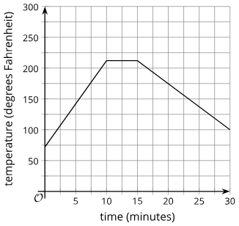
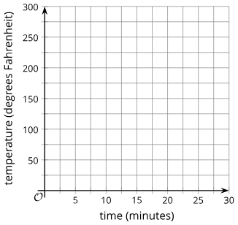
Learning Activity - Function Notation and Temperature 🌡️
Create a graph that shows each statement from questions 1 - 6.
W(0) = 72
W(5) > W(2)
W(10) = 212
W(12) = W(10)
W(15) > W(30)
W(0) < W(30)
Notes:
Answers
Your answers may vary, but here are some samples.
Sample Graph: Graph appears on slide click.
Anticipated Misconceptions
Some students may think there is not enough information to accurately graph the function. Assure them that this is true, but clarify that we are not after the graph, but rather a possible graph of the function based on the information we do have.
Activity Synthesis
Select previously identified students to share their interpretations of the inequalities in the first question and to show their graphs. Ask them to explain how each statement is evident in their graph. Discuss questions such as:
“Why might it be true that W(15) > W(30)?” (The heat was turned off at or after 15 minutes, or the kettle was taken off the stove.)
“You and your partner agreed on what each statement meant. Are your graphs identical? If not, why might that be?” (Function W was not not completely defined. We have information about the temperature at some points in time and how they compare, but we don’t have all the information about all points in time.)

Slide 21
Self Check
The function C gives the temperature, in degrees Fahrenheit, of a pot of coffee x minutes after it is made.
What does the statement C(10) < C(5) mean in the context of the problem?
The coffee pot has less coffee in it after 10 minutes than after 5 minutes.
The temperature of the coffee after 10 minutes was cooler than after 5 minute
The temperature of the coffee after 10 minutes was warmer than after 5 minutes.
The temperature of the coffee after 10 hours was cooler than after 5 hours.
Let’s review!
Notes:
Answer Feedback - Individualized by Response
Incorrect. The function C determines the temperature, not the amount of coffee. The answer is the temperature of the coffee after 10 minutes was cooler than after 5 minutes.
That’s correct! The function C stands for coffee temperature at a particular time. The temperature at 10 minutes was less than it was at 5 minutes.
Incorrect. The coffee temperature after 10 minutes is less than after 5 minutes. The correct answer is the temperature of the coffee after 10 minutes was cooler than after 5 minutes.
Incorrect. The time was measured in minutes, not hours. The answer is the temperature of the coffee after 10 minutes was cooler than after 5 minutes.

Slide 22
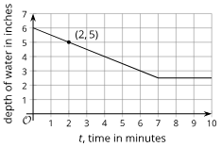
Self Check - Review
Function f gives the depth, in inches, of water in a tub as a function of time, t, in minutes, since the tub started being drained.
Each point on the graph has the coordinates (t, f(t) ), where the first value is the input of the function and the second value is the output.
What does each function represent? What is the value of each function?
f(2)
f(0)
f(3)
Notes:
Meanings in Functions
Answers:
f(2) represents the depth of water 2 minutes after the tub started being drained. The graph passes through (2,5), so the depth of water is 5 inches when t = 2. The equation f(2) = 5 captures this information.
f(0) gives the depth of the water when the draining began, at t = 0. The graph shows the depth of water to be 6 inches at that time, so we can write f(0) = 6.
f(t)=3 tells us that t minutes after the tub started draining, the depth of the water is 3 inches. The graph shows that this happens when t is 6.
Discuss the Answers with the Students:
In the graph, f(2) > f(7).
f(7 )= f(10)
f(4) > f(6)
f(0) = 6

Slide 23

Lesson Journey
Warm Up
Learning Activity
Practice
Learning Activity
Cool Down
Lesson Synthesis

Slide 24

Cool Down
An art museum opens at 9 a.m. and closes at 5 p.m. The function V gives the number of visitors in the museum h hours after it opens.
Explain what this statement tells us about
the situation: V(1.25) = 28
Use function notation to represent each statement.
  At 1 p.m., there were 257 visitors in the museum.
  At the time of closing, there were no visitors in the museum.
Use the previous statements about the visitors in the museum to sketch a graph that could represent the function.
Notes:
Cool Down (5 minutes)
Answers
Explain what this statement tells us about the situation: V(1.25) = 28
An hour and 15 minutes after the museum opened (at 10:15 a.m.), there were 28 visitors in the building.
Use function notation to represent each statement:
At 1 p.m., there were 257 visitors in the museum.
V(4)=257
At the time of closing, there were no visitors in the museum.
V(8) = 0
Use the previous statements about the visitors in the museum to sketch a graph that could represent the function.
A graph showing points at (1.25,28) and (4,257), with or without lines connecting these points.
See sample graph.: https://k12.openstax.org/contents/raise/resources/9d9c9143a47676cf17c502e8befe2d755bcc4ab2
ALT TEXT: A graph showing points at (1.25,28) and (4,257), with or without lines connecting these points.
Response to Student Thinking - More Chances
Students will have more opportunities to understand the mathematical ideas in this cool-down, so there is no need to slow down or add additional work to the next lessons. Instead, use the results of this cool-down to provide guidance for what to look for and emphasize over the next several lessons to support students in advancing their current understanding.

Slide 25

Lesson Journey
Warm Up
Learning Activity
Practice
Learning Activity
Cool Down
Lesson Synthesis

Slide 26

Practice
Put your hard work to action, practice what you’ve learned!
Notes:
Digital Practice: Access the practice pages at https://openstax.org/details/books/algebra-1

Slide 27

Lesson Journey
Warm Up
Learning Activity
Practice
Learning Activity
Cool Down
Lesson Synthesis

Slide 28

Lesson Synthesis
At noon, a news organization published a piece of breaking news on its website. The function Q gives the number of visitors, in thousands, to the website h hours after the news was published. By 2:30 p.m., the news article had been viewed by 1.6 million visitors.
Q(2:30) = 1.6
Q(2.5) = 1.6
Q(2.5) = 1600
Q(2:30) = 1,600,000
Q(150) = 1600
Q(2.5) = 1,600,000
Notes:
Prompt: Give students a moment of quiet time to think individually to decide which statement in function notation correctly represents the visitor data at 2:30 p.m. Ask them to be prepared to explain why they believe all the other statements that are not selected do not accurately represent the situation.
Make sure students understand why Q(2.5) = 1600 is the only one that represents the quantities in the situation.

Slide 29
Self Assessment
How much do you agree with the following statements?
I can… | I can | Almost | Not yet
Describe the connections between a statement in function notation and the graph of the function.
Use function notation to efficiently represent a relationship between two quantities in a situation.
Use statements in function notation to sketch a graph of a function.

