Slide 1


Algebra 1
Unit 2 Linear Inequalities and Systems
Lesson 2.15 Solving Problems with Systems of Linear Inequalities in Two Variables

Slide 2
How to use these slides
On the activity slides check the speaker notes for teacher support and instructional information.
Each lesson includes 1 warm up, 2-3 learning activities, a cool down, practice and a lesson synthesis.
  Learning activities are followed by a self check question, and review section.
Some slides have been hidden from student view, more information can be found on the next slide (Reference Key).
You can edit and use these slides for personal and classroom use, but cannot sell them and must keep the attribution logos.
For more information, Check out the digital quick start guide!

Slide 3






Reference Key
Check the top right corner for an icon referencing these unique sections.
 | Support for Students with Disability | Hidden | Learning Strategies slide, provides additional support to students for understanding the activity. Learning Strategies slide, provides additional support to students for understanding the activity.
 | Support for English Language Learners | Hidden
 | Extending Your Thinking | Hidden | Extending Your Thinking slide, provides an extra challenge for students.
 | Self Check | Not Hidden | Self Check slide, checkpoint to assess student understanding after the learning activity.
 | Review | Hidden | Self Check- Review slide, designed to help review topics from the self check question.
On the next slides, check the speaker notes for teacher instructions and support.
Notes:
Check the Speaker Notes: On the next slides you can find discussion questions, lesson information, answers to the activities, and ways to adjust the activity for your students!

Slide 4

Learning Goals
By the end of this lesson you will be able to -
Explain how to tell if a point on the boundary of the graph of the solutions to a system of inequalities is a solution.
Notes:
Lesson Narrative
In a previous lesson, students learned that the solutions to a system of linear inequalities can be represented graphically with overlapping regions.
In this lesson, students take a closer look at whether points on the boundary lines of the system’s solution region are included in the solutions. Analyzing graphs and communicating observations about them require attention to precision.
Required Preparation
Print the data and problem cards for activity 2.15.3
Cut apart the cards to prepare them for distribution to pairs of students
Required Materials
Pre-printed slips, cut from copies of the blackline master of data and problem cards
Coordinate Grids
Texas Essential Knowledge and Skills
A1(G) display, explain, and justify mathematical ideas and arguments using precise mathematical language in written or oral communication.
A2(H) write linear inequalities in two variables given a table of values, a graph, and a verbal description.
A3(H) graph the solution set of systems of two linear inequalities in two variables on the coordinate plane.

Slide 5
Vocabulary
Previous
Boundary Line
  A line that separates the coordinate plane into regions.
System of Inequalities
  Two or more inequalities that represent the constraints in the same situation.
Solution to a System of Inequalities
  All pairs of values that make the inequalities in a system true. The region where the graphs of the two inequalities overlap.
Notes:
Lesson Vocabulary
To support student understanding of key vocabulary:
Familiarize students with the vocabulary words they will see throughout the lesson. Encourage students to look for these words and notice their use and meanings.
Encourage students to use key vocabulary words in “math talk” and their written and oral explanations.
Utilize a word wall. Sample cards are located here: Sample word wall cards are available here.
For newcomers or students with beginning English proficiency, use these Quizlet sets to support vocabulary learning:
Unit 2 Spanish Vocabulary – use first to build understanding
Unit 2 Vocabulary (English) – use after anchoring in Spanish
Support for English Language Learners
ELPS 1(F) use accessible language and learn new and essential language in the process
ELPS 1(H) develop and expand repertoire of learning strategies such as reasoning inductively or deductively, looking for patterns in language, and analyzing sayings and expressions commensurate with grade-level learning expectations
ELPS 2(F) listen to and derive meaning from a variety of media such as audiotape, video, DVD, and CD-ROM to build and reinforce concept and language attainment
ELPS 3(E) share information in cooperative learning interactions
ELPS 3(G) express opinions, ideas, and feelings ranging from communicating single words and short phrases to participating in extended discussions on a variety of social and grade-appropriate academic topics

Slide 6





Lesson Journey
Warm Up
Learning Activity
Practice
Learning Activity
Cool Down
Lesson Synthesis

Slide 7

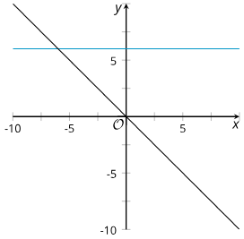
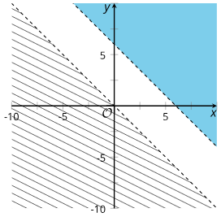
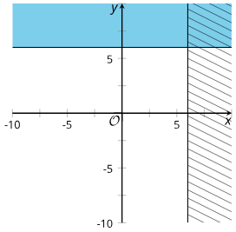
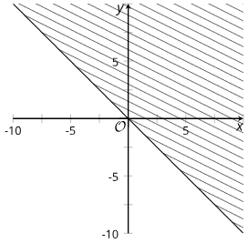
Warm Up - Graph Comparison 📉
Which One Doesn’t Belong?
Graph A
Graph B
Graph C
Graph D
Notes:
Warm Up (5 minutes)
This warm up prompts students to carefully analyze and compare graphs that represent linear equations and inequalities. Making comparisons prompts students to think about the solutions to the equations, inequalities, or systems that are being represented.
Launch
Arrange students in groups of 2 – 4.
Display the graphs for all to see.
Ask students to indicate when they have noticed one that does not belong and can explain why.
Give students 1 minute of quiet time to think individually.
Then, give them time to share their thinking with their small group.
In their small groups, tell each student to share their reasoning why a particular item does not belong and together find at least one reason each item doesn’t belong.
Continue scrolling down to the activity answers and synthesis questions.
Activity Answers - Answers may vary, but here are some samples.
Graph A is the only set of graphs that represents a system of equations. It is the only system with exactly one solution.
Graph B is the only set of graphs that represents a system of inequalities with no solutions.
Graph C is the only set of graphs in which the boundaries are horizontal and vertical lines. It is the only one representing a system with an infinite number of solutions.
Graph D is the only graph that does not represent a system. It only represents one inequality.
Activity Synthesis
Ask each group to share one reason why a particular item does not belong. Record and display the responses for all to see. After each response, ask the class if they agree or disagree. Since there is no single correct answer to the question of which one does not belong, attend to students’ explanations and ensure the reasons given are correct.
During the discussion, ask students to explain the meaning of any terminology they use, such as “infinitely many solutions” or “boundary line.” Also, press students on unsubstantiated claims.

Slide 8

Lesson Journey
Warm Up
Learning Activity
Practice
Learning Activity
Cool Down
Lesson Synthesis

Slide 9

Learning Strategies - Graph Comparison 📉
Teacher Instruction: Use these strategies to adjust the activity to support english language learners and students with disabilities.
You can copy and paste the callout directly on top of the activity or give the instructions aloud.
Discuss how you know if a point is a solution to a system of inequalities.
Create a list of steps, a flow chart, a diagram, etc. that explains the process.
Double check that you explained what happens when the point –
  … is not located within any of the shaded regions.
  …is located in one of the shaded regions but not both shaded regions.
  … lies within both shaded regions.
  … lies on one of the boundary lines.
Representation
Notes:
Support for Students with Disabilities: Representation: Access for Perception
Prior to independent work, engage the whole class in developing a set of directions that displays criteria for checking if points are a solution. This can be written as a flow chart or as a list. Recommend students start with the step of plotting the point on their graph. Support them in articulating criteria that address evaluating shaded regions and boundary lines. Check for understanding by inviting students to rephrase directions in their own words. Consider keeping the display of directions visible throughout the activity.
Supports accessibility for: Language; Memory
For example:
Plot the first inequality from the system of inequalities on the graph.
(check boundary line & shade region)
Plot the second inequality form the system.
(check boundary line & shade region)
Locate where the graph contains shading for BOTH inequalities. This is the solution region.
Plot the point on the graph.
Determine if the point is in the solution region.
If the point lies on one of the boundary lines that edges the solution region -
… it is a solution if the line is solid (inclusive).
… it is not a solution if the line is dashed (exclusive).

Slide 10
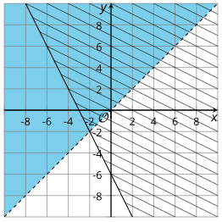
Learning Activity - Graph Comparison 📉
Here are the graphs of the inequalities in this system:
Decide whether each point is a solution to the system. Be prepared to explain how you know.
(3, – 5)
(0, 5)
(– 6, 6)
(3, 3)
(– 2, – 2)
x < y y ≤ −2x − 6
Are you ready for more?
Notes:
Support for All Learners
This activity offers additional support and an extension for students:
For English language learners and students with disabilities, be sure to review the Learning Strategies slide!
For students looking for an extra challenge, be sure to review the Extending Your Thinking slide!
Activity (10 minutes)
In this activity, students take a closer look at whether points that are on the boundary lines are solutions to the system. In contrast to previous lessons where they have learned that any point in the overlapping solution regions of the graphs of two inequalities is a solution to the system formed by those inequalities.
Continue scrolling down for suggestions on how to launch the activity, answers to the questions, and synthesis questions.
Launch
Arrange students in groups of 2.
Display the system of inequalities and the graphs for all to see.
Think Pair Share: Give students a minute of quiet time to think about which region represents the solutions to each inequality and be prepared to explain how they know. Then, give students another minute to discuss their thinking with a partner.
Follow with a class discussion.
If students do not bring up the following, provide prompting questions to help them connect the algebraic and graphical representations.
Students are likely to identify the inequality that each graph represents by considering the equation of the boundary line. They may relate the solidly shaded region to x < y because the dashed line is the graph of x = y.
Or they may relate the hashed region to the solutions of y ≤ −2x − 6 because the boundary line has a negative slope and it intersects the y-axis at (0, −6).
Other students may test some coordinate pairs in each region and see if they make an inequality true. For example, they may say that all points above the graph of x = y have an x-value that is less than the y-value.
Activity Answers
No. (3, −5) is in the shaded region containing the solutions to one of the inequalities but not in the region where the shading overlaps.
Yes. (0, 5) is in the region where the solutions to the two inequalities overlap.
Yes. (−6, 6) is on the solid boundary of y ≥ −2x − 6 because 0 = −2(−3) − 6, and it is within the shaded region representing solutions to x.
No. While (3, 3) is clearly a solution to y ≥ −2x − 6, it is on the dashed boundary of x < y. The statement 3 < 3 is not true.
No, because −2 < −2 is not true. Even though it is on the solid boundary of one, it is on the dashed boundary of the other.
Activity Synthesis
Focus the discussion on the points on the boundary lines and how students determined if they are or are not solutions to the system (points #3, 4, 5).
Highlight explanations that state that a solution to a system of linear inequalities must be a solution to every inequality in the system.
If a point on the boundary line is not included in the solution set of one inequality (so the graph is a dashed line), then it is also not included in the solution set of the system.

Slide 11
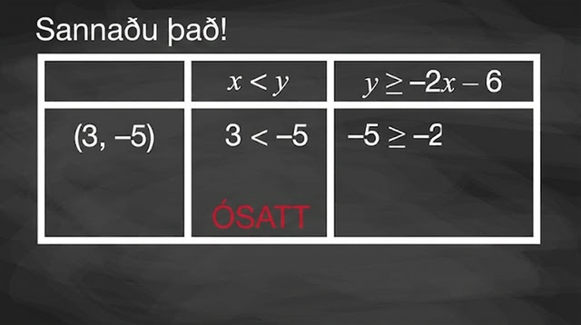
Video: Solving Systems of Inequalities
Notes:
https://teachers.raiselearning.org/2e/unit-2-linear-inequalities-and-systems/2-15-2-determining-if-points-on-boundary-lines-are-solutions-to-a-system

Slide 12
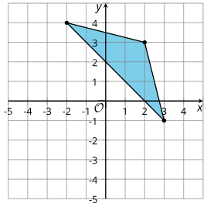
Extending Your Thinking
Find a system of inequalities with this triangle as its set of solutions.
Notes:
Answer
x + y ≥ 2,
x + 4y ≤ 14,
4x + y ≤ 11 or equivalent

Slide 13
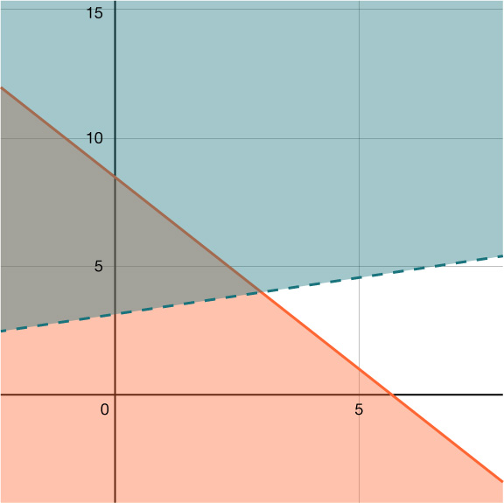
Self Check
Here is the graph of this system of inequalities. Which of the following ordered pairs falls within the solution set?
(3, 4)
(5, 1)
(10, 6)
(2, 4)
6x + 4y ≤ 34 – 2x + 7y > 22
Let’s review!
Notes:
Answer Feedback - Individualized by Response
Incorrect. This ordered pair falls on both boundary lines, but it only satisfies the first inequality.
Incorrect. This ordered pair falls on a boundary line and satisfies the first inequality, but it does not satisfy the second inequality.
Incorrect. This ordered pair falls on a dashed boundary line, and it does not satisfy either inequality.
That’s correct! This ordered pair is a solution to both inequalities and falls within the solution region on the graph. This is the correct answer.

Slide 14
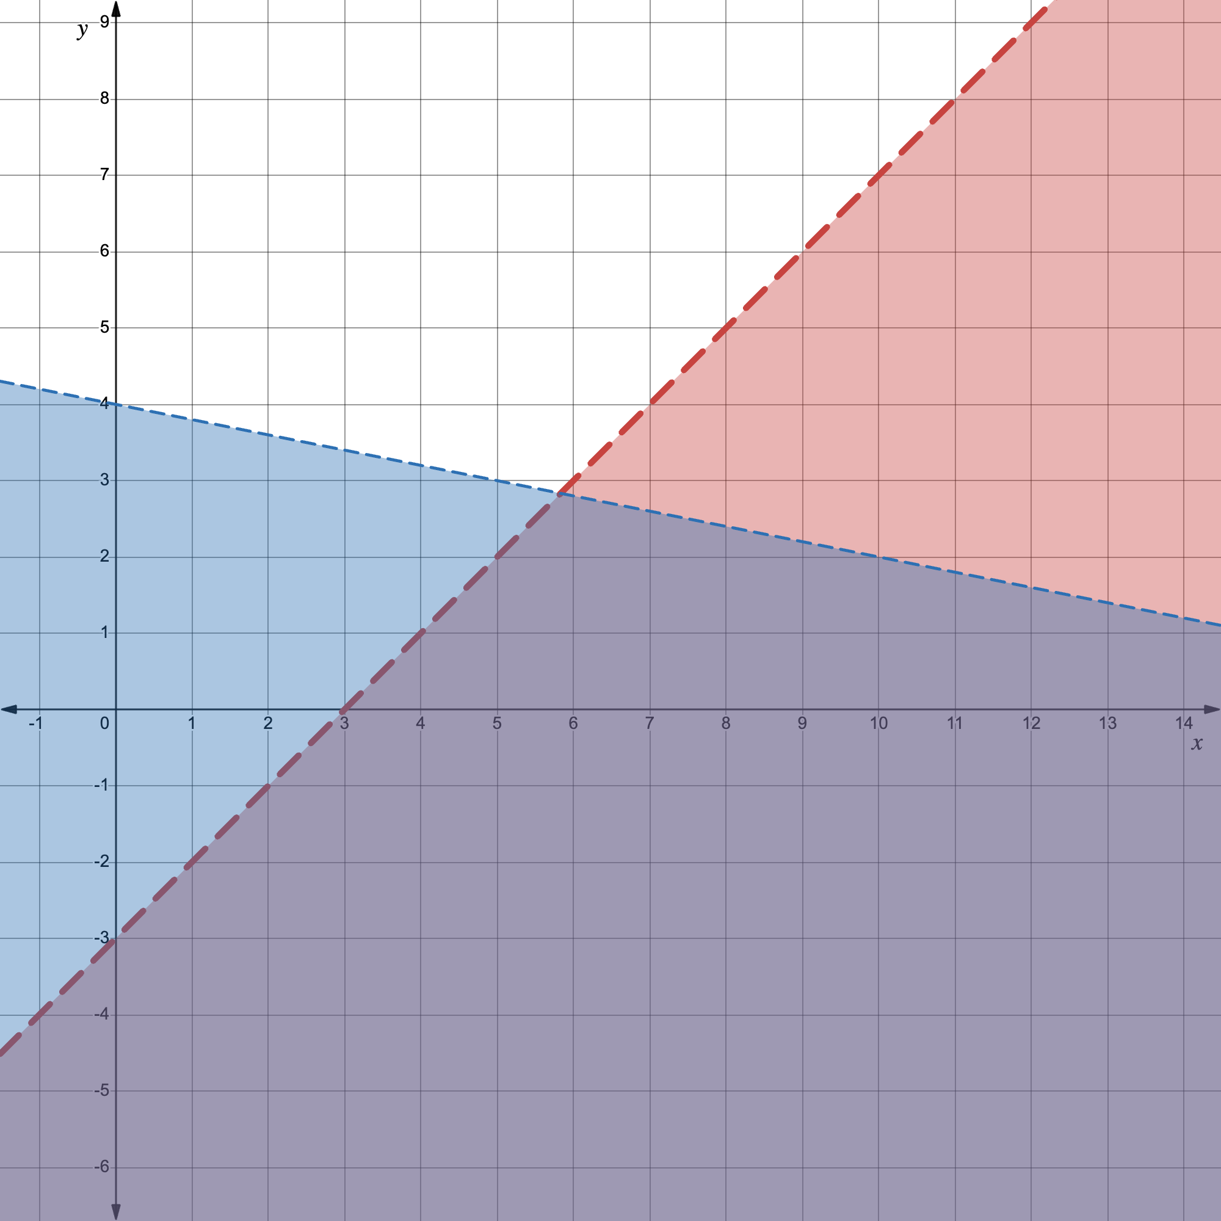
Self Check - Review
Are the points (0, –3) or (4, –2) solutions
to the system of inequalities given below?
x – y > 3 y < – ⅕ x + 4
Notes:
A Desmos graph showing the inequalities and the points can be accessed by clicking on the graph on the slide or by clicking here.
Remind Students
Remember that when a coordinate is on a boundary line, it must be solid if it is a solution.
The coordinate must also be in the overlapping shaded regions to be a solution to the entire system.

Slide 15
Lesson Journey
Warm Up
Learning Activity
Practice
Learning Activity
Cool Down
Lesson Synthesis

Slide 16
Learning Strategies - Information Gap
Teacher Instruction: Use these strategies to adjust the activity to support english language learners and students with disabilities.
  You can copy and paste the callouts directly on top of the activity or give the instructions aloud.
Remember to ask each other for information.
“Can you tell me…?”
“Why do you need to know that?”
If needed, look at the Desmos graph for a hint.
Information Gap
Read the directions for how to participate in the activity.
Rephrase the directions in your own words.
Refer to the directions during the activity.
Engagement
Notes:
Support for English Language Learners: MLR 4 Information Gap: Conversing
This activity uses MLR4 Information Gap to give students a purpose for discussing information necessary to solve problems that involve satisfying multiple constraints simultaneously. Display questions or question starters for students who need a starting point, such as: “Can you tell me . . . (specific piece of information)?” and “Why do you need to know . . . (that piece of information)?”
Design Principle(s): Cultivate Conversation
Provide support for students
Distribute graphic organizers to the students to assist them with participating in this routine.
Support for Students with Disabilities: Engagement: Develop Effort and Persistence
Display or provide students with a physical copy of the written directions (from slide 17). Check for understanding by inviting students to rephrase directions in their own words. Keep the display of directions visible throughout the activity.
Supports accessibility for: Memory; Organization

Slide 17

Learning Activity - A MATH MYSTERY!
Each of you will get a card … but …
One of you will have information about the problem you are trying to solve
One of you will have the information needed to solve the problem
DON’T SHOW EACH OTHER YOUR CARDS!
Read your cards silently to yourselves.
  If you have a PROBLEM CARD, think about what information you need to answer the question.
  If you have a DATA CARD, think about the types of questions your information provides answers for.
Now, you will need to start asking each other questions in order to solve the problem.
Notes:
Support for All Learners
This activity offers additional support for students:
For English language learners and students with disabilities, be sure to review the Learning Strategies slide!
Continue scrolling down to view how to launch the activity and the information on the problem and data cards students should be discussing.
Activity (20 minutes)
The info gap structure requires students to make sense of problems and persevere in solving them. Students need to determine what information is necessary to solve a problem, ask for the information, and then explain their request. This may take several rounds of discussion if their first requests do not yield the information they need. It also allows them to refine the language they use and ask increasingly precise questions until they get the information they need.
Students may approach the problems in different ways, including by guessing and checking, but the problems can be efficiently solved by writing and solving systems of linear inequalities. Every clue given in a data card can be written as an inequality.
If x is the number of children on a team and y the number of adults, the clue “a team with only adults is not allowed” can be expressed as x > 0, and “a team without adults is allowed” can be expressed as y ≥ 0.
But because other membership rules are more restrictive, and because thinking only about positive values of x and y is natural in this situation, it is not essential for these constraints to be represented. (Blank coordinate planes can be provided or displayed to also show only the first quadrant, implying positive solutions.)
Launch
Explain the info gap structure and consider demonstrating the protocol if students are unfamiliar with it. Because this activity was designed to be completed without technology, ask students to put away any devices.
Arrange students in groups of 2.
In each group, distribute a problem card to one student and a data card to the other student.
After reviewing their work on the first problem, give them the cards for a second problem and instruct them to switch roles.
Information Gap Cards
Problem Card 1: To participate in a competition, each team must follow the rules about the allowable number of adults and children on a team.
A team has 6 adults and 8 children. Does the team meet all the membership rules of the competition?
What is the maximum number of adults allowed on a team?
If helpful, use the coordinate planes in Desmos or graph paper. (provide this link to students https://www.desmos.com/calculator/xfdtwctoc3)
Data Card 1:
A team without adults is allowed.
A team with only adults is not allowed.
If 3 adults are on a team, there must be at least 6 children.
Each team must have no more than 16 members in total.
The number of adults must be at most half the number of children on the team.
Problem Card 2:
Another competition has different membership rules.
What is the minimum number of members that a team could have? How many adults and children would be on that team?
What is the maximum number of adults allowed on a team?
If helpful, use the coordinate planes in Desmos or graph paper. (provide this link to students https://www.desmos.com/calculator/xfdtwctoc3)
Data Card 2:
A team with only adults is not allowed.
A team with only children is not allowed.
The number of children must be at least three times that of adults.
The total number of people cannot exceed 20.
This graph represents a rule about the number of adults on the team. (A graph of the first quadrant displays y > 2 where the y-values represent the number of adults on a team.)
Activity answers, anticipated misconceptions, and synthesis on the next slide.

Slide 18
Learning Activity - A MATH MYSTERY!
If you hold the PROBLEM CARD:
Ask your partner for the specific information that you need: “Can you tell me …?”
Explain to your partner how you are using the information to solve the problem.
When you have enough information, solve the problem independently.
Share your cards with each other and discuss your reasoning.
If you hold the DATA CARD:
Wait for your partner to ask for information. Only give information that is on your card. (Do not figure out anything for your partner!)
Before telling your partner the information, ask, “Why do you need to know (that piece of information)?”
When you have gotten enough information from your partner about the problem, solve it independently.
Share your cards with each other and discuss your reasoning.
Notes:
Answers
Card 1:
No. The combination meets the rule about the total number of members, but does not meet the rule about the number of adults compared to the number of students. For example:
The point (8,6) is not in the shaded region of the graph representing the rule about children-to-adult ratio.
If 6 is substituted into the inequality representing the rule about children-to-adult ratio and then evaluated, the inequality, 6≤12(8), is a false statement.
The maximum number of adults is 5.
Card 2:
Each team can have at least 8 people: 6 children and 2 adults. For example: The region where all three graphs overlap represent combinations that meet all three rules. The lowest numbers of children and adults in the region are 6 and 2.
The maximum number of adults on a team is 5.
Anticipated Misconceptions
Students in both roles may wonder if all clues on the data card constitute a “rule.” Those holding a data card may not know how to respond if or when asked, “What is the first rule?” or “What is one of the rules?” Those who are asking for information may not know if what is given counts as a rule. Clarify that a rule should be general enough to include multiple possibilities, rather than just one specific case. For example, “If there are 3 adults, there must be at least 6 children” is a specific case, rather than a general constraint.
Activity Synthesis
Invite students who solved the problems by graphing a system of inequalities to share their graphs and their thinking, or display the following graphs: Situation 1 Desmos and Situation 2 Desmos. Discuss questions such as:
“Which membership rule does each shaded region on the graphs represent?”
“Can all the clues be written as inequalities? If so, what are they?”
“Should we graph them all? Why or why not?”
“How does the first set of graphs help us answer questions about whether 6 adults and 8 children are acceptable?”
“How do they tell us about the maximum allowable number of adults on a team?”
“How does the second set of graphs help us find the minimum number of team members and the composition of the team?”
Situation 1: and Situation 2: Access the online Teacher Guide to see the graph for this question

Slide 19
Self Check
Which of the following ordered pairs falls within the solution set to the system of inequalities?
(3, 5)
(0, 9)
(2, 5)
(1, 0)
– 5x + 2y > – 5 4x + 3y < 27
Let’s review!
Notes:
Answer Feedback - Individualized by Response
Incorrect. This ordered pair falls on both boundary lines and does not satisfy either inequality.
Incorrect. This ordered pair does not satisfy both inequalities.
That's correct! This ordered pair falls within the region representing the solution set.
Incorrect. This ordered pair falls on a boundary line and does not satisfy both inequalities.

Slide 20


Self Check - Review
Omar needs to eat at least 800 calories before going to his team practice. All he wants is hamburgers, ℎ, and cookies, 𝑐, and he doesn’t want to spend more than $5. At the hamburger restaurant near his college, each hamburger has 240 calories and costs $1.40. Each cookie has 160 calories and costs $0.50.
Write a system of inequalities that models this situation.
Graph the system.
Could he eat 3 hamburgers and 1 cookie?
Could he eat 2 hamburgers and 4 cookies?
Notes:
Remind students:
When we use variables other than 𝑥 and 𝑦 to define an unknown quantity, we must change the names of the axes of the graph as well.
We could also test the possible solutions by substituting the values into each inequality.
Answers (for detailed explanations and the fully worked out example, access the Additional Resources for this lesson in the online textbook.
Let h equal the number of hamburgers and c equal the number of cookies. Our system of equations is –
240h + 160c > 800
1.40h + 0.50c< 5
h > 0
c > 0
See this Desmos graph for the system of inequalities.
To determine if 3 hamburgers and 1 cookie would meet Omar’s criteria, we see if the point (3, 1) is in the solution region. It is, so Omar might choose to eat 3 hamburgers and 1 cookie. (If needed, in the Desmos graph provided in answer 2, enter (3, 1) into the 3rd line.)
To determine if 2 hamburgers and 4 cookies would meet Omar’s criteria, we see if the point (2,4) is in the solution region. It is, so Omar might choose to eat 2 hamburgers and 4 cookies. (Again, if needed, enter the point (2, 4) into the Desmos graph provided in answer 2.)

Slide 21

Lesson Journey
Warm Up
Learning Activity
Practice
Learning Activity
Cool Down
Lesson Synthesis

Slide 22


Cool Down
A factory produces “widgets” and “zurls.” The combined number of widgets and zurls made each day cannot be more than 12. The maximum number of widgets the factory can produce in a day is 4.
Let x be the number of widgets and y be the number of zurls.
Select two inequalities that represent this situation.
  x > 4
  x + y < 12
  x > 4
  x + y > 12
  x < 4
Use Desmos to graph the equations x = 4 and x + y = 12.
Notes:
Cool Down (5 minutes)
Answers
𝑥 ≤ 4 (e) and 𝑥+𝑦 ≤ 12 (b)
A Desmos graph can be accessed here.
Additional questions, answers, and response to student thinking continues on the next slide.

Slide 23
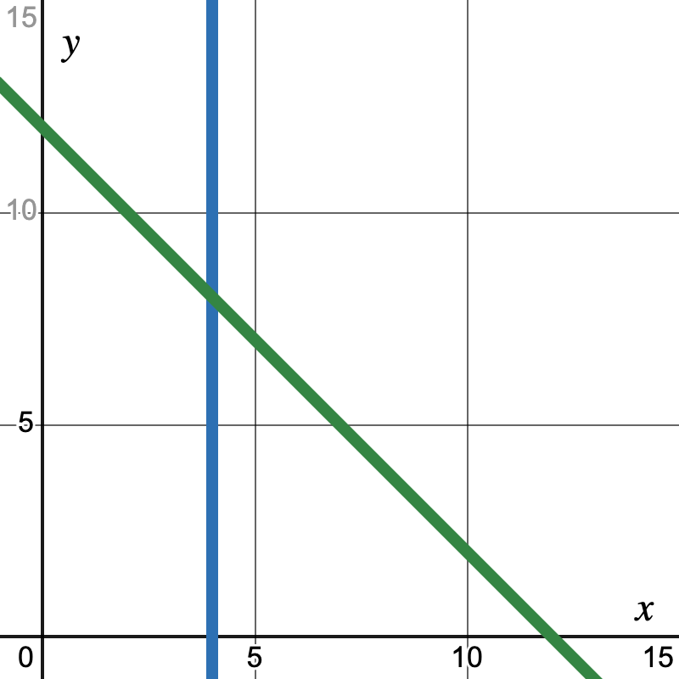
Cool Down
After graphing the equations 𝑥 = 4 and
𝑥 + 𝑦 = 12, shade the regions and adjust the line types as needed to show all the allowable numbers of widgets and zurls that the factory can produce in one day.
(Desmos graph)
Does the ordered pair represent an allowable combination of widgets and zurls produced in one day?
(4, 5)
(11, 1)
(4, 12)
(3, 9)
Notes:
Answers
Access this Desmos Graph for this question.
Yes
No
No
Yes
Response to Student Thinking - Press Pause
If students are still struggling to shade graphs appropriately, highlight student work from the cool-down to address misconceptions and assign practice problems from this lesson for additional opportunities for students to practice.

Slide 24

Lesson Journey
Warm Up
Learning Activity
Practice
Learning Activity
Cool Down
Lesson Synthesis

Slide 25

Practice
Put your hard work to action, practice what you’ve learned!
Notes:
Digital Practice Access the practice pages at https://openstax.org/details/books/algebra-1

Slide 26

Lesson Journey
Warm Up
Learning Activity
Practice
Learning Activity
Cool Down
Lesson Synthesis

Slide 27
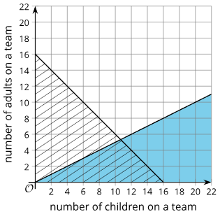
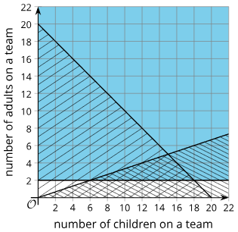
Lesson Synthesis
Situation 1:
In the graphs of the first system, are points on the two lines – say (14,2) or (8,4) – solutions to the system? How do you know?
In this situation, are points on the horizontal axis solutions to the system?
In the graphs of the second system, are points on the boundaries of the overlapping triangular region solutions to the system?
Situation 2:
Notes:
Refer to the constraints in the “Terms of a Team” info gap activity listed on the data cards. Reiterate the importance of attending carefully to the boundary lines of the regions using the questions in the slide. If preferred, you could also display the Desmos versions of the graphs of Situation 1 Desmos and Situation 2 Desmos.
Answers
Yes. Points on a solid line are included. Substituting 14 and 2, or 8 and 4, makes each inequality true.
Yes. Points on the horizontal axis represent no adults. The rules say that a team with only children and no adults is allowed.
Yes.

Slide 28
Self Assessment
How much do you agree with the following statements?
I can… | I can | Almost | Not yet
Explain how to tell if a point on the boundary of the graph of the solutions to a system of inequalities is a solution.

