Slide 1
Algebra 1
Unit 6 Working with Polynomials
Lesson 6.7 General Strategy for Factoring Polynomials

Slide 2

How to use these slides
On the activity slides check the speaker notes for teacher support and instructional information.
Each lesson includes 1 warm up, 2-3 learning activities, a cool down, practice and a lesson synthesis.
  Learning activities are followed by a self check question, and review section.
Some slides have been hidden from student view, more information can be found on the next slide (Reference Key).
You can edit and use these slides for personal and classroom use, but cannot sell them and must keep the attribution logos.
For more information, Check out the digital quick start guide!
OpenStax CC BY NC SA

Slide 3





Reference Key
Check the top right corner for an icon referencing these unique sections.
Icon | Title | View | Location and Description
n/a | Support for Students with Disability | Hidden | Learning Strategies slide, provides additional support to students for understanding the activity.
n/a | Support for English Language Learners | Hidden | Learning Strategies slide, provides additional support to students for understanding the activity.
n/a | Extending Your Thinking | Hidden | Extending Your Thinking slide, provides an extra challenge for students.
n/a | Self Check | Not Hidden | Self Check slide, checkpoint to assess student understanding after the learning activity.
n/a | Review | Hidden | Self Check - Review slide, designed to help review topics from the self check question.
On the next slides, check the speaker notes for teacher instructions and support.
Notes:
Check the Speaker Notes: On the next slides you can find discussion questions, lesson information, answers to the activities, and ways to adjust the activity for your students!

Slide 4

Learning Goals
By the end of this lesson you will be able to -
Recognize and use the appropriate method to factor a polynomial completely.
Notes:
Lesson Narrative
This lesson challenges students to recognize polynomials of many different forms. After assessing the form of the polynomial, and with no other context, students will select an appropriate strategy for factoring the polynomial. They will then implement that strategy by factoring the polynomial down to its fully factored form, where all the factors are prime.
Additionally, students will analyze an expression to determine if it is prime or fully factored, or if it can be factored further.
Required Preparation
None
Required Materials
None
Texas Essential Knowledge and Skills
A1(B) use a problem-solving model that incorporates analyzing given information, formulating a plan or strategy, determining a solution, justifying the solution, and evaluating the problem-solving process and the reasonableness of the solution.
A1(F) analyze mathematical relationships to connect and communicate mathematical ideas.
A1(G) display, explain, and justify mathematical ideas and arguments using precise mathematical language in written or oral communication.
A10(D) rewrite polynomial expressions of degree one and degree two in equivalent forms using the distributive property.
A10(E) factor, if possible, trinomials with real factors in the form 𝑎𝑥² + 𝑏𝑥 + 𝑐, including perfect square trinomials of degree two.
A10(F) decide if a binomial can be written as the difference of two squares and, if possible, use the structure of a difference of two squares to rewrite the binomial.

Slide 5
Vocabulary
Previous
Binomial
  An algebraic expression with two terms.
Trinomial
  An algebraic expression with three terms.
Factoring
  Determining the numbers or expressions that multiply to a specific product.
Greatest common factor [GCF]
  The largest expression that is a factor of all given expressions.
Conjugate pair
  Two binomials of the
  form (a – b) and (a + b).
Difference of squares
  The product of a conjugate pair of binomials that has the form a² – b².
Notes:
Lesson Vocabulary
To support student understanding of key vocabulary:
Introduce and review the vocabulary words students will see in this lesson.
Encourage students to notice how these words are used and to include them in their math discussions and explanations—both written and oral.
Use a word wall to reinforce vocabulary. Sample word wall cards are available here.
For newcomers or students with beginning English proficiency, use these Quizlet sets to support vocabulary learning:
Unit 6 Spanish Vocabulary – use first to build understanding
Unit 6 Vocabulary (English) – use after anchoring in Spanish
Support for English Language Learners
ELPS 2(F) listen to and derive meaning from a variety of media such as audiotape, video, DVD, and CD-ROM to build and reinforce concept and language attainment.
ELPS 3(C) speak using a variety of grammatical structures, sentence lengths, sentence types, and connecting words with increasing accuracy and ease as more English is acquired.
ELPS 3(D) speak using grade-level content area vocabulary in context to internalize new English words and build academic language proficiency.
ELPS 3(E) share information in cooperative learning interactions.
ELPS 3(I) adapt spoken language appropriately for formal and informal purposes.

Slide 6

Lesson Journey
First Stop: Warm Up

Slide 7

Warm Up | Part 1
Brainstorm of Strategies! ⛈
Working with a partner, list as many strategies as you can for factoring polynomials!
Notes:
Warm Up (5 minutes)
This warm up refreshes and reviews all the factoring strategies learned in this unit. Students will remember that each strategy is useful for a specific type of polynomial.
In this activity, they will work in pairs to recall the ideal type of polynomial for each strategy learned so far.
Launch
Arrange students in groups of two.
Have each pair of students complete the activity questions together.
Activity Answers: Answers may vary, but here are some samples.
Factoring by finding the GCF of an expression and using reverse distribution
Factoring using grouping
Factoring trinomials of the form 𝑥² + 𝑏𝑥 + 𝑐 (undo FOIL)
Factoring trinomials of the form 𝑎𝑥² + 𝑏𝑥 + 𝑐 using trial and error
Factoring trinomials using the “𝑎𝑐” method
Factoring using substitution
Factoring the difference of squares
Factoring perfect square trinomials
Additional activity questions, answers, and the activity synthesis are located on the next slide.

Slide 8
Warm Up | Part 2
Brainstorm of Strategies! ⛈
Factoring strategy | Sample polynomial
Factoring by finding the GCF and using reverse distribution | ?
Factoring using grouping | ?
Factoring trinomials of the form x² + bx + c (undoing FOIL) | ?
Factoring trinomials of the form ax² + bx + c using trial and error | ?
Factoring trinomials using the “ac” method | ?
Factoring using substitution | ?
Factoring the difference of squares | ?
Factoring perfect square trinomials | ?
Did you come up with all of these strategies?
Now, write a sample polynomial that would be fitting for each strategy listed in the table.
Notes:
Activity Answers: Answers may vary, but here are some samples.
Factoring by finding the GCF of an expression and using reverse distribution EXAMPLE = 14a + 8ab + 12
Factoring using grouping EXAMPLE = 𝑥² + 2𝑥 – 5𝑥 – 10
Factoring trinomials of the form 𝑥² + 𝑏𝑥 + 𝑐 (undo FOIL) EXAMPLE = t² + 14t + 24
Factoring trinomials of the form 𝑎𝑥² + 𝑏𝑥 + 𝑐 using trial and error EXAMPLE = 18x² – 3xy – 10y²
Factoring trinomials using the “𝑎𝑐” method EXAMPLE = 16𝑥² – 32𝑥 + 12
Factoring using substitution EXAMPLE = (x – 2)² + 7(x – 2) + 12
Factoring the difference of squares EXAMPLE = 81y² – 1
Factoring perfect square trinomials EXAMPLE = 25v² + 20v + 4
Activity Synthesis
Ask students:
Are there any strategies that you are not sure when to use? Address their questions in regard to when to use any strategies mentioned.
Do you have a favorite strategy? Explain. (Sample answer: the “𝑎𝑐” method because it works on any trinomial of the form 𝑎𝑥² + 𝑏𝑥 + 𝑐.)
Do you have a least favorite strategy? Explain.

Slide 9
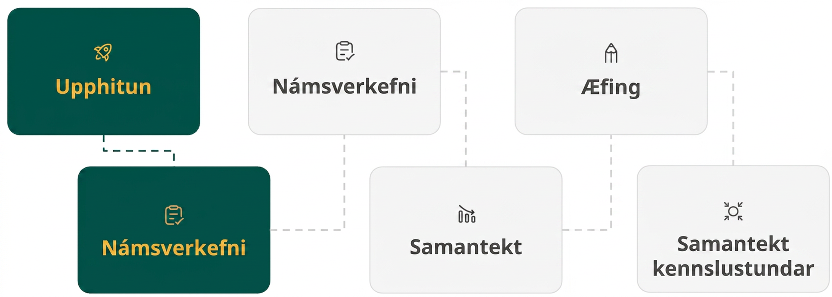
Lesson Journey
Second Stop: Learning Activity A

Slide 10
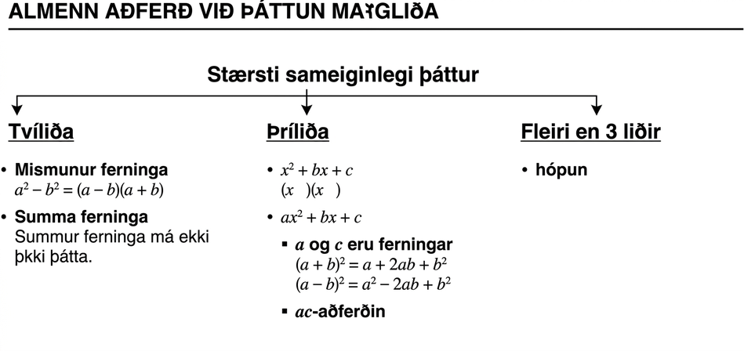
Learning Activity A | Part 1
Putting It All Together 🧩
Review the diagram. Are there
any parts that you do not
understand?
Use the diagram to determine
the best strategy to factor the
polynomial.
Example: 4x² + 20xy + 25y²
Reasoning?
Strategy?
Notes:
Support for All Learners
This activity offers an extension for students:
For students looking for an extra challenge, be sure to review the Extending Your Thinking slide!
Activity (20 minutes)
In this activity, students are given polynomials without any additional context. They must choose a strategy to factor them appropriately and defend their choice with reasoning.
Launch
Take 2 – 3 minutes to review the diagram at the start of the activity as a class.
Using the sample polynomial from the table, 4𝑥² + 20𝑥𝑦 + 25𝑦², find its correct place in the diagram and corresponding strategy.
Reasoning: After GCF, [perfect square] trinomial of the form 𝑎² + 2𝑎𝑏 + 𝑏²
Strategy: Trinomial square pattern or undo FOIL
Allow students 10 – 12 minutes to complete questions 1 – 7 individually.
Leave 3 – 5 minutes for students’ questions regarding appropriate strategies.
For an additional challenge, pose the polynomial in Extending Your Thinking. The factored solution requires multiple strategies implemented in the correct order.
Activity questions, answers, and synthesis on the next slide.

Slide 11
Learning Activity A | Part 2
Putting It All Together 🧩
Determine the best strategy to factor the polynomial. Be prepared to show your reasoning.
8y³ + 16y² – 24y
16x³ – 36x
6pq² – 9pq – 6p
4x² – 12xy + 9y² – 25
a² + 9
9x² – 24xy + 16y
27y² – 48
Are you ready for more?
Notes:
Activity Answers
After GCF, trinomial of form x² + bx + c; undo FOIL
After GCF. a binomial of squares; difference of squares
After GCF, trinomial of form ax² + bx + c; “ac” method or trial and error
Polynomial of 4 terms; grouping
No factors; prime
After GCF, trinomial of form a² – 2ab + b²; trinomial square pattern
After GCF. a binomial of squares; difference of squares
Activity Synthesis
Pose the following questions to students:
Which strategy is applicable to factoring binomials? (difference of squares; factoring the GCF)
Which strategy is applicable to factoring trinomials of the form x² + bx + c? (undoing FOIL)
Which strategy is applicable to factoring trinomials of the form ax² + bx + c? (trial and error, the “𝑎𝑐” method)
Which strategy is applicable to factoring trinomials of the form 𝑎² ± 2𝑎𝑏 + 𝑏²? (perfect square trinomials)
Which strategy is applicable to factoring polynomials with 4 expressions? (grouping)
Which strategy is applicable to polynomials that don’t seem to factor easily? (substitution, grouping, factoring the GCF)

Slide 12

Learning Activity A
Extending Your Thinking
Factor the polynomial below. Write down every factoring strategy that you use.
9x² – 12xy + 4y² – 49
Notes:
Go back to Lesson Activity
Answer
(3x – 2y – 7)(3x – 2y + 7)
Strategies used:
Factor out GCF, grouping, perfect square trinomial, difference of squares
Here is how to factor this polynomial:
Step 1 - Is there a GCF?
9x² – 12xy + 4y² – 49
No
Step 2 - With more than three terms, use grouping. The last two terms have no GCF. Try grouping the first three terms.
Step 3 - Factor the trinomial with 𝑎 ≠ 1. But the first term is a perfect square. Is the last term of the trinomial a perfect square?
(3x)² – 12xy + (2y)² – 49
Yes
Step 4 - Does the trinomial fit the pattern 𝑎² ± 2𝑎𝑏 + 𝑏²?
(3x)² – 12xy + (2y)² – 49
Middle term = –2(3x)(2y) and the (3x) comes from the first term, while the (2y) comes from the last term
Yes
Step 5 - Write the trinomial as a square.
(3x – 2y)² – 49
Step 6 - Is this binomial a sum or difference? Of squares or cubes? Write it as a difference of squares.
(3x – 2y)² – 7²
Step 7 - Write it as a product of conjugates.
((3x – 2y) – 7)((3x – 2y) + 7)
(3x – 2y – 7)(3x – 2y + 7)
Step 8 - Is the expression factored completely?
Yes
Step 9 - Check your answer by multiplying.
(3x – 2y – 7)(3x – 2y + 7)
9x² – 6xy – 21x – 6xy + 4y² + 14y + 21x – 14y – 49
9x² – 12xy + 4y² – 49 ✓

Slide 13

Learning Activity A
Self Check
Which strategy would you use to factor 40x²y + 44xy – 24y? What is the factored result?
Factor out the GCF. Use the undo FOIL method.
4y(5x + 2)(2x – 3)
Factor out the GCF. Use the difference of squares.
4y(5x – 2)(5x + 2)
Factor out the GCF. Use the “ac” method.
4y(5x – 2)(2x + 3)
Factor out the GCF. Use the perfect square trinomial strategy.
4y(5x + 2)(2x – 3)
Let’s review!
Notes:
Answer Feedback - Individualized by Response
Incorrect. The GCF is 4y. Since the first term of the remaining trinomial does not have a coefficient of 1, this is not the best strategy. Use the “ac” method.
Incorrect. The GCF is 4y. The remaining polynomial is a trinomial, and you cannot use the difference of squares. Use the “ac” method.
That’s correct! The GCF is 4y. The remaining trinomial has the form ax² – bx + c. You can use trial and error or the “ac” method.
Incorrect. The GCF is 4y. The remaining polynomial does not have the form a² + 2ab + b² for that method. Use the “ac” method.

Slide 14

Learning Activity A
Self Check - Review
Factor 24y² – 150.
What should be done first?
What should you ask yourself next?
What do you need to look for?
How do you know if it is factored completely?
Notes:
Answer
6(2y – 5)(2y + 5)
Factor the GCF first.
Then, ask yourself if it is a binomial, trinomial or if there are more than three terms. Next, since it is a binomial, determine if it is a sum or difference.
Since it is a difference, look to see if the two terms are squares.
Once we have written the conjugates. Check if any of the remaining polynomial factors can be factored further. If not, then it is factored completely.
Remind students of the questions they can ask themselves as they use a GENERAL STRATEGY FOR FACTORING POLYNOMIALS
Step 1 - Is there a greatest common factor? If yes, factor it out.
Step 2 - Is the polynomial a binomial, a trinomial, or are there more than three terms?
If it is a binomial:
Is it a sum?
Of squares? Sums of squares do not factor.
Of cubes? Use the sum of cubes pattern.
Is it a difference?
Of squares? Factor as the product of conjugates.
If it is a trinomial:
Is it of the form 𝑥² + 𝑏𝑥 + 𝑐? Undo FOIL.
Is it of the form 𝑎𝑥² + 𝑏𝑥 + 𝑐?
If 𝑎 and 𝑐 are squares, check if it fits the trinomial square pattern.
Use trial and error or the “𝑎𝑐” method.
If it has more than three terms:
Use the grouping method.
Step 3 - Check.
Is it factored completely?
Do the factors multiply back to the original polynomial?
Access the online textbook for more examples.

Slide 15

Lesson Journey
Third Stop: Learning Activity B

Slide 16
Learning Activity B | Learning Strategies
Finish Strong 🏁
Use the following sentence stems:
  “We should do ___ next because …”
  “I noticed ___, so I think …”
Ask questions if you don’t understand or challenge each other if you disagree.
Discussion Supports
Teacher Instruction: Use these strategies to adjust the activity to support English language learners and students with disabilities.
  You can copy and paste the callouts directly on top of the activity or give the instructions aloud.
Access the Factor Pairs 1 to 100 handout.
Use it to help find the factor pairs for “ac.”
Select the pair that sum to “b.”
Action and Expression
Notes:
Support for English Language Learners: MLR 8 Discussion Supports: Listening, Conversing
As students are working in groups of two to choose a strategy to solve the polynomial problem, provide the following sentence frames for all to see: “We should do ____ next because . . .”, and “I noticed ___ , so I think . . . .” . " Encourage students to challenge each other when they disagree. This will help students clarify their reasoning when solving polynomial equations. When students are discussing what is the same and different about their steps and solving strategies, assist students in using negatives and contractions correctly, such as do/don't, can/can't, is/isn't.
Design Principle(s): Maximize meta-awareness
Support for Students with Disabilities: Action and Expression: Appropriate Tools
Use this Factor Pairs 1-100 handout to help support students factoring polynomials of varying levels of difficulty.
Supports accessibility for: Memory

Slide 17
Learning Activity B
Finish Strong 🏁
Find a strategy that fits and factor completely.
5y³ – 15y² – 270y video
75m³ + 12m
16x² + 24xy – 4x – 6y
2n² + 13n – 7
121r² – s²
25w² – 60w + 36
(3x + 1)² – 6(3x + 1) + 9
(4x – 3y – 8)(4x – 3y + 8)
Notes:
Support for All Learners
This activity offers additional support for students:
For English language learners and students with disabilities, be sure to review the Learning Strategies slide!
Activity (20 minutes)
This activity represents the culmination of all of the factoring strategies learned in the unit. Polynomials are given with no context. Students must determine the type of polynomial, choose the correct strategy to implement, and then correctly factor each polynomial.
Continue scrolling down for how to launch the activity, answers to the questions, and activity synthesis.
Launch
Allow students to work with a partner to answer questions 1 – 7 in the activity.
This will encourage discussion and teamwork as they select the correct strategy and factor each polynomial.
Answers
Factor out GCF of 5𝑦. Then use the “undo FOIL” method on the polynomial of the form 𝑥² + 𝑏𝑥 + 𝑐. 5𝑦(𝑦 – 9)(𝑦 + 6)
Factor out GCF of 3𝑚. 3𝑚(25𝑚² + 4)
Factor out GCF of 2. Then use the grouping method. 2(4x – 1)(2x + 3y)
Use the “ac” method or trial and error. (2n – 1)(n + 7)
Use the difference of squares method. (11r – s)(11r + s)
Use the perfect square trinomial method. (5w – 6)²
Use the substitution or perfect square trinomial method. (3x – 2)²
Use the grouping method on the first three terms. They are a perfect square trinomial. Then use the difference of squares on the result. (4x – 3y – 8)(4x – 3y + 8)
Activity Synthesis
Pose the following question to students:
If more than one strategy can be correctly implemented to factor a polynomial, is there an incorrect choice? (As long as you factor a polynomial down to its prime factors, you have correctly factored the polynomial. Sometimes more than one strategy will work.)

Slide 18

Learning Activity B
Self Check
Which strategy would you use to factor 9x² – 24xy + 16y²? What is the factored result?
Trinomial square pattern; (3x + 4y)²
Grouping; (3x – 4y)(3x + 4y)
Difference of squares; (4x – 3y)²
Trinomial square pattern; (3x – 4y)²
Let’s review!
Notes:
Answer Feedback - Individualized by Response
Incorrect. The polynomial has the form a² – 2ab + b². This fits the trinomial square pattern strategy. The signs do not match up with this answer since the second term is negative.
Incorrect. The polynomial has the form a² – 2ab + b². This fits the trinomial square pattern strategy. Grouping is good when there are more than three terms.
Incorrect. The polynomial has the form a² – 2ab + b². This fits the trinomial square pattern strategy. Polynomials that are a difference of squares only have two terms.
That's correct! The polynomial has the form a² – 2ab + b². Square the factors to check that they are equal to the original polynomial.

Slide 19
Learning Activity B
Self Check - Review
Factor 7x³ – 21x² – 70x.
GENERAL STEPS FOR FACTORING
Step 1 - Factor any GCF.
Step 2 - Factor (using special binomials, trinomials, trial/error, “ac” or grouping).
Step 3 - Verify if factored completely.
Step 4 - Check by multiplying factors.
Notes:
Remind Students
A polynomial is completely factored if, other than monomials, its factors are prime!
Answer
7x(x + 2)(x – 5)
Access the online textbook for more examples.

Slide 20
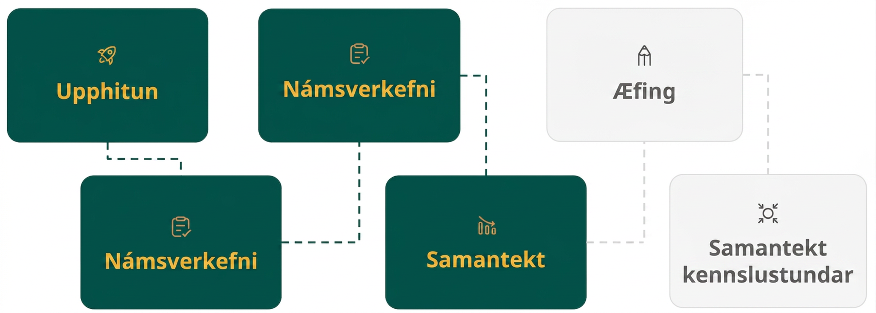
Lesson Journey
Fourth Step: Cool Down

Slide 21
Cool Down
Explain what it means to factor a polynomial completely.
Determine if each polynomial is completely factored. If the answer is no, write the completely factored form.
3x(8x² – 9x – 3)
60x²y – 75xy + 30y
2c(4c² + 20cd + 81d²)
5n² + 5n + 12
5q² – 15q – 90
64x² + 16xy + y²
Notes:
Cool Down (5 minutes)
Answers
To factor a polynomial completely means that every factor you have found, or the polynomial itself, is prime.
Yes
No; 15y(4x² – 5x + 2)
Yes
Yes
No; 5(q + 3)(q – 6)
No; (8x + y)²
Response to Student Thinking - Points to Emphasize
If students are still struggling to identify polynomials that are prime, encourage them to develop a set of questions they can pose to themselves like a checklist. For instance, “Is there one number that has been multiplied into every term of the polynomial?” like in question 6. Or, “Is there a variable (or two) that has been multiplied into every term?” - like the y-variable we see in question 3 … that also has a common number! For trinomials, they might ask a question like, “Is there a set of factors for the constant term that might sum to be the middle term? Or combine with factors of the first term to sum to be the middle term?” or “Is the trinomial ‘perfect’?” etc.
Students will have opportunities to review and practice how to factor polynomial expressions again in Unit 8 when they use factoring to solve quadratic equations.

Slide 22
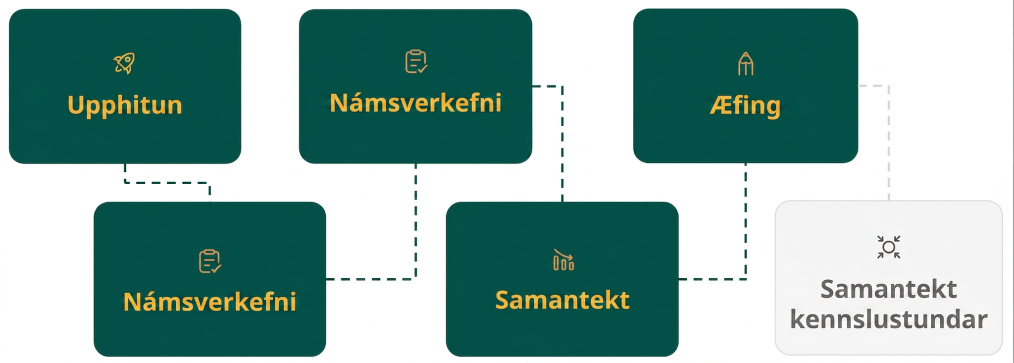
Lesson Journey
Fifth Stop: Practice

Slide 23

Practice
Put your hard work to action, practice what you’ve learned!
Notes:
Digital Practice: Access the practice pages at https://openstax.org/details/books/algebra-1

Slide 24
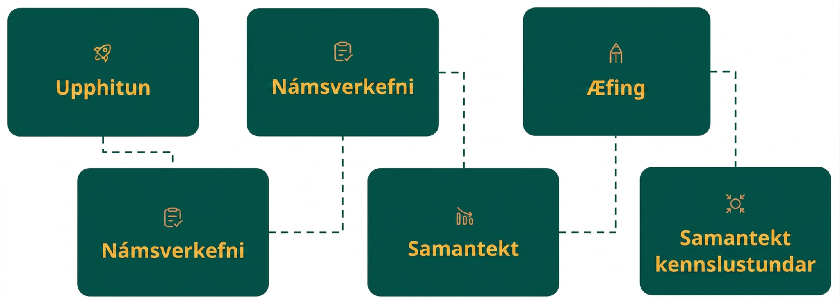
Lesson Journey
Sixth Stop: Lesson Synthesis

Slide 25
Lesson Synthesis
Which strategy is applicable to factoring binomials?
Which strategy is applicable to factoring binomials of the form x² + bx + c?
Which strategy is applicable to factoring binomials of the form ax² + bx + c?
Which strategy is applicable to factoring binomials of the form a² ± 2ab + b²?
Which strategy is applicable to factoring polynomials with 4 terms?
Which strategy is applicable to polynomials that don’t seem to factor easily?
Notes:
To summarize the key concepts from the lesson, pose the sample questions again to see if students have learned all of the possible situations.
Answers
Which strategy is applicable to factoring binomials? (difference of squares; factoring the GCF)
Which strategy is applicable to factoring trinomials of the form 𝑥² + 𝑏𝑥 + 𝑐? (undoing FOIL)
Which strategy is applicable to factoring trinomials of the form 𝑎𝑥² + 𝑏𝑥 + 𝑐? (trial and error, the “𝑎𝑐” method)
Which strategy is applicable to factoring trinomials of the form 𝑎𝑥² ± 2𝑎𝑏 + 𝑏²? (perfect square trinomials)
Which strategy is applicable to factoring polynomials with 4 terms? (grouping)
Which strategy is applicable to polynomials that don’t seem to factor easily? (substitution, grouping, factoring the GCF)

Slide 26
Self Assessment
How much do you agree with the following statements?
Learning Goals | I can | Almost | Not yet
Recognize and use the appropriate method to factor a polynomial completely. | ⃞ | ⃞ | ⃞

