Slide 1
Algebra 1
Unit 7 Introduction to Quadratic Functions
Lesson 7.15 Vertex Form
Notes:
How to Get Started
Review Slide 2: How to use these slides
Check out the Check out the digital quick start guide!
Review Slide 3: Reference Key of Icons

Slide 2

How to use these slides
On the activity slides check the speaker notes for teacher support and instructional information.
Each lesson includes 1 warm up, 2-3 learning activities, a cool down, practice and a lesson synthesis.
  Learning activities are followed by a self check question, and review section.
Some slides have been hidden from student view, more information can be found on the next slide (Reference Key).
You can edit and use these slides for personal and classroom use, but cannot sell them and must keep the attribution logos.
For more information, Check out the digital quick start guide!
OpenStax CC BY NC SA

Slide 3





Reference Key
Check the top right corner for an icon referencing these unique sections.
Icon | Title | View | Location and Description
n/a | Support for Students with Disability | Hidden | Learning Strategies slide, provides additional support to students for understanding the activity.
n/a | Support for English Language Learners | Hidden | Learning Strategies slide, provides additional support to students for understanding the activity.
n/a | Extending Your Thinking | Hidden | Extending Your Thinking slide, provides an extra challenge for students.
n/a | Self Check | Not Hidden | Self Check slide, checkpoint to assess student understanding after the learning activity.
n/a | Review | Hidden | Self Check - Review slide, designed to help review topics from the self check question.
On the next slides, check the speaker notes for teacher instructions and support.
Notes:
Check the Speaker Notes: On the next slides you can find discussion questions, lesson information, answers to the activities, and ways to adjust the activity for your students!

Slide 4

Learning Goals
By the end of this lesson you will be able to -
Recognize the "vertex form" of a quadratic equation.
Relate the numbers in the vertex form of a quadratic equation to its graph.
Notes:
Lesson Narrative
In earlier lessons, students found the vertex’s x-coordinate by locating the value halfway between the x-intercepts and learned that the vertex shows a function’s maximum or minimum. In this lesson, they explore quadratic expressions in vertex form, which makes the vertex easy to identify. Using technology, students adjust parameters, observe how changes affect the graph, and compare these patterns to those seen in earlier forms.
Required Preparation
Acquire devices that can run Desmos (recommended) or other graphing technology. It is ideal if each student has their own device.
Required Materials
Graphing technology
Texas Essential Knowledge and Skills
A1(F) analyze mathematical relationships to connect and communicate mathematical ideas
A1(G) display, explain, and justify mathematical ideas and arguments using precise mathematical language in written or oral communication
A7(A) graph quadratic functions on the coordinate plane and use the graph to identify key attributes, if possible, including x-intercept, y-intercept, zeros, maximum value, minimum values, vertex, and the equation of the axis of symmetry
A7(C) determine the effects on the graph of the parent function f(x) = x² when f(x) is replaced by af(x), f(x) + d, f(x − c), f(bx) for specific values of a, b, c, and d

Slide 5
Vocabulary
Previous
Factored Form
  A quadratic expression that is written as the product of a constant times two linear factors. f(x) = a(x − r₁)(x − r₂).
Standard Form
  When a quadratic expression is written as f(x) = ax² + bx +c.
New
Vertex Form
  An expression in the form 𝑎(x − h)² + k where 𝑎, h, and k are constants, and
𝑎 ≠ 0.
Notes:
Lesson Vocabulary
To support student understanding of key vocabulary:
Introduce and review the vocabulary words students will see in this lesson.
Encourage students to notice how these words are used and to include them in their math discussions and explanations—both written and oral.
Use a word wall to reinforce vocabulary. Sample word wall cards are available here.
For newcomers or students with beginning English proficiency, use these Quizlet sets to support vocabulary learning:
Unit 7 Spanish Vocabulary – use first to build understanding
Unit 7 Vocabulary (English) – use after anchoring in Spanish
Support for English Language Learners
ELPS 2(F) listen to and derive meaning from a variety of media such as audiotape, video, DVD, and CD-ROM to build and reinforce concept and language attainment
ELPS 3(B) expand and internalize initial English vocabulary by learning and using high-frequency English words necessary for identifying and describing people, places, and objects, by retelling simple stories and basic information represented or supported by pictures, and by learning and using routine language needed for classroom communication
ELPS 3(D) speak using grade-level content area vocabulary in context to internalize new English words and build academic language proficiency
ELPS 3(E) share information in cooperative learning interactions
ELPS 3(F) ask and give information ranging from using a very limited bank of high-frequency, high-need, concrete vocabulary, including key words and expressions needed for basic communication in academic and social contexts, to using abstract and content-based vocabulary during extended speaking assignments

Slide 6

Lesson Journey
First Stop: Warm Up

Slide 7

Warm Up | Part 1
Are They the Same or Different? 🤔
Set 1
f(x) = x² + 4x
g(x) = x(x + 4)
h(x) = (x + 2)² − 4
Set 2
p(x) = −x² + 6x − 5
q(x) = (5 − x)(x − 1)
r(x) = −1(x − 3)² + 4
Observe the two sets.
What do you notice?
What do you wonder?
Notes:
Warm Up (5 minutes)
This warm up prompts students to analyze two sets of equations that they will study more closely in a later activity. In each set, the three equations define the same function but are written in different forms—factored form, standard form, and vertex form. Noticing and wondering about the features of the equations prepares students to reason later that the expressions defining each output are equivalent.
When students articulate what they notice and wonder, they have an opportunity to attend to precision in the language used to describe what they see. They might first propose less formal or imprecise language, and then restate their observation with more precise language in order to communicate more clearly.
Launch
Display the two sets of equations for all to see.
Give students one minute of quiet time to think individually and ask them to be prepared to share at least one thing they notice and one thing they wonder.
Give students another minute to discuss their observations and questions.
Follow with a whole-class discussion.
Activity Answers
Things you notice:
Each set has three equations.
Each equation has the output in function notation on the left side of the equal sign, and an expression on the right side.
The expressions are in standard form, factored form, and one other form.
The equations in standard and factored form are equivalent.
Things you may wonder:
Why are the equations in each set grouped together?
In each set, is the expression in the last equation written in a particular form? What is it called?
In each set, is the expression in the last equation equivalent to the other two?
Activity Synthesis
Ask students to share the things they noticed and wondered. Record and display their responses for all to see. If possible, record the reasoning on or near the relevant equations. After all responses have been recorded without commentary or editing, ask students, "Is there anything on this list that you are wondering about now?" Encourage students to respectfully disagree, ask for clarification, or point out contradicting information, etc.
Some students may struggle with what to notice about these equations. Consider asking questions such as
“What do you notice that is the same in all the equations?”
“What do you notice that is different between all the equations?”
Be prepared to respond to students who note that all the equations contain x, or that two of the equations have squared terms and the third does not, and push for more similarities and differences to get at the different forms, etc.

Slide 8
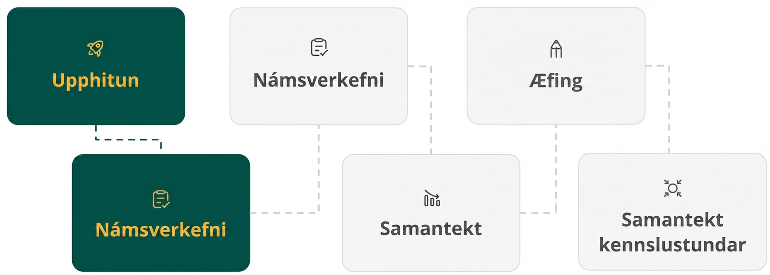
Lesson Journey
Second Stop: Learning Activity A

Slide 9

Learning Activity A | Learning Strategies
Introducing Vertex Form📢
Teacher Instruction: Use these strategies to adjust the activity to support students with disabilities.
You can copy and paste the callouts directly on top of the activity or give the instructions aloud.
Help create a display of key terms and vocabulary.
Suggest words or diagrams that explain vertex form.
Add ideas that will help everyone understand the topic.
Representation
Notes:
Support for Students with Disabilities: Representation: Develop Language and Symbols
Create a display of important terms and vocabulary. Invite students to suggest language or diagrams to include that will support their understanding of vertex form.
Supports accessibility for: Conceptual processing; Language

Slide 10
Learning Activity A | Part 1
Introducing Vertex Form📢
Set 1
f(x) = x² + 4x
g(x) = x(x + 4)
h(x) = (x + 2)² − 4
All of the functions is Set 1 are equivalent.
h(x) = (x + 2)² − 4 is in Vertex Form.
By expanding and simplifying h(x) we see it is equivalent to f(x).
(x + 2)² − 4 = (x + 2)(x + 2) − 4
= x² + 2x + 2x + 4 − 4
= x² + 4x ← f(x) ← Standard Form
If f(x) is simplified we see it is equivalent to g(x).
x² + 4x = x(x + 4). ← g(x) ← Factored Form
Notes:
Support for All Learners
This activity offers additional support for students:
For students with disabilities, be sure to review the Learning Strategies slide!
Activity (10 minutes)
This activity introduces vertex form. Students explore how the numbers in a vertex-form expression relate to the vertex of its graph. They also rewrite vertex-form expressions into other equivalent forms, practicing how to expand expressions using the distributive property.
Launch
Give students a minute to read the task statement.
Before students answer the questions, briefly discuss the worked example to make sure students can follow the reasoning that illustrates the equivalence of the expressions defining h and f.
Review with Students
Each step of the simplification process
How each form is related.
Activity questions, answers, anticipated misconceptions and synthesis on the next slide.

Slide 11
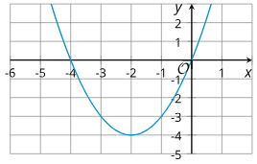
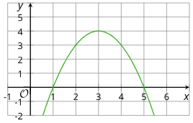
Learning Activity A | Part 2
Introducing Vertex Form📢
Set 2
p(x) = −x² + 6x − 5
q(x) = (5 − x)(x − 1)
r(x) = −1(x − 3)² + 4
Show that the expressions defining
r and p are equivalent.
For Questions 2 - 3, find the coordinate of the vertex.
The graph of h(x).
The graph of r(x).
Notes:
Activity Answers
Expanding and simplifying function r, −1(x − 3)² + 4 gives −1(x² − 6x + 9) + 4, which equals −x² + 6x − 9 + 4
or −x² + 6x − 5.
-2, -4
3, 4
More activity questions, answers, anticipated misconceptions and synthesis on the next slide.

Slide 12
Learning Activity A | Part 3
Introducing Vertex Form📢
h(x) = (x + 2)² − 4
r(x) = −1(x − 3)² + 4
Why do you think expressions such as those defining h and r are said to be written in vertex form?
Notes:
Activity Answers
The numbers in vertex form seem to give the coordinates of the vertex of the graph. When a positive number is added to the x in the parentheses, the x-coordinate of the vertex seems to be negative—which is the opposite of that number. When a number is subtracted from x, the x-coordinate of the vertex seems to be positive—which is the opposite of what it looks like.
Anticipated Misconceptions
Some students may incorrectly think that (x−3)² is (x²− 3²). Remind them that (x−3)² means ((x−3)(x−3). Consider pointing out the example in the task statement to help students show that the expressions for r and p are equivalent.
Activity Synthesis
Invite students to show that the expressions defining functions r and p are equivalent. Consider pointing out that at the moment it is easier to show equivalence by going from vertex form to standard form than from standard form to vertex form. In a future unit, we will look at how to do the latter.
Then, discuss questions such as:
"What information does a quadratic expression in the vertex form reveal? How does it show that information?" (It reveals the coordinates of the vertex of the parabola. The number in the parentheses seems to be related to the x-coordinate of the vertex. The number outside seems to be the y-coordinate of the vertex.)
"What doesn't it tell us?" (It does not allow us to easily see the x- or y-intercepts.)
"Why do you think this form is used?" (Sometimes we want to know the maximum or the minimum of a function. It is helpful to be able to see it in the expression or equation defining the function.)
"Can you give an example of a situation when it might be useful to have the relationship modeled using an expression in vertex form?" (Examples: when we are interested in the maximum height of an object in projectile motion, or when we want to know the maximum revenue in a business model.)

Slide 13
Learning Activity A
Self Check
Which equation is equivalent to y = (x − 3)² − 9?
y = x² − 18
y = x² − 3x - 9
y = x² − 6x
y = x² + 6x - 9
Let’s review!
Notes:
Answer Feedback - Individualized by Response
Incorrect. Remember to expand the binomial by multiplying (x − 3)(x − 3).
Incorrect. Remember to expand the binomial by multiplying (x − 3)(x − 3)
That’s correct! Multiply (x − 3)(x − 3) then subtract 9.
Incorrect. Remember to expand the binomial by multiplying (x − 3)(x − 3). Watch the signs. For the middle terms −3x + −3x = −6x.

Slide 14

Learning Activity A | Part 1
Self Check - Review
Equivalent Forms of Quadratics
Standard: y = ax² + bx + c
Factored: y = (x + a)(x + b)
Vertex: y = a(x - h)² + k
The equation y = (x + 2)² - 9 represents a quadratic function. What is the specific form in which this quadratic equation is written?
Notes:
Remind Students
Review the equivalent forms with students.
Answer
Vertex Form
More review, questions, and answers on the next slide.

Slide 15
Learning Activity A | Part 2
Self Check - Review
Here is the vertex form of the equation: y = (x + 2)² − 9.
  Convert it to standard form
  Convert it to factored form.
GENERAL STEPS FOR CONVERTING VERTEX TO STANDARD FORM
Step 1 - Expand the vertex form to multiply the binomials.
Step 2 - Multiply the binomials.
Step 3 - Combine like terms.
GENERAL STEPS FOR CONVERTING STANDARD TO FACTORED FORM
Step 1 - From the standard form, find the factors of the trinomial expression.
Step 2 - Examine the trinomial expression.
Step 3 - Factor the trinomial.
Notes:
Answers
y = x² + 4x − 5
y = (x + 5)(x − 1)

Slide 16
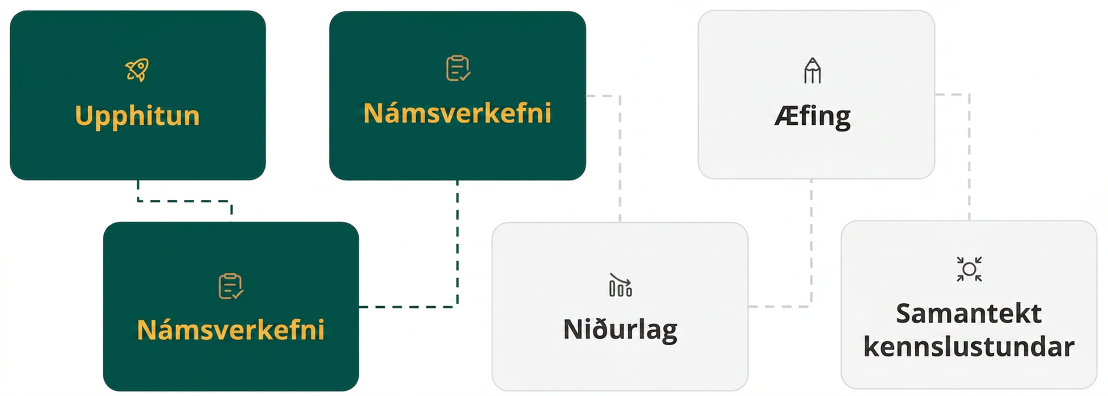
Lesson Journey
Third Stop: Learning Activity B

Slide 17
Learning Activity A | Learning Strategies
Take a Closer Look at the Vertex 👀
Teacher Instruction: Use these strategies to adjust the activity to support English language learners and students with disabilities.
You can copy and paste the callouts directly on top of the activity or give the instructions aloud.
Listen to each observation.
Restate it using precise math language.
Check with the speaker and note words that clarify ideas.
Discussion Supports
Use a graphing calculator or graphing software to explore.
Follow a checklist or steps if you need help using the tool.
Action and Expression
Notes:
Support for English Language Learners: MLR 8 Discussion Supports: Speaking
Use this routine to support whole-class discussion. For each observation that is shared, ask students to restate what they heard using precise mathematical language. Ask the original speaker if their peer was accurately able to restate their thinking. Call students' attention to any words or phrases that helped to clarify the original statement. This provides more students with an opportunity to produce language as they interpret the reasoning of others.
Design Principle(s): Support sense-making
Support for Students with Disabilities: Action and Expression: Provide Access for Physical Action
Provide access to tools and assistive technologies such as a graphing calculator or graphing software. Some students may benefit from a checklist or list of steps to be able to use the calculator or software.
Supports accessibility for: Organization; Conceptual processing; Attention

Slide 18
Learning Activity B | Part 1
Take a Closer Look at the Vertex 👀
Describe how each change affects the graph and the vertex.
Graph y = x². Then, add different numbers to x before it is squared (for example, y = (x + 4)², y = (x − 3)²).
Graph y = (x − 1)².
  Add different constant terms (for example: y = (x − 1)² + 5,
  y = (x − 1)²−9).
  Multiplying by different coefficients y = 3(x − 1)², y = 2(x − 1)², y = 0.5(x − 1)².
Notes:
Support for All Learners
This activity offers additional support and an extension for students:
For English language learners and students with disabilities, be sure to review the Learning Strategies slide!
For students looking for an extra challenge, be sure to review the Extending Your Thinking slide!
Activity (20 minutes)
Students now take a closer look at how the parameters in vertex form relate to the coordinates of the vertex. Using graphing technology, they vary each parameter and observe the effects on the graph, building on earlier work with standard and factored forms. Working with a partner, students alternate operating the technology and recording observations, giving them opportunities to explain and critique reasoning. This activity also begins to develop their understanding of the structure of vertex form in preparation for the next lesson.
Launch
Provide access to graphing technology for all students.
Arrange students in pairs. For Questions 1–2, assign one partner to operate the graphing tool and the other to record observations. Have them switch roles halfway.
Pause for a brief class discussion after Question 2. Invite students to share observations about how adding a constant to(𝑥 − h)² shifts the graph. Highlight how vertical shifts affect the 𝑥-intercepts, including cases where the graph no longer intersects the 𝑥-axis.
Ask students to put graphing tools away while working on Question 3 so they rely on reasoning rather than technology.
Answers
Adding a number to 𝑥 moves the graph to the left. Subtracting a number (or adding a negative number) moves the graph to the right. The vertex stays on the 𝑥-axis.
Adding a constant term moves it up and subtracting moves it down. The 𝑥-coordinate of the vertex doesn't change.
Multiplying the squared term by a number doesn't change the vertex, but it changes the opening of the graph to "wider" or "narrower," or changes the direction of the graph to open upward or downward.
More activity questions and answers on the next slide.

Slide 19
Learning Activity B | Part 2
Take a Closer Look at the Vertex 👀
Without graphing, complete the table by finding the coordinates of the vertex of each function and determine if it opens up or down.
Find patterns to help continue to find the vertices of the next equation.
Equation | x coordinate of the vertex | y coordinate of the vertex | Graph opens up or down?
y = (x + 10)² | a. ___ | b. ___ | c. ___
y = (x - 4)² + 8 | d. ___ | e. ___ | f. ___
y = (x - 4)² + 8 | g. ___ | h. ___ | i. ___
y = x² - 7 | j. ___ | k. ___ | l. ___
Notes:
Answers
-10
0
Up
4
8
Up
4
8
Down
0
-7
Up
Question 7 has been omitted from the slides but can be found here in the online book.
More activity questions, answers, and synthesis on the next slide.

Slide 20
Learning Activity B | Part 3
Take a Closer Look at the Vertex 👀
Use the completed rows of the table on the previous slide to hypothesize about the coordinates of the vertex of the equation in question 8, and whether the parabola opens up or down.
Equation | x coordinate of the vertex | y coordinate of the vertex | Graph opens up or down?
y = a(x + m)² + n | a. ___ | b. ___ | c. ___
Are you ready for more?
Note: Question 7 has been omitted from the slide deck but can be found here in the online book.
Notes:
Answers
Question 7 has been omitted from the slides but can be found here in the online book.
-m
n
The direction can not be determined because the direction of opening depends on whether a is positive or negative.
Activity Synthesis
Invite students to share their responses and reasoning. If not mentioned in students' explanations, highlight the following points:
To determine which baseball stayed in flight longer, we can compare where the graphs intersect the horizontal axis or the zeros of the functions, which tell us when the baseball hits the ground.
The graph of function h intersects the horizontal axis around 5.
Function g is given in factored form, so one zero will be a very small negative number (about −1/16), and the other zero will be 4.
The maximum height of Player A's baseball (function h) is shown in the graph. For Player B (function g), we can approximate the halfway point between the horizontal intercepts, which is around t = 2, and then find g(2).
The baseball was hit at t=0, so to find the height we would look at the vertical intercept (y-intercept).
For function h, this point is shown on the graph.
For function g, it is not immediately apparent because the equation is in factored form. If it was in standard form, the constant term is the vertical intercept. We can either expand the (−16t − 1)(t − 4) and write an equivalent expression in standard form, or find g(0).

Slide 21
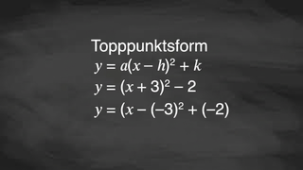
Learning Activity B | Video
Learning About the Vertex Form of a Quadratic
Notes:
This video discusses question 3 of activity 7.15.3

Slide 22

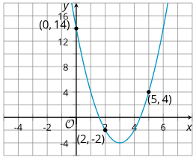
Learning Activity A
Extending Your Thinking
Examine the graph, then use it to answer questions.
What is the x-coordinate of the vertex?
What is the y-coordinate of the vertex?
Which quadratic equation best fits the function in the graph?
Notes:
Go back to Lesson Activity
Answers
3
-4
y = 2(x − 3)² − 4. The equation y = 2(x − 3)² − 4 has the vertex at (3, −4). The graph shown has a y-intercept at (0, 14) which doesn't work for the equation y = (x − 3)² − 4. The equation y = 2(x − 3)² − 4 appears to fit. When x = 0 the y-value is 2(0 − 3)² − 4 = 14.

Slide 23

Learning Activity B
Self Check
Find the vertex for y = 3(x − 2)² − 5.
(3, −5)
(2, −5)
(−2, −5)
(2, 5)
Let’s review!
Notes:
Answer Feedback - Individualized by Response
Incorrect. The 3 does not cause the parabola’s vertex to shift.
That's correct! The parabola’s vertex shifts right 2 and down 5 so the vertex is at (2, −5).
Incorrect. Watch the signs. The parabola’s vertex shifts right 2 and down 5.
Incorrect. Watch the signs. How does subtracting 5 affect the graph? The vertex shifts down 5.

Slide 24
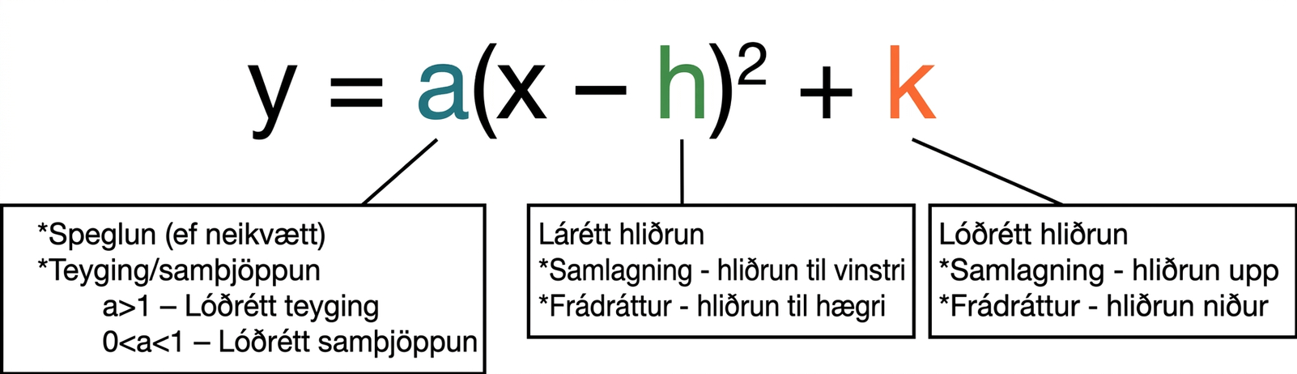
Learning Activity B | Part 1
Self Check - Review
Vertex Form
Notice that the value of h is the opposite of what it is in the parenthesis. This seems odd: when we add k, the vertex of the parabola moves up k units. But when we subtract h within the squared term, the vertex of the parabola moves right h units, not left. Let’s explore why this happens on the next slide.
Notes:
Review with Students
The vertex form and all of it’s variables and meanings
More explanation, question, and answer on the next slide.

Slide 25
Learning Activity B | Part 2
Self Check - Review
We know the y-coordinate of the vertex is y = k. To find that using this equation, we need to know where
a(x − h)² is zero, because that will make y = k.
Set a(x − h)² = 0 . This happens when x − h = 0, which is when x = h. That means h is the x-coordinate of the vertex.
Find the vertex of y = 3(x − 4)² − 2.
Notes:
Review with Students
The information about why the value of h is the opposite of what it is in the parenthesis.
Answer
The parabola of the quadratic will shift right 4 (remember this horizontal shift is counterintuitive and translates in the opposite direction of what the expression “looks like”) and down 2. So, the vertex is at (4, −2).

Slide 26
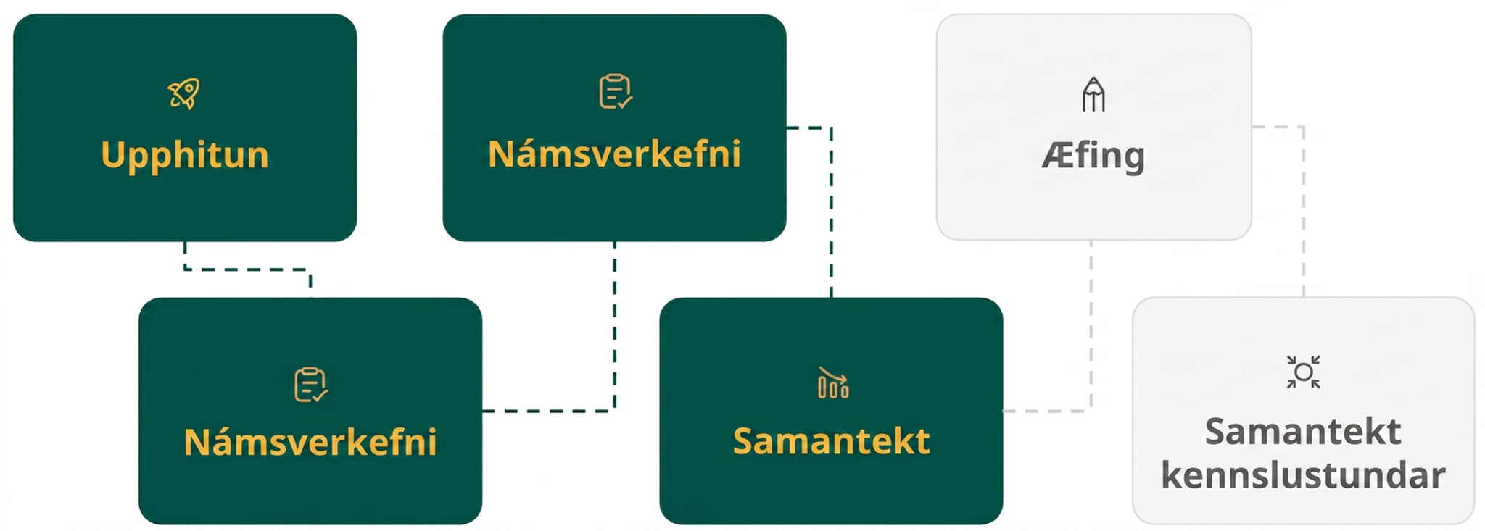
Lesson Journey
Fourth Step: Cool Down

Slide 27
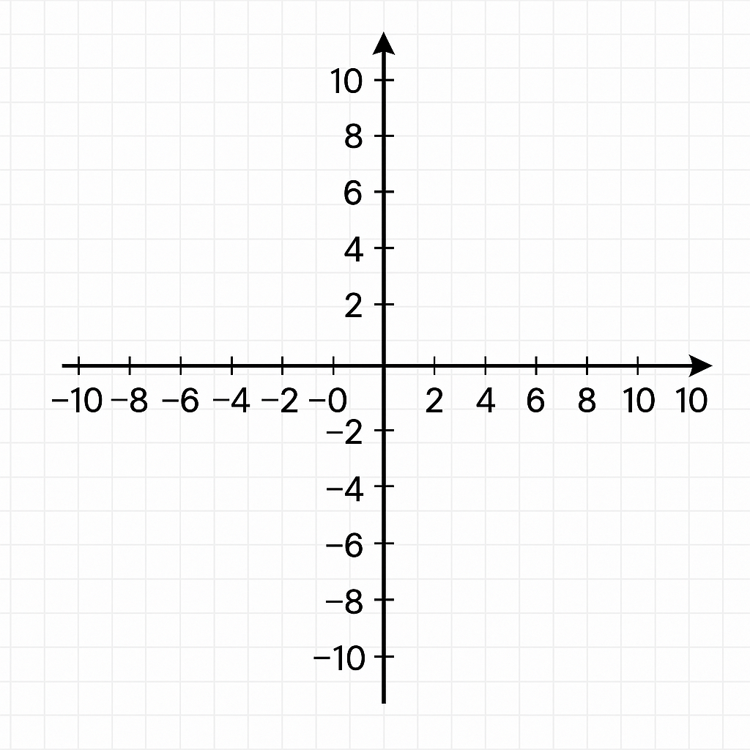
Cool Down
Answer the questions about the function f, given by
f(x) = (x + 3)² − 1.
What is the x-coordinate of the vertex of the graph of f?
What is the y-coordinate of the vertex of the graph of f?
Does the graph open up or down?
Notes:
Cool Down (5 minutes)
Launch
Since this activity was designed to be completed without technology, ask students to put away any devices.
Answers
-3
-1
The graph opens upward. The squared term has a positive coefficient (1).).
Response to Student Thinking - More Chances
Students will have more opportunities to understand the mathematical ideas in this cool down, so there is no need to slow down or add additional work to the next lessons. Instead, use the results of this cool down to provide guidance for what to look for and emphasize over the next several lessons to support students in advancing their current understanding.

Slide 28
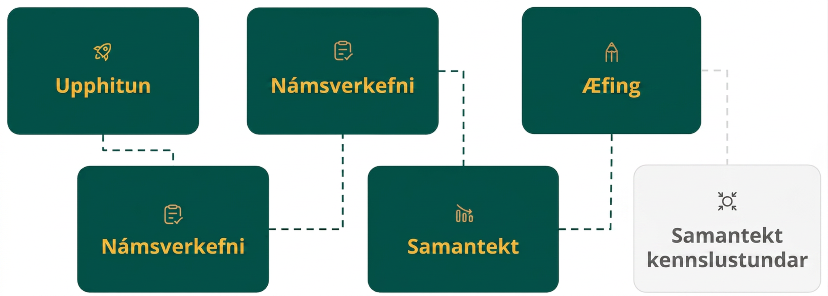
Lesson Journey
Fifth Stop: Practice

Slide 29

Practice
Put your hard work to action, practice what you’ve learned!
Notes:
Digital Practice: Access the practice pages at https://openstax.org/details/books/algebra-1

Slide 30
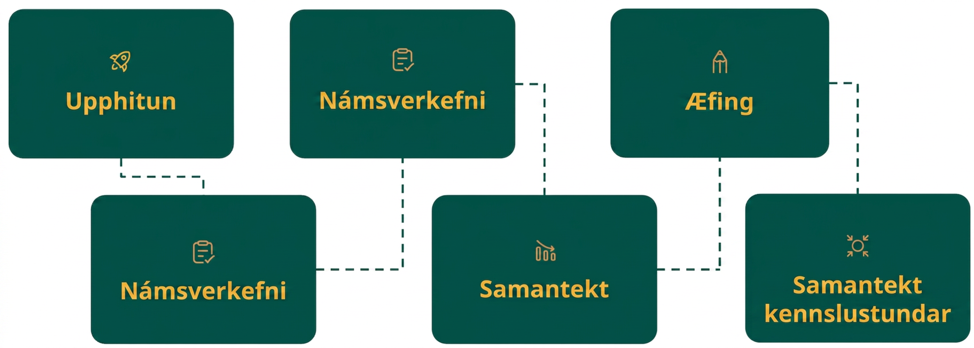
Lesson Journey
Sixth Stop: Lesson Synthesis

Slide 31

Lesson Synthesis
Answer these questions to show your understanding of the connections between the three different forms of quadratic expressions.
The standard form has a constant term: the c in ax² + bx + c. The vertex form also has a constant term: the k in a(x − h)² + k. Are the two constant terms visible on the graph in the same way?
In both the vertex and standard form, the squared term x² has a coefficient (which could be 1). Does this coefficient affect the graph in similar ways?
Notes:
Answers
No. The k in vertex form gives us the y-coordinate of the vertex. The c in standard form gives us the y-coordinate of the y-intercept. That said, changing these parameters has the same effect of moving the graph up or down.
Yes, they both influence the direction of the opening of the function's graph and how wide or narrow the opening is.

Slide 32
Self Assessment
How much do you agree with the following statements?
Learning Goals | I can | Almost | Not yet
Recognize the "vertex form" of a quadratic equation. | ⃞ | ⃞ | ⃞
Relate the numbers in the vertex form of a quadratic equation to its graph. | ⃞ | ⃞ | ⃞

