Slide 1


Algebra 1
Unit 2 Linear Inequalities and Systems
Lesson 2.9 Solutions to Inequalities

Slide 2
How to use these slides
On the activity slides check the speaker notes for teacher support and instructional information.
Each lesson includes 1 warm up, 2-3 learning activities, a cool down, practice and a lesson synthesis.
  Learning activities are followed by a self check question, and review section.
Some slides have been hidden from student view, more information can be found on the next slide (Reference Key).
You can edit and use these slides for personal and classroom use, but cannot sell them and must keep the attribution logos.
For more information, Check out the digital quick start guide!

Slide 3






Reference Key
Check the top right corner for an icon referencing these unique sections.
 | Support for Students with Disability | Hidden | Learning Strategies slide, provides additional support to students for understanding the activity. Learning Strategies slide, provides additional support to students for understanding the activity.
 | Support for English Language Learners | Hidden
 | Extending Your Thinking | Hidden | Extending Your Thinking slide, provides an extra challenge for students.
 | Self Check | Not Hidden | Self Check slide, checkpoint to assess student understanding after the learning activity.
 | Review | Hidden | Self Check- Review slide, designed to help review topics from the self check question.
On the next slides, check the speaker notes for teacher instructions and support.
Notes:
Check the Speaker Notes: On the next slides you can find discussion questions, lesson information, answers to the activities, and ways to adjust the activity for your students!

Slide 4

Learning Goals
By the end of this lesson you will be able to -
Graph the solution to an inequality in one variable.
Solve one-variable inequalities.
Interpret the solutions to one-variable inequalities in terms of the situation.
Notes:
Lesson Narrative
In this lesson, students revisit the meaning of the solutions to an inequality in one variable and recall that the solution set is a range of values. They also investigate different ways to find the solution set to an inequality—by reasoning about the quantities and relationships in context; by guessing some values, substituting them into the inequality, and checking them to see if they make the inequality true; and by first solving a related equation in one variable. Along the way, students reason abstractly and quantitatively.
Required Preparation
Devices that can run Desmos (recommended) or other graphing technology, or graph paper are needed.
Required Materials
None
Texas Essential Knowledge and Skills
A1(A) apply mathematics to problems arising in everyday life, society, and the workplace
A5(B) solve linear inequalities in one variable, including those for which the application of the distributive property is necessary and for which variables are included on both sides

Slide 5
Vocabulary
Previous
Inequality
  A mathematical sentence that contains <, >, ≥, ≤, or ≠ in order to compare two quantities.
New
Solution Set
  The set of all solutions to an equation or inequality.
Notes:
Lesson Vocabulary
To support student understanding of key vocabulary:
Familiarize students with the vocabulary words they will see throughout the lesson. Encourage students to look for these words and notice their use and meanings.
Encourage students to use key vocabulary words in “math talk” and their written and oral explanations.
Utilize a word wall. Sample cards are located here: Sample word wall cards are available here.
For newcomers or students with beginning English proficiency, use these Quizlet sets to support vocabulary learning:
Unit 2 Spanish Vocabulary – use first to build understanding
Unit 2 Vocabulary (English) – use after anchoring in Spanish
Support for English Language Learners
ELPS 2(F) listen to and derive meaning from a variety of media such as audio tape, video, DVD, and CD ROM to build and reinforce concept and language attainment
ELPS 3(E) share information in cooperative learning interactions
ELPS 5(B) write using newly acquired basic vocabulary and content-based grade-level vocabulary

Slide 6





Lesson Journey
Warm Up
Learning Activity
Cool Down
Lesson Synthesis
Learning Activity
Learning Activity
Practice

Slide 7

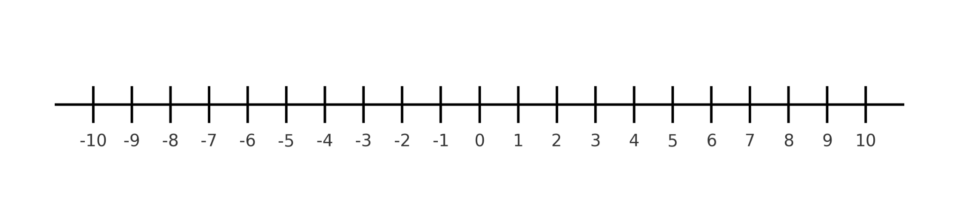
Warm Up - Potato Launch 🥔
Write some solutions to the inequality y ≤ 9.2. Be prepared to explain what makes a value a solution to this inequality.
Write one solution to the inequality 7(3 − x) > 14. Be prepared to explain your reasoning.
Notes:
Warm Up (5 minutes)
This warm up activates what students know about the solutions to an inequality and ways to find the solutions. For the first time, students refer to the solutions as the solution set of the inequality. Throughout their work with one-variable inequalities, students will use the terms “solutions” and “solution set” interchangeably. By now, students are likely to have internalized that a solution to an equation in one variable is a value that makes the equation true. The work here makes it explicit that we can extend this understanding of solutions to inequalities in one variable.
Launch
Display a number line for all to see that looks like that on the screen.
Activity Answers
Your answer may vary, but here are some samples. 9.2, 8, 4.5, –7
Your answer may vary, but here are some samples. 0.5, 0, –1, –6
Activity Synthesis
Invite students to share some solutions to the first inequality and explain what it means for a value to be a solution to y ≤ 9.2. Be sure to mention some negative numbers that are solutions. If necessary, show the solution set on a number line. Then, focus the discussion on the second inequality.
Ask each student to mark the one solution they have for 7(3 − x) > 14 on the class number line (from the launch). (Students could draw a point or put a dot sticker, if available, on the number line.)
Discuss with students:
“How did you know that the value you chose is a solution?”
When substituted for x in the inequality, the value makes a true statement.
“What do you notice about all the points that are on the line?”
They are all to the left side of 1.
“On the number line, we can see that the solutions are values that are less than 1. All these values form the solution set to the inequality. Is there a way to write the solution set concisely, without using the number line and without writing out all the numbers less than 1?”
We can write x<1
“Does the solution set have anything to do with the solution to the equation 7(3−x)=14?”
The solution to the equation is x = 1.
“Why does the solution set to the inequality 7(3−x)>14 involve numbers less than 1?”
The inequality can be taken to say “7 times 3−x is greater than 14.” For the inequality to be true, 3−x must be greater than 2. For 3−x to be greater than 2, x must be less than 1.

Slide 8

Lesson Journey
Warm Up
Learning Activity
Cool Down
Lesson Synthesis
Learning Activity
Learning Activity
Practice

Slide 9




Learning Activity - Number Lines 🔢
Work with a partner to match each of the following inequalities to its correct number line.
x > 2
x ≤ 2
x ≥ 2
x < 2
Notes:
Activity (20 minutes)
Students will work to match inequalities with their graphs. Encourage students to read each inequality aloud and identify some numbers are less than or greater than the number in the inequality.
Launch
Put students into pairs.
Activity Answer
C: x ≥ 2
D: x < 2
A: x > 2
B: x ≤ 2
Activity Synthesis
As a class, facilitate a discussion about the direction of the shaded arrow and the closed vs. open circle.

Slide 10





Self Check
Which number line is represented by the inequality x ≥ − 4?
Let’s review!
Notes:
Answer Feedback - Individualized by Response
Incorrect. Let’s try again a different way: The symbol ≥ is represented by a closed circle. The answer is b.
That’s correct! Check yourself: There is a closed circle on −4. The number line to the right of −4 is highlighted.
Incorrect. Let’s try again a different way: The number line to the right should be highlighted instead of the left. The answer is b.
Incorrect. Let’s try again a different way: The symbol ≥ is represented by a closed circle. The number line to the right should be highlighted instead of the left. The answer is b.

Slide 11
Self Check - Review
For questions 1 - 2 use the following inequality:
x > -3
Write the inequality on a number line.
Write the inequality in interval notation.
For questions 3 and 4 use the following inequality:
x ≤ 5
Write the inequality on a number line.
Write the inequality in interval notation.
Notes:
Remind Students
This activity challenges you to complete a very difficult task!
The more you know about the situation, the closer you are to being able to solve this problem mathematically instead of guessing and checking to see if you are correct.
Answers
Access the online Teacher Guide to see the work for this question.
(-3, ∞)
Access the online Teacher Guide to see the work for this question.
(∞,5]

Slide 12
Lesson Journey
Warm Up
Learning Activity
Cool Down
Lesson Synthesis
Learning Activity
Learning Activity
Practice

Slide 13
Learning Strategies - Apple Orchard 🍎
Look only at the picture and task statement.
Write your own math questions (1–2 minutes).
Share with a partner, focusing on cost comparisons.
Then see the rest of the task.
Co-Craft Questions
Teacher Instruction: Use these strategies to adjust the activity to support english language learners and students with disabilities.
  You can copy and paste the callout directly on top of the activity or give the instructions aloud.
Use a table to organize the information.
Choose input values near 17 to include.
Use the table to support your thinking.
Representation
Notes:
Support for English Language Learners: MLR 5 Co-Craft Questions: Reading, Writing
Use this routine to help students consider the context of this problem and to increase awareness of the language of mathematical comparisons. Ask students to keep their books or devices closed and display only the image and the task statement, without revealing the questions that follow. Give students 1 – 2 minutes to write their own mathematical questions about the situation, and then invite them to share their questions with a partner. Listen for and amplify any questions involving comparing costs. Once students compare their questions, reveal the remainder of the task.
Design Principles: Maximize Meta-awareness, Support Sense-making
Learn more about this routine
View the instructional video and follow along with the materials to assist you with learning this routine.
Provide support for students
Distribute graphic organizers to the students to assist them with participating in this routine.
Support for Students with Disabilities: Representation: Internalize Comprehension
Represent the same information through different modalities by using a table. If students are unsure where to begin, suggest that they use a table to help organize the information provided. Guide students in making decisions about what inputs to include in their table. Be sure that they include 17 and some values directly above and below to support their analysis.
Supports accessibility for: Conceptual processing; Visual-spatial processing

Slide 14

Learning Activity - Apple Orchard 🍎
A teacher is choosing between two options for a class field trip to an orchard. At each orchard, the same price applies to both chaperones and students.
At Orchard A, admission costs $9 per person, and 3 chaperones are required.
At Orchard B, the cost is $10 per person, but only 1 chaperone is required.
Which orchard would be cheaper to visit if the class has 8 students?
Which orchard would be cheaper to visit if the class has 12 students?
Which orchard would be cheaper to visit if the class has 30 students?
Notes:
Support for All Learners
This activity offers additional support and an extension for students:
For english language learners and students with disabilities, be sure to review the Learning Strategies slide!
Activity (20 minutes)
This activity encourages students to interpret an inequality and its solution set in terms of a situation. A context can help students intuit why the solutions to an inequality from a ray on the number line. The activity also prompts students to think about the solutions to an inequality in terms of a related equation. Here, the situation involves choosing between two options. An equation can be written to represent the two options being equal. The solution to that equation can be seen as a tipping point, on either side of which one option would be better.
Launch
Read the first part of the task statement with the class and make sure students understand the given information. Arrange students in groups of 2. For the first set of questions, ask one partner to find the cost of going to Orchard A and the other partner to find the cost of going to Orchard B, and then compare the costs. Before students move on to the second set of questions, pause to hear which option works best for 8, 12, and 30 students.
Answers
Orchard B
Orchard B
Orchard A
More activity questions, answers, anticipated misconceptions, and synthesis on the next slide.

Slide 15

Learning Activity - Apple Orchard 🍎
Use the following information to answer questions 4 – 7.
To help her compare the cost of her two options, the teacher first writes the equation 9(n + 3) = 10(n + 1), and then she writes the inequality 9(n + 3) < 10(n + 1).
What does n represent in each statement?
In this situation, what does the equation 9(n + 3) = 10(n + 1) mean?
What does the solution to the inequality 9(n + 3) < 10(n + 1) tell us?
The teacher needs a visual aid to show the school budgeting committee. Graph the solution set to the inequality on the number line. Be prepared to show or explain your reasoning.
Notes:
Answers
n represents the number of students on the field trip.
9(n + 3) is the cost of going to Orchard A, and 10(n + 1) is the cost of going to Orchard B. The equation represents the two options costing the same amount.
The solution represents the number of students on the field trip at which it would be cheaper to visit Orchard A.
n > 17; Access the online Teacher Guide to see the work for this question
Anticipated Misconceptions
If students struggle to interpret the meaning of the equation 9(n+3)=10(n+1) and of the inequality 9(n+3)<10(n+1), ask them to think about what each side of the equal sign or the inequality symbol represents.
Activity Synthesis
Be sure students understand the inequality in context and that there are different ways to solve it.
Have selected students share their solution strategies in order (from guessing and checking to more structured reasoning). Point out solving a related equation if it doesn’t come up.
Explain that solving 9(n+3)=10(n+1)9(n+3)=10(n+1)9(n+3)=10(n+1) gives a boundary value for nnn. Test numbers above and below this boundary to see when 9(n+3)<10(n+1)9(n+3)<10(n+1)9(n+3)<10(n+1) is true.
If students mention flipping the inequality when multiplying/dividing by a negative, ask them to explain why it works. Emphasize using reasoning we understand, rather than just rules, to avoid mistakes.

Slide 16
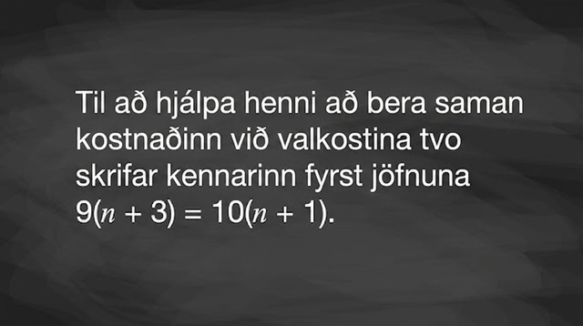
Video: Understanding the Meaning of an Inequality

Slide 17

Self Check
A water park charges $17 per entry plus a $40 fee for raft rentals. An amusement park charges $21 per entry.
For the number of entries, e, which inequality represents the total cost of the water park being less than the total cost of the amusement park?
17e - 40 < 21e
17e + 40 < 21e
17e < 21e + 40
17e + 40 > 21e
Let’s review!
Notes:
Answer Feedback - Individualized by Response
17e - 40 < 21e
Incorrect. Let’s try again in a different way: Should the fee be added or subtracted?
17e + 40 < 21e
That's correct! Check yourself: The water park is represented by 17e+40 and the amusement park by 21e. In this inequality, the water park is less than the total cost of the amusement park.
17e < 21e + 40
Incorrect. Let’s try again in a different way: The $40 fee applies to the water park, not the amusement park.
17e + 40 > 21e
Incorrect. Let’s try again in a different way: This represents the total cost of the water park being greater than the total cost of the amusement park.

Slide 18

Self Check - Review
Imani won a mini-grant of $4,000 to buy tablet computers for her classroom. The tablets she would like to buy cost $254.12 each, including tax and delivery. She can only spend up to the amount of the mini-grant.
Translate this situation into an inequality, then translate the inequality into a mathematical sentence.
Step 1 - Choose a variable to represent the quantity of tablet computers.
Step 2 - Translate: Write a sentence that gives the information provided.
Step 3 - Translate into an inequality.
Notes:
Many real-life situations require us to use inequalities. Translating the details of these situations into inequalities is the first step in understanding them. Let’s look at how we can translate these situations into mathematical sentences.
Choose a variable to represent the quantity of tablet computers:
Let 𝑛= the number of tablets.
Translate: Write a sentence that gives the information provided.
$254.12 times the number of tablets is no more than $4,000.
Translate into an inequality:
254.12𝑛≤4000
Imani’s situation is represented by the inequality 254.12𝑛≤4000.
Additional Example
Taleisha’s phone plan costs her $28.80 a month plus $0.20 per text message. Her monthly bill can be no more than $50.
Choose a variable to represent the quantity of text messages:
Let t = the number of text messages.
Translate: Write a sentence that gives the information provided.
$28.80 plus $0.20 times the number of text messages is less than or equal to $50.
Translate into an inequality:
28.80 + 0.20t ≤ 50
Taleisha’s situation is represented by the inequality 28.80 + 0.20t ≤ 50.

Slide 19
Lesson Journey
Warm Up
Learning Activity
Cool Down
Lesson Synthesis
Learning Activity
Learning Activity
Practice

Slide 20
Learning Activity - One Side at a Time
Use this equation for questions 1 - 2:
- ⅕[4(x + 3)]
Solve this equation. What is the value of x?
Check your solution.
Use the following information to answer questions 3–6. Consider the inequality:
-⅕ [4(x + 3)] ≤ 4x − 12
Choose a couple of values less than 2 for x. Are they solutions to the inequality?
Choose a couple of values greater than 2 for x. Are they solutions to the inequality?
Choose 2 for x. Is it a solution?
Graph the solution to the inequality on the number line.
Are you ready for more?
Notes:
Support for All Learners
This activity offers additional support and an extension for students:
For english language learners and students with disabilities, be sure to review the Learning Strategies slide!
Activity (10 minutes)
The purpose of this activity is to further develop the idea that we can solve an inequality by first solving a related equation. Previously, students reasoned about the solutions to an inequality in context. Here, they transition to solving an inequality without a context. This activity offers another opportunity to point out the trouble with isolating the variable directly on the inequality statement, or with assuming that the solution set can be expressed using the same symbol as in the original inequality.
Launch
N/A
Answers
2
Access the online Teacher Guide to see the work for this question
Values less than 2 are solutions.
Values greater than 2 are solutions.
Yes, 2 is a solution.
Access the online Teacher Guide to see the graph for this question
Activity Synthesis
Display a blank number line for all to see. Ask students to share some values on the number line that are and are not solutions. Use different colors or different symbols to mark on the number line the solutions and non-solutions.
Emphasize that if we solve an inequality by using a related equation, it is important to make sure that the solution to the equation is correct because that solution gives us a boundary from which we could check the solutions to the inequality. If the boundary value is off, we may not be able to correctly find the solution set to the inequality.

Slide 21
Learning Strategies - One Side at a Time
Teacher Instruction: Use these strategies to adjust the activity to support english language learners and students with disabilities.
  You can copy and paste the callout directly on top of the activity or give the instructions aloud.
Test the number on your sticky note (greater than 2 or less than 2).
Place it under “Solution” or “Not a Solution.”
Use the class display to finish the questions.
Engagement
Notes:
Support for English Language Learners: N/A
Support for Students with Disabilities: Engagement: Internalize Self Regulation
Chunk this task into more manageable parts to differentiate the degree of difficulty or complexity. Hand out numbers to test using sticky notes. Assign each student only a single value to test for, being sure to assign half the class values greater than 2, and the other half values less than 2. Label two areas on a display with “Solution” and “Not a Solution.” Once students have calculated whether their number is a solution, invite them to place their sticky note under the appropriate grouping. Invite students to complete the remaining questions using the display of collected data.
Supports accessibility for: Conceptual processing; Visual-spatial processing

Slide 22
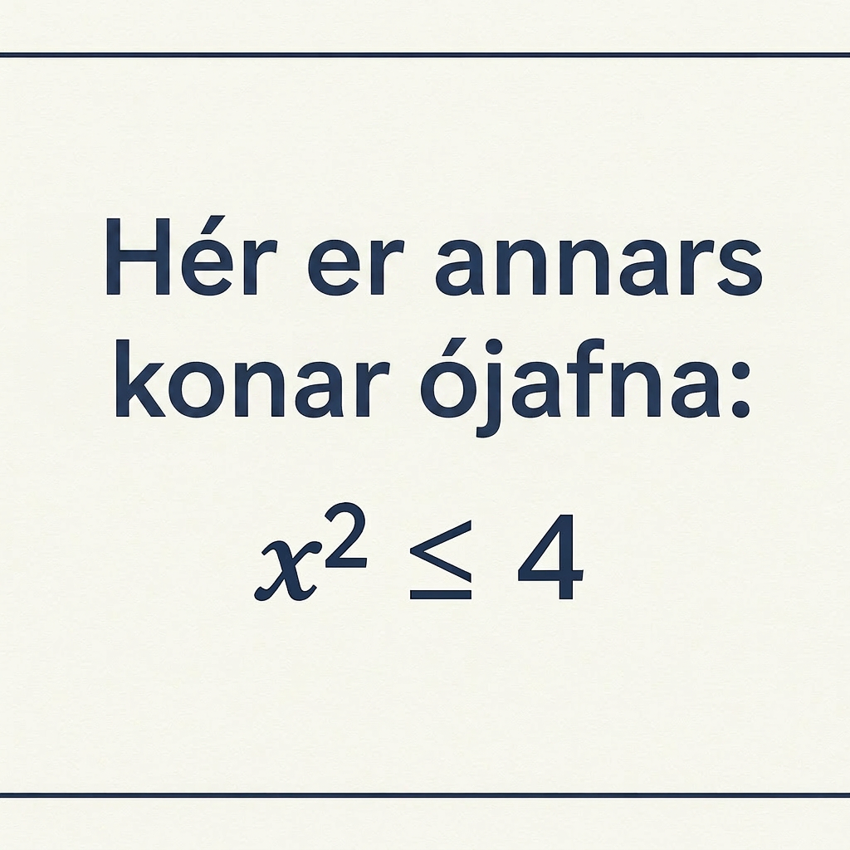
Extending Your Thinking
Which of the following values solve the inequality: 1, 3 or -3?
Describe all solutions to this inequality. (If you like, you can graph the solutions on a number line.)
Describe all solutions to the inequality x² ≥ 9. Test several numbers to make sure your answer is correct.
Notes:
Answer
From the given values, only 1 is a solution of the inequality.
-2 ≤ x ≤ 2
x ≤ −3 or x ≥ 3

Slide 23




Self Check
Which number line represents the solution to the inequality? 12(–2z + 2) ≥ 12
Let’s review!
Notes:
Answer Feedback - Individualized by Response
Incorrect. Let’s try again a different way: What does the open circle mean? The value −11 is also a solution. The answer has a closed circle on the point −11 with the number line to the left shaded.
Incorrect. Let’s try again a different way: The value −10 is not a solution. The answer has a closed circle on the point −11 with the number line to the left shaded.
That's correct! Check yourself: The solution is z≤−11.
Incorrect. Let’s try again a different way: Check your operations when solving the related equation for z. The answer has a closed circle on the point −11 with the number line to the left shaded.

Slide 24
Self Check - Review
Here’s an inequality with one variable on one side of the equation.
2x - 3 < 5
We can solve its related equation.
2x - 3 = 5
2x = 8
x = 4
Now, let’s verify which solutions verify the original inequality.
Step 1 - Verify if the solution itself to the related equation satisfies the original inequality.
Step 2 - Verify if a value greater than the solution to the related equation satisfies the original inequality.
Step 3 - Verify if a value less than the solution to the related equation satisfies the original inequality.
Notes:
We can use related equations to help find solutions to inequalities.
Answer:
Step 1 - Verify if the solution to the related equation satisfies the original inequality.
Does 𝑥=4 satisfy the inequality?
2(4)−3<?5
5<?5
No, 4 is not a solution since it the 5≮5.
Step 2 - Verify if a value greater than the solution to the related equation satisfies the original inequality.
Let’s try a number bigger than 4. For example, try the value of 𝑥=8.
2(8)−3<?5
13<?5
So, 8 does not satisfy the inequality since 13≮5. That means 𝑥is not a value greater than 4.
Step 3 - Verify if a value less than the solution to the related equation satisfies the original inequality.
Let’s try a number smaller than 4, such as 𝑥=0.
2(0)−3<?5
−3<?5
Thus, 0 satisfies the inequality since −3<5. Since 0 is a number less than 4, this means the solution set is 𝑥<4.

Slide 25

Lesson Journey
Warm Up
Learning Activity
Cool Down
Lesson Synthesis
Learning Activity
Learning Activity
Practice

Slide 26
Cool Down
Which graph correctly shows the solution to the inequality ⅑(7x - 3) ≥ 8 − 2x? Show or explain your reasoning.
Notes:
Cool Down (5 minutes)
Answers
Your answers may vary, but here are some samples. Graph C.
I tested 2, 3, and 4 for the values of x, and 3 and 4 make the inequality true.
I solved a related equation and then tested a couple of values on either side of the solution.
Response to Student Thinking - More Chances
Students will have more opportunities to understand the mathematical ideas in this cool-down, so there is no need to slow down or add additional work to the next lessons. Instead, use the results of this cool-down to provide guidance for what to look for and emphasize over the next several lessons to support students in advancing their current understanding. A later activity offers another opportunity to discuss determining if a solution set is greater than or less than a boundary value.

Slide 27

Lesson Journey
Warm Up
Learning Activity
Cool Down
Lesson Synthesis
Learning Activity
Learning Activity
Practice

Slide 28

Practice
Put your hard work to action, practice what you’ve learned!
Notes:
Digital Practice: Access the practice pages at https://openstax.org/details/books/algebra-1

Slide 29

Lesson Journey
Warm Up
Learning Activity
Cool Down
Lesson Synthesis
Learning Activity
Learning Activity
Practice

Slide 30
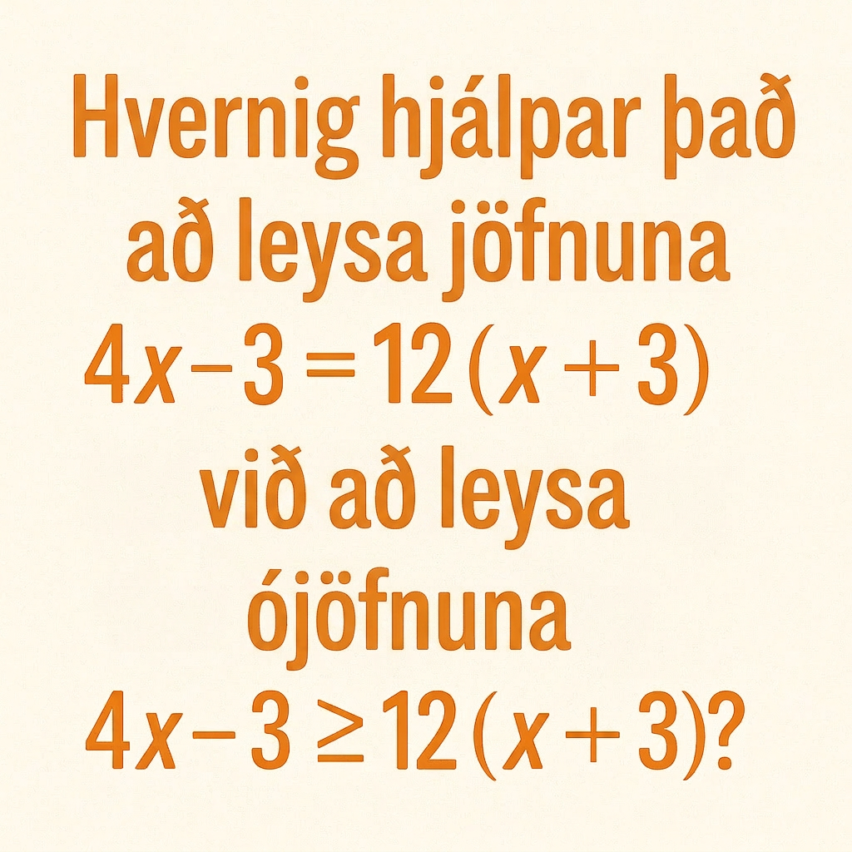
Lesson Synthesis
Explain in your own words and in writing.
Notes:
Prompt: Ask students to explain in their own words and in writing. If time permits, ask students to share their response with a partner, and then invite a student or two to share with the class a particularly clear explanation their partner has written.
Answers:
Answers may vary.

Slide 31
Self Assessment
How much do you agree with the following statements?
I can… | I can | Almost | Not yet
Graph the solution to an inequality in one variable.
Solve one-variable inequalities.
Interpret the solutions to one-variable inequalities in terms of the situation.

