Slide 1


Algebra 1
Unit 1 Linear Equations
Lesson 1.12: Writing the Equation of a Line

Slide 2
How to use these slides
On the activity slides check the speaker notes for teacher support and instructional information.
Each lesson includes 1 warm up, 2-3 learning activities, a cool down, practice and a lesson synthesis.
  Learning activities are followed by a self check question, and review section.
Some slides have been hidden from student view, more information can be found on the next slide (Reference Key).
You can edit and use these slides for personal and classroom use, but cannot sell them and must keep the attribution logos.
For more information, Check out the digital quick start guide!

Slide 3






Reference Key
Check the top right corner for an icon referencing these unique sections.
 | Support for Students with Disability | Hidden | Learning Strategies slide, provides additional support to students for understanding the activity. Learning Strategies slide, provides additional support to students for understanding the activity.
 | Support for English Language Learners | Hidden
 | Extending Your Thinking | Hidden | Extending Your Thinking slide, provides an extra challenge for students.
 | Self Check | Not Hidden | Self Check slide, checkpoint to assess student understanding after the learning activity.
 | Review | Hidden | Self Check- Review slide, designed to help review topics from the self check question.
On the next slides, check the speaker notes for teacher instructions and support.

Slide 4

Learning Goals
By the end of this lesson you will be able to -
Write an equation of the line given the slope and y-intercept.
Write an equation of the line given the slope and a point.
Write an equation of the line given two points.
Notes:
Lesson Narrative
This lesson reviews how to find slope using the slope formula and prepares students to write equations of lines. They’ll start by finding slope from two points, then use that to write equations in different forms. Students will write equations when given: (1) The slope and y-intercept, (2) The slope and a point, and (3) Two points.
They’ll practice substituting into formulas and solving. Graphs can help students see how slope and y-intercept affect the line. Encourage students to show their work and check their answers by sharing with a partner or using a graphing tool like Desmos.
Required Preparation
None
Required Materials
Slips to print out Unit 1_Lesson 12.5_Slips_resource
Graphing calculator or Desmos
Texas Essential Knowledge and Skills
A1(F) analyze mathematical relationships to connect and communicate mathematical ideas
A2(B) write linear equations in two variables in various forms, including y = mx + b, Ax + By = C, and y − y₁= m(x − x₁), given one point and the slope and given two points

Slide 5
Vocabulary
Previous
Slope
  The change in two dependent values of a linear function divided by the change in the corresponding two independent values (rise over run).
y-intercept
  The point of the graph the 𝑥-value is 0. This is where the graph of the function crosses the 𝑦 axis. (0, 𝑦)
Slope-intercept form (of a linear equation)
  𝑦 = 𝑚𝑥 + 𝑏 where 𝑚 is the slope of the line and 𝑏 is the 𝑦-intercept.
New
Point-slope form (of a linear equation)
  The equation of a line with slope 𝑚 and containing the point (𝑥₁, 𝑦₁) when in the form: (𝑦 − 𝑦₁) = 𝑚(𝑥 − 𝑥₁).
Notes:
Lesson Vocabulary
To support student understanding of key vocabulary:
Introduce and review the vocabulary words students will see in this lesson.
Encourage students to notice how these words are used and to include them in their math discussions and explanations—both written and oral.
Use a word wall to reinforce vocabulary. Sample word wall cards are available here.
For newcomers or students with beginning English proficiency, use these Quizlet sets to support vocabulary learning:
Unit 1 Spanish Vocabulary – use first to build understanding
Unit 1 Vocabulary (English) – use after anchoring in Spanish
Support for English Language Learners
ELPS 2(F) listen to and derive meaning from a variety of media such as audio tape, video, DVD, and CD ROM to build and reinforce concept and language attainment
ELPS 2(I) demonstrate listening comprehension of increasingly complex spoken English by following directions, retelling or summarizing spoken messages, responding to questions and requests, collaborating with peers, and taking notes commensurate with content and grade-level needs
ELPS 3(E) share information in cooperative learning interactions
ELPS 3(I) adapt spoken language appropriately for formal and informal purposes

Slide 6





Lesson Journey
Warm Up
Learning Activity
Cool Down
Lesson Synthesis
Learning Activity
Learning Activity
Practice

Slide 7

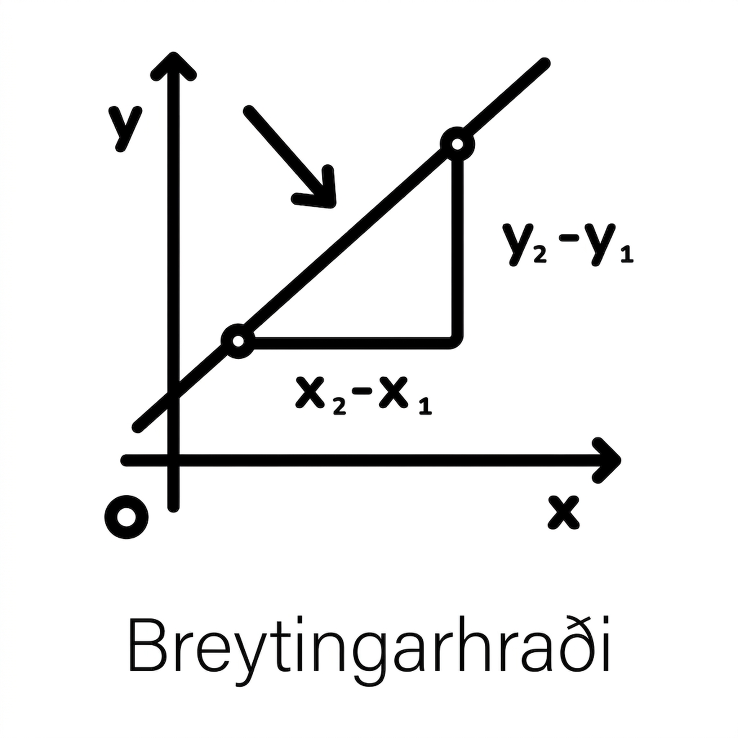
Warm Up - Finding m
Use the slope formula, m = (y₂ − y₁)/(x₂ − x₁), to find the slope of the line through the given points.
(1, −2) and (3, 4)
(−2,−3) and (−7, 4)
Notes:
Warm Up (5 minutes)
The purpose of this warm up is to help students recall finding the slope of a line. Remind students that slope is the ratio of the change in y and the change in x. Substituting is an important skill in writing equations.
Launch
Arrange students in groups of 2. Encourage students to write out each step and to use parentheses, especially when working with negative numbers.
Activity Answers
m = 3
First, name (1, −2) as point 1(x₁, y₁) and (3, 4) as point 2 (x₂, y₂).
Use the slope formula. m = (y₂ − y₁)/(x₂ − x₁). Substitute the values: y₂ = 4, y₁ = −2, x₂ = 3, x₁ = 1.
m = (4 − (−2)/(3 − 1)
Simplify. m = 6/2; m = 3
m = −(7/5)
First, name (−2, −3) as point 1(x₁, y₁) and (−7, 4) as point 2 (x₂, y₂).
Use the slope formula. m = (y₂ − y₁)/(x₂ − x₁). Substitute the values: y₂ = 4, y₁ = −3, x₂ = −7, x₁ = −2.
m = (4 − (−3)/(−7 − (−2))
Simplify. m = 7/−5; m = −(7/5)
Anticipated Misconceptions
Some students may be confused by the subscripts. Point out that the notation helps make sure that you are matching the correct x-value with the corresponding y-value. Demonstrate that you can name either point as (x₁, y₁) by having students find the slope by naming (−7, 4) as (x₁, y₁) and (−2, −3) as (x₂, y₂).
Activity Synthesis
Ask students to share their methods for finding the slope. Discuss with students, ASK:
“How do you decide which point to use for (x₁, y₁) and (x₂, y₂)?” (Your answer may vary, but here is a sample. I substituted the first coordinate pair as (x₁, y₁).)
“Does it matter which point you choose for (x₁, y₁) and (x₂, y₂)?” (No.)
“How can you make sure you use the correct corresponding x for each y?” (Your answer may vary, but here is a sample: Always start with the y in the second point, so start with x in the second point).

Slide 8

Lesson Journey
Warm Up
Learning Activity
Cool Down
Lesson Synthesis
Learning Activity
Learning Activity
Practice

Slide 9
Learning Activity - Slope-Intercept Form
Recall that the slope-intercept form of the equation of a line is y = mx + b, where m is the slope and b is the y-intercept. The y-intercept is the point where the graph crosses the y-axis. For y-intercept b, the coordinates of the point are (0, b). In the following activity, you will complete a series of questions regarding this information.
For questions 1 – 3, determine the slope, m, and the y-intercept, b.
y = 2x + 5
y = −3x + 2
y = −15x − 1
Notes:
Support for All Learners -
This activity offers an extension for students:
For students looking for an extra challenge, be sure to review the Extending Your Thinking slide!
Activity (10 minutes)
We can determine the slope and intercept of a line if the equation is written in slope-intercept form, y = mx + b, where m is the slope and b is the y-intercept. Now we will do the reverse—we will start with the slope and y-intercept and use them to write the equation of the line.
Launch
Students found the slope of a line using the formula. Use a graph to demonstrate that the slope of the line is the ratio of rise over run, change in y over change in x. ASK:
How can you identify the y-intercept from a graph? (It is the point where the line crosses the y-axis.)
What is the value of x where the line crosses the y-axis? (0)
Decide if students should complete the activity on their own notebook paper or using Desmos. As students work on the questions, allow them to use a graphing calculator or Desmos to check their answers. This helps students develop a connection between the equation of a line and the features of its graph.
*If using Desmos - Desmos Activity: OpenStax Alg1 – 1.12.2 Writing an Equation Given the Slope and y-intercept
Use the Teacher Dashboard to monitor screens 1–3.
Screen 4: Students match equations to slopes and y-intercepts.
Screen 5: Students write an equation, then optionally share and compare with the class.
Screen 6: Students write an equation and explain their thinking. Hold short class discussions after Screens 5 and 6 to help students connect equations and graphs.
Tip: Desmos activities are interactive and guide students step by step. Use the dashboard to monitor responses and spark whole-class discussion. You can also have students work in pairs.
*Access the Desmos guide PDF to learn more about accessing and customizing activities.
Activity answers and synthesis on the next slide.

Slide 10
Learning Activity - Slope-Intercept Form
For questions 4 – 7, match the correct slope and y-intercept to the given equations (A, B, C, or D)
What is the correct slope and y-intercept of y = −2x + 3?
What is the correct slope and y-intercept of y = 3x − 2?
What is the correct slope and y-intercept of y =2x − 3?
What is the correct slope and y-intercept of y = −12x − 3?
Slope: −12, y-intercept: −3
Slope: 2, y-intercept: −3
Slope: −2, y-intercept: 3
Slope: 3, y-intercept: −2
Are you ready for more?
Notes:
Answers
m = 2; b = 5
m = −3; b = 2
m = −15; b = −1
C. slope: −2, y-intercept: 3
D. slope: 3, y-intercept: −2
B. slope: 2, y-intercept: −3
A. slope: −12, y-intercept: −3
Activity Synthesis
The slope-intercept form is y = mx + b, where m is the slope and b is the y-intercept. Students may think all four letters are variables; remind them that m and b are numbers that get substituted into the equation. Clarify that the y-intercept is where the graph crosses the y-axis, which always happens when x = 0. For example, if the y-intercept is 2, it really means the y-intercept is (0, 2), and the equation would be y = mx + 2.
To build understanding, have students:
Write equations with the same slope and different y-intercepts (e.g., y = 2x + 4; y = 2x − 1; y = 2x + 3)
Then, write equations with different slopes and the same y-intercept (e.g., y = 4x + 5; y = 2x + 5; y = −1x + 5)
This helps them see how slope and y-intercept each affect the graph.

Slide 11
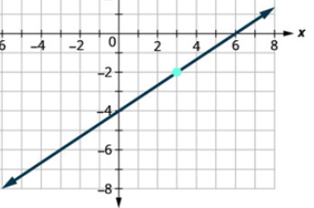
Extending Your Thinking
We can find the slope and y-intercept from an equation in the form y = mx + b. Now we’ll do the reverse: use the slope and y-intercept to write the equation.
Example 1
Find the equation of a line with slope −1 and y-intercept (0,−3).
Step 1 - Name the slope.
Step 2 - Name the y-intercept.
Step 3 - Substitute the values into y = mx + b.
Example 2
Find the equation of the line shown in the graph.
Step 1 - Find the slope by counting the rise and run.
Step 2 - Find the y-intercept
Step 3 - Substitute the values into y = mx + b.
Notes:
Answers
Example 1
Step 1 - m = −1
Step 2 - b = −3
Step 3 - y = −1x + −3; y = −x −3
Example 2
Step 1 - m = rise/run; From (0, −4) to (3, −2), the slope is m = 2/3.
Step 2 - b = −3
Step 3 - y = −1x + −3; y = −x −3

Slide 12

Self Check
Write the equation of a line in slope-intercept form with the slope of −3/4 and a y-intercept of −2.
y = −3/4x + 2 | y = −3/4x − 2
3x + 4y = −8 | y = 3/4x − 2
Let’s review!
Notes:
Answers and Feedback
y = −3/4x + 2
Incorrect. The slope-intercept form of the equation of a line is y = mx + b. Be careful with the signs during substitution. The answer is y = −3/4x − 2.
3x + 4y = −8
Incorrect. Make sure to use the correct form. This is standard form, not slope-intercept form. The answer y = −3/4x − 2.
y = −3/4x − 2
That’s correct! The slope-intercept form is y = mx + b. The slope is m = −3/4, and the y-intercept is b = −2, so this is the correct equation.
y = 3/4x − 2
Incorrect. The slope-intercept form for the equation of a line is y = mx + b. Be careful with the signs during substitution. The answer is y = −3/4x − 2.

Slide 13
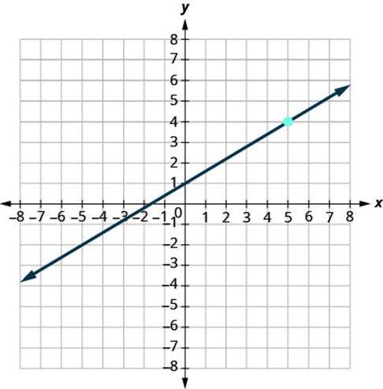
Self Check - Review
Write the equation of the line graphed in slope-intercept form.
Notes:
Answer:
Here is how to write the equation of the line in slope-intercept form:
Step 1 - Find the slope by counting the rise and run.
m = rise/run
From (0,1) to (5,4), the slope is m = 3/5.
Step 2 - Find the y-intercept.
y-intercept (0, 1)
b = 1
Step 3 - Substitute the values into y = mx + b.
y = mx + b
y = 3/5x + 1.

Slide 14
Lesson Journey
Warm Up
Learning Activity
Cool Down
Lesson Synthesis
Learning Activity
Learning Activity
Practice

Slide 15
Learning Activity - Point-Slope Form
What if the point you are given isn’t a y-intercept? Point-slope is a great form to use when you are given the slope and any point. First, work to derive the point-slope formula by completing the following steps:
Start with the slope formula as: m = (y – y₁)/(x – x₁)
Step 1 - Multiply both sides of the equation by x – x₁.
Step 2 - Simplify.
Step 3 - Rewrite the equation with the y terms on the left.
Notes:
Support for All Learners -
This activity offers an extension for students:
For students looking for an extra challenge, be sure to review the Extending Your Thinking slide!
Activity (18 minutes)
Students wrote the equation of a line in slope-intercept form given the slope and the y-intercept. In this lesson, students will find the equation of a line given the slope and a point that is not the y-intercept. Point-slope form is new to students. Deriving the formula from the formula for slope can help students see that there is a connection to the slope, which they already know how to find. Allow students to use a graphing calculator or Desmos where appropriate to check their answers. Point out to students that most graphing calculators require the equations to be in slope-intercept form to graph them.
Launch
Have students work in pairs. When deriving the formula, watch that students do not distribute m to the x-variables. While students are working, check to see that they are substituting the correct values into the equation. Remind students they can graph a line given a point and the slope by plotting the given point and using the rise over run to find another point. Remind them the rise is the change in y and the run is the change in x. For example, a slope of 3 can be written as 31: the rise is 3, and the run is 1.
Answers
Step 1 - m(x − x₁) = [(y − y₁)/(x − x₁)] ᐧ (x − x₁)
Step 2 - m(x − x₁) = y − y₁
Step 3 - y − y₁ = m(x − x₁)
Activity answers and synthesis on the next slide.

Slide 16
Learning Activity - Point-Slope Form
With a partner, find the equation of the line in point-slope form that goes through the point (3, 4) and has a slope of 2 by answering the following questions.
Use the point and slope to graph the line on a coordinate plane.
Write the equation for point-slope form. Name the point (x₁, y₁) and the slope, m.
Substitute the point and slope into the point-slope form.
With your partner, each solve for y to write the equation in slope-intercept form. Compare your answers for any possible errors. Graph the line on a coordinate plane using a graphing calculator or Desmos to check your answer.
Convert slope-intercept form to standard form.
Are you ready for more?
Notes:
Answers
The graph should show the equation y = 2x – 2 and go through the points (0, –2) and (3, 4).
y − y₁ = m(x − x₁)
x₁ = 3, y₁ = 4, m = 2
y − 4 = 2(x − 3)
y = 2x – 2
2x − y = 2
Activity Synthesis
Students may get a little confused because x and y appear twice in the formula. Point out that the x and y with the subscript indicate the x and y values that are given to you. The x and y with the subscript are replaced by the known values in the given point. Point out to students that writing the equation in the slope-intercept form allows them to graph the equation using a graphing calculator.

Slide 17
Extending Your Thinking
Use slope-intercept form when you know the slope and y-intercept of a line. If you're given the slope and a point that's not the y-intercept, use point-slope form instead.
y − y₁ = m(x − x₁)
This form helps you write the equation of a line when you know the slope (m) and a point (x₁, y₁) on the line.
Example: Write the equation of a line with slope m = −1/3 that contains point (6, −4). Write the equation in slope-intercept form and standard form.
Step 1 - Identify the slope. | Step 2 - Identify the point. | Step 3 - Substitute the values into the point-slope form, y − y₁ = m(x − x₁). Simplify.
Step 4 - Write the equation in slope-intercept form. |  | Step 5 - Convert slope-intercept form to standard form.
Notes:
Answers
Step 1 - Identify the slope. The slope is given. m = 1/3
Step 2 - Identify the point. The point is given. (x₁, y₁) → (6,−4)
Step 3 - Substitute the values into the point-slope form, y − y₁ = m(x − x₁). Simplify.
y − y₁ = m(x − x₁)
y − (−4) = 1/3(x − 6)
y + 4 = 1/3x + 2
Step 4 - Write the equation in slope-intercept form. y = 1/3x − 2
Step 5 - Convert slope-intercept form to standard form.
y = 1/3x − 2
3y = 3⅓x − (3)2
3y = x − 6
−x + 3y = −6
(−1)(−x + 3y = −6)
x − 3y = 6

Slide 18
Self Check
Which equation represents the slope-intercept form of the equation of a line with slope m = −3/4 that contains the point (4, −7)?
y = −3/4x − 4 | y = −3/4x − 11
y = −3/4x − 5/4 | y = −3/4x + 10
Let’s review!
Notes:
Answers and Feedback
y = −3/4x − 4
That’s correct! Substitute −3/4 for m, 4 for x₁, and −7 for y₁ in the point-slope form: y − y₁ = m(x − x₁). Simplify the equation y − (−7) = −3/4(x − 4) to get y + 7 = −3/4x + 3.
y = −3/4x − 5/4
Incorrect. Remember the x-coordinate is the first coordinate and the y-coordinate is the second coordinate. Substitute −3/4 for m, 4 for x₁, and −7 for y₁ in the point-slope form: y − y₁ = m(x − x₁). Simplify the equation y − (−7) = −3/4(x − 4) to get y + 7 = −3/4x + 3. The answer is y = −3/4x − 4.
y = −3/4x − 11
Incorrect. Substitute −3/4 for m, 4 for x₁, and −7 for y₁ in the point-slope form: y − y₁ = m(x − x₁). Simplify the equation y − (−7) = −3/4(x − 4). Be careful when using the distributive property to multiply −3/4 by x and by 4. The equation simplifies to y + 7 = −3/4x + 3. The answer is y = −3/4x − 4.
y = −3/4x + 10
Incorrect. Substitute −3/4 for m, 4 for x₁, and −7 for y₁ in the point-slope form: y − y₁ = m(x − x₁). Simplify the equation y − (−7) = −3/4(x − 4). Watch the signs when simplifying. The equation simplifies to y + 7 = −3/4x + 3. The answer is y = −3/4x − 4.

Slide 19
Self Check - Review
Write the equation of a line with slope m = −2/5 that contains the point (10, −5). Write the equation in slope-intercept form.
Notes:
Answer:
Here is how to write the equation of a line with a point and slope using a general strategy.
Step 1 - Identify the slope.
m = −2/5
Step 2 - Identify the point. (x₁, y₁) → (10, −5)
Step 3 - Substitute the values into the point-slope form, y − y₁ = m(x − x₁). Simplify.
y − y₁ = m(x − x₁)
y − (−5) = −2/5(x − 10)
y + 5 = −2/5x + 4
Step 4 - Write the equation in slope-intercept form.
y = −2/5x − 1

Slide 20
Lesson Journey
Warm Up
Learning Activity
Cool Down
Lesson Synthesis
Learning Activity
Learning Activity
Practice

Slide 21

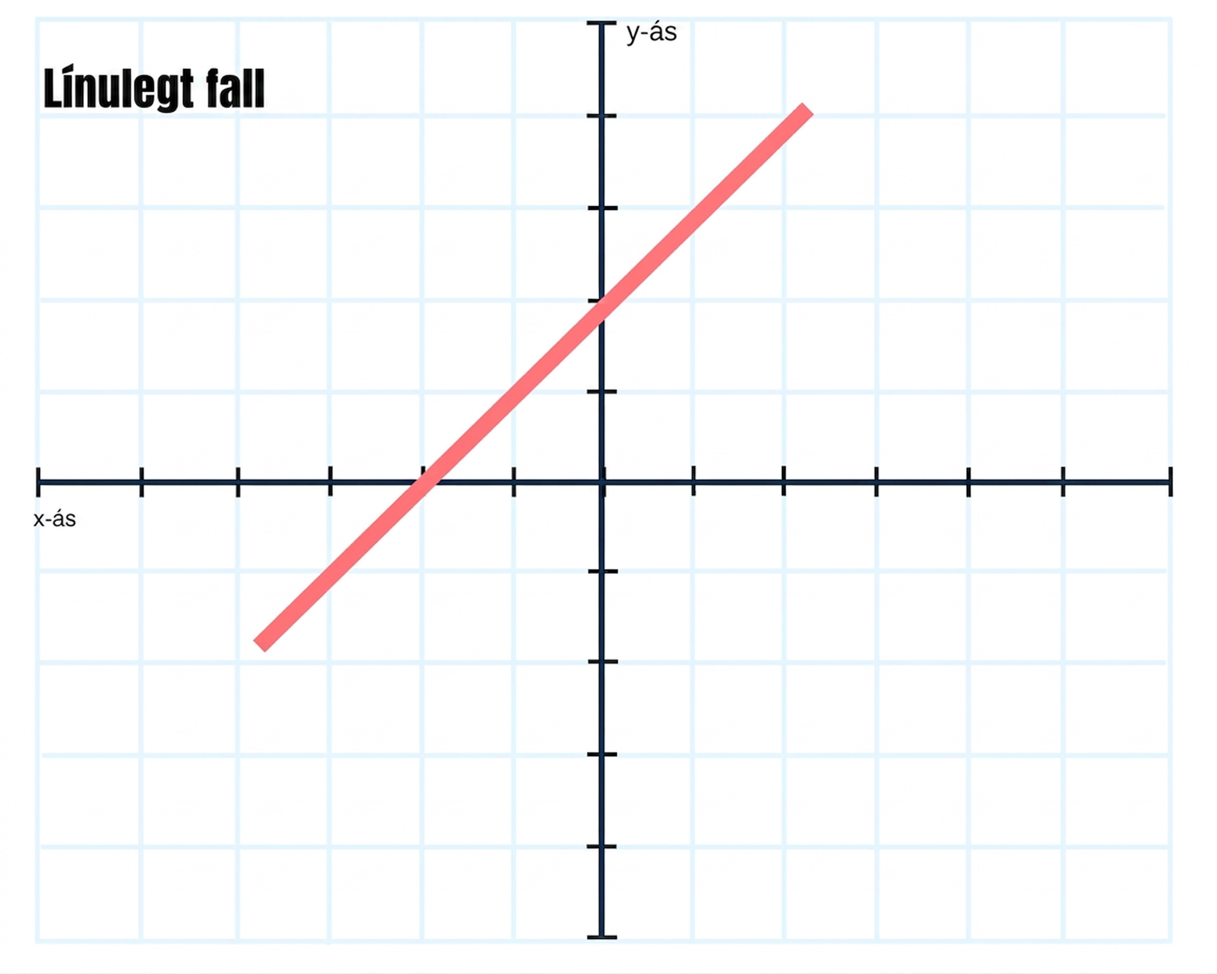
Learning Activity - 3 Different Forms
Work with a partner to answer 1 - 3.
What is the slope-intercept form of a linear equation?
What is the point-slope form of a linear equation?
What is the standard form of a linear equation?
Notes:
Support for All Learners -
This activity offers an extension for students:
For students looking for an extra challenge, be sure to review the Extending Your Thinking slide!
Activity (10 minutes)
Earlier in the lesson, students wrote equations in slope-intercept form and point-slope form. This activity will give students an opportunity to work on manipulating the different forms of linear equations to create equivalent equations. They will manipulate equations to write them in slope-intercept, point-slope, and standard forms.
Launch
Divide students in pairs to work. This activity will give students an opportunity to work on manipulating the different forms of linear equations to create equivalent equations
Activity answers and synthesis on the next slide.

Slide 22
Learning Activity - 3 Different Forms
Linear equations can be written in the different forms to create linear equations. Use the linear equation forms from 1 - 3 to help you complete the rest of the activity.
*Remember to show all of your work on your paper and to use inverse operations to move terms to different sides of the equation.
For 4 - 5, use the equation y−4=3(x+1).
Write the equation in slope-intercept form.
Write the equation in standard form.
Write 4x−6y=12 in slope-intercept form.
Are you ready for more?
Notes:
Answers
y = mx + b
y − y₁ = m(x − x₁)
Ax + By = C
y = 3x + 7
3x − y = −7
y = 4/6x − 2 or y = 2/3x − 2
Activity Synthesis
After students have time to discuss 1 - 3 with a partner, bring the class together to share the three forms and write them on the board. Ask for volunteers to explain what each variable stands for in the forms.
Allow students to work independently on 4 - 6, then come together as partners to check each other’s work and discuss how they wrote the equations in the different forms. Encourage students to discuss any mistakes they made. Ask for volunteers to share to the class what they will watch out for next time (such as changing signs, properly using inverse operations, balancing equations, and making sure standard form does not lead with a negative).
If time allows, encourage students to each make up an equation in one form and ask their partners to write their equation in a different form. Students can then switch partners and exchange another equation with another partner and repeat. This can continue as time allows.

Slide 23
Extending Your Thinking
The steps for writing percent equations are the same—just convert the percent to a decimal first.
The label on Audrey’s yogurt said that one serving provided 12 grams of protein, which is 24% of the recommended daily amount. What is the total recommended daily amount of protein?
Step 1 – Read the problem.
Step 2 – Identify the variables and known values (sketch a picture if needed).
Step 3 – Write a sentence using the relationship among the values.
Step 4 – Translate the sentence into an equation.
Notes:
Answers
The label on Audrey's yogurt said that one serving provided 12 grams of protein, which is 24% of the recommended daily amount. What is the total recommended daily amount of protein?
1 serving = 12 grams of protein; 1 serving is 24% of recommended daily amount; Let a = total amount of protein (in grams).
12 grams is 24% of the total amount
12 = 0.24a

Slide 24
Self Check
Which of the following is equivalent to y = 4x + 5 in standard form?
x = 4y + 5
−4x + y = 5
4x − y = −5
y − 4x = 5
Let’s review!
Notes:
Answer Feedback - Individualized by Response
x = 4y + 5
Incorrect. Bring the x term over with the y term. The answer is: 4x − y = −5.
−4x + y = 5
Incorrect. The leading term can not be negative. Divide each term on both sides by −1. The answer is: 4x − y = −5.
4x − y = −5
That’s correct! Subtract 4x from both sides then divide by –1 so that you are not leading with a negative. The equation is in the form Ax + By = C.
y − 4x = 5
Incorrect. After subtracting 4x from both sides, write the equation in Ax + By = C form and make sure to divide by a −1 so as not to lead by a negative. The answer is: 4x − y = −5.

Slide 25
Self Check - Review
Write the equation 3x + 8y = 24 in slope-intercept form.
Notes:
Answer
Compare your answer: y = −3x/8 + 3
3x − 3x + 8y = 24 − 3x
8y = 24 − 3x
8y/8 = 24/8 − 3x/8
y = −3x/8 + 3

Slide 26

Lesson Journey
Warm Up
Learning Activity
Cool Down
Lesson Synthesis
Learning Activity
Learning Activity
Practice

Slide 27
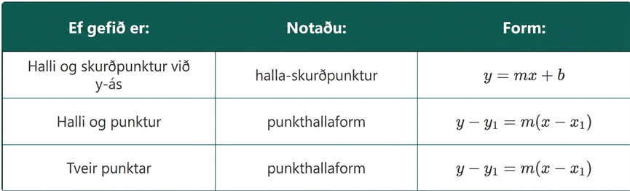
Cool Down
You have seen that you can use either the slope-intercept form or the point-slope form to find an equation of a line. Which form you use will depend on the information you are given. As you complete the activity, use the table as a reference.
Notes:
Cool Down (5 minutes)
In this activity, students examine the point-slope form of a line.
Students work in groups of 2. Each group is given 8 slips of paper. Two of the slips have a pair of points listed. Each partner takes one of the Points slips.
The rest of the slips have equations, written in point-slope form.
The goal for students is to find which of the equations represent an equation of a line that goes through the points on their slip. There are 2 equations that do not match either of the given points.
Make a copy of the Points/Equation Activity slips paper, one for each group. Cut out each sheet into 8 slips. Distribute the set of 8 slips to each group. Students start by each partner choosing one of the two Points slips in the set. They can set the Equation slips aside for the second part of the activity. You may want to start with a brief review of the forms of equations and when to use them.
At the end of the activity, ASK: Is identifying the slope enough to match your set of points to an equation? (No, the slope is not enough to identify the equation, because lines with the same slope can go through different points.)
Answers
Your answer may vary, but here is a sample.
Use the point-slope form to find the line y − y1 = m(x − x1) given the two points on your slip.
Points (3,4) and (6,2)
y − y₁ = m(x − x₁)
y − (4) = m(x − (3))
(6) − 4 = m((2) − 3)
2 = m(−1)
2 = –m
m = −2
Compare your answers.
Points: (3, 4) and (6, 2)
y − 2 = −2/3(x − 6)
y − 4 = −2/3(x − 3)

Slide 28

Lesson Journey
Warm Up
Learning Activity
Cool Down
Lesson Synthesis
Learning Activity
Learning Activity
Practice

Slide 29

Practice
Put your hard work to action, practice what you’ve learned!
Notes:
Access the practice pages at https://openstax.org/details/books/algebra-1

Slide 30

Lesson Journey
Warm Up
Learning Activity
Cool Down
Lesson Synthesis
Learning Activity
Learning Activity
Practice

Slide 31
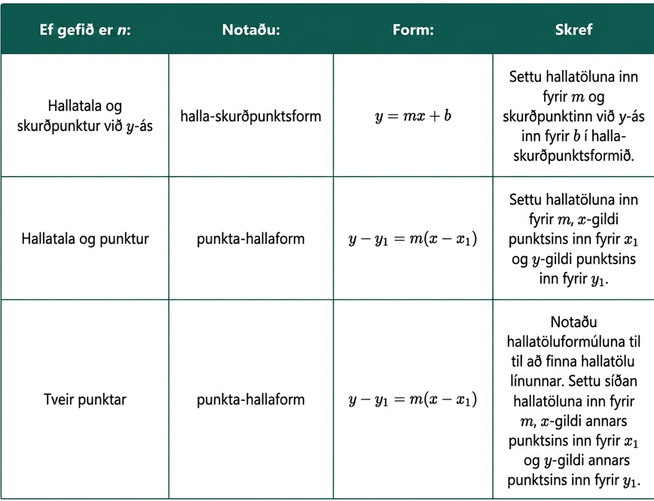
Lesson Synthesis
The focus of the lesson is methods for writing equations of a line. The method you use is based on the information you are given.
The table can be used as a reference to write the equation of a line, based on the information given.
Notes:
Prompt: After completing the Lesson Synthesis, wrap up the class by directing students to the Lesson Summary in their student textbook. In this section, students review the day’s learning targets, read summaries about the key takeaways from each activity, and then respond to a reflection question regarding their confidence with the material.
For more on the benefits of using this type of metacognitive reflection, see the Research in Practice section of the course.

Slide 32
Self Assessment
How much do you agree with the following statements?
I can… | I can | Almost | Not yet
Write an equation of the line given the slope and 𝑦-intercept.
Write an equation of the line given the slope and a point.
Write an equation of the line given two points.

