Slide 1


Algebra 1
Unit 3 Two Variable Statistics
Lesson 3.5 Using the Correlation Coefficient

Slide 2
How to use these slides
On the activity slides check the speaker notes for teacher support and instructional information.
Each lesson includes 1 warm up, 2-3 learning activities, a cool down, practice and a lesson synthesis.
  Learning activities are followed by a self check question, and review section.
Some slides have been hidden from student view, more information can be found on the next slide (Reference Key).
You can edit and use these slides for personal and classroom use, but cannot sell them and must keep the attribution logos.
For more information, Check out the digital quick start guide!

Slide 3






Reference Key
Check the top right corner for an icon referencing these unique sections.
 | Support for Students with Disability | Hidden | Learning Strategies slide, provides additional support to students for understanding the activity. Learning Strategies slide, provides additional support to students for understanding the activity.
 | Support for English Language Learners | Hidden
 | Extending Your Thinking | Hidden | Extending Your Thinking slide, provides an extra challenge for students.
 | Self Check | Not Hidden | Self Check slide, checkpoint to assess student understanding after the learning activity.
 | Review | Hidden | Self Check- Review slide, designed to help review topics from the self check question.
On the next slides, check the speaker notes for teacher instructions and support.
Notes:
Check the Speaker Notes: On the next slides you can find discussion questions, lesson information, answers to the activities, and ways to adjust the activity for your students!

Slide 4

Learning Goals
By the end of this lesson you will be able to -
Describe the strength of a relationship between two variables.
Use technology to find the correlation coefficient and explain what the value tells you about a linear model in everyday language.
Notes:
Lesson Narrative
In this lesson, students will compute (using technology) and interpret the correlation coefficient for a bivariate, numerical data set. The work of this lesson connects to previous work because students learned how to read and interpret the correlation coefficient.
When students use the value of the correlation coefficient to describe the relationship between two variables, they are looking for and making use of structure.
When students examine relationships to think about correlations, they also consider additional variables that might have an influence on any trends they see.
Deciding which variables need to be included is a part of the process of modeling with mathematics.
Required Preparation
Students should have access to graphing technology that can compute the least-squares regression line and correlation coefficient from a set of bivariate data. Acquire devices that can run Desmos (recommended) or other graphing technology. It is ideal if each student has their own device.
Required Materials
Graphing technology
Texas Essential Knowledge and Skills
A1(A) apply mathematics to problems arising in everyday life, society, and the workplace.
A1(C) select tools, including real objects, manipulatives, paper and pencil, and technology as appropriate, and techniques, including mental math, estimation, and number sense as appropriate, to solve problems.
A1(F) analyze mathematical relationships to connect and communicate mathematical ideas
A4(A) calculate, using technology, the correlation coefficient between two quantitative variables and interpret this quantity as a measure of the strength of the linear association.
A4(C) write, with and without technology, linear functions that provide a reasonable fit to data to estimate solutions and make predictions for real-world problems.

Slide 5
Vocabulary
Previous
Correlation coefficient
  Describes the strength and direction of a linear association between two numerical variables.
New
Negative relationship
  An increase in one variable tends to be paired with a decrease in the other variable.
Positive relationship
  An increase in one variable tends to be paired with a increase in the other variable.
Strong relationship
  A relationship between two numerical variables where data is tightly clustered about the best fit line.
Weak relationship
  A relationship between two numerical variables where data is loosely spread around the best fit line.
Notes:
Lesson Vocabulary
To support student understanding of key vocabulary:
Introduce and review the vocabulary words students will see in this lesson.
Encourage students to notice how these words are used and to include them in their math discussions and explanations—both written and oral.
Use a word wall to reinforce vocabulary. Sample word wall cards are available here.
For newcomers or students with beginning English proficiency, use these Quizlet sets to support vocabulary learning:
Unit 3 Spanish Vocabulary – use first to build understanding
Unit 3 Vocabulary (English) – use after anchoring in Spanish
Support for English Language Learners
ELPS 1(E) internalize new basic and academic language by using and reusing it in meaningful ways in speaking and writing activities that build concept and language attainment
ELPS 1(F) use accessible language and learn new and essential language in the process
ELPS 2(F) listen to and derive meaning from a variety of media such as audiotape, video, DVD, and CD-ROM to build and reinforce concept and language attainment
ELPS 2(I) demonstrate listening comprehension of increasingly complex spoken English by following directions, retelling or summarizing spoken messages, responding to questions and requests, collaborating with peers, and taking notes commensurate with content and grade-level needs
ELPS 3(B) expand and internalize initial English vocabulary by learning and using high-frequency English words necessary for identifying and describing people, places, and objects, by retelling simple stories and basic information represented or supported by pictures, and by learning and using routine language needed for classroom communication
ELPS 3(E) share information in cooperative learning interactions

Slide 6






Lesson Journey
Warm Up
Learning Activity
Practice
Learning Activity
Cool Down
Lesson Synthesis

Slide 7

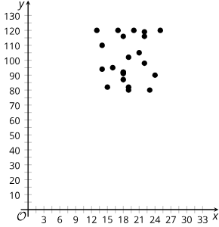

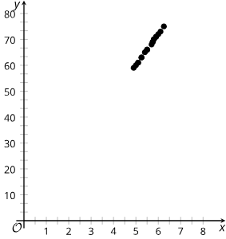
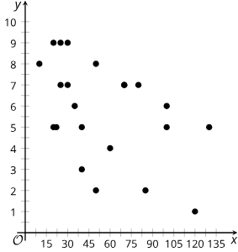
Warm Up - Match the Graph 👀
Which variables best describe the
relationships in the graphs?
1. | 2.
3. | 4.
Variable Combinations
x = average number of free throws shot in a season y = basketball team score per game
x = daily low temperature in Celsius for Denver, CO y = boxes of cereal in stock at a grocery in Miami, FL
x = measured student height in feet y = measured student height in inches
x = average no. of min. spent in a waiting room y = hospital satisfaction rating
Notes:
Warm Up (5 minutes)
The mathematical purpose of this activity is for students to match bivariate data with its context.
Students should think about whether they might expect a strong correlation or not as well as whether the relationship has a positive or negative correlation.
Monitor for students who discuss linear relationships or variability in the data.
Launch
Arrange students in groups of 2–4. Students are expected to match the variables to the scatter plot they think best fit. Students should be prepared to explain their reasoning.
This activity helps students consider not only the relationship between variables, but the strength of the relationship and how this is represented graphically.
There are three options for how this activity can be completed: Card sort, Desmos activity, or answering the questions from the textbook.
Continue to scroll down through the notes for activity answers, misconceptions, and synthesis questions.
Activity Answers:
𝑥 - variable: Daily low temperature in Celsius for Denver, CO; 𝑦 - variable: Boxes of cereal in stock at a grocery in Miami, FL
𝑥 - variable: Average number of free throws shot in a season; 𝑦 - variable: Basketball team score per game
𝑥 - variable: Measured student height in feet; 𝑦 - variable: Measured student height in inches
𝑥 - variable: Average number of minutes spent in a waiting room; 𝑦 - variable: Hospital satisfaction rating
Anticipated Misconceptions
Students may struggle with matching the pairs of variables with a scatter plot.
Encourage students to think about how related the variables are and how the 𝑦 variable might change as the 𝑥 variable increases.
Suggestion to have students create a table of values that might represent the scenario & variables in order to help them match the variables with the scatter plots. (They could graph their generated tables to help them with the visualization).
Activity Synthesis
The goal of this discussion is for students to discuss how the characteristics of the scatter plots allowed them to determine the context. For each context, select groups to share their match and reasoning. Select groups who used linear models and variability in their small-group discussions.
Here are some questions for discussion.
How did the concept of linear relationships help you make a match?
For the height in inches and the height in feet, I knew that the data would be very linear. I chose scatter plot 3 because it was the only one that appeared linear. I did wonder why scatter plot 3 was not perfectly linear. Maybe it had to do with rounding or measurement error.
How did you use the concept of linearity to help you make a match?
First, I expected the temperature and cereal context relationship to be totally random rather than linear at all, so that fit with scatter plot 1. Second, I knew that the heights variables matched with scatter plot 3 because I knew it should be almost perfectly linear. For a given height in feet, there is only one height in inches.
Which matches were the most difficult? What helped you figure them out?
It was hardest to find the matches for scatter plots 2 and 4 because they were pretty scattered. I noticed that the data in scatter plot 4 displayed a negative relationship, so I looked for a context that would have a negative relationship. It makes sense that customer satisfaction decreases as wait time increases.

Slide 8

Lesson Journey
Warm Up
Learning Activity
Practice
Learning Activity
Cool Down
Lesson Synthesis

Slide 9

Learning Strategies - Travel Time 🗺
Teacher Instruction: Use these strategies to adjust the activity to support English language learners or students with disabilities.
  You can copy and paste the callouts directly on top of the activity or give the instructions aloud.
“Would you say the relationship is strong or weak?”
“Would you say the relationships is positive or negative?”
“Can you say that again using the bolded terms?”
Discussion Supports
Notes:
Support for English Language Learners: MLR 8 Discussion Supports: Conversing, Representing
Use this routine to amplify mathematical uses of language to describe the strength of linear models. After students share a response, invite them to repeat their reasoning using mathematical language relevant to the lesson, such as strong, weak, positive, or negative. For example, if students forget to use the desired language, ask, “Would you say that the relationship is strong or weak?” or “Would you say it is positive or negative?” For students who benefit from greater language support, ask, “Can you say that again, using the phrase ‘strong, positive relationship’?” Consider inviting the remaining students to repeat these phrases to provide additional opportunities for all students to produce this language.
Design Principle(s): Support sense-making

Slide 10
Learning Activity - Travel Time 🗺
Enter the data into Desmos
(use + table)
Calculate the regression
(use y₁ ~ mx₁ + b)
Priya takes note of the distance the car drives (in miles) and the time (in minutes) it takes to get to the destination for many trips.
Distance is one factor that influences the travel time of Priya’s car trips. What are some other factors?
Which of these factors (including distance) most likely has the most consistent influence for all the car trips? Be prepared to show your reasoning.
Create the scatter plot and calculate the best fit line using Desmos.
DATA – DESMOS DATA
Notes:
Support for All Learners
This activity offers additional support for students:
For English language learners, be sure to review the Learning Strategies slide!
Activity (20 minutes)
The mathematical purpose of this activity is for students to use technology to find a correlation coefficient and use it to interpret the strength of the linear relationship in context. In addition, students interpret the coefficients of the equation of the line of best fit and use the equation to make predictions.
Continue scrolling down for how to launch the activity, how to display the data, and answers to the questions.
Launch
Show students how to find a correlation coefficient using technology. If you will be using technology other than Desmos, you may need to prepare alternate instructions. The Teacher Guide in the online textbook contains the data for scatter plot 1 from the warm up if it is needed for this demonstration. The data can also be accessed from this Google Sheet or this Desmos graph for display or to share a copy with students.
For the activity data (Priya’s driving distance and time), use this Google sheet and display or share a copy with students. Recall that students can copy and paste data from a spreadsheet into Desmos. A Desmos graph of this data can also be shared with students. The online textbook also contains this data for students to access in the activity.
Answers - Answers may vary, but here are some samples.
Traffic, stop signs, stop lights, refueling, whether the driver is in a hurry, driving on surface streets or interstate.
Distance is the most consistent influence since it is always part of the reason a trip will take the time it does. The other factors, like stop lights, are only a factor sometimes since you may hit all green lights one day and all red lights the next day.
Graph is given on the next slide.
Additional activity questions, answers, anticipated misconceptions, and synthesis on the next slide.

Slide 11
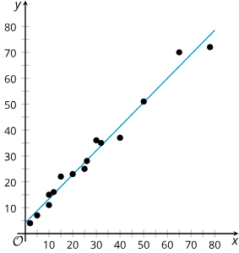
Learning Activity - Travel Time 🗺
y = 0.93x + 4.15
What do the slope and y-intercept of the best fit line mean in this situation?
Find the correlation coefficient for this data. Based on the value, how would you describe the strength of the linear relationship?
How long do you think it would take Priya to make a trip of 90 miles if the linear relationship continues?
Notes:
Answers
The slope represents the number of minutes it takes to drive one additional mile using the linear model. Assuming the linear relationship continues, the 𝑦-intercept represents the number of minutes it takes to drive zero miles; this may account for things like time getting ready or warming up the car before driving.
𝑟 = 0.99. Since 𝑟 is near 1, there is strong positive linear relationship between distance (𝑥) and travel time (𝑦).
It would take Priya about 88 minutes. I used the equation 𝑦 = 0.93𝑥 + 4.15 and figured out that 𝑦 was 87.85 minutes by substituting 90 miles for 𝑥.
Anticipated Misconceptions
Students may misunderstand how to interpret negative correlation coefficients. Ask students how the sign of the correlation coefficient is related to the linear model for the situation. Students may benefit from drawing an example scatter plot representing the situation.
Activity Synthesis
The purpose of this discussion is for students to understand that the correlation coefficient quantifies the strength of a linear relationship. Introduce the terms positive and negative relationship. Give some guidelines as to when to call a relationship strong. For example:
When |𝑟| ≥ 0.8, there is a strong, linear relationship;
when |𝑟| ≤ 0.5, the relationship is weak; and
when 0.5 < |𝑟| < 0.8, the relationship is moderately strong.
Although these are good guidelines, they should not be treated as a rule. Context is also important when determining whether to call a relationship strong or weak. In general, 𝑟 is related to how much of an improvement a linear model is over just using the mean as an estimate for the data.
Here are some questions for discussion:
How would you describe the relationship between distance and time for Priya’s trips? Be prepared to show your reasoning.
It is a strong positive relationship. It is strong because 𝑟=0.99, and it is positive because time, 𝑦, tends to increase as distance, 𝑥, increases.
Refer students to scatter plot 4 from the warm up: How would you describe the relationship between wait time and customer satisfaction? The correlation coefficient is 𝑟=−0.52.
It is a negative relationship. It is a moderately strong relationship since the linear model is an improvement over merely using the mean for the data, but it is not a great improvement.
What is an example of data with a strong, negative relationship?
An example of a strong negative relationship could be the relationship between the time it takes you to run a mile and your speed. As your speed increases, the time decreases.

Slide 12
Self Check
Determine the correlation coefficient of the data in the table below to
3 decimal places and interpret the value.
𝑟 = − 0.987;
there is a weak negative relationship.
𝑟 = 0.987;
there is a weak positive relationship.
𝑟 = 0.987;
there is a strong positive relationship.
𝑟 = − 0.987;
there is a strong negative relationship.
x | 8 | 15 | 26 | 31 | 56
y | 23 | 41 | 53 | 72 | 103
3.5.2 Finding and Using Correlation Coefficient to Interpret the Strength of Linear Relationships
Let’s review!
Notes:
Answer Feedback
Incorrect. The slope of the points in the table is positive, so the correlation coefficient should be positive. 𝑟-values close to 1 or –1 show strong relationships.
Incorrect. 𝑟-values close to 1 indicate a strong relationship.
That’s correct! Using graphing technology, ensure that you enter the data correctly. The slope of the points in the table is positive and the points are close to the line, so the correlation coefficient should be a positive number close to 1.
Incorrect. The slope of the points in the table is positive, so the correlation coefficient should be positive.

Slide 13
Self Check -
Review
If the correlation coefficient is … | You can say there is a …
r = 1.0 | perfect, positive linear relationship
0.7 < r < 1.0 | strong positive linear relationship
0.3 ≤ r < 0.7 | moderate positive linear relationship
0 < r < 0.3 | weak positive linear relationship
r = 0 | no linear relationship
– 0.3 < r < 0 | weak negative linear relationship
– 0.7 < r < – 0.3 | moderate negative linear relationship
– 1.0 < r < – 0.7 | strong negative linear relationship
r = – 1.0 | perfect, negative linear relationship
How would you describe the strength of the following relationships?
The data for shoe length in inches and height for 10 men in inches results in a correlation coefficient of r ≈ 0.65.
The data for fat content in grams and number of calories per serving in 16 fast-food items yields a correlation coefficient of r ≈ 0.44.
Notes:
Answers
Based on the correlation coefficient, there is a moderate positive linear relationship between shoe length and height.
The correlation coefficient indicates a moderate, positive linear relationship between fat content and calories.
NOTE: If students need more practice entering the data into tables and running the regressions, access the data tables for the two described relationships from the online textbook.

Slide 14
Lesson Journey
Warm Up
Learning Activity
Practice
Learning Activity
Cool Down
Lesson Synthesis

Slide 15
Learning Strategies - What “r” you?
Teacher Instruction: Use these strategies to adjust the activity to support English language learners or students with disabilities.
  You can copy and paste the callouts directly on top of the activity or give the instructions aloud.
“The cost of a package of light bulbs and the number of light bulbs in the package has a correlation coefficient value near 1. This means that these variables have a very strong, positive relationship. In other words, the price of the package is very closely related to the number of light bulbs in the package (strong relationship), and when one of the variables goes up, the other variable tends to go up, too (positive relationship).”
Engagement
Notes:
Support for Students with Disabilities: Engagement: Develop Effort and Persistence
Display or provide students with a physical copy of the example of the type of response from the launch. Encourage students to highlight or annotate to anchor understanding. Check for understanding by inviting students to rephrase in their own words. Keep the display of the example visible throughout the activity.
Supports accessibility for: Memory; Organization

Slide 16
Learning Activity - What “r” you?
Are you ready for more?
Describe the linear relationship between the variables, based on r.
Number of steps taken per day and number of kilometers walked per day. r = 0.92
Temperature of a rubber band and distance the rubber band can stretch. r = 0.84
Car weight and distance traveled using a full tank of gas.
r = – 0.86
Average fat intake per citizen of a country and average cancer rate of a country. r = 0.73
Score on science exam and number of words written on the essay question. r = 0.28
Average time spent listening to music per day and average time spent watching TV per day. r = – 0.17
Be sure to use the following terms in your responses:
Strong
Moderate
Weak
Positive
Negative
Notes:
Support for All Learners
This activity offers additional support and an extension for students:
For students with disabilities, be sure to review the Learning Strategies slide!
For students looking for an extra challenge, be sure to review the Extending Your Thinking slide!
Activity (10 minutes)
The mathematical purpose of this activity is to use the correlation coefficient to describe the relationship between two variables. Students examine a pair of variables and a correlation coefficient to describe the relationship between the variables as strong or weak and as positive or negative.
Launch
Arrange students in groups of 2. Give students an example of the type of response expected by telling students: “The cost of a package of light bulbs and the number of light bulbs in the package has a correlation coefficient value near 1. This means that these variables have a very strong, positive relationship. In other words, the price of the package is very closely related to the number of light bulbs in the package (strong relationship), and when one of the variables goes up, the other variable tends to go up, too (positive relationship).”
Continue scrolling for activity answers and the synthesis questions.
Answers
There is a strong, positive linear relationship. An increase in the number of kilometers walked tends to go along with an increase in the number of steps taken per day.
There is a strong, positive linear relationship. An increase in temperature tends to go along with an increase in the distance a rubber band can stretch.
There is a strong, negative relationship. An increase in the weight of a car tends to go along with a decrease in the distance it can travel on a full tank of gas.
There is a moderate positive linear relationship. An increase in the fat intake per citizen of a country tends to go along with an increase in the average cancer rate of a country, but it is not a strong relationship.
There is a weak, positive linear relationship. An increase in the number of words written on the essay question tends to go along with an increase on the score for a science exam, but the relationship is weak.
There is a weak, negative relationship. An increase in the average time spent listening to music per day tends to go along with a decrease in the average time spent watching TV per day, although the relationship is weak.
Activity Synthesis
The purpose of this discussion is for students to interpret the data based on the relationship between the two variables that they determined using the correlation coefficient. Ask students the following questions:
Do these correlations make sense based on what you understand about these variables?
Yes, mostly. Walking more, for example, usually means you take more steps.
Based on the information here, does a greater fat intake cause cancer?
Not necessarily. There seems to be a link, but there are many other factors about countries with greater fat intake that might play a part.) Causal relationships are the focus of the next lesson, so it is okay for students to struggle with this question now.
What does it mean for the relationship between the score on a science exam and the number of words written to be weak and positive?
It means that, in general, the exam score tended to increase as the number of words written increased, but the relationship between these two variables was weak. This makes sense because if you wrote very few words, you probably would not get a good score, but writing lots of words does not necessarily guarantee you a good score.

Slide 17
Extending Your Thinking
DATA – DESMOS DATA
A biologist is trying to determine if a group of dolphins is a new species of dolphin or if it is a new group of individuals within the same species of dolphin. The biologist measures the width (in millimeters) of the largest part of the skull, zygomatic width, and the length (in millimeters) of the snout, rostral length, of 10 dolphins from the same group of individuals.
After checking the data, the biologist realizes that the first zygomatic width listed as 147 mm is an error. It is supposed to be 180 mm. Find the equation of a line of best fit and the correlation coefficient for the corrected data (corrected Desmos data).
Compare the new equation of the line of best fit with the original. What impact did changing one data point have on the slope, 𝑦-intercept, and correlation coefficient on the line of best fit?
Why do you think that a weak positive association became a moderately strong association? Be prepared to show your reasoning.
Notes:
NOTE: The initial data can be accessed in tab 1 of this Google sheet and displayed or a copy can be shared with students. Recall that students can copy and paste data from a spreadsheet into Desmos. A Desmos graph of the initial data can also be shared with students. The data can also be accessed in the Extending Your Thinking section for this lesson in the online textbook.
The corrected data discussed in question 1 is located in tab 2 of the same Google sheet or in this Desmos graph. A copy of the Desmos graph that contains both data sets and regression lines can be accessed here.
Answers
𝑦 = 0.693𝑥 − 18.373 and 𝑟 = 0.76
The slope increased, and the correlation coefficient got closer to 1. The 𝑦-intercept also changed significantly.
I think it became moderately strong because the data point that was changed did not follow the roughly linear pattern of the other 9 data points, and when it was changed, it did follow the linear pattern more closely.
Additional Extension Questions and Answers (All answers may vary, but these are some samples.)
For questions 4—6, use technology to change the 𝑦-value for the first and second entries in the table.
How does changing each point’s 𝑦-value impact the correlation coefficient?
Answer: Changing the points to numbers well above or below the existing linear trend in the data makes the correlation coefficient get closer to zero.
Can you change two values to get the correlation coefficient closer to 1? Use data to support your answer.
Answer: I managed to get the 𝑟-value to 0.86 by changing the 2 values that appeared farthest from the line of best fit, (272,184) and (272,161), to values that are very close to the existing line of best fit, (272,168) and (272,168).
By leaving (288,180), can you change a value to get the relationship to change from a positive one to a negative one? Use data to support or refute your answer.
Answer: By changing (247,147) to (247,1000), I was able to change the relationship to a negative one because the line of best fit had a negative slope, 𝑦 = − 14.187𝑥 + 4071.1.

Slide 18
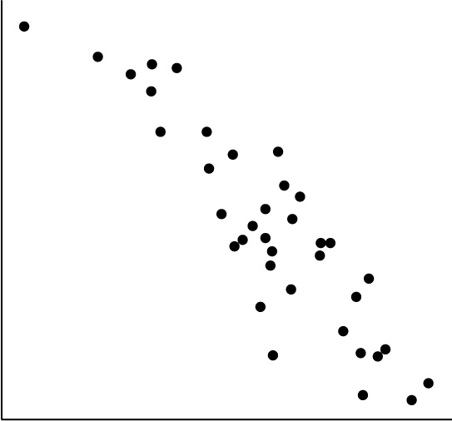
Self Check
In the graph, which BEST describes the scatter plot of points?
𝑟 = 0.90, positive, weak correlation
𝑟 = − 0.90, strong, negative correlation
𝑟 = − 0.24, weak, negative correlation
𝑟 = 0.24, strong, positive correlation
Let’s review!
Notes:
Answer Feedback
Incorrect. Notice the slope of the line is negative. As the line goes farther right, the line goes down.
Incorrect. As the line goes farther right, the line goes down.
Correct! As the number of hours spent on video games increases, the line goes down, so the number of hours spent sleeping decreases.
Incorrect. There is a linear model to the data points.

Slide 19
Self Check - Review
Chirps | Temperature
44 | 80.5
35 | 70.5
20.4 | 57
33 | 66
31 | 68
35 | 72
18.5 | 52
37 | 73.5
26 | 53
Determine the Strength of a Linear Relationship
Calculate the correlation coefficient for cricket-chirp data in the table.
Tell if the linear relationship is positive or negative and if it is strong, weak, or moderate.
HINT: Enter the chirps in the 𝑥-column of the table and the temperature in the 𝑦-column of the table. Then, use y₁ ~ mx₁ + b.
Notes:
Answers
The correlation coefficient is 𝑟 = 0.9509.
This value is very close to 1, which suggests a strong, positive, linear relationship.

Slide 20

Lesson Journey
Warm Up
Learning Activity
Practice
Learning Activity
Cool Down
Lesson Synthesis

Slide 21
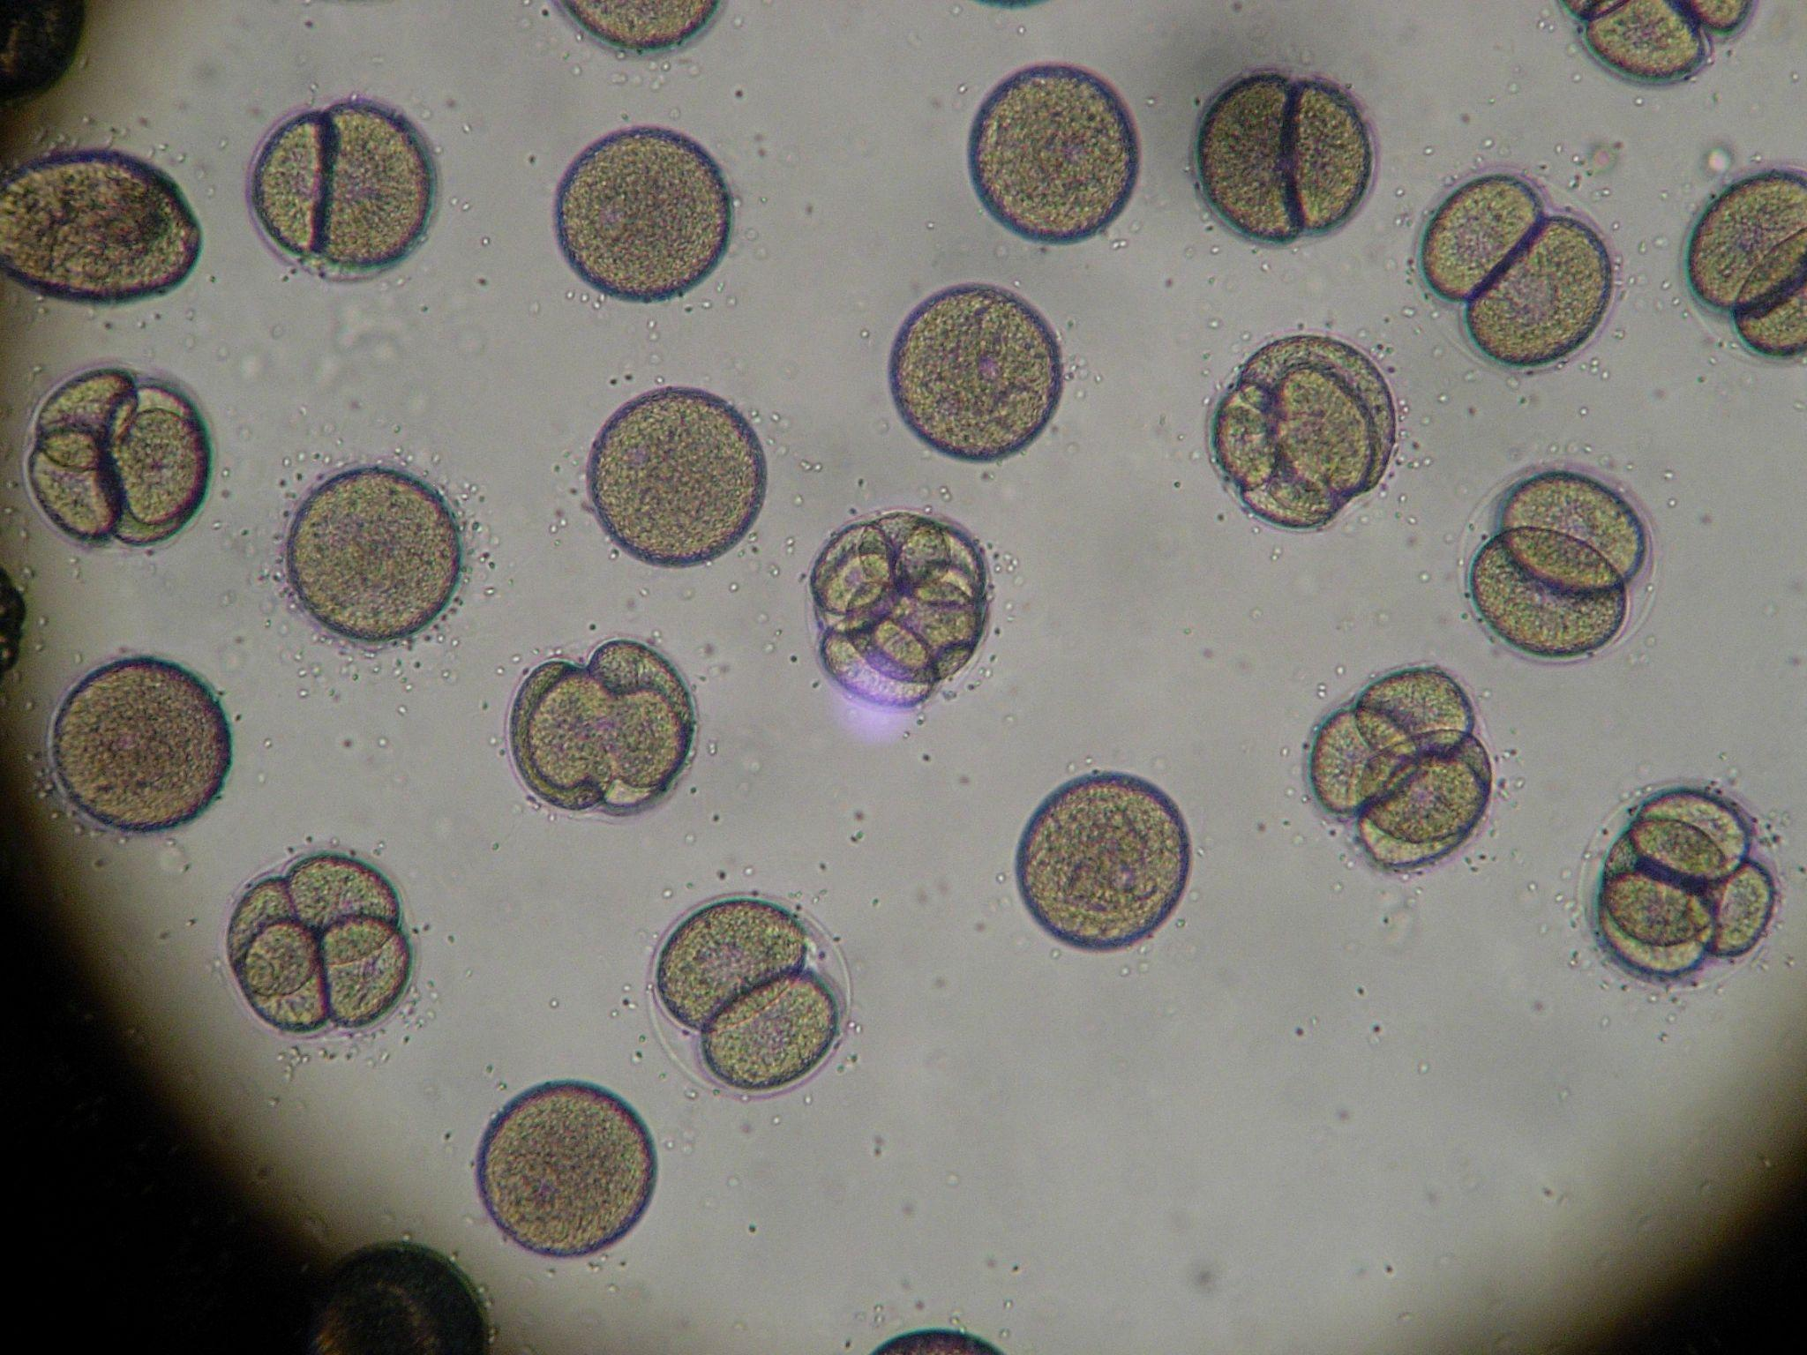
Cool Down
Doctors suspect a strain of bacteria is becoming resistant to antibiotics. They put various concentrations of antibiotic in petri dishes and add some of the bacteria to allow it to grow. The bacteria grow into groups called colonies. After time, the doctors return and count the number of colonies for the different amounts of antibiotic.
The data are plotted with a best fit line. The correlation coefficient is 𝑟 = − 0.83.
What does the sign of the correlation coefficient tell you about the relationship
between the number of bacteria colonies and the concentration of antibiotic
in the dish?
What does the numerical value of the correlation coefficient tell you about the relationship between the number of bacteria colonies and the concentration of antibiotic in the dish?
In a follow-up study, a group of scientists collect data that were fit by a linear model with a correlation coefficient of 𝑟 = − 0.94. Which study suggests a stronger relationship between the number of bacteria colonies and the concentration of antibiotic: the doctors’ study or the scientists’ study? Be prepared to show your reasoning.
Notes:
Cool Down (5 minutes)
Answers
There is a negative relationship between the number of bacteria colonies and the concentration of antibiotic in the dish. When the concentration of antibiotic is higher, there are fewer bacteria colonies.
The relationship between the number of bacteria colonies and the concentration of antibiotic in the dish is strong since this value is fairly close to –1.
The scientists’ study suggests a stronger relationship since both correlation coefficients are negative and the correlation coefficient for the scientists’ line is closer to –1.
Response to Student Thinking - More Chances
Students will have more opportunities to understand the mathematical ideas in this cool down, so there is no need to slow down or add additional work to the next lessons. Instead, use the results of this cool down to provide guidance for what to look for and emphasize over the next several lessons to support students in advancing their current understanding.
Microbiology image from Pixy.org by CC0

Slide 22

Lesson Journey
Warm Up
Learning Activity
Practice
Learning Activity
Cool Down
Lesson Synthesis

Slide 23

Practice
Put your hard work to action, practice what you’ve learned!
Notes:
Digital Practice: Access the practice pages at https://openstax.org/details/books/algebra-1

Slide 24

Lesson Journey
Warm Up
Learning Activity
Practice
Learning Activity
Cool Down
Lesson Synthesis

Slide 25

Lesson Synthesis
What does it mean for two variables to have a weak, positive relationship?
If the 𝑟-value for a line of best fit in a scatter plot is 0.8, what would you expect the data in the scatter plot to look like?
What does the correlation coefficient tell you about the relationship between two variables?
Notes:
The key takeaway from this lesson is that the value for the correlation coefficient can be used to determine the strength of the relationship between the two variables represented in the data.
Pose the provided questions for discussion with students.
Answers:
When one of the variables increases, the other variable also tends to increase, but since the linear relationship is weak, the data do not follow a linear path.
I would expect the scatter plot to show the data generally increasing from left to right, and for the data to look somewhat like a line, but not perfectly like a line.
It tells you if the two variables are positively or negatively related. It also tells you how strong the relationship between the two variables is.
Remind students:
When the variables increase together, we can say they have a positive relationship.
If an increase in one variable’s data tends to be paired with a decrease in the other variable’s data, the variables have a negative relationship.
When the data are tightly clustered around the best fit line, we say there is a strong relationship.
When the data are loosely spread around the best fit line, we say there is a weak relationship.

Slide 26
Self Assessment
How much do you agree with the following statements?
I can… | I can | Almost | Not yet
Describe the strength of a relationship between two variables.
Use technology to find the correlation coefficient and explain what the value tells you about a linear model in everyday language.

