Slide 1
Algebra 1
Unit 8 Quadratic Equations
Lesson 8.12 Using Technology to Find the Quadratic Regression

Slide 2

How to use these slides
On the activity slides check the speaker notes for teacher support and instructional information.
Each lesson includes 1 warm up, 2-3 learning activities, a cool down, practice and a lesson synthesis.
  Learning activities are followed by a self check question, and review section.
Some slides have been hidden from student view, more information can be found on the next slide (Reference Key).
You can edit and use these slides for personal and classroom use, but cannot sell them and must keep the attribution logos.
For more information, Check out the digital quick start guide!
OpenStax CC BY NC SA

Slide 3





Reference Key
Check the top right corner for an icon referencing these unique sections.
Icon | Title | View | Location and Description
n/a | Support for Students with Disability | Hidden | Learning Strategies slide, provides additional support to students for understanding the activity.
n/a | Support for English Language Learners | Hidden | Learning Strategies slide, provides additional support to students for understanding the activity.
n/a | Extending Your Thinking | Hidden | Extending Your Thinking slide, provides an extra challenge for students.
n/a | Self Check | Not Hidden | Self Check slide, checkpoint to assess student understanding after the learning activity.
n/a | Review | Hidden | Self Check - Review slide, designed to help review topics from the self check question.
On the next slides, check the speaker notes for teacher instructions and support.
Notes:
Check the Speaker Notes: On the next slides you can find discussion questions, lesson information, answers to the activities, and ways to adjust the activity for your students!

Slide 4

Learning Goals
By the end of this lesson you will be able to -
Graph a quadratic data set using technology.
Find a regression curve, or curve of best fit, using a quadratic data set.
Use a regression curve to create a quadratic model for making predictions.
Make predictions about a real-world situation using a quadratic data set.
Notes:
Lesson Narrative
In an earlier lesson, students used scatter plots to perform linear regression on a data set. In this lesson, students will familiarize themselves with graphing technology in order to display a data set modeling a quadratic function. They will learn how to use this graphing technology to analyze the data set and generate an equation for a curve of best fit. These equations, modeling real-world situations, can be used to make predictions about those situations.
Required Preparation
Acquire devices that can run Desmos (recommended) or other graphing technology. It is ideal if each student has their own device.
Required Materials
Paper and pencil
Graphing technology
Master List of Data Sets: Lesson 8.12
Texas Essential Knowledge and Skills
A1(A) apply mathematics to problems arising in everyday life, society, and the workplace.
A1(C) select tools, including real objects, manipulatives, paper and pencil, and technology as appropriate, and techniques, including mental math, estimation, and number sense as appropriate, to solve problems.
A8(B) write, using technology, quadratic functions that provide a reasonable fit to data to estimate solutions and make predictions for real-world problems.

Slide 5
Vocabulary
Previous
Quadratic function
  A function where the output
  is given by a quadratic expression in the input. f(x) = ax² + bx + c.
Variable
  A quantity that can take on different values.
Scatter plot
  A graph of points demonstrating the relationship between the data of two variables.
New
Curve of best fit
  A curve modeled by the equation that best approximates the points in a data set or scatter plot.
Quadratic regression
  The process of determining the equation of a parabola that best fits a data set.
Notes:
Lesson Vocabulary
To support student understanding of key vocabulary:
Introduce and review the vocabulary words students will see in this lesson.
Encourage students to notice how these words are used and to include them in their math discussions and explanations—both written and oral.
Use a word wall to reinforce vocabulary. Sample word wall cards are available here.
For newcomers or students with beginning English proficiency, use these Quizlet sets to support vocabulary learning:
Unit 8 Spanish Vocabulary – use first to build understanding
Unit 8 Vocabulary (English) – use after anchoring in Spanish
Support for English Language Learners
ELPS 2(F) listen to and derive meaning from a variety of media such as audiotape, video, DVD, and CD-ROM to build and reinforce concept and language attainment.
ELPS 2(G) understand the general meaning, main points, and important details of spoken language ranging from situations in which topics, language, and contexts are familiar to unfamiliar.
ELPS 2(H) understand implicit ideas and information in increasingly complex spoken language commensurate with grade-level learning expectations.

Slide 6

Lesson Journey
First Stop: Warm Up

Slide 7

Warm Up
“Greetings, programs!” 🤖
Go to Desmos. Above the first input cell, click on “+” and choose “Add a table.”
Enter the data set into the corresponding x₁ and y₁ columns.
Adjust the graphing window as needed.
Examine the data for a pattern that might fit any quadratic function you recognize.
What equation do you hypothesize would best fit the data?
x₁ | y₁
1 | 2
2 | 5
3 | 10
4 | 17
5 | 26
Notes:
Warm Up (5 minutes)
This warm up serves two purposes. The first is to familiarize the students with Desmos as a graphing technology, if they have not already used it. Desmos is a useful graphing tool that has been referenced in previous lessons. The second is to introduce how to input a data set into a table so that it may be graphed, forming a scatter plot.
Continue scrolling down for directions on how to launch this activity, answers, and synthesis questions.
Launch
Arrange students in pairs or groups, if necessary, so they have access to Desmos. If possible, allow students to work individually so that each understands the steps necessary to graph a data set.
After students open a window to Desmos, instruct them to click into each cell in the table and insert each corresponding value in the data set. Once a student has clicked into the first cell in the table, they may also use the arrow keys to navigate from one cell to the next.
Instructions are provided if they wish to copy and paste the entire table, but emphasize that unless the values are copied from a spreadsheet, they will not be pasted together into the table.
Show students that the graphing window, or field of view, may be changed by clicking onto the graph and dragging it in different directions.
Answer
You may wish to provide students with access to this Google sheet. If preferred, the data can be copied and pasted into Desmos from a spreadsheet using keyboard shortcuts. Windows: Ctrl+C for copy and Ctrl+V for paste. Mac: Command+C for copy and Command+V for paste.
The window should be appropriately set to display the points in the table, but sometimes it will be necessary to adjust the window of the graph in order to properly view the data set. Use the mouse to drag and change the viewing window. To zoom in or out, use the buttons in the top right or the scrolling wheel on the mouse. The suggested window for this data is: – 2 < x < 8 with step of 1; – 3 < y < 30 with step of 3.
The data match the quadratic function 𝑦 = 𝑥² + 1.
Activity Synthesis
If students are having difficulty finding the pattern in the data set, tell them to square the 𝑥-value and compare the result to the 𝑦-value.
If students think the data look like a linear pattern, graph the equation 𝑦 = 𝑥² + 1 on the same graph to demonstrate that the points match the quadratic function perfectly. Inform students that while these data match the function exactly, the data in this lesson will not perfectly align to the functions we find. The functions we find using the data sets in this lesson will be a close fit, but never an exact match.
Ask students to predict the 𝑦-value of the function if the 𝑥-value is 6. (37)
Tell students, in this lesson, we will use a data set to find an equation to represent those data. We will then use that equation to make predictions about other values that might fit into the data set.

Slide 8
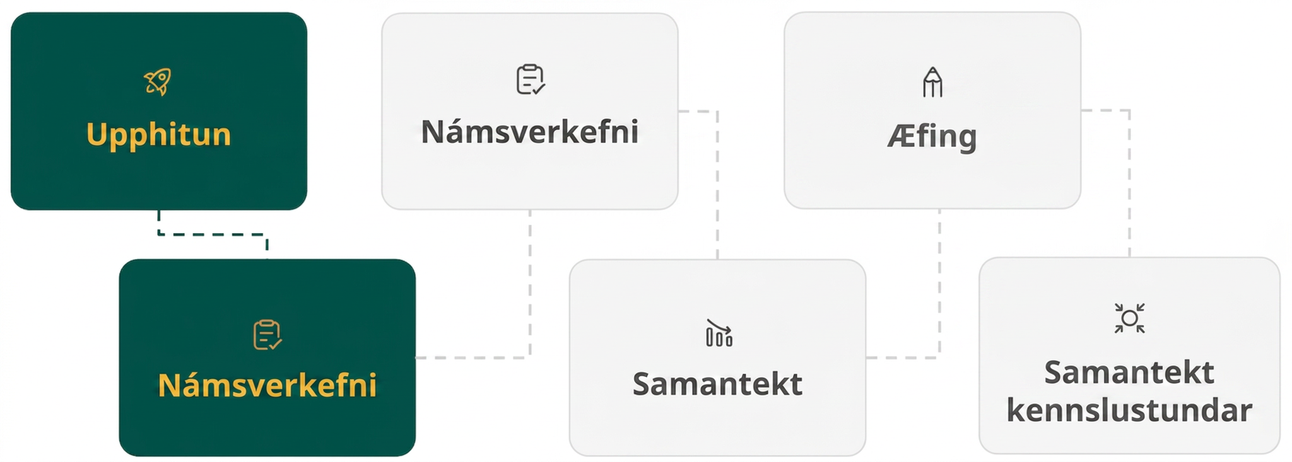
Lesson Journey
Second Stop: Learning Activity A

Slide 9

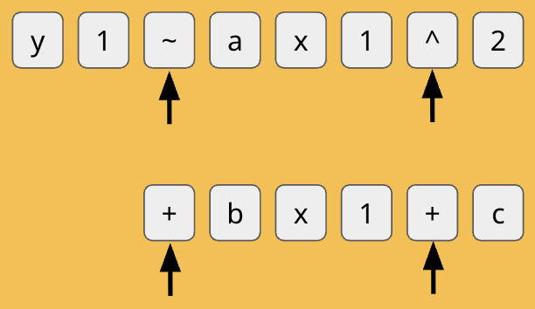
Learning Activity A | Learning Strategies
“The thing about perfection is …” 🤖
Teacher Instruction: Use this strategy to adjust the activity to support English language learners and students with disabilities.
You can copy and paste the callout directly on top of the activity or give the instructions aloud.
KEYS TO ENTER EQUATION FOR CURVE OF BEST FIT:
Notes:
Support for English Language Learners: MLR 8 Discussion Supports: Representing, Listening, Reading
Display the keys that need to be pressed to enter the equation for the curve of best fit. The black arrows under certain keystrokes indicate the SHIFT key was needed to access this specific symbol for entry. Recall that students can also expand and use the digital keyboard located in the lower left corner of the input list on the Desmos screen.
Design Principle(s): Support sense-making

Slide 10
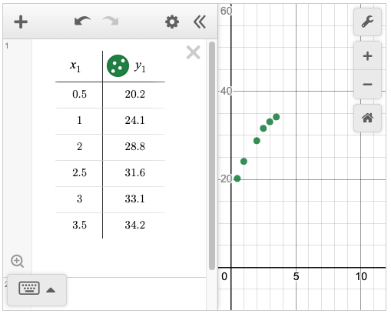
Learning Activity A | Part 1
“The thing about perfection is …” 🤖
Examine the data set and graph given in the Desmos tool. What do you notice? What do you wonder?
Do the data appear to form a line or a curve?
Notes:
Support for All Learners
This activity offers additional support for students:
For English language learners, be sure to review the Learning Strategies slide!
Activity (15 minutes)
In this activity, students continue to familiarize themselves with the process of entering information into Desmos. They use quadratic regression on a data set to find the equation of a curve of best fit.
In the next activity, they will use a similar curve of best fit to make predictions about a situation.
Launch
Arrange students in pairs or groups, if necessary, so they have access to Desmos. If possible, allow students to work individually so that each understands the steps necessary to find a curve of best fit.
Read the activity introduction as a class.
Ask students if they remember finding the line of best fit of a data set. Introduce the new vocabulary words: curve of best fit and quadratic regression. Tell students they have already used linear regression in a previous lesson, and they will now use quadratic regression.
Allow students to open the graphed data set in question 1 and answer question 2. [Desmos graph link https://www.desmos.com/calculator/cm0xclfgli]
The rest of the Launch will be continued on the next slide.
NOTE: Question 2 has been animated to appear on a click so it does not give away anything that students might notice or wonder about in question 1.
Answers
Answers will vary.
They appear to be the start of a curve.
Additional activity questions, answers, and synthesis questions are on the next slide.

Slide 11
Learning Activity A | Part 2
“The thing about perfection is …” 🤖
FINDING THE CURVE
OF BEST FIT
Step 1 - Click the + symbol and select table. Enter the data.
Step 2 - On the next input line, enter the instructions to generate the curve of best fit:
y₁ ~ ax₁² + bx₁ + c
Step 3 - Use the coefficients generated to write the equation for the curve of best fit.
Enter the command to generate a regression: y₁ ~ ax₁² + bx₁ + c
Examine the information provided with the regression.
What is the value of a?
What is the value of b?
What is the value of c?
What is the full equation, y = ax² + bx + c?
Notes:
Activity Launch continued
Display the graph for the class to see (it is also linked to the image on the slide). Read each bullet point in question 3 before entering the equation.
QUESTION 3: We will use graphing technology to find a curve of best fit. Click the pointer below the table into entry box #2 to enter a new function. The cursor should start blinking. Enter the equation: 𝑦1 ~ 𝑎⁢𝑥2 + 𝑏⁢𝑥1 + 𝑐
Notice that when you type the 1 after 𝑦 or 𝑥, Desmos automatically places it as subscript.
Also notice that we are not using an equal sign. The symbol ~ means approximately and tells Desmos to approximate a line or curve of best fit. It should be in the top-left corner of your keyboard, and you might press it using the Shift button. If you are using the Desmos on-screen keyboard, it will be on the ABC keyboard.
After pressing the subscript 1 after the 𝑦 and the first 𝑥, use the ^ symbol to tell Desmos you would like to enter an exponent.
Demonstrate the keys pressed to accurately enter the equation, 𝑦₁ ∼ 𝑎𝑥₁² + 𝑏𝑥₁ + 𝑐. Then, if possible, instruct students to enter the equation on their own screens.
Allow students to complete questions 5 – 9 on their own. Remind them that exponents may be entered using the ^ symbol.
For English language learners or students with disabilities, display the keys that need to be pressed to enter the equation for the curve of best fit (see slide 10).
Reinforce that the Shift button will need to be held down first when pressing the ~ symbol.
Answers
See the online textbook for images of the regression equation or access the Desmos exemplar.
– 0.86
8.09
16.53
y = – 0.86x² + 8.09x + 16.53
Time permitting, mention to students: You may notice the 𝑅² value. The closer this value is to 1, the better your curve of best fit matches the data set. The 𝑅² value for this data set is 0.9972. Since this value is relatively close to 1, this curve of best fit is a reasonably accurate match to the data set.
Activity Synthesis
Reinforce the idea that the curve of best fit does not precisely align with each point in the data set. In other words, no point in the data set is guaranteed to fall exactly onto the curve of best fit.
Inform students that while the 𝑅² value is an important measurement of how closely the curve of best fit matches the data set, we will not be using it in this lesson.
To review key ideas from the activity, discuss questions such as:
If you graph the equation, 𝑦 = − 0.86𝑥² + 8.09𝑥 + 16.53, into Desmos, how will it compare to the curve of best fit shown on the screen now? (It will be nearly identical, aside from rounding differences, to the curve of best fit that was derived using the equation, 𝑦₁ ∼ 𝑎𝑥₁² + 𝑏𝑥₁ + 𝑐.)
What do you think would happen if you changed one of the values in the data set? (Changing the value of a point in the data set would change the equation of the curve of best fit. It would no longer be 𝑦 = − 0.86𝑥² + 8.09𝑥 + 16.53.)
Demonstrate the impact that changing a value in one point of the data set, even slightly, will have on the equation of the curve of best fit. (Use one of the prior data sets that students were provided access to in Desmos.)

Slide 12
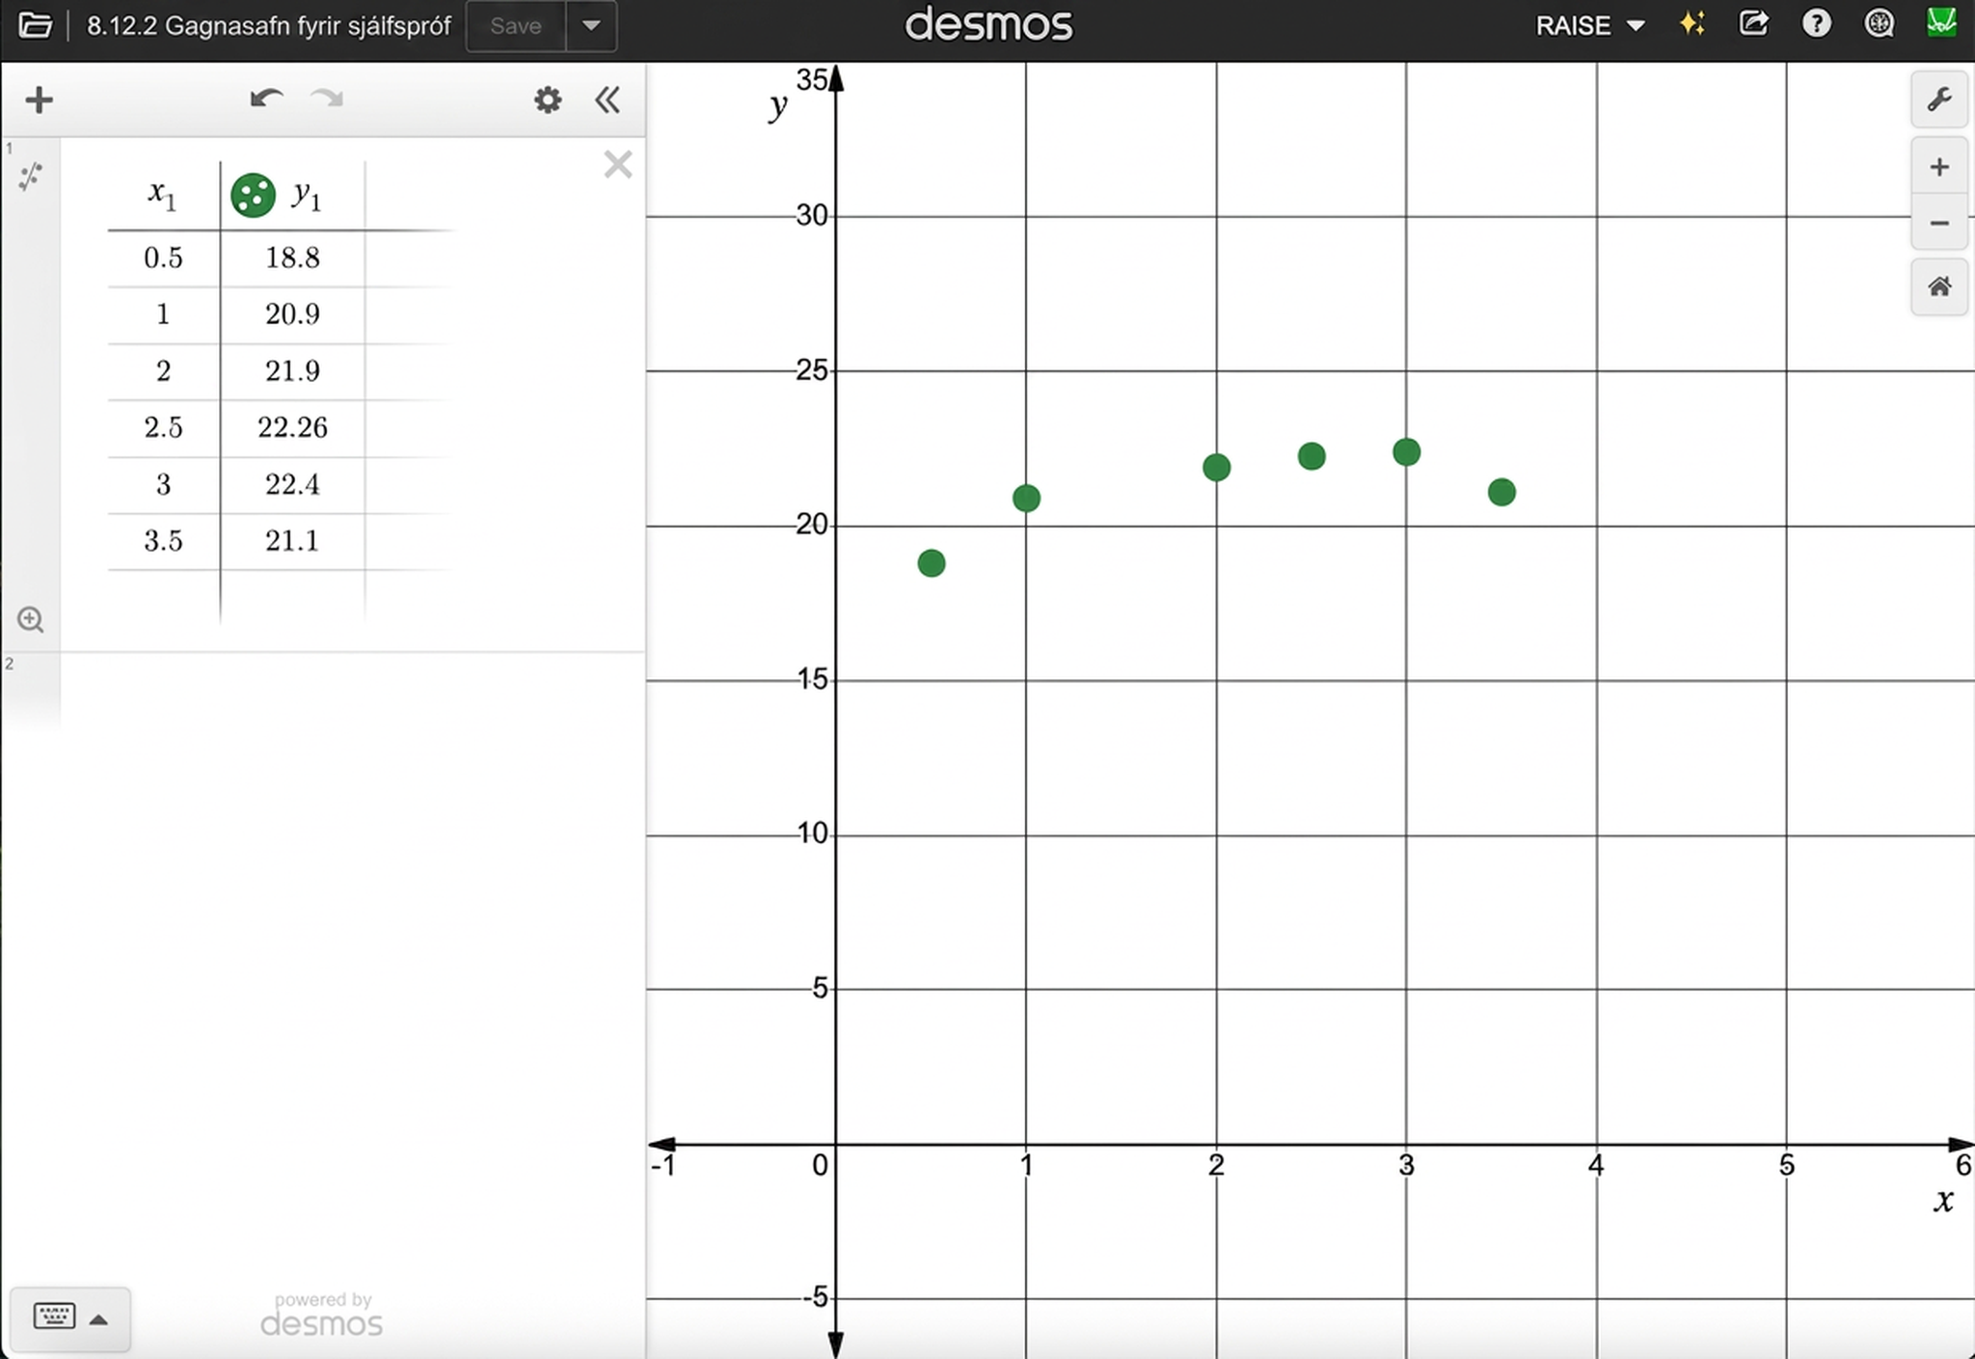
Learning Activity A
Self Check
Find the equation of the curve of best fit. Round each coefficient to the nearest hundredth.
y = – 0.92x² + 4.25x + 8.36
y = – 0.97x² + 7.62x + 19.34
y = – 0.94x² + 4.51x + 16.96
y = – 0.91x² + 2.23x + 16.42
Let’s review!
Notes:
Answer Feedback -
Incorrect. Did you enter y₁ ~ ax₁² + bx₁ + c to find the curve of best fit?
Incorrect. Did you enter y₁ ~ ax₁² + bx₁ + c to find the curve of best fit?
That’s correct! The graph of the curve lines up with the data set as closely as possible.
Incorrect. Did you enter y₁ ~ ax₁² + bx₁ + c to find the curve of best fit?
NOTE: The image of the table of values and graph are linked to the actual Desmos interactive [https://www.desmos.com/calculator/uvm5iege9a], if you would like to share it with students to access on their own devices.

Slide 13

Learning Activity A
Self Check - Review
FINDING THE CURVE
OF BEST FIT
Step 1 - Click the + symbol and select table. Enter the data.
Step 2 - On the next input line, enter the instructions to generate the curve of best fit:
y₁ ~ ax₁² + bx₁ + c
Step 3 - Use the coefficients generated to write the equation for the curve of best fit.
Find the curve of best fit for the given data set.
x₁ | y₁
1 | 99.7
2 | 130
3 | 149
4 | 172
9 | 175
11 | 140
Notes:
Remind Students
They can use the physical keyboard or expand the digital keyboard that is accessible in the lower left corner of the input list.
Remember from the activity that Desmos will automatically place the 1 as subscript after an 𝑥 or 𝑦.
Don't forget to use the symbol ~ that means approximately and is located in the upper left corner of the keyboard.
Use the ^ symbol to enter an exponent.
As soon as they enter the instruction line, Desmos will generate the curve of best fit.
Encourage students to round coefficients to the nearest hundredths, but remind them that this level of precision may be defined differently based on the context (in science, for example).
Answer Desmos data set (regression has not been entered)
The curve of best fit is 𝑦 = −2.76𝑥² + 37.04𝑥 + 65.66.
NOTE: For the data provided, the suggested graphing window is – 10 < x < 20 and – 25 < y < 225)

Slide 14
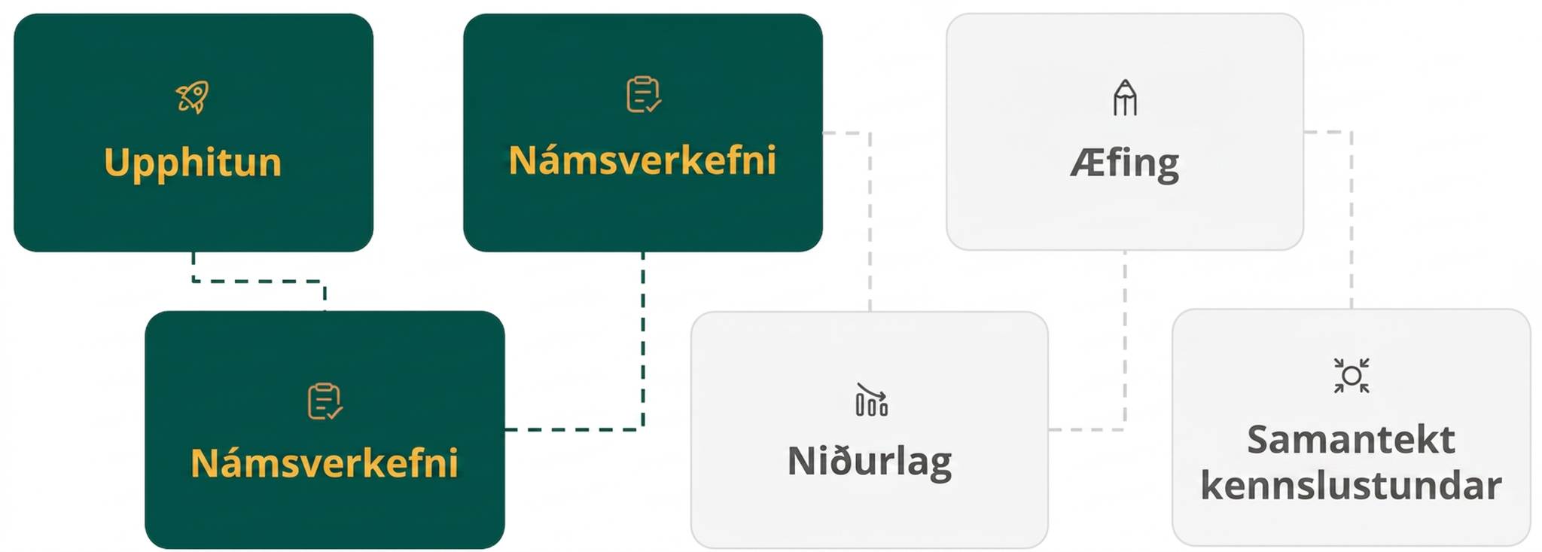
Lesson Journey
Third Stop: Learning Activity B

Slide 15
Learning Activity B | Learning Strategies
Up, Up, and Away 🎈
Prepare to share your thinking with the class.
Listen and watch for words and phrases that connect ideas for you.
Identify how the same key characteristics about the data or graphs can be expressed differently.
Collect and Display
Teacher Instruction: Use this strategy to adjust the activity to support English language learners.
  You can copy and paste the callout directly on top of the activity or give the instructions aloud.
Notes:
Support for English Language Learners: MLR 2 Collect and Display: Conversing, Writing
As students discuss the questions with their partner, listen for and collect the language students use: vertex, 𝑦-intercept, zeros, initial height, etc. Write the students' words and phrases on a visual display. As the activity continues, refer to and update the visual display and continue to do so throughout the remainder of the lesson. Remind students to borrow language from the display as needed. This will help students read and use mathematical language during their partner and whole-class discussions.
Design Principle(s): Maximize meta-awareness; Support sense-making
Provide support for students
Distribute graphic organizers to the students to assist them with participating in this routine.

Slide 16
Learning Activity B | Part 1
Up, Up, and Away 🎈
A helium balloon is released and floats up before coming back down to the ground. The data shows the height in feet, y, of the balloon corresponding to the number of minutes passed, x.
Enter the data into a table in Desmos.
What is the equation of the curve of best fit? Round coefficients to the nearest hundredth. y₁ ~ ax₁² + bx₁ + c
x₁ (minutes) | y₁ (height in feet)
1 | 99.7
1.5 | 130
3 | 149
4.5 | 172
7 | 108
9 | 84
Notes:
Support for All Learners
This activity offers additional support for students:
For English language learners, be sure to review the Learning Strategies slide!
Activity (15 minutes)
This activity takes quadratic regression a step further by using a data set that models a real-world situation. Students will model the data set representing the flight of a helium balloon by creating a scatter plot, find the equation of a curve of best fit, and use that equation to make predictions about the balloon’s flight.
Launch
Arrange students in pairs or groups, if necessary, so they have access to Desmos. If possible, allow students to work individually so that each understands the steps necessary to make predictions using a curve of best fit.
This activity starts from the beginning in Desmos, allowing students to create a table and then populate it with the data set representing the balloon’s flight. Gauge students’ comfort with entering the data set and finding the curve of best fit.
Review the steps as needed while allowing students to complete the first two questions. Desmos graph without regression
Pause the class and be sure that students have correctly entered the data and generated a curve of best fit before moving to question 3. Desmos graph with regression equation.
Allow students quiet time to think individually as they attempt question 3. Reinforce the idea that they can enter the equation 𝑥 = 4 into Desmos to help them solve the problem.
After discussing the solution to question 3 as a class, allow students time to complete the remaining questions.
Activity questions, answers, anticipated misconceptions, and synthesis on the next slide.

Slide 17
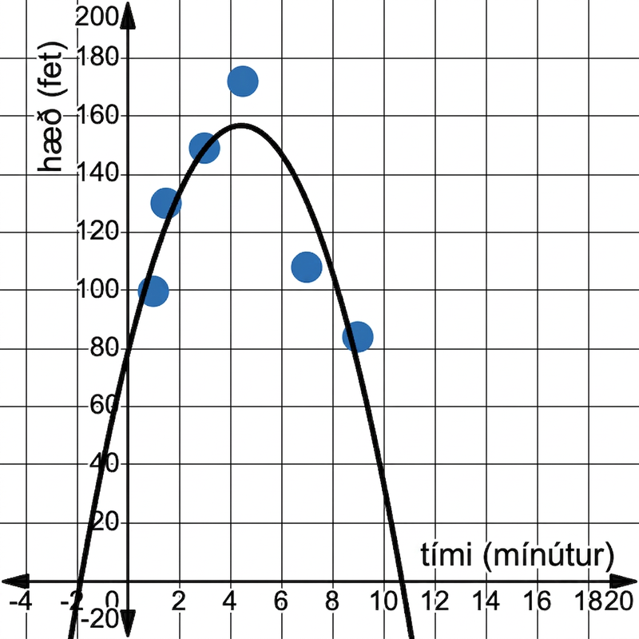
Learning Activity B | Part 2
Up, Up, and Away 🎈
How high will the balloon be
after 4 minutes?
How high will the balloon be
after 10 minutes?
At what time will the balloon
first be at a height of 95 feet?
At what time will the balloon
return to a height of 95 feet?
When will the balloon reach
the ground, or have a height
of 0 feet?
Desmos interactive graph
Notes:
Answers (Note that more “precise” answers can be determined using the Desmos interactive graph but they are still approximations.)
Approximately 156 feet (Hint for students: Graph the line x = 4 to help identify where it intersects with the curve of best fit.)
Approximately 33.83 feet
At approximately 0.49 minute (Hint for students: Graph the line y = 95 to help identify where it intersects with the curve of best fit.)
At approximately 8.38 minutes
At approximately 10.72 minutes
Anticipated Misconceptions
Students may assume that the data set models a symmetrical flight of the balloon from the ground up to a maximum height and back down to the ground. Show where the graph crosses the 𝑦-axis, or where time equals 0 minutes. Emphasize that at the start of this data set, or 𝑥 = 0, the balloon already had a height of approximately 78.6 feet.
Activity Synthesis
To review key ideas from the activity, discuss questions such as:
How does graphing an additional line on the coordinate plane help to visualize making a prediction using the curve of best fit? (The line that is being graphed represents a given 𝑥- or 𝑦-value in the situation. By finding its intersection point with the curve of best fit, the corresponding 𝑥- or 𝑦-value is determined.)
In the activity, what does a vertical line with the equation 𝑥 = 8 represent? (It represents the moment in the balloon’s flight when 8 minutes have passed.)
In the activity, what does a vertical line with the equation 𝑦 = 36 represent? (It represents the moment or moments in the balloon’s flight when it has a height of 36 feet.)

Slide 18

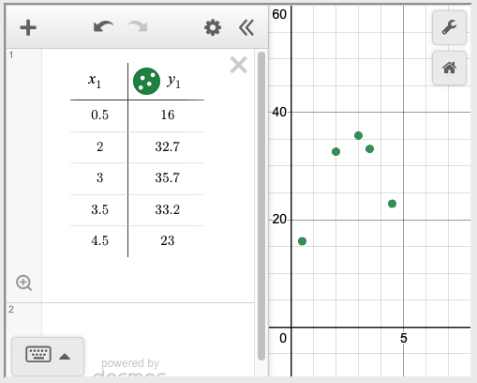
Learning Activity B
Self Check
A baseball is thrown into the air. The given data set shows the height in
feet, 𝑦, of the baseball corresponding
to the number of seconds passed, 𝑥. Approximately how long will it be
before the baseball hits the ground?
2.73 seconds
5.74 seconds
6.75 seconds
7.18 seconds
Let’s review!
Notes:
Answer Feedback -
Incorrect. This is the time it takes the baseball to reach its maximum height.
That's correct! The curve of best fit is 𝑦 = −3.93𝑥² + 21.46𝑥 + 6.09. The curve intersects the 𝑥-axis at 5.74.
Incorrect. The curve of best fit is 𝑦 = −3.93𝑥² + 21.46𝑥 + 6.09. The curve intersects the 𝑥-axis at 5.74.
Incorrect. The curve of best fit is 𝑦 = −3.93𝑥² + 21.46𝑥 + 6.09. The curve intersects the 𝑥-axis at 5.74.
Link to Desmos data set https://www.desmos.com/calculator/dcb13c56f6 (can be shared with students). It is also linked to the image on the slide.

Slide 19
Learning Activity B
Self Check - Review
A filtration system is being tested in a new aquarium. A pollutant is continuously added to the aquarium, and the filtration system is turned on until it has removed all of the pollutant from the water.
The given data set shows the milliliters (mL) of pollutant present, 𝑦, corresponding to the number of minutes that have passed, 𝑥, since the experiment started.
How many mL of pollutant will be in the water after 12 minutes?
At what time(s) will there be 1000 mL of pollutant in the water?
How long after the experiment has started will the filtration system have removed all of the pollutant from the aquarium?
x₁ (minutes) | y₁ (pollutant in mL)
14 | 600
24 | 800
35 | 1050
60 | 1350
95 | 1092
107 | 840
Notes:
Remind students (and answers)
To answer question 1, we want to know the 𝑦-value on the curve of best fit when the 𝑥-value is 12. So, we can graph the line 𝑥 = 12 and see where it intersects with the curve of best fit. By moving the cursor over the intersection point, we see that the 𝑦-value is approximately 507.49. This means that after 12 minutes, there will be approximately 507.49 mL of pollutant in the water.
To answer question 2, we want to know the 𝑥-value on the curve of best fit when the 𝑦-value is 1000. So, we can graph the line 𝑦 = 1000 and see where it intersects with the curve of best fit. The line 𝑦 = 1000 intersects with the curve of best fit at two points. This means there are two times when there is 1000 mL of pollutant. We see that the 𝑥-values are approximately 31.51 and 99.91. In other words, there will be 1000 mL of pollutant at approximately 31.51 minutes and again at approximately 99.91 minutes after the experiment starts.
To answer question 3, we want to know the 𝑥-value of the 𝑥-intercept of the curve of best fit. If we graph 𝑦 = 0, we can click on the intersection point to find its coordinates. The 𝑥-intercept of the curve of best fit is (133.92, 0). So, approximately 133.92 minutes after the experiment starts, there will be no pollutant left in the water.

Slide 20
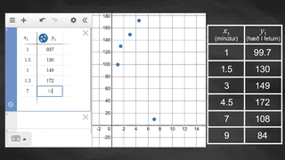
Learning Activity B | Video
Using Technology to Find the Quadratic Regression
Notes:
This video discusses questions 1 – 3 of activity 8.12.3.

Slide 21
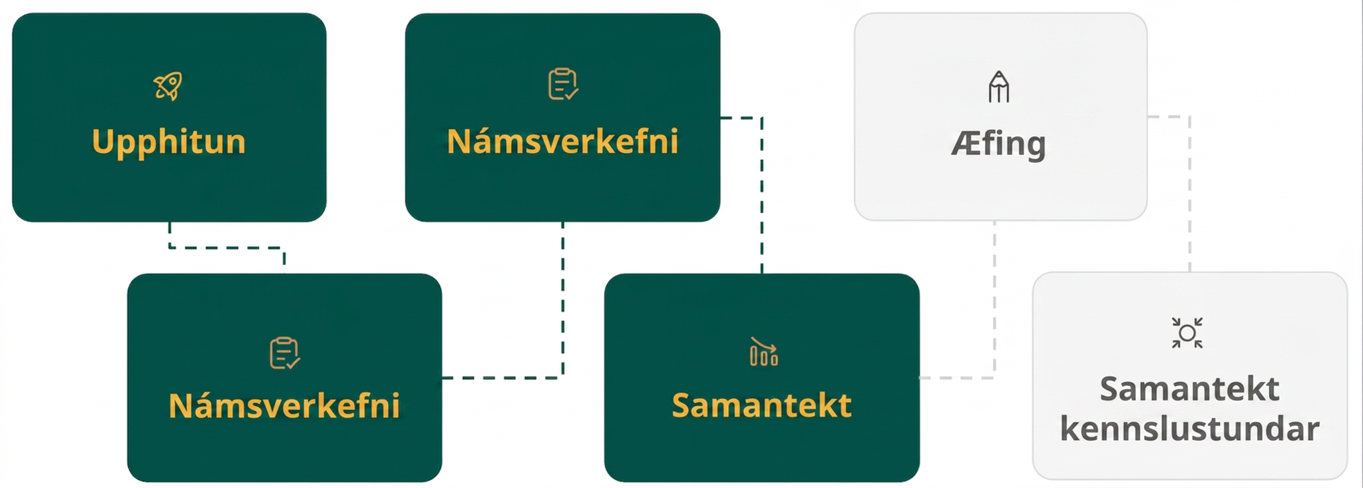
Lesson Journey
Fourth Step: Cool Down

Slide 22
Cool Down
Thomasina used a quadratic data set to create a curve of best fit for her data. Then she accidentally spilled paint on her paper and lost some of the entries in the table.
She needs to work backward to fill in the missing entries in her data set. Use the curve of best fit she created to complete the table.
x₁ | y₁
6 | ?
? | 452.06
? | 632.24
58.2 | ?
? | 176.12
Notes:
Cool Down (5 minutes)
Allow students to use Desmos to complete the activity. You may want to share the Desmos regression equation and graph (https://www.desmos.com/calculator/f7swq5eqbf) with students so they may access them on their own devices.
Remember, the activity is also available in the online textbook along with the answer for students to check their understanding immediately.
Answers
(6, 188.07)
(17.9, 452.06)
(31.1, 632.24)
(58.2, 630.83)
(83.6, 176.12)
Response to Student Thinking - Press Pause
At this point, students need to be able to evaluate and interpret quadratic equations with equations, graphs, and tables. If students continue to struggle, select examples from this unit to highlight and clarify misconceptions, and then have students work to revise cool downs and reflect on their misconceptions. Practice problem 10 from this lesson provides a similar opportunity for practice and additional formative assessment. The incorrect equations from question 5 could also be adapted for practice purposes.

Slide 23
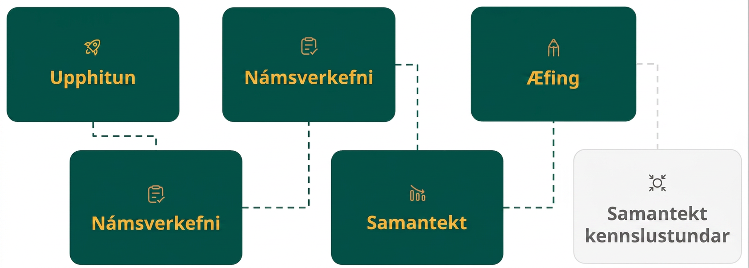
Lesson Journey
Fifth Stop: Practice

Slide 24

Practice
Put your hard work to action, practice what you’ve learned!
Notes:
Digital Practice: Access the practice pages at https://openstax.org/details/books/algebra-1

Slide 25
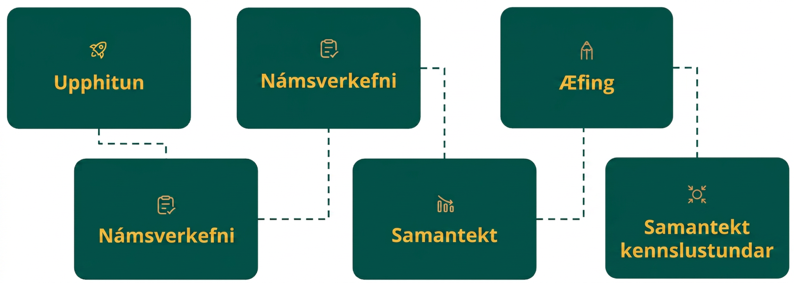
Lesson Journey
Sixth Stop: Lesson Synthesis

Slide 26
Lesson Synthesis
How can one represent a data set using graphing technology?
What does entering the equation 𝑦₁ ∼ 𝑎𝑥₁² + 𝑏𝑥₁ + 𝑐 into a Desmos graph containing a data set representing a quadratic equation do?
Will each point in a data set representing a quadratic equation fall onto its corresponding curve of best fit? Explain your answer.
Imagine a curve of best fit is graphed representing the height in meters, 𝑦, of a projectile corresponding to the number of seconds passed, 𝑥.
  What does a vertical line with the equation 𝑥 = 5 intersecting with the curve of best fit represent?
  What does a horizontal line with the equation 𝑦 = 10 intersecting with the curve of best fit represent?
Notes:
Remind students –
A key takeaway from this lesson is the idea that we can use a data set that models a quadratic equation to represent a real-life situation. We can then find a curve of best fit to represent the data set. Additionally, we can then use that curve of best fit to make further predictions about that situation.
Tell students that many situations can be modeled by a data set representing a quadratic function. Using graphing technology to analyze these data sets and generate an equation for the curve of best fit is an important skill and ensure the predictions are accurate.
Answers
By inputting the data into a table in the graphing technology to create a scatter plot.
A curve of best fit will be generated.
No, the curve of best fit represents the quadratic equation that best models all of the points in a data set. There is no guarantee that any individual point will align onto the curve.
a. It represents the moment in the projectile's flight when 5 seconds have passed.
b. It represents the moment or moments in the projectile's flight when it has a height of 10 feet.

Slide 27
Self Assessment
How much do you agree with the following statements?
Learning Goals | I can | Almost | Not yet
Graph a quadratic data set using technology. | ⃞ | ⃞ | ⃞
Find a regression curve, or curve of best fit, using a quadratic data set. | ⃞ | ⃞ | ⃞
Use a regression curve to create a quadratic model for making predictions. | ⃞ | ⃞ | ⃞
Make predictions about a real-world situation using a quadratic data set. | ⃞ | ⃞ | ⃞

