Slide 1


Algebra 1
Unit 4 Functions
Lesson 4.8: Using Graphs to Find Average Rate of Change

Slide 2
How to use these slides
On the activity slides check the speaker notes for teacher support and instructional information.
Each lesson includes 1 warm up, 2-3 learning activities, a cool down, practice and a lesson synthesis.
  Learning activities are followed by a self check question, and review section.
Some slides have been hidden from student view, more information can be found on the next slide (Reference Key).
You can edit and use these slides for personal and classroom use, but cannot sell them and must keep the attribution logos.
For more information, Check out the digital quick start guide!

Slide 3






Reference Key
Check the top right corner for an icon referencing these unique sections.
 | Support for Students with Disability | Hidden | Learning Strategies slide, provides additional support to students for understanding the activity. Learning Strategies slide, provides additional support to students for understanding the activity.
 | Support for English Language Learners | Hidden
 | Extending Your Thinking | Hidden | Extending Your Thinking slide, provides an extra challenge for students.
 | Self Check | Not Hidden | Self Check slide, checkpoint to assess student understanding after the learning activity.
 | Review | Hidden | Self Check- Review slide, designed to help review topics from the self check question.
On the next slides, check the speaker notes for teacher instructions and support.
Notes:
Check the Speaker Notes: On the next slides you can find discussion questions, lesson information, answers to the activities, and ways to adjust the activity for your students!

Slide 4

Learning Goals
By the end of this lesson you will be able to -
Explain the meaning of the term “average rate of change.”
Estimate or calculate the average rate of change between two points from the graph of a function.
Notes:
Lesson Narrative
Previously, students described how functions change qualitatively and interpreted slopes as rates of change. In this lesson, they quantify changes using average rate of change.
Students learn to calculate average rate of change using known input-output pairs or estimate it from a graph.
Units are essential in interpreting average rates of change, helping students focus on precision.
By calculating average rates of change from data or graphs to analyze situations or make predictions, students engage in mathematical modeling.
Required Preparation
None
Required Materials
None
Texas Essential Knowledge and Skills
A1(D) communicate mathematical ideas, reasoning, and their implications using multiple representations, including symbols, diagrams, graphs, and language as appropriate
A12(A) decide whether relations represented verbally, tabularly, graphically, and symbolically define a function;

Slide 5
Vocabulary
Previous
Function
  A relation that takes inputs from one set and assigns them to outputs from another set, assigning exactly one output to each input.
Slope
  The change in two dependent values of a linear function divided by the change in the corresponding two independent values. This can be thought of rise over run, the rate of change in 𝑦 over the change in 𝑥, or steepness of a line.
New
Average rate of change
  The change in the outputs divided by the change in the inputs. It is the slope of the line on the graph.
Positive and Negative slope
  Shape of a sloping line as it moves from left to right.
  Positive = Upwards(Increasing)
  Negative = Downwards (Decreasing)
Zero slope
  The slope of a horizontal line because the line does not have a change in 𝑦-values.
Notes:
Lesson Vocabulary
To support student understanding of key vocabulary:
Introduce and review the vocabulary words students will see in this lesson.
Encourage students to notice how these words are used and to include them in their math discussions and explanations—both written and oral.
Use a word wall to reinforce vocabulary. Sample word wall cards are available here.
For newcomers or students with beginning English proficiency, use these Quizlet sets to support vocabulary learning:
Unit 4 Spanish Vocabulary, part 1 – use first to build understanding
Unit 4 Vocabulary (English), part 1 – use after anchoring in Spanish
Unit 4 Spanish Vocabulary, part 2 – use first to build understanding
Unit 4 Vocabulary (English), part 2 – use after anchoring in Spanish
Support for English Language Learners
ELPS 1(E) internalize new basic and academic language by using and reusing it in meaningful ways in speaking and writing activities that build concept and language attainment
ELPS 2(F) listen to and derive meaning from a variety of media such as audiotape, video, DVD, and CD-ROM to build and reinforce concept and language attainment
ELPS 3(C) speak using a variety of grammatical structures, sentence lengths, sentence types, and connecting words with increasing accuracy and ease as more English is acquired
ELPS 3(E) share information in cooperative learning interactions
ELPS 3(F) ask and give information ranging from using a very limited bank of high-frequency, high-need, concrete vocabulary, including key words and expressions needed for basic communication in academic and social contexts, to using abstract and content-based vocabulary during extended speaking assignments
ELPS 3(G) express opinions, ideas, and feelings ranging from communicating single words and short phrases to participating in extended discussions on a variety of social and grade-appropriate academic topics
ELPS 3(H) narrate, describe, and explain with increasing specificity and detail as more English is acquired
ELPS 3(I) adapt spoken language appropriately for formal and informal purposes

Slide 6





Lesson Journey
Warm Up
Learning Activity
Cool Down
Lesson Synthesis
Learning Activity
Learning Activity
Practice

Slide 7
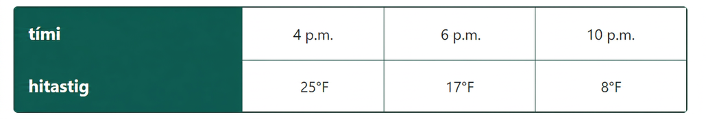
Warm Up - Temperature Change 🌡️
Here are the recorded temperatures at three different times on a winter evening.
Tyler says the temperature dropped faster between 4 p.m. and 6 p.m.
Mai says the temperature dropped faster between 6 p.m. and 10 p.m.
Who do you agree with? Be prepared to show your reasoning.
Notes:
Warm Up (5 minutes)
In this warm-up, students compare temperature changes over two time intervals—one with a larger total change, the other with a faster rate of change.
Thinking about what it means for temperature to drop “faster” activates the idea of rates of change and prepares for the work later in the lesson.
Launch
Display the task for all to see. Give students 2 minutes of quiet time to work the question and then follow with a whole-class discussion.
Activity Answers
Compare your answer:
I agree with Mai. The temperature dropped 8°F between 4 p.m. and 6 p.m., but it fell 9°F between 6 p.m. and 10 p.m.
I agree with Tyler. The temperature dropped 4°F per hour between 4 p.m. and 6 p.m. It fell less than 4°F per hour in the evening.
Anticipated Misconceptions
Some students may ask for a clarification as to what is meant by “faster” in this situation. Acknowledge that thinking about its meaning in context is a great way to approach the task. Encourage these students to interpret the word based on their understanding of the given information.
Activity Synthesis
Poll the class on whether they agree with Mai or with Tyler. Select 1 – 2 students from each group to explain their reasoning. As they explain, record and display their thinking for all to see. After both groups have had a chance to present, ask if anyone changed their mind because of the explanation they heard. If so, invite them to share their reasons.
It is not necessary to resolve the question at this point. Students will continue thinking about this question in the next activity.

Slide 8

Lesson Journey
Warm Up
Learning Activity
Cool Down
Lesson Synthesis
Learning Activity
Learning Activity
Practice

Slide 9
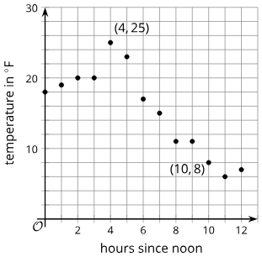
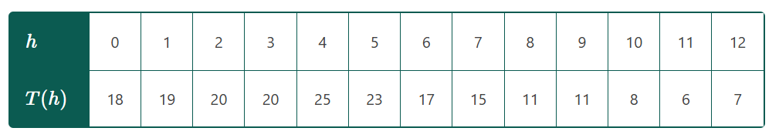
Learning Activity - Winter Temperatures ❄️
The table and graph show a more complete picture of the temperature changes on the same winter day. The function T gives the temperature, in degrees Fahrenheit, h hours since noon.
Notes:
Support for All Learners
This activity offers additional support and an extension for students:
For English language learners and students with disabilities, be sure to review the Learning Strategies slide!
For students looking for an extra challenge, be sure to review the Extending Your Thinking slide!
Activity (10 minutes)
In this activity, students explore functions by analyzing a dog’s distance from a post over time. They sketch graphs from movement descriptions and interpret each point as a time and distance. This helps them recall independent and dependent variables and understand why the relationship is a function—the dog can't be in two places at once. Teachers should note graphs that go above 5 feet or miss key points, as these offer chances to clarify the context and its limits.
Launch
Read the task statement and the descriptions about the dog owner and his three days of dog walking.
Provide students with a copy of the RAISE 4.1.2 Activity Handout.
Discuss features of a graph that could represent the dog’s movement on Day 3 and display a possible graph. An example is shown here.
Click here for the slide with Launch Image 1.
Keep students in groups of 4. Ask 2 group members to graph the dog's movement on Day 1, and the other 2 members to graph the movement on Day 2.
One person who graphed day 1 should pair with someone who graphed day 2. Students should explain their graphs and help partners change the graphs where needed.
Digital graphing strategy - To graph day 3, have students access the GeoGebra link https://www.geogebra.org/classic/z8zah6ak to open a blank graph for the dog movement scenario. Provide students with the following prompting questions
If the dog was 1.5 feet from the post when the owner left him outside the store, how much time has passed?
What point does this represent? (t = 0; (0, 1.5) is the point that students will need to graph.)
If the dog is 4 feet away from the post after 60 seconds, what point does this represent? ((60, 4) is the point that students will need to graph.)
To graph the points (0, 1.5) and (60, 4), students can enter the points in the Input menu on the left side of the screen or they plot the points on the graph by using the Point tool. (Students click on the point tool to activate it, then click on the locations for the points on the graph.)
Click here for the slide with Launch Image 2.
Now, have the students use the Freehand Shape tool (accessed through the Move tool menu) to draw the graph that is described by the dog’s movement on Day 3.
Click here for the slide with Launch Image 3.
Students can reload the page to create their digital graphs for Days 1 and 2 or they can continue adding to their graph using the Freehand Shape tool and the left input menu. (Note that students can select/de-select the previous freehand shape or delete it.)
Activity image answer, and synthesis on the next slide.

Slide 10
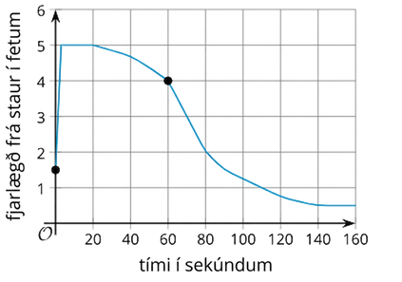
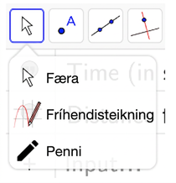

Learning Activity - Winter Temperatures ❄️
Launch Image 1
Launch Image 2
Launch Image 3
Notes:
Activity Images

Slide 11
Learning Activity - Winter Temperatures ❄️
Teacher Instruction: Use these strategies to adjust the activity to support English language learners and students with disabilities.
  You can copy and paste the callouts directly on top of the activity or give the instructions aloud.
Create a visual showing how you found the average rates of change for each interval.
Represent your strategy so that other students will be able to understand your solution method.
Add notes or details to your displays to help communicate your reasoning and thinking.
Compare and Connect
Notes:
Support for English Language Learners: MLR 7 Compare and Connect: Representing, Conversing
Prior to the whole-class discussion, invite students to create a visual display that shows how they determined the average rates of change for the specified intervals. Students should consider how to represent their strategy so that other students will be able to understand their solution method. Students may wish to add notes or details to their displays to help communicate their reasoning and thinking. Begin the whole-class discussion by selecting and arranging 2 – 4 displays for all to see. Give students 1 – 2 minutes of quiet time to think individually to interpret the displays before inviting the authors to share their strategies as described in the activity narrative. This will help students make connections between different ways to find the average rate of change.
Design Principle(s): Cultivate conversation; Maximize meta-awareness
Learn more about this routine
View the instructional video and follow along with the materials to assist you with learning this routine.
Provide support for students
Distribute graphic organizers to the students to assist them with participating in this routine.
Support for Students with Disabilities: Representation: Internalize Comprehension
Represent the same information through different modalities by using physical objects to represent abstract concepts. Use a three-dimensional prop to represent the situation and the dog’s movement. This prop might use a dowel rod for the post and a piece of string or yarn for the leash. Viewing or manipulating the prop can help students better understand the context and quantities involved.
Supports accessibility for: Conceptual processing; Visual-spatial processing

Slide 12
Learning Activity - Winter Temperatures ❄️
In questions 1 – 3, find the average rate of change for the following intervals. Be prepared to show your reasoning.
between noon and 1 p.m.
between noon and 4 p.m.
between noon and midnight
In questions 4 – 6, use the slope formula to find the slope of the line that connects the following points.
(0,18) and (1,19).
(0,18) and (4,25)
(0,18) and (12,7)
Compare your answers to questions 1–3 and 4–6. What do they reveal about slope of a line and average rate of change?
Are you ready for more?
Notes:
Activity Answers
1°F per hour. The temperature rose by 1°F in 1 hour.
1.75°F per hour. The temperature increased by 7°F in 4 hours. The average increase is ⁷⁄₄ or 1.75.
–0.92°F an hour. I found the slope of the line connecting the two points, and it is −¹¹⁄₁₂.
¹⁹⁻¹⁸⁄₁₋₀ = 1
²⁵⁻¹⁸⁄₄₋₀ = ⁷⁄₄
⁷⁻¹⁸⁄₁₂₋₀ = −¹¹⁄₁₂
The average rate of change between two points is the same as the slope of the line connecting the 2 points.
Anticipated Misconceptions
Students may not realize that graphs are read left to right, which can lead to confusion when identifying intervals of increase and decrease. They also often mix up x- and y-values when calculating average rate of change. Encouraging them to check if their answer makes sense can help them catch and correct mistakes.
Activity Synthesis
Select students to share how they determined the average rates of change for the specified intervals. Arrange the presentations in the order listed in the Activity Narrative.
Then, point out that all strategies involve finding how much the temperature (the output) changed per unit of change in time (the input), and that this is done by division.
Display a graph with two points labeled (a,f(a)) and (b,f(b)). Ask students how we might find the average rate of change between the two points.
Click here for the slide with Synthesis Image 2.
Make sure students can generalize their work and see that:
f(b) − f(a)
average rate of change = --------------
b − a

Slide 13
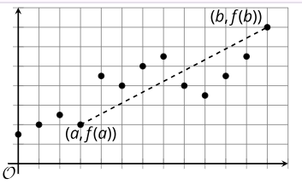
Learning Activity - Winter Temperatures ❄️
Synthesis Image 1
Notes:
Activity Images

Slide 14

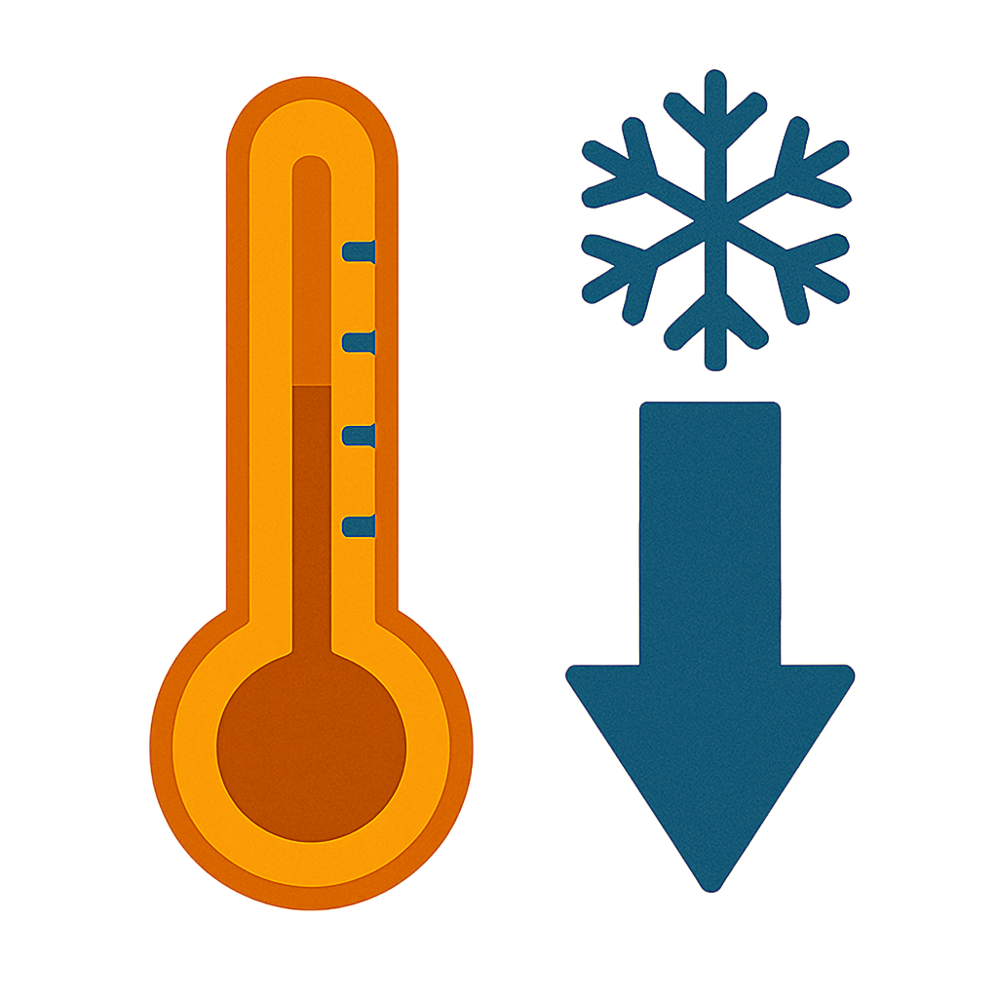
Extending Your Thinking
Over what interval did the temperature decrease the most rapidly?
Over what interval did the temperature increase the most rapidly?
Notes:
Answer
between 5 p.m. and 6 p.m.
between 3 p.m. and 4 p.m.

Slide 15
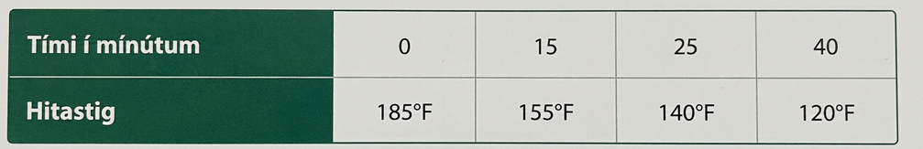
Self Check
The table represents the temperature t, in degrees Fahrenheit, of a cup of coffee that was poured and then forgotten for m minutes. What was the average rate of change from when the cup was poured to 40 minutes later?
–2 degrees per minute
–0.615 degrees per minute
–1.333 degrees per minute
–1.625 degrees per minute
Let’s review!
Notes:
Answer Feedback - Individualized by Response
Incorrect. The graph is looking at time and elevation, not speed. The answer is that the person was hiking up a hill for the first 3 minutes.
Incorrect. The graph is looking at time and elevation, not speed. The answer is that the person was hiking up a hill for the first 3 minutes.
That’s correct! : As time passed during the first 3 minutes, the person’s elevation increased.
Incorrect. The elevation stayed the same from 3 to 4 minutes and about 5 to 6 minutes, so that is where they stopped climbing. The answer is that the person was hiking up a hill for the first 3 minutes.

Slide 16
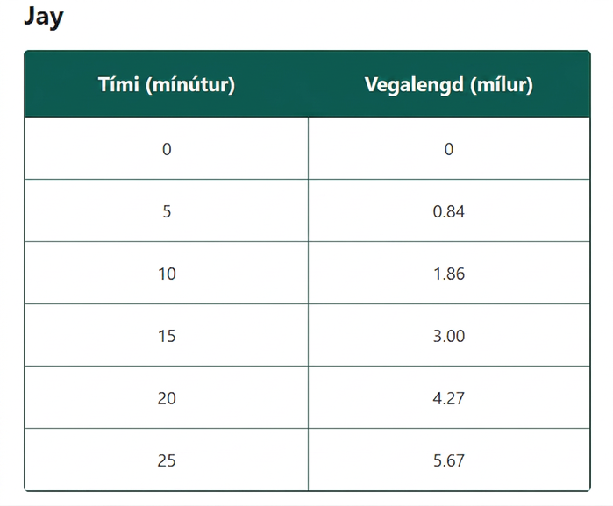
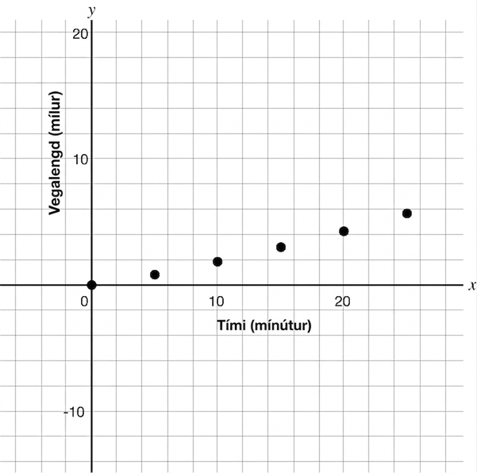
Self Check - Review
Finding Rates of Change
Jay was racing bikes with a friend on the way to the park. The table and chart show his times.
What is the average rate of change of the first 10 minutes of the race?
Notes:
Discuss with Students
To find the average rate of change of the first 10 minutes of the race, you would look at the first data value on the table and the third data value on the table, since it corresponds to 10 minutes.
Remember the average rate of change formula is
f(b) − f(a)
--------------,
b − a
where (b,f(b)) typically represents your second data point and (a,f(a)) represents your first data point.
For this situation, it would be (0,0) or a = 0 and f(a) = 0 and (10,1.86) or b = 10 and f(b) = 1.86.
Substituting the points into the average rate of change formula results in the following:
f(b) − f(a)
--------------,
b − a
which is
1.86
------ or 0.186 mile per minute.
10
Notice that the answer is positive, and the points on the graph are higher each time.

Slide 17
Lesson Journey
Warm Up
Learning Activity
Cool Down
Lesson Synthesis
Learning Activity
Learning Activity
Practice

Slide 18
Learning Strategies - Population Over Time 🧑🏾‍🤝‍🧑🧑🏾‍🤝‍🧑🧑🏾‍🤝‍🧑
Teacher Instruction: Use these strategies to adjust the activity to support English language learners and students with disabilities.
You can copy and paste the callouts directly on top of the activity or give the instructions aloud.
“Which state’s population grew more quickly between 1900 and 2000?”
“Can you say that a different way?”;
“Does your method work using a different time interval?”
Stronger and Clearer Each Time
Suggest words or diagrams that help explain rate of change, slope, and average rate of change.
Representation
Notes:
Support for English Language Learners: MLR 1 Stronger and Clearer Each Time: Writing, Listening, Conversing
Use this routine to help students improve their verbal and written responses to the question, “Which state’s population grew more quickly between 1900 and 2000?” Give students time to meet with 2 – 3 partners to share and get feedback on their responses. The listener should press for detail and precision in language by asking: “Can you say that a different way?”; “Does your method work using a different time interval?”; or “Besides computing the average rate of change, can you think of another way to determine this?” Invite students to go back and revise or refine their written explanation based on the feedback from peers. This will help students find and interpret average rates of change in context.
Design Principle(s): Support sense-making
Provide support for students
Distribute graphic organizers to the students to assist them with participating in this routine.
Support for Students with Disabilities: Representation: Develop Language and Symbols
Create a display of important terms and vocabulary. During the launch, take time to review terms that students will need to access this activity. Invite students to suggest language or diagrams to include that will support their understanding of rate of change, slope, and average rate of change.
Supports accessibility for: Conceptual processing; Language

Slide 19
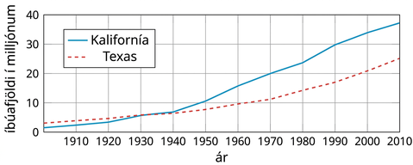
Learning Activity - Population Over Time 🧑🏾‍🤝‍🧑🧑🏾‍🤝‍🧑🧑🏾‍🤝‍🧑
The graphs show the populations of California and Texas over time.
Use this graph to answer the following questions.
Notes:
Support for All Learners
This activity offers additional support and an extension for students:
For English language learners and students with disabilities, be sure to review the Learning Strategies slide!
Activity (10 minutes)
This activity gives students practice computing average rates of change by estimating the coordinates on a graph without using tables.
Students analyze the graph, use symbolic reasoning, and interpret results with attention to units (years and millions of people), reinforcing precision.
Launch
Support for Students with Disabilities: Representation: Develop Language and Symbols
Create a display of important terms and vocabulary. During the launch, take time to review terms that students will need to access this activity. Invite students to suggest language or diagrams to include that will support their understanding of rate of change, slope, and average rate of change.
Supports accessibility for: Conceptual processing; Language
Activity questions, answers, and synthesis on the next slide.

Slide 20

Learning Activity - Population Over Time 🧑🏾‍🤝‍🧑🧑🏾‍🤝‍🧑🧑🏾‍🤝‍🧑
Estimate the average rate of change in the population in California between 1970 and 2010. Be prepared to show your reasoning.
In this situation, what does the rate of change mean for California?
Estimate the average rate of change in the population in Texas between 1970 and 2010. Be prepared to show your reasoning.
In this situation, what does the rate of change mean for Texas?
Which state’s population grew more quickly between 1900 and 2000? Be prepared to show your reasoning.
Notes:
Answers
The population of California was about 20 million in 1970 and 37 million in 2010. The average rate of change is: ³⁷⁻²⁰⁄₂₀₁₀₋₁₉₇₀ = ¹⁷⁄₄₀ = 0.425 million per year.
On average, the population of California was growing by 425,000 people per year.
The population of Texas was about 11 million in 1970 and 25 million in 2010. The average rate of change is ²⁵⁻¹¹⁄₂₀₁₀₋₁₉₇₀ = ¹⁴⁄₄₀ = 0.35 million per year.
On average, the population of Texas was growing by 350,000 people per year.
California is growing more quickly. For example: If we connect each pair of points representing the population of each state in 1900 and 2000, the segment for California has a greater slope, so it has a greater average rate of change.
Anticipated Misconceptions
Interpreting slope can be challenging, as students may struggle to see points as meaningful data. Emphasize what each coordinate represents.
Remind students that the y-values go on top in the slope formula, so the slope means y-units per x-unit. Highlighting it as a unit rate can help.
Activity Synthesis
Students may get slightly different average rates of change for California and Texas due to differences in estimating values from the graph—discuss this.
Have students share their responses and note that trends can be compared visually by looking at the steepness of lines, without doing exact calculations.

Slide 21
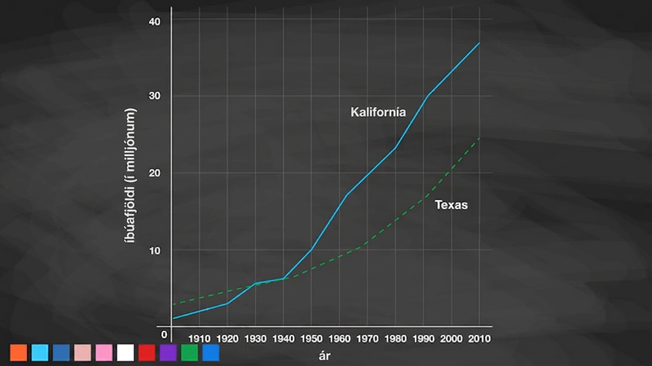
Video: Interpreting Average Rate of Change

Slide 22
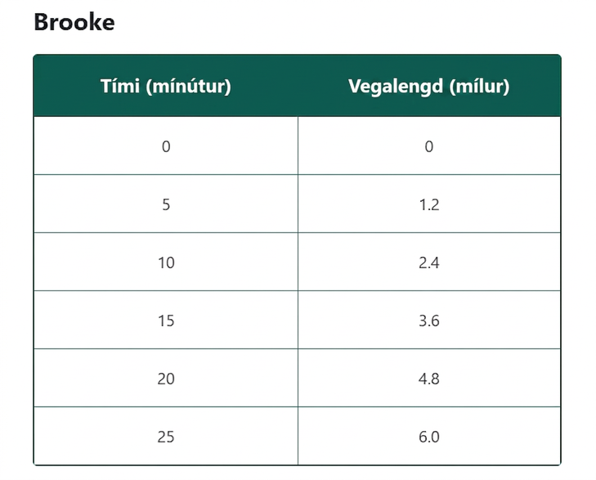
Self Check
Brooke was racing bikes with a friend on the way to the park. A table of her distance traveled over time is shown.What was Brooke’s average rate of change between 5 minutes and 20 minutes? What does it mean in the context of the problem?
The average rate of change is 3.6 miles per minute.
The average rate of change is 15 minutes per mile.
The average rate of change is 0.24 mile per minute.
The average rate of change is 4.17 minutes per mile.
Let’s review!
Notes:
Answer Feedback - Individualized by Response
Incorrect. 3.6 is the change in distance. When finding the average rate of change, you need to find the change in the distance and the change in the time. Then divide those values,
(change in distance)
--------------------
(change in time).
The answer is 0.24 mile per minute.
Incorrect. 15 minutes is the change in time. When finding the average rate of change, you need to find the change in the distance and the change in the time. Then divide those values,
(change in distance)
--------------------
(change in time).
The answer is 0.24 mile per minute.
That’s correct!. Check yourself: Substitute the data values into the formula to find the
(change in distance)
--------------------
(change in time),
or 3.615. The correct answer is 0.24 mile per minute.
Incorrect. This is the change in time over the change in distance. Substitute the data values into the formula to find the
(change in distance)
--------------------
(change in time) ,
or 3.615. The answer is 0.24 mile per minute.

Slide 23
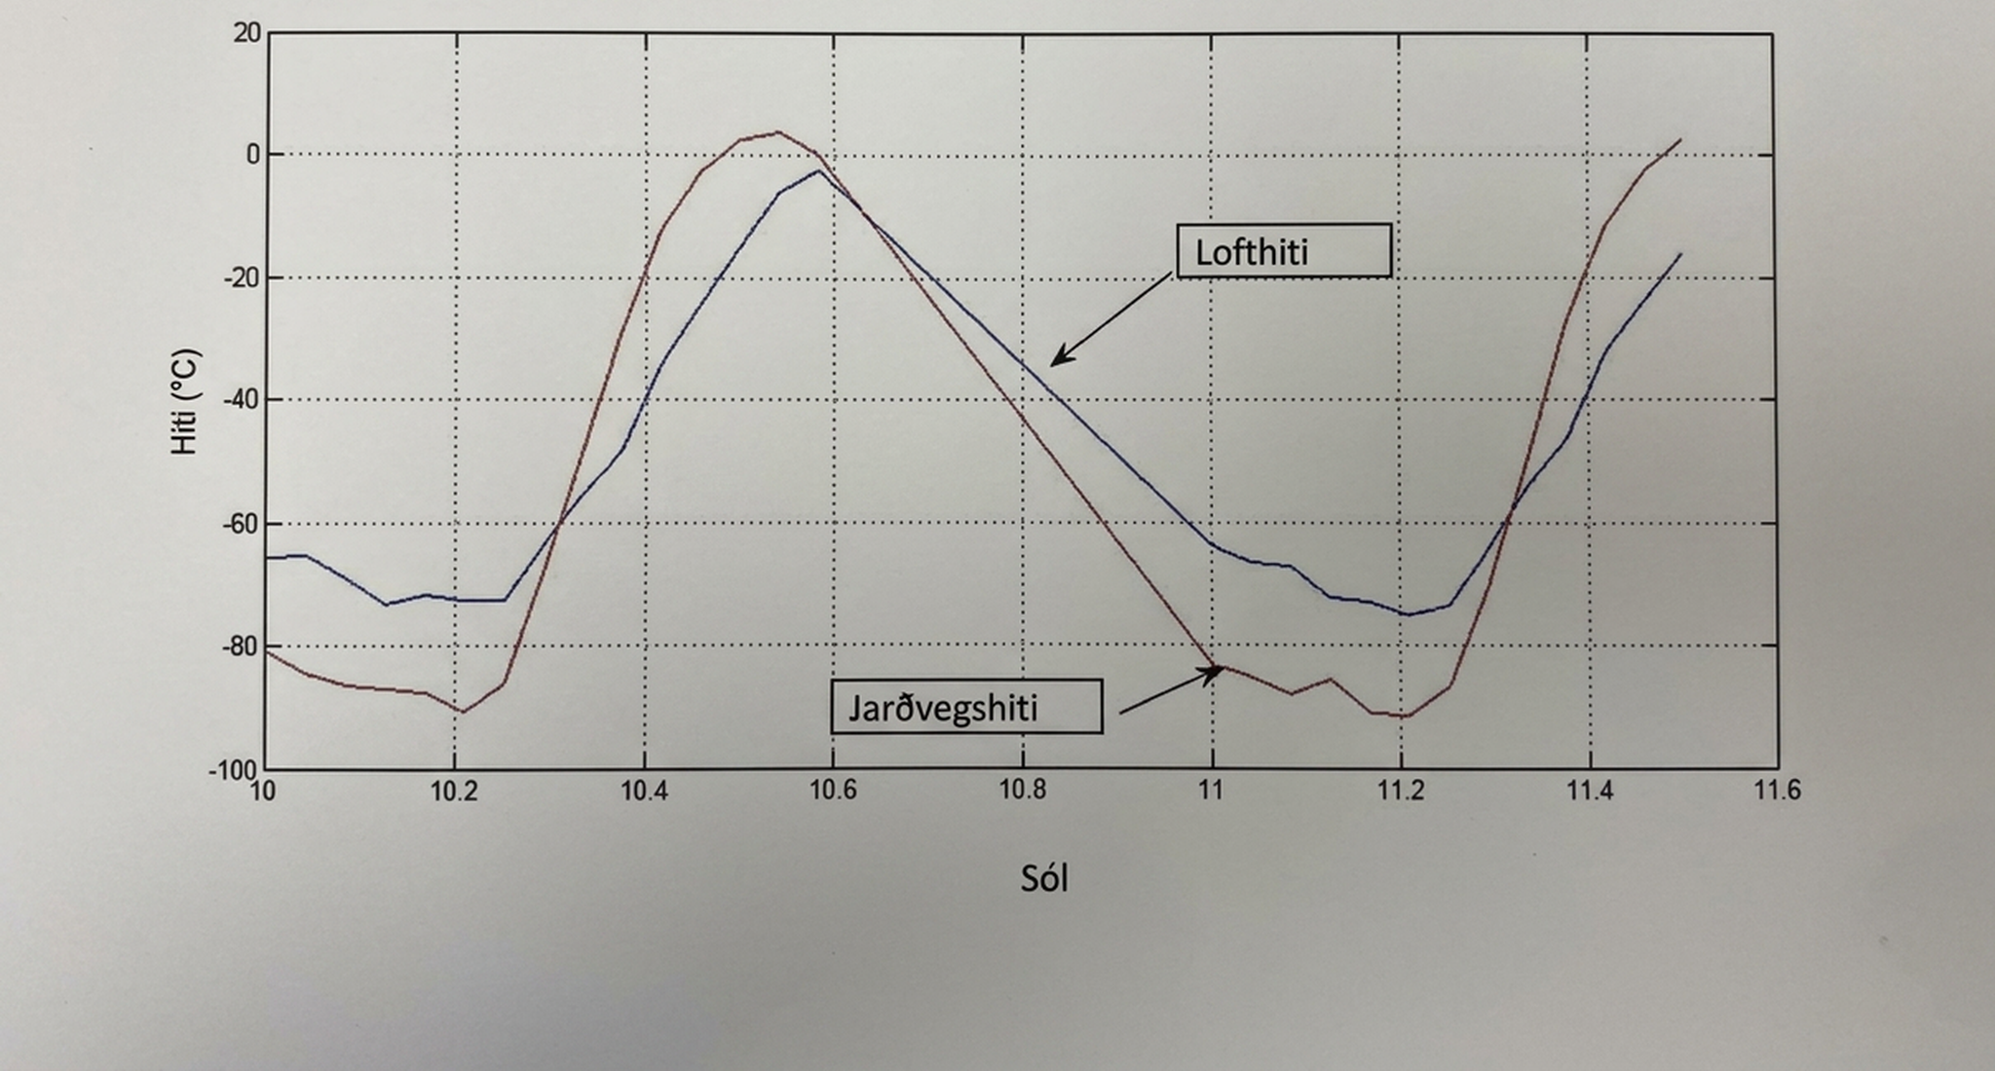
Self Check - Review
A Mars rover collected the following temperature data over 1.6 Martian days. A Martian day is called a Sol.
GROUND AND AIR TEMPERATURE SENSOR
Which had a greater average rate of change between 10.2 and 10.4 Sol, ground temperature or air temperature? What is the meaning of each rate change?
Notes:
Answers
Since ground temperature has a greater slant or slope, it has a greater rate of change. Slope is another word for the rate of change of a graph.
To find the average rate of change, first you need to find Sol on the graph (which is what a day is called on Mars). Find the values of 10.2 and 10.4 on the x-axis. Find the corresponding y-values of the points for both the ground temperature and air temperature graphs. By finding the average rate of change, you will be able to determine exactly one was greater.
Ground Temperature: (10.2,−90) (10.4,−20)
Air Temperature: (10.2,−70) (10.4,−40)
Substitute each set of points into the average rate of change formula:
Ground Temperature
(change in distance) -20 - (-90) 70
-------------------------- = --------------------- = ------- = 350
(change in time) 10.4 − 10.2 0.2
Air Temperature
(change in distance) -40 - (-70) 30
-------------------------- = --------------------- = ------- = 150
(change in time) 10.4 − 10.2 0.2
Remember that to interpret the meaning of the rate of change, you need to compare the axes. It is the change in the y-axis units divided by the change in the x-axis units, or
(change in temperature in degrees celsius)
-------------------------------------------------------- .
(change in Sol)
That means that each average rate of change of each can be interpreted as:
Ground Temperature’s average rate of change is 350 degrees celsius per Sol (or day on Mars).
Air Temperature’s average rate of change is 150 degrees celsius per Sol (or day on Mars).

Slide 24
Lesson Journey
Warm Up
Learning Activity
Cool Down
Lesson Synthesis
Learning Activity
Learning Activity
Practice

Slide 25

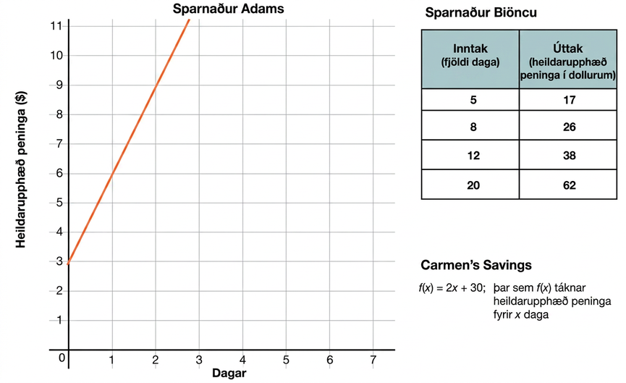
Learning Activity - Save Money 💰
Three people, Adam, Bianca, and Carmen, are competing to see who can save the most money in one month. Use the table, graph, or equation in each question to find the average rate of change during the time given.
Use the graph to find Adam’s savings between:
  0 and 1 days
  1 and 2 days
  1 and 3 days
Notes:
Activity (10 minutes)
Students compare three linear functions representing savings over time, using different tools for each person.
Adam: graph, Bianca: table, and Carmen: equation
They calculate average rates of change over intervals and determine who saves the fastest and who has the most after 30 days.
Launch
Display the scenario:
"Adam, Bianca, and Carmen are competing to save the most money in 30 days."
Ask:
What does saving money at a constant rate look like?
How can we tell who saves the fastest using graphs, tables, or equations?
Introduce the representations:
Adam: Line through (0, 3) and (1, 6)
Bianca: Table of values
Carmen: f(x) = 2x + 30
Activity questions, answers, anticipated misconceptions, and synthesis on the next slide.

Slide 26
Learning Activity - Save Money 💰
Use the table to find Bianca’s savings between:
  5 and 8 days
  12 and 20 days.
  5 and 20 days.
Use the equation to find Carmen’s savings between:
  1 and 2 days.
  2 and 4 days.
  1 and 4 days.
Which two statements are true? All three functions:
  are linear functions.
  have the same rate of change.
  have a constant rate of change.
Who has the most money after 30 days? Explain how you know.
Notes:
Answers
Using the graph:
3 dollars per day
3 dollars per day
3 dollars per day
Using the table:
3 dollars per day
3 dollars per day
3 dollars per day
Using the equation:
2 dollars per day
2 dollars per day
2 dollars per day
a and c
Adam; Adam’s function is A(30) = 3(30) + 3 = 93
Bianca’s function is B(30) = 3(30) + 2 = 92
Carmen’s function is C(30) = 2(30) + 30 = 90.
Anticipated Misconceptions
Mixing up x- and y-values when finding rate of change
Misreading uneven table intervals
Thinking the constant in Carmen’s equation (30) is the rate instead of the slope (2)
Activity Synthesis
Discuss:
All three functions are linear
Adam and Bianca have the same rate: $3/day
Carmen saves $2/day
Conclude:
A constant rate = linear function
Rate of change helps compare savings over time
Adam saves the fastest and has the most after 30 days

Slide 27
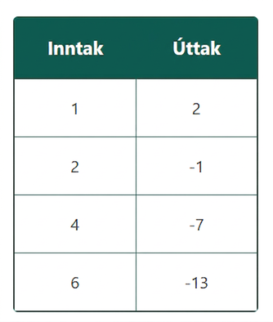
Self Check
What is the average rate of change for the linear function?
3
-3
-⅓
⅓
Let’s review!
Notes:
Answer Feedback - Individualized by Response
3
Incorrect. Watch the signs when finding the differences. The rate of change of a linear function is the slope,
(change in y)
--------------------
(change in x).
The answer is -3.
-3
That’s Correct! That’s correct! Check yourself: The rate of change of a linear function is the slope,
(change in y)
--------------------
(change in x).
The answer is -3.
-⅓
Incorrect. This is the reciprocal of the answer. Remember the slope is
(change in y)
--------------------
(change in x).
The answer is -3.
⅓
Incorrect. Watch the signs when finding the differences. Remember the slope is
(change in y)
--------------------
(change in x).
The answer is -3.

Slide 28

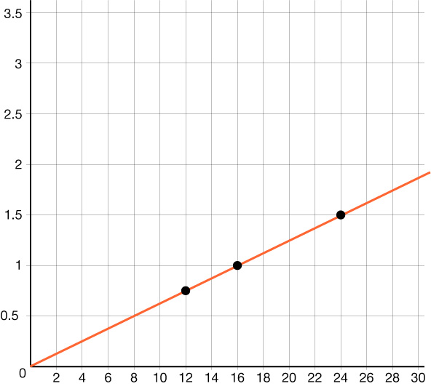
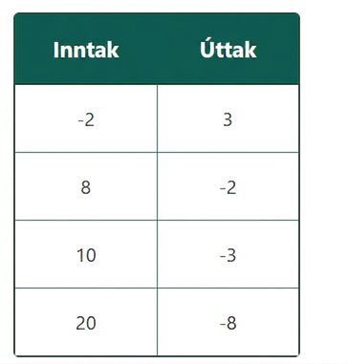
Self Check - Review
The graph of a linear function is identical to the graph of the linear equation that describes it. The rate of change of a linear equation is constant. The rate of change is the slope, . Find the rate of change of a linear function:
From a graph
From a table
From an equation
F(x) = 7x + 6
Notes:
Answers:
The rate of change of a linear function is constant, so you can choose any 2 points to find the slope. Use (16,1) and (24,1.5)
y₂ − y₁ 1.5 - 1 0.5
m = ---------- = - --------- = --------- = ¹⁄₁₆
x₂ − x₁ 24-16 8
The rate of change is ¹⁄₁₆.
The rate of change of a linear function is constant, so you can choose any 2 points to find the slope. Use (−2,3) and (8,−2)
y₂ − y₁ -2 -3 -5 -5
m = ---------- = - --------- = --------- = --------- = - ½
x₂ − x₁ 24-16 8 - (-2) 10
The rate of change is - ½.
Use the slope intercept form, y = mx + b, where m is the slope and b is the y-intercepts.
y = 7x + 6
The slope is 7. The rate of change is 7.

Slide 29

Lesson Journey
Warm Up
Learning Activity
Cool Down
Lesson Synthesis
Learning Activity
Learning Activity
Practice

Slide 30
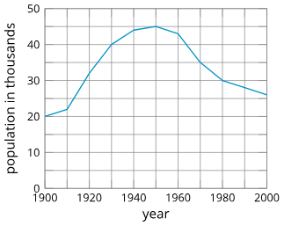
Cool Down
What is the average rate of change of the population between 1930 and 1950? Be prepared to show your reasoning.
For questions 2 - 4, decide if the average rate of change is positive or negative for the listed time period.
1930 to 1940
1950 to 1970
1930 to 1970
In which decade (10-year interval) did the population grow the fastest? Explain how you know.
Graph representing the population of a city from 1900 to 2000.
Notes:
Cool Down (5 minutes)
Answers
About 250 people per year. The population was 40,000 in 1930 and about 45,000 in 1950, an increase of 5,000 people over 20 years, which equals 250 people per year.
Positive
Negative
Negative
Compare your answers:
From 1910 to 1920. For example: The graph has the steepest slope between the two points on the graph (1910,22) and (1920,32).

Slide 31

Lesson Journey
Warm Up
Learning Activity
Cool Down
Lesson Synthesis
Learning Activity
Learning Activity
Practice

Slide 32

Practice
Put your hard work to action, practice what you’ve learned!
Notes:
Digital Practice: Access the practice pages at https://openstax.org/details/books/algebra-1

Slide 33

Lesson Journey
Warm Up
Learning Activity
Cool Down
Lesson Synthesis
Learning Activity
Learning Activity
Practice

Slide 34

Lesson Synthesis
How would you explain average rate of change to a classmate who is absent today? What does it tell us? How do we find it?
Which representation—a table or a graph—can give us a better sense of the general trend of a function over a certain interval? Why?
What does a negative average rate of change tell us?
If a function has a negative average rate of change over an interval, does it mean that the function value never increases?
When dealing with Mai and Tyler’s case, we compared average rates of change over two intervals that are not the same length. Was that a fair comparison? Does the length of the interval matter?
Notes:
Discuss questions such as:
“How would you explain average rate of change to a classmate who is absent today? What does it tell us? How do we find it?”
“Which representation—a table or a graph—can give us a better sense of the general trend of a function over a certain interval? Why?” (A graph, because we can visualize a line that fits the data in an interval and reason about its slope.)
“What does a negative average rate of change tell us?” (The output of the function is decreasing for every unit of increase in input.)
“If a function has a negative average rate of change over an interval, does it mean that the function value never increases?” (No, there might be parts of the interval where the function value rises, but overall it is falling.)
“When dealing with Mai and Tyler’s case, we compared average rates of change over two intervals that are not the same length. Was that a fair comparison? Does the length of the interval matter?” (Yes, it is a fair comparison. The length of the interval doesn’t matter because an average rate of change gives the amount of change per unit of input.)
Closing the Lesson
After completing the Lesson Synthesis, wrap up the class by directing students to the Lesson Summary in their student textbook. In this section, students review the day’s learning targets, read summaries about the key takeaways from each activity, and then respond to a reflection question regarding their confidence with the material.
For more on the benefits of using this type of metacognitive reflection, see the Research in Practice section of the course.

Slide 35
Self Assessment
How much do you agree with the following statements?
I can… | I can | Almost | Not yet
Explain the meaning of the term “average rate of change.”
Estimate or calculate the average rate of change between two points from the graph of a function.

