Slide 1


Algebra 1
Unit 5 Introduction to Exponential Functions
Lesson 5.12 Reasoning about Exponential Graphs, Part 1

Slide 2
How to use these slides
On the activity slides check the speaker notes for teacher support and instructional information.
Each lesson includes 1 warm up, 2-3 learning activities, a cool down, practice and a lesson synthesis.
  Learning activities are followed by a self check question, and review section.
Some slides have been hidden from student view, more information can be found on the next slide (Reference Key).
You can edit and use these slides for personal and classroom use, but cannot sell them and must keep the attribution logos.
For more information, Check out the digital quick start guide!

Slide 3






Reference Key
Check the top right corner for an icon referencing these unique sections.
 | Support for Students with Disability | Hidden | Learning Strategies slide, provides additional support to students for understanding the activity. Learning Strategies slide, provides additional support to students for understanding the activity.
 | Support for English Language Learners | Hidden
 | Extending Your Thinking | Hidden | Extending Your Thinking slide, provides an extra challenge for students.
 | Self Check | Not Hidden | Self Check slide, checkpoint to assess student understanding after the learning activity.
 | Review | Hidden | Self Check- Review slide, designed to help review topics from the self check question.
On the next slides, check the speaker notes for teacher instructions and support.
Notes:
Check the Speaker Notes: On the next slides you can find discussion questions, lesson information, answers to the activities, and ways to adjust the activity for your students!

Slide 4

Learning Goals
By the end of this lesson you will be able to -
Describe the effect of changing a
and b on a graph that represents
f(x) = a ⋅ b^{x}.
Use equations and graphs to compare exponential functions.
Notes:
Lesson Narrative
In this lesson, students analyze exponential functions of the form f(x) = ab^{x}, focusing on how different values of b affect the graph’s shape when b > 1 and when 0 < b < 1. By comparing functions with the same a, they attend to growth factors rather than context. Real-world connections show the importance of exponential functions, and one activity is best done with Desmos so students can see the relationships dynamically.
Required Preparation
Students should have access to Desmos (preferred) or other graphing technology.
Required Materials
Graphing technology
Texas Essential Knowledge and Skills
A1(C) select tools, including real objects, manipulatives, paper and pencil, and technology as appropriate, and techniques, including mental math, estimation, and number sense as appropriate, to solve problems
A1(E) create and use representations to organize, record, and communicate mathematical ideas.
A1(F) analyze mathematical relationships to connect and communicate mathematical ideas.
A3(E) determine the effects on the graph of the parent function f(x) = x when f(x) is replaced by af(x), f(x)+d, f(x−c), f(bx) for specific values of a, b, c, and d
A9(C) write exponential functions in the form f(x) = ab^{x} (where b is a rational number) to describe problems arising from mathematical and real-world situations, including growth and decay
A9(D) graph exponential functions that model growth and decay and identify key features, including y-intercept and asymptote, in mathematical and real-world problems

Slide 5
Vocabulary
Previous
Exponential function
  A function that has a constant growth factor. Another way to say this is that it grows by equal factors over equal intervals.
Exponential growth
  A percent increase of the original amount over time.
Exponential decay
  A percent decrease of the original amount over time.
Asymptote
  A line which a graph of a function approaches closely but never touches.
New
None
Notes:
Lesson Vocabulary
To support student understanding of key vocabulary:
Introduce and review the vocabulary words students will see in this lesson.
Encourage students to notice how these words are used and to include them in their math discussions and explanations—both written and oral.
Use a word wall to reinforce vocabulary. Sample word wall cards are available here.
For newcomers or students with beginning English proficiency, use these Quizlet sets to support vocabulary learning:
Unit 5 Spanish Vocabulary – use first to build understanding
Unit 5 Vocabulary (English) – use after anchoring in Spanish
Support for English Language Learners
ELPS 1(E) internalize new basic and academic language by using and reusing it in meaningful ways in speaking and writing activities that build concept and language attainment
ELPS 2(F) listen to and derive meaning from a variety of media such as audiotape, video, DVD, and CD-ROM to build and reinforce concept and language attainment
ELPS 3(F) ask and give information ranging from using a very limited bank of high-frequency, high-need, concrete vocabulary, including key words and expressions needed for basic communication in academic and social contexts, to using abstract and content-based vocabulary during extended speaking assignments
ELPS 3(G) express opinions, ideas, and feelings ranging from communicating single words and short phrases to participating in extended discussions on a variety of social and grade-appropriate academic topics

Slide 6





Lesson Journey
Warm Up
Learning Activity
Practice
Learning Activity
Cool Down
Lesson Synthesis

Slide 7

Warm Up - Spending Money 💰
Jada received a gift of $180. In the first week, she spent a third of the gift money. She continues spending a third of what is left each week thereafter.
Which equation best represents the amount of
gift money g, in dollars, she has after t weeks?
  g = 180 − ⅓^{t}
  g = 180 ⋅ (⅓)^{t}
  g = ⅓ ⋅ 180^{t}
  g = 180 ⋅ (⅔)^{t}
Explain your reasoning.
Notes:
Warm Up (5 minutes)
The goal of this warm up is to practice modeling exponential decay with an equation. Students may test equations by plugging in a value (like
𝑡 =1), but encourage them to also reason about whether each equation matches the situation.
For instance, in Option A, the term ⅓^{t} in the expression would mean “a third of the time in weeks” (rather than a third of the gift money), suggesting that this expression doesn’t accurately reflect the situation. Similarly, in Option C, ⅓ ⋅ 180^{t} would mean ⅓ being multiplied by 180 repeatedly (t times), which also does not represent the situation.
Launch
Remind students this warm-up is about modeling exponential decay.
Present Jada’s situation: $180 gift, spends ⅓ each week, keeps ⅔.
Show the four equation options.
Encourage two strategies:
Test values (e.g., t = 1).
Match terms in the equation to the situation.
Briefly note why some options don’t fit (e.g., Option A uses time instead of money, Option C multiplies 180 repeatedly).
Activity Answers
g = 180 ⋅ (⅔)^{t}
Jada's initial gift is $180. Then, she spends a third ⅓ of the whole amount each week. This means that she has ⅔ left after each week because 1− ⅓ = ⅔ (the whole amount minus a third).
When writing the equation, a = 180 because that is the starting amount she was given. Then, because she spends ⅓ each week, that means only ⅔ is leftover. so, b = ⅔ . The equation that results is g = 180 ⋅ (⅔)^{t}.
Anticipated Misconceptions
Some students may choose Option B because of the words “a third of what is left” in the prompt. Ask them what fraction of the quantity is left if ⅓
of it is spent. If students are still not convinced, ask them: “How much of the 180 is spent in week 1? How much is left?” Use your equation to verify that 120 is left.
Activity Synthesis
Ask students for the correct response and prompt them to explain why the other ones are not correct.
Make sure students understand that if a third of the balance is spent every week, two-thirds of the balance is what remains every week, so the value of b is ⅔, and the amount available after t weeks would be 180 ⋅ (⅔)^{t}.

Slide 8

Lesson Journey
Warm Up
Learning Activity
Practice
Learning Activity
Cool Down
Lesson Synthesis

Slide 9
Learning Strategies - Money in the Bank 🏦
Talk with your partner about how changing the values of a and b affects the graph.
Share with the class the words/phrases you use to describe what you notice.
Use these words when you talk with your partner or with the whole class.
Collect and Display
Teacher Instruction: Use these strategies to adjust the activity to support English language learners and students with disabilities.
  You can copy and paste the callouts directly on top of the activity or give the instructions aloud.
Review today’s math words.
Add ideas or diagrams to the math word wall.
Use the word wall to talk about y = a⋅ b^{x}.
Representation
Notes:
Support for English Language Learners: MLR 2 Collect and Display: Conversing
As students discuss their ideas with a partner, listen for and collect the language students use to identify and describe how changing the values of a and b affect the graph. Write the students’ words and phrases on a visual display and update it throughout the remainder of the lesson. Remind students to borrow language from the display as needed. This will help students read and use mathematical language during their partner and whole-group discussions.
Design Principle(s): Maximize meta-awareness
Provide support for students
Distribute graphic organizers to the students to assist them with participating in this routine.
Support for Students with Disabilities: Representation: Develop Language and Symbols
Create a display of important terms and vocabulary. During the launch, take time to review terms that students will need to access for this activity. Invite students to suggest language or diagrams to include on a display that will support their understanding of exponential expressions in the form y = a⋅b^{x}.
Supports accessibility for: Conceptual processing; Language

Slide 10

Learning Activity - Money in the Bank 🏦
In this activity, each function represents the amount of money in a bank account, in dollars, as a function of time x, in years. They are written in the form m(x) = a ⋅ b^{x}.
It may be helpful to graph all functions on the same coordinate plane, using different colors for each function.
  f(x) = 50 ⋅ 2^{x}
  g(x) = 50 ⋅ 3^{x}
  h(x) = 50 ⋅ (³⁄₂)^{x}
  j(x) = 50 ⋅ (0.5)^{x}
Graph each function.
Explain how changing the value of b changes the graph.
Notes:
Support for All Learners
This activity offers additional support and an extension for students:
For English language learners and students with disabilities, be sure to review the Learning Strategies slide!
For students looking for an extra challenge, be sure to review the Extending Your Thinking slide!
Activity (15 minutes)
The goal of this lesson is to see how the numbers a and b affect the graph of an exponential function f(x) = a ⋅ b^{x}. A money example is used to make the idea accessible. Students compare bank accounts to see which grows faster (though not realistic, it motivates attention to growth factors). As students work in groups, note who can explain how a and b shape the graph and invite them to share. The activity works best if each student has a device with Desmos to explore the relationship dynamically.
Launch
Arrange students in pairs and ensure each has access to graphing technology.
Have students read the first question. Ask: “If the account were yours, which function would you choose: f, g, h, or j?” Allow time for discussion.
Direct students to read the second question and discuss which function—p, q, or r—they would choose.
Assign roles: one partner graphs the functions from the first question, the other graphs the functions from the second question.
Partners analyze their graphs together and compare results.
Answers
a. Link to Desmos graph: https://www.desmos.com/calculator/fvzbwa1hng
b. When b is greater than 1, larger values of b mean that the function grows more quickly as x increases. A positive value of b that is less than
1 means the function is decreasing as x increases.
More activity questions, answers, misconceptions, and synthesis on the next slide.

Slide 11
Learning Activity - Money in the Bank 🏦
  p(x) = 10 ⋅ 4^{x}
  q(x) = 40 ⋅ 4^{x}
  r(x) = 100 ⋅ 4^{x}
Graph each function.
Explain how changing the value of a changes the graph.
  f(x) = 4^{x} + 2
  g(x) = 4^{x}
  h(x) = 4^{x} - 2
Graph each function.
Explain how changing the value of d changes the graph.
Are you ready for more?
Notes:
Activity Answer
a. Link to Desmos graph: https://www.desmos.com/calculator/lc0kuau8qt
b. Changing the value of a changes the y-intercept to (0,a).
a. Link to Desmos graph: https://www.desmos.com/calculator/oakuthg9ri
b. Changing the value of d changes the horizontal asymptote from y = 0 to y = d. So function f(x) has a horizontal asymptote of y = 2, and h(x)
has a horizontal asymptote of y = −2.
Anticipated Misconceptions
Once students have used graphing technology to graph four functions on the same set of axes, they may need help choosing a graphing window so that they can see salient features of all four graphs. They may also need help understanding how to determine which graph represents which function. (Some tools make it easier to distinguish than others.)
Activity Synthesis
Invite previously selected students or groups to share their responses. Discuss:
“On the graph, where do you see the a of each function? How does the size of a affect the graph?” (The a is the y-intercept. The greater the a, the higher it is on the vertical axis.)
“On the graph, where do you see the b of each function? How does the size of b affect the graph?” (The b appears in the steepness of the curve. When the function is characterized by exponential growth, the larger the b, the steeper the curve, or the more quickly the quantity is growing or decaying.)
“How is the graph of j different from the other graphs?" (It represents a situation characterized by exponential decay: j(x) decreases as x increases.)
“How is the b value for function j different from those of the other functions?” (The value of b is less than 1.)

Slide 12
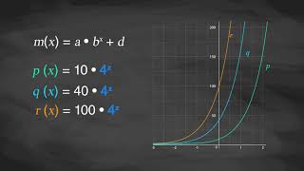
Exponential Equations and How They Affect the Graphs

Slide 13

Extending Your Thinking
As before, consider bank accounts whose balances are given by the following functions:
f(x) = 10 ⋅ 3^{x}
g(x) = 3^{x+2}
h(x) = ½ ⋅3^{x+3}
Which function would you choose?
Does your choice depend on x?
Notes:
Answers
We can rewrite each of the functions as a multiple of 3x to more easily compare them:
f(x) = 10 ⋅ 3^{x}
g(x) = 3^{x+2} = 3^{x} ⋅ 3² = 9⋅ 3^{x}
h(x) = ½ ⋅3^{x+3} = ½ ⋅ 3^{x} ⋅ 3³ = 27/2⋅ 3^{x} = 13.5 ⋅ 3^{x}
Since 9 < 10 < 13.5, we see that h has the most money for any value of x.
h(x) = ½ ⋅3^{x+3}, because it always gives the largest balance.
No, because all three have the same exponential base (3^{x}), so the order of size depends only on the coefficient. h(x) is always the largest.

Slide 14
Self Check
What is the horizontal asymptote for the function f(x) = 2 ⋅ 3^{x} − 5?
y = 5
y = 2
y = -5
y = 3
Let’s review!
Notes:
Answer Feedback - Individualized by Response
Incorrect. Subtracting 5 is the same as adding –5. The graph is shifted down 5. The answer is y = -5.
Incorrect. The 2 is the a in the function and changes the y-intercept, not the asymptote. The answer is y = -5.
That's correct! The –5 causes the function to shift down 5.
Incorrect. The 3 affects the growth factor, not the asymptote of the graph. The answer is y = -5.

Slide 15
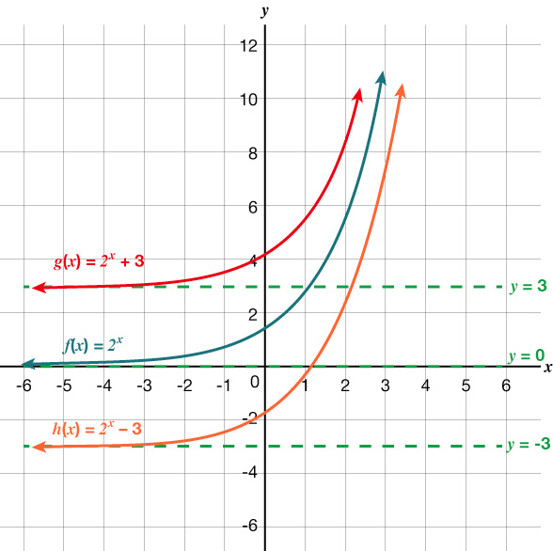
Self Check - Review
The parent function f(x) = 2^{x} is transformed vertically in the graph.
What is d ?
Fill in the table with the missing information.
 | g(x) = 2^{x} + 3 | h(x) = 2^{x} - 3
Shift Direction
y-intercept
asymptote
range
Notes:
Vertical Shifts with Exponential Functions
Explain to the students:
The first transformation occurs when we add a constant d to the parent function f(x) = b^{x}, giving us a vertical shift d units in the same direction as the sign.
For example, if we begin by graphing a parent function, f(x) = 2^{x}
We can then graph two vertical shifts alongside it, using d = 3
g(x) = 2^{x} + 3
h(x) = 2^{x} - 3
Both vertical shifts are shown in the graph
Answers
3
a. up 3 units
b. (0 , 4)
c. y = 3
d. (3 , ∞)
a. down 3 units
b. (0 , -2)
c. y = -3
d. (-3 , ∞)

Slide 16
Lesson Journey
Warm Up
Learning Activity
Practice
Learning Activity
Cool Down
Lesson Synthesis

Slide 17
Learning Strategies - Show Me the Money💵
“The equation _____ matches graph _____ because . . .”
“I noticed _____ , so I matched . . . .”
“The equation helped determine the bounciness by . . .”
Challenge each other’s ideas respectfully.
Use math words.
Conversing
Teacher Instruction: Use these strategies to adjust the activity to support English language learners and students with disabilities.
You can copy and paste the callouts directly on top of the activity or give the instructions aloud.
Pause and think before seeing the next functions.
Remember: Jada spent ⅓, so she had ⅔ left.
Use this to make sense of the new functions.
Representation
Notes:
Support for English Language Learners: MLR 8 Discussion Supports: Conversing
In groups of 2, students should take turns explaining their reasoning of how they matched the equations to the graphs. Display the following sentence frames for all to see: “The equation _____ matches graph _____ because . . .” and “I noticed _____ , so I matched . . . .” Encourage students to challenge each other when they disagree. When monitoring the discussions, point out key words and phrases such as “the bases are less than 1,” “slowly decaying,” or “more vertical curve.” This will help students solidify their understanding of how the b affects the graph.
Design Principle(s): Support sense-making; Maximize meta-awareness
Support for Students with Disabilities: Representation: Internalize Comprehension
Differentiate the degree of difficulty by beginning with more accessible values. When presenting the scenario, begin by displaying only m(x) and p(x) for students to consider briefly before revealing the remaining functions. In addition, some students may benefit from revisiting findings from the warm up, in which after spending ⅓ of the gift money, Jada had ⅔ left.
Supports accessibility for: Conceptual processing; Visual-spatial processing

Slide 18
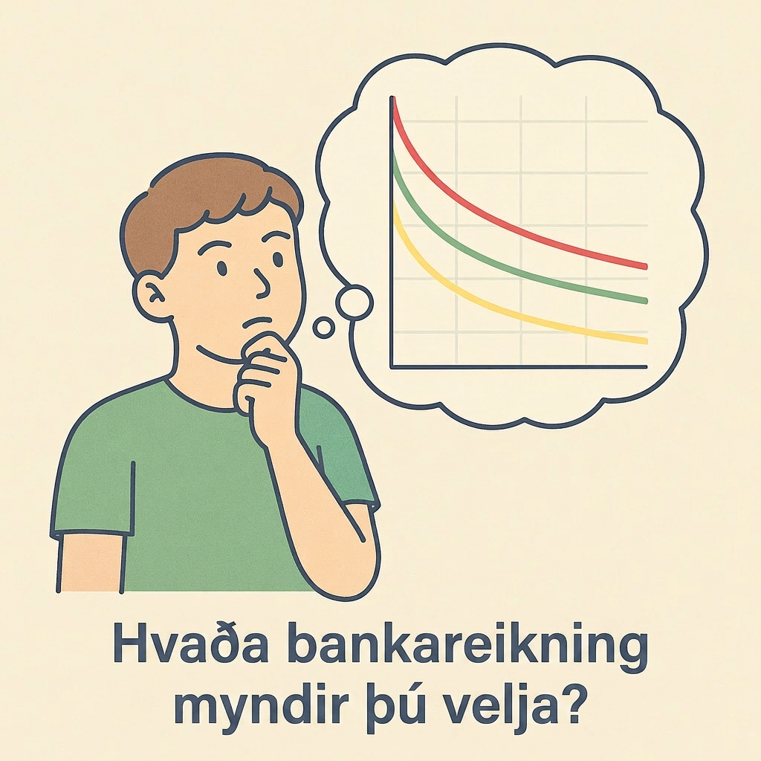
Learning Activity - Show Me the Money💵
Discussion: Suppose you are presented with these four functions that describe the amount of money, in dollars, in a bank account as a function of time x, in years.
If the account is yours (and more money is better), which function would you choose? Why?”
  m(x) = 200 ⋅ (¼)^{x}
  n(x) = 200 ⋅ (½)^{x}
  p(x) = 200 ⋅ (¾)^{x}
  q(x) = 200 ⋅ (⅞)^{x}
Notes:
Support for All Learners
This activity offers additional support for students:
For English language learners and students with disabilities, be sure to review the Learning Strategies slide!
Activity (15 minutes)
This activity complements the previous one. For a situation characterized by exponential growth, a larger base value b means faster growth. For a situation characterized by exponential decay, however, a smaller value of b (between 0 and 1) corresponds to faster decay. Understanding how the parameter b influences the graph of an exponential function will prepare students to make sense of and model situations involving repeated percentage change later in the unit.
Launch
Give students quiet time to think individually and ask students to share their responses.
Ask a student who chose the first option and one who chose the last option to share their reasoning.
Tell students they will now consider the options graphically before confirming their choice.
Arrange students in groups of 2.
Provide access to graphing technology.
To further scaffold student thinking, allow students to complete question 1 with their partner using the Desmos activity.
Activity questions, answers, and synthesis on the next slide.

Slide 19
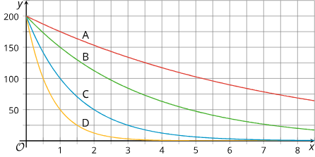
Learning Activity - Show Me the Money💵
Match each equation with a graph. Be prepared to explain your reasoning.
Functions f and g are defined by these two equations:
  f(x) = 1,000 ⋅ (⅒)^{x}
  g(x) = 1,000 ⋅ (⁹⁄₁₀)^{x}
Which function is decaying more quickly? Explain your reasoning.
Use graphing technology to verify your response.
Notes:
Answers
Sample reasoning: The functions are all exponential and the bases are all less than 1 so the graphs will be decreasing. The most rapidly decreasing will be the one with the smallest base and the least rapidly decreasing will be the one with the largest base.
Graph D: m(x) = 200 ⋅ (¼)^{x}
Graph C: n(x) = 200 ⋅ (½)^{x}
Graph B: p(x) = 200 ⋅ (¾)^{x}
Graph A: q(x) = 200 ⋅ (⅞)^{x}
a. f(x) = 1,000 ⋅ (⅒)^{x} has a smaller base than g(x) = 1,000 ⋅ (⁹⁄₁₀)^{x} Both bases are less than 1 so both functions decrease but f(x) = 1,000 ⋅ (⅒)^{x} decreases more rapidly.
b. Link to Desmos graph: https://www.desmos.com/calculator/ehbjrkj5ck
Activity Synthesis
Focus the discussion on the connection between the numbers in the equation (especially the b) and the features of the graph. Discuss questions such as:
“In the first question, what does the point that the graphs share on the y-axis say about the situation?” (All of the accounts started with $200.)
“How does Graph A compare to Graph D?” (Graph A appears more horizontal, so the function is decaying at a slower rate.)
“What does the largest factor (⅞) tell us? To which graph does it correspond?” (The function loses only ⅛ of its value when x increases by 1, so it is decaying the most slowly. Graph A must be the graph of q(x) = 200 ⋅ (⅞)^{x} since it shows the slowest decay.)
“What might a graph representing a function v given by v(x) = 200 ⋅ (⁹⁹⁄₁₀₀)^{x} look like?” (It would look very close to a horizontal line because nearly all of its value remains as x increases by 1, so it is decaying very slowly.)
“What might a graph representing a function w given by w(x) = 200 ⋅ (¹⁄₁₀₀)^{x} look like?” (It will go toward 0 extremely quickly because it loses ⁹⁹⁄₁₀₀ of its value each time x increases by 1, so it is decaying very quickly.)
Emphasize that, in situations characterized by exponential growth (when b > 1), a larger value of b means a curve that is more vertical. In situations characterized by exponential decay, where b is between 0 and 1, the closer b is to 1, the more the graph approaches a horizontal line. Conversely, the smaller the value of b, the more swiftly it heads toward 0 (the more vertical the curve is) before it flattens out and approaches a horizontal line.

Slide 20
Self Check
Which of the following functions will decay the fastest?
f(x) = 0.86^{x} − 10
g(x) = 0.34^{x} + 2
h(x) = 1.34^{x} − 90
j(x) = 0.5^{x}
Let’s review!
Notes:
Answer Feedback - Individualized by Response
Incorrect. This is actually decaying the slowest since 0.86 is closest to 1. The answer is g(x) = 0.34^{x} + 2.
That's correct! Of all of the functions, b = 0.34 is the closest to 0, so it is decaying the fastest.
Incorrect. This function is growing exponentially since b > 1. The answer is g(x) = 0.34^{x} + 2.
Incorrect. his is decaying slower than 0.34. The answer is g(x) = 0.34^{x} + 2.

Slide 21
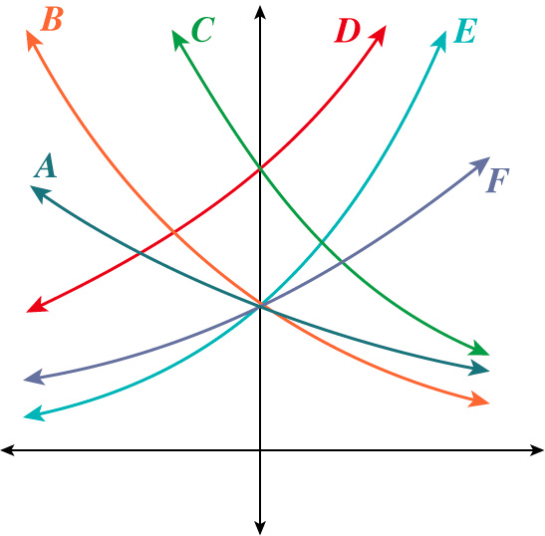
Self Check - Review
For each of the following, match each function with one of the graphs.
Equation | y-intercept | Growth/Decay
f(x) = 2(0.68)^{x} | (0,2) | Decay
f(x) = 2(1.28)^{x} | (0,2) | Growth
f(x) = 2(0.81)^{x} | (0,2) | Decay
f(x) = 4(1.28)^{x} | (0,4) | Growth
f(x) = 2(1.59)^{x} | (0,2) | Growth
f(x) = 4(0.68)^{x} | (0,4) | Decay
Notes:
Matching Exponential Functions and Graphs
Remind the students:
Remember, the equation for an exponential function is y = a ⋅ b^{x}.
The a will affect the y-intercept.
When b < 1, there is exponential decay.
The closer b is to 0, the faster it decays.
The closer b is to 1, the slower it decays.
When b > 1, the larger the value of b, the faster it grows.
Answers
B
F
A
D
E
C

Slide 22

Lesson Journey
Warm Up
Learning Activity
Practice
Learning Activity
Cool Down
Lesson Synthesis

Slide 23
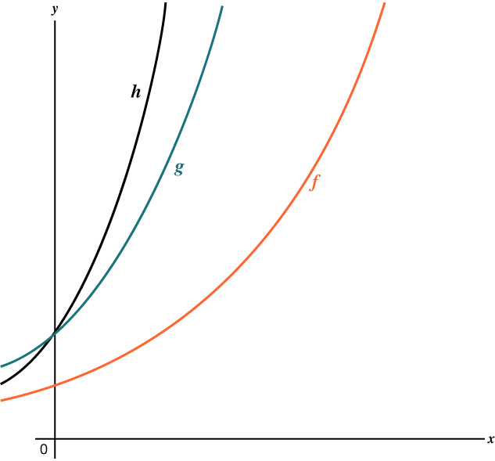
Cool Down
Examine the three graphs representing three exponential functions: f, g, and h.
The functions f and h are defined as:
f(x) = 10 ⋅ 2^{x}
h(x) = 20 ⋅ 4^{x}
Which of the following could define function g?
  g(x) = 20 ⋅ (1.5)^{x}
  g(x) = 20 ⋅ (2.5)^{x}
  g(x) = 10 ⋅ (3.5)^{x}
  g(x) = 20 ⋅ (4.5)^{x}
Be prepared to show your reasoning.
Notes:
Cool Down (5 minutes)
Answers
g(x) = 20 ⋅ (2.5)^{x}
Equation b. The graph of g has the same y-intercept as the graph of h, which is 20. It grows more quickly than f but more slowly than h, so the growth factor must be greater than 2 but less than 4.
Response to Student Thinking - More Chances
Students will have more opportunities to understand the mathematical ideas in this cool-down, so there is no need to slow down or add additional work to the next lessons. Instead, use the results of this cool-down to provide guidance for what to look for and emphasize over the next several lessons to support students in advancing their current understanding.

Slide 24

Lesson Journey
Warm Up
Learning Activity
Practice
Learning Activity
Cool Down
Lesson Synthesis

Slide 25

Practice
Put your hard work to action, practice what you’ve learned!
Notes:
Digital Practice: Access the practice pages at https://openstax.org/k12/algebra

Slide 26

Lesson Journey
Warm Up
Learning Activity
Practice
Learning Activity
Cool Down
Lesson Synthesis

Slide 27
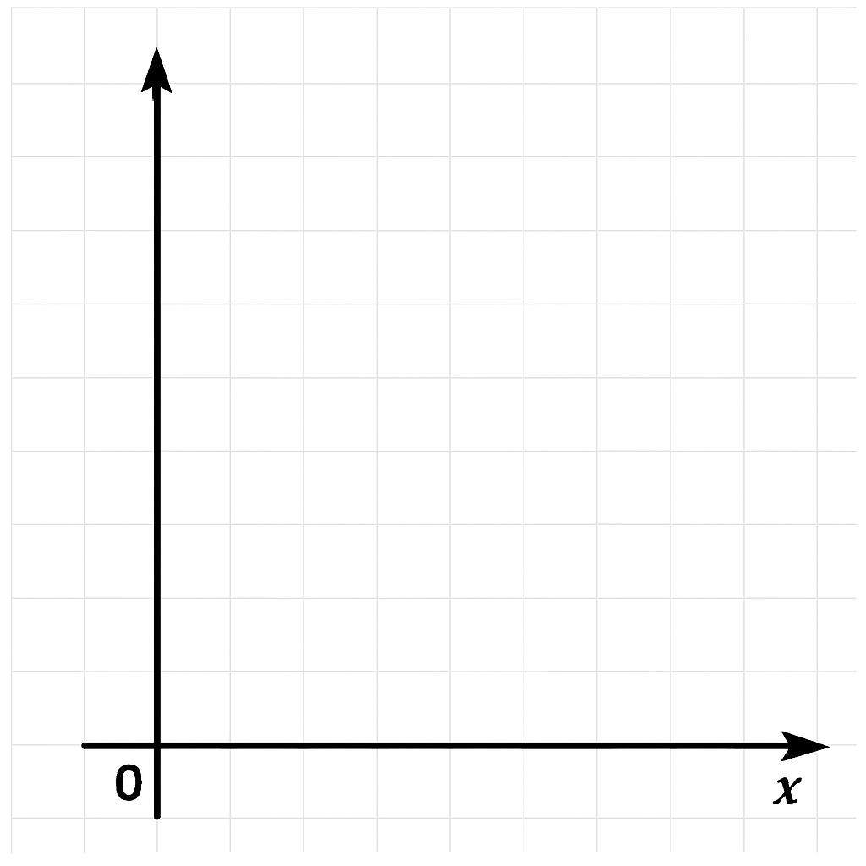
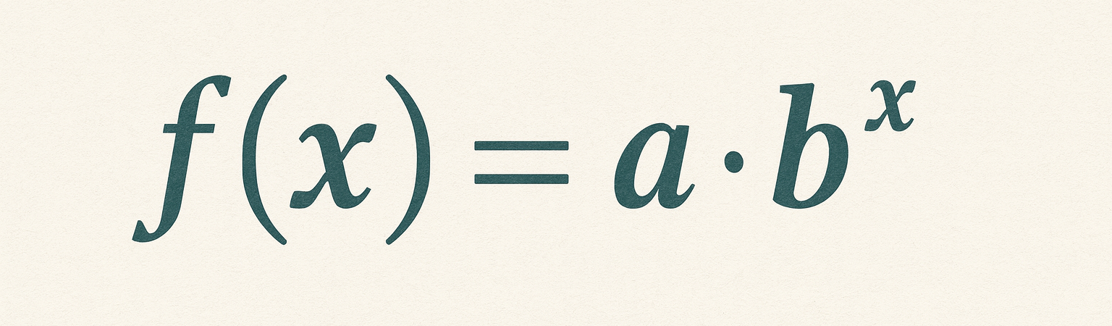
Lesson Synthesis
In this lesson, we looked at how the parts of a function representing exponential change are expressed on the graph.
Choose three different positive numbers
If b is 2, how would these three different numbers in place of a affect a graph representing this function?
Sketch the graphs. Explain how to decide on a graphing window.
If b is ½, what would the three graphs look like now? Sketch them.
Notes:
In this lesson, students explored models to represent successive bounce heights of different kinds of balls. The data they used were rather messy. Invite students to reflect on the process of modeling with such data by discussing the questions.
Answers
Your answer may vary, but here is an example.
a = {2, 5, 10}
For x = 0,1,2,3
y = 2⋅2^{x}: 2, 4, 8, 16
y = 5⋅2^{x}: 5, 10, 10, 40
y = 10⋅2^{x}: 10, 20, 40, 80
Link to Desmos graph: https://www.desmos.com/calculator/009omjk5et
Choose x = 0 to 4 and y = 0 to 200 so all three growth curves are visible
For x = 0,1,2,3
y = 2⋅ (½)^{x}: 2, 1, 0.5, 0.25
y = 5⋅(½)^{x}: 5, 2.5, 1.25, 0.625
y = 10⋅(½)^{x}: 10,5,2.5,1.25
Link to Desmos graph: https://www.desmos.com/calculator/dzubgzv1zw
If time permits, set a fixed value for a, ask students to suggest three different positive numbers to use in place of b, and repeat.

Slide 28
Self Assessment
How much do you agree with the following statements?
I can… | I can | Almost | Not yet
Describe the effect of changing 𝑎 and 𝑏 on a graph that represents 𝑓(𝑥) = 𝑎 ⋅ 𝑏
Use equations and graphs to compare exponential functions.

