Slide 1
Algebra 1
Unit 9 More Quadratic Equations
Lesson 9.10 Rewriting Quadratic Expressions in Vertex Form
Notes:
How to Get Started
Review Slide 2: How to use these slides
Check out the Check out the digital quick start guide!
Review Slide 3: Reference Key of Icons
Note: Lesson Activity 9.10.5: Different Forms of Quadratic Expression is an extension of the expectations in the TEKS and is not included in this slide deck.

Slide 2

How to use these slides
On the activity slides check the speaker notes for teacher support and instructional information.
Each lesson includes 1 warm up, 2-3 learning activities, a cool down, practice and a lesson synthesis.
  Learning activities are followed by a self check question, and review section.
Some slides have been hidden from student view, more information can be found on the next slide (Reference Key).
You can edit and use these slides for personal and classroom use, but cannot sell them and must keep the attribution logos.
For more information, Check out the digital quick start guide!
OpenStax CC BY NC SA

Slide 3





Reference Key
Check the top right corner for an icon referencing these unique sections.
Icon | Title | View | Location and Description
n/a | Support for Students with Disability | Hidden | Learning Strategies slide, provides additional support to students for understanding the activity.
n/a | Support for English Language Learners | Hidden | Learning Strategies slide, provides additional support to students for understanding the activity.
n/a | Extending Your Thinking | Hidden | Extending Your Thinking slide, provides an extra challenge for students.
n/a | Self Check | Not Hidden | Self Check slide, checkpoint to assess student understanding after the learning activity.
n/a | Review | Hidden | Self Check - Review slide, designed to help review topics from the self check question.
On the next slides, check the speaker notes for teacher instructions and support.
Notes:
Check the Speaker Notes: On the next slides you can find discussion questions, lesson information, answers to the activities, and ways to adjust the activity for your students!

Slide 4

Learning Goals
By the end of this lesson you will be able to -
Identify the vertex of the graph of a
quadratic function when the expression
that defines it is written in vertex form.
Explain the meaning of the term "vertex form"
and recognize examples of quadratic expressions written in this form.
When given a quadratic expression in factored form, rewrite it in standard form.
When given a quadratic expression in standard form, rewrite it in vertex form.
Notes:
Lesson Narrative
In this lesson, students encounter another use for completing the square: To rewrite a quadratic expression from standard form to vertex form.
The lesson begins with a review of the vertex form of a quadratic function, its advantage, and its connections to the graph. Then, students recall how to transform expressions in vertex form into standard form, and then they experiment with transforming the same expressions back to vertex form. Students notice that to take an expression from standard form to vertex form is essentially to complete the square, while being careful not to change the value of the expression.
Required Preparation
Acquire devices that can run Desmos (recommended) or other graphing technology. It is ideal if each student has their own device.
Required Materials
Graphing technology
Pre-printed slips, cut from copies of the blackline master
Texas Essential Knowledge and Skills
A1(F) analyze mathematical relationships to connect and communicate mathematical ideas
A1(G) display, explain, and justify mathematical ideas and arguments using precise mathematical language in written or oral communication
A6(B) write equations of quadratic functions given the vertex and another point on the graph, write the equation in vertex form (f(x) = a(x −h)² + k), and rewrite the equation from vertex form to standard form (f(x) = ax² + bx + c).

Slide 5
Vocabulary
Previous
Vertex (of a graph)
  On a parabola, it is the point where the graph changes from increasing to decreasing or vice versa. It is the highest or lowest point on the graph.
Vertex Form (of a quadratic)
  An expression in the form
a(x − h)² + k where a, h, and k are constants, and a ≠ 0.
x-intercept
  The point of the graph of a function where the 𝑦-value is 0. This is where the graph of the function crosses the x-axis.
  (x, 0)
y-intercept
  The point of the graph of a function where the x-value is 0. This is where the graph of the function crosses the y axis.
  (0, y)
Notes:
Lesson Vocabulary
To support student understanding of key vocabulary:
Introduce and review the vocabulary words students will see in this lesson.
Encourage students to notice how these words are used and to include them in their math discussions and explanations—both written and oral.
Use a word wall to reinforce vocabulary. Sample word wall cards are available here.
For newcomers or students with beginning English proficiency, use these Quizlet sets to support vocabulary learning:
Unit 9 Spanish Vocabulary – use first to build understanding
Unit 9 Vocabulary (English) – use after anchoring in Spanish
Support for English Language Learners
ELPS 2(D) monitor understanding of spoken language during classroom instruction and interactions and seek clarification as needed.
ELPS 2(E) use visual, contextual, and linguistic support to enhance and confirm understanding of increasingly complex and elaborate spoken language.
ELPS 2(F) listen to and derive meaning from a variety of media such as audiotape, video, DVD, and CD-ROM to build and reinforce concept and language attainment.
ELPS 3(E) share information in cooperative learning interactions.
ELPS 3(I) adapt spoken language appropriately for formal and informal purposes.

Slide 6
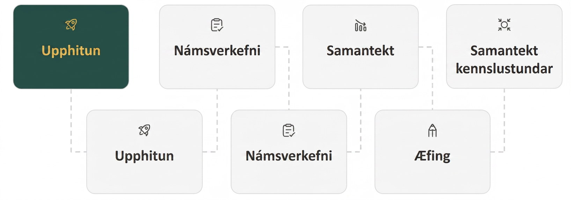
Lesson Journey
First Stop: Warm Up A

Slide 7

Warm Up A
Unlocking the Graph With Each Form 🔓
Without graphing or calculation, locate each feature on the function’s graph.
The x-coordinate of the vertex (of a graph).
The y-coordinate of the vertex (of a graph).
Select both x-intercepts from the list below.
  (−2, 0)
  (−6, 0)
  (−4, 0)
  (−8, 0)
The y-coordinate of the y-intercept (0, _____)
The expressions listed below define the same function.
x² + 6x + 8
(x + 2)(x + 4)
(x + 3)² − 1
Notes:
Warm Up (5 minutes)
This warm up reminds students about features of the graph that are visible in the different forms of expressions defining a quadratic function.
Launch
Encourage and support opportunities for peer interactions. Invite students to talk about their ideas with a partner.
Next, ask students to write down their ideas.
Answers
– 3
– 1
(– 2, 0), (– 4, 0)
8, The y-intercept is (0, 8).
Activity Synthesis
Invite students to share how they would locate the specified features on a graph. Make sure students are reminded that:
The constant term in the standard form tells us the y-intercept.
The factored form shows us the x-intercepts.
The vertex form reveals the vertex.
Consider using graphing technology to demonstrate that the three expressions appear to produce the same graph. (We can verify algebraically that the three expressions define the same function, but we can't be sure that the three expressions define the same function just by looking at the graph.) Label the vertex, x-intercepts, and y-intercept.

Slide 8
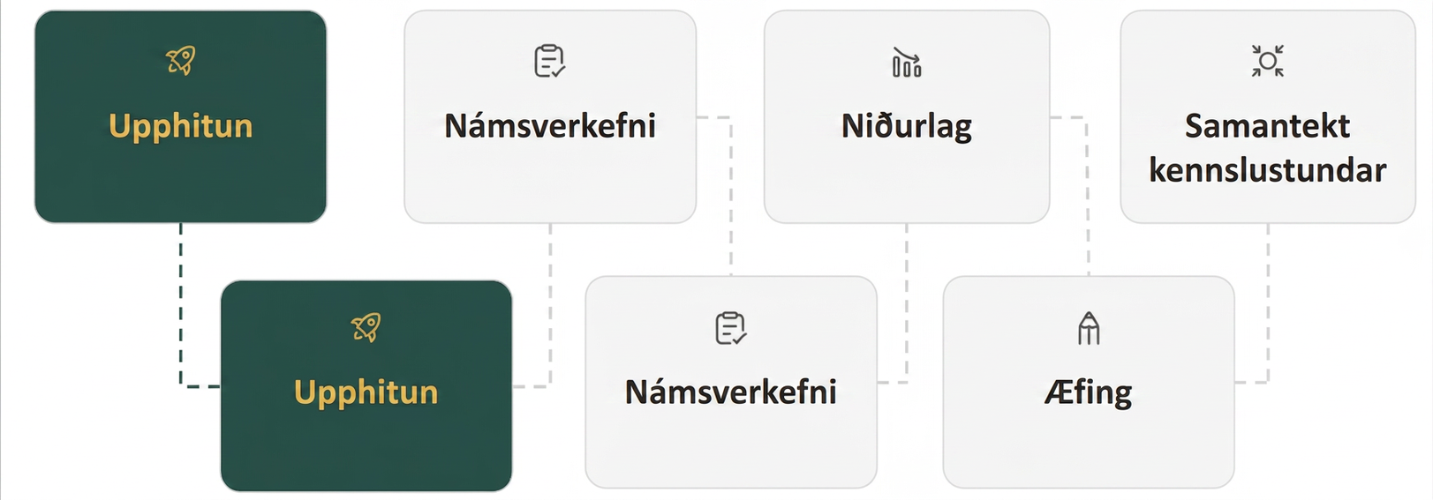
Lesson Journey
Second Stop: Warm Up B

Slide 9

Warm Up B | Learning Strategies
Perfect Squares Written as Squared Factors ⏹️
Teacher Instruction: Use these strategies to adjust the activity to support students with disabilities.
  You can copy and paste the callout directly on top of the activity or give the instructions aloud.
Use color to show steps
Add short notes
Label each step
Use arrows to show changes
Include key phrases you used
Representation
Notes:
Support for Students with Disabilities: Representation: Internalize Comprehension
Use color and annotations to illustrate student thinking. As students share their reasoning about how to convert standard form back into vertex form, scribe their thinking on a visible display. Use annotations and labels to show the structure of the steps using the form included in the launch. For example, labeling the first step as “standard form,” labeling +9 as “add nine to complete the square,” and drawing an arrow to the -9 and labeling it as “keeping it equivalent.” Continue to add in any key phrases students contributed that illustrate the steps.
Supports accessibility for: Visual-spatial processing; Conceptual processing

Slide 10
Warm Up B
Perfect Squares Written as Squared Factors ⏹️
Review how to factor perfect square trinomials from Unit 6. Study examples 1 and 2, then complete each section of questions 1 – 4.
Problem | Factored Form | Equation | Standard Form
Example 1 | (x + 4)² | (1x)² + 2(1x)(4) + 4² | x² + 8x + 16
Example 2 | (2x + 5)² | (2x)² + 2(2x)(5) + 5² | 4x² + 20x + 25
Problem 1 | (3x – 4)² | (3x)² + 2( a.x)( b.) + (c.)² | 9x² – 24x + 16
Problem 2 | (5x – a.)² | (b.x)² + 2( c.x)( d.) + (e.)² | 25x² + 30x + f.
Problem 3 | (kx + m)² | (a.x)² + 2( b.x)( c.) + (d.)² | (e.x)² + f.x + (g.)²
Look at the expression in the last row of the table. If ax² + bx + c is equivalent to (kx + m)², how are a, b, and c related to k and m?
Notes:
Support for All Learners
This activity offers additional support for students:
For students with disabilities, be sure to review the Learning Strategies slide!
Warm Up (10 minutes)
This second warm up reminds students of the structure that governs the relationship between perfect squares written as squared factors and their equivalent expression in standard form. The key goal is for students to see that when we expand a squared factor of the form (kx + m)², the equivalent expression in standard form has this structure: (kx)² + 2kmx + m². Seeing the coefficient of the squared term as (something)² and the coefficient of the linear term as 2 times a product of two numbers (k and m) would enable students to complete the square more easily. This would in turn help them make sense of where the quadratic formula comes from, which they will explore in this lesson.
Students practice looking for and making use of structure as they think about the relationships between equivalent expressions.
Continue scrolling down for directions on how to launch, answers, and the activity synthesis.
Launch
Ask students to expand the squared factor (x + 4)² into standard form and show all the steps.
Students are likely to show (x + 4)(x + 4) = x² + 4x + 4x + 42 = x² + 8x + 16, or (x + 4)(x + 4) = x² + 2(4x) + 4² = x² + 8x + 16.
Next, arrange students in groups of two. Tell students to use the relationship between the factored and standard forms to write some equivalent perfect-square expressions. Ask students to think quietly about the expressions in the table before conferring with their partner.
Answers
3
-4
-4
(3x)² + 2(3x)(-4) + (-4)²
3
5
5
3
3
9
(5x - 3)²
(5x)² + 2(5x)(3) + (3)²
25x² + 30x + 9
k
k
m
m
k
2km
m
(kx)² + 2(kx)(m) + (m)²
(kx)² + 2kmx + (m)²
a = k2, b = 2km, and c = m²
Activity Synthesis
Display the table for all to see and ask students for the missing values. Then, discuss the following questions to highlight the ways in which the numbers in the middle column are related to the two numbers in each expression in factored form.
For the expressions in the middle column, how do you know what to write for the first squared term? (It's the square of the linear term of the expression in factored form.)
The coefficient of the linear term is always 2 times the two other numbers. How do you know what those are? (It's the two terms from factored form: the linear term and the constant term.)
How do you know what to write for the last squared term? (It's the square of the constant term of the expression in factored form.)
When making 25x² + 30x a perfect square, how do you know what values to write in the middle column? (The first squared term is (something)² that equals 25x², so that "something" must be 5x because (5x)² = 25x². The linear term is 2(5x) (another thing) that equals 30x, so that other thing must be 3 because 2(5x)(3) = 30x. The last squared term is (another thing)², so it is 32.)
Emphasize the general structure of the equivalent expressions, as shown in the last row. When (kx + m)² is expanded, the standard form always has the structure of (kx)² + 2(kx)m + m². Also, make sure students understand how the numbers in the factored form are related to ax² + bx + c, that is, that they recognize that a = k², b = 2km, and c = m².
Highlight that when we want to complete the square for ax² + bx and write an equivalent expression of the form (kx + m)², having a perfect square for a makes it much easier to find k, and having an even number for b makes it easier to find m (because an even number gives a whole number when divided by 2).

Slide 11
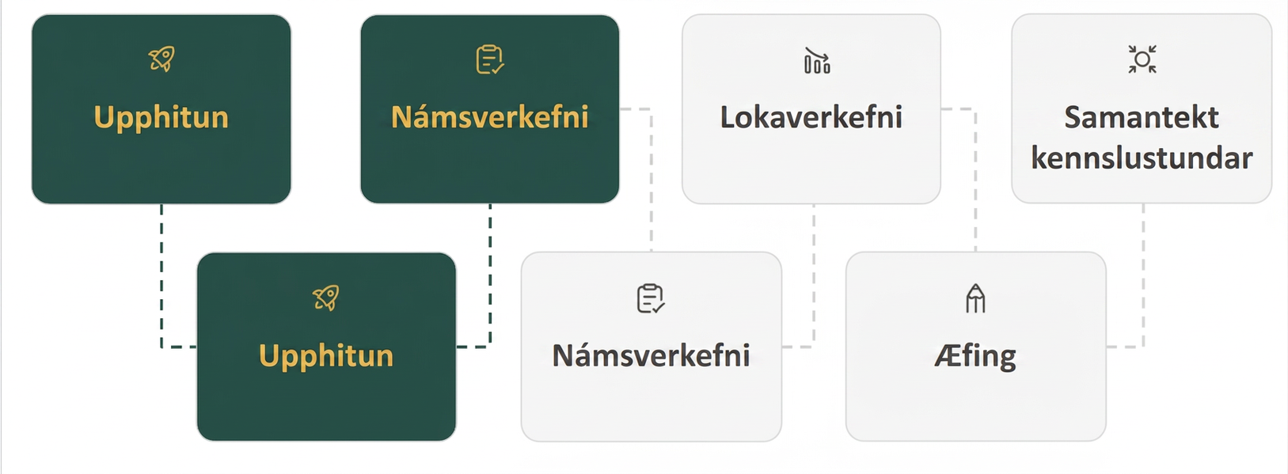
Lesson Journey
Third Stop: Learning Activity A

Slide 12
Learning Activity A | Learning Strategies
Back and Forth Forms 🏓
Teacher Instruction: Use these strategies to adjust the activity to support students with disabilities.
  You can copy and paste the callouts directly on top of the activity or give the instructions aloud.
Break the task into smaller parts
Talk about the steps with a partner
Use the printed slips to match each step
Share slips and work together
Keep the slips nearby as a guide
Engagement
Notes:
Support for Students with Disabilities: Engagement: Internalize Self Regulation
Chunk this task into more manageable parts to differentiate the degree of difficulty or complexity. Allow students to discuss the steps and then provide students with printed slips of explanations from the student responses. Divide the slips between partners and encourage them to work together to identify which slip matches with each step. Allow them to keep the steps nearby and put them next to their steps as they check their work and use them as a guide.
Supports accessibility for: Organization; Attention

Slide 13
Learning Activity A | Part 1
Back and Forth Forms 🏓
Rewrite (x + 5)² + 1 in standard form.
Rewrite (x – 3)² – 7 in standard form.
Reverse the steps: For questions 1 and 2 rewrite the standard form in vertex form and explain your process.
Notes:
Support for All Learners
This activity offers additional support for students:
For students with disabilities, be sure to review the Learning Strategies slide!
Activity (15 minutes)
The goal of this activity is for students to recognize that rewriting a quadratic expression from standard form to vertex form essentially entails completing the square.
Students had quite a bit of experience completing the square, mostly in the context of solving equations, in which they know to add or subtract the same number from both sides of an equation to keep the equation true. Here, students are dealing with expressions and need to be careful to keep each expression equivalent to the original. If they add a number to the expression, they need to remember to subtract the same number to keep the value of the expression unchanged.
Launch
Arrange students in groups of two.
Give students quiet time to think about the first two questions and then time to share their thinking with a partner.
Pause for a class discussion after the second question and invite one or more students to demonstrate their strategy. Highlight approaches that involve completing the square. If no students took that approach, display and discuss the following:
x² − 6x + 2
x² − 6x + 9 − 9 + 2
(x − 3)² − 7
Then, ask students to proceed with the rest of the activity (that is provided on the next slide). Provide access to devices that can run Desmos or other graphing technology.
Answers
x² + 10x + 26
x² − 6x + 2
To convert x² − 6x + 2 back to vertex form, you can complete the square by adding 9 and then subtracting 9 so that the expression remains unchanged. The part that is a perfect square, x² − 6x + 9, can be written as (x − 3)², and then there is the 2 − 9, which equals – 7.
Answers, anticipated misconceptions, and activity synthesis on next slide.

Slide 14
Learning Activity A | Part 2
Back and Forth Forms 🏓
Test your strategy by rewriting x² + 10x + 9 in vertex form.
Check the expression you rewrote in vertex form.
  Use Desmos or graph paper to graph both x² + 10x + 9 and your new expression. Do they define the same function?
  If you convert your expression in vertex form back into standard form, do you get x² + 10x + 9?
Notes:
Answers
(x + 5)² − 16
Yes. Both expressions seem to produce the same graph
(x + 5)² − 16 = x² + 10x + 25 − 16, which is x² + 10x + 9.
Anticipated Misconceptions
Some students may wonder why they need to both add and subtract a number from the standard form expression in order to complete the square. In previous lessons, students completed the square while solving an equation, often adding the same number to each side of the equal sign to maintain equality. Here, there is no equal sign. Emphasize that each move must generate an equivalent expression. Show a few expressions such as 5, 5 + 0, 5 − 2 + 2, 5 + 7 − 7, 5 + 8, and 5 + 8 − 3. Ask them which ones are equal to 5. Next, ask them to write two more expressions that include the number 5 and also equal 5. Encourage students to notice that the sum of the numbers excluding 5 must be 0.
Activity Synthesis
Invite students to share their graph and response to the last question. Emphasize that while graphing is a quick way to check whether two expressions define the same function, it is not always reliable. If we make an algebraic error, the graph would almost certainly show it. But having two graphs that appear to be identical does not prove that two expressions are indeed equivalent. We can only be sure that two expressions define the same function by showing equivalence algebraically. For example, when students convert the expression in vertex form back to standard form, does it produce the original expression?
Make sure students understand that whatever operation is performed on an expression to complete the square, it should not change the value of the expression. Adding opposites (for example, 9 and – 9, or – 25 and 25), or adding and subtracting the same number, has the effect of adding 0, which keeps the original and the transformed expressions equivalent.

Slide 15

Learning Activity A
Self Check
Which of the following is the equivalent vertex form of the expression x² + 14x − 3?
(x + 7)²
(x + 7)² − 3
(x + 7)² − 52
(x + 7)² + 40
Let’s review!
Notes:
Answer Feedback - Individualized by Response
Incorrect. This is only the factored perfect square trinomial.
Incorrect. When the 49 is added to complete the square, it must also be subtracted to balance the expression.
That's correct! Complete the square with 49, and then subtract 49 from -3. Factor the trinomial and simplify.
Incorrect. Since 49 was added to complete the square, it must be subtracted from -3 to balance the expression.

Slide 16

Learning Activity A
Self Check - Review
Rewrite x² + 8x − 7 in vertex form (of a quadratic expression).
CHANGING
STANDARD FORM
TO VERTEX FORM
Step 1 - Complete the square.
Step 2 - Balance the expression by adding the constant to the expression to complete the square and also subtract it from the expression.
Step 3 - Factor the trinomial and simplify.
Notes:
Remind students -
Different forms are useful for finding different characteristics of quadratic functions.
Answer
Step 1: b = 8, so (^{b}/₂)² = (⁸/₂)² = 16.
Step 2: x² + 8x + 16 − 7 − 16
Step 3: (x + 4)² − 23

Slide 17
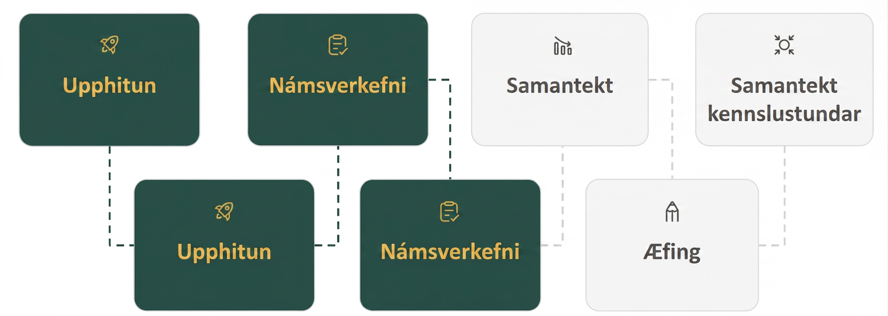
Lesson Journey
Fourth Stop: Learning Activity B

Slide 18
Learning Activity B | Learning Strategies
Quadratics When a Isn’t 1😣
Teacher Instruction: Use these strategies to adjust the activity to support students with disabilities.
  You can copy and paste the callouts directly on top of the activity or give the instructions aloud.
Break the task into smaller parts
Talk about the steps with a partner
Use the printed slips to match each step
Share and sort the slips together
Keep the slips beside your work as a guide
Engagement
Notes:
Support for Students with Disabilities: Engagement: Internalize Self Regulation
Chunk this task into more manageable parts to differentiate the degree of difficulty or complexity. Allow students to discuss the steps and then provide students with printed slips of explanations from the student responses. Divide the slips between partners and encourage them to work together to identify which slip matches with each step. Allow them to keep the steps nearby and put them next to their steps as they check their work and use them as a guide.
Supports accessibility for: Organization; Attention

Slide 19
Learning Activity B | Part 1
Quadratics When a Isn’t 1😣
Here is one way to rewrite 3x² + 12x + 9 in vertex form.
Study the steps and briefly
explain each one.
What is the x-coordinate of
the vertex of the graph that
represents this expression?
What is the y-coordinate of
the vertex of the graph that
represents this expression?
Does the graph open upward or downward? Explain how you know.
Step 1: 3(x² + 4x + 3)
Step 2: 3(x² + 4x + 4 + 3 − 4)
Step 3: 3(x² + 4x + 4 − 1)
Step 4: 3((x + 2)² − 1)
Step 5: 3(x + 2)² − 3
Notes:
Support for All Learners
This activity offers additional support and an extension for students:
For English language learners and students with disabilities, be sure to review the Learning Strategies slide!
For students looking for an extra challenge, be sure to review the Extending Your Thinking slide!
Activity (15 minutes)
In the first activity, students rewrote quadratic expressions whose squared term has a coefficient of 1 into vertex form. They did so by completing the square. In this activity, they transform expressions whose squared term has a coefficient other than 1 into vertex form.
Students learn that one way to deal with an inconvenient a in ax² + bx + c is to rewrite the expression as a product of a and an expression (which now has a leading coefficient of 1), complete the square for the latter, and redistribute a afterward to obtain an equivalent expression in vertex form.
Continue scrolling down for directions on how to launch the activity and answers to the questions.
Launch
Keep students in groups of two. Display these expressions for all to see and explain that these are some other expressions to rewrite in vertex form so that we could identify the vertex of their graph.
3x² + 12x + 9
−2x² − 4x + 6
4x² + 24x +20
−x² + 20x
Give students one minute of quiet time to think individually and ask them to be prepared to share at least one thing they notice and one thing they wonder.
Students may notice:
In all of the expressions, the coefficient of the squared term is not 1.
Each of the expressions contains terms that have a common factor.
The coefficients of some squared terms are negative.
The last expression has no constant term.
Students may wonder:
How to write these expressions in vertex form.
Whether it is still possible to write the last expression in vertex form given that it has no constant term.
Invite a few students to share what they noticed and wondered, and then begin the activity.
Pause for a class discussion after the first question.
Display the worked example. Ask students to share their explanation for each step and record their explanation for all to see. Make sure students understand the rationale for each step and how to check that their expression is equivalent to the original (by converting it back into standard form).
Students have learned in an earlier unit that a positive a in a(x − h)² + k means an upward-opening graph and may offer this explanation for the last part of the question. It is not necessary to focus on the direction of the opening of the parabola here, as students will explore it further in an upcoming lesson.
Answers
Original expression
3x² + 12x + 9
Step 1 - Rewrite the expression with 3 as a factor.
3(x² + 4x + 3)
Step 2 - Add 4 to complete the square.
Subtract 4 to keep the value of the expression the same.
3(x² + 4x + 4 + 3 − 4)
Step 3 - Combine like terms so we can see the perfect square, x² + 4x + 4.
3(x² + 4x + 4 − 1)
Step 4 - Rewrite x² + 4x + 4 as a squared expression.
3((x + 2)² − 1)
Step 5 - Apply the distributive property to put the expression in vertex form.
3(x + 2)² − 3
-2
3
The graph opens upward. For example, in an earlier unit, we saw that when the coefficient of the squared term (x − h)² is positive, the graph opens upward.
More activity questions, answers, and activity synthesis on the next slide.

Slide 20
Learning Activity B | Part 2
Quadratics When a Isn’t 1😣
Rewrite −2x² − 4x + 6 in vertex form.
Rewrite 4x² + 24x + 20 in vertex form.
Rewrite −x² + 20x in vertex form.
Are you ready for more?
Notes:
Answers
−2(x + 1)² + 8
4(x + 3)² – 16
−(x − 10)² + 100
Activity Synthesis
Select students to display their responses for all to see. Discuss questions such as:
How did you know what factor to use to rewrite the original expression? (Find a factor that all terms in an expression have in common. Use the coefficient of the squared term so that, after the expression is rewritten, the squared term has a coefficient of 1.)
In 4x² + 24x +20, both 2 and 4 are common factors. Is one number better than the other for our purposes here? (4 is a better factor to use because it allows the squared term to have a coefficient of 1, which makes it easier to complete the square. If we use 2, the squared term still has an inconvenient coefficient that is neither 1 nor a perfect square.)
How can we check if the expression in vertex form is equivalent to the original expression? (One way is to convert it back into standard form and see if it is the same expression as the original.)

Slide 21

Learning Activity B
Extending Your Thinking
Without completing the square, rewrite f(x) = 2(x − 3)(x − 9) in vertex form. Fill in the missing parts of the function:
f(x) = a.(x b. c.)² d. e. Be prepared to explain your reasoning.
Without completing the square, rewrite g(x) = 2(x − 3)(x − 9) + 21 in vertex form. Fill in the missing parts of the function:
g(x) = a.(x b. c.)² d. e. Be prepared to explain your reasoning.
Hints: 🗝️
Think about finding the zeros of the function.
Questions b and d are operation signs.
Notes:
Go back to Lesson Activity
If needed, hints have been provided to help students fill in the blanks. THE HINT BOX HAS BEEN ANIMATED TO ONLY DISPLAY WITH A CLICK so that it will not be seen by students unless you determine it is needed.
Answer
2
Subtraction (–)
6
Subtraction (–)
18
The zeros of f are 3 and 9. Because the graph of a quadratic function has a vertical line of symmetry across the vertex, the vertex of the graph must have x-coordinate 6. The y-coordinate of the vertex is – 18 because
f(6) = −18. This means f(x) can be expressed as a(x − 6)² − 18. If we expand 2(x − 3)(x − 9), we can see that the coefficient of x² is 2. This means that a in the vertex form has to be 2 as well. In vertex form the correct answer is
2(x − 6)² − 18.
2
Subtraction (–)
6
Addition (+)
3
Although 3 and 9 are not zeros of g, when x is 3 and when x is 9, g(x) is 21, or g(3) = g(9) = 21. Because the graphs of quadratic functions are symmetric, the x-coordinate of the vertex is still 6. The y-coordinate of the vertex is 3 because g(6) = 3. The value of a is 2 for the same reason as in function f. In vertex form the correct answer is 2(x − 6)² + 3.

Slide 22
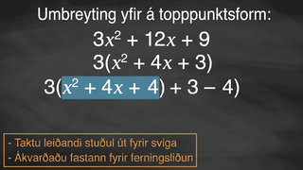
Learning Activity B | Video
Rewriting Expressions in Vertex Form
Notes:
This video discusses question 1 of activity 9.10.4

Slide 23
Learning Activity B
Self Check
Write 2x² + 20x + 20 in vertex form.
2(x + 5)²
2(x + 5)² – 30
2(x² + 10x + 10)
2(x + 5)² – 15
Let’s review!
Notes:
Answer Feedback - Individualized by Response
Incorrect. The constant needs to be included in the process.
That’s correct! First factor out the 2. Then complete the square and add in 25 while subtracting to balance the expression. This becomes 2(x² + 10x + 25 + 10 −25). Then factor and simplify.
Incorrect. This is factored, but not vertex form.
Incorrect. The 2 has to be distributed to the -15.
Note: Lesson Activity 9.10.5: Different Forms of Quadratic Expression is an extension of the expectations in the TEKS and is not included in this slide deck. It can be found at this link. ⚠️⚠️

Slide 24
Learning Activity B
Self Check - Review
CHANGING STANDARD FORM
TO VERTEX FORM
WHEN a ≠ 1
Step 1 - Factor the expression so the coefficient of x is 1 (inside parentheses).
Step 2 - Complete the square. Balance the expression by adding the constant to the expression to complete the square and also subtract it from the expression.
Step 3 - Combine like terms.
Step 4 - Factor the trinomial (rewrite it as a squared expression).
Step 5 - Apply the distributive property and move the constant term to finalize the expression in vertex form.
Rewrite 2x² + 8x + 4 in vertex form (of a quadratic expression).
Notes:
Remind Students
Step 1: Rewrite the expression with 2 as a factor. 2(x² + 4x + 2)
Step 2: Add 4 to complete the square. Subtract 4 to keep the value of the expression the same. 2(x² + 4x + 4 + 2 - 4)
Step 3: Combine like terms so we can see the perfect square, x² + 4x + 4. 2(x² + 4x + 4−2)
Step 4: Rewrite x² + 4x + 4 as a squared expression. 2((x + 2)²− 2)
Step 5: 2(x + 2)²− 4
Note: Lesson Activity 9.10.5: Different Forms of Quadratic Expression is an extension of the expectations in the TEKS and is not included in this slide deck. If can be found at this link.

Slide 25
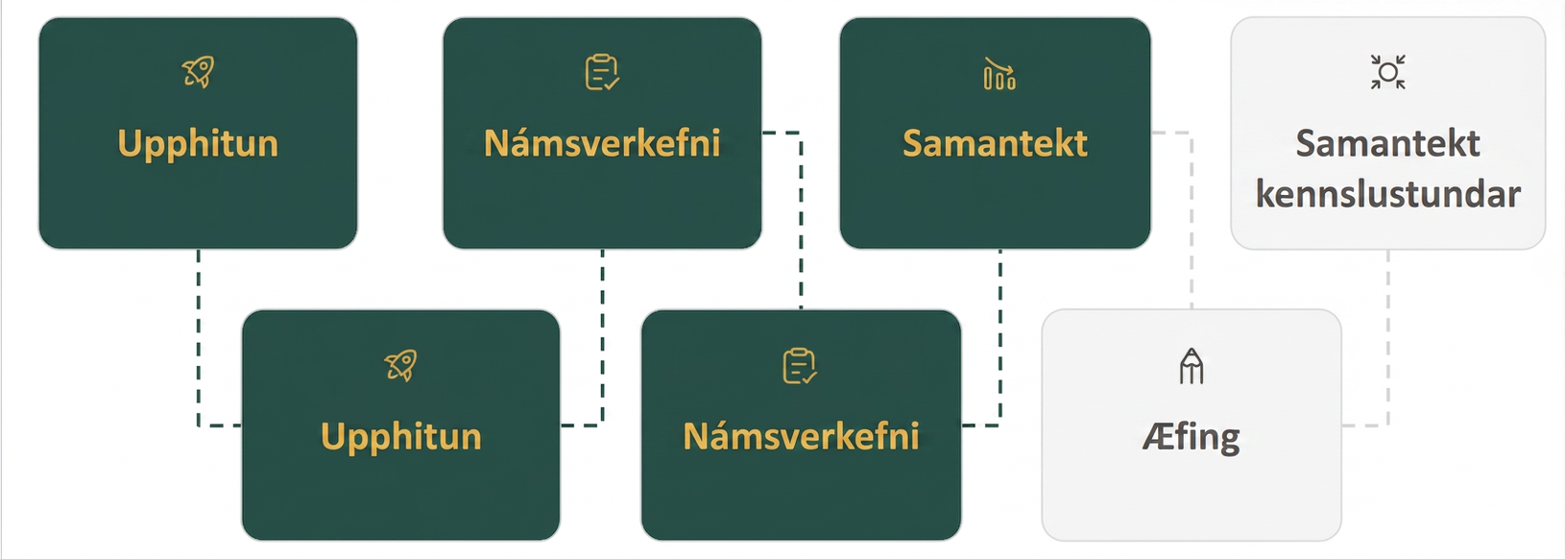
Lesson Journey
Fifth Step: Cool Down

Slide 26

Cool Down
A quadratic function is defined by the expression x² − 20x + 19.
Rewrite the expression in vertex form (of a quadratic expression) and give the coordinates of the vertex (of a graph).
Be prepared to show your reasoning.
Notes:
Note: Lesson Activity 9.10.5: Different Forms of Quadratic Expression is an extension of the expectations in the TEKS and is not included in this slide deck. If can be found at this link.
Cool Down (5 minutes)
Launch
Ask students to put away their devices for the cool down.
Answer
(x − 10)² − 81.
The vertex is at (10, −81).
x² − 20x + 19
x² − 20x + 100 + 19 −100
x² − 20x + 100 − 81
(x − 10)² − 81
Response to Student Thinking - More Chances
Students will have more opportunities to understand the mathematical ideas in this cool down, so there is no need to slow down or add additional work to the next lessons. Instead, use the results of this cool down to provide guidance for what to look for and emphasize in 9.9 to support students in advancing their current understanding.

Slide 27
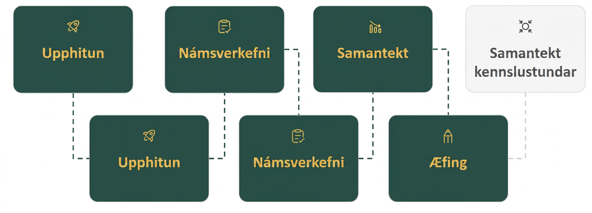
Lesson Journey
Sixth Stop: Practice

Slide 28

Practice
Put your hard work to action, practice what you’ve learned!
Notes:
Digital Practice: Access the practice pages at https://openstax.org/details/books/algebra-1

Slide 29
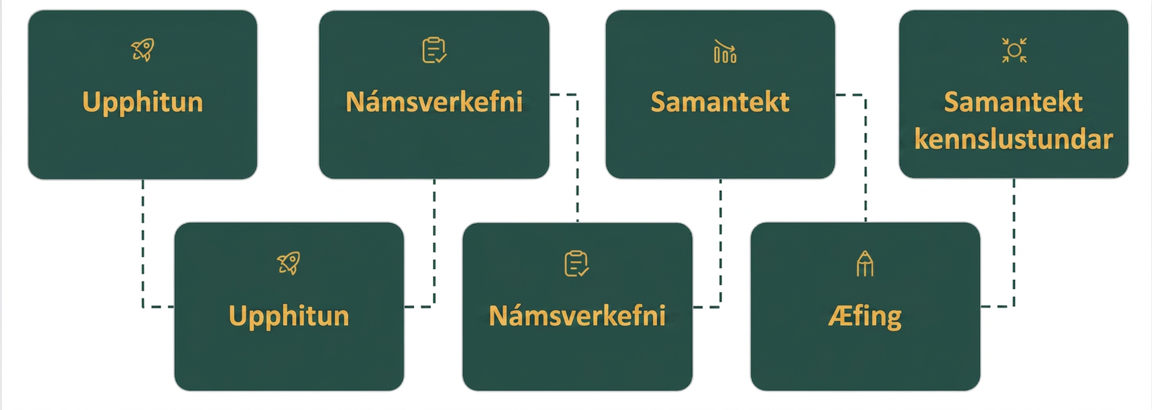
Lesson Journey
Seventh Stop: Lesson Synthesis

Slide 30
Lesson Synthesis
Consider the equation f(x) = −3x² + 24x − 36. Explain how you would find each of the following features of f without graphing.
y-intercept
x-intercepts
Coordinates of vertex
Notes:
Remind students that –
The x-intercepts and the coordinates of the vertex aren't easy to spot in the standard form of the expression as given, but we have techniques to rewrite the expression in other forms.
Answer
f(0) = −3(0)² + 24(0) − 36 = −36
To rewrite in factored form, we can use the distributive property twice:
−3x² + 24x − 36
−3(x² − 8x + 12)
−3(x − 2)(x − 6)
Once the expression is in factored form, we can tell that the x-intercepts of a graph of x are at (2, 0) and (6, 0).
To rewrite in vertex form, we can complete the square:
−3(x² − 8x + 12)
−3(x² − 8x + 12 + 4 − 4)
−3(x² − 8x + 16 − 4)
−3((x − 4)² − 4)
−3(x − 4)² + 12
Once the expression is in vertex form, we can tell that the vertex of a graph of f is at (4, 12).
Demonstrate
Time permitting, demonstrate that with all of this information, we can now sketch a reasonable graph of f by hand

Slide 31
Self Assessment
How much do you agree with the following statements?
Learning Goals | I can | Almost | Not yet
Identify the vertex of the graph of a quadratic function when the expression that defines it is written in vertex form. | ⃞ | ⃞ | ⃞
Explain the meaning of the term "vertex form" and recognize examples of quadratic expressions written in this form. | ⃞ | ⃞ | ⃞
When given a quadratic expression in factored form, rewrite it in standard form. | ⃞ | ⃞ | ⃞
When given a quadratic expression in standard form, rewrite it in vertex form. | ⃞ | ⃞ | ⃞

