Slide 1
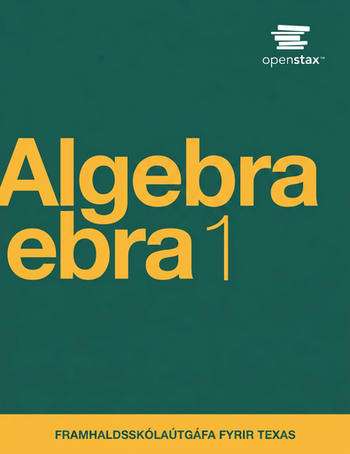

Algebra 1
Unit 7 Introduction to Quadratic Functions
Lesson 7.2 Introduction to Quadratic Relationships
Notes:
How to Get Started
Review Slide 2: How to use these slides
Check out the digital quick start guide!
Review Slide 3: Reference Key of Icons

Slide 2
How to use these slides
On the activity slides check the speaker notes for teacher support and instructional information.
Each lesson includes 1 warm up, 2-3 learning activities, a cool down, practice and a lesson synthesis.
  Learning activities are followed by a self check question, and review section.
Some slides have been hidden from student view, more information can be found on the next slide (Reference Key).
You can edit and use these slides for personal and classroom use, but cannot sell them and must keep the attribution logos.
For more information, Check out the digital quick start guide!

Slide 3






Reference Key
Check the top right corner for an icon referencing these unique sections.
 | Support for Students with Disability | Hidden | Learning Strategies slide, provides additional support to students for understanding the activity. Learning Strategies slide, provides additional support to students for understanding the activity.
 | Support for English Language Learners | Hidden
 | Extending Your Thinking | Hidden | Extending Your Thinking slide, provides an extra challenge for students.
 | Self Check | Not Hidden | Self Check slide, checkpoint to assess student understanding after the learning activity.
 | Review | Hidden | Self Check- Review slide, designed to help review topics from the self check question.
On the next slides, check the speaker notes for teacher instructions and support.
Notes:
Check the Speaker Notes: On the next slides you can find discussion questions, lesson information, answers to the activities, and ways to adjust the activity for your students!

Slide 4

Learning Goals
By the end of this lesson you will be able to -
Describe how a pattern is growing.
Tell whether a pattern is growing linearly, exponentially, or quadratically.
Explain that an expression with a squared term is called quadratic.
Notes:
Lesson Narrative
Students compare quadratic, linear, and exponential patterns by creating tables, expressions, and graphs. They learn that a quadratic expression includes a squared term and practice recognizing structure and regularity in patterns.
Technology is optional but may be used for problem solving. In Activity 7.2.4, students explain their reasoning in writing; support EL students with grammar and sentence development.
Required Preparation
None
Required Materials
None
Texas Essential Knowledge and Skills
A1(B) use a problem-solving model that incorporates analyzing given information, formulating a plan or strategy, determining a solution, justifying the solution, and evaluating the problem-solving process and the reasonableness of the solution
A1(F) analyze mathematical relationships to connect and communicate mathematical ideas
A7(A) graph quadratic functions on the coordinate plane and use the graph to identify key attributes, if possible, including x-intercept, y-intercept, zeros, maximum value, minimum values, vertex, and the equation of the axis of symmetry

Slide 5
Vocabulary
Term
  Part of an expression that can be a single number, a variable, or a number and a variable that are multiplied together.
Variable
  A quantity that can take on different values. Often represented by a letter such as 𝑥, 𝑦, 𝑎, 𝑏, 𝑚, etc.
New
Quadratic Relationship
  A quadratic relationship is a relationship between two values, 𝑥 and 𝑦, where 𝑦 is related to 𝑥².
Quadratic Expression
  An expression in 𝑥 that is equivalent to an expression of the form a𝑥² + b𝑥 + 𝑐 (where a, b, and 𝑐 are constants and a ≠ 0).
Previous
Constant
  In an expression like (5𝑥 + 2), it is the number 2 because it doesn't change when the 𝑥-value changes.
Expression
  The sum of products of numbers and variables. The variables can be raised to different powers.
Growth Factor
  A measurement of the total space contained by a shape on a 2-dimensional surface. It is measured by the number of nonoverlapping square units
Factors
  The length of the continuous line forming the boundary around a closed geometric figure.
Notes:
Lesson Vocabulary
To support student understanding of key vocabulary:
Introduce and review the vocabulary words students will see in this lesson.
Encourage students to notice how these words are used and to include them in their math discussions and explanations—both written and oral.
Use a word wall to reinforce vocabulary. Sample word wall cards are available here.
For newcomers or students with beginning English proficiency, use these Quizlet sets to support vocabulary learning:
Unit 7 Spanish Vocabulary – use first to build understanding
Unit 7 Vocabulary (English) – use after anchoring in Spanish
Support for English Language Learners
ELPS 2(F) listen to and derive meaning from a variety of media such as audiotape, video, DVD, and CD-ROM to build and reinforce concept and language attainment
ELPS 2(I) demonstrate listening comprehension of increasingly complex spoken English by following directions, retelling or summarizing spoken messages, responding to questions and requests, collaborating with peers, and taking notes commensurate with content and grade-level needs
ELPS 3(C) speak using a variety of grammatical structures, sentence lengths, sentence types, and connecting words with increasing accuracy and ease as more English is acquired
ELPS 3(E) share information in cooperative learning interactions
ELPS 3(G) express opinions, ideas, and feelings ranging from communicating single words and short phrases to participating in extended discussions on a variety of social and grade-appropriate academic topics
ELPS 3(J) respond orally to information presented in a wide variety of print, electronic, audio, and visual media to build and reinforce concept and language attainment
ELPS 4(D) use prereading supports such as graphic organizers, illustrations, and pretaught topic-related vocabulary and other prereading activities to enhance comprehension of written text
ELPS 5(Ei) employ increasingly complex grammatical structures in content area writing commensurate with grade-level expectations, such as: using correct verbs, tenses, and pronouns/antecedent
ELPS 5(Eii) employ increasingly complex grammatical structures in content area writing commensurate with grade-level expectations, such as: using possessive case (apostrophe s) correctly
ELPS 5(F) write using a variety of grade-appropriate sentence lengths, patterns, and connecting words to combine phrases, clauses, and sentences in increasingly accurate ways as more English is acquired
ELPS 5(G) narrate, describe, and explain with increasing specificity and detail to fulfill content area writing needs as more English is acquired

Slide 6





Lesson Journey
Warm Up
Learning Activity
Practice
Learning Activity
Cool Down
Lesson Synthesis

Slide 7
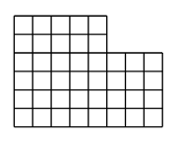
Warm Up - Represent the Squares ⏹️
How does each expression represent the number of small squares in the figure?
Expression A: 6 ⋅ 8 − 2 ⋅ 3
Expression B: 4 ⋅ 8 + 2 ⋅ 5
Expression C: 8 + 8 + 8 + 8 + 5 + 5
Expression D: 5 ⋅ 6 + 3 ⋅ 4
Notes:
Warm Up (5 minutes)
This warm up encourages students to quantify the number of squares in a geometric pattern by looking for and making use of structure. The thinking involved here prepares students to reason about other patterns that illustrate quadratic relationships.
Launch
Arrange students in groups of two.
Give students 2 – 3 minutes of quiet time to think individually.
Ask them to share their thinking with their partner.
Activity Answers
There are 6 rows with 8 small squares, but from this, 2 rows of 3 small squares have been removed.
There are 4 rows of 8 small squares, and to this, 2 rows of 5 small squares are added.
This counts each row, starting from the bottom.
There are 5 columns of 6 small squares and 3 columns of 4 small squares.
Activity Synthesis
Make sure students see how each expression tells us about a way the squares can be counted or how the area of the figure can be determined. If time permits, ask students if they could generate a different expression that also represents the number of squares in the figure.

Slide 8

Lesson Journey
Warm Up
Learning Activity
Practice
Learning Activity
Cool Down
Lesson Synthesis

Slide 9
Learning Strategies - Comparing Dot Patterns🟣🟣🟣🟣🟣
Teacher Instruction: Use these strategies to adjust the activity to support English language learners.
  You can copy and paste the callouts directly on top of the activity or give the instructions aloud.
Think quietly about what is the same and different in each pair of representations (patterns, tables, and graphs).
Discuss your ideas with a partner.
Use math language to describe the connections you notice.
Share ideas during the class discussion.
Compare and Connect
Notes:
Support for English Language Learners: MLR 7 Compare and Connect: Representing, Conversing
Use this routine to prepare students for the whole-class discussion. Give students quiet think time to consider what is the same and what is different about each of the pairs of representations (patterns, tables, and graphs). Invite students to discuss what they notice with a partner. Listen for and amplify mathematical language students use to describe connections they notice across and between the different representations.
Design Principle(s): Support sense-making
Learn more about this routine
View the instructional video and follow along with the materials to assist you with learning this routine.
Provide support for students
Distribute graphic organizers to the students to assist them with participating in this routine.

Slide 10

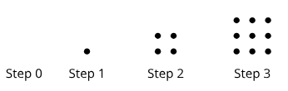
Learning Activity - Comparing Dot Patterns🟣🟣🟣🟣🟣
Pattern 1
How is the number of dots in each step changing?
  In Pattern 1
  In Pattern 2
How many dots will be in Step 5 in the pattern, and how will they be arranged?
  In Pattern 1
  In Pattern 2
Pattern 2
Notes:
Support for All Learners
This activity offers additional support for students:
For English language learners, be sure to review the Learning Strategies slide!
Activity (15 minutes)
In this activity, students compare two dot patterns—one linear and one quadratic. They use tables, expressions, and graphs to represent each.
The quadratic pattern clearly shows “squaring” in both the dots (1, 4, 9, …) and the curved graph. Students describe how the dots grow, write expressions with variables, and use structure to extend the pattern. They may also use spreadsheets or graphing tools to explore the relationships.
Launch
Some students may choose to use a spreadsheet tool to study the pattern and subsequently to use graphing technology to plot the data. Make these tools accessible, in case they are requested.
Answers
a. Each step has 2 rows of dots, with each row having the same number of dots as the step number, plus one extra dot.
b. Each step has as many rows and columns of dots as the step number.
a. In Step 5, there will be 2 rows of 5 dots plus one additional dot.
b. Step 5 is a 5-by-5 array of dots.
More question, answers and Activity Synthesis on next slide

Slide 11
Learning Activity - Comparing Dot Patterns🟣🟣🟣🟣🟣
Step | Number of dots in Pattern 1 | Number of dots in Pattern 2
0 | 1 | 0
1 | 3 | 1
2 | 5 | 4
3 | 7 | 9
4 | a.___ | f.___
5 | b.___ | g.___
10 | c.___ | h.___
12 | d.___ | i.___
n | e.___ | j.___
Complete questions a - e in the table with the number of dots for Pattern 1.
Complete questions f - j in the table with the number of dots for Pattern 2
Use the graphing tool or technology outside the course. Plot the number of dots at each step number for :
  Pattern 1
  Pattern 2
Explain why the graphs of the two patterns look the way they do.
Notes:
Answers
a. 9
b. 11
c. 21
d. 25
e. 2n + 1
f. 16
g. 25
h. 100
i. 144
j. n ⋅ n or n²
a. Link to Desmos graph: https://www.desmos.com/calculator/qsyah2ughd
b. Link to Desmos graph: https://www.desmos.com/calculator/4cw4mobckh
The points representing the first pattern lie on a line because getting from one step to the next involves adding the same number of dots (2 dots). The points representing the second pattern do not lie on a line. They “curve” upward because the number of dots added at each step increases from step to step.
Activity Synthesis
Invite students to describe how they see the number of dots change in each pattern. Focus the discussion on the connections between students’ descriptions, the changes in the table, and the graphs. Make sure these points are uncovered in the discussion:
For the first pattern, each successive step adds two dots. The growth is constant. The points on the graph form a straight line.
For the second pattern, the number of dots that is added changes (and grows) at each step. As a result, the number of dots for the second pattern curves upward when graphed.
Highlight that, in the second pattern, the expression for the number of dots at Step n can be expressed as n², which can be read as “n squared.” Point out that the “squaring” is also evident in the visual pattern.

Slide 12
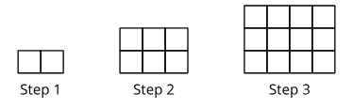
Self Check
How many squares will be in Step 5?
20
25
30
35
Let’s review!
Notes:
Answer Feedback - Individualized by Response
Incorrect. This is the number of squares in Step 4.
Incorrect. The number of rows is the same as the number of the step, and the number of columns is 1 more than the number of the step.
That’s correct! The number of rows is the same as the number of the step, and the number of columns is 1 more than the number of the step. Step 5 has 5 rows and 6 columns.
Incorrect. The number of rows is the same as the number of the step, and the number of columns is 1 more than the number of the step.

Slide 13
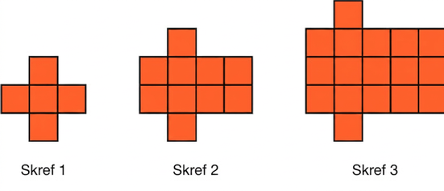
Self Check - Review
Use the information in the table to help find the number of squares in Step 5.
Step | # of Squares
1 | 5
2
3 | 17
4
5
Find the expression for Step n.
Notes:
Writing Expressions for Patterns
Answers
First, look to see the pattern. Every step, another row and another column are added, plus the two extra squares.
Step 1: 1 row of 3 + 2
Step 2: 2 rows of 4 + 2
Step 3: 3 rows of 5 + 2
So the width is always 1 by n, or n. The length is n + 2, and then another 2 is added.
Draw pictures or create a table like the one shown
At Step 5, there are 37 squares.
Multiply the length and width, and then add the 2 extra squares:n(n + 2) + 2 = n² + 2n + n

Slide 14
Lesson Journey
Warm Up
Learning Activity
Practice
Learning Activity
Cool Down
Lesson Synthesis

Slide 15
Learning Strategies - Quadratic Growth in Visual Patterns 🪴
Listen to each strategy carefully.
Say what you heard using math language.
Practice saying it with a partner, then share with the class.
Ask the original speaker if your what you said was right.
Notice words or phrases that make the idea clearer.
Discussion Supports
Teacher Instruction: Use these strategies to adjust the activity to support English language learners and students with disabilities.
You can copy and paste the callouts directly on top of the activity or give the instructions aloud.
Help make a display of key math words.
Add pictures or notes for quadratic, quadratic relationship, and quadratic expression.
Include examples of patterns and equations.
Representation
Notes:
Support for English Language Learners: MLR 8 Discussion Supports: Speaking
Use this routine to support whole-class discussion. For each strategy that is shared, invite students to restate and/or revoice what they heard using precise mathematical language. Consider providing students with time to restate what they hear to a partner before selecting one or two students to share with the class. Ask the original speaker if their peer was accurately able to restate their thinking. Call students’ attention to any words or phrases that helped to clarify the original statement. This will provide more students with an opportunity to produce language as they interpret the reasoning of others.
Design Principle(s): Support sense-making
Support for Students with Disabilities: Representation: Develop Language and Symbols
Create a display of important terms and vocabulary. Invite students to suggest language or diagrams to include that will support their understanding of: quadratic, quadratic relationship, and quadratic expressions. Provide examples of both visual patterns and quadratic equations in the display.
Supports accessibility for: Conceptual processing; Language

Slide 16
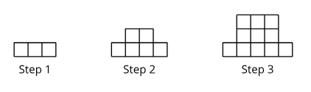
Learning Activity - Quadratic Growth in Visual Patterns 🪴
Step | Number of small squares
1 | 3
2 | 6
3 | 11
4 | a. ___
5 | b.___
10 | c.___
12 | d.___
n | e.___
Is the number of small squares growing linearly? Explain how you know.
To complete the table answer questions a – e, What is the number of small squares for the given step?
Is the number of small squares growing exponentially? Explain how you know.
Are you ready for more?
Notes:
Support for All Learners
This activity offers additional support and an extension for students:
For English language learners and students with disabilities, be sure to review the Learning Strategies slide!
For students looking for an extra challenge, be sure to review the Extending Your Thinking slide!
Activity (15 minutes)
In this activity, students explore another quadratic visual pattern where the number of squares follows the rule 𝑛² + 2. Since it’s not a perfect square, the quadratic growth may be less obvious. Students look for structure—like the 2 × 2 and 3 × 3 squares—and use it to extend the pattern and write an expression. They also decide if the pattern is linear or exponential and explain why. During discussion, highlight different strategies—drawing, describing, or using numbers—to show multiple ways of reasoning.
As students work, look for students who draw a picture (especially for Step 5), those who describe the picture (especially for Steps 10 and 12), and those who rely on numerical (rather than visual) reasoning. Invite them to share their strategies during the synthesis of this activity.
Launch
Display the pattern of squares for all to see.
Ask students to be prepared to share one thing they notice and one thing they wonder about.
Give them a moment to share their observations and questions with a partner.
The last question asks whether the pattern grows exponentially. If needed, remind students that a quantity that changes exponentially grows or decays by equal factors over equal intervals.
Answers
No, there are 3 squares in the first step, 6 squares in the second step, and 11 squares in the third step. So the number of additional squares is 3 going from the first to the second step and 5 going from the second to the third step.
a. 18
27
102
146
n² + 2
No, from Step 1 to Step 2, the number of squares doubles. From Step 2 to Step 3, the number of squares increases by a factor of ¹¹⁄₆. From Step 3 to Step 4, the number of squares increases by a factor of ¹⁸⁄₁₁. These growth factors are all different; in contrast, for an exponential function, the values increase by equal growth factors over equal intervals.
The nth expression, n² + 2, is an example of a quadratic expression. A quadratic expression can be written using a squared term. It can be written in other ways as well, but the expression should be able to be written with the highest exponent on the variable as 2.
A quadratic relationship is not like a linear relationship because as one quantity increases by a certain amount, the second quantity doesn’t increase by the same amount.
A quadratic relationship is not like an exponential relationship because as one quantity increases by a certain amount, the second quantity doesn’t change by the same factor. (In this case, if the number of squares grew exponentially, this would mean that, from each step to the next, the number of squares is multiplied by the same factor.)
Anticipated Misconceptions
Some students may struggle to draw the next step in the visual pattern. Prompt them to compare Steps 2 and 3 and describe what stays the same and what changes. For example, the two small squares on either side stay the same, and the square in the middle increases. If needed, show them a drawing for Step 4 (two 1-by-1 squares on each side with a 4-by-4 square in the middle) and ask them to draw Step 5.
Some students may not notice the table goes from Step 4 to Step 10 and record 27 (the number of small squares for Step 5) instead of 102. Prompt them to draw a picture of Step 10 and count the number of small squares in their drawing. Emphasize that when the step size increases by more than 1, we are skipping ahead several steps and our pattern needs to reflect that as well. Show students a table with the missing steps included so they can see the growth pattern.
Activity Synthesis
Have students share how they figured out the pattern’s growth—starting with pictures, then moving to equations. Ask where they see the +2 and the n² in the pattern. Introduce quadratic to describe when one number is multiplied by itself.
Explain that the relationship between the step number and the number of squares is a quadratic relationship, which includes one quantity (the step number, in this case) being multiplied by itself to obtain a second quantity (the number of squares).
Explain that n² + 2 is a quadratic expression, like the area formula s² for a square.
Point out that quadratic relationships are different because:
They don’t grow by the same amount (not linear).
They don’t grow by the same factor (not exponential).

Slide 17

Extending Your Thinking
Han wrote n(n + 2) − 2(n − 1) for the number of small squares in the design at Step n in the pattern at the beginning of the activity.
Explain why Han is correct.
On your own, draw and label what Step 3 would look like when Han was writing his expression.
Notes:
Answer
At Step n, there is an n by n+2 rectangle containing n(n + 2) small squares with two columns of n − 1 squares removed from either side.
I drew a rectangle with three small squares down and five small squares across. Then I removed the two small squares from the first column and the last column.
Rectangle example link, refer to online teacher edition textbook: Openstax Teacher Edition 7.2.3
Go back to activity information.

Slide 18
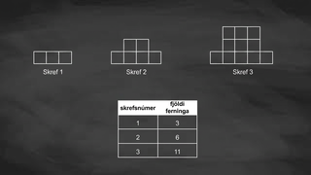
Video: Quadratic Expressions

Slide 19
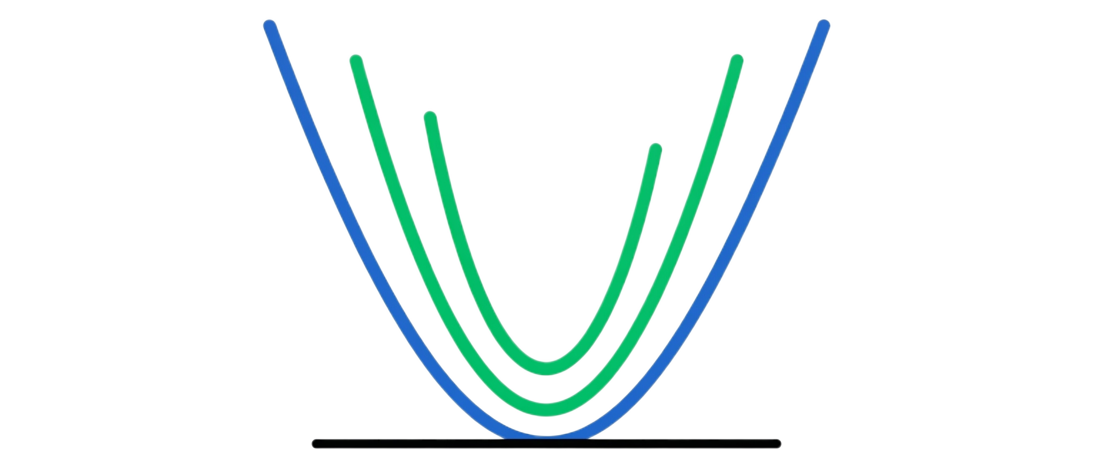
Self Check
Which of the following is an example of a quadratic expression?
2n + 4
2^{n} + 3
3(n + 2)
n² + 3
Let’s review!
Notes:
Answer Feedback - Individualized by Response
Incorrect. This is a linear expression.
Incorrect. This is an exponential expression.
Incorrect. This is a linear expression.
That’s correct! Since the variable is squared, this is a quadratic expression. The highest exponent is 2, making it quadratic.

Slide 20
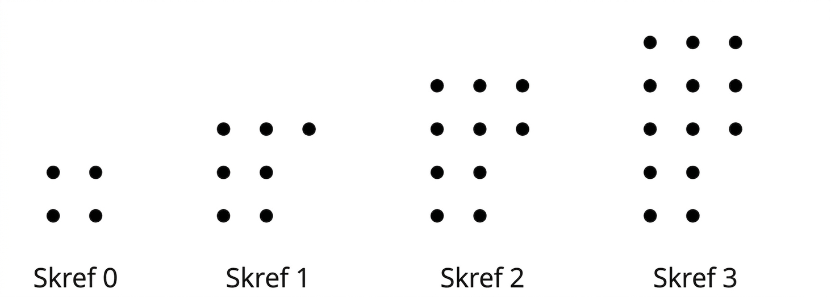
Self Check - Review
Writing Expression from Patterns
Make a table for steps 0 to 3 to help you find the pattern.
Using your table, What do you notice about each step?
Add steps 4 and 5 to your table.
Find the number of dots in Step 5.
Write an expression to find n number of dots. Name the type of expression
Notes:
Writing Expression from Patterns
Answers
Step 0, Number of Dots: 4
Step 1, Number of Dots: 7
Step 2, Number of Dots: 10
Step 3, Number of Dots: 13
Notice that the start has 2 rows and 2 columns, or 4 dots. Each step adds a row of 2 dots, plus 1 more dot. So, each step adds 3 dots.
Step 4, Number of Dots: 16
Step 5, Number of Dots: 19
Step 5 would have 19 dots.
An expression could be 3n + 4.
This is a linear expression.

Slide 21

Lesson Journey
Warm Up
Learning Activity
Practice
Learning Activity
Cool Down
Lesson Synthesis

Slide 22
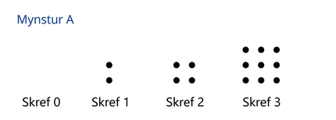
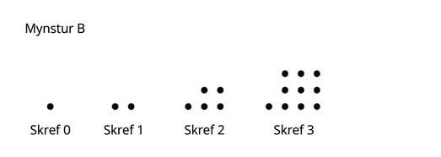
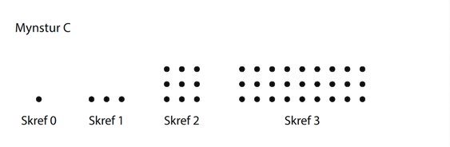
Cool Down
Which pattern shows a quadratic relationship between the step number and the number of dots? Explain how you know algebraically and in complete sentences.
Notes:
Cool Down (5 minutes)
Answers
Pattern B shows a quadratic relationship.
The number of dots is the step number squared plus 1, or n² + 1.
Pattern A is growing linearly. It is growing by 2 each time. Pattern C is growing by a factor of 3 each time, so it is growing exponentially.
Pattern B is growing by 1, then by 3, and then by 5, which is the pattern we saw in other examples of quadratic relationships in the lesson.
Response to Student Thinking - More Chances
Students will have more opportunities to understand the mathematical ideas in this cool down, so there is no need to slow down or add additional work to the next lessons. Instead, use the results of this cool down to provide guidance for what to look for and emphasize over the next several lessons to support students in advancing their current understanding.

Slide 23

Lesson Journey
Warm Up
Learning Activity
Practice
Learning Activity
Cool Down
Lesson Synthesis

Slide 24

Practice
Put your hard work to action, practice what you’ve learned!
Notes:
Digital Practice: Access the practice pages at https://openstax.org/k12/algebra

Slide 25

Lesson Journey
Warm Up
Learning Activity
Practice
Learning Activity
Cool Down
Lesson Synthesis

Slide 26

Lesson Synthesis
Summarize your understanding so far of what a quadratic expression (or relationship) is and is not.
In what ways is the relationship between the step number and the number of small squares different from linear functions we’ve seen so far?
In what ways is the relationship between the two quantities different from the exponential functions we’ve encountered?
How would you describe ‘quadratic relationship’ to someone who is unfamiliar with it?
Notes:
Possible Answers
When one quantity increases by a certain amount, the other quantity does not change by the same amount. The graph relating the two quantities is not a straight line. The rule that relates the two quantities is different from a linear expression.
When the input increases by an amount, the output does not always change by the same factor. The graph representing this relationship is a curve, but it is different from the graph of an exponential function. Even though there may be an exponent in the expression (for example, n²), the rule that relates the two quantities is not like exponential expressions we’ve seen, where the input was the exponent.
Answers may vary.

Slide 27
Self Assessment
How much do you agree with the following statements?
I can… | I can | Almost | Not yet
Describe how a pattern is growing.
Tell whether a pattern is growing linearly, exponentially, or quadratically.
Explain that an expression with a squared term is called quadratic.

