Slide 1
Algebra 1
Unit 8 Quadratic Equations
Lesson 8.8 Rewriting Quadratic Equations in Factored Form, Part 3

Slide 2

How to use these slides
On the activity slides check the speaker notes for teacher support and instructional information.
Each lesson includes 1 warm up, 2-3 learning activities, a cool down, practice and a lesson synthesis.
  Learning activities are followed by a self check question, and review section.
Some slides have been hidden from student view, more information can be found on the next slide (Reference Key).
You can edit and use these slides for personal and classroom use, but cannot sell them and must keep the attribution logos.
For more information, Check out the digital quick start guide!
OpenStax CC BY NC SA

Slide 3





Reference Key
Check the top right corner for an icon referencing these unique sections.
Icon | Title | View | Location and Description
n/a | Support for Students with Disability | Hidden | Learning Strategies slide, provides additional support to students for understanding the activity.
n/a | Support for English Language Learners | Hidden | Learning Strategies slide, provides additional support to students for understanding the activity.
n/a | Extending Your Thinking | Hidden | Extending Your Thinking slide, provides an extra challenge for students.
n/a | Self Check | Not Hidden | Self Check slide, checkpoint to assess student understanding after the learning activity.
n/a | Review | Hidden | Self Check - Review slide, designed to help review topics from the self check question.
On the next slides, check the speaker notes for teacher instructions and support.
Notes:
Check the Speaker Notes: On the next slides you can find discussion questions, lesson information, answers to the activities, and ways to adjust the activity for your students!

Slide 4

Learning Goals
By the end of this lesson you will be able to -
Explain why multiplying binomials that are a sum and a difference, (𝑥 + 𝑚)(𝑥 − 𝑚), results in a quadratic expression with no linear term.
Rewrite a quadratic expression of the form 𝑥² − 𝑐 into its factored form.
Notes:
Lesson Narrative
So far, the quadratic expressions that students have transformed from standard form to factored form have at least a squared term and a linear term. In this lesson, students encounter quadratic expressions without a linear term and consider how to write them in factored form.
Students begin by studying numerical examples and noticing that expressions such as (20 + 1)(20 − 1) and 20²−1² are equivalent. Students generalize the equivalence of these two forms as (𝑥 + 𝑚)(𝑥 − 𝑚) = 𝑥² − 𝑚². Then, they rewrite these expressions from one form to the other.
Along the way, they encounter a variety of quadratic expressions that can be seen as differences of two squares, including those in which the squared term has a coefficient other than 1, and expressions that involve fractions.
Students also consider why a difference of two squares (such as 𝑥² − 25) can be written in factored form, but a sum of two squares (such as 𝑥² + 25) cannot be, even though both are quadratic expressions with no linear term.
Remind students that when they want to enter a number with an exponent, they should use the ^ symbol. It will look like "𝑥²" when they want to enter 𝑥². To make the ^ symbol, push shift and the numeral 6 at the same time.
After this lesson, students will have the tools they need to solve factorable quadratic equations given in standard form by first rewriting them in factored form. That work begins in the next lesson.
Required Preparation
None
Required Materials
Paper and pencil
Texas Essential Knowledge and Skills
A1(F) analyze mathematical relationships to connect and communicate mathematical ideas
A8(A) solve quadratic equations having real solutions by factoring, taking square roots, completing the square, and applying the quadratic formula.

Slide 5
Vocabulary
Previous
Quadratic expression
  A polynomial expression of degree two.
Factored form (of a quadratic expression)
  A quadratic expression in the form a(x – r₁)(x – r₂), where a, r₁, and r₂ are constants and a ≠ 0.
Standard form (of a quadratic expression)
  A quadratic expression in the form ax² + bx + c, where a, b, and c are constants and a ≠ 0.
Linear Term
  The term bx in a quadratic expression of the form ax² + bx + c, where a, b, and c are constants.
Difference of Squares
  An algebraic expression of the form a² – b² resulting from a product of binomials: (a + b)(a – b).
Notes:
Lesson Vocabulary
To support student understanding of key vocabulary:
Introduce and review the vocabulary words students will see in this lesson.
Encourage students to notice how these words are used and to include them in their math discussions and explanations—both written and oral.
Use a word wall to reinforce vocabulary. Sample word wall cards are available here.
For newcomers or students with beginning English proficiency, use these Quizlet sets to support vocabulary learning:
Unit 8 Spanish Vocabulary – use first to build understanding
Unit 8 Vocabulary (English) – use after anchoring in Spanish
Support for English Language Learners
ELPS 2(F) listen to and derive meaning from a variety of media such as audiotape, video, DVD, and CD-ROM to build and reinforce concept and language attainment
ELPS 3(E) share information in cooperative learning interactions
ELPS 4(G) demonstrate comprehension of increasingly complex English by participating in shared reading, retelling, or summarizing material, responding to questions, and taking notes commensurate with content area and grade level needs

Slide 6
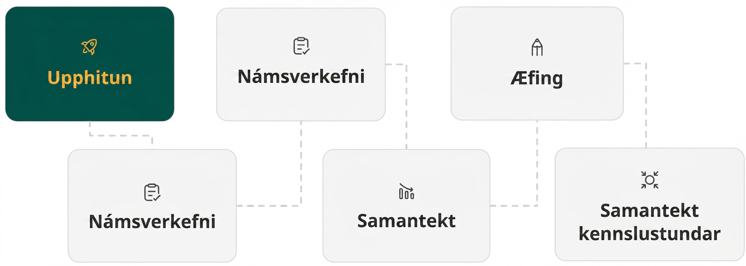
Lesson Journey
First Stop: Warm Up

Slide 7

Warm Up
Mental Multiplication🤔💭
For the following questions, find each product mentally. Then, explain how you changed the way you looked at each multiplication problem to use the distributive property.
(9 ⋅ 11)
(19 ⋅ 21)
(99 ⋅ 101)
(109 ⋅ 101)
Notes:
Warm Up (10 minutes)
This warm up activity prompts students to recall strategies for multiplying mentally.
Launch
Display one problem at a time.
Give students quiet time to think individually for each problem and ask them to give a signal when they have an answer and a strategy.
Keep all problems displayed throughout the talk.
Follow with a whole-class discussion.
Answers
99 (Explanations may vary. For example, 9⋅11 can be thought of as 9⋅(10+1). This simplifies to 90+9, or 99.)
399 (Explanations may vary. For example, 19⋅21 can be thought of as 19⋅(20+1). This simplifies to 380+19, or 399.)
9999 (Explanations may vary. For example, 99⋅101 can be thought of as 99⋅(100+1). This simplifies to 9900+99, or 9999.)
11,009 (Explanations may vary. For example, 109⋅101 can be thought of as 109⋅(100+1). This simplifies to 10,900+109, or 11,009.)
Anticipated Misconceptions
None
Activity Synthesis
Ask students to share their strategies for each problem. Record and display their responses for all to see. To involve more students in the conversation, consider asking:
"Who can restate _______’s reasoning in a different way?"
"Did anyone have the same strategy but would explain it differently?"
"Did anyone solve the problem in a different way?"
"Does anyone want to add on to _______’s strategy?"
"Do you agree or disagree? Why?"

Slide 8
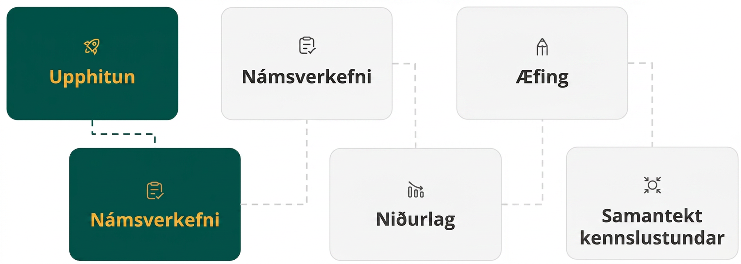
Lesson Journey
Second Stop: Learning Activity A

Slide 9

Learning Activity A | Learning Strategies
Can You See the Pattern?👀
Teacher Instruction: Use these strategies to adjust the activity to support English language learners and students with disabilities.
You can copy and paste the callouts directly on top of the activity or give the instructions aloud.
For question 4, study the expressions (𝑥 + 4)² and 𝑥²+4². Are they equal? Explain your reasoning.
Clarify, Critique, Correct
Use a different color to identify linear terms that result from multiplying the factors.
Circle the linear terms and show their sum.
Representation
Notes:
Support for English Language Learners: MLR 3 Clarify, Critique, Correct: Reading, Writing, Speaking
Before students share their explanations for the last question, present an incorrect answer and explanation. For example, "(𝑥 + 4)² is equivalent to 𝑥²+4² because when you square an expression you square each term.” Ask students to identify the error, critique the reasoning, and write a correct explanation. As students discuss with a partner, listen for students who use diagrams or examples to illustrate the error in the author's reasoning. Invite students to share their critiques and corrected explanations with the class. Listen for and amplify the language students use to explain how to use the distributive property to square an expression. This helps students evaluate, and improve upon, the written mathematical arguments of others.
Design Principle(s): Optimize output (for explanation); Maximize meta-awareness
Learn more about this routine
View the instructional video and follow along with the materials to assist you with learning this routine.
Provide support for students
Distribute graphic organizers to the students to assist them with participating in this routine.
Support for Students with Disabilities: Representation: Internalize Comprehension
Use color coding and annotations to highlight connections between representations in a problem. For example, use color coding to highlight the opposites that occur in the linear term after the products are distributed. Then, use annotations to illustrate the sum is zero, which results in no linear term. Encourage students to annotate their work while working independently.
Supports accessibility for: Visual-spatial processing

Slide 10
Learning Activity A | Part 1
Can You See the Pattern?👀
Clare claims that (10 + 3)(10 − 3) is equivalent to 10² − 3² and (20 + 1)(20 − 1) is equivalent to 20² − 1². Do you agree? Show your reasoning.
You can use your observations from the first question to mentally solve an expression such as 105⋅95.
  First, think about the problem differently. Evaluate (100 + 5)(100 − 5) using the distributive property, or FOIL. Show your reasoning.
  Check your answer by computing 105⋅95.
Notes:
Support for All Learners
This activity offers additional support and an extension for students:
For English language learners and students with disabilities, be sure to review the Learning Strategies slide!
For students looking for an extra challenge, be sure to review the Extending Your Thinking slide!
Activity (15 minutes)
In this activity, students multiply expressions of the form (𝑥 + 𝑚) and (𝑥 − 𝑚). They discover that the expanded product of such factors can be expressed as a difference of two square numbers: 𝑥² − 𝑚². Students use diagrams and the distributive property to make sense of their observations.
In the last question, they have an opportunity to notice that an expression in the form (𝑥+𝑚)² is not equivalent to 𝑥² + 𝑚², to discourage overgeneralizing. Later in the lesson, they will transform quadratic expressions in standard form into factored form and vice versa.
To answer the first two questions, some students may simply evaluate the expressions rather than reasoning about their structure. For example, to see if (10 + 3)(10 − 3) is equivalent to 10² − 3², they may calculate 13⋅7 and 100 − 9 and see that both are 91. Ask students to see if they could show that this is not a coincidence. Could they show, for example, that (50 + 4)(50 − 4) would also be equivalent to 50² − 4²?
As students work, look for those who expand the factored expression using the distributive property and leave the partial products unevaluated to show the equivalence of the two expressions.
Launch
Provide access to calculators, in case requested.
Activity image answer, and synthesis on the next slide.

Slide 11
Learning Activity A | Part 2
Can You See the Pattern?👀
Is (𝑥 + 4)(𝑥 − 4) equivalent to 𝑥² − 4²?
  First, support your thinking using a diagram.
  Now, support your thinking using the distributive property, or FOIL.
Is (𝑥 + 4)² equivalent to 𝑥² + 4²? Support your answer, either with or without a diagram.
 | 𝑥 | 4
𝑥
-4
Are you ready for more?
Notes:
Activity Answer
Agree.
(10 + 3)(10 − 3) = (10 + 3)(10 + (−3)) = 10² + 10(−3) + 3(10) +3(−3) = 10² − 30 + 30 − 3² = 10² − 3²
(20 + 1)(20 − 1) = (20 + 1)(20 + (−1)) = 20² + 20(−1) + 20(1) + 1(−1) = 20² − 1²
(100 + 5)(100 − 5) = 100² − 5² = 10,000 − 25 = 9975
105⋅95 = 9975
Yes.
A completed diagram for this question is available on the next slide.
(𝑥 + 4)(𝑥 − 4) = 𝑥² + 4𝑥 −4𝑥 −4(4) = 𝑥² − 4²
No.
With a diagram: A completed diagram for this question is available on the next slide.
With FOIL:
(𝑥 + 4)² = (𝑥 + 4)(𝑥 + 4) = 𝑥² + 4𝑥 + 4𝑥 + 4(4) = 𝑥² + 8𝑥 + 16
𝑥² + 4² = 𝑥² + 16
Anticipated Misconceptions
Some students may struggle to generalize the pattern after just a few examples. Before starting the activity synthesis, provide additional factored expressions for students to expand, for instance: (𝑥 + 3)(𝑥 − 3), (2𝑥 + 1)(2𝑥 − 1), (4𝑥 + 5)(4𝑥 − 5), and (6 − 𝑥)(6 + 𝑥).
Activity Synthesis
To help students generalize their observations, display the expression (𝑥+𝑚)(𝑥−𝑚) and a blank diagram that can be used to visualize the expansion of the factors. Ask students what expressions go in each rectangle. A blank diagram is available on this slide.
Illustrate that when the terms in each factor are multiplied out, the resulting expression has two squares, one with a positive coefficient and the other with a negative coefficient (𝑥² and 𝑚²) and two linear terms that are opposites (𝑚𝑥 and −𝑚𝑥). Because the sum of 𝑚𝑥 and −𝑚𝑥 is 0, what remains is the difference of 𝑥² and 𝑚², or 𝑥² − 𝑚². There is now no linear term.
Emphasize that knowing this allows us to rewrite into factored form any quadratic expression that has no linear term and that is a difference of a squared variable and a squared constant. For example, we can write 𝑥² − 9 as (𝑥 + 3)(𝑥 − 3) because we know that when the latter is expanded, the result is 𝑥² − 9.
Use the last question to point out the importance of paying attention to the structure of these expressions (the subtraction in the first expression, the presence of both addition and subtraction in the second). For example, we can't use any patterns observed in this activity to rewrite 𝑥² + 9 in factored form.

Slide 12
Learning Activity A | Part 2
Can You See the Pattern?👀
Is (𝑥 + 4)(𝑥 − 4) equivalent to 𝑥² − 4²?
  First, support your thinking using a diagram.
  Now, support your thinking using the distributive property, or FOIL.
Is (𝑥 + 4)² equivalent to 𝑥² + 4²? Support your answer, either with or without a diagram.
 | 𝑥 | 4
𝑥 | 𝑥² | 4⁢𝑥
-4 | -4𝑥 | -16
 | 𝑥 | 4
𝑥 | 𝑥² | 74𝑥
4 | 4𝑥 | 16
Are you ready for more?
Notes:
Activity Answer
Agree.
(10 + 3)(10 − 3) = (10 + 3)(10 + (−3)) = 10² + 10(−3) + 3(10) +3(−3) = 10² − 30 + 30 − 3² = 10² − 3²
(20 + 1)(20 − 1) = (20 + 1)(20 + (−1)) = 20² + 20(−1) + 20(1) + 1(−1) = 20² − 1²
(100 + 5)(100 − 5) = 100² − 5² = 10,000 − 25 = 9975
105⋅95 = 9975
Yes.
A completed diagram for this question is available on the next slide.
(𝑥 + 4)(𝑥 − 4) = 𝑥² + 4𝑥 −4𝑥 −4(4) = 𝑥² − 4²
No.
With a diagram: A completed diagram for this question is available on the next slide.
With FOIL:
(𝑥 + 4)² = (𝑥 + 4)(𝑥 + 4) = 𝑥² + 4𝑥 + 4𝑥 + 4(4) = 𝑥² + 8𝑥 + 16
𝑥² + 4² = 𝑥² + 16
Anticipated Misconceptions
Some students may struggle to generalize the pattern after just a few examples. Before starting the activity synthesis, provide additional factored expressions for students to expand, for instance: (𝑥 + 3)(𝑥 − 3), (2𝑥 + 1)(2𝑥 − 1), (4𝑥 + 5)(4𝑥 − 5), and (6 − 𝑥)(6 + 𝑥).
Activity Synthesis
To help students generalize their observations, display the expression (𝑥+𝑚)(𝑥−𝑚) and a blank diagram that can be used to visualize the expansion of the factors. Ask students what expressions go in each rectangle. A blank diagram is available on this slide.
Illustrate that when the terms in each factor are multiplied out, the resulting expression has two squares, one with a positive coefficient and the other with a negative coefficient (𝑥² and 𝑚²) and two linear terms that are opposites (𝑚𝑥 and −𝑚𝑥). Because the sum of 𝑚𝑥 and −𝑚𝑥 is 0, what remains is the difference of 𝑥² and 𝑚², or 𝑥² − 𝑚². There is now no linear term.
Emphasize that knowing this allows us to rewrite into factored form any quadratic expression that has no linear term and that is a difference of a squared variable and a squared constant. For example, we can write 𝑥² − 9 as (𝑥 + 3)(𝑥 − 3) because we know that when the latter is expanded, the result is 𝑥² − 9.
Use the last question to point out the importance of paying attention to the structure of these expressions (the subtraction in the first expression, the presence of both addition and subtraction in the second). For example, we can't use any patterns observed in this activity to rewrite 𝑥² + 9 in factored form.

Slide 13
Learning Activity A | Lesson Synthesis
Can You See the Pattern?👀
Are you ready for more?
Notes:
Activity Synthesis
To help students generalize their observations, display the expression (𝑥+𝑚)(𝑥−𝑚) and a blank diagram that can be used to visualize the expansion of the factors. Ask students what expressions go in each rectangle.
Illustrate that when the terms in each factor are multiplied out, the resulting expression has two squares, one with a positive coefficient and the other with a negative coefficient (𝑥² and 𝑚²) and two linear terms that are opposites (𝑚𝑥 and −𝑚𝑥). Because the sum of 𝑚𝑥 and −𝑚𝑥 is 0, what remains is the difference of 𝑥² and 𝑚², or 𝑥² − 𝑚². There is now no linear term.
Emphasize that knowing this allows us to rewrite into factored form any quadratic expression that has no linear term and that is a difference of a squared variable and a squared constant. For example, we can write 𝑥² − 9 as (𝑥 + 3)(𝑥 − 3) because we know that when the latter is expanded, the result is 𝑥² − 9.
Use the last question to point out the importance of paying attention to the structure of these expressions (the subtraction in the first expression, the presence of both addition and subtraction in the second). For example, we can't use any patterns observed in this activity to rewrite 𝑥² + 9 in factored form.

Slide 14

Learning Activity A
Extending Your Thinking
Explain how your work in the previous questions can help you mentally evaluate 22⋅18.
Explain how your work in the previous questions can help you mentally evaluate 45⋅35.
Explain why the following shortcut works for squaring a two digit number, such as 83².
83 is 80 + 3.
Compute 80²and 3², which gives 6400 and 9. Add these values to get 6409.
Compute 80⋅3, which is 240. Double it to get 480.
Add 6409 and 480 to get 6889.
Notes:
Go back to Lesson Activity
Answer
22⋅18 can be written as (20 + 2)(20 − 2) = 20² − 2² = 400 − 4 = 396.
45⋅35 can be written as (40 + 5)(40 − 5) = 40²−5² = 1600−25 = 1575.
Any two-digit number can be written as 𝑎 + 𝑏, where 𝑎 is 10 times the first digit and 𝑏 is the second digit.
We are interested in squaring 𝑎 + 𝑏:
(𝑎 + 𝑏)² = (𝑎 + 𝑏)(𝑎 + 𝑏) = 𝑎² + 𝑎𝑏 + 𝑎𝑏 + 𝑏² by the distributive property.
𝑎² + 𝑎𝑏 + 𝑎𝑏 + 𝑏² = 𝑎² + 2𝑎𝑏 + 𝑏² by combining like terms.
𝑎² + 2𝑎𝑏 + 𝑏² = 𝑎² + 𝑏² + 2𝑎𝑏 because addition is commutative.
We get the 𝑎² + 𝑏² from squaring 𝑎 and 𝑏 and adding them, and the 2𝑎𝑏 from multiplying the two values and doubling them.

Slide 15
Learning Activity A
Self Check
Which of the following is equivalent to 9² − 6²?
(9 − 6)²
(9 − 6)(9 − 6)
(9 + 6)(9 + 6)
(9 + 6)(9 − 6)
Let’s review!
Notes:
Answer Feedback - Individualized by Response
Incorrect. This expression is (9−6)² = 3² = 9. The original expression is 9² − 6² = 81 − 36 = 45.
Incorrect. This expression is (9 − 6)(9 − 6) = (3)(3) = 9. The original expression is 9² − 6² = 81 − 36 = 45.
Incorrect. This expression is (9 + 6)(9 + 6) = (15)(15) = 225. The original expression is 9² − 6² = 81 − 36 = 45.
That’s correct! Check yourself: Multiply the expression to check. (9 + 6)(9 − 6) = (15)(3) = 45. The original expression is equivalent, 9² − 6² = 81 − 36 = 45.

Slide 16

Learning Activity A
Self Check - Review
Is (12 + 5)(12 − 5) equivalent to 12² − 5²?
Is (𝑥 + 7)(𝑥 − 7) equivalent to 𝑥² − 7²?
Is (𝑥 + 5)² equivalent to 𝑥² + 25?
WHY IS (a + b)(a – b) EQUIVALENT TO a² – b²?
Use the distributive property to multiply (a + b)(a – b).
Products that are opposites add to zero.
a² + ab – ab – b²
The result is a² – b².
Notes:
Remind Students
Diagrams like those used in Lesson 8.6.2 are useful for multiplying two binomials using the distributive property.
In this lesson, we reverse this process to rewrite the standard form of a quadratic expression into its factored form.
The linear term equals zero only holds true for the difference of squares. It does not work for an expression such as 𝑥² + 25.

Slide 17
Learning Activity A - Optional Self Check Review Resource
Use a Diagram!
Use these diagrams to determine whether the expressions are equivalent.
(𝑥 + 7)(𝑥 − 7) and 𝑥² − 7²
(𝑥 + 5)² and 𝑥² + 25
Notes:
Consider using a diagram to support students who are struggling to see the correct relationship between the expressions.

Slide 18
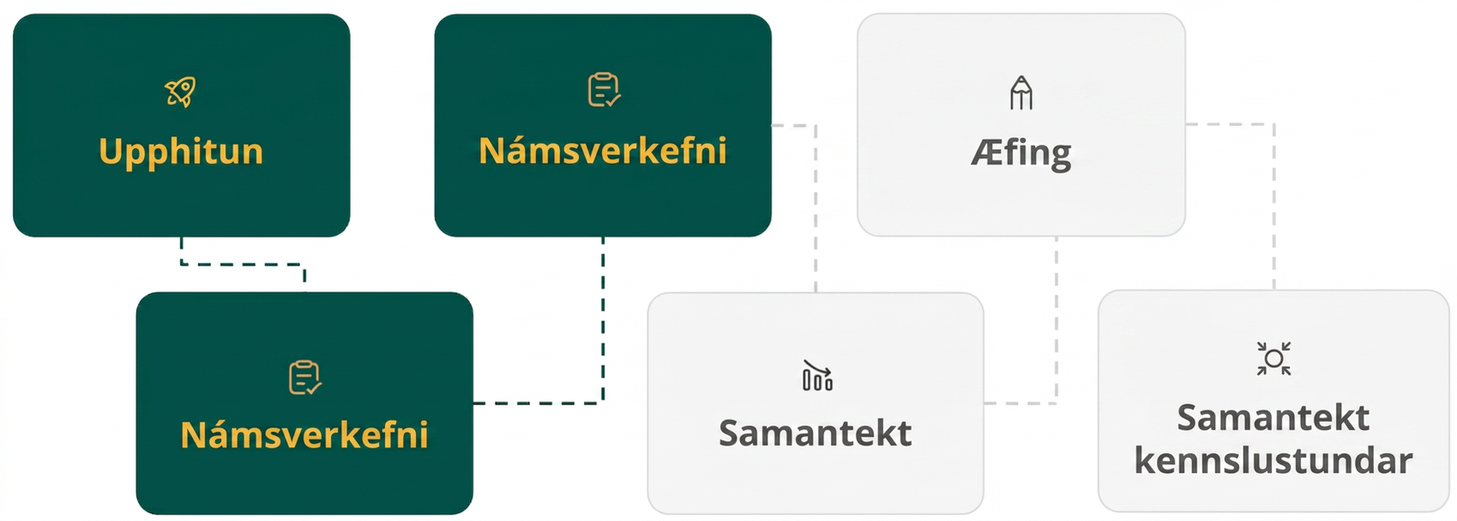
Lesson Journey
Third Stop: Learning Activity B

Slide 19
Learning Activity B | Learning Strategies
Make Them Equivalent: Next Level 🔄
Teacher Instruction: Use these strategies to adjust the activity to support English language learners and students with disabilities.
  You can copy and paste the callouts directly on top of the activity or give the instructions aloud.
Share your response, starting with either:
“I agree because . . .”
“I disagree because . . . .”
Speaking & Representing
With your partner, decide which rows each of you will complete.
Engagement
Notes:
Support for English Language Learners: MLR 8 Discussion Supports: Speaking, Representing
Use this routine to support whole-class discussion. After each student shares, provide the class with the following sentence frames to help them respond: “I agree because . . .” or “I disagree because . . . .” If necessary, revoice student ideas to demonstrate mathematical language use by restating a statement as a question in order to clarify, apply appropriate language, and involve more students.
Design Principle(s): Support sense-making
Support for Students with Disabilities: Engagement: Provide Access by Recruiting Interest
Leverage choice around perceived challenge. Invite students to work in pairs and take turns selecting rows to complete. Chunking this task into more manageable parts may also support students who benefit from additional processing time.
Supports accessibility for: Organization; Attention; Social-emotional skills

Slide 20
Learning Activity B | Part 1
Make Them Equivalent: Next Level 🔄
In questions 1 - 2, each row of the table contains a pair of equivalent expressions.
Convert the factored form expression to the standard form.
Factored Form | Standard Form
(𝑥 − 10)(𝑥 + 10)
(2𝑥 + 1)(2𝑥 − 1)
(4 − 𝑥)(4 + 𝑥)
(𝑐 + ⅖)(𝑐 − ⅖)
(𝑥 + 5)(𝑥 + 5)
Notes:
Support for All Learners
This activity offers additional support for students:
For English language learners and students with disabilities, be sure to review the Learning Strategies slide!
Activity (10 minutes)
In this activity, students use the insights from the previous activity to write equivalent quadratic expressions in standard form and factored form. They see that when a quadratic expression in standard form is a difference of two squares (a squared variable, 𝑥², and a squared constant, 𝑚²) and has no linear term, the factored form is (𝑥 + 𝑚)(𝑥 − 𝑚). Even if the constant term is not a perfect square, we can still find the factored form, but the numbers in the factors would not be rational numbers.
Students also notice that when a quadratic expression is a sum (instead of a difference) of a squared variable and a squared constant, it cannot be written in factored form.
Launch
Consider arranging students in groups of two.
Ask students to think quietly about the problems before discussing their responses with their partner.
Ask students to write as many equivalent expressions as time permits while aiming to complete at least the first six rows and the last row of the table.
Activity questions, answers, anticipated misconceptions, and synthesis on this slide.

Slide 21
Learning Activity B | Part 1 Answers
Make Them Equivalent: Next Level 🔄
In questions 1 - 2, each row of the table contains a pair of equivalent expressions.
Convert the factored form expression to the standard form. ANSWERS
Factored Form | Standard Form
(𝑥 − 10)(𝑥 + 10) | 𝑥² − 100
(2𝑥 + 1)(2𝑥 − 1) | 4𝑥² − 1
(4 − 𝑥)(4 + 𝑥) | 16 − 𝑥²
(𝑐 + ⅖)(𝑐 − ⅖) | c² – ⁴/₂₅
(𝑥 + 5)(𝑥 + 5) | 𝑥² + 10𝑥 + 25
Notes:
Support for All Learners
This activity offers additional support for students:
For English language learners and students with disabilities, be sure to review the Learning Strategies slide!
Activity (10 minutes)
In this activity, students use the insights from the previous activity to write equivalent quadratic expressions in standard form and factored form. They see that when a quadratic expression in standard form is a difference of two squares (a squared variable, 𝑥², and a squared constant, 𝑚²) and has no linear term, the factored form is (𝑥 + 𝑚)(𝑥 − 𝑚). Even if the constant term is not a perfect square, we can still find the factored form, but the numbers in the factors would not be rational numbers.
Students also notice that when a quadratic expression is a sum (instead of a difference) of a squared variable and a squared constant, it cannot be written in factored form.
Launch
Consider arranging students in groups of two.
Ask students to think quietly about the problems before discussing their responses with their partner.
Ask students to write as many equivalent expressions as time permits while aiming to complete at least the first six rows and the last row of the table.
Activity questions, answers, anticipated misconceptions, and synthesis on this slide.

Slide 22
Learning Activity B | Part 2
Make Them Equivalent: Next Level 🔄
Convert the standard form expression to the factored form.
Factored Form | Standard Form
 | 𝑥² − 81
 | 49 − 𝑦²
 | 9z² − 16
 | 25𝑡² − 81
 | ⁴⁹/₁₆ – d²
 | 𝑥² − 6
 | 𝑥² + 100
Notes:
Answers
A completely filled in table is on this slide.
A completely filled in table is on this slide.
Anticipated Misconceptions
Some students may struggle to see the numbers in the expressions in standard form as perfect squares. Prompt them to create a list or table of square numbers (1² = 1, 2² = 4, 3² = 9, and so on) to have as a handy reference. Others may benefit by rewriting both terms as squares before writing the factored form. Demonstrate how to rewrite 49𝑥² − 81 as (7𝑥)² − (9)² and ¼𝑥² − 25 as (½𝑥)² − (5)².
Activity Synthesis
Consider displaying the incomplete table for all to see and asking students to record their responses. Give the class time to examine the responses and to bring up any disagreements or questions. Discuss with students:
"How can we check if the expression in factored form is indeed equivalent to the given expression in standard form?" (We can expand the factored expression by applying the distributive property and see if it gives the expression in standard form.)
"Some of the expressions show a squared variable subtracted from a number, instead of the other way around. Can we still write an equivalent expression in factored form?" (Yes. As long as the expression in standard form can be written as a difference of two squares, it can be written in factored form.)
"What if the number is not a perfect square, for example, 𝑥² − 5?" (We can still write it in factored form, by thinking about what number can be squared to get 5. Both √5 and −√5 can be squared to get 5. Regardless of which number we use, the factored form is (𝑥 + √5)(𝑥 − √5)).
"Why can 𝑥² − 100 be written in factored form but 𝑥² + 100 cannot?" (One possible approach is to rewrite the former as 𝑥² + 0𝑥 − 100. We learned previously that, to write this expression in factored form, we would need to look for two numbers whose product is –100 and whose sum is 0. The numbers 10 and –10 meet this requirement. For 𝑥² + 0𝑥 + 100, however, we need two numbers whose product is 100 and whose sum is 0. No such numbers exist. To have a sum of 0, one number has to be positive and the other negative, so their product can’t be positive 100.)

Slide 23
Learning Activity B | Part 2 Answers
Make Them Equivalent: Next Level 🔄
Convert the standard form expression to the factored form. ANSWERS
Factored Form | Standard Form
(𝑥 − 9)(𝑥 + 9) | 𝑥² − 81
(7 − 𝑦)(7 + 𝑦) | 49 − 𝑦²
(3𝑧 + 4)(3𝑧 − 4) | 9z² − 16
(5𝑡 + 9)(5𝑡 − 9) | 25𝑡² − 81
(⁷/₄ − 𝑑)(⁷/₄ + 𝑑) | ⁴⁹/₁₆ – d²
(𝑥 − √6)(𝑥 + √6) | 𝑥² − 6
prime | 𝑥² + 100
Notes:
Answers
A completely filled in table is on this slide.
A completely filled in table is on this slide.
Anticipated Misconceptions
Some students may struggle to see the numbers in the expressions in standard form as perfect squares. Prompt them to create a list or table of square numbers (1² = 1, 2² = 4, 3² = 9, and so on) to have as a handy reference. Others may benefit by rewriting both terms as squares before writing the factored form. Demonstrate how to rewrite 49𝑥² − 81 as (7𝑥)² − (9)² and ¼𝑥² − 25 as (½𝑥)² − (5)².
Activity Synthesis
Consider displaying the incomplete table for all to see and asking students to record their responses. Give the class time to examine the responses and to bring up any disagreements or questions. Discuss with students:
"How can we check if the expression in factored form is indeed equivalent to the given expression in standard form?" (We can expand the factored expression by applying the distributive property and see if it gives the expression in standard form.)
"Some of the expressions show a squared variable subtracted from a number, instead of the other way around. Can we still write an equivalent expression in factored form?" (Yes. As long as the expression in standard form can be written as a difference of two squares, it can be written in factored form.)
"What if the number is not a perfect square, for example, 𝑥² − 5?" (We can still write it in factored form, by thinking about what number can be squared to get 5. Both √5 and −√5 can be squared to get 5. Regardless of which number we use, the factored form is (𝑥 + √5)(𝑥 − √5)).
"Why can 𝑥² − 100 be written in factored form but 𝑥² + 100 cannot?" (One possible approach is to rewrite the former as 𝑥² + 0𝑥 − 100. We learned previously that, to write this expression in factored form, we would need to look for two numbers whose product is –100 and whose sum is 0. The numbers 10 and –10 meet this requirement. For 𝑥² + 0𝑥 + 100, however, we need two numbers whose product is 100 and whose sum is 0. No such numbers exist. To have a sum of 0, one number has to be positive and the other negative, so their product can’t be positive 100.)

Slide 24
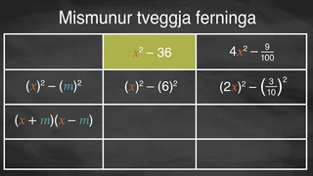
Learning Activity B | Video
Factoring Quadratic Equations Without a Linear Term
Notes:
This video discusses question 2 of activity 8.8.3. The examples in the video are different from those in the learning activity!

Slide 25

Learning Activity B
Self Check
Find the factored form of the expression 16𝑝² − 49.
(4𝑝 + 7)(4𝑝 − 7)
(4𝑝 + 7)(4𝑝 + 7)
(4𝑝 − 7)(4𝑝 − 7)
𝑝(16𝑝 − 49)
Let’s review!
Notes:
Answer Feedback - Individualized by Response
That's correct! Check yourself: Multiply the factored form to check. (4𝑝 + 7)(4𝑝 − 7) = 16𝑝² − 28𝑝 + 28𝑝 − 49 = 16𝑝² − 49.
Incorrect. This expression multiplies to be (4𝑝 + 7)(4𝑝 + 7) = 16𝑝² + 56𝑝 + 49. Look for the binomials that lead to the middle terms canceling each other out because they are opposites.
Incorrect. This expression multiplies to be (4𝑝 − 7)(4𝑝 − 7) = 16𝑝² − 56𝑝 + 49. Look for the binomials that lead to the middle terms canceling each other out because they are opposites.
Incorrect. This expression multiplies to be 𝑝(16𝑝 − 49) = 16𝑝² − 49𝑝.

Slide 26
Learning Activity B
Self Check - Review
Write 𝑣² − 36 in factored form.
Write 16𝑚² − 81 in factored form.
Write 64 − 9𝑏² in factored form.
Notes:
Remind Students
Remember that any expression of the form 𝑥² + 𝑐 or 𝑎𝑥² + 𝑐 does not have a factored form!
For 𝑥² + 𝑐, the 𝑐 is not squared, and the terms are not being subtracted.
For 𝑎𝑥² + 𝑐, neither the 𝑎 nor the 𝑐 is a perfect square, and the terms are not being subtracted.
Access the online textbook for the work that explains how to solve these examples and for additional examples.
This alternate version of this slide includes a summary of the 3 types of examples found in this AR.

Slide 27
Learning Activity B
Self Check - Review
Write 𝑣² − 36 in factored form.
Write 16𝑚² − 81 in factored form.
Write 64 − 9𝑏² in factored form.
Factoring Quadratic Equations Without a Linear Term
Leading coefficient is 1.
𝑥² − 𝑐² = (𝑥 + 𝑐)(𝑥 − 𝑐)
Leading coefficient is a².
𝑎²𝑥² − 𝑐² = (𝑎𝑥 + 𝑐)(𝑎𝑥 − 𝑐)
Leading term is c².
𝑐² – 𝑎²𝑥² = (𝑐 + 𝑎𝑥)(𝑐 − 𝑎𝑥)
Notes:
Remind Students
Remember that any expression of the form 𝑥² + 𝑐 or 𝑎𝑥² + 𝑐 does not have a factored form!
For 𝑥² + 𝑐, the 𝑐 is not squared, and the terms are not being subtracted.
For 𝑎𝑥² + 𝑐, neither the 𝑎 nor the 𝑐 is a perfect square, and the terms are not being subtracted.
Access the online textbook for the work that explains how to solve these examples and for additional examples.

Slide 28
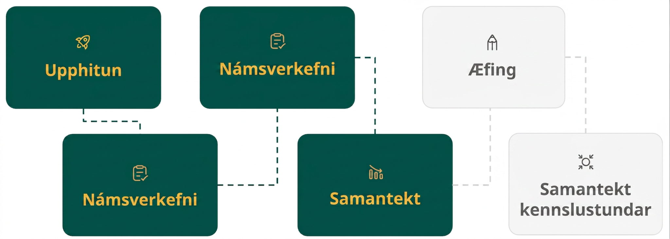
Lesson Journey
Fourth Step: Cool Down

Slide 29

Cool Down
Write each expression in factored form. If it is not possible, write “not possible.”
𝑎² − 36
49 − 25𝑏²
Notes:
Cool Down (5 minutes)
Answers
(𝑎 + 6)(𝑎 − 6)
(7 + 5𝑏)(7 − 5𝑏)
(10/9 + 4d)(10/9 – 4d)
Response to Student Thinking - Press Pause
If students are still struggling to identify and factor special polynomials, have them access the practice problems and additional resources from the “Factor Special Products” lesson in Unit 6.

Slide 30
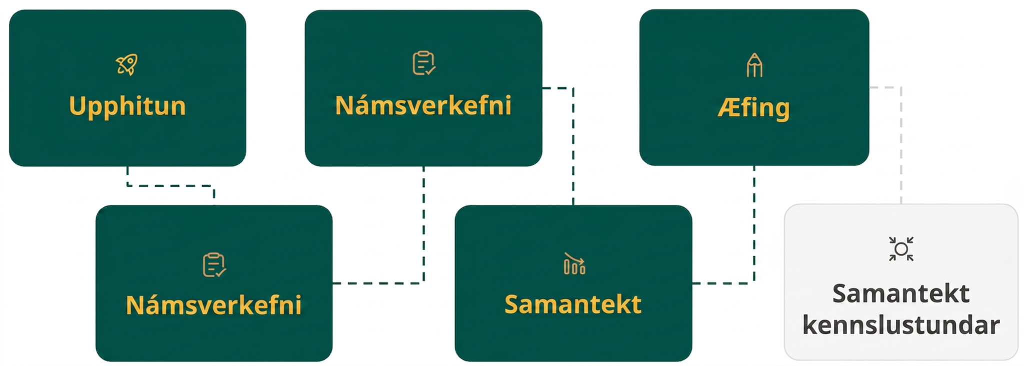
Lesson Journey
Fifth Stop: Practice

Slide 31

Practice
Put your hard work to action, practice what you’ve learned!
Notes:
Digital Practice: Access the practice pages at https://openstax.org/details/books/algebra-1

Slide 32
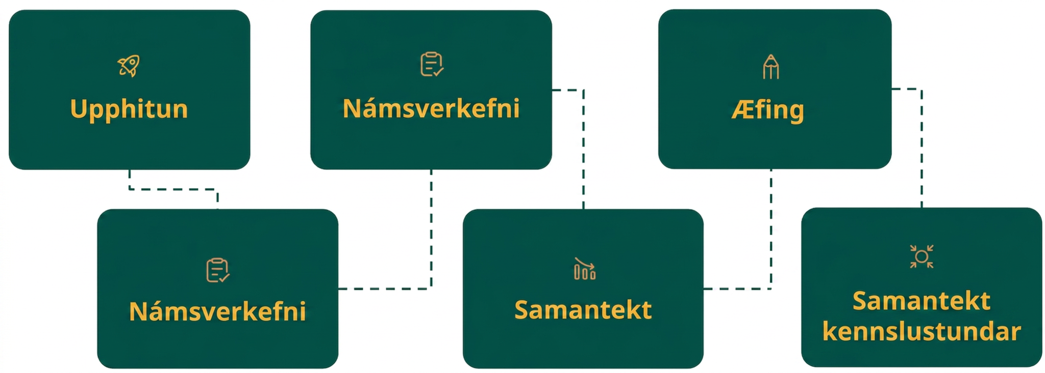
Lesson Journey
Sixth Stop: Lesson Synthesis

Slide 33
Lesson Synthesis
Respond to each question.
The expression (𝑥 + 4)(𝑥 − 4) has a sum and a difference, and so does (𝑥 + 8)(𝑥 − 2). When expanded into standard form, why does one have a linear term but the other does not?
Can ¼ − 100𝑚² be seen as a difference of two squares? Can it be written in factored form? If so, what would it be?
Think of another example of a quadratic expression in factored form that, when rewritten in standard form, is a difference of two squares and does not have a linear term. What is the expression in standard form?
Notes:
Suggested Launch
To help students consolidate and articulate their understanding of the relationship between (𝑥 + 𝑚)(𝑥 − 𝑚) and 𝑥² − 𝑚², ask them to reflect, in writing or by talking to a partner, their responses to each question.
Possible Student Responses
Multiplying out (𝑥 + 4)(𝑥 − 4) gives two linear terms that are opposites, 4𝑥 and −4𝑥, which add up to 0, so the linear term disappears.
Multiplying out (𝑥 + 8)(𝑥 − 2) also gives two linear terms, 8𝑥 and −2𝑥. Because they are not opposites, their sum is not 0, so the linear term remains.
Yes. ½ squared is ¼, and (10𝑚)² is 100𝑚². The factored form is (½ + 10𝑚)(½ − 10𝑚).
Answers may vary. For example, factored form: (2𝑥 + 9)(2𝑥 − 9); standard form: 4𝑥² − 81.

Slide 34
Self Assessment
How much do you agree with the following statements?
Learning Goals | I can | Almost | Not yet
Explain why multiplying binomials that are a sum and a difference, (𝑥 + 𝑚)(𝑥 − 𝑚), results in a quadratic expression with no linear term. | ⃞ | ⃞ | ⃞
Rewrite a quadratic expression of the form 𝑥² − 𝑐 into its factored form. | ⃞ | ⃞ | ⃞

