Slide 1


Algebra 1
Unit 4 Functions
Lesson 4.16: Introducing Arithmetic Sequences

Slide 2
How to use these slides
On the activity slides check the speaker notes for teacher support and instructional information.
Each lesson includes 1 warm up, 2-3 learning activities, a cool down, practice and a lesson synthesis.
  Learning activities are followed by a self check question, and review section.
Some slides have been hidden from student view, more information can be found on the next slide (Reference Key).
You can edit and use these slides for personal and classroom use, but cannot sell them and must keep the attribution logos.
For more information, Check out the digital quick start guide!

Slide 3






Reference Key
Check the top right corner for an icon referencing these unique sections.
 | Support for Students with Disability | Hidden | Learning Strategies slide, provides additional support to students for understanding the activity. Learning Strategies slide, provides additional support to students for understanding the activity.
 | Support for English Language Learners | Hidden
 | Extending Your Thinking | Hidden | Extending Your Thinking slide, provides an extra challenge for students.
 | Self Check | Not Hidden | Self Check slide, checkpoint to assess student understanding after the learning activity.
 | Review | Hidden | Self Check- Review slide, designed to help review topics from the self check question.
On the next slides, check the speaker notes for teacher instructions and support.
Notes:
Check the Speaker Notes: On the next slides you can find discussion questions, lesson information, answers to the activities, and ways to adjust the activity for your students!

Slide 4

Learning Goals
By the end of this lesson you will be able to -
Explain what it means for a sequence to be arithmetic or geometric.
Notes:
Lesson Narrative
This lesson helps students understand arithmetic sequences and connect them to linear functions, both defined by a constant rate of change. Students compare sequences to highlight key differences and practice precise language. They analyze arguments and use tables and graphs to justify whether a sequence is arithmetic, working with multiple function representations throughout.
Required Preparation
None
Required Materials
None
Texas Essential Knowledge and Skills
A1(F) analyze mathematical relationships to connect and communicate mathematical ideas
A12(C) identify terms of arithmetic and geometric sequences when the sequences are given in function form using recursive processes

Slide 5
Vocabulary
Previous
Geometric Sequence
  A sequence in which each term after the first nonzero term is found by multiplying the preceding term by a constant called the "common ratio 𝑟," where 𝑟 ≠ 0 or 1. A sequence where the ratio between consecutive terms is always the same.
New
Arithmetic Sequence
  A sequence where the difference between consecutive terms is constant. A numerical pattern that increases or decreases according to a constant value or proportion.
Notes:
Lesson Vocabulary
To support student understanding of key vocabulary:
Introduce and review the vocabulary words students will see in this lesson.
Encourage students to notice how these words are used and to include them in their math discussions and explanations—both written and oral.
Use a word wall to reinforce vocabulary. Sample word wall cards are available here.
For newcomers or students with beginning English proficiency, use these Quizlet sets to support vocabulary learning:
Unit 4 Spanish Vocabulary, part 1 – use first to build understanding
Unit 4 Vocabulary (English), part 1 – use after anchoring in Spanish
Unit 4 Spanish Vocabulary, part 2 – use first to build understanding
Unit 4 Vocabulary (English), part 2 – use after anchoring in Spanish
Support for English Language Learners
ELPS 2(F) listen to and derive meaning from a variety of media such as audiotape, video, DVD, and CD-ROM to build and reinforce concept and language attainment
ELPS 3(E) share information in cooperative learning interactions
ELPS 4(D) use prereading supports such as graphic organizers, illustrations, and pretaught topic-related vocabulary and other prereading activities to enhance comprehension of written text

Slide 6





Lesson Journey
Warm Up
Learning Activity
Practice
Learning Activity
Cool Down
Lesson Synthesis

Slide 7
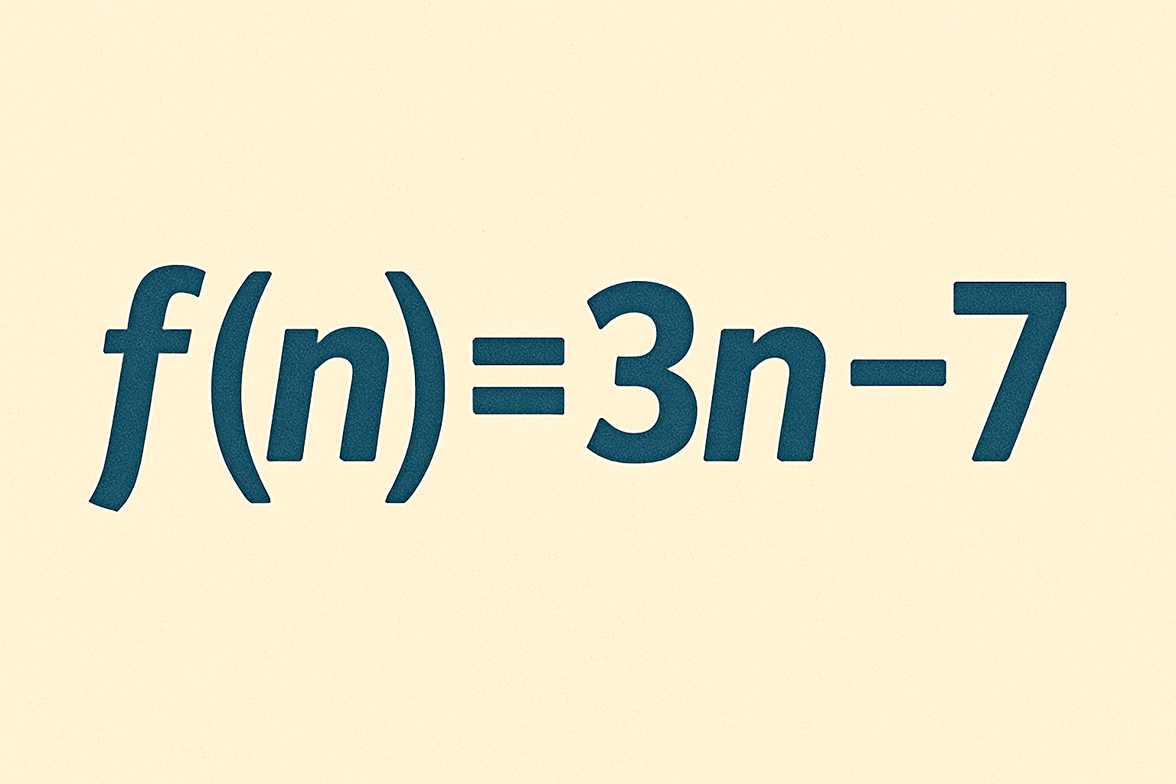
Warm Up - Mentally Evaluate Functions 🤯
Consider the function f given by f(n) = 3n − 7.
This function takes an input, multiplies it by 3, and then subtracts 7.
Mentally evaluate each of the following four questions:
f(10)
f(10) − 1
f(10 − 1)
f(5) − f(4)
Notes:
Warm Up (5 minutes)
The purpose of this warm up is to informally assess strategies and understandings students currently have for interpreting function notation, which they learned about in an earlier course. Students will use function notation when they define sequences with equations in later lessons, so this warm up is an opportunity for practice.
Launch
Note to Teacher for Slide Deck Function: The launch suggests showing one problem at a time. Click enter to show each of the four problems one at a time.
Display the first two sentences and ask students to read them quietly. Then, display one problem at a time. Give students quiet time to think individually for each problem and ask them to give a signal when they have an answer before displaying the next problem. Keep all problems displayed throughout the warm up. Follow with a whole-class discussion
Anticipated Misconceptions
Some students may believe that function notation “distributes,” that is, that expressions like f(5) − f(4) are equivalent to f(5 − 4) = f(1). Ask these students to work out the value of the expression both ways to make clear that f(5) − f(4) and f(5 − 4) = f(1) are not equivalent expressions, with a reminder that function notation is not multiplication, but rather a way to write the output of a function for a specific input.
Activity Answers
23
22
20
3
Activity Synthesis
Ask students to share their strategies for each problem. Record and display their responses for all to see.

Slide 8

Lesson Journey
Warm Up
Learning Activity
Practice
Learning Activity
Cool Down
Lesson Synthesis

Slide 9
Learning Strategies - Arithmetic Sequence Patterns🔁
Teacher Instruction: Use these strategies to adjust the activity to support English language learners and students with disabilities.
You can copy and paste the callouts directly on top of the activity or give the instructions aloud.
What patterns do you notice in the sequences?
Collect and Display
Let’s talk about what you know about sequences.
Representation
Notes:
Support for English Language Learners: MLR 2 Collect and Display: Conversing, Speaking, Writing
As students discuss the sequences, circulate and listen to students talk about the patterns they notice. Write down common or important phrases you hear students say about each type, for example: “add 10 each time” or “multiply each term by 2.” Collect the responses into a visual display. Throughout the remainder of the lesson, continue to update collected student language and remind students to borrow language from the display as needed. In the lesson synthesis, after the term “arithmetic sequence” is introduced, ask students to sort the collected language into three groups, one for language used to describe arithmetic sequences, a second for geometric sequences, and the third for neither.
Design Principle(s): Support sense-making; Maximize meta-awareness
Provide support for students
Distribute graphic organizers to the students to assist them with participating in this routine.
Support for Students with Disabilities: Representation: Internalize Comprehension
Activate or supply background knowledge about sequences. Allow students to use calculators to ensure inclusive participation in the activity.
Supports accessibility for: Memory; Conceptual processing

Slide 10
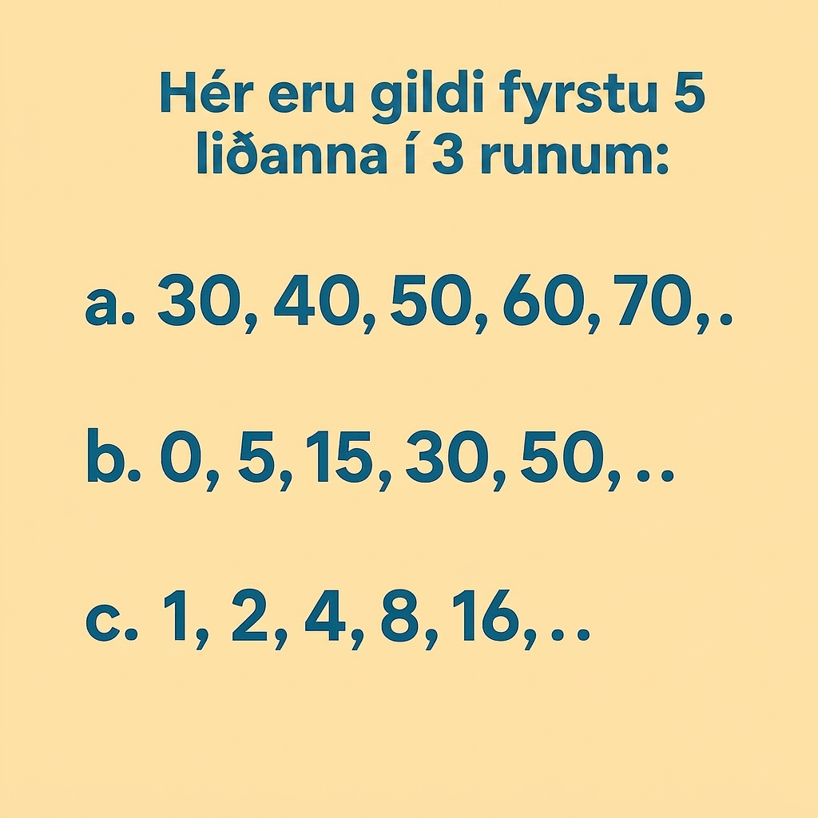
Learning Activity - Arithmetic Sequence Patterns🔁
For each sequence, describe a way to produce a new term from the previous term.
If the patterns you described continue, which sequence has the second-greatest value for the 10th term?
Which of these could be geometric sequences? Explain how you know.
Which of these could be arithmetic
sequences? Explain how you know.
Are you ready for more?
Notes:
Support for All Learners
This activity offers additional support and an extension for students:
For English language learners and students with disabilities, be sure to review the Learning Strategies slide!
For students looking for an extra challenge, be sure to review the Extending Your Thinking slide!
Activity (10 minutes)
The purpose of this activity is for students to contrast three different types of sequences and to introduce the term “arithmetic sequence.”
Monitor for students using precise language, either orally or in writing, during work time to invite to share during the whole-class discussion.
Launch
Arrange students in groups of 2. Give students quiet work time and then time to share their work with a partner.
Activity Answers
Compare your work: Your answer may vary, but here is a sample for each day.
a. For example: Each term is 10 more than the previous term.
b. For example: Each term is the result of adding 10 more than was added to the previous term (add 5, then add 10, and then add 15).
c. For example: Each term is double the previous term.
30, 40, 50, 60, 70, . . .
0, 5, 15, 30, 50, . . .
1, 2, 4, 8, 16, . . .
Sequence B
Sequence C. For example: A geometric sequence has the same multiplier from one term to the next, the common ratio, and neither A nor B has this. Sequence C does; the common ratio is 2.
An arithmetic sequence is a sequence in which each term is the previous term plus a constant.
This constant is called the common difference.
Sequence A. For example: An arithmetic sequence gets each term by adding the same constant to the previous term. Sequence A adds 10 to each term to find the next term.
Anticipated Misconceptions
Students may struggle to identify patterns in non-geometric sequences. Ask, “How does each term change from the previous one?” Encourage informal descriptions. For Sequence B, suggest making a table to visualize term numbers and values side by side.
Activity Synthesis
This discussion introduces arithmetic sequences by comparing different types of sequences. Start by asking how sequences A and C are alike and different. Students may note that C is geometric (multiply by 2) while A adds 10 each time. Explain that A is an arithmetic sequence, identified by adding the same number between terms or by constant differences when subtracting consecutive terms.
Explain that this constant is called the rate of change or common difference. In sequence A, it is 10 (e.g., 40 = 30 + 10).
Some students may connect arithmetic sequences to linear functions due to the constant rate of change. Invite these observations. If no one mentions it, ask, “What do you remember about linear functions?” and record responses to highlight the connection between arithmetic sequences and linear functions.

Slide 11
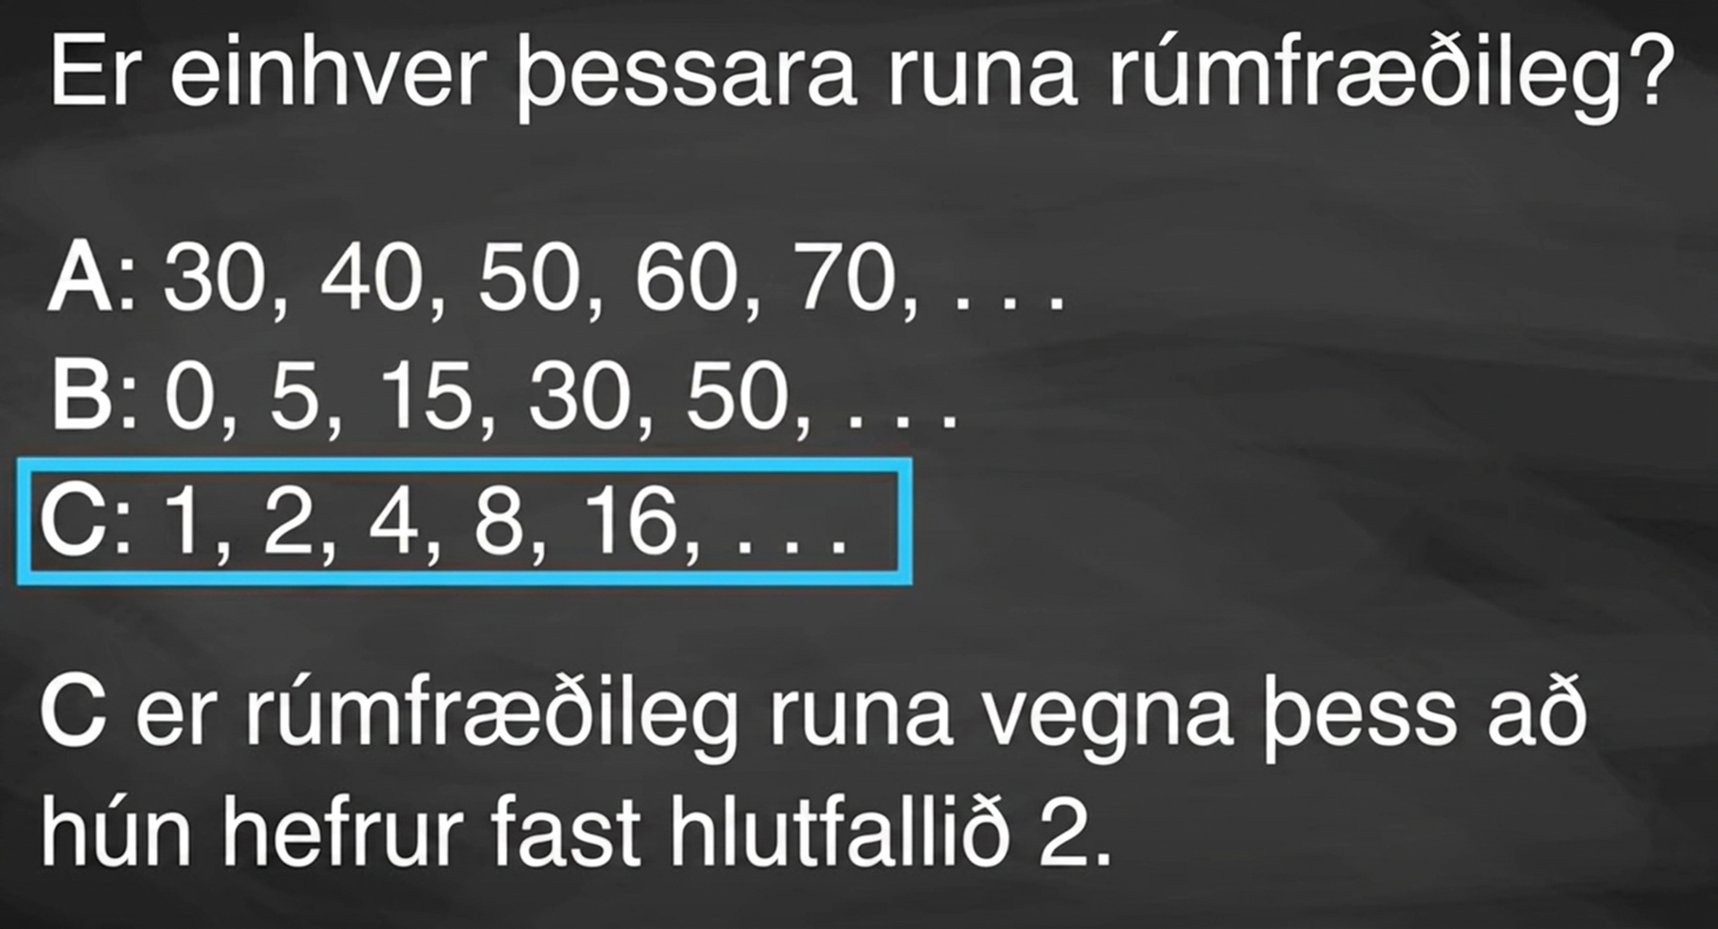
Video: Comparing Sequences

Slide 12
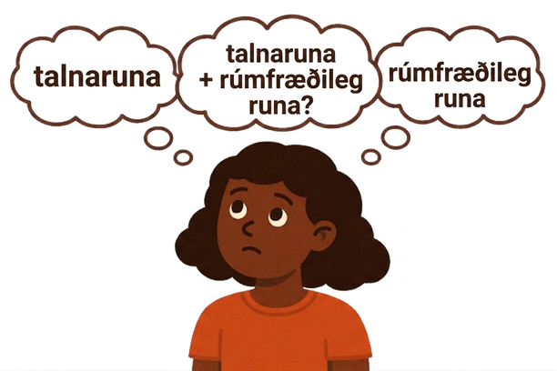
Extending Your Thinking
Elena says that it’s not possible to have a sequence of numbers that is both arithmetic and geometric. Do you agree with Elena? Be prepared to show your reasoning.
Notes:
Answer
Elena is incorrect. Sample explanation: the sequence 1, 1, 1, . . . is arithmetic (adding 0 each time), but it is also geometric (multiplying by 1 each time).

Slide 13

Self Check
Which of the following sequences is arithmetic?
3, 4, 6, 9, 13, . . .
1, 4, 16, 64, …
3, 7, 11, 15, . . .
25, 5, 1, ⅕, . . .
Let’s review!
Notes:
Answer Feedback - Individualized by Response
Incorrect. While a constant is added to the previous term to generate the next term, the constant is different each time. The answer is 3, 7, 11, 15, . . .
Incorrect.This sequence is geometric with a common ratio of 4. The answer is 3, 7, 11, 15, . . .
That’s correct! To find the next term, 4 is added to the previous term. This is arithmetic.
Incorrect. This sequence has a common ratio of ⅕ and is geometric. The answer is 3, 7, 11, 15, . . .

Slide 14


Self Check - Review
An arithmetic sequence is a list of numbers where each term increases or decreases by a constant value, called the common difference.
Example 1: Truck Value Depreciation: A truck bought for $25,000 decreases by $3,400 each year.
Example 2: Increasing by 3
A simple arithmetic sequence with a common difference of +3:
Formula:To find any term in an arithmetic sequence:
aₙ = a₁ + (n – 1)d, where: a₁ is the first term, d is the common difference. n is the term number
This forms an arithmetic sequence with a common difference of –3,400
Notes:
Example problems on next slide

Slide 15
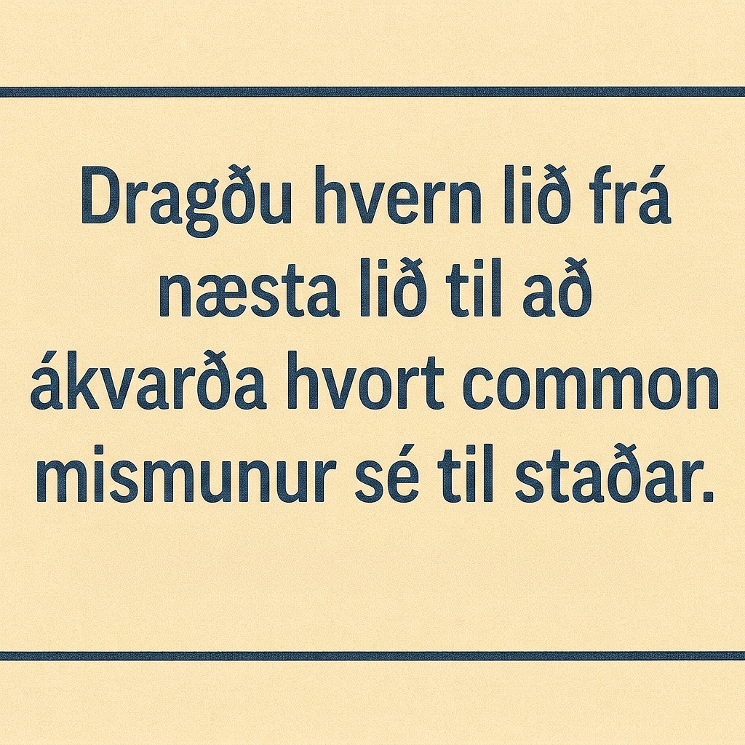
Self Check - Review
Is each sequence arithmetic? If so, find the common difference.
{1, 2, 4, 8, 16, . . .}
{-3, 1, 5, 9, 13, . . .}
Notes:
Answers
{1, 2, 4, 8, 16, . . .}
The sequence is not arithmetic because there is no common difference.
2−1=1, 4−2=2, 8−4=4, 16−8=8
{-3, 1, 5, 9, 13, . . .}
The sequence is arithmetic because there is a common difference. The common difference is 4.
1−(−3)=4, 5−1=4, 9−5=4, 13−9=4

Slide 16
Lesson Journey
Warm Up
Learning Activity
Practice
Learning Activity
Cool Down
Lesson Synthesis

Slide 17
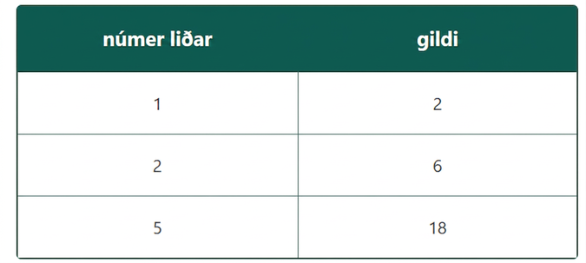
Learning Activity - A Sequence is a Function 🔃
Jada and Mai are trying to decide what type of sequence this could be:
Jada says: “I think this
sequence is geometric
because in the value column,
each row is 3 times the
previous row.”
Mai says: “I don’t think it is
geometric. I graphed it, and
it doesn’t look geometric.”
Do you agree with Jada or Mai? Be prepared to show your reasoning using a graph.
Notes:
Activity (10 minutes)
The purpose of this activity is for students to create another representation of a given sequence and to give them an opportunity to use the vocabulary they have learned for geometric and arithmetic sequences.
Monitor for students who create Mai’s graph to understand her reasoning and for students who reason about whether the sequence is defined by a rate of change or a growth factor to invite to share during the discussion.
Answer
For example: I agree with Mai. Jada noticed that each value is multiplied by 3 to get to the next row, but the table skips terms. If the sequence were geometric, it would have to be 2, 6, 18, 54, 162. When Mai made a graph, she could see the gap in the sequence.
Click here for graph image.
Without knowing the missing terms, we don’t know for sure if the sequence is arithmetic, but it could be since the three given points are all on the same line with slope 4. The missing points could be (3,10) and (4,14) so that the sequence would be 2, 6, 10, 14, 18.
Activity Synthesis
Invite previously selected students to share their reasoning, displaying any graphs created for all to see. If the idea of slope or average rate of change does not come up, ask students how they could have found the missing points for an arithmetic sequence just given (2,6) and (5,18). Draw in the slope triangle and show the computation for the average rate of change.

Slide 18
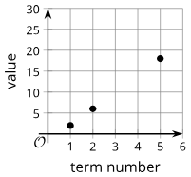
Learning Activity - A Sequence is a Function 🔃

Slide 19
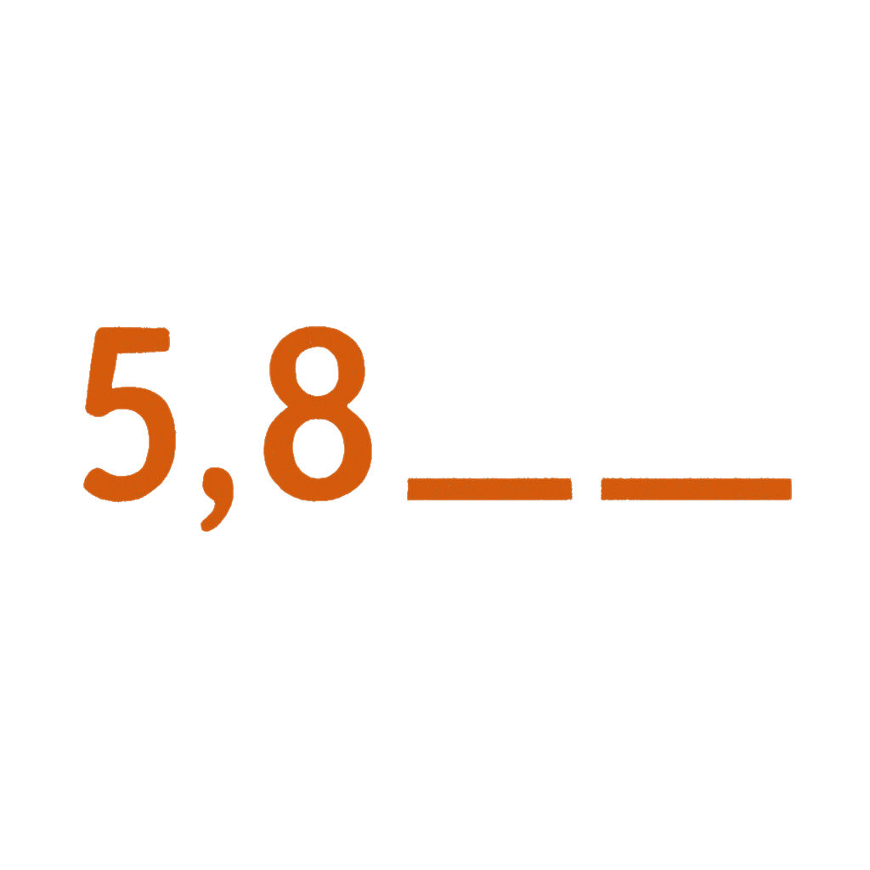
Self Check
Which two terms could be next in the sequence to make it arithmetic?
5, 8, ____, ____
12.8, 7.68
11, 14
13, 20
13, 21
Let’s review!
Notes:
Answer Feedback - Individualized by Response
12.8, 7.68
Incorrect. These would be the next two terms if the sequence were geometric. The answer is 11, 14.
11, 14
That’s correct! The common difference from 5 to 8 is 3, so continue to add 3 to find the next two terms.
13, 20
Incorrect. This is the result of adding 3, then 5, and then 7. The common difference remains the same in an arithmetic sequence. The answer is 11, 14.
13, 21
Incorrect. This is the result of adding the two previous terms. This sequence does not have a common difference. The answer is 11, 14.

Slide 20
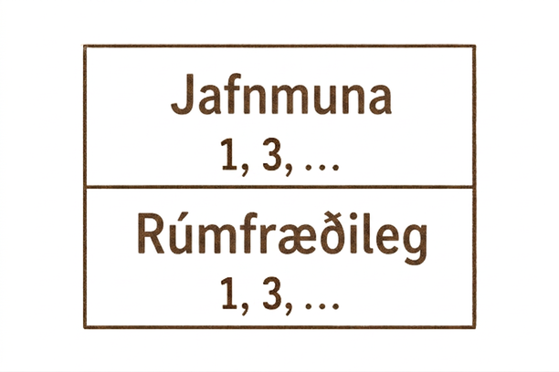
Self Check - Review
For a sequence: 1, 3, . . .
Write the next two terms that would make the sequence:
geometric
arithmetic
Notes:
Discuss the Answers with the Students:
To make the sequence geometric, there must be a common ratio.
1⋅3 = 3, so use a common ratio of 3 to multiply each term by.
The sequence becomes: 1, 3, 9, 27 . . .
To make the sequence arithmetic, there must be a common difference.
3−1 = 2, so use a common difference of 2 to add to each term.
The sequence becomes: 1, 3, 5, 7 . . .

Slide 21

Lesson Journey
Warm Up
Learning Activity
Practice
Learning Activity
Cool Down
Lesson Synthesis

Slide 22
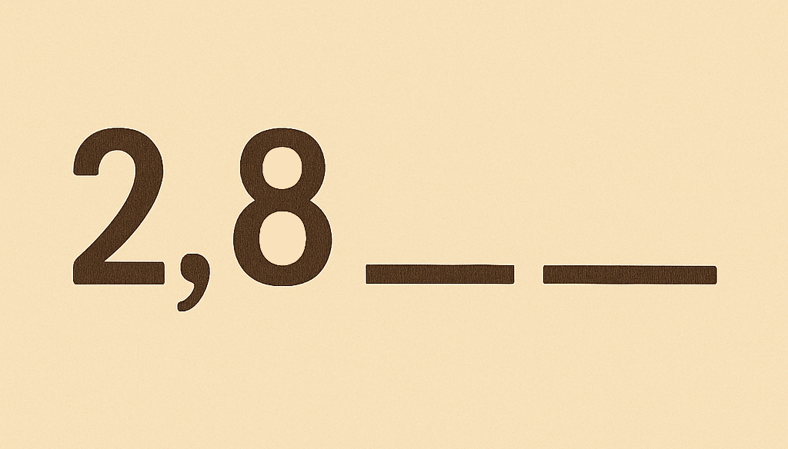
Cool Down
Many sequences start with the terms 2 and 8.
Find the next two terms of the arithmetic sequence 2, 8, ____, ____.
Find the next two terms of the geometric sequence 2, 8, ____, ____.
Find two possible next terms of a sequence 2, 8, ____, ____ that is neither geometric or arithmetic.
Notes:
Cool Down (5 minutes)
Answers
14, 20
32, 128
For Example: 9, 16
Response to Student Thinking - More Chances
Students will have more opportunities to understand the mathematical ideas in this cool-down, so there is no need to slow down or add additional work to the next lessons. Instead, use the results of this cool-down to provide guidance for what to look for and emphasize over the next several lessons to support students in advancing their current understanding.

Slide 23

Lesson Journey
Warm Up
Learning Activity
Practice
Learning Activity
Cool Down
Lesson Synthesis

Slide 24
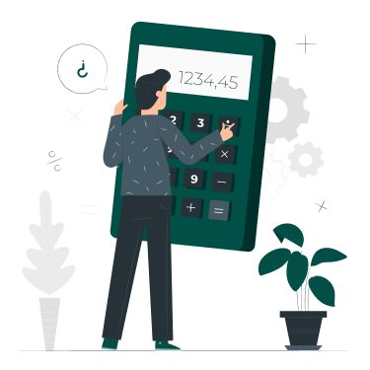
Practice
Put your hard work to action, practice what you’ve learned!
Notes:
Digital Practice: Access the practice pages at https://openstax.org/k12/algebra

Slide 25

Lesson Journey
Warm Up
Learning Activity
Practice
Learning Activity
Cool Down
Lesson Synthesis

Slide 26
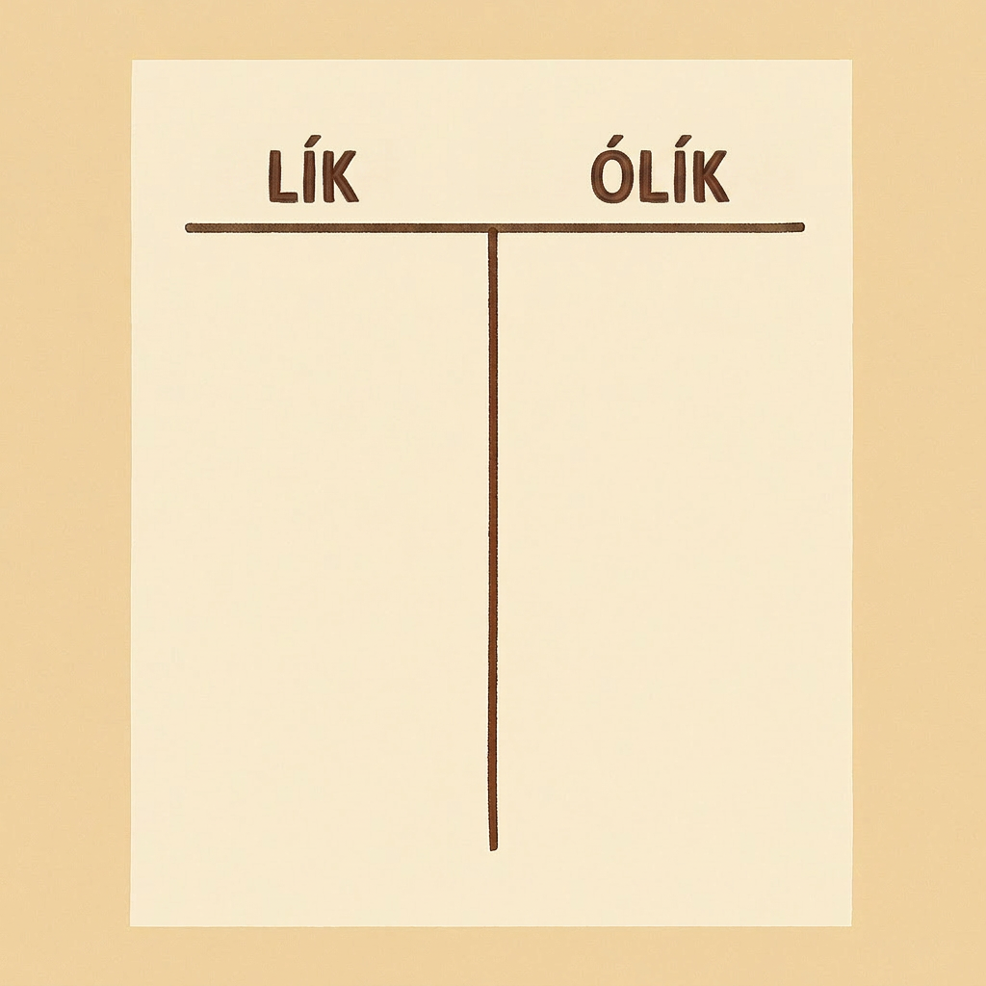
Lesson Synthesis
Discuss with a partner: “How are arithmetic and geometric sequences alike and different?”
Notes:
Prompt: Ask students to discuss with a partner: “How are arithmetic and geometric sequences alike and different?” After they have had a few minutes to discuss, ask several students to share the things that came up. Some things to highlight:
They are both types of sequences. That is, they are both lists of numbers.
To get from one term to the next for both arithmetic and geometric sequences, you “do the same thing each time.”
For geometric sequences, you always multiply by the same number to get the next term. For arithmetic sequences, you always add the same number to get the next term.
Geometric sequences have growth factors (the quotient of any term and the previous term), but arithmetic sequences have a constant rate of change (the difference of any term and the previous term).
Closing the Lesson
After completing the Lesson Synthesis, wrap up the class by directing students to the Lesson Summary in their student textbook. In this section, students review the day’s learning targets, read summaries about the key takeaways from each activity, and then respond to a reflection question regarding their confidence with the material.
For more on the benefits of using this type of metacognitive reflection, see the Research in Practice section of the

Slide 27
Self Assessment
How much do you agree with the following statements?
I can… | I can | Almost | Not yet
Explain what it means for a sequence to be arithmetic or geometric.

