Slide 1


Algebra 1
Unit 1 Linear Equations
Lesson 1.5 Equations and Their Graphs

Slide 2
How to use these slides
On the activity slides check the speaker notes for teacher support and instructional information.
Each lesson includes 1 warm up, 2-3 learning activities, a cool down, practice and a lesson synthesis.
  Learning activities are followed by a self check question, and review section.
Some slides have been hidden from student view, more information can be found on the next slide (Reference Key).
You can edit and use these slides for personal and classroom use, but cannot sell them and must keep the attribution logos.
For more information, Check out the digital quick start guide!

Slide 3






Reference Key
Check the top right corner for an icon referencing these unique sections.
 | Support for Students with Disability | Hidden | Learning Strategies slide, provides additional support to students for understanding the activity. Learning Strategies slide, provides additional support to students for understanding the activity.
 | Support for English Language Learners | Hidden
 | Extending Your Thinking | Hidden | Extending Your Thinking slide, provides an extra challenge for students.
 | Self Check | Not Hidden | Self Check slide, checkpoint to assess student understanding after the learning activity.
 | Review | Hidden | Self Check- Review slide, designed to help review topics from the self check question.
On the next slides, check the speaker notes for teacher instructions and support.
Notes:
Check the Speaker Notes: On the next slides you can find discussion questions, lesson information, answers to the activities, and ways to adjust the activity for your students!

Slide 4

Learning Goals
By the end of this lesson you will be able to -
Use graphing technology to graph linear equations and identify solutions to the equations.
Explain how the coordinates of the points on the graph of a linear equation are related to the equation.
Describe what the points on a graph mean in a real-life situation.
Notes:
Lesson Narrative
So far, students have used descriptions, expressions, and equations to show relationships and constraints. In this lesson, they revisit how graphs can represent those relationships. They’ll interpret points on and off graphs and connect them to equations and real-world meaning. This helps strengthen their problem-solving skills.
Students are also introduced to graphing technology. This can be taught separately, as long as it happens before the second activity.
Required Preparation
Graphing technology
Required Materials
Acquire devices that can run Desmos (recommended if accessible) or other graphing technology. It is ideal if each student has their own device.
Texas Essential Knowledge and Skills
A1(A) apply mathematics to problems arising in everyday life, society, and the workplace
A1(C) select tools, including real objects, manipulatives, paper and pencil, and technology as appropriate, and techniques, including mental math, estimation, and number sense as appropriate, to solve problems
A1(D) communicate mathematical ideas, reasoning, and their implications using multiple representations, including symbols, diagrams, graphs, and language as appropriate
A2(C) write linear equations in two variables given a table of values, a graph, and a verbal description
A3(C) graph linear functions on the coordinate plane and identify key features, including x-intercept, y-intercept, zeros, and slope, in mathematical and real-world problem

Slide 5
Vocabulary
Previous
Constraint
  In an expression like (5𝑥 + 2), it is the number 2 because it doesn't change when the 𝑥-value changes.
Model
  A mathematical or statistical representation of a problem from science, technology, engineering, work, or everyday life, used to solve problems and make decisions.
New
Origin
  The point of intersection of the axes in a coordinate system. The ordered pair for this point is written (0, 0).
Notes:
Lesson Vocabulary
To support student understanding of key vocabulary:
Introduce and review the vocabulary words students will see in this lesson.
Encourage students to notice how these words are used and to include them in their math discussions and explanations—both written and oral.
Use a word wall to reinforce vocabulary. Sample word wall cards are available here.
For newcomers or students with beginning English proficiency, use these Quizlet sets to support vocabulary learning:
Unit 1 Spanish Vocabulary – use first to build understanding
Unit 1 Vocabulary (English) – use after anchoring in Spanish
Support for English Language Learners
ELPS 2(F) listen to and derive meaning from a variety of media such as audiotape, video, DVD, and CD-ROM to build and reinforce concept and language attainment
ELPS 3(E) share information in cooperative learning interactions
ELPS 4(G) demonstrate comprehension of increasingly complex English by participating in shared reading, retelling, or summarizing material, responding to questions, and taking notes commensurate with content area and grade level needs

Slide 6





Lesson Journey
Warm Up
Learning Activity
Cool Down
Lesson Synthesis
Learning Activity
Learning Activity
Practice

Slide 7

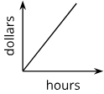
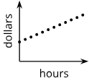
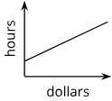
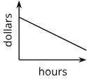
Warm Up - Time and Money $
Which graph doesn’t belong?
 | C.
B. | D.
Notes:
Warm Up (5 minutes)
This warm-up encourages students to closely compare features of linear graphs and use precise language. It gives you a chance to hear what terms they know and how they describe graph characteristics.
It also sets the stage for reasoning about solutions through graphing, which is the focus of today’s lesson.
Launch
Arrange students in groups of 2 – 4. Display the graphs for all to see.
Give students 1 minute of quiet time to think individually and then time to share their thinking with their small group. In their small groups, ask each student to share their reasoning as to why a particular graph does not belong, and together find at least one reason each item doesn’t belong.
Activity Answers
Graph A is the only graph that intersects the vertical axis at 0 (or that starts at the origin).
Graph B is the only graph where the horizontal axis represents dollars and the vertical axis represents hours.
Graph C is the only graph where the horizontal axis represents dollars and the vertical axis represents hours.
Graph D is the only one that shows plotted points (which lie along a line) instead of a continuous line.
Activity Synthesis
Ask each group to share one reason why a particular item does not belong. Record and display the responses for all to see. After each response, ask the class if they agree or disagree. Since there is no single correct answer to the question of which one does not belong, attend to students’ explanations and ensure the reasons given are correct.
During the discussion, ask students to explain the meaning of any terminology they use, such as “y-intercept” or “negative slope.” Also, press students on unsubstantiated claims. (For example, if a student claims that graph A is the only one with a slope greater than 1, ask them to explain or show how they know.)

Slide 8

Lesson Journey
Warm Up
Learning Activity
Cool Down
Lesson Synthesis
Learning Activity
Learning Activity
Practice

Slide 9
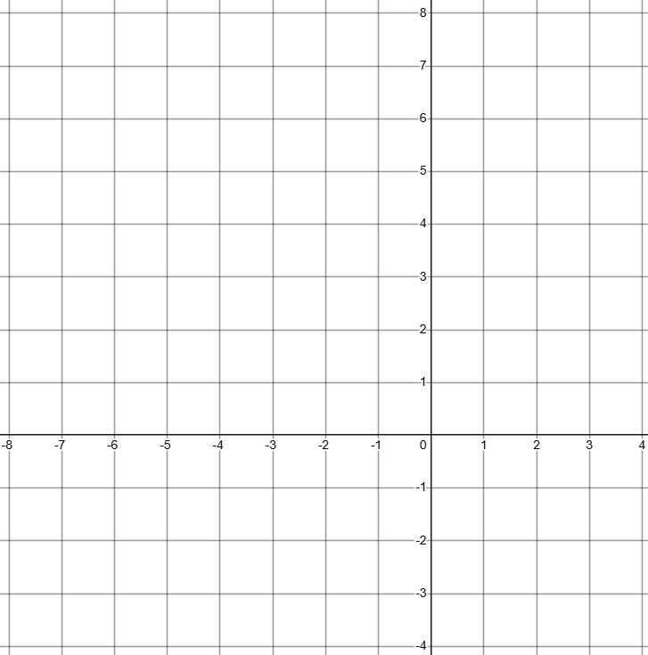
Learning Activity - Two Variables ͏͏͏(𝒙⸴ 𝒚)
For questions 1 - 7, use the equation 3x + 4y = 12
Find the value of y when x = 0
Find the value of x when y = 0
Plot both of those points on a coordinate grid and use a ruler to draw a line.
Notes:
Support for All Learners
This activity offers additional support and an extension for students:
For english language learners and students with disabilities, be sure to review the Learning Strategies slide!
For students looking for an extra challenge, be sure to review the Extending Your Thinking slide!
Activity (15 minutes)
In this activity, students will work to graph equations written in standard form using the x- and y-intercepts by hand, not technology. They will then use the graphs to find the slope of the lines.
The teacher may choose to begin to associate the slope of the equation of the line in this form to −A/B. Students will later graph these equations using graphing technology in lesson 1.10, so it is helpful for students to understand how to complete the process on their own.
Launch
Give each student a piece of graph paper or a coordinate grid. Have students recall how to plot a point with the x-value before the y-value.
Arrange students in pairs.
Encourage students to check with their partner at each step to compare their work before moving on to the next step. Have students explain their steps to their partner.
Activity image answer, and synthesis on the next slide.

Slide 10
Learning Activity - Two Variables ͏͏͏(𝒙⸴ 𝒚)
What is the coordinate of the x-intercept?
What is the coordinate of the y-intercept?
What are two other names for the x-intercept?
What is the slope of the line?
Are you ready for more?
Notes:
Activity Answer
3
4
The graph of the line will go through the coordinates (0, 3) and (4, 0)
(4, 0)
(0, 3)
zero, solution
–(¾)
Activity Synthesis
Facilitate a discussion with students with them explaining how they found their answers.
ASK
How did you find your x-intercepts and y-intercepts?
How did you find your slope?
Why do you think an x-intercept is also called a zero or solution?
What did you notice about the numbers in the equation and the numbers in the intercepts and slopes?
If time allows, try another example and ask the questions again and reflect if their analysis was accurate.

Slide 11

Learning Strategies - Two Variables ͏͏͏(𝒙⸴ 𝒚)
Teacher Instruction: Use these strategies to adjust the activity to support english language learners and students with disabilities.
You can copy and paste the callouts directly on top of the activity or give the instructions aloud.
Walk around and find two other frames in the room
Think about what’s the same and different about the frames
Talk with your partner about what you noticed
Compare and Connect
How would you explain the directions in your own words?
Representation
Notes:
Support for English Language Learners: MLR 7 Compare and Connect: Representing, Conversing
Use this routine to prepare students for the whole-class discussion. Invite students to quietly circulate and examine at least two other “frames” in the room. Give students quiet think time to consider what is the same and what is different about the constructed frames. Next, ask students to find a partner to discuss what they noticed. Listen for and amplify observations that include connections across approaches, challenges faced identifying dimensions of framing material, and the need for more sophisticated strategies for solving this problem using quadratic equations.
Design Principle(s): Cultivate conversation
Learn more about this routine
View the instructional video and follow along with the materials to assist you with learning this routine.
Provide support for students
Distribute graphic organizers to the students to assist them with participating in this routine.
Support for Students with Disabilities: Representation: Access for Perception
Display and read the directions aloud. Students who both listen to and read the information will benefit from additional processing time. Check for understanding by inviting students to rephrase directions in their own words.
Supports accessibility for: Language; Memory

Slide 12
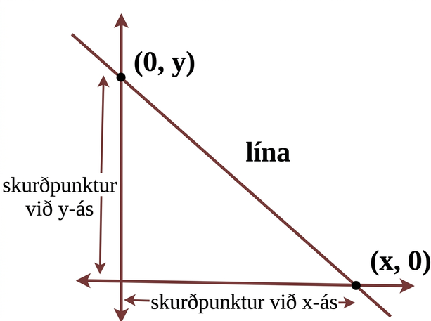
Extending Your Thinking
There are many ways to graph an equation of a line. One way is to use the x-intercepts and y-intercepts as two points on the line.
Graph 3x − 6y = 18 using the intercepts, then identify key characteristics.
Step 1 - Find the x-intercept. To find the x-intercept, let y = 0.
Step 2 - Find the y-intercept. To find the y-intercept, let x = 0.
Step 3 - Graph the line by connecting the x- and y-intercepts.
Step 4 - Find the slope of the line.
Notes:
Answer
Step 1 - 3x − 6y = 18; 3x - 6(0) = 18; 3x = 18; x = 6. (6, 0) is the x-intercept. The x-intercept is also called a solution or zero.
Step 2 - 3x − 6y = 18; 3(0) − 6y = 18; −6y = 18; y = –3. (0, –3) is the y-intercept.
Step 3 - The line should intersect the graph at points (–3, 0) and (6, 0).
Step 4 - Slope = rise/run = 3/6; 3/6 = 1/2

Slide 13
Self Check
Graph the equation 5x − 2y = 10. Which of the following describes the intercepts and slope of the graph?
x-intercept: x = 2; y-intercept: y = −5; Slope: 2/5
x-intercept: x = –5; y-intercept: y = 2; Slope: 5/2
x-intercept: x = 2; y-intercept: y = −5; Slope: 5/2
x-intercept: x = –2; y-intercept: y = 5; Slope: –(5/2)
Let’s review!
Notes:
Answer Feedback - Individualized by Response
x-intercept: x = 2; y-intercept: y = −5; Slope: 2/5
Incorrect. The intercepts are correct, but the slope is the reciprocal of what it should be. The answer is: x-intercept: x = 2; y-intercept: y = −5; Slope: 5/2
x-intercept: x = –5; y-intercept: y = 2; Slope: 5/2
Incorrect. The intercept values are switched. The answer is: x-intercept: x = 2; y-intercept: y = −5; Slope: 5/2
x-intercept: x = 2; y-intercept: y = −5; Slope: 5/2
That’s correct! When y = 0, x = 2. When x = 0, y = −5. On the graph, the rise over run will be up 5 and right 2 for a slope of 5/2.
x-intercept: x = –2; y-intercept: y = 5; Slope: –(5/2)
Incorrect. Be careful with signs when solving for a variable. The answer is: x-intercept: x = 2; y-intercept: y = −5; Slope: 5/2

Slide 14
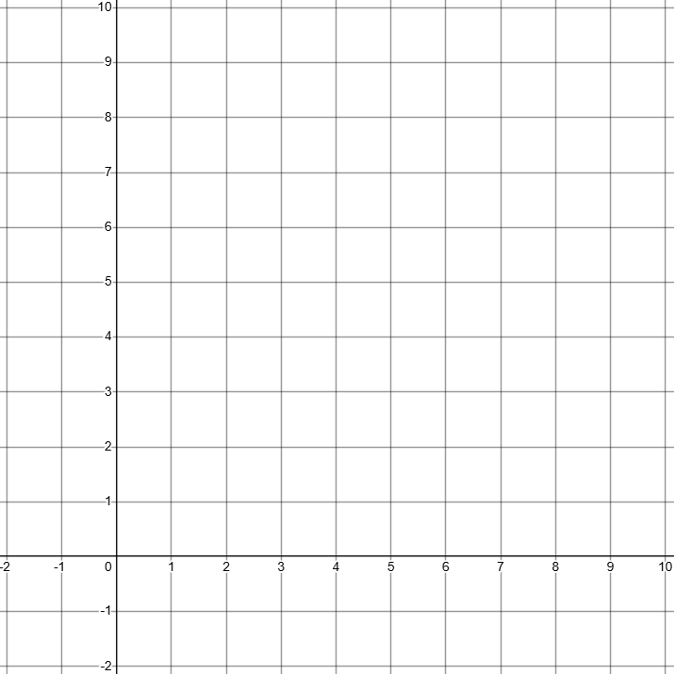
Self Check - Review
For 1 - 2, use the equation 7x − 3y = 21
Graph the equation using the intercepts.
What is the slope of the line?
Notes:
Remind Students
This activity challenges you to complete a very difficult task!
The more you know about the situation, the closer you are to being able to solve this problem mathematically instead of guessing and checking to see if you are correct.
We will use this information in later activities to set up a quadratic equation that can be used to solve the problem.

Slide 15
Lesson Journey
Warm Up
Learning Activity
Cool Down
Lesson Synthesis
Learning Activity
Learning Activity
Practice

Slide 16

Learning Activity - Bulk Foods $
To get snacks for a class trip, Clare went to the “bulk” section of the grocery store, where she could buy any quantity of a product and the prices are usually good.
Clare purchased some salted almonds at $6 a pound and some dried figs at $9 per pound. She spent $75 before tax.
If she bought 2 pounds of almonds, how many pounds of figs did she buy?
If she bought 1 pound of figs, how many pounds of almonds did she buy?
Write an equation that describes the relationship between pounds of figs and pounds of almonds that Clare bought and the dollar amount that she paid. Be sure to specify what the variables represent.
Notes:
Support for All Learners
This activity offers additional support and an extension for students:
For english language learners and students with disabilities, be sure to review the Learning Strategies slide!
Activity (10 minutes)
Students have learned that equations in two variables can have many solutions. This activity shows that idea visually: every point on the graph represents a solution that makes the equation true. However, not all points are meaningful in context. For example, since almonds and figs can’t have negative weights, only points in the first quadrant are relevant. As students work, notice who jumps into calculations right away and who writes an equation first to reason through the questions.
Launch
Arrange students in groups of 2 and provide access to calculators. Give students a few minutes of quiet work time and then time to share their responses with a partner.
Activity questions, answers, anticipated misconceptions, and synthesis on the next slide.

Slide 17
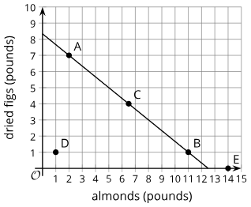
Learning Activity - Bulk Foods $
For questions 4 and 5, use the graph that represents the quantities in the situation.
Choose any point on the line, state its coordinates, and explain what it tells us.
Choose any point that is not on the line, state its coordinates, and explain what it tells us.
Notes:
Answers
7 pounds
11 pounds
6a + 9f = 75
Your answer may vary, but here is a sample. Point A or (2, 7). Clare bought 2 pounds of almonds and 7 pounds of figs for a total of $75.
Your answer may vary, but here is a sample. Point D or (1, 1). Clare bought 1 pound of almonds and 1 pound of figs, and the total was not $75.
Anticipated Misconceptions
Some students may say that the points not on the line are impossible given that Clare spent $75. Encourage these students to think about what those points would mean if we didn’t know how much money Clare spent.
Activity Synthesis
Display the graph for all to see. Invite students to share their equation for the situation and their interpretations of the points on and off the graph. Make sure students understand that a point on the graph of an equation in two variables is a solution to the equation. Discuss questions such as:
“What does the point (10, 3) mean in this situation?” (Clare purchased 10 pounds of almonds and 3 pounds of figs.)
“Is that a possible combination of pounds of figs and almonds? Why or why not?” (No. It doesn’t lie on the graph. Also, if Clare bought 10 pounds of almonds and 3 pounds of figs, it would cost her $87, not $75.)
“From the graph, it looks like (7, 3.5) might be a solution, but it is hard to know for sure. Is there a way to verify?” (Substitute the values into the equation and see if they make the equation true.)
“Suppose we extend the two ends of the graph beyond the first quadrant. Would a point on those parts of the line—say, (−1, 9)—be a solution to the equation 6a + 9f = 75? Why or why not?” (It would still be a solution to the equation, but it wouldn’t make sense in this context. The weight of almonds or figs cannot be negative.)

Slide 18
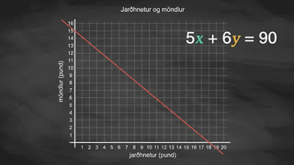
Video: Using a Graph to Solve an Equation

Slide 19
Learning Strategies - Bulk Foods $
Teacher Instruction: Use these strategies to adjust the activity to support english language learners and students with disabilities.
  You can copy and paste the callouts directly on top of the activity or give the instructions aloud.
First read: listen and describe the situation without numbers.
Second read: list what can be counted or measured.
Third read: listen for the question and brainstorm ways to solve.
Three Reads
We will read the directions together out loud as a class. Then, turn and talk with a partner to make sure you both understand what to do.
Representation
Notes:
Support for English Language Learners: MLR 6 Three Reads: Reading, Listening, Conversing
Use this routine to support reading comprehension, without solving, for students. Use the first read to orient students to the situation. Ask students to describe what the situation is about without using numbers (creating a frame for a rectangular picture). If students understand the situation based on their work in the prior activity, skip to the next read. After the second read, students list any quantities that can be counted or measured, without focusing on specific values (dimensions of the picture and framing materials). During the third read, the question or prompt is revealed. Invite students to brainstorm possible strategies, referencing the relevant quantities named after the second read. This helps students connect the language in the word problem and the reasoning needed to solve the problem while keeping the cognitive demand of the task.
Design Principle(s): Support sense-making
Learn more about this routine
View the instructional video and follow along with the materials to assist you with learning this routine.
Provide support for students
Distribute graphic organizers to the students to assist them with participating in this routine.
Support for Students with Disabilities: Representation: Internalize Comprehension
Provide appropriate reading accommodations and supports to ensure student access to written directions, word problems, and other text-based content.
Supports accessibility for: Language; Conceptual processing

Slide 20
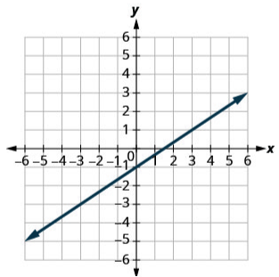
Self Check
Which point is a solution to the line graphed below?
(3, 1) | (1, 3)
(0, 1) | (–3, 3)
Let’s review!
Notes:
Answer Feedback - Individualized by Response
(3, 1)
That's correct! When x = 3, y = 1, so this point is a solution on the graph.
(0, 1)
Incorrect. This point is located above the line that is graphed. When a point is a solution to an equation, it must be located on the graph of the equation. The answer is (3, 1).
(1, 3)
Incorrect. To get to (1, 3), you move 1 right from the origin and 3 up, so this point is not on the line. When a point is a solution to an equation, it must be located on the graph of the equation. The answer is (3, 1).
(–3, 3)
Incorrect. To get to (−3, 3), move 3 left and then 3 up. This point is not a solution to the equation of the line graphed. When a point is a solution to an equation, it must be located on the graph of the equation. The answer is (3, 1).

Slide 21
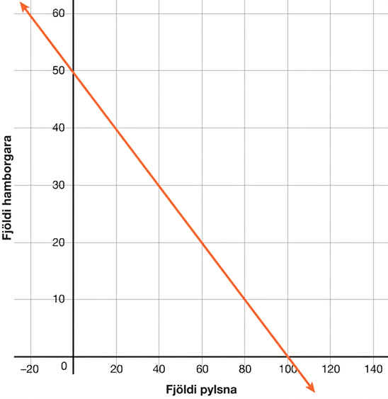
Self Check - Review
At a high school baseball game, the concession stand sold hot dogs and hamburgers. Hot dogs were $1.50, and hamburgers cost $3. The goal is to make $150 for the game.
What is the meaning of the point (40,30) on the graph?
Notes:
Answer
Here is how to determine the meaning of the point (40, 30) on this graph. The x-axis is labeled “number of hot dogs,” and the y-axis is labeled “number of hamburgers.” Since x = 40, there were 40 hot dogs sold, and since y = 30, there were 30 hamburgers sold. Since the point is on the line, the total amount from the hot dogs and hamburgers sold was $150.
Additional Resources
Suppose we are buying beans and rice to feed a large gathering of people, and we plan to spend $120 on the two ingredients. Beans cost $2 a pound, and rice costs $0.50 a pound. If x represents pounds of beans and y pounds of rice, the equation 2x + 0.50y = 120 can represent the constraints in this situation.
The graph of 2x + 0.50y = 120 shows a straight line. (Provide students with a graph of the line with the following points highlighted: (10, 200), (20, 80), (55, 70), (70, 180))
Each point on the line is a pair of x- and y-values that make the equation true and is thus a solution. It is also a pair of values that satisfy the constraints in the situation. The point (10, 200) is on the line. If we buy 10 pounds of beans and 200 pounds of rice, the cost will be 2(10) + 0.50(200), which equals 120. The points (60, 0) and (45, 60) are also on the line. If we buy only beans – 60 pounds of them – and no rice, we will spend $120. If we buy 45 pounds of beans and 60 pounds of rice, we will also spend $120. What about points that are not on the line? They are not solutions because they don’t satisfy the constraints, but they still have meaning in the situation.
The point (20, 80) is not on the line. Buying 20 pounds of beans and 80 pounds of rice costs 2(20) + 0.50(80) or 80, which does not equal 120. This combination costs less than what we intend to spend. The point (70, 180) means that we buy 70 pounds of beans and 180 pounds of rice. It will cost 2(70) + 0.50(180) or 230, which is over our budget of 120. Let’s look at an example.
Example:
Looking at the graph about purchasing beans and rice, is the point (30, 120) a solution? (Yes, because 2(3) + 0.50(12) = 60 + 60 = 120.)
What does the point (30, 120) mean in this situation? (The point means that 30 pounds of beans and 120 pounds of rice were purchased. Since the point is on the line, the total spent was $120.)

Slide 22
Lesson Journey
Warm Up
Learning Activity
Cool Down
Lesson Synthesis
Learning Activity
Learning Activity
Practice

Slide 23
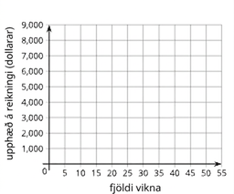
Learning Activity - Saving for College 📜
A student has a savings account with $475 in it. She deposits $125 of her paycheck into the account every week. Her goal is to save $7,000 for college.
How much will be in the account after 3 weeks?
How many weeks will it take until she has $1,350?
Write an equation that represents the relationship between the dollar amount in her account and the number of weeks of saving.
Notes:
Support for All Learners
This activity offers additional support and an extension for students:
For english language learners and students with disabilities, be sure to review the Learning Strategies slide!
For students looking for an extra challenge, be sure to review the Extending Your Thinking slide!
Activity (20 minutes)
In the previous activity, students analyzed and interpreted points on a graph relative to an equation and a situation. In this activity, they write a linear equation to model a situation, use graphing technology to graph the equation, and then use the graph to solve problems. Each given situation involves an initial value and a constant rate of change.
Before students begin the activity, introduce them to the graphing technology available in the classroom. Offer a quick tutorial on how to graph equations, adjust the graphing window, and plot points. This tutorial could happen independently of the activity as long as it precedes the activity.
Launch
Make sure all students can access graphing technology. Let them know they’ll use it often in this course to graph equations and solve problems.
Model how to use the graphing tool in your classroom—show how to enter equations, adjust the window, and plot points. If using Desmos, see the digital activity for guidance.
Put students in groups of 2–4. Assign each group one situation. Have them work through the first few questions (including writing an equation), then graph it and answer the final question.
Activity image answer, and synthesis on the next slide.

Slide 24
Learning Activity - Saving for College 📜
Graph your equation using graphing technology. Mark the points on the graph that represent the amount after 3 weeks and the week she has $1,350. Write down the coordinates.
What is the x-intercept?
What other information does the x-intercept identify in the function?
What is the the y-intercept?
What is the slope?
Are you ready for more?
Notes:
Activity Answer
$850
7 weeks
a = 475 + 125w, where a is the dollar amount in the account and w is the number of weeks of savings.
The graph of the line should go through the points, (0, 475) and (20, 2,975).
(-3.8, 0)
(0, 475
125
Activity Synthesis
Select a group that analyzed the first situation (Saving for College - Slide 24 & 25) and a group that analyzed the second situation (Extend Your Thinking - Slide 27) to share their responses. Display their graphs for all to see.
Focus the discussion on two things: what the points on the graph mean and how the graph could be used to answer questions about the quantities in each situation. Discuss questions such as:
“How did you find the answers to the first two questions?” (By calculation, for example, computing 475 + 125(3), or finding 1,350 − 475, and then dividing by 125.)
“How did you find the answer to the last question?” (By calculation, for instance, finding 7,000 − 475, and then dividing by 125. Or, alternatively, by using the graph.)
Highlight how the graph of the equations could be used to answer the questions. If not already mentioned by students, discuss how the graph of y = 475 − 125x can be used to find the answers to all the questions about the student’s savings account, and the graph of y = 450 − 20x can help us with the questions about draining the water tank.
Keep the graphs of the two equations displayed for the lesson summary.

Slide 25
Learning Strategies - Saving for College 📜
Teacher Instruction: Use these strategies to adjust the activity to support english language learners and students with disabilities.
You can copy and paste the callouts directly on top of the activity or give the instructions aloud.
Walk around and find two other frames in the room
Think about what’s the same and different about the frames
Talk with your partner about what you noticed
Compare and Connect
Notes:
Support for English Language Learners: MLR 7 Compare and Connect: Representing, Conversing
As students share their responses with the class, call attention to the different ways the quantities are represented graphically and within the context of each situation. Take a close look at both graphs to distinguish what the points represent in each situation. Wherever possible, amplify student words and actions that describe the connections between a specific feature of one mathematical representation and a specific feature of another representation.
Design Principle(s): Maximize meta-awareness; Support sense-making
Learn more about this routine
View the instructional video and follow along with the materials to assist you with learning this routine.
Provide support for students
Distribute graphic organizers to the students to assist them with participating in this routine.
Support for Students with Disabilities: Action and Expression: Internalize Executive Functions
Provide students with a physical copy of written directions for using graphing technology and read them aloud. Include step-by-step directions for how to enter equations, adjust the graphing window, and plot a point.
Supports accessibility for: Language; Memory

Slide 26
Extending Your Thinking
A 450-gallon tank full of water is draining at a rate of 20 gallons per minute.
Write an equation that represents the relationship between the gallons of water in the tank and hours the tank has been draining.
Write an equation that represents the relationship between the gallons of water in the tank and seconds the tank has been draining.
Graph each of your new equations.
In what way are all of the graphs the same? In what way are they all different? Write down your answer.
How would these graphs change if we used quarts of water instead of gallons? What would stay the same?
Notes:
Answer
Step 1 - 3x − 6y = 18; 3x - 6(0) = 18; 3x = 18; x = 6. (6, 0) is the x-intercept. The x-intercept is also called a solution or zero.
Step 2 - 3x − 6y = 18; 3(0) − 6y = 18; −6y = 18; y = –3. (0, –3) is the y-intercept.
Step 3 - The line should intersect the graph at points (–3, 0) and (6, 0).
Step 4 - Slope = rise/run = 3/6; 3/6 = 1/2

Slide 27
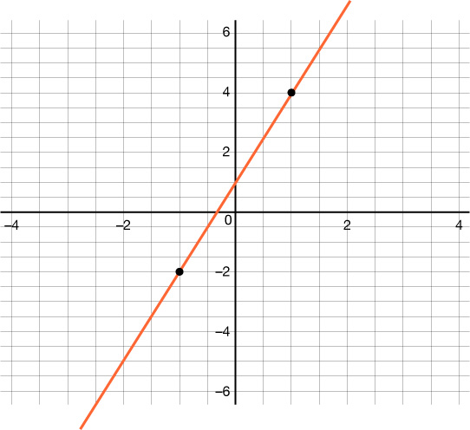
Self Check
Which of the following points is a solution to the graph below?
(2, 7) | (7, 2)
(0, 3) | (–2, –6)
Let’s review!
Notes:
Answer Feedback - Individualized by Response
(2, 7)
That’s correct! When x = 2, y = 3(2) + 1; y =7.
(0, 3)
Incorrect. When x = 0 and y = 3, the point is not on the line, so it is not a solution. Find a point that is on the line. The answer is (2, 7).
(7, 2)
Incorrect. Make sure to always write the x-coordinate first in the ordered pair. Find a point that is on the line. The answer is (2, 7).
(–2, –6)
Incorrect. When x = −2 and y = −6, the point is not on the line, so it is not a solution. Find a point that is on the line. The answer is (2, 7).

Slide 28
Self Check - Review
An equation that contains two unknown quantities or two quantities that vary is called an equation in two variables. A solution is a pair of numbers that makes the equation true.
Tyler spends $40 on T-shirts and socks. T-shirts cost $10 each, and socks cost $2.50 per pair. If t is the number of T-shirts and p is the number of sock pairs, what equation shows this situation?
Step 1 - Create a two-variable equation.
Step 2 - Find the x-intercept (to find the x-intercept, let p = 0.)
Step 3 - Find the y-intercept (to find the y-intercept, let t = 0.)
Step 4 - Graph the line by connecting the intercepts.
Notes:
Answers
Step 1 - The cost is $10 per t-shirt (10t) plus $2.50 per pair of socks (2.50p) and the total spent is $40: 10t + 2.50p = 40. Now, we have to graph the equation using the x- and y-intercepts. We will let t = x and p = y.
Step 2 - 10t + 2.50p = 40; 10t + 2.50(0) = 40; 10t + 0 = 40; t = 4. (4, 0) is the x-intercept. The x-intercept is also called a solution or zero. In this scenario, 4 represents the number of T-shirts Tyler can buy if he doesn't purchase any socks with $40.
Step 3 - 10t + 2.50p = 40; 10(0) + 2.50p = 40; (0) + 2.50p = 40; p = 16. (0,16) is the y-intercept. In this scenario, 16 represents the number of socks Tyler can buy if he doesn't purchase any T-shirts with $40.
Step 4 - The graph of the line should go through points (0, 16) and (4, 0).
ASK: What is the slope of the graph? (m = –4)
ASK: What does the point (4, 6) mean on this graph? (If Tyler bought 4 T-shirts and 6 pairs of socks, it would cost more than $40. Therefore, (4, 6) is not a coordinate point on the line)
Remind Students
This activity challenges you to complete a very difficult task!
The more you know about the situation, the closer you are to being able to solve this problem mathematically instead of guessing and checking to see if you are correct.

Slide 29

Lesson Journey
Warm Up
Learning Activity
Cool Down
Lesson Synthesis
Learning Activity
Learning Activity
Practice

Slide 30
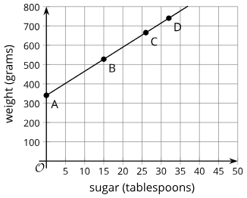
Cool Down
A ceramic sugar bowl weighs 340 grams when empty. Each tablespoon of sugar adds 12.5 grams.
Write an equation showing the relationship between the total weight, W, and the number of tablespoons of sugar, T.
The full bowl weighs 740 grams. How many tablespoons of sugar does it hold? Show your reasoning.
Use the graph to find a point that matches your answer.
About how many tablespoons of sugar are in the bowl if it weighs 600 grams?
Notes:
Cool Down (5 minutes)
Answers
W = 340 + 12.5T or 340 + 12.5T = 740
32 tablespoons; 740 = 340 + 12.5T; 400 = 12.5T; Subtract 340 from both sides. 32 = T; Divide both sides by 12.5. The graph represents the relationship between the number of tablespoons of sugar in the bowl and the total weight of the bowl.
Point D, because its coordinates could be (32, 740).
About 21 tablespoons. Looking at the graph, when the weight is 600, the line is about at 21.
Response to Student Thinking - More Chances
Students will revisit these concepts in upcoming lessons, so there's no need to slow down or add extra work now. Instead, use the results of this cool down to guide your focus in future lessons—pay attention to common gaps and emphasize those areas to help students deepen their understanding over time.

Slide 31

Lesson Journey
Warm Up
Learning Activity
Cool Down
Lesson Synthesis
Learning Activity
Learning Activity
Practice

Slide 32

Practice
Put your hard work to action, practice what you’ve learned!
Notes:
Digital Practice: Access the practice pages at https://openstax.org/details/books/algebra-1

Slide 33

Lesson Journey
Warm Up
Learning Activity
Cool Down
Lesson Synthesis
Learning Activity
Learning Activity
Practice

Slide 34
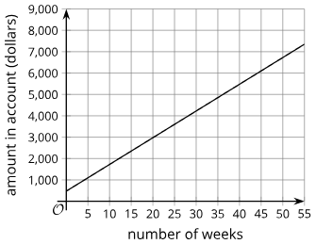
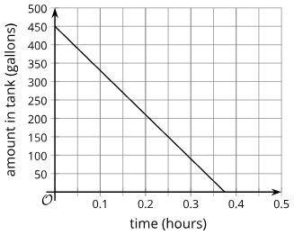
Lesson Synthesis
In Saving for College
Will the student have $5,000 after saving for 20 weeks?
How can we use the graph of y = 475 + 125x to answer the first question?
What does the point (15, 3,000) mean?
Is that ordered pair a solution to the equation y = 475 + 125?? How can we tell?
In the Water Tank problem
After how many minutes should we stop the draining if we want to leave 150 gallons of water in the tank?
How can we use the graph of y=450−20x to answer the second question?
Is (25,−50)
a solution to the equation y=450−20x? Why or why not?”
In general, how can a graph helps us find solutions to two-variable equations?
Notes:
Prompt: In this lesson, we saw a few examples where we knew the output of a function and were interested in finding the input that produced it.
Answers:
No. 5,000 ≠ 475 + 125 (20); 5,000 ≠ 475 + 2,500; 5,000 ≠ 2,975.
See if the point (20, 5,000) is on or below the graph. It is not, so the answer is no.
After 15 weeks, there is $3,000 in the bank account.
No. The point (15,3000) is above the graph, not on the graph. After 15 weeks, there is less than $3,000 in the account.
After 0.25 hours or 15 minutes.
Find the point on the graph where the y-value is 150, and see what the x-value is.
An equation helps us see the relationship between the quantities in the problem, including those whose values are unknown. We can solve for those values.
No. The point is not on the graph. A negative y-value also has no meaning in this situation. The point (25,−50) means that after 25 minutes, there are −50 gallons of water in the tank, which doesn’t make sense.
In general: Any point on the graph of the equation is a solution to that equation.

Slide 35
Self Assessment
How much do you agree with the following statements?
I can… | I can | Almost | Not yet
Use graphing technology to graph linear equations and identify solutions to the equations.
Explain how the coordinates of the points on the graph of a linear equation are related to the equation.
Explain the meaning of points on a graph in terms of the situation it represents when given the graph of a linear equation.

